Slide 1
There is no lecture objectives so,
You're off to great places, today is your day.
No one is perfect - that's why pencils have erasers.
Winning is fun, but those moments that you can touch someone’s life in a very positive way are better
(اللهم لا سهلَ إلا ما جعلتَه سهلاً، وأنت تجعل الحزنَ إذاشئتَ سهلاً.)
Abdullah Alassaf
Editing file

Slide 2
Name 5 radiological modalities
X-Ray
CT scan
To see normal bowel gas distribution
If there's any air fluid level
The standard X-ray view is erect(for air fluid level) and supine(for bowel dilatation)
If we discovered any lesion on abdominal X-ray or fluoroscopy and we want to characterize it we do CT SCAN
in all cases of acute abdomen or trauma patients we start with CT scan
Fluoroscopy
MRI
For more details we do MRI
Stomach=barium meal
Small bowel=barium follow through
Colon=barium enema
Angiography
Ultrasound
Nuclear medicine
1

Slide 3
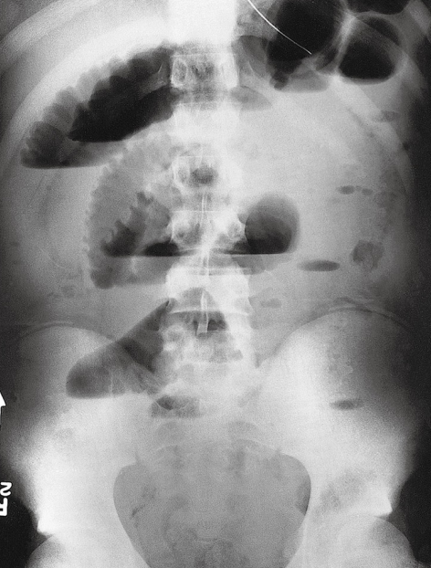
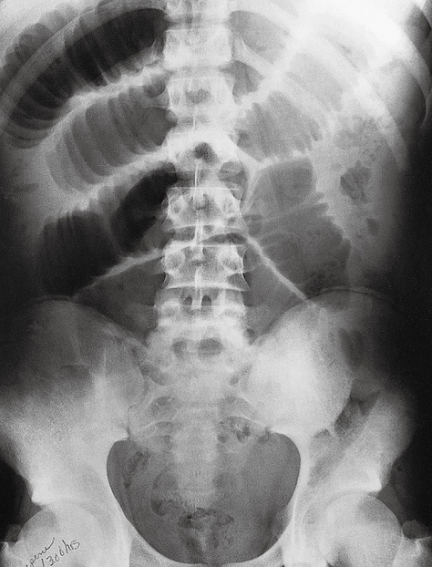
Case 1
What is the modality?
Mention 2 abnormalities?
What is the diagnosis?
Picture 1
Picture 2
2
Erect film

Slide 4
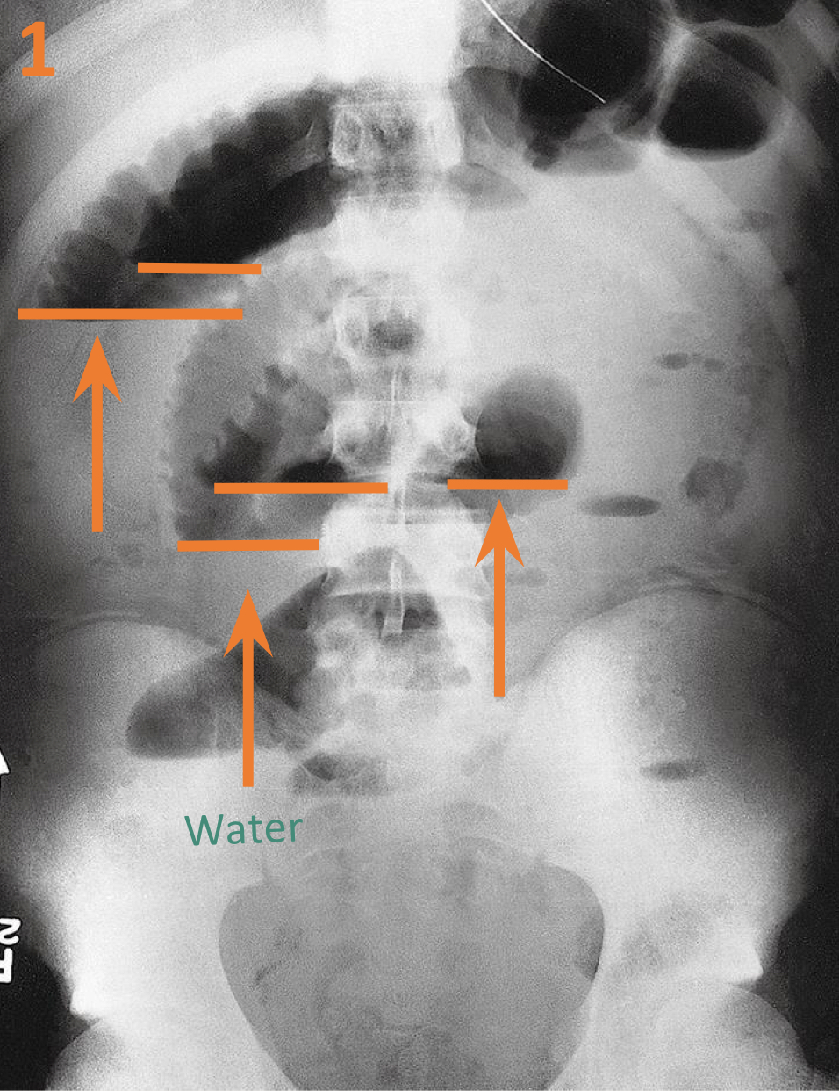
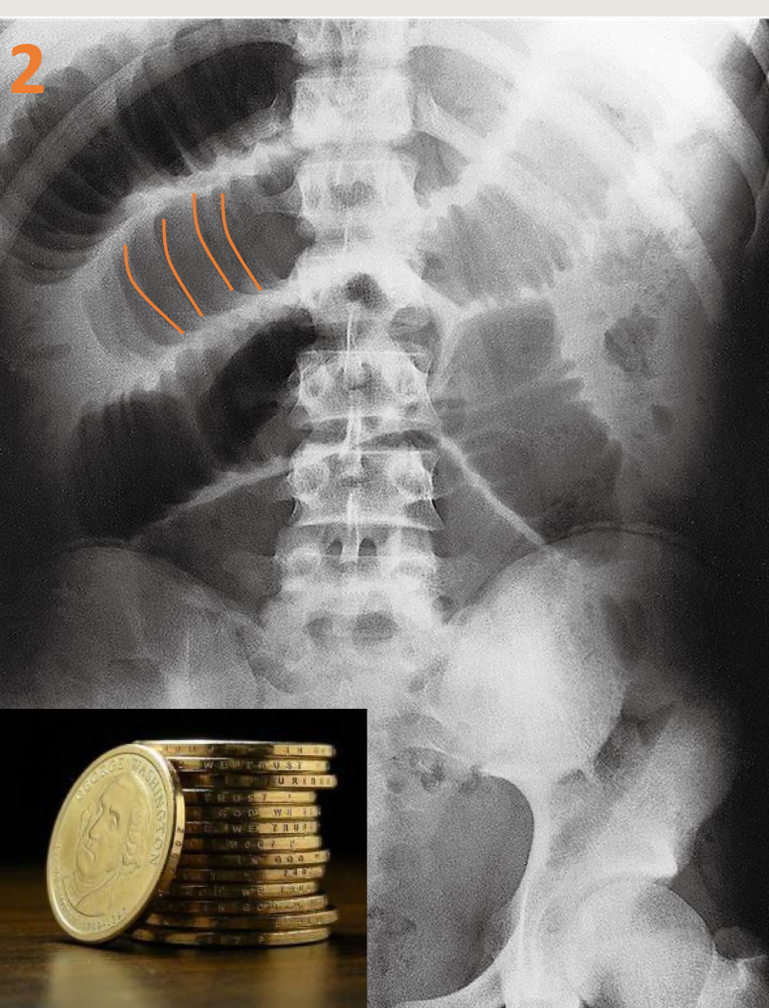
Case 1
What is the modality?
Plain abdominal X-RAYS.
No contrast unlike fluoroscopy.
Pictures 1 : Erect position.
Picture 2 : Supine position .
Mention 2 abnormalities?
Picture 1:
-Multiple air-Fluid levels.
-colon cannot be seen
-their is opacity within the rectum
Picture 2:
-Stack of coins signs (indicate mucosal fold thickening)
- multiple dilated bowels(the maximum bowel dilatation regarding the small bowel=3cm ,more than 3=dilated loop)
Picture 1
Picture 2
What is the diagnosis?
Mechanical bowel obstruction
3

Slide 5
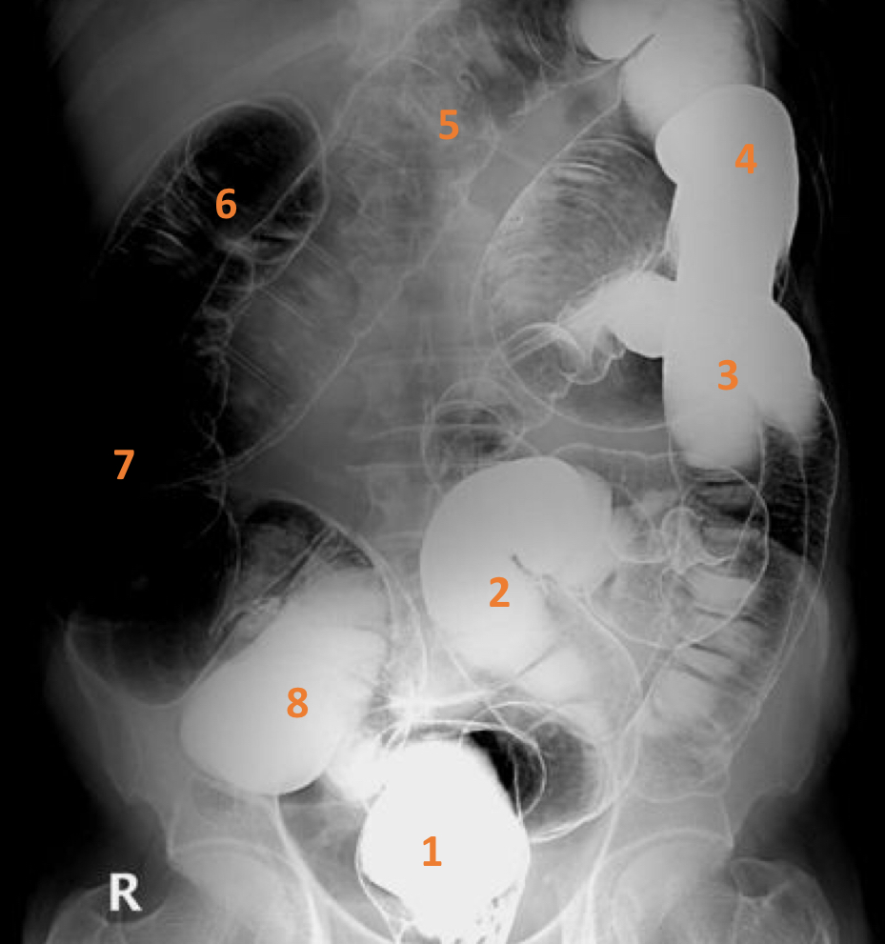
Case 2
What is the name of the study?
Name the labelled structures?
4

Slide 6
Case 2
What is the name of the study?
Air double contrast barium enema.
Name the labelled structures?
1. Rectum.
2. Sigmoid colon.
3. Descending colon.
4. Splenic flexure.
5. Transverse colon.
6. Hepatic flexure.
7. Ascending colon.
8. Cecum.
• Barium enema has two types:
Single contrast barium enema (No air). For example 8,1,2,3,4 are seen with single contrast and the rest in double contrast
Double contrast barium enema (Air & barium) If you see clear bowel wall with gas it’s double as in this image, it gives better idea about any mucosal abnormality (ulceration, lesion. etc..).so we evaluate the area using double contrast
Normally we shouldn't see ileocecal valve or terminal ileum in barium enema of a normal patient.
5

Slide 7
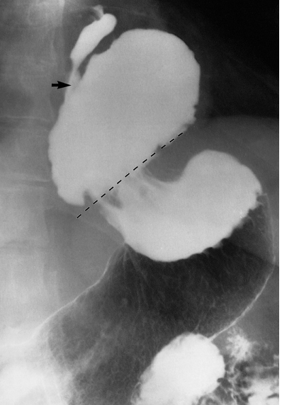
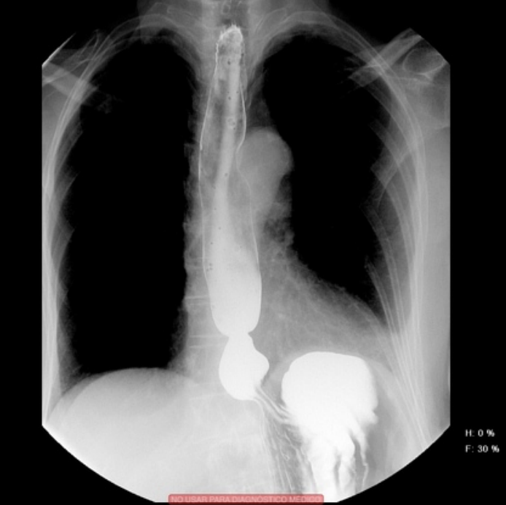
Case 3
What is the modality? (picture 1)
What is the diagnosis? (picture 1)
Picture 1
Picture 2
6

Slide 8
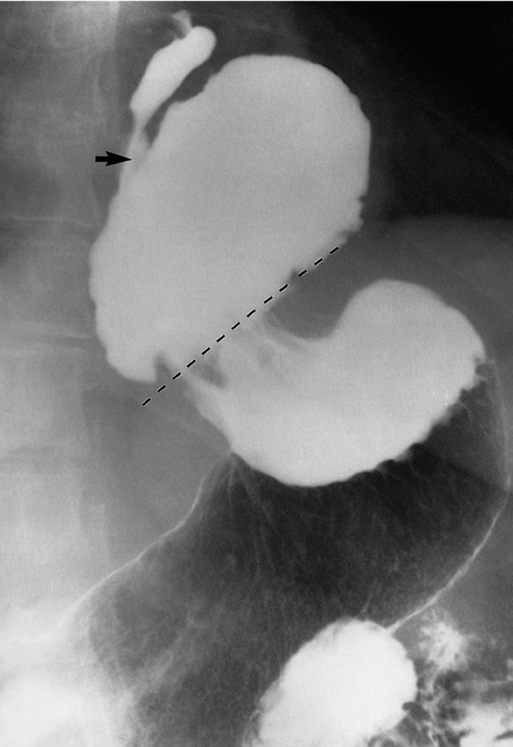
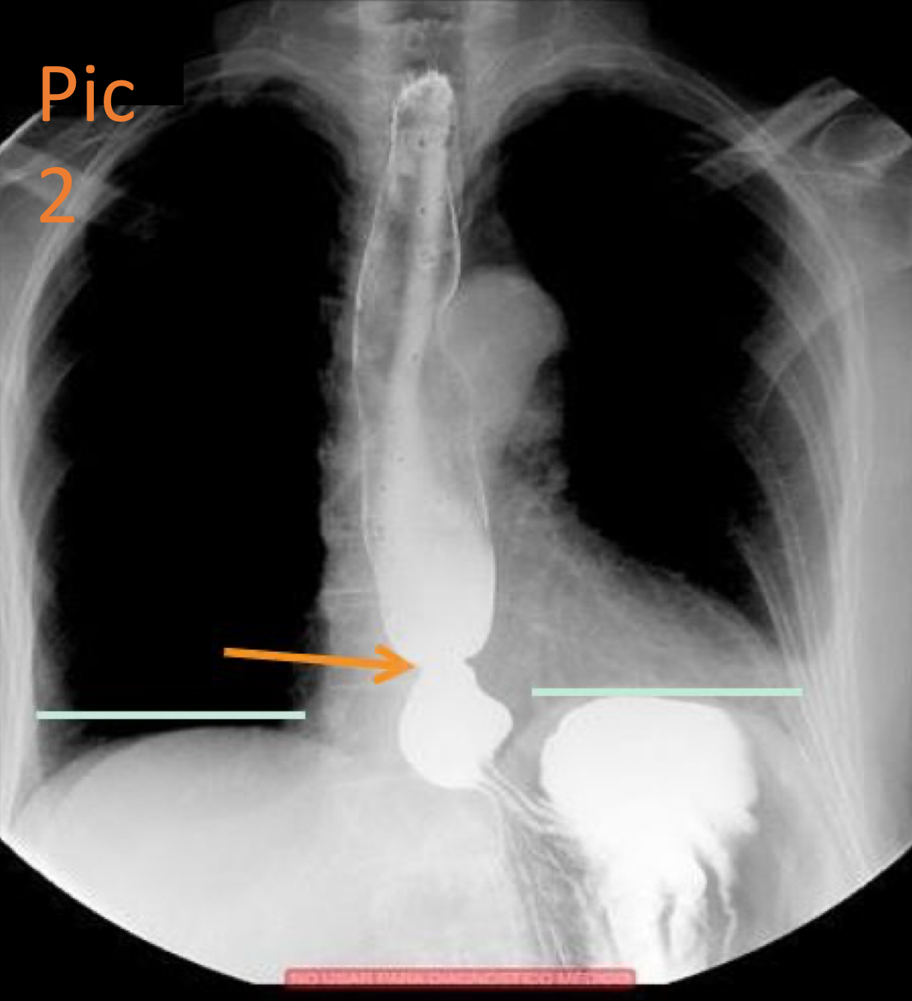
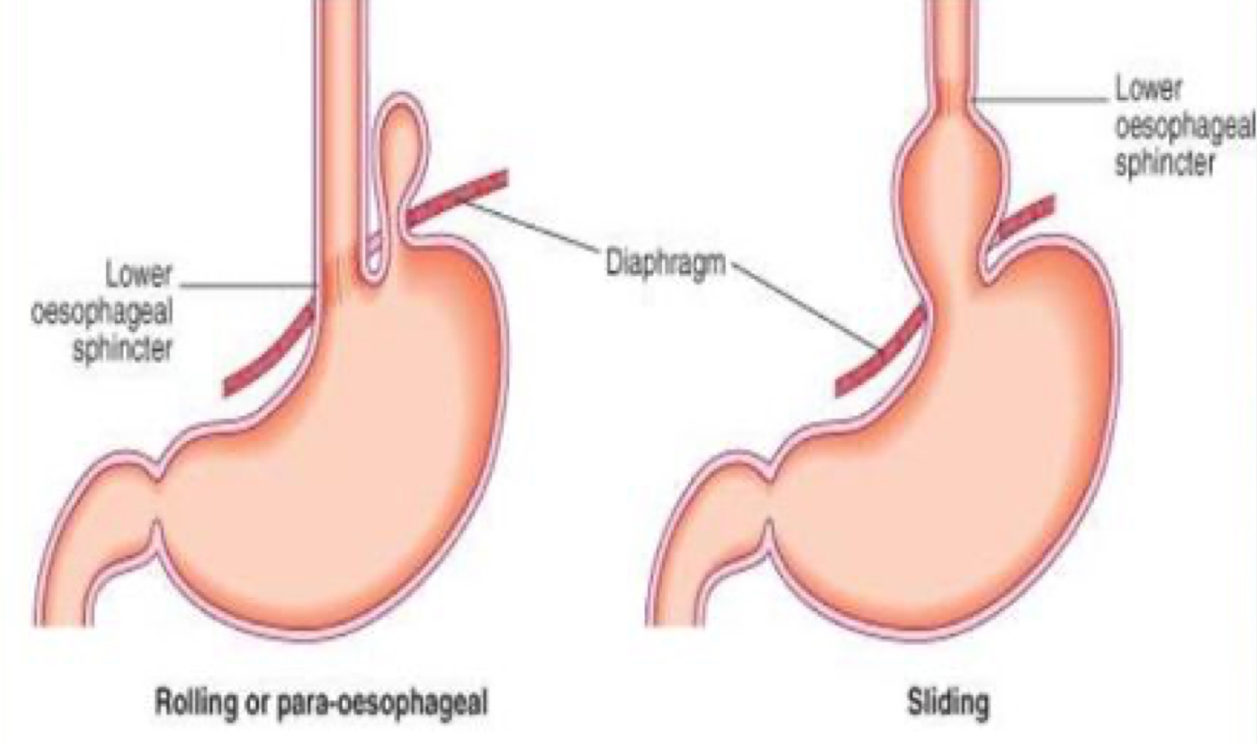
Case 3
What is the modality?
Fluoroscopy (Barium meal).
Esophagus
GE junction
What is the diagnosis?
Hiatus hernia. pic1=(large) pic2=(small)
The lower esophageal sphincter normally will be on the line with diaphragm But here it’s not and part of the gastric fundus is seen above the level of hiatus opening , so it’s sliding hernia (as the green lines in pic2 represents the normal level of the diaphragm).
Hiatus opening
Picture 1
Picture 2
Types of hiatus hernia
7

Slide 9
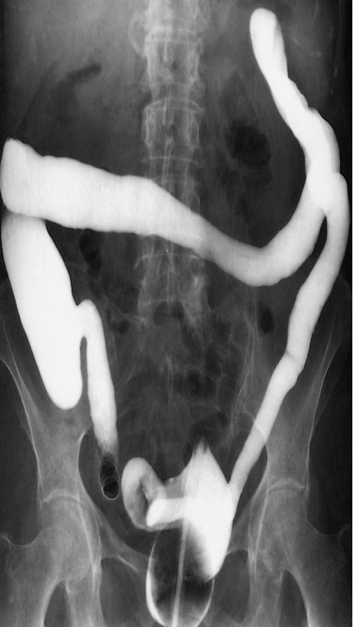
Case 4
What is the modality?
What is the name of the sign?
What is the diagnosis?
8

Slide 10
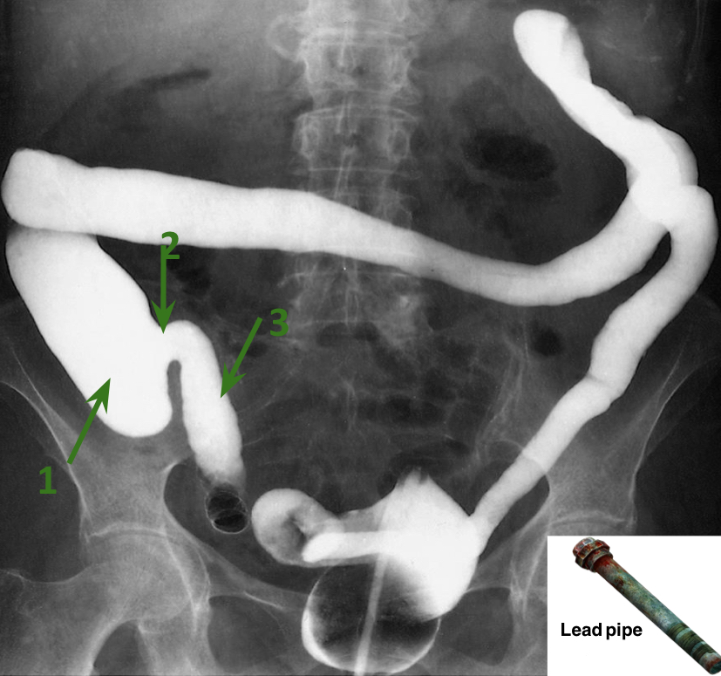
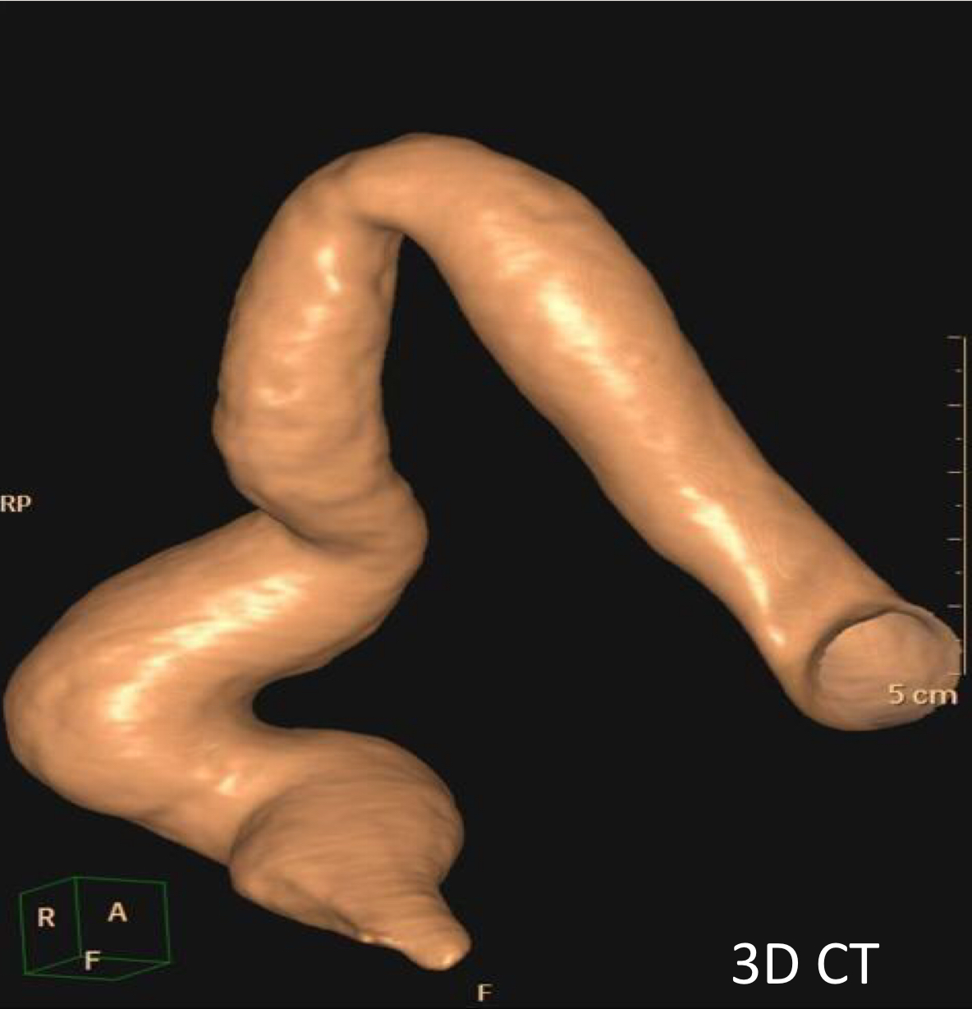
Case 4
What is the modality?
Barium enema- Fluoroscopy
Single because we don’t see the wall of bowel nor we see gases.
What is the name of the sign?
Lead pipe sign.
The colon is identified by its haustration(mucosal folding) but here we cannot see any haustration and the whole colon is of small caliber
What is the findings?
Rigid colon with no haustration
Cecum.
Incompetent ileocecal valve.
Terminal ileum.
What is the diagnosis?
IBD – Ulcerative colitis
(Continuous start from rectum then extends proximal even terminal ileum can be involved sometimes calling it backwash ileitis )
Another example of lead pipe colon (featureless colon)
9

Slide 11
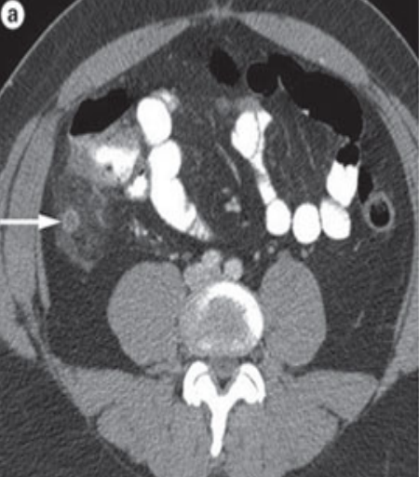
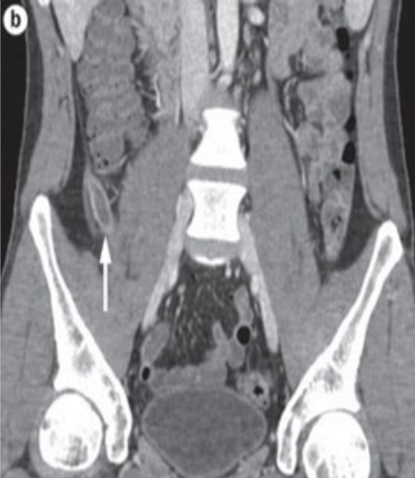
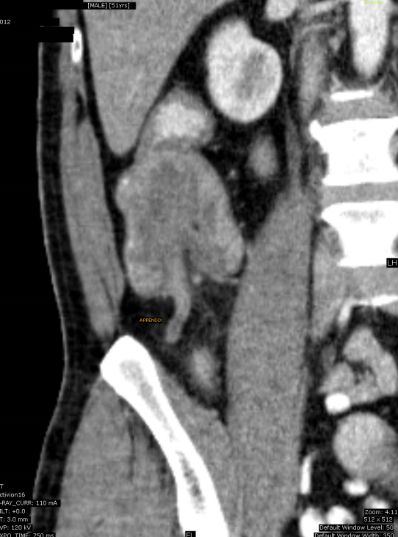
Case 5
What is the name of the study?
What is structure labeled on the image a ?
What is the findings?
What is the diagnosis of the patient on image b?
What is the gold standard imaging modality for such diagnosis? And what is the alternative image modality in pregnant/pediatric patients?
10

Slide 12
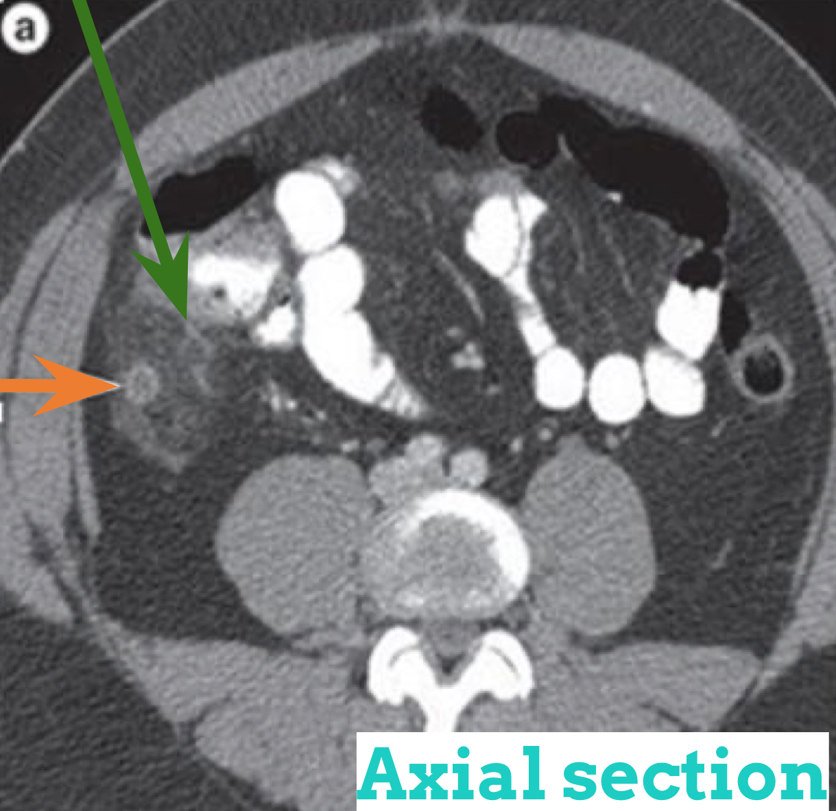
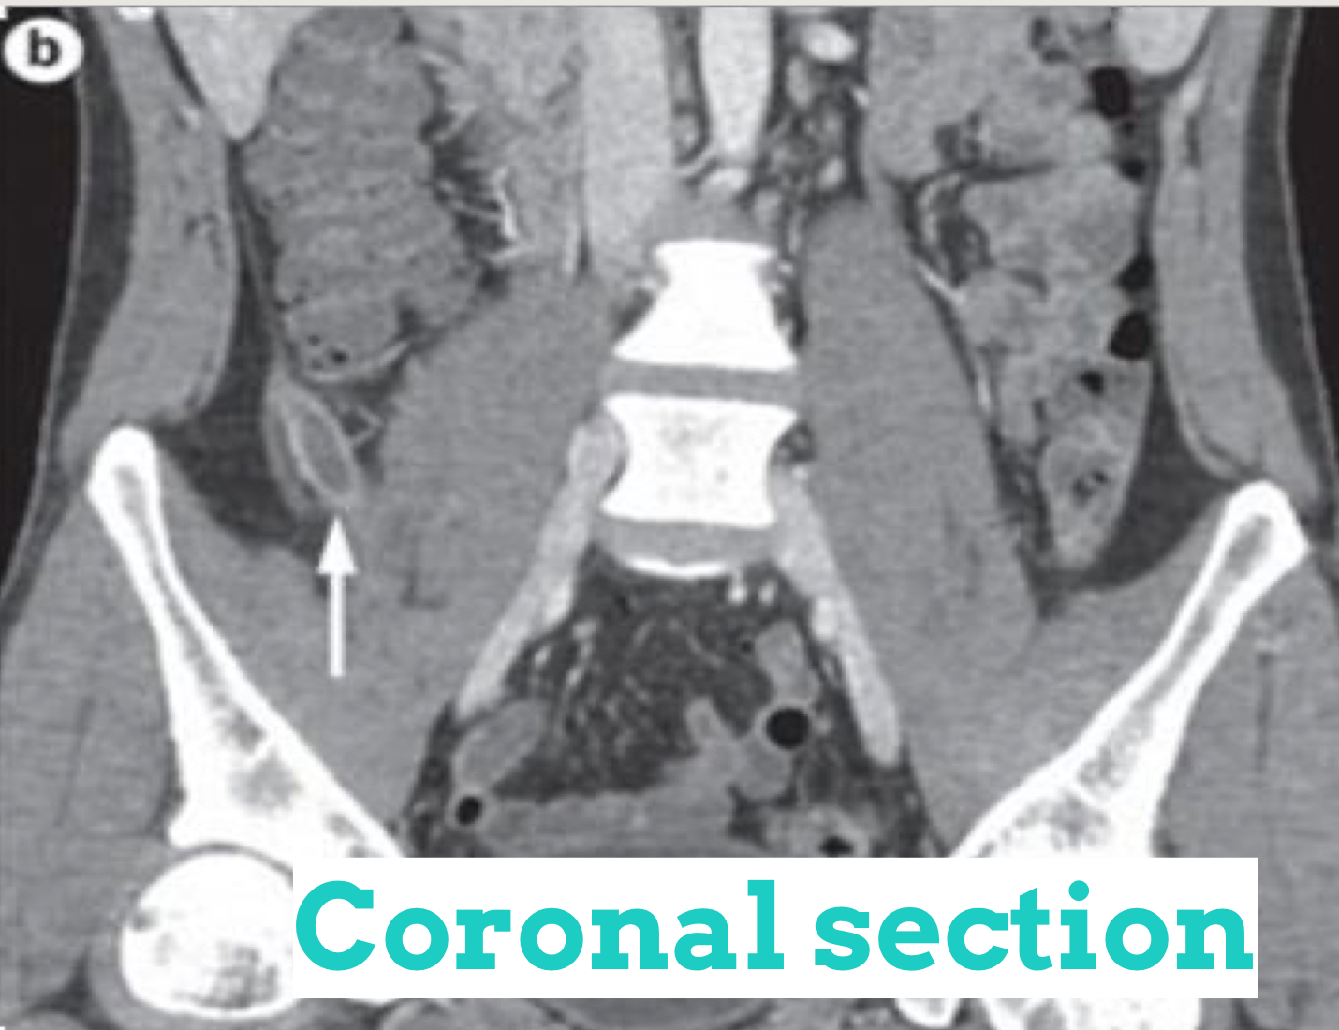
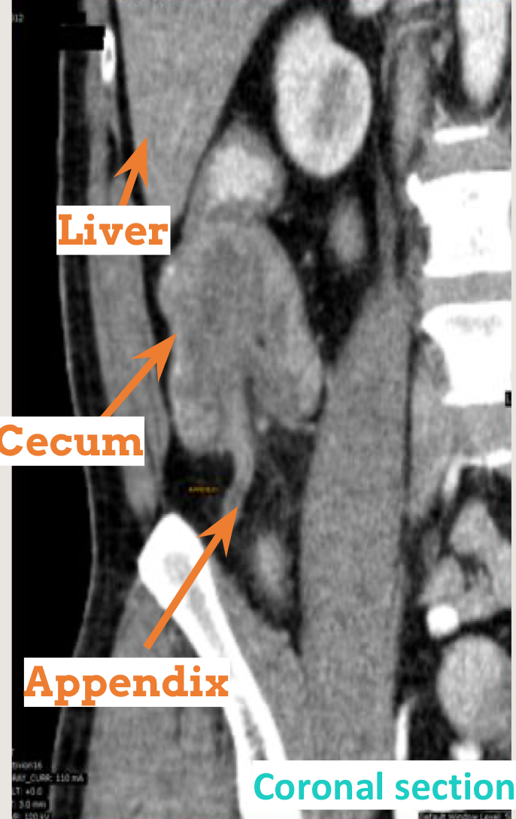
Case 5
What is the name of the study?
CT scan (with IV and oral contrast.The oral contrast is seen within the bowel lumen) .
What is structure labeled on the image a (axial section)?
Appendix
What is the findings?
enlarged appendix
Enhanced wall
Fat around the appendix is inflamed
axial section
coronal section
What is the diagnosis of the patient on image b (coronal section )?
Simple appendicitis.
What is the gold standard imaging modality for such diagnosis? And what is the alternative image modality in pregnant/pediatric patients?
CT scan + contrast is the gold standard, U/S is the alternative for pediatric & pregnant.
Abnormal appendix
11

Slide 13
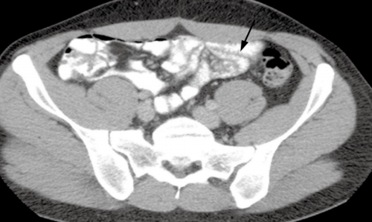
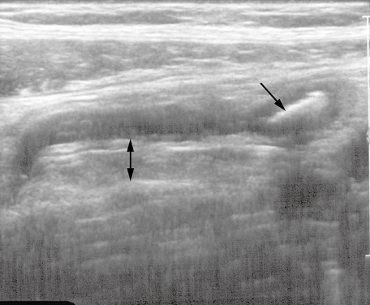
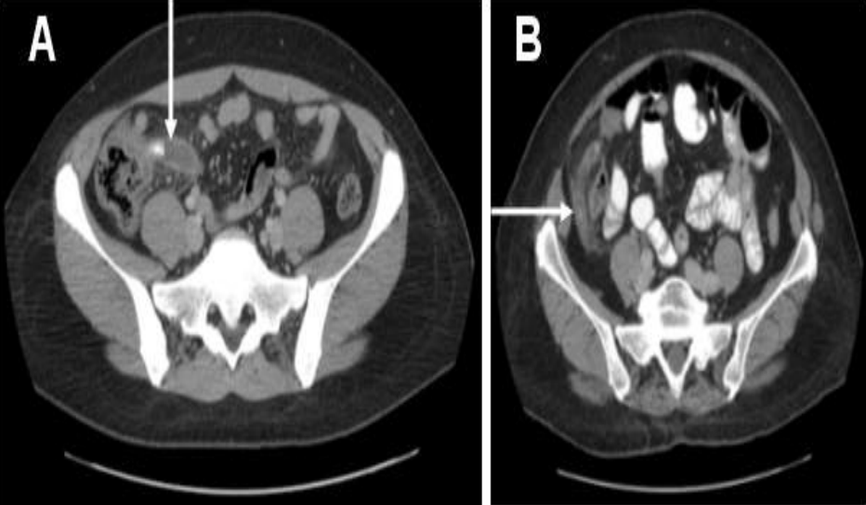
Case 5 , Cont...
Appendix should not exceed 6mm in diameter..
The surrounding fat should be clear.
Appendix normally is compressible by US probe. but here the wall is rigid so the the appendix as whole will get lower when pushed with the probe (not compressible = abnormal = appendicitis).
Normally, there will be no appendicolith (lith=stone, in appendix).
12

Slide 14
Case 5 , Cont...
Appendicitis on Ultrasound
tubular end structure within the right iliac fossa with diameter more than 6mm and when we try to compress it by probe it won't be compressible and you can see appendicolith within the lumen
Signs of appendicitis:
Dilated diameter (normal diameter of appendix is 0.6 cm or 6 mm).
Hyper-attenuation (or stranding) of periappendicular fat.
Enhancing of wall (thick wall).
Appendix
directed medially
Appendicolith (stone)
Stone
cecum
thickened
wall
shadow
13

Slide 15
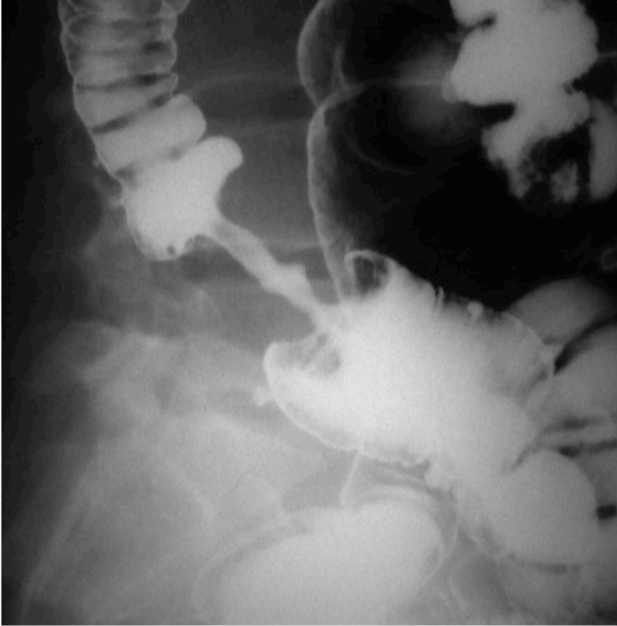
Case 6
What is the name of the study?
What is the findings?
What is the pertinent sign?
What is the diagnosis?
14

Slide 16
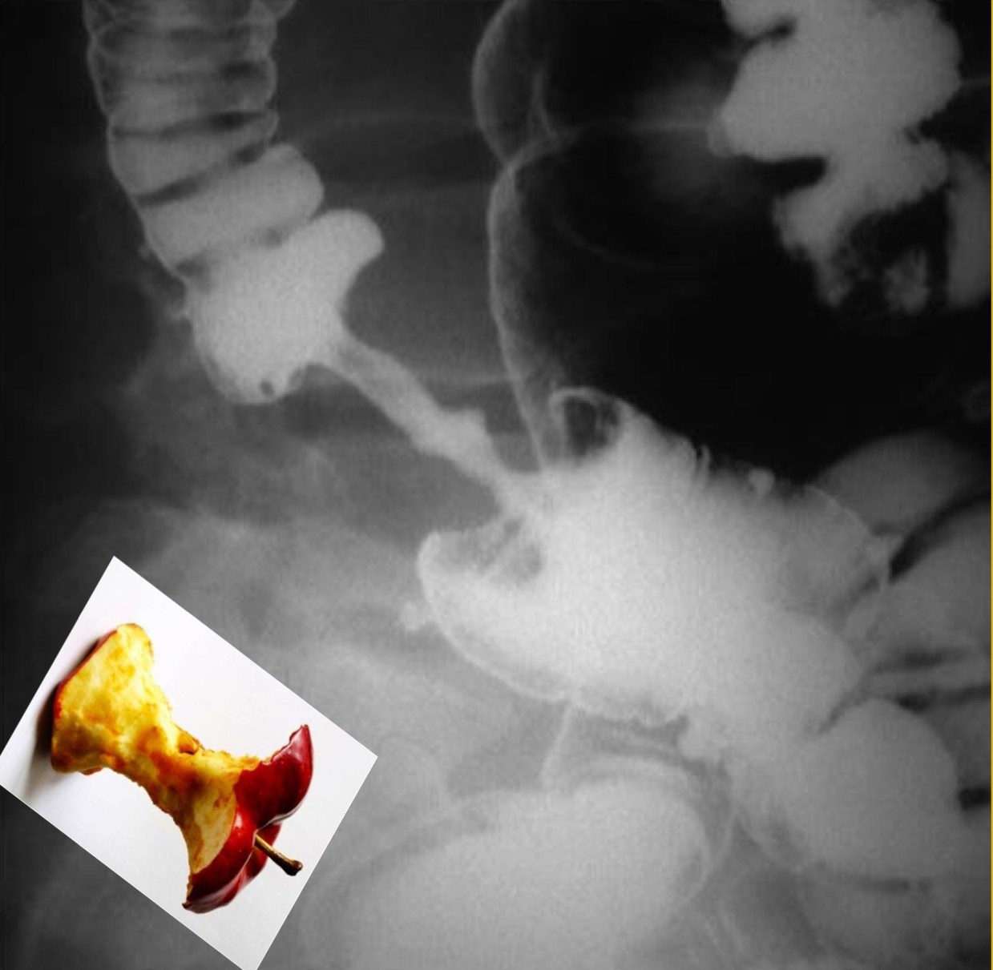
Case 6
What is the name of the study?
Double contrast Barium enema.
What is the findings?
Focal area of luminal narrowing with irregular outline
What is the pertinent sign?
Apple-core sign.
What is the diagnosis?
Colon cancer, 100% until proven otherwise.
(You have to differentiate between malignant stricture and benign stricture) Malignant strictures show=
1-focal area
2-there is shouldering
3-irregularity in the outline
15

Slide 17
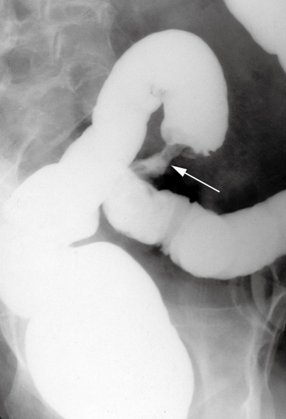
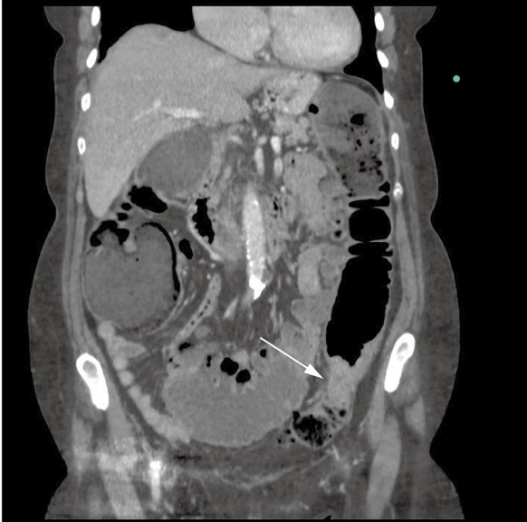
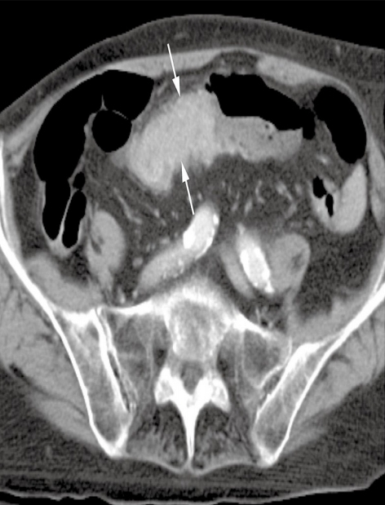
Case 6 , Cont...
Examples of colon cancer in barium enema and CT scan
Coronal section of CT
Axial section of CT
16

Slide 18
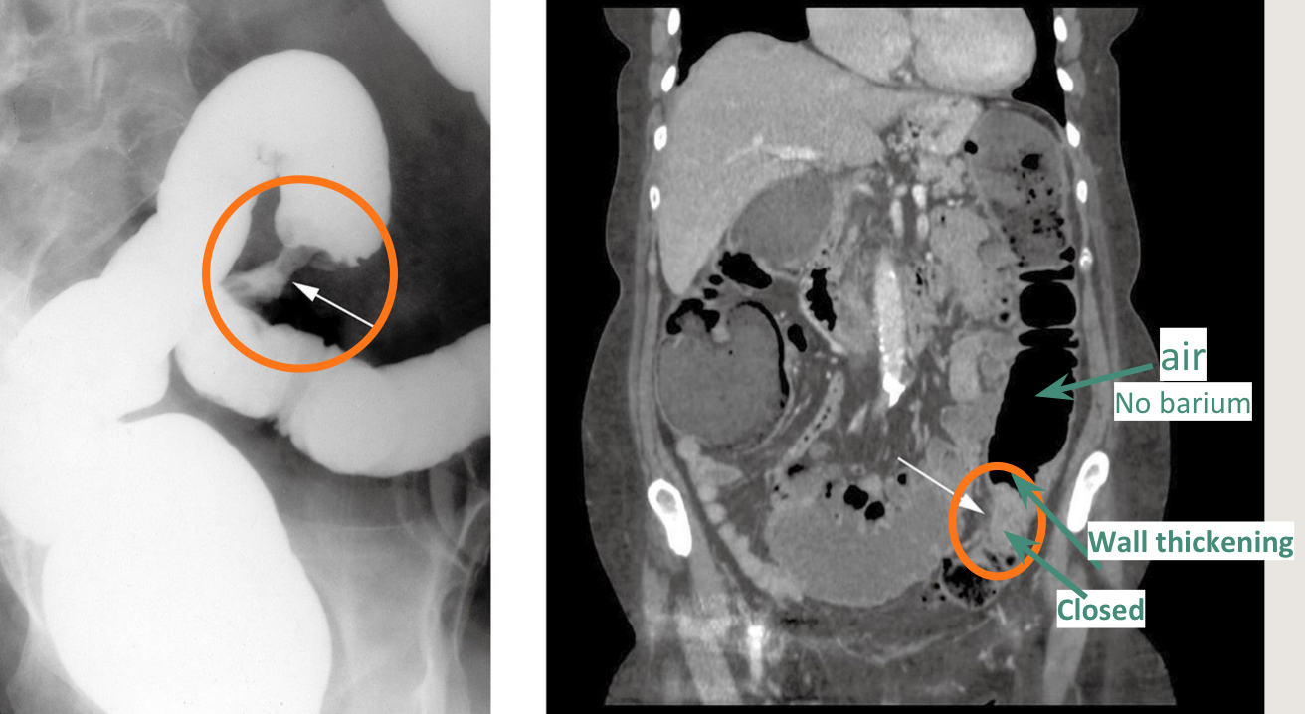
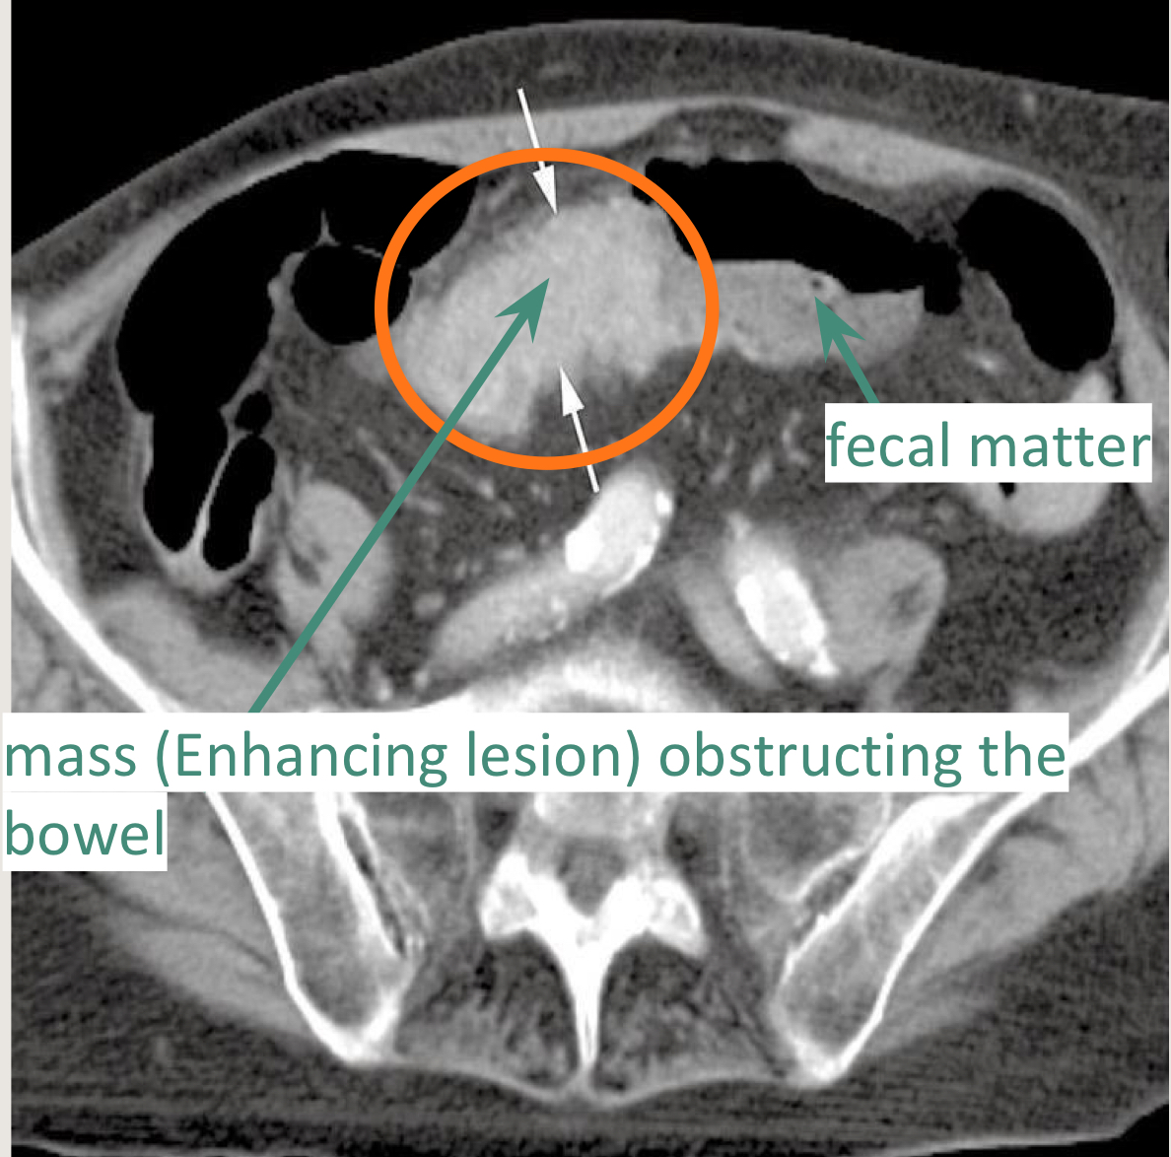
Case 6 , Cont...
Examples of colon cancer in barium enema and CT scan
Left picture : Barium enema represents apple core sign (malignant)
Right picture : coronal CT showing a short, circumferential narrowing which started with wall thickening and then obstruction in the sigmoid colon (arrows) from a tumor.
Standard axial CT acquired on thin sections showing a tumor (arrows) in the transverse colon.
17

Slide 19
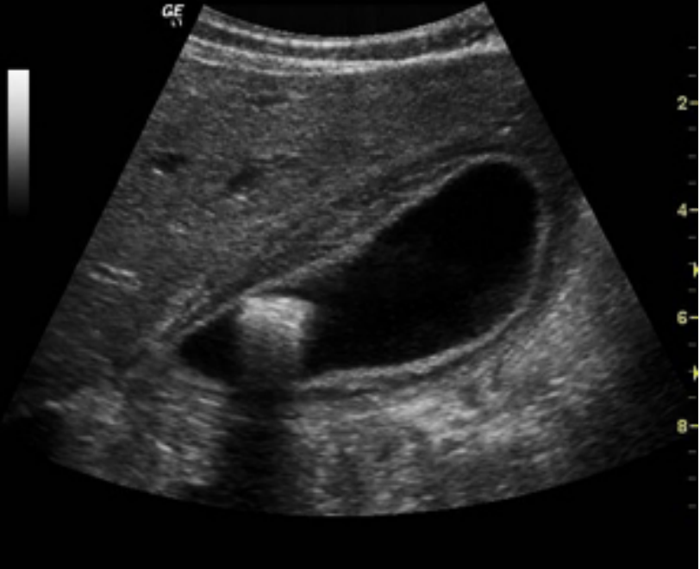
Case 7
What is the name of the modality?
What is the diagnosis?
What are the expected symptoms the patient has?
Treatment :
18

Slide 20
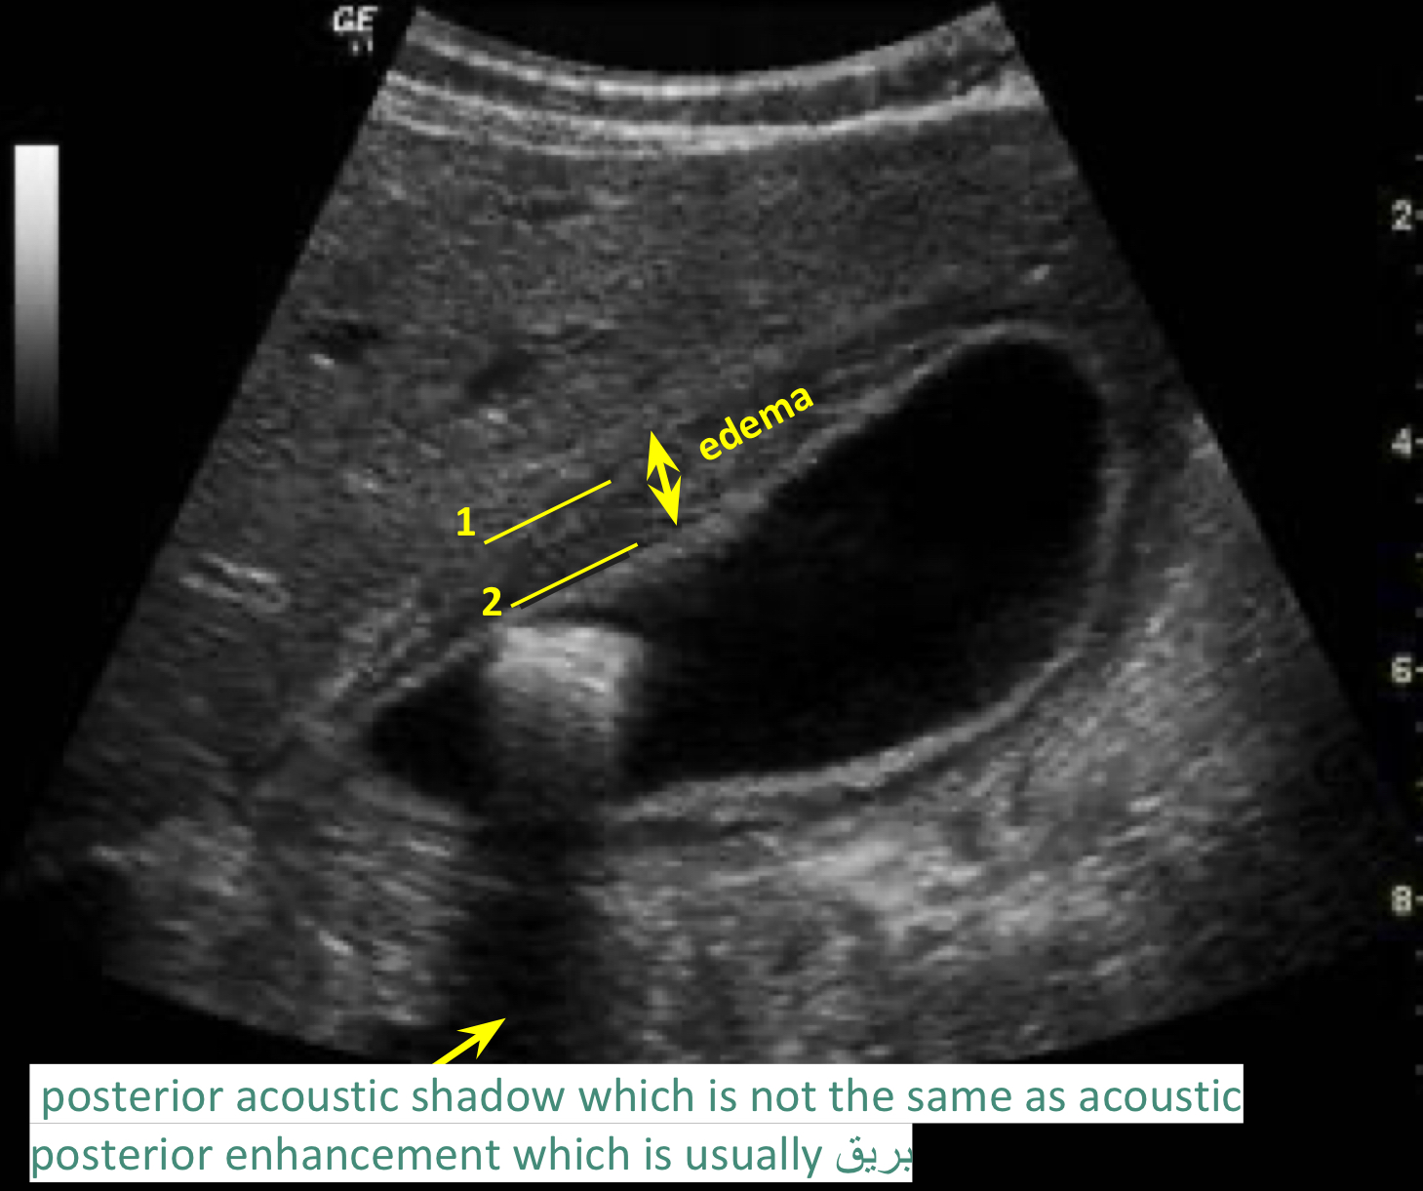
Case 7
What is the name of the modality?
Ultrasound of gallbladder
What is the findings?
We can see echogenic structure(gallstone)seen within lumen of the gallbladder showing distal acoustic shadowing
echogenic mucosa
thickened and edematous wall of gallbladder
Lumen is distended
What is the diagnosis?
Gallstone with Acute cholecystitis (or called calcular cholecystitis).
What are the expected symptoms the patient has?
RUQ pain radiating to right shoulder aggravating by fatty meal.
1. Outer wall of the gallbladder.
2. Inner wall of the gallbladder.
Treatment :
Surgery (cholecystectomy) but wait for the inflammation to subside first.
19

Slide 21
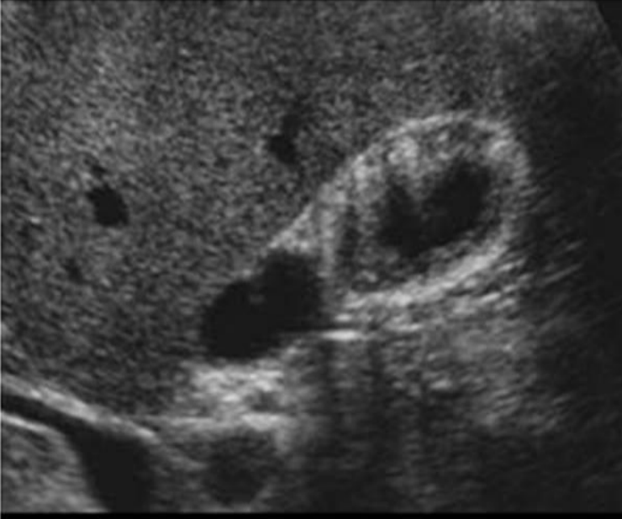
Case 8
What is the name of the modality?
What is the findings?
What is the diagnosis?
What is the important of this disease?
20

Slide 22
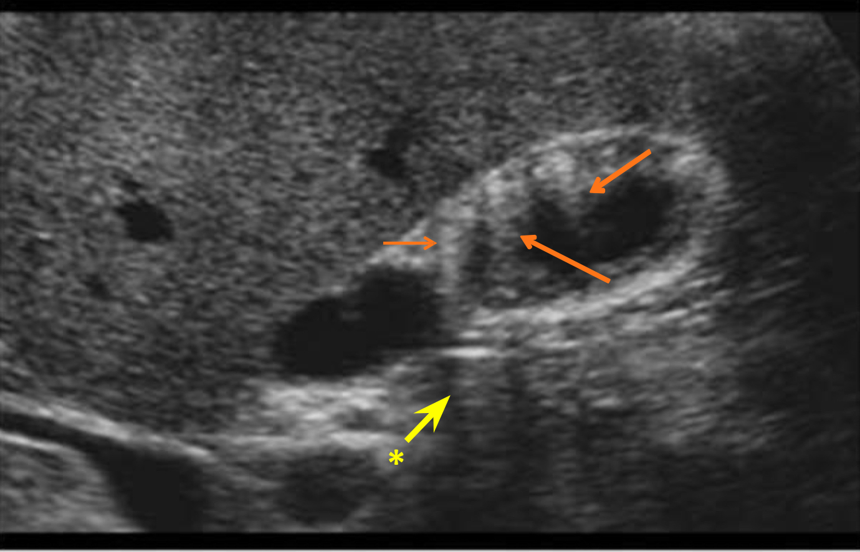
Case 8
What is the name of the modality?
Ultrasound of gallbladder
What is the findings?
Hyperechoic lesions within the wall. Whole wall of gallbladder is involved with acoustic shadow and its either focal or diffuse
What is the diagnosis?
Gallbladder adenomyomatosis (fat + muscle in wall of gallbladder).
What is the important of this disease?
Misdiagnose with stone, benign lesion and can convert to malignant lesions, F/U follow up is needed.
Posterior acoustic enhancement = fat (arrows), unlike stones which give shadows (enhancement → white / shadow → dark)
The yellow arrow is normal area and not hyperechoic and didn’t represent acoustic shadow!!it appears hypodense because it separates two enhancements
21

Slide 23
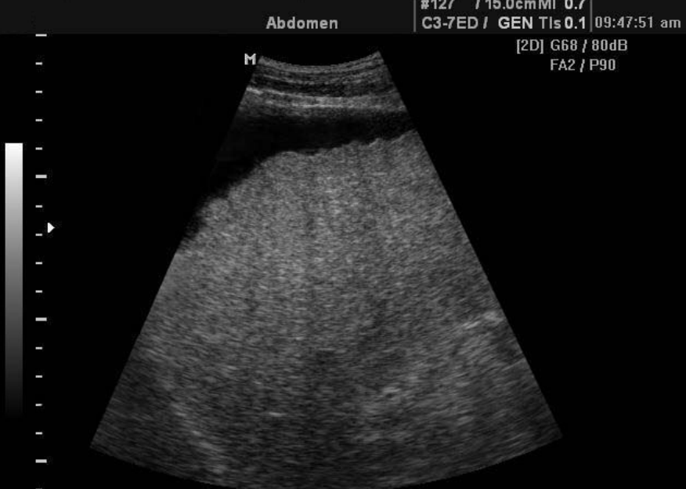
Case 9
What is the name of the modality?
What is the findings?
What is the diagnosis?
22

Slide 24
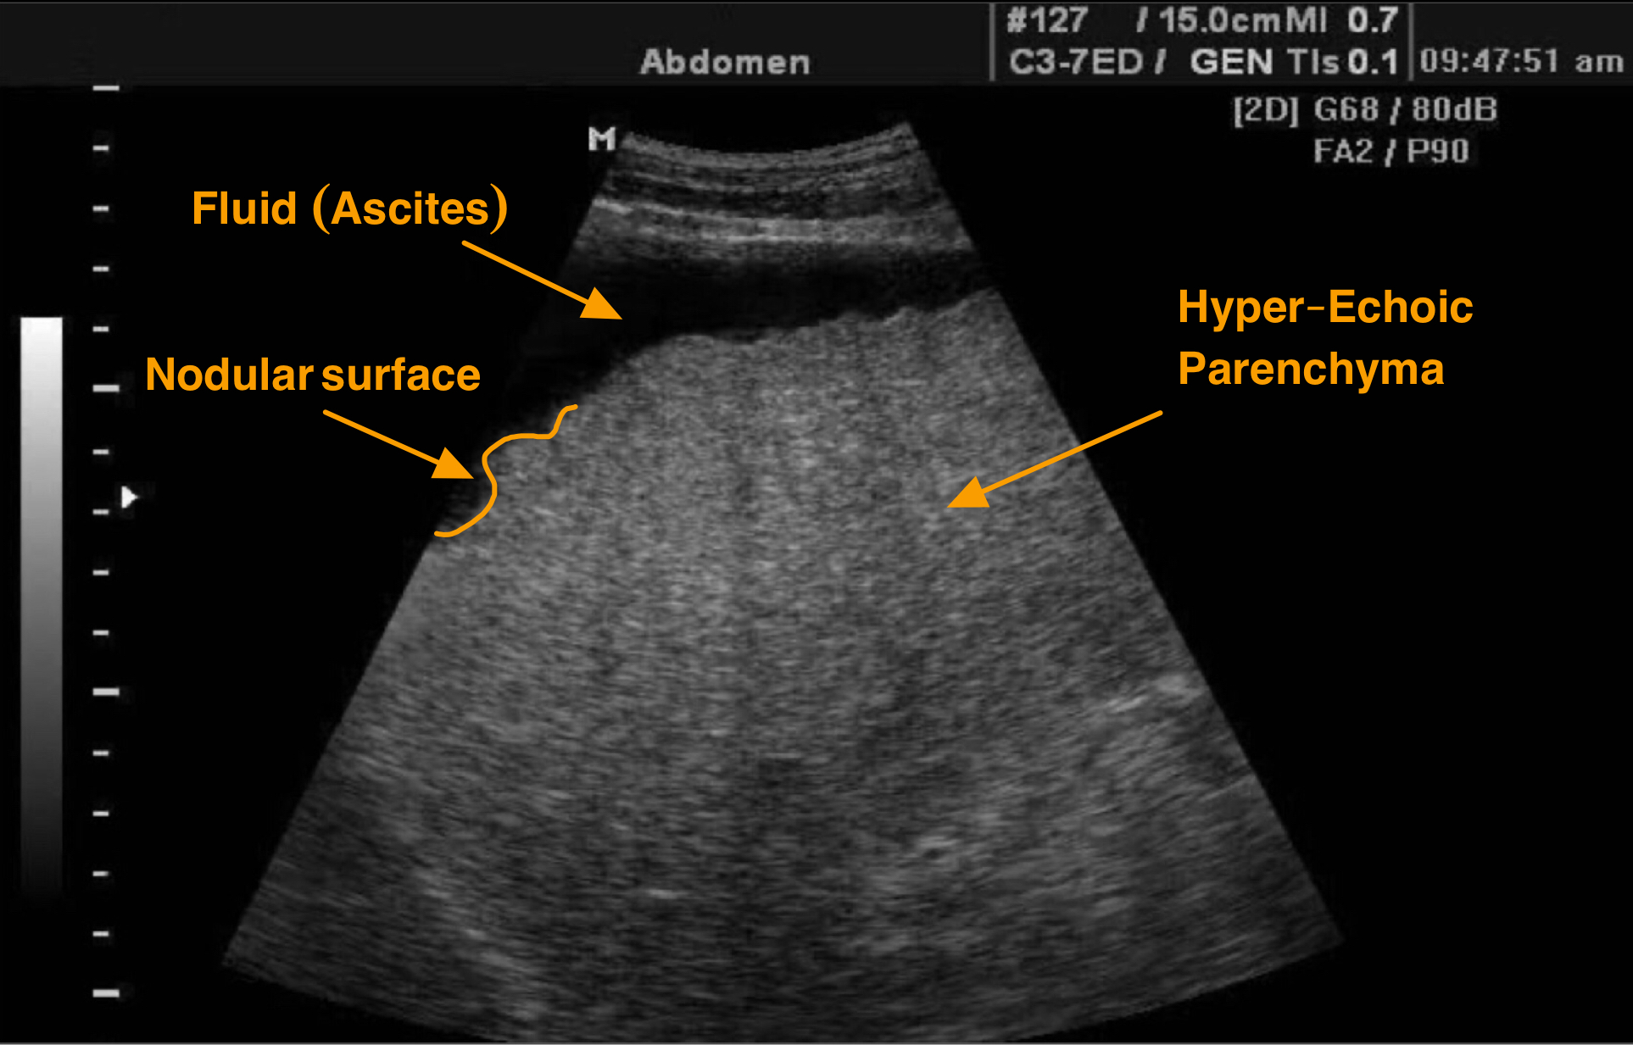
Case 9
What is the name of the modality?
Ultrasound.
What is the findings?
Shrink,
irregular nodular surface
hyperechoic texture (in fatty liver and liver cirrhosis)
ascites.
(Usually craniocaudal dimension of liver is more than 16cm)
What is the diagnosis?
Liver cirrhosis.
23

Slide 25
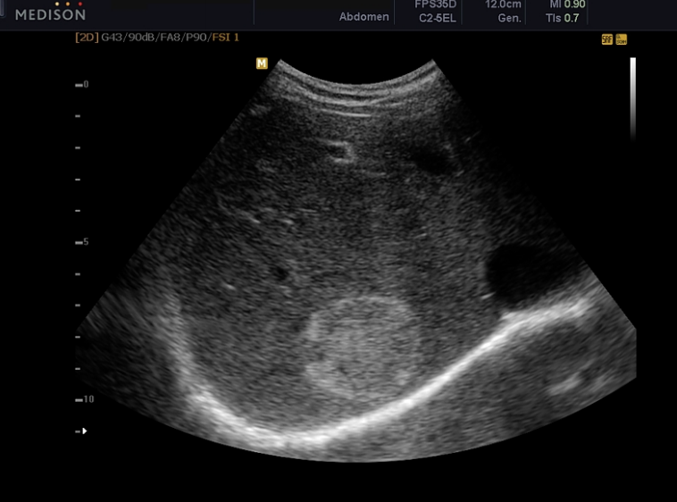
Case 10
What is the name of the modality?
What is the findings?
What is the diagnosis?
What is other imaging modality to confirm the diagnosis?
24

Slide 26
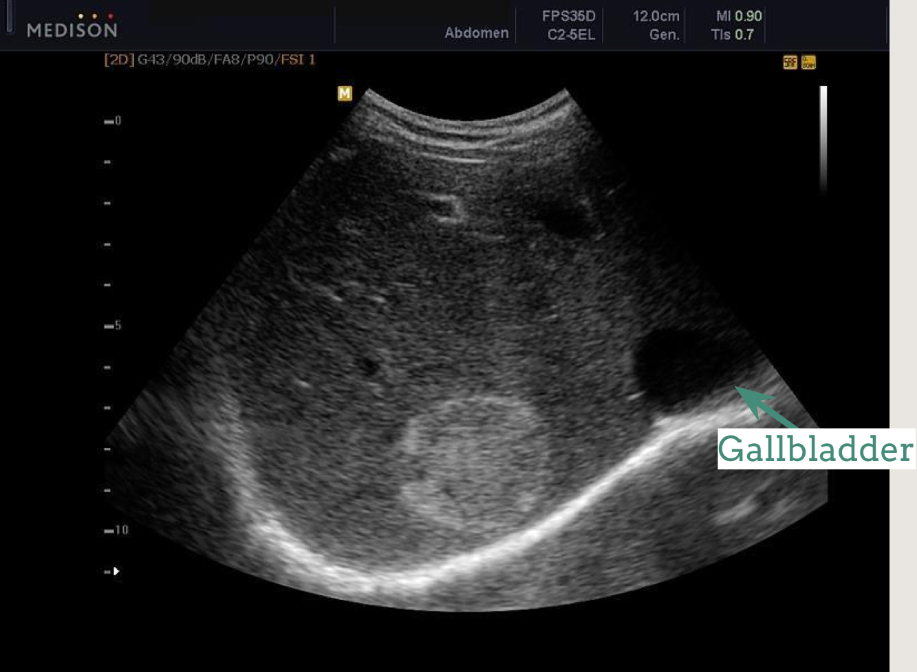
Case 10
What is the name of the modality?
U/S of the liver.
What is the findings?
First you have to start looking at the liver parenchyma here we see:
1-the surface is smooth not nodular
2-normal liver size
3-echogenicity of liver is normal
So;liver parenchyma is normal.Then look for other lesions
Rounded well demarcated Hyperechoic focal hepatic nodule with smooth outlines;no nodules or lobulations
What is the diagnosis?
Hemangioma.=benign
Most of Hyper-echoic solitary nodules which are well defined are hemangioma “ benign”.
What is other imaging modality to confirm the diagnosis?
Triphasic liver CT scan.
MRI.
25

Slide 27
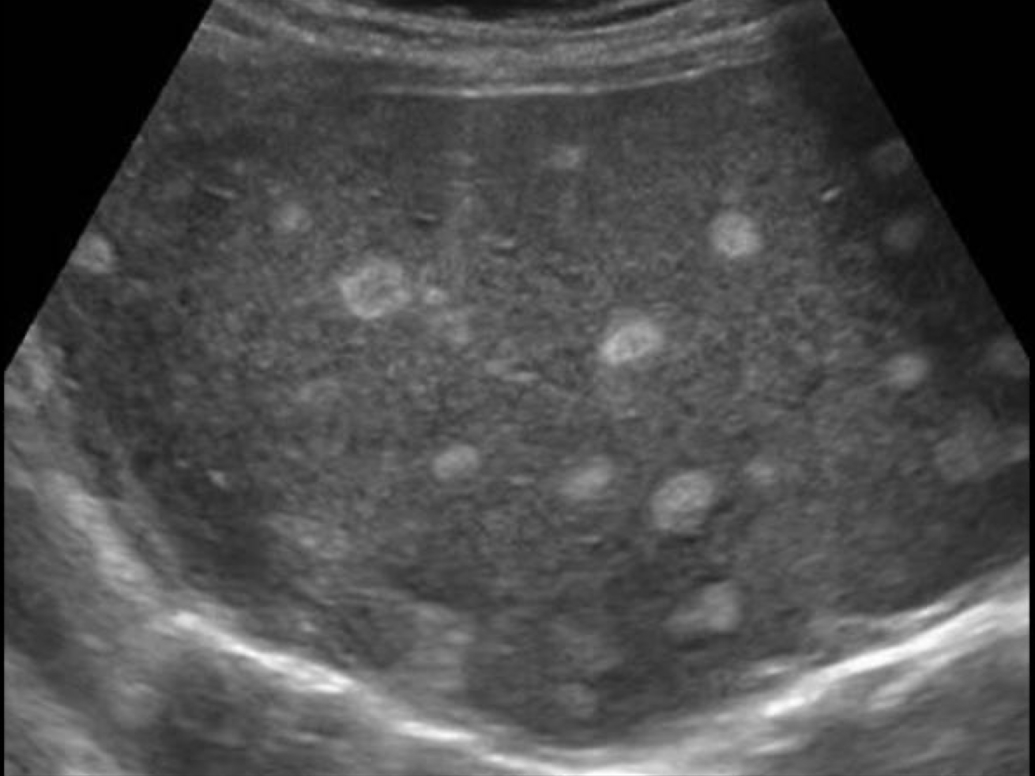
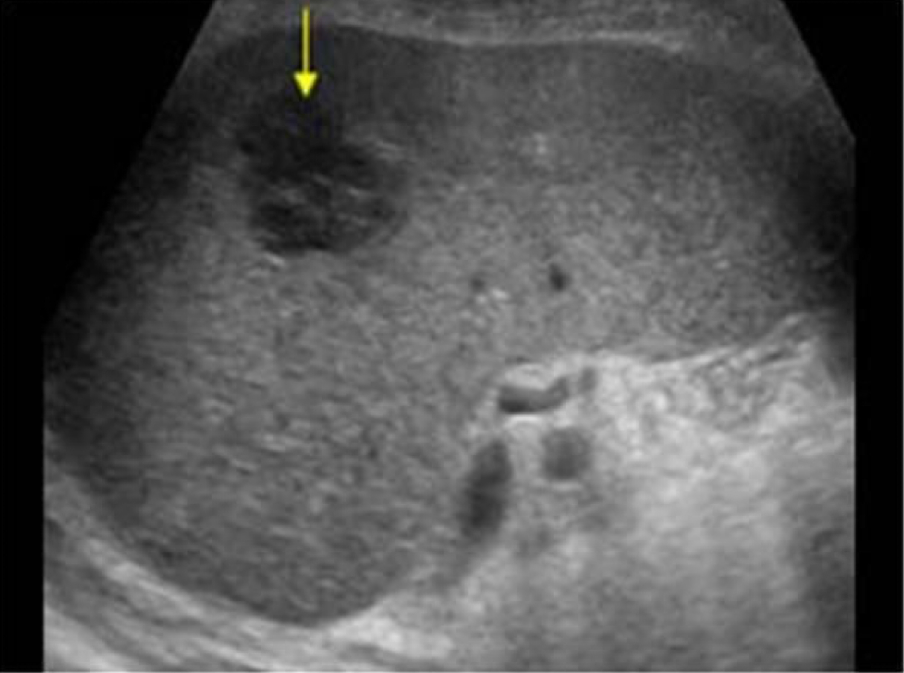
Case 11
Describe the following nodules?
Triphasic liver CT scan of the same patient, what is the diagnosis?
26

Slide 28
Case 11
Hyperechoic lesions
Hypoechoic lesions
Metastatic or HCC Multiple lesions with varying size > metastatic
Most of hypoechoic mass are malignant = metastasis or HCC. This is not a cyst! the cyst will be very black
Triphasic liver CT scan of the same patient :
Characteristic enhancement of hemangioma of CT scan
Arterial phase: Peripheral nodular enhancement , How to know its the arterial phase? Abdominal Aorta filled with contrast
Portal venous phase:
Peripheral nodular enhancement , How to know its the portal phase? Abdominal Aorta and IVC and portal vein filled with contrast
Delayed or Equilibrium phase: Homogenous enhancement
It is the delayed phases because the kidneys appear with the contrast.
27

Slide 29
Case 12
What is the modality?
What is the findings?
What is the diagnosis?
28

Slide 30
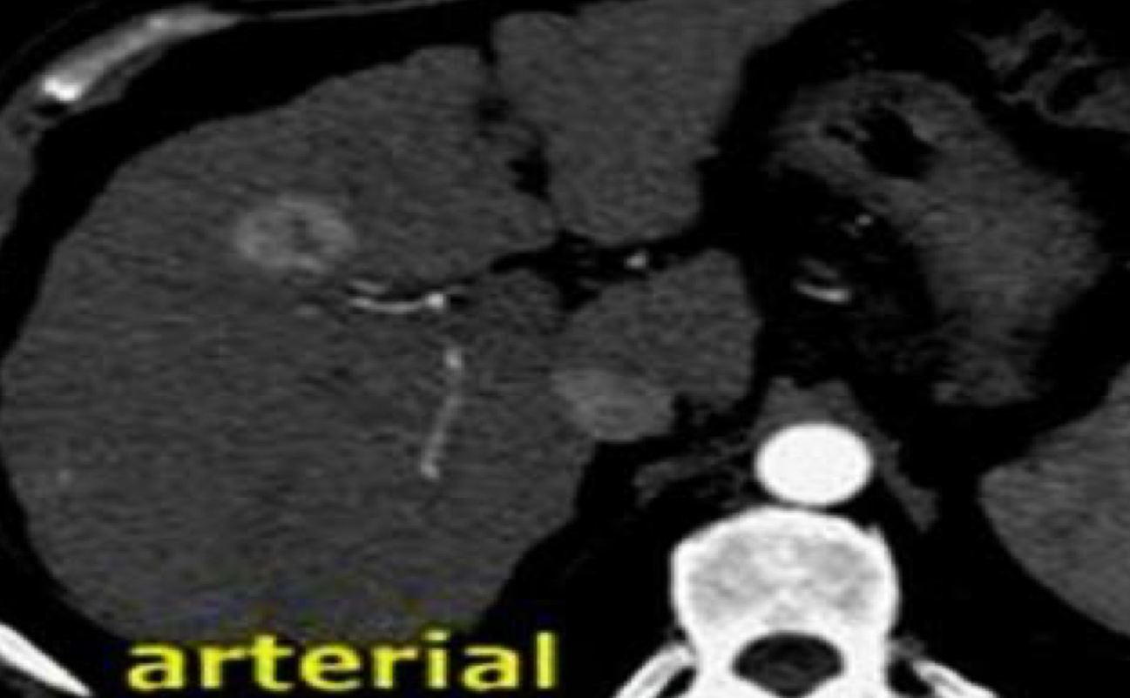
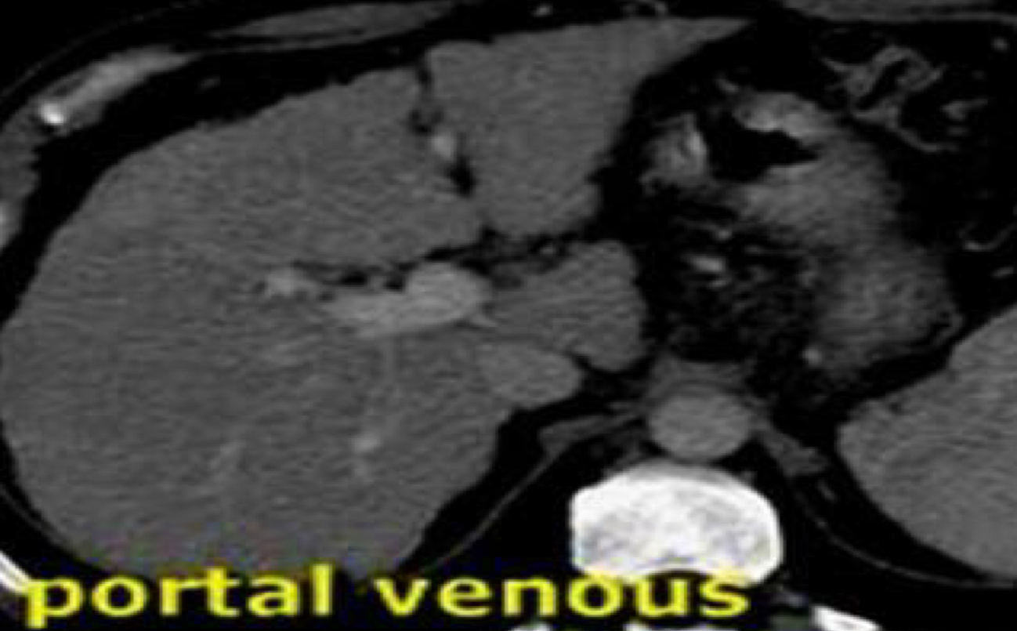
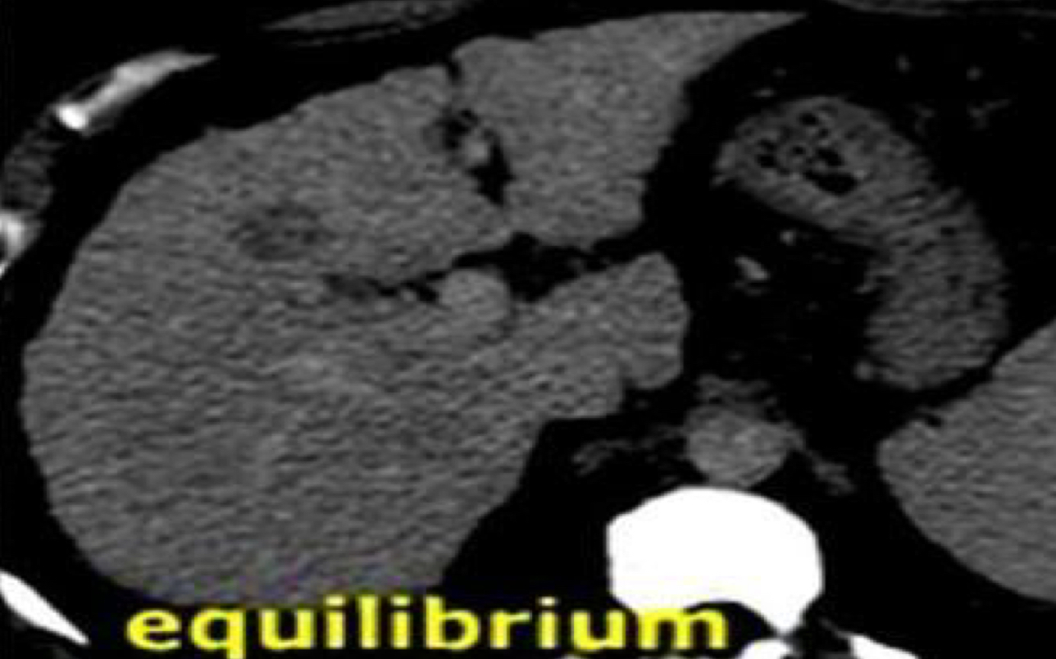
Case 12
What is the modality?
Triphasic Liver CT scan .
What is the findings?
Focal hepatic lesion with fill-in enhancement
Like we said earlier, we start with assessing the liver parenchyma so;
1-there is nodularity of liver surface
2-right liver lobe is small
3-coarse texture
All Indicating liver cirrhosis
Arterial Phase: Homogenous enhancement
What is the diagnosis?
HCC or metastatic.
Portal venous Phase:Isodense
(we can’t see it anymore)
In the arterial phase there is early enhancement then there will be iso-enhancement in the venous phase (same as the surrounding tissue).
And the late phase it will be washout of the contrast and this represent hepatocellular carcinoma or metastasis.
So remember in hemangioma (benign) the full enhancement (tumor uptake of contrast ) will be in the delayed phase , while in HCC (malignant) the full enhancement will be in the arterial phase .
Delayed or Equilibrium phase: Hypodense (Washout)
29

Slide 31
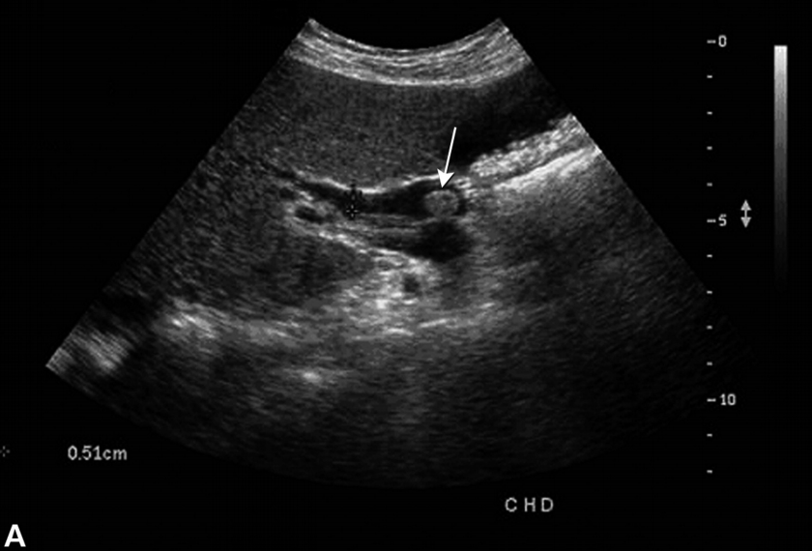
Case 13
What is the modality?
What is the findings?
What is the diagnosis?
What is the expected symptoms and signs the patient has?
30

Slide 32
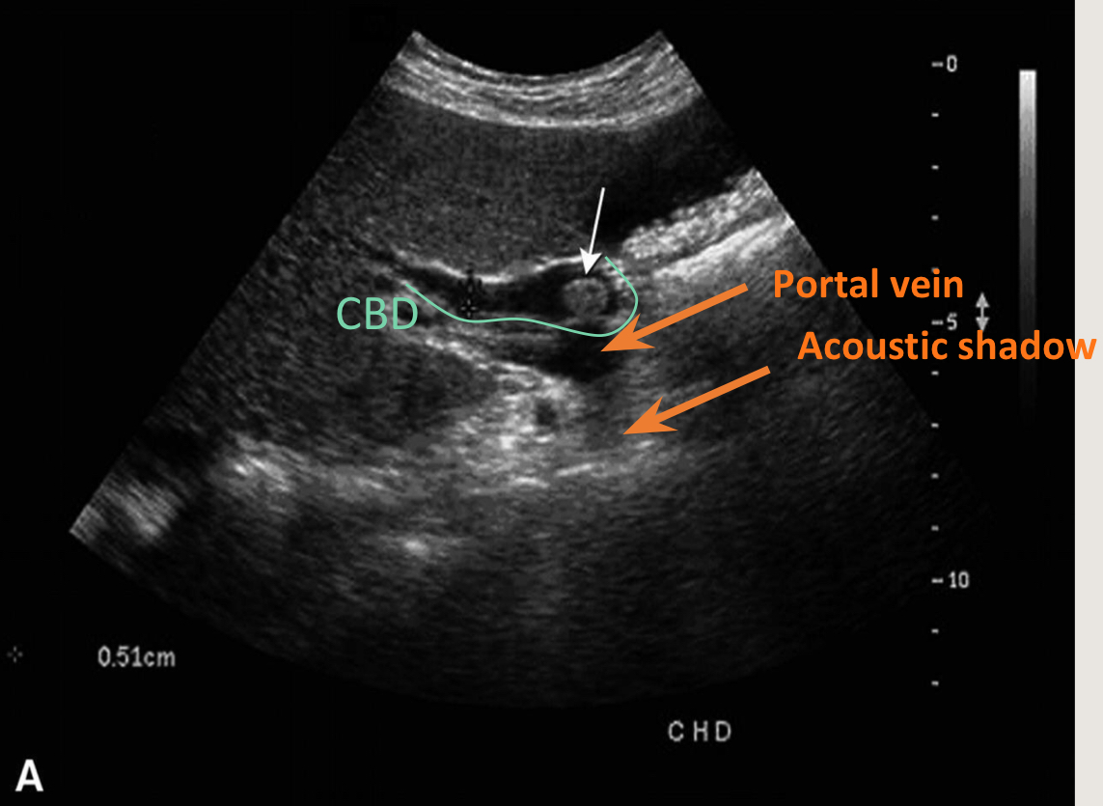
Case 13
What is the modality?
U/S.
What is the findings?
Hyperechoic rounded lesion with acoustic shadow(stone) in CBD (common bile duct).
dilation of CBD
Normal diameter of CBD is 5mm but in the pic 0.51cm. So, CBD is dilated.
What is the diagnosis?
CBD stone (white arrow) → obstructive jaundice.
What is the expected symptoms and signs the patient has?
Yellow discoloration, RUQ pain, Hyperbilirubinemia and dark urine.
How to confirm the CBD stone?
31

Slide 33
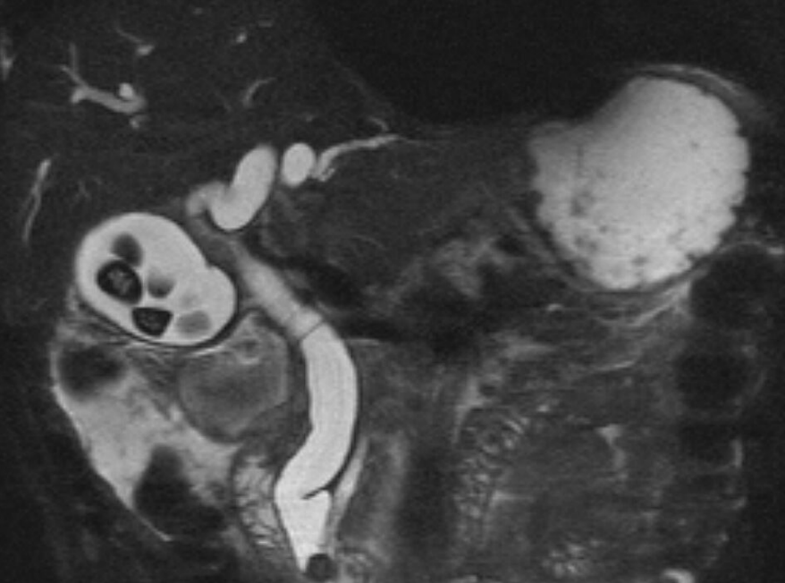
Case 14
MRCP is ?
The dark signals in the gallbladder is ?
The dark signal in the distal CBD is ?
32

Slide 34
Case 14
MRCP = MRI Cholangio-Pancreatico-graphy (imaging of the bile ducts with the pancreas). It’s non invasive so we usually start with it (MRCP) or ERCP for diagnosis of CBD stone
The dark signals in the gallbladder is stone, impacted in distal CBD and dilatation of the bile ducts.
The dark signal in the distal CBD (common bile duct) is stone.
Fluids (water, bile, urine) appear white in MRI while black structures are dense materials.
Fluid
multiple stones
GB
duodenum
Bile D
Stone stuck in the ampulla of vater;distal CBD stone
CBD
33

Slide 35
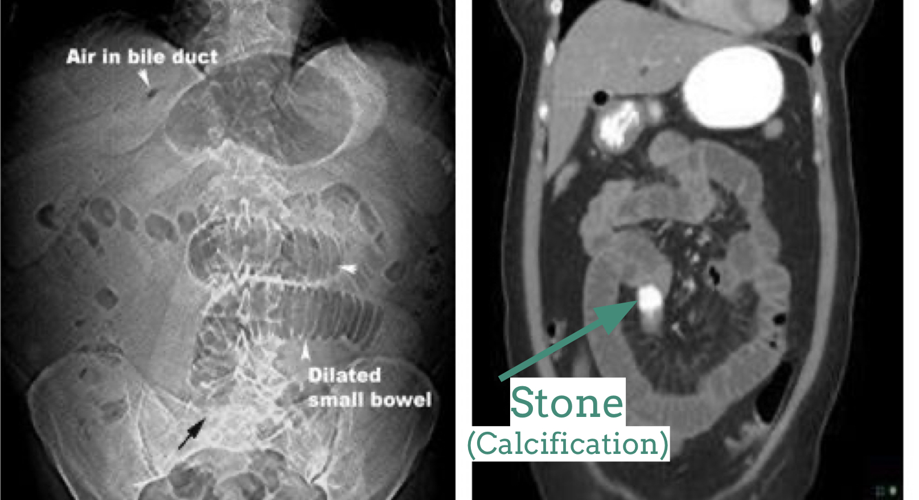
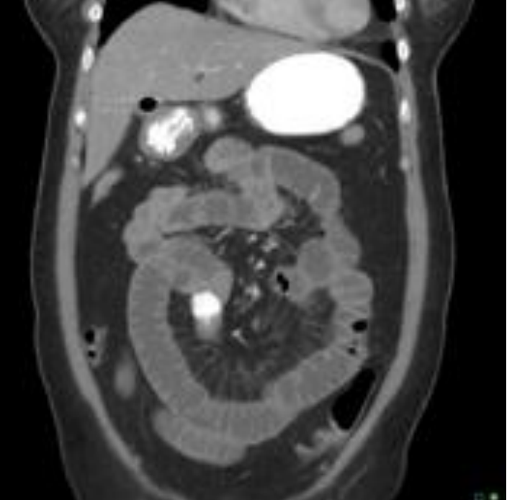
Case 15
Triad of Gallstone ileus:
1.
2.
3.
Diagnosis by?
Treatment
33

Slide 36
Case 15
Triad of Gallstone ileus:
1. Air in the bile ducts, Pneumobilia.
2. Dilatation of the small bowel (stacked coins). (Gallstone ileus)
3. Calcified stone in the distal bowel. Not clear in Pic 1 , clear in CT Pic 2..
(Acute bowel obstruction)
Diagnosis by?
Radiology
Treatment
Surgery.
gallstone ileus → obstruction of small bowel due to gallstone.
- Rare disease, happens when there is chronic inflammation which causes adhesions to form between the gallbladder and the duodenum.
- After time fistula will form and then stones may pass through this fistula and pass until it reaches the narrowest part of the duodenum (ileocecal valve) and obstruct it.
- Air enters the gallbladder so we have air inside the bile duct.
stones
(calcification)
Dilation is distal to the obstruction
34

Slide 37
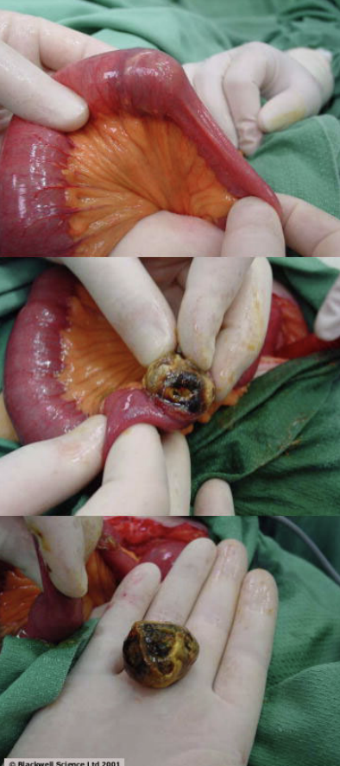
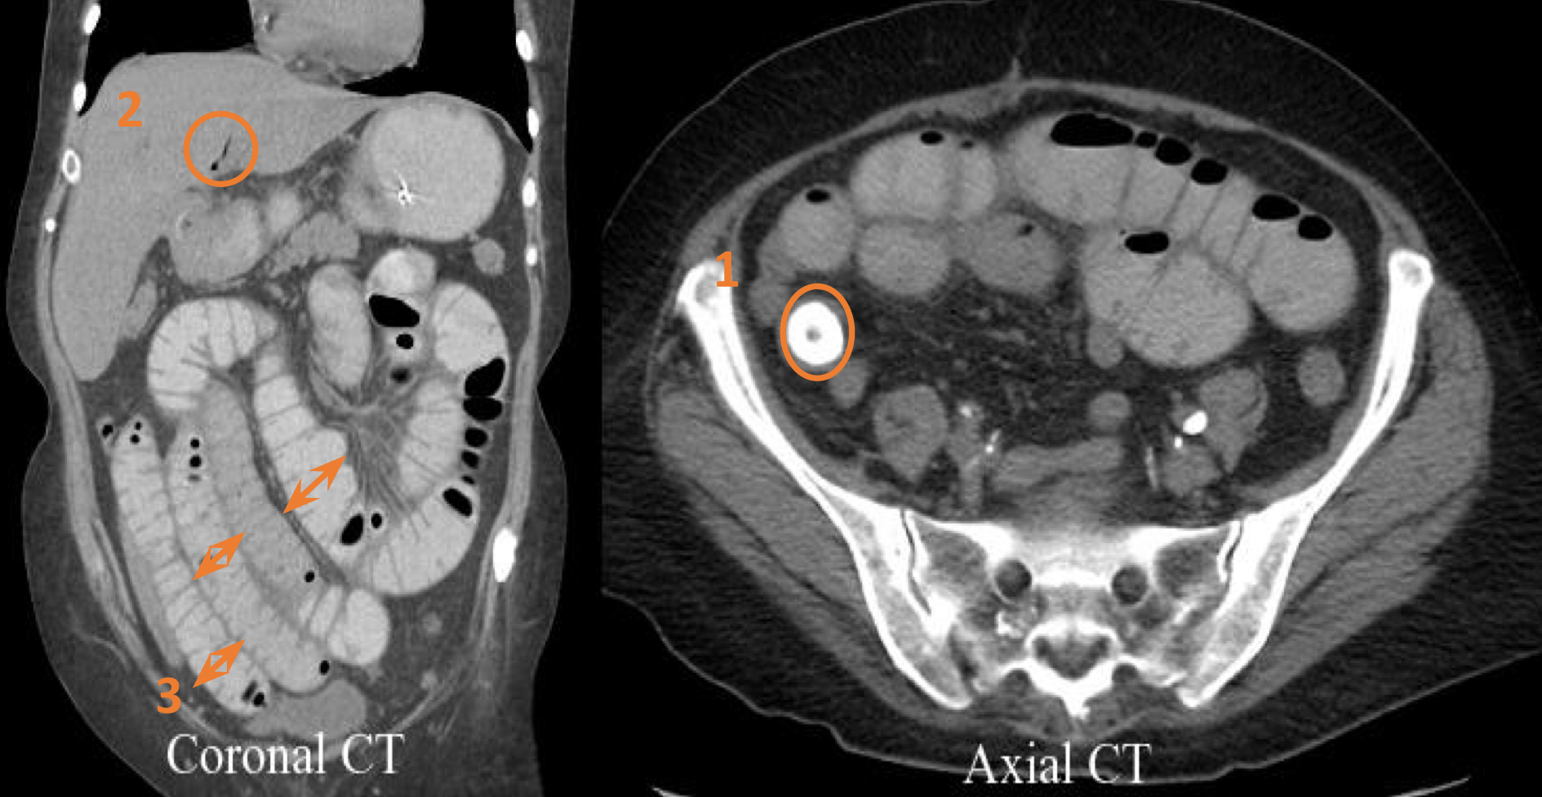
Case 15 , Cont...
What are the findings?
35

Slide 38
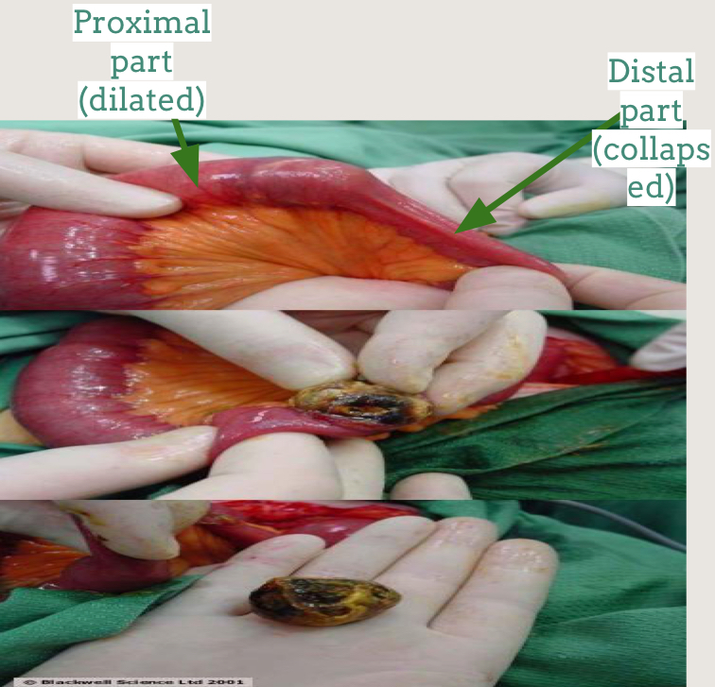
Case 15 , Cont...
What are the findings?
Gallstones in terminal ileum.
Air in biliary tract.
Distended small bowel loops.
Terminal ileum stone → surgery (they cut proximally to the stone and remove it).
36

Slide 39
Extra
This is ERCP shows large filling defect of gallbladder which is large gallstone and we can see the contrast around the stone (white arrows) the gallbladder causes compression and dilatation of the common hepatic or common bile ducts by indirect obstruction (from outside) it is called “Mirizzi's syndrome”.
37

Slide 40
Thank you
To All Of The Amazing Members Of Our Radiology Team Who worked hard and Did a Fantastic Job, Lots And Lots Of Love For All Of You
Alhanouf Alhaluli
Lama Alzamil
Norah Almazrou
Nouf Alhumaidhi
Arwa Alemam
Sarah Alarifi
Njoud bin Dakheel
Rana Alshamrani
Roaa Aljohani
Rahaf Alshuaniber
Norah Alharbi
May Babaeer
Mohammed Al-Huqbani
Zyad Aldosari
Alwaleed Alsaleh
Mohaned Makkawi
Fahad Alsultan
Abdullah Almuamar
Mohmmed Ajarem
Abdullah Alassaf
Dark Theme Night Owls
Yasmeen Almousa
Shahd Alsalamh
Special Thanks
Taif Alotaibi
Amirah Alzahrani
1-
2-
3-
4-
A Huge thank you to our Academic leaders
Noura Alturki
Jehad Alorainy

