Slide 1
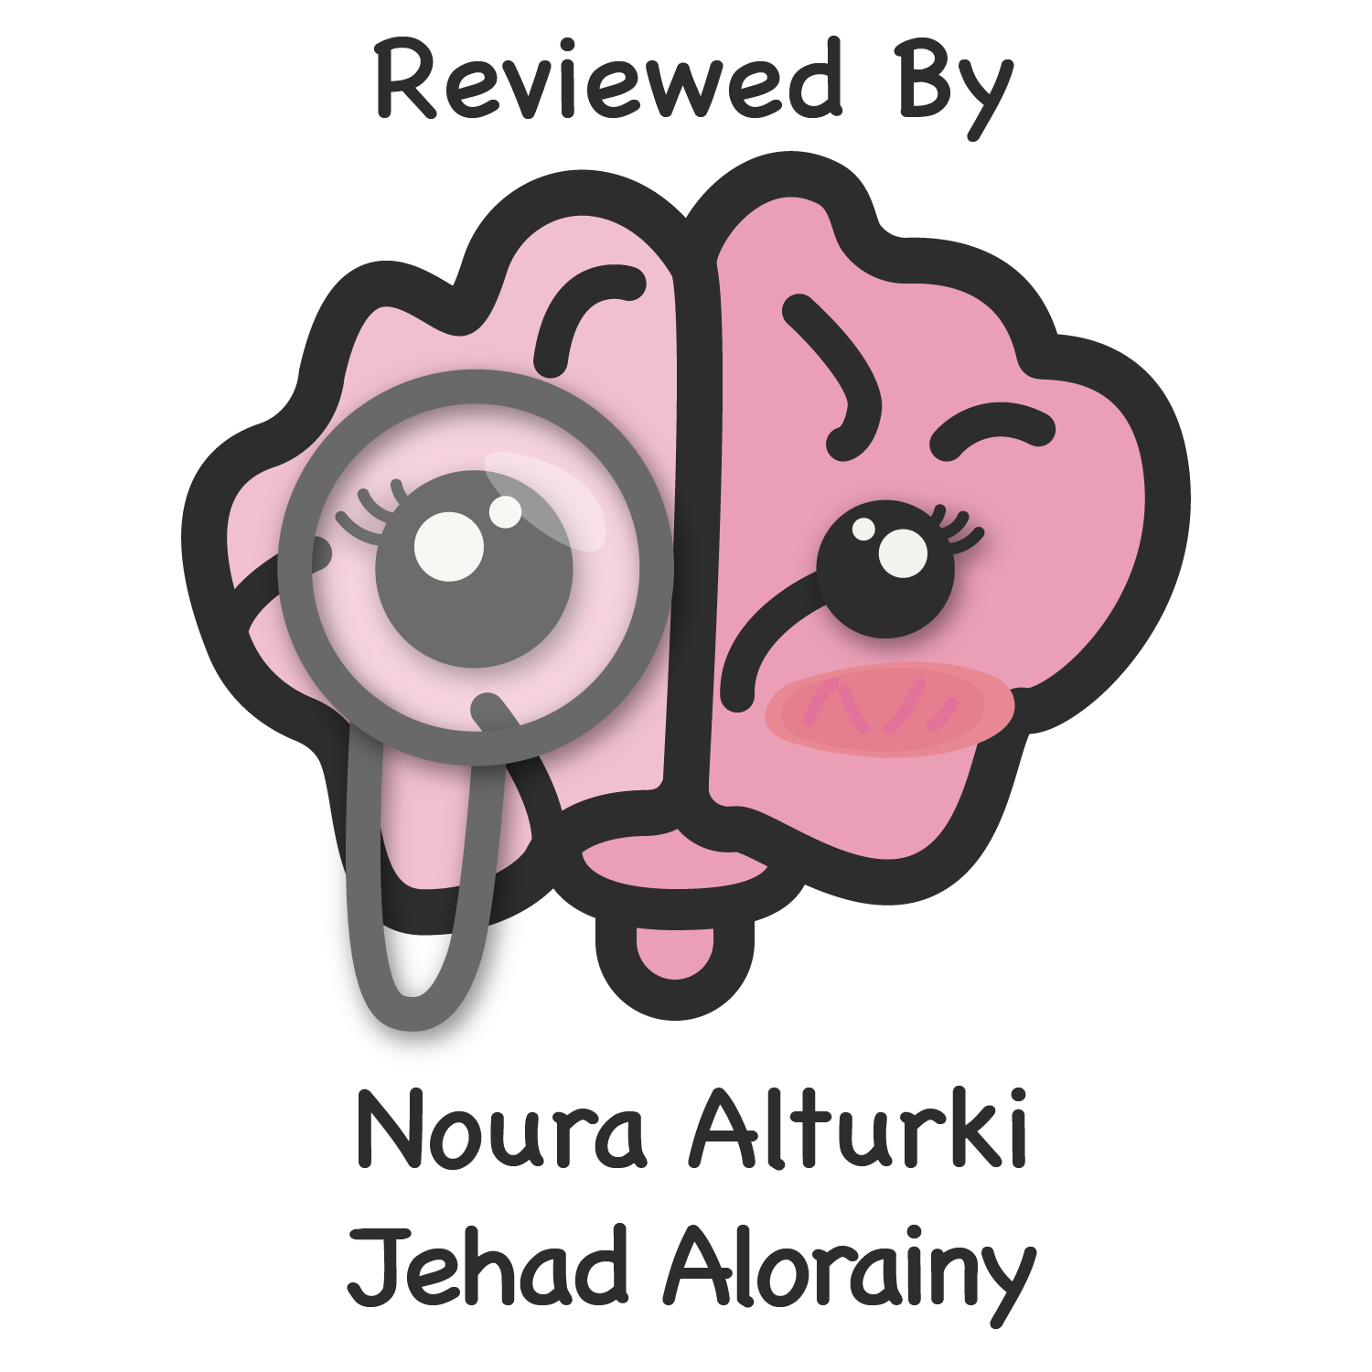
Editing file

Slide 2
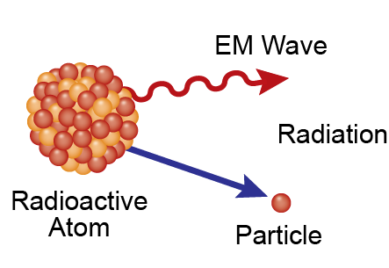
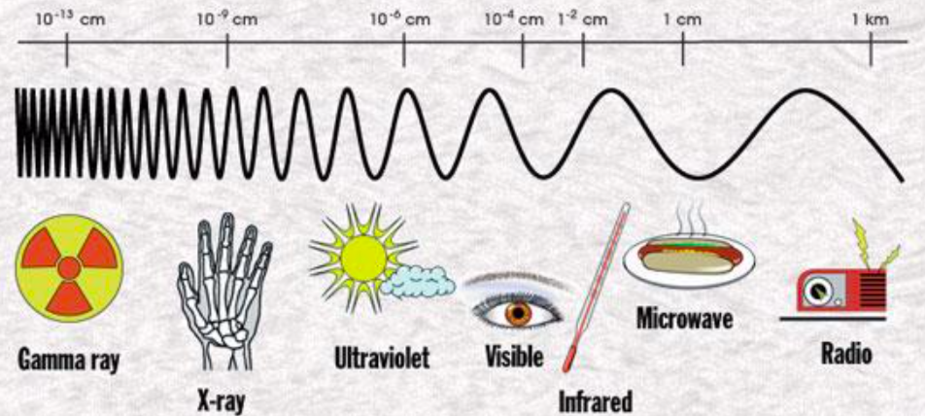
Introduction
Major sources of risk in radiology
Radiation hazard.
Radioactive materials hazard.
Magnetic field hazard.
Contrast agents hazard
Research pioneers in radioactivity
What does it measure=radioactivity
Roentgen
Discovered
X-Rays in 1895.
Becquerel
Discovered Radioactivity in 1896
Rutherford
Discovered Alpha and
Beta Rays in 1897
The Curies
Discovered of radium and polonium 1900-1908
What is radiation?
Radiation is an energy emitted from a substance, subdivided into:
Non-ionizing (non hazard)
Microwave oven, Television, Radio Waves, Ultrasound. We use them in daily life and they are safe and there is no biological effect of using it.
Ionizing
Alpha particles (α), beta (β), gamma (γ) and X-rays (among others) that are capable of producing ions.
Ionizing radiation can be carcinogenic and, to the fetus, mutagenic or even lethal, causes DNA damage.
Explanation: a radioactive atom has an unstable nucleus; it tends to lose energy to reach a more stable state, causing radiation.
Radiation will ionize atoms in living cells, damaging them.
What is X-rays?
X-rays are very short wavelength electromagnetic radiation.
The shorter the wavelength and the higher the frequency, the greater the energy and the greater the ability to penetrate matter.
1

Slide 3
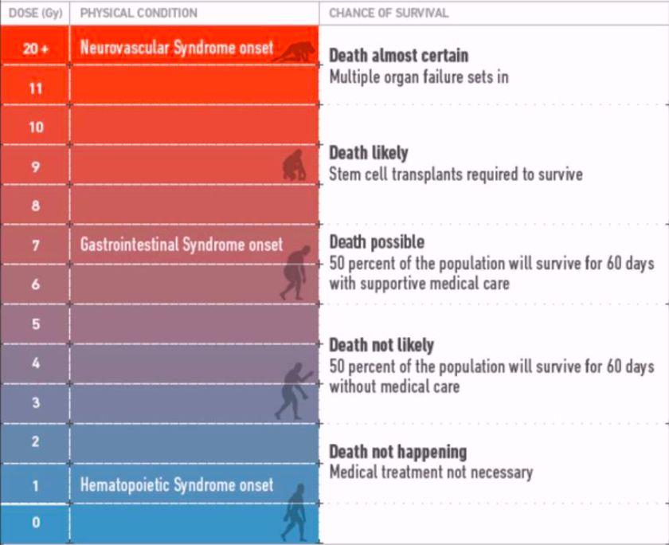
Introduction
Radiation units
RAD (Radiation Absorbed Dose)
Original measuring unit for expressing the absorption of all types of ionizing radiation (alpha, beta, gamma, neutrons, etc) into any medium.
REM (Roentgen Equivalent Man)
Is a measurement that correlates the dose of any radiation to the biological effect of that radiation. Since not all radiation has the same biological effect, the dosage is multiplied by a "quality factor" (Q). For example, a person receiving a dosage of gamma radiation will suffer much less damage than a person receiving the same dosage from alpha particles, by a factor of three.
RAD :e.g.: patient exposed to 2 RAD radiation, it means the amount of radiation.
However, to quantify the risk we use REM. which=RADxQ.
Q is the danger of that factor, depend on type of ionizing radiation
Quantity | Unit | SI unit | Relation between units
Absorbed dose | RAD | Gray (Gy) | 1 Gy=100 RAD 100 mGy=10 RAD 10 mGy=1 RAD 1 mGy= 100mRAD
Equivalent dose | REM | Sievert (Sv) | 1 Sv= 100 REM 100 mSv= 10 REM 10 mSv=1 REM 1 mSv=100 mREM
Gray, Rem, rad, Curie, Becquerel and Sievert are units of radiation.
One chest x-ray 0.15 mGray.
To reach the hazardous level of 2 Gray you need 10000 chest x ray or 100 CT abdomen or 30 mins to 1 hr fluoroscopy exposure.
1 CT= 100 X-rays.
Fluoroscopy has the highest and X-ray has the lowest
Effects of nuclear exposure
2

Slide 4
Radiation Hazard
Goals of Radiation Safety:
To eliminate deterministic (acute) effects.
To reduce incidence of stochastic (Chronic) effects.
Deterministic and Stochastic Effects:
 | Acute/deterministic effects | Chronic/Stochastic effects. (Random events)
Definition | Acute radiation symptoms are caused by high levels of radiation usually over a short period of time. | - Also referred to as (Probabilistic), probability of occurrence depends on absorbed dose. - Chronic radiation symptoms are caused by low-level radiation over a long period of time.
 | - They cannot be predicted with certainty. - Severity of damage increases with increasing dose above that threshold. | - The effect may (potentially) occur following any amount of exposure, there is no threshold. (By accumulation) - Even the smallest quantity of Ionizing Radiation exposure can be said to have a finite probability of causing an effect. - Severity of the effect is not dose related.
Examples | Cataract formation Bone marrow failure Lung Fibrosis Infertility hair loss lowering the WBC count Skin reddening (erythema). | Carcinogenic effect Genetic effect
Characteristics
3

Slide 5
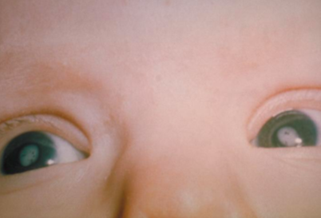
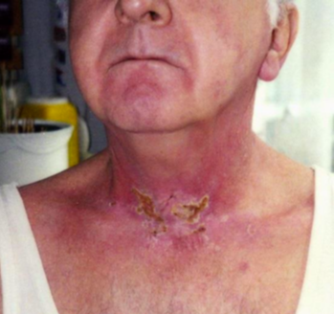
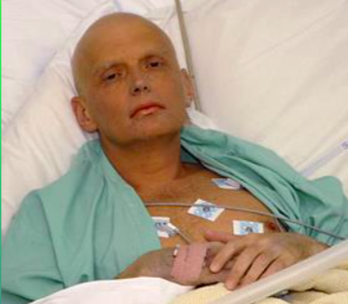
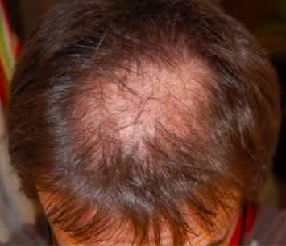
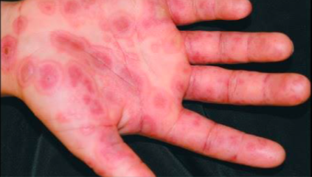
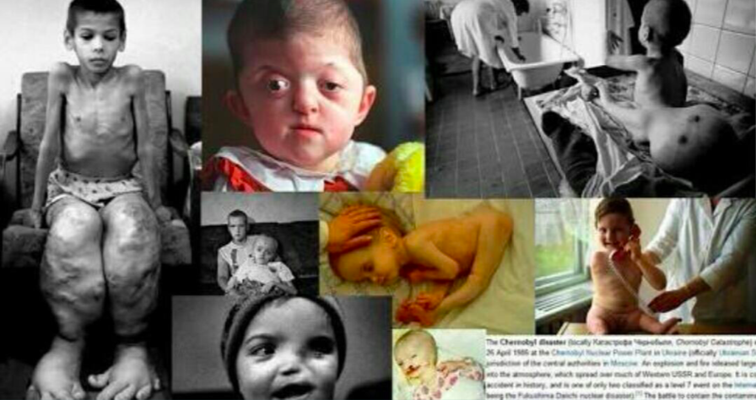
Radiation Hazard
Acute Deterministic Effects
Chronic Stochastic Effects
4

Slide 6
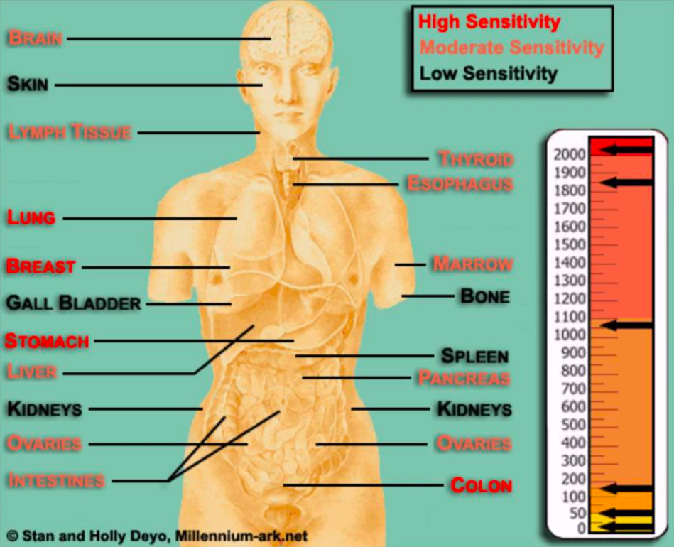
Radiation Hazard
Threshold for deterministic effects
Major organs annual dose limits for preventing deterministic effects are as follows :
doctor said numbers aren’t important just know the effects and compare between them
Organ | Effects | One single absorption (Gy) | Prolonged absorption (Gy-year)
Testes | Permanent infertility | 3.5 - 6 | 2 this is the hazardous level
Ovaries | Permanent infertility | 2.5 - 6 | >0.2
Eye lens | Milky of lens cataract | 0.5 - 2 5 | >0.1 >0.15
Bone marrow | Blood forming deficiency | 0.5 | >0.4
Organ sensitivity to radiation
High Sensitivity
Low sensitivity
Lungs
Skin
Breasts
Bone
Stomach
Gall bladder
Colon
Spleen
Moderate sensitivity
Kidneys
Brain
Lymph tissue
Thyroid
Esophagus
Marrow
Liver
Pancreas
Ovaries
Intestine
5

Slide 7
Radiation Hazard
Radiation Exposure Levels and Effects
0.62 REM/year
Average annual radiation exposure.
2 REM/year
International radiation exposure limit.
25 REM/year
Measureable blood changes.
100 REM
Onset of radiation sickness.
200 REM
Radiation sickness with worse symptoms in less time
400 REM
Approximately the lethal dose for 50% of the population
in 30 days.
1,000 REM
Death probable within about 2 weeks, effects on the GI tract.
5,000 REM
Death probable within 1-2 days, effects on the central nervous system like exposing to a nuclear bomb
Typical Radiation Detectors
Film packet
E.g X-ray film
Thermoluminescent Dosimeter (TLD)
Radiology staff carry it to measure radiation exposure.
Ionization chamber
Detect radiation leakage
Geiger-Müller (GM) detector
Scintillation Detector
For radioactive materials.
6

Slide 8
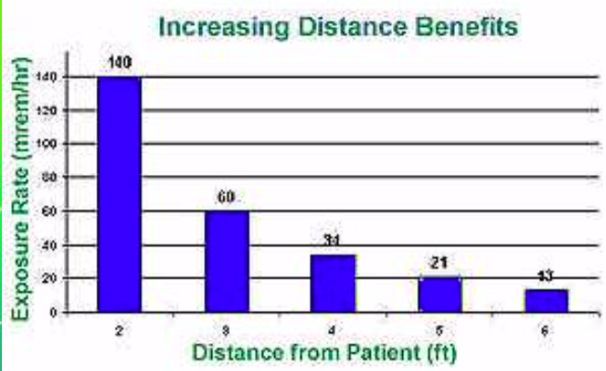
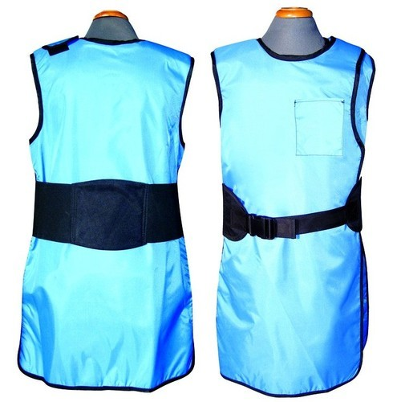
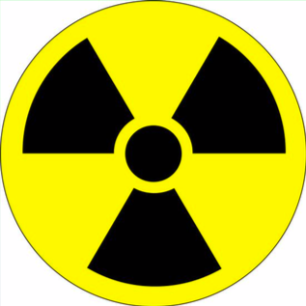
Radiation Hazard
General methods of protection
What are Three basic methods for reducing exposure of workers to X-rays?
Minimize exposure time.
Maximize distance from X-Ray source.
Exposure varies inversely with the square of the distance from the X-Ray tube
Use shielding (stand behind lead protection).
Operators view the target through a leaded glass screen.
Wear lead aprons. almost any material can act as a shield from gamma or X-Rays if used in sufficient amounts.
Standard 0.5mm lead apron protects you from 95% from radiation exposure.
ALARA Rule:
As Low As Reasonably Achievable:
Reduce number of exams.
Reduce time of exams.
Radiation Hazard symbol displayed at places where radioactive materials are used and stored.
Use alternative (Ultrasounds or MRI).
7

Slide 9
Radioactive materials hazard
What does radioactivity means?
Radioactive decay is the process in which an unstable atomic nucleus loses energy by emitting radiation in the form of particles or electromagnetic waves.
An unstable nucleus releases energy to become more stable.
These are other hazard found in the department in the department other than x-ray radiation
Sources of radioactivity
Naturally Occuring Sources:
Radon from the decay of uranium and thorium.
Potassium -40, found in minerals and in plants.
Carbon 14, found in plants and animal tissue. it’s used to know the age of fossils.
Manmade Sources:
Medical use of Radioactive Isotopes.
Certain consumer products e.g. Smoke detectors.
Fallout from nuclear testing.
Emissions from nuclear power plants.
Radioisotopes
Isotopes of an atom that are radioactive are called radioisotopes.
These atoms are radioactive because they have too much energy to be stable; they will release energy until they become stable.
This is called radioactive decay.
Medical Uses of Radioactive Isotopes: Important
Radioactive isotopes are introduced into the body and can be distinguishable by their radiation from the atoms already present.
This permits the relatively simple acquisition of information about the dynamics of processes of uptake, incorporation, exchange, secretion, etc.e.g in the thyroid scan we know that iodine accumulated in thyroid so we inject the patient with ionized iodine which will accumulate there to and then scan the patient to see how much accumulated.
8

Slide 10
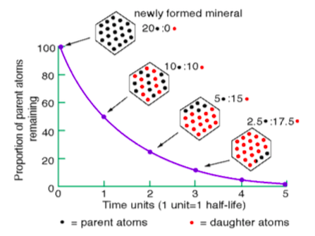
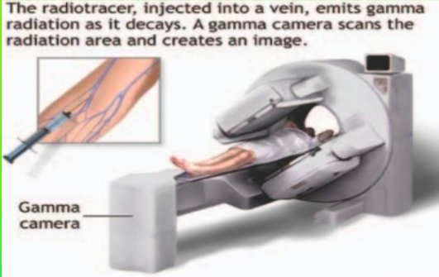
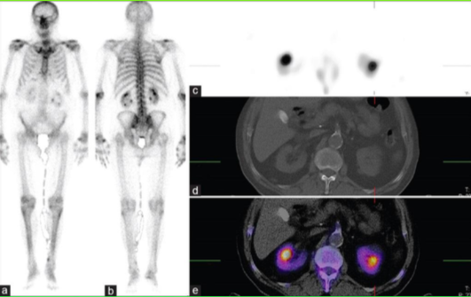
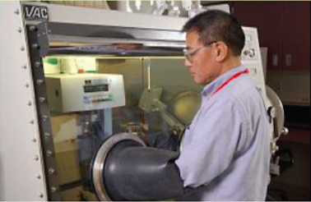
Radiation Hazard
Radioactive decay
In the process of radioactive decay. An atom actually changes from one element to another by changing its number of protons.
The half-life of radioactive substances is the amount of time they require to lose one half of their radioactivity and transform into another element.
Radio-Pharmaceuticals
The most widely used radioisotope is Technetium (Tc), with a half-life of six hours. .(Important to tell us when to scan)
The activity in the organ can then be studied either as a two dimensional picture or, with a special technique called tomography, as a three dimensional picture (SPECT, PET). so the patient will be first injected with Tc then after 6 h he will come to be scanned and we will be able to trace Tc
Handling of Radio-Pharmaceuticals
No radioactive substances should be handled with bare hands. Alpha and beta emitters can be handled using thick gloves.
Radioactive materials must be stored in thick lead containers.
Reactor and laboratories dealing with radioactive materials must be surrounded with thick concrete lined with lead.
People working with radioactive isotopes must wear protective clothing, which is left in the laboratory.
The workers must be checked regularly with dosimeters, and appropriate measures should be taken in cases of overdose.
Radioactive waste must be sealed and buried deep in the ground.
Spill response
On Skin —> flush completely.
On Clothing —> remove them
If Injury —> administer first aid.
Radioactive Gas Release —> vacate area, shut off fans, post warning.
Monitor all the people and define the area of contamination.
9

Slide 11
Magnetic Field Hazard
MRI hazard
MRI is one of the imaging modality that is widely used in radiology.
There is no dangerous radiation in MRI instead it uses very high magnetic field up to 3 Tesla (1 Tesla = 20000 times earth gravity).
This strong magnetic field produces a powerful attractive force and torque which the magnet exerts on ferromagnetic objects, this is called missile effect.
The missile effect can pose a significant risk to anyone in the path of the projectile, and cause significant damage to the scanner.
The effect is clearly greater for high field systems.
Equipment made specific for MRI room are made of diamagnetic material (such as wood and stainless steel ).
Precautions
To guard against accidents from metallic projectiles, the “5 gauss line” should be clearly demarcated and the area with that line kept free of ferromagnetic objects.
The 5, 10 and 200 Gauss lines are marked on the floor of each magnet room. These Gauss lines serve as a reminder that you are inside a magnetic field which increases sharply as you move closer to the magnet. The 5 Gauss line (the outermost line) defines the limit beyond which ferromagnetic objects are strictly prohibited.
It is essential that patient with ferromagnetic surgical clips, implants containing ferromagnetic components and who have suffered shrapnel or steel fragments injuries (such as those who work in mines), especially to the eyes, to be excluded from the imager.
A number of general precautions must be taken to ensure the safety of patients and personal working in the imaging suite:
Access to the imaging area should be limited, and signs should be displayed to warn persons with cardiac pacemaker or neuro-stimulators not to enter the area.
Credit cards and watches with mechanical parts should be left outside the imaging area to prevent magnetic tape erasure and watch malfunction.
Some body implants are paramagnetic, or even ferromagnetic. These implants tend to move and align with the main magnetic field.
This results in a force and torque on the implant and the implant may become dislodged, resulting in severe injury to the patient or death if displaced such as Aneurysm clips, Pacemaker and implanted cardiac defibrillator are typical examples of such devices.
there are two units for measuring a magnetic field: Tesla and Gauss, where 1 tesla = 10,000 gauss
10

Slide 12
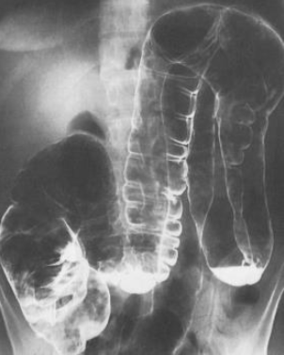
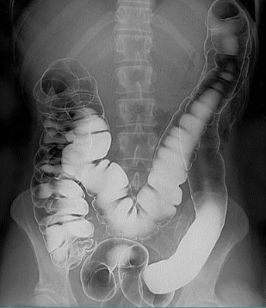
Contrast Medium Hazard
Contrast agents
Compounds used to improve the visibility of internal bodily structures in an image.
Since their introduction in the 1950s, organic radiographic iodinated contrast media (ICM) have been among the most commonly prescribed drugs in the history of modern medicine.
These contrast agents attenuate x-rays more than body soft tissues due to their high atomic weight.
Millions of intravascular contrast media examinations are performed each year.
Types of contrast agents
Many forms of contrast (gas,liquid,suspension) with many forms of delivery (by mouth, per rectum, intraluminal, intravenous, and intra-arterial).
Each different delivery mode has unique applications, for example: oral contrast, a suspension of barium, is used for fluoroscopy (esophagrams, upper gastrointestinal series, and small bowel follow-throughs).
Administration or leakage of barium outside the intestinal tract may have severe adverse outcomes.
Negative Contrast
Positive Contrast
Organs become more radiolucent (more DARK).
X-Rays penetrate more easily.
Low atomic weight.
Appears black on film.
Examples of negative contrast:
Air
CO2.
Commonly used to inflate a structure; distinguish colon
from other structures.
Organ become radioopaque (LIGHT).
Substance absorbs X-Rays hence why it becomes more light.
High atomic weight.
Appears white on film
Examples of Positive contrast:
Iodinated contrast agent.
Barium sulfate
Urogenital Studies
Vascular Studies
11

Slide 13
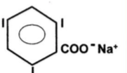
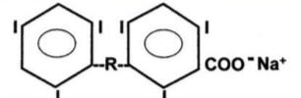
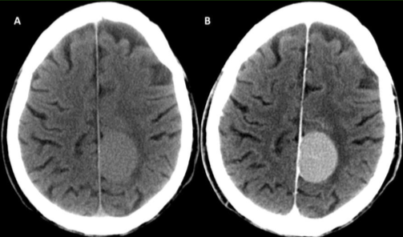
Contrast Medium Hazard
Classification of agents
Contrast agents are classified based on three properties:
The charge of the iodinated molecule (ionic or nonionic).
The molecular structure (monomeric or dimeric).
The osmolality of the injected preparation (hyperosmolal, low osmolal, or iso-ismolal relative to normal serum osmolality [275 to 290 mosm/kg])
RCM Classification
Ionic
Non ionic
Monomeric
Dimeric
Monomeric
Dimeric
Hyperosmolal
>1400 mosm/kg
Diatrizoate
lothalamate metrizoate
Low osomalal
600 mosm/kg
loxagiate
Low osmolal
500 to 850 mosm/kg
lohexol
lopamidol
lversol
lopromide
loxilan
Iso-osomlal
290 mosm/kg lodixanol
Iodinated contrast media (ICM)
Iodinated contrast media generally have a good safety record.
Adverse effects from the intravascular administration of ICM are generally mild and self-limited.
Reactions that occur from the extravascular use of ICM are rare.
Nevertheless, severe or life-threatening reactions can occur with either route of administration.
Why iodine?
IODINE (atomic wt 127) provides excellent radio-opacity.
Higher atomic number maximizing the photoelectric effect.
12

Slide 14
Contrast Medium Hazard
Iodinated Contrast Agents
The toxicity of contrast agents decreases as osmolality approaches that of serum.
This has been accomplished by developing non-ionizing compounds and then combining two monomers to form a dimer.
Currently used iodinated agents are cleared almost completely by Glomerular filtration.
Circulatory half life is 1–2 hours, assuming normal renal function.
Effect of Ionic vs. Non-ionic Contrast Agents
Ionic | Non ionic
Dissociate into separate ion when injected | Does not dissociate
Creates hypertonic condition | Remains near isotonic
Increase in blood osmolality | No significant increase
Less money | More money
More reaction | Less reaction
Methods of Administration of Contrast Material
INGESTED
Oral: Barium sulfate suspension.
RETROGRADE
Against normal flow: Barium enema.
INTRATHECAL
Spinal canal CSF aka myelography
INTRAVENOUS Most Common Method!
Injecting into bloodstream.
Anything other than oral.
Note:Has highest degree of radiation among ct chest and x-ray
13

Slide 15
Contrast Medium Hazard
Reaction Classification
Immediate reactions
Delayed reactions
Were defined as those occurring within the department (within one hour).
As those occurring between the time the patient left the department and up to seven days later.
The American College of Radiology has divided adverse reactions severity to contrast agents into the following categories:
Mild
Moderate
Severe
Mild reaction (5%)
Signs and symptoms appear self-limited without evidence of progression.
Nausea, vomiting, warmth, headache, dizziness, shaking, altered taste, itching, flushing, chills, sweats, rash, nasal stuffiness, swelling: eyes, face and anxiety.
Treatment: Observation and reassurance. Usually no intervention or medication is required; however, these reactions may progress into a more severe category.
Moderate reaction (1%)
Reactions which require treatment but are not immediately life-threatening.
Tachycardia/ bradycardia, hypertension, pronounced cutaneous reaction, hypotension, dyspnea, pulmonary edema, bronchospasm, wheezing and laryngeal edema.
Treatment: Prompt treatment with close observation.
Severe reaction (0.05%)
Life-threatening with more severe signs or symptoms including: Laryngeal edema (severe), profound hypotension, convulsion, unresponsiveness and cardiopulmonary arrest.
Treatment: Immediate treatment, antiemetic drugs. Usually requires hospitalization.
14

Slide 16
Contrast Medium Hazard
Delayed Contrast Reactions
Delayed contrast reactions can occur anywhere from 3 hours to 7 days following the administration of contrast.
It is important for anyone administering intravenous contrast media to be aware of delayed reactions.
More common reactions include:
Other symptoms:
Cutaneous exanthema
Flu like symptoms
Pruritus without urticaria
Delayed arm pain
Nausea and vomiting
Rash/pruritus
Drowsiness
Salivary gland swelling
Headache
Steven Johnson syndrome
Skin effects:itching, rash, and hives.
GI side effects: Nausea, vomiting, and diarrhea.
General side effects: headache, dizziness, and fever.
Infants and patients older than 60 years old are at increased risk of developing a side effect.
Some Reaction Medications
Aggressive fluids
Lasix
Dopamine
Mannitol
Contraindications For Contrast
Renal failure
Check BUN and Creatinine, elevated levels could cause renal shutdown
Anuria (no urine production)
Asthma
Possible allergies
History of contrast allergy/ reactions
Diabetes
Get a history of medications taken
Glucophage must be stopped 48 hrs before contrast injection.
Multiple Myeloma
Pregnancy
Risk of fetal thyroid toxicity
Allergic reaction, pre-medication is available
15

Slide 17
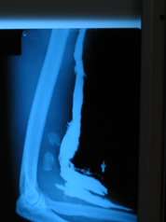
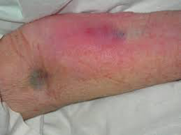
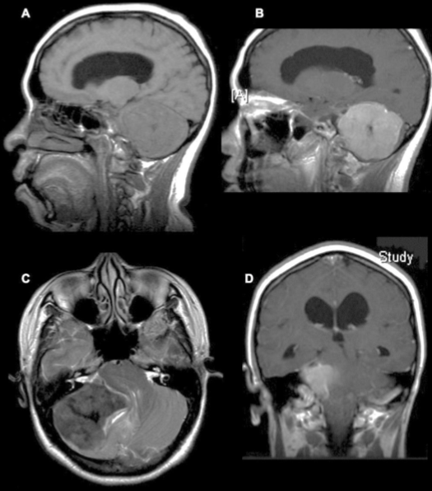
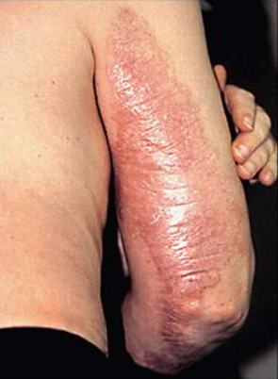
Contrast Medium Hazard
Extravasation
Contrast material has seeped outside of vessel.
Apply warm compress 1st 24 hours.
Cool compress for swelling.
Extravasation of Contrast into soft tissue of arm.
MRI Contrast Agents
The Contrast used in MRI is based on paramagnetic ions e.g. Gadolinium.
By themselves these ions are highly toxic so bound up in large molecules eg. DTPA.
Provides a greater contrast between normal and abnormal tissues.
Gadolinium Side Effects
With impaired kidney function, gadolinium could lead to a serious and potentially fatal disorder called Nephrogenic Systemic Fibrosis (NSF)
- NSF: Nephrogenic systemic fibrosis (NSF), also known as nephrogenic fibrosing dermopathy (NFD), is a disease of fibrosis of the skin and internal organs reminiscent but distinct from scleroderma or scleromyxedema. It is caused by gadolinium exposure used in imaging in patients who have renal insufficiency. It could even lead to death.
- Check if the patient has renal failure, decreased GFR, decreased clearance before giving Gadolinium.
16

Slide 18
Summary
Radiation hazard
- Hazardous Ionizing radiation comprize (α, β, γ) particles, and X-rays.
Acute/deterministic effects | Chronic/Stochastic effects
- Caused by high levels of radiation usually over a short period of time. - Severity of damage increases with increasing dose above that threshold. - Cataract formation, Bone marrow failure, Lung Fibrosis, Infertility, hair loss, lowering the WBC count, Skin reddening (erythema). | - Caused by low-level radiation over a long period of time. - Severity of the effect is not dose related. - Carcinogenic effect and Genetic effect.
General methods of protection
Three basic methods for reducing exposure of workers to X-rays: | ALARA Rule: As low as reasonably achievable:
- Minimize exposure time. - Maximize distance - Use shielding | - Reduce number of exams. - Reduce time of exams. - Radiation Hazard symbol displayed at places where radioactive material are used and stored. - Use alternative (US or MRI).
Radioactive materials hazard
- Radioactive decay is the process in which an unstable atomic nucleus loses energy by emitting radiation in the form of particles or electromagnetic waves. - Examples: Radioisotopes and Radiopharmaceuticals. - Spill response: On Skin → flush completely. On Clothing → remove them. If Injury → administer first aid. Radioactive Gas Release → vacate area, shut off fans, post warning. Monitor all the people and define the area of contamination.
Magnetic field hazard
MRI Safety: The “5 gauss line” should be clearly demarcated and the area free of ferromagnetic objects. Access to the imaging area should be limited, and signs should be displayed to warn persons with cardiac pacemaker or neuro-stimulators not to enter the area. | MRI Contraindications: Patients with ferromagnetic surgical clips Pacemaker, shrapnel or steel fragment injuries... | MRI Contrast Agents: The Contrast used in MRI is based on paramagnetic ions e.g. Gadolinium. With impaired kidney function, gadolinium could lead Nephrogenic Systemic Fibrosis. (NSF)
3

Slide 19
Summary
Contrast Agents
- Adverse effects: Adverse effects from the intravascular administration of ICM are generally mild and self-limited; Reactions that occur from the extravascular use of ICM are rare.
Classification of contrast agents
- The toxicity of contrast agents decreases as osmolality approaches that of serum. (non-ionizing ,dimeric compounds)
Ionic | Non ionic
- Creates hypertonic condition - Increase in blood osmolality - Less money - More reaction | - Remains near isotonic - No significant increase - More money - Less reaction
Reaction classifications
The most common reactions include: Cutaneous exanthema, pruritus without urticaria, nausea, vomiting, drowsiness, headache ,flu like symptoms delayed arm pain , salivary gland swelling, and Steven Johnson syndrome. Duration: 1- immediate reaction 2- delayed reaction Severity: 1- Mild Reaction (5%) 2- Moderate Reaction (1%) 3- Severe Reaction (0.05%)
Reaction medications
- Aggressive fluids - Lasix - Dopamine - Mannitol
Contraindication for contrast
- Diabetes - Multiple Myeloma. - Renal Failure - Anuria - Asthma - Hx of Contrast Allergy / Reactions - Pregnancy - Allergic Reaction. - Get a hx of medications taken
3

Slide 20
quiz
1- Which of the following is a characteristic of X-ray
Shorter wavelength and shorter frequency
High wavelength and high frequency
Shorter wavelength and high frequency
High wavelength and Shorter frequency
2- Which of the following is an example of stochastic effects
Cataracts
Infertility
Lung fibrosis
Carcinogenic abnormalities
3- which organ is considered highly sensitive to radiation
Pancreas
Stomach
Intestine
Kidney
4- The least toxic class of contrast agents:
ionizing, dimers
non ionic, monomer
non ionic, dimer
ionizing, monomers
5- The area around the MRI should be clear of any ferromagnetic objects due to?
Missile effect
Patient falls
Radiation
Distorted results
6- Which of the following cause NSF with impaired kidney function?
barium
gadolinium
Thorotrast
Iodinated contrast
7- Which cell structure that is the most affected by radiation ?
Cell membranes
B) Cell wall
C) DNA
D) Cytoplasm
8- Which of the following IS NOT a side effect of iodinated contrast material?
A) Urticarial rash
B) Bronchospasm
C) Laryngeal edema
D) Hypertension
Answers
1) c
2)d
3)b
4)c
5) a
6) b
7)c
8)d
4

