Slide 1
CMED 305
Cohort Studies
Nurah Alamro, MD. MPH. DrPH.
Assistant Professor - Community Medicine Unit, Family & Community Medicine Department
nmalamro@ksu.edu.sa

Slide 2
Learning Objectives: By end of this session students will be able to:
Describe the types of cohort studies
Describe the design of cohort studies
Identify steps for conducting cohort studies
Identify issues in the design of cohort studies
Describe the strengths and weaknesses of cohort studies

Slide 3
1
Types of cohort studies

Slide 4
All Studies
Generates Hypotheses
Descriptive (PO)
Analytical (PICO)
Tests Hypotheses
Case report
Experimental
Observational
Case series
Randomized Clinical Trials (RCTs)
Group data
Individual
Cross-sectional (survey)
Ecological study
Cross-sectional (analytical)
Qualitative
Cohort
Case-Control
Notes:
Research question facilitates study design selection! Remember from our last lecture.

Slide 5
A cohort study is an analytical observational study in which a group of people with a common characteristic is followed over time to find how many reach a certain health outcome of interest (disease, condition, event, death, or a change in health status or behavior).

Slide 6
Term "cohort" is defined as a group of people, usually 100 or more in size, who share a common characteristic or experience within a defined time period (e.g., age, occupation, exposure to a drug or vaccine, pregnancy, and insured persons).
The comparison group may be the general population from which the cohort is drawn, or it may be another cohort of persons thought to have had little or no exposure to the substance in question, but otherwise similar.

Slide 7
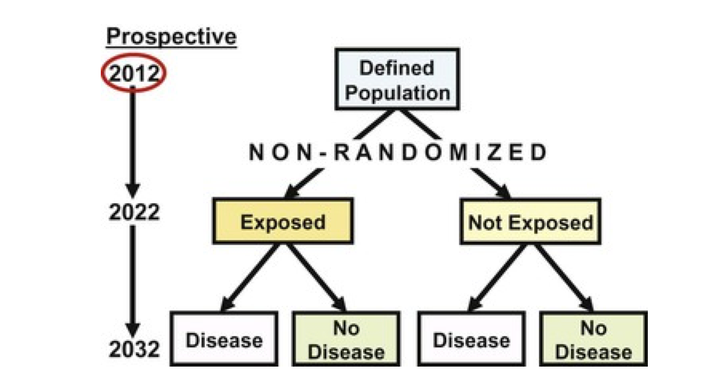
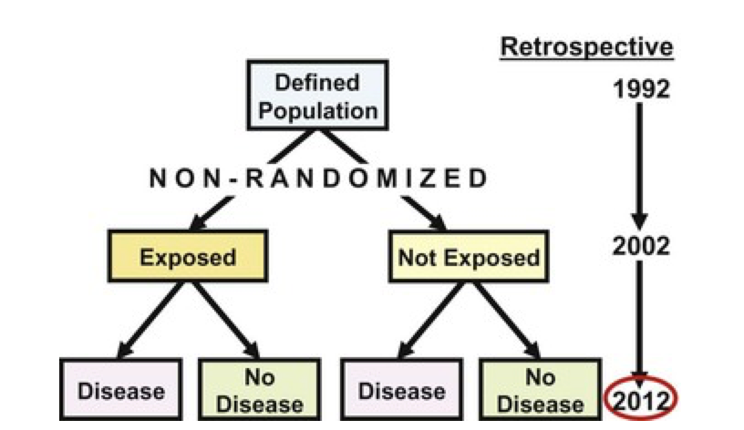
Two types of cohort studies have been distinguished on the basis of the time of occurrence of disease in relation to the time at which the investigation is initiated and continued
Notes:
Two types of cohort studies have been distinguished on the basis of the time of occurrence of disease in relation to the time at which the investigation is initiated and continued

Slide 8
When to Conduct a Cohort Study
When there is good evidence of an association between exposure and disease (﻿If we observe an association between an exposure and a disease or another outcome, the question is: Is the association causal?)
When exposure is rare, but the incidence of disease high among exposed, e.g. special exposure groups like those in industries, or exposure to X-rays
When attrition (loss during follow up) of study population can be minimized, e.g. follow-up is easy, cohort is stable, cooperative and easily accessible
When funds and time are available

Slide 9
2
Design of a Cohort Study

Slide 10
Time
Direction of Inquiry
Source Population
Exposed
Unexposed
People Without the Disease
Disease
No Disease
Disease
No Disease

Slide 11
3
How to conduct a cohort study?

Slide 12
1- Define a source population
2- Select Study Populations (subjects & controls): two methods: based on exposure status OR based on factor other than exposure e.g. geographic location
3- Measure the exposure
4- Follow up at intervals to get accurate outcome data
5- Analyze data
Steps in conducting a cohort study

Slide 13
Measuring Exposure | Measuring Outcome
Levels of exposure (e.g. packs of cigarettes smoked per year) are measured for each individual at: baseline at the beginning of the study and assessed at intervals during the period of follow-up. A particular problem occurring in cohort studies is whether individuals in the control group are truly unexposed. For example, study participants may start smoking or they may fail to correctly recall past exposure. Similarly, those in the exposed group may change their behaviour in relation to the exposure such as diet, smoking or alcohol consumption. Sources for Exposure data: medical or employment records, standardized questionnaires, interviews and by physical examination. | Sources for outcome data: routine surveillance of cancer registry data, death certificates, medical records or directly from the participant. Method used to ascertain outcome must be identical for both exposed and unexposed groups.

Slide 14
Analysis in Cohort Studies
The data are analyzed in terms of:
1. Incidence rates of outcome among exposed and non-exposed
2. Estimation of risk:
Relative Risk (also knows Risk Ratio) (RR)
Attributable Risk (AR)
Notes:
Note that the risk ratio uses as a denominator the entire group recruited at the start of the study, while the rate ratio uses as a denominator the person years, which takes account of losses to follow-up.

Slide 15
Incidence Rates:
Incidence Rate among exposed= a/a+b
Incidence Rate among unexposed= c/c+d
RR:
Incidence rate among exposed
Incidence rate among unexposed
= a/a+b
c/c+d
AR:
Incidence rate among exposed - Incidence rate among unexposed
Incidence among exposed
X 100
“What is the ratio of the risk of disease in exposed individuals to the risk of disease in unexposed individuals?”
“How much the disease can be prevented if we have an effective measure of eliminating the exposure?”

Slide 17
Vaping and Pulmonary “illness”
Cohort study of vaping and pulmonary illness followed for 1 year.
Exposure: vaping Outcome: pulmonary illness
 | Pulmonary Illness | No Pulmonary Illness | Total
vaping | 42 | 27,000 | 27,042
No vaping | 7 | 63,000 | 63,007
Total | 49 | 90,000 | 90,049

Slide 18
 | Pulmonary Illness | No Pulmonary Illness | Total
vaping | 42 | 27,000 | 27,042
No vaping | 7 | 63,000 | 63,007
Total | 49 | 90,000 | 90,049
Incidence Rates:
Incidence Rate among exposed= 1.5/1000/year
Incidence Rate among unexposed= 0.1/1000/year
RR
= 15
What does 15 mean?
➔ The risk of pulmonary illness is 15 times higher among vapors than non-vapers
AR
= 93%
What does 93% mean?
➔ 93% of the morbidity from pulmonary illness among vapers may be attributable to vaping and could be prevented by elimination of vaping

Slide 19
4
Issues in the design of case-control studies

Slide 20
Loss to Follow Up
Cohort members may die, migrate, change jobs or refuse to continue to participate in the study.
In addition, losses to follow-up may be related to the exposure, outcome or both.
For example, individuals who develop the outcome may be less likely to continue to participate in the study.
Notes:
The degree to which losses to follow-up are correlated with exposure and outcome will lead to serious bias in the measures of effect of exposure and outcome.

Slide 21
Differential Misclassification of Subjects
A major source of potential bias in cohort studies arises from the degree of accuracy with which subjects have been classified with respect to their exposure or disease status.
Differential misclassification can lead to an over or underestimate of the effect between exposure and outcome

Slide 22
Selection Bias
Selection bias is more common in case-control studies.
However, it can happen in cohort studies if:
The completeness of follow-up is different among exposed and unexposed.
Outcome ascertainment differs between exposed and unexposed.

Slide 23
Confounding
Confounding is a distortion (inaccuracy) in the estimated measure of association that occurs when the primary exposure of interest is mixed up with some other factor that is associated with the outcome.
In the figure above, the primary goal is to ascertain the strength of association between physical inactivity and heart disease. Age is a confounding factor because it is associated with the exposure (meaning that older people are more likely to be inactive), and it is also associated with the outcome (because older people are at greater risk of developing heart disease).

Slide 24
5
Strengths & Weaknesses

Slide 25
Strengths
Multiple outcomes can be measured for any one exposure.
Weakness
Costly and time consuming.
Can look at multiple outcomes.
Exposure is measured before the onset of disease (in prospective cohort studies).
Good for measuring rare exposures.
Can measure incidence.
Prone to bias due to loss to follow-up.
Prone to confounding.
Participants may move between one exposure category.
Knowledge of exposure status may bias classification of the outcome.
Being in the study may alter participant's behavior.
Poor choice for the study of a rare disease (rare outcome).
Classification of individuals (exposure or outcome status) can be affected by changes in diagnostic procedures.
Demonstrate causality.

Slide 26
Thank you!
Office Hours (by appointment via email):
Mondays & Wednesdays
11 AM – 1 PM
College of Medicine West Building
Level 1 - Office 4011034
nmalamro@ksu.edu.sa

Slide 27
References:
Celentano, David D., and Scd Mhs. Gordis Epidemiology. Elsevier, 2018.
Hulley, Stephen B., ed. Designing clinical research. Lippincott Williams & Wilkins, 2007.
Haynes, R. Brian. Clinical epidemiology: how to do clinical practice research. Lippincott williams & wilkins, 2012.
Carlson, Melissa DA, and R. Sean Morrison. "Study design, precision, and validity in observational studies." Journal of palliative medicine 12.1 (2009): 77-82.
The Centre for Evidence-Based Medicine develops, promotes and disseminates better evidence for healthcare. Study Design. NA. Accessed September 13, 2019: https://www.cebm.net/2014/04/study-designs/
Alexander, Lorraine K., Brettania Lopes, Kristen Ricchetti-Masterson, and Karin B. Yeatts. "ERIC notebook." 2014. Accessed September 27, 2019: https://sph.unc.edu/files/2015/07/nciph_ERIC6.pdf
Coggon, David, David Barker, and Geoffrey Rose. Epidemiology for the Uninitiated. John Wiley & Sons, 2009.
Hennekens, Charles H., and J. E. Buring. ”Cohort studies." Epidemiology in medicine (1987).

