Slide 1
Plagiarism
Dr. Noura Abouammoh, MPH, PhD
Community Medicine
nabouammoh@ksu.edu.sa

Slide 2
Objectives
Define plagiarism
Understand the implications of plagiarism
Understand the causes of plagiarism
List the types of plagiarism
Different ways to avoid plagiarism

Slide 3
Plagiarism
An act or instance of using or closely imitating the language and thoughts of another author
without authorization and there presentation of that author's work as one's own,
as by not crediting the original author.
(plagiarism. (n.d.). The New Dictionary of Cultural Literacy, Third Edition. http://www.dictionary.com/browse/plagiarism)

Slide 4
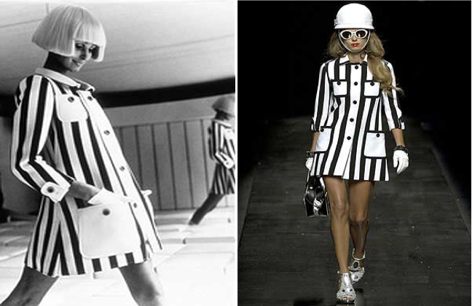
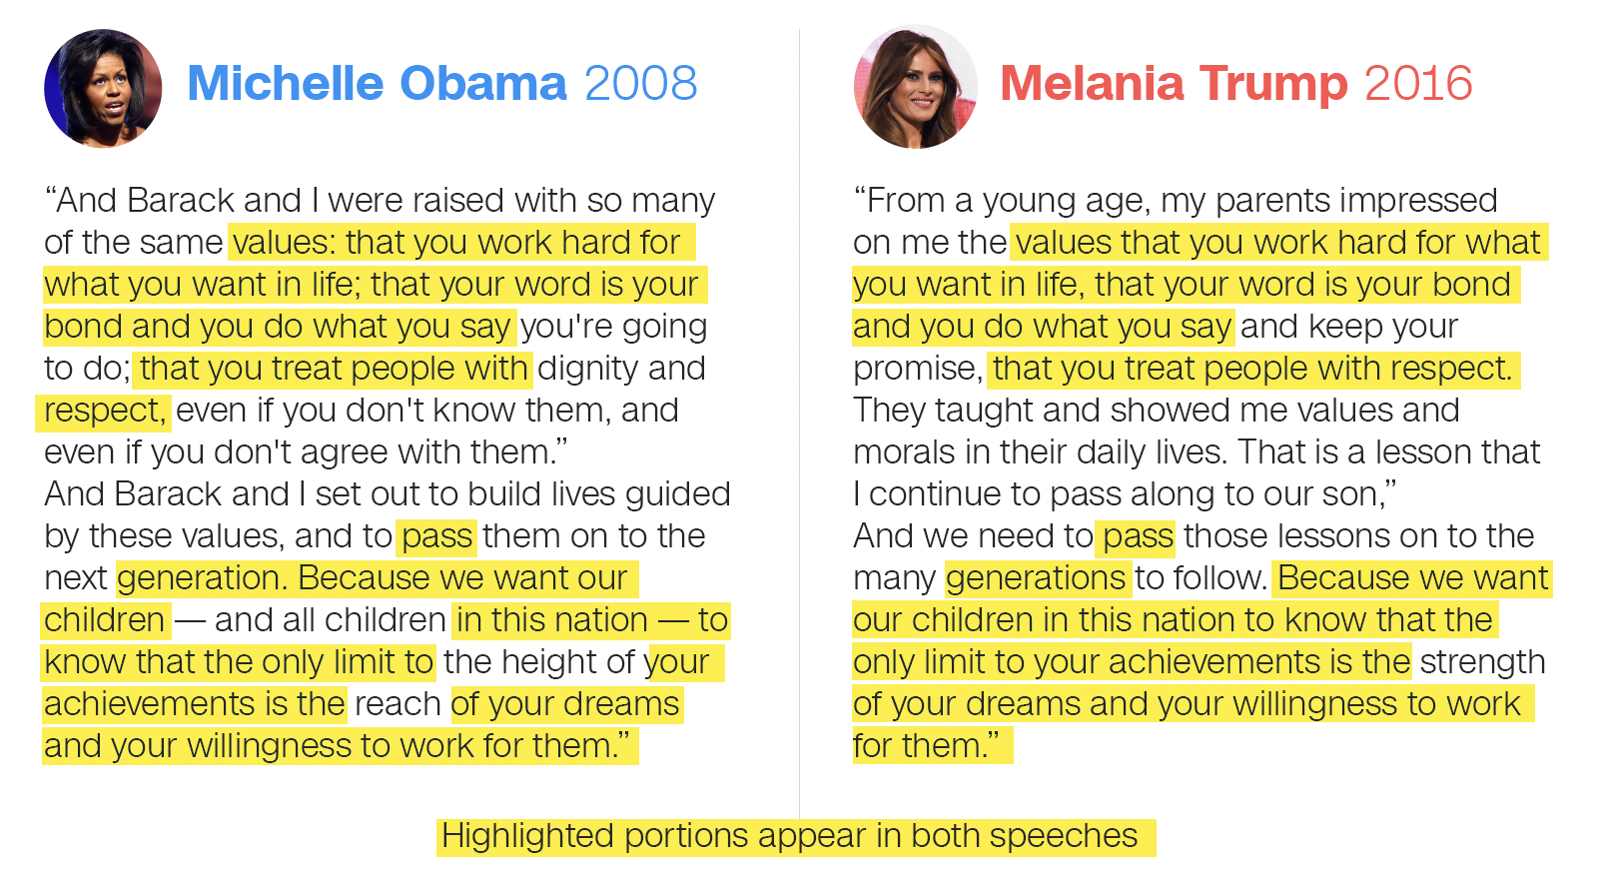
Plagiarism

Slide 5
http://turnitin.com/assets/en_us/media/plagiarism_spectrum.php

Slide 6
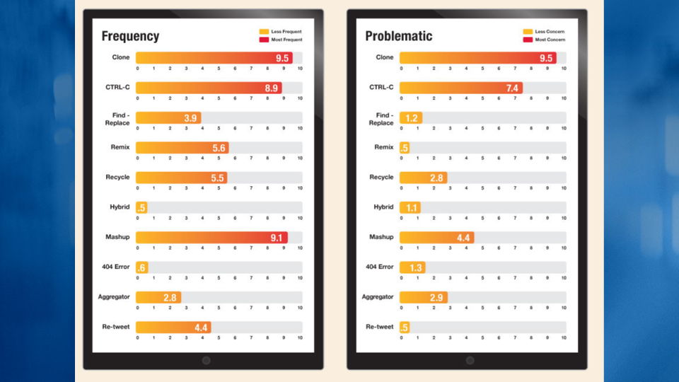

Slide 11
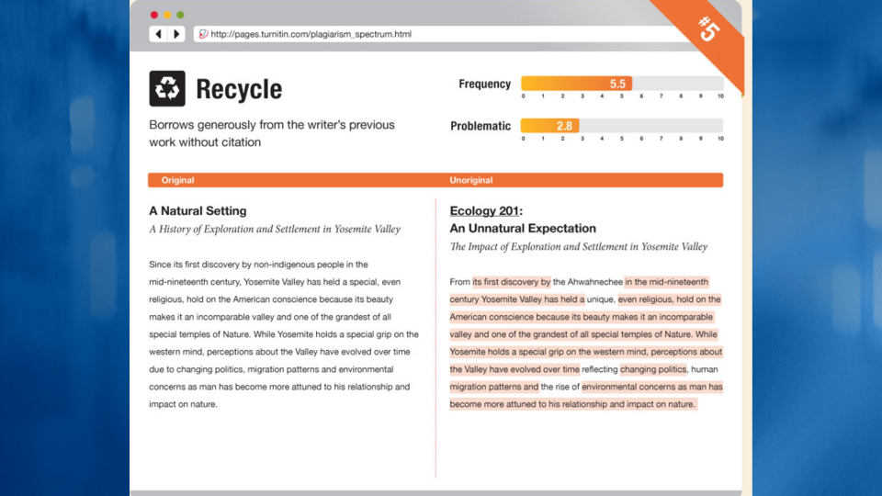

Slide 12
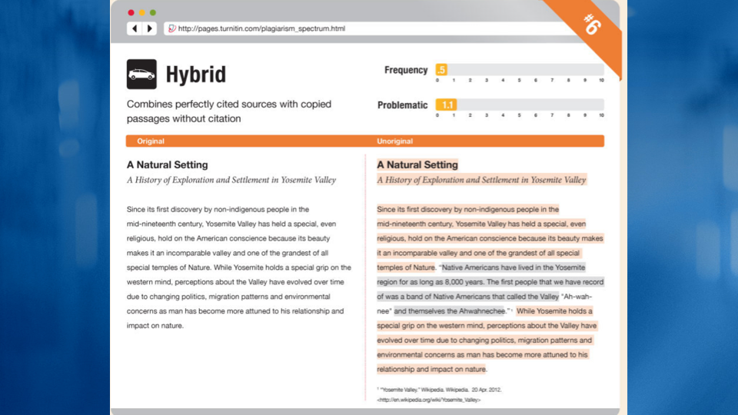

Slide 17
Why is it important?
You are cheating yourself
Misrepresents the work of another as your own.
Devalues others' original work.
Unfair advantage over students who do their own work.

Slide 18
Implications
You might fail the assignment
Fail the course
Suspended from the institution
Legal action

Slide 19
Why do people plagiarize?
Ignorance
Lack of knowledge on the ethics of scholarly writing / poor writing skills
Ambition, fierce competition
Pressure from seniors
Publish or perish system
Faster
Chances of getting caught or action being taken is slim

Slide 20
Types of plagiarism
Intentional
Unintentional
Self plagiarism

Slide 21
How to avoid plagiarism?
Be honest (give credit to source, acknowledge the author of the original work)
Quote and/or cite your sources properly
Use your own work as often as possible
Paraphrasing

Slide 22
Example

Slide 23
Is this plagiarism?
Our source and format:
We will be using Green Eggs and Ham, written by Theodor Seuss Geisel (aka Dr. Seuss) in 1960, to help us understand plagiarism.
We will be using APA (American Psychological Association) citation style.
For the following examples, imagine that your assignment is to write a paper about perception of unfamiliar food. Green Eggs and Ham is one of your sources.
Plagiarism prevention presentation by Rosiana (Nani) L. Azman and Stephen H. Fox, University of Hawai‘i Maui College.

Slide 24
Many people do not like green eggs and ham.
Is this plagiarism?
YES!
The phrase, “do not like green eggs and ham” was taken directly from someone else’s work, word for word, and was not cited appropriately.

Slide 25
Many people “do not like green eggs and ham.”
Is this plagiarism?
YES!
The phrase “do not like green eggs and ham” is in quotes, showing that it is in fact someone else’s work, but there is no reference listed as a citation.

Slide 26
Many people do not like green eggs and ham (Geisel, 1960).
Is this plagiarism?
YES!
While a citation is present, the phrase “do not like green eggs and ham” is still taken word for word from Geisel’s work. The lack of quotes implies that these are your words, which they are not.

Slide 27
Many people “do not like green eggs and ham” (Geisel, 1960, p. 12).
Is this plagiarism?
No!
The phrase “do not like green eggs and ham” is in quotes, showing that it is someone else’s work, and the correct citation is in place. However, most instructors would prefer you to paraphrase a quote this short and convey the meaning of the source.

Slide 28
Many people dislike green ham and eggs (Geisel, 1960).
Is this plagiarism?
YES!
This is not adequate paraphrasing. The sentence structure is still too similar to the original quotation, and you can’t put this one in quotes because it’s not the exact words of Geisel.

Slide 29
Many people have a strong distaste for forest-colored fowl embryos and cured domesticated pig products (Geisel, 1960).
Is this plagiarism?
YES!
This is still not adequate paraphrasing. The sentence structure is still too similar to the original quotation, and you still can’t put this one in quotes because it’s not the exact words of Geisel.

Slide 30
have a strong distaste = do not like
forest-colored = green
fowl embryos = eggs
cured domesticated pig products = ham
This is Turnitin’s #3 “Find – Replace

Slide 31
Lack of familiarity with particular preparation styles of foods is likely to lead to premature rejection based on ignorance rather than an objective appraisal of the inherent taste qualities of that food (Geisel, 1960).
Is this plagiarism?
No!
This is an adequate paraphrasing that represents Geisel’s intended message, but it’s not very readable. In fact, this pretty much represents everything people hate about academic writing

Slide 32
When something is unfamiliar or foreign to us, we tend not to judge it fairly (Geisel, 1960).
Is this plagiarism?
No!
Finally, we have an adequate paraphrasing that accurately represents Geisel’s message and that is clear and easily understood.

Slide 33
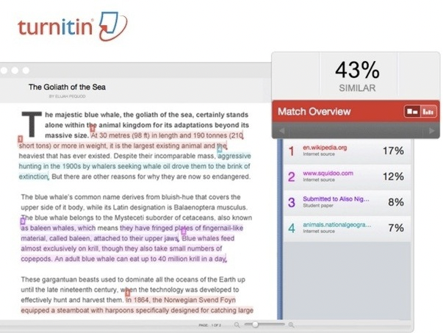
Check your work

Slide 34
Tips on writing…

Slide 35
Thank you

