Slide 1
CMED 305
Research Questions, Hypotheses and Objectives
Nurah Alamro, MD. MPH. DrPH.
Assistant Professor - Community Medicine Unit, Family & Community Medicine Department
nmalamro@ksu.edu.sa

Slide 2
Learning Objectives: By end of this session students will be able to:
Formulate research questions
State and describe research hypotheses
Define specific research objectives

Slide 4
1
Develop research questions

Slide 5
Spell out research question
Formulate study Objectives
Plan the analysis
Prepare data collection instruments
Identify data need
Collect data
Analyze data
Draw conclusion
Formulate recommendations
Inform stakeholders
Life Cycle of Research

Slide 6
What is a research question?
Uncertainty about the something in the population that the investigator wants to resolve by measurements in the population.
Uncertainty = Data needs
Clear research question facilitates:
Choosing the optimal study design
Identify who should be included, what outcomes to measure and when to measure

Slide 7
Translating Uncertainty to Research Questions
Frames problem in specific terms (clinical / public health / … etc)
Focuses on one issue
Written in everyday language
Links to a potential action once the question is answered
Is stated as a question

Slide 8
Literature Review
New ideas, technologies, and innovation
Careful observations
Mentors / Guides
Sources for Research Questions

Slide 9
Two Categories of Research Questions
Descriptive Questions
Analytical Questions
Involve observations to measure quantity
Involve comparisons / interventions to test hypothesis
No comparison groups / Interventions

Slide 10
Review of up to date literature and information
Raise a question!
Decide worth investigating by peer-review
Refine the question by specifying details (PICOT!)
Define measurable exposures and outcomes
Sharpen the initial question
1
2
Steps in Conceiving a Research Question
3
4
5
6

Slide 12
Is vaping bad?

Slide 13
1) Review of up to date literature and information
E-cigarettes have the potential to benefit adult smokers who are not pregnant if used as a complete substitute for regular cigarettes and other smoked tobacco products.
E-cigarettes are not safe for youth, young adults, pregnant women, or adults who do not currently use tobacco products.
While e-cigarettes have the potential to benefit some people and harm others, scientists still have a lot to learn about whether e-cigarettes are effective for quitting smoking.
If you’ve never smoked or used other tobacco products or e-cigarettes, don’t start.
Additional research can help understand long-term health effects.

Slide 14
2) Raise a question!
Can vaping help in quitting smoking?
Vague question, need to define:
“vaping” and “quitting smoking”

Slide 15
3) Decide worth investigating by peer-review
What is the optimal type of vaping, frequency, and duration?
What is the rate of quitting smoking? (How many cigarettes smoked? Length of quitting (days, weeks, moths))
What are the risks? What are the other benefits?

Slide 16
4) Define measurable exposures and outcomes
Exposure: Vaping
Smoking vapors produced from electronic nicotine delivery systems.
Daily for the past 30 days.
Outcome: Quitting Smoking
Discontinuing the habit of smoking cigarettes.

Slide 17
5) Sharpen the initial question
Initial Question
Can vaping help in quitting smoking?
Now
Among cigarette smokers, does vaping daily for at least 30 days increase the chance of smoking abstinence?

Slide 18
6) Refine the question by specifying details (PICOT)
PICOT Criteria
P | Population / Patients | Who are the relevant patients? Think about age, sex, geographic location, or specific characteristics that would be important to your question. | 3rd year medical students at KSU who smoke cigarettes in the last 12 months
I | Intervention / Indicator | What is the treatment, diagnostic test, or exposure that you are interested in? | E-cigarettes
C | Comparison / Control | Is there a control or alternative treatment you would like to compare to the intervention or indicator? | Nicotine gum
O | Outcome | What do you intend to accomplish, measure, improve or affect? | Smoking abstinence
T | Time | What is the appropriate follow-up time to assess outcome? | 30 days

Slide 19
Among 3rd year medical students at KSU who smoke cigarettes in the last 12 months, does vaping daily for 30 days increase the chance of smoking abstinence in comparison to daily nicotine gums?
So What?!

Slide 20
Passing the “So What?!” Test: FINER
FINER criteria for a good research question
F | Feasible | Adequate number of subjects Adequate technical expertise Affordable in time and money Manageable in scope
I | Interesting | Getting the answer intrigues investigator, peers and community
N | Novel | Confirms, refutes or extends previous findings
E | Ethical | Amenable to a study that institutional review board will approve
R | Relevant | To scientific knowledge To clinical and health policy To future research

Slide 21
2
State research hypotheses

Slide 22
Statement of Research Hypothesis
Hypothesis: is a specific and measurable version of the research question.
Hypothesis is important for two reasons:
Summarizes the 3 main elements of the study: sample, exposure and outcome
Establishes the basis for the statistical tests of significance.
Hypotheses are only for Analytical Questions (Comparisons).
Purely Descriptive Questions: No!

Slide 23
Vaping vs Nicotine Gum Hypothesis
Among 3rd year medical students at KSU who smoke cigarettes in the last 12 months, vaping daily for 30 days increase the chance of smoking abstinence by 80% in comparison to daily nicotine gums.
Hajek, Peter, et al. "A randomized trial of e-cigarettes versus nicotine-replacement therapy." New England Journal of Medicine 380.7 (2019): 629-637.

Slide 24
Characteristics of Good Hypothesis
Simple
One exposure
One outcome
Specific
Clear study participants and variables
Stated in Advance
Written at the start of the study
Focused on primary objective

Slide 25
3
Formulate research objectives

Slide 26
Spell out research question
Formulate study Objectives
Plan the analysis
Prepare data collection instruments
Identify data need
Collect data
Analyze data
Draw conclusion
Formulate recommendations
Inform stakeholders
Life Cycle of Research

Slide 27
Research Objectives
Objective: an active statement about how the study is going to answer the specific research question.
Objectives are important for two reasons:
For the development of the protocol and design of study
For the sample size calculations and determining the power of the study

Slide 28
Research Objectives
Contrary to hypotheses, both descriptive and analytical questions require objectives.
Framed in scientific / epidemiological terms
Use no more than one verb for each objective
State primary and secondary objectives

Slide 29
Objectives for Descriptive vs Analytical Studies
Descriptive Studies
Analytical Studies
Estimating a quantity
Testing a hypothesis
Use the verb “Estimate”
Example: To estimate the prevalence of vaping among medical students.
Use the verb “Determine”
Example: To determine whether vaping increases the chance of smoking abstinence

Slide 30
Vaping vs. Nicotine Gum Objectives
Primary Objective:
To determine whether vaping increases the chance of smoking abstinence in comparison to nicotine gums at 30 days.
Secondary Objectives:
To determine whether vaping increases the chance of smoking abstinence in comparison to nicotine gums at 30 days in females and males subsets.
To evaluate withdrawal symptoms of vaping, relative to nicotine gums.

Slide 31
Tips for developing research questions, hypotheses and objectives

Slide 32
Perform a literature review to increase knowledge and familiarity with the topic and to assist with research development.
Learn about current trends and technological advances on the topic.
Seek careful input from experts, mentors, colleagues and collaborators to refine your research question as this will aid in developing the research question and guide the research study.
Use the FINER criteria in the development of the research question.
Ensure that the research question follows PICOT format.
Develop a research hypothesis from the research question.
Develop clear and well-defined primary and secondary (if needed) objectives.
Ensure that the research question and objectives are answerable, feasible and relevant.

Slide 33
THANK YOU

Slide 34
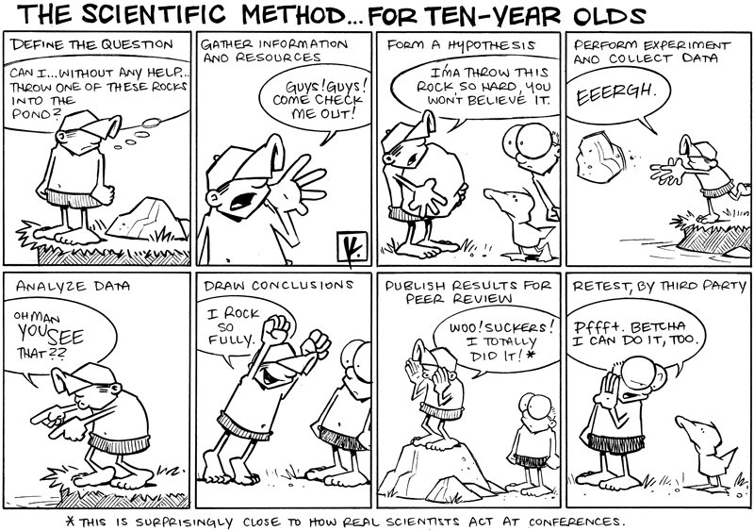
Thank you!
Office Hours (by appointment via email):
Mondays & Wednesdays
11 AM – 1 PM
West Building
Level 1 - Office 4011034
nmalamro@ksu.edu.sa
https://techknowtools.files.wordpress.com/2012/09/scientificfor10yo.jpg

Slide 35
References:
Hulley, Stephen B., ed. Designing clinical research. Lippincott Williams & Wilkins, 2007.
Farrugia, Patricia, et al. "Research questions, hypotheses and objectives." Canadian Journal of Surgery 53.4 (2010): 278.
Haynes, R. Brian. Clinical epidemiology: how to do clinical practice research. Lippincott williams & wilkins, 2012.
Hanson, Beate P. "Designing, conducting and reporting clinical research.: A step by step approach." Injury 37.7 (2006): 583-594.
CDC. Electronic cigarettes. https://www.cdc.gov/tobacco/basic_information/e-cigarettes/index.htm
Hajek, Peter, et al. "A randomized trial of e-cigarettes versus nicotine-replacement therapy." New England Journal of Medicine 380.7 (2019): 629-637.
Google images. https://images.google.com

