Slide 1
CMED 305
Cross-Sectional Studies
Nurah Alamro, MD. MPH. DrPH.
Assistant Professor - Community Medicine Unit, Family & Community Medicine Department
nmalamro@ksu.edu.sa

Slide 2
Learning Objectives: By end of this session students will be able to:
Describe types of cross-sectional studies
Identify steps for conducting cross-sectional studies
Identify issues in the design of cross-sectional studies
Describe the strengths and weaknesses of cross-sectional studies

Slide 3
1
Types of cross-sectional studies

Slide 4
All Studies
Generates Hypotheses
Descriptive (PO)
Analytical (PICO)
Tests Hypotheses
Case report
Experimental
Observational
Case series
Randomized Clinical Trials (RCTs)
Group data
Individual
Cross-sectional (survey)
Ecological study
Cross-sectional (analytical)
Qualitative
Cohort
Case-Control
Notes:
Research question facilitates study design selection! Remember from our last lecture.

Slide 5
A cross-sectional study is a study that either quantifies an outcome of interest AND/OR examines the relationship between disease (or other health related state) and other variables of interest as they exist in a defined population at a single point in time or over a short period of time.

Slide 6
Types of Cross-Sectional Studies
Descriptive
Analytical
Study prevalence of health related events at a point in time/snapshot
(Diseases, risk factors, coverage of interventions, health service utilization, knowledge, attitude and practice)
Assess association between exposure and outcome.
Exposure and disease status are assessed simultaneously among individuals at the same point in time
Compare prevalence of disease in persons with and without the exposure of interest

Slide 7
In practice, cross-sectional studies will include an element of both types of design.

Slide 8
When to Conduct a Cross- Sectional Study
To estimate prevalence of a health condition or prevalence of a behavior or risk factor
To learn about characteristics such as knowledge, attitude and practices of individuals in a population
To monitor trends over time with serial cross- sectional studies (National example of cross- sectional studies of great importance is the National Health and Nutrition Surveys (NHANES)).

Slide 9
2
How to conduct a cross-sectional study?

Slide 10
1- Define a population of interest (reference or source population)
2- Recruit a representative sample (adequate size, random selection)
3- Measure the variables of interest (exposure/outcome) at the same point in time
4- Analyze the data
Steps in conducting a cross-sectional study

Slide 11
The participants in a cross-sectional study are selected based on the inclusion and exclusion criteria set for the study.
Identify Subjects from population
Collect data on exposure and outcome (e.g. disease)
Exposed and have a disease
Not Exposed and have a disease
Exposed, and Do not have a disease
Not Exposed, and Do not have a disease

Slide 13
Measurement & Analysis in Cross-Sectional studies
Cross-Sectional Studies
Descriptive
Analytical
Prevalence on an outcome
Compare prevalence of an outcome between exposed and unexposed
Prevalence=Cases / Total Population X 100
They compare the proportion of exposed persons who are diseased with the proportion of non-exposed persons who are diseased
Simply characterize the prevalence of a health outcome in a specified population.
Prevalence Odd Ratio (POR)

Slide 14
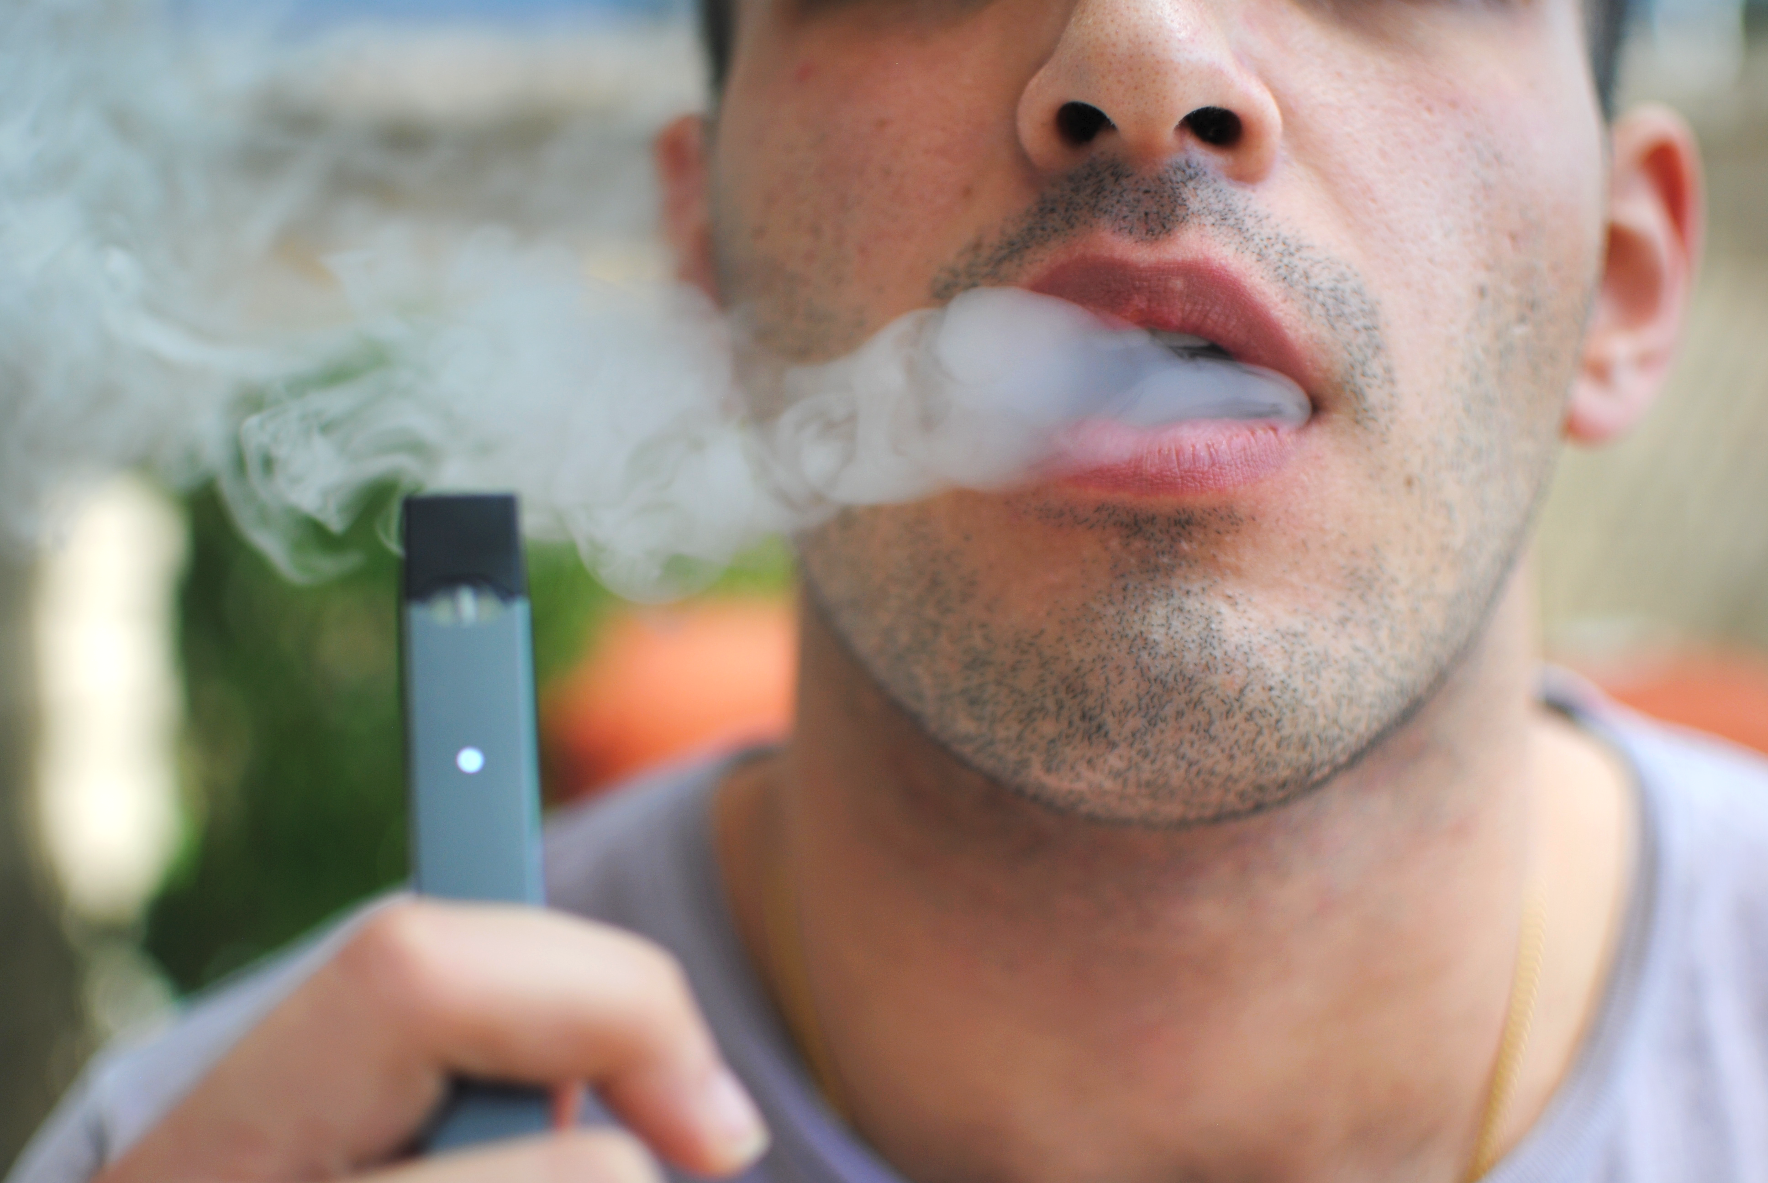

Slide 15
Vaping and Advertisement
You identify a random sample of young adults aged 18 – 25 at city of Riyadh.
Exposure: Ads about vaping Outcome: Vaping
 | Vaping | Not Vaping | Total
Ads | 50 | 200 | 250
No Ads | 50 | 700 | 750
Total | 100 | 900 | 1000

Slide 16
 | Vaping | Not Vaping | Total
Ads | 50 | 200 | 250
No Ads | 50 | 700 | 750
Total | 100 | 900 | 1000
Descriptive Cross-Sectional:
What is the prevalence of vaping?
=Number of people who vape/ Total population X 100
= 100 /1000 X 100
= 10%
Analytical Cross-Sectional:
Does the prevalence of vaping vary by the status of exposure to advertisement?
I.e. What are the odds of vaping given exposure to advertisement versus not exposed to advertisement?

Slide 17
 | Vaping | Not Vaping | Total
Ads | 50 a | 200 b | 250
No Ads | 50 c | 700 d | 750
Total | 100 | 900 | 1000
Analytical Cross-Sectional:
Does the prevalence of vaping vary by the status of exposure to advertisement?
i.e. What are the odds of vaping given exposure to advertisement versus not exposed to advertisement?
OR = odds an exposed person develop the outcome (a/b)
odds an unexposed person develop the outcome (c/d)
= ad / bc
= (50X700) / (200X50) = 3.5
What does 3.5 mean??

Slide 18
The odds of vaping is 3.5 times higher after seeing a vaping advertisement as opposed to not seeing one.

Slide 19
3
Issues in the design of cross-sectional studies

Slide 20
Choosing a representative sample
A cross-sectional study should be representative of the population if generalizations from the findings are to have any validity.
For example, a study of the prevalence of diabetes among women aged 40-60 years in Town A should comprise a random sample of all women aged 40-60 years in that town.

Slide 21
Sample Size
The sample size should be sufficiently large enough to estimate the prevalence of the conditions of interest with adequate precision.
Sample size calculations can be carried out using sample size tables or statistical packages such as Epi Info.

Slide 22
Biases in Cross-Sectional Studies
Selection Bias: when the study participants are systematically different in their characteristics compared with eligible participants who were not selected for the study. Common type: Non-response bias.
Recall bias
Confounding!

Slide 23
More males (higher risk of vaping)
Seeing an ad (Exposed)
Association between seeing a vaping ad and vaping overestimated
Not seeing an ad (Unexposed)
More Females (lower risk of vaping)
Confounding

Slide 24
4
Strengths & Weaknesses

Slide 25
Strengths
Relatively quick and easy to conduct
Data on all variables is only collected once.
Weakness
Difficult to determine whether the outcome followed exposure in time or exposure resulted from the outcome.
Difficult to determine whether the outcome followed exposure in time or exposure resulted from the outcome.
Able to measure prevalence for all factors under investigation.
Multiple outcomes and exposures can be studied.
Good for descriptive analyses and for generating hypotheses.
Associations identified may be difficult to interpret.
Susceptible to bias due to low response and misclassification due to recall bias.

Slide 26
Thank you!
Office Hours (by appointment via email):
Mondays & Wednesdays
11 AM – 1 PM
College of Medicine West Building
Level 1 - Office 4011034
nmalamro@ksu.edu.sa

Slide 27
References:
Celentano, David D., and Scd Mhs. Gordis Epidemiology. Elsevier, 2018.
Hulley, Stephen B., ed. Designing clinical research. Lippincott Williams & Wilkins, 2007.
Haynes, R. Brian. Clinical epidemiology: how to do clinical practice research. Lippincott williams & wilkins, 2012.
Carlson, Melissa DA, and R. Sean Morrison. "Study design, precision, and validity in observational studies." Journal of palliative medicine 12.1 (2009): 77-82.
The Centre for Evidence-Based Medicine develops, promotes and disseminates better evidence for healthcare. Study Design. NA. Accessed September 13, 2019: https://www.cebm.net/2014/04/study-designs/

