Slide 1
CMED 305
Case Control Studies
Nurah Alamro, MD. MPH. DrPH.
Assistant Professor - Community Medicine Unit, Family & Community Medicine Department
nmalamro@ksu.edu.sa

Slide 2
Learning Objectives: By end of this session students will be able to:
Describe the design of case-control studies
Identify steps for conducting case-control studies
Identify issues in the design of case-control studies
Describe the strengths and weaknesses of case-control studies

Slide 3
1
Design of Case-Control Studies

Slide 4
All Studies
Generates Hypotheses
Descriptive (PO)
Analytical (PICO)
Tests Hypotheses
Case report
Experimental
Observational
Case series
Randomized Clinical Trials (RCTs)
Group data
Individual
Cross-sectional (survey)
Ecological study
Cross-sectional (analytical)
Qualitative
Cohort
Case-Control
Notes:
Research question facilitates study design selection! Remember from our last lecture.

Slide 5
A case-control study is a study that compares patients who have a disease or outcome of interest (cases) with patients who do not have the disease or outcome (controls), and looks back retrospectively to compare how frequently the exposure to a risk factor is present in each group to determine the relationship between the risk factor and the disease.

Slide 6
When to Conduct a Case-Control Study
The outcome of interest is rare
Multiple exposures may be associated with a single outcome
Funding or time is limited
(1) To investigate cause-effect when experimental trials (e.g. RCT) are not ethical or feasible, (lung cancer and smoking)
(2) To investigate cause-effect when cohort studies are expensive or non-feasible e.g. (to investigate etiology of rare disease e.g. cancer)

Slide 7
2
How to conduct a case-control study?

Slide 8
1- Define a source population
2- Determine Study Subjects: “Cases”
(Case-subjects: They have the disease or outcome of interest)
3- Determine Study Subjects: “Controls”
(Control-subjects: They DO NOT have the disease or outcome of interest)
4- Decide on the Ratio of Cases to Controls
Steps in conducting a case-control study
Important principles in case-control study design – will discuss more later

Slide 9
8- Measure Exposure (Risk Factor(s))
9- Analyze the data
6- Estimate sample size
7- Select Cases and Controls
5- Decide on Matching Cases and Controls
Steps in conducting a case-control study
Important principles in case-control study design – will discuss more later

Slide 10
Past
Present
Source Population
Cases (Diseased)
Exposed
Unexposed
Controls
(No Disease)
Exposed
Unexposed
Assess Exposure History
Determine “cases” and “controls”

Slide 11
Determine Study Subjects: “Cases”= WHO IS THE CASE
Sources for Cases |  | Selection of Cases
Hospital- Based | Cases admitted to or discharged from a hospital, clinic or any health care facility. | Establish a “standard case definition”: adopt a “standard diagnostic criteria” Set inclusion and exclusion criteria: Area of residence, age, gender, etc Decide on the type of cases: incident cases (newly diagnosed cases) prevalent cases ((people who may have had the disease for some time)
Population-based | Death certificates with recorded cause of death.
 | Disease registries (e.g. Cancer registry)
 | Incident cases in a going cohort study
 | Cases reported or diagnosed during a survey or surveillance system
 | Employment records
Notes:
Incident cases comprise cases newly diagnosed during a defined time period. The use of incident cases is considered as preferential, as the recall of past exposure(s) may be more accurate among newly diagnosed cases. In addition, the temporal sequence of exposure and disease is easier to assess among incident cases.
Prevalent cases comprise individuals who have had the outcome under investigation for some time. The use of prevalent cases may give rise to recall bias as prevalent cases may be less likely to accurately report past exposures(s). As a result, the interpretation of results based on prevalent cases may prove more problematic, as it may be more difficult to ensure that reported events relate to a time before the development of disease rather than to the consequence of the disease process itself. For example, individuals may modify their exposure following the onset of disease. In addition, unless the effect of exposure on duration of illness is known, it will not be possible to determine the extent to which a particular characteristic is related to the prognosis of the disease once it develops rather than to its cause.
In case-control studies where cases are hospital based, it is common to recruit controls from the hospital population. However, the choice of controls from a hospital setting should not include individuals with an outcome related to the exposure(s) being studied. For example, in a case-control study of the association between smoking and lung cancer the inclusion of controls being treated for a condition related to smoking (e.g. chronic bronchitis) may result in an underestimate of the strength of the association between exposure (smoking) and outcome. Recruiting more than one control per case may improve the statistical power of the study, though including more than 4 controls per case is generally considered to be no more efficient.

Slide 12
Determine Study Subjects: “Controls” = WHO IS THE CONTROL
Hospital-Based Controls |  | Community-Based Controls
Advantages | Disadvantages | Advantages | Disadvantages
Subjects are easily accessible. Patients usually have time to participate. Patients are often motivated to cooperate with investigators. Controls and cases may be drawn from similar social and geographical environment. Differential recalls of prior exposure is likely to be minimized. | Differential hospitalization patterns may introduce selection bias. Difficult to blind disease status from cases and controls. An underestimate of the study effect may result if control’s disease is etiologically similar to cases’ disease. | Reduction of selection bias. Generalization of study results is more valid. May provide convenient control of extraneous (confounding) variables. | Time and money consuming. May suffer low participation rate. Cases and control may exhibit differential recall of prior exposures.
Notes:
The challenge is this: If we conduct a case-control study and find more exposure in the cases than in the controls, we would like to be able to conclude that there is an association between the exposure and the disease in question. The way the controls are selected is a major determinant of whether such a conclusion is valid.

Slide 13
Determine Study Subjects: “Controls” = WHO IS THE CONTROL
Selection of Controls:
The ideal “controls” are the healthy ones (very challenging!)
It is crucial to select control group/s from people who we are certain not to have got the specified disease/condition.
Aim of selecting controls:
Is to compare the exposure rate among both cases and controls (e.g. % smoking among cases and controls)
Then to confirm/refute if that the risk factor has occurred more frequently in the cases than in the controls using the measurement of association.

Slide 14
3- Being comparable to cases in terms of susceptibility
2- Free from health problems known to be associated with the exposure
1- Free from the disease / health problem under investigation
Determining controls

Slide 15
Decide on the Ratio of Cases to Controls
The ratio of cases to control should be at least and ideally 1:1
However, in many situations we may not be able recruit a large number of cases and it may be easier to recruit more controls for the study.
It has been suggested that we can increase the number of controls to increase statistical power (if we have limited number of cases) of the study.
Increase in the ratio lead to increase in “study precision”: 1:2, 1:3, 1:4
Further increase in the ratio is associated with little increase in study precision relative to the cost involved (i.e will not add much to the study power but will add to the cost!)

Slide 16
Decide on Matching Cases and Controls
A major concern in conducting a case-control study is that cases and controls may differ in characteristics or exposures other than the one that has been targeted for study.
An approach to deal with this challenge: Matching!
Matching: The process of selecting the controls so that they are similar to the cases in certain characteristics (confounders), such as age, race, gender, socioeconomic status, and occupation.
Matching reduces the possible confounding effect
Matching on several characteristics is not advisable as it:
Creates difficulties in finding controls
Requires more complex statistical analysis
May result in overmatching

Slide 17
Analysis in Case-Control Studies
The odds ratio (OR) is used in case-control studies to estimate the strength of the association between exposure and outcome.
Note that it is not possible to estimate the incidence of disease from a case control study unless the study is population based and all cases in a defined population are obtained.
The odds ratio is a measure of the odds of disease in the exposed compared to the odds of disease in the unexposed (controls) and is calculated as: OR = ad/bc
OR interpretations: OR>1, OR=1, OR<1

Slide 18
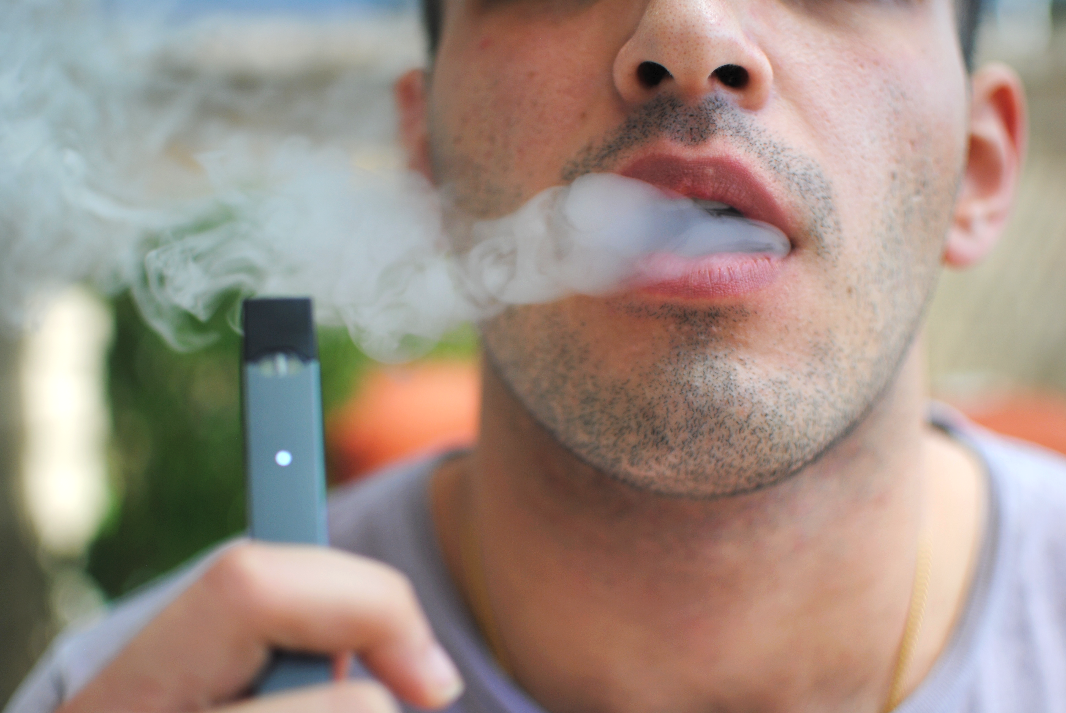

Slide 19
Vaping and Pulmonary “illness”
Case-control study of vaping and pulmonary illness among 100 cases and 400 controls.
Exposure: vaping Outcome: pulmonary illness
 | cases | controls | Total
vaping | 60 | 100 | 160
No vaping | 40 | 300 | 340
Total | 100 | 400 | 500

Slide 20
 | cases | controls | Total
vaping | 60 a | 100 b | 160
No vaping | 40 c | 300 d | 340
Total | 100 | 400 | 500
OR = Odds of exposure among cases (a/c)
Odds of exposure among controls(b/d)
= ad / bc
= (60X300) / (100X40) = 4.5
What does 4.5 mean??

Slide 21
Those who vape are 4.5 times more likely to develop pulmonary illness than non-vaping

Slide 22
3
Issues in the design of case-control studies

Slide 23
Formulation of a clearly defined hypothesis, case, and sources
Clearly defined hypothesis: a case-control study should begin with the formulation of a clearly defined hypothesis.
Case definition: It is essential that the case definition is clearly defined at the outset of the investigation to ensure that all cases included in the study are based on the same diagnostic criteria.
Source of cases: The source of cases needs to be clearly defined.

Slide 24
Measuring exposure status
In case-control studies, the measurement of exposure is established after the development of disease.
As a result is prone to both recall and observer bias.
Various methods can be used to ascertain exposure status, including:
Standardized questionnaires
Biological samples
Interviews with the subject
Interviews with spouse or other family members
Medical records
Employment records
Pharmacy records
The procedures used for the collection of exposure data should be the same for cases and controls.

Slide 25
Bias in Case-Control Studies
Selection bias: Selection bias occurs when the persons in one group are different on some factor (other than disease)
Ascertainment bias: may arise because:
Cases may recall exposure better
Investigators may search for exposure more thoroughly in cases
Different data collection instrument may be used for the controls
Confounding

Slide 26
Confounding in Case-Control Studies
The two groups differ in some characteristic which is associated with both the outcome and exposure being studied
A confounding variable is one that can influence both the exposure and the outcome
E.g. in relation between vaping and pulmonary illness, cigarette smoking is a likely confounder
Males who use vapors are more likely to smoke, and smoking is strongly associated with pulmonary illness. Age could be another confounder!
E.g., is vapors use associated with pulmonary illness?
Cases: all males admitted to hospital with pulmonary illness aged 20-49 in region X
Controls: a random sample of resident males in region X; age: 20-49 who have not had pulmonary illness
Exposure: vapors use during 3 months prior to interview
Data collection: personal interview of cases and controls – cases in hospital, controls telephone interview
Potential bias: cases are younger than controls. Age is related to both exposure (vapors use) and outcome (pulmonary illness)
Notes:
Control of confounding:
1-Design of the study
Matching cases and controls on the relevant confounding variables
E.g., matching in age
2- Analysis phase
Restrict the analysis to a limited age group – discards much of the collected information
Stratification /Multivariate analysis
Note: confounding bias is the only type of bias that can be controlled in the analysis (selection bias can not be handled at the analysis stage)

Slide 27
4
Strengths & Weaknesses

Slide 28
Strengths
Cost effective relative to other analytical studies such as cohort studies.
Weakness
Particularly prone to bias; especially selection, recall and observer bias.
Case-control studies are retrospective, and cases are identified at the beginning of the study; therefore there is no long follow up period (as compared to cohort studies).
Efficient for the study of diseases with long latency periods.
Efficient for the study of rare diseases.
Good for examining multiple exposures.
Case-control studies are limited to examining one outcome.
Unable to estimate incidence rates of disease (unless study is population based).
Poor choice for the study of rare exposures.

Slide 29
Thank you!
Office Hours (by appointment via email):
Mondays & Wednesdays
11 AM – 1 PM
College of Medicine West Building
Level 1 - Office 4011034
nmalamro@ksu.edu.sa

Slide 30
References:
Celentano, David D., and Scd Mhs. Gordis Epidemiology. Elsevier, 2018.
Hulley, Stephen B., ed. Designing clinical research. Lippincott Williams & Wilkins, 2007.
Haynes, R. Brian. Clinical epidemiology: how to do clinical practice research. Lippincott williams & wilkins, 2012.
Carlson, Melissa DA, and R. Sean Morrison. "Study design, precision, and validity in observational studies." Journal of palliative medicine 12.1 (2009): 77-82.
The Centre for Evidence-Based Medicine develops, promotes and disseminates better evidence for healthcare. Study Design. NA. Accessed September 13, 2019: https://www.cebm.net/2014/04/study-designs/
Alexander, Lorraine K., Brettania Lopes, Kristen Ricchetti-Masterson, and Karin B. Yeatts. "ERIC notebook." 2014.
Coggon, David, David Barker, and Geoffrey Rose. Epidemiology for the Uninitiated. John Wiley & Sons, 2009.
Hennekens, Charles H., and J. E. Buring. "Case-control studies." Epidemiology in medicine (1987): 132-152.

