Slide 1
GENITOURINARY ANOMALIES
Pr. Hamdan ALHAZMI
Professor and Consultant Pediatric Urologist
drhamdan@ksu.edu.sa

Slide 2
Lecture Objectives
13. GU anomalies (pathophysiology, etiology, clinical manifestations, complications, Guideline of managements)
  13.1. Discuss congenital anomalies of kidney (K/C)
  13.2. Discuss congenital anomalies of ureter (K/C)
  13.3. Discuss congenital anomalies of bladder (K/C)
  13.4. Discuss congenital anomalies of urethra (K/C)
  13.5. Recognize congenital anomalies of genitalia (K/C)
K- Knowledge C- Cognitive
P-Psychomotor Co-Communication

Slide 3
More common
Ureteropelvic junction obstructiion (UPJO)
Multicystic dysplatic kidney (MCDK)
Vesicoureteral Reflux (VUR)
Posterior Urethral Valve (PUV)
Ureterovesical Junction Obstruction (UVJO)
Hypospadias

Slide 4
Less common
Unilateral Renal Agenesis
Ureterocele
Duplication Anomalies
Ectopic ureter
Horseshoe Kidney
Crossed Renal Ectopia
Bladder Diverticulum
Prune -Belly Syndrome
Epispadias
Bladder Exstrophy

Slide 5
Uncommon
Bilateral Renal Agenesis
Supernumerary Kidney
Anomalies of rotation
Bladder duplication
Cloacal exstrophy
Urachal abnormalities
Neurospinal dysraphism

Slide 6
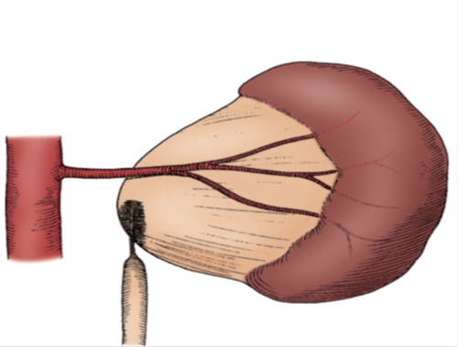
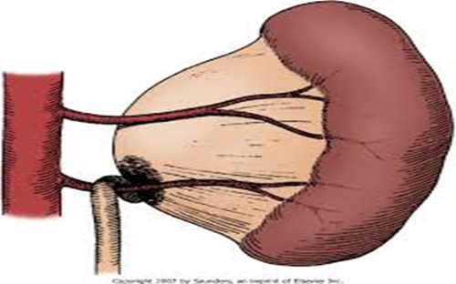
Ureteropelvic junction (UPJ) obstruction
UPJO

Slide 7
UPJO…
Presentation:
Prenatal US
Incidental in Neonates/Children
Symptomatic:
  UTI
  Pain
  Mass
  Hematuria
  Stone

Slide 8
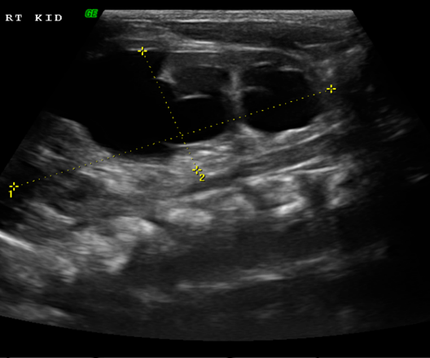
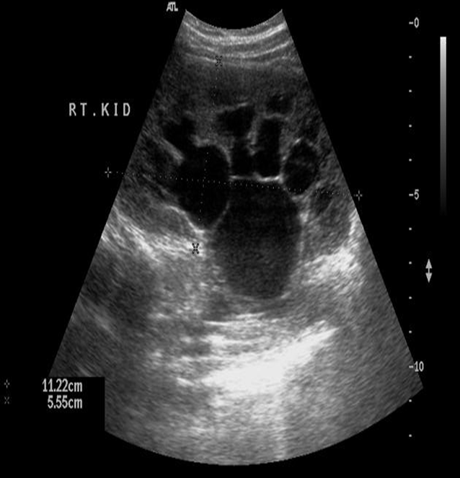
UPJO…

Slide 9
UPJO…
Dynamic renogram
Washout curve
Function

Slide 10
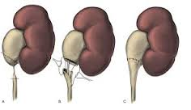
UPJO…
Dismembered Pyeloplasty

Slide 11
Management:
Observation
  Spontaneous resolution
Surgerical intervention
  Worsoning hydronephrosis
  Renal function
    less than 40%
    deterioration more than 10%
  Pyelonephritis
  Stone formation

Slide 12
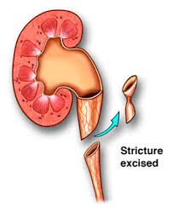
Management:
Observation
  Spontaneous resolution
Surgerical intervention
  Worsoning hydronephrosis
  Renal function
    less than 40%
    deterioration more than 10%
  Pyelonephritis
  Stone formation
Dismembered Pyeloplasty

Slide 13
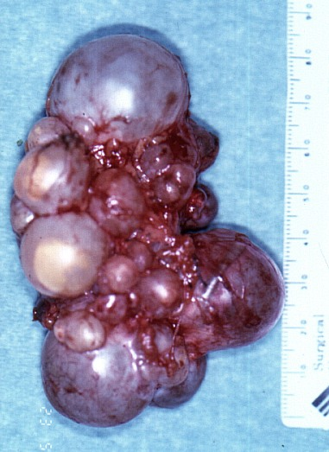
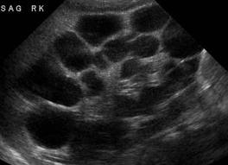
Multicystic dysplatic kidney (MCDK)
Unilateral
The kidney non functioning
Ultrasound:
  Very thin and abnormal renal parenchyma, surrounded by multiple cysts of various sizes that do not connect, nor they connect to the renal pelvis.

Slide 14
MCDK
Diagnosis:
Prenatal US
Incidental in Neonates/Children
Symptomatic:
  Mass
  UTI
  Pain
DMSA
  Little or no uptake of radionuclide
MCUG/ VCUG
  Contralateral VUR
  18%-43%

Slide 15
Management:
Observation
  Cyst fluid disappears
Surgerical intervention
  Hypertension
  Pain
  Pyelonephritis
Nephrectomy

Slide 16
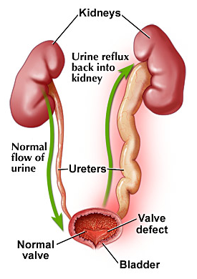
Vesicoureteral Reflux (VUR)

Slide 17
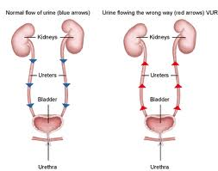
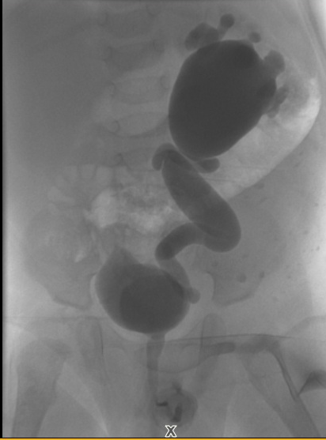
MCUG /VCUG

Slide 18
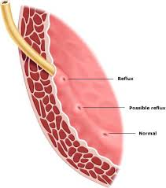
Vesicoureteral Reflux (VUR)…
Normal anti-reflux mechanism “Flap valve”
Oblique course as it enters the bladder.
Proper muscular attachments to provide fixation.
Posterior support to enable its occlusion.
Adequate submucosal length.

Slide 19
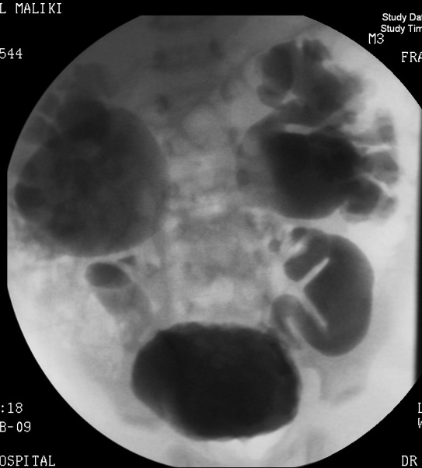
VUR…
Presentation
  Asymptomatic
    Prenatal
    Fluctuated dilatation
  Febrile UTIs

Slide 20
VUR…
Diagnosis:
  MCUG (VCUG)

Slide 21
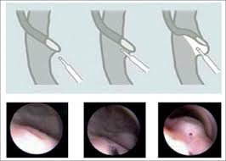
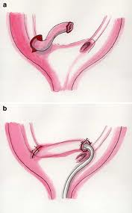
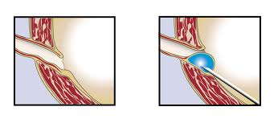
6-Vesicoureteric Reflux….
All patient should started on prophylactic antibiotics
Surgical intervention :
Ureteral reimplantation
Endoscopic correction

Slide 22
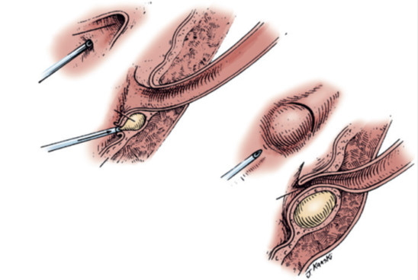
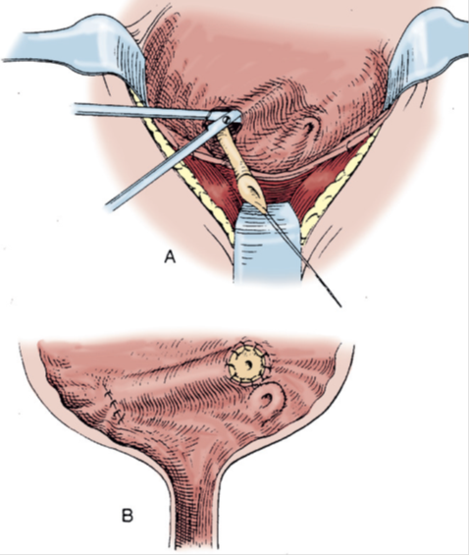
VUR…
Endoscopic treatment
Management:
Prophylactic antibiotic
  Spontaneous resolution
Surgical treatment
  Recurrent pyelonephritis on antibiotic prophylaxis (outbreak infection)
  Noncompliant with medical treatment
  Persistence of reflux (high grade)
Ureteral reimplantation

Slide 23

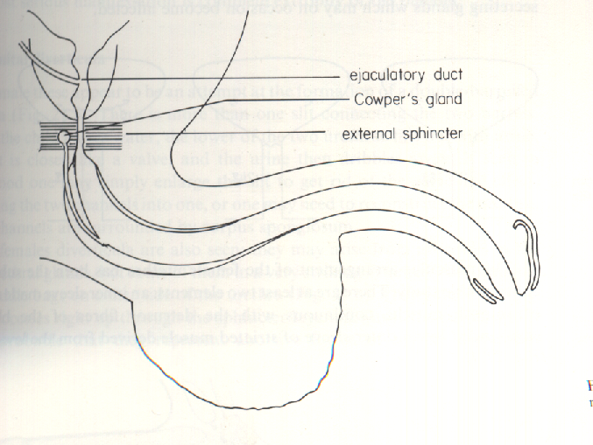
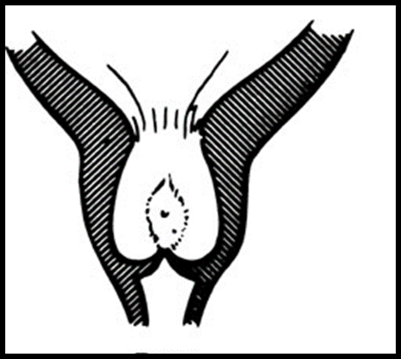
Posterior Urethral Valves (PUV)

Slide 24
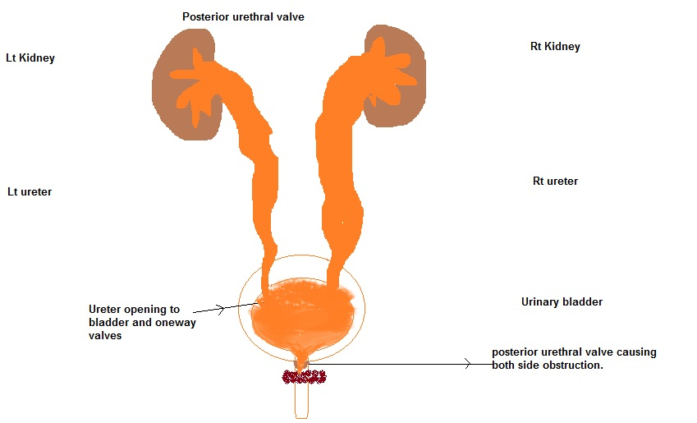
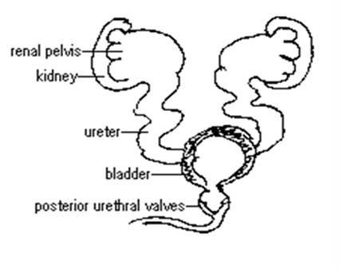
Posterior Urethral Valves (PUV)
Associated findings:
  Oligohydramnios
  Bilateral renal dilatation
  VUR: 40%
  Valve bladder
  Renal impairment
The bladder and the kidneys developed under high pressure and resistance.

Slide 25
PUV…
1 in 8000 to 25,000 live births.
Make up 10% of urinary obstructions diagnosed in utero.
Most common cause of urine retention in male infants.
50% have renal impairment.

Slide 26
PUV…
Presentation:
  Antenatal
  Urine retention
  UTI
  Poor urinary stream
  Urinary incontinence
  CRF (ESRD)

Slide 27
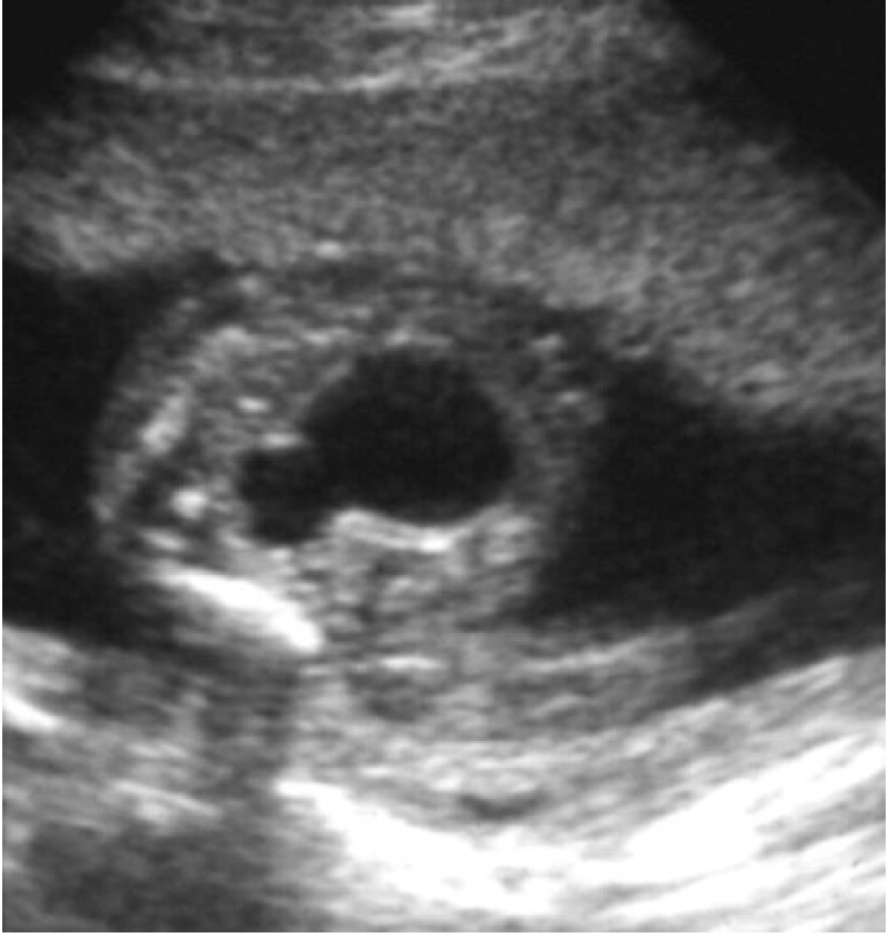
PUV…

Slide 28
PUV…
Initial urological l treatment
  Feeding tube insertion
  Start antibiotic prophylactic
  Ultrasound
  MCUG

Slide 29
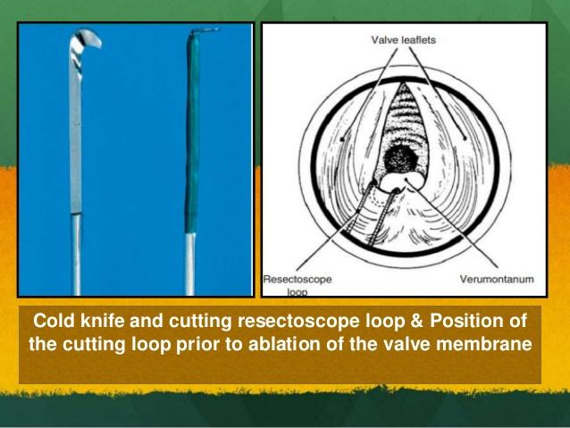
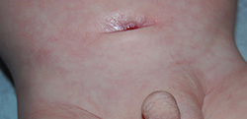
PUV…
Endoscopic valve ablation
Cutaneous vesicostomy

Slide 30
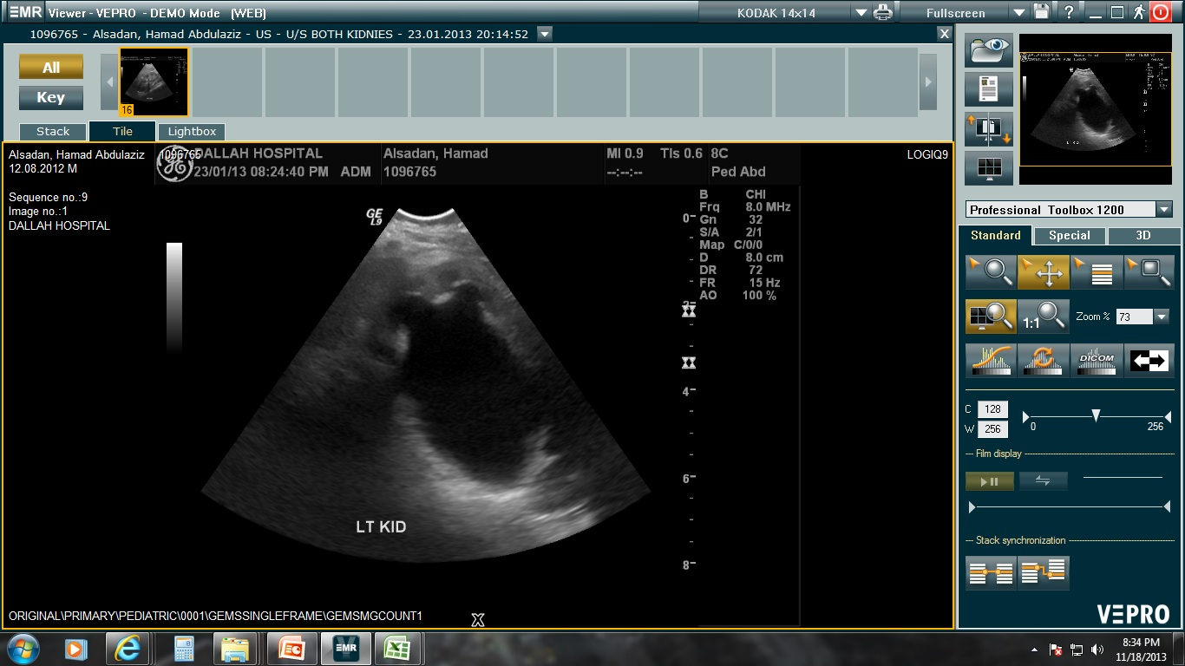
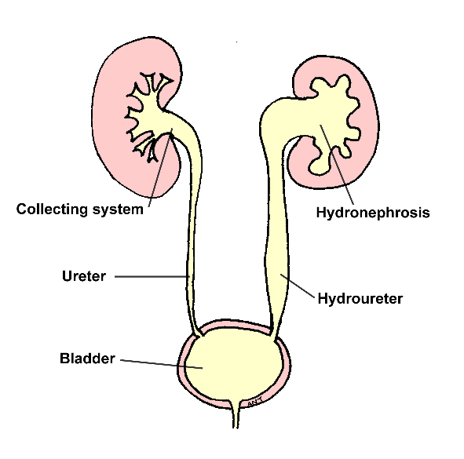
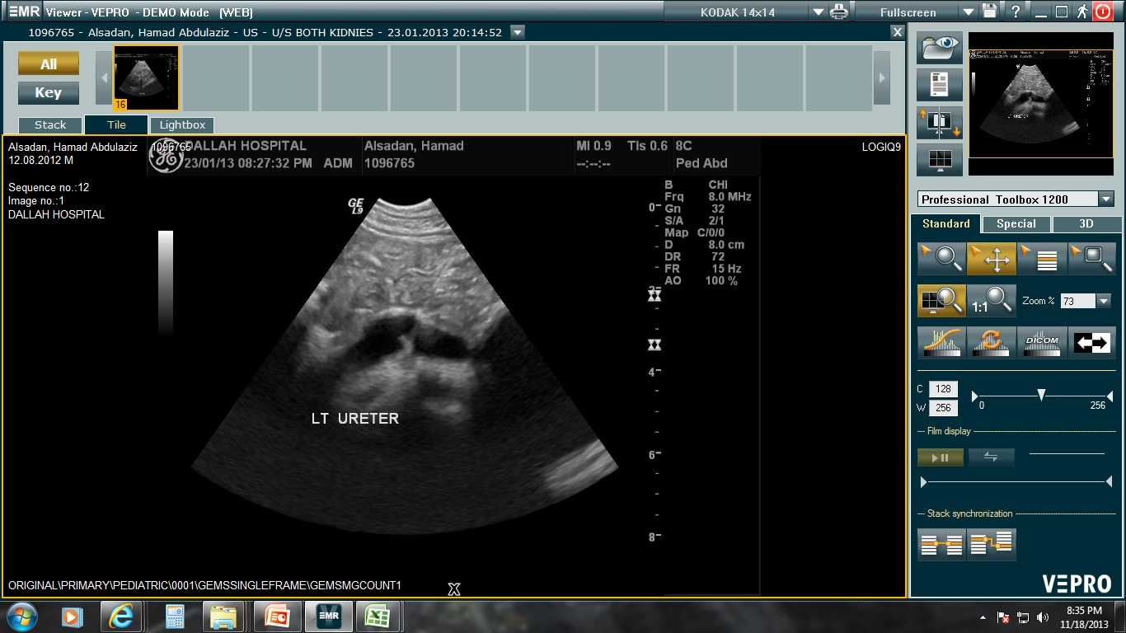
Ureterovesical junction obstruction (UVJO)
(Megaureters)
Ureteral reimplantation

Slide 31
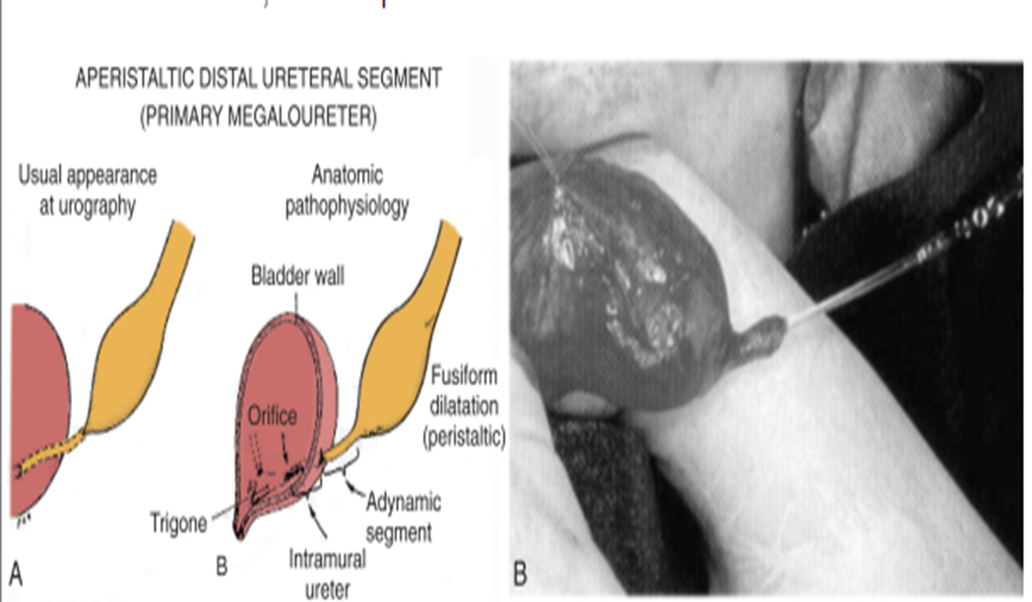
Ureterovesical junction obstruction (UVJO)
(Megaureters)

Slide 32
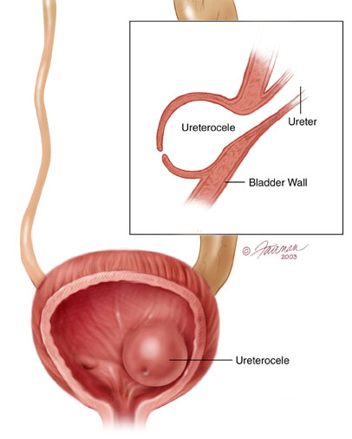
Ureterocele
A cystic dilation of the distal aspect of the ureter
Located either within the bladder or spanning the bladder neck and urethra.
Presentation:
Antenatal (U/S)
Urine retention
Infection
Stone formation

Slide 33
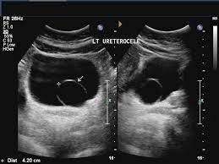
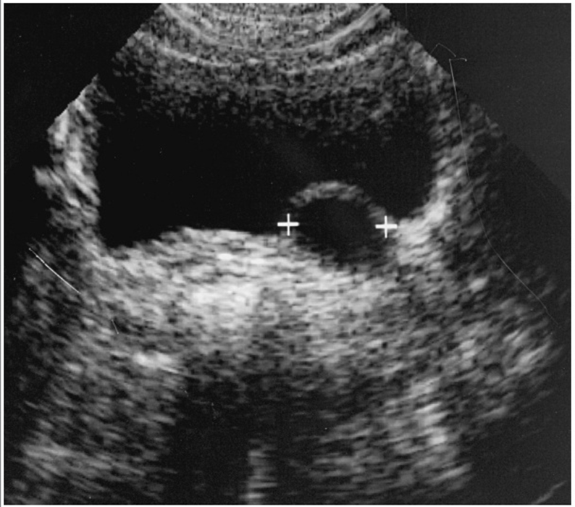
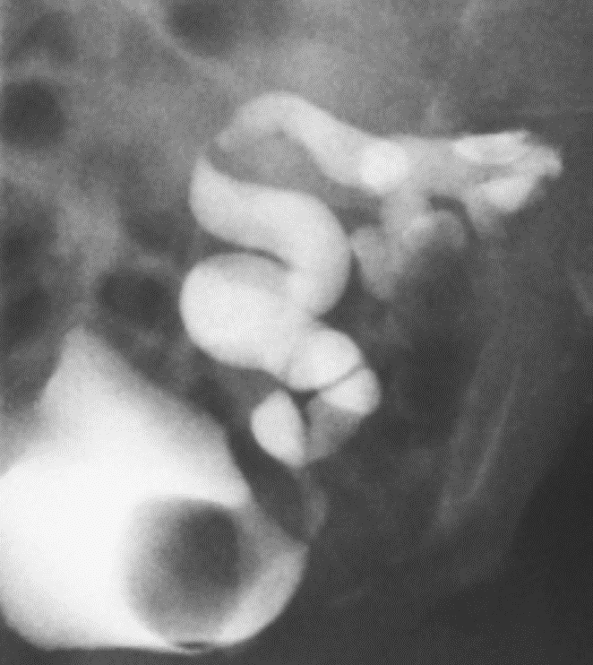
Ureterocele…
Endoscopic incision of ureterocele

Slide 34
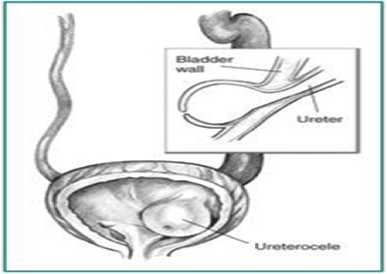
4-Ureterocele

Slide 35
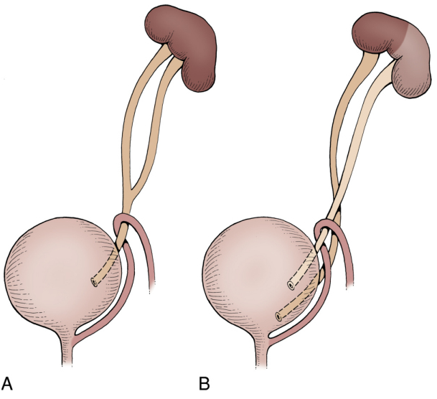
Duplication Anomalies
Obstructed ureter
1%
1.6:1 F:M
85% unilateral.
Complete or incomplete
Associated
  Reflux 43%
  Renal dilatation 29%
  Ectopic insertion 3%
  Ureterocele.
Refluxing ureter

Slide 36
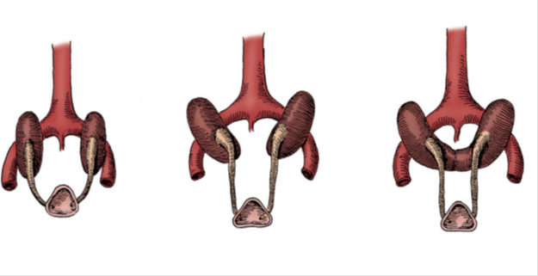

Horseshoe Kidney
The isthmus is bulky and consists of parenchymatous tissue.

Slide 37
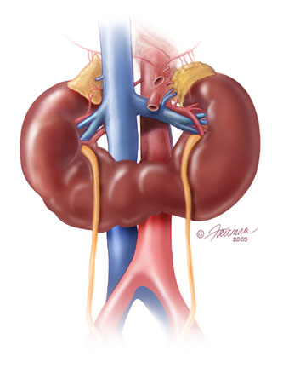
Horseshoe Kidney
Occurs 1 in 400 persons.
The calyces:
  normal in number
  atypical in orientation.
  pelvis remains in the vertical or obliquely lateral plane
Horseshoe kidney is frequently found in association
with other congenital anomalies.
UPJ obstruction in one third.
60 % asymptomatic.

Slide 38
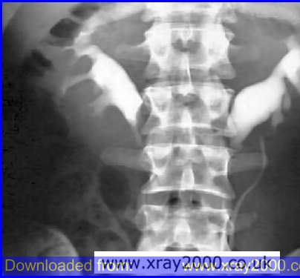

Slide 39
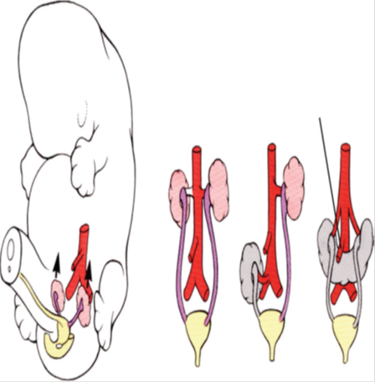
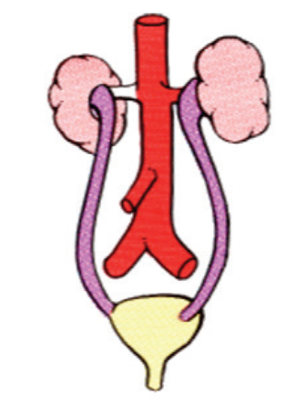
Simple Renal Ectopia

Slide 40
Simple Renal Ectopia
Left more than the right.
1 of 2100 to 3000 autopsies.
Most ectopic kidneys are clinically asymptomatic.

Slide 41
Simple Renal Ectopia…
Associated Anomalies:
  50% have a hydronephrosis:
    Obstruction: UPJO and UVJO
    Reflux (VUR): grade III or greater
    Malrotation
  Genital anomalies in the patient with ectopia is about 15%.

Slide 42
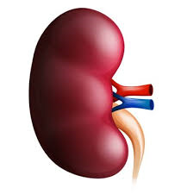
Crossed Renal Ectopia
Crossed ectopia: kidney is located on the side opposite from that in which its ureter inserts into the bladder.
The ureter from each kidney is usually orthotopic.

Slide 43
Crossed Renal Ectopia…
with Fusion
without Fusion
90% are fused
the superior pole of the ectopic kidney usually joins with the inferior aspect of the normal kidney.

Slide 44
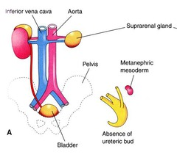
Unilateral Renal Agenesis
1 in 1100 births.
Male: Female of 1.8 : 1
The left side is absent more frequently .
The ipsilateral ureter is completely absent in 50%.

Slide 45
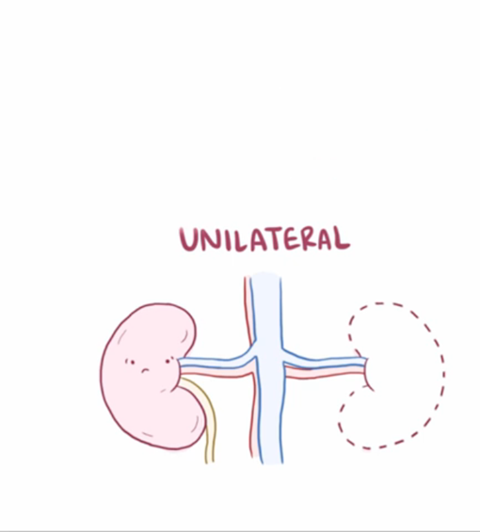
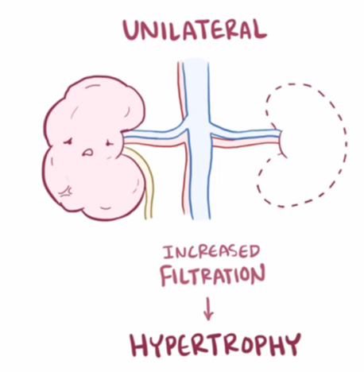
Unilateral Renal Agenesis…

Slide 46
Unilateral Renal Agenesis….
Associated anomalies:
  Anomalies of other organ systems are found frequently in affected individuals
  CVS,GIT,MSC
  Müllerian duct abnormalities
    25% to 50% of females
    10% to 15% of males
    Approximately one fourth to one third of women with Mullerian duct anomalies are found to have URA.

Slide 47
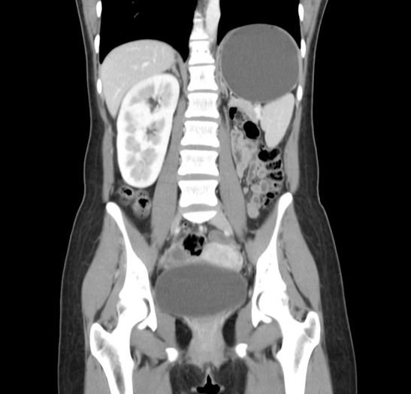
Unilateral Renal Agenesis…
Diagnosis:
  Prenatal US
  Incidentally
    Abdominal US
    Abdominal CT
  Confirmed
    Nuclear study (DMSA)

Slide 48
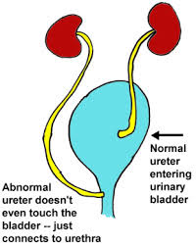
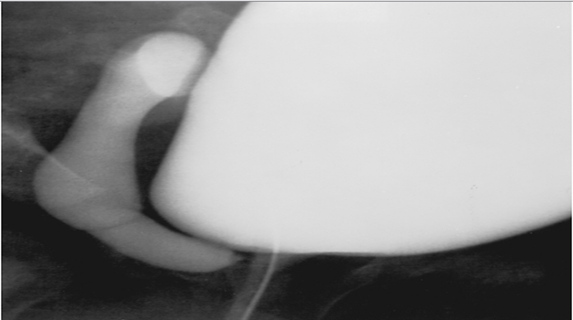
Ectopic Ureter
An ectopic ureter is any ureter, single or duplex, that doesn't enter the trigonal area of the bladder.

Slide 49
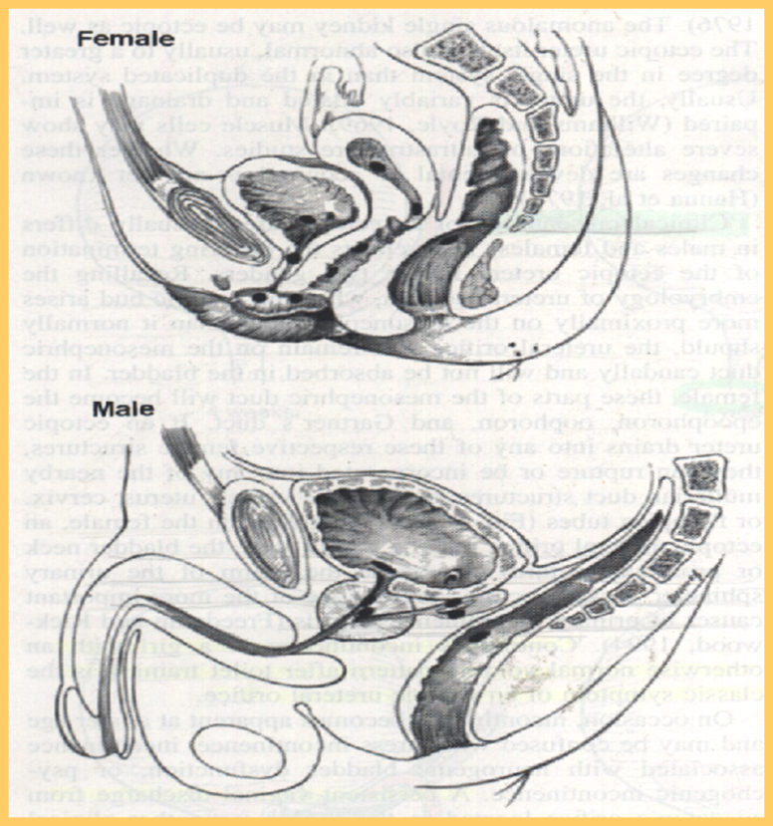
Ectopic Ureter…
In females the ectopic ureter may enter anywhere from the bladder neck to the perineum and into the vagina, uterus,and even rectum.
One of the classic symptoms is continuous wetting.

Slide 50
Ectopic Ureter
In males the ectopic ureter always enters the urogenital system above the external sphincter or pelvic floor, and usually into the wolffian structures including vas deferens, seminal vesicles, or ejaculatory duct.

Slide 51
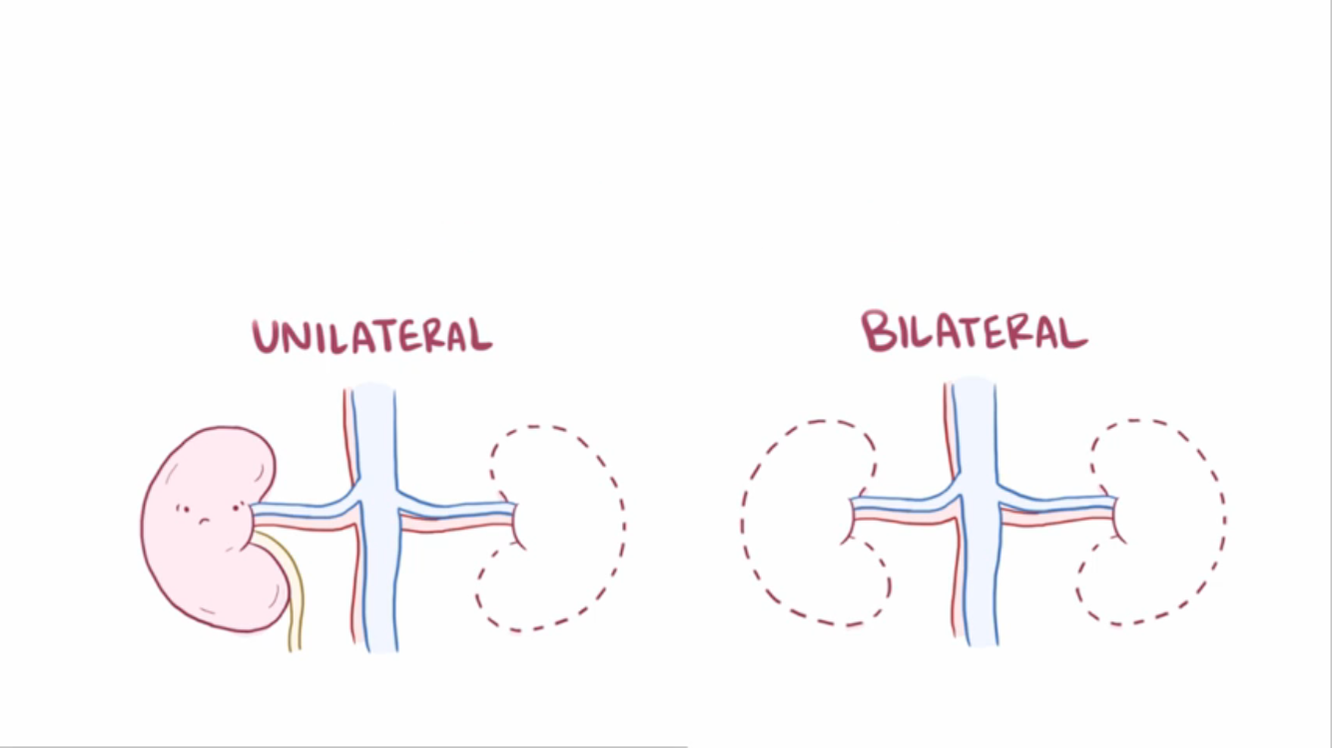
Bilateral Renal Agenesis

Slide 52
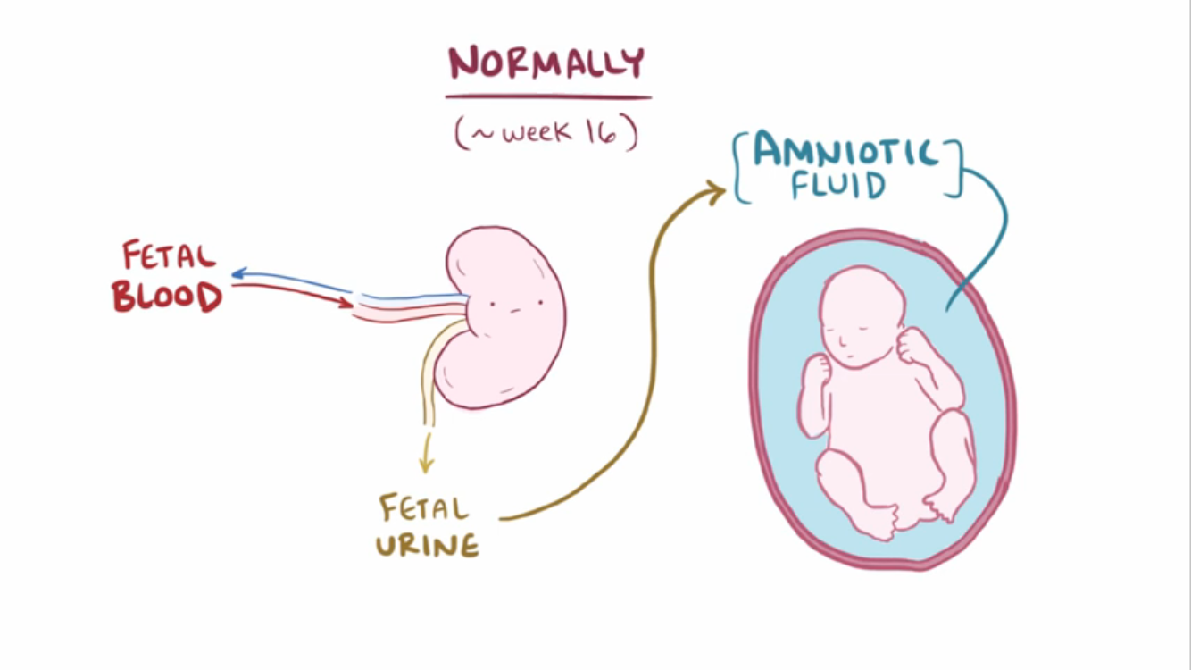

Bilateral Renal Agenesis…

Slide 53

Bilateral Renal Agenesis…

Slide 54
Bilateral Renal Agenesis
Ureters are almost always absent.
Bladder is either absent or hypoplastic.
Adrenal glands are usually positioned normally.
Müllerian duct anomalies are commonly observed.

Slide 55
Bilateral Renal Agenesis…
Prognosis
  40% are stillborn.
  Do not survive beyond 48 hours due to respiratory distress associated with pulmonary hypoplasia.

Slide 56

Supernumerary Kidney
Definitive accessory organ with its own collecting system, blood supply, and distinct encapsulated parenchyma.
Either completely separate or loosely attached to the kidney on the ipsilateral side.
The ureteral inter-relationships on the side of the supernumerary kidney can be variable.

Slide 57
Anomalies of Rotation
The kidney and renal pelvis normally rotate 90 degrees ventromedially during ascent
  the calyces point laterally.
  the pelvis faces medially.
When this alignment is not exact, the condition is known as malrotation.
Frequently associated with Turner syndrome.

Slide 58


Hypospadias
Abnormal position of the EUM on the ventral surface.
Types:
  Distal hypospadias.
  Proximal hypospadias.
NO Circumcision
6 to 9 months repair.

Slide 59



Slide 60

Epispadias
Male
Female

Slide 61

Anomalies of the kidney
Anomalies of:
  Number
  Ascent
  Form and Fusion
  Rotation

Slide 62
Prune-Belly Syndrome
The incidence :1 in29,000 to 1 in 40,000 live births
The three major findings are
  deficiency of the abdominal musculature,
  bilateral intra-abdominal testes,
  anomalous urinary tract
Other names
  Triad syndrome
  Eagle-Barrett syndrome
  abdominal musculation syndrome

Slide 63



Bladder Exstrophy
The incidence of bladder exstrophy has been estimated as between 1 in 10,000 and 1 in 50,000.

Slide 64


Bladder Exstrophy-Epispadias Complex

Slide 65

Cloacal Exstrophy
1 per 200,000 live births
Associated anomalies:
  Omphalocele
  Gastrointestinal anomalies
    Malrotation, duplication,duodenal atresia, Meckel diverticulum
  Genitourinary anomalies
    Separate bladder halves,bifid genitalia

Slide 66
Urachal abnormalities
Urachal anomalies are usually detected postnatally due to umbilical drainage.
Imaging possibilities include ultrasound, CT, and VCUG.

Slide 67
Urachal abnormalities…
Conservative treatment with observation is justified in asymptomatic cases due to possible spontaneous resolution
Infected urachal remnants are initially treated with drainage and antibiotics, followed by surgical excision.
Nonresolved urachal remnants should be excised due to theincreased risk of later adenocarcinoma formation

Slide 68
Bladder Diverticulum
Bladder diverticula can be detected on prenatal ultrasound, but the gold standard remains VCUG, which will reveal possible accompanying VUR.

Slide 69
Bladder Diverticulum…
Types:
  Primary diverticula
    arise as a localized herniation of bladder mucosa at the ureteral hiatus and are most likely caused by a congenitally deficient bladder wall.
  Secondary para-ureteral diverticula
    are acquired and develop due to existing infra- vesical obstruction.
Symptomatic diverticula, especially in conjunction with VUR, should be treated surgically.

Slide 70
Bladder Duplication
Often associated with duplication anomalies of the external genitalia and lower gastrointestinal tract.
Initial treatment is directed toward
  renal preservation.
  prevention of infections.

Slide 71
Bladder Duplication…
Long-term goals include achieving continence and reconstructing the internal and external genitalia.
Due to the rarity of the disease and the large variety of presentations, the surgeries must be individualized

Slide 72

NEUROSPINAL DYSRAPHISMS
The most common cause of neurogenic bladder dysfunction in children is abnormal development of the spinal canal and internecine spinal cord.

Slide 73
NEUROSPINAL DYSRAPHISMS…
Cutaneous lesions occur in 90% of children with various occult dysraphicstates.
These lesions vary from
  small lipomeningocele
  hair patch
  dermal vascular malformation
  sacral dimple
  abnormal gluteal cleft.

Slide 74



