Slide 1
Vascular Investigations
Abdulmajeed Altoijry, MD, MSc, FRCSC
Assistant Professor & Consultant Vascular Surgeon
King Saud University Medical City
King Saud University

Slide 2
Sensitive:
Operator dependent:
Toxic:
Therapeutic:

Slide 3
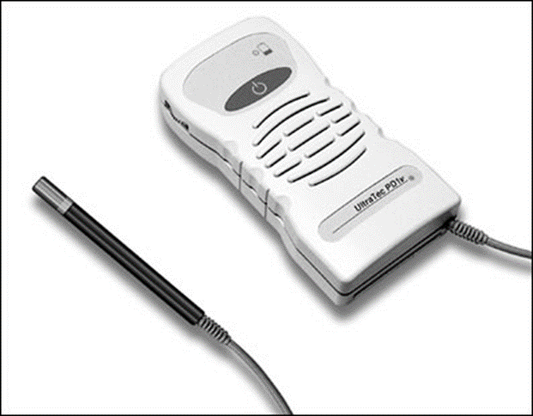
Handheld Doppler

Slide 4
Handheld Doppler
Notes:
The Doppler device compares the frequency of backscattered sound from moving red blood cells with the transmitting frequency
to determine the frequency shift, which is proportional to the speed of the flowing blood, the transmitting frequency, and the cosine of the
Doppler angle, θ. The drawing shows a Doppler probe transmitting ultrasound at a wavelength T to a red blood cell moving in a direction indicated
by an arrow. The red cell is moving toward the probe in (A) and away from the probe in (B). The angle between the ultrasound beam and
the direction of red cell velocity is given by θ. The frequency of the ultrasound that is transmitted is the same in both cases (red line). The ultrasound
signal that is received (yellow line) has a shorter wavelength (R) in (A) and a longer wavelength in (B).

Slide 5
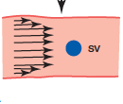
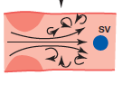
Handheld Doppler

Slide 6
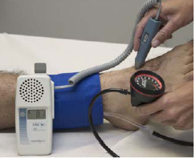
Ankle Brachial Index
ABI= Ankle SBP(PT or DP)/Highest Arm SBP

Slide 7
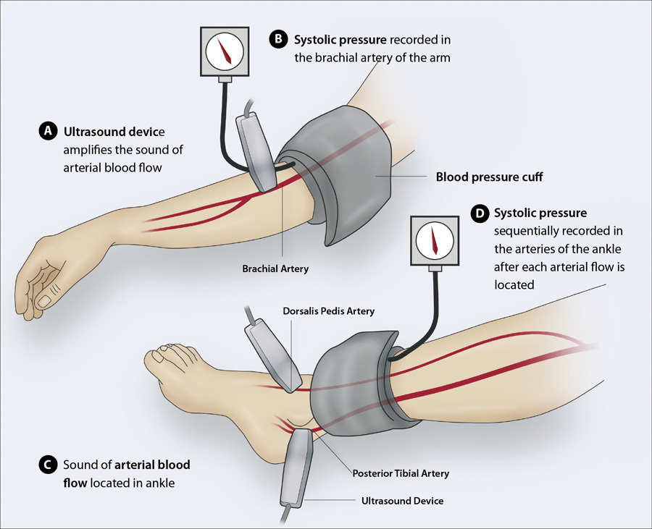

Slide 8
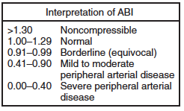
The ABI has limited use in evaluating calcified vessels that are not compressible as in Diabetics

Slide 9
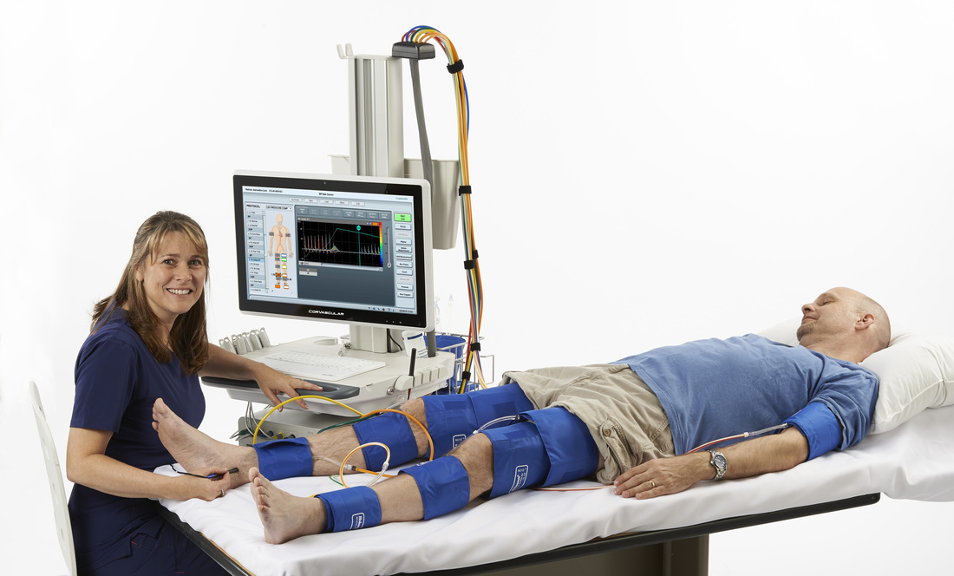
Segmental pressure

Slide 10
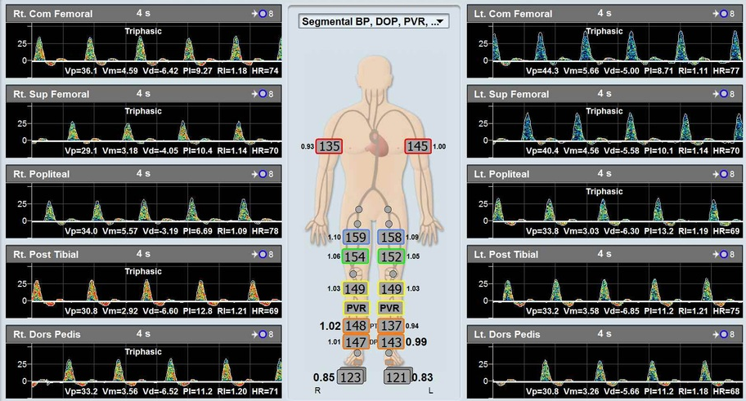

Slide 11
Sensitive:
Operator dependent:
Toxic:
Therapeutic:
✓
✓✓✓
✗
✗

Slide 12
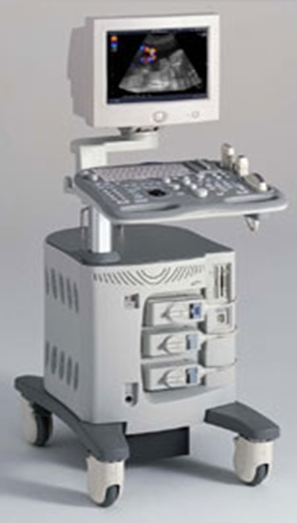
Duplex Ultrasound
B - mode + Color Doppler

Slide 13
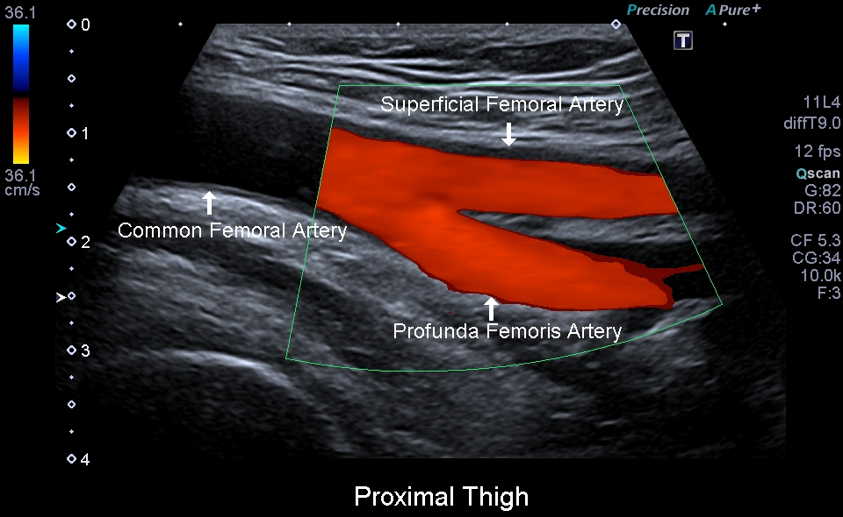
Duplex Ultrasound

Slide 14
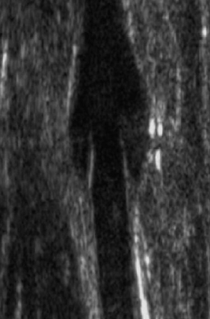
Duplex Ultrasound

Slide 15
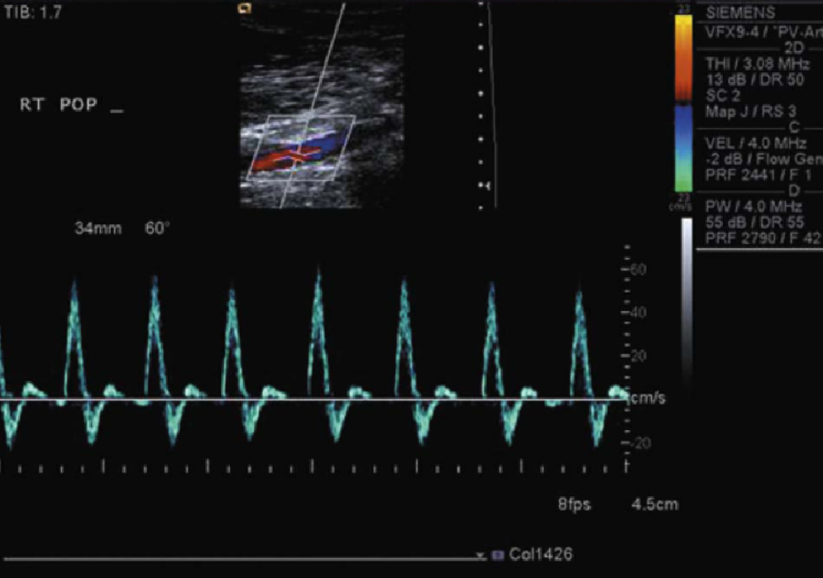
Duplex Ultrasound

Slide 16
Duplex Ultrasound

Slide 17
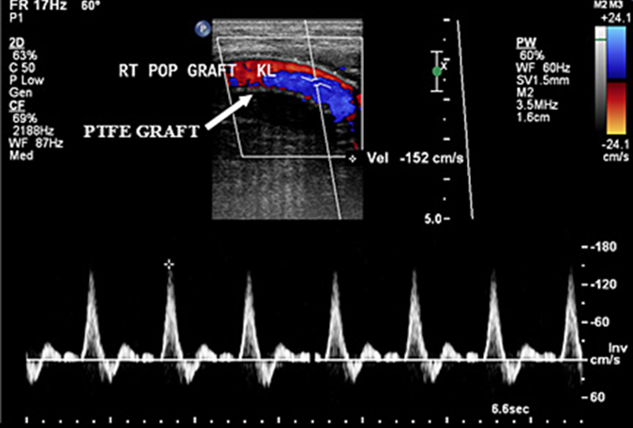
Duplex Ultrasound

Slide 18
Sensitive:
Operator dependent:
Toxic:
Therapeutic:
✓✓✓
✓✓✓
✗
✗

Slide 19
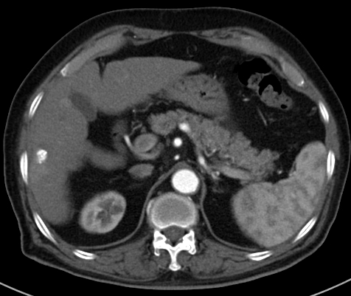
CT Angiogram

Slide 20
CT Angiogram

Slide 21
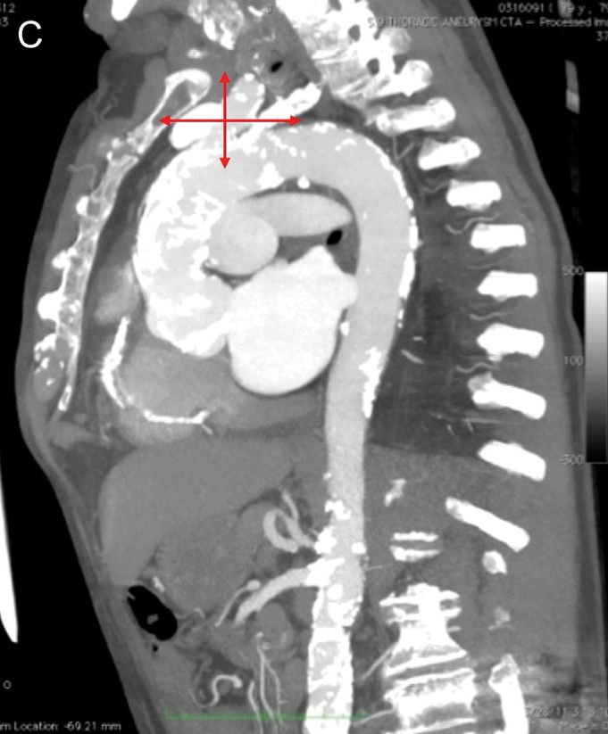
CT Angiogram

Slide 22
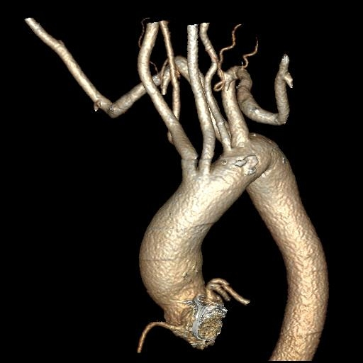
CT Angiogram

Slide 23
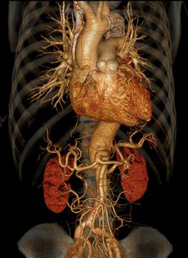
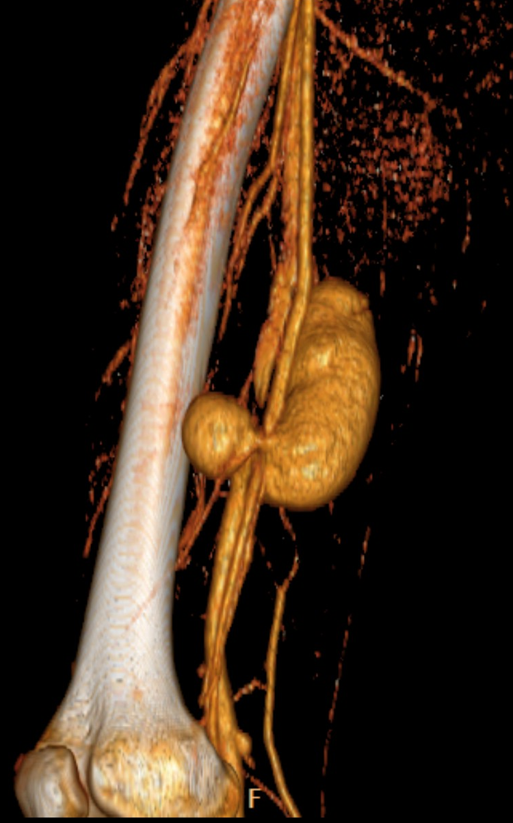
CT Angiogram

Slide 24
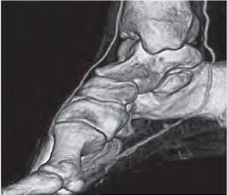
CT Angiogram

Slide 25
Sensitive:
Operator dependent:
Toxic:
Therapeutic:
✓✓✓✓✓
✗
✓✓✓
✗

Slide 26
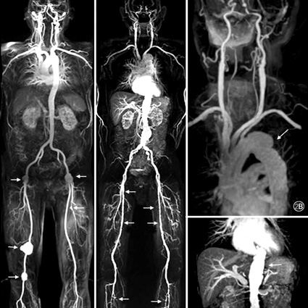
MR Angiogram
Notes:
gadolinium

Slide 27
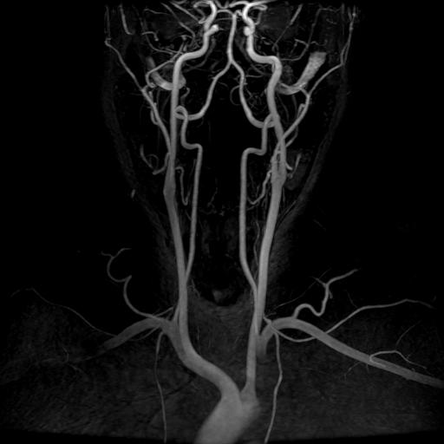
MR Angiogram

Slide 28
Sensitive:
Operator dependent:
Toxic:
Therapeutic:
✓✓✓✓
✗
✓✓✓
✗

Slide 29
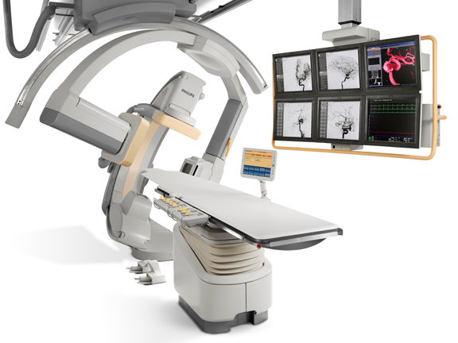
Angiography

Slide 30
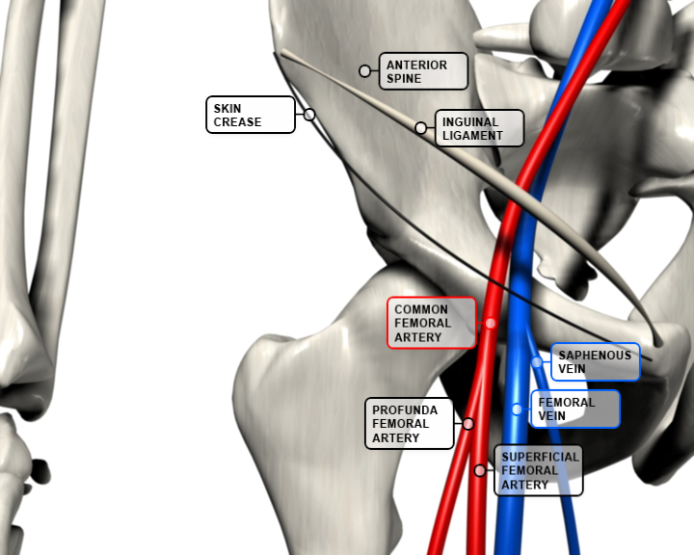
Femoral Artery
Skin
crease
CFA

Slide 31
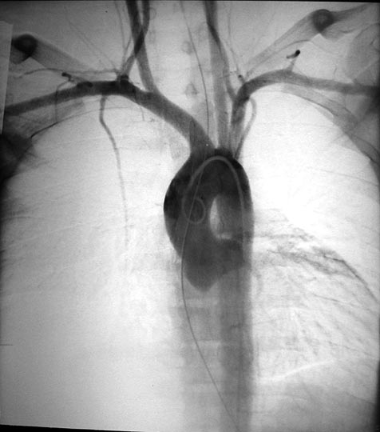
Angiography

Slide 32
Angiography

Slide 33
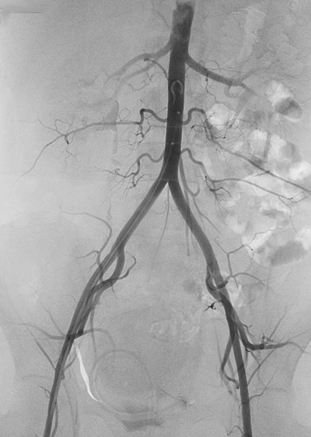
Angiography

Slide 34
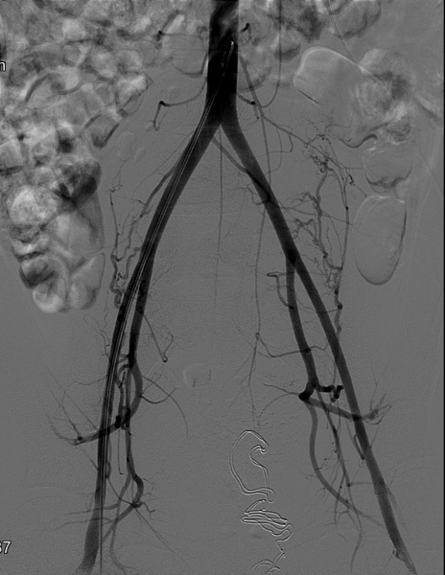
Angiography

Slide 35
Angiography

Slide 36
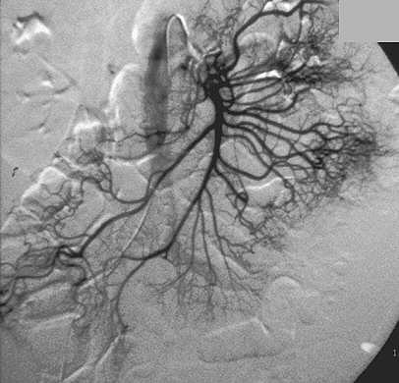
Angiography

Slide 37
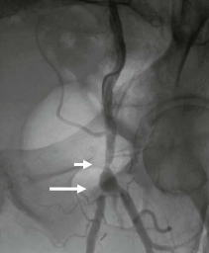
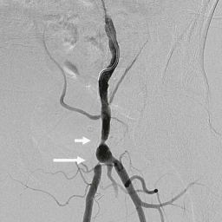
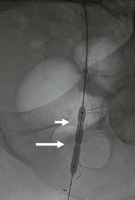
Angiography

Slide 38
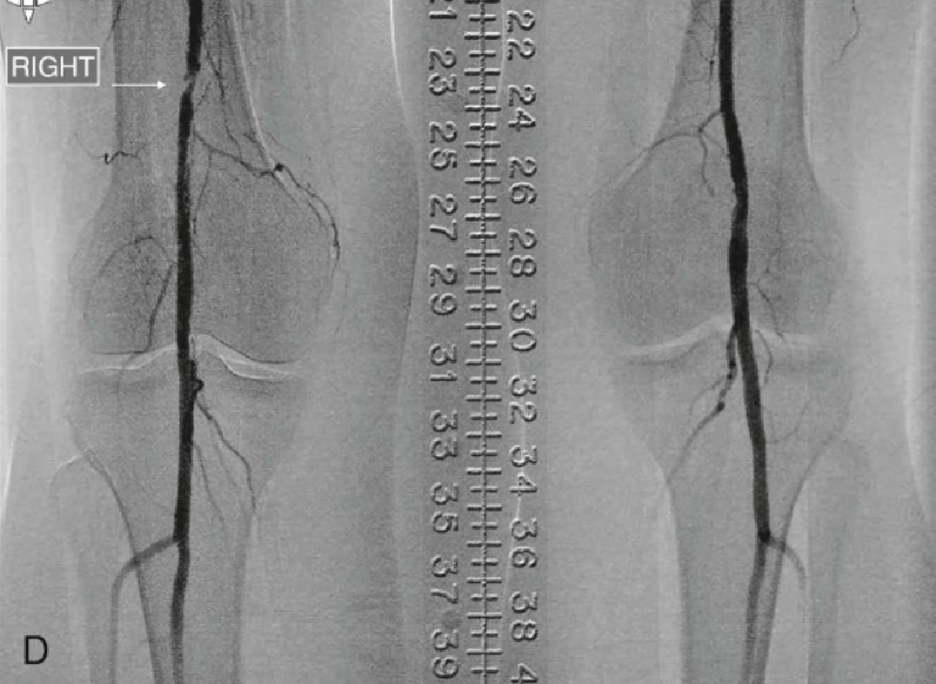
Angiography

Slide 39
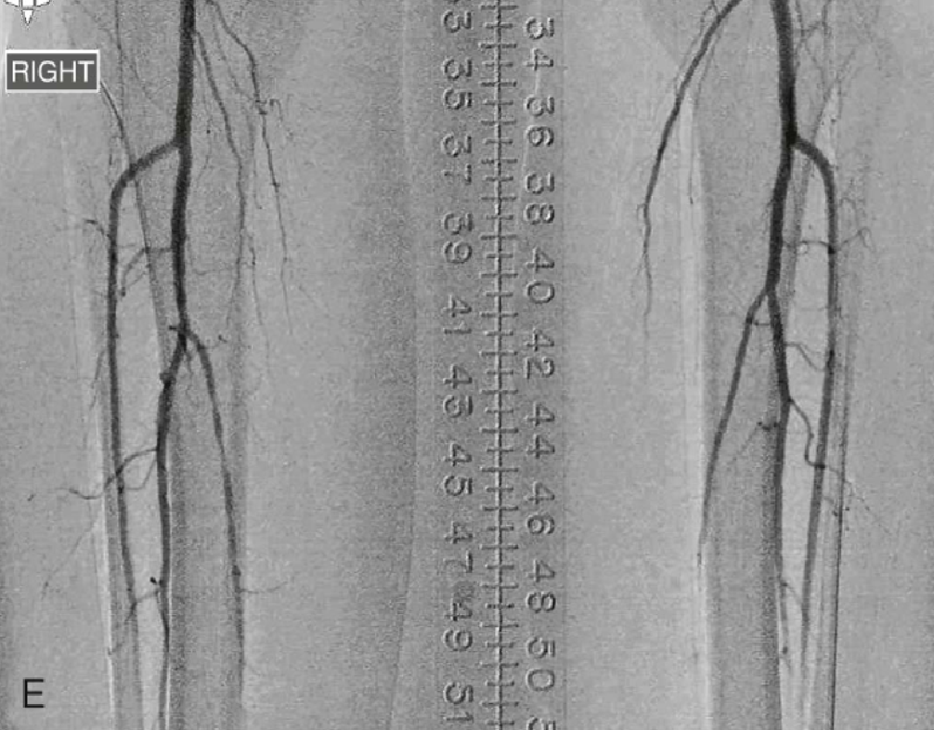
Angiography

Slide 40
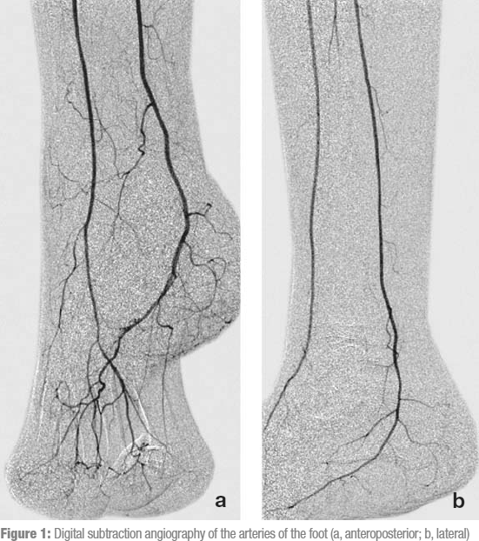
Angiography

Slide 41
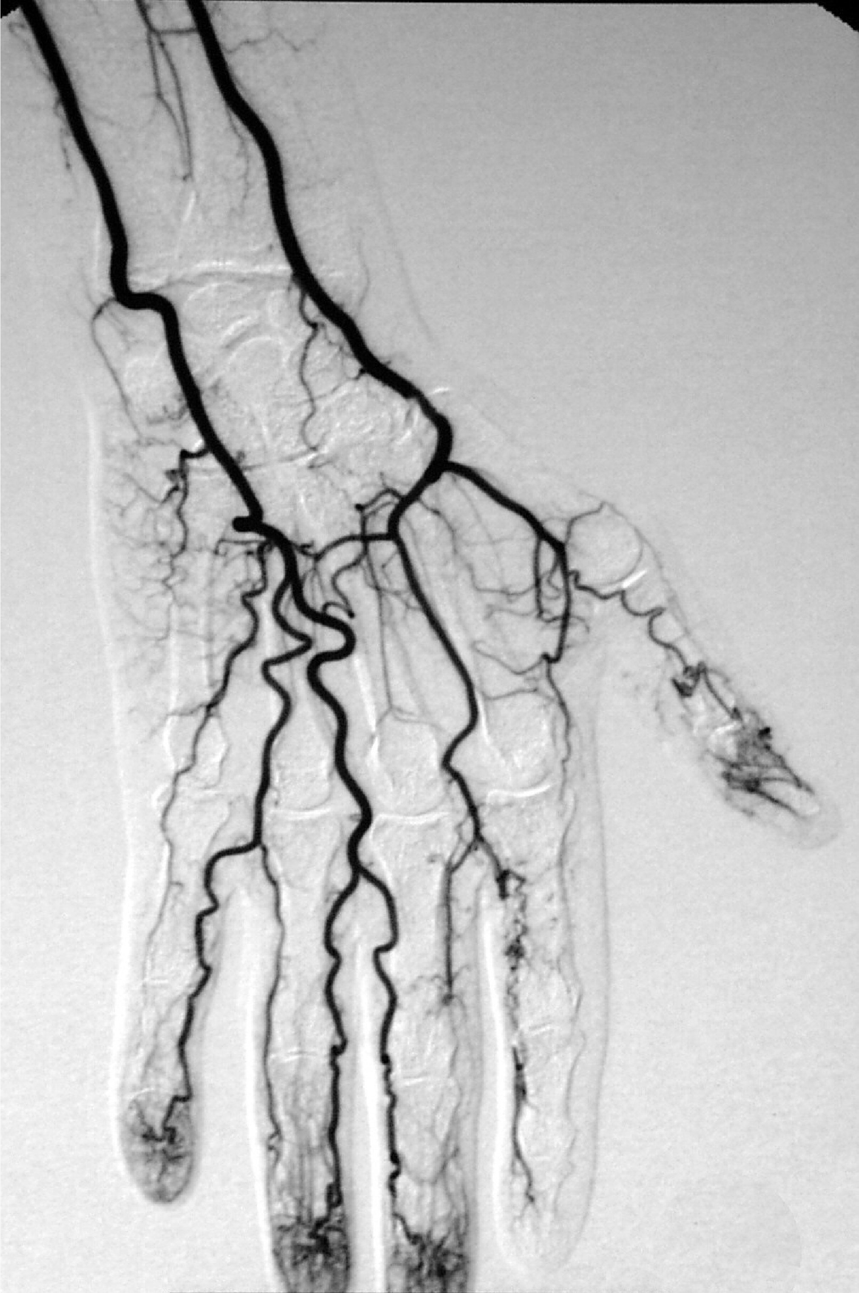
Angiography

Slide 42
Angiography

Slide 43
Sensitive:
Operator dependent:
Toxic:
Therapeutic:
✓✓✓✓✓
✗
✓✓✓
✓✓✓

Slide 44
Thank you

