Slide 1
Trauma
Objectives
Mention the epidemiology of trauma.
Discuss the mechanism of trauma (Penetrating, Blunt trauma).
Explain the prehospital care in trauma.
Discuss the triage and scoring for severity in trauma cases.
Describe the emergency department management per “ATLS” protocol.
Discuss the primary survey (diagnosis of the problems and immediate management).
Recognize the adjuncts to primary survey
Discuss the secondary survey.
Colour Index
Main Text
Males slides
Females slides
Doctor notes
Textbook
Important
Golden notes
Extra
Editing File

Slide 2
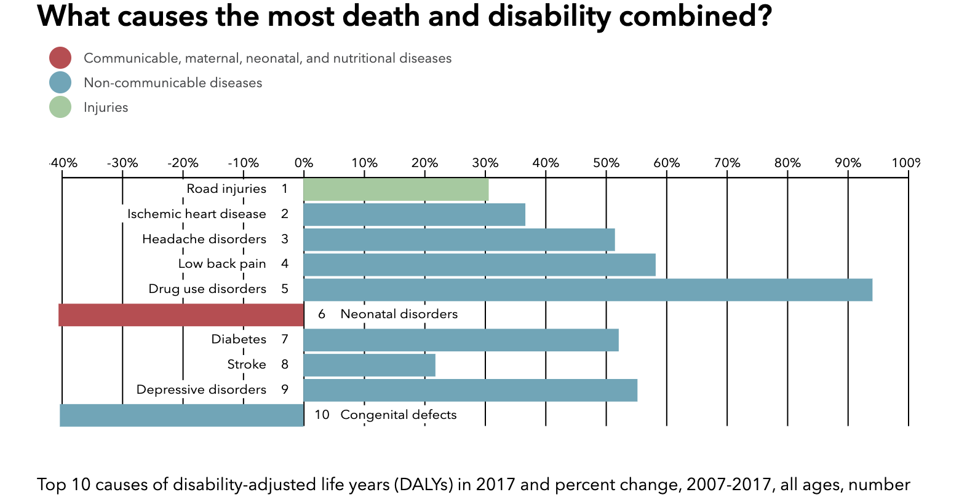
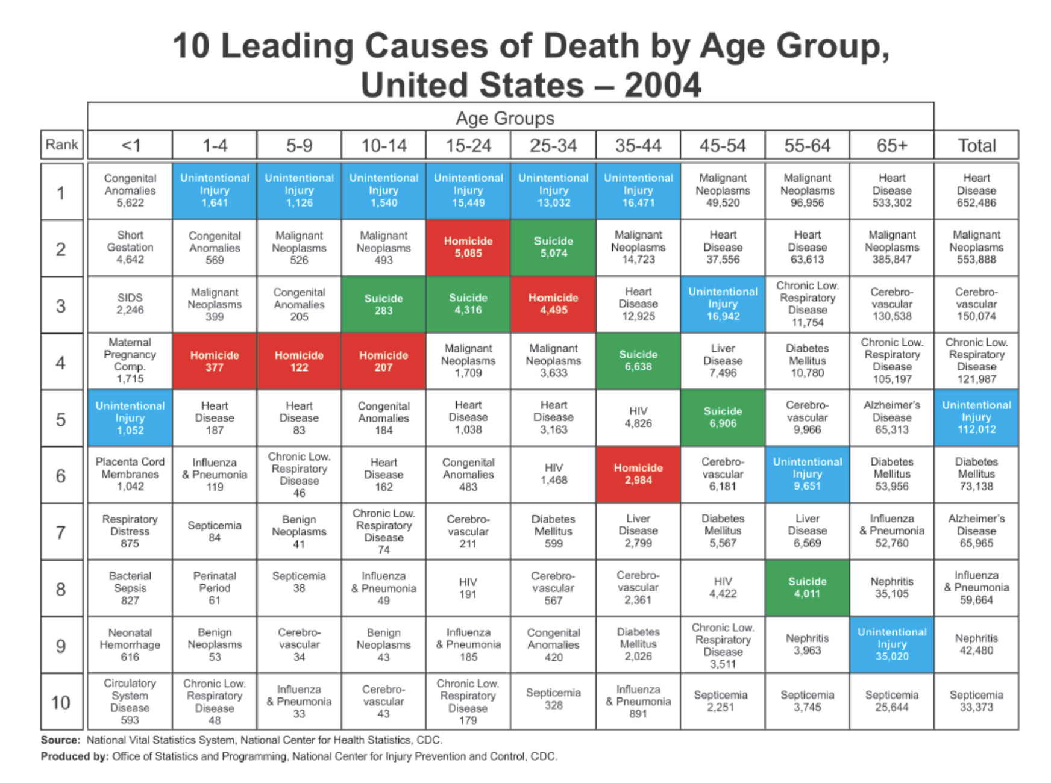
Trauma
Types of Trauma:
Major trauma:
in physical medicine, is a severe physical injury caused by an external source.
Psychological trauma:
a type of damage to the psyche that occurs as a result of a severely distressing event.
Traumatic injury:
sudden physical injury caused by an external force, which does not rise to the level of major trauma.
Stats:
Leading cause of death for individuals up to the age of 45.
Fourth leading cause of death overall for all ages.
More than 5 million trauma-related deaths worldwide each year.
Road traffic crashes kill 1.2 million people annually around the world (3242 people a day).
Estimated cost: $518 billion globally.
Leading causes of death & disability in Saudi Arabia:

Slide 3
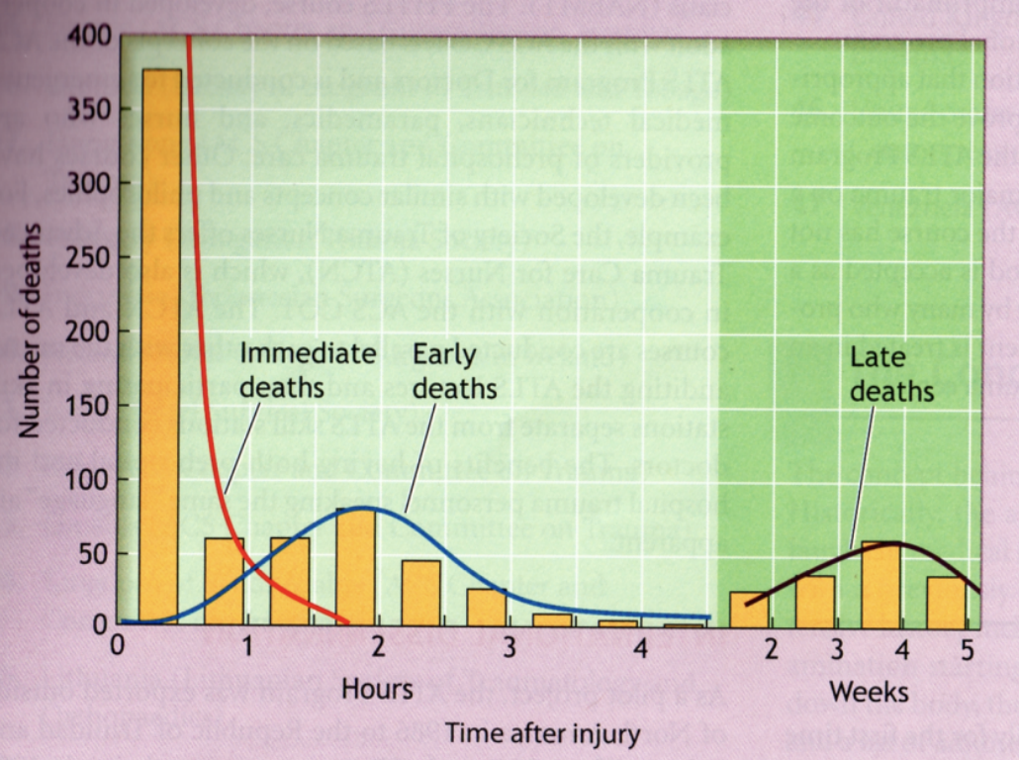
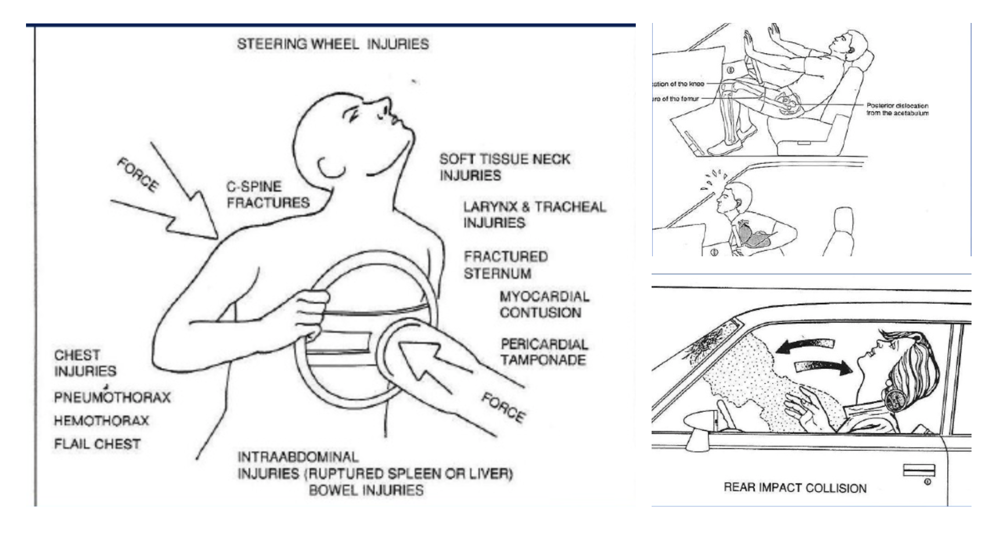
Mechanism of Injury
Relatively few patients die after the first 24 hours following injury. Rather, the majority of deaths occur either at the scene or within the first four hours after the patient reaches a trauma center.
Classification of Injury:
Trimodal Death Distribution ¹
The World Health Organization (WHO) developed the International Classification of External Causes of Injury (ICECI). Under this system, injuries are classified by:
01
02
03
04
05
Mechanism of
injury
Objects/substances producing injury
Place of
occurrence
Activity when
injured
The role of
human intent
Blunt Injuries | Penetrating Injuries
Motor Vehicle Collisions (MVC)² Fall from height (for adults: 2 stairways=6m=20ft is considered significant. And for kids: 3m=10ft is considered significant). | High velocity (gun shot, or shrapnel) Low velocity (stabbing, or falling on shattered ice)
1. It is often quoted that trauma deaths have a trimodal distribution. The first peak ‘immediate deaths’, represent deaths (unsurvivable injuries) occurring immediately after or within a few seconds of injury, contributes up to 50% of the total. This peak is impacted by increased trauma preventive measures which is done at level of the government. The second peak ‘early deaths’, up to 4 hours after injury and accounts for 30% of deaths (This peak is the golden hour of care, and is impacted by early hospital care) , and the final 20% occur in the third peak ‘late deaths’ and it takes place (usually in an intensive care unit) days or weeks after the event (usually caused by sepsis and multiorgan dysfunction syndrome). This peak is mainly impacted by optimal early care and trauma center management.
2. When reporting a MVC it’s very important to describe the details of the event, you report where they were riding (driver or passenger seat? And if passenger, back seat or front seat?), wearing seatbelt or not? The type of collision, Was it a Head on collision? Side impact collision? Rear impact (“whiplash”)? Rollover? Pedestrian hit/run over by a car?
if not belted, the first thing that the patient would hit is the steering wheel, resulting in steering wheel injuries which are: soft tissue & neck injuries, larynx & tracheal injuries, fractured sternum, myocardial contusion, pericardial tamponade, intra abdominal injuries (ruptured spleen or liver, bowel injuries), C-spine fractures, chest injuries (pneumothorax, hemothorax, flail chest) chest injuries will be further explained in the following slides.
If the patient sled forward (top picture on the right) that’d lead to long bone injury, fracture of the femur and injury/dislocation of the knee.
Rear impact collision leads to the famous whiplash injury. Whiplash is an injury that occurs to a person's neck following a sudden acceleration-deceleration force that causes unrestrained, rapid forward and backward movement of the head and neck

Slide 4
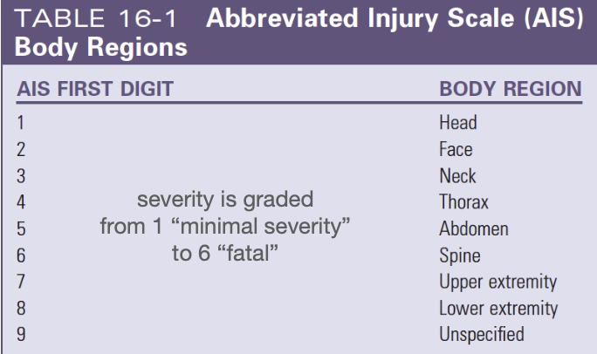
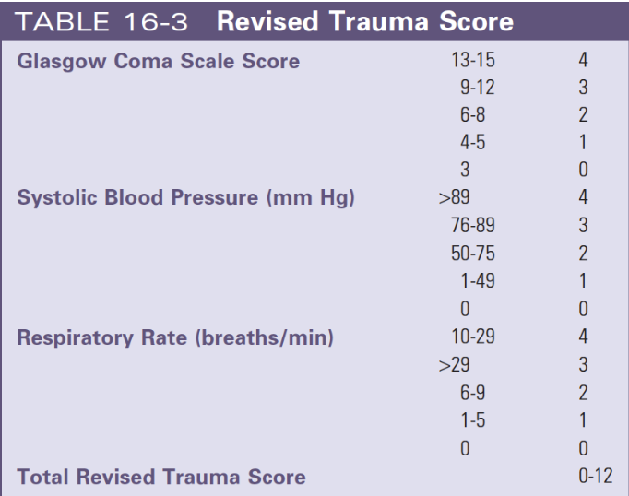
Triaging and scoring ¹
Comparing and describing:
The Abbreviated Injury Scale (AIS) has been the most used anatomic system of injury classification since 1971.
In 1974, Baker and colleagues presented the Injury Severity Score (ISS), calculated by summing the squares of the AIS severity codes for the three most severely injured body regions.
ISS scores “injury severity grouping”:
Revised Trauma Score (RTS).
Glasgow Coma Scale (GCS).
Minor
Moderate
Serious
Severe
<9
9-15
16-24
> 25
The importance of this scoring system is to facilitate triage decision and transport patients to optimal trauma centre.
Two types of classification are used In assessing injury severity:
Anatomical assessment: The most commonly used system is the Abbreviated Injury Scale (AIS). Once the patient's injuries have all been identified (this may only be possible at discharge or autopsy), each separate injury is assessed from a scoring ‘dictionary’ and awarded a numerical score. The Injury Severity Score (ISS) is then derived from summing the squares of the three highest AIS scores within six body areas (head and neck, abdomen and pelvic contents, bony pelvis and limbs, face, chest and body surface). ISS provides an internationally recognized objective evaluation of anatomical injury. AIS is used to identify patient injuries according to their regions . A number is given to each category from 1-6 where 1 is minimal and 6 is fatal. ISS summarise multiple injury in the patient using AIS square value Example : Chest (3), Abdominal (2), extremities (4). ISS = (9)+(4)+(16) = 29 Severe.
Physiological assessment: The best known physiological scoring system is the Glasgow Coma Scale which is used to assess the neurological state of injured patients objectively, and it also has a prognostic value. The Glasgow Coma score (GCS), in conjunction with two other physiological recordings, systolic blood pressure and respiratory rate, can be used to produce the ‘Revised Trauma Score’. The GCS is a three-point scale used to describe the level of consciousness in patients with head injury. The highest score is 15 (normal) and the lowest score is 3 (deep coma or death). The patient is assessed on ability to open eyes, motor responses and vocalisation. A patient of GCS 8 or less is considered to be in coma and intubation is indicated

Slide 5
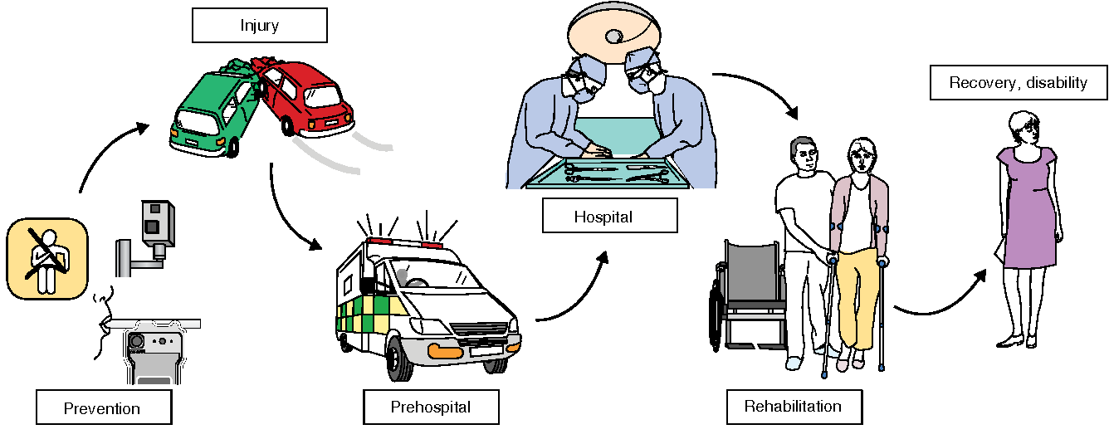
Prehospital care
Trauma Systems:
Trauma systems include the entire care continuum, starting at the time of the injury, with a patient’s access to care, and extending through the rehabilitation process
Prehospital Care ¹ :
The goal is to move a patient to a location capable of providing definitive injury management as quickly as possible.
The approach to the injured patient in the prehospital setting includes four key priorities:
01
Evaluate the scene
02
Perform an initial assessment
03
Make triage-transport decision
04
Initiate critical interventions and transport the patient
The objective of prehospital care is to prevent further injury, initiate resuscitation and transport the patient safely and rapidly to the most appropriate hospital.
1. when communicating about an injury ask about: the type of injury, speed of the car (highway speed (>120km/h) or downtown speed (40-80 km/h), how much indentation is on the car (significant damage is at 20 cm), time needed for extraction (taking the victim out of the car) and death at the scene.

Slide 6
The Approach to Trauma Patient
Standard concept (Advanced Trauma Life Support ‘ATLS’):
ABCDE approach to evaluation and treatment.
Treat greatest threat to life first.
Definitive diagnosis not immediately important.
Time is of the essence.
Do no further harm.
Regular Medical Assessment ¹:
Injury
History
Physical
Differential Diagnosis
Treatment
Differential Diagnosis
Investigations
Initial Assessment and Management for Trauma Patients ²:
Injury
Primary Survey ABCDE
Resuscitation
Reevaluation
Transfer
Optimize Patient Status
Reevaluation
Detailed Secondary Survey
1. The routine approach used for regular patients is called a secondary survey in trauma settings. A trauma patient would die before receiving treatment if we approach him this way.
2. In trauma patients we start with the primary survey first to save the patient’s life (will be further explained in the following slides). Then once we’ve secured the primary survey, we do secondary survey and detailed assessment.

Slide 7
The Approach to Trauma Patient
Case:
24-year-old male involved in a motorcycle crash in to a truck, Not wearing a helmet, Arrives at hospital with the red crescent:
BP 80/40 (hypotensive), P140 (high, to compensate and improve the cardiac output), RR 33 (high, normal RR= 12-20), and central cyanosis (a clear indication that there’s an issue with ventilation and oxygenation).
C-collar, Oxygen at 8L/min, Dressing to forehead & thigh soaked in blood (indicates active bleeding).
Has a wrist splint & is on a spinal board.
How do we deal with this case? ¹
Standard Precautions (PPE) ² :
Cap, Gown, Gloves, Mask N95 especially during the COVID-19 pandemic, Shoe covers, Goggles/face shield. (All personnel must be appropriately immunized for hepatitis B.)
The Quick Assessment ³ :
It’s a quick, simple way to assess the patient in 10 seconds
01
02
03
Identify yourself
Ask the patient his/her name
Ask the patient what happened
Appropriate response confirms:
A → Patent airway.
B → Sufficient air reserve to permit speech.
C → Sufficient perfusion to permit cerebration.
D → Clear sensorium we need adequate cardiac output to ensure clear sensorium.
1. We start by applying the standard precautions (PPE), then we do the quick assessment test and primary survey.
2. To protect the patient and the trauma team members from transmitting communicable diseases.
3. A patient that fails this test needs immediate attention

Slide 8
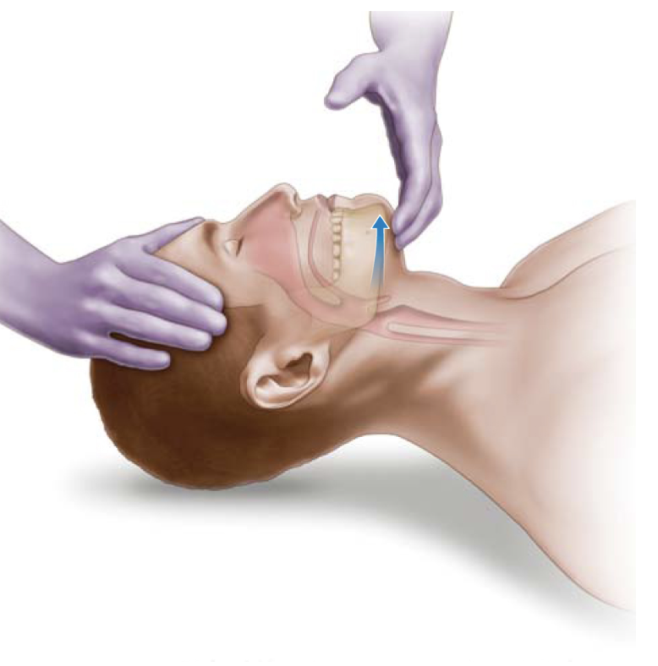
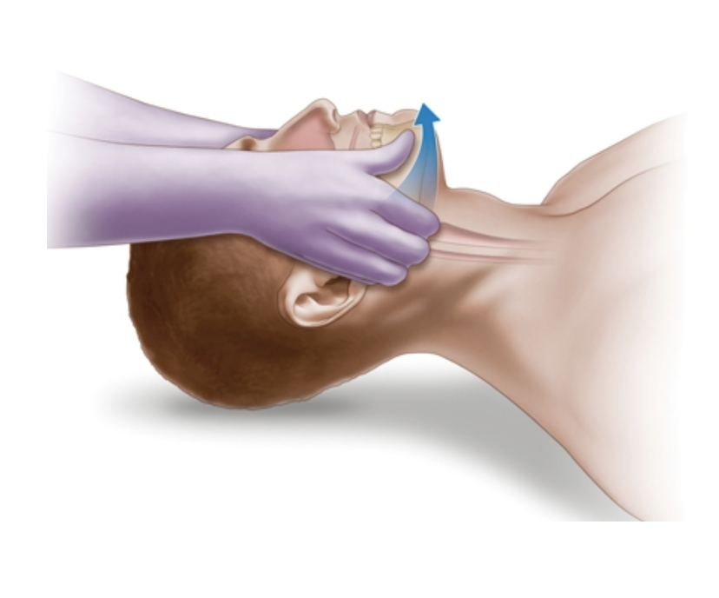
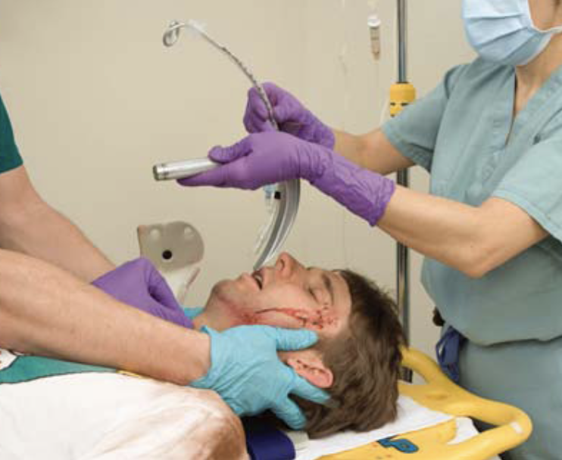
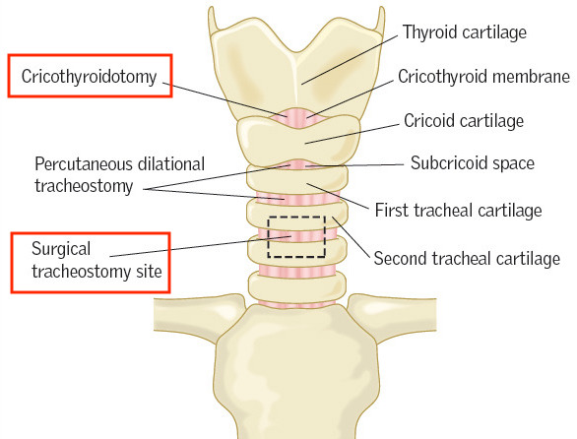
The ATLS concept ¹
The Primary Survey (the priorities are the same for all the patients):
A
Airway
Establish patent airway and protect c-spine with a collar (Assume every pt has a C spine injury)
(Establishing and securing the airway is always the first step in managing any patient with acute trauma or change in mental status. Altered mental status is the most common indication for intubation in trauma patients since unconscious patients can’t maintain their airways).
Basic Airway Techniques:
Chin-lift Maneuver
(No head tilt! ²)
Jaw-thrust Maneuver
Advanced Airway Techniques ³:
Orotracheal intubation ⁴:
The definitive airway control.
In case of failure → surgical airway (Cricothyroidotomy ⁵).
Nasotracheal intubation: Nasotracheal intubation is indicated in any patient with spontaneous respirations or when orotracheal intubation is not feasible (e.g. in patients with limited mouth opening). However, it’s rarely used.
Chin-lift
Jaw-thrust
(better than chin-lift)
Pitfalls
Occult airway injury.
Progressive loss of airway (E.g. bleeding in the neck that’s slowly pressing on the trachea and with time you’ll notice that the patient is having breathing difficulties.)
Equipment failure.(E.g. you want to light up your laryngoscope but the battery is out)
Inability to intubate.
1. ATLS provides a structured approach to trauma patients with standard Algorithms of care. It provides a guide for assessment and resuscitation to save the patient’s life. However, judgment is required to determine which procedure is needed to save the patient from death. The goal is to provide initial care during the golden hour (window of opportunity which has the greatest impact on morbidity and mortality).
2. To avoid further damage in case the patient had a cervical injury. Bc if the patient had a C-Spine injury and you did a head tilt the patient will be quadriplegic and
the innervation to the diaphragm will be lost.
- The patency of the airway is first assessed by direct inspection, identifying and removing obstructions. Noisy breathing, snoring or stridor implies airway obstruction. The most common cause of airway obstruction is a reduced conscious level, with the tongue falling back and blocking the oropharynx. Airway clearance, together with the ‘chin-lift’ or ‘jaw-thrust’ manoeuvres, will correct this.
3. Advanced airway techniques are required when: protective airway reflexes are absent (usually caused by altered consciousness), basic techniques are unable to cope with current or predicted airway compromise (e.g. major facial or burns/inhalation injury), there is a need for controlled ventilation (e.g. head and/or chest injury).
4. Orotracheal intubation is the advanced airway technique of choice, It protects the airway from aspiration of vomit or blood, and allows ventilation with controlled levels of oxygen and airway suctioning to remove debris. It does, however, require expertise in using anaesthetic and neuromuscular paralyzing agents.(prior to intubation, the patient is pre-oxygenated and must be carefully monitored throughout the process.)
5. Surgical cricothyroidotomy is performed by making an incision that extends through the cricothyroid membrane and inserting a tracheostomy tube.
Used for patients in whom attempts of intubation have failed or who are precluded from intubation due to extensive facial injuries.
- Emergent Tracheostomy: Is indicated in patients with extensive laryngeal injury.

Slide 9
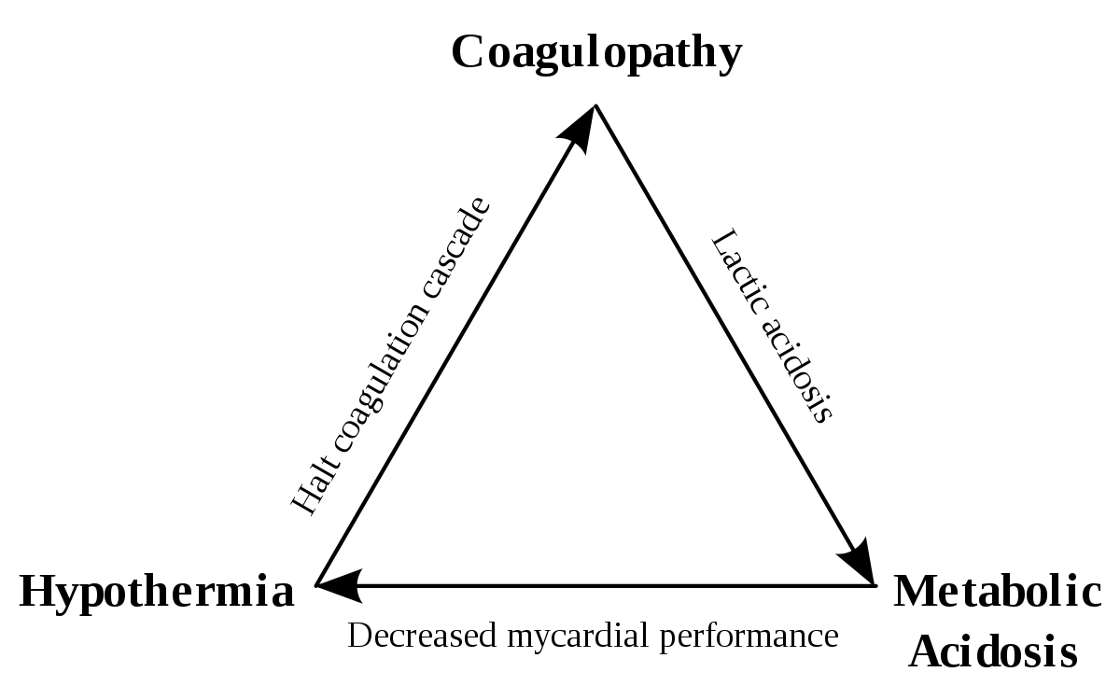
The ATLS concept ¹
The Primary Survey:
Breathing
Assess and ensure adequate oxygenation and ventilation ¹:
Respiratory rate.
Chest Movement.
Air entry.
Oxygen saturation (you look for central cyanosis, cold periphery and the periphery of the nails).Always check for oxygen saturation. If saturation <90%, obtain an arterial blood gas (ABG) and determine likely causes of hypoxia based on the history.
The Immediate life threatening injuries are:
Laryngotracheal injury / Airway obstruction
Tension pneumothorax (air in the chest that’s massive and may cause mediastinal shift to the other side. Needle thoracocentesis is indicated)
Open pneumothorax (laceration to the chest causing the O₂ to move in and out).
Flail chest and pulmonary contusion (fracture in two or more consecutive ribs, causing paradoxical movement of that region of the chest).
Massive hemothorax (the insertion of an intercostal drain is indicated)
Cardiac tamponade (bleeding into the pericardium space due to an injury to the myocardium, resulting in constriction of heart, decreased inflow and decreased cardiac output. Immediate needle pericardiocentesis is indicated)
B
C
Circulation
Level of consciousness
Skin color and temperature
Pulse rate and character
Circulatory Management
Control hemorrhage ²
Restore volume normal blood volume: 5L
Reassess patient is the patient responding? Still hypotensive?
Lethal triad (Acidosis, Hypothermia & Coagulopathy): caused by
tremendous loss of blood that’s not being replaced ³
Apply direct local pressure when site is visible (e.g., extremity)
1. Keep in mind that even when placing high flow O₂ on the patient, if the patient isn’t breathing well it won’t guarantee adequate ventilation.
- The risk of pneumothorax in patients with coexisting chest injuries is markedly increased by positive pressure ventilation (method of providing noninvasive ventilatory support). If pneumothorax is already present, tension may be induced. For these reasons, tube thoracostomy is mandatory (tube thoracostomy involves making a small incision in the chest to place a hollow tube between the ribs and into the chest to drain fluid or air from around the lungs).
2. Blood loss into the peritoneal cavity, thorax or pelvis is usually concealed, can be life-threatening, and cannot be simply controlled. Patients with major pelvic fractures pose a difficult management problem, as conventional splintage is impossible and massive and uncontrollable blood loss may result. The optimal approach is the application of external fixator devices in the resuscitation phase, followed, if required, by angiographic embolization.
3. Coagulopathy: when the patient’s blood isn’t restored, as a mechanism of defense the body will try to stop the bleeding by activating the intrinsic and the extrinsic pathways of the coagulation cascade, and the patient will reach a stage where the PT and the PTT are sky-high.
Acidosis: the patient’s O₂ carrying capacity is gone and the acidosis will take over.

Slide 10
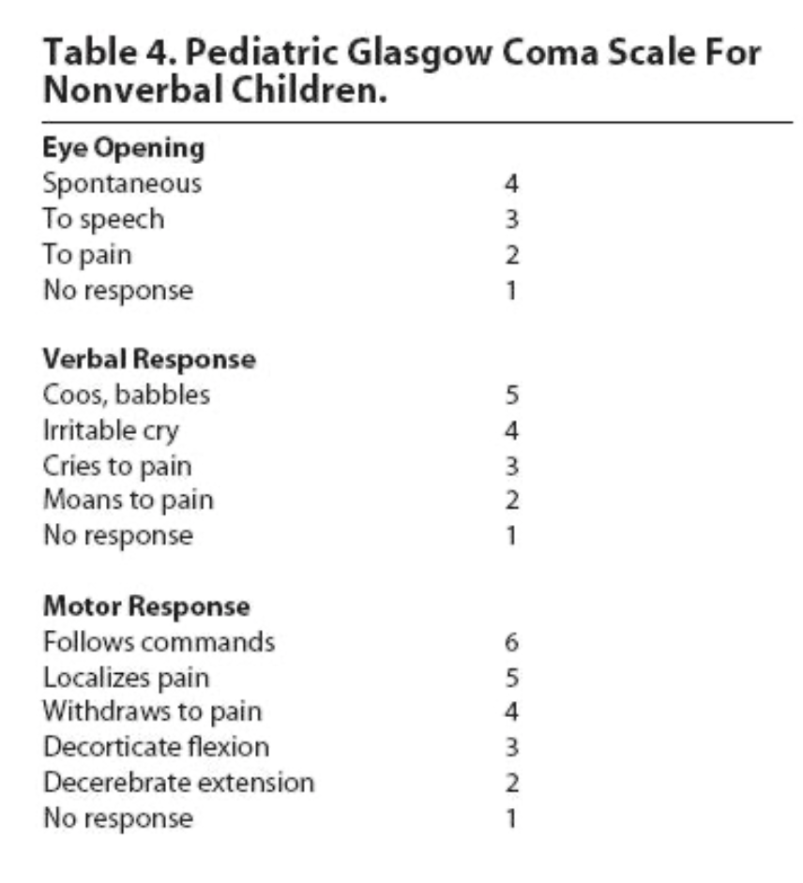
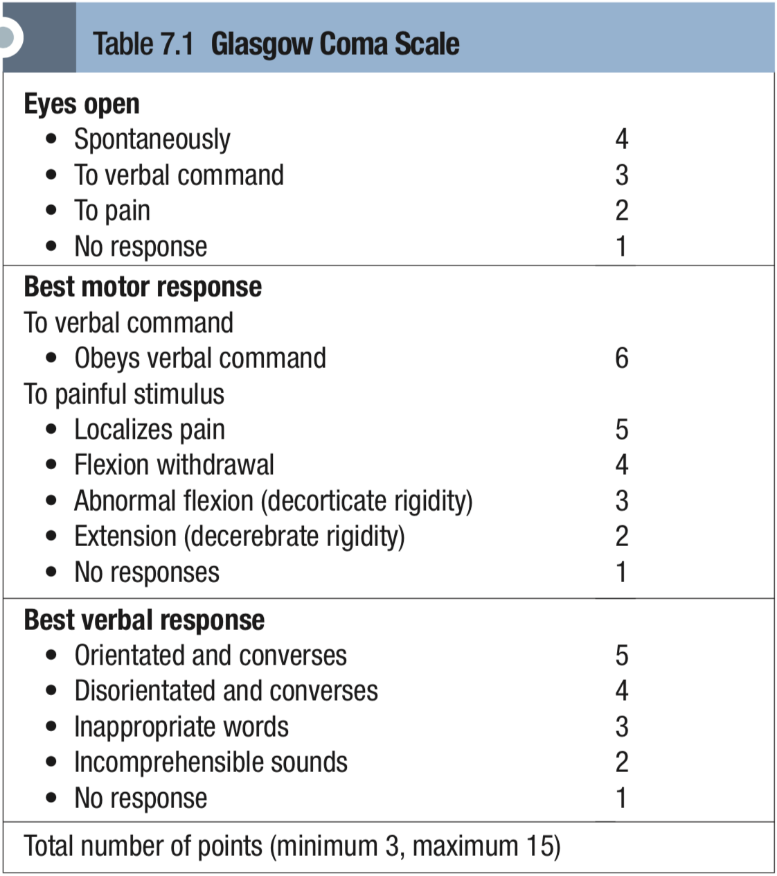
The ATLS concept
The Primary Survey:
D
Disability ¹
Baseline neurologic evaluation
Glasgow Coma Scale score by calculating: eye opening response + verbal response + motor response
Pupillary response ²
E
Exposure / Environment
Completely undress the patient ³
Prevent hypothermia
Pitfalls: Missed injuries
Special Considerations
Trauma in the elderly ⁴
Pediatric trauma ⁵
Trauma in pregnancy ⁶
1. It’s essential to identify neurological injuries in order to: A- avoid secondary brain injury B- identify surgically correctable lesions C- provide a baseline GCS to identify trends and changes throughout treatment process.
2. Check the pupils for asymmetry. If the pupils are symmetrical and reactive it’s most likely that the patient doesn’t have a skull injury. But if there’s bleeding and pressure in one side it will press on the nerves and the muscle of the pupils making them unequal/asymmetrical and you need to start worrying about intracranial bleeding.
3. To make sure you’re not missing any lesions.
4. because they’re usually weak and on medications; which alters injury response. E.g. The patient may not be able to respond to hypovolemia by increasing the heart rate because of age, pre-existing cardiac disease or medications such as β-blockers or calcium channel blockers.
5. The effective resuscitation of the injured child requires an appreciation of the physiological differences that exist between children and adults. The normal cardiovascular and respiratory parameters vary with age. For example, the normal heart rate of a newborn infant is 160 beats/minute; the normal respiratory rate of a 1-year-old is about 30 breaths per minute.
6. If you lay a pregnant lady on her back, the uterus (in the 2nd & 3rd trimester) will compress and weigh down on vasculature (IVC) leading to hypotension. To avoid this: rest her on her left side.

Slide 11
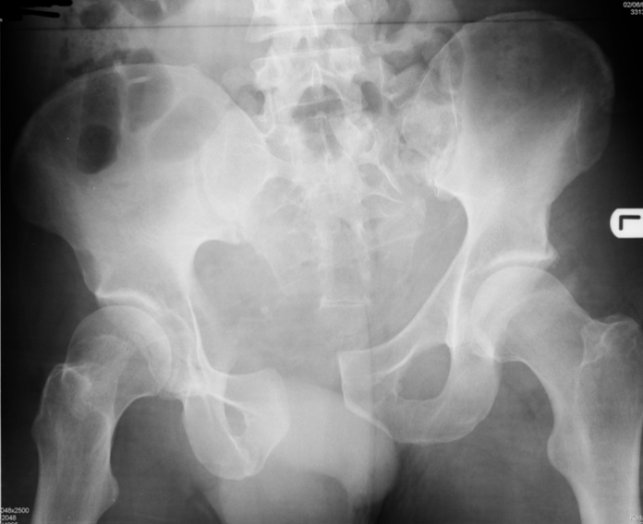
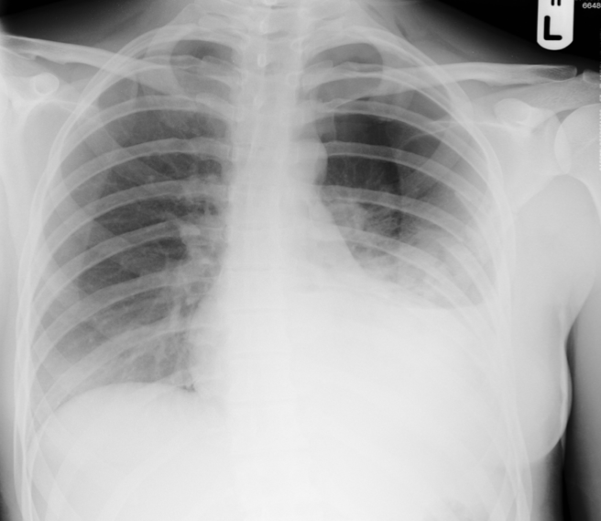
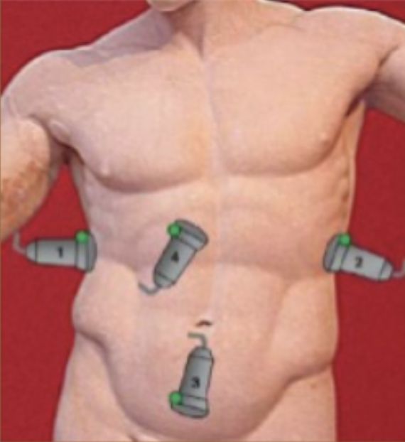
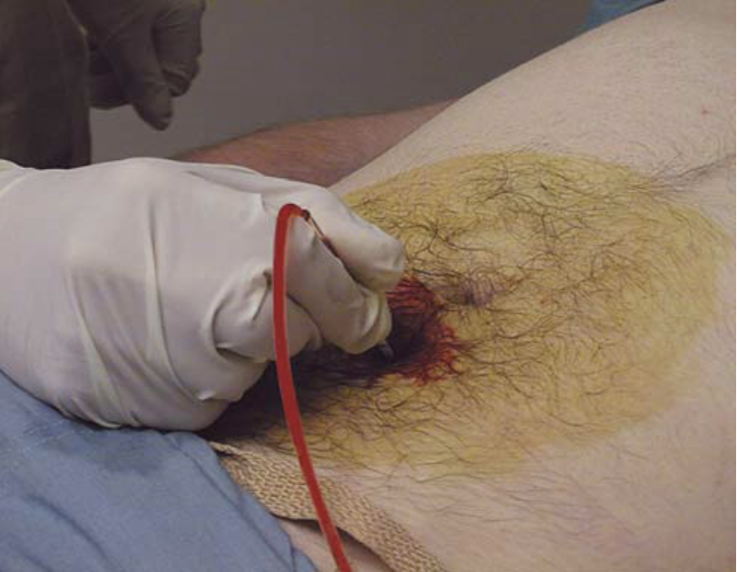
Primary Survey
Resuscitation ¹ :
Protect and secure airway
Ventilate and oxygenate
Stop the bleeding!
Vigorous shock therapy
Protect from hypothermia
Adjuncts to Primary Survey ²:
01
02
03
ECG: when suspecting cardiac intuition.
Vital signs
ABGs (arterial blood gasses)
Urinary Output: to estimate the cardiac output
Urinary / gastric catheters: to rule out bleeding or elaboration to GI tract unless contraindicated
Pulse oximeter and CO2: to make sure chest is fine, no pneumothorax.
Imaging studies ³
Chest X-Ray
Pelvic X-Ray
Diagnostic tools:
Focused Abdominal Sonography Test (FAST).
Diagnostic Peritoneal Lavage ⁴ (DPL).
Consider Early Transfer ⁷:
Use time before transfer for resuscitation
Do not delay transfer for diagnostic tests or for secondary survey
1
2
4
3
“Open-book” fracture
Probably Hemothorax ⁵
FAST ⁶
DPL
1. Identifying and providing treatment to life-threatening conditions while resuscitating and reassessing are processes that occur during the primary survey and are performed simultaneously.
2. These are tools that are done selectively (depending on the spectrum of injuries and the physical response) to help you pick up unidentified injuries and to help you in resuscitation and reassessment.
3. Chest and pelvic X-Ray are mandatory for trauma patients. Previously, Lateral cervical spine imagining was included in the primary survey..but it’s no longer needed (unless indicted), the reason behind this is that patients wear C-collars and other systems are needed to be assessed first.
4. A cut is made in the abdomen where a catheter is inserted and the bag is leveled on the ground to allow gravitational force to pull fluid out. In the picture illustrated, the blood is coming out meaning this test is positive.
- Abdominal injury is commonly missed in patients with altered consciousness of whatever cause. Clinical signs are modified or absent in paralyzed and sedated patients, and so additional investigations, such as ultrasound, CT or diagnostic peritoneal lavage, are important.
5. opacity on the lower left side of the chest with blood leveling, it’s probably hemothorax.
6. You look for bleeding with FAST in these 4 areas (as shown in the figure) The 4 Ps 1- pericardial 2- Perihepatic 3- Perirenal 4- Pelvic. EFAST or Extended Fast also evaluate pleural spaces (the 5th P)
7. The time to initiate the transfer process is when the need is recognised. Therefore the need to transfer must be determined early, and the sooner the need is recognised and communicated the more efficiently it occurs. In addition, the time spent waiting for transportation should be spent stabilizing the patient.
- Reasons to transfer: no available surgeons (trauma, orthopaedic surgeons..), no available operating room, no available equipments.

Slide 12
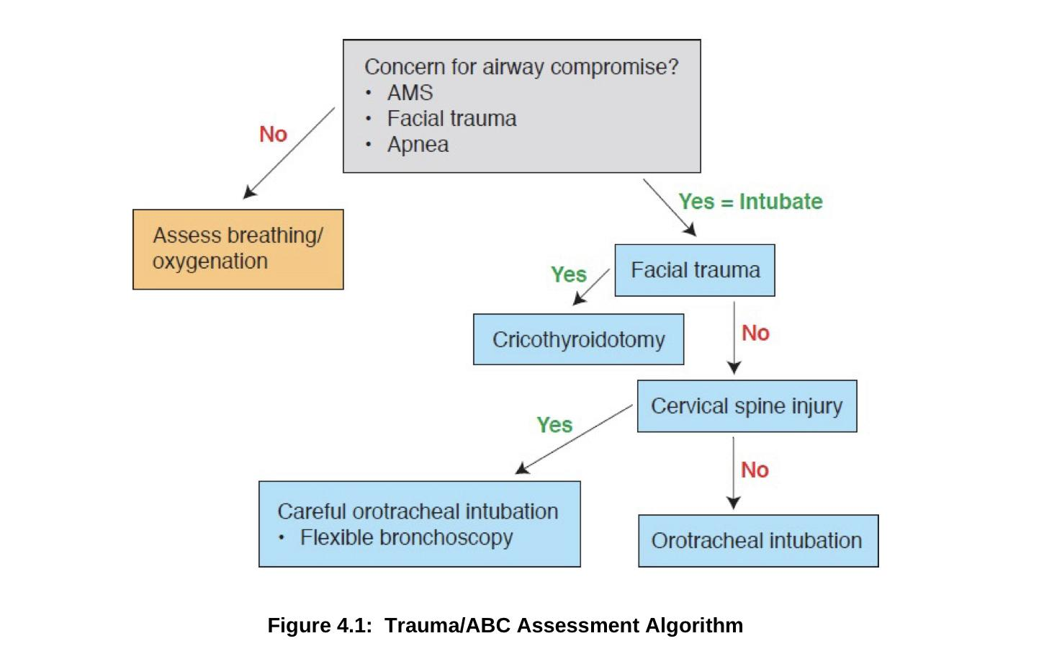
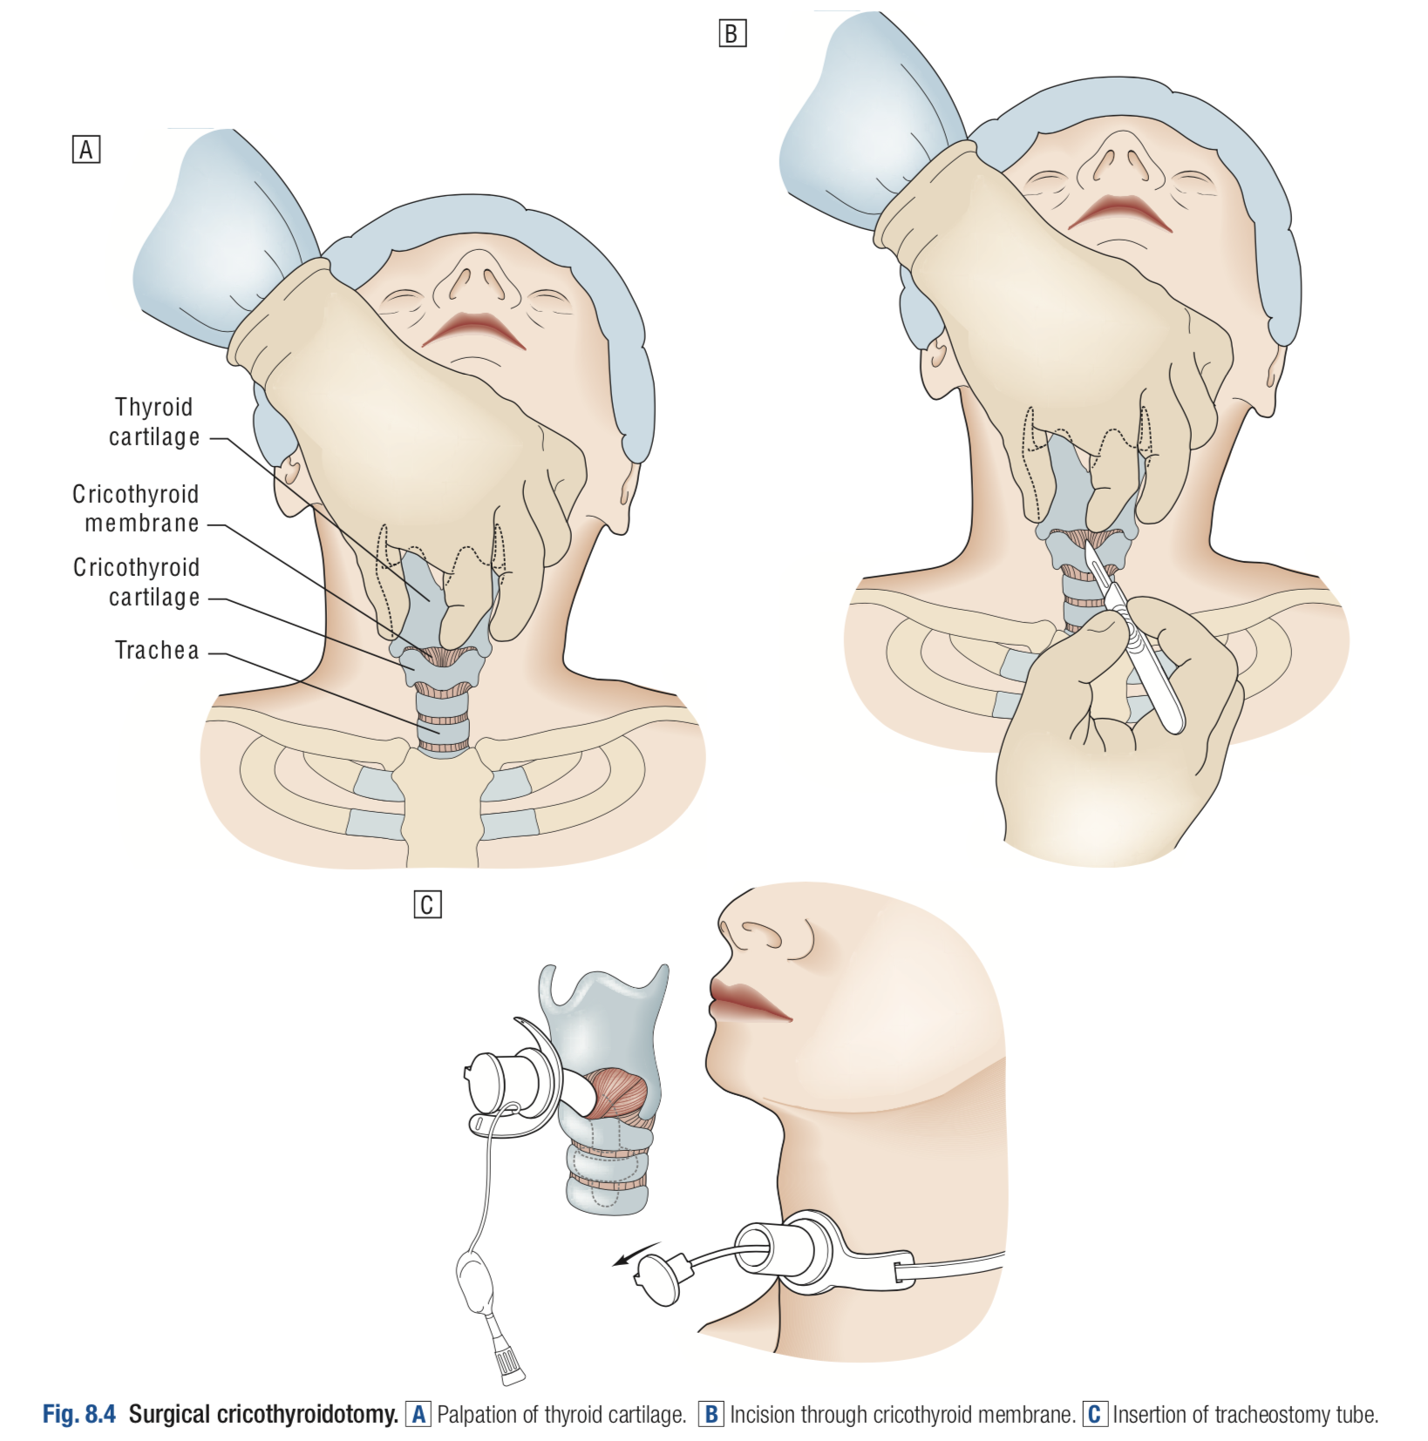
Secondary Survey
When Do We Start the Secondary Survey?
The complete history and physical examination, Start after:
Primary survey is completed
ABCDEs are assessed, reassessed and addressed
Vital functions are returning to normal
Components:
History
Physical exam: Head to toe
Complete neurologic exam
Special diagnostic tests
Reevaluation
Summary
Recall
Q1:What are the 3 main elements of ATLS protocol? ?
A. Primary survey/resuscitation (Life threatening problems discovered during the primary survey are always
addressed before proceeding to the next step) B. Secondary survey C. Definitive care
Q2: In addition to the airway, what MUST be considered during the airway step?
Spinal immobilization, by using a full backboard and rigid cervical collar.
Q3: What is the first maneuver used to establish an airway? If these methods are unsuccessful, what is the next maneuver used to establish an airway?
Chin lift, jaw thrust. If these methods failed → Endotracheal intubation.
Q4: If all other methods are unsuccessful, what is the definitive airway?
Cricothyroidotomy, a.k.a. “surgical airway”: Incise the cricothyroid membrane between the cricoid cartilage
inferiorly and the thyroid cartilage superiorly and place an endotracheal or tracheostomy tube into the trachea.
Q5: What are the goals in assessing breathing?
A) Securing oxygenation and ventilation B) Treating life-threatening thoracic injuries
Q6: What are the goals in assessing circulation?
Securing adequate tissue perfusion; treatment of external bleeding.
Q7: What comprises adequate assessment of disability?
A) Mental status: Glasgow Coma Scale (GCS) B) Pupils: a blown pupil suggests ipsilateral brain mass (blood) as herniation of the brain compresses CN III C) Motor/sensory: screening exam for lateralizing extremity movement, sensory deficits.
Q8: What are the goals in obtaining adequate exposure?
Complete disrobing to allow a thorough visual inspection.
Q9: What is the “environment” of the E in ABCDEs?
Keep a warm environment (i.e., keep the patient warm; a hypothermic patient can become coagulopathic).

Slide 13
Quiz
MCQ
Q1: Alice Brown, a 20-year-old female, presents to the emergency department with a suspected overdose.
On examination:
She opens her eyes when you say her name.
She is making short gasps and other sounds but she is not forming any clear words.
She undergoes abnormal flexion in response to a painful stimulus.
What is Alice's Glasgow Coma Scale (GCS) score?
A) 8
B) 9
C) 10
Q2: A 25-year-old motorcyclist has been brought to the A&E department in a panicky state as he is unable to breathe properly and is intensely hypoxic (oxygen saturation of 90 per cent). The trachea is shifted to the right, the left hemithorax does not move and there is hyperresonance over the left chest wall. The noise in the A&E department makes listening to breath sounds difficult.What’s the next appropriate line of management ?
A) Pleural aspiration (Thoracocentesis)
B) Order a Chest X-ray and wait for the results
C) Chest tube drainage
Q3: A 22-year-old rugby player has been brought to the A&E department with severe left-sided chest pain following blunt injury sustained in a match about 2 h ago. He is very tachypnoeic and extremely tender over the central part of his left hemithorax. The skin over the ribs looks badly bruised and the chest wall is unstable when he coughs or tries to take a deep breath. What’s the correct diagnosis?
A) Open pneumothorax
B) Flail chest
C) Cardiac tamponade
Q4: Which of the following statements regarding the immediate management of a trauma patient is true?
A) The patient should be asked a simple question such as ‘What is your name?’
B) Oxygen should be administered with great care in trauma patients who might suffer from chronic bronchitis.
C) The physical signs of a tension pneumothorax are difficult to pick up in the resuscitation room and so it is best diagnosed by an immediate chest X-ray.
Q5:A 28-year-old male was injured in a motorcycle accident in which he was not wearing a helmet. On admission to the emergency room he was in severe respiratory distress and hypotensive (blood pressure 80/40 mm. Hg), and appeared cyanotic. He was bleeding profusely from the nose and had an obviously open femur fracture with exposed bone. Breath sounds were decreased on the right side of the chest. The initial management priority should be:
A)Control of hemorrhage with anterior and posterior nasal packing.
B) Obtain intravenous access and begin emergency type O blood transfusions.
C) Endotracheal intubation with in-line cervical traction
Q6: A 15-year-old boy has been brought into the A&E department having been stabbed on the left side of his axilla. He is gasping for breath and his pulse oximeter shows a saturation of 90 per cent. There is an open wound in the region of the fifth left interspace through which a sucking sound can be heard.
A) Massive haemothorax
B) Tension pneumothorax
C) Open pneumothorax
Answers
Q1 | A | Q4 | A
Q2 | A | Q5 | C
Q3 | B | Q6 | C
Extra Questions

Slide 14
Good Luck!
Team leaders:
Nouf Alshammari
Haneen Somily
Naif Alsulais
Mohammed Alshuwaier
This lecture was done by:
Lama Alzamil
Nujud Alabdullatif
Khalid Alkhani
Omar Alotaibi
Moath AlJehani
Special thanks to May Babaeer for designing the theme.
Feedback
Note taker
Reviewer

