Slide 1
Common Genitourinary Tract Malignancy
Objectives
Discuss the renal tumors.
Identify bladder tumor.
Discuss the testicular cancer.
Recognize prostate cancer.
Colour Index
Main Text
Males slides
Females slides
Doctor notes
Textbook
Important
Golden notes
Extra
Editing File

Slide 2
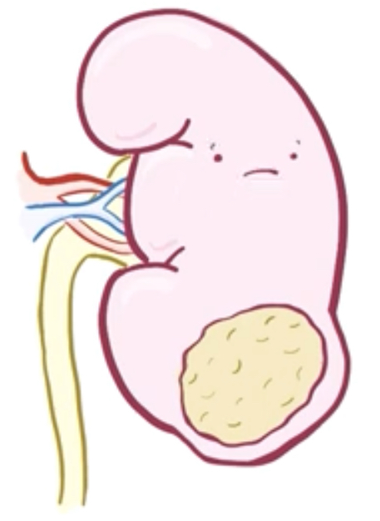
Renal Tumors
Benign Tumors
Malignant tumors
Benign tumours of the kidney are rare.
All renal neoplasms should be regarded as potentially malignant.
Oncocytomas
The most common one.
Difficult to differentiate from a kidney cancer on imaging.
Angiomyolipomas
Associated with tuberous sclerosis. (autosomal dominant disease with multisystem benign tumours , caused by mutation in TSC1 or TSC2 tumor suppressor genes)
Characterised by a typical appearance on CT due to their high fat content.
Benign tumors treatment: observation, embolization or surgery
Dictated by symptoms and size.
Nephroblastoma.
Renal cell carcinoma:
Clear cell (most common).
Papillary (Type 1 & 2).
Chromophobe.
Collecting duct.
Renal cell carcinoma:
Renal cell carcinomas arise from the proximal tubule cells
Male : female ratio approximately 2:1
Increased incidence seen in von Hippel-Lindau syndrome an autosomal dominant disorder due to mutation in VHL gene in short arm of chromosome 3, associated with pheochromocytoma, renal cysts, pancreatic cyst & hemangioblastoma of the eye or spinal cord and Birt–Hogg–Dubé (diagnosed by family hx of either: 1- Fibrofolliculomas (benign tumors of the hair follicles) 2- pulmonary cysts 3- kidney tumors. confirmed by a genetic test for mutation in FLCN gene, which codes for the protein folliculin.)
Clinical features:
most of the cases are diagnosed incidentally by imaging (U/S and CT) that is indicated for another purpose.
Classic triad «In 10%»
Paraneoplastic Syndrome
Haematuria
Pyrexia (fever)
Unknown origin.
Loin pain
Treated by Nephrectomy.
Hypertension
Mass
Polycythaemia
due to erythropoietin production.
Stauffer's syndrome
Signs and symptoms of liver dysfunction due to presence of renal cell carcinoma without tumor infiltration of the liver.
Can be treated medically.
Hypercalcaemia
due to a PTH-like hormone production.

Slide 3
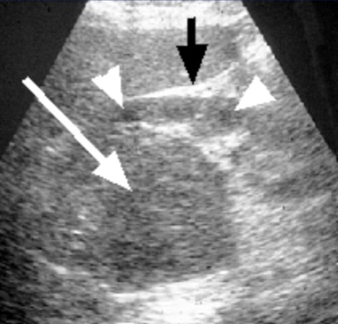
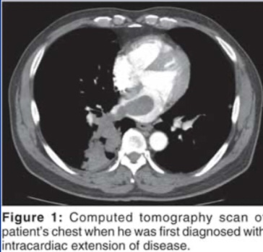
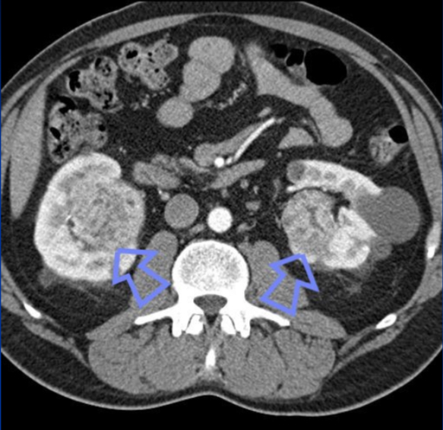
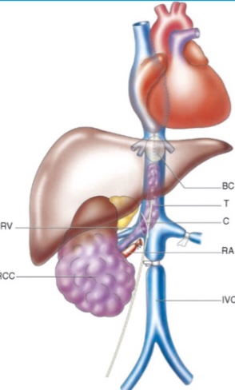
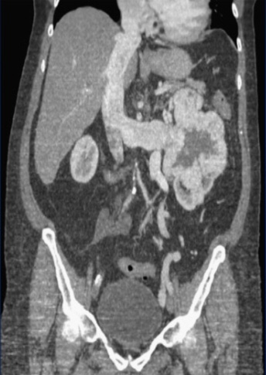
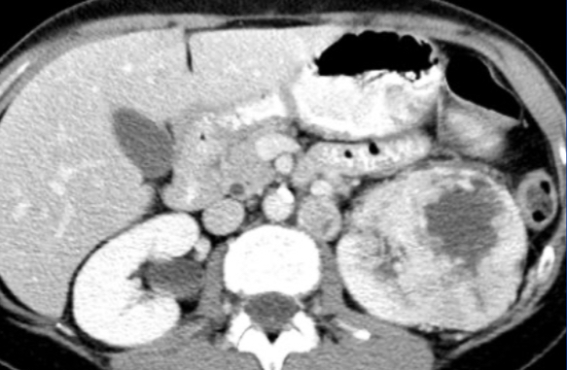
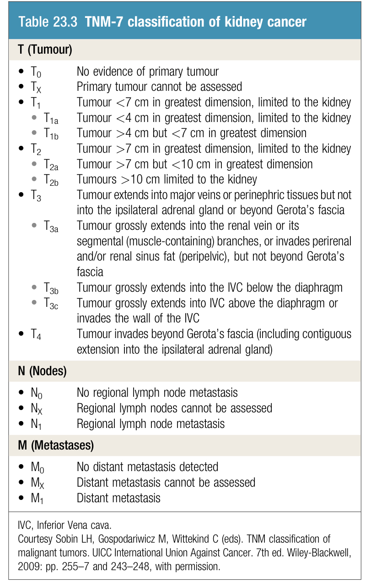
Renal Tumors
Investigations¹:
Renal ultrasound
CT scan
Echocardiogram
➤ Diagnosis can be confirmed.
➤ Assessment of renal vein and caval spread
➤ should be considered if clot in IVC extends above diaphragm
RCC with IVC thrombus
Renal tumors may present bilaterally "in this cases you have to think about genetic disorders LIKE VHL & tuberous sclerosis
and you have to do genetic screening for the family also
Staging:
Staging: TNM staging
1.
US or CT urogram (initial investigation)
CT of abdomen and chest (Key investigation)

Slide 4
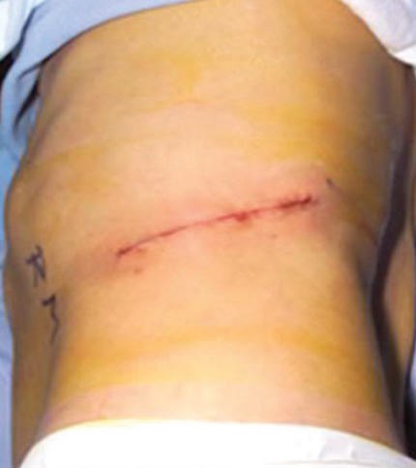
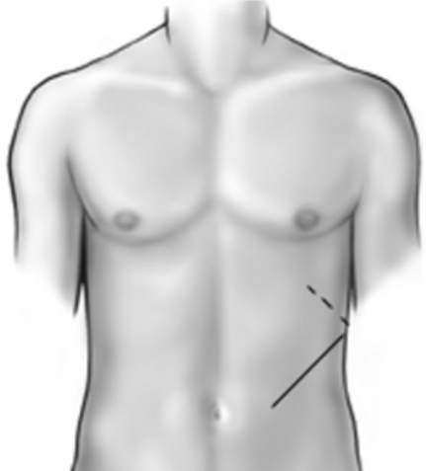
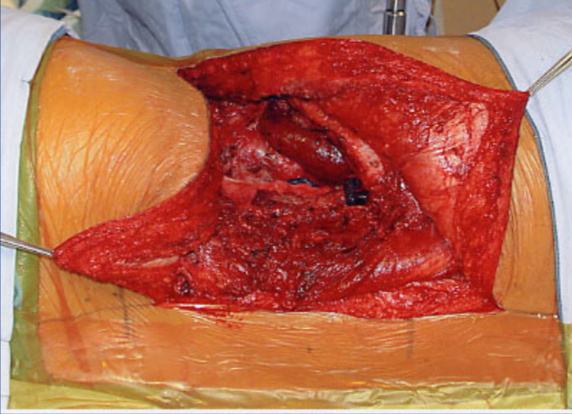
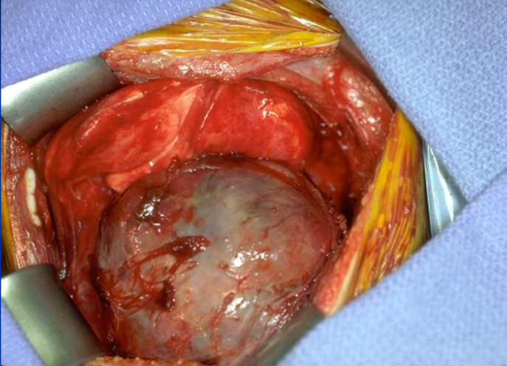
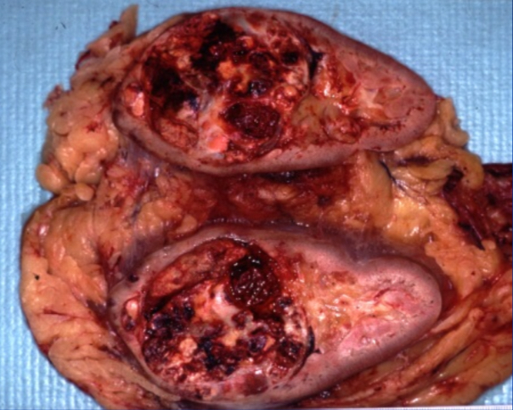
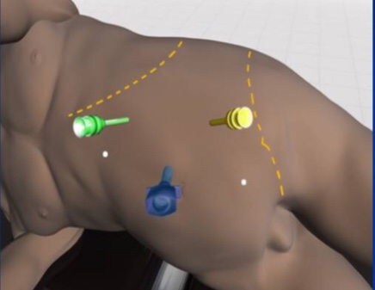
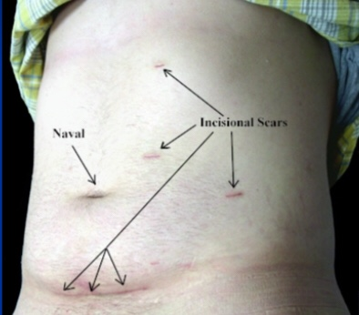
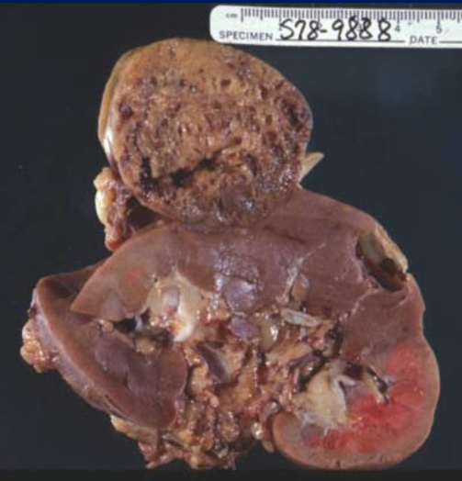
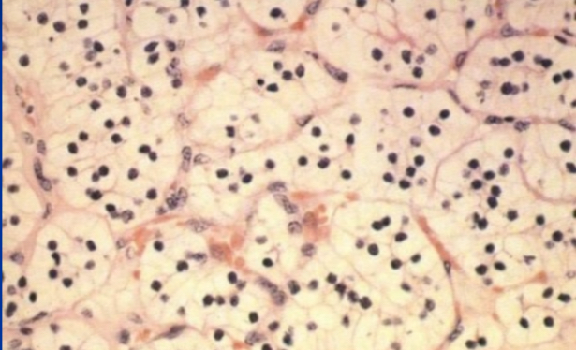
Renal Tumors
Management:
Unless extensive metastatic disease it invariably involves surgery.
Organ-confined: laparoscopic or open nephrectomy.
<7 cm confined to one pole: partial nephrectomy
open, robot assisted or laparoscopic
Surgical option usually involves a radical nephrectomy. radical → removal of the kidney & its surrounding tissues: adrenal gland, upper part of ureter, and lymph nodes.
Radical Nephrectomy
Approach (Incision)
Ligation
Excision
Transabdominal
Renal vein
early to reduce tumor propagation
Kidney
Loin incision
Adjacent tissue
Adrenal fat
Perinephric fat
Open Radical Nephrectomy
In gross pathology, clear cell carcinoma (most common type) is embedded within the kidney.
This is the old method, unfortunately it's painful & extensive surgery.patients hospitalized for week to 10 days after surgery, it takes time to recover from this surgery.
Laparoscopic Nephrectomy
In this picture, we see a bulging mass of the kidney, this is "chromophore" (2nd most common type) which is another type of kidney tumors
Microscopic CRCC
Now, we excise tumor by this method. not painful, patient hospitalize for nearly only 1 day or maximum 2 days after surgery.

Slide 5
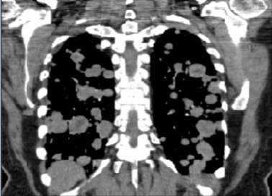
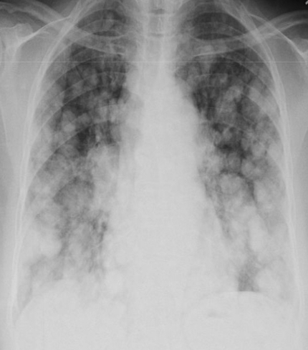
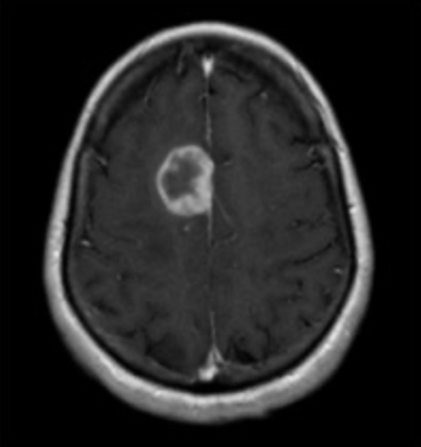
Renal Tumors
Metastases:
Spread:
Direct spread : perinephric tissues (common)
the whole fascial envelope and kidney should be removed at the same time
Lymphatic: para-aortic nodes.
Pathologically may extend into renal vein and inferior vena cava and reaches the right atrium.
Blood borne spread can result in ‘Cannon ball’ pulmonary metastases.
Cannon ball pulmonary metastases: multiple white patches (deposits of renal cancer metastasis) that resemble miliary TB
Metastasis Rx
Lymph node dissection
Of no proven benefit
May be applied if the tumor metastasized only into renal lymph nodes.
Solitary
(e.g. lung metastases)
Occasionally resected.
Radiotherapy
& chemotherapy
Have No role
(Radio & chemo resistant)
Multitarget tyrosine kinase inhibitors (TKIs) (antiangiogenic)
median 12 months progression-free survival benefit.
Immunotherapy
E.g: IL-2 or IFN-gamma
it can control the disease and improve survival for few months (does not cure the tumor)
Can help (Performance status).
We must evaluate the performance status of the patient before starting immunotherapeutic agents.
Performance factor is an important prognostic factor.
(T-cell checkpoint inhibitors)
survival advantage in the 2nd line setting

Slide 6
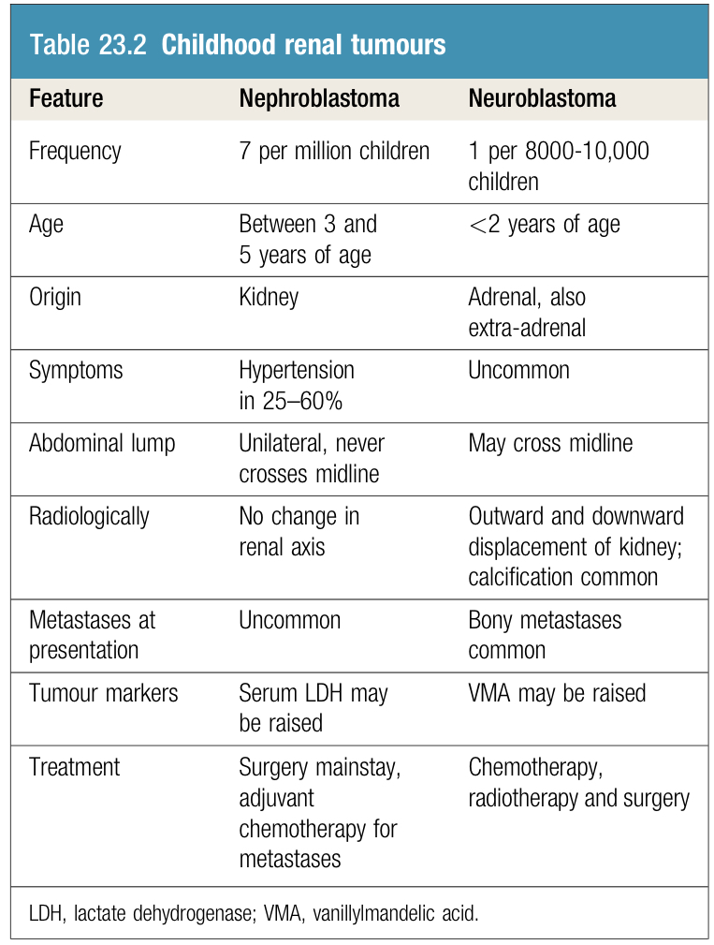
Renal Tumors
Malignant tumors:Nephroblastoma (Wilm’s tumor)
Most common childhood urological malignancy (<4 years).
Better prognosis in those presenting in 1st year of life.
Rapid Growth -> early local spread -> invasion of the renal vein.
Invasion of the renal pelvis occurs late -> hematuria not common.
Distant metastases to the lungs, liver and bones.
01
large abdominal mass (cardinal sign)
02
Unusual: fever, hypertension
Investigations and Markers:
Management:
CT of the abdomen and chest (Essential for diagnosis and staging)
Differential diagnosis:
Adrenal neuroblastoma.
Hydronephrosis.
Cystic kidney disease.
Confirmed by biopsy
Markers: Serum LDH may be raised
Chemotherapy followed by transabdominal nephrectomy with wide excision of the mass.
Further chemotherapy with or without radiotherapy dependent upon the histopathological features

Slide 7
Adrenal Tumors
Pheochromocytoma
Very important, it isn't mentioned in the slides but you are expected to read about it.
Arise from adrenal medulla (80%) and extra-adrenal paraganglionic tissue (20%)
10% are multiple and 10% are malignant
Associated with neurofibromatosis, medullary carcinoma of the thyroid, duodenal ulcer, and renal artery stenosis.
Clinical Features:
Hypertension and paroxysmal hypertension may be precipitated by abdominal pressure, exercise, or postural changes.
02
01
40 years is typical presentation
03
headache , palpitation, sweating, anxiety, chest and abdominal pain, pallor, dilated pupils, and tachycardia are prominent features.
Investigations:
Management:
Surgical removal of the tumour is the treatment of choice.
The use of α- and β-blocking drugs has greatly reduced the risk of hypertensive crisis, tachycardia and arrhythmias during induction of anaesthesia or tumour handling.
The patient should come to operation with blood pressure and pulse rate controlled. Adrenergic blockade also allows restoration of blood volume, so that sudden hypotension after removal of the tumour is unusual.
To achieve blockade, an α-adrenergic receptor blocker such as phenoxybenzamine or doxazosin should be used,
Once and only once α-blockade has been established, unopposed β effects, such as tachycardia, may become evident and are treated with a β-blocker such as propranolol.
β-blockade should not be instituted first, as this may allow unopposed α-agonist effects, which may make hypertension worse and precipitate heart failure.
Preoperatively, short-acting α- and β-blocking agents and sodium nitroprusside (which acts directly on vessels independent of adrenergic receptors and gives additional control of hypertension) should be available.
All young hypertensive patients aged 40 and under should be screened for a catecholamine secreting tumor.
24 hour urine samples analyzed for metadrenaline and normetadrenaline.
CT or MRI may show the tumor
Radiolabeled metaiodobenzylguanidine scanning may demonstrate the tumor

Slide 8
Bladder Tumors
Pathology:
Of all bladder carcinomas:
90%
5%
2%
are transitional cell carcinoma (TCCs).
are squamous carcinoma
are adenocarcinomas
Urothelial cell carcinomas (transitional cell carcinomas)
Squamous carcinoma
Adenocarcinomas
vast majority
3 times More common in men
The bladder is more susceptible to urinary carcinogens (extensively dyes), as urine is stored in for relatively long periods of time.
Naphthylamines
Benzidine
Appearance:
Delicate papillary
Superficial
Less aggressive
Solid ulcerating
More aggressive
in urothelium that has undergone metaplasia due to chronic irritation
chronic inflammation.
irritation by a stone.
Schistosomiasis
Rare
Urachal remnant (in the dome of the bladder)
local infiltration e.g., bowel cancer.
TCCs should be regarded a 'field change' disease with a spectrum of aggression
Tumor above muscle layer → superficial
Tumor reached muscle → deep
Why? Different management approach
80% of TCCs are superficial and well differentiated:
Only 20% progress to muscle invasion (cardinal feature of bladder cancer).
Associated with good prognosis.
20% of TCCs are high-grade and muscle invasive.
50% have muscle invasion at time of presentation.
Associated with poor prognosis.

Slide 9
Etiological factors:
Occupational exposure
20% of TCCs are believed to result from occupational factors. Those who work in industries and deal with dyes and rubbers are of highly susceptible
Analgesic abuse e.g. Phenacetin
Old medication that have been banned
Pelvic irradiation
for carcinoma of the cervix or colorectal
01
03
05
Cigarette smoking
Chemical implicated
Schistosoma haematobium
02
aniline dyes, chlorinated hydrocarbons
04
associated with increased risk of squamous carcinoma
06
Presentation:
Obstructive symptoms
tumour at the lower end of a ureter
tumour in the ureteric orifice
02
01
80% present with painless hematuria. either gross or microscopic .
should be assumed a tumor until proven otherwise.
In women it may be thought as part of occasional cystitis since symptoms are so common
Mid stream urine → no growth → further investigations
Also, presents with treatment-resistant infection or bladder irritability and sterile pyuria.
03

Slide 10
Bladder Tumors
Investigations Of Painless Hematuria
Urinalysis
First step
Ultrasound for bladder and kidneys
Cystoscopy
when you find a mass or erythema, you have to take a biopsy
Urine Cytology
KUB kidney,ureter,and bladder X-ray
IVU- CT scan Intravenous urogram CT scan
➤ to exclude urinary tract calcification because stone causes painless hematuria
➤ Considered if no pathology identified
Investigations
Visible hematuria -> local anaesthetic flexible cystoscopy & CT urogram (CTU).
If lesion is found within the bladder -> cystourethroscopy under general anaesthesia the bladder and tumour are examined bimanually to determine the depth & physical features of tumor -> transurethral resection of bladder tumour (TURBT) & biopsy.
A
B
IVP
Cystoscopy
Picture A: Normal bladder with smooth outline and no filling defect
Picture B: filling defect (apple core appearance)

Slide 11
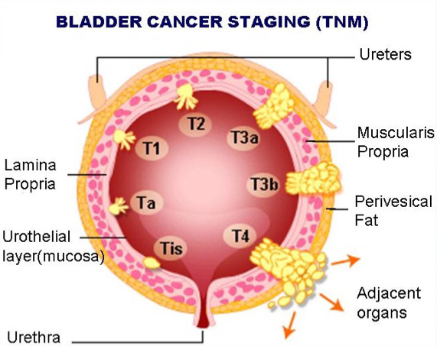
Bladder Tumors
Pathological staging:
Grade of tumor:
Requires bladder muscle to be included in specimen.
Staged according to depth of tumor invasion.
G1 Well differentiated.
Tis In-situ disease.
G2 Moderately well differentiated
Ta Epithelium only
G3 Poorly differentiated.
T1 Lamina propria invasion.
T2 Superficial muscle invasion.
T3a Deep muscle invasion.
T3b Perivesical fat invasion.
T4 Prostate or contiguous muscle
How are staging and grading done?:
Biopsy
Clinical examination, urography & CT
Confirm the diagnosis (cell type)
Guide Choice of treatment
Degree of differentiation (grade)
Depth of penetration (T in TNM stage) *prime clinical importance
Regional and juxtaregional lymph nodes (N)
Distant metastases (M)
Upper tract tumor involvement

Slide 12
Bladder Tumors
Carcinoma in-situ characteristics
Immunotherapy - BCG
An aggressive disease.
01
04
How does a vaccine kill cancer cells?
The PTEN protein normally acts as a tumor suppressor; impaired PTEN function appears to increase a cell’s vulnerability to becoming cancerous and also to mycobacterial infection.
Just as macrophages are more vulnerable to TB infection & CD4+ cells for HIV.
The mucosa appears normal. With only generalized redness of the bladder.
02
05
If BCG fails patient may need radical cystectomy
02
Should be considered in:
Ongoing storage urinary symptoms. W/pain.
Symptoms of Ongoing UTI with negative culture.
High risk of progression to cancer if not treated.
Often associated with positive cytology (proliferative tumor).
50% of patients progress to muscle invasion.
03
06
Management of bladder carcinomas:
Superficial TCC (Ta,T1)
Invasive
TCC (T2-T4)
Requires transurethral resection of the tumor with sampling of detrusor muscle and regular cystoscopic follow-up.
how to remove the tumor? By trans urethral resection of bladder tumor (TURBT)
intravesical chemotherapy with mitomycin C (reduces the risk of recurrence)
single intravesical dose
6-week course
treat multiple low-grade bladder tumours
Consider prophylactic chemotherapy if risk factor for recurrence or invasion (e.g. high grade)
Consider immunotherapy
BCG = attenuated strain of Mycobacterium bovis.
Reduces risk of recurrence and progression
50-70% response rate recorded
Occasionally associated with development of systemic mycobacterial infection
<70 years -> Radical cystectomy Removal of the bladder along with the prostate, (seminal vesicles or uterus & upper part of cervix), lymph nodes, distal part of ureter and anterior part of urethra.
Older -> Radiotherapy -> if not treated -> ‘salvage’ cystectomy
Invasive T4 fixed to the pelvis or surrounding organs -> palliative treatment
Radical cystectomy has an operative mortality of about 5% .
Cystectomy always necessitates urinary diversion.
Urinary diversion achieved by:
Ileal conduit (more common)
Neo-bladder
Local recurrence rates after surgery are approximately 15% and after radiotherapy alone 50% .
Pre-operative radiotherapy is no better than surgery alone.
Adjuvant chemotherapy may have a role.
This is TURB

Slide 13
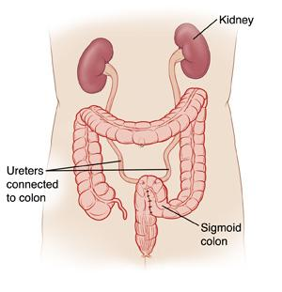
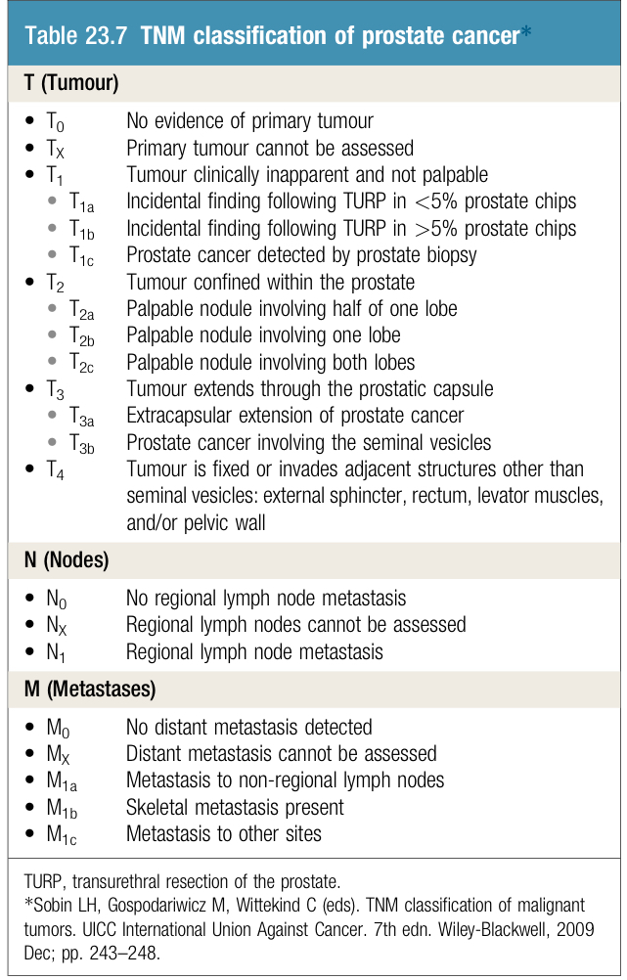
Bladder Tumors
Types of Urinary Diversion
Ileal Conduit
Continent Cutaneous Reservoir
Orthotopic Neobladder
Ureterosigmoidostomy
Incontinent diversion to skin.
In less favorable circumstances.
The ureters are anastomosed to drain the urine in the detached section of the ileum, which is brought out through an opening (stroma) in the abdominal wall. The urine is collected through a bag that attaches on the outside of the body. It’s prefered because it has the least complication.
Continent diversion to skin.
connected to the body surface via a continent conduit (ileum or appendix).
the patient drains the urine at regular intervals with a catheter.
Continent diversion to urethra.
construct a new bladder from colon or small bowel
Urethra can be retained
Ureters implanted into the sigmoid colon
In some countries where ostomy is not acceptable
Serious complications: renal infection and metabolic disturbances
Management of recurrences:
Repeat diathermy or Resection
If Frequent & excessive → cystectomy
Prostate Cancer
Commonest malignancy of male urogenital tract.
Rare before the age of 50 yrs. a tumor of old people (in comparison to testicular tumors which is for the young)
More men die with than from prostate cancer.
Found at post-mortem in 50% of men >80 yrs.
5-10% of operation for benign disease reveal unsuspected prostate cancer.
Very slow growing

Slide 14
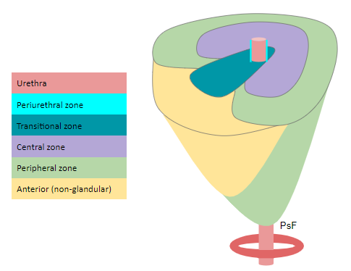
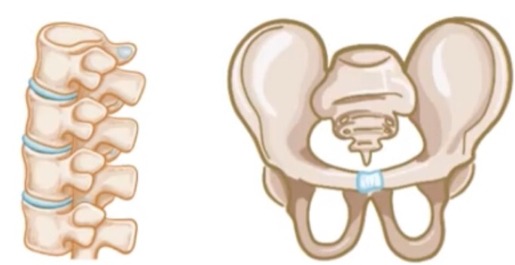
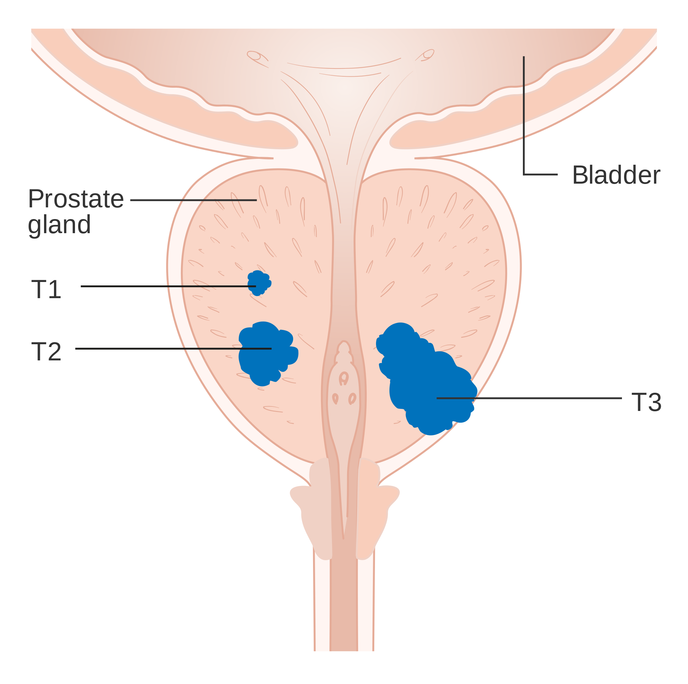
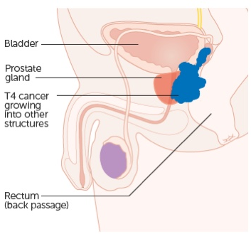
Prostate Cancer
Pathology:
Type
Location
Grading
Spread
01
02
03
03
Adenocarcinoma
Most of the cases are adenocarcinomas
Peripheral zone
70%
BPH → central (transitional) zone.
By Gleeson classification
Cells are graded 1–5 depending upon their level of differentiation
grade 1 = most differentiated
grade 5 = least differentiated or most anaplastic
Gleason score = most common type+ 2nd most common type
range from 2 to 10
always expressed as an equation (e.g., 4+3¼7)
Common
Lymphatic
Haematogenous
Axial skeleton
Capsule
perineural spaces
bladder neck , pelvic wall
rectum
Clinical Features:
Cord compression
(causing paraplation)
Leucoerythroblastic anaemia
the presence of nucleated erythrocytes and
immature white cells in the peripheral blood.
(due to Replacement of the marrow with cancer cells).
01
Bone pain
03
02
Alteration in bowel habit (the tumor extends posteriorly around the rectum)
Renal failure
(due to bilateral ureteric obstruction)
04
05

Slide 15
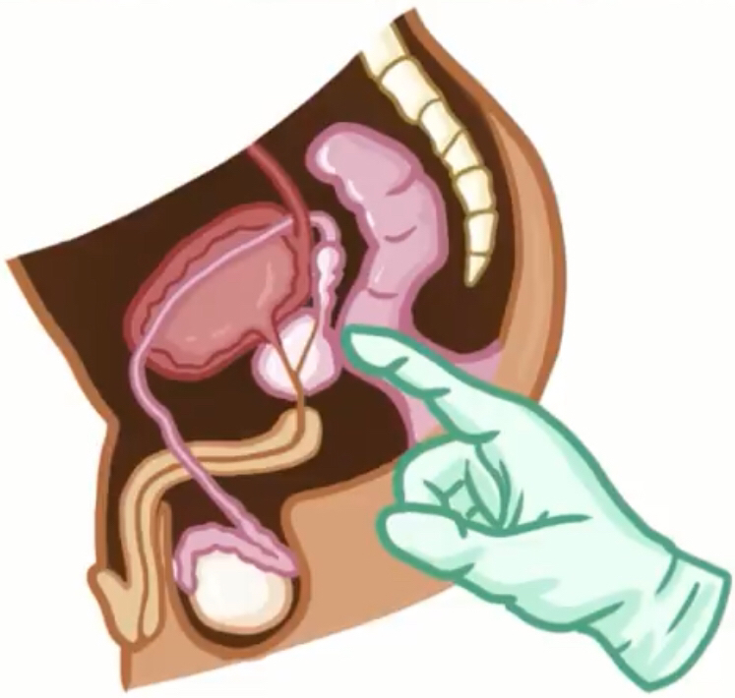
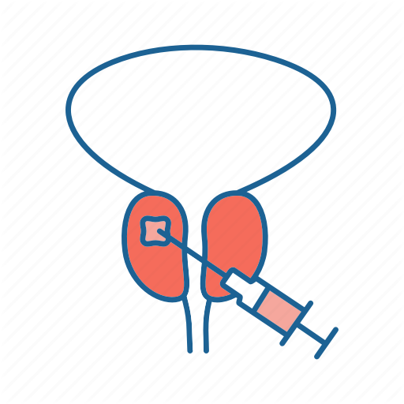
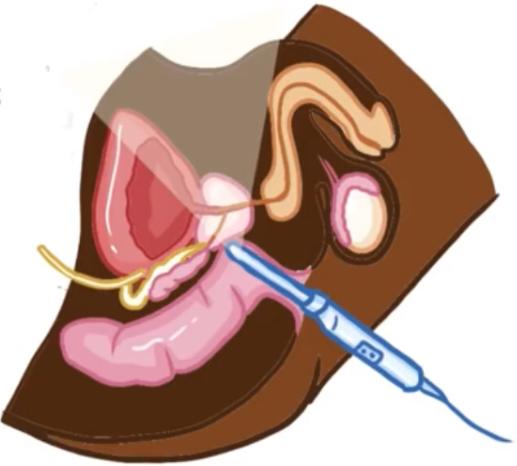
Diagnosis:
Majority
10%
Remainder
Picked up by screening
Asymptomatic unless it’s advance and late
Incidental findings at (TURP)
transurethral resection of the prostate
Present with the clinical features mentioned above
 | ➤ Diagnosis can be confirmed with locally advanced tumors. ➤ Features: hard nodule or loss of central sulcus.
 | ➤ Should be performed in men with elevated PSA or abnormal DRE. confirms the diagnosis
 | ➤ May be useful in the staging of the disease. ➤ Evaluate for abnormal foci in men with a persistently elevated PSA with previous negative prostate biopsy. ➤ Assess pelvic lymphadenopathy and evidence of locally advanced disease.
 | ➤ Detect the presence of metastases.
 | ➤ Kallikrein-like protein produced by prostatic epithelial cells ➤ Can be significantly raised in BPH . ➤ Useful for monitoring response to treatment. ➤ Normal : <4 ng//ml ➤ prostatic carcinoma : >10 ng/ml ➤ < 10 ng/ml & asymptomatic → Unlikely to be abnormal or due to infections and BPH. ➤ >100 ng/ml almost always indicate bone metastases. Routine screening after the age of 50, however with family history from the age of 40. ➤ It may be high in infections or BPH, but, it's sky high in prostatic cancer "usually"
Rectal examination
Transrectal biopsy
Multi-parametric MRI
Bone scanning
Serum prostate specific antigen (PSA)

Slide 16
Treatment:
Treatment depends on:
Age
Stage of disease
General fitness.
Treatment options are for:
Local disease.
Less than 70 years old → the best option is radical prostatectomy.
Old patients above 75 years → if there were no symptoms consider observation without treatment, If there were symptoms and the patient can't tolerate surgery, radiotherapy is good option
Above the age of 80 → observation
Locally advanced disease.
Metastatic disease.
 | local | Locally advanced | Metastatic
Observation
Radical Radiotherapy
Radical Prostatectomy
Hormonal therapy
Hormonal therapy:
01
Produces good palliation
until tumours escape from hormonal control.
Involves androgen depletion
80-90% of prostate cancers are androgen dependent for their growth.
02
Can be achieved by :
Bilateral orchidectomy (castration)
LHRH agonists (Goseraline).
Anti-androgens (cyproterone acetate, flutamide, Biclutamide).
Complete androgen blockade.
03

Slide 17
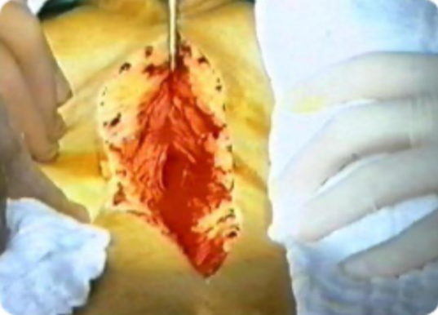
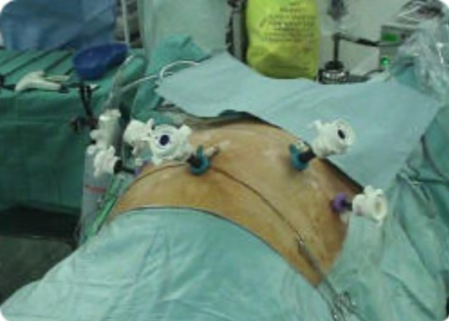
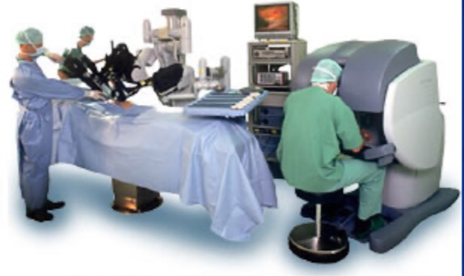
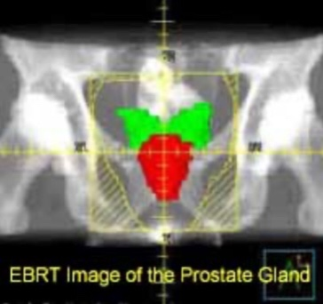
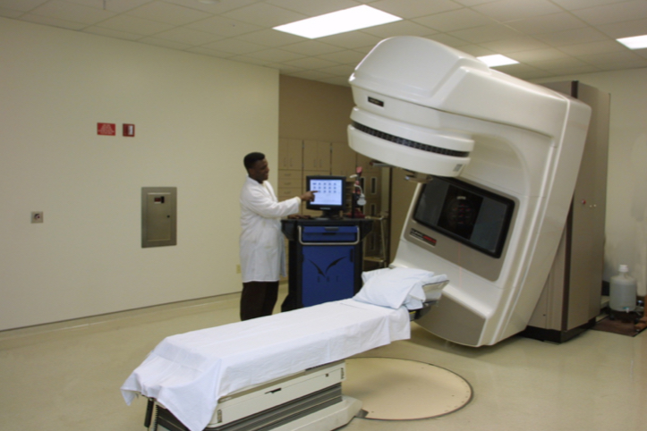
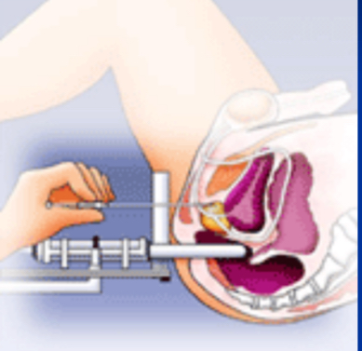
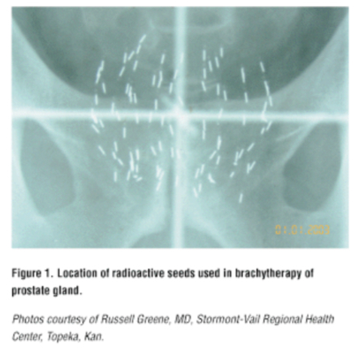
Organ- confined disease | A small focus, well-differentiated (Gleason score 3+3=6) | Close follow-up with DRE,PSA,MRI, repeat TRUS biopsy.
 | Less well-differentiated Gleason score 7 or more | Radical prostatectomy laparoscopic robotic traditional open route Radiotherapy external beam radiotherapy (EBRT) intensity-modulated the insertion of radioactive seeds in the prostate (brachytherapy) the choice of treatment tends to be based upon patient preference.
Locally advanced disease the cancer has invaded directly outside the prostate but has not metastasised |  | EBRT along with hormonal therapy is the standard In patients not able to tolerate EBRT hormone therapy alone or conservative symptomatic treatment
Castrate-resistant prostate cancer (CRPC) |  | Happens in a small number of patients who fail to respond to endocrine treatment PSA levels are a useful marker of response, ideally falling to <0.01 ng/ml in well-controlled cases. Chemotherapy with taxanes has shown improvement in both symptoms and survival Newer hormonal agents such as enzalutamide (androgen receptor inhibitor) and abiraterone acetate (androgen biosynthesis inhibitor) provide some survival benefit
Skeletal metastases |  | Bone-protective agents (i.e., denosumab and zoledronic acid) palliate bone pain prevent loss of bone mass reduce the risk of metastatic bone fractures Radiotherapy effective treatment for localised bone pain.
Prostate Cancer
Open
Laparoscopic
Robotic
EBRT
Brachytherapy
Two types of radiotherapy:
From outside: External Beam Radiation Therapy (EBRT)
From inside: Brachytherapy (better because it doesn't affect adjacent tissues as EBRT)

Slide 18
Testicular Tumors
Commonest presentation is painless testicular swelling on the side of the tumor¹.
5 year survival possible In those with disease localized to testis more than 95%.
It's a rapid growing tumor, it only needs 3-4 weeks to duplicate it’s size.
01
03
Commonest malignancy in young men, Highest incidence in Caucasians in northern Europe and USA.
Peak incidence for teratomas is 25 years and seminomas is 35 years.
Risk factors include cryptorchidism and Klinefelter's syndrome (47, XXY)
Orchidopexy (a surgery to move a testicle that has not descended or moved down to its proper place in the scrotum)does not reduce this risk but it allow the testis to be moved into a position where it allows regular self-examination
02
04
Testicular tumors classification:
Occasionally,both types occur in the same testis.
Teratomas
Non-Seminomas(50%)
Arise from primitive germinal cells.
Classified according to the degree of differentiation.
Yolk sac tumors
Seminomas(50%)
Embryonal
The most common testicular tumor
Arise from seminiferous tubules
Relatively low-grade
Metastases occur mainly via the lymphatics and may involve the lungs
Mixed Germ cell tumor
Investigations:
Imaging
Pathological diagnosis
Tumor markers
Diagnosis is confirmed by testicular ultrasound.
Stage is confirmed by thoraco -abdominal CT scanning.²
Pathological diagnosis made by performing an inguinal orchiectomy.
No biopsy is taken beforehand from the testis due to the risk of tumor cells spillage and metastasis, thus they perform an inguinal incision and clamp the spermatic cord before taking biopsy, and then if it is a cancer the precede removing the whole testis.
Tumor markers³ are useful in staging and assessing response to treatment.
Alpha-fetoprotein (alpha FP):
Produced by yolk sac elements.
Not produced by seminomas.
Beta-human chorionic gonadotrophin (beta HCG):
Produced by trophoblastic elements .
Elevated in both teratomas and seminoma.
(LDH) lactate dehydrogenase
A hydrocoele in a young man mandates investigation, as testicular tumours may be accompanied by blood-stained effusion in the tunica vaginalis. There may be pain and swelling suggesting inflammation. The patient may have wrongly received treatment for ‘acute epididymitis’. Very rarely, patients with teratoma may complain of gynaecomastia. As a result of increased hcg (LH analogue) -> stimulate leydig cell -> increased secretion of testosterone & estrogen.
CT is used to follow the response of enlarged lymph nodes to treatment.
Measured As soon as a tumour is suspected, and before orchiectomy useful to increase the suspicion if there are +Ve. if they are normal that doesn't mean there's no cancer

Slide 19
Stage definition:
dr said you are not required to know the staging
I
Disease confined to testis.
IM
Rising post-orchidectomy tumour marker.
A
< 2 cm
II
Abdominal lymphadenopathy.
B
=2-5 cm
III
Supradiaphragmatic disease.
C
> 5 cm
Management:
Be aware when you have a patient with testicular cancer, you have to diagnose early and treat early. Any delay in diagnosis and treatment may compromise the outcome.
Radical orchiectomy with division of the spermatic cord (at the level of the deep inguinal ring)
Seminomas
VS
Non-Seminomas²
Radiosensitive^{1.}
The overall cure rate for all stage 90%.
Stage I and II disease treated by inguinal orchidectomy plus
Radiotherapy to ipsilateral abdominal and pelvic nodes ('Dog leg').
Surveillance close surveillance will avoid unnecessary radiotherapy in 80%.
Stage IIC and above treated with chemotherapy .
not radiosensitive.
Stage I is treated by orchidectomy and surveillance for 2 years (by measuring tumor markers) Vs RPLVD( Retroperitoneal lymph node dissection) Vs Chemo.
(RPLVD) to prevent recurrence, or for residual or recurrent nodal masses.
Chemotherapy (BEP = Bleomycin, Etopiside, Cisplatin) given to:
Stage I patients who relapse.
Metastatic disease at presentation .
First orchiectomy and then radiotherapy to control the disease, and chemotherapy in advanced cases.
First orchiectomy and surveillance, RPLVD if lymph nodes are affected, and chemotherapy in advanced cases.

Slide 20
Summary
Recall
Q1: What is the differential diagnosis of scrotal mass?
1. Cancer. 2. Torsion. 3. Epididymitis. 4. Hydrocele. 5. Spermatocele.
6. varicocele. 7. inguinal hernia. 8. testicular appendage. 9. swollen testicle after trauma.
10. Non-Testicular tumor (paratesticular tumor) : e.g. rhabdomyosarcoma, leiomyosarcoma, liposarcoma
Q2: What are the causes of hematuria?
1. Bladder cancer. 2. Trauma. 3. UTI. 4. cystitis from chemotherapy or radiation.
5. Stones. 6. kidney lesion. 7. BPH.
Q3: What is the most common cause of severe gross hematuria without trauma or chemotherapy/radiation?
Bladder cancer
Q4: What is the differential diagnosis for bladder outlet obstruction?
1. BPH. 2. Stone. 3. foreign body. 4. urethral stricture. 5. urethral valve.
Q5: What is the differential diagnosis for ureteral obstruction?
1. Stone. 2. tumor. 3. iatrogenic (suture). 4. stricture.
5. gravid uterus. 6. radiation injury. 7. retroperitoneal fibrosis
Q6: What is the differential diagnosis for kidney tumor?
1. Renal cell carcinoma. 2. sarcoma. 3. adenoma
4. angiomyolipoma. 5. hemangiopericytoma. 6. oncocytoma.
Q7: what is Renal cell carcinoma (RCC)?
Most common solid renal tumor (90%
originates from proximal renal tubular epithelium
Q8: What is the epidemiology of RCC?
Primarily a tumor of adults (40-60 y.o)
3:1 male:female ratio
5% of cancers overall in adults
Q9: What are the risk factors for RCC?
Male sex, tobacco, von Hippel–Lindau syndrome, polycystic kidney
Q10: What are the symptoms of RCC?
1. Pain (40%). 2. hematuria (35%). 3. weight loss (35%) 4. flank mass (25%). 5. HTN (20%).
Q11: What is the classic TRIAD of renal cell carcinoma?
1. Flank pain. 2. Hematuria. 3. Palpable mass
(Triad occurs in only 10-15% of cases.)
Q12: How are most cases diagnosed these days?
Found incidentally on an imaging study (CT scan, MRI, US) for another reason.
Q13: What radiologic tests are performed?
IVP, Abdominal CT scan with contrast.
Q14: What is the metastatic workup?
CXR, IVP, CT scan, LFTs, calcium
Q15: What are the sites of metastases?
Lung, liver, brain, bone
tumor thrombus entering renal vein or IVC is common
Q16: What is the unique route of spread?
Tumor thrombus into IVC lumen.
Q17: What is the treatment of RCC?
Radical nephrectomy (excision of the kidney and adrenal, including Gerota’s fascia) for stages I-IV
Q18: What gland is removed with a radical nephrectomy?
Adrenal gland

Slide 21
Summary
Recall
Q19: What is the unique treatment for metastatic spread?
α-interferon 2.
LAK cells (Lymphokine-Activated Killer) and IL-2 (interleukin-2)
Q20: What is a syndrome of RCC and liver disease?
Stauffer’s syndrome
Q21: What is the concern in an adult with new-onset left varicocele?
Left RCC
—the left gonadal vein drains into the left renal vein
Q22: What is the incidence of prostate cancer?
Most common GU cancer (>100,000 new cases per year in the United States)
most common carcinoma in U.S. men.
second most common cause of death in U.S. men.
Q23: What is the epidemiology?
“Disease of elderly men”
present in 33% of men 70-79 y.o
in 66% of men 80 -89 y.o at autopsy
African American patients have a 50% higher incidence than do White patients.
Q24: What is the histology?
Adenocarcinoma (95%)
Q25: What are the symptoms?
Often asymptomatic; usually presents as a nodule found on routine rectal examination. in 70% of cases cancer begins in the periphery of the gland and moves centrally; thus, obstructive symptoms occur late
Q26: What percentage of patients have metastasis at diagnosis?
40% of patients have metastatic disease at presentation, with symptoms of bone pain and weight loss.
Q27: What are the common sites of metastasis?
Osteoblastic bony lesions, lung, liver, adrenal
Q28: What provides lymphatic drainage?
Obturator and hypogastric nodes
Q29: What is the significance of Batson’s plexus?
Spinal cord venous plexus; route of isolated skull/brain metastasis.
Q30: What are the steps in early detection?
Prostate-specific antigen (PSA )—most sensitive and specific marker.
Digital rectal examination (DRE)
Q31: When should men get a PSA-level check?
Controversial:
All men >50 years old.
>40 years old if first-degree family history or African American patient.
Q32: What percentage of patients with prostate cancer will have an elevated PSA?
≈60%
Q33: What is the imaging test for prostate cancer?
Trans Rectal Ultra Sound (TRUS)
Q34: How is the diagnosis made?
Transrectal biopsy
Q35: What is the Gleason score?
Histologic grades 2-10:
Low score = well differentiated
High score = poorly differentiated

Slide 22
Summary
Recall
Q36: What are the indications for transrectal biopsy with normal rectal examination?
PSA >10 or abnormal transrectal ultrasound
Q37: What does a “radical prostatectomy” remove?
Prostate gland
Seminal vesicles
Ampullae of the vasa deferentia
Q38: What is “androgen ablation” therapy?
Bilateral orchiectomy
or Luteinizing Hormone–Releasing Hormone (LHRH) agonists
Q39: What are the generalized treatment options according to stage:
Stage I? Radical prostatectomy
Stage II? Radical prostatectomy ± lymph node dissection
Stage III? Radiation therapy, ± androgen ablation
Stage IV? Androgen ablation, radiation therapy
Q40: What is the medical treatment for systemic metastatic disease?
Androgen ablation
Q41: What is the option for treatment in the early-stage prostate cancer patient >70 years old with comorbidity?
XRT

Slide 23
Quiz
MCQ
Q1: A 58-year-old man is found to have high serum prostate–specific antigen (PSA) concentration with a normal prostate examination. A biopsy of the prostate confirms low-grade carcinoma. The patient wishes to avoid therapy involving any risk for impotence. Which of the following is the most appropriate management of this patient?
Observation
Chemotherapy
Prostatectomy
Radiation therapy
Hormonal therapy
Q2: A 45-year-old woman presents with a 7-cm renal cell carcinoma with radiologic evidence of abdominal lymph node involvement with no distant metastases. Which of the following is the most appropriate management of this patient?
Radical nephrectomy
Radiation
Chemotherapy
Radiation followed by nephrectomy
Chemotherapy followed by nephrectomy
Q3: Renal cell carcinoma (adenocarcinoma of the kidney):
characteristically radiosensitive
rarely metastasizes
commonly occurs in von Hippel Lindau (VHL) disease
the commonest urological malignancy
usually presents with blood in the urine
Q4:Which of the following is the recommended treatment for stage A (superficial and submucosal) transitional cell carcinoma of the bladder?
A)local excision and intravesicular chemotherapy
B)Topical chemotherapy
C)Radiation therapy
Q5:Which of the following is the most accurate method in obtaining a diagnosis of testicular cancer?
A)percutaneous biopsy of the testis
B)Serum alpha-fetoprotein levels
C)Inguinal orchiectomy
Q6:What is the treatment of choice in pheochromocytoma?
A)Radio and chemotherapy
B)Surgical removal
C)Alpha and Beta blockers
Answers
Q1 | A | Q4 | A
Q2 | A | Q5 | C
Q3 | C | Q6 | B
Extra Questions

Slide 24
Good Luck!
Team leaders:
Nouf Alshammari
Haneen Somily
Naif Alsulais
Mohammed Alshuwaier
This lecture was done by:
Taif Alshammari
Deema Almaziad
Razan Alrabah
Khalid Alkhani
Ahmad Alshamasi
Special thanks to Razan Alrabah
Feedback
Note taker
Reviewer

