Slide 1
Emergency in Urology
Objectives
Discuss testicular torsion presentation, workup and management
Discuss hematuria presentation, workup and management
Discuss Renal colic presentation, workup and management
Discuss Priapism presentation, workup and management
Discuss Genitourinary trauma presentation, workup and management
Recognize Fournier’s gangrene presentation, workup and management
Colour Index
Main Text
Males slides
Females slides
Doctor notes
Textbook
Important
Golden notes
Extra
Editing File

Slide 2
Introduction
Compared to other surgical fields, there are relatively few urological emergencies. However, they require rapid diagnosis and immediate treatment.
Emergencies
Non- Traumatic
Traumatic¹
Haematuria
Renal Colic
Renal Trauma
Ureteral Injury
Urinary Retention
Acute Scrotum
Bladder Trauma
Urethral Injury
Priapism
External Genital Injury
Haematuria is the most important symptom that need immediate medical help.
Pain is the most important symptom that brings the patients to the emergency.
Non traumatic Urological Emergencies : Haematuria
Types of haematuria
Gross (Macroscopic, Visible, Clinical) | Microscopic (Non visible, Not clinical)
1 ml of blood in 1 liter of urine (visible for the patients). | 3 or more RBCS/High power, in 2 out of 3 properly collected samples ( AUA). (Blood isn’t visible to the patient)
Emergency or urgency | Not an emergency or urgency
Susceptibility to develop a cancer is >40% | Susceptibility to develop a cancer is 1-3%
1. Usually traumatic injuries are present in more than one organ

Slide 3
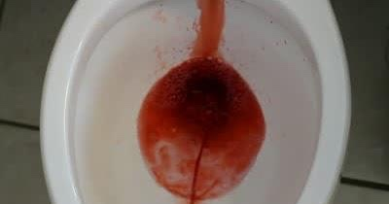
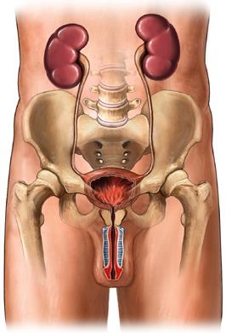
Non traumatic Urological Emergencies : Haematuria
Causes of haematuria vary according to:
1
Patient’s Age
2
Symptomatic or Asymptomatic
Painful → indicates renal stones or UTI.
Painless → indicates malignancy.
3
Existence of malignancy risk factors
E.g. smoking, as it’s the most common risk factor for renal tumors (Painless, gross hematuria).
4
The type : gross & microscopic (Important)
Any patient presenting with GROSS hematuria (whether the risk factors are present or not) should undergo cystoscopy and imaging (cystoscopy is endoscopy of the urinary bladder via the urethra).
If the patient is presenting with MICROSCOPIC hematuria in the presence of risk factors then the patient should undergo both cystoscopy and imaging, but if the risk factors are absent then you'll do imaging only.
5
5
Timing (Important)
Presence of clots
Initial “before urine” = suspect urethra (post-renal).
Terminal “after” = suspect neck of bladder or sphincters.
Total “along with urine” = suspect kidney or ureter (renal).
One of the most important determinant is the presence of clots & its amount.
If it were highly coagulated or long clots = most likely from upper urinary tract (kidney, ureter)
If it wasn’t coagulated, or little coagulation or small clots = most likely from lower UT (Urethra, Prostate)

Slide 4
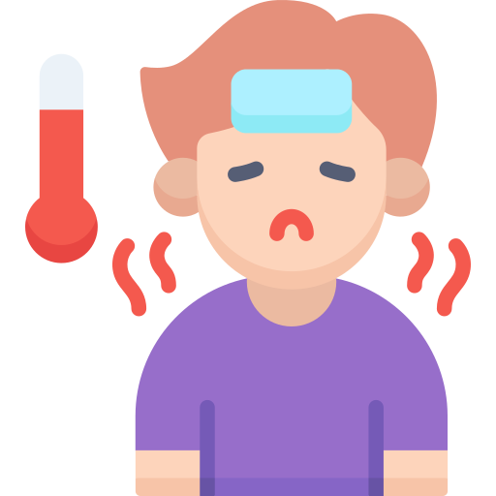
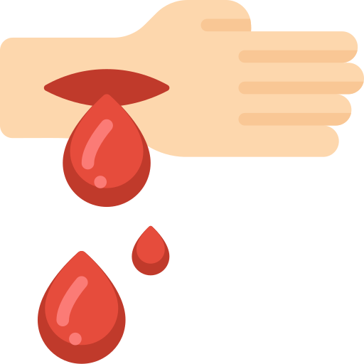
Non traumatic Urological Emergencies : Haematuria
History
Residency
Higher incidence of schistosomiasis in Egypt
Pain or painless
Timing & Clots
Duration
Color
Brownish urine is a sign of pre-renal cause “hemolytic anemia”
Trauma or bleeding from other sites
Age
Malignancy associated with middle age ~40
Occupation
people who work in paint and tire ”rubber” factories have a high chance of Bladder tumor.
Associated symptoms
Fever = UTI
Dizziness = severe bleeding
Past history: of bleeding disorders, TB, SC, Bilharziasis & stones.
Family History: Malignancy or haematological disorders.
Consumption of Colored food or drinks: Beetroot & Some candies especially cotton candies.
Smoking (Key risk factor for Bladder tumor)
Drugs
Like aspirin, heparin, warfarin
Physical Examination, Investigations & Management:
Physical Examination
Investigation
Management
We have to do: Urine culture & Urinalysis (to detect UTI), Electrolytes (to detect renal impairment), Urine Cytology (to detect malignant cells), CBC, and coagulation profile. The presence of WBC casts and RBC casts is strongly indicative of glomerulonephritis.
The single most important imaging modality for a patient with gross hematuria is CTU (CT Urography) with contrast. This is the gold standard method.
Usually no much signs
Digital Rectal exam is an obligatory step in physical examination.
Insert 3 way foley urethral catheter and bladder wash out for heavy bleeding.
Treat according to the cause.

Slide 5
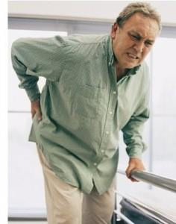
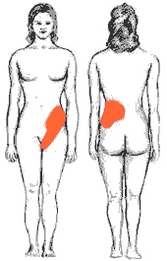
Non traumatic Urological Emergencies : Renal colics
The most common urological emergency (in Saudi Arabia cases are seen daily).
One of the most common causes of differentials associated with “Acute Abdomen”
01
Clinical Features
Patient present with sudden, severe pain –the second in severity after having babies-
Colicky (starts and stops abruptly, pain is on & off) in character, Radiate from flank down to groin (look for lower quadrant & scrotum differentials)
May change in location, from the flank to the groin, (the location of the pain does not provide a good indication of the position of the stone = Mean if the if the stone is in the ureteropelvic junction (UPJ) or the proximal ureter, you may find the pain radiate to groin or scrotum or labia)
The patient cannot get comfortable, and may rolled around
Associated with nausea / Vomiting, and fever if got infected.
Severe cases associated with past history of renal colics, patients will tell you that I know this is a stone & give me a treatment.
02
Differential diagnosis
Acute appendicitis (Pain is constant, localized & get worse with movement (colics patient will be moving and rolling in bed.)
Burst peptic ulcer.
Radiculitis (pseudo-renal)
Leaking (ruptured) abdominal aortic aneurysms.
Myocardial infarction or Pneumonia or Testicular torsion (The pain is mainly in the genitalia.).
Ovarian pathology (e.g., twisted ovarian cyst) or Ectopic pregnancy
Inflammatory Bowel Disease (Crohn’s, ulcerative colitis) or Bowel obstruction or Diverticulitis
03
Work-up
Start with history “first 2 lines in clinical features is the typical presentation”
History may be mixed with other complications as UTI > Presence of fever
Or if there’s complete obstruction, the leading symptoms will be “persistent” pain rather than colicky as the continuous peristalsis tries to push the colic forward.
Examination nothing significant but:
patient tends to move around in an attempt to find a comfortable position.
Check for tenderness

Slide 6
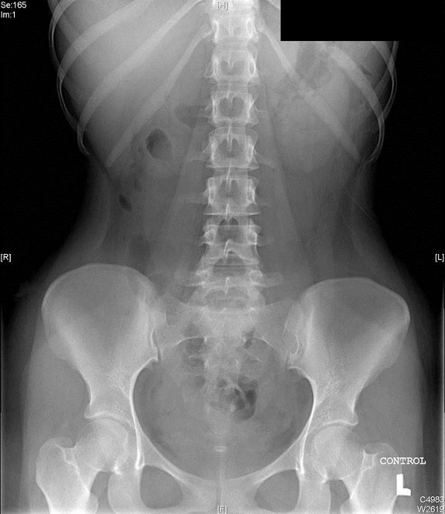
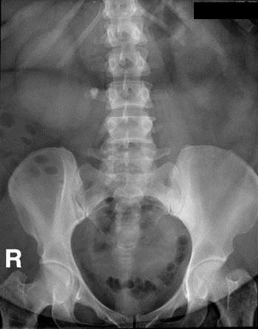
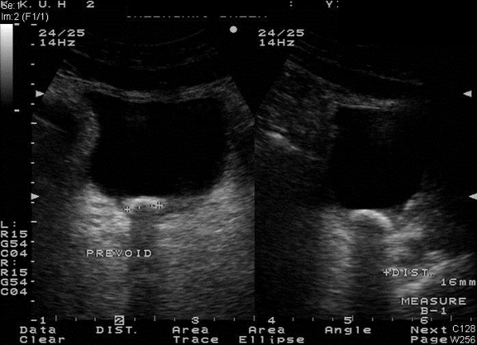
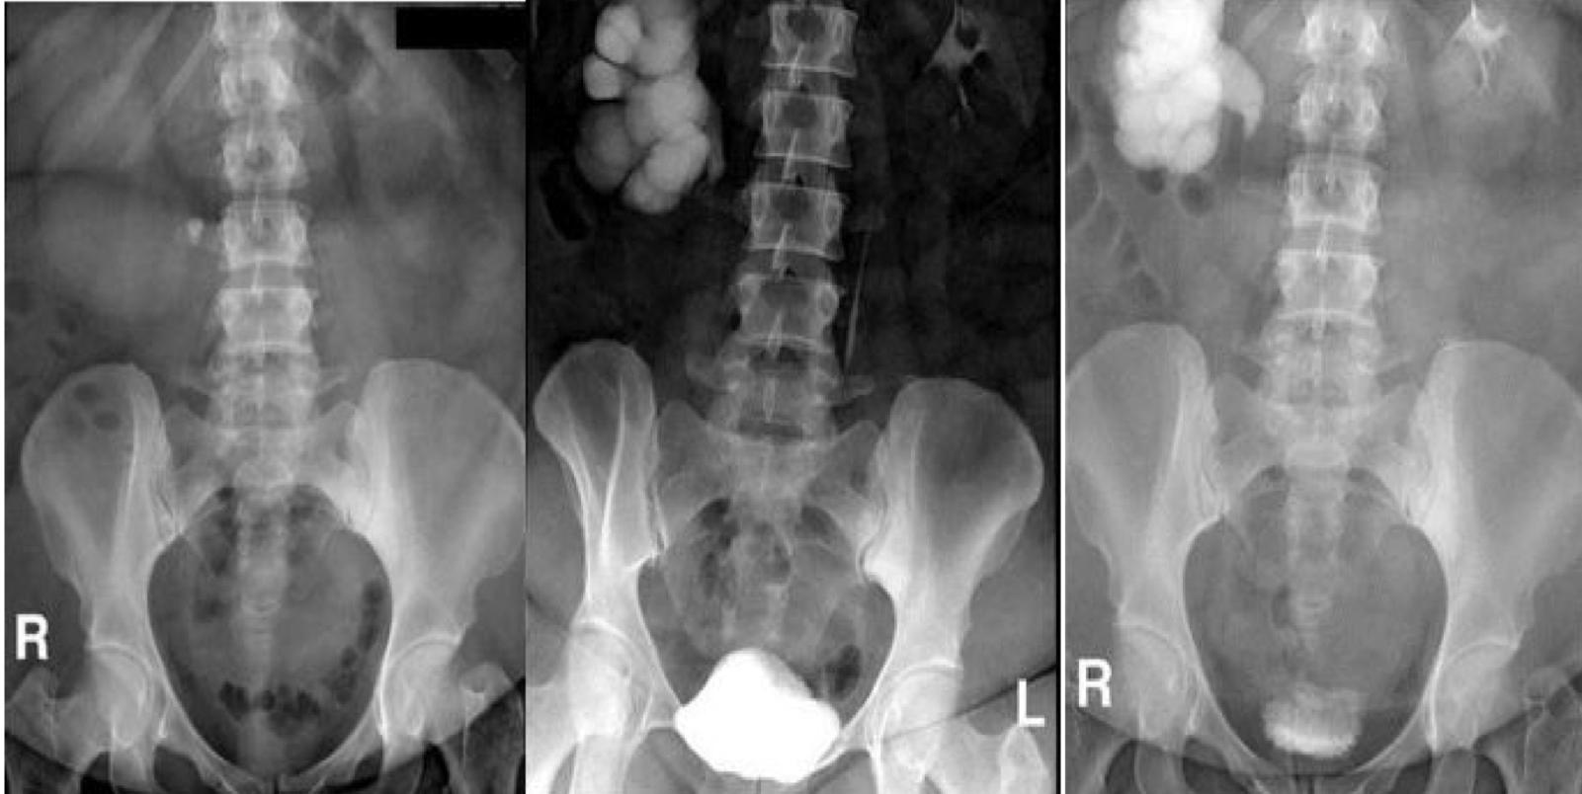
Non traumatic Urological Emergencies : Renal colics
04
Investigations
Pregnancy test: pain may be due to pregnancy nothing more.
MSU (Mid stream urine, most likely you will find RBCs in the urine).
Urinalysis & culture: to detect complications (high creatinine, Hyperkalemia).
Radiological testing:
U/S: Acoustic shadowing.
X-Ray: not very accurate, you can’t determine whether the stone is inside or outside the kidney. But, It can be used as starting point, it is a good option to rule out gallbladder stones
Helical CT: Without contrast, Best modality, GOLD STANDARD
Kidney, ureter, bladder (KUB) X-Ray
This is an abdominal X Ray.
You can’t Determine the location of Radiopaque stones.
Same area as gallbladder
90% of kidney stones are radiopaque
In comparison, 90% of gallbladder stones are radiolucent
Renal U/S (RUS)
Hyperechogenic area with Acoustic shadow indicate stones.
Intravenous urography (IVU)
You can see the stones blocking the ureter
Not used anymore because the contrast is nephrotoxic.

Slide 7
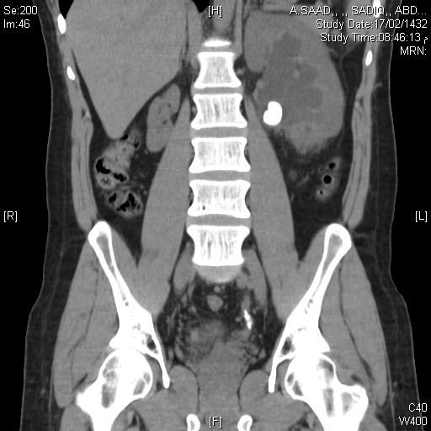
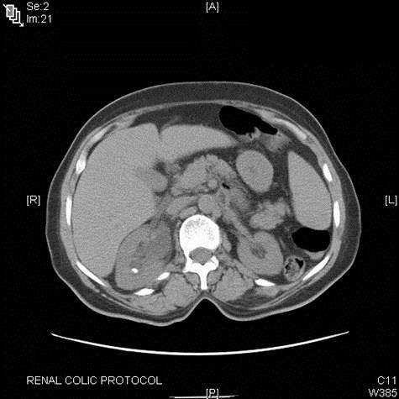
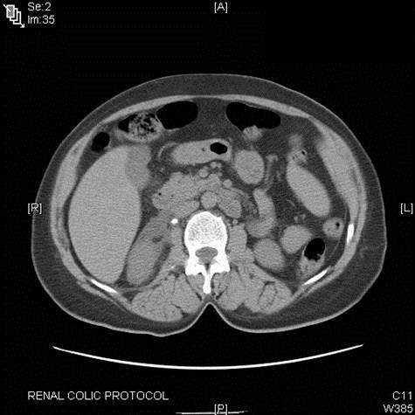
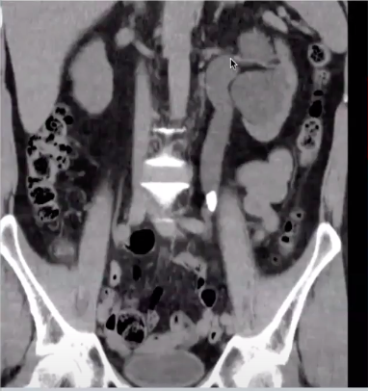
Non traumatic Urological Emergencies : Renal colics
Helical -spiral- CT-scan without contrast
A
The gold standard the best radiological investigation in renal colic.
Greater specificity (95%) and sensitivity (97%).
Can identify other non-stone causes of flank pain.
No need for contrast administration.
Faster, taking just a few minutes
The cost of CTU is almost equivalent to that of IVU.
You can determine the location of the stone
Picture A&C = renal pelvis stones
Picture B = renal stone
Pregnant? do MRI
Picture D = small stone in the distal ureter which lead to hydronephrosis
B
C
D
05
Management (Medical or surgical)
Medical
Hydration (mainly drinking, or I.V if needed)
5mm Stone or less: ‘watchful waiting’ with analgesic supplements is the best approach; 95% of 5mm or less stones pass spontaneously
Pain relievers (Depending on the severity)
NSAIDs. Paracetamol of mild, or stronger E.g. Brufen, voltaren
Intramuscular or intravenous injection, by mouth, or per rectum.
+/- Opiate analgesics (pethidine or morphine).
Be careful some opiates addicts can come to ER and act for the sake of this
Alpha-blockers
Help to relax smooth muscle of ureter “for ureter stones, not for kidney stones”
In mild cases, give paracetamol if needed, advice for hydration, send home & reschedule for follow-up 2 weeks later.

Slide 8
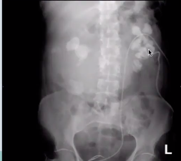
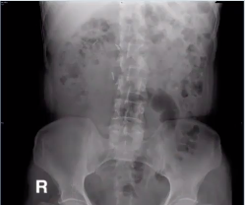
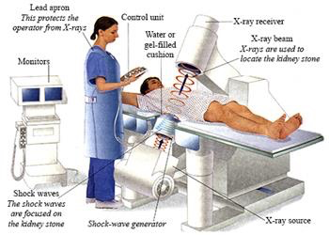
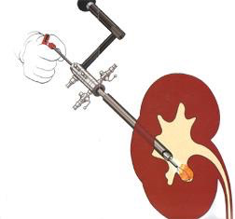
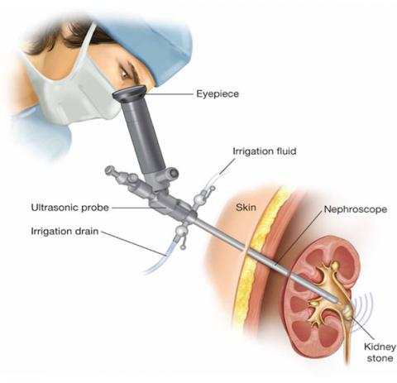
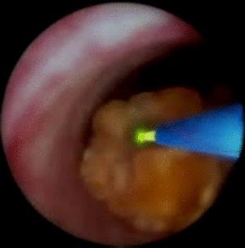
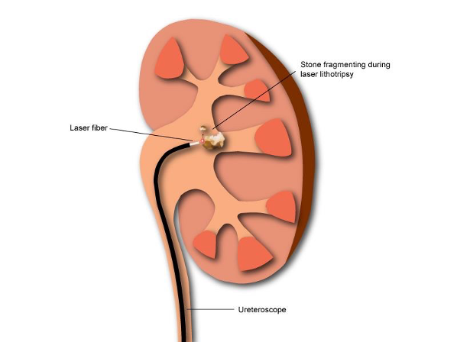
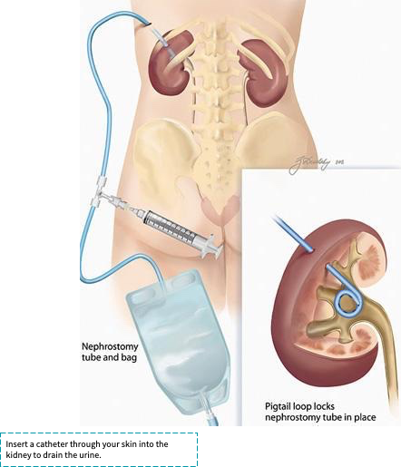
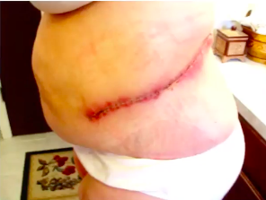
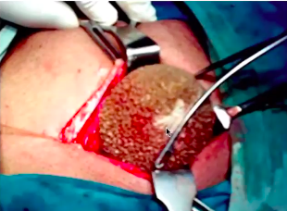
Non traumatic Urological Emergencies : Renal colics
05
Management
Surgical
After treatment
Before treatment
To Relieve Obstruction and/or Remove the stone.
Indications for Intervention:
Obstruction Unrelieved (not to exceed 4 weeks!=Necrosis) “patient came after 2 weeks & the obstruction haven’t relieved”
Pain that fails to respond to analgesics “Comes back to clinic before the scheduled 2 weeks”.
Association With Fever (fever highly suggests pyelonephritis which requires drainage because it may cause septicemia)
Renal Function Impairment (creatinine & Potassium) caused by stone (Solitary kidney obstructed by a stone, bilateral ureteric stones).
Personal Or Occupational Reasons (Pilots as example or doctors, or even those who live in poor countries that aren’t be able to reach health services if the symptoms exacerbate)
Temporary
(Urine is diverted first, then the stone is treated)
Definitive
Insertion of JJ stent
Extracorporeal Shock Waves Lithotripsy (ESWL)
A.K.A urinary stent, which’s a thin tube that gets inserted into the ureter to divert the urine flow.
Used for small stones in the kidney or the upper ureter
Percutaneous Nephrolithotomy (PCNL or PNL)
For large stones.
Ureteroscopy (URS) (laser) - very common
Percutaneous nephrostomy tube
Another method to divert urine flow in septic patients in which a needle is inserted through the skin to drain the urine until sepsis regress.
Laparoscopic extraction
Rarely used
Open surgery
Very limited

Slide 9
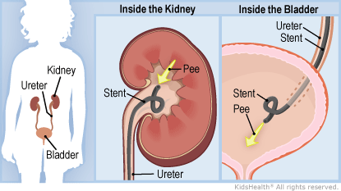
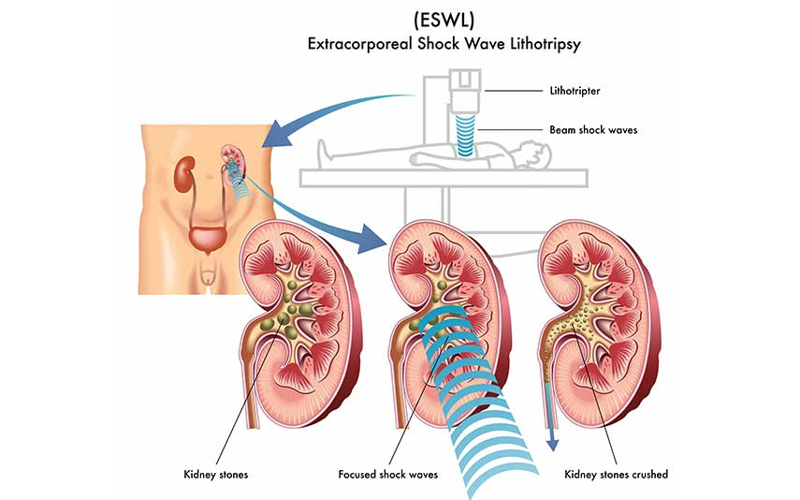
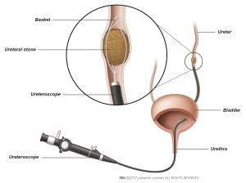
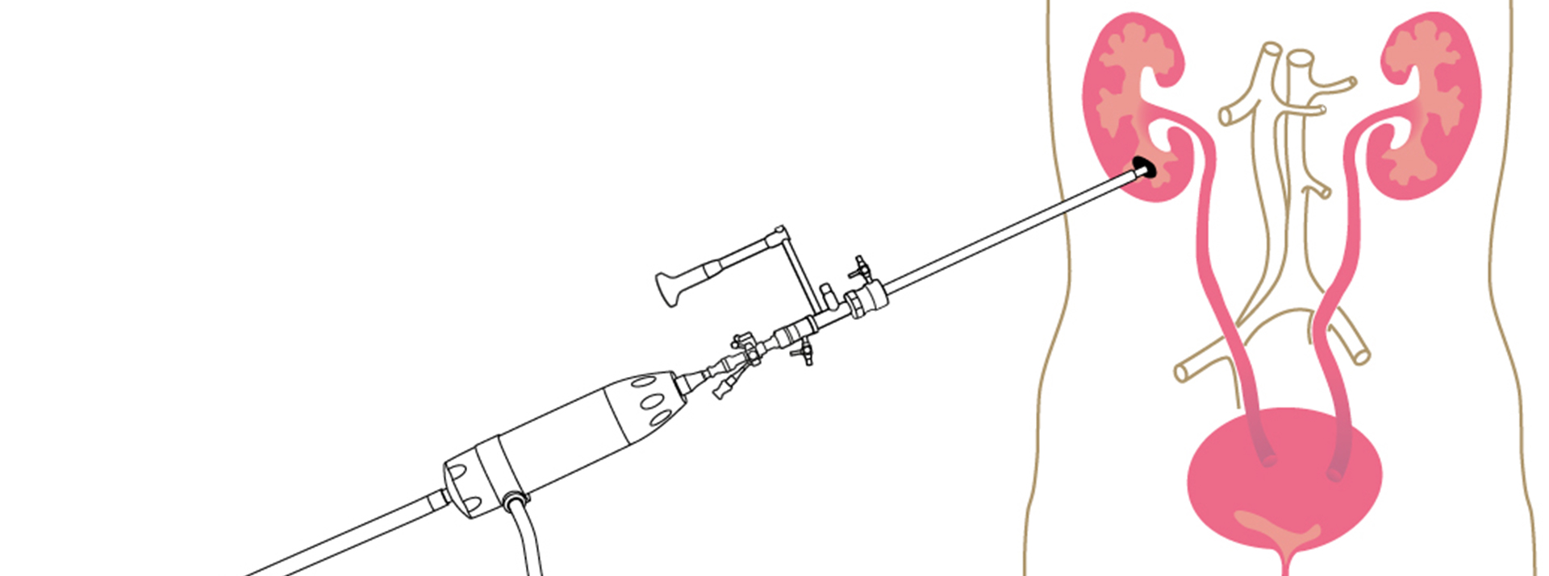
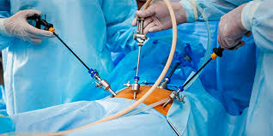
JJ stent (Double J stent “DJ stent”)
In patients with acute obstruction and sepsis (infected obstructed kidney) or renal impairment, decompression of the kidney either via insertion of a ureteric stent or percutaneous
A ureteral stent is a small plastic tube placed inside the ureter to help urine (pee) pass from a kidney into the bladder.
Extracorporeal Shock Waves Lithotripsy (ESWL)
Extracorporeal shockwave lithotripsy (ESWL), the technique of focusing external shock waves to break up stones, has revolutionised the treatment of renal and ureteric stones. Stones visualised on x-ray or US can be treated by ESWL, especially those that are single and up to 2 cm in size.
Ureteroscopy (URS) (laser)
Other stones can be visualised directly by ureterorenoscopy (URS), and the stones broken up using a holmium laser or removed intact using a Dormia wire basket.
It involves the passage of a small telescope, called a ureteroscope, through the urethra and bladder and into the ureter to the point where the stone is located. Then the stone is fragmented with a laser.
Percutaneous Nephrolithotomy(PCNL or PNL)
Some stones in the kidney that are unlikely to pass, even if broken up, are best treated by direct puncture of the kidney, insertion of a sheath and removal under vision with a nephroscope with or without ultrasonic disaggregation (percutaneous nephrolithotomy).
The surgery consists of making a small incision in the back, through which a hollow tube is placed to provide access to the inside part of the kidney that contains the stone(s). Using a rigid metal telescope, the stones are removed directly or broken into fragments which are then removed.
Laparoscopic extraction
Vesical calculi can be treated endoscopically like ureteric calculi, using a stone-crushing device, pneumatic lithotrite or holmium laser. Alternatively, large stones can be dealt with through an open suprapubic cystolithotomy, or by suprapubic insertion of a nephroscope and the use of ultrasonic shattering.

Slide 10
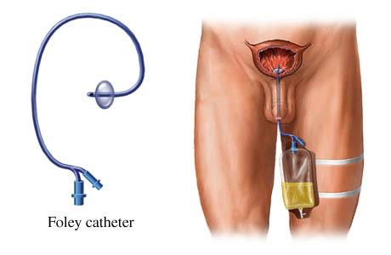
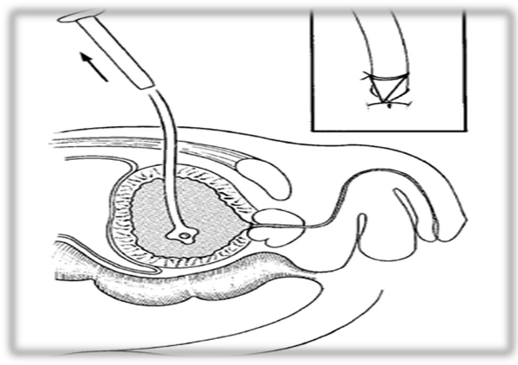
Non traumatic UE : Urinary Retention
1
Acute urinary retention
Acute Urinary Retention: Painful inability to void , with relief of pain following drainage of the bladder by catheterization. More common in Men than in Women (in women urinary incontinence (involuntary leakage of urine) is more common than urinary retention due to females’ short urethra).
Causes
In men | In women (Rare)
Benign prostatic enlargement (BPE) due to BPH (The most common cause). Carcinoma of the prostate Prostatic abscess Urethral stricture Stones Constipation (In children) | Pelvic prolapse (cystocele, rectocele, uterine) Pelvic masses (e.g., ovarian masses) Urethral stenosis Urethral diverticulum Post surgery for ‘stress’ incontinence (Transvaginal tape (sling) in those with stress incontinence is very common ) - if this procedure is overdone it will cause urinary retention Post operational: spinal or epidural, pelvic surgery, morphine
Management
01
02
Initial management is to drain urine by catheterization::
First option: Urethral catheter
Second option: Suprapubic catheter -through skin-
Late management is to treat underlying cause

Slide 11
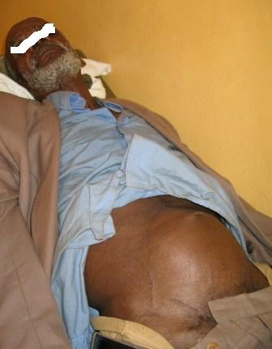
Non traumatic UE : Urinary Retention
2
Chronic urinary retention
Chronic Urinary Retention: Obstruction develops slowly, the bladder is distended (stretched) very gradually over weeks/months, Pain is not a feature (Unless if Acute-on-Chronic occured)
Usually associated with
Reduced renal function
Upper tract dilatation & diabetes (neuropathy)
Presentation
Management
LUTS
Overflow incontinence.
Palpable Bladder with no pain.
Symptoms of renal failure (nausea and malaise, Hyperkalemia and high creatinine).
Pyelonephritis
Hydronephrosis (swelling of the kidney due to a build-up of urine).
Treatment is directed to renal support (treat the renal failure first!).
Bladder drainage (Catheter at home).
Late Treatment of underlying cause.
Treat the electrolyte imbalance.
LUTS
(Lower urinary tract symptoms)
Storage
(Irritative)
Voiding
(Obstructive)
Frequency: may be caused by an actual decrease in the capacity of the bladder or by a decrease in the functional capacity of the bladder
Urgency: a sudden uncontrollable desire to void (storage problem).
Nocturia: night-time frequency may be a result of renal disorders leading to a decrease in the concentrating ability of the kidney, or due to excessive intake of fluids, caffeine or alcohol before bedtime.
incontinence: passage of urine occurs without warning and without any precipitating factors. Urge incontinence is associated with urgency and is seen in acute inflammatory conditions, patients with upper motor neuron injuries and in individuals with an overactive bladder.
Pain
Weak stream: poor stream, they have to strain and increase pressure.
Intermittency: Urine starts and stops, starts and stops
Straining to void
Hesitancy: poor stream (delay in starting the stream) and dribbling (obstruction symptoms).
Incomplete Emptying
Urinary Retention
Oliguria: decreased urinary output.
anuria: complete absence of urine output
Post void dribbling
N
I
S

Slide 12
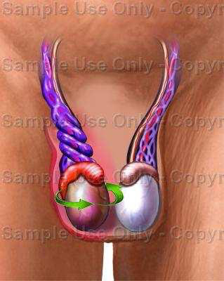
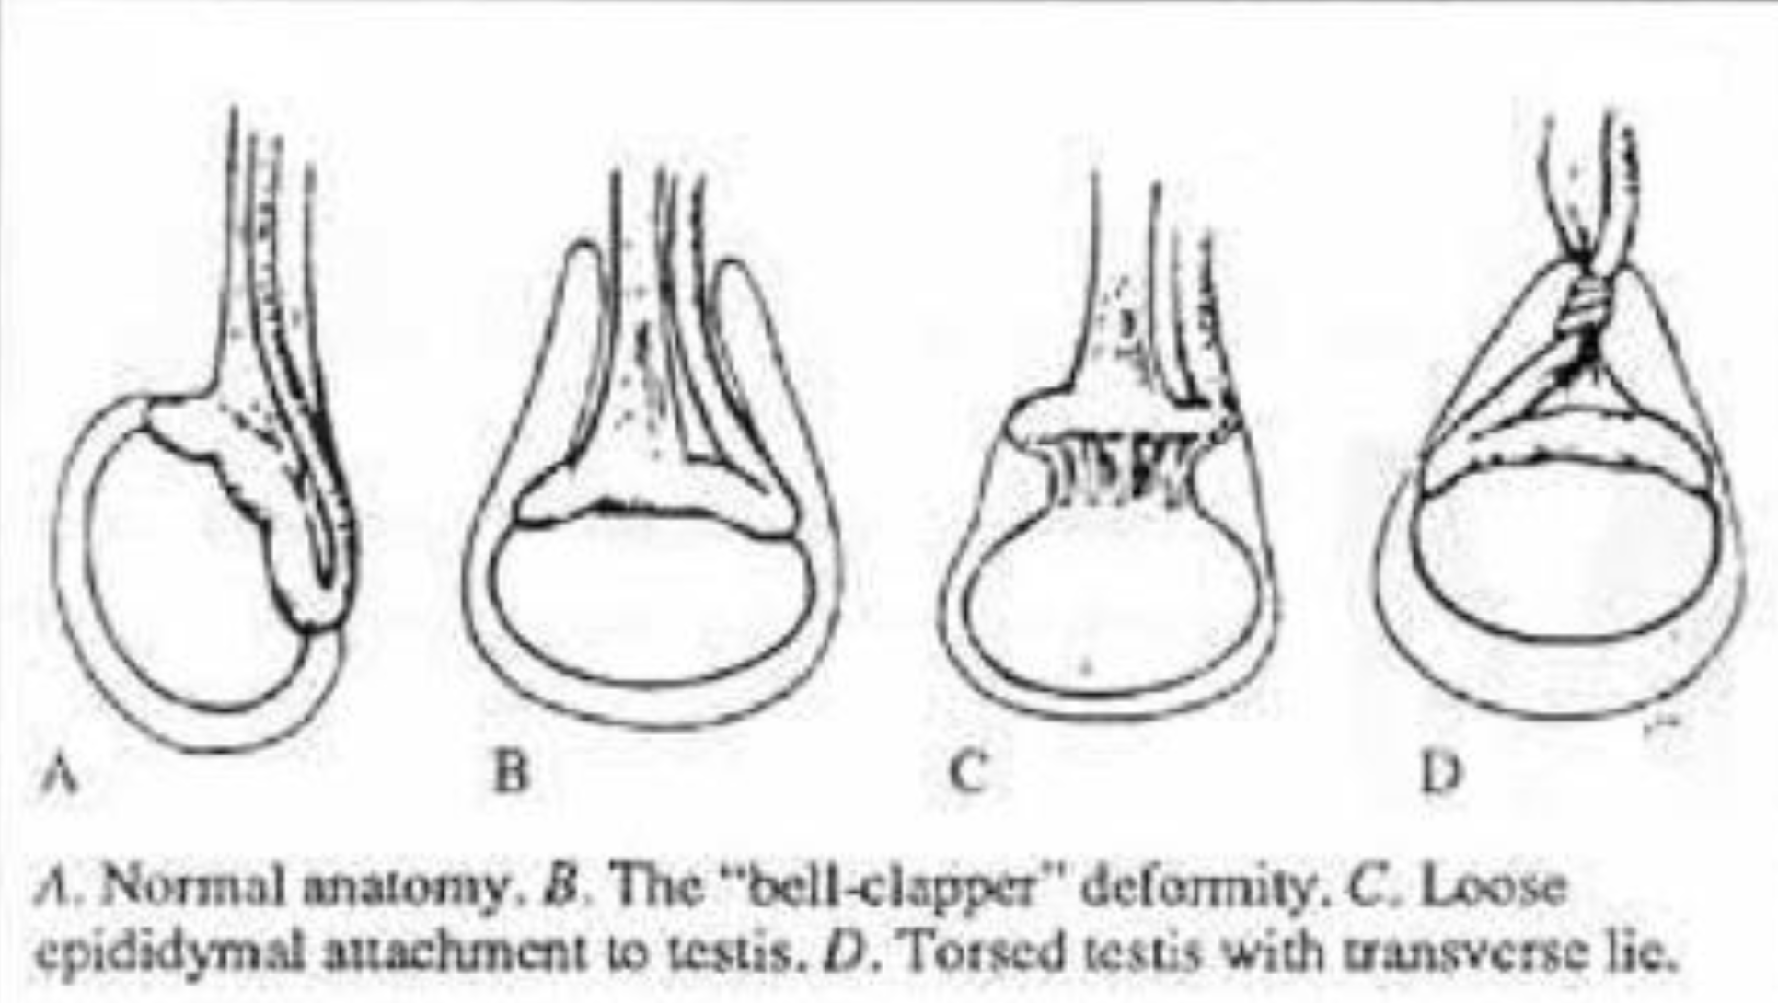
Non traumatic UE : Acute Scrotum
Acute Scrotum: An emergency situation requiring prompt evaluation, differential diagnosis, and potentially immediate surgical exploration
Differential diagnosis
Torsion of the spermatic cord (Most serious) Torsion of the appendix epididymis Epididymo-orchitis Trauma/ insect bite Inflammatory vascultits Epididymitis (most common). Torsion of the appendix testis Orchitis Hernia Dermatological lesion Neurological ( adductor tendonitis)
1
Torsion of the spermatic cord
01
Common among teenagers (12-18) years.
Unlikely after the age of 25 .
Possible in children and neonates.
02
True surgical emergency of the highest order.
Irreversible ischemic injury to the testicular parenchyma may begin as soon as 4 hours (you have 4 hours to save testicles).
Testicular salvage ↓ as duration of torsion ↑ (Ischemia then necrosis)
Anatomical variations
Picture A: this is the normal position of tunica vaginalis )in which it covers anterior wall & part of posterior wall of testcles.
Picture B: This is “Bell-clapper” deformity in which the in which Vaginalis is floppy, which lead to hang the testcles as in Picture D.

Slide 13
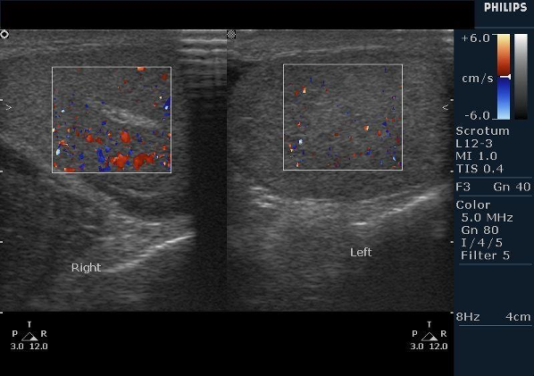
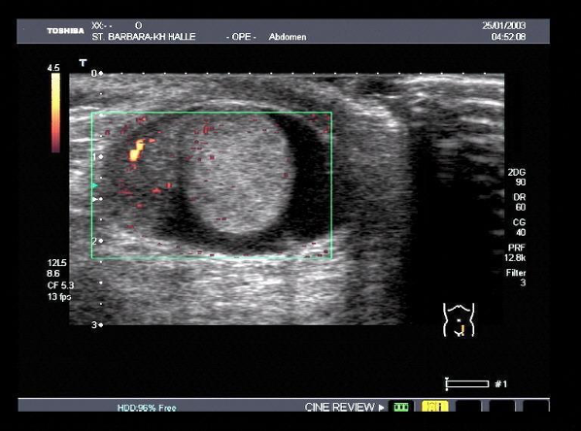
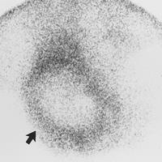
Non traumatic UE : Acute Scrotum
Symptoms
Signs & Symptoms
Acute onset of scrotal pain (Very severe pain). That’s located in scrotum & referred to the ipsilateral lower quadrant of the abdomen.
Majority with history of prior episodes of severe, self-limited scrotal pain and swelling (Alarming pain that goes on & off, not in all patients)
Nausea/Vomiting
Children might not complain of testicular pain
Dysuria and other bladder symptoms are usually absent. (sign of scrotum infections “orchitis or epididymitis)
The affected testis is high riding
Acute hydrocele or massive scrotal edema
Tender larger than other side
Transverse -not vertical- orientation
Cremasteric reflex is absent in torsion.
Elevation of the scrotum causes more pain (to differentiate from epididymitis)
Redness & inflammation only in Orchitis. Here, there’s no redness
Examinations
Torsion investigations
(Adjunctive tests)
(If the diagnosis is clinically suspicious don’t delay the patient for any investigations).
If we delay the diagnosis we may lose testicle
To aid in differential diagnosis of the acute scrotum.
Or to confirm the absence of torsion of the cord.
Doppler examination of the cord and testis
High false-positive and false-negative
A
Color-Doppler U/S
Is the best test
Assessment of anatomy and determining the presence or absence of blood flow.
Sensitivity: 88.9% specificity of 98.8%
Operator dependent.
Operator have to direct the device toward the blood flow.
Picture A: red color is sign of proper blood flow, Torsion confirmed if there’s no flow.
RadioNuclide Imaging
You don’t need to know about it :)
Assessment of testicular blood flow.
A sensitivity of 90%, & specificity of 89%.
False impression from hyperemia of scrotal wall.

Slide 14
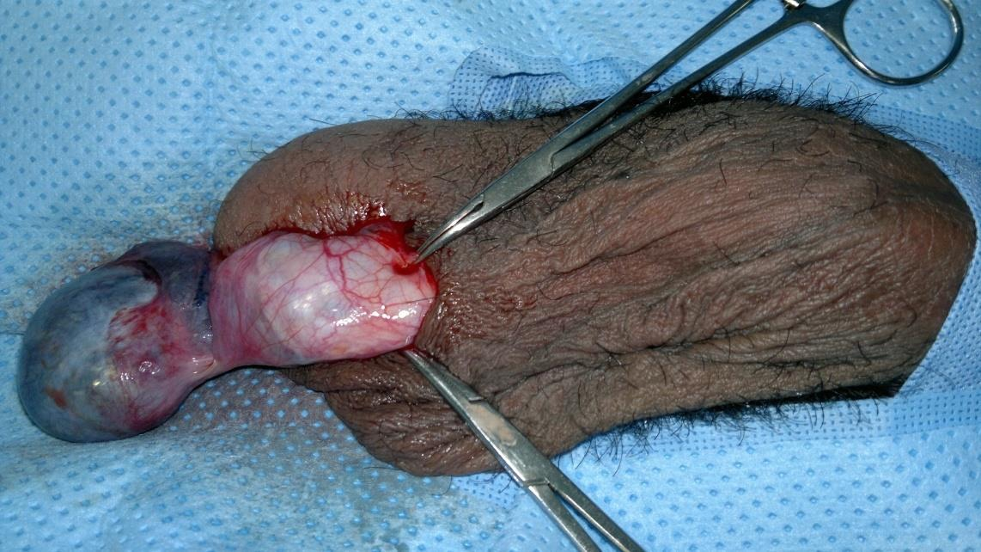
Non traumatic UE : Acute Scrotum
Torsion Management
Surgical Explorations: (orchiopexy)
A scrotal incision
The affected side should be examined first (The cord should be detorsed (Untwisted, left for some time, if the “black color” of testis changed & improved, then you can save the testis..
Testes with marginal viability should be placed in warm and re-examined after several minutes.
A necrotic testis should be removed
If the testis is to be preserved, it should be fixed
The contralateral testis must be fixed to prevent subsequent torsion (Bell-clapper deformity if occured in one testis, usually it occurs in the other one. You have to examine both testcles.)
2
Epididymo-orchitis
Presentation:
Physical Examination
Management
Indolent process.
Scrotal swelling, erythema, and pain (can be a complication of either UTI or Urethritis).
Dysuria and fever is more common
If there was fever: consider abscess
localized epididymal tenderness, a swollen and tender epididymis, or a massively swollen hemi-scrotum with absence of landmarks.
Cremasteric reflex should be present
Bed rest for 1 to 3 days then relative restriction
Scrotal elevation, the use of an athletic supporter
Oral antibiotics therapy (Bactrim-TMP) should be used unless the patient is sick.
Urethral instrumentation should be avoided
Urinalysis
pyuria, bacteriuria, or a positive urine culture

Slide 15
Non traumatic UE : Priapism
Priapism: Persistent erection of the penis for more than 4 hours that is not related or accompanied by sexual desire. Not common, but we see it usually in sickle cell patients.
Types of Priapism
Ischemic (most common) | Non-Ischemic
(veno-occlusive, low flow) ”Occlusion of venous return” - | arterial, high flow
Due to hematological disease The most common, mainly Sickle cell), malignant infiltration of the corpora cavernosa with malignant disease, or drugs (+users of cocaine or Heroin). Painful | Due to perineal trauma, which creates an arterio-venous fistula. Painless-not an acute presentation Usually we don’t see these patients coming to the ER
01
02
Primary
Secondary
(Idiopathic): 30% - 50 %
Drugs, Trauma, Neurological, Hematological disease(The most common, mainly Sickle cell), Tumors, spider bite (Phoneutria nigriventer; spider name).
Diagnosis
Examination
Usually obvious from history
Duration of erection >4 hours?
Is it painful or not?.
Previous history and treatment of priapism (sickle cell) ?
Identify any predisposing factors and underlying cause
Erect, tender penis (in low- flow)
Characteristically the corpora cavernosa are rigid and the glans is flaccid.
Abdomen for evidence of malignant disease
DRE: to examine the prostate and check anal tone.

Slide 16
Non traumatic UE : Priapism
CBC (white cell count and differential, reticulocyte count).
Hemoglobin electrophoresis for sickle cell.
Urinalysis including urine toxicology (For drug users-abusers).
Blood gases taken from either corpora
It’s a diagnostic & Therapeutic test for priapism.
We do ABG at the same time of aspirate the blood from corpora.
Investigations
 | Low flow (Ischemic) | High flow (Non-Iscemic)
Blood color | dark blood | bright red blood similar to arterial blood at room temperature
PH | <7.25 (acidosis) | = 7.4 (normal)
PO2 | pO2 <30 mmHg (hypoxia) | pO2 >90 mmHg (normal)
PCO2 | pCO2 >60 mmHg (hypercapnia) | pCO2 <40 mmHg (normal)
Color flow duplex ultrasonography in cavernosal arteries (the best diagnostic method for non-ischemic priapism to detect the fistula);
Ischemic (inflow low or nonexistent)
Non-ischemic (inflow normal to high)
Depends on the type of priapism (In sickle cell: we do oxygenation, hydration, give morphine to decrease the pain & dislodge the clot.)
Conservative treatment should first be tried
Medical treatment (alpha-agonist may relieve priapism)
Surgical treatment.
Treatment of underlying cause
Treatment

Slide 17
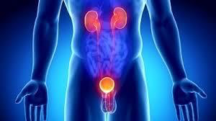
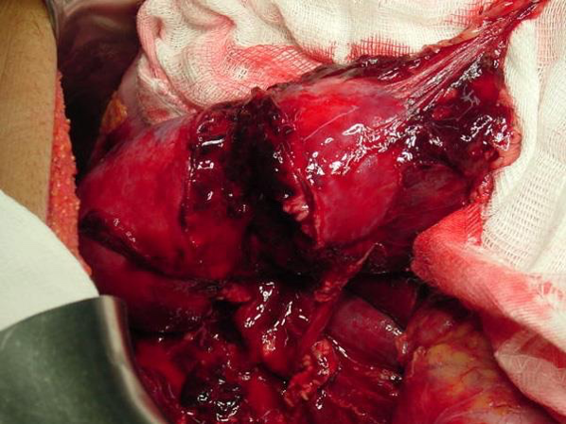
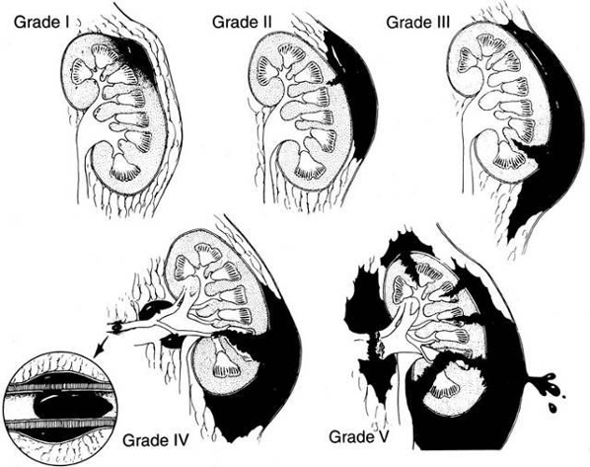
Traumatic Urinary Emergencies : renal trauma
Emergencies
Non- Traumatic
Traumatic
Haematuria
Renal Colic
Renal Trauma
Ureteral Injury
Urinary Retention
Acute Scrotum
Bladder Trauma
Urethral Injury
Priapism
External Genital Injury
The kidneys relatively protected from traumatic injuries
considerable degree of force is usually required to injure a kidney.
The kidneys are anatomically well protected ( by the vertebral column & Rib cage ) any injury to the kidney especially when it's blunt it should be massive or rapid accelerated and decelerated injury.
Mechanism of renal trauma
Blunt:
direct blow or acceleration/ deceleration,e.g., road traffic accidents, falls from a height, fall onto flank
Penetrating
knives, gunshots, iatrogenic, e.g., percutaneous nephrolithotomy (PCNL)
Grade I : small hematoma around the kidney
Grade II: +Ulceration into the kidney (<1cm)
Grade III: If the ulceration >1cm but didn’t reach the the collecting system (calyx of the kidney)
Grade IV: If the tearing reached the calyx with urinary extravasation
Grade V: If kidney teared into pieces.
Grade I, II, III, and even IV treated conservatively (As long as the patient BP is stable), While Grade V treated surgically right away.
The kidneys are in the retroperitoneal space.. so when the bleeding happens the pressure keeps it controlled, if you opened the space and intervened you will end up releasing the pressure and actually causing more bleeding and you may lose the kidney.
Staging (Grading)
by CT scan
Doctor said you don’t need to remember this :)
Just understand the last point

Slide 18
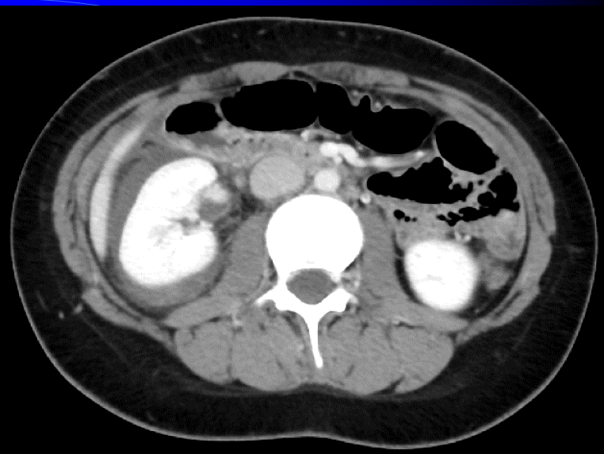
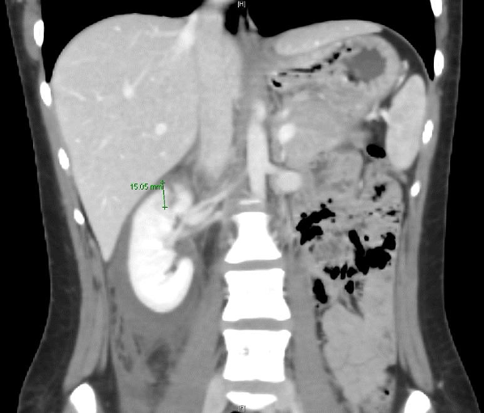
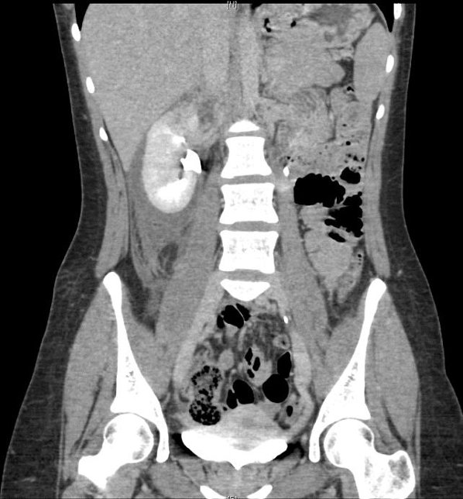
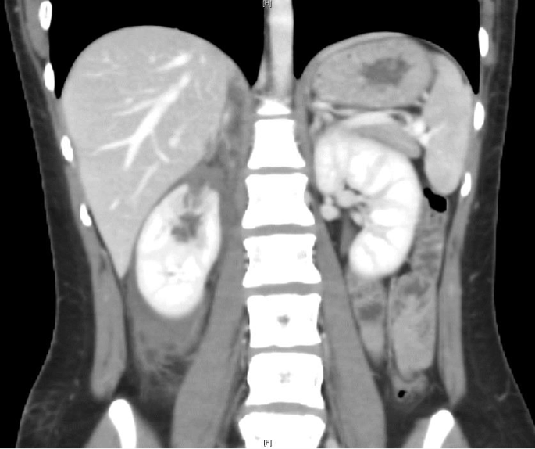
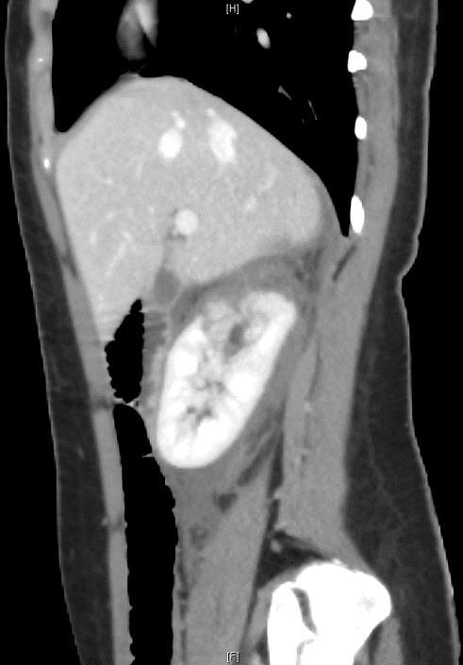
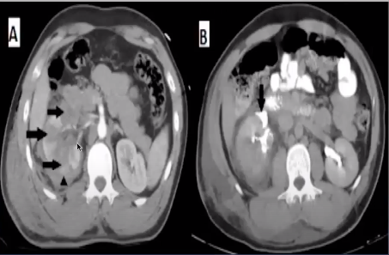
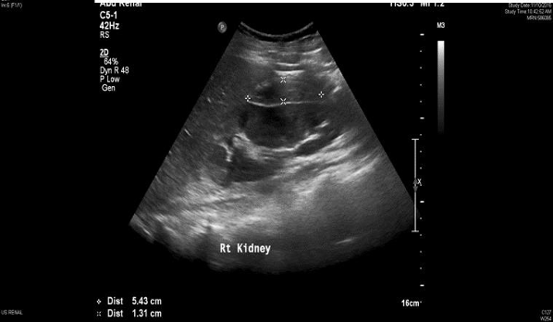
Traumatic Urinary Emergencies : renal trauma
Renal Imaging Indications
Macroscopic haematuria
Penetrating chest, flank, and abdominal wounds
Microscopic [>5 red blood cells (RBCs) per high powered field] or dipstick with picture of hypertension (low blood pressure and tachycardia)
Hypotensive patient (SBP <90mmHg )
A history of a rapid acceleration or deceleration injury
Any child with microscopic or dipstick or macroscopic haematuria who has sustained trauma (Do US then CT)
CT-Scan
Dark color around kidney is hematoma (fluid surrounding the kidney)
Whitish color of the kidney is due to the contrast, which indicates functioning kidney.
You can see the tearing here (Not reaching calyx)
Contrast
extravasation
Remember:
Renal colics: CT without contrast
Kidney trauma: CT with contrast
Spiral non contrast
does not allow accurate staging.
Contrast-enhanced
(Imaging study of choice)
accurate, rapid, images other abdominal structures.
This tearing reached the calyx
the kidney is shattered into pieces
Fluid around the kidney = blood or urine
IVU (Intravenous urogram) - no pictures
Replaced by the contrast enhanced CT.
On-table IVU (intraoperative) if patient is transferred immediately to the operating theater without having a CT scan & retroperitoneal hematoma is found.
We do it in emergencies only.
We don’t do it so often, it's an old way in which we inject contrast and see how the kidneys clears it. when the patient is very hypotensive and we take to the OR and we don’t know the reason we use it to check the kidney
Left Picture: A kidney shattered into pieces, absence of contrast indicate the loss of blood supply
Right picture: contrast leaked outside the kidney
Renal Ultrasound
Good option but not the best modality, we prefer it in those who cannot tolerate radiation “as pediatrics”
Advantages:
can certainly establish the presence of two kidneys
the presence of a retroperitoneal hematoma
power Doppler can identify the presence of blood flow in the renal vessels
Disadvantages:
cannot accurately identify parenchymal tears, collecting system injuries, or extravasations of urine until a later stage when a urine collection has had time to accumulate.

Slide 19
Traumatic Urinary Emergencies : renal trauma
Renal Trauma Management
01
Consevative Therapy
The best approach for Blunt injuries unless the injury is grade V or the patient is unstable.
In over 95% of blunt injuries.
In 50% of renal stab injuries and 25% of renal gunshot wounds (Specialized centers)
Includes:
Wide Bore IV line
2 Large IV access
Bed rest to contain the existing bleeding, usually for 2-3 weeks.
01
03
Vital signs monitoring.
Serial CBC and HCT
Follow up US &/or CT. in a week or two
IV antibiotics.
02
04
02
Surgical Exploration
Usually penetrating injuries require surgical intervention.
Persistent bleeding (persistent tachycardia and/or hypotension failing to respond to appropriate fluid and blood replacement
Expanding peri-renal hematoma (again the patient will show signs of continued bleeding)
Pulsatile peri-renal hematoma
Traumatic Urinary Emergencies : Ureteral Injuries
The ureters are protected from external trauma by surrounding bony structures, muscles and other organs
Causes of Ureteral injuries are either: External Or Internal.
External Trauma (rare) | Internal Trauma
Rare Severe force is required. Blunt external: trauma severe enough to injure the ureters will usually be associated with multiple other injuries. Penetrating knife or bullets to the abdomen or chest may damage the ureter, as well as other organs. | Uncommon but is more common than external trauma. Iatrogenic (during surgery): Oncology surgeries like: Hysterectomy ​​(because the ureter is really close to the uterine artery) oophorectomy, and sigmoidcolectomy. Caesarean section. Ureteroscopy. Aortoiliac vascular graft replacement. Laparoscopies. Orthopedic operations.

Slide 20
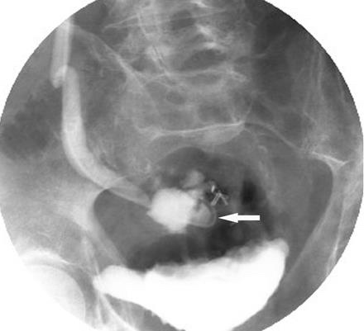
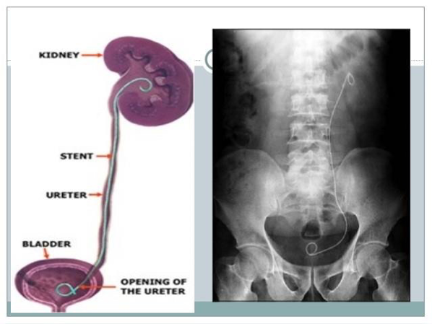
Traumatic Urinary Emergencies : Ureteral Injuries
Diagnosis
Lab
Management
Requires a high index of suspicion, usually diagnosed Intra-operatively.
Late diagnosis:
An ileus: the presence of urine within the peritoneal cavity
Prolonged postoperative fever or overt urinary sepsis
Persistent drainage of fluid from abdominal or pelvic drains, from the abdominal wound, or from the vagina.
Flank pain if the ureter has been ligated
An abdominal mass, representing a urinoma
Vague abdominal pain
Diversion with: JJ (Double J) stenting or nephrostomy (to allow the ureter to heal by itself. This can’t be applied in complete cut of the ureter.) ​
If the ureter healed, no need to do anything. If not you need to connect the ureter back together by Primary closure of partial transaction of the ureter
No need to know so much about the details of ureter surgery below :)
Direct ureter to ureter anastomosis
Re-implantation of the ureter into the bladder.
Trans uretero-ureterostomy
Auto-transplantation of the kidney into the pelvis
Permanent cutaneous ureterostomy
Nephrectomy
Traumatic Urinary Emergencies : Bladder Injuries
Causes:
Iatrogenic
External
Transurethral resection of bladder tumor (TURBT)
Cystoscopy bladder biopsy
Cystolitholapaxy
Caesarean section, especially as an emergency (Very common)
Pelvic surgery
Penetrating trauma to the lower abdomen or back
Blunt pelvic trauma—in association with pelvic fracture or ‘minor’ trauma in a drunkard patient
Rapid deceleration injury seat belt injury with full bladder in the absence of a pelvic fracture (Injury to both breast and bladder)

Slide 21
Traumatic Urinary Emergencies : Bladder Injuries
Types of Perforation
Intra-peritoneal
Extra-peritoneal
The peritoneum overlying the bladder (It’s retroperitoneal organ), has been breached along with the wall the of the bladder, allowing urine to escape into the peritoneal cavity.
The peritoneum is intact and urine escapes into the space around the bladder (Between bladder and peritoneum), but not into the peritoneal cavity.
Symptoms
The classic triad of symptoms and signs that are suggestive of a bladder rupture :
Suprapubic pain and tenderness.
Difficulty or inability in passing urine.
With or w/o Haematuria.
Usually recognized intra- operatively
01
03
intra-peritoneal rupture symptoms: The urine will leak to the intra-peritoneal space and cause
1- Ileus 2-Localized peritonitis.
02
Treatment
Intra-peritoneal:
By open repair…why?
If you left it it may cause sepsis.
Unlikely to heal spontaneously.
Usually large
Leakage causes peritonitis
Associated other organ injury.
01
Extra-peritoneal:
Bladder drainage +++++ (Usually Observational)
Open repair + (If not healed after 2 or 3 weeks)
02

Slide 22
Traumatic Urological Emergencies: Urethral Injuries
A
1
Anterior urethral injuries
Rare
Injury of Penile and bulbous urethra (look at picture A)
The majority is a result of a straddle injury in boys (children who learn to bike & Skewers ) or men
Direct injuries to the penis
Penile fractures
Inflating a catheter balloon in the anterior urethra
Penetrating injuries by gunshot wounds.
It can also be caused by sexually transmitted diseases
Signs & Symptoms
Meatal Bleeding (From external meatus)
Meatal bleeding is an alarming symptoms, don’t insert a Foley catheter in patient with meatal bleeding
Difficulty in passing urine
Frank haematuria
Hematoma may accumulate around the site of the rupture
Penile swelling
With\ or without urinary retention.
2
Posterior urethral injuries
Injury of membranous and prostatic urethra (look at picture A)
Great majority of posterior urethral injuries occur in association with pelvic fractures
10% to 20% have an associated bladder rupture
Signs & Symptoms
Blood at the meatus, gross hematuria, and perineal or scrotal bruising.
High-riding prostate (You can’t reach the prostate when applying digital rectal exam.)
The diagnostic tool is Retrograde urethrography (Ascending urethrogram):
Contusion:
no extravasation of contrast
Treatment: A small-gauge urethral catheter for one week
Partial rupture:
extravasation of contrast, with contrast also present in the bladder
Treatment:
No blind insertion of urethral catheterization ( may be by using cystoscopy and guide wire)
Majority can be managed by suprapubic urinary diversion for one week
Penetrating partial disruption (e.g., knife, gunshot wound), primary (immediate) repair.
Complete disruption:
no filling of the posterior urethra or bladder
Treatment:
patient is unstable: a suprapubic catheter.
patient is stable: the urethra may either be immediately repaired or a suprapubic catheter
Penetrating Anterior Urethral Injuries are generally managed by surgical debridement and repair

Slide 23
3
Urethral injuries Diagnosis, staging & Management
Anterior Urethral
Posterior Urethral
If the patient presents to you with a history suggestive of pelvis fracture e.g.. car accident you should approach the patient with ABC first.
The diagnostic tool is Retrograde urethrography (Ascending urethrogram):
1-Contusion
No extravasation of contrast
Treatment: A small-gauge urethral catheter for one week
1- Type I
Rare
stretch injury with intact urethra
Treatment: Stenting in urethral catheter (The same as contusion)
2-Partial Rupture
extravasation of contrast, with contrast also present in the bladder
Treatment:
No blind insertion of urethral catheterization ( may be by using cystoscopy and guide wire) (you may worsen the injury by mistake.) = Catheter under vision.
Majority can be managed by suprapubic urinary diversion (catheter) for one week
Penetrating partial disruption (e.g., knife, gunshot wound), primary (immediate) repair.
2-Type II
25% of posterior urethral injuries
Partial tear but some continuity remains
Treatment: Stenting in urethral catheter (The same as contusion)
3- Type III
3-Complete Rupture
75% of posterior urethral injuries
Complete tear with no evidence of continuity
Treatment:
Patient is at varying risk of urethral stricture, urinary incontinence, and erectile dysfunction (ED).
Initial management with suprapubic cystostomy and attempting primary repair at 7 to 10 days after injury.
No filling of the posterior urethra or bladder
Treatment:
patient is unstable: a suprapubic catheter.
patient is stable: the urethra may either be immediately repaired or a suprapubic catheter
4-Penetrating Anterior Urethral Injuries
are generally managed by surgical debridement and repair
In women, partial rupture at the anterior position is the most common urethral injury associated with pelvic fracture.

Slide 24
Traumatic Urological Emergencies: External genitalia
01
Male External Genitalia Injuries
Penile Fracture, eggplant deformity sign (Injury mainly of corpora spongium)
Pathology: ulceration in the tunica albuginea due to heavy sexual intercourse then the bleeding happens by the corporal body. It's an emergency treat promptly, otherwise the patient will have a life long erection problem.
Penile amputation and injuries
Scrotal Injuries.
Glans Injury (Caused mainly by circumcision)
02
Female External Genitalia Injuries
Managed by Gynecologists unless the urethra or the
bladder is involved.
Fournier gangrene
1
Definition & Causes
Defined as a polymicrobial necrotizing fasciitis of the perineal, perianal, or around genital areas ”only”.
Localized infection adjacent to a portal of entry is the inciting event in the development of fournier gangrene.
Ultimately, an obliterative endarteritis >>Subcutaneous vascular necrosis >> localized ischemia
Mortality of 10-20% despite aggressive measures
Anorectal causes
Urogenital causes
Perianal, perirectal, and ischiorectal abscesses
Anal dissures or fistula (that is not treated and complicated)
Colonic perforations, secondary to colorectal injury of malignancy
IBD
Colonic diverticulitis or appendicitis
Urethral injury
Iatrogenic urethral manipulation cystoscopy and other surgeries
Epididymitis or Orchitis
Lower urinary tract infection

Slide 25
Fournier gangrene
2
Most common agents & people at risk
Causative Microorganisms | Risk groups
Polymicrobial involvement (majority) And usually agents are from skin flora Streptococcal species Staphylococcal species Enterobacteriaceae Anaerobic organism Fungi | Any immunocompromised patient Diabete mellitus Morbid obesity Alcoholism Cirrhosis Extremes of age Malignancy “especially those with chemotherapy” HIV infection Malnutrition Iatrogenic immunosuppression (E.g: long-term corticosteroid therapy or chemotherapy)
3
Signs & symptoms
Physical Examination:
Vital signs (will be tachycardic, hypotensive with the other signs of infection)
Palpation of the genitalia and perineum and to DRE (digital rectal examination)
Fluctuance, soft-tissue crepitation, localizing tenderness, or occult wounds
++ Creptus (gas on X-ray too) -palpable crepitation & gases on X-ray are diagnostic
Skin overlying the affected region may be normal, erythematous, edematous, cyanotic and/or gangrenous
History:
Prodromal symptoms of fever and lethargy .
Intense genital pain and tenderness >> erythema. (progressive)
Dusky appearance of the overlying skin; subcutaneous crepitation (feels bubbles under the skin due to gas-producing bacteria)
Obvious gangrene of a portion of the genitalia; purulent drainage
Elderlies usually present late, because it is a private area, his son will bring him to the hospital because his father “feel unwell”, and the one who will do the physical examination will discover the gangrene.
And important aspect is that the progressing of the infection into gangrene is very fast, it may progress from stage and more advanced stage within hours while the patient wait in the emergency department.

Slide 26
Fournier gangrene
CBC (WBC, Hb)
ABG (Septic, Acidosis)
Urine and blood C/S (C/S means Culture)
Swap and discharge C/S
Imaging: CT (with contrast) is the best modality (to detect the underlying cause)
Investigations and markers:
CT-Scan
You can see here gases in the subcutaneous tissue and when you feel this area you would feel the crepitus.
This picture mimic any another necrotizing gangrene
The gas is indicator of “polymicrobial” infection that includes anaerobes, this indicates an urgent intervention because it is fastly spread into septicemia
Aggressive resuscitation in anticipation of surgery. (IV fluid)
Early, broad-spectrum antibiotics are indicated
Earlier surgical intervention has been associated with reduced mortality
Surgical intervention:
Examination under anesthesia
Incision into the are of greatest clinical concern.
If frankly gangrenous tissue is found or purulence is drained, the diagnosis of Fournier gangrene is established
Management:
Once a diagnosis of Fournier's gangrene is established, all necrotic tissue must be excised
(you need to remove “debri” everything that is infected, even if you reached the muscles or deeper, do the same each one or two days until you make sure you have removed everything, then do muscle and skin grafting)

Slide 27
Summary
Recall
Q1:What are the causes of decreased urine output?
Answer Hypovolemia, urinary retention, Foley catheter malfunction, cardiac failure, MI, acute tubular necrosis (ATN), ureteral/urethral injury, abdominal compartment syndrome, sepsis
Q2: How do you act initially in a case of decreased urine output?
Answer Examine, vital signs, check or place Foley catheter, irrigate Foley catheter, IV fluid bolus
Q3: A 77-year-old man s/p laparoscopic cholecystomy returns to the clinic with a palpable lower abdominal mass, confusion, and weak urine stream
Answer Urinary retention
Q4: What are the causes of hematuria?
Answer Bladder cancer, trauma, UTI, cystitis from chemotherapy or radiation, stones, kidney lesion, BPH
Q5: What is the most common cause of severe gross hematuria without trauma or chemotherapy/radiation?
Answer Bladder cancer
Q6: What is testicular torsion?
Answer Torsion (twist) of the spermatic cord, resulting in venous outflow obstruction, and subsequent arterial occlusion → infarction of the testicl
Q6: What is the classic history of testicular torsion ?
Answer Acute onset of scrotal pain usually after vigorous activity or minor trauma
Q7: What is a “bell clapper” deformity?
Answer Bilateral nonattachment of the testicles by the gubernaculum to the
scrotum (free like the clappers of a bell)
Q8: What are the signs?
Answer Very tender, swollen, elevated testicle; nonillumination; absence of cremasteric reflex
Q9: How is the diagnosis made?
Answer Surgical exploration, U/S (solid mass) and Doppler flow study
Q10: What is the treatment?
Answer Surgical detorsion and bilateral orchiopexy to the scrotum
Q11: How much time is available from the onset of symptoms to detorse the testicle?
Answer <6 hours will bring about the best results
Q12: What is Epididymitis ? What are the signs/symptoms?
Answer Infection of the epididymis, Swollen, tender testicle; dysuria; scrotal ache/pain; fever; chills; scrotal mass
Q13: What are the common bugs in the following types of patients:
Answer Elderly patients/children? Escherichia coli
Young men? STD bacteria: Gonorrhea, chlamydia
Q14: What is the workup?
Answer U/A, urine culture, swab if STD suspected, ± U/S with Doppler or nuclear study to rule out torsion
Q15: What is the treatment?
Answer: Antibiotics

Slide 28
Summary
Recall
Q16: What is the incidence of calculus diseases?
Answer: 1 in 10 people will have stones
Q17: What are the risk factors?
Answer: Poor fluid intake, IBD, hypercalcemia (“CHIMPANZEES”), renal tubular acidosis, small bowel bypass
Q18: What are the four types of stones?
Answer:1. Calcium oxalate/calcium PO 4(75%)—secondary to hypercalciuria (↑ intestinal absorption, ↓ renal reabsorption, ↑ bone reabsorption)
2. Struvite (MgAmPh) (15%)—infection stones; seen in UTI with urea-splitting
bacteria (Proteus); may cause staghorn calculi; high urine pH
3. Uric acid (7%)—stones are radiolucent (Think: Uric = Unseen); seen in gout,
Lesch–Nyhan, chronic diarrhea, cancer; low urine pH
4. Cystine (1%)—genetic predisposition
Q19: What type of stones is not seen on AXR? Uric acid (Think: Uric = Unseen)
What stone is associated with UTIs? Struvite stones (Think: Struvite = Sepsis
What stones are seen in IBD/bowel bypass? Calcium oxalate
Q20: What is the significance of hematuria and pyuria?
Answer:Stone with concomitant infection
Q21: What are the classic findings/symptoms?
Answer Flank pain, stone on AXR, hematuria
Q22: Diagnosis?
Answer KUB (90% radiopaque), IVP, urinalysis and culture, BUN/Cr, CBC
Q23: Treatment?
Answer Narcotics for pain, vigorous hydration, observation Further options: ESWL (lithotripsy), ureteroscopy, percutaneous lithotripsy, open surgery; metabolic workup for recurrence
Q24: What are the indications for intervention?
Answer Urinary tract obstruction Persistent infection, Impaired renal function.
Q25: What are the three common sites of obstruction?
Answer 1. UreteroPelvic Junction (UPJ) 2. UreteroVesicular junction (UVJ) 3. Intersection of the ureter and the iliac vessels
Q26: What is priapism?
Answer Persistent penile erection
Q27: What are its causes?
Answer Low flow: leukemia, drugs (e.g., prazosin), sickle-cell disease, erectile dysfunction treatment gone wrong High flow: pudendal artery fistula, usually from trauma
Q28: What is first line treatment?
Answer 1. Aspiration of blood from corporus cavernosum 2. α-Adrenergic agent

Slide 29
Non traumatic Urological Emergencies Summary
1-Hematuria
The most important symptom that needs immediate medical help. Cause vary according to​​ : Age Painful or painless. Risk factors for malignancy like smoking Types gross or microscopic. Timing Prsence of clot Work up​​ : History more important than PE Physical examination (rectal examination). Investigation​​: ​ CT urography which is the gold standard. You need also to to urine cultrue, urinalsis, electrolytes, urine cytology and CBC
2-Renal colics
The most common urological emergency. Sudden, severe, colicy pain that radiates from flank down to the groin, scrotum & labia Investigation​​: Helical CT withou contrast Don’t forget to exclude pregnancy Treatment: Hydration Pain relievers Alpha blocker “for ureter stones only” Schedule for follow-up 2 weeks later Do surgery if one of the indications is present.
3a-Acute Urinary Retention​​ | 3b-Chronic Urinary Retention​​
Painful ​inability​​ to void Caused mainly by BPH. In children main cause is constipation Initial management​​: give the patient analgesic urethral catheterization. Late management​​ : Treating the underlying cause. | pain is not a feature​ and many patient come to ER with renal failure or DM. Symptoms: Urinary dribbling Overflow incontinence Palpable bladder with no pain. Management: treatment ​​: Renal support Bladder drainage. Late treatment of the underlying cause.
4-Acute Scrotum
Most common causes are Torsion of spermatic cord & Epididymitis Torsion: Teenagers (12-18 You have 4 hours to save testicles ( Symptoms include: acute onset of severe scrotal pain, referred to ipsilateral lower quadrant In examination the testis is high riding & oriented in transverse direction., elevation of scrotum cause more pain. -ve Cremasteric reflex If suspicious, don’t delay the patient for investigation, treat immediately Investigation: Color-doppler U/S is gold standard Treatment: surgical exploration (contralateral testis must be examined also) Epididymo-Orchitis Scrotal swelling with erythema Examinations: Tenderness & +ve cremasteric reflex Urinalysis: Pyuria or bacteuriaa Management: Bed rest, scrotal elevation & Antibiotics.

Slide 30
5-Priapism
Persistent erection of the penis ​more than 4 hours not related to sexual desire . Cause​​: Primary:​​ idiopathic 30-50% of the cases. Secondary:​​ drugs , trauma, neurological and hematological . Types​​ : Ischemic, ​painful​ is the most common. Non ischemic ​painless. The diagnosis​​ usually obvious from the history, duration of erection more than 4 hours.
Traumatic Urological Emergencies Summary
1-Renal Truama
Either Blund (road traffic accident), or Penetrating (gunshots) Radiological image​​ : Contrast-enhanced CT is the study of choic U/S is the alternative method Management: Conservative, includes: wide Bore IV line, IV antibiotics, Bed rest , vital signs, serial CBC and HCT and follow up US and CT . Surgical exploration (if the indications present).
2-Bladder Injuries
Causes : Iatrogenic injury: Due to surgery (cesarean delivery is the most common) Penetrating trauma Blunt pelvic trauma (Rapid deceleration injury.) Types of perforation : intraperitoneal perforation. (Tx is open repair) Extra-peritoneal perforation.(Tx is urine drainage) Presentation​​: ​classic triad of symptoms 1-suprapubic pain and tenderness 2-difficulty or inability to pass urine. 3-haematuria.
3- Ureteral Injuries
Uncommon injury Either by external (needs severe force) or internal (hysterectomy) Usually diagnosed intraoperatively Treatment by surgery (mainly JJ stenting)
4- Anterior urethral Injuries
Meatal bleeding, difficulty in passing urine, frank haematuria. Diagnosis Diagnostic tool is retrograde urethrography. Management: Contusion: small gauge Urethral catheter Partial rupture: majority managed by suprapubic urinary diversion Complete rupture: unstable patient : use a suprapubic catheter stable patient urethra may be immediate repaired or suprapubic catheter Penetrating anterior urethral injuries are managed by surgical debridement and repair
5-Posterior Urethral Injuries
Mechanism​​: mostly are associated with pelvic fracture, 10-20% ​associated with bladder rupture. Signs​​: ​high riding prostate​​ when Examining by digital rectal exam . Management​​: type 1: stretch injury with intact urethra and stenting with a Urethral catheter. Type 2 treatment with stenting a Urethral catheter. Type 3 : initial management with suprapubic cystostomy and attempting primary repair at 7 to 10 days after injury.

Slide 31
Quiz
MCQ
Q1: Which of the following symptoms is characteristic for renal-caused hematuria ?
Initial bleeding with no clots
Total bleeding with clots
Terminal bleeding with no clots
Terminal bleeding with clots
Q2: 28 years old male presented with flank pain that radiates to the groin, you did as ultrasound and noticed acoustic shadow. What is the most proper diagnostic test to confirm the diagnosis of this patient ?
CT with contrast
Helical CT w/o contrast
KUB X-ray
IVU
Q3: 48-year-old female was a back seat passenger in a road traffic accident. You suspect renal trauma, what would be the most proper test to confirm the cass ?
CT with contrast
CT without contrast
IVU
Ultrasound
Q4: 88 year old man known to have DM & HT, his son brought him to the hospital because the father not feeling well, on physical examination you noticed some crepitations below the skin. What is the imaging of choice in this condition ?
CT with contrast
Helical CT w/o contrast
KUB X-ray
IVU
Q5: A 24 years old lady underwent hysterectomy, after 2 to 3 weeks she presented with abdominal distension, what would you suspect ?
Urethral Injury
Ureteral Injury
Bladder Injury
Answers
Q1 | B | Q4 | A
Q2 | B | Q5 | B
Q3 | A | Q6
Extra Questions

Slide 32
Good Luck!
Team leaders:
Nouf Alshammari
Haneen Somily
Naif Alsulais
Mohammed Alshoieer
This lecture was done by:
Abdulrahman alsayed
Khaled alharbi
Alkaseem binobaid
Jude Alkhalifah
Khalid alkhani
Mohammed Alqahtani
Special thanks to Jude Alkhalifah
Feedback
Note taker
Reviewer

