Slide 1




Genitourinary Anomalies
Objectives
Discuss congenital anomalies of kidney
Discuss congenital anomalies of ureter
Discuss congenital anomalies of bladder
Discuss congenital anomalies of urethra
Recognize congenital anomalies of genitalia
Colour Index
Main Text
Males slides
Females slides
Doctor notes
Textbook
Important
Golden notes
Extra
Editing File

Slide 2

Genitourinary Anomalies
Ureteropelvic junction obstruction (UPJO)
Multicystic dysplastic kidney (MCDK)
Vesicoureteral Reflux (VUR)
Posterior Urethral Valve (PUV)
Ureterovesical Junction Obstruction (UVJO)
Hypospadias
U Must Void Properly
Unless you Have an anomaly
More common
Less common
Uncommon
Unilateral Renal Agenesis
Ureterocele
Duplication Anomalies
Ectopic ureter
Horseshoe Kidney
Crossed Renal Ectopia
Bladder Diverticulum
Prune -Belly Syndrome
Epispadias
Bladder Exstrophy
Bilateral Renal Agenesis
Supernumerary Kidney
Anomalies of rotation
Bladder duplication
Cloacal exstrophy
Urachal abnormalities
Neurospinal dysraphism

Slide 3
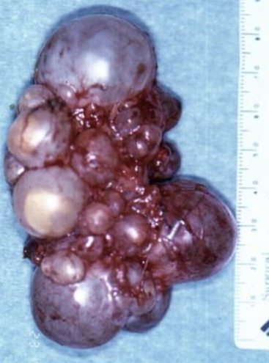


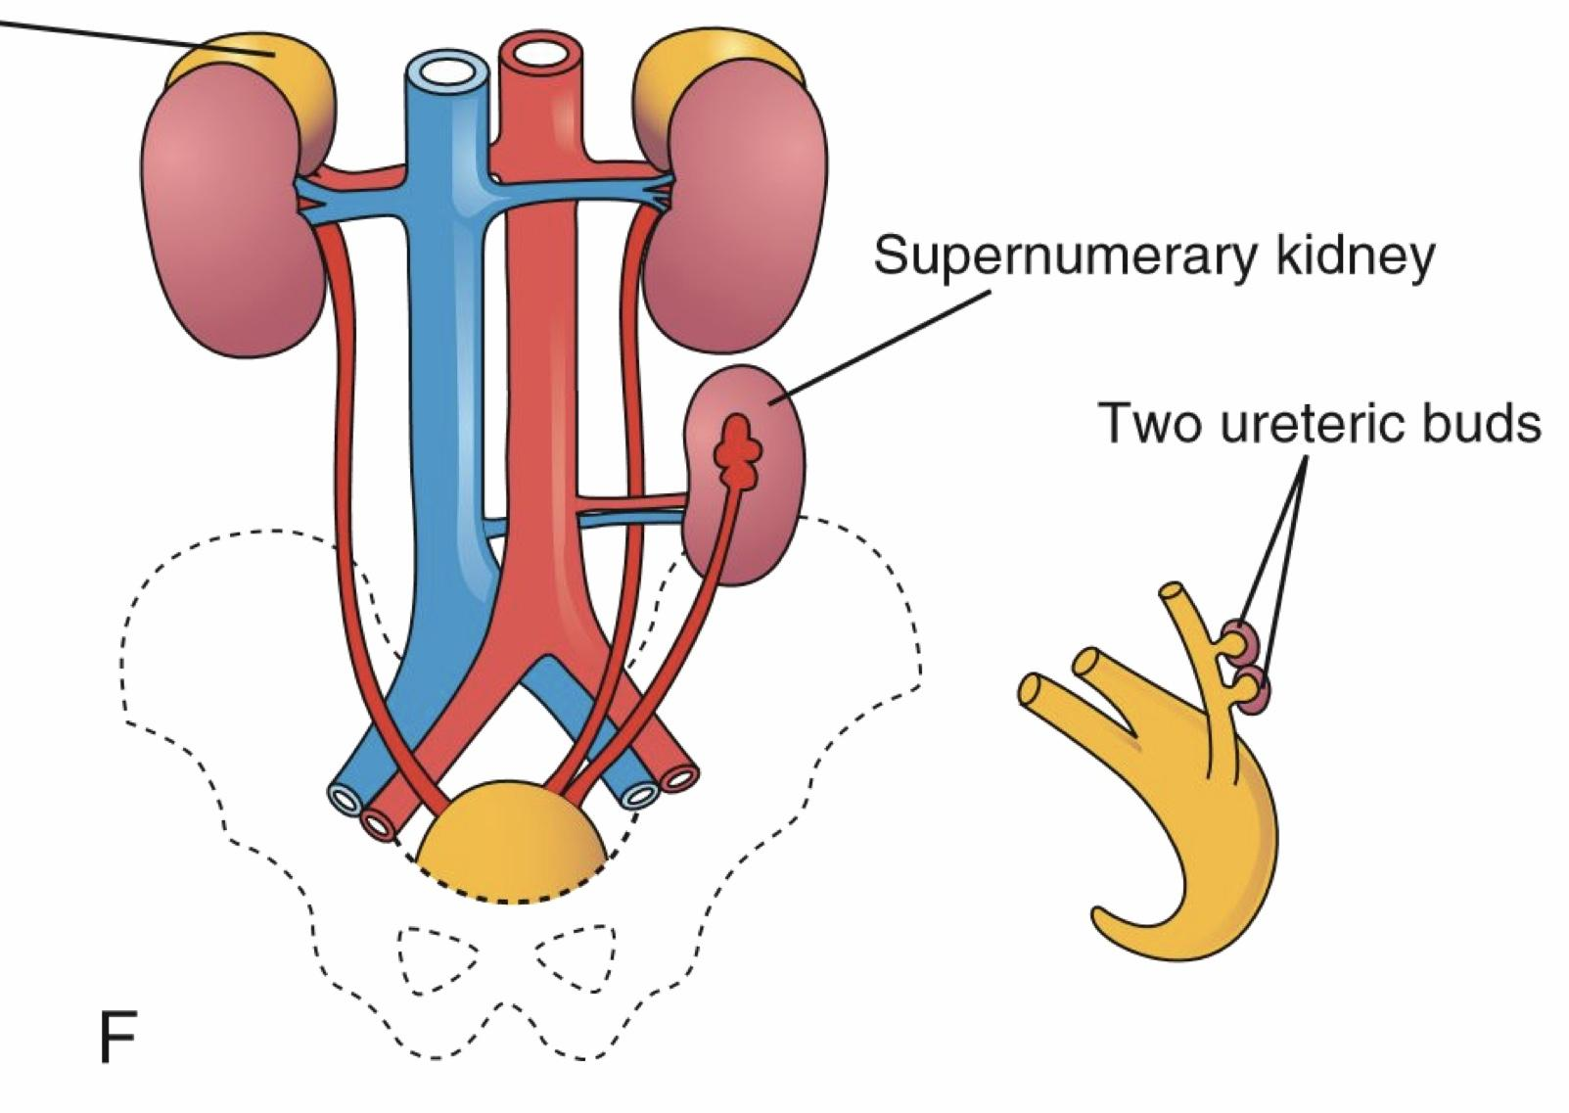
Congenital Anomalies of Kidney
Kidney anomalies
Number
Location
Supernumerary
More
agenesis
Less
Horseshoe
Joined
Rotation
Ectopia
Multicystic dysplastic kidney (MCDK) 2nd most common
There is a difference between MCDK and polycystic kidney disease
Unilateral
There is no renal tissue, only disturbed cysts & there is no communication between them
Ultrasound: Very thin and abnormal renal parenchyma, surrounded by multiple cysts of various sizes that do not connect, nor they connect to the renal pelvis. Urine differ from UPJO case by bring in-organized in distribution (No Mickey mouse sign unlike in UPJO )
Prenatal US
Incidental in Neonates/Children
Symptomatic same other obstructive uropathy
Mass
UTI
Pain
DMSA: nuclear study to look for the function of kidneys
Little or no uptake of radionuclide
The difference between UPJO and MCDK in US that in MCDK there is NO or very little function (diagnostic).
MCUG/ VCUG (X-ray + contrast)
To detect if there is reflux or not, but now days not used routinely unless the patient symptomatic
Contralateral VUR
18%-43%
Diagnosis
Observation + follow up (asymptomatic)
Cyst fluid disappears
Surgical intervention (nephrectomy) indication:
Hypertension
Pain
Pyelonephritis
Management
Supernumerary Kidney:
Definitive accessory organ with its own collecting system, blood supply, and distinct encapsulated parenchyma.
Either completely separate or loosely attached to the kidney on the ipsilateral side.
The ureteral inter-relationships on the side of the supernumerary kidney can be variable.
detected by US confirmed by radiological like CT

Slide 4
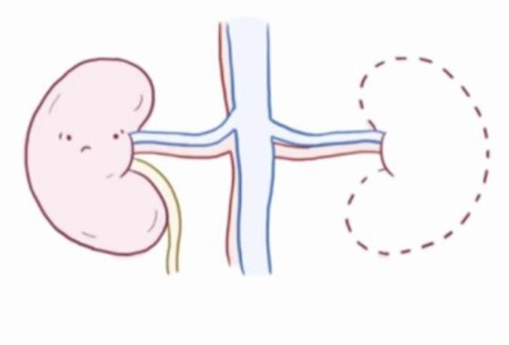
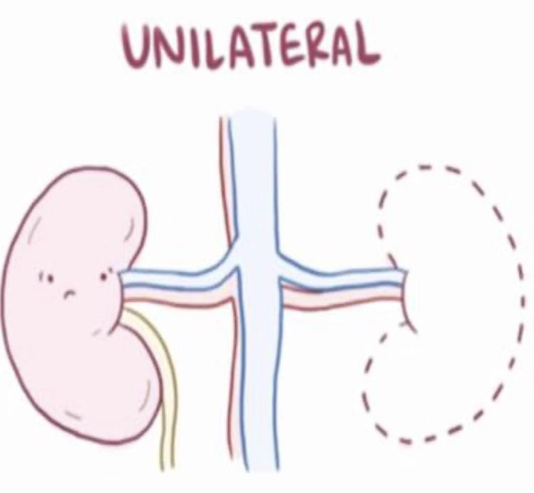
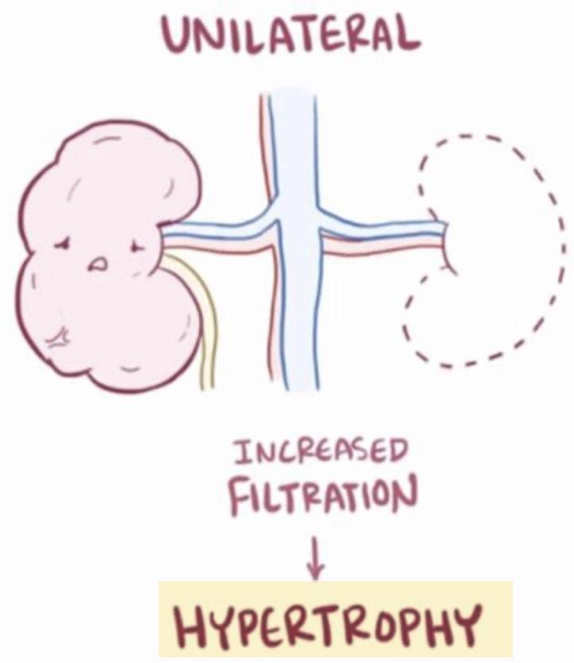
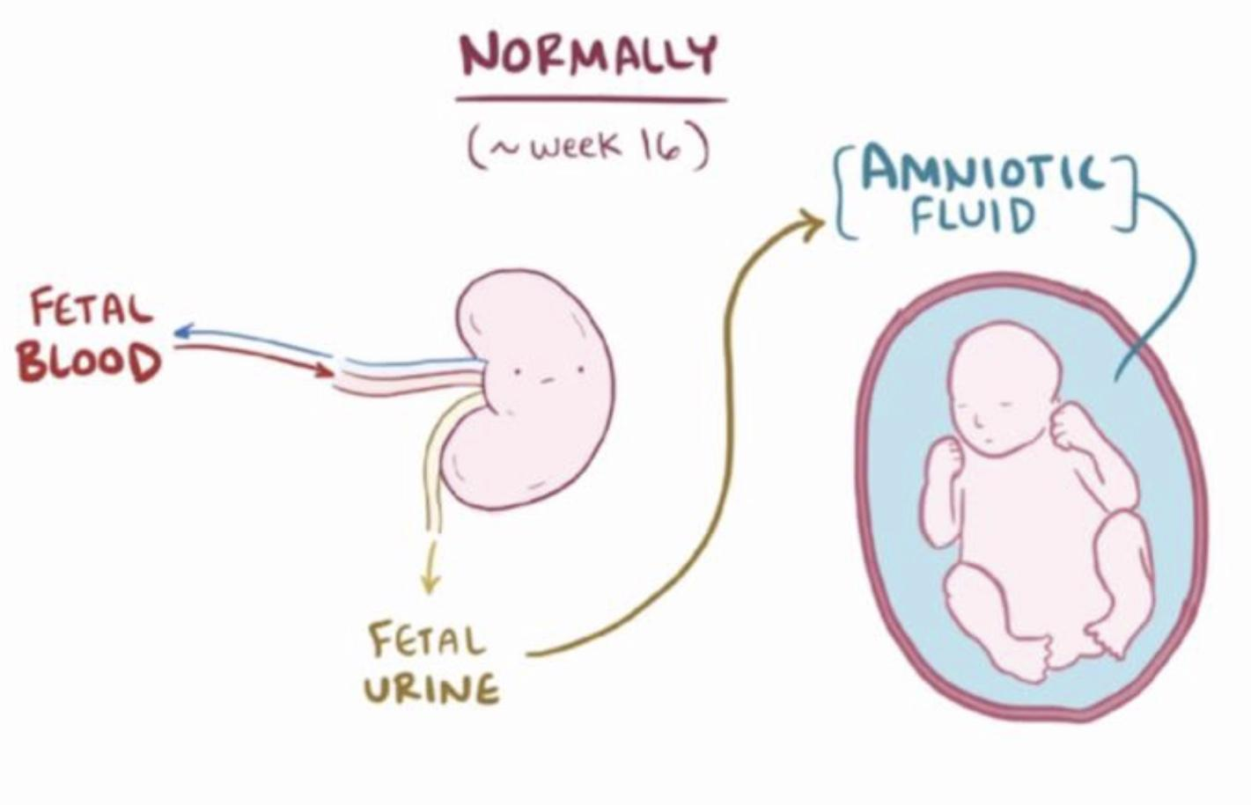
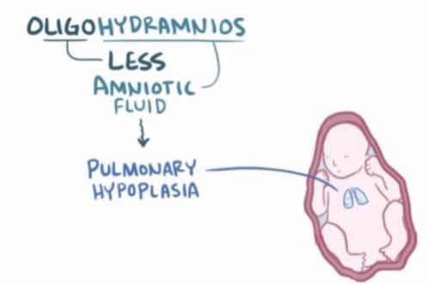
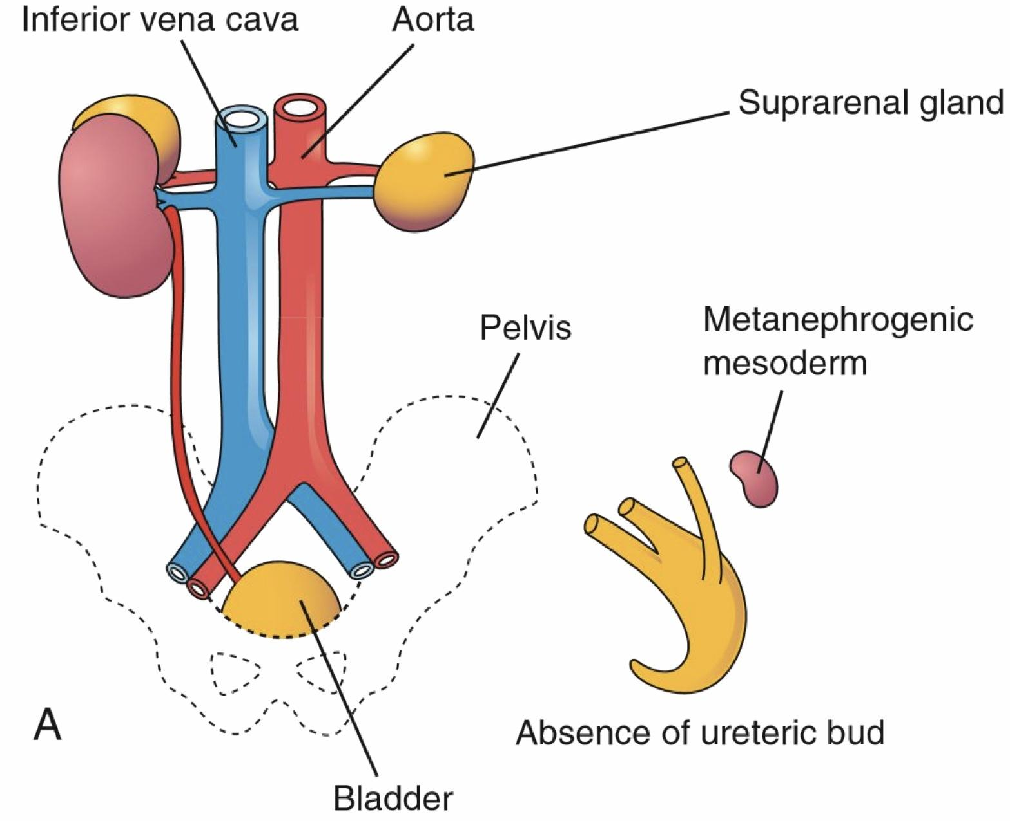
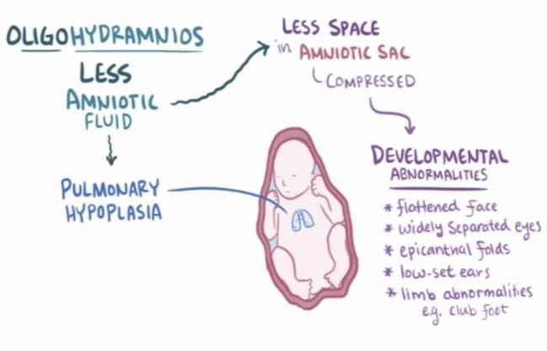
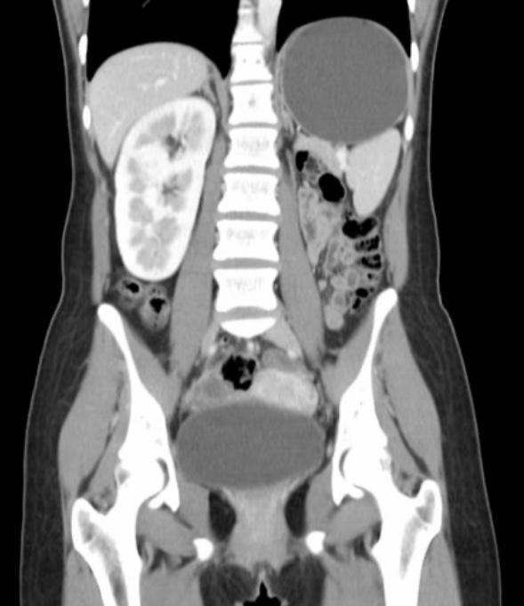
Kidney agenesis:
Unilateral Agenesis
Bilateral Agenesis rare
The blood flow normally goes to the each kidney 50%, in case of unilateral renal agenesis the blood flow 100% goes to the only kidney which with time will be exhausted and shows symptoms: Proteinuria, Pain and Hypertension, we must follow them annually with urinalysis, blood pressure and ultrasound
kidney form the amniotic fluid with urine
No kidney = no amniotic fluid = No space for the fetus to develop = Oligohydramnios leading to Potter's sequence
the most affected organ are the lungs (pulmonary hypoplasia)
1 in 1100 births
Male: Female of 1.8 : 1
The left side is absent more frequently
The ipsilateral ureter is completely absent in 50%
if the kidney is absent that doesn’t mean that the suprarenal gland will be absent too, because both have different embryological origin
This is called Potter face (associated with potter syndrome)
Associated anomalies
Associated anomalies
Anomalies of other organ systems are found frequently in affected individuals: CVS, GIT and MSC
Müllerian duct abnormalities:
25% to 50% of females
10% to 15% of males
Approximately one fourth to one third of women with Mullerian duct anomalies are found to have URA
Ureters are almost always absent.
Bladder is either absent or hypoplastic.
Adrenal glands are usually positioned normally.
Müllerian duct anomalies are commonly observed.
Diagnosis
Prognosis
Prenatal US
Incidentally:
Abdominal US
Abdominal CT
Confirmed: CT alone is not
enough since we might miss the diagnosis
Nuclear study (DMSA)
40% are stillborn.
Do not survive beyond 48 hours due to respiratory distress associated with pulmonary hypoplasia
Abdominal CT shows absent left kidney
DMSA shows if there’s renal tissues or not

Slide 5
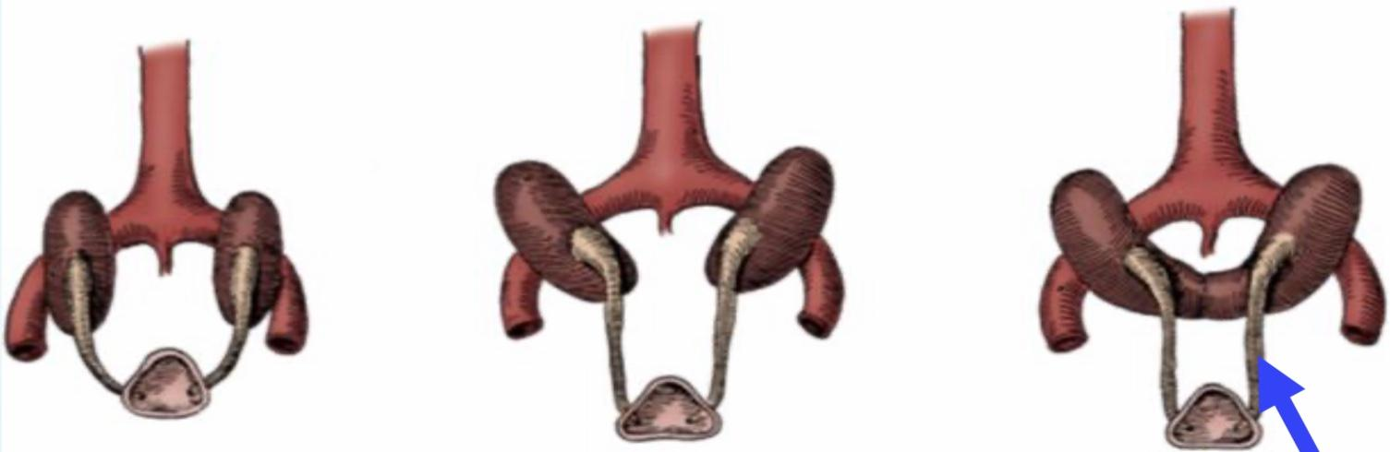

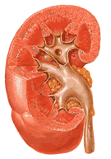
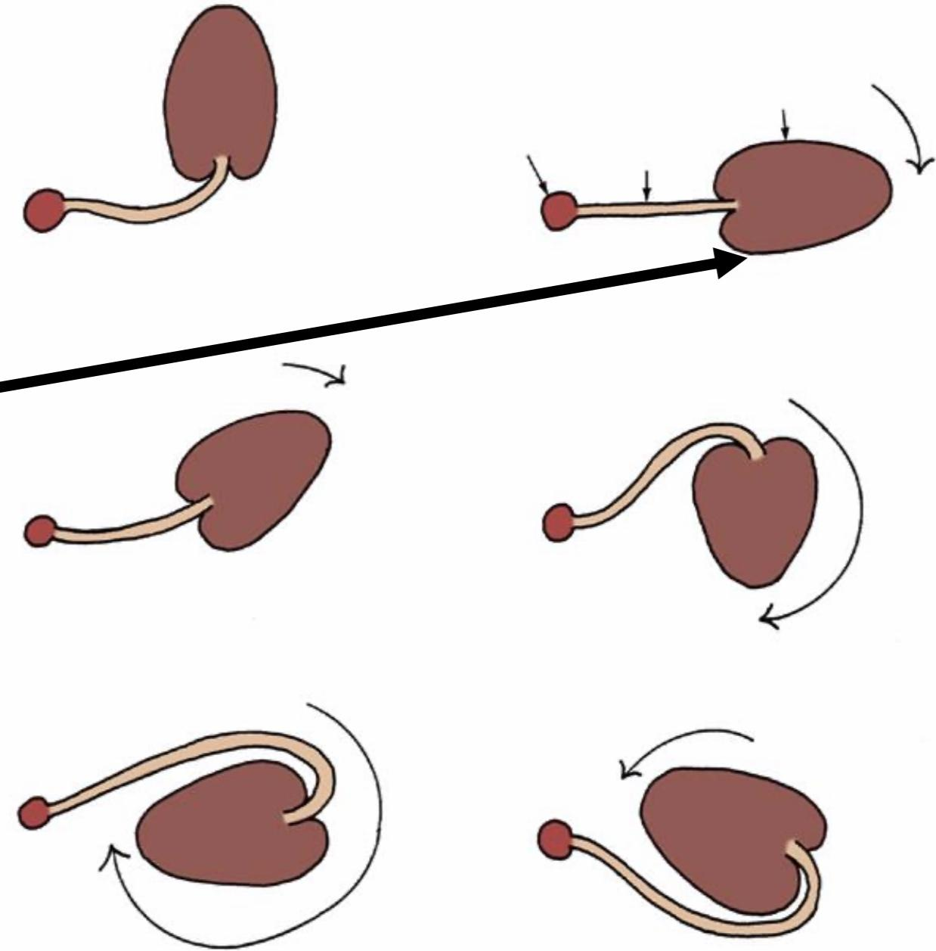
Horseshoe Kidney:
Occurs 1 in 400 persons
Normally the kidneys in the embryological life is inter-pelvic structure facing anteriorly, & with time it will ascend to the normal position.
sometimes for unknown reason, the 2 kidneys fuses together and connected at lower poles (90%) or upper poles (10%) forming the classical horseshoe kidney.
Each kidney is drained by its own ureter.
The calyces by ultrasound or CT:
normal in number
atypical in orientation
pelvis remains in the vertical or obliquely lateral plane
Horseshoe kidney is frequently found in association with other congenital anomalies.
UPJ (Ureteropelvic junction) obstruction in one third due to the acute angle of the ureter
60 % asymptomatic The rest 40% of Symptomatic patients is due to hydronephrosis (Surgery is required)
There is no surgery to separate the the 2 kidneys, we just treat the symptoms if it occurs (treat the associated pathology not Horseshoe kidney).
The isthmus is bulky and consists of parenchymatous tissue, it will get stuck under the Inferior mesenteric artery (failure of ascending)
Anomalies of rotation:
The kidney and renal pelvis normally rotate 90 degrees ventromedially during ascent
When this alignment is not exact, the condition is known as malrotation
Frequently associated with Turner syndrome
the calyces
point laterally
EXTRA Picture
the pelvis
faces medially

Slide 6
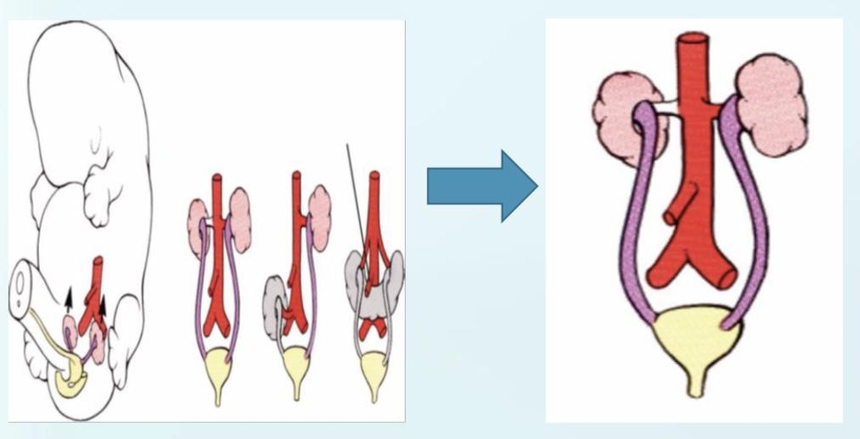
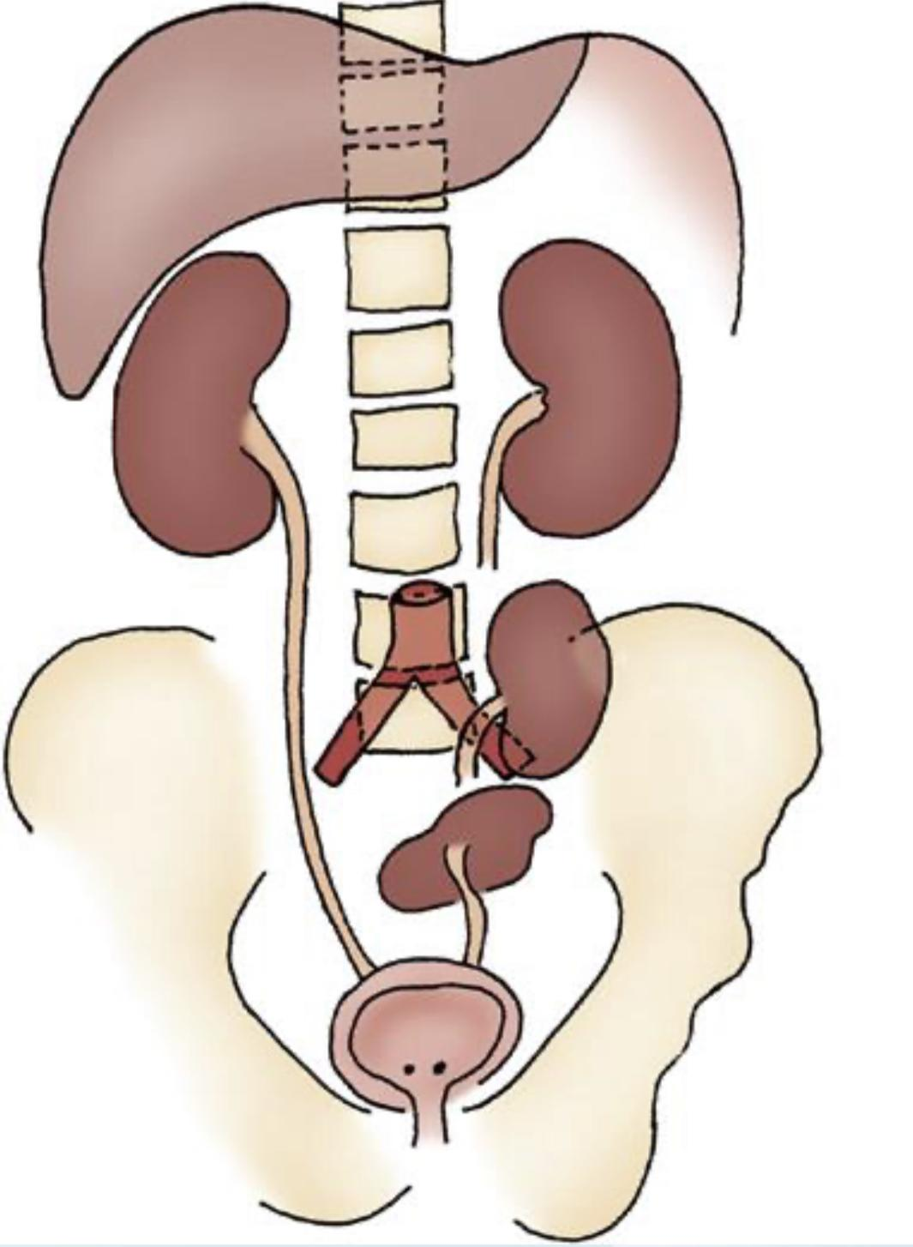
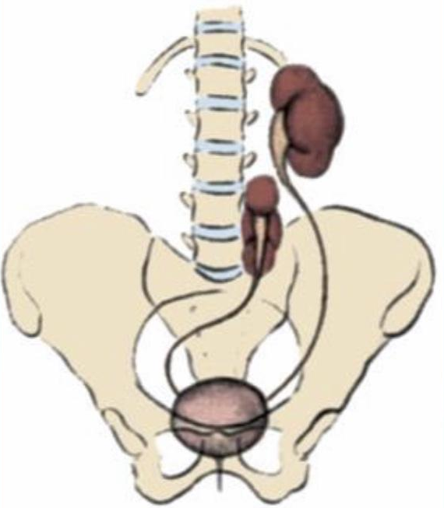
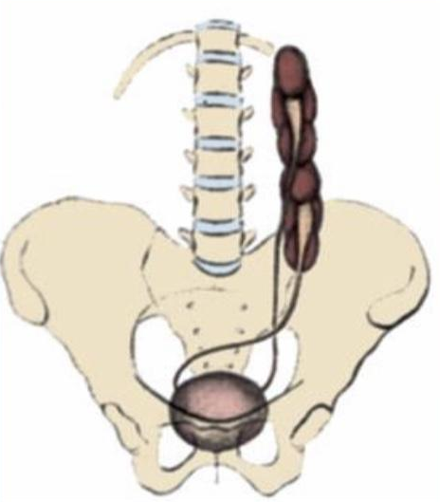
Renal Ectopia:
There is no need to do surgery, we just treat the symptoms if exist
Simple Renal Ectopia
The kidney arrested instead of ascending to its normal position in the same original side.
Left more than the right
1 of 2100 to 3000 autopsies.
Most ectopic kidneys are clinically asymptomatic
50% have a hydronephrosis:
Obstruction: UPJO and UVJO
Reflux (VUR): grade III or greater
Malrotation
Genital anomalies in the patient with ectopia is about 15%.
Associated Anomalies
Crossed Renal Ectopia
Crossed ectopia: kidney is located on the side opposite from that in which its ureter inserts into the bladder unlike simple ectopia
The ureter from each kidney is usually orthotopic
90% are fused: the superior pole of the ectopic kidney usually joins with the inferior aspect of the normal kidney.
Without fusion
With fusion

Slide 7
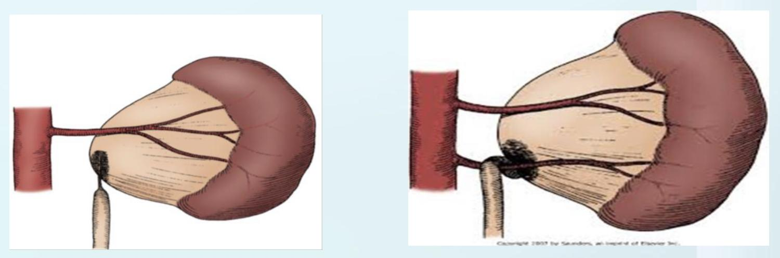
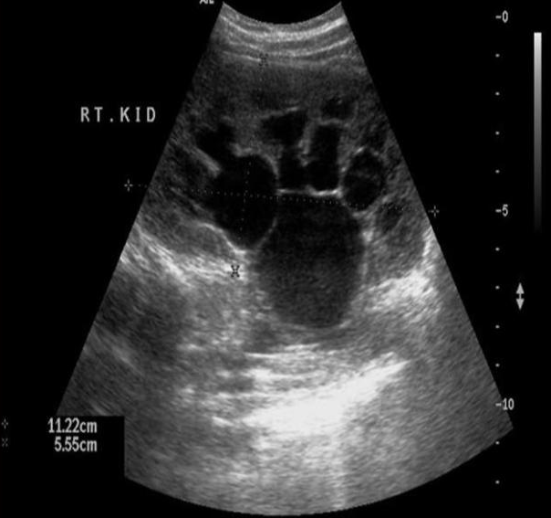
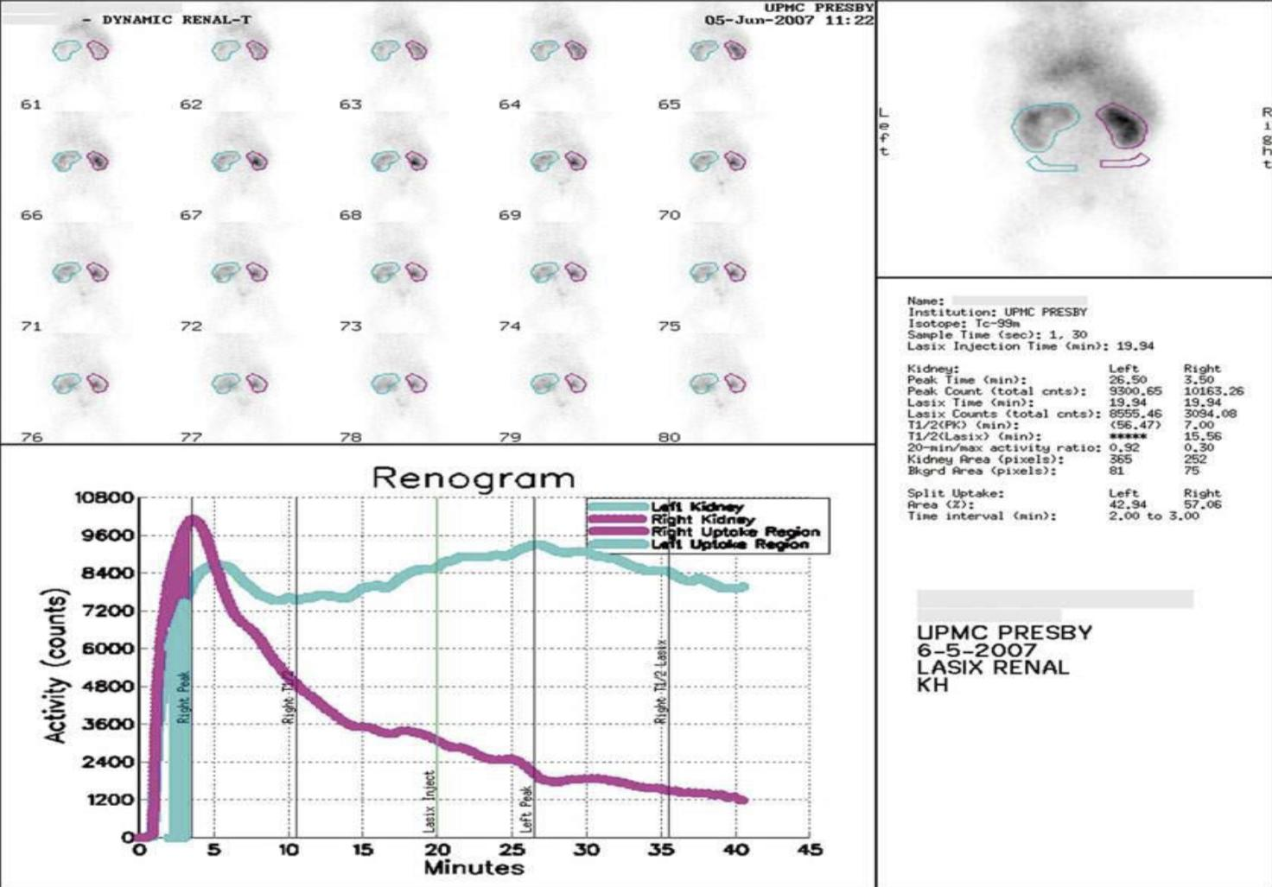
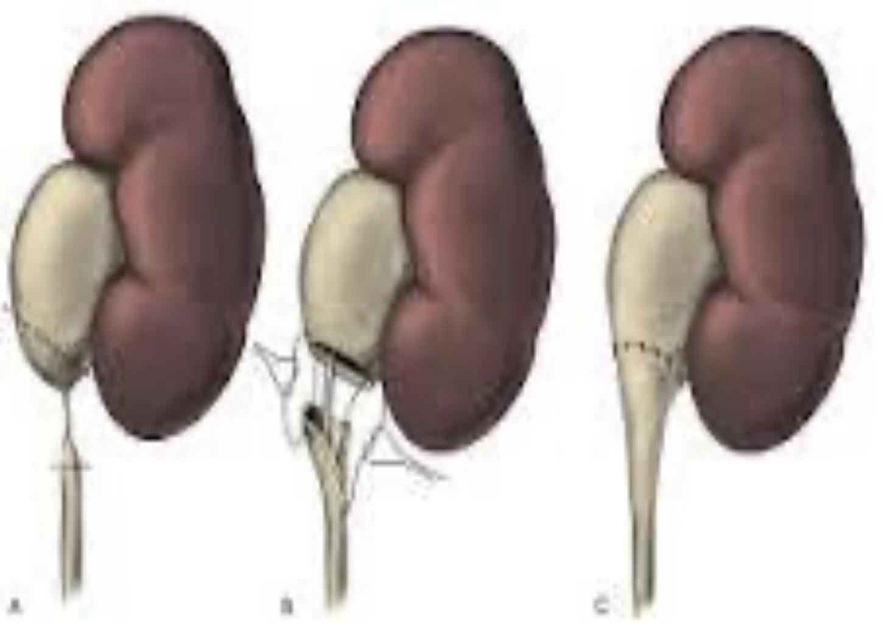
Congenital Anomalies of The Ureter
Ureteropelvic junction obstruction (UPJO) most common
Presentation
Prenatal US most cases
Incidental in Neonates/Children
By symptoms:
UTI: Pyelonephritis
Pain: Flank pain
Mass
Hematuria
Stone: Secondary to urine stagnation
It's not actually obstruction (if complete obstruction kidney loses its function) , Just narrowing of the ureter
First investigation¹ is US and shows Mickey Mouse sign:
Dilated renal pelvis
Dilated major and minor calyces
The dilatation and distribution of urine are organized unlike in (MCDK)
Ultrasound image showing only hydronephrosis (urine inside the kidney appears black)
Here longitudinally we see thinning of the renal parenchyma
Diagnosis
Dynamic renogram² used for conformation and to rule out obstruction as a cause for hydronephrosis. It shows:
Washout curve the right kidney curve reaches the top and then drop immediately means there is excretion and draining. The left doesn’t drop so there is an obstruction
Function: we measure the uptake of isotopes by the kidneys, the summation of both kidneys uptake should be 100% (e.g if it is 30% for 1 kidney then it'll be 70% for the other). Normally each kidney takes 50%
Observation: We wait first and observe there may be spontaneous resolution of the hydronephrosis
Surgical intervention:
Worsening hydronephrosis
Renal function: in dynamic studies if one kidney functions less than 40% or deteriorating more than 10% after follow up.
Pyelonephritis: On top of the pre-existing hydronephrosis
Stone formation
Dismembered Pyeloplasty
we cut the area of narrowing and reattach the ureter, there are a lot of techniques that can be used, but this is the most common one used
Management
When hydronephrosis observed the next step is to rule out vesicoureteral reflux by MCUG since VUR is a more common cause of hydronephrosis than ureteric obstruction
There are 2 studies DTPA and MAG-3 (isotope renography): determines whether the dilatation of the pelvis and calyces is truly obstructive in nature

Slide 8
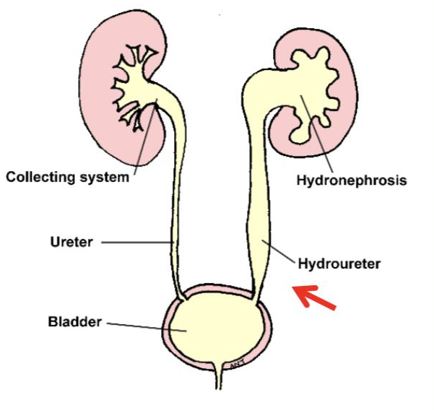
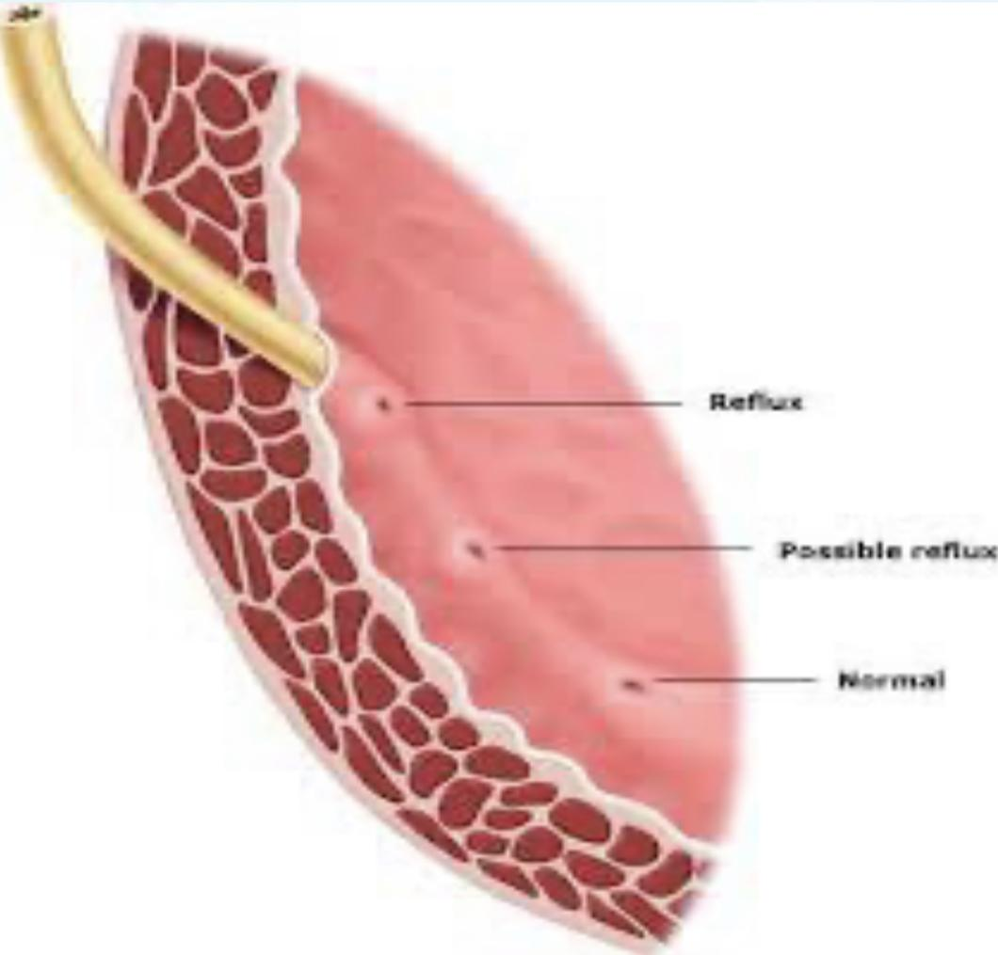
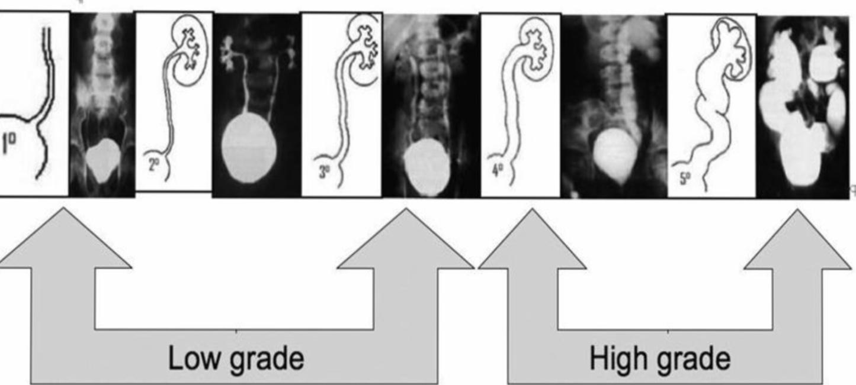
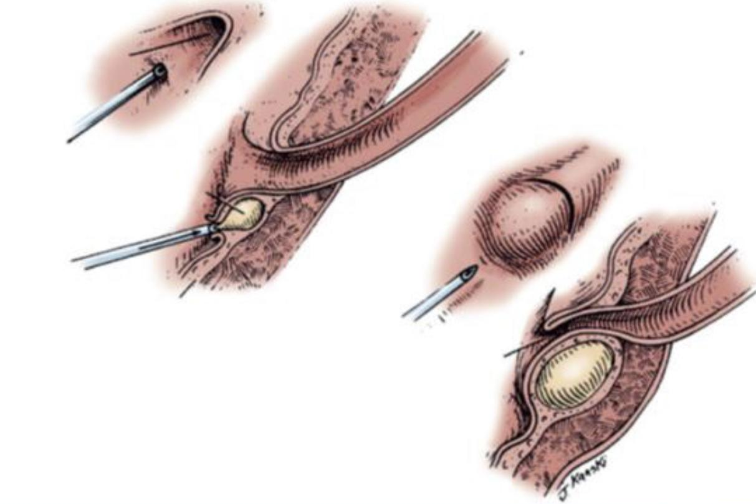
Ureterovesical junction obstruction (UVJO) (Megaureters) 5th most common
Diagnosis
Management
MCUG will be normal
We wait there might be spontaneous resolution, the indication for surgery same as UPJO but the procedure here is Ureteral reimplantation
the obstruction between ureter and bladder dilation of the renal pelvis and ureter (hydrouretronephrosis)
In US dilated kidney
Normally we don’t see ureter but here the ureter is dilated
Vesicoureteral Reflux (VUR) 3rd most common:
Normal anti-reflux mechanism “Flap valve”
Presentation:
Asymptomatic
Prenatal
Fluctuated dilatation
Febrile UTIs
01
Oblique course as it enters the bladder
02
Proper muscular attachments to provide fixation
Reflux¹
03
Posterior support to enable its occlusion
Possible reflux
X-Ray with contrast
normally the contrast stays in the bladder, If there’s any contrast going up it means there’s a reflux which is Abnormal
Normal
04
Adequate submucosal length
MCUG (VCUG): we stage it for treatment: low grade 1,2,3 no need to treat surgically (Spontaneous resolution of reflux) give patients prophylactic antibiotics to prevent UTIs unlike high grade 4,5 needs surgery
Prophylactic antibiotic: Spontaneous resolution
Surgical treatment:
Recurrent pyelonephritis on antibiotic prophylaxis (outbreak infection)
Noncompliant with medical treatment
Persistence of reflux (high grade)
Diagnosis
Management
Endoscopic treatment
Ureteral reimplantation
higher success rate
Short ureter length entering the bladder result in primary reflux: in children may correct on its own if it is not associated with any other abnormality. Secondary reflux: If the abnormality in the bladder or urethra or in adults needs definitive surgical management in the form of vesicoureteroplasty

Slide 9
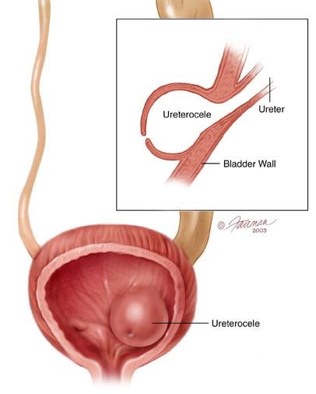
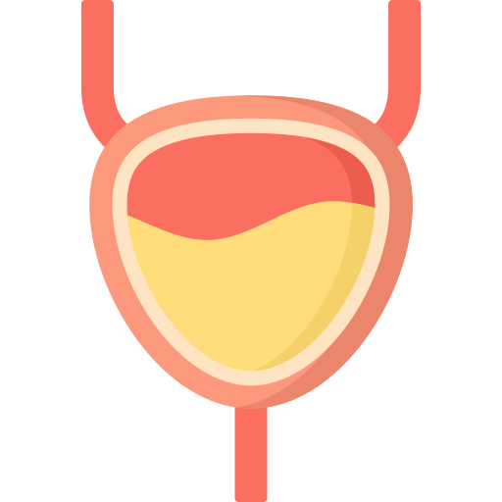
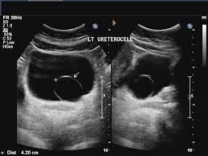
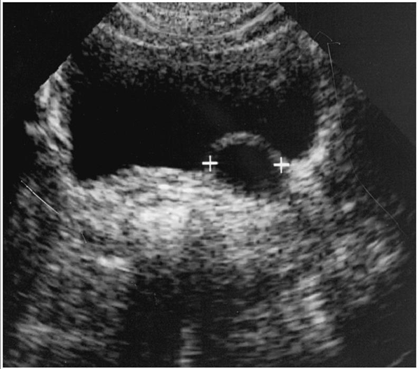
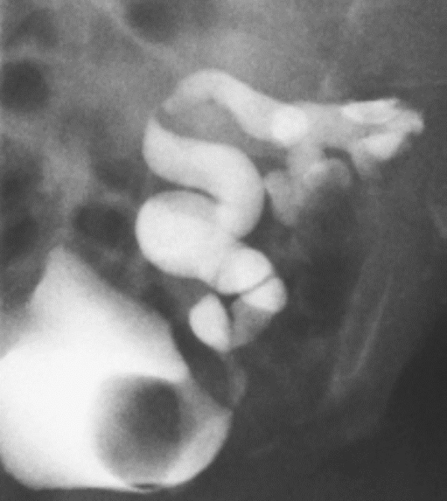
Ureterocele
A cystic dilation of the distal aspect of the ureter
Either within the bladder
or spanning the bladder neck and urethra
Ureterocele cause obstruction and the ureter will be dilated
Initial treatment is (Endoscopic incision of ureterocele)
Not indicated if there’s no back pressure.
Presentation:
Antenatal (U/S).
01
03
Calculus formation.
Urine retention.
02
04
Infection.
Investigations:
Ultrasound
The best modality.
You can see the bulging distal ureter, which is stenosed and prevent urine to reach Urinary Bladder -the stenosis severity may vary from mild to complete occlusion-
MCUG-micturating cystourethrogram
Used for confirmation.
Picture Showing filling defect of bladder.

Slide 10

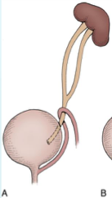
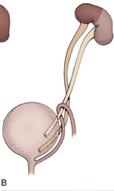
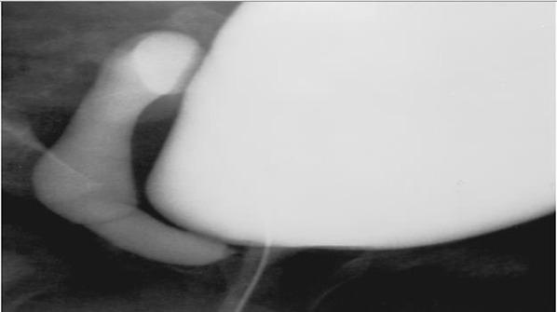


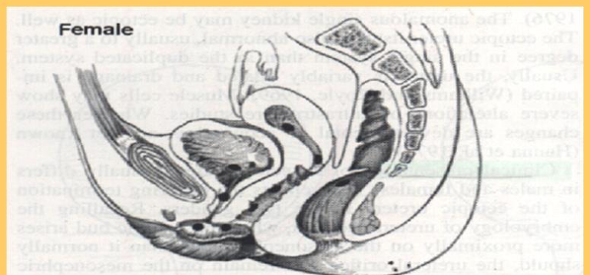
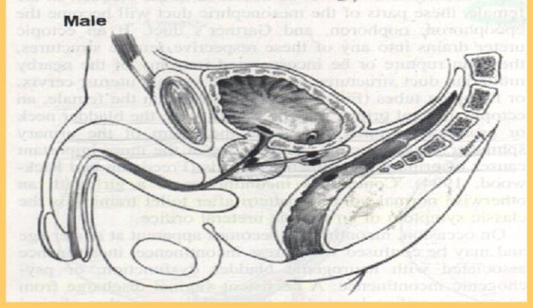
Duplication Anomalies of ureters.
Associated with:
Reflux 43 %
Renal dilatation 29%
Ectopic insertion 3%
Ureterocele
1% of all births
1.6:1 female to male ratio
85% unilateral
Incomplete duplications
Complete duplications
obstructed ureter
Refluxing ureter
There are 2 moieties (upper & lower) of renal pelvises & ureter.
Usually, upper moiety of (ureter & Kidney) is Associated with obstruction
Lower moiety Associated with reflux “bcs the ureter is short”
2 renal pelvises drain into 2 separate ureters that join together distally and form a single ureter
Ectopic Ureter
An ectopic ureter is any ureter, single or duplex, that doesn't enter the trigonal area of the bladder.
The ectopic ureter may open into abnormal site in the urinary bladder, or outside the urinary bladder (most severe) (99% are found out the bladder, most cases open into urethra)
In females the ectopic ureter may enter anywhere from the bladder neck to the perineum and into the vagina, uterus,and even rectum.
One of the classic symptoms is continuous wetting
In males the ectopic ureter always enters the urogenital system above the external sphincter or pelvic floor, and usually into the wolffian structures including vas deferens, seminal vesicles, or ejaculatory duct.
Symptoms occurs as recurrent infections of “all the pathway, E,g : epididymitis”
Dribbling incontinence in a child should raise the suspicion of an ectopic ureter, in which the ureter from the upper pole opens outside the control of the urethral mechanism. The abnormal ureter must be reimplanted in the bladder.

Slide 11

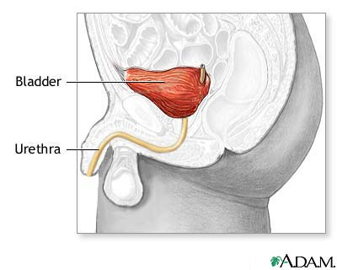
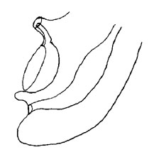
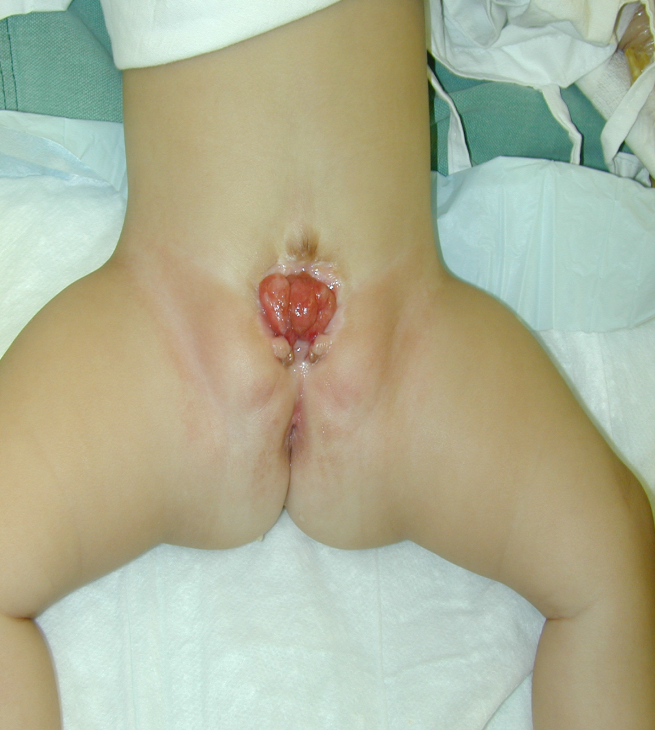
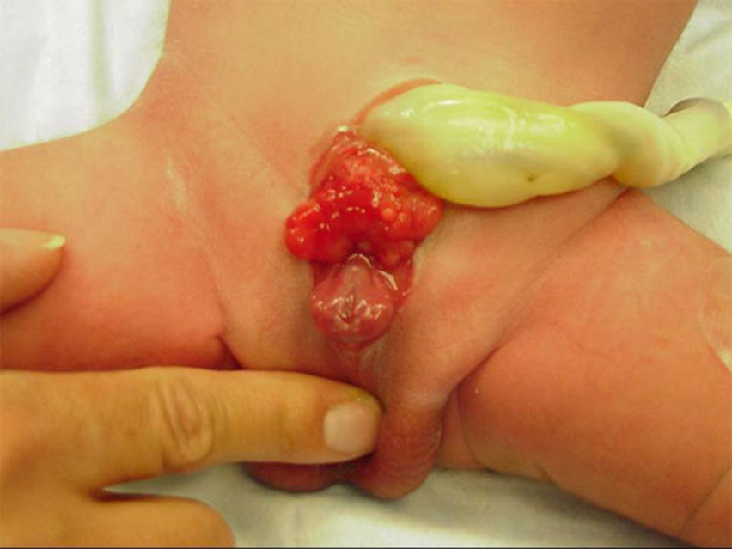
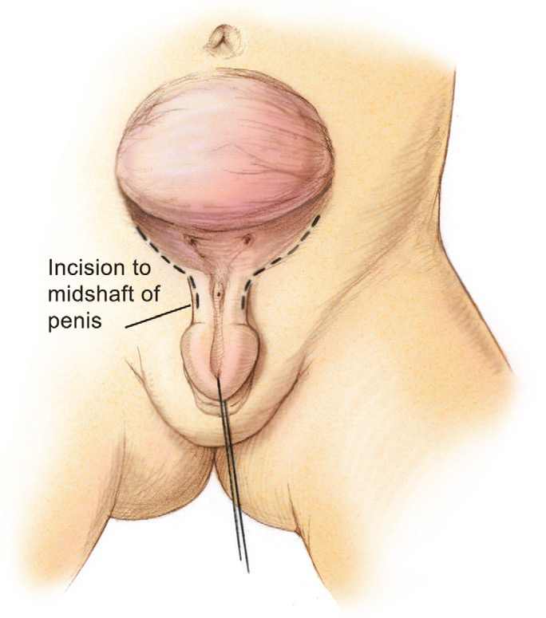
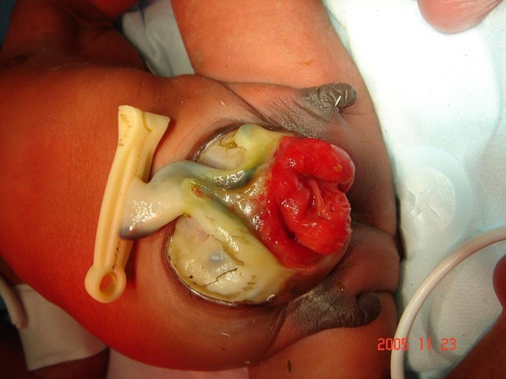
Congenital Anomalies of the Bladder
Bladder exstrophy
Bladder Exstrophy
The incidence of bladder exstrophy has been estimated as between 1 in 10,000 and 1 in 50,000.
Exstrophy means “inside-out”, the inside of the bladder here is exposed to the outer
It is a urological emergency
The bladder is normally covered by skin, subcutaneous tissue & 3 muscle layers. In this anomaly these coverings will be absent
Usually presents as complex with epispadias.
A
B
Bladder Exstrophy- Epispadias complex
Pictures are very important
Picture A : Female
Picture B: Male, there’s testes
Cloacal Exstrophy
1 per 200,000 live births (Rare, but serious)
Cloaca is the embryologic origin that divides into bladder and rectum.
It is a urological emergency
GI tract is involved here.
In the bladder exstrophy, the bladder is opened to the outside but the GI is intact and there is an anal opening, But here, there is no anal opening and all systems are open together.
Associated anomalies:
Omphalocele
Gastrointestinal anomalies: Malrotation, duplication, duodenal atresia and Meckel diverticulum
Genitourinary anomalies: Separate bladder halves and bifid genitalia

Slide 12
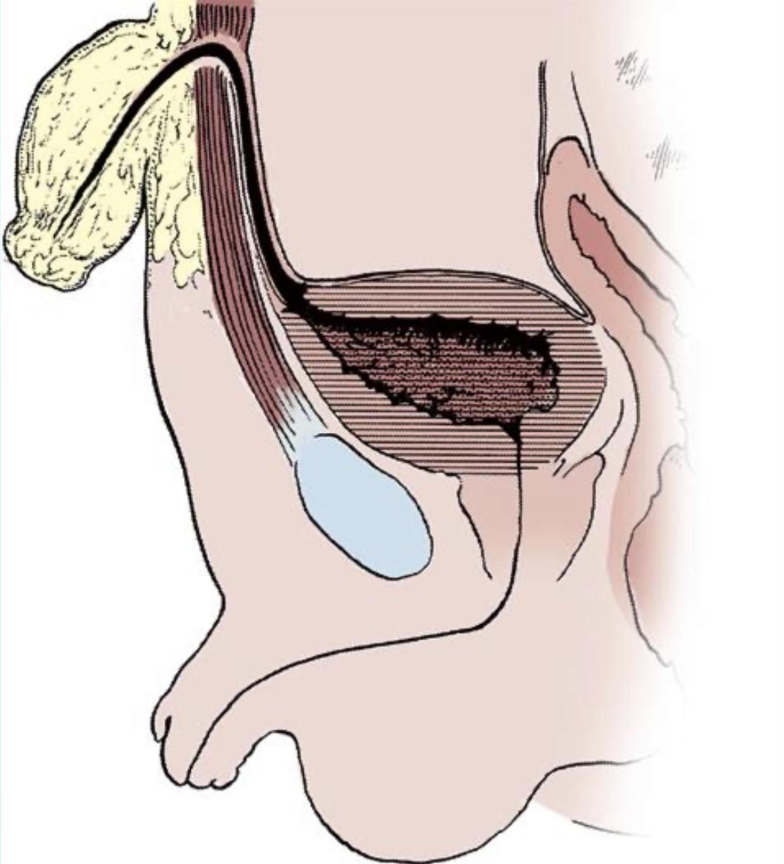
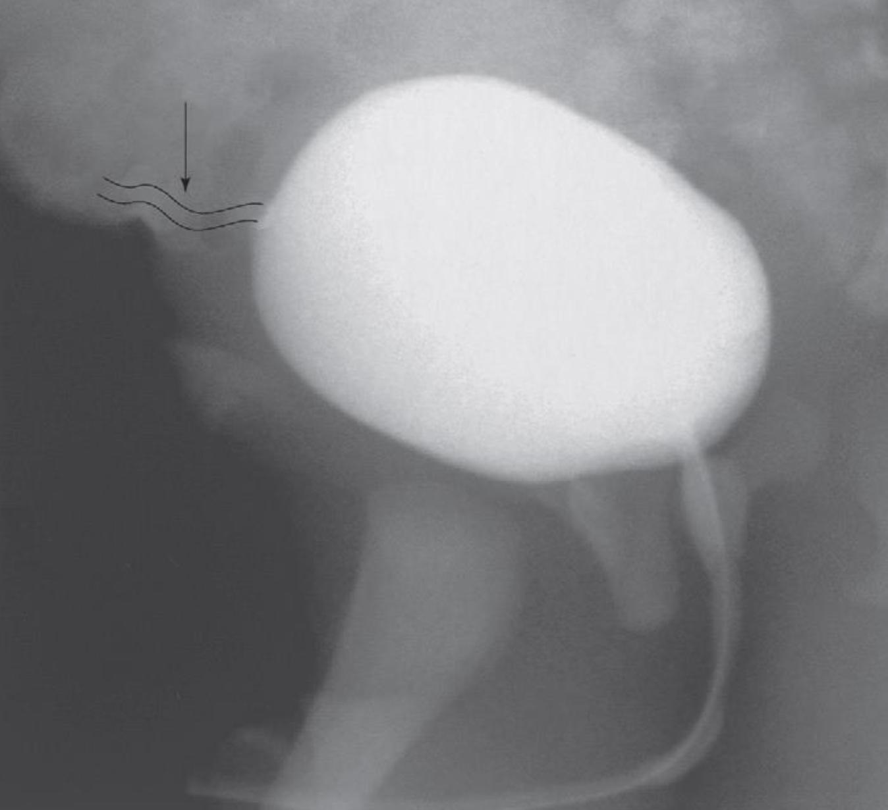
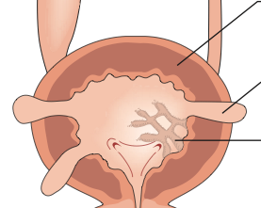
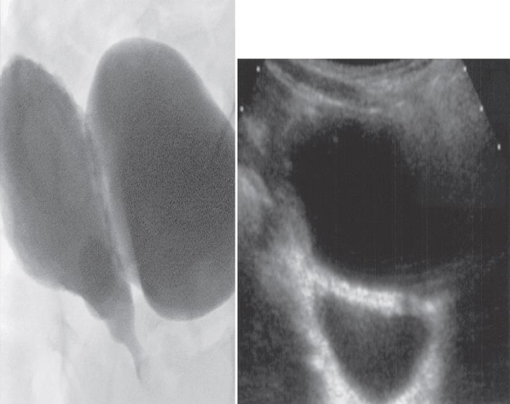
Urachal Abnormalities
Usually detected postnatally due to umbilical drainage mother complain of wet umbilicus
The urachus runs from the apex of the bladder to the umbilicus. It is normally obliterated at birth - closed at its end- but may give rise to cysts, a urinary fistula, or a discharging umbilical sinus if parts of it remain patent. Symptomatic remnants require excision.
The only normal part in this urethra is the distal urethra
Imaging possibilities include ultrasound, CT, and VCUG.
01
02
03
Asymptomatic patients
Infected urachal remnant
Non-resolved urachal remnants
Conservative treatment with observation due to possible spontaneous resolution.
Usually in urachal sinus. Initially are treated with drainage and antibiotics, followed by surgical excision.
should be excised due to the increased risk of later adenocarcinoma formation
Bladder Diverticulum
Primary Diverticula: Arises as a localized herniation of bladder mucosa at the ureteral hiatus & are most likely caused by a congenitally deficient bladder wall “weak wall = forming a sac”.
EXTRA Picture
Secondary Paraureteral Diverticula: Are acquired and develop due to existing infravesical obstruction. Usually due to chronic retention.
Bladder diverticula can be detected on prenatal ultrasound.
The gold standard remains VCUG (Voiding cystourethrogram), which will reveal possible accompanying VUR
We don’t treat unless it’s Symptomatic diverticula, Especially in conjunction with VUR or if it’s very large should be treated surgically
Diagnosis and Management

Slide 13
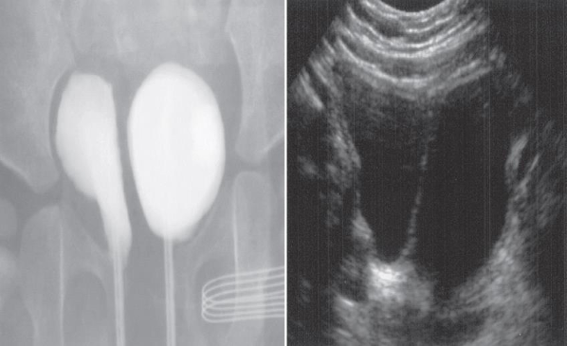
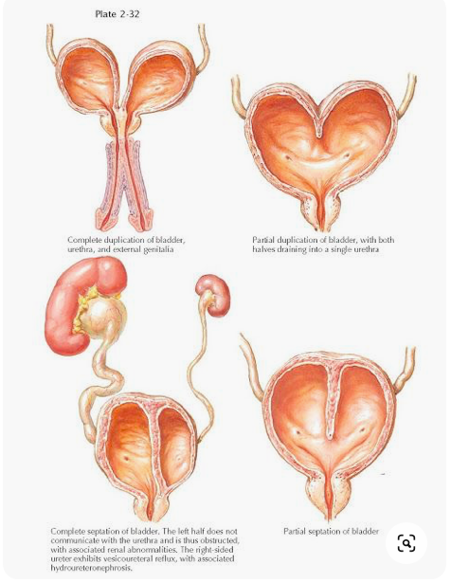

Bladder Duplication
Bladder duplication is often associated with duplication anomalies of the external genitalia & lower GIT
Presentation vary depending on the abnormality. It may presents with separated urethra or with common urethra, one genitalia or more than one
01
Initial treatment:
Directed towards renal preservation.
Prevention of infections
Long term goal:
Achieving continence and reconstructing the internal and external genitalia
Due to the rarity of the disease & the large variety of presentation, the surgeries must be individualized
02
We connect the two bladders and make one external urethral meatus
You deserve a break!

Slide 14
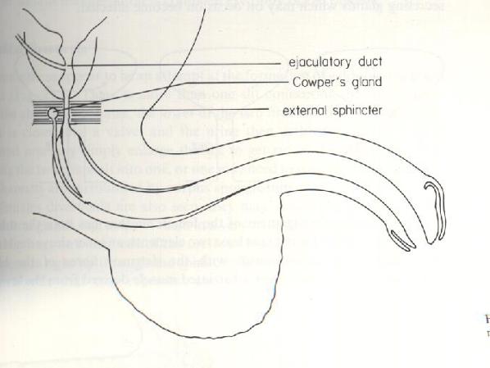
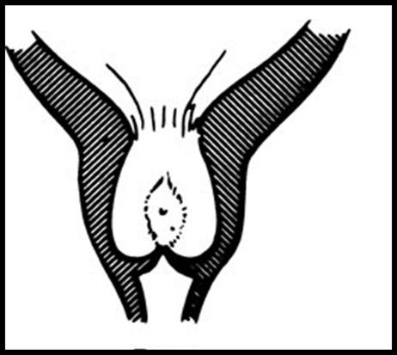
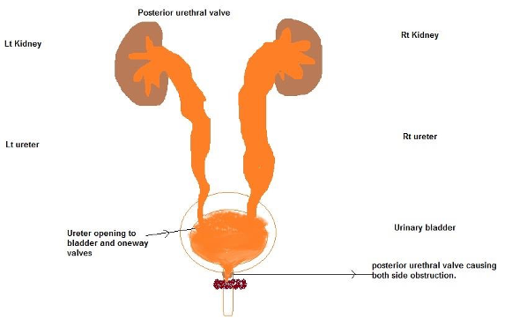






Urethra and external genitalia.
Posterior Urethral Valves (PUV) 4th most common
It’s an extra tissue that grow in posterior part of urethra and “narrow, not completely close” the opening of bladder
Disease of boys, it’s not common but serious, why? B/c the obstruction will affect all urinary tract (universal obstruction of urinary tract)
There’s another anomaly called (Anterior UV), but it’s very rare.
1 in 8000 to 25,000 live births
Make up 10% of urinary obstructions diagnosed in utero
Most common cause of urine retention in male infants
50% have renal impairment.
Associated Findings
Presentation usually is antenatally by US
Urine retention, UTI, Poor urinary stream, Urinary incontinence, CRF (ESRD)
Features of classic case presentation
Boy, bilateral hydronephrosis and has bilateral hydroureter with thickened bladder, Keyhole sign on Ultrasound
The in utero bladder and the kidneys developed under high pressure and resistance (Kidney start to produce urine at age of 20 weeks.) So it’s associated with:
Oligohydramnios Detected by US prenatally
Bilateral renal Dilatation
VUR: 40%
Valve bladder
Renal impairment
01
02
PUV Investigations
PUV Treatment
Initial treatment (whatever patient condition, we start by these to stabilize patient:
Feeding tube insertion
Start antibiotic prophylactic
MCUG & U/S
Surgical treatment:
Endoscopic valve ablation: Classic treatment, simply to cut the extra tissue by a knife “only cutting, not removing”
Cutaneous Vesicostomy: In patients with renal failure or low birth weight, After 1 year, we do endoscopic valve ablation.
Keyhole sign
In U/S you can see bilateral hydronephrosis & thickened bladder wall.
Anterior urethra is normal but posterior urethra is dilated
Sometimes there is reflux
MCUG is the best choice for diagnosis
The only normal part in this urethra is the distal urethra
Dilated part of urethra “between extra valve and bladder”

Slide 15





Hypospadias 6th most common & Epispadias
Hypospadias
Epispadias
Very Common
Abnormal position of the EUM (external urethral meatus) on the ventral (towards the scrotum) surface
Types:
The closer to original meatus called: Distal hypospadias
If the opening closer to the scrotum, it called: Proximal hypospadias
The more proximal the opening, the more severe it is.
The corpus spongiosum may be scarred and fibrosed, leading to a ventral curvature or chordee of the penis
NO Circumcision (Absolute contraindication, because we need this skin for reconstruction of the meatus in the future)
6 to 9 months repair (Surgery before 6 months associated with poor outcome).
The aim of treatment is to correct the chordee by excising the fibrosis, and then to construct a new urethral opening in the normal position on the glans. This procedure should be ideally completed before the boy goes to school
Very rare
Ectopic opening of the external urethral meatus in the dorsal side.
Females present with continuous urinary incontinence
Other associated abnormalities include separation of the symphysis pubis and rectal prolapse.
Reconstruction of these deformities is not always successful, and urinary incontinence may remain a major problem and require urinary diversion.
Female
Male

Slide 16








GU congenital anomalies: Others
Prune-Belly syndrome
Others names:
Triad syndrome
Eagle-Barrett syndrome
Abdominal musculation syndrome
The incidence: 1:29,000 to 1 in 40,000 live birth.
The 3 major findings (triad):
Three systems are affected: musculoskeletal, urinary and genital
02
Bilateral intra- abdominal testes no intra abdominal pressure to descend the testes
Deficiency of the abdominal musculature (You can see the bowel movement very clearly)
01
03
Anomalous urinary tract bilateral hydroureteronephrosis and an enlarged bladder same as PUV
Neuro-Spinal Dysraphisms (Dysraphisms means incomplete fusion)
The most common cause of neurogenic bladder dysfunction in children is abnormal development of the spinal canal and internecine spinal cord
Cutaneous lesions occur in 90% of children with various occult dysraphic states (Any mass or abnormality that compress or compromise the spinal cord may affect the bladder function. So, don’t forget to examine the back of any patient who is presenting with urological symptoms)
Lesions vary like:
small lipomeningocele.
Needs immediate surgical intervention
01
04
Hair Patches
(Spina bifida occulta)
Abnormal Gluteal cleft
02
This patient have cafe au lait spots
Sacral Dimples
03
05
Dermal Vascular malformation

Slide 17
Summary
 | Presentation | Association | Diagnosis | Management
MCDK | Symptomatic Mass UTI Pain | Contralateral VUR 18%-43% | Prenatal US Incidental in Neonates/Children DMSA: Little or no uptake of radionuclide MCUG/ VCUG: now days not used routinely unless the patient symptomatic | Observation Surgical intervention: : Hypertension Pain Pyelonephritis
Super numerary kidney | - | - | By US | -
Unilateral renal agenesis | If there’s symptoms: Proteinuria, Pain and Hypertension | Anomalies of other organ systems: CVS, GIT and MSC Müllerian duct abnormalities | Prenatal US Incidentally: Abdominal US Abdominal CT DMSA: confirm | If symptomatic follow them annually with urinalysis, blood pressure and ultrasound
Bilateral renal agenesis | Do not survive beyond 48 hours due to respiratory distress associated with pulmonary hypoplasia | Ureters absent Bladder absent or hypoplastic Adrenal glands normal Müllerian duct abnormalities | - | Do not survive beyond 48 hours due to respiratory distress associated with pulmonary hypoplasia
Horseshoe kidney | - | UPJO | The calyces by ultrasound or CT: normal in number atypical in orientation pelvis remains in the vertical or obliquely lateral plane | There is no surgery to separate the the 2 kidneys, we just treat the symptoms
Simple renal ectopia | Mostly asymptotic | 50% have a hydronephrosis: Obstruction: UPJO and UVJO Reflux (VUR): grade III or greater Malrotation 15% Genital anomalies | - | There is no need to do surgery, we just treat the symptoms if exist

Slide 18
Summary
 | Presentation | Association | Diagnosis | Management
Crossed renal ectopia | - | 90% are fused | - | There is no need to do surgery, we just treat the symptoms if exist
UPJO | UTI Pain Mass Hematuria Stone | only hydronephrosis | Prenatal US: only hydronephrosis Incidental Dynamic renogram used for conformation | Observation Surgical intervention (Dismembered Pyeloplasty): Worsening hydronephrosi deteriorating Renal function Pyelonephritis Stone formation
UVJO | - | Hydrouretronephrosis | US: dilated kidney | We wait there might be spontaneous resolution, the indication for surgery same as UPJO but the procedure here is Ureteral reimplantation
VUR | Asymptomatic Febrile UTIs | - | MCUG (VCUG | Prophylactic antibiotic: Spontaneous resolution Surgical indication: Recurrent pyelonephritis on antibiotic prophylaxis (outbreak infection) Noncompliant with medical treatment Persistence of reflux (high grade) Procedure: Ureteral reimplantation Endoscopic treatment
Ureterocele | Antenatal US Urine retention Calculus formation Infection | - | US: the best modality MCUG: confirmation | Endoscopic incision of ureterocele: not indicated if there’s no back pressure

Slide 19
Summary
 | Presentation | Association | Diagnosis | Management
Ureter duplication | - | Associated with: Reflux 43 % Renal dilatation 29% Ectopic insertion 3% Ureterocele | - | -
Ectopic ureter | Recurrent infections of “all the pathway, classic symptom in female is continuous wetting | - | - | reimplantation in the bladder
Bladder exstrophy | Emergency coverings above bladder will be absent | Usually presents as complex with epispadias. | - | -
Cloacal exstrophy | Emergency GI is involved | Omphalocele Gastrointestinal anomalies Genitourinary anomalies | - | -
Urachal abnormalities | Usually detected postnatally due to umbilical drainage mother complain of wet umbilicus | - | ultrasound CT VCUG | Asymptomatic patients: conservative Infected urachal remnant: drainage and antibiotics, followed by surgical excision Non-resolved urachal remnants: should be excised due to the increased risk of later adenocarcinoma
Bladder diverticulum | - | conjunction VUR | prenatal ultrasound VCUG: gold standard | We don’t treat unless it’s Symptomatic diverticula, in conjunction with VUR or if it’s very large should be treated surgically

Slide 20
Summary
 | Presentation | Association | Diagnosis | Management
Bladder duplication | separated urethra or with common urethra one genitalia or more than one | duplication anomalies of the external genitalia & lower GIT | - | Initial treatment: renal preservation and Prevention of infections Long term goal: Achieving continence and reconstructing the internal and external genitalia Due to the rarity of the disease & the large variety of presentation, the surgeries must be individualized
PUV | Urine retention UTI Poor urinary stream Urinary incontinence CRF (ESRD) | Oligohydramnios Bilateral renal Dilatation VUR: 40% Valve bladder Renal impairment | U/S: bilateral hydronephrosis & thickened bladder wall and keyhole sign MCUG is the best choice for diagnosis | Initial treatment: Feeding tube insertion Start antibiotic prophylactic Surgical: Endoscopic valve ablation Cutaneous Vesicostomy
Hypospadias | - | ventral curvature or chordee of the penis | - | NO Circumcision 6 to 9 months repair
Epispadias | continuous urinary incontinence in female | separation of the symphysis pubis rectal prolapse | - | Reconstruction of these deformities is not always successful incontinence require urinary diversion.
Prune-belly syndrome | Three systems are affected: musculoskeletal, urinary and genital | Deficiency of the abdominal musculature Bilateral intra- abdominal testes Anomalous urinary tract | - | -
Neuro-spinal dysraphisms | Cutaneous lesions occur in 90% of children with various occult dysraphic states | Small lipomeningocele Abnormal Gluteal cleft Sacral Dimples Hair Patches Dermal Vascular malformation | examination of the back | Refer to neurosurgeon

Slide 21
Quiz
MCQ
Q1: what is the best test to establish that dilatation is caused by obstruction?
Ultrasound
Isotope renography
Micturating cystourethrogram
Q2: The most common cause of antenatal hydronephrosis?
Pelviureteric junction obstruction
Vesicoureteric reflux
Ureterovesical junction obstruction
Q3: A 1-year-old girl is brought to the physician because of fever and crying while passing urine for 2 days, she was treated for a urinary tract infection with oral cefixime. Renal ultrasonography shows hydronephrosis of the left kidney. Empirical antimicrobial therapy is initiated. Which of the following is the most appropriate next step in diagnosis?
Dynamic renogram
Voiding cystourethrography
Cystoscopy
Q4: 1 day-old boy with a history of bilateral antenatal hydronephrosis and hydroureter with thick walled bladder and mild oligohydramnios. After confirmation by MCUG and stabilizing the patient what is the best procedure to do?
Ureteral reimplantation
Cutaneous vesicostomy
endoscopic valve ablation
Q5: An infant presented to you with a discharge from umbilicus. What is the most likely diagnosis?
Ureterocele
Prune belly syndrome
Patent urachus
Q6: surgical treatment for vesicoureteral reflux is indicated in which of the following?
Stone formation
Pyelonephritis
non-compliant medical treatment
Answers
Q1 | B | Q4 | C
Q2 | A | Q5 | C
Q3 | B | Q6 | C
Extra Questions

Slide 22


Good Luck!
Team leaders:
Nouf Alshammari
Haneen Somily
Naif Alsulais
Mohammed alshoieer
This lecture was done by:
Fahad alsultan
Hamdan aldossari
Haneen Somily
Khaled Al-harbi
Badr Al-Qarni
Omar Alshenawy
Feedback
Note taker
Reviewer

