Slide 1
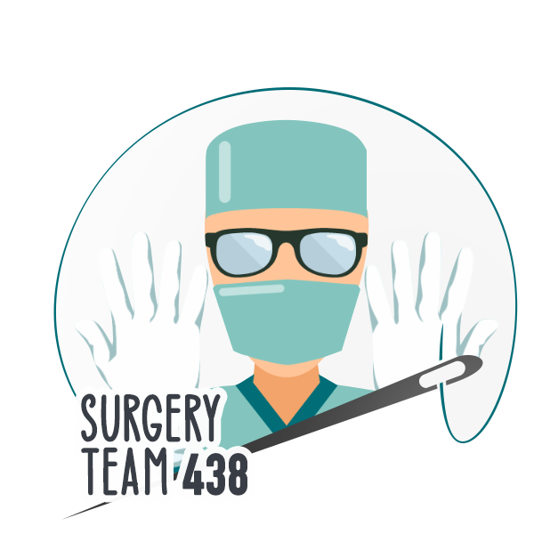
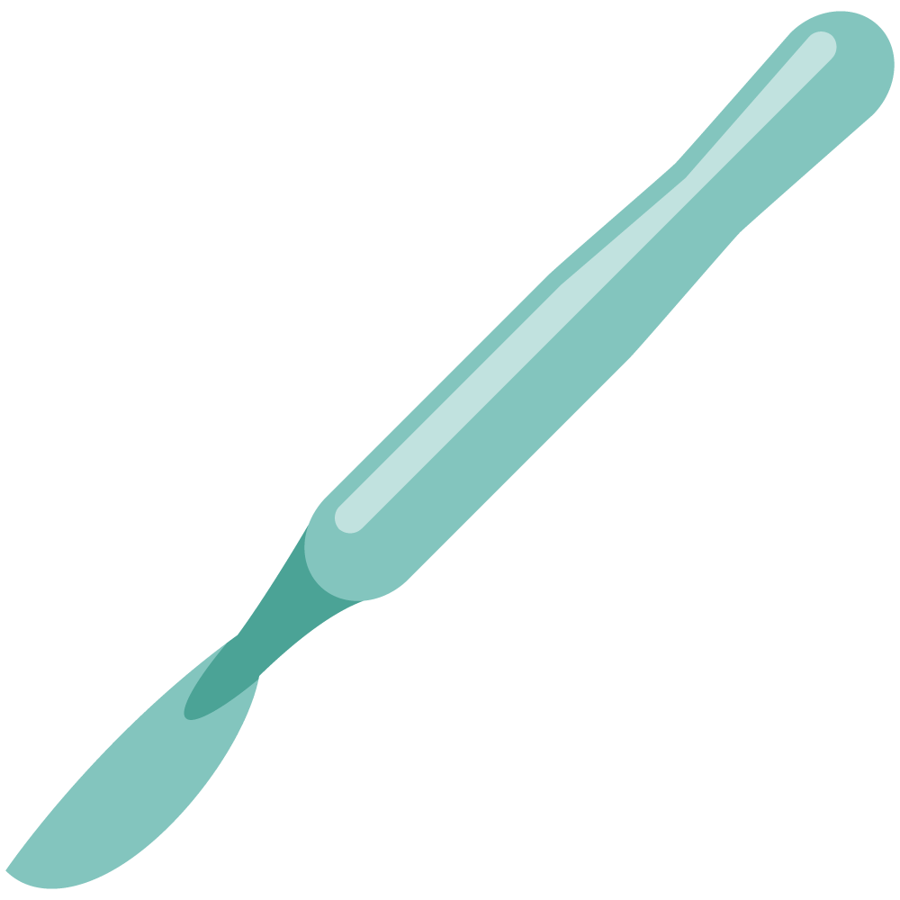
Arterial Diseases
Objectives
Discuss the pathophysiology and epidemiology of peripheral arterial disease
Discuss the anatomy and clinical features of peripheral arterial disease
Discuss the diagnosis and managements of peripheral arterial disease
Recognize the difference between the chronic & critical lower limb ischemia
Discuss the etiology and classification of acute limb ischemia
Discuss the clinical features and diagnosis of acute limb ischemia
Discuss the managements and complications of acute limb ischemia
Discuss the pathophysiology and epidemiology of carotid arterial disease
Discuss the anatomy and clinical features of carotid arterial disease
Discuss the diagnosis and managements of carotid arterial disease
Colour Index
Main Text
Males slides
Females slides
Doctor notes
Textbook
Important
Golden notes
Extra
Editing File

Slide 2
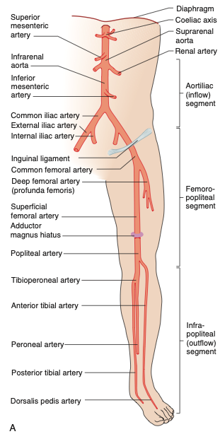
Arterial system
Types of arteries:
Muscular Arteries: Medium sized arteries, distributing arteries. (exhibit smooth muscles in their walls)
Elastic Arteries: Aorta & Beginning of its Large branches (majority of elastic fibers in media)
02
01
03
Small Arteries: Major site of autonomic regulation of blood flow.
Contains 30% of blood volume
Normal systolic pressure <130 mmHg
Arterial capillary pressure 25 mmHg
High pressure /low volume system -Compared to the venous system-
Anatomy of Peripheral arteries
You have to know the main branches of abdominal aorta
Atherosclerotic diseases are described as:
Inflow disease
Outflow disease
The aortoiliac segment above the inguinal ligament (inflow)
The femoropopliteal segment
The infrapopliteal segment (outflow)

Slide 3
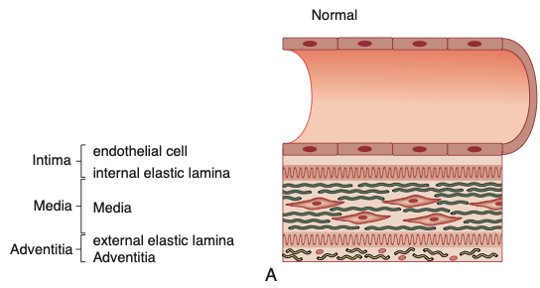
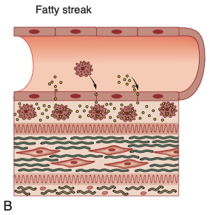
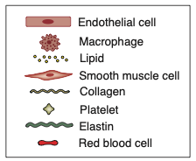
Atherosclerosis
Atherosclerosis risk factors:
Non-modifiable | Modifiable
Age Male gender Menopause Familial predisposition Genetic | Smoking HTN DM Dyslipidemia
Other risk factors
Sedentary lifestyle, Stressful & competitive lifestyle, Obesity, Type A personality, Elevated homocysteine, High carbohydrate intake
Pathophysiology of atherosclerosis
A) Endothelial Injury
Chemical Injury (Smoking, hypercholesterolemia)
Physical Injury
Atheroma
Hypertension increases this stress “lead to propagation of plaque to larger area”
B) Fatty streak
Increased permeability to lipids and inflammatory cells to leak into sub-endothelial area
Leukocytes adhere into the subendothelial space and digest lipids to become foam cells
Protease and free radicals liberated
Cytokines attract more leukocytes and smooth muscle cells

Slide 4
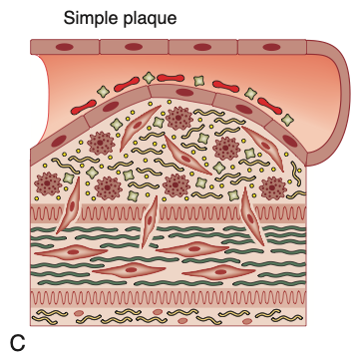
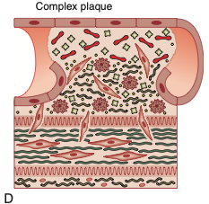
Atherosclerosis
C) Simple Plaque
Smooth muscle cells exit the media
Proliferate, take on the characteristics of fibroblasts and produce collagen, raising the atheroma
D) Complex Plaque
Proliferation forms an endothelial cap, which may rupture, ensuing further endothelial Injury
this results in thrombosis and distal embolization
Peripheral Arterial Disease (PAD)
Chronic
Acute
Slow gradual luminal stenosis
secondary to plaque
Collateral development compensate (look at next slide)
Symptoms proportional to disease burden For example:
One area of stenosis → asymptomatic
Multiple → claudication
More → peripheral ischemia
Exertional symptoms appear first
Leads to:
Intermittent Claudication (IC)
Critical limb ischemia (CLI)
10% of Diabetic foot (DF)
Emergency PADs
Sudden occlusion in the absence of adequate collaterals
Caused by
Embolism
Thrombosis
Injury
Leads to:
Acute Limb ischemia (ALI)

Slide 5
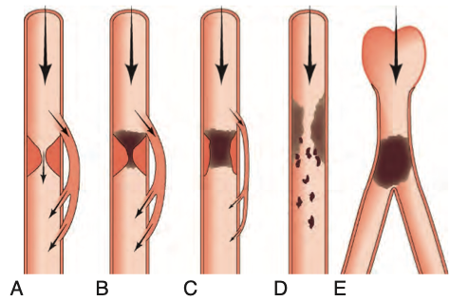
Peripheral Arterial Disease (PAD)
Mechanism of Injury
A
E
Thromboembolism
“thrombus” emboli
Atrial fibrillations are the most common cause
Critical stenosis compensated by collateral vessels
Symptomatic on exercise.
A plaque starts to slowly develop over years until there’s critical stenosis. But because the plaque is developing over years there’s compensation by collaterals. Therefore the patient is usually asymptomatic, however, pain can be triggered by vigorous exertion. stenosis decrease blood flow distal to it.
severe ischemia because of lack of collateral supply
as in aortoiliac - femoral bifurcation - popliteal bifurcation
D
B
Atheroembolism from ruptured plaque
“cholesterol” emboli.
C
Acute thrombosis of a critical stenosis
little change in symptoms due to collateral already developed
A thrombus is formed. Which can cause critical stenosis or total occlusion. But because there’s collaterals, the patient may be asymptomatic or the symptoms may be minimal.
Acute thrombosis of non-critical stenosis
Severe symptoms either severe claudication or rest pain due to poorly developed collaterals
In the previous picture:
A,B & occasionally C = chronic
Collaterals compensate, pain only after walking 300m-1km.
D & E = Acute manifestation “emergencies-pain on rest”
Speed of occlusion onset is one of the major determinants of clinical manifestations of arterial diseases
Slow development
Rapid Occlusion
E.g: atherosclerosis plaque building up = give chance for collateral development -needs months or years.- (e.g., profunda [deep] femoral artery collaterals around a diseased superficial femoral artery in patients with intermittent claudication).
Rapid occlusion of previously normal artery = no collaterals = severe ischemia

Slide 6
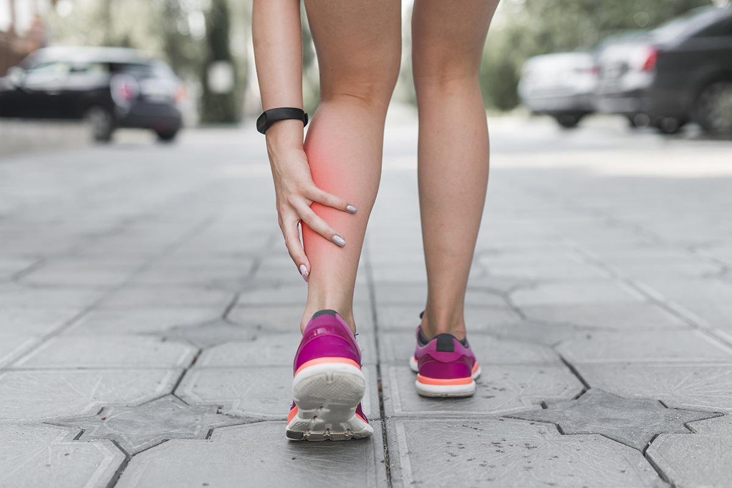
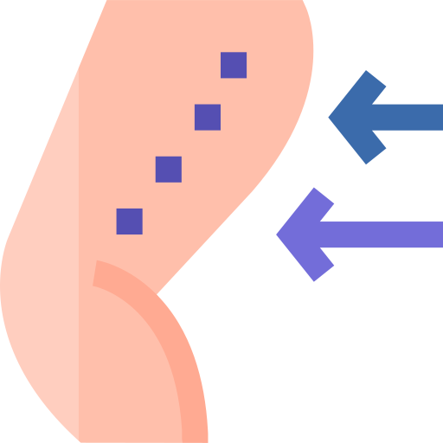
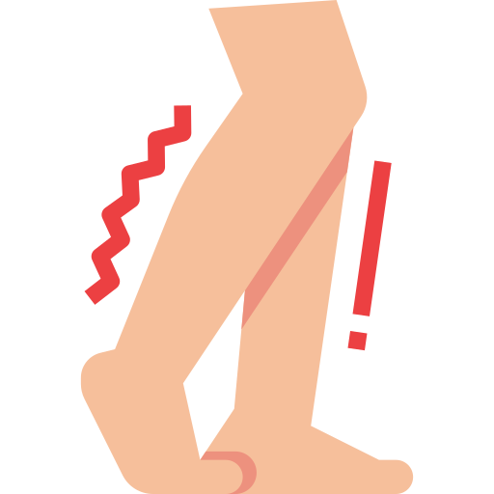
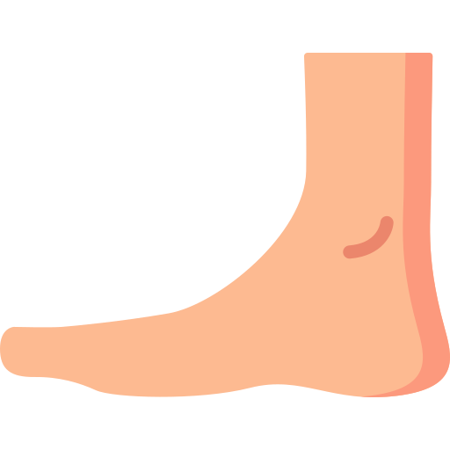
Chronic Peripheral Arterial Disease (PAD)
1
Intermittent Claudications (IC)
Up to 5% of people >60 years
1–2% of patients
will deteriorate if they comply with best medical treatment (BMT)
The emphasis is on the preservation of life. then limb, then function.
The annual mortality rate is 5–10% per year,
2–3-times higher than non-claudicant
Marker of atherosclerosis ,(once you have one plaque, by default you have also another atherosclerotic plaques in your vessels.) and most of these patients succumb to myocardial infarction (MI), stroke and limb loss
Clinical Features
Claudication pain is a muscular pain (affecting muscle groups)
Not present at rest
The pain comes on after walking a particular distance, which is known as the claudication distance.
Typical complaining: “When I go to the mosque, I stop by our neighbour house due to calf pain (same house every time). I stop for few minutes (relieve), & after resting I can complete my way to mosque without issue”.
01
03
Other symptoms:
Impotence (leriche syndrome) due to internal iliac occlusion - aortoiliac occlusion.
Weakness / decreased mobility
Skin changes
Toe nail changes
Muscle wasting
It is quickly relieved by resting.
It is repetitive (always the same distance), the patient will develop the pain after walking the claudication distance.
02
04
Claudications site
the site of claudication gives a clue to site of arterial disease:
to differentiate and locate the site of occlusion. check the most proximal muscle pain, as the pain occurs distal to the occlusion.
EXTRA: Peripheral artery disease at the level of the aortic bifurcation or bilateral occlusion of the iliac arteries that leads to the classic triad of bilateral buttock, hip, or thigh claudication; erectile dysfunction; and absent/diminished femoral pulses.
Bilateral thigh and/or buttock: aortoiliac arteries
Calf:
femoropopliteal arteries
Foot (instep) :
tibial arteries (rare)
Unilateral thigh and/or buttock: iliac arteries
Buttock = Common iliac (blood doesn’t reach internal iliac)
Thigh = External iliac

Slide 7
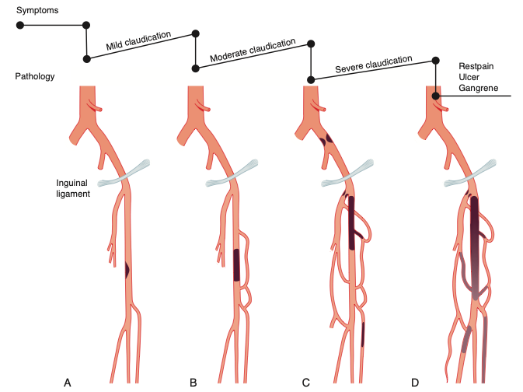
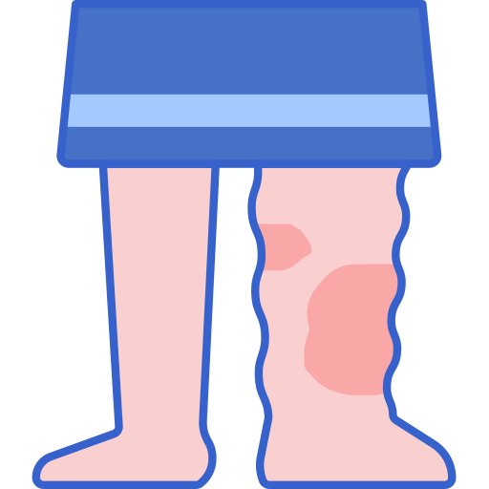
Chronic Peripheral Arterial Disease (PAD)
2
Critical Limb Ischemia (CLI)
Sequence of events
Superficial femoral artery (SFA) stenosis “start of claudications”
Complete occlusion of SFA, collaterals developed from deep femoral artery (PFA)
Stenosis of PFA & common iliac, worsening symptoms.
Critical Limb Ischemia (CLI) - pain at rest, gangrene, ulcer.
CLI is caused by multiple lesions affecting different arterial segments in the affected limb-When its occurs fast or in more than one area . These patients usually have:
Clinical Features
Classically felt at night and is relieved by sleeping with feet hanging over the bed or sleeping on a chair.
the patient may present with foot swelling.
Rest pain
Exacerbated by lying down or elevation of the foot, because the patient is depending on the gravity to help deliver more blood.
relieved by sleeping with feet hanging over the bed or sleeping on a chair.
02
01
03
Tissue loss Usually in form of:
Ulceration
Gangrene

Slide 8
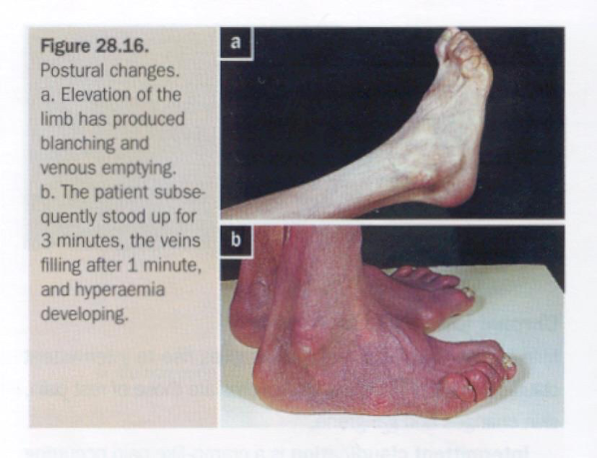
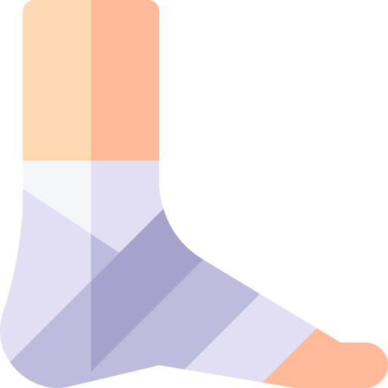
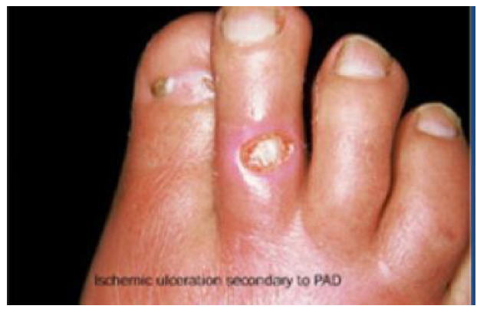
Chronic Peripheral Arterial Disease (PAD)
01
Upon dependency “postural changes”, the foot becomes bright red; this is known as dependent rubor or ‘sunset foot’, and is due to reactive hyperaemia (Buerger’s test)¹
Skin
Skin is thin and dry
Pallor, particularly on elevation
Reduced temperature
02
03
Muscles & nails
Veins
Superficial veins that fill
sluggishly in the horizontal
position and empty upon
minimal elevation (venous guttering)
Physical Examinations
Brittle Nails
Muscle wasting
04
Pulses
All patients must have their pulse status recorded
This includes, carotid, subclavian, brachial, radial, ulnar, femoral, popliteal, posterior tibial and dorsalis pedis
(examine all pulses)
The pulses are recorded as normal, weak or absent
The presence of a thrill and/or bruit denotes turbulent flow
Ankle/brachial pressure index should be recorded
Arterial Ulcers:
Often located on toes or foot
Pale and with necrotic floor
Irregular margins
Painful
Surrounding ischemic features “Pinkish but non erythematous”
Tissue loss in (CLI)
1- Buerger’s test is used to assess the adequacy of the arterial supply to the leg.
It's performed by positioning the patient in a supine position, then both of the patient’s feet are raised to 45º for 1-2 minutes.
The development of pallor indicates that peripheral arterial pressure is unable to overcome the effects of gravity, resulting in loss of limb perfusion. If a limb develops pallor, note at what angle this occurs (e.g. 25º), this is known as Buerger’s angle.
In a healthy individual, the entire leg should remain pink, even at an angle of 90º.
Examination for venous guttering is done during Buerger’s test. The patient is asked to hang their legs down over the side of the bed:
Gravity should now aid reperfusion of the leg, resulting in the return of color to the patient’s limb.
The leg will initially turn a bluish color due to the passage of deoxygenated blood through the ischemic tissue. Then the leg will become red due to reactive hyperaemia secondary to post-hypoxic arteriolar dilatation (driven by anaerobic metabolic waste products).

Slide 9
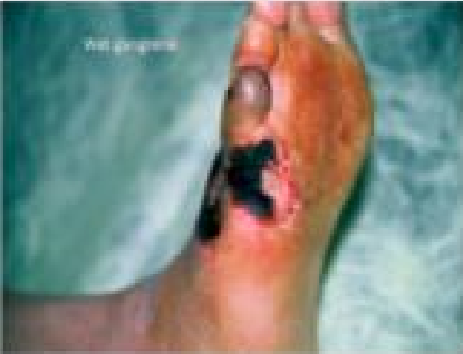
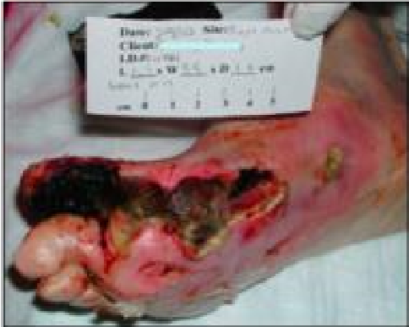
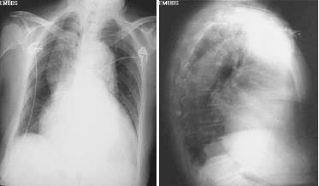
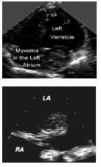
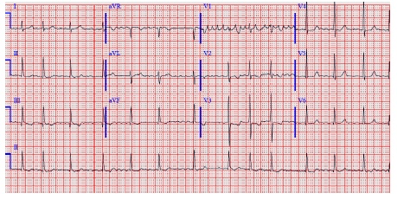
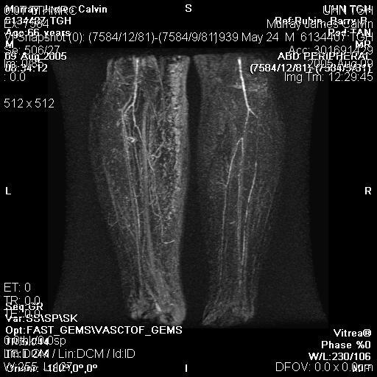
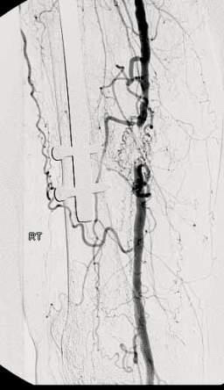
Chronic Peripheral Arterial Disease (PAD)
Inspection
Palpation
Site (location)
Number
Size
Shape
Floor - The exposed part of an ulcer (Inspection)
Edges – Part between the margin and the floor of an ulcer (Undermined, Punched out, Sloping, Rolled, Raised)
Depth - in mm, or if you see deep structures sat its deep, if not say " i don't see deep structures so i assume it's not deep because i don't see structures"
Exudate (Discharge)
Surrounding area
Margin - Line of demarcation between normal and abnormal
Tenderness
Base - the structure on which the ulcer rests (Felt on palpation) - What’s the difference between floor and base? The floor is what you see, and the base is what you feel on palpation
Relation with Deeper structures
Examination of Surrounding Area
Examination of Lymph Nodes
Examination of the pulse.
PAD Investigation
CBC, Electrolytes, creatinine - changes to the renal arteries which increases the risk of having a chronic kidney disease
Coagulation profile (aPTT, INR).
Type and screen
Lipid profile & Hemoglobin A1c (modifiable risk factors)
ECG, Chest X Ray
Echocardiogram (By default, any patient with PAD already have coronary disease, but the question “how severe is it?”)
Intermittent claudications (IC):
Ankle Brachial Index (ABI) = 0.8-0.4 (Normal is 0.9 and above)
Toe pressures = <50 mmHg
Segmental pressure (pressure difference e.g: between thigh and leg) = 20 mmHg reduction
Volume Plethysmography = Measures arterial volume changes
Duplex Ultrasound = Stenosis or single occlusion
CT Angiogram & MRA (same as doplex)
Invasive Vascular Investigations
Critical Limb Ischemia (CLI):
Ankle Brachial Index (ABI) = <0.5
Toe pressures = <30 mmHg
Segmental pressure
Volume Plethysmography
Duplex Ultrasound = Multiple stenosis or occlusion
CT Angiogram & MRA (same as doplex)
Invasive Vascular Investigations
Tibial occlusion and popliteal occlusion.
Green: collaterals.
Yellow: occlusion

Slide 10
Chronic Peripheral Arterial Disease (PAD)
IC & CLI Management:
1
Primary Prevention
Modifiable risk factors-lifestyle changes: If you have a patient with atherosclerostic arterial disease, you have to consider primary prevention of PAD as the most important step in your management.
This can happen by reducing weight, being active.
2
Secondary Prevention - Best Medical Treatment
01
BMT
All patients should be strongly urged to comply with Best Medical Therapy (BMT):
Cessation from smoking (most important)
Control of hypertension (ACE Inhibitors)
Prescription of a statin despite the absence of dyslipidemia - Because statins have an anti-inflammatory effect that inhibits the migration of inflammatory cells, which slows the progression of the disease and improves the plaque’s morphology.
Prescription of antiplatelet agent : aspirin (81 mg daily), or clopidogrel(75mg daily)
Regular exercise
Control of obesity
The identification and treatment of patients with diabetes (HbA1c<7%)
02
Walking Exercise Program
Along with BMT
You ask the patient to walk on a flat surface for 3 months, 3 days/week, 30 Minutes/day.
If patient can’t walk (E.g: more than 5 minutes)
Ask him to walk these 5 minutes, and push himself for additional 1 or 2 minutes, all these are included in the 30 minutes.
This can help:
Improve the collaterals
train muscles to use less O2 (anaerobic respiration)
03
Compliance
Many patients fail to comply (For many causes, E.g: feel it’s hard to walk in hot weather)
Compliance with BMT & walking exercise program increases
Walking distance, Affords protection against cardiovascular events, Improves the quality of life and life expectancy, BMT reduces the overall intervention risks and increases the likely success

Slide 11
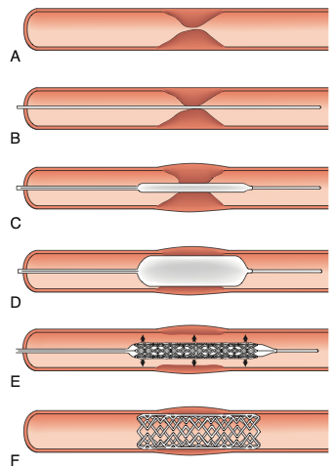
Chronic Peripheral Arterial Disease (PAD)
3
Endovascular and Surgical Interventions
Endarterectomy
Percutaneous Angioplasty
Bypass procedures
Indications for intervention:
Disabling claudication pain - It depends
Not needed in Elderly >70 y/o presented with claudication for 400m (High risk, low benefit of surgery)
In the other hand, It’s needed in patient who is 40 y/o & work as security (needs to walk 1 km or more daily) if presented with the same claudication for 400m .
Of course, you need trying to improve his condition my BMT & Exercise firstly.
CLI -Always, due to tissue loss-
Intervention Includes
Balloon angioplasty, with or without stenting
Surgery
01
Balloon-Angioplasty
The lesion is identified (Critical arterial stenosis)
Lesion crossed with a wire
A balloon “angioplasty catheter” is inserted
And inflated, This enlarges the lumen by disrupting the plaque
In patients with occlusions and complex disease, stents may be deployed
(Some plaques comes back and recluse the lumin, in such cases we need to mount a stent.)
The benefit of stents is to keep a radial force on the vessels to prevent reclusion

Slide 12
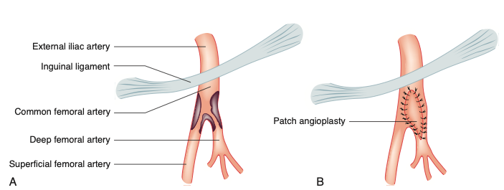
Chronic Peripheral Arterial Disease (PAD)
3
Endovascular and Surgical Interventions
01
Balloon-Angioplasty
Drug-eluting (Paclitaxel → chemo drug which has local effect) balloons and stents reduce the neointimal hyperplasia that can lead to restenosis and occlusion
Balloon are either normal (conventional balloons)
Or drug coated Balloons that is coated by chemotherapy agent to prevent neointimal hyperplasia (Arterial scarring)
Favorable lesions - short concentric stenosis
Unfavorable lesions- long eccentric stenosis or occlusion
02
Surgery
02-A
Endarterectomy
Direct removal of atherosclerotic plaque and thrombus, for patients who have plaques at the site of bifurcation usually done at the carotid and femoral bifurcations.
The surgeon will make a cut in the blocked part of the artery and remove the plaque that is blocking the blood flow.
Then the artery will be closed by performing either a primary closure or patch angioplasty (patch made out of either synthetic material or bovine pericardium).
Patch angioplasty is the preferred technique. Why? Patch angioplasty reduce the risk of restenosis due to hyperplasia and scar tissue formation and, therefore, reduce the risk of recurrent blockage and consequent stroke or death.

Slide 13
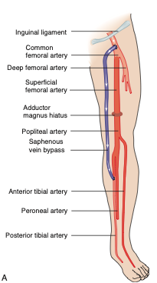
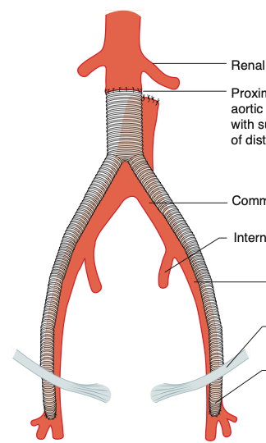
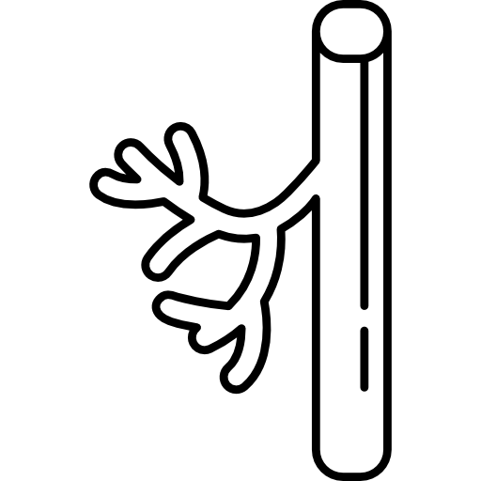
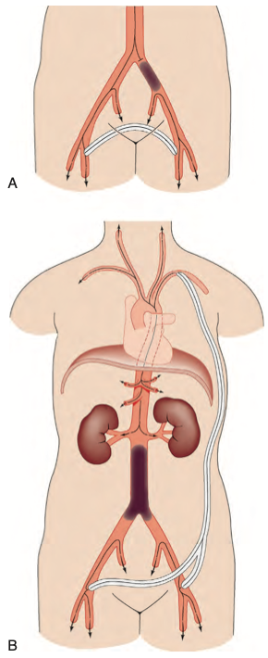
Chronic Peripheral Arterial Disease (PAD)
3
Endovascular and Surgical Interventions
02-B
Arterial reconstruction: Bypass grafting
For a bypass operation to be successful in the long term, three conditions must be fulfilled:
There must be high-flow, high-pressure blood entering the graft (inflow)
The conduit must be suitable,
The blood must have somewhere to go when it leaves the graft (outflow or run-off.
Two main types of Anatomical conduit are available:
Autogenous Material
Prosthetic Material
Most commonly a vein (either by flipping the vein or removing the valves)
Picture: Femoro-distal bypass
Expanded polytetrafluoroethylene (ePTFE) or Dacron.
Prosthetics grafts are prone to infections.
Picture: Aorto-bifemoral bypass
Extra-anatomical Bypass:
Lesser procedures and preferred in high-risk patients or those that have a limited life expectancy. -those who cannot tolerate laparotomy-
Fem-Fem (femoro-femoral) crossover for patients with Unilateral occluded iliac
Axillobifemoral if both iliac arteries are occluded
Do not have as good long-term patency as anatomic -Maximum 10 years-
4
Choice of treatment
Choice of treatment decided depending on :
Patient symptoms, Comorbidities. Life expectancy, Risk and benefits, Anatomy of the disease, Prior interventions

Slide 14
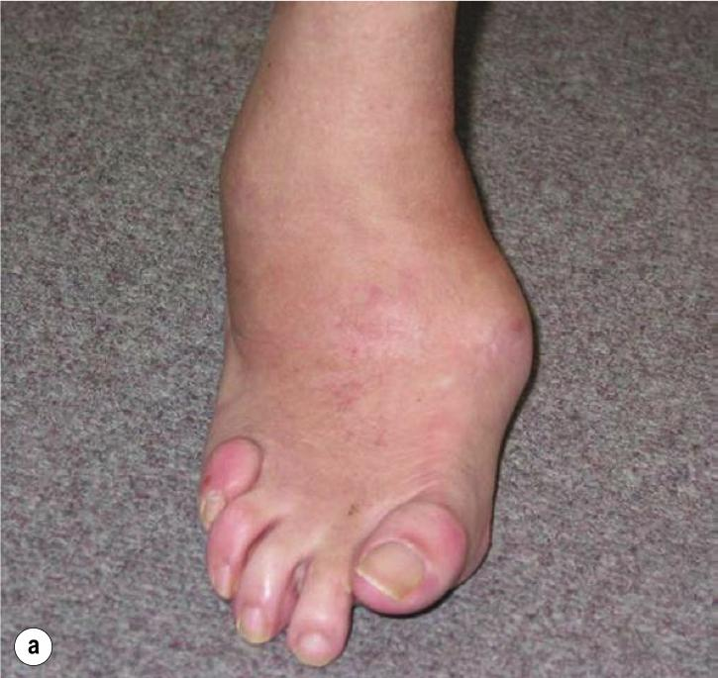
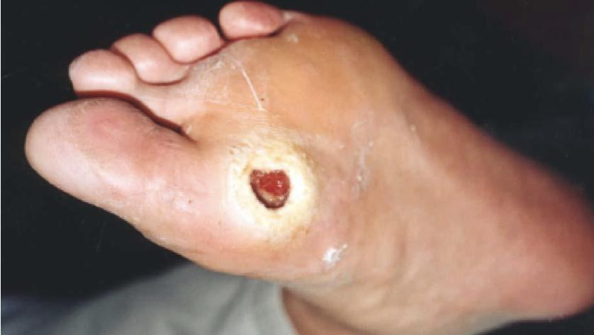
Chronic Peripheral Arterial Disease (PAD)
3
Diabetic Foot (DF)
Approximately 40% of patients with CLI have diabetes
Combination of ischemia, neuropathy and immunocompromised pt
Diabetic neuropathy affects the motor, sensory and autonomic nerves
Diabetic neuropathy may lead to foot ulceration in its own, and also complicates peripheral ischemia
Arteries are often calcified
These patients usually have very Severe multisystem arterial disease (CAD, CVD and PAD)
Diabetic vascular disease has a tendency for the infrapopliteal vessels
“Tibial clots”, remember the 3 conditions the must be fulfilled for a bypass operation to be successful? These patients have poor outflow due to diseased small vessels..
01
02
03
Sensory Neuropathy:
Patient incapable of feeling pain.
It affects proprioception such that, when walking, pressure is applied at unusual sites.
Abnormal walking leads to joint disruption as you see in the picture
This leads to ulcer formation and joint destruction (Charcot’s Foot).
Autonomic Neuropathy:
Dry foot deficient in the sweat that normally lubricates the skin and contains antibacterial substances.
Causing scaling and fissuring.
Abnormal flow in the bones due to loss of autonomic control may also contribute to osteopenia and bony collapse.
Motor Neuropathy:
The flexors are affected more than the extensors.
The extensors are unopposed and the toes become dorsiflexed.
This dorsiflexion exposes the metatarsal heads to abnormal pressure, and they are a frequent site of callus
formation and ulceration. - as in the picture

Slide 15
Chronic Peripheral Arterial Disease (PAD)
DF Management:
Diabetic foot diagnosis is similar to PAD:
Physical exam
History
Investigations
1
Diabetic Foot prevention
Diabetic control (Hb A1c <7%) most important approach to prevent DF
Comprehensive behavioral foot care education
Washing the feet with soap daily and dry it thoroughly -Dry it more than once per single wash
Use a file to shape the nails (not a clipper)
Keep the skin moisturized
Don’t walk barefoot
Change daily into clean soft socks -Must be cotton sucks
Daily foot inspection for injuries
Therapeutic footwear
2
Diabetic Foot Management
If the blood supply to the foot is adequate
Excise dead tissue -Considering that it will grow back again
Control the Infection
Protected the foot from pressure (off-loading) - By either a cast or boots, this is orthopedic job
If there is ischemia, the priority is to revascularize the foot, if possible -This is our job, we treat him as any CLI condition “if possible”
Many patients present late, with extensive tissue loss and unreconstructable disease accounting for the very high amputation rate

Slide 16
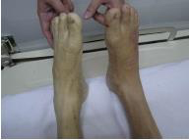
Acute Peripheral Arterial Disease (PAD)
1
Acute Limb Ischemia (ALI)
Acute limb ischemia is caused most frequently by
Acute thrombotic occlusion of a preexisting stenotic arterial segment (60%)
Embolism (30%)
Trauma
Distinguishing between thrombosis and embolism is important because investigation, treatment and prognosis are different
Thrombosis
Embolism
Thrombosis in situ may arise from:
Acute plaque rupture
Hypovolaemia
Increased blood coagulability (e.g., in association with sepsis,malignancy)
Pump failure (e.g., cardiac event)
More than 70% of peripheral emboli are due to Atrial Fibrillations
On the basis of onset and severity:
Incomplete acute ischemia
Complete ischemia
Irreversible ischemia
01
02
03
usually due to thrombosis in situ.
can often be treated medically, at least in the first instance
Patient with CLI, presented with acute rest pain. There’s a pain, but the patient is able to move his foot.
Such patient can wait on, give him heparin, confirm diagnosis by investigations, then treat him.
Usually due to embolus.
Normally result in extensive irreversible tissue injury within 6 hours unless the limb is revascularized.
Mandates early amputation or, if the patient is elderly and unfit, end-of-life care.

Slide 17
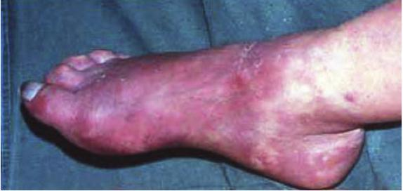
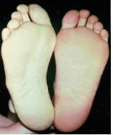
Acute Peripheral Arterial Disease (PAD)
2 Distinctive features of acute ischemia
Paralysis (inability to wiggle toes or fingers)
Paresthesia (loss of light touch over the dorsum of the foot or hand)
Both indicate Loss of function which is the most important feature of acute limb ischaemia and denotes a threatened limb that is likely to be lost unless it is revascularised within a few hours
4 additional features of acute ischemia
Pain (May absent in complete acute ischemia & severe pain in chronic ischemia).
Pallor (feature of chronic ischemia also)
Poikilothermia - Perishing cold: (Cold foot is Unreliable, as the ischaemic limb takes on the ambient temperature)
Pulselessness (feature of chronic ischemia also)
(ALI) signs & Symptoms
(6Ps)
ALI Early stage
ALI Late stage
Acute complete ischemia is associated with intense distal arterial spasm and the limb is ‘marble’ white
As the spasm relaxes over the next few hours and then fills with deoxygenated blood, mottling appears
This appears light blue or purple has a fine reticular pattern, and on pressure, so-called non-fixed mottling when you push it will blanch (color will change )
At this stage, the limb is salvageable - you can mostly save the limb by surgery.
As ischemia progresses, blood coagulates in the skin, leading to fixed mottling that is darker in colour and does not blanch on pressure
Blistering and liquefaction - beyond the skin, occurs after skin coagulation.
Treatment: amputation. Because Attempts at revascularization are futile and will lead to life-threatening reperfusion injury (will be discussed later on this lecture)

Slide 18
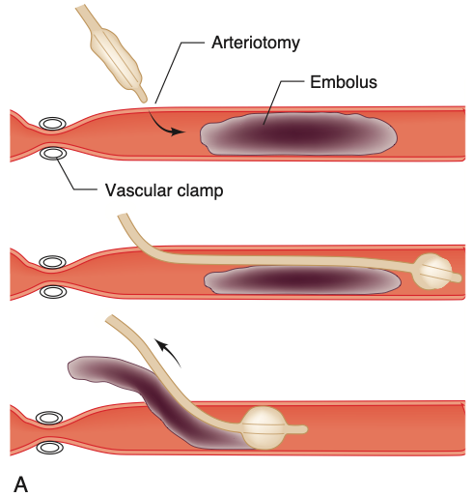
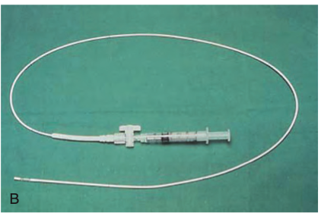
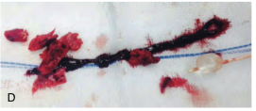
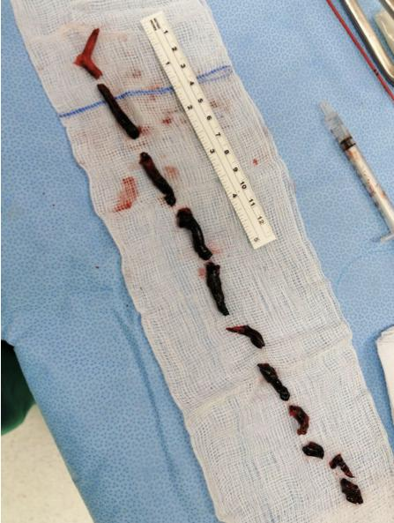
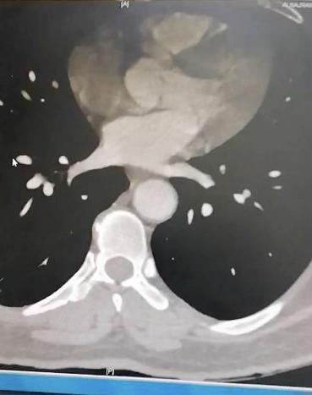
Acute Peripheral Arterial Disease (PAD)
(ALI) management
Must be discussed immediately with a vascular surgeon
Blood work, ECG, and cross-match
If there are no contraindications, IV heparin (5000-8000 IU) is administered
to limit propagation of thrombus and protect the collaterals.
01
If ischemia is complete
The patient proceeds for embolectomy -we have to remove this embolism as fast as we can.
If ischemia is incomplete - patient can wait on
Preoperative imaging is obtained (simple embolectomy or thrombectomy is unlikely to be successful they already have a chronic plaque, they need bypass or angioplasty)
Preoperative optimization
02
Acute Embolus
Femoral embolus is associated with ischemia to the upper thigh.
Acute embolic occlusion of the aortic bifurcation (saddle embolus) leads to absent femoral pulses and having white or mottled waist & legs.
May also present with paraplegia due to ischemia of the cauda equina.v
Embolectomy (using Fogarty Catheter) can be performed under Local Anesthesia or General Anesthesia
Postoperatively, the patient should continue on IV heparin
Warfarin reduces the risk of recurrent embolism but is associated with an annual risk of significant bleeding of 1–2%
In-hospital mortality from cardiac death or recurrent embolism,e.g. stroke, is 10-20%
Embolectomy:
Balloon embolectomy is done by inserting a catheter with a small inflatable balloon attached at the end into the artery and past the clot. The balloon is then inflated and slowly pulled back out of the artery, removing the clot with it.
We calculate the distance between the embolism & toe, then insert the catheter as far as we can.
We do the procedure in opposite “insert the catheter distally” in those who have embolism in the aortic bifurcation.
Embolism:
Management:
Femoral embolus is associated with ischemia to the upper thigh.
Acute embolic occlusion of the aortic bifurcation (saddle embolus) leads to absent femoral pulses and having white or mottled waist & legs.
May also present with paraplegia due to ischemia of the cauda equina.v
Embolectomy (using Fogarty Catheter) can be performed under Local Anesthesia or General Anesthesia
Postoperatively, the patient should continue on IV heparin
Warfarin reduces the risk of recurrent embolism but is associated with an annual risk of significant bleeding of 1–2%
In-hospital mortality from cardiac death or recurrent embolism,e.g. stroke, is 10-20%
Embolectomy: Balloon embolectomy is done by inserting a catheter with a small inflatable balloon attached at the end into the artery and past the clot. The balloon is then inflated and slowly pulled back out of the artery, removing the clot with it.
We calculate the distance between the embolism & toe, then insert the catheter as far as we can. We do the procedure in opposite “insert the catheter distally” in those who have embolism in the aortic bifurcation.

Slide 19
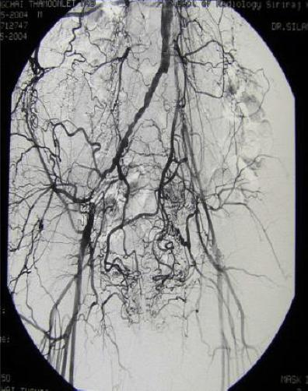
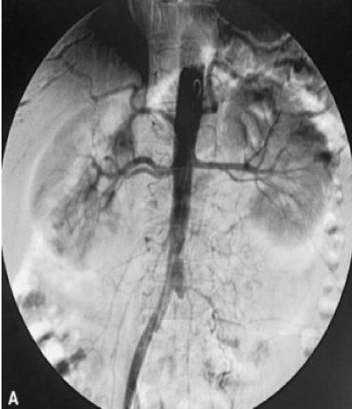
Acute Peripheral Arterial Disease (PAD)
Thrombosis in-situ
Thrombosis-in-situ Generally occurs in vessels affected by pre–existent atherosclerosis
Ischemia is often less severe than with acute embolism
Location of occlusion may play a role in the severity of limb ischemia
Causes of exacerbation acute-on-chronic attack include:
Pump failure (e.g., silent or overt MI)
Hypovolaemia, which may be associated with widespread thrombosis
Increased blood coagulability (e.g. sepsis, malignancy)
01
Many patients can be managed medically -Especially in the early consequences. Give them anti-coagulants & follow-up
If the limb remains threatened after one day or two of follow-up then it may be possible to clear thrombus by:
Thrombectomy
Endoluminal techniques -E.g: Balloon catheter
Thrombolysis Takes time, therefore it’s not used for patients with acute ischemia due to embolus.
Bypass
02
03
If an urgent intervention is required, the in-hospital limb loss rate may approach 30%, with an in-hospital mortality rate of 10–20%
Treatment
Thrombosis-in-situ | Embolism
Previous claudication | No previous symptoms of arterial insufficiency
No source of emboli | Obvious source of emboli ( atrial fibrillation, myocardial infarction)
Long history ( days to weeks ) | Sudden onset (hours to days)
Less severe ischemia | Severe ischemia
Lack of pulses in the contralateral leg | Normal pulses in the contralateral leg
Positive signs of chronic ischemia | No signs of chronic ischemia
(Acute Thrombosis) lots of collaterals
(Acute embolus) no collaterals

Slide 20
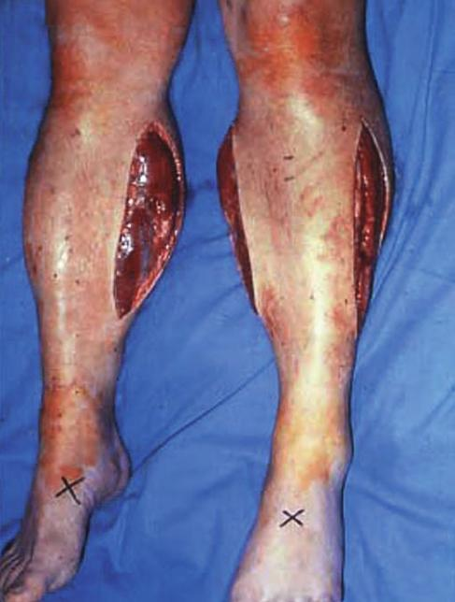
Post-Ischemic Syndrome
Pathophysiology
01
Management
Compartment Syndrome
(local)
Endothelial cell injury leads to increased permeability Postoperative or post treatment Calf muscles swelling
The calf muscles are confined within tight fascial compartments -Which compress the swollen muscles
The increase in interstitial tissue pressure leads to muscle necrosis despite adequate arterial inflow: compartment syndrome (>25mmHg)
There is swelling and pain on squeezing the calf muscle or moving the ankle
Palpable pedal pulses do not exclude compartment syndrome
+ve Pedal pulse indicates good perfusion of large vessels, compartment syndrome affects the small vessels that supply the individual muscle.
Prevention through expeditious revascularisation
Low threshold for fasciotomy to relieve the pressure
Medial incisions = for posterior compartment (both deep & superficial)
Lateral incisions = for anterior and lateral compartment
Pathophysiology
02
Management
Reperfusion Injury
(Systemic)
Caused by activated neutrophils, free radicals, enzymes, hydrogen ions, carbon dioxide, potassium and myoglobin released from reperfused tissue -Washed out due to reperfusion of necrotic tissue
Leads to:
Acute respiratory distress syndrome (ARDS)
Myocardial stunning
Endotoxaemia
Acute Tubular Necrosis
Multiple organ failure and death
Hydrate the patient
Communication with the anesthesiologist and intensivist
Protect the heart with calcium
Prevent and treat hyperkalemia before reperfusion Or produce hypokalemia until reperfusion is accomplished
Correct acidosis and produce alkalosis in anticipation to reperfusion
Use inotropic support liberally
if patient had myocardial stunning and low blood pressure. He may need inotropic agent to keep the BP high enough to preserve the vital organs

Slide 21
Cerebrovascular Disease (CVD)
Stroke:
An episode of focal neurological dysfunction lasting > 24 hours, of vascular etiology
Transient ischaemic attack (TIA) :
Symptoms last for less than 24 hours
E.g: “Patients had a slurred speech for half a day, then it got back to normal.”
02
01
Amaurosis fugax
Transient incomplete -sometimes complete- unilateral loss of vision, never synchronously bilateral
A veil or curtain coming across the eye
E.g: “patient feel like there is a curtain closing in front of his eyes”
03
Clinical Assessment:
Complete Neurological exam
It is important to exclude other causes of cerebral ischemia and haemorrhage
01
03
‘Carotid’ bruit has no reliable relationship to the severity of the internal carotid artery disease and the risk of stroke
Complete History
Risk factor assessment
02
Pathophysiology:
Approximately 80% of strokes are ischemic
About half of these are thought to be due to atheroembolism from the carotid artery -Both cranial and sub-cranial.
Emboli entering the ophthalmic artery leads to amaurosis fugax or permanent monocular blindness on the same side (ipsilateral)
The origin of the internal carotid artery is most common site of atheroma formation -comparing to the middle internal carotid and MCA-
The tighter the degree of stenosis, the more likely it is to cause symptoms
If they enter the middle cerebral artery they may cause hemiparesis and hemisensory loss on the opposite side (contralateral)
If the dominant hemisphere is affected there may also be dysphagia
If someone was left handed, and get a stroke in right side, he will have:
Dysphagia
Ipsilateral vision loss
Contralateral weakness

Slide 22
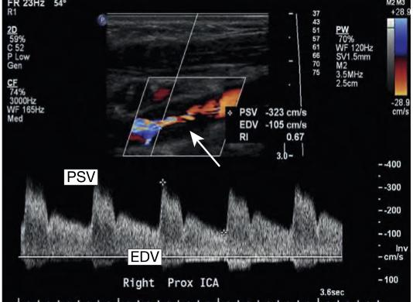
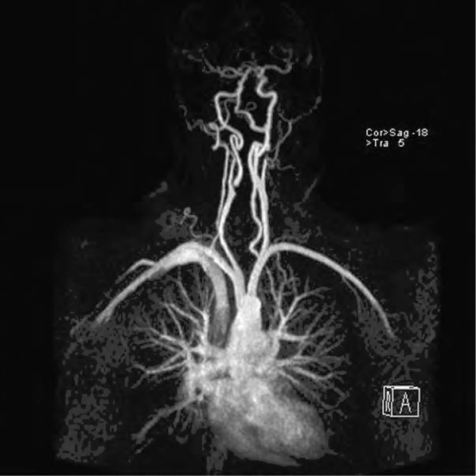
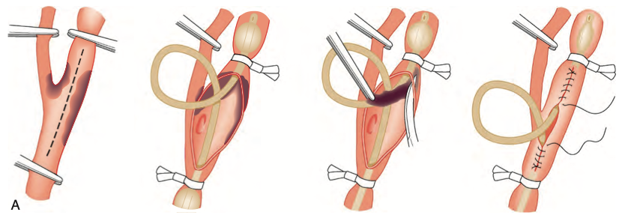
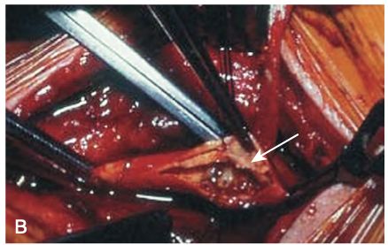
Cerebrovascular Disease (CVD)
CVD Investigations:
A
Doppler (duplex) ultrasound
We check the peak systolic volume (PSV), End Diastolic Volume (EDV)
You can see also the narrowing in picture A “arrow”, this most likely is the stenosis
Intra-arterial digital subtraction angiography is associated with risk of TIA/stroke as it is an invasive procedure
Catheter or contrast may disrupt the plaques.
Magnetic resonance angiography (MRA)
Computed tomographic angiography (CTA)
01
02
03
04
CVD Investigations: (There will be a separate lecture for investigations)
Asymptomatic patients are treated with BMT (Best Medical Therapy)
Because, the risk of developing TIA/stroke are low (< 10% at 5 years)
The Relative Risk Reduction (RRR) is 50%, the Absolute Risk Reduction (ARR) would be only 1% per year
The number needed to prevent one TIA or stroke is at least 20–30 (Carotid endarterectomy)
While, the number needed to treat for symptomatic disease is less than 10
01
Carotid Endarterectomy (CEA)
CEA with BMT is associated with a significant reduction in recurrent stroke, compared with BMT alone
Patient must fulfill this criteria to be suitable for CEA
ICA stenosis (> 50%)
Life expectancy of at least 2y
Undertaken with a stroke and/or death rate of <5%
The intervention can be performed soon
The sooner the better
Performed under GA or LA (General or Local anaesthesia)
Patients with major stroke and little in the way of recovery are not candidates for carotid intervention -they can't tolerate the surgery
Patients with an occluded Internal carotid are not candidates for carotid intervention -The risk of opening the artery is higher the benefits
Here, We insert a shunt -the yellow pipe- to pass blood into brain during surgery.
We also make the carotid wider than its normal size to compensate neointimal hyperplasia

Slide 23
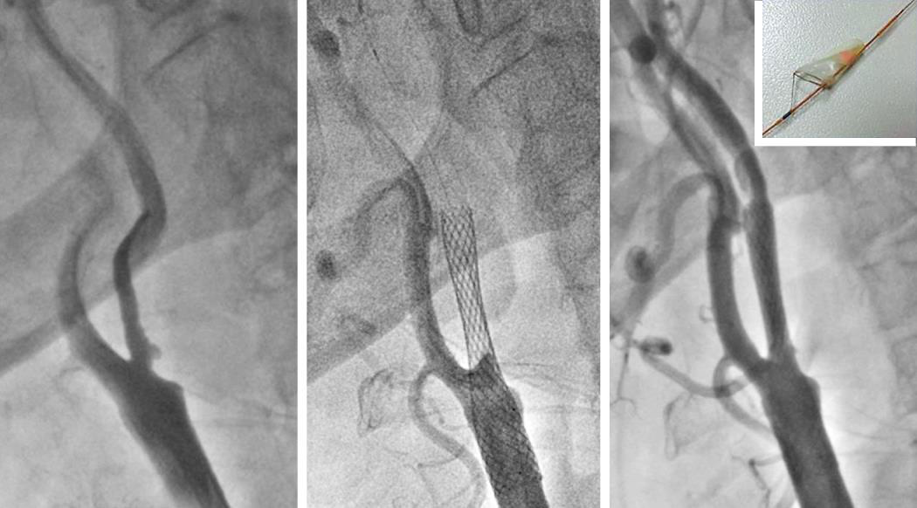
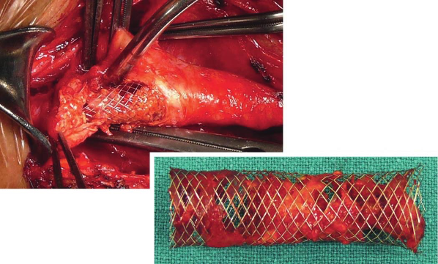
Cerebrovascular Disease (CVD)
02
Carotid Artery Stenting (CAS)
The role of (CAS) remains controversial -Not prefered
Have 2 benefit only:
Avoids a neck wound and the risks of cranial nerve injury
Reduces the risk of MI
Short-term risks of clinical and subclinical strokes are greater than CEA
CAS should be reserved for
patients where CEA is not possible or desirable because of anatomic and clinical factors (e.g., recurrent stenosis after previous surgery or radiation arteritis)
You can see In picture B this patient who undergoes CAS, the stent precipitated strokes as you see in the second picture due to the neointimal hyperplasia and the plaques formation.
Recall
Q1:What must be present for a successful arterial bypass operation?
Answer: 1. Inflow (e.g., patent aorta)
2. Outflow (e.g., open distal popliteal artery)
3. Run off (e.g., patent trifurcation vessels down to the foot)
Q2: What is the most common site of arterial atherosclerotic occlusion in the lower extremities?
Answer Occlusion of the SFA in Hunter’s canal
Q3: What is intermittent claudication?
Answer: Pain, cramping, or both of the lower extremity, usually the calf muscle, after walking a specific distance; then the pain/cramping resolves after stopping for a specific amount of time while standing; this pattern is reproducible
Q5: What is the site of a PVD ulcer versus a venous stasis ulcer?
Answer: PVD arterial
Answer: insufficiency ulcer—usually on the toes/foot
Venous stasis ulcer—medial malleolus (ankle)
Q6: What ABIs are associated with normals, claudicators, and rest pain? Normal ABI:
Answer:
≥1.0
Claudicator ABI: <0.6
Rest pain ABI: <0.4

Slide 24
Summary
Recall
Q7: What are the indications for surgical treatment in PVD?
Answer: Use the acronym “STIR”:
Severe claudication refractory to conservative treatment that affects quality of
life/livelihood (e.g., can’t work because of the claudication)
Tissue necrosis
Infection
Rest pain
Q8: How can the medical conservative treatment for claudication be remembered?
Answer: Use the acronym “PACE”:
Pentoxifylline Aspirin
Cessation of smoking Exercise
Q9: What is the risk of limb loss with claudication?
Answer: 5% limb loss at 5 years (Think: 5 in 5), 10% at 10 years (Think: 10 in 10)
Q10: What is the risk of limb loss with rest pain?
Answer: >50% of patients will have amputation of the limb at some point
Q11: What is a FEM-POP bypass?
Answer: Bypass SFA occlusion with a graft from the FEMoral artery to the POPliteal artery
Q11: What is a FEM-POP bypass?
Answer: Bypass SFA occlusion with a graft from the FEMoral artery to the POPliteal artery
Q12: What is a FEM-DISTAL bypass?
Answer: Bypass from the FEMoral artery to a DISTAL artery (peroneal artery, anterior tibial artery, or posterior tibial artery)
Q13: What graft material has the longest patency rate?
Answer:Autologous vein graft
Q14: What type of graft is used for below-the-knee FEM-POP or FEM- DISTAL bypass?
Answer:Must use vein graft; prosthetic grafts have a prohibitive thrombosis rate
Q15:What is DRY gangrene?
Answer:Dry necrosis of tissue without signs of infection (“mummified tissue”)
Q16 What is WET gangrene?
Answer:Moist necrotic tissue with signs of infection
Q17: What is blue toe syndrome?
Answer:Intermittent painful blue toes (or fingers) due to microemboli from a proximal arterial plaque

Slide 25
Summary
Recall
Q18: What is atherosclerosis?
Answer: Diffuse disease process in arteries; atheromas containing cholesterol and lipid form within the intima and inner media, often accompanied by ulcerations and smooth muscle hyperplasia
Q19:What is the common theory of how atherosclerosis is initiated?
Answer: Endothelial injury → platelets adhere → growth factors released → smooth muscle hyperplasia/plaque deposition
Q20:What are the common sites of plaque formation in arteries?
Answer: Branch points (carotid bifurcation), tethered sites (superficial femoral artery [SFA] in Hunter’s canal in the leg)
Q21:What must be present for a successful arterial bypass operation?
Answer:
Inflow (e.g., patent aorta)
Outflow (e.g., open distal popliteal artery)
Run off (e.g., patent trifurcation vessels down to the foot)
Q22:What is the major principle of safe vascular surgery?
Answer: Get proximal and distal control of the vessel to be worked on!
Q23:What does it mean to “POTTS” a vessel?
Answer: Place a vessel loop twice around a vessel so that if you put tension on the vessel loop, it will occlude the vessel
Q24:What is the suture needle orientation through graft versus diseased artery in a graft to artery anastomosis?
Answer: Needle “in-to-out” of the lumen in diseased artery to help tack down the plaque and the needle “out-to-in” on the graft
Q26:Which arteries supply the blood vessel itself?
Answer: Vaso vasorum
Q27:What is a true aneurysm?
Answer: Dilation ( >2 × nL diameter) of all three layers of a vessel
Q28:What is a false aneurysm (a.k.a pseudoaneurysm)?
Answer: Dilation of artery not involving all three layers (e.g., hematoma with brous covering) Often connects with vessel lumen and blood swirls inside the false aneurysm
Q29:What is “ENDOVASCULAR” repair?
Answer: Placement of a catheter in artery and then deployment of a graft intraluminally

Slide 26
Quiz
MCQ
Q1: 63 year old patient known to be smoker and have HT & DM presented with 500m claudications, what is the proper first step in management?
Smoking cessation
Administer heparin
Start aspirin
Balloon Angioplasty
Q2: 63 year old patient presented with pain in his lower limbs, the pain is presented during rest & relieved with feet hanging over the bed, what is the most likely diagnosis?
Chronic Limb Ischemia
Acute Limb Ischemia
Chronic Venous Insufficiency
Critical Limb Ischemia
Q3: Patient have claudications in the left thigh, which of the following arteries is the most likely to be occluded ?
Femoral artery
Tibial artery
Popliteal artery
External Iliac Artery
Q4: A 51 year old who known to have CLI and got an operation done, postoperative his leg is swollen and tender with fever, What is the proper management for this patient?
Embolectomy
Fasciotomy
Balloon Angiopathy
Bypass grafting
Q5: A 68 year old patient diagnosed with CVD, he presented with Dysphagia, right sided vision loss, Left-sided weakness. What is the site of lesion ?
Right common carotid
Right Internal carotid origin
MCA
Left Internal carotid origin
Answers
Q1 | A | Q4 | B
Q2 | D | Q5 | B
Q3 | D
Extra Questions

Slide 27
Good Luck!
Team leaders:
Nouf Alshammari
Haneen Somily
Naif Alsulais
Mohammed Alshoieer
This lecture was done by:
Ibrahim AlAsoos
Bader Aldhafeeri
Khalid Alkhani
Omar Alotaibi
Nouf Alshammari
Omar Alshenawy
Feedback
Note taker
Reviewer

