Slide 1
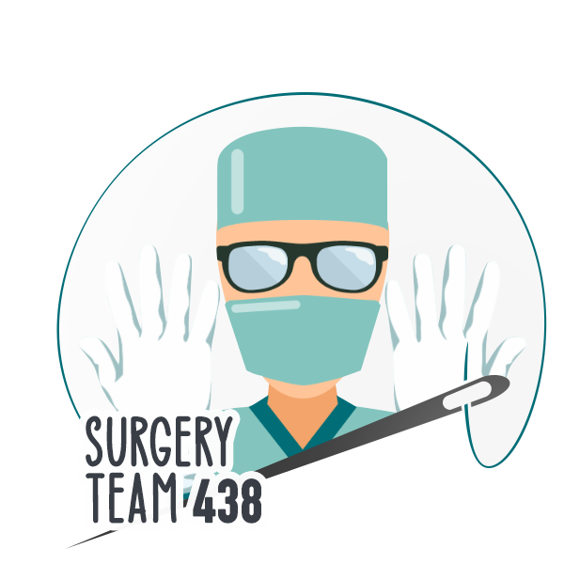
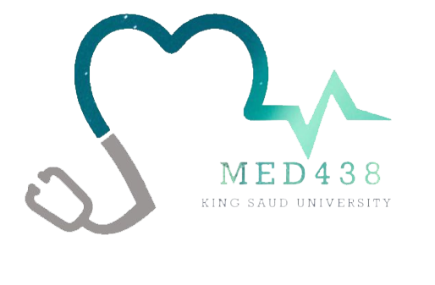
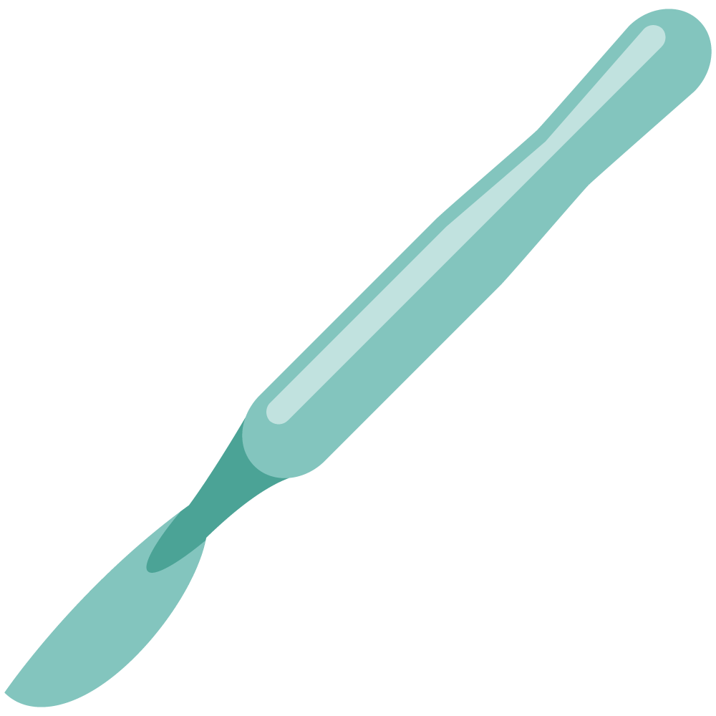
Venous Diseases
Objectives
Discuss the pathophysiology and epidemiology of varicose veins
Discuss the classification and clinical features of varicose veins
Discuss the diagnosis and managements of varicose veins
Discuss the pathophysiology and clinical assessment of chronic venous insufficiency
Discuss the managements of chronic venous insufficiency
Discuss the pathophysiology and epidemiology of venous thromboembolism
Discuss the classification and clinical features of venous thromboembolism
Discuss the diagnosis and management of venous thromboembolism
Colour Index
Main Text
Males slides
Females slides
Doctor notes
Textbook
Important
Golden notes
Extra
Editing File

Slide 2
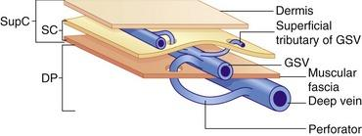
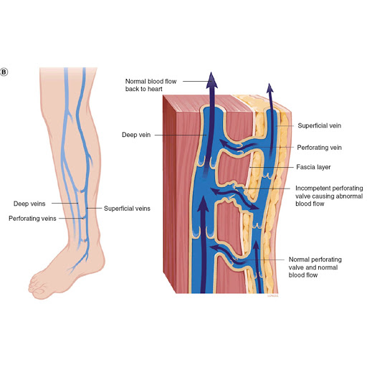
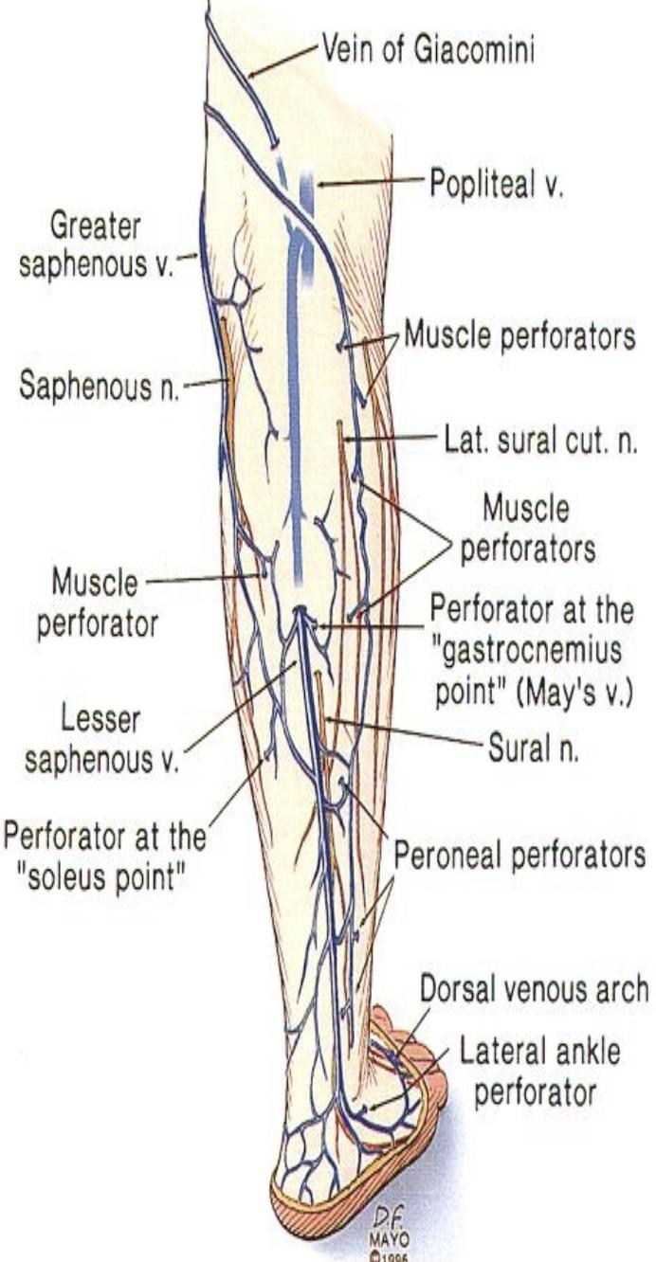
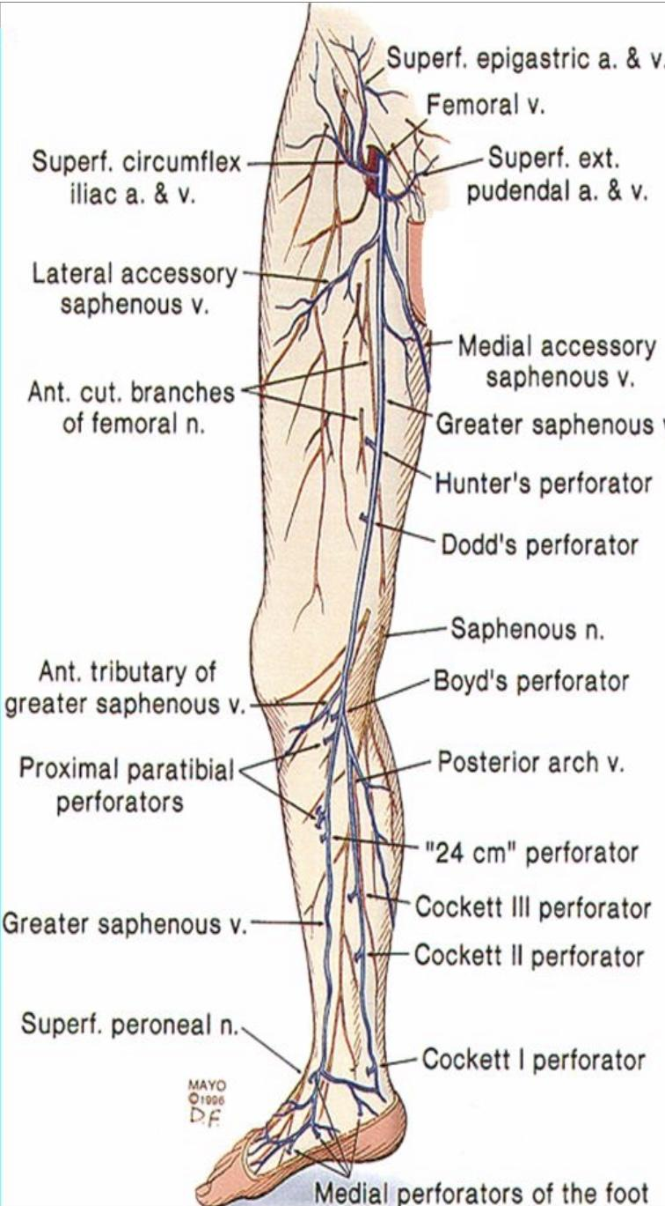
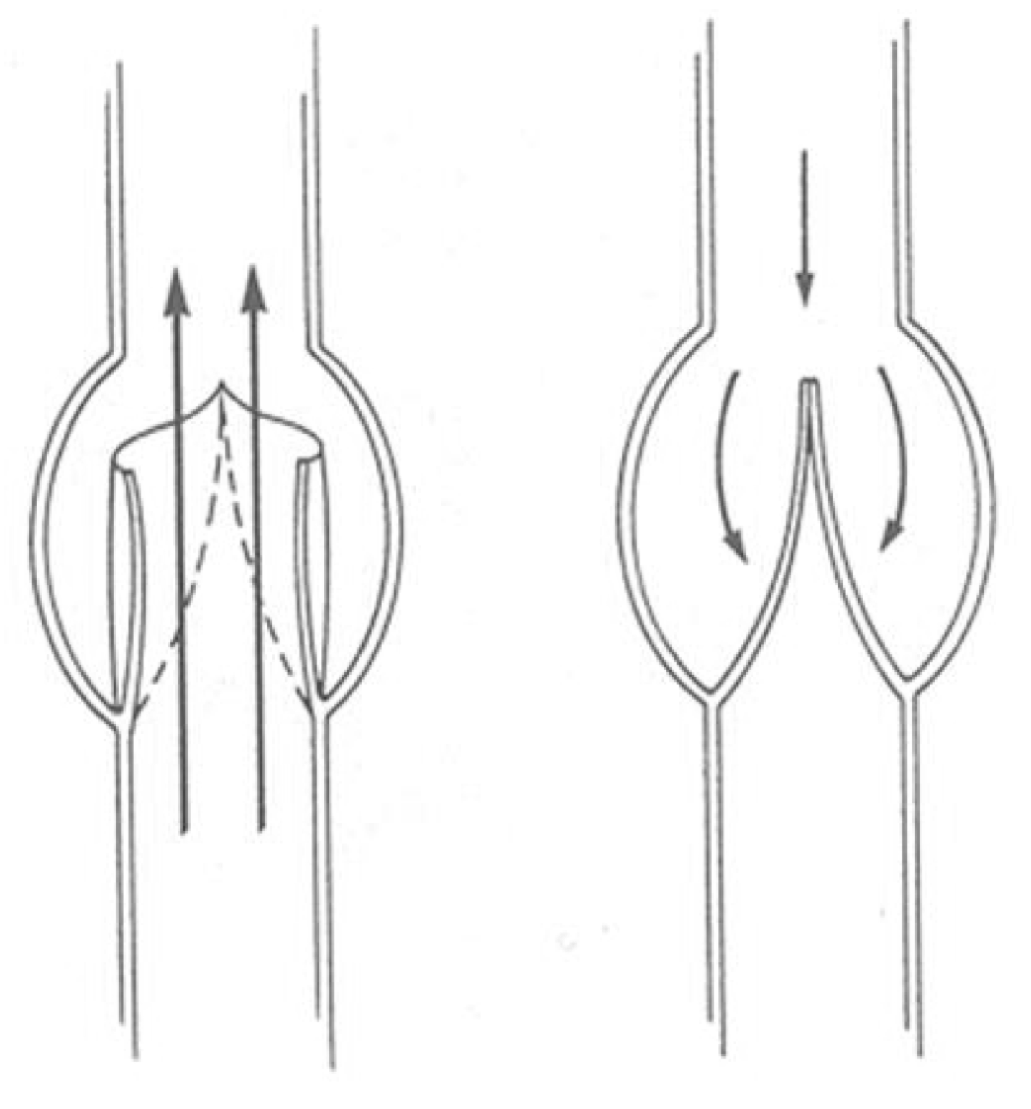
Anatomy Of Venous System ¹:
Lower Extremity Veins:
1
Superficial veins “Saphenous system”: Lie in the fatty layer just beneath the skin. And is further divided into 1- Great Saphenous Vein (GSV) medially 2- Lesser Saphenous Vein (LSV) laterally.
The saphenous veins and their tributaries lie outside the deep fascia and in healthy individuals carry about 10% of the venous return from the limb.
2
Deep veins: Lie deeply within the muscles, it has valves that allow the blood to flow upward towards the heart. Naming follows arterial system: femoral vein, popliteal vein, etc.
3
Perforators: perforate the deep fascia (muscular fascia) to connect the superficial and deep systems.
GSV
LSV
The most important system.
It begins at the medial end of the dorsal venous arch, crosses in front of the medial malleolus and ascends the medial side of the leg. It penetrates the deep (cribriform) fascia 2.5 cm below and lateral to the pubic tubercle to enter the common femoral vein at the saphenofemoral junction (SFJ).
It starts at the lateral end of the dorsal venous arch, passes posterior to the lateral malleolus, then ascends the median posterior line of the calf to join the popliteal vein at the saphenopopliteal junction (SPJ), usually just above the knee. Anatomical variations are very common.
Valves:
A valve is not a muscular structure, but a fold within the vein formed from a single layer of endothelial cells.
There are two types of valves:
Vertical valves; prevent blood from going down (flow direction: down to up)
Perforating veins valve; directing blood from superficial to deep veins (flow direction: out to in)
The greatest challenge that veins must overcome is achieving sufficient venous return given the force of gravity which tends to pool blood in veins. Venous return in the face of gravity is achieved by an anatomical solution which involves using a muscle pump and the existence of one-way valves within the veins. These valves allow blood to move in the direction of the heart but prevent backward flow.

Slide 3
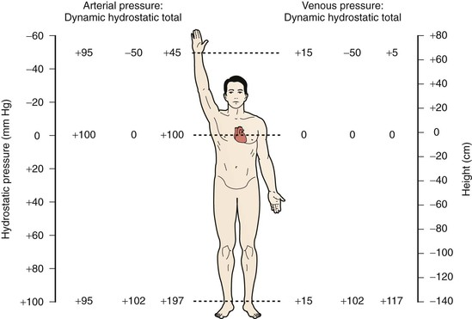
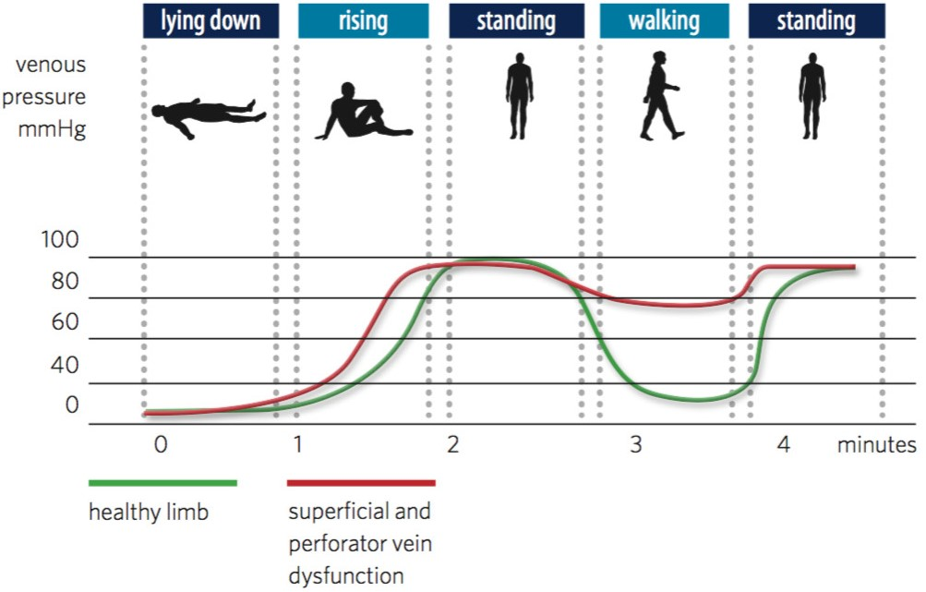
Physiology Of Venous System:
Hydrostatic and Dynamic Pressure:
Dynamic
Hydrostatic
The pumping action of the heart causes movement of blood through both arteries and veins. The pressure generated by cardiac pumping is termed dynamic pressure.
Under normal conditions in the supine position, blood flow is determined by dynamic pressure gradients, with arterial pressure being higher than venous pressure. The majority of dynamic pressure is dissipated in the arterial system before it reaches the capillary bed. At the venous end of the capillary bed, it ranges from 12 to 18 mm Hg. Atrial pressure averages 4 to 7 mm Hg under normal conditions. Hence, blood flows along this gradient and is returned to the heart.
Is the pressure that results from the weight of the fluid and it’s fixed in arteries and veins.
In the upright position, venous flow in the lower extremities is dominated by the effects of hydrostatic pressure.
When a person is standing absolutely still, the pressure in the veins of the feet is about +90 mmHg simply because of the gravitational weight of the blood in the veins between the heart and the feet.
Arterial blood pressure at the ankle in a standing position =
Hydrostatic + Dynamic → 102 + 95 = 197 mmHg
Venous blood Pressure at the ankle in a standing position =
Hydrostatic + dynamic → 102 + 15 = 117 mmHg
(117 mmHg is a high pressure that the physiological mechanisms need to push against.) The physiological mechanisms are explained in the next slide.
Once those mechanisms fail, we will have very high pressure in the foot. And the consequences of venous insufficiency are as high as a systolic failure in the upper limb (of the arterial system).
Ambulatory Venous Pressure:
If you understand normal you will be able to advise and guide regarding therapy for the abnormal.
In supine position → AVP is around 10 mmHg
when the person starts to rise AVP increases to reach 100 mmHg
Standing still → AVP is 90 mmHg
Upon walking, muscle pump works and AVP falls to 25 mmHg (7 steps = max effect)
The green graph depicts the normal rise and fall of venous pressure according to body positioning and gravitational effect.

Slide 4
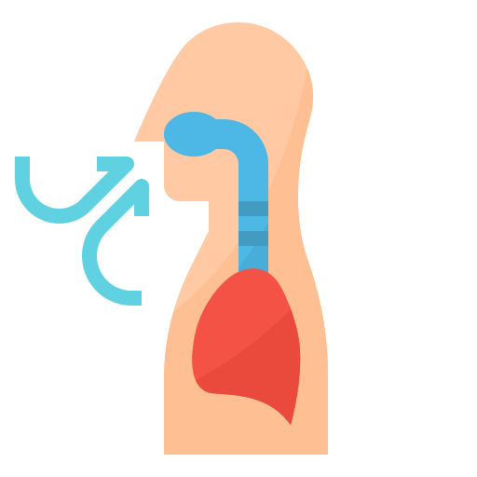
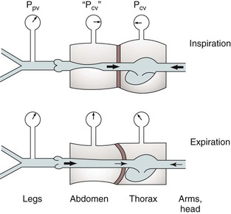
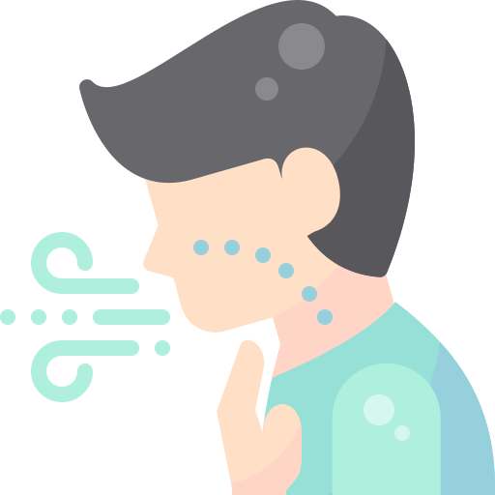
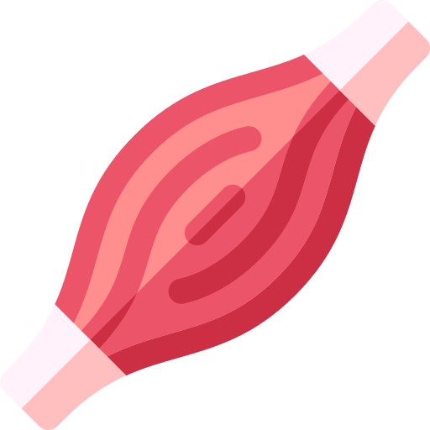
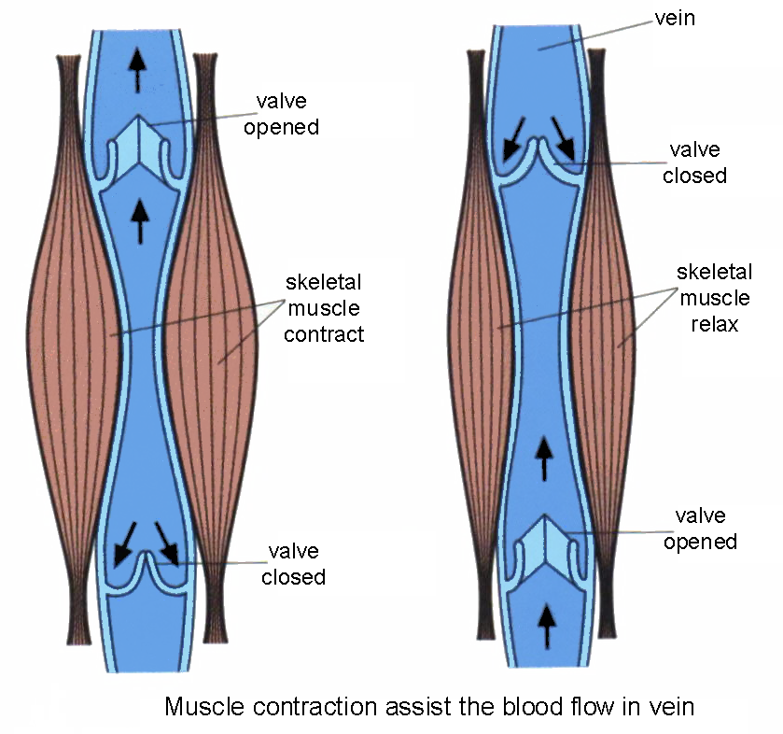
Physiology Of Venous System:
How does the blood travel through veins?
By many simple (e.g the venous plexus in soleus muscle) and complicated physiological mechanisms, which are:
Abdominothoracic (Respiratory) Pump:
Upon inspiration there will be +ve pressure in abdomen, and -ve pressure in thorax (diaphragm will go down, creating a +ve pressure which will lead to closure of veins. That cycle will continue and form a valve like function).
1
In expiration diaphragm will go up creating a –ve pressure, which will push the blood upward towards the heart from the legs.
2
As a result of pregnancy, large tumors, abdominal obesity, ascites, intra-abdominal pressure can rise to +15 or +30 mmHg (normally +6 mmHg), when it rise, the pressure in the veins of the legs must rise above the abdominal pressure before the abdominal veins will open and allow the blood to flow from the legs to the heart.
3
Venomuscular pump (Leg-Calf muscle pump):
What’s the strongest, most powerful system that can resist venous pressure in the lower limb? Venous plexus in leg ‘venous pump’.
The contraction and relaxation of the skeletal muscles surrounding the veins impress volume and pressure variations to the venous blood, while the flow direction is conditioned by the valvular arrangements (flow can be only toward the heart, from down to up and from out to in).
Weight-bearing compresses the veins in the sole of the foot, which propels blood into the calf (‘foot pump’).
Contraction
On subsequent muscle relaxation, venous pressure falls below the pressure at rest. The fall is greater in the deep veins and less in the superficial veins.
Relaxation
The vein is squeezed to push the blood upward. So when we move our legs, it moves up and empties.
03
Competent valves prevent backflow from the popliteal to the deep calf veins.
01
05
When the calf muscles contract, the pressure rises in all veins of the lower limb.
Venous pressure exceeds the intramuscular pressure in calf compartments in most of the step phases, but competent venous valves prevent retrograde flow.
A suction effect will happen which will suck the fluid from the superficial veins (through the perforaters) and from down (through the valves).
02
04
06

Slide 5
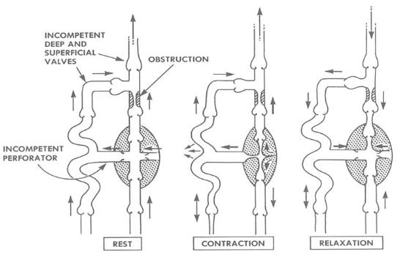
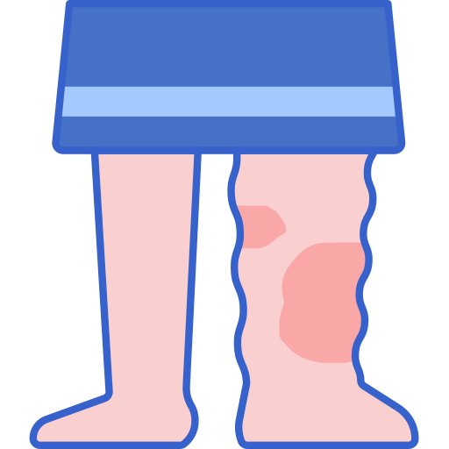
Venous Disorders:
Varicose veins
Venous ulcer
01
02
03
Chronic venous insufficiency
Most venous disease arises as a result of incompetent valves, either:
Primary valvular incompetence (floppy valve).
Secondary valvular incompetence.
Incompetent valves lead to reflux of blood or increased ambulatory venous pressure (the hydrostatic pressure exerted by the column of venous blood stretching from the ankle to the right atrium). This leads to symptoms and signs such as:
Causes of valvular failure:
02
Lipodermatosclerosis
Swelling
01
03
Ulceration and hyperpigmentation.
Congenital
Acquired valvular failure:
Avalvular venous system (rare).
occur with obesity, pregnancy, CHF, Ascites, and prolonged frequent standing, for the following reasons:
Increased abdominal pressure, which will make the venous emptying from the legs to the chest much harder → the blood volume in veins increases which will increase the pressure within the vein leading to dilation and as a result of that the valve edges no longer touch each other.
Issues above the abdomen (such as a tumor, surgery, radiation) and anything that obstructs flow leading to dilatation.
Issues inside the veins; such as thrombosis (DVT).

Slide 6
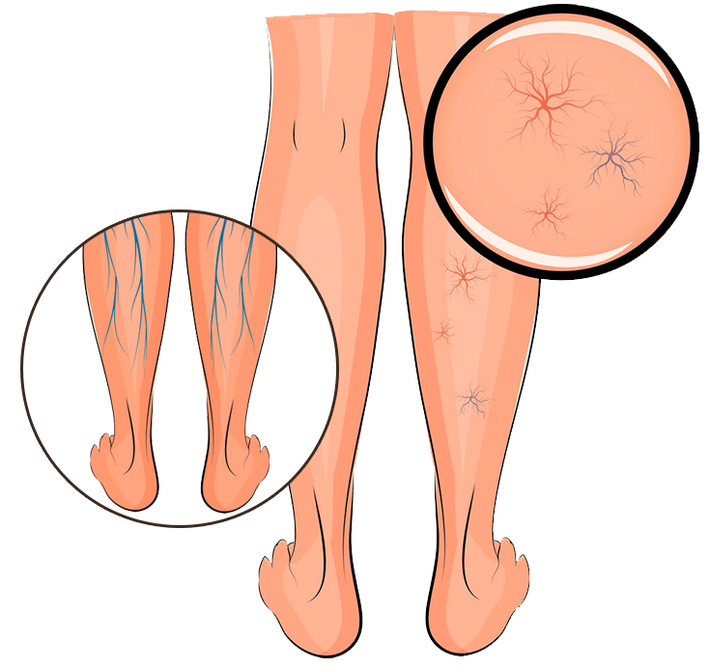
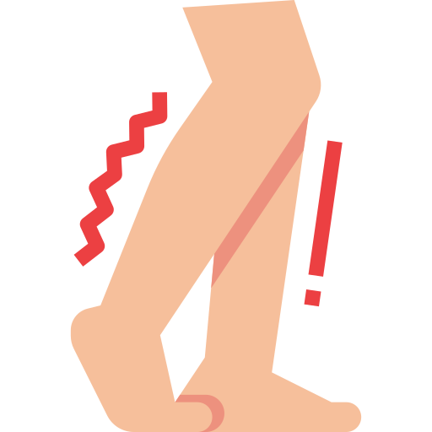
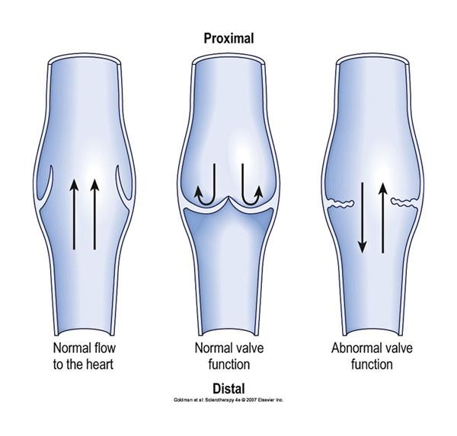
Venous Disorders:
Varicose veins:
Their prevalence increases markedly with age and they are an almost universal finding in individuals over the age of 60 years.
A great majority of individuals with varicose veins are asymptomatic, and seek treatment for cosmetic purposes.
Only a portion of patients with varicose veins go on to develop the complications of chronic venous insufficiency: e.g., leg ulcers, haemorrhage and thrombophlebitis.
Classification:
Trunk varices:
Reticular varices:
Telangiectasia:
These involve the main stem and/or major tributaries of the GSV and LSV, are usually > 4 mm in diameter.
These lie deep in the dermis, are < 4 mm in diameter (present in 80% of adult population) render the overlying skin dark blue.
These are also called spider and thread veins. They lie superficially in the dermis, are usually 1 mm or less (overlying skin purple or bright red).
Chronic venous insufficiency:
CVI is defined as the presence of (irreversible) skin damage (such as eczema, lipodermatosclerosis) in the lower leg as a result of sustained ambulatory venous hypertension.
CVI collectively describes the manifestations of impaired venous return mainly due to failure of valves that leads to continued reflux of blood.
This hypertension is due to failure of the mechanisms that normally lower venous pressure upon ambulation, namely:
90%
10-20%
Venous reflux due to valvular incompetence.
This may affect the superficial veins, the deep veins or both, and may be due to primary valvular insufficiency (as in VV) or to postthrombotic damage.
Venous obstruction.
This is usually postthrombotic in nature and coexists with reflux.

Slide 7
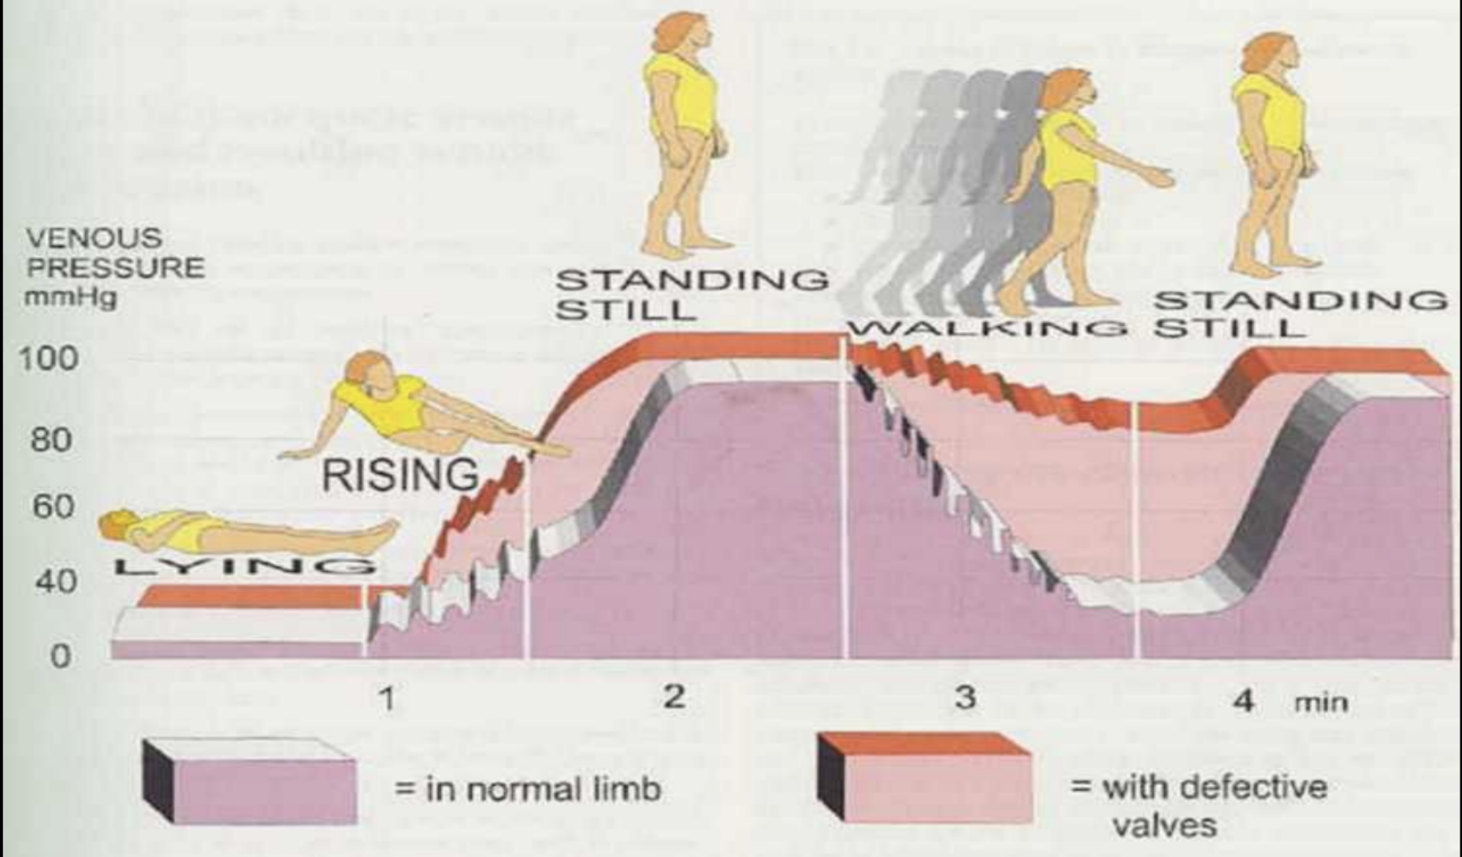
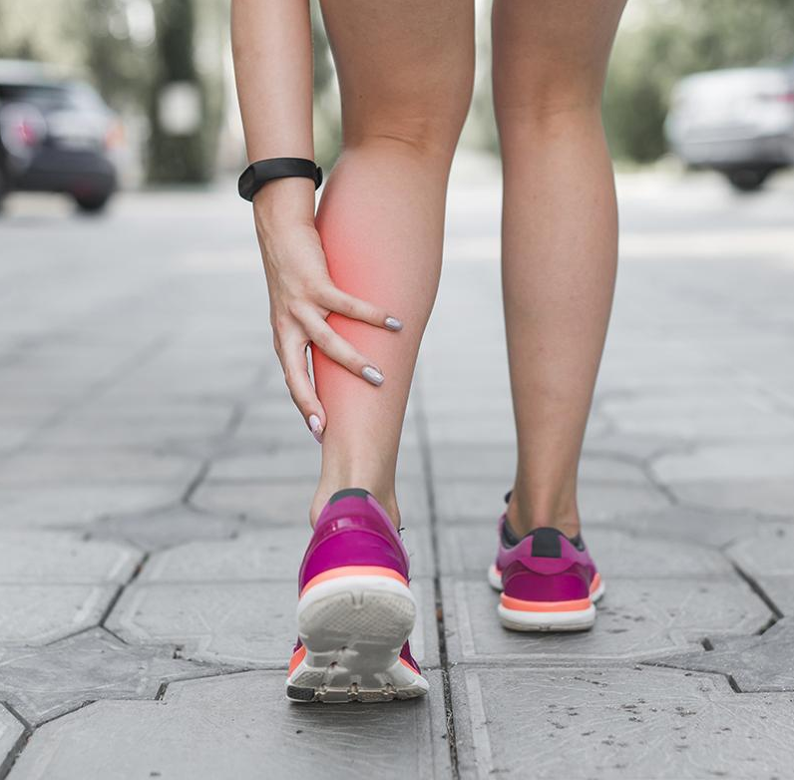
Venous Disorders:
So, What happens to the venous pressure?
1
With normal functioning valves:
2
In someone with defective valves:
When a person is lying down, the venous pressure of lower limb is distributed to be around 10 mmHg, but when the person starts to rise it increases to reach 100 mmHg, which stays like that if the person is standing still. Upon walking the muscle pump works to reduce the pressure (suction → push → suction → push).
The rising phase is faster because the vein fills from up (backflow) and gravity. And walking won’t reduce the venous pressure.
This graph depicts the pressures in a healthy limb, in mauve, while lying, rising, standing still and walking compared with the pressures present in a limb with defective valves.
The mauve depicts the normal rise and fall of venous pressure according to body positioning and gravitational effect.
Venous ulcer
Why? Because the longest vein in the superficial venous system (GSV) starts at the medial malleolus. Once venous system failure occur, it will be the highest point of pressure in the venous system. Which will lead to pain and increased: edema, protein rich fluid, lipodermatosclerosis and skin pigmentation and finally ulcers.
Venous leg ulcers are classically located in the “gaiter” region of the leg.
01
02

Slide 8
Evaluation
History
Physical Examination
Investigation
Clinical aspect of CEAP classification (used to stage the severity of venous diseases):
Non invasive (Doppler/ Duplex scanning)
Invasive (AVP / Venography)
Clinical-Etiology-Anatomy-Pathophysiology (CEAP):
C0
No signs of venous disease
C1
Telangiectasia & Spider veins (non bulging veins)
C2 varicose veins
C3
Edema
C4
Lipodermatosclerosis
(skin pigmentation due to the increased pressure inside the veins, the veins will release protein rich toxin which cause inflammation of skin and pigmentation)
C5
Healed
venous
ulcer
C6
Active
venous
ulcer
“gaiter region”

Slide 9
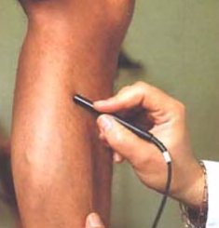
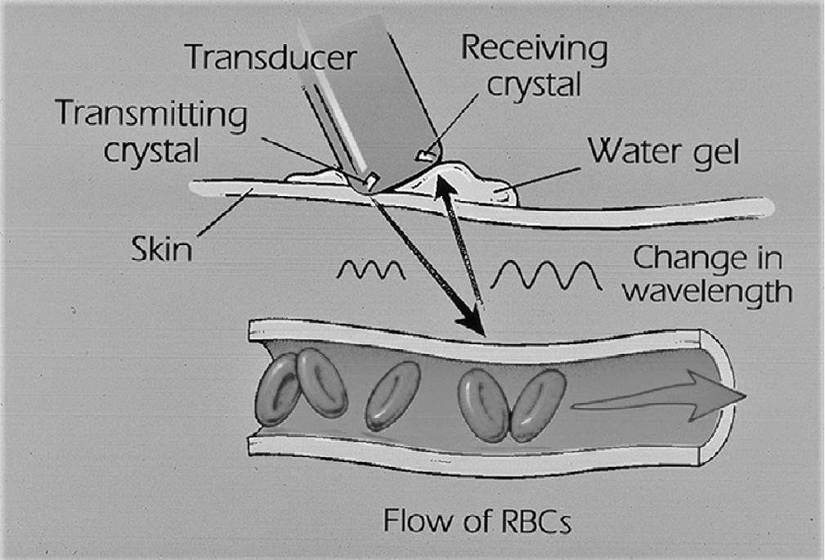
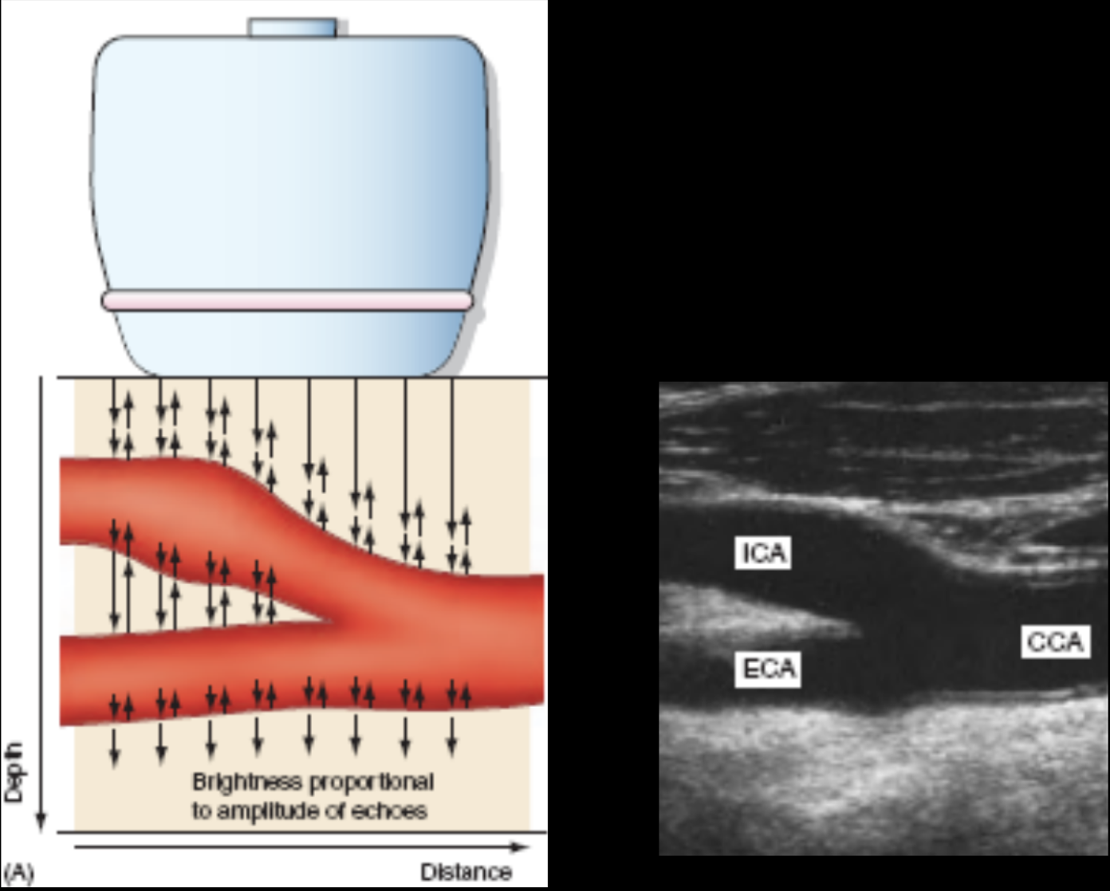
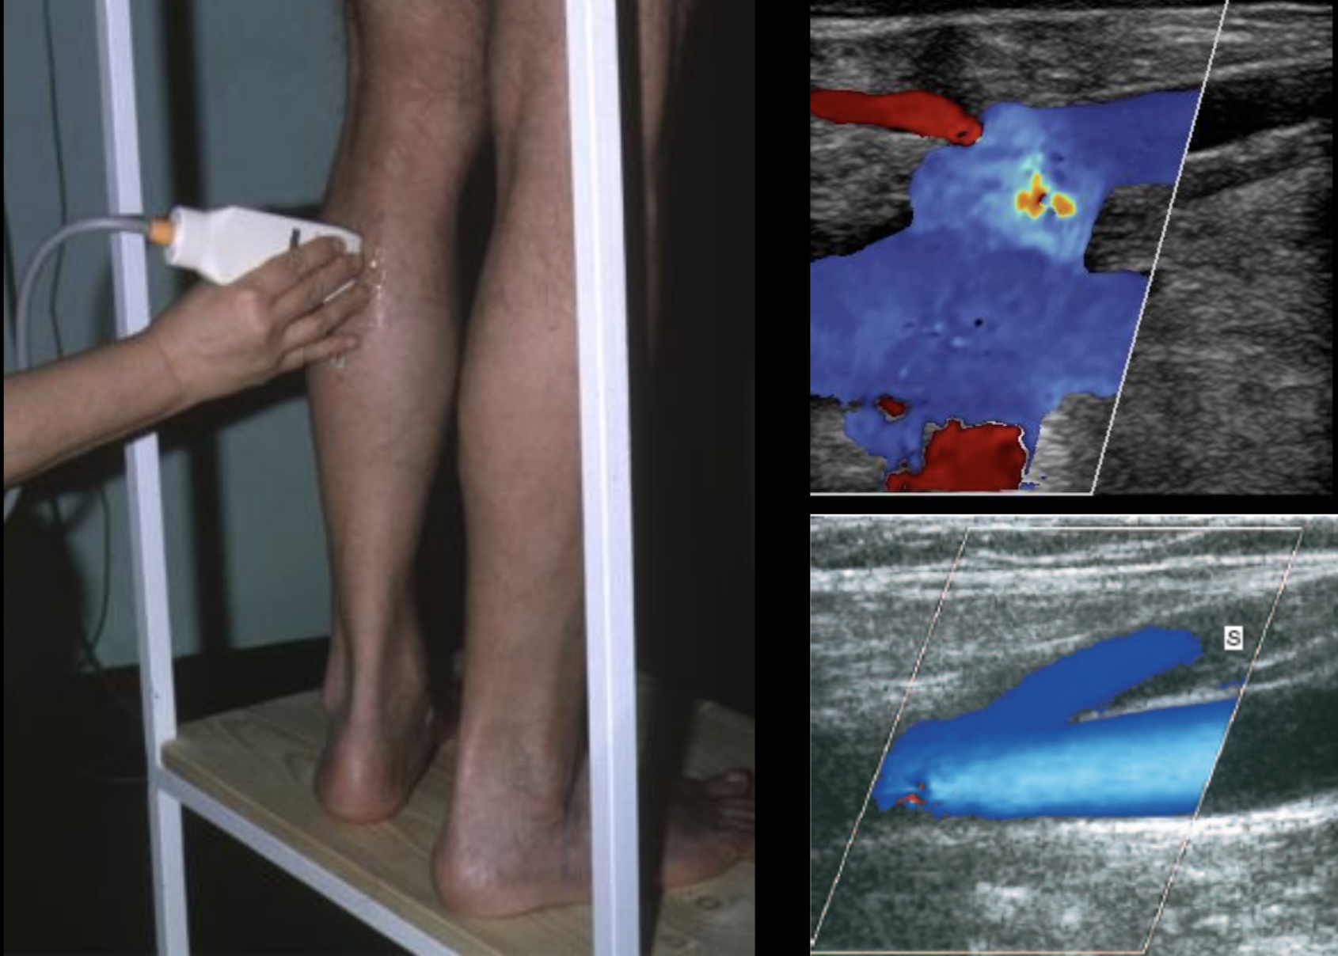
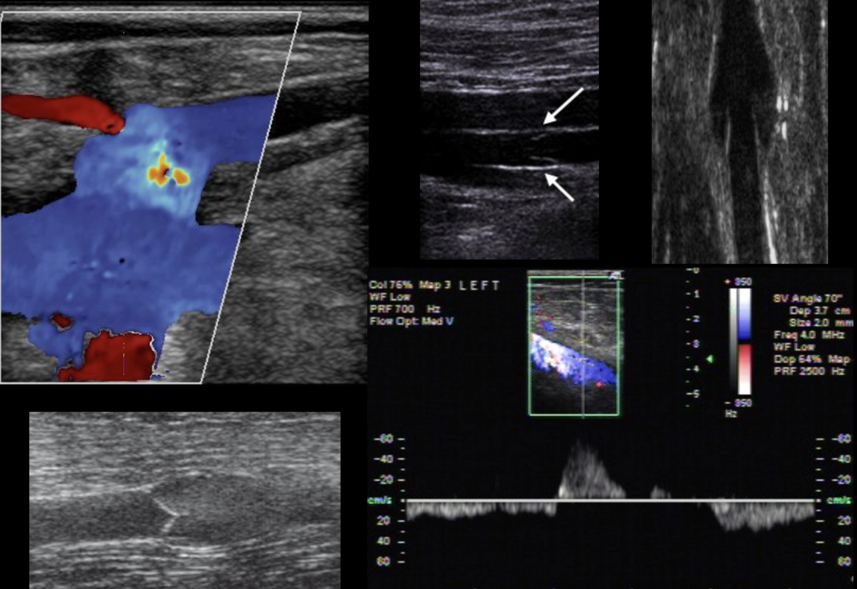
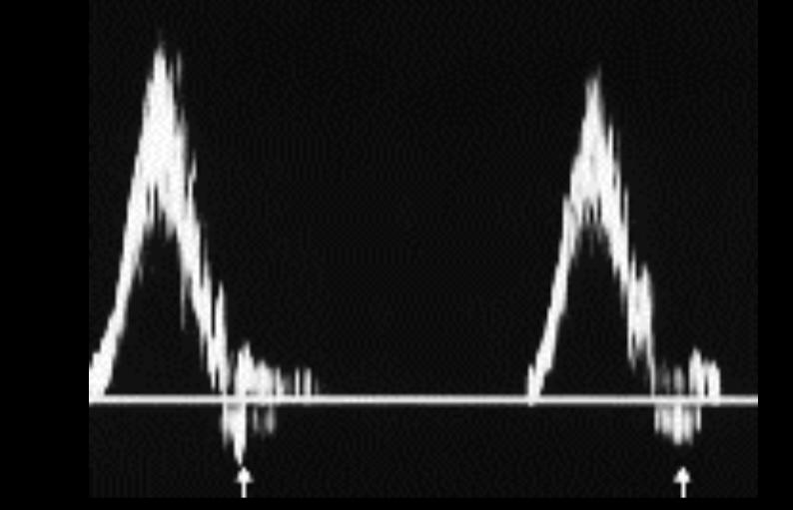
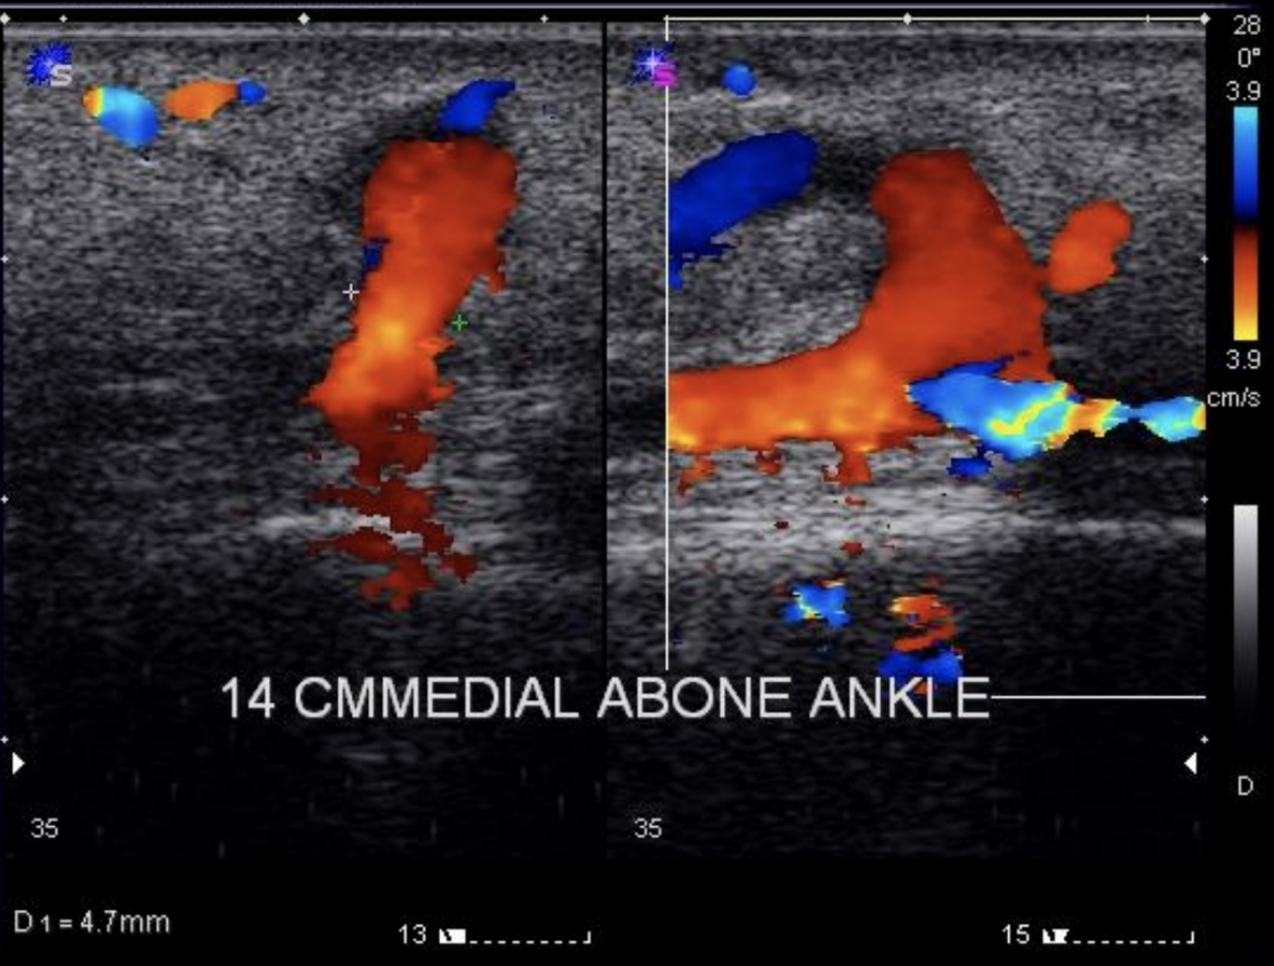
Evaluation
Non Invasive:
Tells us that there is fluid & it’s moving. You can also asses valve closure.
Normal venous blood flow is spontaneous and phasic during respiration, yielding a wind-like audible Doppler signal. Manual compression of the limb below the probe should augment forward flow, with resultant increased amplitude of the audible Doppler signal. When the limb is compressed above the probe, the Doppler signal will normally cease, because competent valves restrict retrograde venous flow. When compression above the probe is released, an augmented, forward flow signal should be noted.
01
Doppler
Non Invasive:
Duplex ultrasound involves using high frequency sound waves to look at the speed of blood flow, and structure of the leg veins. The term "duplex" refers to the fact that two modes of ultrasound are used, Doppler and B-mode. The B-mode transducer (like a microphone) obtains an image of the vessel being studied. The Doppler probe within the transducer evaluates the velocity and direction of blood flow in the vessel.
The probe also has a receiver to receive the sound waves back and analyze it. Sound waves passing through fluid rapidly and easily will make the fluid appear black. While those passing through thick tissue will reflect the sound waves back. The receiver on the probe can also inform us if the sound waves are increasing (which indicates movement of fluid. This movement is either away from the probe or towards it)
Duplex scanning is the most commonly used investigation tool.
All patients must undergo duplex ultrasound to define the nature and distribution of superficial and deep venous disease, as this has an important bearing on both treatment and prognosis.
02
- Wave is up (green circle): blood is moving towards the probe.
- Wave is down (pink circle): blood is moving away from the probe.
Duplex scanning
Normal
Incompetent Valves
Incompetent Perforator Vein
- The arrows in this picture indicate speed and not direction! (in this picture the wave is up which means that the direction of the flow is towards the probe).
- The blue arrow: speed is fast
- The purple arrow: speed is low
AND BOTH ARE GOING IN THE SAME DIRECTION BECAUSE THE VALVE IS FUNCTIONING WELL.
How do we know that the valve is functioning normally? Because when the direction of the flow (the wave) was about to get reversed, the flow stopped = valve is working (orange circle).
- Reversed flow

Slide 10
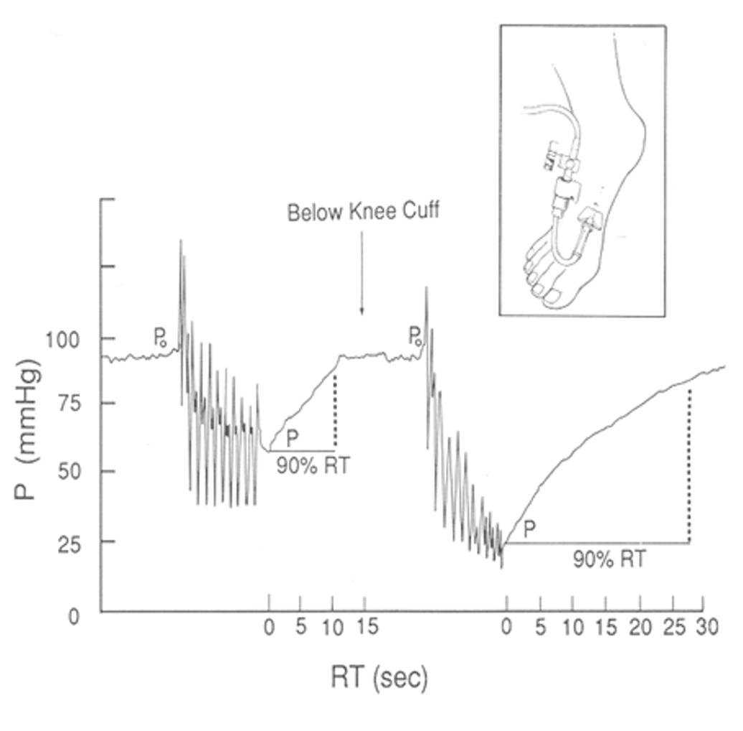
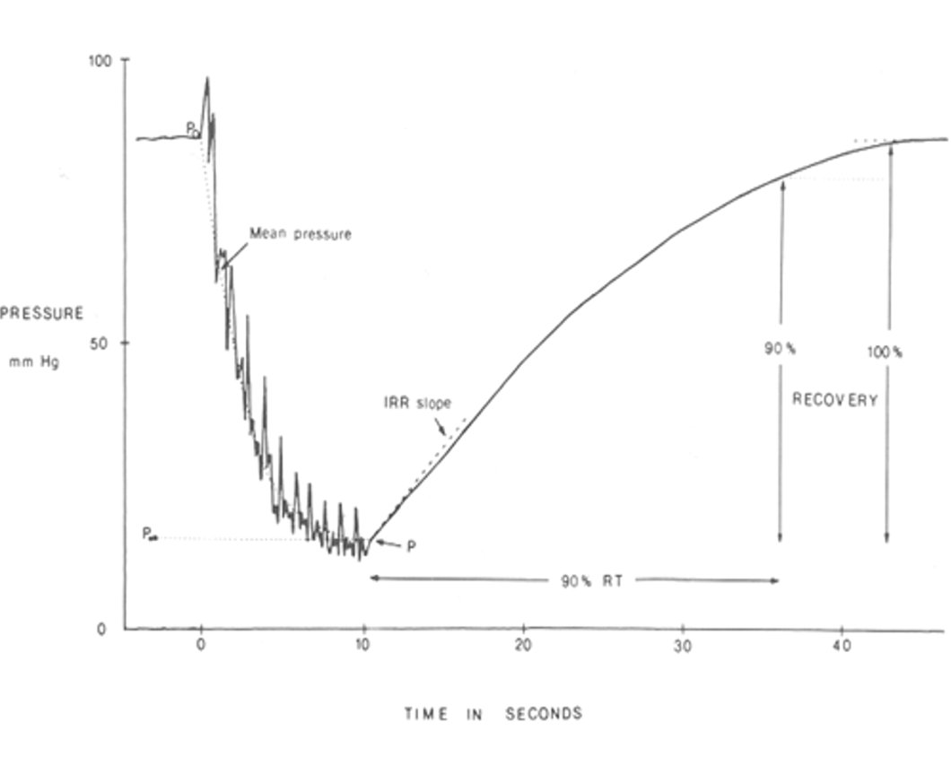
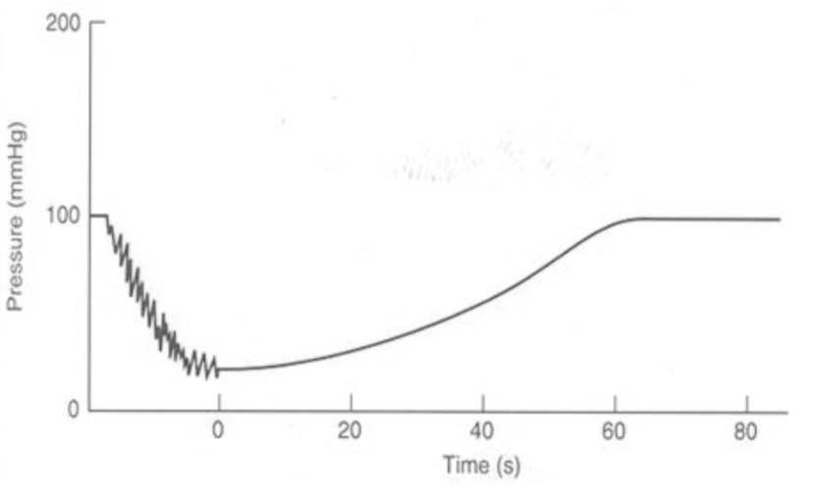
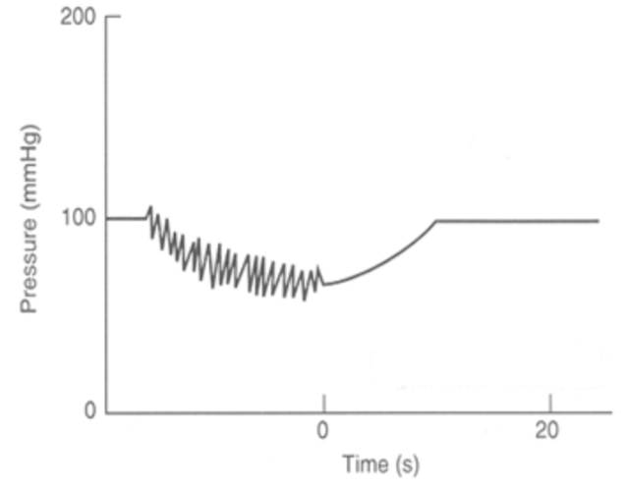
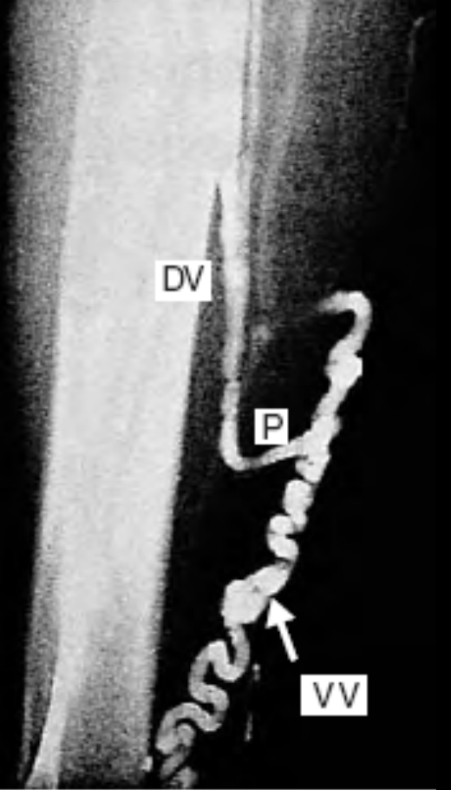
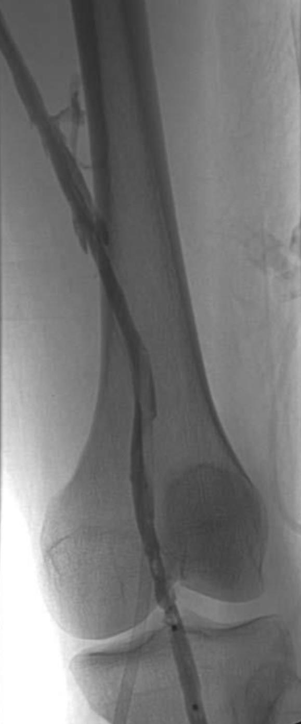
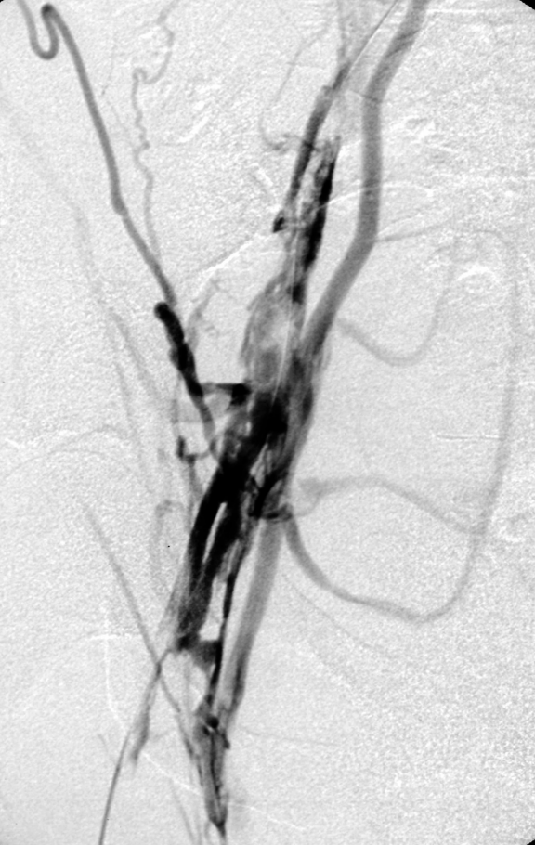
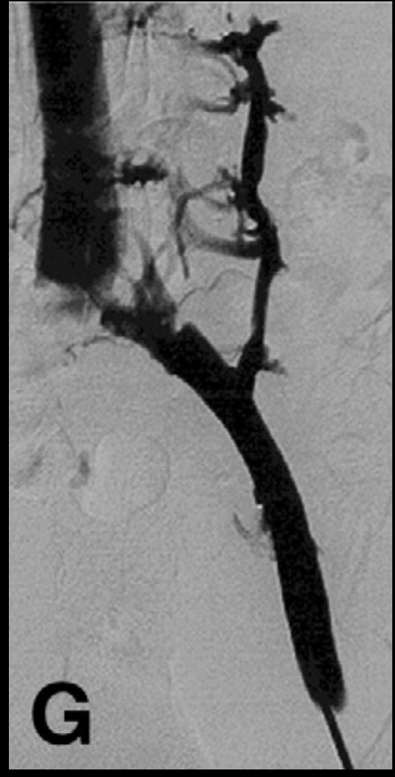
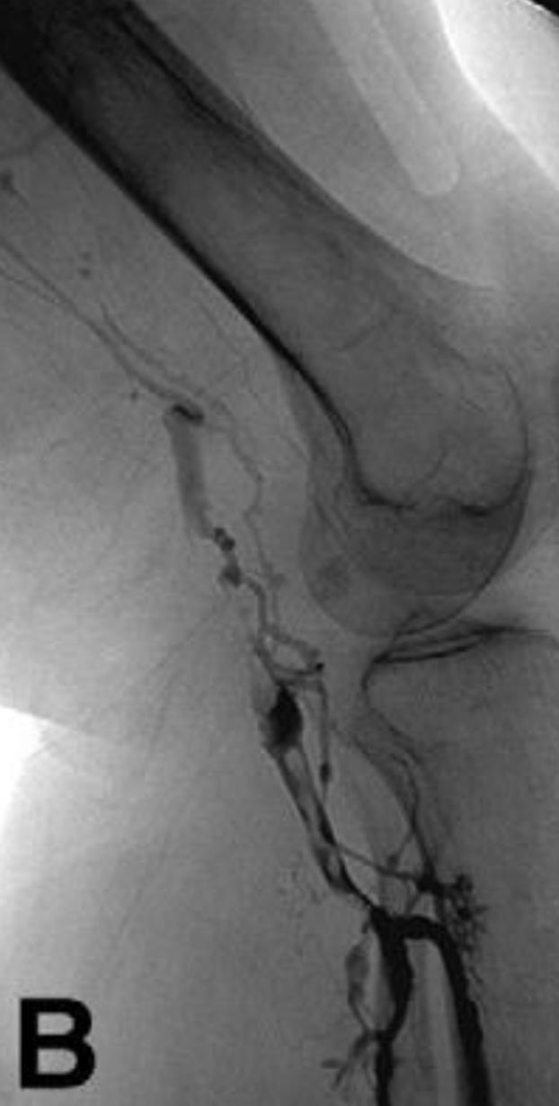
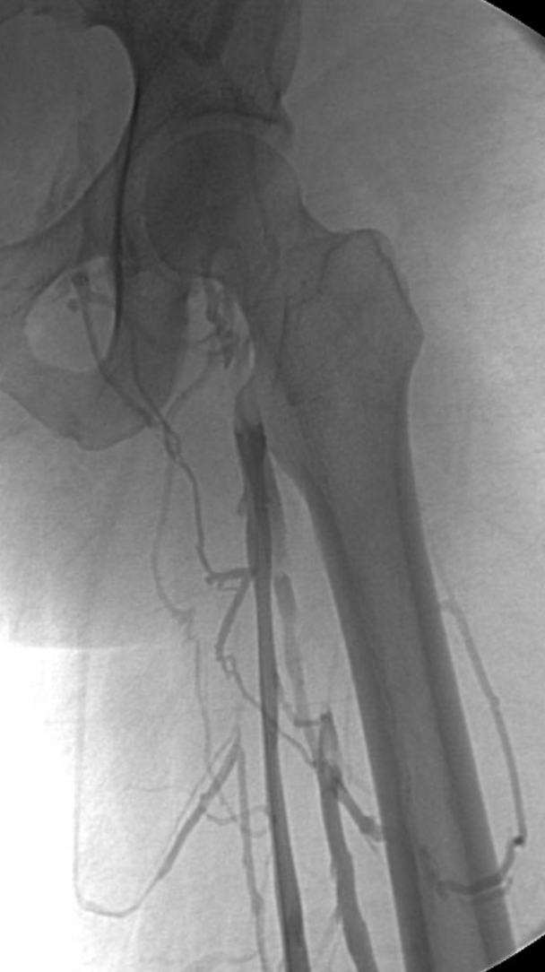
Evaluation
Invasive:
AVP (ambulatory venous pressure)
Reflux - 20-21 gauge Butterfly Needle
Superficial Dorsal Vein (Foot)or Ankle Vein
Standing, Heal Raised, Measurements.
Normal : Pressure drop from 80 -90 to 20-30 mmHg / or > 50% drop.
Venous Refill Time (VRT) ≥ 20 sec
Abnormal: Lack of sufficient drop in pressure with ambulation →P < 50%
Short Venous Refill Time (VRT) < 20 sec
03
AVP
Deep venous incompetence
Normal
Invasive:
Injecting dye + x-ray to see inside the veins. The vein in the picture is the popliteal and it’s blocked in the picture ‘B’.
04
popliteal vein. Green circle: valve.
popliteal vein with filling defect (blocked vein).
Blue arrow: Saphenous vein
Orange arrow: Femoral vein with filling defect due to DVT.
Phlebography (Venography)

Slide 11
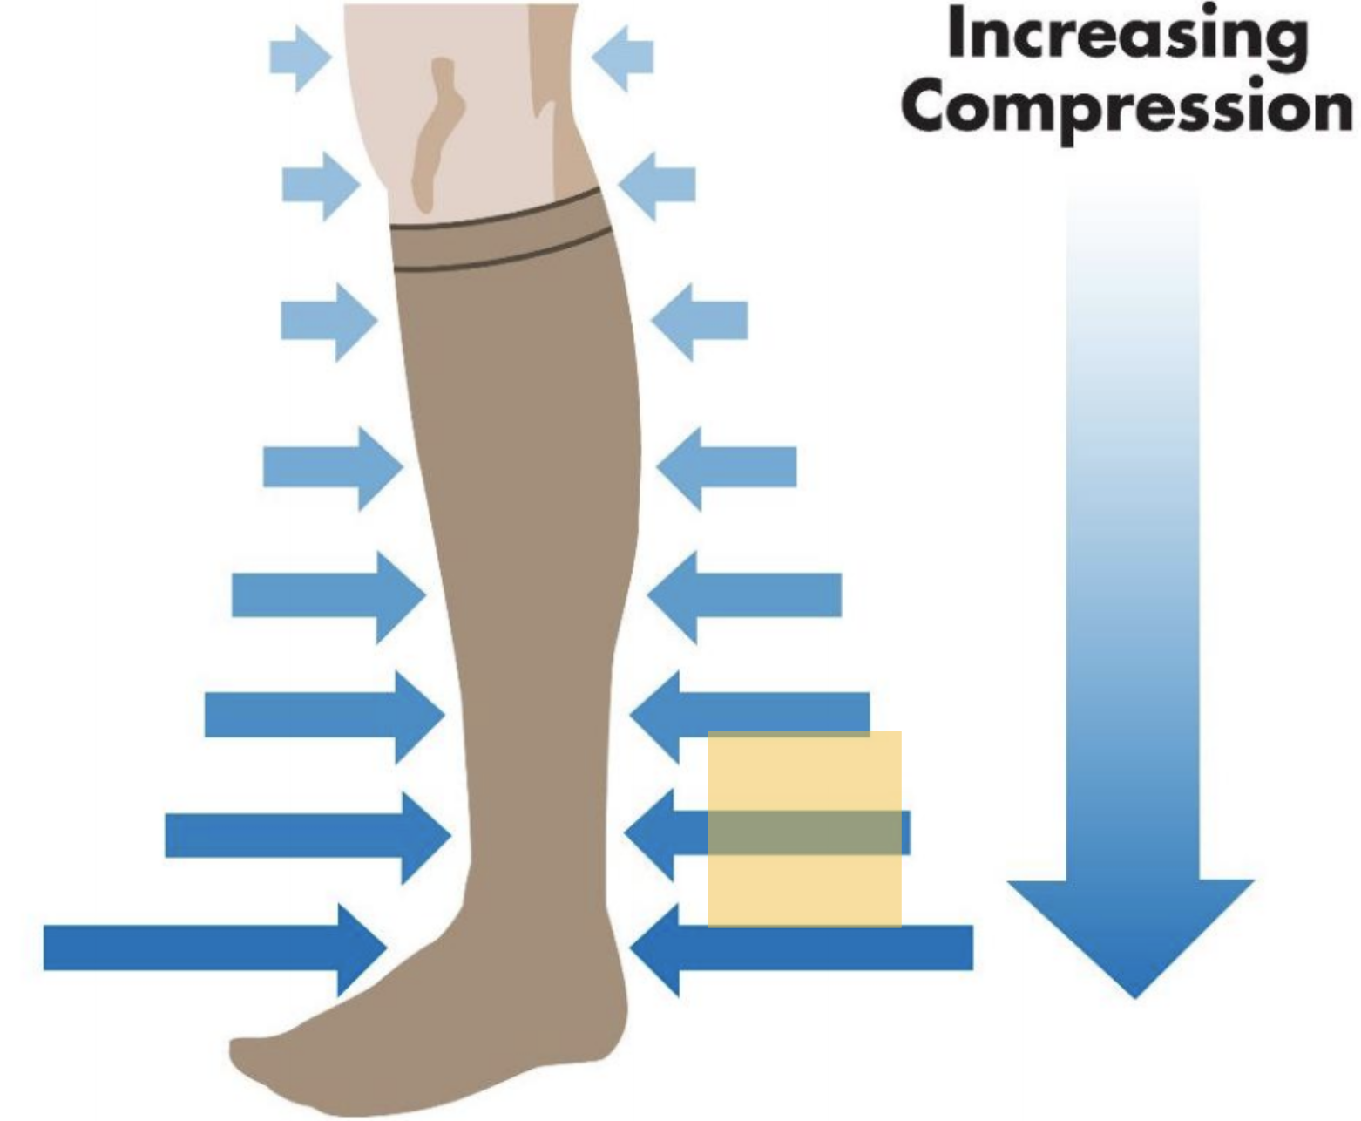
Treatment (types of ablations)¹:
Compression stocking: a temporary solution that provides high compression below and low compression up; for 2 reasons:
To close veins that aren’t working properly which will shift blood to deep veins
Make valve leaflets close to each other
Disadvantage patients usually have compliance issues with it especially elderly patients because it’s hard to put on (high pressure) & may reduce arterial perfusion.
Mechanical
Sclerotherapy: Sclerotherapy is the injection of a sclerosing agent into a vein (small veins only!) , causing an inflammatory reaction in the endothelium of the vein wall. The vein walls adhere together under compression and form a scar (fibrotic tissue) that is absorbed by the body. And the blood will be shifted to other working veins. Usually it is a cosmetic procedure.
Contraindicated with large veins.
Complications : pigmentation, allergic reaction, necrosis, pain.
Chemical
EndoVenous Ablation Techniques ²: Denaturation of vein wall collagen → contraction → fibrous obliteration
EndoVenous Laser Therapy (EVLT)
Thermal
Surgery (stripping the saphenous vein)
We don’t do it anymore, big wound, very painful, very challenging to the patient.
An absolute contraindication is if the rest of the veins are diseased (e.g. DVT)
Surgical
Telangiectasia Reticular veins
varicose veins
Edem - Cutaneous ulcer - Local wound
Stocking and/or Sclero-Rx
Stocking
USG-Sclero-Rx (less used in large ones to avoid chemical toxicity)
EVLT/Surgery
Stocking
USG-Sclero
ELVT/Surgery
1. We do ablation, but before that we have to make sure and ask : Is the other veins functioning? What is causing this condition (tumor,DVT)?
Say you have a C2 (varicose veins), before initiating therapy, one needs to consider the following;
Is the rest of the veins working? The rest could be thrombosed and you’d be ablating the only functioning one! So you need to check the deep veins. For example, see if the patient has DVT, by duplex-scanning (standard protocol).
This could be the tip of the iceberg with an underlying cause (proximal occlusion) , such as; tumor in proximal areas like groin lymph nodes or sarcoma in abdomen. Or could be a trauma or post-op fibrosis.
2. Laser or radio ablation can be used where a laser fiber is inserted in the GSV to reach the saphenofemoral junction, then the thermal beam is turned on and pulled slowly out closing the vein entirely.

Slide 12
Venous Thromboembolism (VTE):
Epidemiology:
DVT is a common condition in medical and surgical patients.
pulmonary embolism (PE) is consistently cited as the most common cause of potentially preventable death in the surgical patient.
Pathophysiology:
01
02
03
04
DVT probably begins in the calf in most cases.
Clot may extend into the popliteal, femoral or iliac veins, and even the inferior vena cava.
At first, the clot is free-floating within a column of flowing blood.
The risk of PE is highest at this point. Later, when thrombus has completely occluded the vein and incited an inflammatory reaction in the vein wall, the clot becomes densely adherent and is unlikely to embolize.
Aetiology and Clinical Features:
Virchow's triad: namely, venous stasis, intimal damage and hypercoagulability of the blood (These include antithrombin, protein C and protein S deficiency, as well as factor V Leiden.)
Clinical risk factors for DVT are related to venous stasis: for example, immobility, obesity, pregnancy, paralysis, operation and trauma.
Clinical features:
Leg swelling
1
Dilated superficial veins
2
Thrombophlebitis (redness, pain and tenderness, heat)
3

Slide 13
Venous Thromboembolism (VTE):
Diagnosis and Management:
Diagnosis:
Management:
Colour duplex ultrasound imaging has largely replaced conventional venography in the diagnosis of DVT.
At times of doubt, MR or CT venography may be useful.
Before treatment is instituted, the diagnosis of DVT should normally have been established by means of ultrasound or MR (CT) venography.
However, where the clinical suspicion of DVT and/or PE is high and there is no contraindication to heparin, the potential benefits of ‘blind’ treatment until the diagnosis is confirmed often outweigh the risks of withholding anticoagulation.
Uncomplicated DVT vs. Complicated DVT:
Uncomplicated DVT | Complicated DVT
If thrombus is confined to the calf, the patient is fully mobile and other risk factors are reversible, then an elastic stocking and physical exercise may be all that is required. For most uncomplicated DVT, it is now clear that: Bed rest is unnecessary and the patient can be mobilized immediately, wearing an appropriately fitted compression stocking. LMWH given by intermittent subcutaneous injection is more effective than unfractionated heparin given by infusion. | The DVT is more extensive (iliofemoral, vena cava, phlegmasia). The DVT is recurrent. The patient has had a PE. The patient has one or more major irreversible congenital and/or acquired thrombophilia. Heparinization is contraindicated (heparin-induced thrombocytopenia, trauma – especially intracranial,recent haemorrhage).

Slide 14
Summary
Lower Extremity Veins
Superficial
Deep
Perforating
Factors Affecting Venous Blood Flow
Hydrostatic pressure
Intra-abdominal pressure
Upon standing about 90 mmHg
Upon walking less than 20 mmHg
Expiration → -ve pressure → blood moves from the legs to the heart
Inspiration → +ve pressure → closure of the valves
Ambulatory venous pressure
Venous pump
In supine position = 10 mmHg
Standing still = 90 mmHg
Upon walking = 25 mmHg
Calf muscles relax → deep veins expand → pressure collapse → blood sucked from superficial veins
Calf muscles contract → blood forced up → opening of the valves → blood pumped towards the heart
Venous Disorders
01
02
03
Chronic venous insufficiency
Varicose veins
Venous ulcer
presence of (usually irreversible) skin damage (such as eczema, lipodermatosclerosis) in the lower leg as a result of sustained ambulatory venous hypertension.
usually located in the “gaiter” region of the leg
Non invasive:
Doppler
Duplex scanning
Invasive:
Ambulatory venous pressure
Compression stocking
Sclerotherapy
EndoVenous Ablation Techniques
Evaluation:
Management:
Surgery

Slide 15
Quiz
MCQ
Q1: A 41-year-old woman, diagnosed with varicose veins in the left leg, presents to your clinic with a 2-month history of severe pain in the left leg on prolonged standing. The patient is obese and the pain has affected her working and social lifestyle and she asks you about the most effective treatment option. From the list below, choose the most effective treatment option that you would discuss with this patient.
A) Use of compression stockings
B) Injection sclerotherapy
C) Surgery
Q2: Lipodermatosclerosis is commonly associated with which one of the following conditions?
A) Deep vein thrombosis
B) Varicose veins
C) Intermittent claudication
Q3: A 65-year-old man presents for the first time to your clinic with a painless wound in his right leg, which has been present for over 2 months. On examination you notice a 3 cm × 4 cm leg ulcer in the gaiter area of the right leg, covering the medial malleolus. The shallow bed of the ulcer is covered with granulation tissue, which is surrounded by sloping edges. There is no history of trauma. From the list below, choose the most likely diagnosis.
A) Arterial leg ulcer
B) Neuropathic ulcer
C) Venous ulcer
Q4: Which of the following statements regarding venous leg ulcers are true?
A) Less than 10 percent of patients will get a recurrence within 5 years after healing.
B) Venous ulcers are best managed by ‘two layer’ bandaging.
C) Greater than 60 percent of all leg ulcers are venous in origin.
Q5: A 48-year-old man has a body mass index (BMI) of 37 and is a heavy smoker. He has primary symptomatic varicose veins with skin changes and duplex scan demonstrates an isolated saphenopopliteal junction incompetence and short saphenous reflux.
A) Endovascular laser treatment (EVLT)
B) Foam sclerotherapy
C) Valve surgery
Answers
Q1 | C | Q4 | C
Q2 | B | Q5 | A
Q3 | C | Q6
Extra Questions

Slide 16
Good Luck!
Team leaders:
Nouf Alshammari
Haneen Somily
Naif Alsulais
Mohammed alshoieer
This lecture was done by:
Abeer Almutairi
Amirah Alzahrani
Nujud Alabdullatif
Khaled Alharbi
Faris Almubarak
Feedback
Note taker
Reviewer

