Slide 1
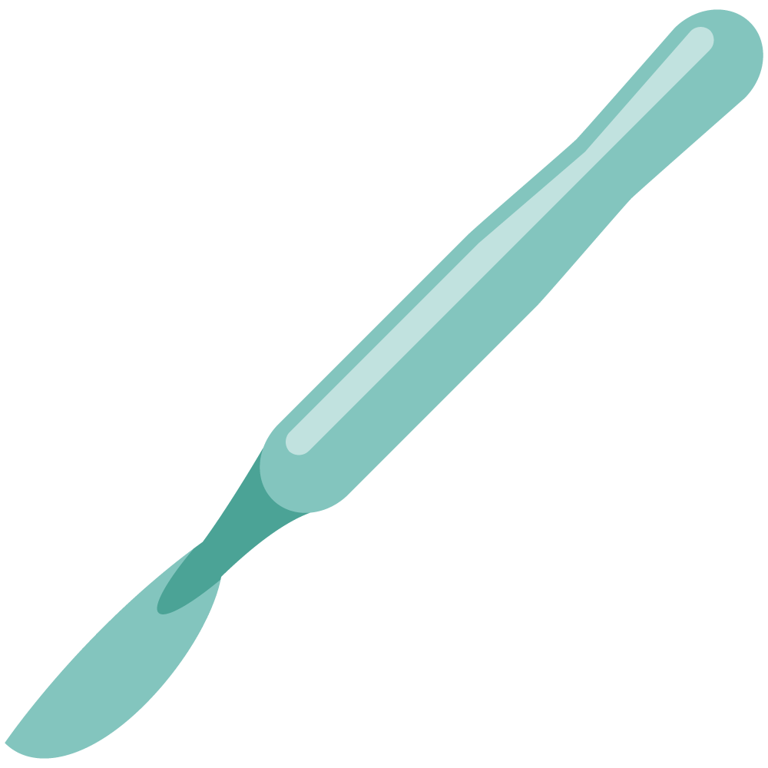
Vascular investigations
Objectives
Identify the types of vascular investigations including:
Ankle brachial index
Duplex ultrasound
CT angiogram
MR angiogram
Conventional angiography
Discuss the classification of vascular investigation based on:
Sensitivity
Operator dependency
Toxicity
Therapeutic or diagnostic.
Colour Index
Main Text
Males slides
Females slides
Doctor notes
Textbook
Important
Golden notes
Extra
Editing File

Slide 2
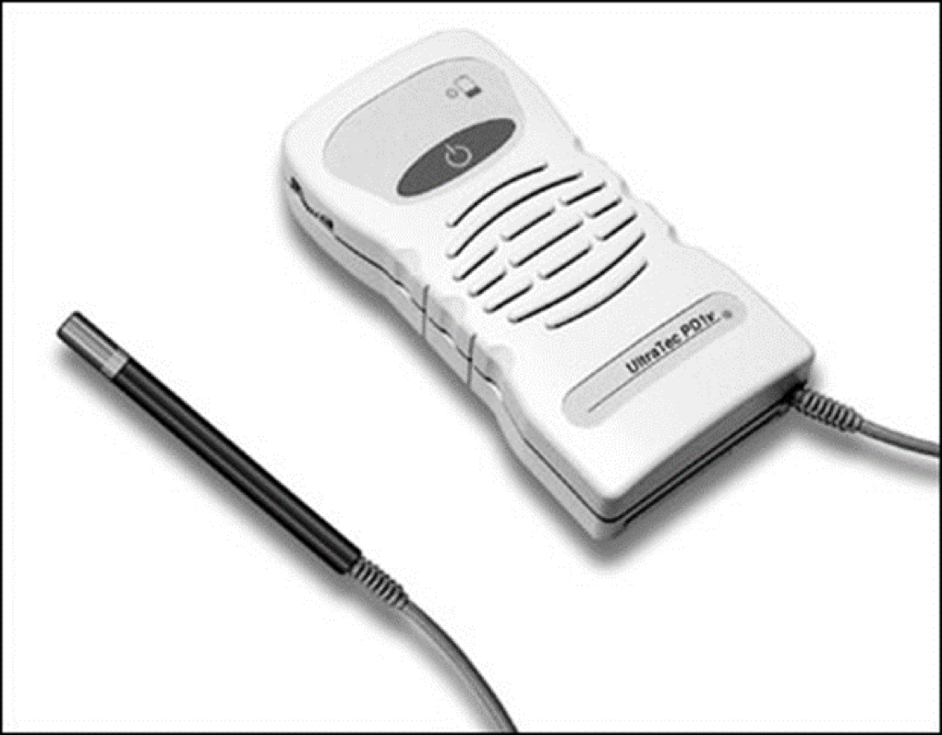
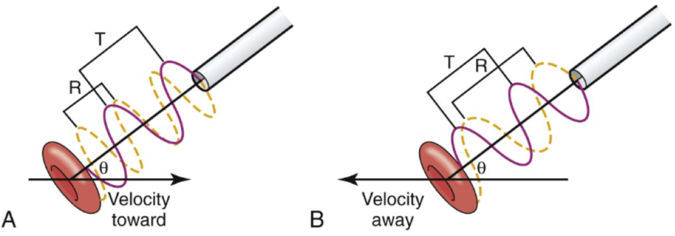
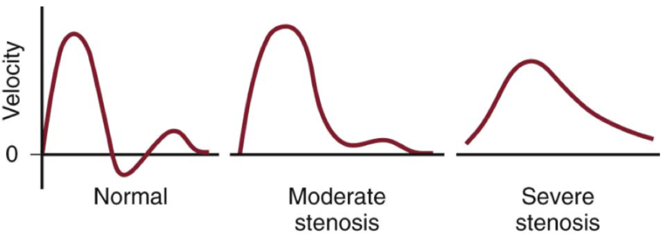
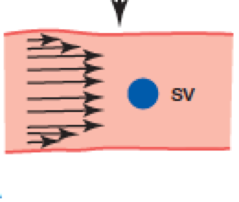
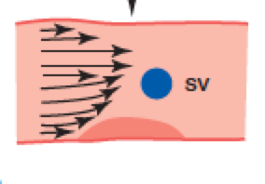
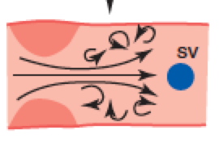
Handheld Doppler
Used to hear the arterial signals in the peripheral arteries if it is not palpable
The Doppler device compares the frequency of backscattered sound from moving red blood cells with the transmitting frequency. to determine the frequency shift, which is proportional to the speed of the flowing blood, the transmitting frequency, and the cosine of the Doppler angle, θ.
The drawing shows a Doppler probe transmitting ultrasound at a wavelength T to a red blood cell moving in a direction indicated by an arrow.
The red cell is moving toward the probe in (A) and away from the probe in (B). The angle between the ultrasound beam and the direction of red cell velocity is given by θ.
The frequency of the ultrasound that is transmitted is the same in both cases (red line). The ultrasound signal that is received (yellow line) has a shorter wavelength (R) in (A) and a longer wavelength in (B).
Velocity : - If stenosis velocity will increase.
- If occlusion velocity will be zero.
(normal artery without stenosis)
The wave will be triphasic
(Mild stenosis)
The wave will be biphasic
(Severe stenosis)
The wave will be monophasic
Some surgeons use hand-held Doppler probes to help delineate patterns of reflux, but even in the best of hands the method lacks precision and accuracy. In reality, as duplex ultrasound machines become smaller, more portable, easier to use and cheaper, there is a move towards performing duplex examination in the clinic on all patients being considered for intervention.

Slide 3
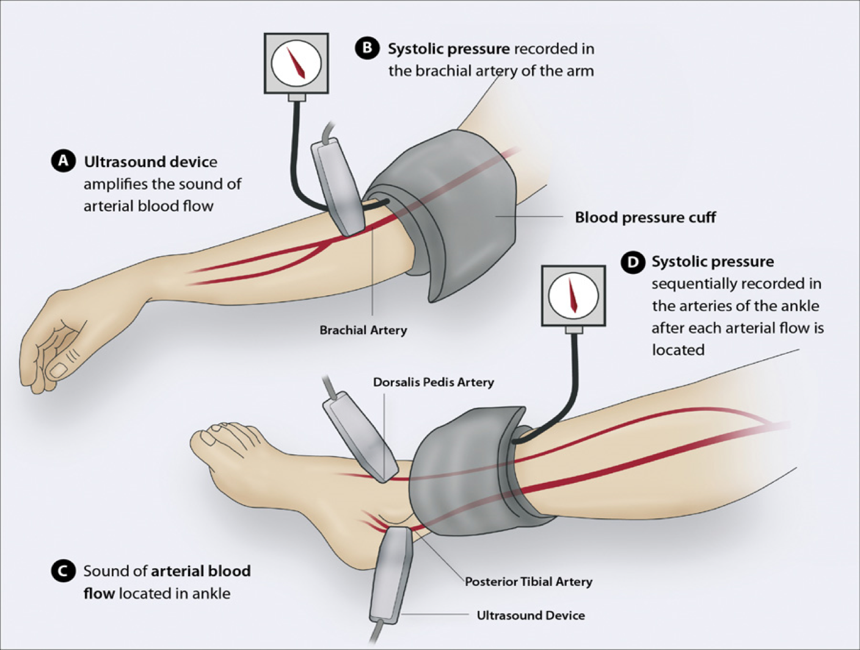
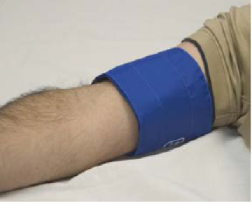
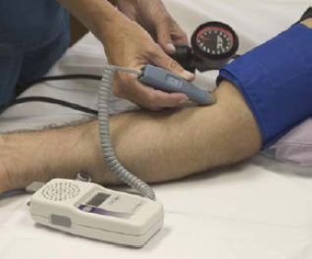
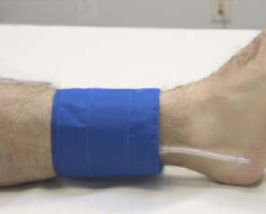
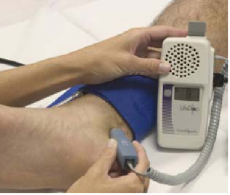
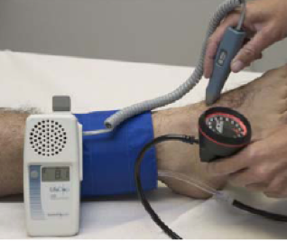
Ankle Brachial Index:
ABI= ANKLE SBP(PT OR DP)/HIGHEST ARM SBP ABI= Ankle systolic pressure/Arm systolic pressure
Normally the pressure in upper limb and lower limb is the same so if you divide the systolic pressure of the ankle by the pressure of the brachial the result will be 1. ( we accept the range between 0.9-1.29).
If the index is less than 0.9 that means there is decrease blood flow to the limb. Ex: stenosis of the arteries in the lower limb.
The ABI has limited use in evaluating calcified vessels that are not compressible as in Diabetics.
>1.3 is considered false positive, in patient with DM their vessels are calcified so it can't be compressed enough to read the pressure.
In diabetics digital arteries are not usually calcified so we measure the pressure with small cuff for the toe, the normal range is (70-100) “they aren't available everywhere
Interpretation of ABI
>1.30 | Noncompressible
1.00-1.29 | Normal
0.91-0.99 | Borderline (equivocal)
0.41-0.90 | Mild to moderate peripheral arterial disease Seen in intermittent claudication
0.00-0.40 | Severe peripheral arterial disease Critical Limb Ischemia
Sensitive
Operator dependant
Toxic
Therapeutic
✓
✓✓✓
✗
✗

Slide 4
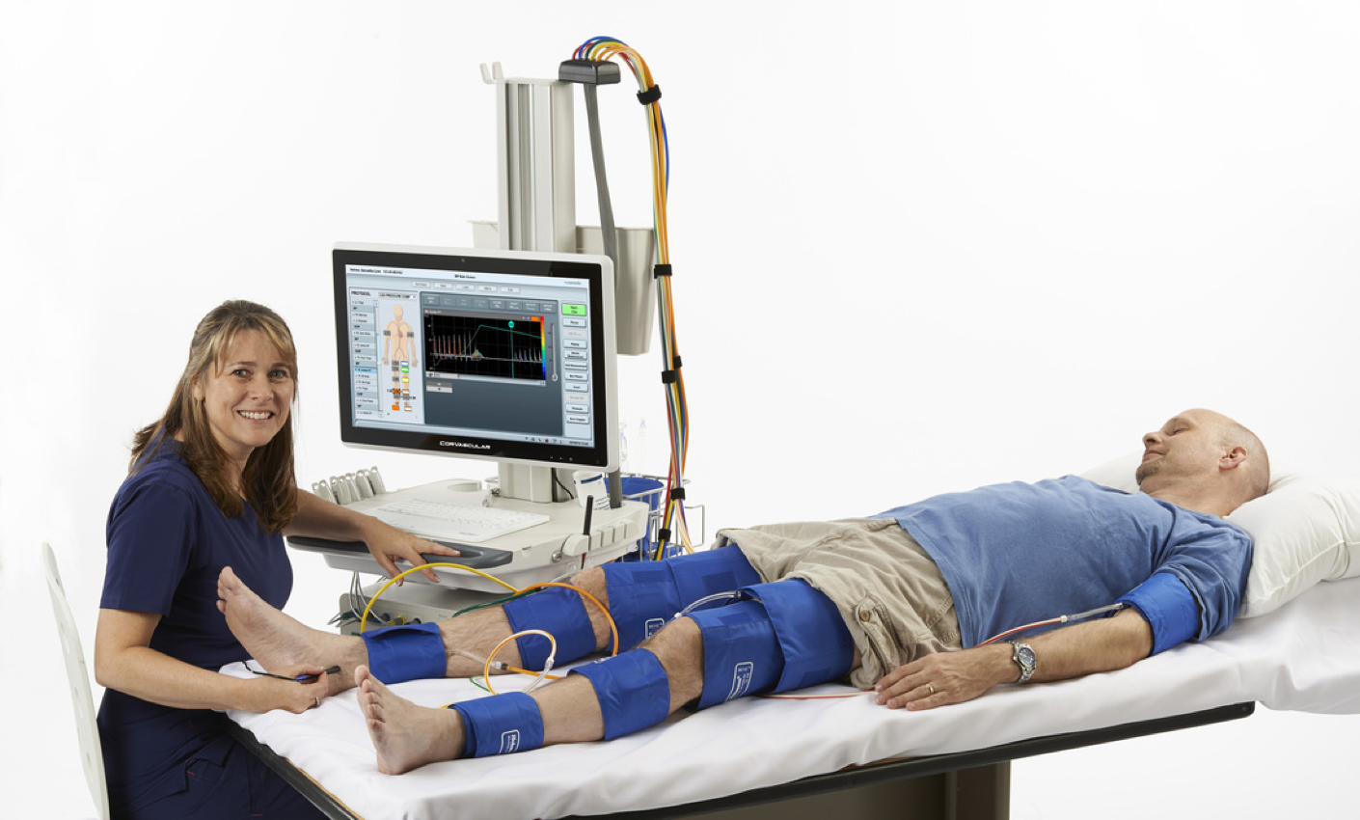
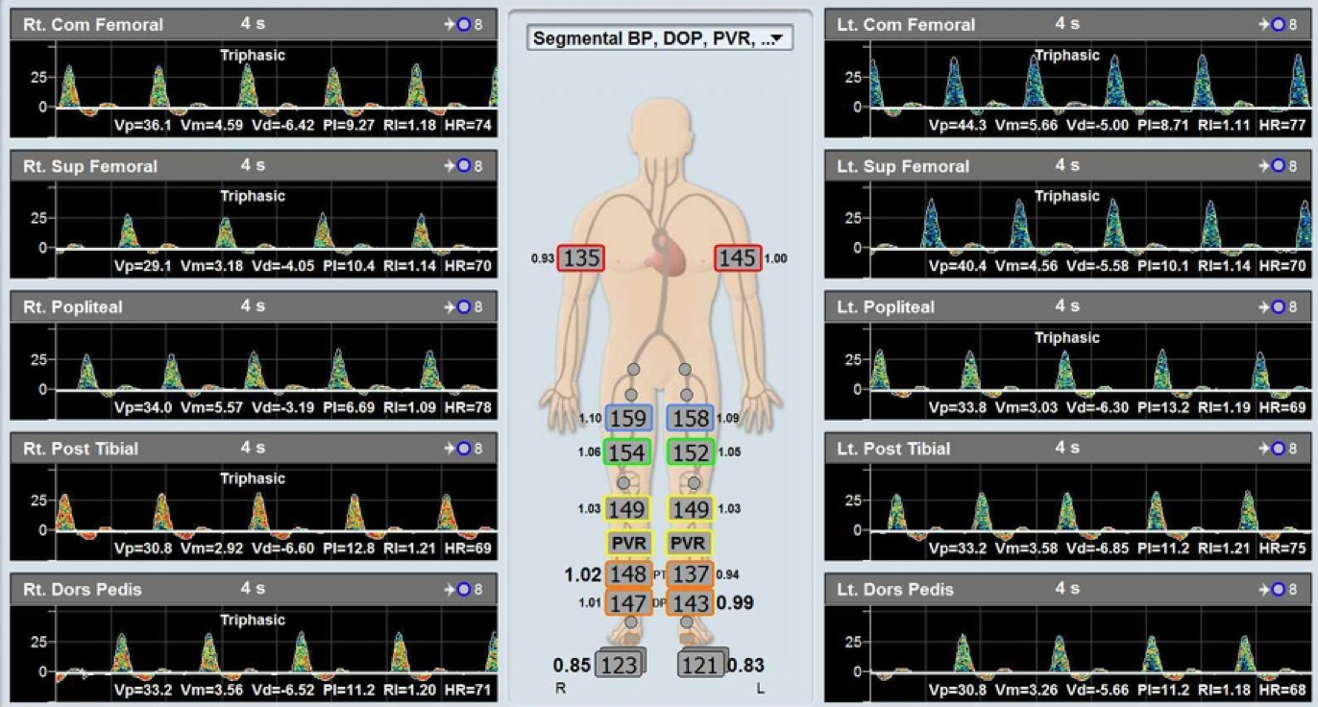
Segmental pressure
01
A non-invasive test used to measure the pressure in the lower limb.
It doesn't tell us the exact disease.
02
Measures will be taken from multiple areas ( upper thigh, middle thigh, upper leg, and middle leg).
03
Normally pressure is the same all along the limb (normal person have same pressure in the whole body).
If there is a change this indicated stenosis.
So if in one place its triphasic and distal to that area the reading was biphasic this means that there could be stenosis between the two segments.
Sensitive
Operator dependant
Toxic
Therapeutic
✓
✓✓✓
✗
✗
Could give false readings if not done by an expert

Slide 5
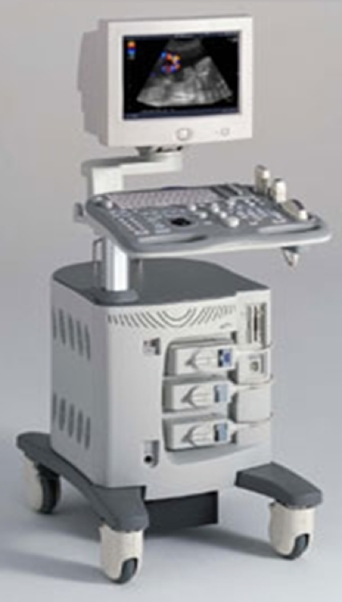
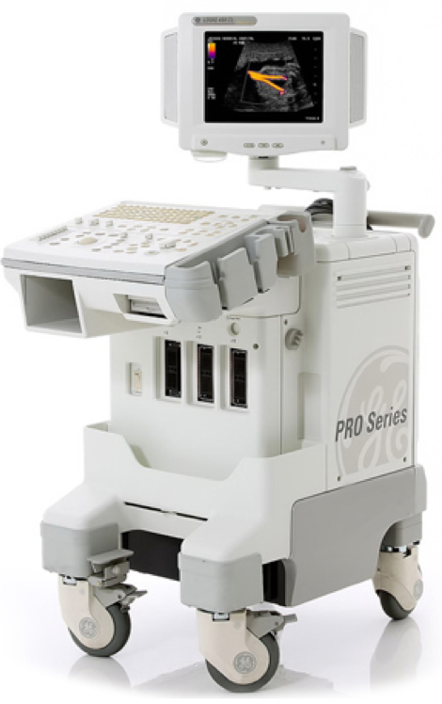
Duplex Ultrasound
B - mode + Color Doppler.
Ultra
sound
Doppler
Duplex
Used to see anatomy (liver, kidney, arteries or veins), to evaluate the integrity of the structure.
Used to hear sounds, that reflect pulsation, and evaluate the physiology of the artery or vein.
Doppler + Ultrasound
Also called Colour flow Doppler
Duplex can help you see
the pulse (Triphasic...)
Velocity (Stenosis there is high velocity, in occlusion there is no velocity)
can check for DVT, reflux (Varicose veins, Venous insufficiency)
For venous system it can help
Assess the diameter and flow rates
Determining the underlying etiology (reflux, obstruction, or reflux and obstruction)
Determining specific anatomical sites involved (deep or superficial veins, perforators, or greater veins)
Determining the severity of the disease

Slide 6
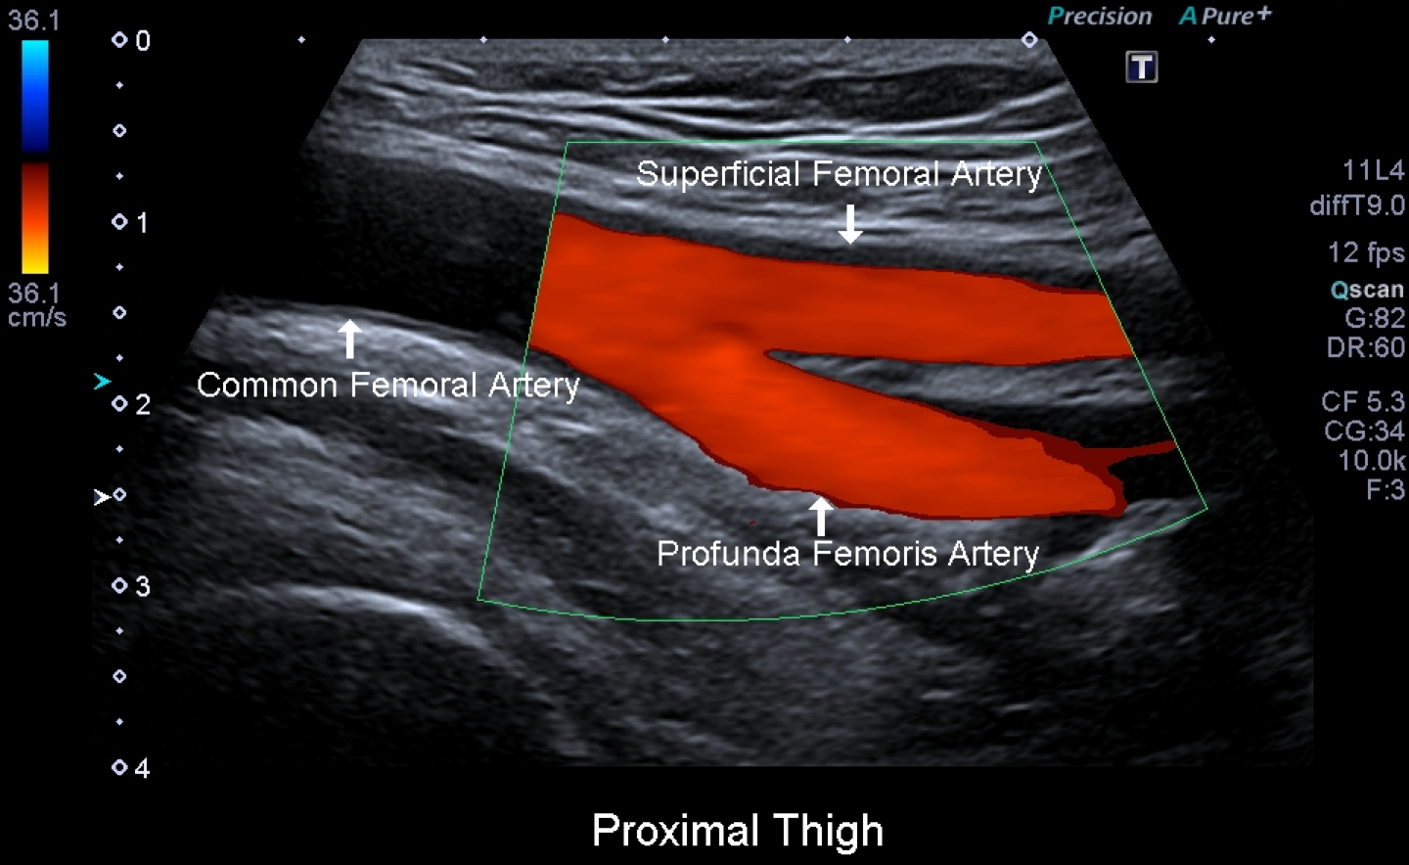
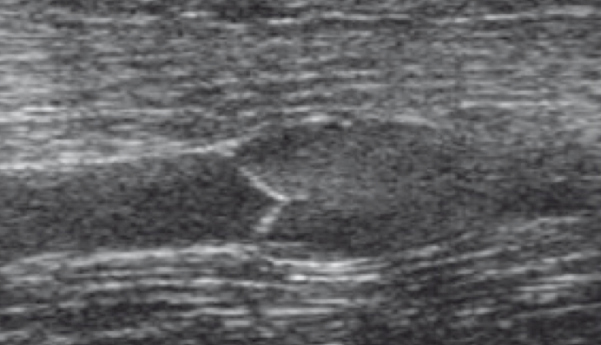
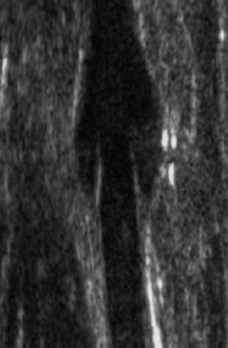
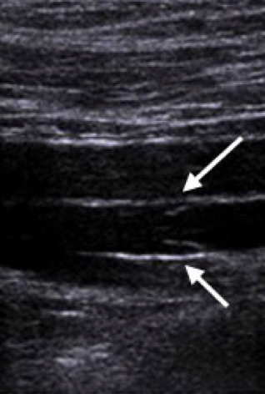
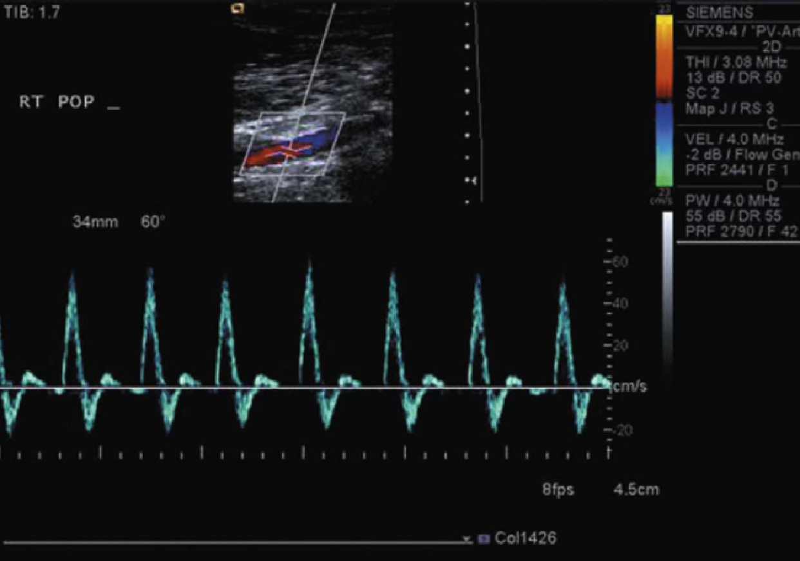
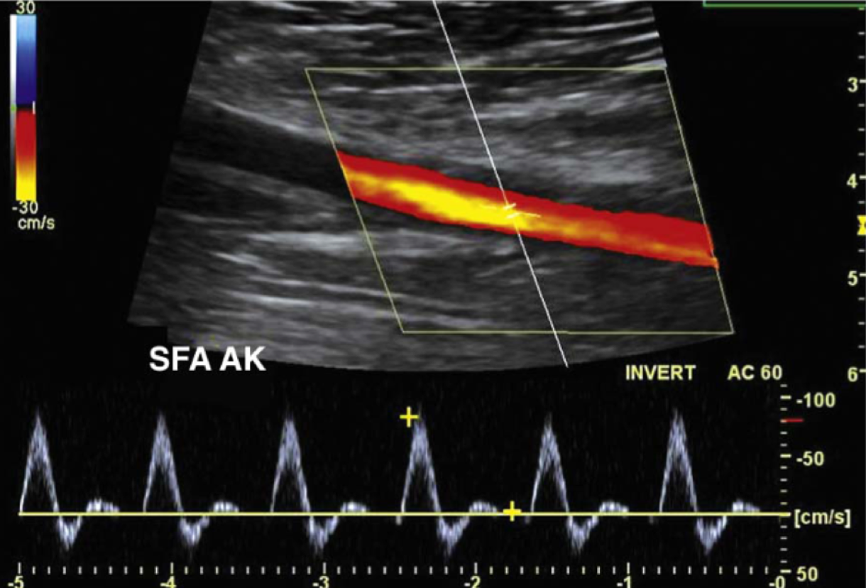
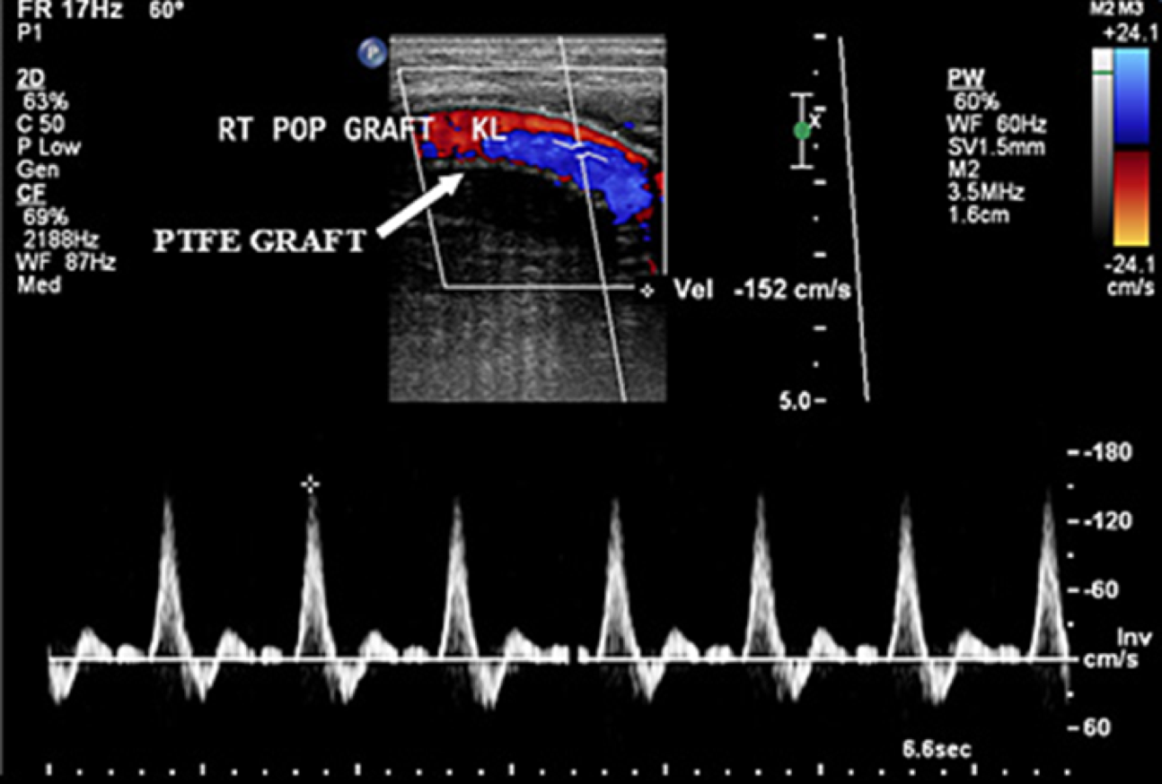
Ultrasound
Shows the anatomy of the artery without physiology (normal function of that artery).
Common femoral artery
peripheral vein (you can tell its a vein from the valve)
Duplex Ultrasound¹
Normal waves (triphasic).
Normal velocity.
Duplex ultrasound of superficial femoral artery.
Anatomically : no stenosis, no calcification.
Functionally: normal velocity, triphasic wave.
Sensitive
Operator dependant
Toxic
Therapeutic
✓✓✓
✓✓✓
✗
✗
More sensitive than ABI because it gives you the exact spot of the stenosis.
1.The colour flow by using Doppler ultrasound can show narrowing.By measuring the peak systolic velocity (PSV) and end-diastolic velocity (EDV) of the blood travelling through the stenosis it is possible to quantify the degree of narrowing

Slide 7
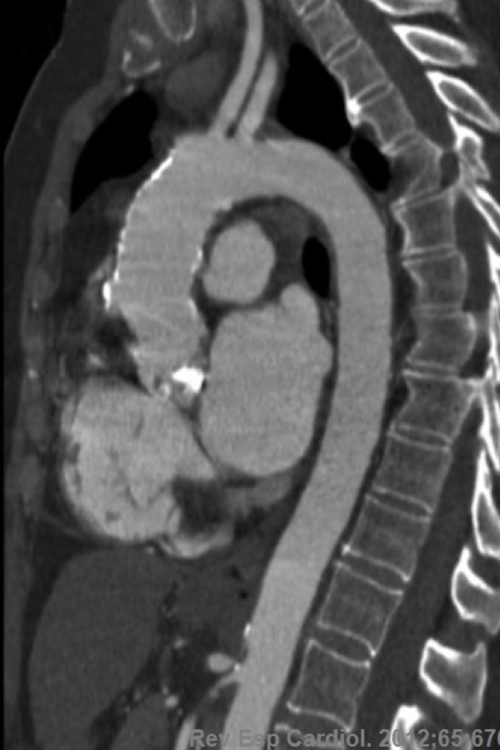
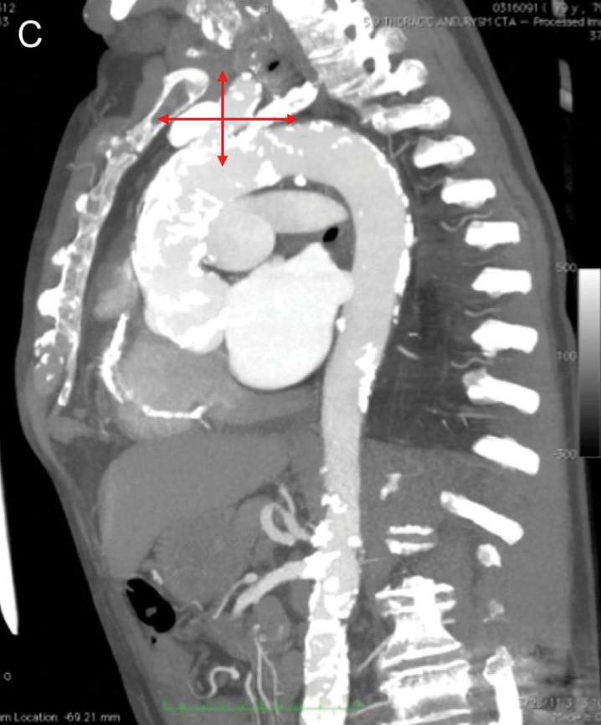
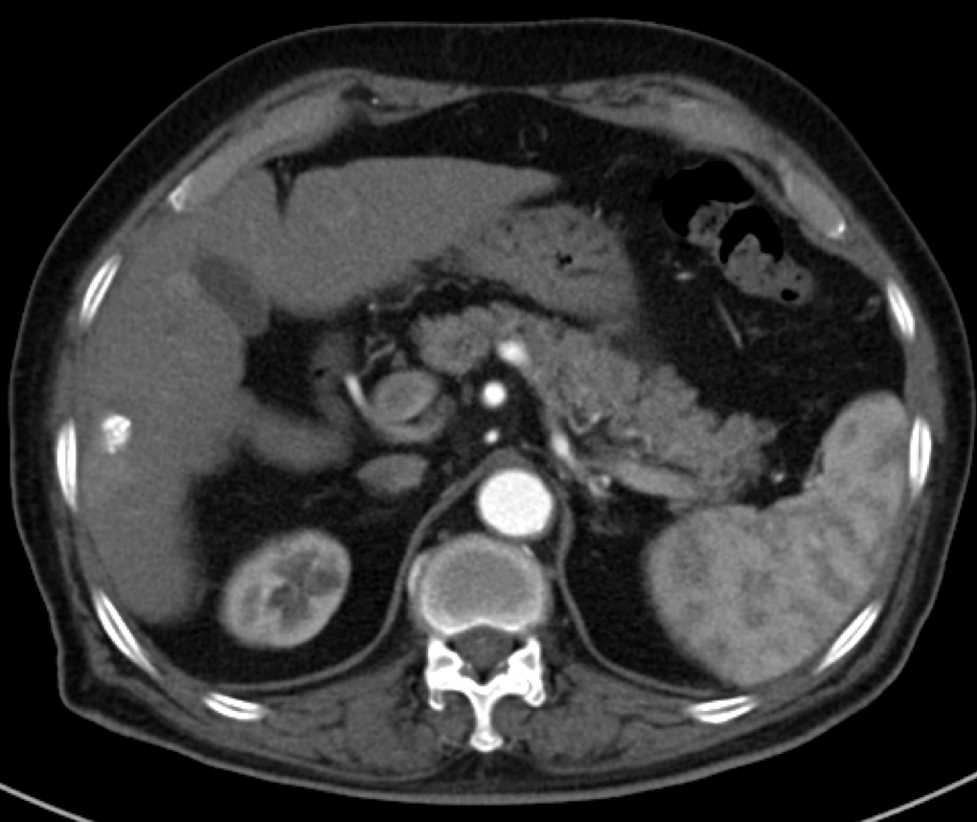
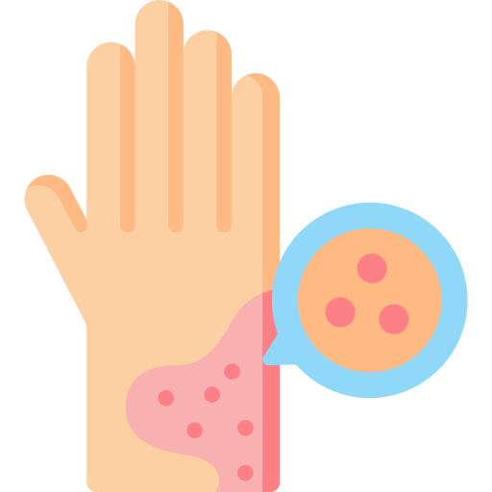
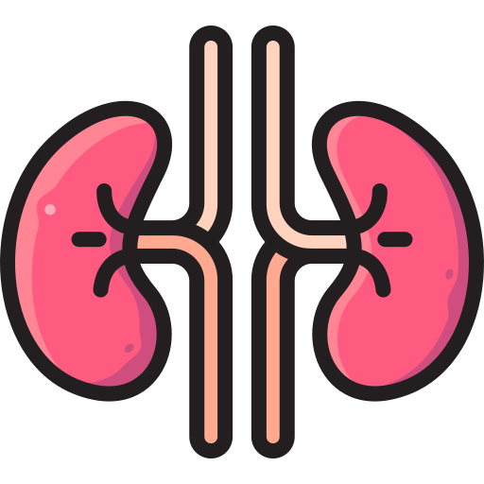
CT Angiogram
CT with injected contrast.
Based on time you get: (you give the order to the machine and it will time it)
Angiogram = artery
venogram = vein
Sagittal pic of ascending and descending aorta
Abnormal calcification of the ascending aorta
CT of the abdomen
we use CT with contrast, if we use CT without contracts won't be able to see the vessels
Side effect/contraindications Due to contrast:
Allergy
Renal impairment & Nephropathy
Radiation
Especially patients sensitive to iodine.
Usually we give antihistamine and prednisone.
patient with renal failure its fine, because the kidney is not functioning anyway and they are on dialysis. but if the patient is borderline creatinine then there is a high chance he will develop kidney failure, therefore we do dialysis.
Sensitive
Operator dependant
Toxic
Therapeutic
✓✓✓✓✓
✗
✓✓✓
✗
more sensitive, shown exact location of abnormality & type of abnormality

Slide 8
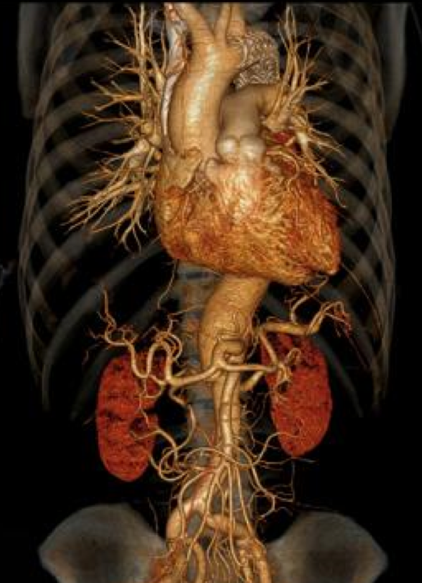
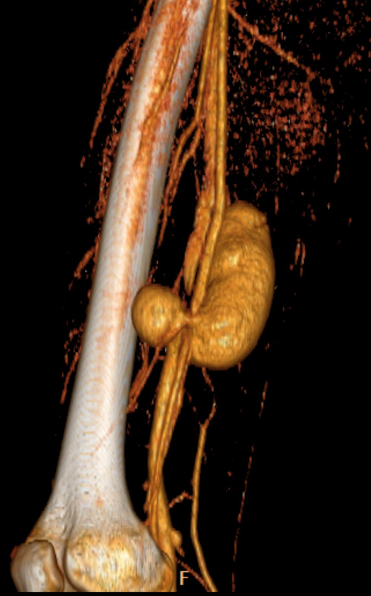
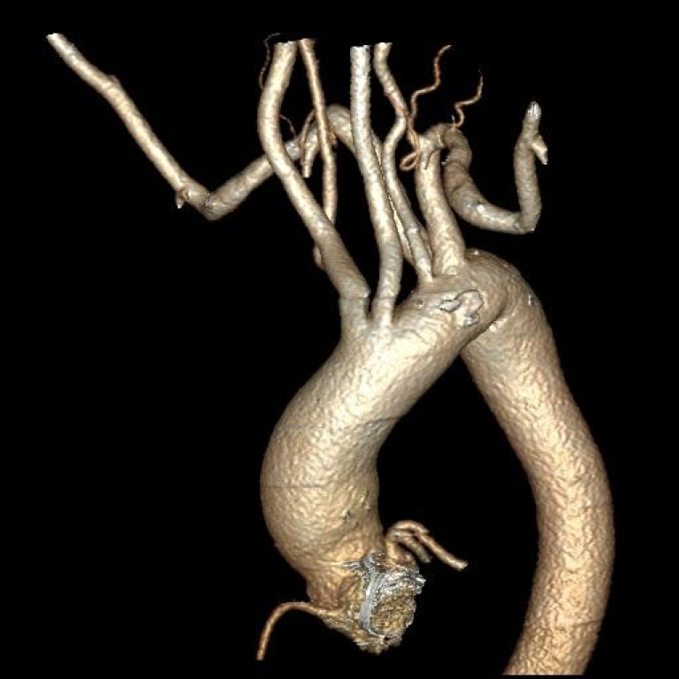
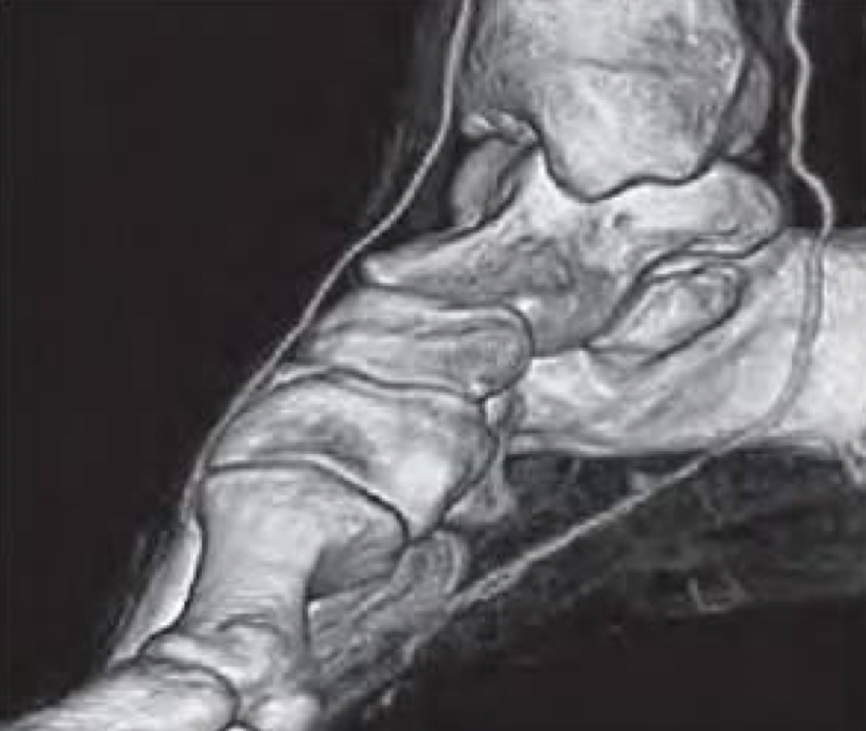
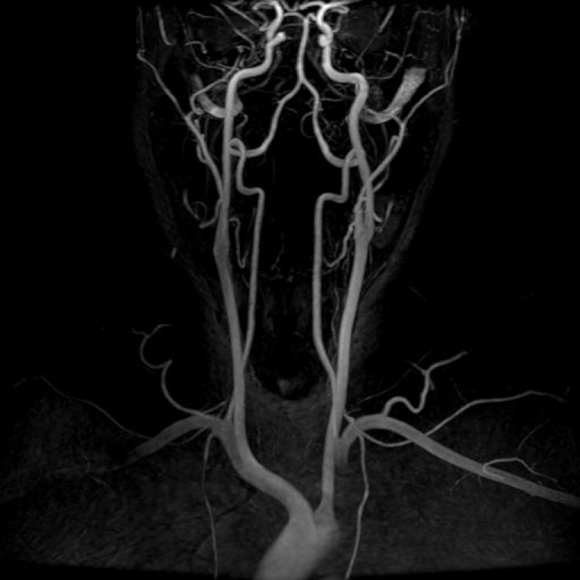
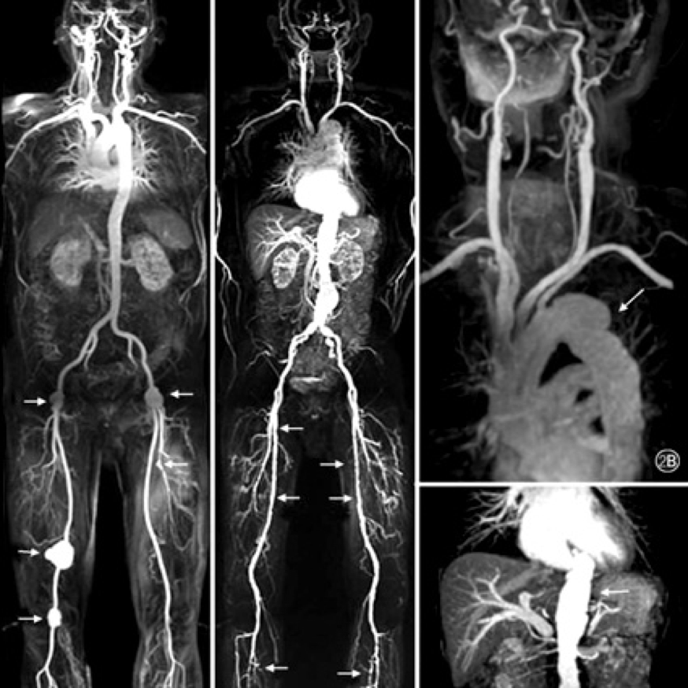
CT Angiogram
3D modality
Pseudoaneurysm of the superficial femoral artery
MR Angiogram
01
MRA is usually used in soft tissue diseases like popliteal entrapment syndrome.
02
Popliteal artery entrapment syndrome (PAES) is an uncommon condition in which an abnormally positioned or enlarged calf muscle presses on the main artery behind the knee (popliteal artery). The artery becomes trapped, making it harder for blood to flow to the lower leg and foot (common among athletes).
03
MRA is less toxic than CT.
Sensitive
Operator dependant
Toxic
Therapeutic
✓✓✓✓
✗
✓✓✓
✗
Gadolinium Contrast cause nephrogenic toxicity.

Slide 9
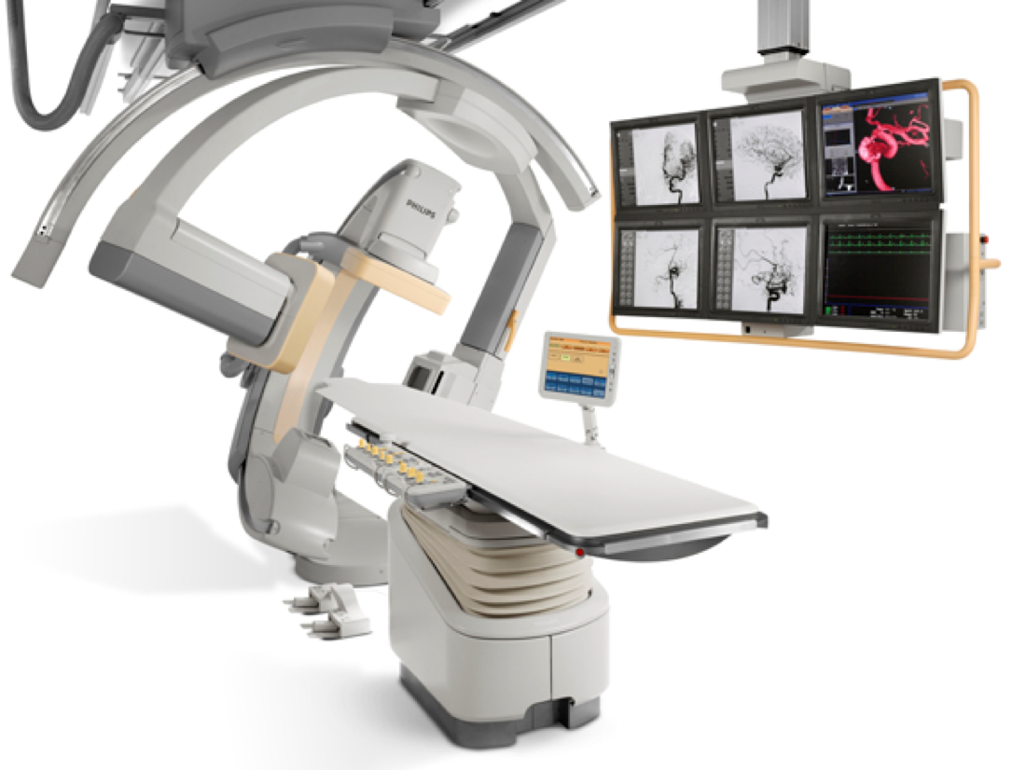
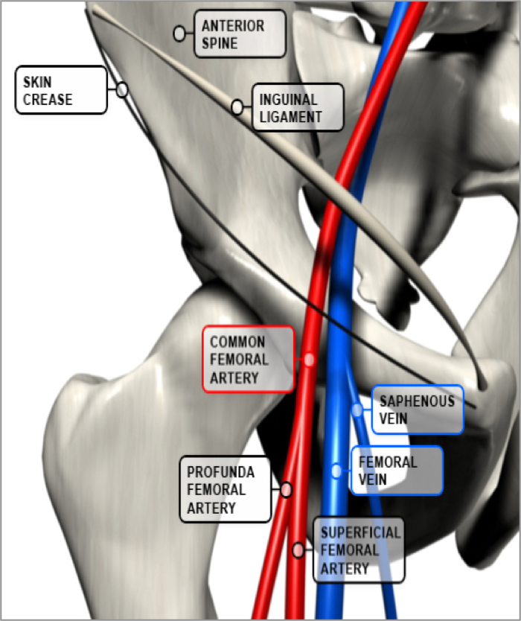
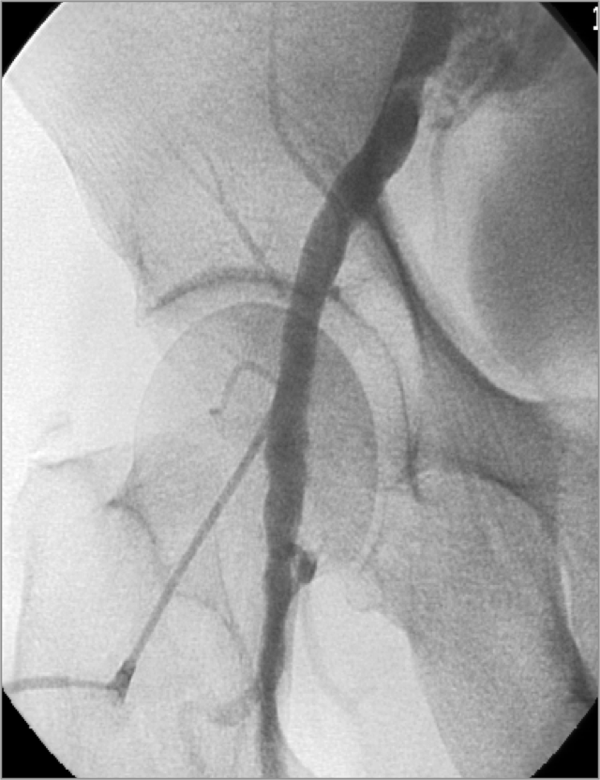
Angiography
Invasive procedure we rarely use it theses days because there are better non invasive methods
We enter a catheter in a specific artery and inject a dye.
It might cause bleeding or hematoma if the it was done at the wrong site
There are also chances of thrombosis, or pseudoaneurysm.
Areas of entry:
Most of the time the arterial access is through the common femoral artery, why?
01
02
03
Femoral artery
90%
Bronchial artery
Radial artery
Accessable
Clear anatomical landmark (femoral head)
It is important to enter with ultrasound guidance to search for the bifurcation of the common femoral artery
if you enter above the Common femoral (E. Iliac) there is nothing to compress the artery against after the procedure.
If you enter below the Common femoral, this would lead to occlusion or thrombosis.
We can use X-ray check where is the head of the femur and puncture over the head.
Easily compressed against the head of the femur
To stop the bleeding after removing the catheter.
Femoral artery

Slide 10
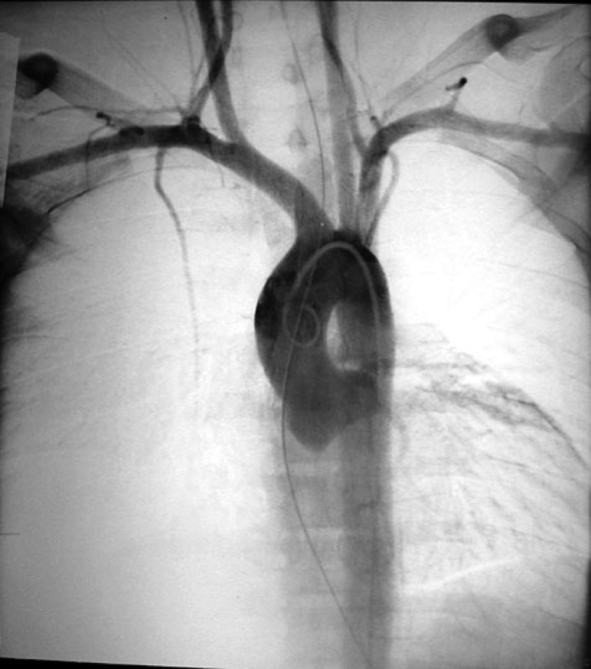
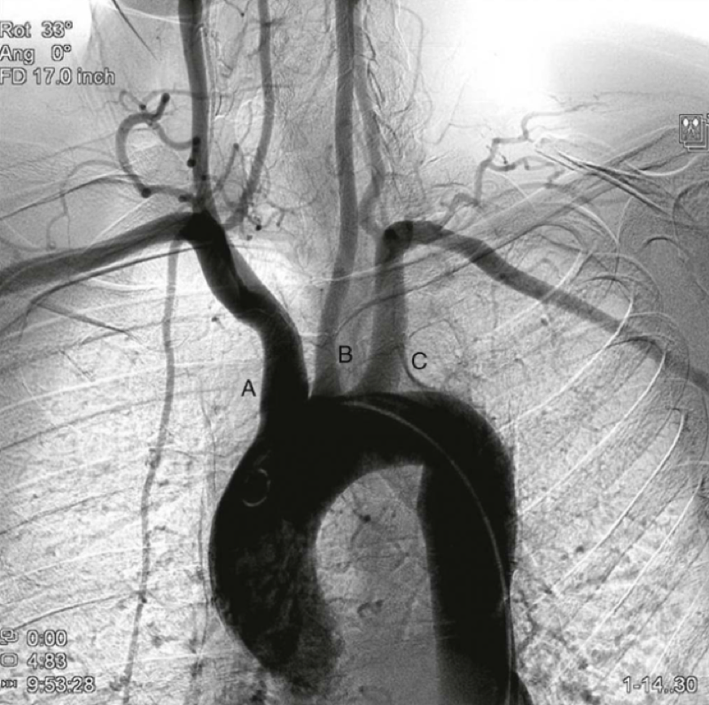
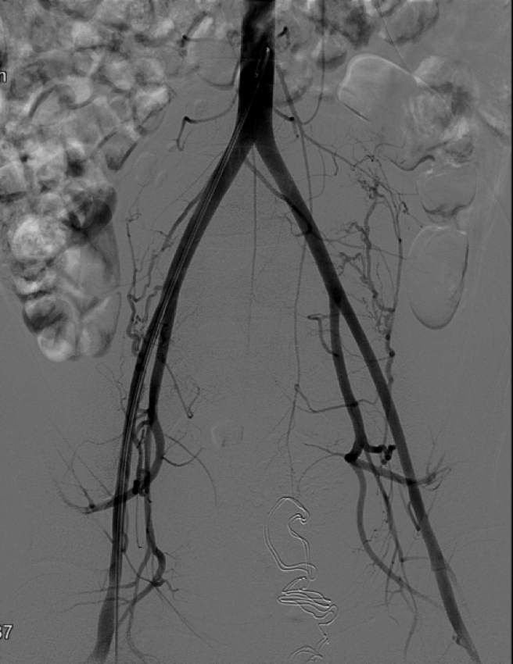
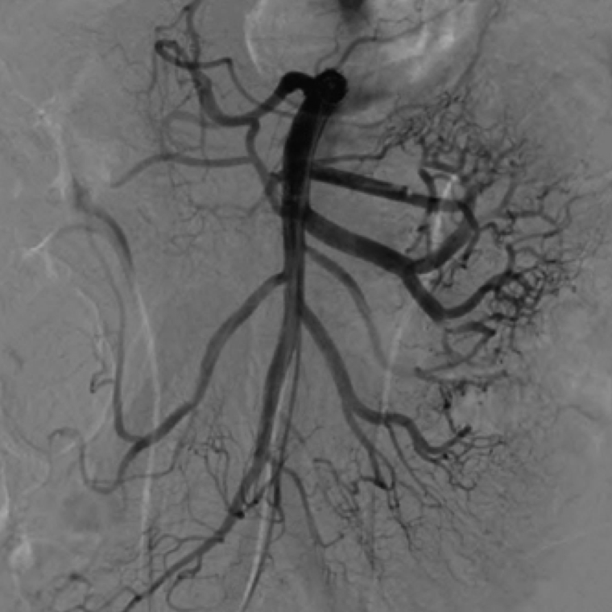
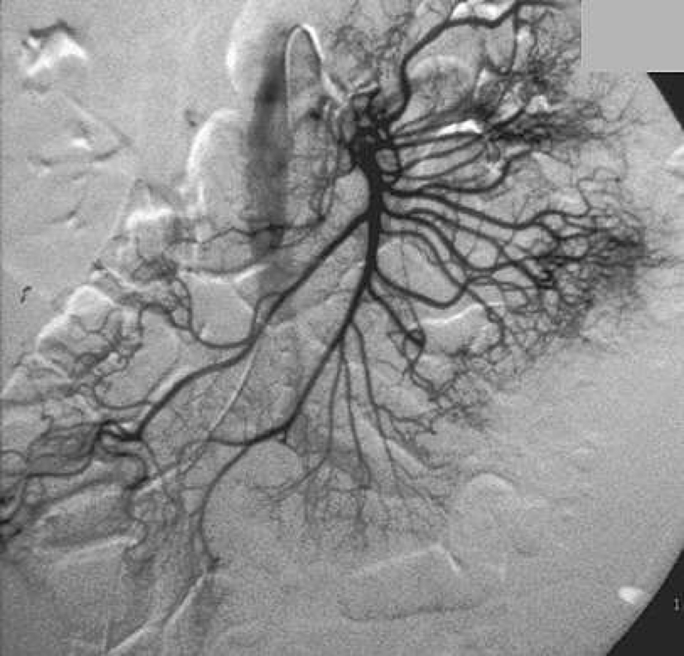
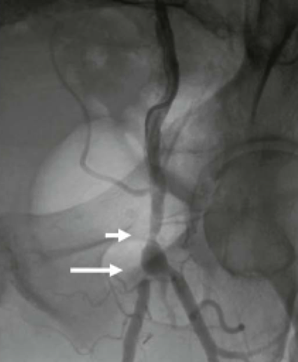
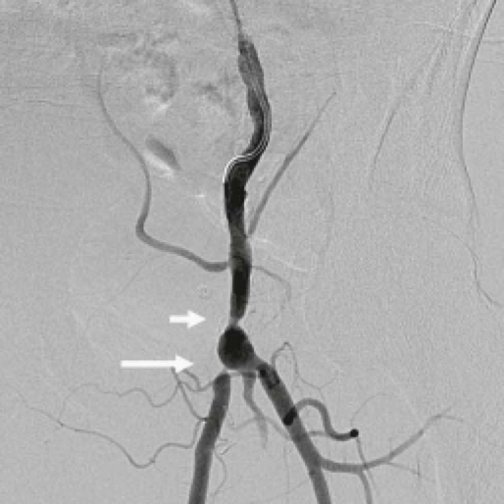
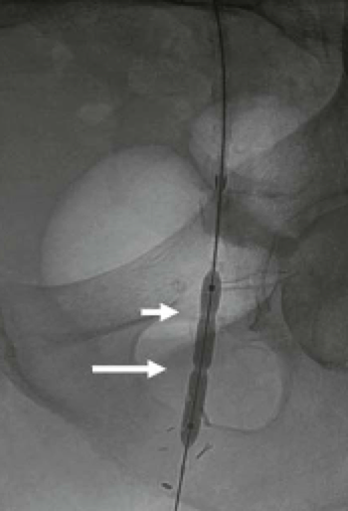
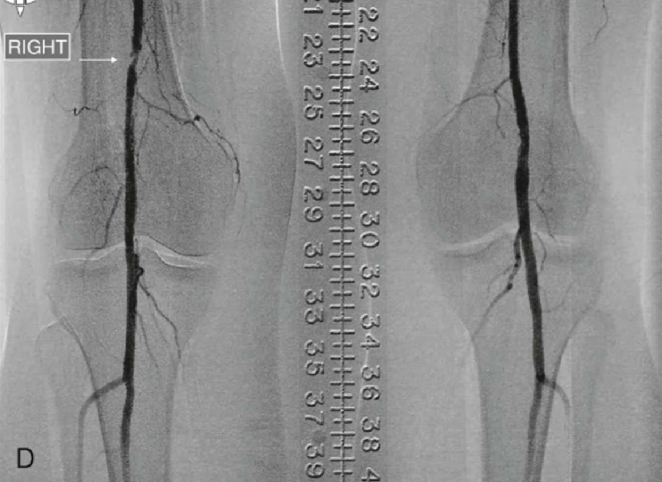
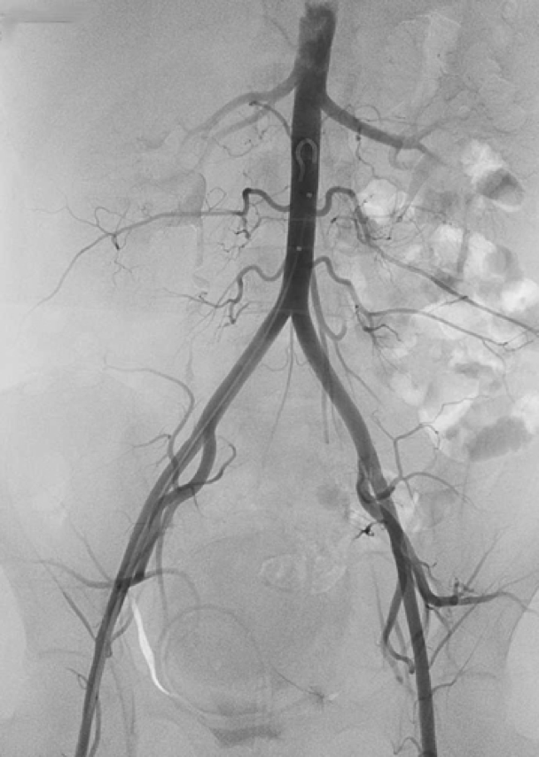
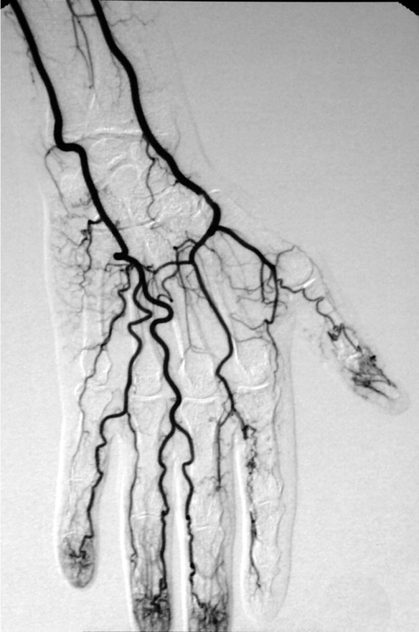
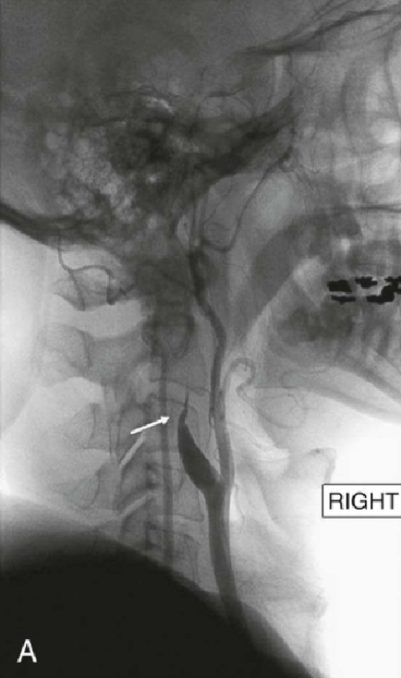
Angiography
Sensitive
Operator dependant
Toxic
Therapeutic
✓✓✓✓✓
✗
✓✓✓
✓✓✓
Contrast allergy and radiation:
less contrast than CT because selective (to one area), not systemic.
The only therapeutic investigation, we can treat the stenosis and open it with a balloon.
Example
Patient with rest pain the ABI is low (0.4), so we know that there is a peripheral arterial disease.
After that we did a duplex US that showed a superficial femoral artery lesion and stenosis.
Then we take the pt to the angiogram to confirm the diagnosis and do angioplasty to open the artery by balloon.

Slide 11
Summary
Recall
Q1: What is the ABI?
Ankle brachial index: simply the ratio of systolic blood pressure at the ankle to the systolic blood pressure at the arm (brachial artery) A:B ; ankle pressure.
Taken with doppler; the ABI is non-invasive.
Q2: What ABI are associated with normal, claudicators, and rest pain?
Normal ABI: >= 1.
Claudicator ABI: < 0.6.
Rest pain ABI: <0.4.
Q3: What gets false ABI reading?
Patients with calcified arteries, especially those with diabetes.
Q4: What are PVRs?
Pulse volume recordings; pulse waveforms are recorded from lower extremities representing volume blood per heartbeat at sequential sites down leg.
Large wave form means good collateral blood flow.
Non-invasive using pressure cuffs.
Q5: prior to surgery for chronic PVD, What diagnostic test wii every patient receive?
A-gram (arteriogram: dye in vessel and X-ray) maps disease allows for best treatment option (i.e., angioplasty vs surgical bypass vs endarterectomy)
teast | sensitive | Operator dependent | toxic | therapeutic
Handheld doppler | ✓ | ✓✓✓ | ✗ | ✗
Duplex ultrasound | ✓✓✓ | ✓✓✓ | ✗ | ✗
CT angiogram | ✓✓✓✓ | ✗ | ✓✓✓ | ✗
MR angiogram | ✓✓✓✓ | ✗ | ✓✓✓ | ✗
Angiography | ✓✓✓✓✓ | ✗ | ✓✓✓ | ✓✓✓

Slide 12
Quiz
MCQ
Q1: A 75-year-old man is found by his internist to have an asymptomatic carotid bruit. Which of the following is the most appropriate next test?
A)Transcranial Doppler studies.
B)Doppler ultrasonography (duplex)
C)Spiral CT angiography
Q2:As part of the peripheral vascular examination, you are asked to record the ankle–brachial pressure index of the patient. Which one of the following values reflects a normal ankle–brachial pressure index?
A)Between 0.9 and 0.6
B)Greater than 1.3
C)Greater than or equal to 1.0
Q3:You see a 60-year-old man with a history of coronary heart disease, diabetes and hyperlipidaemia in your clinic. The patient has found it increasingly hard to walk due to the gradual increase in intensity of the cramping pain he experiences in his right leg on walking, which is relieved by resting a few minutes. In addition, he tells you that cramps have started to occur at night when he is sleeping. On examination of the right leg, you notice that there is a ‘punched out’ ulcer on the right heel. The right posterior tibial and dorsalis pedis pulses are weak. You suspect that this patient has critical limb ischaemia. What is the most appropriate next line investigation that would support your diagnosis?
A)Computed tomography angiography
B)Ankle–brachial pressure index
C)Magnetic resonance angiography
Q4:A patient came with resting calf pain, upon investigations ABI result was 0.4, duplex found a lesion in SFA 9 cm long, How do you confirm your diagnosis?
A)CT angiogram.
B)DuplexUS.
C)Angiography
Q5:A patient with Critical limb ischemia who has a tissue loss in his foot What do you expect his AB index to be?
A)0.4-0.9
B)0.0-0.4
C)1.0-1.3
Q6:A 55-year-old man, with a positive smoking history, presents to you in the out- patient clinic with pain in the lower leg which is brought on by walking. The pain is cramping in nature, well localized to the left calf only, and is relieved by rest. The patient has noticed that his walking distance has progressively decreased because of the cramps in the left calf. There are no abnormal findings on physical examination. What is the most appropriate way to investigate the patient’s symptoms?
A)Measure the ankle–brachial pressure index
B)Angiography
C)Duplex ultrasound
Answers
Q1 | B | Q4 | C
Q2 | C | Q5 | B
Q3 | B | Q6 | A
Extra Questions

Slide 13
We’d like to express our sincere gratitude to our team members. We are so appreciative of your efforts and hard work. Your diligence as well as dedication is admirable. We’re so fortunate to have you on our team!
Our gratitude also extends to our brilliant note takers. The exceptionally high-quality work you deliver is outstanding. Without your hard work it would not have been possible for us to accomplish our team goal. You are a true asset to our team. Thank you!
Words will fall small to express the appreciation we have for our reviewers. Thank you for always going the extra mile with every little detail. Our team wouldn’t have been the same without your invaluable insight. Your hard work is recognized and greatly appreciated.
Our appreciation also extends to our team members who helped us during summer but their lectures didn’t see the light of day. Thanks for showing your strong desire to work and the urge to fulfill it with excellence and perfection! We’re so grateful for all of your hard work. It definitely hasn’t gone unnoticed.
Special thanks to Razan AlRabah for her immense contribution. Your phenomenal contribution make you unique in every sense of the word. You raise the bar each time with your pursuit of excellence. You have surpassed all expectations. Glad we have you on-board!
And special thanks to one of the purest souls this world would ever encounter May Babaeer for designing an exquisite logo and theme for our team. We can’t begin to express how much gratitude we have for her. The goodness of her soul will always remain in our hearts.
You were one gem of a person we had.
Finally, special thanks to Noura Alturki and Jehad Alorainy your words of encouragement, guidance, and advice kept us sane while chasing deadlines. We just wanna express how glad we are to have worked under your leadership. We’re, truly, proud to be led by such great leaders.
Surgery Team Leaders:
Nouf Alshammari, Haneen Somily, Naif Alsulais, Mohammed alshoieer

Slide 14
Reviewers:
Moath Aljehani
Hashem Bassam
Faris Almubarak
Abdulaziz Alghamdi
Ahmed Alshamasi
Mohammed Alqahtani
Omar Alshenawy
Note Takers:
Razan AlRabah
Njoud Alabdullatif
Sedra Elsirawani
Khalid Alkhani
Omar Alotaibi
Badr AlQarni
Khalid Alharbi
Team Members:
Noura Alturki
May Babaeer
Deema Almaziad
Lama Alzamil
Alhanouf Alhaluli
Njoud Almutairi
Renad Almutawae
Lina Alosaimi
Maha Alnahdi
Rahaf Alshabri
Rema Almutawae
Njoud Alali
Ajeed Alrashoud
Taif Alshammari
Amirah Alzahrani
Taif alotaibi
Lama Alassiri
Shahad Althaqib
Ghalia Alnufaei
Wejdan Alnufaie
Sara Alkhalife
Sarah Alfarraj
Sarah Alhilal
Ghaidah Albraithen
Jude Alkhalifah
Shahad Binselayem
Wejdan Alshamry
Abeer Almutairi
Rawan Albayat
Razan Alzohaifi
Rema Alkahtani
Fatemah Alsaleh
Faisal Alqifari
Faisal Alkoblan
Badr Alqarni
Mohammed Alhamad
Abdulaziz aljarbou
Ibrahim AlAsous
Abdulrahman Bedaiwi
Alkaseem Binobaid
Hamdan Aldossri
Rakan Alfaifi
Khalid Nagshabandi
Khalid Alkhani
Khaled Alharbi
Fahad Alsultan
Abdulrahman Alsayed
bader aldhaferi

Slide 15
See you next semester!
Heroes of Modern Surgery
The Clinic of Dr. Agnew by Thomas Eakins (1889)
The Clinic of Dr. Gross by Thomas Eakins (1875)

Slide 16
Good Luck!
Team leaders:
Nouf Alshammari
Haneen Somily
Naif Alsulais
Mohammed Alshuwaier
This lecture was done by:
Taif AlOtaiby
Sedra Elsirawani
Khalid AlKhani
Omar AlOtaiby
Mohammed Alqahtani
Feedback
Note taker
Reviewer

