Slide 1
Shock
Objectives
Define shock.
List the types and clinical features of shock.
Define the terminology distributive and obstructive shock.
Discuss the Pathophysiology of shock (Macrocirculation, Microcirculation, Cellular function).
Discuss the Systemic effects of shock.
Discuss the general principles of management (airway, breathing and circulation).
Discuss the Specific treatment of each type of shock.
Colour Index
Main Text
Males slides
Females slides
Doctor notes
Textbook
Important
Golden notes
Extra
Editing File

Slide 2
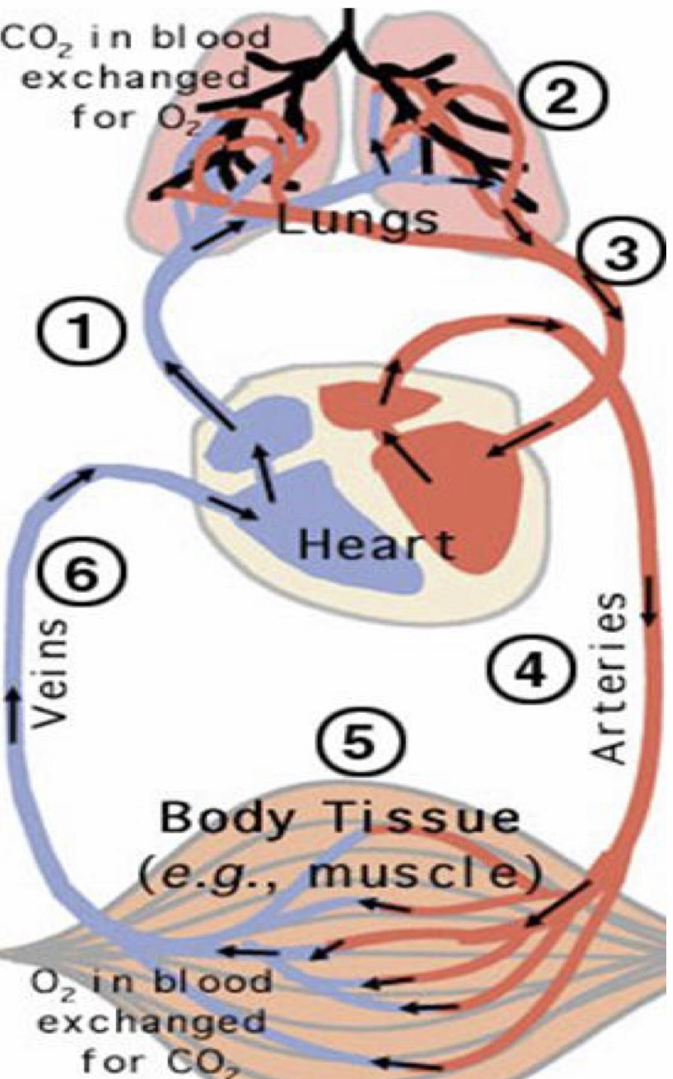
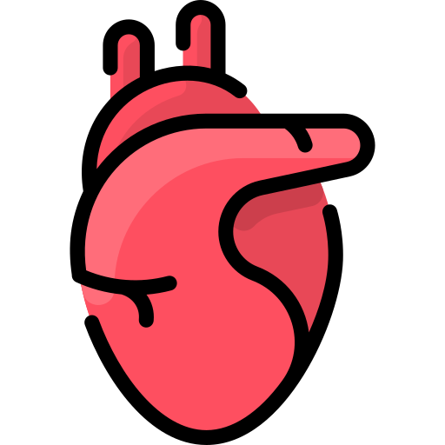
Shock :
What is shock?
Inadequate oxygen delivery to meet metabolic demand.
Results in global tissue hypoperfusion and metabolic acidosis¹.
Shock can occur with a normal blood pressure, and hypotension can occur without shock².
Oxygen delivery is the function of the circulatory system.
This system³ is basically:
Pump (heart⁴)
Pipes (vessels)
Solution (blood)
Needs to function at adequate pressure (depends on the individual),volume
and O₂ carrying capacity⁵.
Understanding Shock
Inadequate systemic oxygen delivery activates autonomic responses (first thing to be activated) to maintain systemic oxygen delivery.
When body senses less O₂ it tries to alarm us by sympathetic activation to make you feel anxious and to increase the heart rate, sometimes this stimulation is enough and sometimes damage might happen. Will be covered in “metabolic responses to injury” lecture
Sympathetic nervous system
Renin-angiotensin axis
NE, epinephrine, dopamine, and cortisol release
Causes vasoconstriction⁶, increase in HR (chronotropy), and increase of cardiac contractility (inotropy) (cardiac output)
Water and sodium conservation and vasoconstriction
Increase in blood volume and blood pressure
Hypoperfusion and ischemia will shift the cells to anaerobic glycolysis and the production of lactate causing acidosis.
Shock is more than hypotension, don’t restrict yourself on the BP, you should think about the molecular changes.
Failure in any of these can result in different types of shock.
The heart is designed to pump about 5L of blood per minute. In young healthy adults it can pump more, and in some athletes it can pump up to 13L. Thus in abnormal situations in healthy young adults the heart is able to pump more to compensate and the situation won’t progress to shock. However, in an elderly patient with underlying conditions and a maximum capacity of 5L AT REST the heart won’t be able to meet the demand when there’s an increased effort or when they get an infection or bleeding and their condition will progress to shock.
In any given moment, about 30% of the vessels are closed (shunted blood is part of the normal circulatory system) e.g. sitting and relaxing after having a heavy meal, will cause shunting of the blood to your splanchnic circulation to optimize digestion and absorption.
for non-vital organs eg. skin.
Define shock.

Slide 3
Shock :
Understanding Shock:
Cellular responses to decreased systemic oxygen delivery
ATP depletion¹ → ion pump dysfunction
Cellular edema²
Hydrolysis of cellular membranes and cellular death
The body tries to maintain vital organs: cerebral and cardiac perfusion³
Vasoconstriction of splanchnic, musculoskeletal, and renal blood flow
Global cellular reliance on anaerobic glycolysis and increased lactate production⁴ , some patients will die from shock with normal lactate levels, bc the cells are too sick to attempt anaerobic glycolysis.
Systemic metabolic lactic acidosis⁵ (The hallmark of patient in shock)
Multi-organ Dysfunction Syndrome (MODS):
Progression of physiological effects as shock ensues⁶:
Result is end organ failure. As a physician you should be able to detect shock before reaching this stage, because in septic shock with:
1 organ failure the risk of mortality is 30%
2 organs failure the risk of mortality is 50%
3 organs failure the risk of mortality is 90%
01
02
03
03
Cardiac depression
Respiratory distress
Renal failure
DIC⁷
Due to oxygen insufficiency which will shift the cells to anaerobic glycolysis (Aerobic glycolysis produces 36 + 2 ATP while anaerobic glycolysis produces only 2 ATP).
Normally, Na/K pump will remove excess Na⁺ from the cells, but with ion pump dysfunction Na⁺ influx will occur and it will withdraw water with it, which will cause swelling and edema.
The most important vital organs. If vasoconstriction is intact, there will be vasoconstriction everywhere except in the cardiac and the cerebral vessels.
Under normal (aerobics) conditions glycolysis converts glucose to pyruvate which is converted to (acetyl-CoA) and enters the Krebs cycle to generate (NADH) and (FADH₂), which enter the ETC to produce ATP. In hypoxaemia aerobic glycolysis is blocked, leading to pyruvate accumulation, which will be converted to lactate enabling the limited production of ATP by anaerobic glycolysis generating only 2 moles of ATP.
accumulation of lactic acid reduces intracellular pH together with ATP depletion (failure of vital ATP dependent cell functions) results in disruption of protein synthesis, damage to lysosomal and mitochondrial membranes, and ultimately cell necrosis.
As the shock progresses it gets harder to differentiate between the different type of shock as they will start to overlap.
When a cell dies it releases mediators and tissue factors and activates the coagulation cascade which will ultimately lead to disseminated intravascular coagulation.
Define shock.

Slide 4
Types of shock :
Low cardiac output states (Hypovolemic & Cardiogenic):
01
02
03
04
Hypovolemic (↓solution)
Cardiogenic
Neurogenic
Vasogenic
(blood pump is working with no blood) most common and most readily corrected cause of shock encountered in surgical practice results from a reduction in intravascular volume secondary to loss of:
blood e.g. bleeding (the most common cause of acute hypovolemic shock in surgical practice)
plasma (e.g. burns).
water and electrolytes (dehydration¹) (e.g. vomiting, diarrhoea , diabetic ketoacidosis).
In dehydration, there’s a low cardiac output state. However, the heart is working just fine. There is less blood volume to carry oxygen, thus the mediators (such as NE and hormones) will force the heart to increase tropic volume and inotropy. This increase is up to a certain point then a shock might happen.
Clinical features²: tachycardia (to compensate) + increased inotropy + delayed capillary refill + cool temp + dry skin, muscle will be deprived of blood and dysfunctional
01
02
03
04
Hypovolemic
Cardiogenic
(↓ pump)
Neurogenic
Vasogenic
Impaired inflow e.g. tamponade, constrictive pericarditis
Primary pump dysfunction e.g.HF, ACS leading to MI,Myocarditis
Impaired outflow e.g. massive PE
In cardiogenic shock, there’s adequate blood volume but the heart itself is abnormal. We will notice blunted heart response to stimulatory mediators such as NE and epinephrine.
The patient might be tachycardic (or even bradycardic) but with ECG we find that stroke volume is low, some sick hearts can increase the rate but cannot increase the volume some patients will enter bradycardia in later stages since the heart is too sick to compensate with tachycardia.
clinical features: tachycardia, vasoconstriction, cold clammy skin, systemic vascular resistance will be high.
Using ultrasound probe can confirm whether the heart is functioning (in hypovolemic) or not (in cardiogenic).
Dehydration is less common, but it complicates other types of shock e.g. patient with infection (septic shock) and severe vomiting → dehydration (caused by the vomiting) → hypovolemic shock along with the septic shock.
The skin is the 1st organ in which blood is shunted from unless it’s sepsis/anaphylaxis and the vasodilation is the issue so the blood is more to skin.
first organ to lose blood:
1st: skin 2nd: GI (splanchnic circulation) —-> bowel edema + ischemia
3rd: muscle 4th: Renal blood flow——> decrease urine output, kidney dysfunction
List the types and clinical features of shock.

Slide 5
Types of shock :
Low peripheral resistance states,↑pipes (Neurogenic & Vasogenic):
01
02
03
04
Hypovolemic
Cardiogenic
Neurogenic
Vasogenic
Loss of sympathetic tone
complete loss of sympathetic tone that normally maintains some vasoconstriction
Loss of sympathetic tone also affects the heart, so the heart won’t be able to compensate the vasodilation with tachycardia.
This typically occurs following injury to the thoracic or cervical spinal cord.
A temporary drug-induced form can also occur in ‘high’ spinal anaesthesia.
important: since both a neurogenic shock and a hemorrhagic shock can result from trauma¹ always make sure your patient is not bleeding, treat as hemorrhagic shock after which take a step back and determine whether the patient is tachycardic or not? Bradycardia and warm skin indicate a neurogenic shock.
Clinical features: Bradycardia and vasodilation are very characteristic of the neurogenic shock
01
02
03
04
Hypovolemic
Cardiogenic
Neurogenic
Vasogenic
The heart is functioning normally but the vessels are leaky and dilated, thus, the heart needs to push through all of that. Young healthy individuals can compensate with tachycardia, but if the heart isn’t able to compensate (as in an elderly patient) then shock might happen.
Septic²
Bacteria > toxins > cell damage > release of cell mediators > uncontrolled vasodilation and leakage.
Patient is febrile and it takes time to develop.
Anaphylactic
Allergic reaction resulting in the the release of histamine which causes vasodilation and shortness of breath.
Clinical features: low peripheral vascular resistance, heart is intact and try to compensate (tachycardia).
Neurogenic shock is relatively rare, so if there is a trauma in head think about hypovolemic shock caused by hemorrhage FIRST.
As septic shock progresses cardiac ventricular dysfunction impairs the compensatory increase in cardiac output. As a result, peripheral perfusion falls and the clinical signs may become indistinguishable from those associated with the low cardiac output state.
List the types and clinical features of shock.

Slide 6
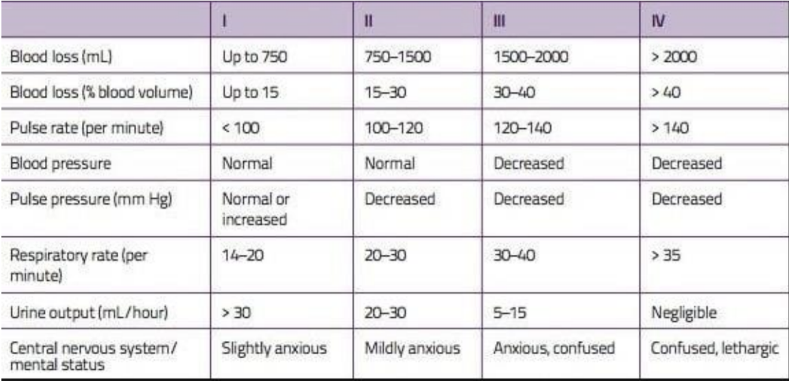
Types of shock :
You have to know how to diagnose shock based on hemodynamic parameters.
Shock type | Example | HR | BP⁶ | CO (cardiac output) | Capillary refill | Extremity temperature | SVR (systemic vascular resistance) | Treatment
Hypovolemic | Hemorrhage, Dehydration | ↑ | ↓ | ↓ | Delayed | Cool | High | - Stop bleeding - Fluid resuscitation
Cardiogenic | Myocarditis, Dysrhythmia | ↑¹ | ↓ | ↓ | Delayed | Cool | High | - Inotropes - Caution with fluids - ECMO
Obstructive⁴ | Tamponade, Tension pneumothorax | ↑ | ↓ | ↓ | Delayed | Cool | High | - Pericardiocentesis - Chest tube
Distributive² | Sepsis, Anaphylaxis | ↑ | ↓ | ↓ or ↑³ | Flash or delayed | Warm or cool | Low or high | - Antibiotics - Fluids - Epinephrine
Neurogenic | Spinal cord injury, Traumatic brain injury | ↓ | ↓ | ↓ | Flash or normal | Warm | Low | - Fluid resuscitation - Vasopressors
Dissociative⁵ | Carbon monoxide, Cyanide | ↑ | Normal or ↑ | ↑ | Normal | Normal | Low to normal | - Antidotes - Hyperbaric therapy
Classes of Hypovolemic Shock:
Shock is a spectrum, not zero or one.
There are four classes of hypovolemic shock depending on the blood loss.
The more blood loss the more/severe symptoms.
We shouldn’t rely on the patient's blood pressure because hypotension is a late finding.
To detect shock we look at the end organ perfusion, most importantly the brain, it’s very sensitive to oxygen delivery. Secondly, the kidney through the urine output (the less blood flow the less urine).
This table isn’t important clinically. However, it’s important
academically and you might get asked about the numbers in this table.
⁷
⁷
⁸
⁹
Initially tachycardia followed by bradycardia if not treated.
Initially may appear as hypovolemic shock that's why we hydrate the patients first until symptoms of septic shock (like warm skins) start to appear. Big examples seen in patients with acute abdomen (gastroenteritis) this is not seen in patients with sepsis of the chest or anywhere else (if patient came with typical symptoms of shock complaining of abdominal pain (gastroenteritis) + culture was positive for microorganism think about hypovolemic shock caused by a dehydration FIRST. Anywhere else = septic shock.
In distributive shock (also called vasogenic shock, including septic and anaphylactic shock) cardiac output may initially increase, then decrease in cases where the heart is fatigued or when the heart itself is a part of the problem e.g. if the heart is the source of the infection that caused sepsis.
Obstructive shock is a type of cardiogenic shock where the problem is outside the heart obstructing it. eg: tension pneumothorax, pulmonary embolism, and cardiac tamponade.
In dissociative shock, everything is normal. However, there’s no oxygen delivery due to abnormal hemoglobin.
BP could be normal in the early stage of shock.
Note that BP starts to decrease in advanced classes (III, IV).
we check for reduced O₂ supply in end organs such as kidney and brain by ordering their respective function tests.
mental status deteriorates very early because the brain is very sensitive to O₂.
List the types and clinical features of shock.

Slide 7
Pathophysiology of shock :
Pathophysiology of Shock (macro-micro circulation):
there is often significant overlap between the causes of shock, ex: patients with septic shock are frequently also hypovolemic. all share common pathophysiological features at the cellular level. Whilst differences can be detected at the level of the macrocirculation:
hypovolemic
septic
neurogenic
Cardiogenic
fall in intravascular volume results in a fall in cardiac output > tachycardia and increased myocardial contractility to preserve cardiac output. whilst vasoconstriction acts to maintain arterial blood pressure
discussed in page 5 footnote 2
Loss of cardiac accelerator fibres, anhydrosis as a result of loss of sweat gland innervation (patient presents with warm dry skin).
unlike hypovolemic shock, circulating volume is typically normal or increased secondary to increased circulating AT-II and aldosterone levels. If associated with left ventricular failure, there may be pulmonary oedema.
In microcirculation level arteriolar vasoconstriction, seen in early hypovolemic and cardiogenic shock, helps to maintain a satisfactory MAP, and the resulting fall in the capillary hydrostatic pressure encourages the transfer of fluid from the interstitial space into the vascular compartment
If shock remains uncorrected:
In sepsis, endothelial and inflammatory cell activation results in widespread activation of coagulation. Microthrombi occlude capillary blood flow, and the consumption of platelets and coagulation factors leads to thrombocytopenia, coagulopathy and DIC.
1
complications of shock override compensatory vasoconstriction leading to precapillary vasodilation.
3
capillary permeability increases with the loss of fluid into the interstitial space and increase in blood viscosity
2
4
further compromises flow through the microcirculation, predisposing to platelet aggregation and the formation of microthrombi.
pooling of blood within the capillary bed and endothelial cell damage
Discuss the Pathophysiology of shock (Macrocirculation, Microcirculation, Cellular function).

Slide 8
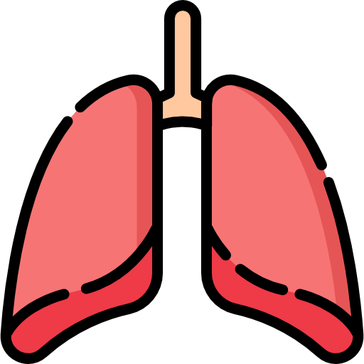
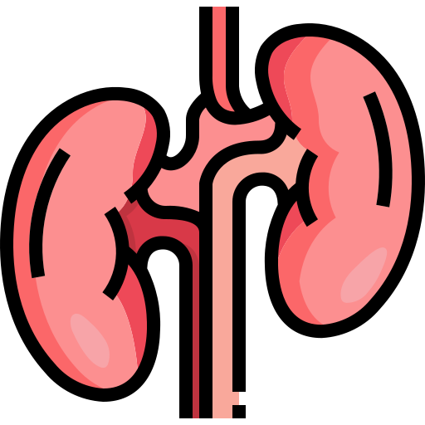
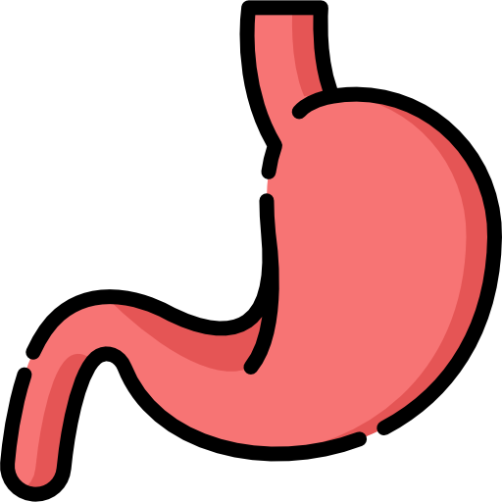
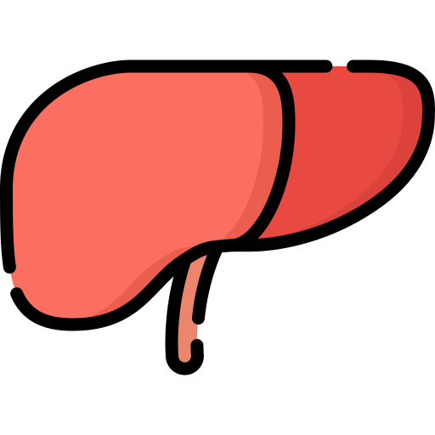
Pathophysiology of shock :
Pathophysiology of Shock (cellular function):
We’ve discussed previously the shifting of aerobic glycolysis to anaerobic glycolysis in page 3.
Under normal conditions, the tissues globally extract about 25% of the oxygen delivered to them, with the normal oxygen saturation of mixed venous blood¹. As oxygen delivery falls, cells extract about 50%.
further reductions in oxygen delivery lead to a critical reduction in oxygen consumption and anaerobic metabolism, a state described as dysoxia.
sepsis is associated with significant mitochondrial dysfunction and marked inhibition of oxidative phosphorylation. The phrase ‘cytopathic shock’ has been used to describe this condition.
The effect of shock on individual organ system:
 | Effect
CVS | ischaemia in the watershed areas of the endocardium. This impairs myocardial contractility. Acid–base and electrolyte abnormalities, combined with local tissue hypoxia, increase myocardial excitability and predispose to both atrial and ventricular dysrhythmias. In sepsis inflammatory mediators depress myocardial contractility and ventricular function, increase endothelial permeability (resulting in intravascular volume depletion) and DIC.
Nervous system | Due to the increased sympathetic activity, patients may appear inappropriately anxious, there is increasing restlessness, progressing to confusion, stupor and coma. In septic shock, the clinical picture may be complicated by the presence of an underlying (septic) encephalopathy and/ or delirium.
Respiratory system | Tachypnoea driven by pain, pyrexia, local lung pathology, pulmonary oedema, metabolic acidosis or cytokines is one of the earliest features of shock The increased minute volume typically results in reduced arterial PCO2 and a respiratory alkalosis (compensating for the metabolic acidosis) Sepsis and hypovolemic shock are both recognised causes of acute respiratory distress syndrome
Renal system | Reduced renal blood flow results in the production of low-volume, high-osmolality and low sodium content urine hypoxia leads to acute tubular necrosis. With a fall in glomerular filtration, blood urea and creatinine rise; hyperkalemia and metabolic acidosis are also usually present. Renal failure occurs in about 30–50% of patients with septic shock.
GIT | marked reduction in splanchnic blood flow. In the stomach predispose to stress ulceration and haemorrhage. In the intestine movement of bacteria and/or bacterial endotoxin from the gut lumen to the portal vein and hence systemic circulation may occur. This is thought to be an important pathophysiological mechanism in the development of SIRS and multiple organ failure in shock.
Hepatobiliary system | ischaemic hepatic injury is frequently seen following hypovolaemic or cardiogenic shock Increases in prothrombin time and/or hypoglycaemia are markers of more severe injury. Significant ischaemic hepatitis is more frequent in patients with underlying cardiac disease and a degree of hepatic venous congestion.
MVO₂ (mixed venous oxygen saturation): the amount of O₂ bound to hemoglobins who aren’t extracted from tissues and going back to the heart, will be decreased in hypovolemic and cardiogenic shock, and will be normal or increased in distributive (vasogenic) shock.
Discuss the Pathophysiology of shock (Macrocirculation, Microcirculation, Cellular function).
Discuss the Systemic effects of shock.
1- Cardiovascular system
2- Respiratory system
3- Renal system
4- Nervous system
5- Gastrointestinal tract
6- Hepatobiliary system

Slide 9
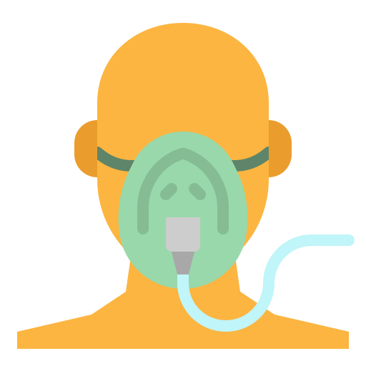
Treatment of shock :
Goal is to Restore perfusion¹ & Reverse the cause, both are priority
As with most clinical emergencies, treatment and diagnosis should occur simultaneously with the immediate assessment and management following an Airway, Breathing, Circulation (ABC) approach.
Method : Depends on type of shock, detecting the type of shock is a priority also.
general principles of management (airway, breathing and circulation):
Airway and breathing
Hypoxaemia (O₂ saturation < 90%) must be prevented and, if present, rapidly corrected by maintaining a clear airway (e.g. head tilt, chin lift) and administering high flow oxygen (e.g. 10–15 litres/min).
The adequacy of the therapy can be estimated continuously using pulse oximetry, but frequent arterial blood gas analysis allows a more accurate assessment of oxygenation (PaO2), ventilation (PaCO2) and indirect measures of tissue perfusion (pH, base excess, HCO3 and lactate levels).
In patients with severe hypoxaemia, cardiovascular instability, depressed conscious level or exhaustion > intubation and ventilatory support may be required.
Circulation
Initial resuscitation should be targeted at arresting haemorrhage.
Providing fluid (crystalloid or colloid) to restore intravascular volume and optimize cardiac preload, It is common practice to use blood to maintain a haemoglobin concentration > 10 g/dl (with haematocrit around 0.3) during the initial resuscitation of shock if there is evidence of inadequate oxygen delivery, such as a raised lactate concentration or low central venous saturations.
Endpoints of Resuscitation in Shock management²:
01
02
03
Normal vital signs
(can be misleading)
For instance, an elderly patient with a usual BP of 170/100 then suddenly his BP drops to 100/60 (which is considered normotensive in healthy individuals). However, in his case it’s considered hypotension and the patient is still in shock (because this is half of his usual BP).
Normal serum lactate levels
1. Lactate can be misleading because in some situations of shock, cells are too sick for anaerobic metabolism, so we won’t find elevation of lactate.
2. If the lactate was high then you resuscitated the patient successfully, and the levels of lactate returned back to normal this is called “lactate clearance” and it’s a reassuring sign.
Evidence of adequate
tissue perfusion
(The Best)
normal mental status
normal urine output (best marker) Remember, Kidneys may get damaged during shock.
normal liver function.
With fluid, inotropes and vasopressors.
If blood pressure remains low and/or signs of inadequate tissue oxygen delivery persist , then inotropes and/or vasopressors may be required. Adrenaline, which has both vasopressor and inotropic effects, is a useful first line drug in the emergency treatment of shock. Dopamine can be used.
Discuss the general principles of management (airway, breathing and circulation).

Slide 10
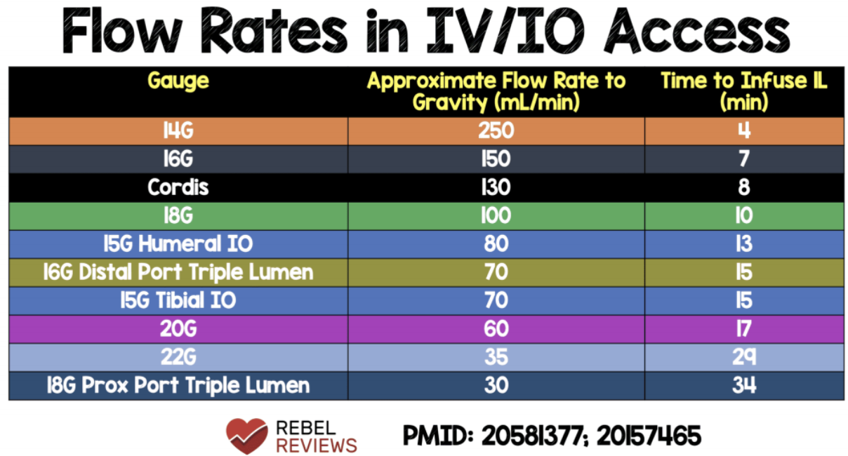
Treatment of shock :
Hypovolemic Shock management:
ABCs
(Airway, Breathing, Circulation)
Control
any bleeding
Establish 2
large bore
IVs or a central line¹
Crystalloids²
Normal Saline or Lactate Ringers
PRBCs³
O negative or
cross matched
(Packed RBCs)
Arrange definitive treatment
Evaluation of Hypovolemic Shock:
CBC & Electrolytes
As Indicated :
ABG(Arterial blood gas)/Lactate
Trauma patient: CXR, Pelvic X-Ray
Kidney Function: BUN(Blood Urea Nitrogen)/Creatinine
Stable patient to detect bleeding source: CT scan
Coagulopathy: Coagulation studies
incase of hematemesis: GI endoscopy
Incase of hemoptysis: Bronchoscopy
incase of History of AAA: Vascular radiology
Types and cross match
IV Resuscitation:
2 large bore IV is usually the best option for resuscitation. Why? High flow rate achieved in a short period of time. Large bore IV means using 14 or 16 gauge needles to administer fluid quickly. For instance, with two 14G IV 2L of fluid is administered in 4 minutes.
The forearms or antecubital fossa are the most accessible peripheral sites, but the nature and location of the injuries may require alternative sites, such as the femoral or external jugular vein.
Central venous cannulation is difficult and potentially hazardous in shocked hypovolemic patients.
The doctor said you don’t have to memorize the numbers but you have to understand the concept
2 large bores are used for hypovolemic shock, blood is used instead incase of hemorrhagic shock.
A types of IV fluids Containing water and electrolytes. Colloids: Contain protein particles that exert oncotic pressure and cause fluid to remain in the intravascular
Preferred in hemorrhagic shock, because it prevents coagulopathy.
Discuss the Specific treatment of each type of shock.
1- Hypovolemic
2- Septic
3- Cardiogenic
4- Anaphylactic
5- Neurogenic

Slide 11
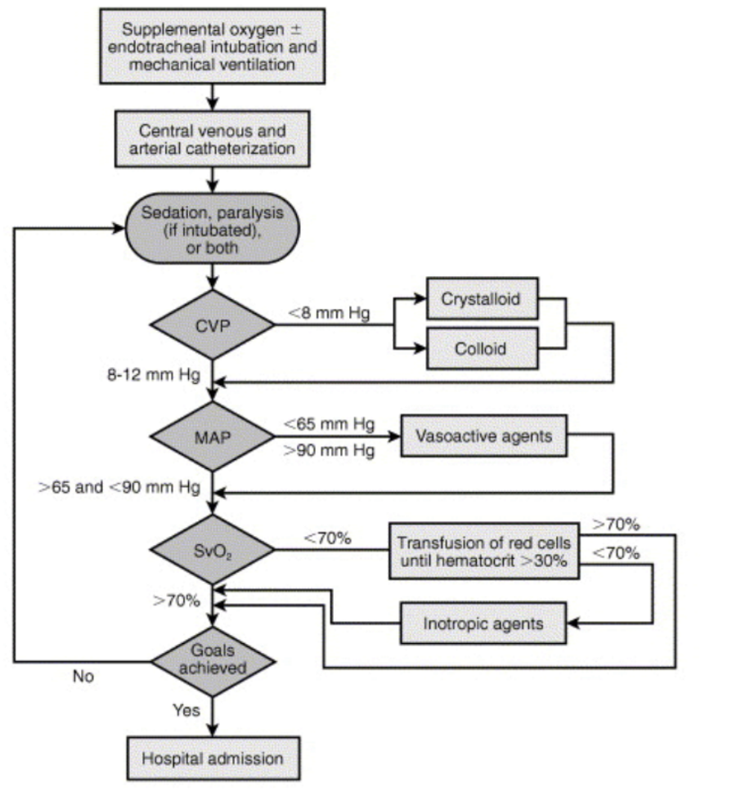
Treatment of shock :
Septic shock treatment:
2 large bore IVs, fluid resus ⁵.
Supplemental oxygen.
Broad spectrum IV antibiotics, based on suspected source, as soon as possible.
Goal directed therapy.
Treatment algorithm:
Treatment Algorithm: (this is one way to manage sepsis. However, this has changed now)
What we actually do if we suspect a patient with sepsis:
Blood Culture
Broad spectrum antibiotic (very important, in every one hour delay of antibiotic administration you increase the mortality chance by 10%)
Fluid in case of hypovolemia
If the patient is still hypotensive we give vasopressors
In the meantime look for the source of the sepsis and control it.
Anaphylactic Shock treatment:
Diagnosis
Treatment
Clinical Diagnosis ¹
Defined by airway compromise ² , hypotension, or involvement of Cutaneous ³, respiratory, or GI systems
Look for exposure to drug, food, or insect.
Labs have no role.
ABC’s Airway is major steps
Angioedema and respiratory
compromise require immediate intubation
IV, cardiac monitor, pulse oximetry.
IVFs, oxygen
First line: Epinephrine ⁴
Second line:
Corticosteroids: Hydrocortisone 200 mg IV
H1 and H2 blockers: Chlorphenamine 10–20 mg slow IV
No test will help you, in fact it’s just a waste of time.
Hallmark of anaphylaxis.
E.g rash and urticaria.
To achieve severe vasoconstriction and bronchodilation.
1-2L only, not as much as hypovolemic shock.
Discuss the Specific treatment of each type of shock.
1- Hypovolemic
2- Septic
3- Cardiogenic
4- Anaphylactic
5- Neurogenic

Slide 12
Treatment of shock :
Cardiogenic Shock treatment:
The commonest cause of cardiogenic shock is acute (anterior) myocardial infarction.
As with other forms of shock, the management of cardiogenic shock is based upon the identification and treatment of reversible causes and supportive management to maintain adequate tissue oxygen delivery.
Routine investigations to identify the cause of cardiogenic shock include:
o 12-lead ECGs. o troponin
o creatinine kinase-MB (CK-MB) levels. o CXR.
o transthoracic¹
General supportive treatment include:
1- administration of high concentrations of inspired oxygenation.
2- intra-aortic balloon pump (IABP) as an adjunct and as a last resort supportive treatment.
3- correction of hypovolaemia and optimization of intravascular volume (preload) through cautious fluid
resuscitation (Except for HF patients).
01
02
03
04
acute heart failure
chronic heart failure
acute myocardial infarction
Emergency cardiogenic shock
usually normovolaemic or relatively hypovolaemic as a result of intravascular fluid loss into the lungs and the development of pulmonary oedema.
usually hypervolemic as a result of long-standing activation of the renin–angiotensin system and salt and water retention.
IV opiates titrated cautiously to control pain, reduce anxiety and reduce myocardial oxygen demand afterload by causing peripheral vasodilation.
the most appropriate choice of vasoactive drug in cardiogenic shock is one that has both ionotropic and vasodilating properties such as the β-agonist dobutamine. Alternative inodilating agents include: calcium sensitizer levosimendan and the PDE inhibitor milrinone.
Neurogenic Shock treatment:
IV fluid resuscitation (Only add vasopressors if hypotension refractory to IV fluids ).
echocardiogram may provide useful information on (systolic and diastolic) ventricular function and exclude potentially treatable causes of cardiogenic shock such as cardiac tamponade, valvular insufficiency and massive pulmonary embolus
Discuss the Specific treatment of each type of shock.
1- Hypovolemic
2- Septic
3- Cardiogenic
4- Anaphylactic
5- Neurogenic

Slide 13
Cases :
What Type of Shock is This?
68 yo M with hx of HTN and DM risk factors for intra abdominal bleeding presents to the ER with abrupt onset of diffuse abdominal pain¹ indicates possible bleeding into the abdomen with radiation to his low back. The patient is hypotensive shock. tachycardic, afebrile cannot be anaphylactic or septic with cool but dry skin. Vasoconstriction is functional.
Hypovolemic shock (there is evidence of blood shunt)
A 34 female presents to the ER after dining at a restaurant where shortly after eating the first few bites of her meal², became anxious, diaphoretic, began wheezing, noted diffuse pruritic rash, nausea, and a sensation of her “throat closing off”. She is currently hypotensive, tachycardic and ill appearing.
Anaphylactic shock (history is the most important) Note that in all shock types you won’t find bronchospasm unless if it was an anaphylactic shock
A 73 year old lady with a history of ischemic heart disease, HTN, DM II presents to the ED with altered mental status. She is febrile³ to 39.4, hypotensive with a widened pulse pressure⁴, tachycardic, with warm extremities and decreased urine output.
Septic Shock
Sudden Pain and radiate to the back? GI bleeding caused by ruptured Aneurysm, pancreatitis takes 3 days.
Anaphylactic within minutes, sepsis within days.
Cardiogenic shock patients will not have fever.
wide pulse pressure: high systolic (heart is working fine) + low diastolic (Vasodilation) > Sepsis.

Slide 14
Summary
 | Hypovolemic | Cardiogenic | Neurogenic | Septic | Anaphylactic
Clinical picture | - Hypotension - Tachycardia - Cold, clammy skin | - hypotension - tachycardia - cold,clammy skin | - Hypotension - Bradycardia - Warm, dry skin | - Hypotension - Tachycardia - Warm, dry skin - febrile | - Hypotension - Tachycardia - Warm, dry skin
Cause/s | Most common: Hemorrhagic: GLOATS¹ Nonhemorrhagic: - Dehydration - Plasma (burns) | Most common: - MI - Cardiac tamponade - Tension pneumothorax - Arrhythmias - Massive PE - Valve dysfunction | Most common: - Spinal cord injury (Thoracic/cervical) -Traumatic brain injury | - Localized infection ( mostly from gram +ve bacteria) | - Exposure to allergic agents
Investigation/Diagnosis | - Clinical diagnosis - blood tests | - ECG - Chest x-ray - Troponin/CK-MB | - | - Clinical diagnosis - Culture | - Clinical diagnosis
1st step management | Arrest the hemorrhage if found | Treat the underlying cause | IV fluid resuscitation | IV broad spectrum antibiotics | - Maintain airway and give 100% O₂ - IV/IM Epinephrine
Further management | 1- IV fluid 2- Blood transfusion 3- Vasopressors | - | Vasopressors in IVF refractory cases | 1- IV fluid 2- Vasopressors | 1- Chlorphenamine 2- Hydrocortisone
Recall
Q1:What are the best indicators of tissue perfusion?
Urine output, mental status (earliest).
Q2: What lab tests help assess tissue perfusion?
Lactic acid (elevated with inadequate tissue perfusion), base deficit, pH from ABG (acidosis associated with inadequate tissue perfusion).
Q3: What is the most common vital sign change associated with early hypovolemic shock?
Tachycardia.
Q4: What type of patient does not mount a normal tachycardic response to hypovolemic shock?
Patients on β-blockers, spinal shock (loss of sympathetic tone), endurance athletes.
Q5: What is the lowest reflex available to the examiner?
Bulbocavernous reflex: checking for contraction of the anal sphincter upon compression of the glans penis or clitoris.
Q6: What is the lowest level voluntary muscle?
External anal sphincter.
GI hemorrhage,Lung hemorrhage,Obstetric hemorrhage,Aneurysms,Trauma,major Surgical blood loss

Slide 15
Quiz
MCQ
Q1:A 76-year-old male is brought to the hospital with persistent diarrhoea and vomiting for the
past 4 days. He has been unable to keep his food down and feels very tired. On examination
he is very dehydrated. His pulse is 128/min and his BP is 88/52 mmHg.
A)Hemorrhagic hypovolemic shock
B)Non-hemorrhagic hypovolemic shock
C)Cardiogenic shock
Q2:An 86-year-old male has been complaining of increasing lower abdominal pain for the past
week. On examination he looks very unwell with warm peripheries. He has signs of generalised
peritonitis. His pulse is 130/min and his BP 84/50 mmHg.
A)Neurogenic shock
B)Septic shock
C)Hypovolemic shock
Q3:Which of the following statements regarding hypovolaemic shock are true?
A)The venous pressure is low.
B)The vascular resistance is low.
C)The mixed venous saturation is high
Q4:A 50-year-old male who’s previously diagnosed with post-traumatic amnesia and vitally stable complaining of pain in all 4 extremities,which type of shock might’ve develop in his case?
A)Septic shock
B)Hypovolemic shock
C)Neurogenic shock
Q5:A 19-year-old male is brought to the hospital after sustaining an abdominal injury while playing
rugby. He is complaining of left upper abdominal pain and has some bruising over the same
area. His pulse is 140/min and his BP is 100/82 mmHg.
A)Hemorrhagic hypovolemic shock
B)Non-hemorrhagic hypovolemic shock
C)Septic shock
Q6:A 24-year-old man presents to the ED with 3 stab wounds to the abdomen. He was intubated in the field for airway protection. Blood pressure is 70/30 mm Hg and pulse 140/min. On examination, 3 penetrating wounds covered by abdominal pressure pads are noted. What is the best next step in management?
A)IV fluids
B)Abdominal X-ray
C)Start broad spectrum antibiotics immediately.
Answers
Q1 | B | Q4 | C
Q2 | B | Q5 | A
Q3 | A | Q6 | A
Extra Questions

Slide 16
Good Luck!
Team leaders:
Nouf Alshammari
Haneen Somily
Naif Alsulais
Mohammed Alshuwaier
This lecture was done by:
Faisal Alkoblan
Moath Aljehani
Razan AlRabah
Badr Alqarni
Khaled Alharbi
Feedback
Note taker
Reviewer

