Slide 1
Burn
Objectives
Define burn.
Discuss the incidence of burn.
Discuss the pathophysiology of burn
Recognize the calculation.
List the types of burn.
Explain the inhalation injury.
Discuss the burn management:
Non-Surgical: Tetanus, Analgesia, Dressing, Nutrition, Fluid, Foley Catheter.
Surgical: Escharotomy, skin grafting.
Identify the complications of burn.
Explain the electrical Burn.
Explain the chemical Burn.
Colour Index
Main Text
Males slides
Females slides
Doctor notes
Textbook
Important
Golden notes
Extra
Editing File

Slide 2
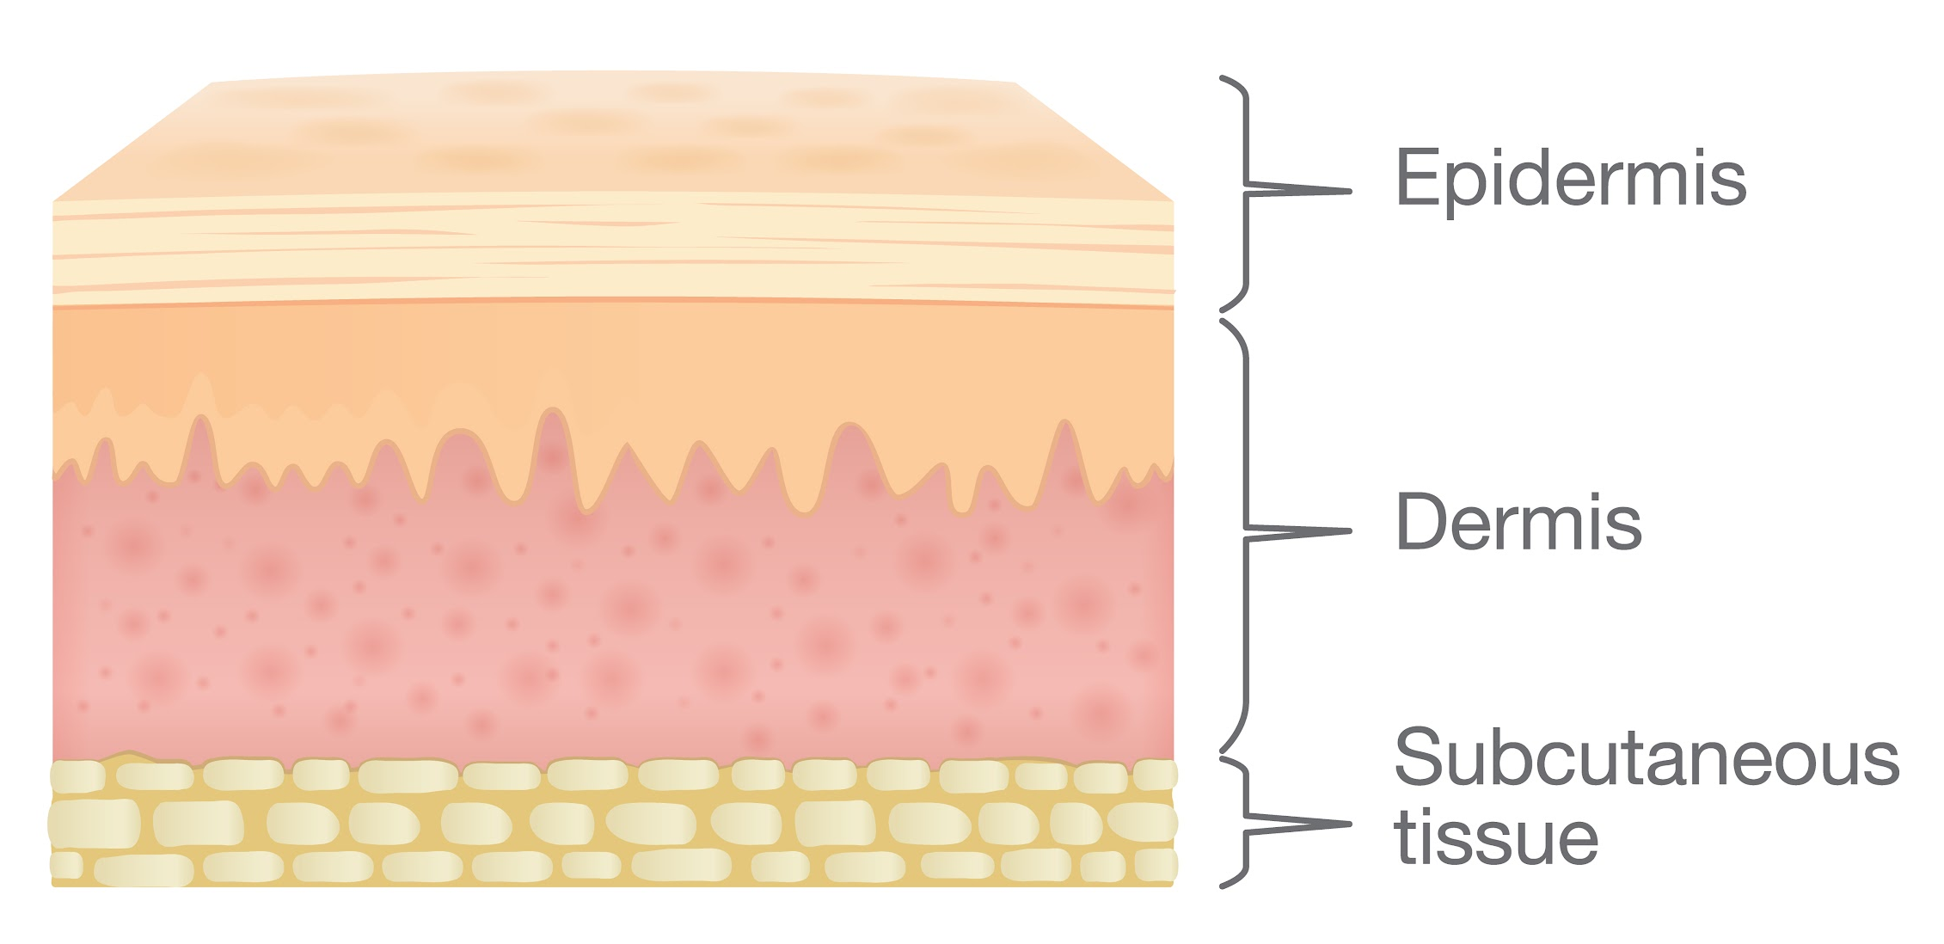
Skin Anatomy (overview)
Functions of the skin
Protection of muscles, bones, ligament and organs.
Forms a barrier to infectious pathogens
Prevent water loss
Structure of the skin
Epidermis
Dermis
Subcutaneous tissue
The outer protective layer of the skin.
Composed of keratinised, stratified squamous epithelium through which three appendages (hair follicles, sweat glands and sebaceous glands) pass to subcutaneous tissue.
These appendages can escape destruction in partial-thickness burns and are therefore a source of new epidermal cells for reconstitution of the epidermis.
The basal layer of the epidermis generates keratin-producing cells (keratinocytes) and pigment cells (melanocytes) that produce melanin, which is passed to the keratinocytes and protects the basal layer from ultraviolet light and determines hair colour.
Subclassified into two layers:
1- Papillary Dermis (upper part of the dermis).
2- Reticular Dermis (lower part of the dermis).
The Dermis, which is bound to the epidermis through a basement membrane, is composed of three cell types (fibroblasts,macrophages and adipocytes), collagen, elastic fibres and an extracellular gel-like matrix.
It supports the blood vessels, lymphatics, nerves and the epidermal appendages as well as pressure and temperature receptors.
Made of fat and connective tissue.
It insulates & pads deeper tissue.
It anchors the skin to the muscle.

Slide 3
Burn
Definition:
Destruction of tissues caused by various etiologies including flames, and hot liquids, that ranges from trivial to life threatening which requires extensive treatment and rehabilitation with the chances of permanent dysfunction and distortion.
incidence:
1
Estimated 2 million burns per year in the US.
2
500K burns treated in the ER.
70K burn hospital admissions.
3
Mortality is highest in the age groups: 2-4 years & 17-25 years.
4
Deep hand burns are a criteria for referral to burn center or hand specialist.
5
Industrial accidents account for the majority of electrical and chemical burns.
Alcohol and smoking are a common contributing factors in local burn injuries.

Slide 4
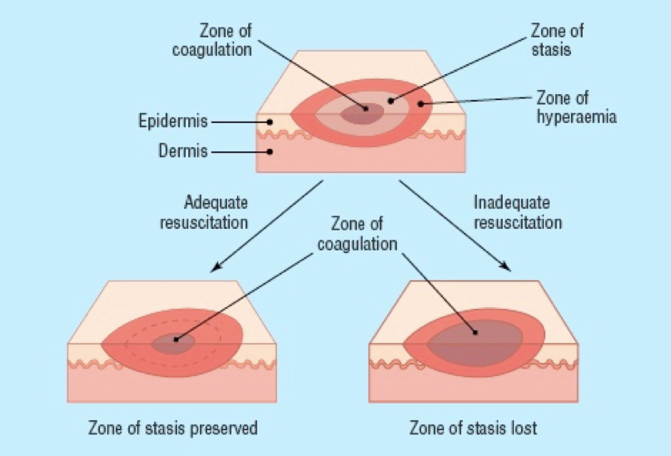
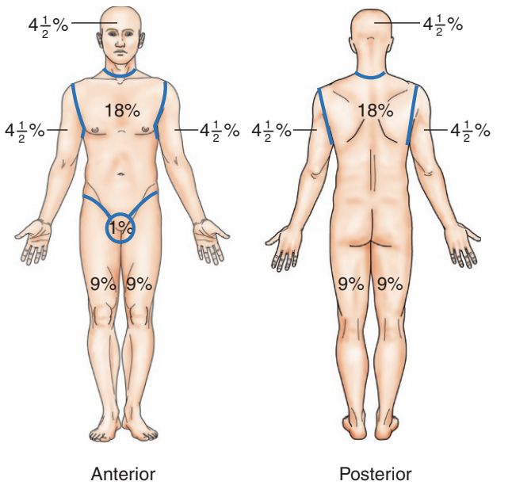
Burn
Pathophysiology of burn:
01
The local effects are the result of tissue destruction and inflammatory response.
02
The inflammatory response to injury causes capillary dilation (manifested as erythema) in mild cases, or if there is capillary damage, that leads to protein leakage and edema.
03
Insensible fluid loss can cause severe hypovolemia which might progress to hypovolemic shock ( when > 15% of the body surface area is burned).
04
Destruction of the Epidermis causes impairment of the physical barriers and predispose to infections which can delay healing and increase energy demand.
05
Burns have 3 zones : 1-Zone of coagulations 2-Zone of stasis (the area of potential reversible cell damage) 3-Zone of hyperemia.
Calculations:
01
02
03
Rule of nines
Mortality
Parkland formula
Used to approximate burn size.
Divides the body into areas that each represent approximately 9% of the total body surface area (TBSA) of an adult
less useful in children because of the relatively large head size (and the relatively small limbs.
Palm without fingers = 1%
Head in kids = 18% (9% in adults)
Single leg in kids = 9% (18% in adults)
Mortality =
(body surface area % + age )/100
Fluid volume of crystalloid administration during the first 24 hours of admission
Volume of lactated Ringer's
= 4 mL × weight (kg) × TBSA%
50% given in the first 8 hours
50% given in the next 16 hours
Crystalloid is preferred because of the tendency to hyponatremia after the injury

Slide 5
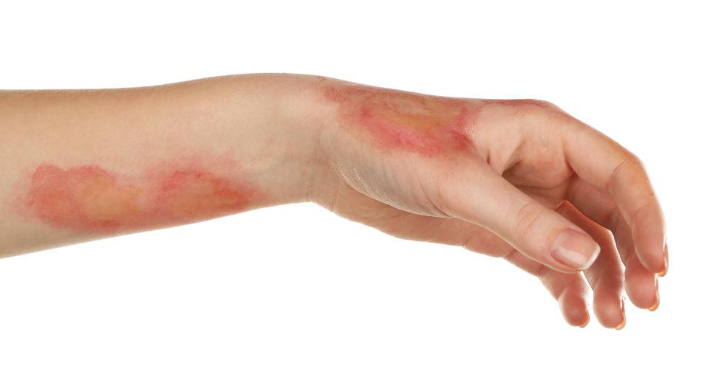
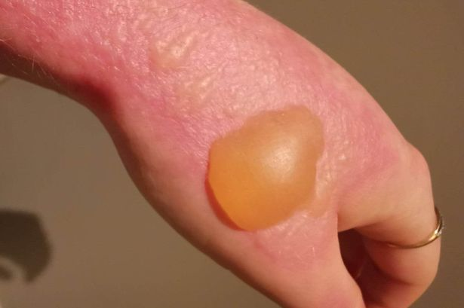
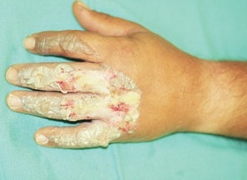
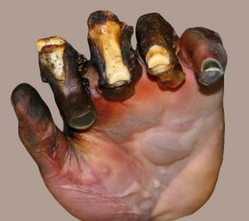
Classification of Burns Based on the Depth of Skin Injury¹ (main clinical classification):
 | Degree | Treatment
First Degree (superficial burn) | Epidermal injury only. Clinically characterized by: edema and erythema. No fluid collection occur at this degree. Most common presentation is kitchen burns and sunburns. | Symptomatic treatment: Mild analgesics/NSAIDs pain is the commonest presentation Local wound care: Daily cleansing. Topical antibiotics (silver sulfadiazine)² if needed. Elevation Occupational therapy Splints in functional position. Early range of motion.³
Second Degree (superficial/deep partial thickness) | Injury to epidermal +/- dermal⁴ layers. Clinically characterized by: painful blisters⁴ (Hallmark of Second degree burns). Skin is repopulated by viable germinal cells in follicles.⁵ | Similar to first degree burns. Leave blisters intact they are the best natural dressing . If debrided, cover with an occlusive dressing. Compression garment after wound epithelialization.
Third Degree⁶ (full thickness) | Entire dermal layer and subdermal fat injury the entire content of the skin+nerve endings are completely burnt here. Clinically characterized by: dry, inelastic and waxy appearing scar skin is similar to commercial leather. | Early tangential skin excision and meshed split thickness skin grafting (within 7 days). We have to surgically debride and skin graft. We remove the eschar (the white patch) we clean the wound until we reach healthy tissue then we remove a skin patch from one area of the body and transplant it to the burned area.
Fourth Degree (full thickness) | Dermis and deep tissue injury. Clinically characterized by: injury to all skin layers, and injury to tendon, nerve, bone and joint in addition to Muscles and subcutaneous fat. Caused when the patient is unable to move away from the burning agent eg: unconscious patients/disabled patients/infants. | Skin grafts not adequate for exposed deep structures. Treatment options: Amputation. Flap coverage with salvage procedures. Both grafts and flaps will be further explained in the following slides
First degree burn
Second degree burn
Third degree burn
Fourth degree burn
1- In clinical practice, most burns are a mix of types. Any burn is surrounded by lighter zones eg: 2nd degree burns are surrounded by 1st degree burns and 3rd degree burns are surrounded by an engorge erythematous area (2nd degree burns). First site to come in contact with the burning agent is the deepest site of the burn. Retainment of sensations at the site of the burn suggest more superficial injury.
2-AKA: Flamazine is the gold standard in preventing infections due to its broad spectrum activity.
3-Start early physical therapy if burns and edema are near a joint.
4-Blistering occur when the burn exceed the basement membrane of the epidermis going down to the dermis.
5-In partial thickness burns the epithelium lining the skin appendages is preserved and heals the wound by creating new epithelium in a process called (epithelization), unlike full thickness burn where there’s no remaining appendages to heal the skin eg: Deep 2nd degree burn > “the burn has exceeded reticular layer of the dermis” leading to delayed healing and scarring and surgical intervention is indicated.
6-Whitish in color; Skin has 5 vascular plexuses, the most important are the Sub-dermal and Sub-epidermal plexuses, these Plexuses provide blood to the skin (give the reddish appearance of the skin).In 3rd ° burn These plexus are gone = no blood supply = skin looks white.
white skin = no skin content to re-Heal = Surgery is required.

Slide 6
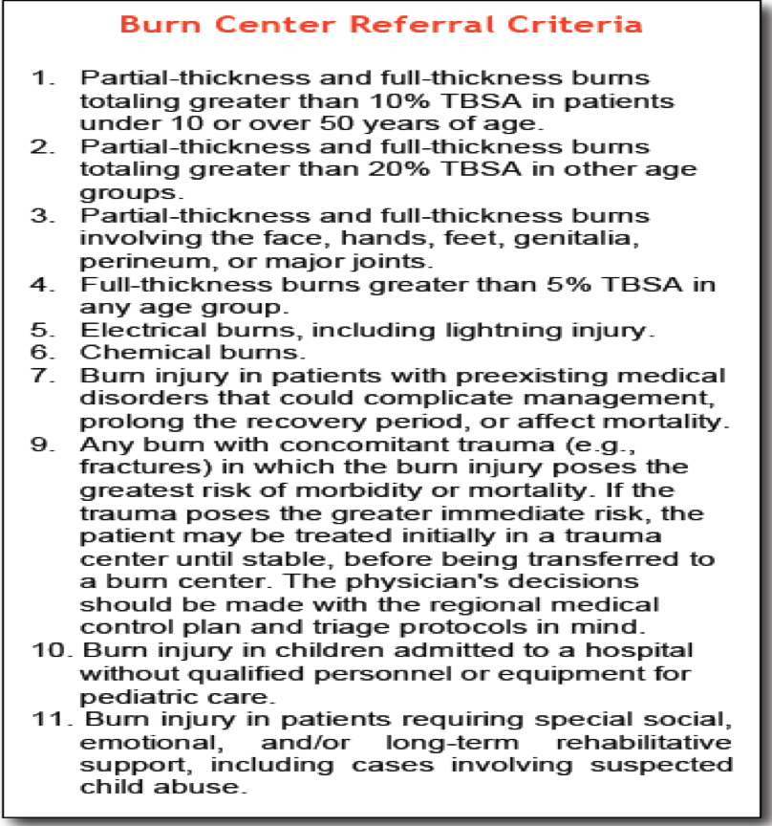
Burn
Wound Closure:
First degree and superficial second degree burns:
Local wound care only.
Deep second¹ degree burns:
Controversial.
Functional results worse than superficial second degree burns.
Consider excision and skin grafting if hand burns will take 14 days to “close”.
Objectives of treatment:
01
02
03
04
Prevention of Edema
Prevention of contractures due to poor positioning and prolonged immobilization
Prevention of infection
Preserve viable tissue
When to transfer to a burn center
(transfer criteria):
>25% body surface area (BSA).
>20% BSA in children.
High voltage burns.
Inhalation injuries.
Burns in the genital area, face, neck, feet and hands in addition to full thickness burns.
Chemical burns.
1-Grey zone !
we don’t know whether the burn will heal by itself or not so we wait for 14 days, if it didn’t heal we use grafts.
During these 14 days we maximize resuscitation and give topical antibiotics

Slide 7
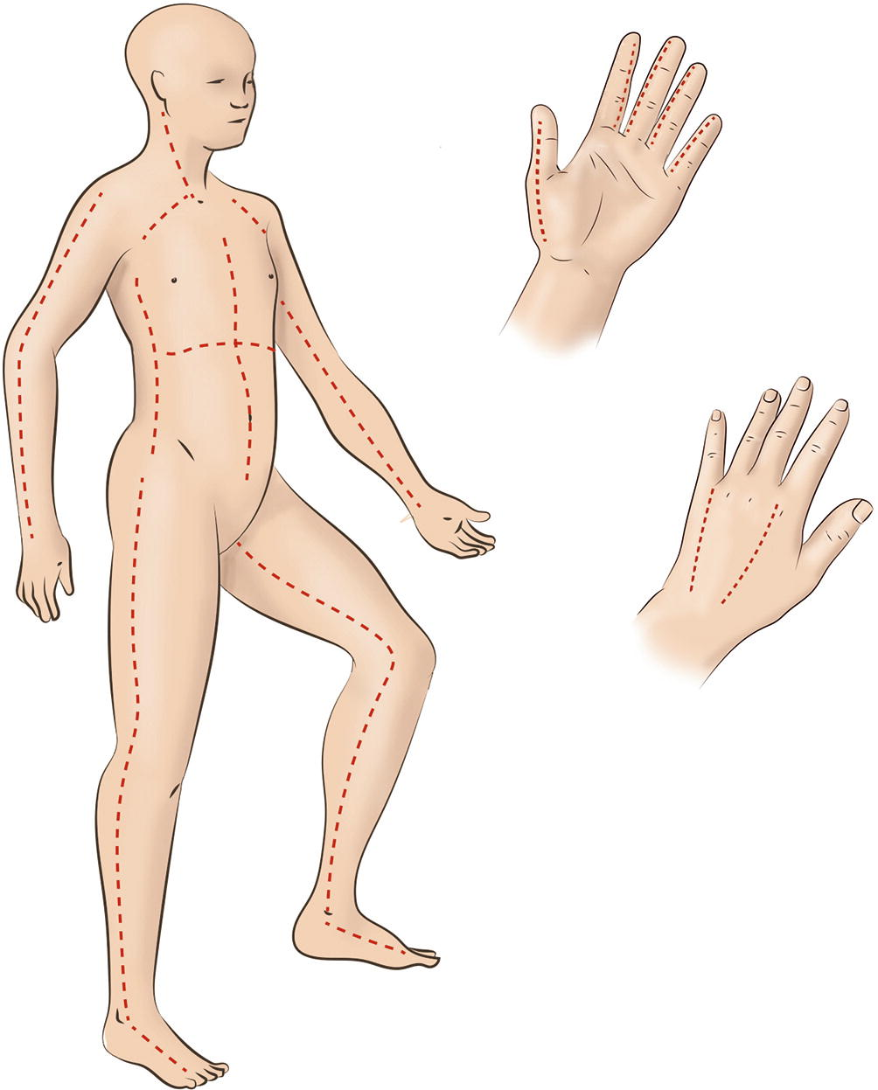
Management of Burns:
Surgical
Non surgical
Escharotomy
Skin grafting
Tetanus prophylaxis
Analgesia
Dressing
Nutrition
Fluid
Foley Catheter
01
Escharotomy¹:
Indication:
Poor tissue perfusion.
Threat to perfusion after volume resuscitation.
Deep Circumferential burns.
Use mid-axial incisions.
Digital Escharotomy:
Use mid-axial incisions:
Index, long → ulnar incision.
Ring → radial or ulnar incision.
Little → radial incision.
Leave wounds open
Consider carpal tunnel release.
Consider intrinsic muscle release.
Skin Grafting & Flap:
Skin grafting is a surgical procedure that involves removing skin from one area of the body and moving it, or transplanting it, to a different area of the body.
Grafts are similar to first degree burns (First layer is removed and appendages are preserved in both of them so healing and epithelialization is possible) the difference is that grafts occur in a controlled environment unlike burns.
The main differences between grafts and flap:
Grafts do not contain blood vessels but flaps do
Grafts are thin sheet of skin and is used more with 3rd degree. Flap is a bulky tissue (e.g. muscle flap, subcutaneous tissue flap) used when there’s a deep burn (4th degree burns) or when a deep reconstruction following cancer ablation is needed.
1- The most important indication of escharotomy is circumferential burn (which causes hypoperfusion due to edema).
Circumferential burns: are seen in cases where a full thickness burn affects the entire circumference of a digit, extremity, or even the torso, this is called a circumferential burn. as oedema forms the inelastic eschar can cause a buildup of pressure and act like a tourniquet (impairs blood flow). This pressure can lead to significant complications such as respiratory compromisation and loss of tissue perfusion requiring a surgical procedure known as an ‘escharotomy’. An escharotomy is performed by making an incision through the eschar to release the pressure.

Slide 8
02
Antibiotics:
Intravenous or oral antibiotics should cover skin flora for initial treatment.
Topical antibiotics (silver sulfadiazine) for prevention of infection.
Topical application of (mafenide acetate) penetrates through eschar and may be effective against a wider variety of organisms.
03
Non-Surgical Management:
The first Priority would be maintaining an adequate airway and first Aid (ABCDE) especially in case of risk of inhalation injury, with continuous observation for signs of respiratory failure.
IV fluid resuscitation if > 15% of BSA is affected (Parkland formula).
Analgesic (eg: opioids).
placing the patient in a warm room (to reduce energy expenditure) and enteral feeding using nasogastric tube with vitamin supplements and iron (Better to eat normally after 48 hours).
Prophylaxis against Tetanus (eg: Clostridium Tetani) by Tetanus Immunoglobulins (TIG)
Foley catheter to monitor urine output
Dressings, essential to protect from contamination and for promotion of healing
Types:
Evaporative dressings: eg: paraffin, gauze
Semi occlusive and occlusive: eg: hydrogel, hydrocolloid
Topical antibiotics, like Silver Sulfadiazine (Flamazine) and Povidone Iodine (Betadine)
(Not advised in the first 48 hours as they can make the determination of the depth more difficult).
special Cases
preexisting Renal disease or Impaired renal function → diuretics.
Only in positive blood culture and septicemia → Systemic antibiotics.
Proton pump inhibitors (PPI) eg: Omeprazole → prophylaxis for curling’s ulcer.

Slide 9
Burn
Types of burns according to the causative agent:
1
Thermal burns:
Caused by heat
Heat is classified into 2 types: 1-Dry heat e.g. oven heat 2-Moist heat e.g. Hot coffee/kitchen oil.
Extent and depth of the injury is proportional to intensity and duration of heat applied. For that: the first thing to do is to remove clothes if something hot spills on it, otherwise the burn will go deeper and deeper.
Thermal response:
Edema
Ischemia
Infection
Inflammatory phase.
Hand edema produces joint fibrosis and contractures.
Edema may indirectly reduce blood flow by fluid accumulation (will compress blood vessels).
Multiple factors contribute to development of the infection:
Systemic factors: impaired immune response.
Local factors: as bacterial counts increase, invasion of bacteria into the dermis occurs.
Infection can convert burns from a partial to a full thickness injury (because infections cause further reduction in blood supply).
Prior to antibiotic use, Streptococcus species was most common organism. Still seen with burn cellulitis (nowadays Staph are more common than Strept)
Pseudomonas species is most common cause of systemic sepsis.
Systemic factors:
Hypovolemia from evaporation and increased capillary permeability.
Fluid resuscitation is required for significant burns.
Parkland formula:
LR volume= 4cc x kg x %burn
(It’s extremely important to understand parkland formula
Example:
If a burn is estimated to cover 10% Body surface of a child weighing 7kg the amount of fluid need to be replaced is equals to
4 x 10 x 7 = 280mL).
Local factors:
Unyielding eschar/compartment.
Ischemia leads to loss of injured/viable tissue.

Slide 10
Burn
Types of burns according to the causative agent cont.
2
Chemical burns
Chemical burns don’t simply end with removing the burning agent like thermal burns; because chemical agents react with the body’s tissue and the injury extends deeper.
Acid → The most common cause of chemical burns, they cause fast tissue necrosis (Acids burns are most commonly seen in those working in Gas stations or Chemical laboratories).
Base → The most dangerous cause of chemical burns.
Acute vs chronic
Short acting vs long acting
Superficial vs deep
Factors which worsen the burn:
Area of contact (skin damage, pressure)
01
Amount of contact (volume of chemical applied)
05
02
PH & Concentration of contact solution
Duration of contact
04
03
Form of contact agent

Slide 11
Acids |  | Bases | Pathophysiology:
Batteries: Sulfuric acid/lithium | Acetic acid | Ammonia Tile cleaners: Ammonium chloride | Bases: Proton acceptor (OH⁻). Higher pH is stronger on logarithmic scale. Liquefaction necrosis. Protein denaturation. Lipid saponification (exothermic = heat producing). Eschar can’t form and base penetrates deeper than acid (continuous action). Acids: Proton donor (H⁺). Lower pH is stronger on logarithmic scale. Necrosis by protein denaturation. Forms eschar which limits penetration.
Rust removers: Hydrofluoric acid²/chromic acid | Trichloroacetic acid | Drain cleaners: Sodium hypochlorite (lye), Sodium hydroxide
Pool cleaner: Hydrochloric acid | Chloroacetic acid | Potassium hydroxide
Phosphoric acid | Chemical peels: Phenol (Carbolic acid) | Cement: Calcium hydroxide/oxide (lye), Alkali. Calcium hypochlorite
Nitric acid | Cresols | SIlicates, Phosphates, Lithium hydride
Formic acid | Toilet bowl cleaners/cement removers: Muriatic acid | Petroleum solvents: organics. Air bag deployment: Alkali. Bleaches/household cleaners: oxidizers.
Special categories
Oxidants |  | Bleaches, peroxides, chromates, manganates Neutralize with milk/egg white/starch before water irrigation
Reduction reactions |  | Binds free electrons and thus denatures proteins. Neutralize first with soda lime, soap,magnesium before water irrigation
Corrosives |  | White phosphorus (military), metals, aqueous ammonia, phenol. Remove particles, copper sulfate solution
Desiccants |  | Sulfuric acid, muriatic acid Dehydrates tissue Exothermic: heat producing Neutralize with lime water, soap,magnesium.
Vesicants |  | Chemical warfare (phosgene, mustard, etc) Blisters, edema, ischemic necrosis Special antidotes Chemotherapy agents
Protoplasmic proteins |  | Hydrofluoric acid, acetic acid, tungstic acid, tannic acid. Forms salts and bind proteins/calcium or ions.
Hydrofluoric acid |  | After initial lavage for 30 minutes to treat the H⁺ ion, treat fluoride ion. 10% Calcium gluconate gel topically: May need to remove nails to get contact. May combine with 50% DMSO (dimethyl sulphoxide). Consider injection (not with digits). Consider intra-arterial injection.
1-History should give you a hint about the type of burn which is important because they are managed differently (eg. Gas station explosion, chemistry lab fire, household chemical cleaners acids/bases…etc).
2-Causes Hypocalcemia
• If you don’t know the type of the chemical agent just dilute it with water to minimize its effect “The solution of pollution is dilution”

Slide 12
Burn
Types of burns according to the causative agent cont.
3
Electrical burns:
Pathophysiology
Current burns can be described as burning from inside out from deeper organs till it arrives to skin, patients who experience electric shock may have no external injuries.
History of electrical shock (voltage, current type and source of electricity) should give you a hint if there’s any muscle or bone damage and doesn’t exclude electrical injury as a differential.
Severity of an electrical injury depends upon:
Tissue resistance:
Bone > Fat > Tendon > Skin > Muscle > Vessel > Nerve
Path of current:
Low voltage follows least resistance (The worst type).
High voltage direct flow.
Voltage
01
Duration of contact
05
02
Amperage
Type of current
04
03
Resistance

Slide 13
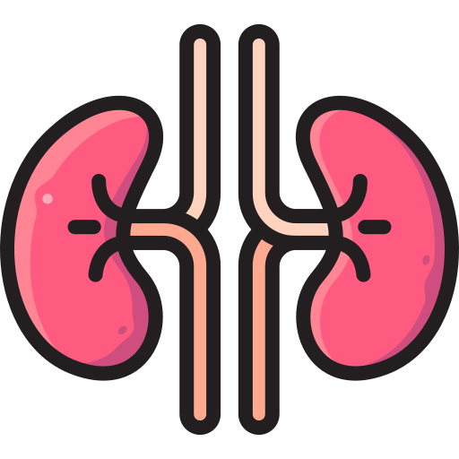
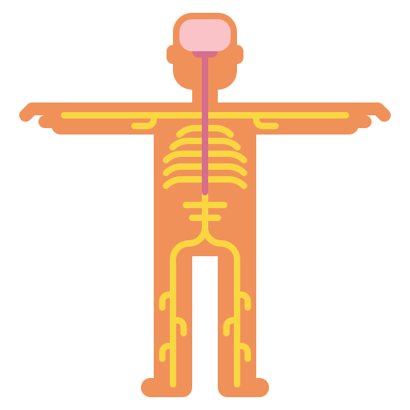
Burn
3
Electrical burns cont.:
Systemic injury: if a current entered from one hand and exits from the other it means that it went through the heart and can cause arrhythmia
Cardiac arrhythmias
sepsis
Renal failure
PNS injury
Due to muscle necrosis
Evaluation
Treatment
01
02
Extent of necrosis is hard to asses
Red, swollen extremity
Entry and exit wound
Skeletal injury possible secondary to a fall or being thrown
Compartment syndrome ¹
Low threshold for fasciotomy
Fasciotomy ²:
Within 4-6h
Nerve decompression
as needed
Debridement of devitalized tissue
Second look procedure
48-72h
Expect additional necrosis from vascular thrombosis
Definitive treatment:
Amputation and/or flap coverage
Compartment syndrome results from the combination of increased interstitial tissue pressure (tissue pressure exceeds the perfusion pressure) and the noncompliant nature of the fascia and osseous structures that make up a fascial compartment resulting in edema and swelling of the deep compartments (muscles or bones). Compartment syndrome is associated with electrical burns.
Fasciotomy has the same principle as Escharotomy but much deeper. A fasciotomy consists of one or more fascial incisions and remains the only effective way to treat acute compartment syndrome.

Slide 14
Burn
Inhalation injuries:
Common in house fires and caused by inhalation of smoke from burning objects eg:plastic.
Usually fatal.
Carbon monoxide displaces oxygen and binds to hemoglobin forming ( Carboxyhemoglobin)
The patient can be saved if he was put on 100% O2 for 75 min or for 4-6 hours in a room with clean air.
Cyanide inhalation is also common and can be fatal
Damage to lung parenchyma due to inhalation of chemicals or heated smoke can happen.
Complications of burn:
01
02
03
Early consequences
Short Term consequences
Long term consequences
Hypovolemic shock.
Electrolytes imbalance
(hyponatremia followed by hypernatremia, and hyperkalemia followed by hypokalemia).
Sepsis.
Hemolysis .
Hypothermia.
Nutritional depletion and weight loss
Respiratory failure and ARDS
Renal failure (due to hypovolemia)
Venous thrombosis
Curling’s ulcer (acute duodenal ulcer) and erosive gastritis (due to ischemia of the Gut from water loss)
Permanent disfigurement
Prolonged hospitalization
Psychological disturbance
Impaired mental and physical function

Slide 15
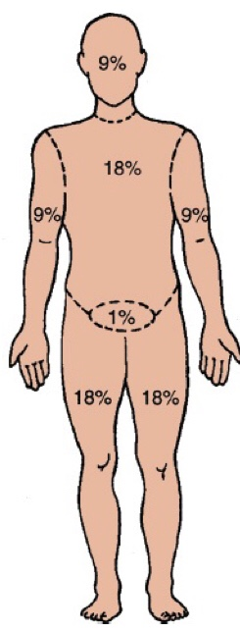
Summary
Recall
Q1:How do superficial burns present?
Painful, dry, red areas that do not form blisters (think of sunburn)
Q2:How do partial-thickness burns present?
Painful, hypersensitive, swollen, mottled areas with blisters and open weeping surfaces
Q3:How do full-thickness burns present?
Painless, insensate, swollen, dry, mottled white, and charred areas; often described as dried leather
Q4:Define STSG
Split-Thickness Skin Graft
Q5:What is an autograft STSG?
STSG from the patient’s own skin
Q6:What is an allograft STSG?
STSG from a cadaver (temporary coverage)
Q7:What prophylaxis should a Burn patient receive?
Tetanus
Q8:What principles guide the initial assessment and resuscitation of
the burn patient?
ABCDEs, then urine output; check for eschar and compartment syndromes
Q9:What are the signs of smoke inhalation?
Smoke and soot in sputum/mouth/nose, nasal/facial hair burns, throat/mouth erythema, history of loss of consciousness/explosion/fire in small enclosed area, dyspnea, low O2 saturation, confusion, headache, coma
Q10:What diagnostic imaging is used for smoke inhalation?
Bronchoscopy
Q11:What lab value assesses smoke inhalation?
Carboxyhemoglobin level (carboxyhemoglobin level >60% is associated with a 50% mortality); treat with 100% O2 and time
Q12:How should the airway be managed in the burn patient with an inhalational injury?
With a low threshold for intubation; oropharyngeal swelling may occlude the airway so that intubation is impossible; 100% oxygen should be administered immediately and continued until significant carboxyhemoglobin is ruled out
Q13:What burns qualify for the Parkland formula?
≥20% TBSA partial- and full-thickness burns only
Q14:What is the Brooke formula for burn resuscitation?
Replace 2 cc for the 4 cc in the Parkland formula
Q15:What is the rule of 10’s?
For determining hourly IVF rate: TBSA × 10 (patients 40 to 80 kg)
Q16:How is the crystalloid given?
Through two large-bore peripheral venous catheters
Q17:Can you place an IV or central line through burned skin?
YES
Q18:Why is glucose-containing IVF contraindicated in burn patients in the first 24 hours postburn?
Patient’s serum glucose will be elevated on its own because of the stress response
Q19:What fluid is used after the first 24 hours postburn?
Colloid; use D5W and 5% albumin at 0.5 cc/kg/% burn surface area
Q20:Why should D5W IV be administered after 24 hours postburn?
Because of the massive sodium load in the first 24 hours of LR infusion and because of the massive evaporation of H2O from the burn injury, the patient will need free water; after 24 hours, the capillaries begin to work and then the patient can usually benefit from albumin and D5W

Slide 16
Summary
Recall
Q21:What is the minimal urine output for burn patients?
Adults 30 cc; children 1 to 2 cc/kg/hr
Q22:Why do most severely burned patients require nasogastric decompression?
Patients with >20% TBSA burns usually develop a paralytic ileus → vomiting→ aspiration risk → pneumonia
Q23:What stress prophylaxis must be given to the burn patient?
PPI to prevent burn stress ulcer (Curling’s ulcer)
Q24:What are the signs of burn wound infection?
Increased WBC with left shift, discoloration of burn eschar (most common sign), green pigment, necrotic skin lesion in unburned skin, edema, ecchymosis tissue below eschar, partial-thickness burns that turn into full-thickness burns,hypotension
Q25:Why are systemic IV antibiotics contraindicated in fresh burns?
Bacteria live in the eschar, which is avascular (the systemic antibiotic will not be
delivered to the eschar); thus, apply topical antimicrobial agents
Q26:Circumferential, full-thickness burns to the extremities are at risk for what complication?
Distal neurovascular impairment
Q27:How is it treated?
Escharotomy: full-thickness longitudinal incision through the eschar with scalpel or electrocautery
Q28:How is carbon monoxide inhalation overdose treated?
100% O2 (± hyperbaric O2)
Q29:Which electrolyte must be closely followed acutely after a burn?
Na+ (sodium)
Q30:What is the name of the gastric/duodenal ulcer associated with burn injury?
Curling’s ulcer (Think: CURLING iron burn = CURLING’s burn ulcer)
Q31:What is the “rule of the palm”?
Surface area of the patient’s palm is ≈1% of the TBSA used for estimating size of small burns
Q32:What is the “rule of nines”?
In an adult, the total body surface area that is burned can be estimated by the following:Each upper limb = 9%/Each lower limb = 18%/Anterior and posterior trunk = 18% each/Head and neck = 9% /Perineum and genitalia = 1%
Classification of Burns:
 | Superficial 1st degree | Superficial partial thickness 2nd degree | Deep partial thickness 2nd degree | Full thickness 3rd degree | Full thickness 4rd degree
Zone involved | Epidermis | Epidermis and upper dermis | Epidermis and most of dermis | Epidermis and total dermis including epidermal appendages and subdermal fat | Extends to underlying structure ; muscle, fascia, bone
Description | Painful + Edema + erythema | Painful +Pink blister | - | Dry, inelastic, waxy appearing scar | -
Management | Mild analgesics Daily cleansing +/- topical antibiotic | Daily dressing Heal within 2 wks | debridement | Debridement and meshed split thickness skin grafting | Amputation or flap coverage with salvage procedure

Slide 17
Quiz
MCQ
Q1: A 30 year old chef 75 kg was admitted to the ER after suffering a burn from boiling water that fell over his entire anterior Arms and anterior forearms. The doctor wants to administer fluids for him in order to avoid hypovolemic shock. Calculate the volume of fluid needed.
A)2700 mL Crystalloid
B)1200 mL Crystalloid
C)2700 mL Colloid
D)1200 mL Colloid
Q2: A 44 year old blacksmith suffered a Burn injury to his leg at work. He was rushed into the ER. His leg showed severe necrosis and loss of sensation over the burned area which covers the entire circumference of the leg. What is the appropriate management in this case
A ) Skin Grafting
B )Apply Dressings and support with fluids
C )Escharotomy with cauterization
D)Systemic Antibiotics
Q3: After a huge fire in one of the houses, a survived teenager was admitted to the ER unconscious. His blood pressure was 90/55 And his heart rate 120 While his RR was 28. Which of the following should be done to save the patient
A ) fluid therapy
B) nutritional support
C) clear airway and put him on 100% O2 mask
D) careful monitoring
Q4 which of the following is a prophylaxis that is given to a Burn patient
VZIG
Penicillin
Rubella specific IgG
TIG
Q5 most common kind of burns between children under 2 years old ?
scald burns
Flame (Thermal) burns
Electrical burns
Chemical burn
Q6 A 25-year-old man is brought to the emergency room after sustaining burns during a fire in his apartment. He has blistering and erythema of his face, left upper extremity, and chest. He also has circumferential frank charring of his right upper extremity with decreased capillary refill. He is agitated, hypotensive, and tachycardic. Which of the following is the most appropriate initial management of his wounds ?
a) Topical antibiotics should be applied to the burn wounds.
b) Excision of facial and hand burns.
c) Escharotomy of the right upper extremity.
d) Excision of all third-degree burns.
e) Split-thickness skin grafts over the areas of third-degree burns.
Answers
Q1 | A | Q4 | D
Q2 | C | Q5 | A
Q3 | C | Q6 | C
Extra Questions

Slide 18
Good Luck!
Team leaders:
Nouf Alshammari
Haneen Somily
Naif Alsulais
Mohammed Alshuwaier
This lecture was done by:
Renad Almutawae
Alhanouf Alhaluli
Njoud almutairi
Sedra Elsirawani
Khalid Alharbi
Hashem Bassam
Feedback
Note taker
Reviewer

