Slide 1
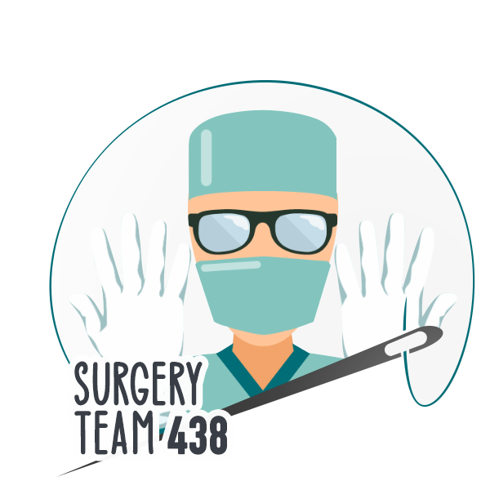
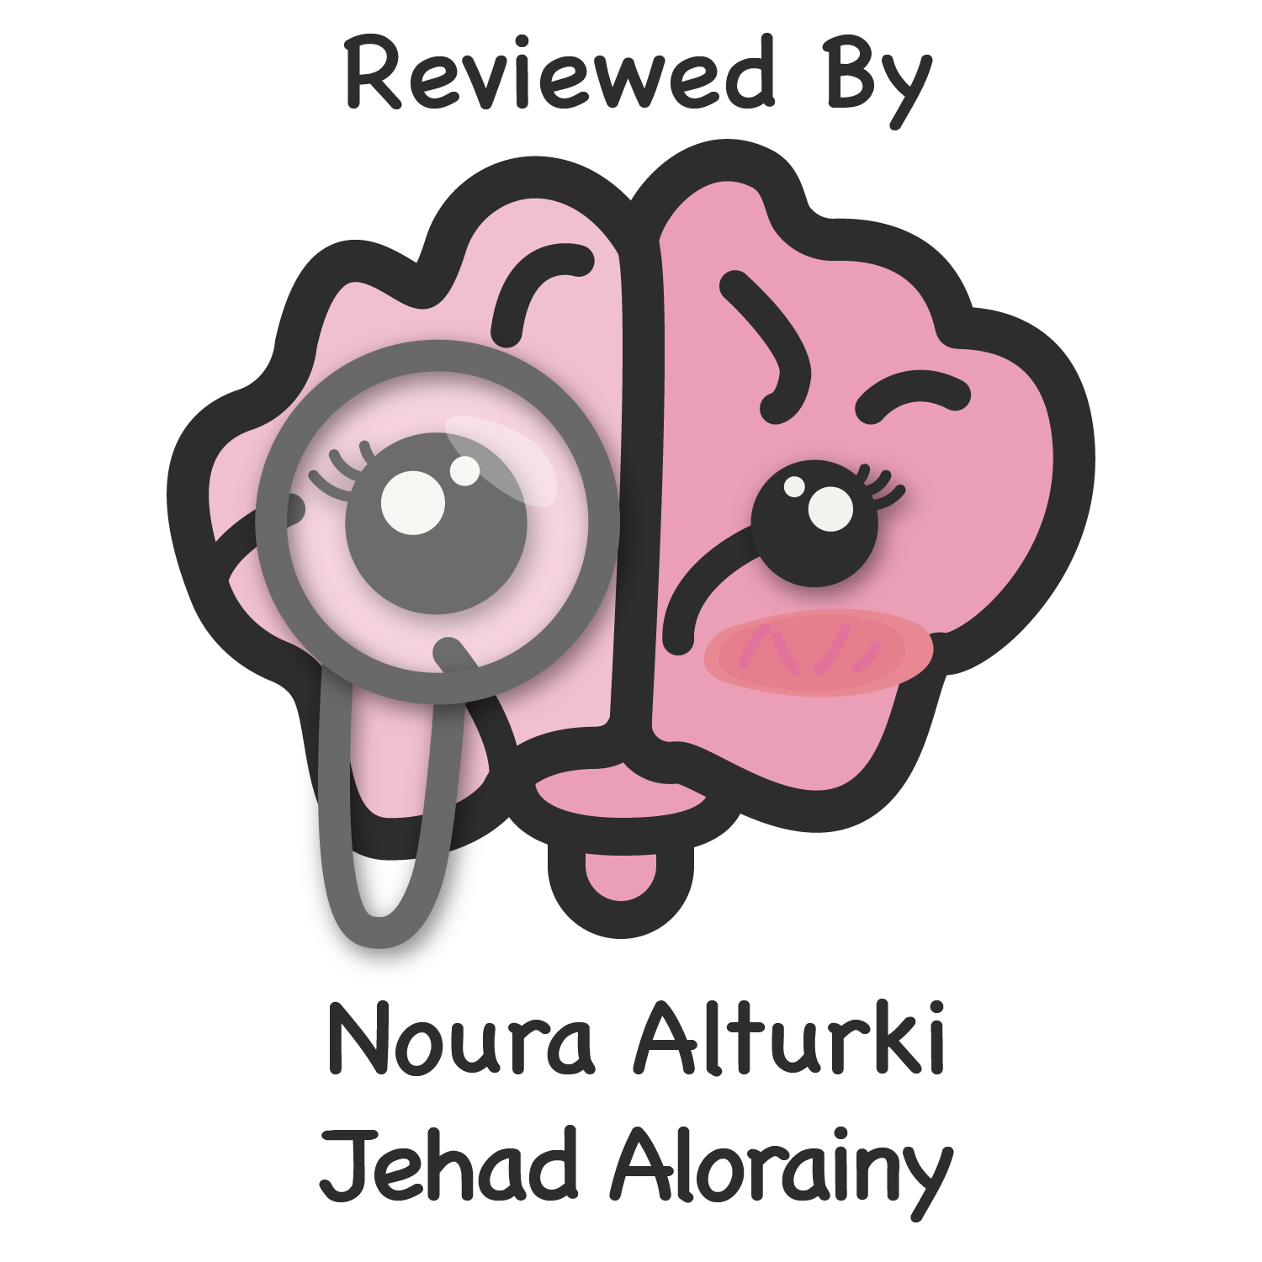
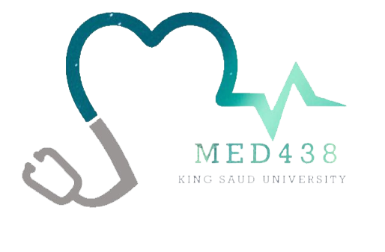
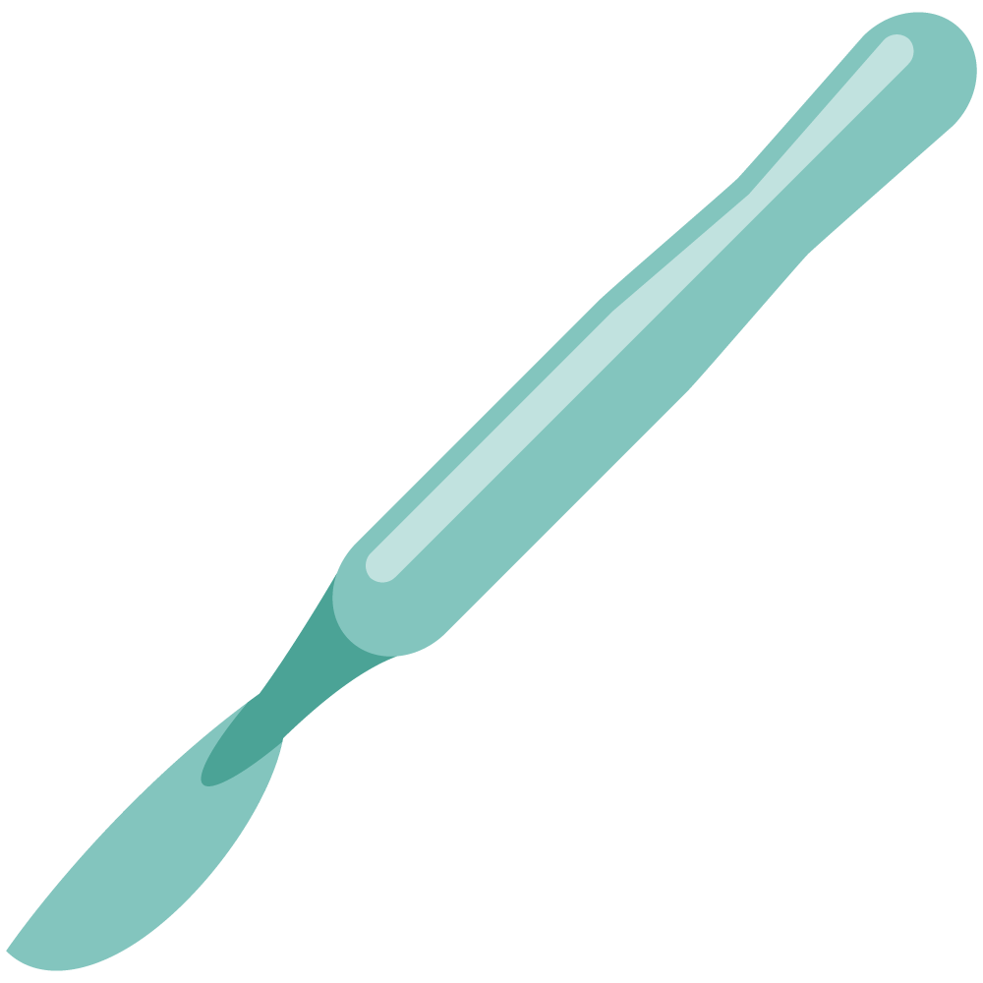
Wound Healing & Management
Objectives
Define the wounds.
Discuss the phases of wound healing .
List the types of wound healing .
Recognize the factors affecting wound healing:
Local
Systemic
Identify the abnormal wound healing which include:
Keloid
Hypertrophic scar
Colour Index
Main Text
Males slides
Females slides
Doctor notes
Textbook
Important
Golden notes
Extra
Editing File

Slide 2
Collagen:
Left handed helix involving 3 polypeptides.
Most abundant family of proteins in the human body (30%).
> 19 types of collagen have been identified.
Types of Collagen:
Type I:
Type II:
Type III:
Type IV:
Type V:
is the major structural component of bones, skin, tendons & muscles.
is found predominantly in cartilage.
is found in association with type I collagen in varying ratios depending on the type and maturity of tissue (predominant type in granulation tissue). ¹
collagen is found in the basement membrane of arteries, nerves, & tendons.
is found in the cornea.
Wound Strength is 80% of original after remodelling (healing).
Lysine and proline hydroxylation required for cross linkage (the main step in collagen synthesis)².
Differs in relative composition of hydroxylysine and hydroxyproline and cross-linking
Type I ≅ 90% of all collagen in body
Normal skin ratio - Type I:Type III = 4:1
Hypertrophic / immature scar 2:1 ratio
Formation inhibited by:
Colchicine, penicillamine, steroid, Vit.C deficiency and Fe deficiency.
They activate collagenase which degrades collagen synthesis and inhibits cross linkage hydroxylation of lysine and proline.
E.g. in traumatic wounded skin (associated with healing). Can also be found in newborns.
Biochemistry: collagen synthesis events: procollagen gets converted to collagen by proline and lysine hydroxylation (essential component to have complete collagen synthesis).

Slide 3
Wound:
Definition:
The skin is the largest organ in the body, and when there is a wound it will lead to the disruption of normal anatomical structure and function. Wound is classified¹ as acute vs. chronic.
Wound healing: is restoration of integrity and continuity of injured tissue to reestablish homeostasis of that tissue and to stabilize the entire organism’s physiology.
Wound healing requires the coordinated completion of a variety of cellular activities, including phagocytosis, chemotaxis, mitogenesis, synthesis of collagen and extracellular matrix components².
Classification of Healing:
By type:
By timing:
By abnormal healing:
01
02
03
Primary:
proximation of the edges and migrations of cells from edge to edge (horizontal).
Delayed primary:
we wait for 2-4 days then we proximate by primary healing.
Secondary:
Horizontal contraction by myofibroblast and epithelization.
partial-thickness wound healing:
No contraction, only vertical epithelization.
Acute
(First week)
Subacute
(Lasts for 1-6 weeks.)
Chronic
(Lasts for > 6 weeks)
Overgrowth³:
(Hypertrophic vs. Keloid).
Undergrowth:
(chronic unstable wound⁴).
Abnormal pigmentation.
Contour abnormality.
Wounds can be classified according to the mechanism of injury:
Incised wounds: A sharp instrument causes these; if there is associated tearing of tissues, the wound is said to be lacerated •
Abrasions: These result from friction damage and are characterized by superficial bruising and loss of a varying thickness of skin and
underlying tissue.
Degloving injuries:These result from shearing forces that cause parallel tissue planes to move against each other: for example, when a hand is caught between rollers or in moving machinery. And others, Crush injuries, burns and gunshot wounds
During a wound healing process there are different cellular activities that happen, the end result of the process is synthesis of collagen.
Due to increased collagen production.
E.g. pressure sore, and diabetic wounds.

Slide 4
Wound:
Classification of Wound Closure:
Primary healing (1st intention) | Secondary healing (2° intention) | Tertiary healing (3° intention)
Primary closure by suturing the edges together. Within hours of repairing full-thickness surgical incision. Results in mortality of minimal number of cellular constituents. Considered the most efficient method and results when a clean incised surgical wound is meticulously apposed. | Wound left open to heal¹ by processes of granulation, contraction², and epithelialization³. Results in more intense inflammatory response. Larger quantity of granulation tissue with pronounced contraction of wounds. | Delayed primary closure Desired for contaminated wounds (infected wounds)⁴. Phagocytosis of contaminated tissues well underway by 4th day. Foreign materials walled off by macrophages. 3° intention healing describes the situation where a wound healing by 2nd intention (neglected traumatic wound/burn) is treated by excising its margins and then apposing them or covering the area with a skin graft. The final cosmetic result may be better than if the wound had been left to heal by 2° intention.
Epithelial Repair:
Epithelial continuity is reestablished across a wound: Multiple events happen during the healing process. The cells (from the two edges of the wound) mobilize & migrate to the middle and get in proximity then duplicate by mitosis and differentiate to different cells.
Mobilization
Migration
1st
2nd
(stimulus is loss of contact inhibition)
Cellular differentiation
4th
3rd
Mitosis
You keep the wound open (you do dressing and wound care but no suturing) and it heals by itself by contraction of myosin and actin, as well as epithelialization of dermis and epidermis, and it usually takes longer than primary healing.
Contraction results in edge to edge (horizontal) repair.
Epithelialization results in vertical repair.
Tertiary healing is a combination of primary healing and secondary healing. Clean the contaminated wound, wait for about 3 days and then re-approximate it by suturing.

Slide 5
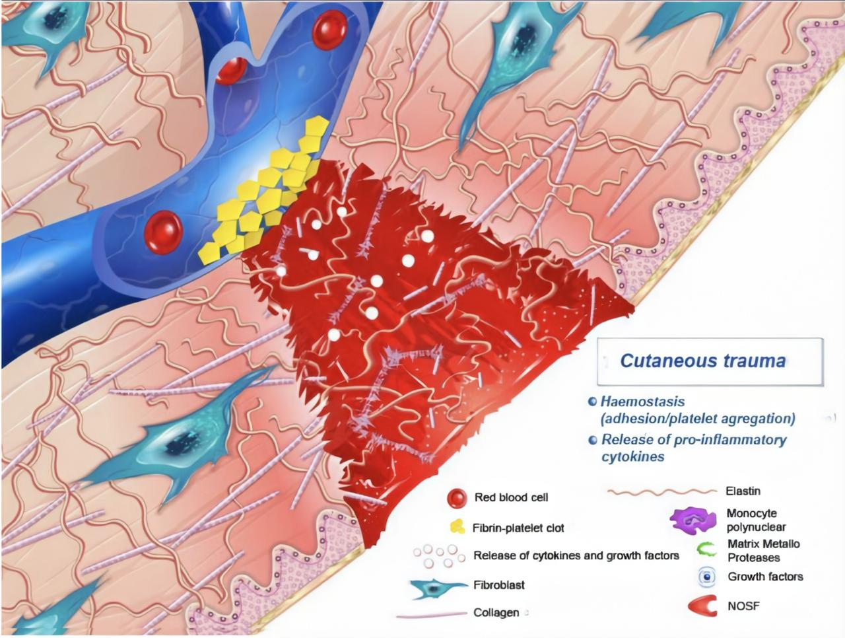
Phases of Wound Healing:
01
Heamostasis¹ (5-10min)
Main cells in this phase: platelets
Initial response to injury = constriction followed by dilation.
Platelet plug forms after adherence to exposed subendothelial collagen via vWF
Platelets degranulate releasing: ADP, thromboxane-A2, bradykinin, and 5-HT → further vasoconstriction and platelet aggregation.
Platelets stimulated to release :
platelet derived growth factor (PDGF)
made by macrophages, endothelial cells, fibroblasts
chemotaxis, fibroblast stimulation
transforming growth factor β (TGFβ)²
made by macrophages, platelets, fibroblasts
fibrinogenesis, angiogenesis, chemotaxis, immune suppression
fibroblast growth factor
made by macrophages and endothelial cells
angiogenesis and chemotaxis
Form the platelet plug
Degranulation of platelets (release of cytokines and growth factors)
Activation and recruitment of neutrophils
Considered as phase zero or part of the inflammatory phase. This phase is delayed by bleeding disorders.
It has a major role in wound healing. The main source for the production of TGFβ is the Alpha granules of platelets. Excess production of TGF-β isoforms causes abnormal scars (Hypertrophic and Keloid scars).

Slide 6
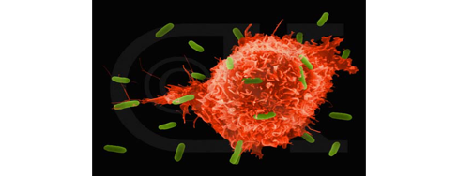
Phases of Wound Healing cont.:
02
Inflammatory/Migratory ”lag” phase¹ (1-4 Days)
Typically starts immediately after hemostasis.
Main cells in the inflammatory phase: in the first 24 hours → PMNs (neutrophils)
After 24 hours → Macrophages.
Classically represented by:
01
Rubor (redness) caused by:
vasodilation
primarily result of prostacyclin (PGI₂) and histamine, also caused by prostaglandin A, D, E (PGA, PGD, PGE)
02
Tumour (swelling):
caused by leakage of plasma proteins through gaps in vascular endothelium
edema potentiated by PGE₂, prostaglandin F_{2α} (PGF_{2α})
03
Calour (heat)
Increased local temperature secondary to both:
Increased blood flow
Elevated metabolic rates
04
Dolour (pain)
Macrophages :
Phagocytosis
Wound debridement
activation of fibroblast
Angiogenesis
Matrix synthesis (granulation tissue formation) regulation
Characterized by an inflammatory response to injury, through an increased capillary permeability, proliferation of capillaries at wound edges and accumulation of protein-rich exudate preceding collagen synthesis

Slide 7
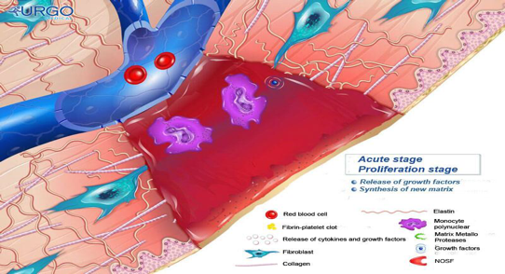
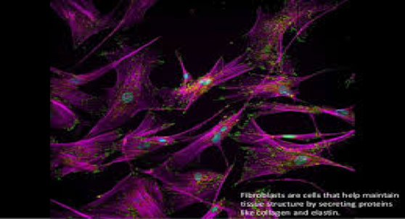
Phases of Wound Healing cont.:
03
Proliferative/Fibroplasia “incremental“ ¹ (3 days - 3 weeks)
Begins 2-3 days after wounding.
Signalled by arrival of fibroblasts (Main cells in the proliferative phase, they play a role in collagen synthesis).
Driven by macrophage-derived bFGF, TGFβ, PDGF to proliferate and synthesize glycosaminoglycans (GAGs) and proteoglycans (building blocks of new extracellular matrix of granulation tissue and collagen).
Also produce bFGF, TGFβ, PDGF, keratinocyte growth factor, insulin-like growth factors-1.
Dominant cell type peaking at 7-14 days.
Collagen synthesis² (net production for next 3-6 weeks).
↑ Keratinocyte mitosis, ↑Endothelial cells and ↑Angiogenesis (from vessels at wound margins).
Lasts 2-4 weeks depending on site and size of wound with slowing of fibroblast
migration and proliferation.
Different cells differentiate into different types and new blood vessels are formed (angiogenesis).
Collagen and elastin synthesis
In this phase there is progressive collagen synthesis by fibroblasts and a corresponding increase in tensile strength with Increased collagen turnover. This phase is delayed by: Microvascular diseases (Diabetes), Macrovascular (Atherosclerosis).
Arterial oxygen tension (PaO2) is a key determinant of the rate of collagen synthesis.

Slide 8
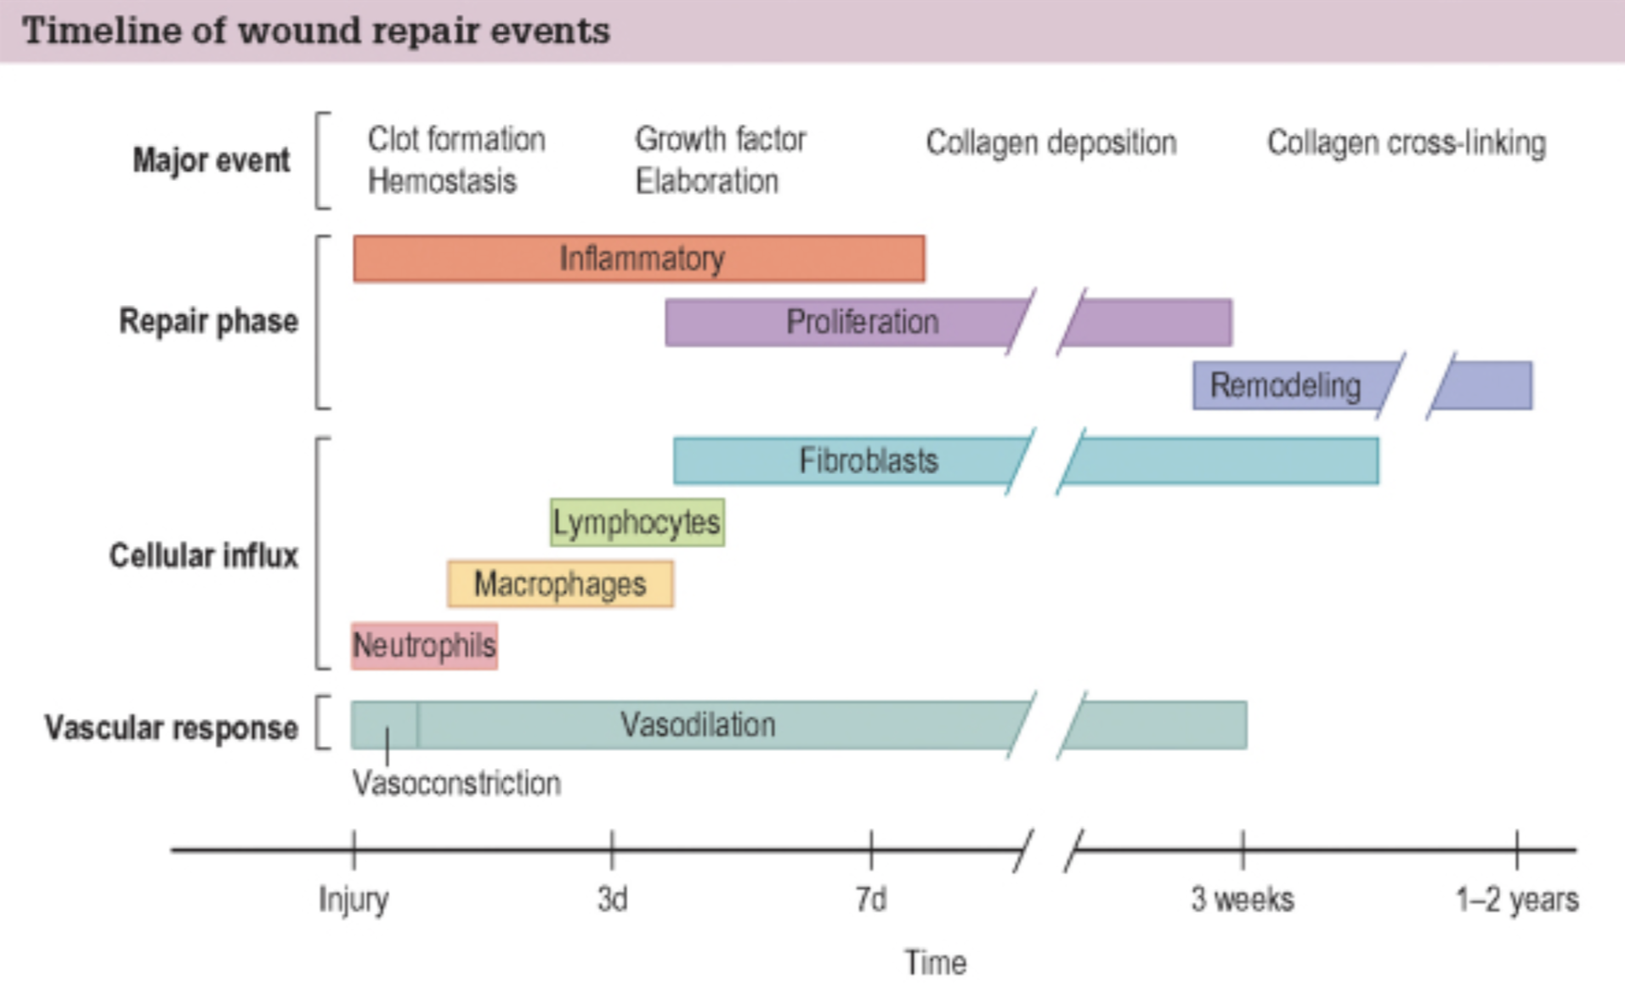
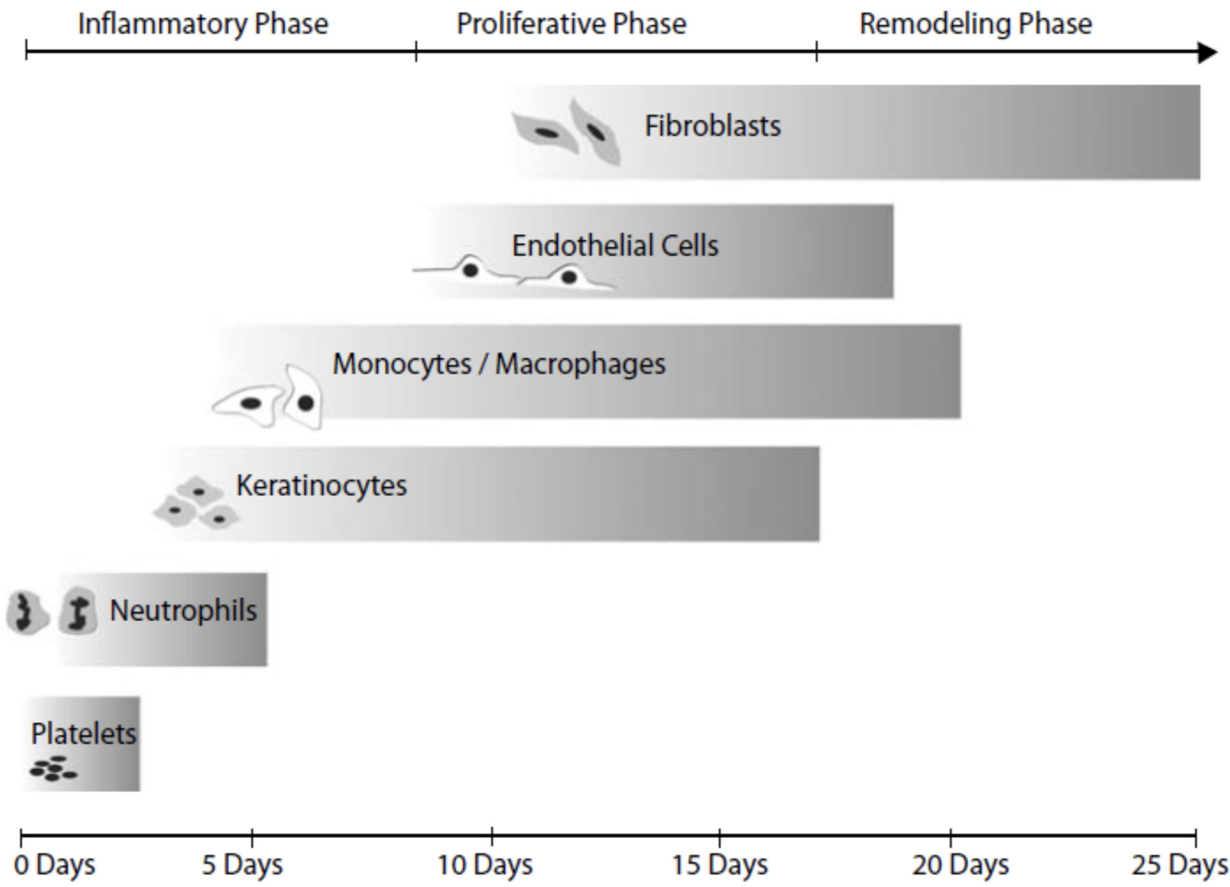
04
Remodeling /Maturation (3 weeks - one year)
Begins approx. 3 weeks after injury
Collagen synthesis and degradation are accelerated but in equilibrium
with collagen breakdown (no net increase in collagen content)¹
Collagen deposition peaks by 3rd week
Large capillaries growing into wound regress/disappear
Indurated, raised, pruritic scar becomes mature scar
Collagen fibers become organized
Type III collagen replaced by type I collagen
re-establishing normal 4:1 ration (I:III):
Duration depends on age, genetics, type of wound, location (1-2 years)².
Tensile strength increases to 80% of pre-injured skin³
Factors Affecting Wound Healing:
General (patient):
Local (wound):
Nutrition⁴
Drugs/Toxins⁵
Age⁶
DM
Smoking⁷
Vascular disease
Obesity
Systemic diseases
Idiopathic
Inherited diseases
Surgical technique⁸
Oxygen
Infection
Acidity
Radiation
Loss of growth factors
Denervation (in diabetics)
Iatrogenic
Edema
Cancer⁹
Foreign body
The major event in the remodeling phase.
Type three collagen is the main collagen present in the wound healing process. In abnormal wound healing (such as in hypertrophic scars and keloids) we have a higher ratio that could reach up to 1:30 so you'll have high collagen type 3 compared to the normal ratio, and you’ll have abnormal scarring.
Especially in healing tendons, muscles, and blood vessels. For example for tendons it reaches up to 60-80%, but for normal wounds it usually reaches 100%.
Patients with pressure sore are usually malnourished therefore the healing process is usually delayed in such patients, Malnutrition has to be severe before healing is affected. Protein availability is most important, and wound dehiscence and infection are common when the serum albumin is low. Healing problems should be anticipated if recent weight loss exceeds 20%. Vitamin C is essential for proline hydroxylation and collagen synthesis.
E.g. penicillin, steroids and chemotherapy.
Elderly patients are more prone to have chronic wounds, they heal poorly because of impaired blood supply, poor nutritional status or intercurrent disease.however, they still form ‘good’ scars.
Vasoconstriction →reduced oxygen delivery.
Dead spaces must be avoided, as the accumulation of blood and exudate encourage infection. Correct suturing of the deeper layers avoids dead space and often allows the skin edges to fall together without tension. 5/0 or 6/0 sutures are appropriate for the face, stronger ones (3/0 or 4/0) are needed for incisions near joints and still stronger ones for the abdominal wall
Chemo and radiotherapy lead to fibrosis of the skin as well as stenosis of the arteries.

Slide 9
Classification of contamination in Surgical wounds (WHO classification of wound)¹:
1
Clean:
3
Clean-contaminated:
nontraumatic, non infected wounds & no breach of Resp, GI, or GU tract.
No spillage of the content of the tract itself.
E.g. thyroid and breast surgeries.
No need for antibiotics.
Infection rate should be less than 1%.
Use of Ab prophylaxis isn’t recommended.
Small breach in protocol; Resp/GI/GU tract are entered with minimal contamination.
Very minor spillage of the content.
E.g. cholecystectomy, uncomplicated appendicitis, intestinal resection ONLY if there was no spillage.
Infection rates in excess of 5% may suggest a breakdown in wards.
2
Contaminated² “Dirty”:
4
Infected:
Fresh traumatic wounds; major break in sterile technique, nonpurulent inflammation; in or near contaminated skin.
Major spillage.
E.g. hemicolectomy or resection of the intestine with spillage, emergency surgery for perforated diverticular disease, or drainage of a subphrenic abscess.
Purulent infection.
Traumatic & severe wounds.
They have positive culture and require broad spectrum antibiotics.
E.g. traumatic open bone fracture, and purulent pyogenic perforated appendicitis.
Acute wound³:
Debridement if needed
Tetanus immunization status⁵
Dressing
Skin closure without tension
Cleansing
Exploration and diagnosis⁴
Replacement of lost tissues where indicated
Skin cover if required
To determine whether the administration of antibiotics is needed or not.
When wound contamination is anticipated, topical or systemic antibiotics can be used for prophylaxis .For example, systemic antibiotic is normally used to reduce the risk of infection during gastrointestinal surgery and when prosthetic material (hip joint, cardiac valves, arterial bypass) is inserted.
If it’s a major trauma start with ATLS, if not start with vital signs. Don’t jump to the wound directly, the patient should be stable, history needs to be taken, examination needs to be done, and then manage the wound.
To identify any risk factors that may interfere with wound healing.
In acute traumatic wounds, tetanus prophylaxis is routine.

Slide 10
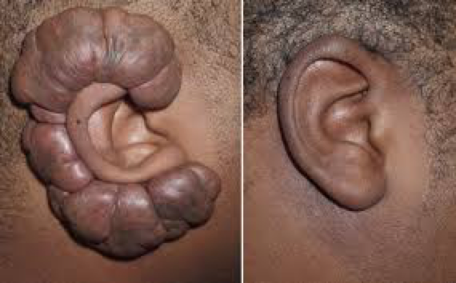
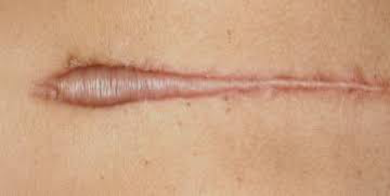
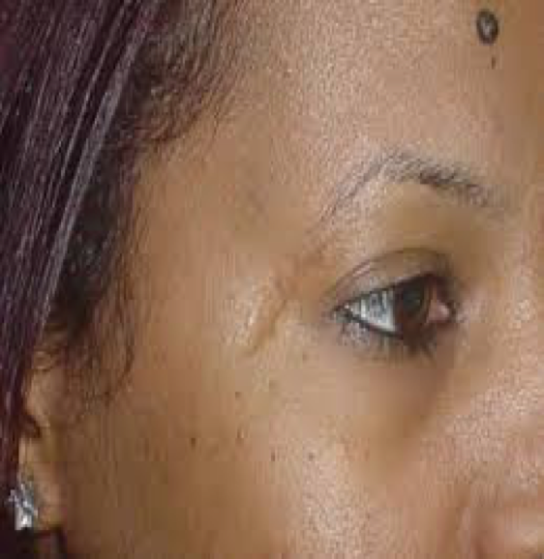
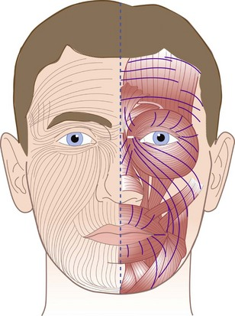
Ideal Scar:
01
02
03
04
05
Flat
Narrow
Pliable
good colour and contour match to surrounding skin
parallel to or within resting skin tension lines (RSTL)¹
does not restrict function or distort normal anatomy²
matures within 6-18 months
Asymptomatic and painless
Abnormal Scars (IMPORTANT):
Keloid scar
excision can be done as an alternative.
Hypertrophic scars
These scars should not be excised.
Wide scar
Caused by traumatic wounds that are not closed properly.
Features | Hypertrophic scar | Keloid scar³
Genetic | Not familial | May be familial
Race | Not race related | Black > White
Sex | Female = Male | Female > Male
Age | Children | 10-30 years
Borders | Remains within wound | Outgrows wound area
Natural history | Subsides with time | Rarely subsides
Site | Flexor surfaces | Sternum, shoulder, face
Aetiology | Related to tension | Unknown
For example when you operate on the forehead (frontalis muscle), RSTL are perpendicular
to the muscle fibers, therefore you should do the scar horizontally rather than vertically
to decrease the tension, create less visible scars & decrease the risk of hypertrophic scar.
Wounds that cross a joint (hands, fingers, etc) are at high risk for causing functional defects
due to contracture (myofibroblasts).
Classical presentation: 20 year old African American female, with a scar in the earlobe.
Keloid scars have high recurrence rate.

Slide 11
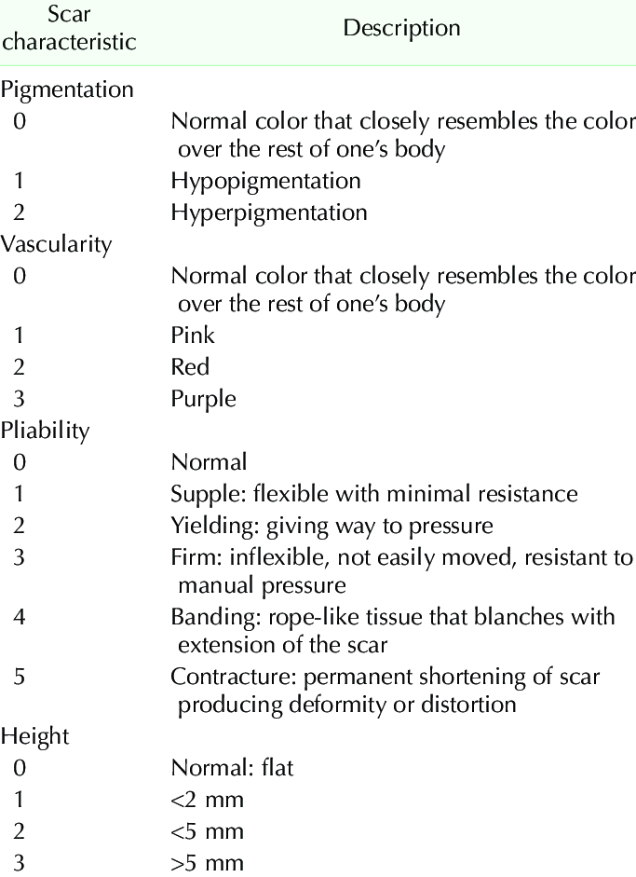
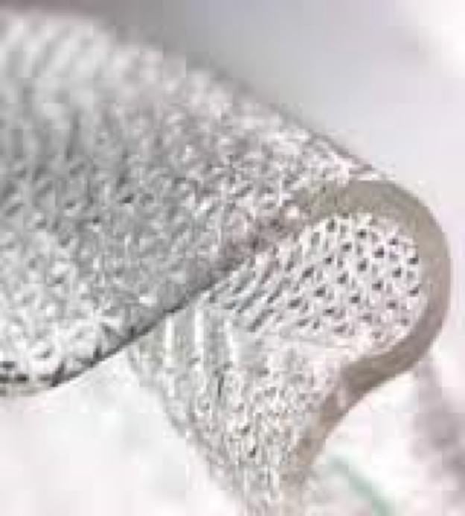
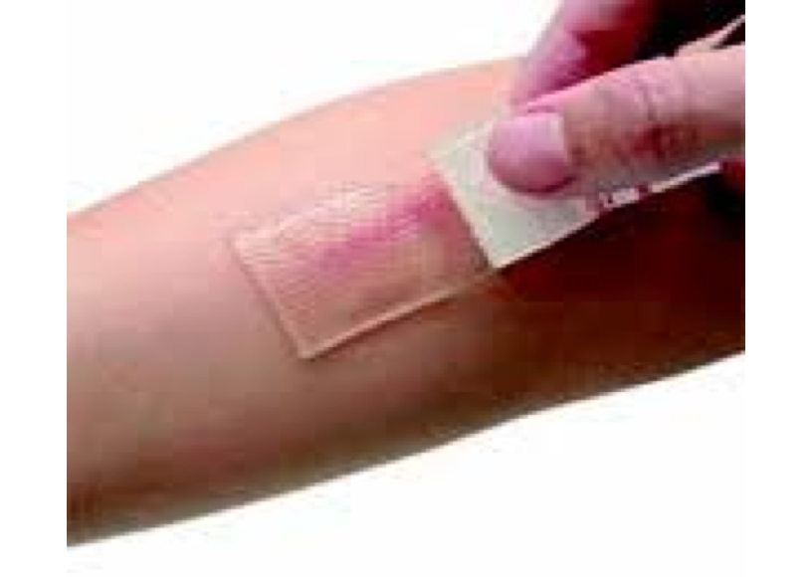
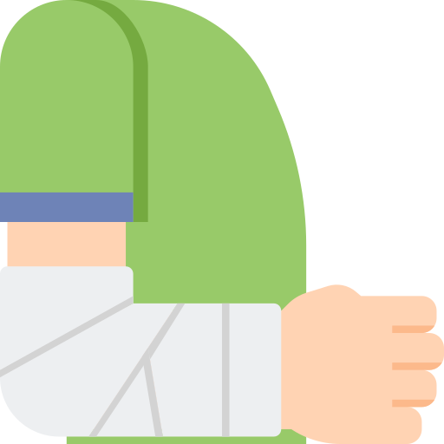
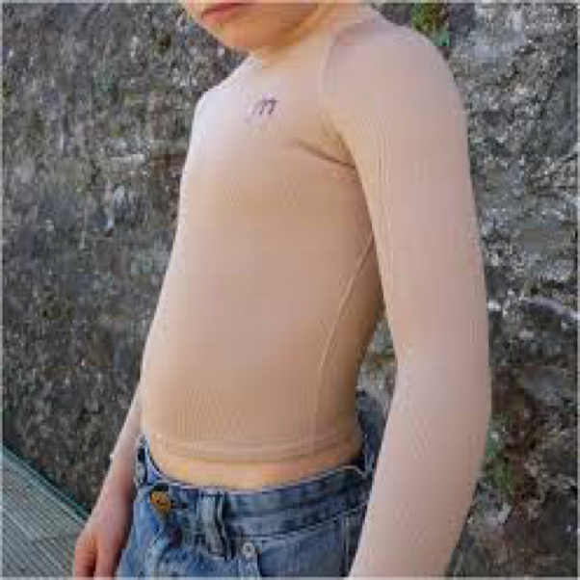
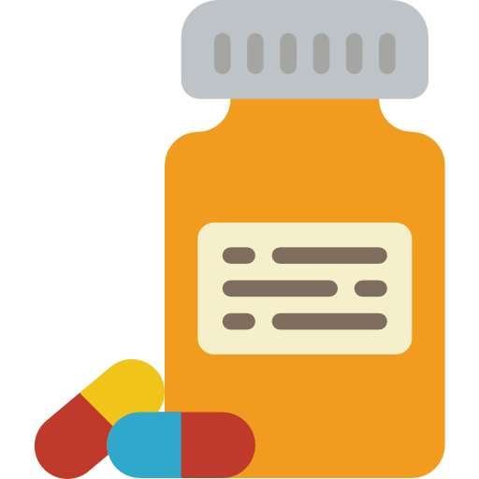
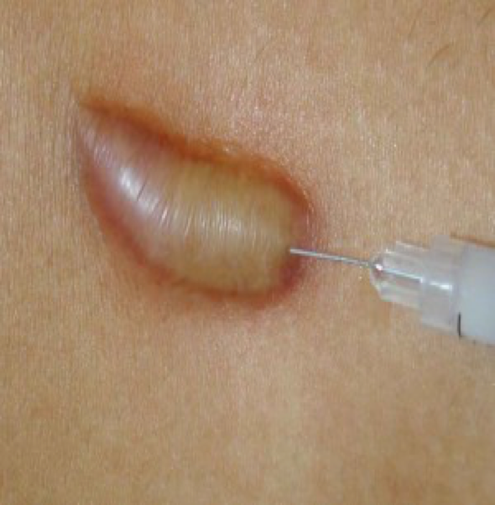
Vancouver Scale:
Treatment of hypertrophic scar and keloid¹:
Prevention
Non surgical:
Pressure: compression garment.
Silicone sheets or gels.
Medical ²:
5-FU (Fluorouracil is a chemotherapy).
Intralesional Steroids (first-line therapy).
Radiation
Laser
Surgery
In keloids, if the measures described above fail, the best treatment approach is a combination of intralesional excision followed immediately by low-dose radiotherapy.
We should take measures to prevent it from occurring in the first place. You prevent HTS, by avoiding tension in creating a scar parallel to the RSTL, minimal undermining (raising the skin and going underneath it), minimal electrocauter (leads to seroma formation → high tension) closing layer, no strangulation (put spaces between each suture).
How does radiation and chemotherapy heal HTS if it leads to reduced wound healing? the unit of given radiation therapy is the guide. Patients that receive radiation therapy for cancer receive high amounts of radiation compared to HTS. The second thing is that HTS has abnormal collagen synthesis (high turnover of collagen) and radiation stops this by causing fibrosis and less formation of collagen.
There’s still a 10% chance of recurrence after treatment.

Slide 12
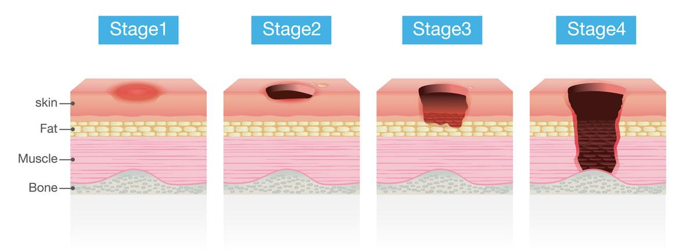
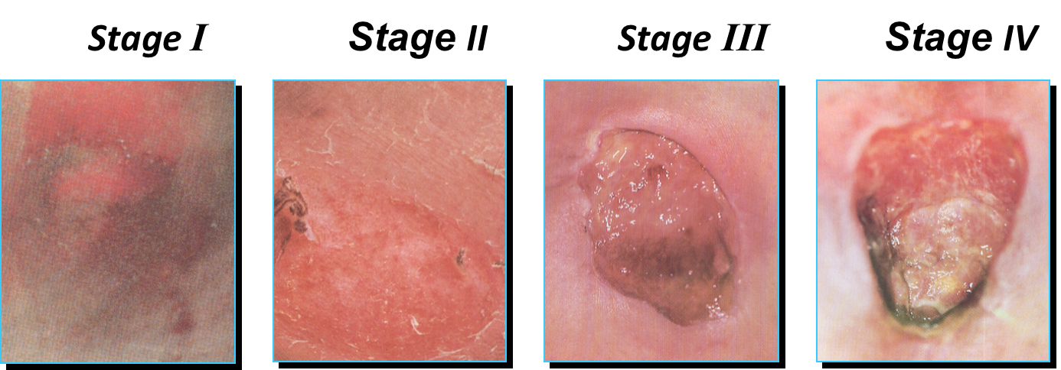
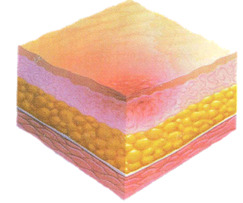
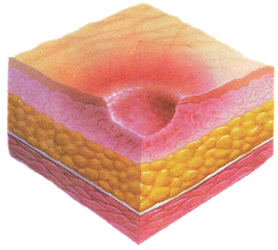
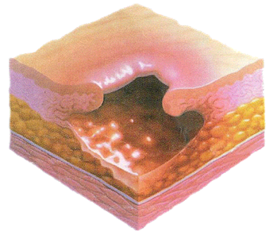
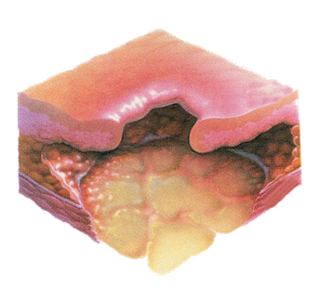
Pressure Sores A.K.A Bed Ulcers:
develops if the patient doesn’t move while sleeping for 2 hours (bed sore).
mainly involves the epidermis.
produces erythema, avoided by changing the position every 30 min.
Involves the epidermis and the upper dermis.
Involves the epidermis, dermis and upper fascia.
Involves the fascia and can reach to the muscle, tendons and bones and they usually develop osteomyelitis.
Stage 1 and 2 require non-medical intervention.

Slide 13
Summary
Recall
Q1: What inhibits wound healing?
Answer: Infection, ischemia, DM, malnutrition, anemia, steroids, cancer, radiation, and smoking.
Q2: How long a sutured wound epitheliazes?
Answer: 24 to 48 hours.
Q3: Define the following terms:
Primary Wound Closure:
Answer: Suture wound closed immediately (a.k.a “first intention”).
Secondary Wound Closure:
Answer: Wound is left open and heals over time without sutures (a.k.a “secondary intention”); it heals by granulation, contraction, and epithelialization over weeks (leaves a large scar).
Delayed Primary Closure
Answer: Suture wound closed 3-5 days AFTER incision (classically 5 days).
Q4: Define the following terms:
Clean Wound:
Answer: Elective, nontraumatic wound without acute inflammation; usually closed primarily.
Infection rate: <1.5%
Clean-contaminated Wound:
Answer: Operation on the GI or respiratory tract without unusual contamination or entry into the biliary or urinary tract. Infection rate: <3%
Contaminated Wound:
Answer: Acute inflammation, traumatic wound, GI tract spillage, or a major break in sterile technique.
Infection rate: ≈5%
Dirty Wound:
Answer: Presence of pus, perforated viscus, or dirty traumatic wound.
Infection rate: ≈33%
Wound healing:
Classification
By type | By timing | By abnormal healing
Primary Delayed primary Secondary Partial-thickness wound healing | Acute Chronic | Overgrowth -hypertrophic - keloid Undergrowth (chronic unstable wound) Contour abnormality)
1
1
1
2
2
3
4
2

Slide 14
Summary
Classification of Wound closure:
Primary
1st intention
Suture
Secondary
2nd intention
No suture
Tertiary
3rd intention
Suture after 3 days
Primary closure
Within hours
Mortality of minimal number of cellular constituent
wound left open to heal by processes ( granulation, contraction, epithelization )
delayed primary closure
Contaminated wounds
Phases of wound healing:
Haemostasis
5-20 mins
aim to stop bleeding
Inflammatory
1-4 d
Proliferative
3d-3wks
Remodeling
3wks-1y
-Vascular constriction -Platelet aggregation -Degranulation -Thrombus formation
-platelet stimulus to release: PDGF, TGF B, FGF
-Neutrophil infiltration -Monocyte infiltration and differentiation to macrophage -Lymphocyte infiltration
- Clinically represented by :Rubor, Tumour, Calour, Dolour
1- Re-Epithelization 2- Angiogenesis 3- Collagen Synthesis 4- ECM formation
Epithelial repair: mobilization, migration, mitosis, cellular differentiation
1- Collagen Remodeling (collagen type lll replaced by type l until ratio of 1:4)
2- vascular maturation and regression
Scars:
Ideal scars:
Abnormal scars:
01
02
flat narrow
Good color
Parallel to RSTL
Doesn’t restrict function
Asymptomatic
Mature 6-18m
Hypertrophic: Common in children, remain with in wound, subside, flexor surface, related to TENSION.
Keloid: Common in black, 10-30 yrs females, outgrow wound area; sternum, shoulder, face.
Wide: Traumatic wounds that are not closed properly

Slide 15
Doctor’s Quiz
MCQ
Q1: The following are the sequence of events and phases taking place in wound healing?
Remodelling, epithelization & contracture
Inflammatory, proliferative & remodeling
Vasoconstriction, epithelization & contracture
Proliferative, remodelling and wound synthesis
Q2: The major cell/s involved in the proliferative phase is/are:
PMN
Fibronectin
Fibroblast
Collagen
Q3: The difference between secondary & partial thickness healing is:
Contracture only in secondary healing
Contracture only in partial thickness healing
Epithelization only in secondary
Epithelization only in partial thickness healing
Q4: Perforated gastric ulcer or Perforated appendicitis is/are:
Clean
Clean-contaminated
Contaminated
infected
Q5: All of the following is/are characteristics of ideal scar except:
Painful
Flat
No restriction of movement
Adequate color
Q6: All of the following is characteristic of keloid:
Crosses border
Genetic predisposition
Common in earlobes/ chest in African
All of the above
Q7: Preventive measures of HTS is/are:
Adequate suture bite closure
Free tension closure
Non-strangulated sutures
Minimal undermining/ electrocautery
All of the above
Answers
Q1 | B | Q4 | C | Q7 | E
Q2 | C | Q5 | A
Q3 | A | Q6 | D

Slide 16
Quiz
MCQ
Q1: which one of the following will have most normal progression of wound healing after surgery?
A 35 obese female with hyper tention
A 73 years old male looking healthy
A 47 years old male with Diabetes
A 40 years old female with peptic ulcer
Q2:a 25 years old african female had an otoplasty a week ago( cosmetic ear surgery ), what is the complication of wound healing that is most probably she would get ?
hypertrophic wound
Hypertrophic wound
Keloid wound
Prolonged healing process
Q3:A 35-year-old woman undergoes an elective laparoscopic cholecystectomy for symptomatic cholelithiasis. Which of the following wound classes best describes her procedure?
Class I, Clean
Class II, Clean/contaminated
Class III, Contaminated
Class IV, Dirty
Q4: A 60-year-old diabetic man undergoes incision and drainage of an infected boil on his back. The wound is left open and packed daily. Week by week, the wound grows smaller and eventually heals. Which of the following terms describes the method of wound closure by the patient?
Primary intention
Secondary intention
Tertiary intention
Delayed primary closure
Delayed secondary closure
Q5: Which of the following statements about the process of wound healing are true?
The inflammatory phase begins 2–3 days after the injury.
The proliferative phase lasts from 3 days to 3 weeks following the injury.
The remodelling phase involves fibroblast activity and production of collagen and ground substance.
Q6: Which of the following statements are true?
Healing by primary intention results in minimum inflammation and the best scar.
Tertiary intention involves immediate closure of the wound.
A crushed and contaminated wound is best suited for healing by primary intention.
Primary repair of all structures should be attempted in an untidy wound
Answers
Q1 | D | Q4 | B
Q2 | C | Q5 | B
Q3 | B | Q6 | A
Extra Questions

Slide 17
Good Luck!
Team leaders:
Nouf Alshammari
Haneen Somily
Naif Alsulais
Mohammed Alshuwaier
This lecture was done by:
Alhanouf Alhaluli
Njoud almutairi
Renad Almutawae
Noura Alturki
Moath AlJehani
Razan Alrabah
Omar Alotaibi
Khalid Alkhani
Special thanks to Ibrahim Aldakhil
Feedback
Note taker
Reviewer

