Slide 1
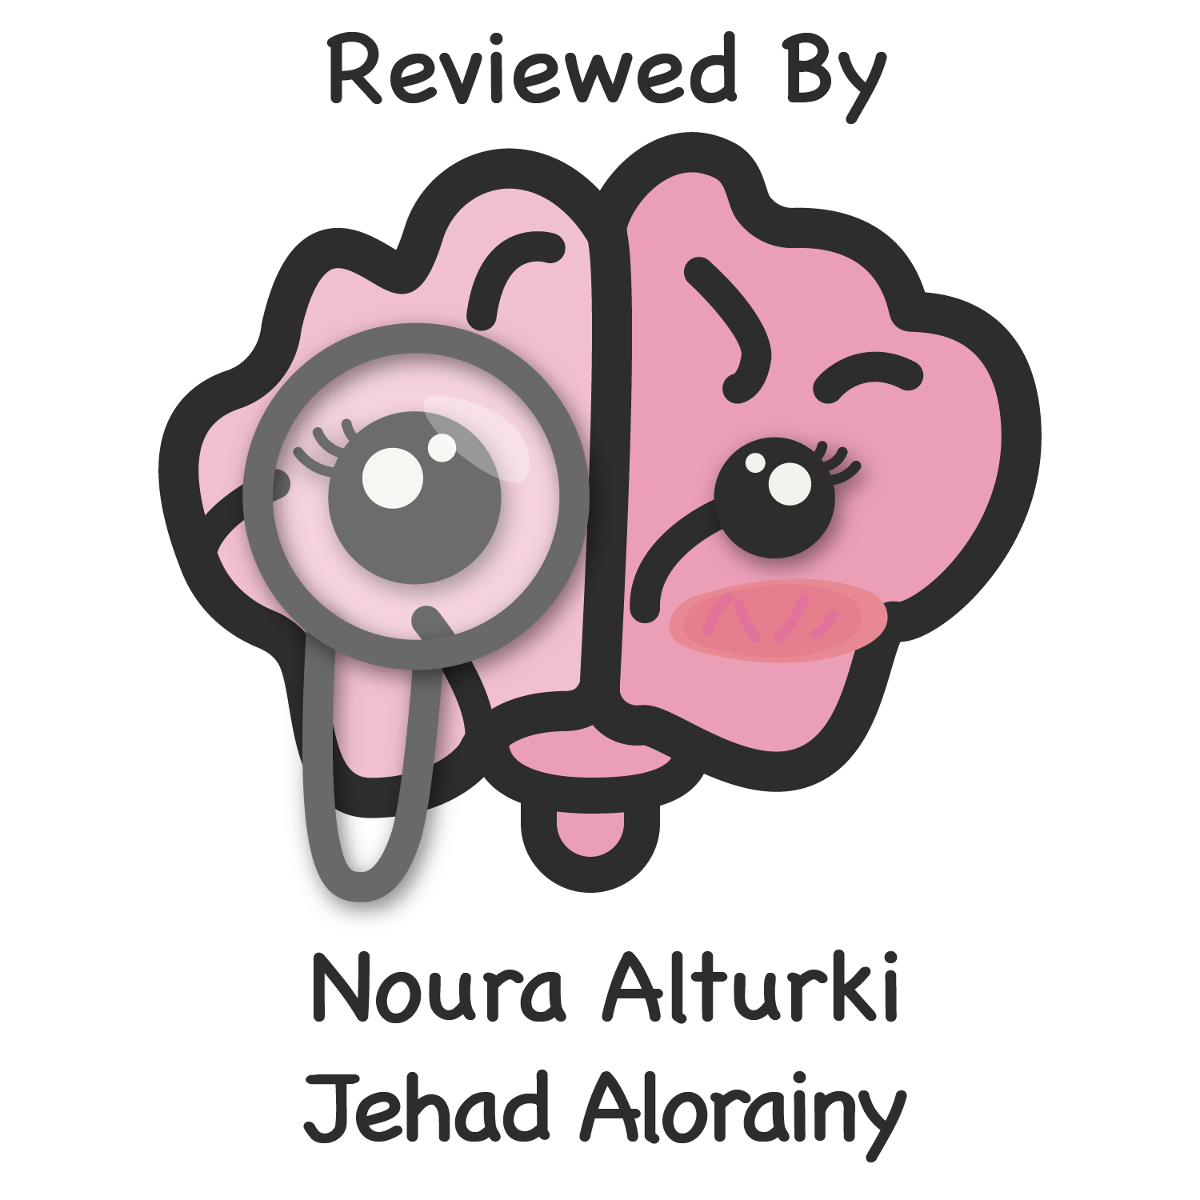
Metabolic Response To Injury
Objectives
Factors mediating the metabolic response.
Consequences of the metabolic response.
The differences between metabolic responses to starvation and trauma.
The effect of trauma on metabolic rate and substrate utilization.
Modifying the metabolic response
Colour Index
Main Text
Males slides
Females slides
Doctor notes
Textbook
Important
Golden notes
Extra
Editing File

Slide 2
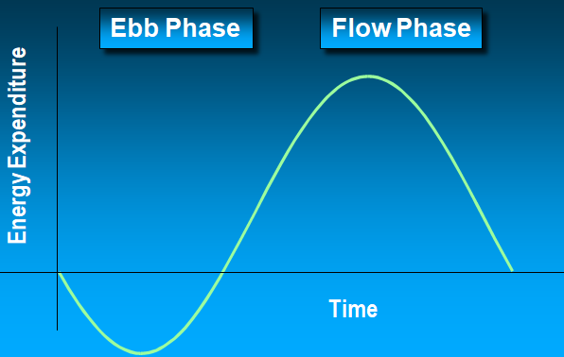
01
Mediating the Response:
Overview:
After injury eg: (surgery), aggressive local and systemic mechanisms takes place to return the body into the preinjury state. While these mechanisms are vital for survival in the wild, in the context of surgical injury they can be harmful.
With trauma patients and surgical patients we interfere by supplementing nutrients and blunting the body’s response to injury to avoid the consequences.
When the patient undergoes a period of starvation or trauma (including surgery) the metabolism of substrates and micronutrients gets affected.
Surgery is an injury but it is a “controlled injury” because they manage to control the body to response to it.
It is important to understand metabolic response to:
Blunt metabolic response in injury or surgery by interventions and medications.
Augment anabolic response, thus helping the body to heal with no permanent sequelae.
Features of The Metabolic Response to Injury:
The response to trauma follows an Ebb & Flow pattern. The ebb phase occurs immediately after trauma and lasts from 24-48 hours followed by the flow phase. After this, comes the anabolism phase and finally, the fatty-replacement phase
Ebb
Flow³
initially in the Ebb phase (first 48 hours of injury) energy expenditure goes way down to conserve energy¹.
Characterized by hypovolemic shock. (because of bleeding)
Priority is to maintain life/homeostasis by²:
↓Cardiac output
↓Oxygen consumption
↓Blood pressure
↓Tissue perfusion
↓Body temperature
↓Metabolic rate
sometimes if the injury is sustained (e.g. multiple surgeries, multiple infections) the patient will continue to be in the Ebb phase for an extended period of time before going to the ‘Flow Phase’.
Trauma causes major alterations in energy and protein metabolism.
when the body senses that the active insult is gone and it’s time to rebuild, the energy expenditure goes way up in the flow phase to rebuild what has been damaged. in this phase there’s rebuilding of muscle and fat. we need to detect this stage to supply the patient with enough nutrients and energy to support the rebuilding process, otherwise,patients will burn their energy sources leading to inability to re-heal and many other complications.
↑Catecholamines
↑Glucocorticoids
↑Glucagon
Release of cytokines, lipid mediators
Acute phase protein production
Our aim is to:
Blunt EBB phase as it will lead to further tissue damage
Supplement patients in Flow phase to assure healing and prevent complications
It helps in surviving but may lead to permanent tissue damage.
these changes are essential for survival however they come with consequences, for example the low cardiac output can cause an injury to the kidney. therefore it’s recommended to interfere in this phase so the body can emerge in a much better condition with minimal consequences.
divided into two parts:
A- initial Catabolic phase: lasts about a week, characterized by: 1-high metabolic rate 2-breakdown of protein and Fat 3-A net loss of nitrogen (negative nitrogen balance) 4-weight loss.
B- Anabolic phase: lasts for 2-4 weeks, protein and fat are stored, positive nitrogen balance and weight gain.
The sequence here is how the reference introduced the topic

Slide 3
01
Mediating the Response:
Factors mediating the metabolic response to injury:
The metabolic response is a complex interaction between many body systems:
The Acute Inflammatory Response
when you get injured or there’s a resection or incision.
Cellular activation (cells die releasing mediators).
Inflammatory mediators (TNF, IL1,IL2, IL3, IL4 and IL6, etc).
At the site of injury:
Macrophages releases¹:
IL-8 -> attracts more macrophages and neutrophils.
IL-1, IL-6, TNF alpha -> activate the macrophages and neutrophils.
Inflammatory substances (complement, prostaglandins and free radicals) are released
anti-inflammatory substances² (antioxidants, protease inhibitors and IL-10) are released
Paracrine vs endocrine effects (cortisol secretion, release of NE & Epinephrine, activation of renin-angiotensin system in addition to the activation of the autonomic nervous system).
The Endothelium
Inflammatory markers which play a role in chemotaxis: Selectins, Integrins and ICAMs.
Nitric Oxide (Causes vasodilation and accumulation of WBC’s and promote healing).
Tissue Factor (Activate the extrinsic coagulation pathway and limits the bleeding).³
Vasodilation might cause edema due to protein leak
Although these cytokines act locally, they can cause systemic effects, Eg: IL-1 causes fever.
The clinical condition of the patient depend upon the balance between inflammatory and anti-inflammatory substances.
If the inflammatory response become generalized, there is a risk of disseminated intravascular coagulation (DIC).
Factors mediating the metabolic response.

Slide 4
Mediating the Response:
Afferent nerve stimulation¹
when the nerve is injured or stimulated by circulating mediators
Impulses from afferent nerve fibers reaches the thalamus and causes:
sympathetic nervous system activation and hormones from adrenal medulla:
increase heart rate and cardiac output.
changes in carbohydrates, fat and protein metabolism.
stimulation of other pituitary hormones.
The Endocrine system
Changes in the endocrine system (direct stimulation or by feedback) aims to:
mediate the initial response.
maintain body fluids.
conserve energy in the beginning, and direct it where it’s needed and return substrate metabolism to normal
more stress hormones, less anabolic hormones:
Pituitary gland:
Adrenal:
Pancreas:
Other:
01
02
03
04
GH
ACTH
ADP (ADH)
Cortisol:
to generate energy which
is required in healing
and repairing process.
Aldosterone:
to conserve water and sodium as the body feels that there’s hemorrhage somewhere.
Glucagon
↓Insulin:
to conserve energy by decreasing the metabolic rate
Renin
Angiotensin
↓Sex hormones
↓T4:
to conserve energy by
decreasing the
metabolic rate.
Epidural or spinal Anesthesia is given to blunt afferent nerve stimulation
Factors mediating the metabolic response.

Slide 5
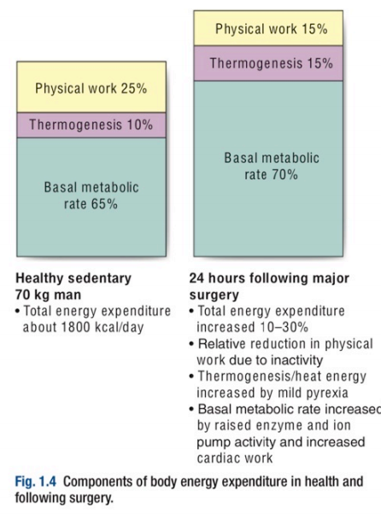
Consequences of the Response:
Limiting injury
Initiation of repair processes
Mobilization of substrates (that’s why glucagon secretion increases and insulin decreases).
Prevention of infection, penetration to the skin increases the risk for infections, that’s why WBC count increases after surgery and trauma.
Distant organ damage e.g. damage to the kidney and the gut when the blood is being shunted to the area of the injury.
1
Hypovolemia:
Reduced circulating volume often characterises moderate to severe injury, and can occur for a number of reasons:
loss of blood (hemorrhage).
loss of electrolyte containing water (vomiting, diarrhea and sweating).
loss of water ( prolonged exposure of viscera during surgery).
loss of protein rich fluid into the interstitial space(increased capillary permeability).
The neuroendocrine response attempt to control hypovolemia by:
Fluids conserving measures (ADH and Aldosterone).
blood flow conserving measures by increasing HR, CO and vasoconstriction (sympathetic activation)
2
Increased energy metabolism and substrate cycling:
although physical activity decreases after surgery, overall energy expenditure rises up to 50% due to:
Increased thermogenesis (mild pyrexia).
BMR increases by 10% for each 1C°
Increased Basal Metabolic Rate BMR.
Consequences of the metabolic response.

Slide 6
Consequences of the Response:
3
Catabolism and Starvation:
Following surgery, Catabolism is mediated by catecholamines, proinflammatory cytokines and hormones
It will affect the metabolism of:
01
02
03
Carbohydrate
Fat
Protein
increase blood glucose (hyperglycemia³) which is caused by:
glycogenolysis by ( glucagon and catecholamines).
gluconeogenesis by (cortisol).
Insulin resistance.
Breakdown of triglycerides into glycerol and FFAs by:
catecholamines.
cortisol.
glucagon.
Breakdown of skeletal muscles (loss of muscle mass) into amino acids to be used for:
gluconeogenesis.
the production of acute phase proteins eg: ( C-reactive protein, alpha1 Antitrypsin)
Starvation is caused by:
Fasting prior to surgery¹.
loss of appetite after surgery.
Fasting after surgery (if the surgery involves the gastrointestinal tract).
Reduced nutritional intake because of the illness requiring treatment
Acute starvation phase
VS
Chronic starvation phase²
Characterized by:
glycogenolysis and gluconeogenesis.
Lipolysis and FFAs release.
Lipolysis and FFAs release.
Ketones production and use for energy in the brain (conserving muscles).
Reduction in energy expenditure (compensated starvation).
Important to empty the stomach so when we give anesthesia food won’t regurgitate to the lungs, but we should let him drink fluids to minimize the starvation and catabolic effect during surgery.
If fat stores are depleted, and the individual is close to death → muscles are used as final energy source.
Severe hyperglycemia may increase morbidity and mortality in surgical patients and glucose levels should be controlled in the perioperative setting.
Consequences of the metabolic response.

Slide 7
Consequences of the Response:
4
Changes in Red Blood Cell synthesis and coagulation:
Anemia is common after major surgery or trauma because of bleeding.
Blood transfusion to correct anemia is not required unless hemoglobin concentration is below 80 g/L.
After tissue injury, blood becomes hypercoagulable because of:
Activation of coagulation cascade following endothelial injury.
Platelet activation by mediations eg: (cytokines).
Venous stasis due to hypovolemia and immobility.
increased concentrations of circulating procoagulant factors (e.g. fibrinogen)
Decreased concentrations of circulating anticoagulants (e.g. Protein C)
5
Anabolism:
Involves re-gaining weight, skeletal muscle mass and fat stores.
Occurs after the inflammatory mediators are no longer produced.
Adequate nutritional support and early mobilization also appear to be important in promoting enhanced recovery after surgery (ERAS).
Hormones contributing to anabolism are:
01
02
03
04
Insulin
Growth Hormone
Androgens
Insulin like growth factor.
Consequences of the metabolic response.

Slide 8
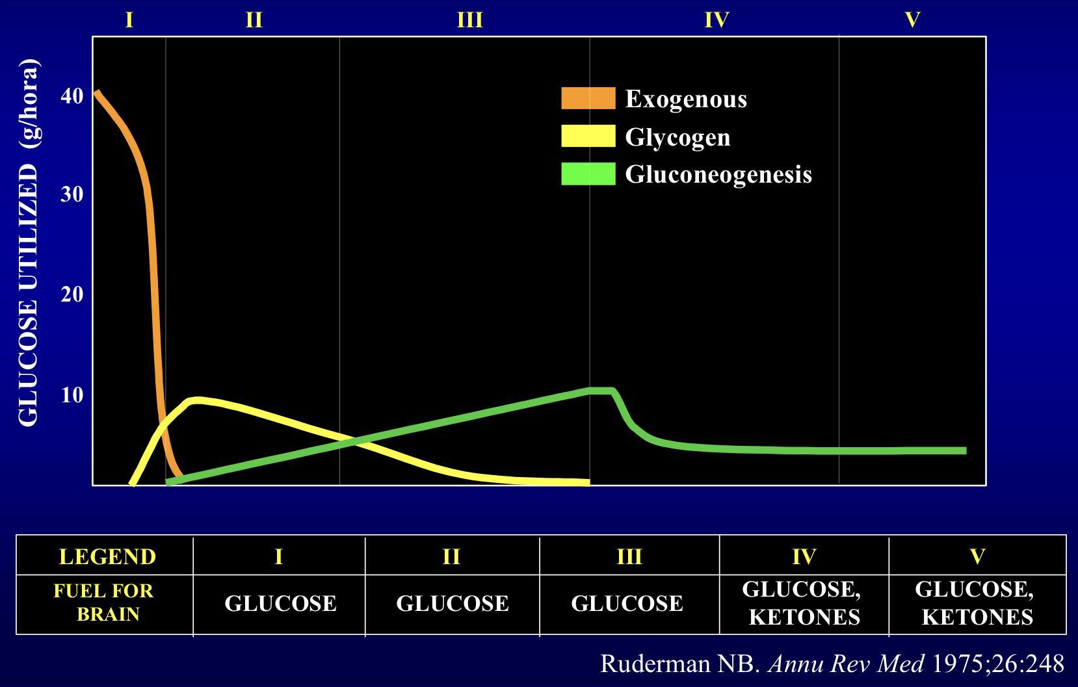
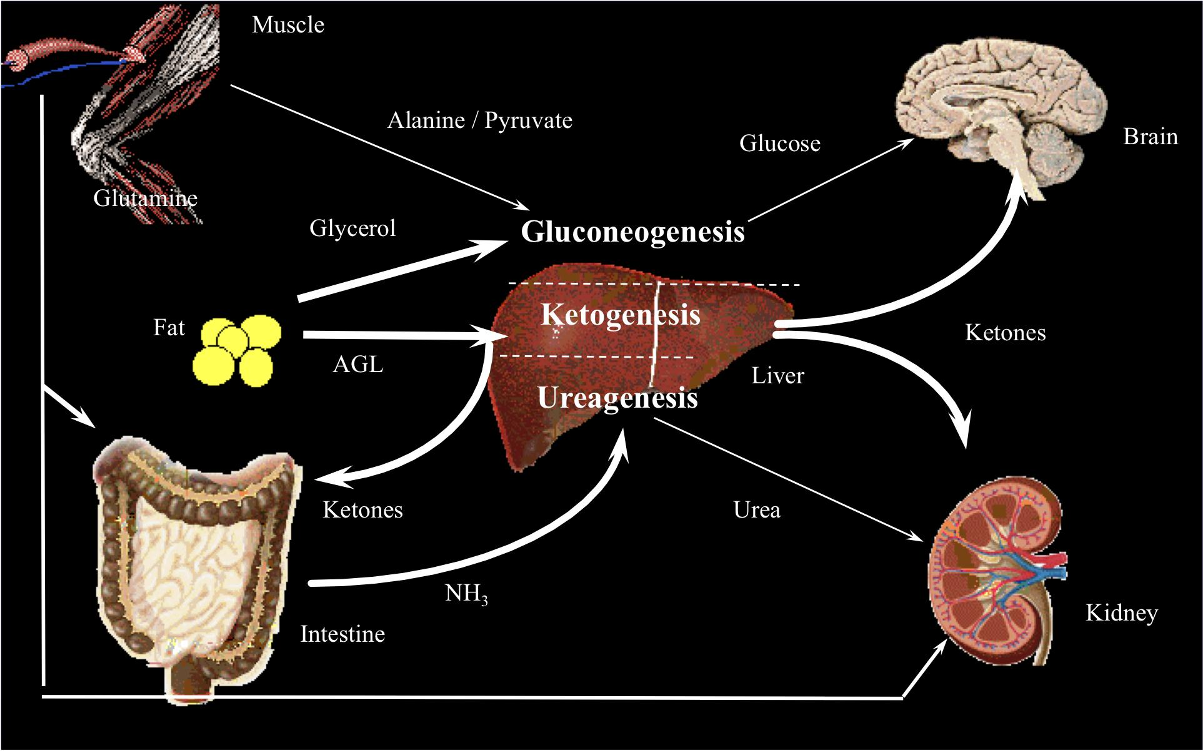
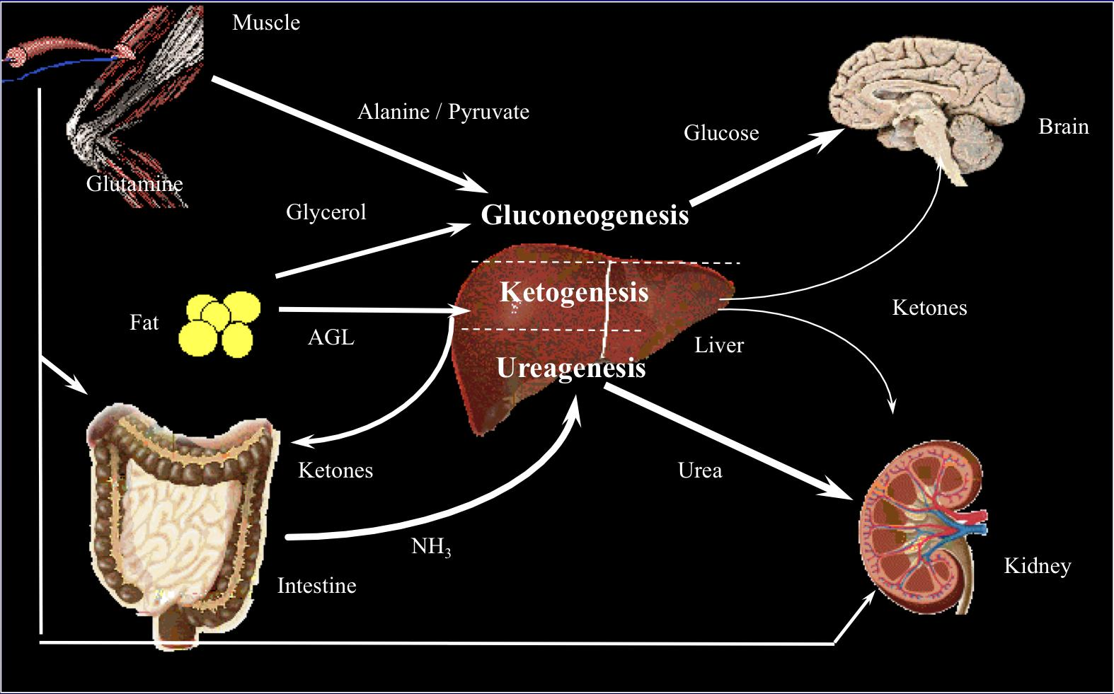
Metabolic Response to Fasting:
Starvation & Injury
Metabolic Response to Fasting:
the body’s response to starvation is different from its response to injury.
when you’re fasting your glucose utilization goes down.
after 40 days of starvation the body starts using ketones for energy.
we need to keep the patient in stage 1 by supplementing the patient with enough nutrients.
Initially in stage 1 the exogenous glucose is the main fuel for the brain.
In stage 2 and 3 the glucose falls and the brain needs to rely on another source for energy. Glucagon will be secreted to breakdown Glycogen.
In stage 4 the glycogen store gets depleted and gluconeogenesis takes over. muscle breakdown increases to release amino acids (which are needed for gluconeogenesis) that’s why this stage needs to be avoided. (in stage 4 and 5 there’s not much glucose left and the brain starts to suffer).
Starvation:
the body’s response to starvation is different from its response to injury.
Metabolic rate decreases significantly in comparison with fasting.
more urea is going to the kidney.
ketones can be used everywhere EXCEPT the brain. The brain needs to rely on glucose for an extended period of time.
Early Stage
Late Stage
There’s breakdown of fat and muscle (muscles are more accessible than fat).
Muscle wasting is an indicator to initiate rehabilitation as its difficult to regain muscle fibers again unlike fat.
after 40 days the body relies on ketone
The differences between metabolic responses to starvation and trauma.

Slide 9
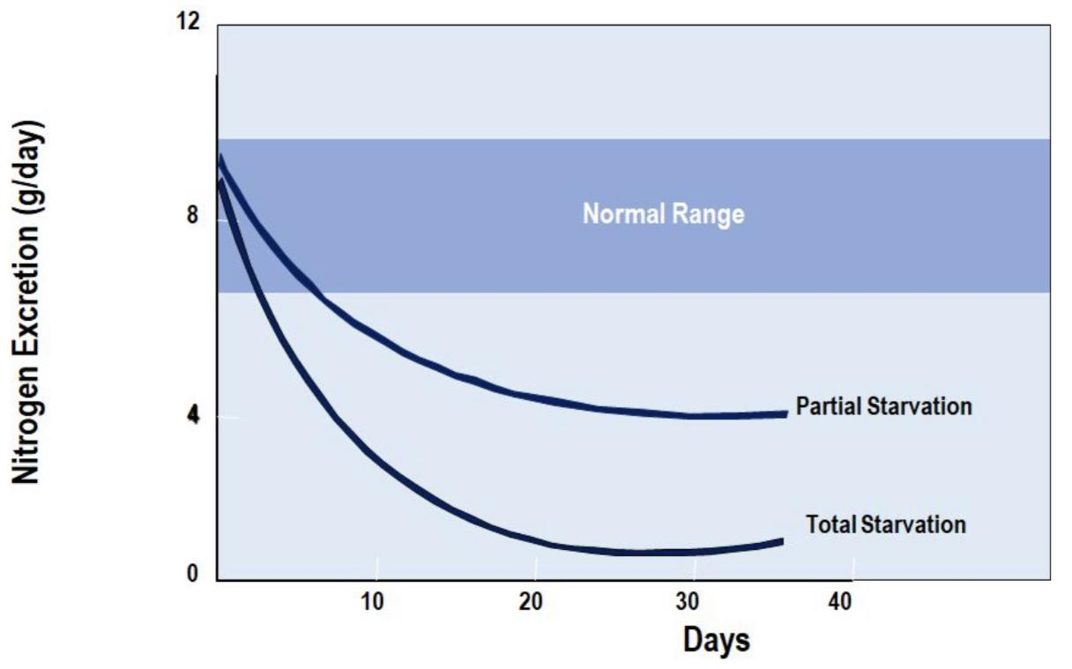
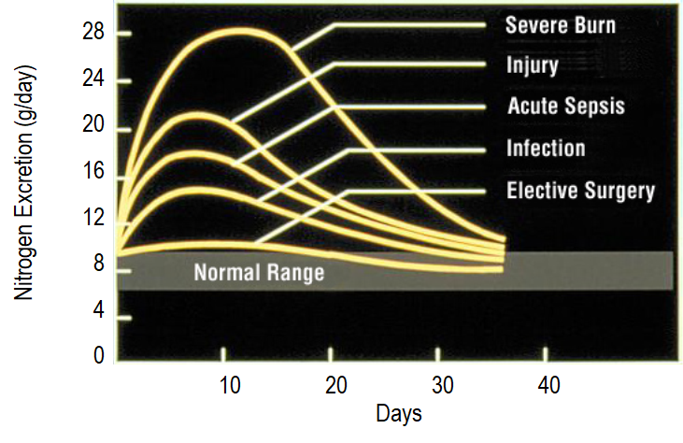
Metabolic Response to Fasting:
Starvation & Injury
Metabolic Response to Starvation:
Initially NE from sympathetic nervous system goes down significantly, however NE secretion from the adrenal gland goes up.
Thyroid hormones goes down to conserve energy.
Hormone | Source | Change in Secretion
Norepinephrine | Sympathetic Nervous System | ↓↓↓
Norepinephrine | Adrenal Gland¹ | ↑
Epinephrine | Adrenal Gland¹ | ↑
Thyroid Hormone T4 | Thyroid Gland (changes to T3 peripherally) | ↓↓↓
Energy Expenditure in Starvation:
in starvation mode, energy expenditure goes down and it reaches a plateau after a month.
An example of partial starvation: a patient who develops post surgical complications that would last for days to weeks making him unable to eat.
Nitrogen excretion is an indicator of catabolic rate and how much muscle was wasted.
This graph illustrates nitrogen losses in relation to trauma. With respect to protein, the greater the trauma, the greater the effect on the nitrogen balance. Similar to metabolic rate, patients experience nitrogen losses according to the severity and duration of the trauma.
The normal range is indicated by the shaded area. The amount of protein requirement relative to calories increases in patients with metabolic stress.
The worse the injury is, the worse the catabolic state. For example, burn victims need immediate fluid treatment and monitoring of nitrogen balance otherwise they fail to heal and they enter the catabolic state.
In elective surgery the response is blunted (with proper Anesthesia, enough nutrition and hydration with clear liquids) to avoid unnecessary tissue injuries and minimize the harm.
Adrenal NE and EP are considered as “stress hormones”, There level rises in starvation to increase the mobilization of fuel sources
The differences between metabolic responses to starvation and trauma.

Slide 10
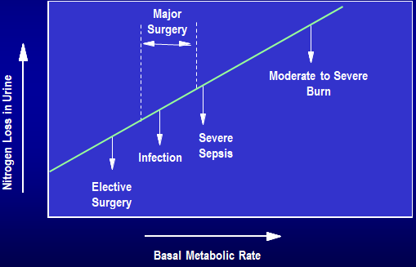
Starvation & Injury
Energy Expenditure in Starvation:
the amount of nitrogen the patient loses in the urine is an indicator of how bad the injury is and how aggressive the patient’s response is
Comparing Starvation & Injury:
The body adapts to starvation, but not in the presence of critical injury or disease.
 | Starvation | Trauma or Disease
Metabolic Rate | ↓ | ↑↑¹
Body Fuels | Conserved | Wasted²
Body Proteins | Conserved | Wasted²
Urinary Nitrogen | ↓ | ↑↑
Weight Loss | Slow | Rapid
The metabolic response to starvation can be contrasted to trauma or disease:
Metabolic rate drops during starvation, while in trauma patients it rises in proportion to the trauma severity³.
Body fuels and body proteins are conserved during starvation⁴, but are wasted during trauma.
Urinary nitrogen values fall with inadequate protein and calorie intake, but increase in response to metabolic stress.
Weight loss is slow in underfed patients but rapid in trauma patients.
Changes in body composition with trauma usually occur two to three times faster than during starvation.
Initially in the Ebb phase it decreases but later on as the patient enters the flow phase the metabolic rate increases.
first the body will try to conserve them but after 48 hours they get used immediately for repair and healing. Specially muscles as they’re easy to break but difficult to rebuild
to achieve better outcomes after a surgery or a trauma we have to blunt the Ebb phase (to avoid hypovolemic shock, hypotension, and reduced tissue perfusion by giving the patient enough blood, stopping the bleeding and supplying the patient with enough oxygen) and support the flow phase by giving them extra nutrition
if the starvation is persistent they get wasted.
The differences between metabolic responses to starvation and trauma.

Slide 11
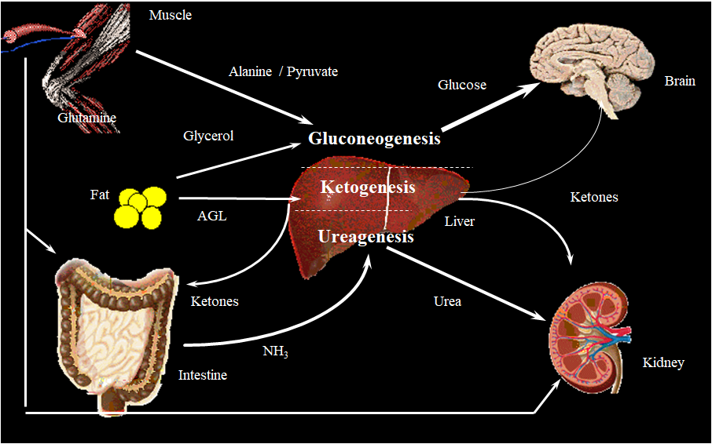
The effect of Injury
Metabolic Changes after Injury:
Fatty Deposits
Liver & Muscle (glycogen)
Muscle (amino acids)
Fatty Acids
Endocrine Response
Glucose
Amino Acids
Endocrine response in the form of increased catecholamines, glucocorticoids and glycogen, leads to mobilization of tissue energy reserves. These calorie sources include fatty acids and glycerol from lipid reserves, glucose from hepatic glycogen (muscle glycogen can only provide glucose for the involved muscle) and gluconeogenic precursors (eg, amino acids) from muscle.
The response to trauma includes a breakdown of muscle tissue. This mechanism provides amino acids for gluconeogenesis and for synthesis of proteins involved in immunologic response and tissue repair. However, this process can lead to a loss of body mass, most notably body protein.
Prolonged metabolic stress without provision of adequate calories and protein leads to impaired body functions and ultimately malnutrition.
Modifying the Response:
Medication (Before or after injury)
Nutritional status
Temperature
Anesthetic technique
Severity of injury
It's an absolute requirement that the patient be in a well nutritional status before any elective surgery, otherwise supplements are needed
Prevent hypothermia to increase metabolic rate
To blunt inflammatory response and the sympathetic system
Perform minimally invasive surgeries.
The effect of trauma on metabolic rate and substrate utilization.
Modifying the metabolic response.

Slide 12
The doctor’s summary
Injury (Trauma or Surgery) leads to a metabolic response.
Metabolic response to injury is an adaptive response.
Metabolic response could overwhelm the body and lead to increased morbidity and mortality.
We can modify the metabolic response before and sometimes after injury.
The body responds differently to starvation and trauma. Starvation is associated with a decreased metabolic rate, which allows the body to adapt to reduced intake. After trauma, metabolic changes are associated with increased nutritional requirements. If nutritional requirements are not met during trauma, loss of protein and body mass can produce significant impairment.
Metabolism of substrates and micronutrients is altered by starvation and trauma. During periods of starvation, metabolic processes slow down to conserve energy and adapt to calorie deprivation. After trauma, the body’s hormonal situation changes, increasing the demand for energy, proteins, and micronutrients. If nutritional requirements are not recognized and met during starvation or trauma, there may be a loss of body mass, body protein, and impairment or loss of body functions.
Summary
Our aim is to blunt EBB phase as it will lead to further tissue damage and supplement patients in Flow phase to assure healing and prevent complications
Ebb phase
VS
Flow phase
↓Cardiac output ↓Oxygen consumption
↓Blood pressure ↓Tissue perfusion
↓Body temperature ↓Metabolic rate
↑Catecholamines
↑Glucocorticoids
↑Glucagon
Release of cytokines, lipid mediators
Acute phase protein production
 | Response
Acute Inflammatory Response | Cellular activation. Inflammatory mediators (TNF, IL1,IL2, IL3, IL4 and IL6). Paracrine vs endocrine effects.
Endothelium | Selectins, Integrins and ICAMs. Nitric Oxide > vasodilation > edema. Tissue Factor > coagulation > DIC.
Afferent nerve stimulation | Sympathetic nervous system activation. Release of hormones from adrenal medulla. Stimulation of other pituitary hormones.
Endocrine system | More stress hormones, less anabolic hormones: Pituitary gland: GH, ACTH and ADH. Adrenal: cortisol, aldosterone. Pancreas : glucagon,↓Insulin. Other: renin, angiotensssion,↓sex hormone,↓T4.

Slide 13
Summary
The metabolic response limits the injury and initiate the repair process by mobilizing substrates. Help in preventing the infections but could cause distance organ damage.
More consequences:
Hypovolemia
loss of blood, electrolyte, water and protein rich fluid
Anabolism
01
Energy
Regaining weight, muscle mass and fat stores.
Increase in anabolic hormones.
05
02
overall energy expenditure rises up to 50%
04
03
RBC synthesis
Catabolism and starvation
Anemia and hypercoagulability
 | Starvation | Trauma or Disease
Metabolic Rate | ↓ | ↑↑
Body Fuels | Conserved | Wasted
Body Proteins | Conserved | Wasted
Urinary Nitrogen | ↓ | ↑↑
Weight Loss | Slow | Rapid
Modifying the metabolic response done through:
Nutritional status
Temperature
Medication (Before or after injury)
Severity of injury
Anesthetic technique

Slide 14
Quiz
MCQ
Q1: A 30 year old man had a successful cholecystectomy, which of the following hormones do you expect to increase in his case?
Insulin
Thyroid hormones
Cortisol
Q2: What is the main physiological role of the ebb phase?
Conserving energy stores
Increasing metabolic rate
Replacement of lost tissue
Q3: which of the following techniques is preferred to avoid postoperative hypertension?
Spinal anesthesia
Fluid resuscitation
Nutritional support
Q4: The flow phase is characterized by?
Increased insulin secretion
Increased glucagon secretion
Decreased catecholamines secretion
Q5: What happens to the overall energy expenditure right after surgery?
Increases
Decreases
Remains unchanged
Q6: Urinary nitrogen in trauma or disease is?
Low
High
Unchanged
Answers
Q1 | C | Q4 | B
Q2 | A | Q5 | A
Q3 | A | Q6 | B
Extra Questions

Slide 15
Good Luck!
Team leaders:
Nouf Alshammari
Haneen Somily
Naif Alsulais
Mohammed Alshuwaier
This lecture was done by:
Maha Alnahdi
Abdulrahman M. Bedaiwi
Khaled Al-harbi
Badr Al-Qarni
Nouf Alshammari
Hashem Bassam
Feedback
Note taker
Reviewer

