Slide 1
Academic logo
Transfusion Medicine & Therapy
Objectives
Describe the blood donation
Discuss the blood components
Discuss the plasma products
Discuss the red cell serology
Identify the pre-transfusion testing
Recognize the indications for transfusion
Discuss the blood administration
Identify the adverse effects of transfusion
Describe the autologous transfusion
Recognize the methods to reduce the need for blood transfusion
Colour Index
Main Text
Males slides
Females slides
Doctor notes
Textbook
Important
Golden notes
Extra
Editing File

Slide 2
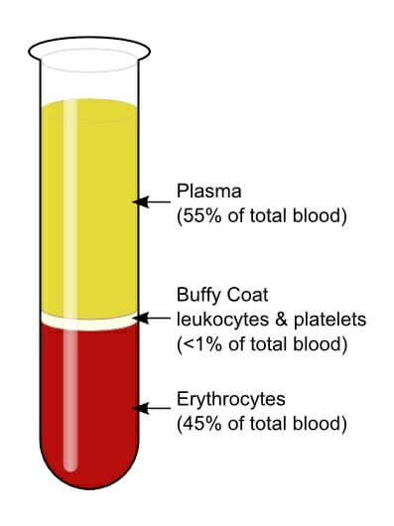
Blood Donation & Components
A nice short video, that we recommend watching
The standard donation contains approximately 200 mg of iron, the loss of which is easily tolerated by healthy donors.
Blood components (red cells, platelets and plasma) can be separated from the donated blood by the use of a cell separator, in a process called apheresis.
All donations are ABO-grouped, Rhesus (Rh) D-typed, antibody-screened, and tested for evidence of infections.
Because of concerns regarding transmission of variant Creutzfeldt–Jakob disease (vCJD) by transfusion: people who have received a blood or blood product transfusion in the UK after 1980 have been excluded from donating blood. Some countries currently exclude donations from individuals who resided in the UK during the time of the bovine spongiform encephalitis (BSE).
The blood is separated into components immediately, as the ”Whole blood” is not as economical as component therapy.
Blood Component:
02
04
01
03
cryoprecipitate
Platelets
Red blood cells in additive solution – Packed RBCs (PRBC)
Fresh Frozen Plasma
(FFP)

Slide 3
1- Red blood cells in additive solution – Packed RBCs (PRBC):
01
PRBCs are given to improve oxygen delivery to tissues at the microvascular level.
The Blood run through leucodepletion filter to reduce the white cells to a very low concentration. The final product has a haematocrit of 55–65% and a volume of approximately 300 mL.
02
The blood cannot be sterilized, should be ABO- & RhD compatible & should be stored at +4°C/+-2°C
Remain for 35 days.
03
in an average adult, 1 U (300ml) of PRBCs increases the Hgb by about 1 g/dL or the hematocrit by about 3%.
PRBCs Dilute only with normal saline only.
04
Lactated ringer’s solution can lead to clotting due to added calcium, and hemolysis may result with a hypotonic solution.
05
Most transfusions are given over 60 to 90 minutes (not longer than 4 hours) due to loss of storing capacity in cold atmosphere and increasing the risk of infections.
Unused blood should be returned promptly to the blood bank (any units unrefrigerated for 30 minutes are discarded).
American Society of Anesthesiologists:
01
02
03
rarely needed with a Hgb concentration >10 g/dL corrected with fluids and lights.
Always needed when the Hgb is <6 g/dL.
Patients with a Hgb between 6 and 10 mg/dL require careful clinical judgment.
Judgment is based mainly on patient status.
E.g: We may consider withholding transfusion for healthy asymptomatic individual with Hb<6. while Ischemic Heart disease patients ” as they’re more intolerant of anemia” needs special judgment <10 g/dl is the cut of point for transfusion.

Slide 4
2- Platelets:
Cannot be refrigerated “susceptible to infections”
should receive Rh-negative platelets .( may cause Rh sensitization).
Stored at 22°C & Remain for 5 days only.
In adults the traditional dose has been 4 to 6 U (a “six pack”of platelets) (=4-6 separate donations pooled together), is Rh compatible (may contain some RBCs & plasma),
In children it is 1 U/10 kg body weight.
Indicated in cases like thrombocytopenia.
3- Fresh Frozen Plasma (FFP)¹:
A unit of FFP typically has a volume of 200 to 250mL, is ABO compatible, and is given through blood tubing within 2 to 6 hours of thawing³.
Stored at -30°C & Remain for 3 years.
Indicated in multiple coagulation factor deficiencies, can be used in blood loss cases if needed.
Plasma products²:
01
02
03
04
Albumin
Prothrombin
Complex
concentrates
Factor VIII
& factor IX
concentrates
Immunoglobulins
Preparations
(90% IgG)
pasteurised at 60°C for 10 hours. There are no compatibility requirements.
Indicated in hypoproteinemia & burns
widely used in the treatment of haemophilia⁴.
contain factors II, IX and X, and may also contain factor VII⁵ Indicated in prophylaxis & treatment of bleeding
Prepared from from individuals known to have high levels of specific antibodies⁶.
Plasma is currently used by dermatologists for hair loss.
The plasma products haven’t mentioned in the slides, but they are one of our objectives !
I –myself- think you don’t need to memorize all these details, but at least you have to know the “products”
defrosting using a hot water bath
But It have almost completely been replaced by recombinant products to reduce (Because they carry risk of vCJD transmission).
vitamin K-dependent clotting factor
Indicated in hyperimmune globulin against hepatitis B, herpes zoster, tetanus and RhD.

Slide 5
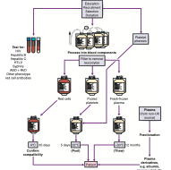
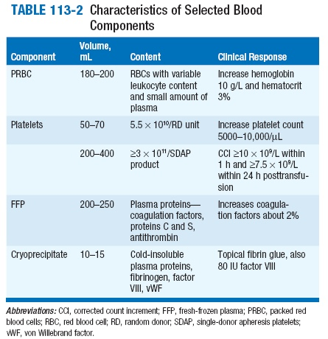
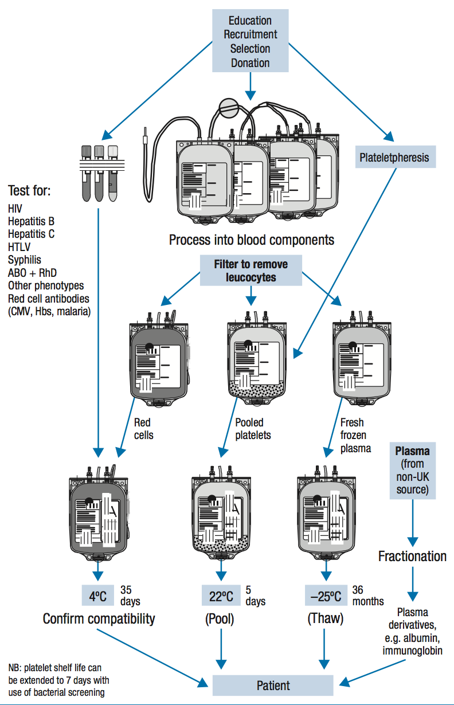
4- Cryoprecipitate:
Removed from FFP, Stored at -30°C & Remain for 3 years.
Cryoprecipitate is a source of fibrinogen, factor VIII, and von Willebrand factor (vWF). It is ideal for supplying fibrinogen to the volume-sensitive patient.
Used when factor VIII concentrates are not available,
Cryoprecipitate may also supply vWF to patients with dysfunctional (type II) or absent (type III) von Willebrand disease and in DIC to replace the depleted fibrinogen.
Brief summary:
Red blood cells | Fresh Frozen plasma | Concentrate of platelets² | cryoprecipitate
To increase the amount of red blood cells after trauma or surgery or to treat severe anemia. | To correct deficiency in coagulation factors or to treat shock due to plasma loss from burns or massive bleeding | To treat or prevent bleeding due to low platelet levels. To correct platelet problems. | To treat fibrinogen deficiencies
STORAGE PERIOD
42 days in the refrigerator or 10 years in the freezer¹ | 1 year in the freezer | 5 days at room temperature | 1 year in the freezer
If the blood melted after refrigerating, it couldn’t be refrigerated again = should be disposed
Centrifugation of whole blood = random donor platelets [RDP]. Apheresis = single donor platelets [SDP].
Usually after 5-6 units of PRBC, FFP is transfused for the coagulation factors.

Slide 6
Blood Transfusion
Blood Banking (Blood Collection):
Blood centres are processing more than 90% of the units collected.
Traditional allogeneic (human to human) donation methods still predominate, but increasing use is being made of red cell apheresis technology; it’s a method by which red cells are separated from the blood at the time of collection, with the rest returned to circulation.
Anticoagulants in Blood:
CPDA-1
SAGM
Additive
Prevents coagulation & prolong RBC half life Up to 35 days¹ and haematocrit of 70 to 80%.
Citrate²
Phosphate
Dextrose³
Adenine
a solution of saline, adenine, glucose and mannitol (SAGM) is added to provide optimal red cell preservation.
Adsol, Nutricel, Optisol are additive solutions which: Provide additional nutrients → extending maximum storage to 42 days for RBCs.
↓ Viscosity → which makes infusion easier.
Storage of Blood:
Refrigerated at 1 to 6°C (usually 4°C ideally).
Storage impairs red cells function
Transfused blood delivers oxygen to the tissues less efficiently.
Cell metabolism continues and changes occur → (↓in pH and↓in the levels of 2,3-DPG⁴).
The deformability of RBCs makes them, over time, more spherical and rigid → increasing resistance to capillary flow.
Cell leakage of Potassium (≈ 6 mEq/U). = Hyperkalemia
Platelets are stored by agitation, platelets have to stay moving, if we stopped that they will clot.
Which means it keeps at least 70% of RBCs viable at the end of 35 days, thus the fresher the blood, the better oxygen carrying capacity.
Anticoagulant.
As nutrition for blood cells to keep their ability to carry oxygen for long.
2,3 DPG important for O2 delivery and shifting the oxygen dissociation curve to the right, thus prolonged storage of blood lead to acidosis and decrease the oxygen delivery.

Slide 7
Red Cell Serology & Pre-transfusion Testing
Pre-transfusion testing consists of three steps:
01
Identified Red Blood Cell
(RBC) Antigens¹:
02
ABO antigens.
Related carbohydrate
antigens (H , P , I , and Lewis).
The 48 Rh system antigens.
More than 200 non-ABO/Rh antigens.
ABO grouping
+RhD typing.
Antibody screen;
about 2% of population have antibodies targeted against RBCs that are non(ABO/Rh) antibodies.
Cross-Matching.
ABO Grouping:
 | A+ | A- | B+ | B- | AB+² | AB- | O+ | O-³
Abs in Plasma | Anti-B |  | Anti-A |  | None |  | Anti-B & Anti-A
Antigens in RBC | A antigen |  | B antigen |  | A & B antigens |  | None
Can donate to | A+ & AB+ | A-, AB-, A+ & AB+ | B+ & AB+ | B-, AB-, B+, & AB+ | AB+ | AB-, & AB+ | O+, A+, B+, & AB+ | All blood types
Can receive | A+, A-, O+, & O- | A- & O- | B+, B-, O+, & O- | B-, & O- | All blood types | AB-, A-, B-, & O- | O+ & O- | O-
Percentage | the second most common(1 in 3 = 34%) | isn’t very common (1 in 16 = 6.3%) | 1 in 12 = 8.5% | 1 in 67 = 1.5% | 1 in 29 = 3.5% | 1 in 167 = 1% | the most common (1 in 3 = 39%) | 1 in 15 = 6.6%
The antigens are found on the RBCs surface
Universal recipient (has no antibodies)
Universal donor (han no antigens)
Rhesus (Rh) factor is an inherited protein found on the surface of red blood cells.
Present Antigen→ Rh positive
Absent Antigen →Rh negative
Rh positive can receive from both Rh+ve and -ve. However, Rh-ve only receive -ve.

Slide 8
Blood Typing:
Blood specimen from the patient is sent for the following tests: ABO grouping, Rh typing,
and an antibody screen,for unexpected (non-ABO/Rh) antibodies.
ABO grouping requires that the recipient’s red cells be tested with anti-A and anti-B serum, and that their serum be tested with A and B red cells.
Those with type AB blood form no ABO group antibodies → (universal recipient).
Those with type O have antibodies against both → (universal donor).
01
02
03
Forward typing
determines the ABO and Rh phenotype of the recipient’s RBC by using antiserum directed against the A,B,andD antigens.
Detect ABO Antigens on the cells by directing antibodies against them¹.
Reverse typing
Rh typing
detects isoagglutinins in the patient’s serum and should correlate with the ABO phenotype,or forwardtype.
Opposite to forward, detect the antibodies in the serum by adding cells express opposite antigens. E.g : if the patient blood type is A, then we mix it with another sample typed B. if agglutination occurred, then the type A confirmed.
Can usually be determined by adding a commercial reagent (anti-D) to recipient RBCs.
Type and Screen:
The type and screen allows quicker selection of appropriate banked blood for complete crossmatch if a transfusion is ordered.
When a blood transfusion is ordered, a formal crossmatch is done by mixing recipient serum with donor RBCs as a final compatibility test prior to transfusion.
Cross-matching
This can be done using a Coombs test (with serum incubated to 37° C) takes around 45 min- 1 hour, or the more rapid “Immediate spin crossmatch” at room temperature, which will detect only ABO incompatibility in case of emergencies.
Thorough Coombs test can detect incompatibilities that were missed with the antibody screen.
if we said “that patient blood type is B”, then we mean the forward typing. Reverse typing used only to confirm Forward typing.
We use screening & cross-matching to choose the “optimal” blood, if there’s an emergency we can give blood depending on ABO typing only.

Slide 9
Transfusion Indications
Oxygen Delivery:
Oxygen Delivery (DO₂)¹ is the oxygen that is delivered to the tissues.
Therefore: DO₂ = HR x SV x CaO₂
If HR or SV are unable to compensate, Hgb is the major determinant factor in O₂ delivery.
DO₂= CO x CaO₂
Cardiac Output (CO): HR x SV
Oxygen Content (CaO2):
(Hgb x 1.39)² x O₂ Saturation + (PaO₂ x 0.003⁾³
Hgb is the main determinant of oxygen content in the blood
Why Do We Transfuse Blood?
01
02
03
Increase oxygen carrying capacity.
Restoration of red cell mass.
Correction of bleeding caused by platelet dysfunction.
Correction of bleeding caused by factor deficiencies.
Correction of anemia.
When To Transfuse?
TRICC (Transfusion Requirements in Critical Care) trial, demonstrated that in the critical care setting, a transfusion threshold of 7 g/dL of Hb was as safe as a threshold of 10 g/dL.
A subgroup analysis generated some concern that patients with ischemic heart disease (IHD) benefit from higher transfusion threshold.
Haemoglobin concentration is not a reliable clinical indicator for transfusion in acute haemorrhage; however, In a clinically stable situation, red cell transfusion is usually not required with a haemoglobin concentration of >100 g/L. a transfusion threshold of 70–80 g/L is appropriate, as this leaves a margin of safety over the critical level of 40–50 g/L
Oxygen delivery equation is used to know how much blood do we need to give
1.39ml of O₂ is carried by each gram of haemoglobin.
(PaO₂ X 0.003) in this equation represent the dissolved oxygen in the plasma. It’s a small fraction & it can be neglected. “Increasing O2 pressure will not help patients with low Hb”.

Slide 10
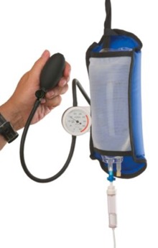
Blood Administration
Legal Aspect:
Two qualified personnel check it at the bedside to prevent a potentially fatal clerical error.
Recipient and unit identification, confirmation of compatibility, expiration date (due the decrease in the oxygen carrying capacity which result in useless transfusion).
60% of transfusions occur perioperatively
Responsibility of transfusing perioperatively is with the anesthesiologist.
Urgent Transfusion:
Urgent transfusion situations require flow rates faster than gravity can provide :
Pressure bags are available that completely encase the blood bag and apply pressure evenly to the blood bag surface.(to squeeze the blood out)
If external pressure is anticipated →large-bore needles (14, 16, or 18 G) are recommended for venous access to prevent hemolysis (deformity of RBCs shape as they pass through the needle).
If only a small-gauge needle is available → the transfusion may be diluted with normal saline, but this may cause unwanted volume expansion.
Management:
Determinant Factors
Clinical Evaluation
Laboratory Evaluation
Patient’s age and weight.
Severity of symptoms
(with mild cases start with fluids and colloids).
Cause of the deficit. (e.g. hemorrhage, iron deficiency)
Underlying medical condition. (some heart and lung diseases are not compatible with massive blood transfusion)
Ability to compensate for decreased oxygen-carrying capacity (some patients needs 7 Hb, others needs 10 Hb to maintain normal condition).
Tissue oxygen requirements (e.g. cyanide toxicity) are all considered.
Appearance
(pallor, diaphoresis).
Mentation (alert, confused) Indicate Hypoxia.
Heart rate (Increase HR, Decrease BP). indicate shock
Blood pressure.
Nature of the bleeding (active, controlled, uncontrolled).
Hgb
Hematocrit
Platelets
Clotting function
Electrolytes

Slide 11
Adverse Reactions of Blood Transfusion
The most common reactions are not life threatening, although serious reactions can present with mild symptoms and signs.
Reactions can be reduced or prevented by modified (filtered, washed, or irradiated) blood components.
Immune mediated reactions
VS
Non -Immune mediated reactions
Acute Hemolytic Transfusion reactions.
Febrile nonhemolytic transfusion reaction.
Allergic reaction
Anaphylactic
Graft-versus-host-disease
Transfusion-related acute lung injury
Fluid overload
Hypothermia
Electrolyte toxicity
Iron overload
Immune mediated reactions:
Acute Hemolytic Transfusion reactions
1
Immune-mediated hemolysis occurs when the recipient has preformed antibodies that lyse donor erythrocytes.
The ABO isoagglutinins (incompatibility) are responsible for the majority of these reactions, although alloantibodies directed against other RBC antigens, i.e., Rh, Kell, and Duffy, may result in hemolysis.
Symptoms
Lab
Management
develop within minutes hypotension, tachypnea, tachycardia, fever, chills, hemoglobinemia, hemoglobinuria, chest and/or flank pain, and discomfort at the infusion site.
Measurement of :
serum haptoglobin low
Lactate dehydrogenase (LDH) High
Indirect bilirubin levels High
Transfusion must be stopped immediately, intravenous access maintained, and the reaction reported to the blood bank.
Diuresis should be induced with IV fluids to prevent renal dysfunction (to boost the urine output, that caused by RBC lysis as Hb is toxic to renal Epithelium) and furosemide or mannitol.
Tissue factor released from the lysed erythrocytes may initiate DIC.
prothrombin time (PT), activated partial thromboplastin time (aPTT), fibrinogen, and platelet count should be monitored.

Slide 12
Immune mediated reactions cont.:
2
Febrile nonhemolytic transfusion reaction (FNHTR)
The most frequent reaction associated with the transfusion of cellular blood components¹ (Due to donor WBC).
characterized by chills and rigors and a ≥1°C rise in temperature.
Treatment : stopping transfusion and the reaction should be reported to the blood bank.
Allergic reaction
3
Urticarial reactions are related to plasma proteins in transfused components.
Mild reactions treated symptomatically by temporarily stopping the transfusion until the symptoms resolve and administering antihistamines (diphenhydramine, 50 mg orally or IM).
Anaphylactic
4
This severe and dangerous reaction presents after transfusion of a few milliliters.
Type 1 hypersensitivity reaction, results from previous transfusion and exposure to the antigens causing the antibodies formation, and in the second exposure anaphylaxis occurs.
Symptoms
Management
Difficulty in breathing.
Coughing.
Nausea and vomiting.
Hypotension
Bronchospasm
Loss of consciousness, Respiratory arrest
Shock.
Stopping the transfusion.
Maintaining vascular access.
Administering epinephrine (0.5–1 mL of 1:1000 dilution subcutaneously).
Glucocorticoids may be required in severe cases
Since FNHTR is the most frequent reaction, to prevent it blood banks nowadays do leukoreduction to remove the WBC from the products which significantly reduced the incidence of FNHTR. In addition, CMV which can be transmitted through blood transfusion infect the WBCs thus it can be avoided by leukoreduction.

Slide 13
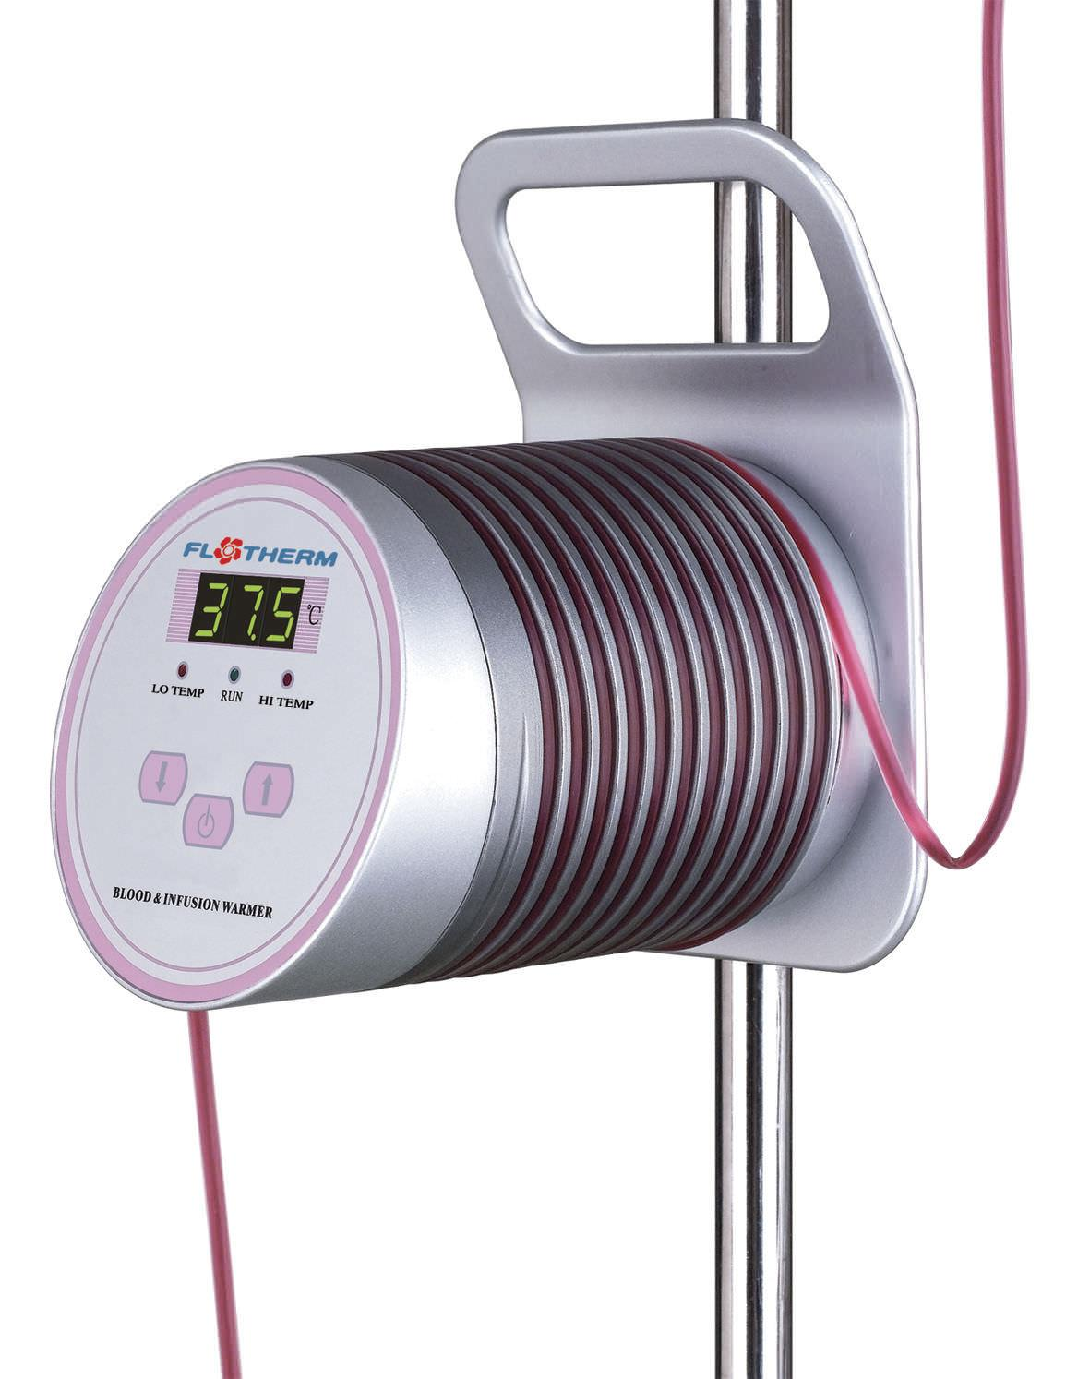
Immune mediated reactions cont.:
5
Graft-versus-host-disease
a frequent complication of allogeneic stem cell transplantation, in which lymphocytes from the donor attack and cannot be eliminated by an immunodeficient host.
Mediated by donor T lymphocytes that recognize host HLA antigens as foreign and mount an immune response
Rare in transfusion
Symptoms
Fever.
A characteristic cutaneous eruption.
Diarrhea.
Liver function abnormalities.
6
Transfusion-related acute lung injury
As result of receiving More than 10-20 units, where the donor antibodies attack the recipient WBCs and pulmonary endothelial cells.
Presents as acute respiratory distress, during or within 6h of transfusion.
Respiratory compromise, hypoxia, and signs of noncardiogenic pulmonary edema, including bilateral interstitial infiltrates on chest x-ray.
Treatment is supportive, and patients usually recover without sequelae.
Non-Immune mediated reactions:
1
Fluid overload
Blood components are excellent volume expanders, and transfusion may quickly lead to volume overload.
Monitoring the rate and volume of the transfusion and using a diuretic can minimize this problem.
2
Hypothermia
Refrigerated (4°C) or frozen (–18°C or below) blood components can result in hypothermia when rapidly infused.
Cardiac dysrhythmias can result from exposing the sinoatrial node to cold fluid.
Use of an in-line warmer will prevent this complication.
Extra:
Infusion warmer

Slide 14
3
Electrolyte toxicity
01
02
03
04
RBC leakage during storage increases the concentration of potassium in the unit.
Citrate, commonly used to anticoagulate blood Components, chelates (bind with) calcium and thereby inhibits the coagulation cascade and cause hypocalcemia.
Hypocalcemia, manifested by circumoral numbness and/or tingling sensation of the fingers and toes, may result from multiple rapid transfusions.
Citrate is quickly metabolized to bicarbonate, calcium infusion is seldom required in this setting.
4
Iron overload
Known as secondary hemochromatosis and occurs with the frequent blood transfusion e.g. thalassemia.
Each unit of RBCs contains 200–250 mg of iron.
Symptoms and signs of iron overload affecting endocrine, hepatic, and cardiac function are common after 100 units of RBCs have been transfused (total-body iron load of 20 g).
5
Infectious complications
Viral
Hepatitis C & B.
HIV Type 1.
Cytomegalovirus.
Parvovirus B-19.
Dengue, chikungunya virus and yellow fever (RARE)
Parasite
Malaria
chagas disease (Trypanosoma cruzi)
Babesiosis
Variant
Creutzfeldt-Jakob disease
Bacterial
there’s another classification –reference classification- for the adverse effects mentioned in the summary, please check it !

Slide 15
Transferred easily because we cannot test each and every agent since testing would be cumbersome and take too long. From 437
Geographic migration and travel of donors shift the incidence of these rare infections.
ALTERNATIVES TO TRANSFUSION :
Autologous blood¹ is the best option when transfusion is anticipated.
The cost-benefit ratio of autologous transfusion remains high.
No transfusion is a zero-risk event; clerical errors and bacterial contamination remain potential complications even with autologous transfusions.
Autologous blood:
Three main autologous programmes exist.
1. Preoperative donation: blood is taken and stored in advance of planned surgery and is used like volunteer donor blood as required –stored for 1 year maximum- .
2. Isovolaemic haemodilution: blood is taken just before surgery and replaced with fluid and then returned unmanipulated immediately after the operation.
3. Cell salvage: blood is collected from the operative field and replaced during or immediately after the surgical procedure.
Methods that reduce the need for blood transfusion:
1-Acute volume replacement: Non-plasma colloid volume expanders of large molecules, such as dextran, are first-line management in volume depletion as a result of bleeding.
2-Mechanisms for reducing blood use in surgery:
A-Preoperative: by making sure patient has a normal haemoglobin and by correcting any pre-existing anaemia.
B-Intraoperative: the skill, experience and the competence of the surgeon is the most important factors in reducing operative blood loss. Also posture, the use of vasoconstrictors, tourniquets, and avoidance of hypothermia.
C-Postoperative: Postoperative cell salvage and the Appropriate use of antifibrinolytic drugs reduce postoperative transfusion.
Is the collection of blood from a single patient and re-transfuse it back to the patient when required.

Slide 16
Summary
Recall
Q1:Which electrolyte is most likely to fall with the infusion of stored blood? Why?
Answer: Ionized calcium; the citrate preservative used for the storage of blood binds serum calcium
Q2: What changes occur in the storage of PRBCs?
Answer ↓Ca+, ↑K+, ↓2,3-DPG, ↑H+ (↓pH), ↓PMNs
Q3: One unit of PRBC increases Hct by how much?
Answer ≈3% to 4%
Q4: What is a type and screen?
Answer Patient’s blood type is determined and the blood is screened for antibodies
Q5: What is a type and cross?
Answer Patient’s BLOOD is sent to the blood bank and cross-matched for specific donor units for possible blood transfusion
Q6: What is the transfusion “trigger” Hgb?
Answer <7.0
Q6: What is the normal life of RBCs?
Answer 120 days
Q6: What common medication causes platelets to irreversibly malfunction?
Answer Aspirin (inhibits cyclooxygenase)
Q6: What should the platelet count be before surgery?
Answer >50,000
Blood & Plasma component
PRBCs
01
03
Plasma
- Administer with normal saline
- 1 unit increase Hb 1g/dL
- 1 Unit increase hematocrit 3%
- Used mainly by dermatologist
- Contains (Albumin, Immunoglobulin, Factor VIII, IX, & Prothrombin)
Platelets
02
04
Cryoprecipitate
Cannot be refrigerated
Should be Rh negative
- Source of fibrinogen & vWF
RBC serology
 | A+ | A- | B+ | B- | AB+ | AB- | O+ | O-
Abs in Plasma | Anti-B |  | Anti-A |  | None |  | Anti-B & Anti-A
Antigens in RBC | A antigen |  | B antigen |  | A & B antigens |  | None
Can donate to | A+ & AB+ | A-, AB-, A+ & AB+ | B+ & AB+ | B-, AB-, B+, & AB+ | AB+ | AB-, & AB+ | O+, A+, B+, & AB+ | All blood types
Can receive | A+, A-, O+, & O- | A- & O- | B+, B-, O+, & O- | B-, & O- | All blood types | AB-, A-, B-, & O- | O+ & O- | O-

Slide 17
Summary
Pre-transfusion testing
ABO grouping
+RhD typing
Described in the previous slide
Antibody screen
For non (ABO/D) antigens
Cross-Matching
Patient’s BLOOD is sent to the blood bank and cross-matched for specific donor units for possible blood transfusion
Transfusion Indications
Administration
Threshold of Hb <7
Increase oxygen carrying capacity.
Restoration of red cell mass.
Correction of bleeding caused by platelet dysfunction .
Correction of bleeding caused by factor deficiencies .
Correction of anemia.
Double check
Check by Id not by name
Check Expiration date
DO2= CO x CaO2
Cardiac Output (CO) = HR x SV
Oxygen Content (CaO2):
(Hgb x 1.39)1 x O2 Saturation + (PaO2 x 0.003)2
Hgb is the main determinant of oxygen content in the blood
Transfusion Adverse effects
Acute Immunological
Acute non-Immunological
1
Hemolytic
Febrile-Non Hemolytic
Transfusion-related Acute Lung Injury
Urticarial (allergic)
Anaphylactic
3
Fluid overload
Hypothermia
Electrolyte toxicity
2
Delayed Immunological
4
Delayed non-Immunological
Hemolytic
VHD
Iron Overload
Infections

Slide 18
Quiz
MCQ
Q1: 1- A 26 year old mother of B- blood type had a miscarriage due to an unfortunate case of erythroblastosis fetalis, what could be the cause?
A) She received a blood transfusion of an Rh+ blood type
B) She was impregnated by an Rh+ father
C) Her first baby was of Rh+ blood type
D) All of the above
Q2: After his blood transfusion, a 45 y/o male patient developed signs of hypotension, tachycardia, fever, chills, hemoglobinemia, and flank pain. What are the findings you would see in a lab analysis?
A) Decreased haptoglobin, absent LDH
B) Decreased haptoglobin, increased LDH
C) Increased haptoglobin, increased LDH
Q3: which of these should be monitored in patients with hemolytic reactions?
A) Prothrombin time (PT)
B) activated partial thromboplastin time (aPTT)
C) platelet count
D) All of the above
Q4: 4- For a 70 kg patient, 1 unit of platelets transfusion increases platelets count by approximately:
A) 500-1000
B) 5000-10000
C) 15000-20000
Q5: What is the solution, if added to donated blood, would maximize the storage duration of RBCs?
A) CPDA-1
B) 2,3 DPG
C) Optisol
Answers
Q1 | D | Q4 | B
Q2 | B | Q5 | C
Q3 | D | Q6
Extra Questions

Slide 19
Good Luck!
Team leaders:
Nouf Alshammari
Haneen Somily
Naif Alsulais
Mohammed alshoieer
This lecture was done by:
Badr al-qarni
Mohammed Alhamad
Khalid al-khani
Omar al-otaibi
Razan AlRabah
Fares Al-mubarak
Feedback
Note taker
Reviewer

