Slide 1
Presentation & Management of Common Thoracic Diseases
Objectives
Identify the symptoms of common thoracic and lung disease
Discuss the physical examination
Describe the surgical Anatomy, Blood Supply, Airway Anatomy.
Recognize the congenital Diseases of the lungs.
Discuss the assessment of the patient, full history and examination.
Describe bronchogenic Carcinoma: Primary: SCLC, NSCLC.
Discuss the assessment for pulmonary resection
Discuss metastatic Disease
Discuss other lung tumors
Describe the Mediastinum
Recognize pneumothorax (Types, Presentation, and management)
Discuss chest trauma
Discuss the pleuro-pulmonary infections like:
Lung abscess, Bronchiectasis, Tuberculosis, Aspergilloma of the Lung, Hydatid cyst and Empyema
Recognize the chest wall deformities, like Pectus
Recognize the chest tube indications
Colour Index
Main Text
Males slides
Females slides
Doctor notes
Textbook
Important
Golden notes
Extra
Editing File

Slide 2
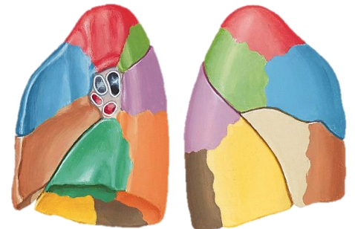
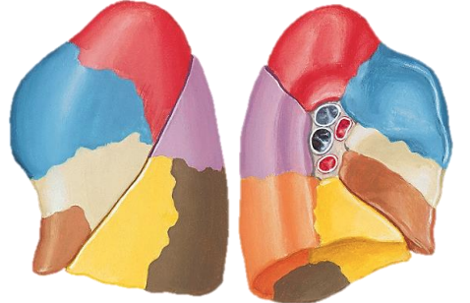
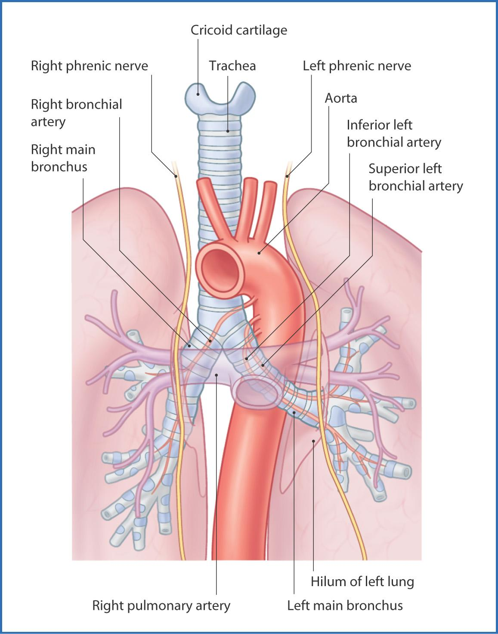
Anatomy of the lung:
The lung
Embryology
Anatomy
Bronchial system
Alveolar system
Lobes
Segments
Fissures
Blood supply
Bronchopulmonary segments:
Right Lung
Left Lung
Has 3 lobes:
Upper lobe, divided into 3 segments [Apical (S1), Posterior (S2), Anterior (S3)].
Middle lobe, divided into 2 segments [Lateral (S4), Medial (S5)] (present in the left lung as Lingular division of upper lobe).
Lower lobe, divided into 5 segments [Superior or Apical lower (S6), Medial basal (S7), Anterior basal (S8), Lateral basal (S9) Posterior basal (S10)].
Has 2 fissures:
oblique fissure: divides the lower lobe from other lobes.
transverse (horizontal) fissure: divides the upper and middle lobes.
Has 2 lobes:
Upper lobe, divided into [Apico-posterior (S1+S2), Anterior (S3) segments] and has Lingular division [Superior (S4), inferior (S5) segments].
Lower lobe, divided into Superior or Apical lower (S6), Anterior-medial basal (S7+8), Lateral basal (S9) and Posterior basal (S10) segments], has no medial segment due to the position of the heart.
Has oblique fissure which divides the left lung.
Blood supply:
Lungs do not receive any vascular supply from the pulmonary vessels (pulmonary artery or veins) As they are part of the pulmonary circulation.
Blood delivered to lung tissue via the bronchial arteries.
Vessels evolve from intercostal arteries or directly from aortic arch.
Travel along the bronchial tree.

Slide 3
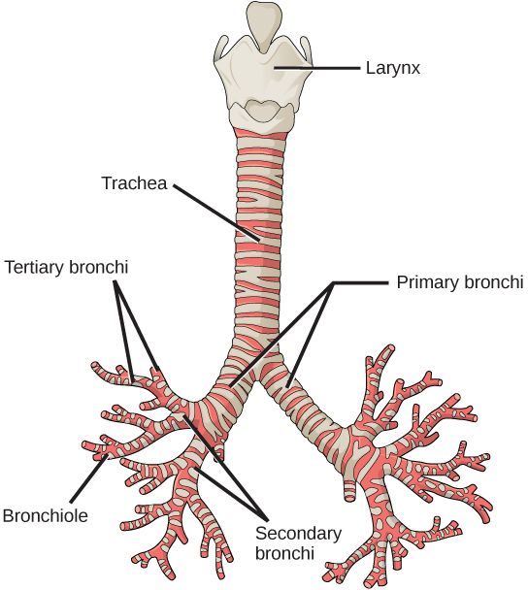
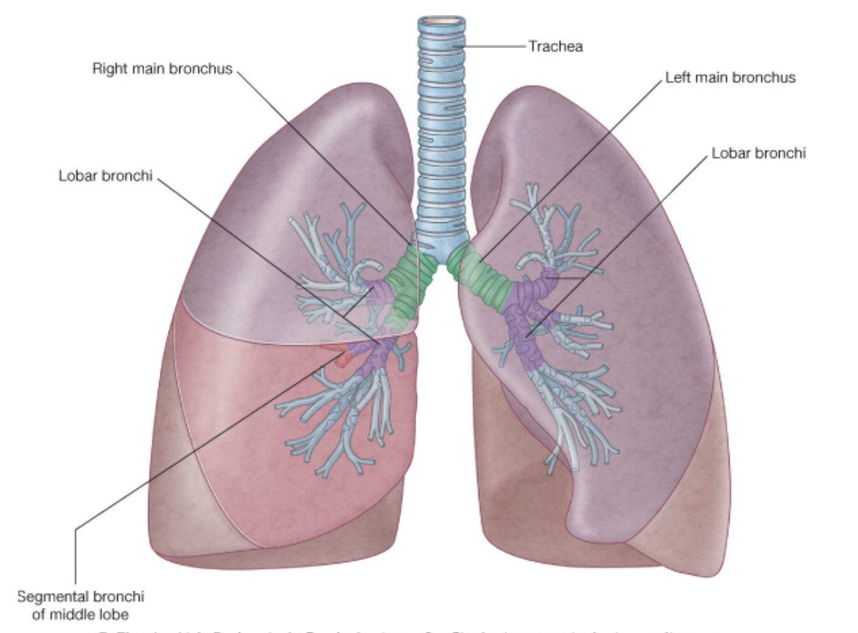
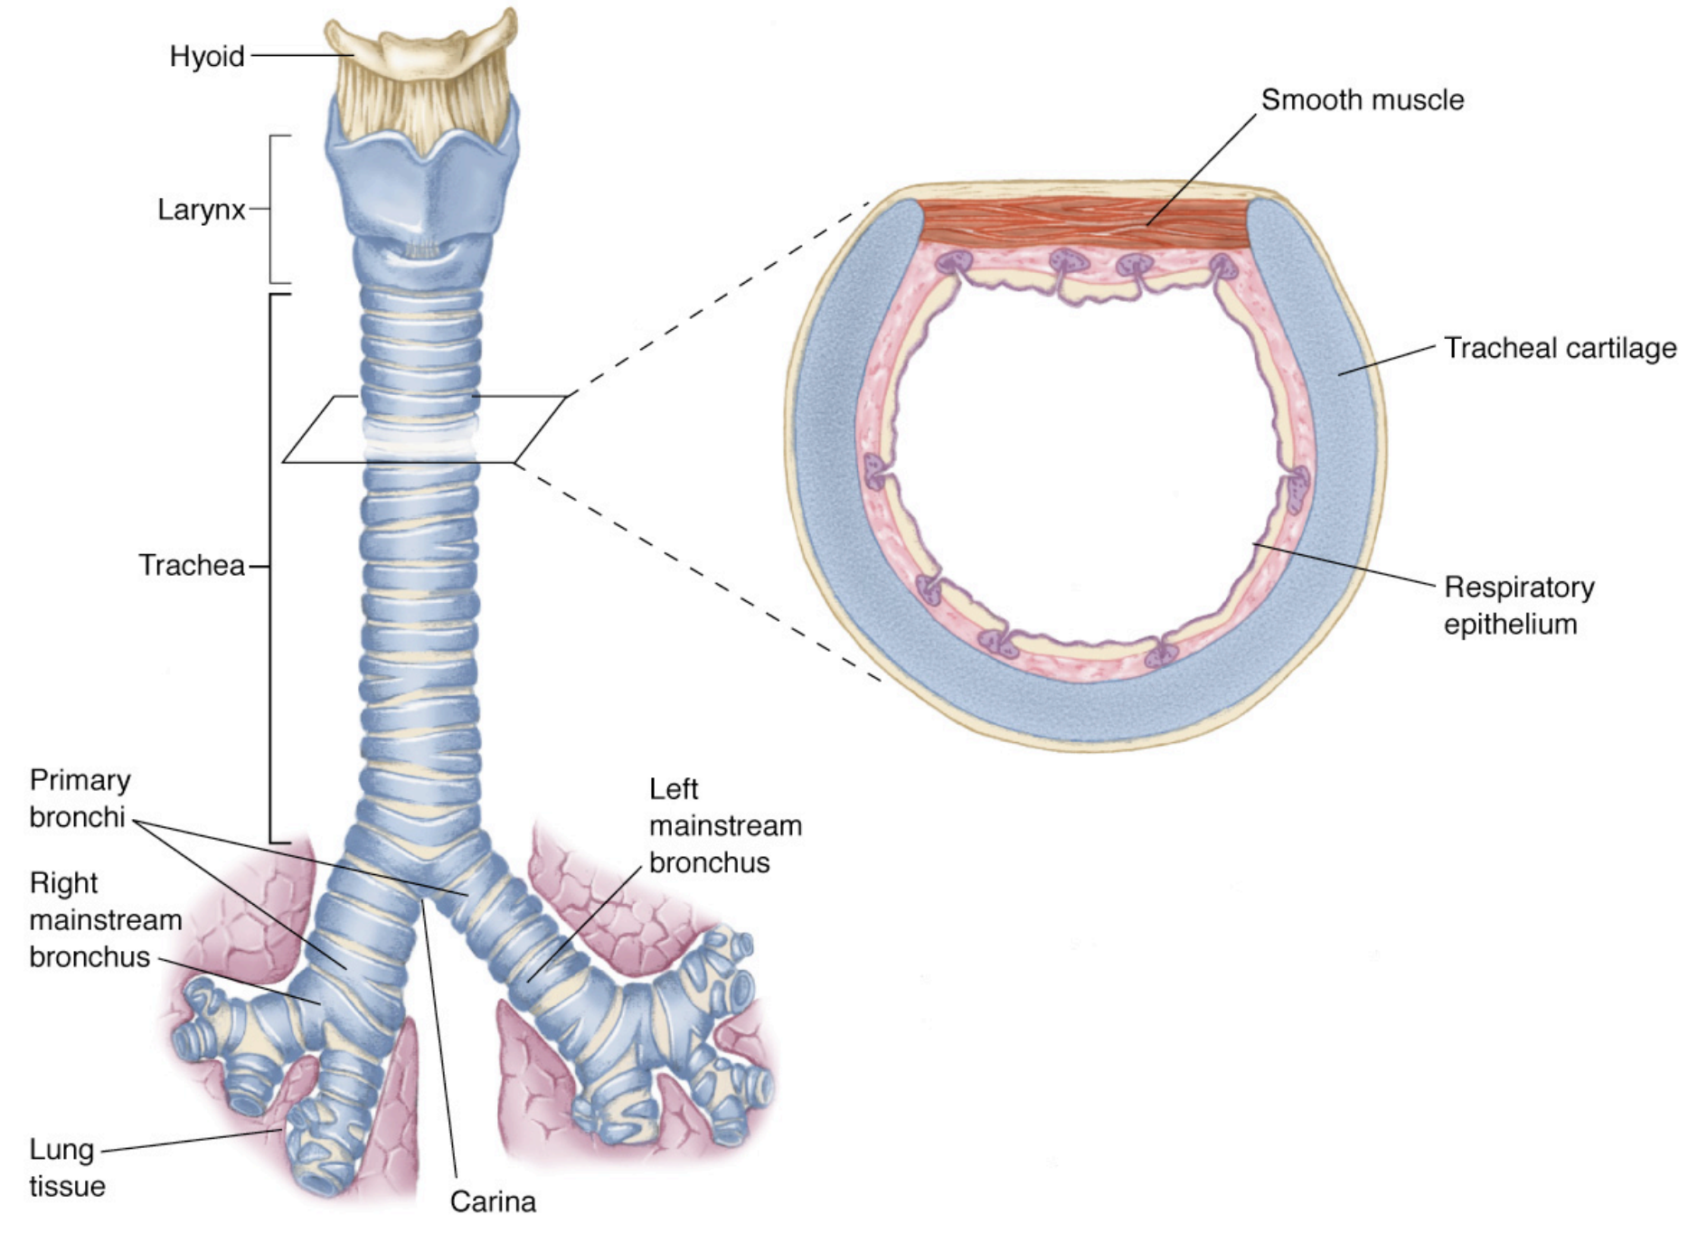
Airways:
Trachea
1ry bronchi
2ry bronchi
3ry bronchi
out to 25 generations
All comprised of hyaline cartilage
Terminal bronchiole
Respiratory bronchiole
(3-8 orders)
Alveoli
Trachea:
Begins where larynx ends (about C6) and bifurcates to right and left bronchi (at the site of primary carina).
10 cm long, half in neck, half in mediastinum.
20 U-Shaped rings of hyaline cartilage, keeps lumen intact but not as brittle as bone.
Lined with epithelium and cilia which work to keep foreign bodies/irritants away from lungs.
Anterior & lateral walls are formed of cartilage while the posterior wall is membranous with smooth muscles and it’s in contact with the esophagus. If there’s increased pressure necrosis of the posterior wall of the trachea (iatrogenic injury, blunt chest or neck trauma, prolonged mechanical ventilation via endotracheal or tracheostomy tube, and excessive tube cuff pressure in patients ventilated for lung disease) it may lead to tracheoesophageal fistula (emergency). Bronchiectasis and immotile cilia syndrome may lead to impaired cilia motility.
Primary -main- bronchi:
The right main bronchus is shorter, wider and vertical (more in continuation with the trachea) while the left main bronchus is longer, narrower and more angular.
So when foreign bodies get aspirated, it will most likely go to the right main bronchus > inferior lobar bronchus > lower lobe of right lung (this is due to the structural differences).
Bronchioles:
First level of airway surrounded by smooth muscle; therefore can change diameter as in bronchoconstriction and bronchodilation.

Slide 4
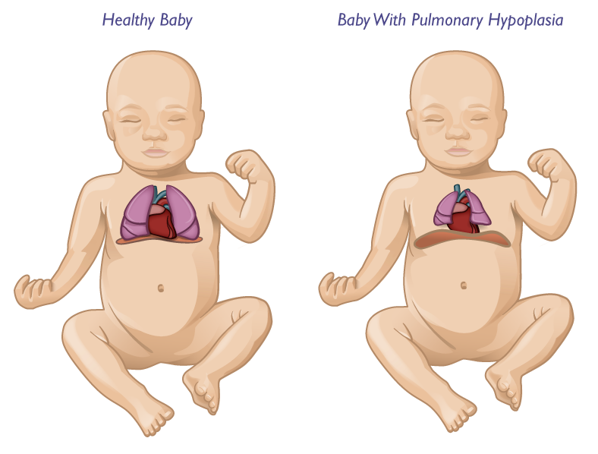
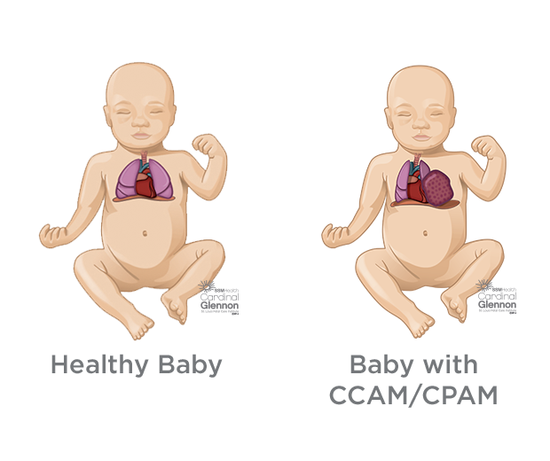
Diseases of the lung:
1- Congenital Lung Diseases:
1
2
3
4
5
6
Agenesis
Hypoplasia
Cystic Adenomatoid Malformation
Pulmonary Sequestration
Lobar Emphysema
Bronchogenic Cyst
Agenesis
No development / complete absence of the lungs (could be unilateral or bilateral).
Hypoplasia
Incomplete development of the lungs
(the patient may present with small non functioning lung).
Cystic Adenomatoid Malformation
Overgrowth of abnormal lung tissue that does not function properly and may form fluid-filled cysts.
Pediatric patients usually present with pneumothorax, repetitive chest infections, fever and malformation & chest abnormality on CXR and CT-scan.
Surgery is needed to remove this part of the lung.
Lobar Emphysema
It can affect children and newborns, it happens when the entire lobe (usually the right upper lobe) is replaced with a big cyst or emphysematous bullae
The newborn will not be able to breath and need to be put on +ve pressure mechanical ventilation.
The longer they’re put on a ventilator the more likely that the emphysematous bullae enlarges and starts to compress other parts of the lung “like a balloon”. So to relieve the patient from the ventilator, we have to do lobectomy (removal of the entire lobe surgically) and then inflate the lung again.

Slide 5
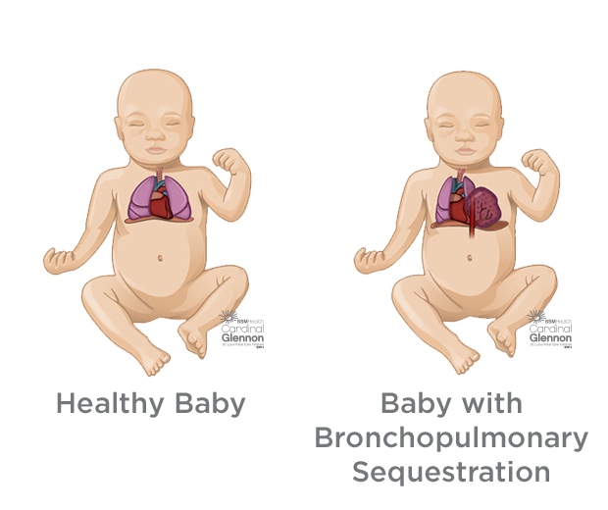
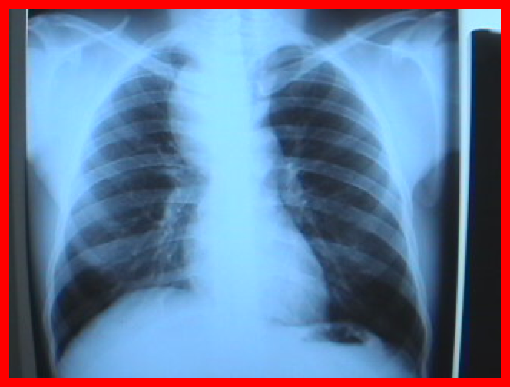
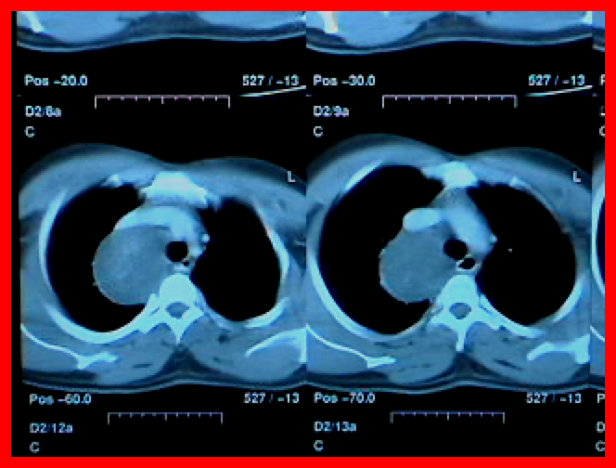
Pulmonary Sequestration
Pulmonary sequestration is more commonly seen in pedia population however it can be present in adults.
It’s a nonfunctional mass of normal lung tissue that lacks normal communication with the airways. Part of the lung loses its connection from the major bronchial tree (appears as sequestered mass) and any secretions or inflammatory processes may precipitate chest infections.
It can be extra- or intralobar¹ and it’s usually located in the left lower lobe.
On CXR or CT-scan: a mass is found (usually in the left lower lobe).
patients present with repetitive infections.
It is characterized by receiving its own arterial blood supply from the systemic circulation (especially thoracic aorta, it could be two or three major arteries). So the surgeon should identify the blood supply (in case of resection) by CT scan with contrast to locate the blood supply (these vessels could be above, below, or directly on the diaphragm) to prevent massive bleeding. We have to control the abnormal systemic blood supply coming from a major Aorta by carefully tying the blood vessel first during the surgical procedure.
arterial blood supply from the systemic circulation.
Bronchogenic Cyst²
It’s a benign cysts with malignant position, because it can compress
vital organs (e.g. trachea, esophagus, vessels) and it’s filled with fluid
and supportive debris which makes it prone to infections.
Location: right paratracheal (most common) and subcarinal.
Patient can present with dysphagia and stridor³.
Complications: infections, hemorrhage and transformation to malignant
adenocarcinoma if left untreated for a long time.
Treatment: surgical resection of the cyst by thoracoscopy.
Or if it’s adherent to SVC or the heart (tricky situations), a thoracotomy is
performed.
Picture A: CXR showing abnormal cyst in the middle posterior mediastinum
which is compressing the esophagus and trachea.
Picture B: CT scan showing a big cyst posterior to SVC and near to trachea,
if it increases in size, it will compress on trachea or esophagus,
could even lead to compression of SVC and massive bleeding.
.A.
.B.
1. Intralobar: Sequestration in normal lung tissue covered by normal visceral pleura; usually found in adults.
Extralobar: Sequestration not in normal lung covered by its own pleura; usually found in children.
2. Bronchus and cartilaginous components are benign in nature.
3. Stridor is a noisy or high-pitched wheezing sound with breathing. It is a sign that the upper airway is partially blocked.

Slide 6
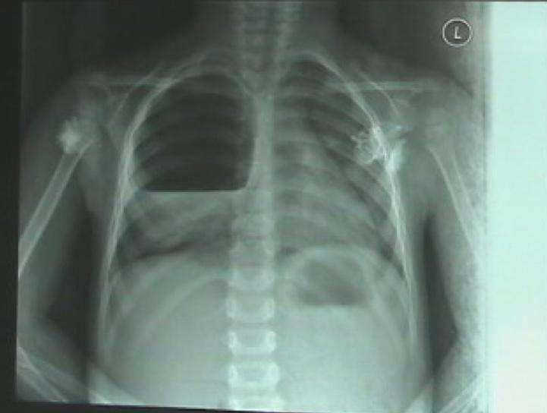
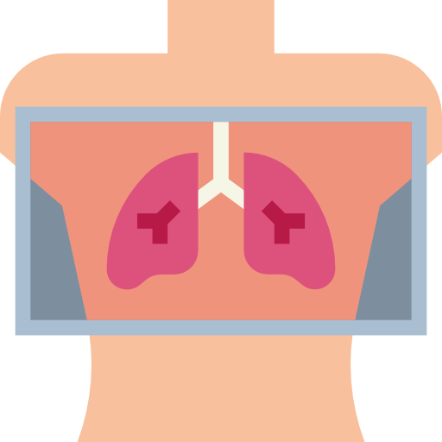
Diseases of the lung:
2- Infectious Lung Disease:
1
2
3
4
5
Lung abscess
Bronchiectasis
Tuberculosis
Aspergillosis
Hydatid Cyst
Lung Abscess
Immunocompromised (Diabetic, HIV, etc), complication of pneumonia, bronchial obstruction (by tumor or inhaled foreign bodies especially In children) bacteremia, and septic emboli.
.A.
Causes
Copious production of foul smelling sputum
Productive Cough +/- hemoptysis
Septic, toxic, high fever & chills
Severe chest pain and difficulty breathing
Picture A: showing air-fluid level abscess in the right upper lobe of the lung (Air-fluid level means it’s made up of these two components).
Clinical
Feature
CXR
CT
Concerted management:
Antibiotics
Drainage by pigtail catheters:
Internal (bronchoscope).
External (Percutaneous Tube Drainage).
Investigation
Treatment
Pulmonary resection
Type of Resection:
Lobectomy
Segmentectomy
Pneumonectomy
Resection Indications:
Failure of medical RX
Giant abscess ( >5cm)
Hemorrhage
Inability to rule out carcinoma due to old age, patient being a heavy smoker or the abscess being large with thick wall.
Which carcinoma causes abscess? Squamous
Rupture with resulting empyema
Surgery

Slide 7
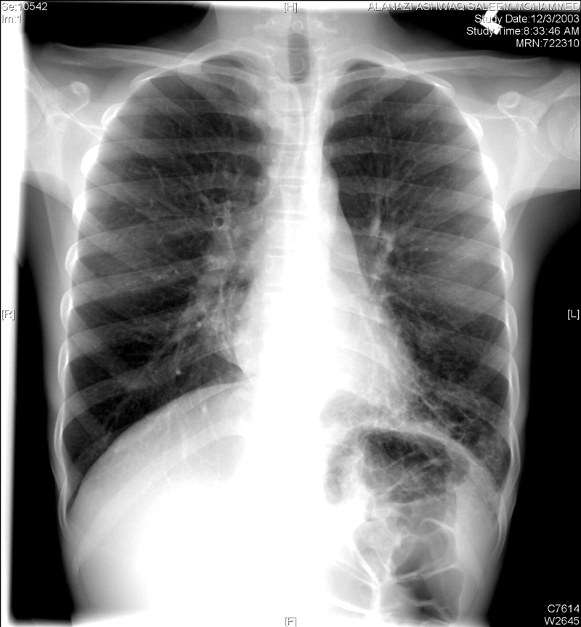
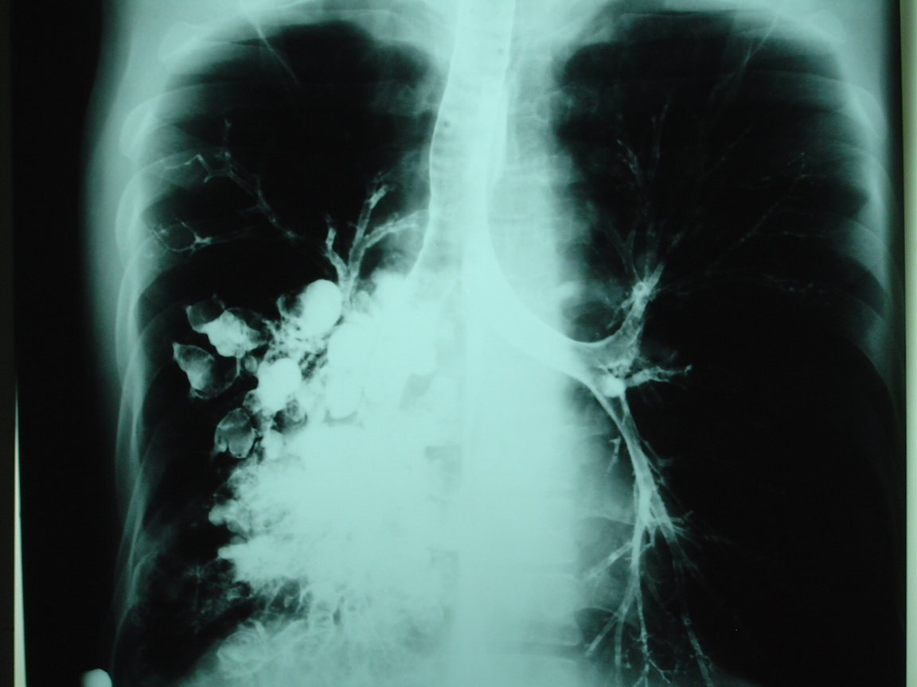
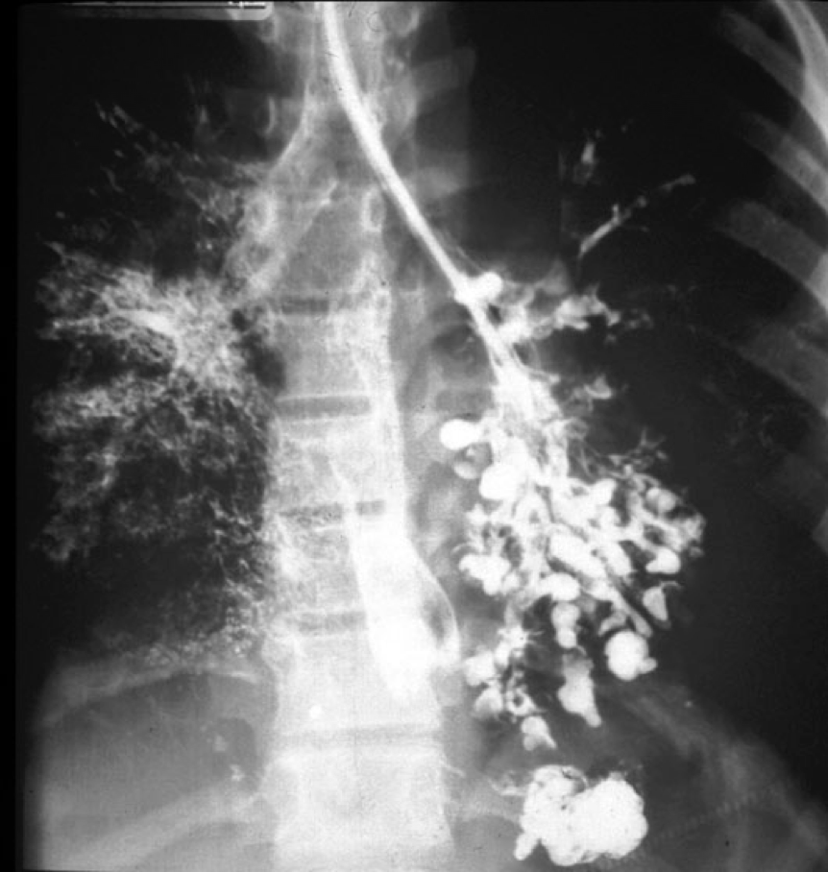
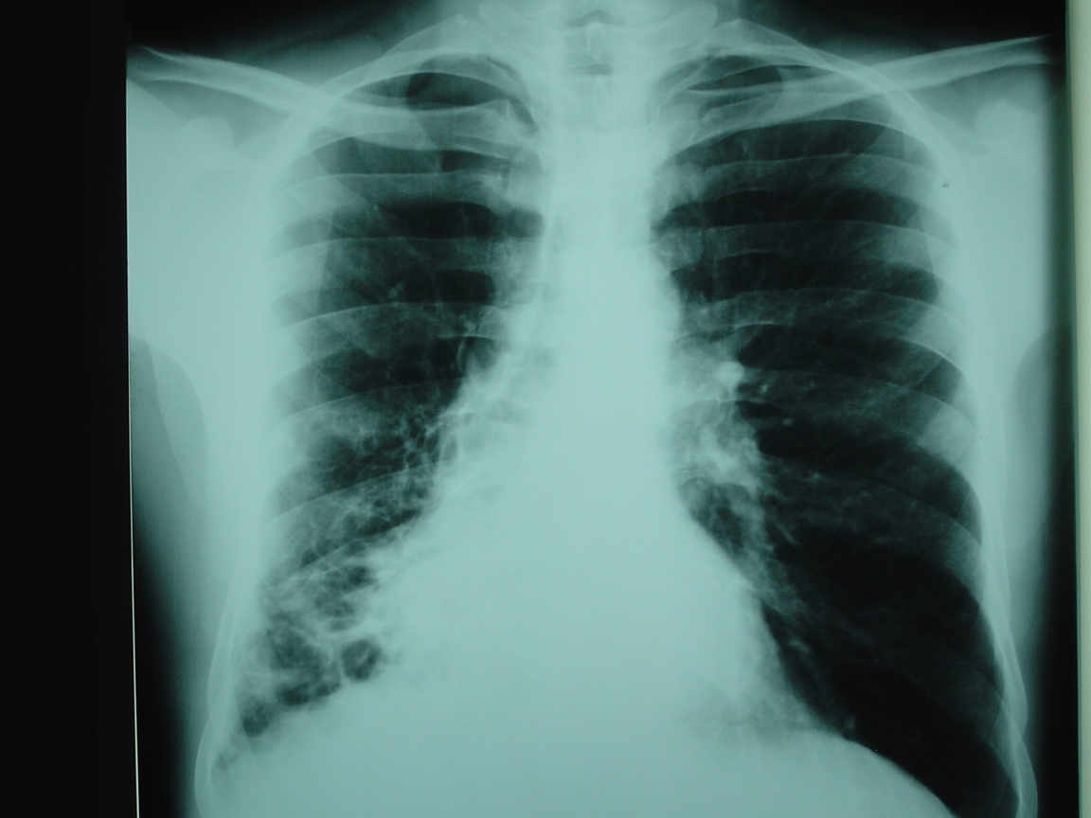
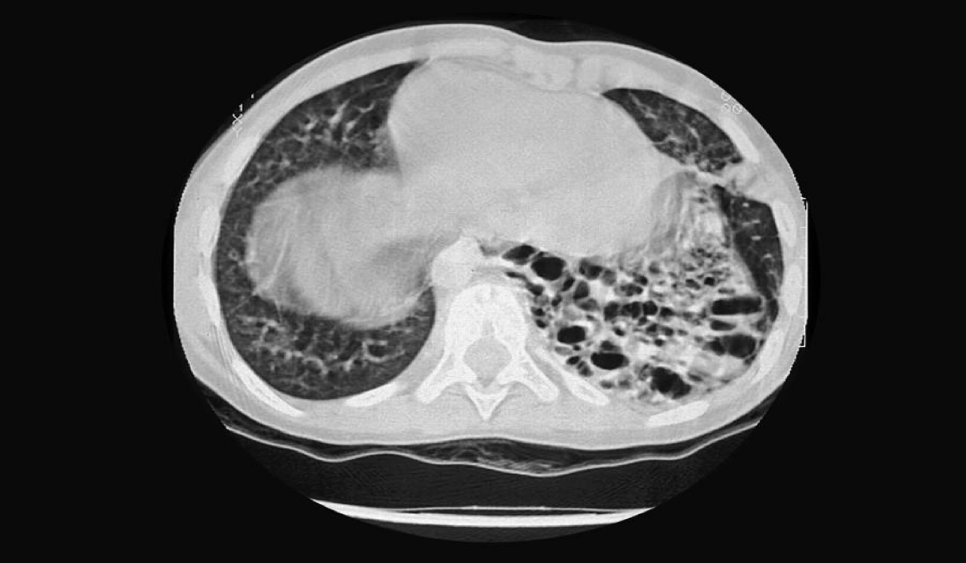
Bronchiectasis¹
It is a bronchial dilatation
Congenital e.g. Immotile cilia syndrome, Mucoviscidosis (cystic fibrosis).
Infection e.g. whooping cough, untreated pneumonia.
Obstruction e.g. Foreign body when a frogein body stays for 6 months or longer (year).
Causes
Types: cystic or cylindrical (cystic type is surgically corrected while Cylindrical type e.g. Cystic fibrosis, immotile cilia syndrome, are not surgically correctable)
Productive morning cough due to collection of secretions during sleep.
Dyspnea
Haemoptysis (50%)
Clubbing can be due to; pulmonary, congenital cardiac, GI disorders or idiopathic.
Clinical
Feature
CXR
CT Confirmatory
Bronchogram rarely used
Bronchoscopy to detect obstruction
Investigation
Medical:
Medical Rx is usually for bilateral conditions (to avoid removing two lungs).
Antibiotics, supportive, Postural drainage.
resolve most cases
Surgical:
Failure of medical RX
Patient with localized disease
Cystic type (cystic type is usually localized & non perfused.)
Non Perfused (perfusion is measured by Ventilation-perfusion scanning.)
Treatment
.A.
Picture A: CXR showing an area of cystic changes affecting the lower lobe of the left lung.
.B.
.B.
Picture B: Bronchogram (using catheter and contrast) shows cystic formation, destroyed bronchi filled with pus.
Dilatation of bronchi and bronchioles can follow childhood infections, e.g., measles or pertussis. The stagnant pools of secretions that collect are subject to continued infection, resulting in episodes of acute pulmonary infection or pneumonia and, more rarely, in haemoptysis.

Slide 8
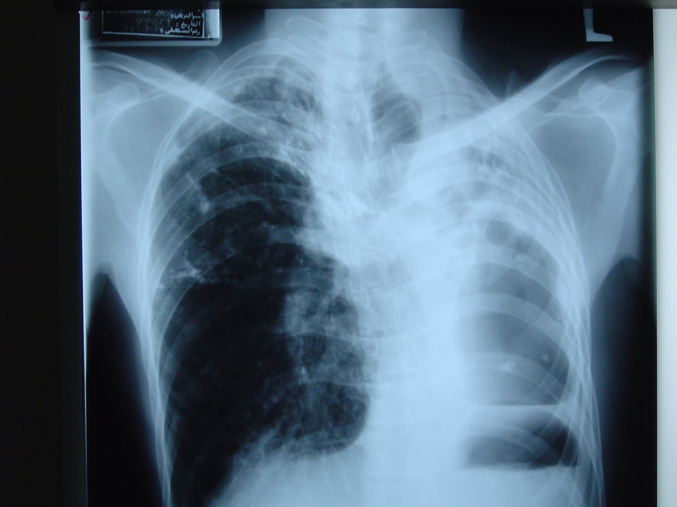
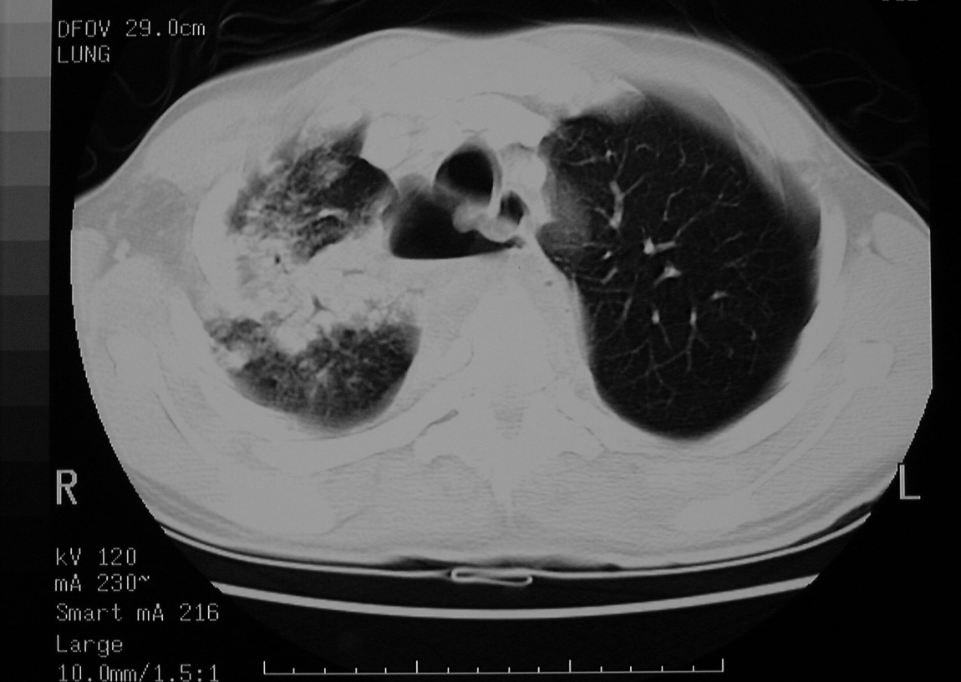
Tuberculosis
30,000 new cases occur annually in U.S.A
Epidemiology
Pulmonary
Extra-pulmonary e.g. TB Empyema, TB Lymphadenitis
Causes
CXR
CT
Bronchoscopy
Investigation
Medical:
1st & 2nd lines of Anti-TB.
Treatment
Surgical¹:
Failure of medical RX
Destroyed lobe or lung
Pulmonary haemorrhage
Persistent open cavity with +ve sputum
Persistent broncho-pulmonary fistula
Surgery
.A.
Picture A: CXR showing full destruction of the left lung (red) and deviation of the trachea (yellow) to the left-towards the pathology- due to increased space (usually tracheal pull is due to; collapsing lung, fibrosis). And this patient was treated by left pneumonectomy.
.B.
Picture B: CT-scan showing right upper lobe destruction (red) with formation of fistula (yellow) between the lung and the pleural cavity & trachea.
Present indications for surgery in pulmonary tuberculosis also include the complications of pulmonary tuberculosis: pneumothorax, empyema, bronchopleural fistula, bronchiectasis, massive haemoptysis, lung abscess and aspergilloma in a tubercular cavity.

Slide 9
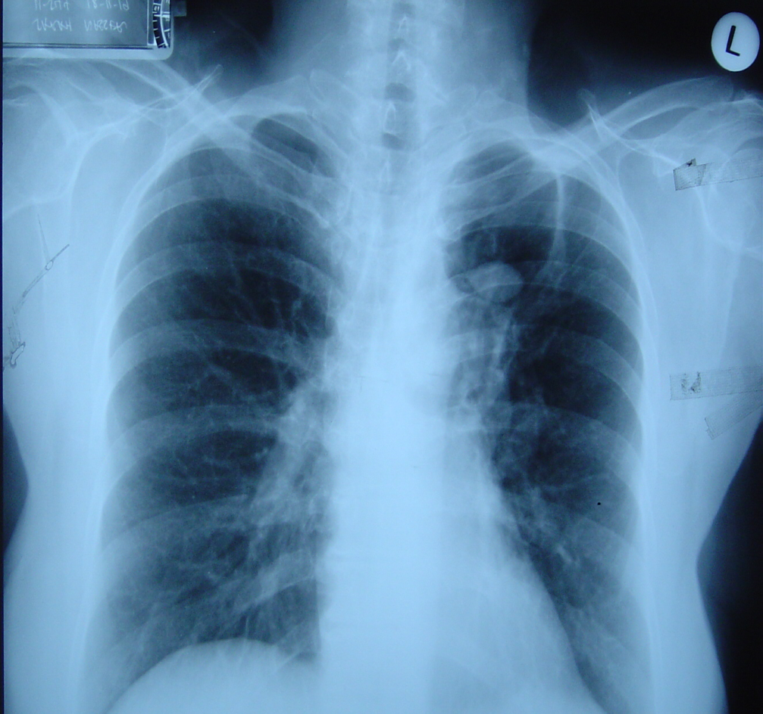
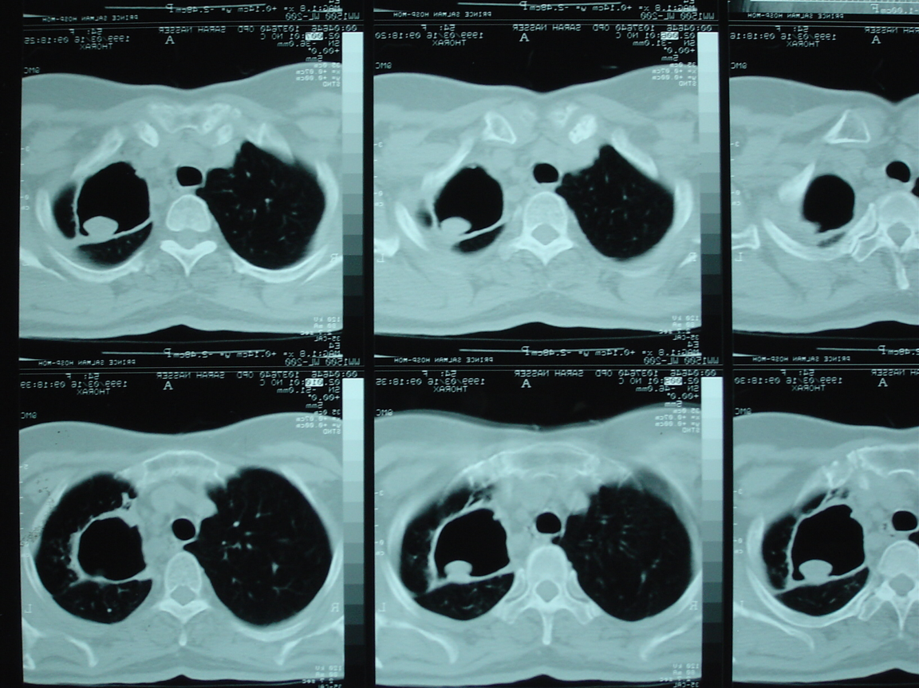
Aspergillosis
Inhalation of airborne conidia, contaminated water (while showering), and nosocomial infections. Especially in immunocompromised patients.
Aspergillus fumigatus, Asp. niger
Causes
Mode of
Transmission
8 forms
Allergic
Saprophytic
Invasive
Forms
Aspergilloma (mycetoma) cavity ball-like in CT
Hemoptysis (patients with preexisting disease like TB or immunocompromised) it starts very mild (a warning sign).
Chronic productive cough
Clinical
Feature
Skin test
sputum
biopsy (Invasive → LVA or open biopsy)
CXR (radiolucent)
CT characteristic; aspergilloma cavity with fungating core that eats the bronchus away, it bleeds once it reaches a bronchial artery.
Investigation
Medical:
Anti-fungal medications
Surgical:
Indication:
A significant aspergilloma & Haemoptysis.
Type of resection:
Segmentectomy, Lobectomy, Pneumonectomy.
Treatment
Surgery
.A.
.B.
Picture A: CXR showing aspergilloma complex with cavity (red) and mycetoma (yellow) which is a mass-like fungus ball.

Slide 10
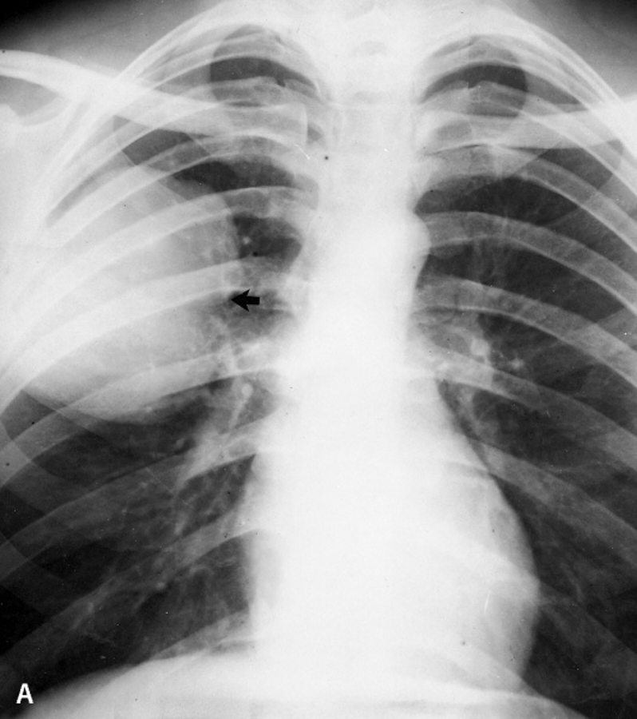
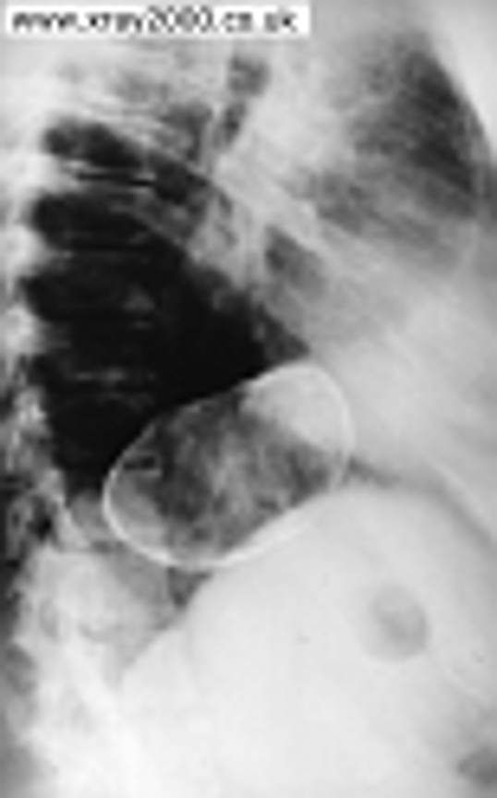
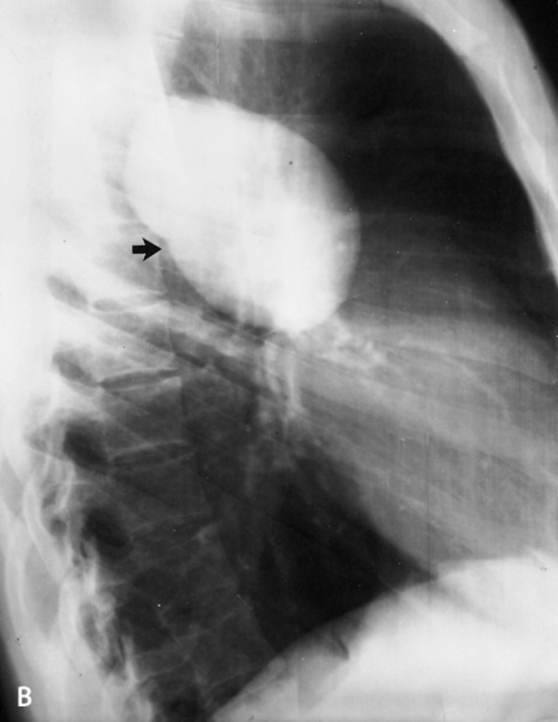
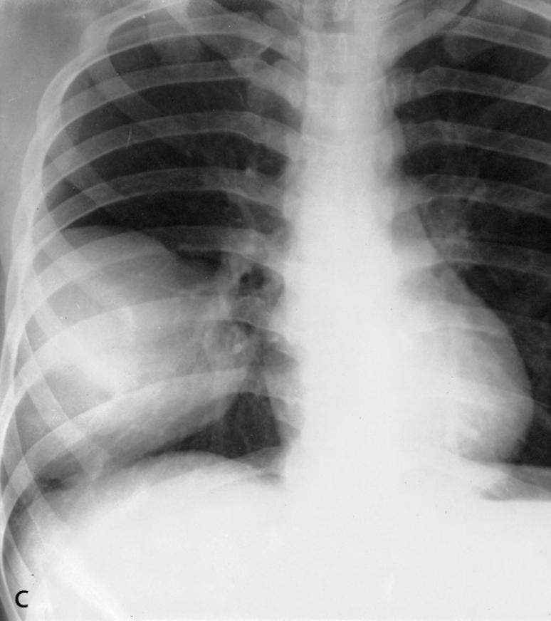
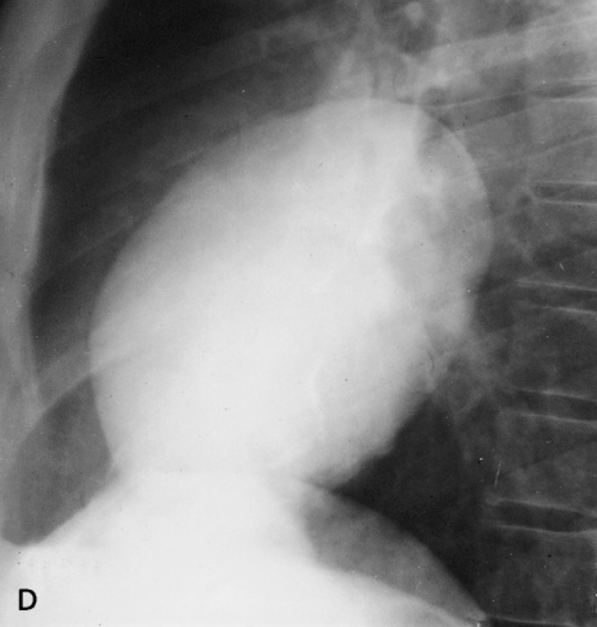
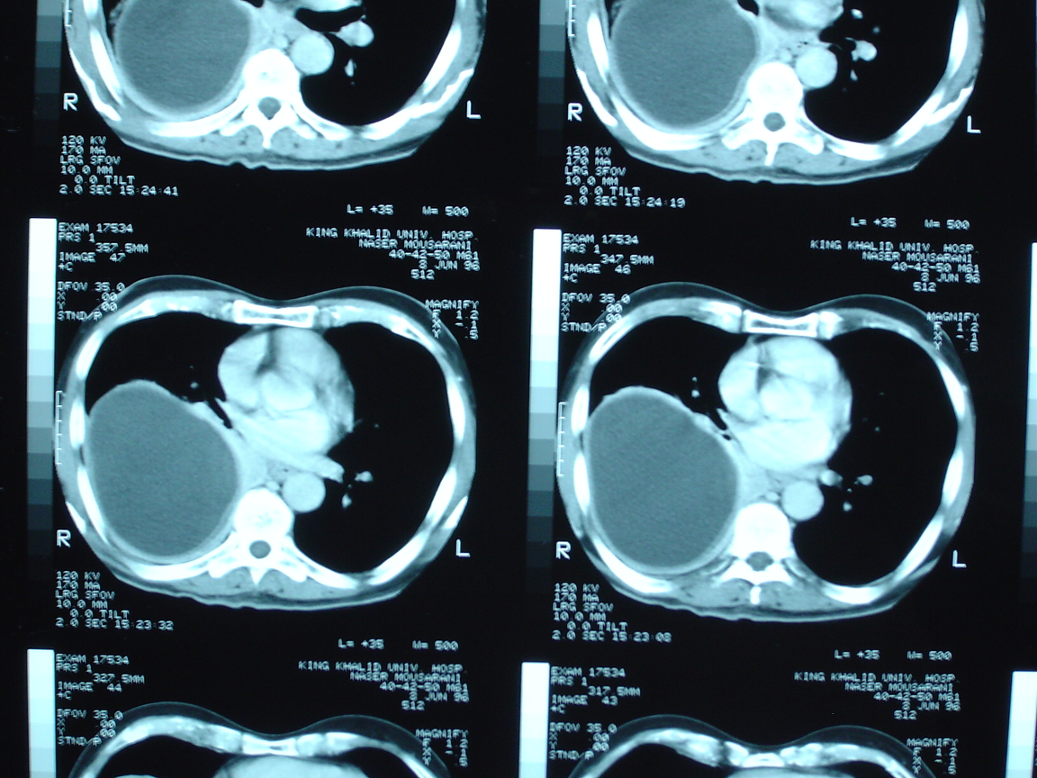
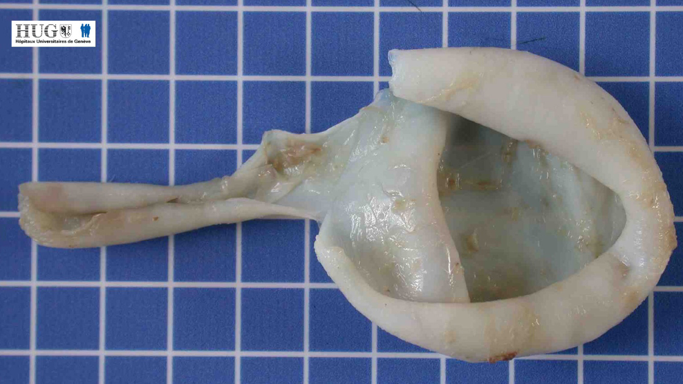
Hydatid Cyst
Echinococcus granulosus
Causes
E. granulosus is made of 4 segments.
The lifecycle of E. granulosus involves dogs as a definitive host where the parasite reaches maturity and reproduce. Sheeps, serve as an intermediate host and transmit the parasite to humans when undercooked meat is eaten (especially the liver). The parasite will go to the bowel → lymphatics → portal system → portal veins → liver → venous system → lungs (Therefore any patient with hydatid cyst in the liver, needs screening of the lungs and vice versa) → pulmonary artery → heart → systemic circulation → and goes anywhere (e.g. brain, bone, pancreas).
lifecycle
Skin test (Casoni’s reaction) & CXR
CT scan (a chronic cyst appears calcified, can be found incidentally or after complications)
High echinococcus titers and other serologic tests
Investigation
Surgery + inject hyperosmotic saline + albendazole (Needle aspiration is contraindicated)
Treatment
.C.
.C.
.D.
Picture C: CXR and CT-scan both showing hydatid cyst which is filled with water and 3-5 millions embryos, if it’s ruptured it can lead to anaphylactic shock thus needles are contraindicated. The cyst can be located anywhere else in the body but mostly common in the lung and liver.
Picture D: the cyst is made of three layers:
1st ‘false layer’ adventitia
2nd laminated membrane
3rd germinal layer (gives eggs)

Slide 11
3- Lung Tumors:
1
2
Benign
Malignant:
Primary or secondary
Almost all cancers metastasize to the lungs, thus biopsy is needed to establish the right diagnosis
 | A. Primary lung carcinoma
Incidence | More common in males.
Risk Factors | Smoking (mainly) other: carcinogenic radiation, asbestos and nickel.
Pathology | NSCLC ( Non-Small Cell Lung Carcinoma) | SCLC (Small Cell Lung Carcinoma)
 | Adenocarcinoma Squamous cell carcinoma Large cell carcinoma Surgery is possible | Systemic dissemination, surgery isn’t possible. CT is used for staging in SCLC.
Clinical Features | Asymptomatic Symptomatic Lung (causing repetitive chest infections, cough, hemoptysis) Surrounding structures: Recurrent laryngeal nerve (causing paralysis of the vocal cords → hoarseness) Esophagus (causing dysphagia) C8, T1 nerve (causing severe pain in the brachial plexus) Sympathetic (causing horner’s syndrome: ptosis, miosis, and anhidrosis) Pleura (causing severe pleuritic chest pain) Superior Vena Cava (causing SVC obstruction syndrome) Distal (paraneoplastic syndrome) results in hypersecretions of: Parathyroid Like Hormone Antidiuretic Like Hormone Adrenocorticotropic Like Hormone Hypertrophic pulmonary osteoarthropathy (severe joint and bone pain, due to hormonal secretion which won’t respond to medications)
Primary lung cancers: arise within the bronchial epithelium and are hence termed bronchogenic carcinoma.
Bronchogenic carcinoma is the leading cause of death because of malignancy in men and women. The far majority of cases are directly related to cigarette smoking; the occasional non- smoker who has lung cancer develops adenocarcinoma. The most common symptom at the time of diagnosis is cough (74%). Weight loss is seen in 68% of patients. Dyspnea is seen in 58% of patients. Hoarseness when seen indicates a unresectable bronchogenic carcinoma. The diagnosis of bronchogenic carcinoma can be made by sputum cytology, with the highest yield in patients with squamous cell carcinoma (>80%) because it is intraluminal and centrally located. Bronchoscopy is best for centrally located lesions (yield of 90%) and is helpful in staging. For the 10% of centrally located lesions not detected by bronchoscopy.
Nodal spread occurs to the intra-lobar, hilar and mediastinal nodes, and thence to the scalene nodes. Metastases occur in bone, brain, liver, adrenals and lung. Local direct spread may involve the chest wall, vertebrae, trachea, oesophagus and great vessels.
Secondary Lung Cancer: are the most common form of intrathoracic malignancy. A confirmatory diagnostic lung biopsy may be helpful for patients with no evident primary. A palliative pleurodesis in patients with associated pleural effusion can be achieved by instilling an irritant such as aluminium silicate powder (kaolin) into the pleural cavity.

Slide 12
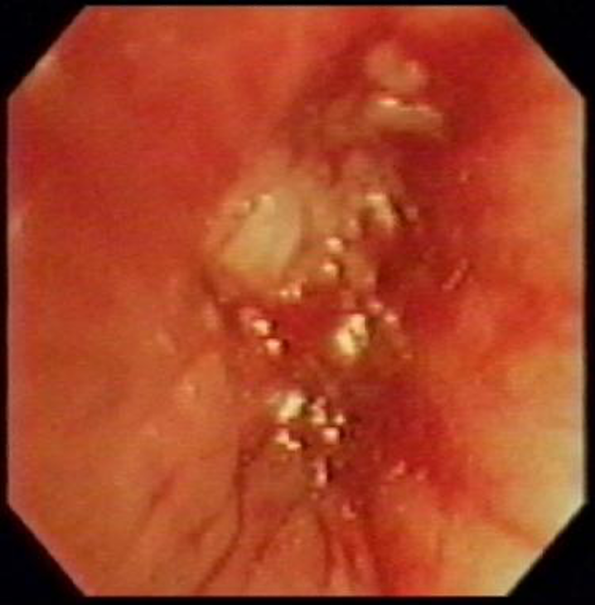
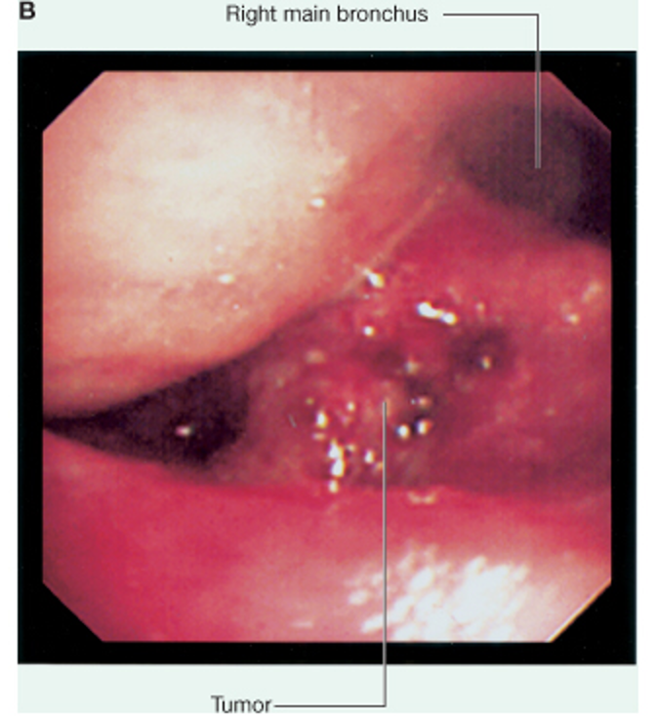
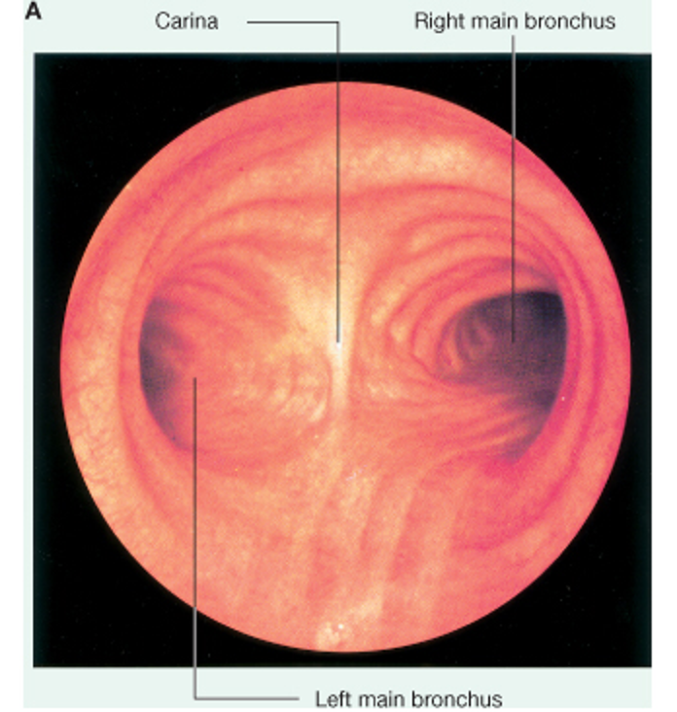
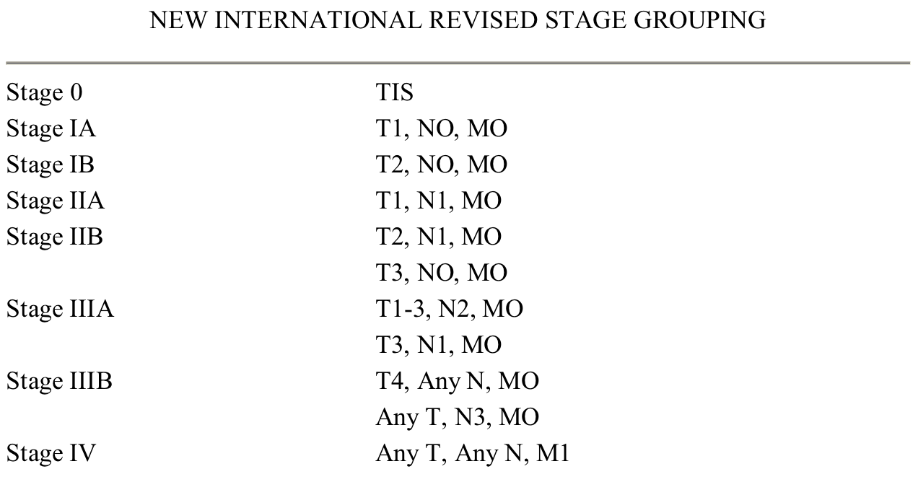
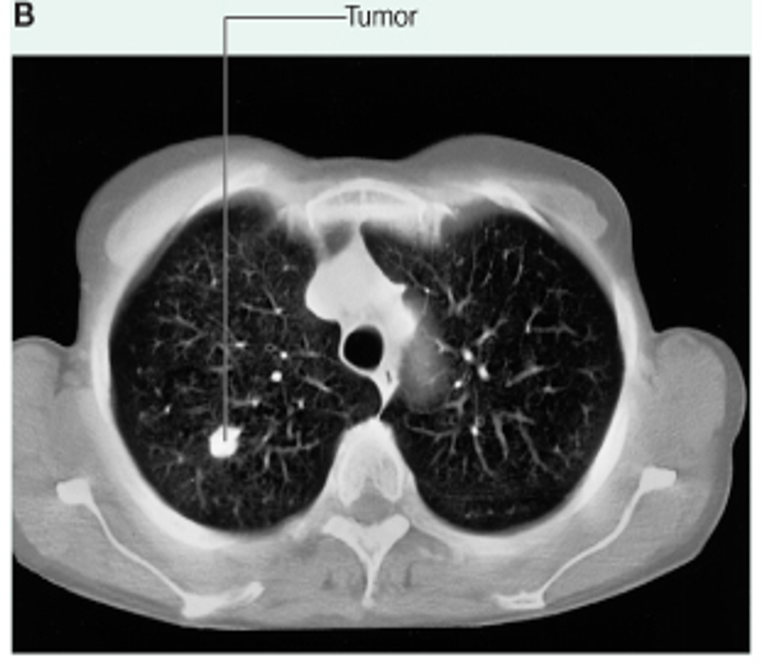
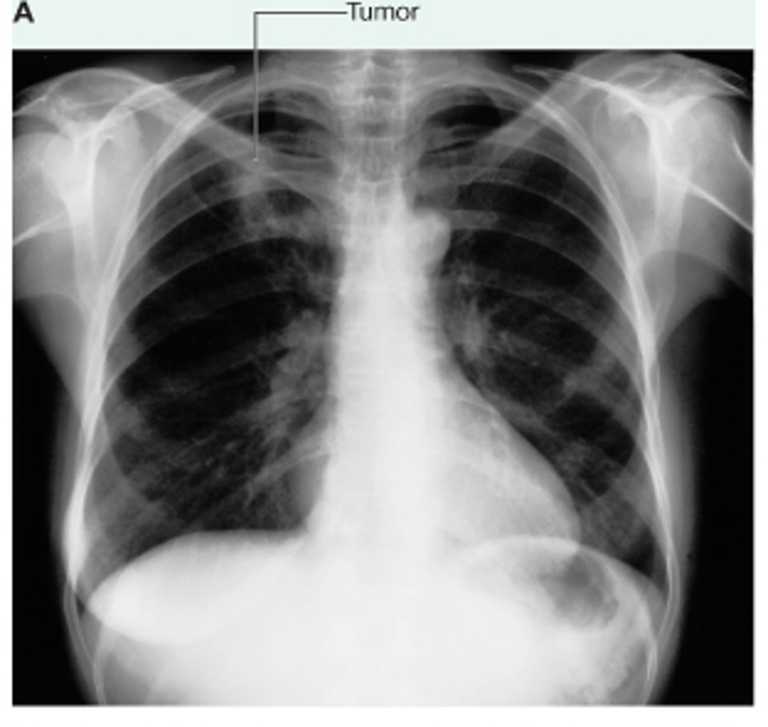
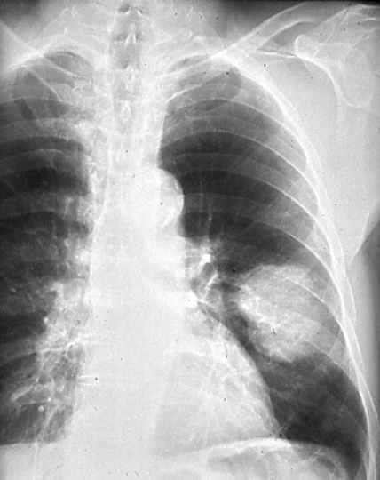
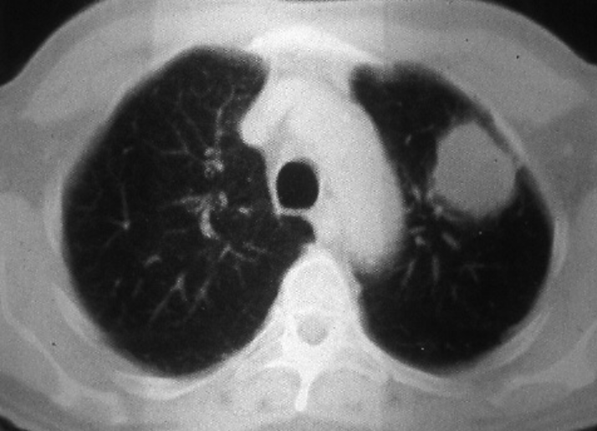
 | A. Primary lung carcinoma
Investigations | CXR Bronchoscopy Trans-thoracic needle aspiration FNA, true cut biopsy CT scan with IV contrast → GOLDEN STANDARD MRI (in case of soft tissue invasion)
Staging | TNM staging system
Management | Depends on: Stage Cell type Patient physical fitness
 | NSCLC ( Non-Small Cell Lung Carcinoma) | SCLC (Small Cell Lung Carcinoma)
 | In early stages: Surgical In advanced stages: Radiotherapy Chemotherapy | Chemotherapy Radiotherapy
Lung cancer - upper lobe
Tumor
Bronchoscope
.A.
.B.
.C.
.D.
Picture A: very early stage curable adenocarcinoma
Picture B: the patient has opacity which was confirmed by CT
Picture C: 60 years old heavy smoker, with chest pain, Hemoptysis, large tumor was found in the lower zone.
picture D: showed a large mass in the left upper lobe, and after biopsy it turned out to be small cell carcinoma.

Slide 13
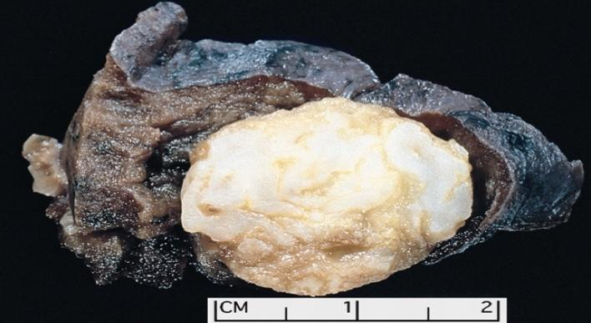
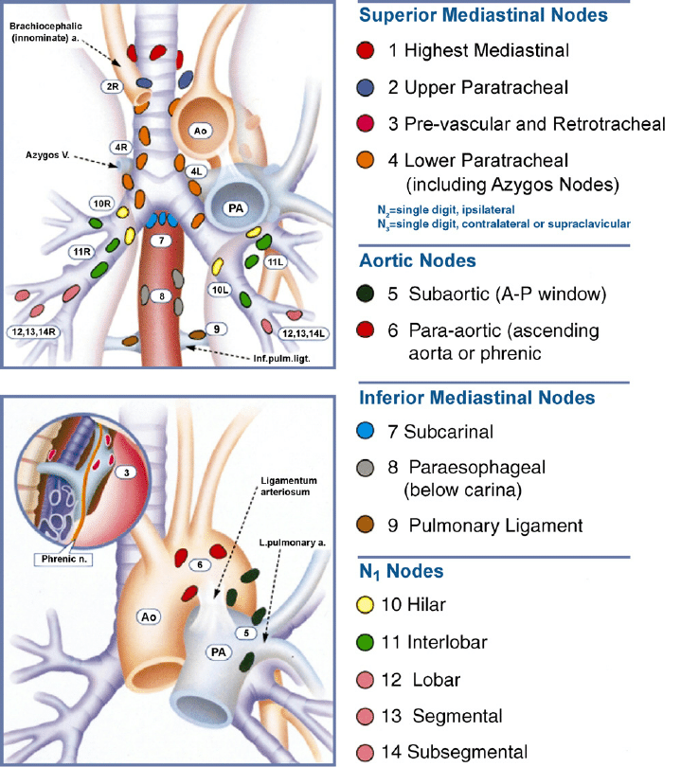
 | B. Secondary lung carcinoma (metastatic)
Types | Solitary lung nodule: Primary lung carcinoma Tuberculous granuloma Mixed tumor Secondary lung carcinoma Miscellaneous e.g. disk pneumonia
Comparison | Hamartoma - carcinoid (benign Vs malignant): Age Sex X-Ray Size Time Calcification
.A.
Picture A: Hamartoma, benign tumor with calcification
Mediastinum Anatomy:
Boundaries
The space in the thoracic cavity between the lungs, it’s divided into superior and inferior compartments by the thoracic plane at the level of the sternal angle, and the intervertebral disc of T4–T5, the inferior space is further divided into: anterior (behind the sternum), middle (around the heart and the major vessels) and posterior (in front the vertebra).
Divisions
Traditional
Clinical
Access
Mediastinoscopy
Mediastinotomy
Pulmonary metastasis is a common presentation and may be the only site of metastasis.
Resection of metastatic lesions may be part of a treatment protocol.
What is Virchow’s node? It is an enlarged left supraclavicular node. It occurs on the left as this is where the cisterna chyli (dilated lymph sac at the end of the thoracic duct) empties into the subclavian vein. Virchow’s node is suggestive of metastatic lung or gastrointestinal malignancy.

Slide 14
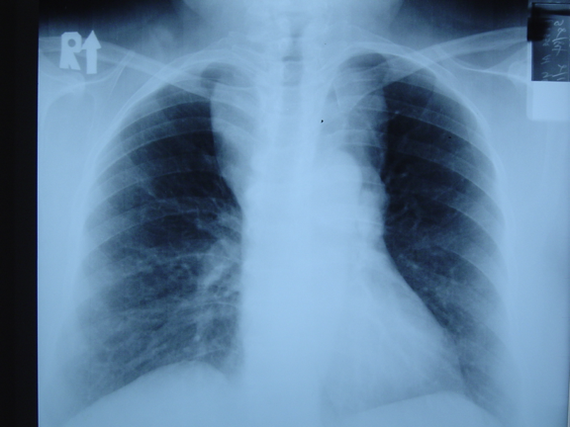
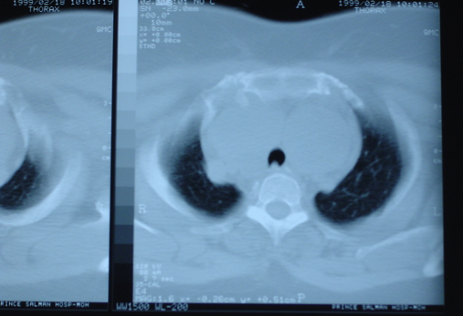
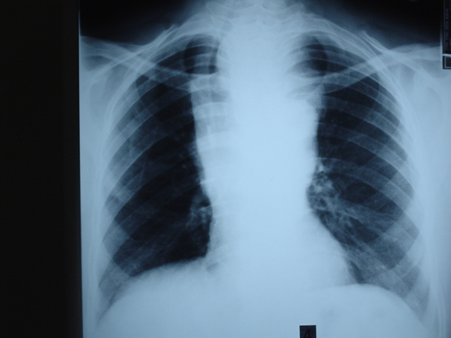
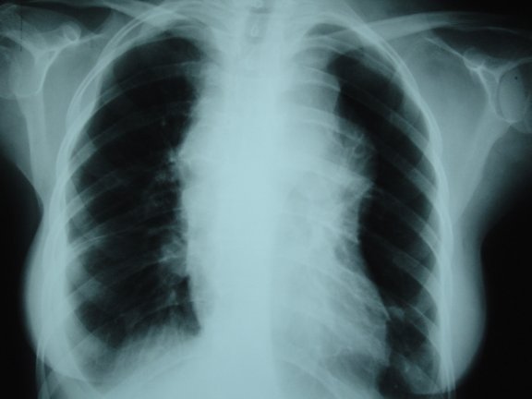
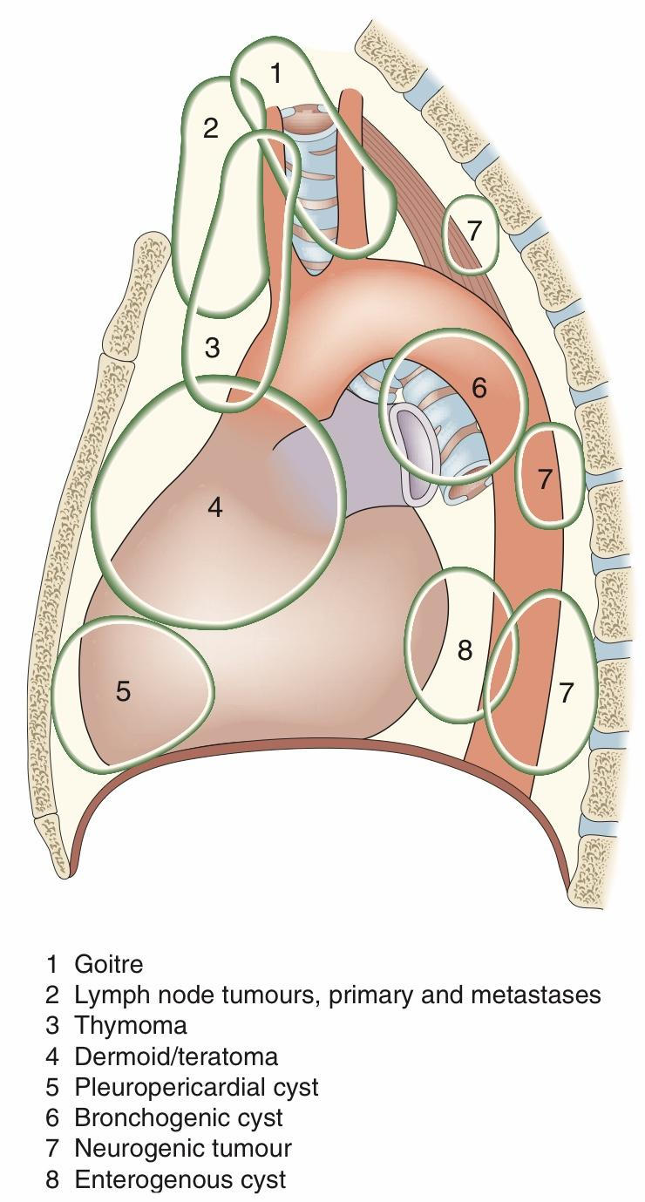
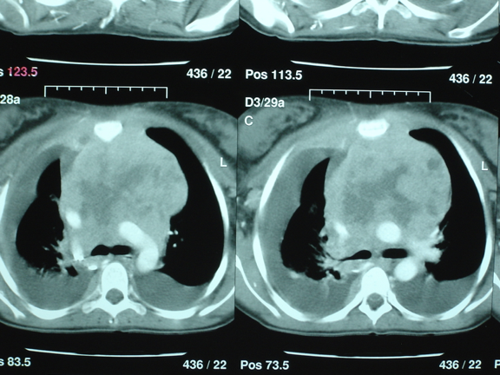
Mediastinal Mass Lesions
Middle Mediastinum
(Cyst: bronchogenic cyst & pericardial cyst)
Anterior Mediastinum (5 T’s)
Posterior Mediastinum (Neurogenic tumors, Enterogenous cysts)
Thymus - thymoma
Thyroid - ectopic thyroid masses (goiter)
Teratoma
T cell lymphoma
Thoracic aneurysms
TB lymphadenitis
.A.
Picture A: large superior mediastinum.
.B.
picture B: large mass behind the sternum ‘retrosternal goitre’.
.C.
Picture C: the trachea is compressed, there is a retrosternal goiter shifting the trachea to the right (away from pathology).
.D.
picture D: superior and anterior mediastinum enlarged.
.E.
picture E: there is a large mass in superior and anterior mediastinum compressing SVC → obstruction.
The patient has advanced stage lymphoma, the mass is invading the ascending aorta, trachea, carania, and right main bronchus, in addition to pleural effusion.
Benign and malignant masses may arise in the mediastinum. Some clue to the likely diagnosis is provided by the location of the lesion within the mediastinum. Where the diagnosis is in doubt, tissue may be obtained by CT-guided needle biopsy. If this is either not feasible or is unsuccessful, a surgical biopsy can be obtained using mediastinotomy, mediastinoscopy or videothoracoscopy. Patients may be asymptomatic or having vague symptoms. Surgical resection is generally undertaken via a median sternotomy for anterior lesions or a thoracotomy for mid and posterior lesions.

Slide 15
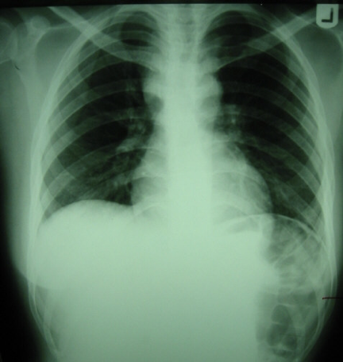
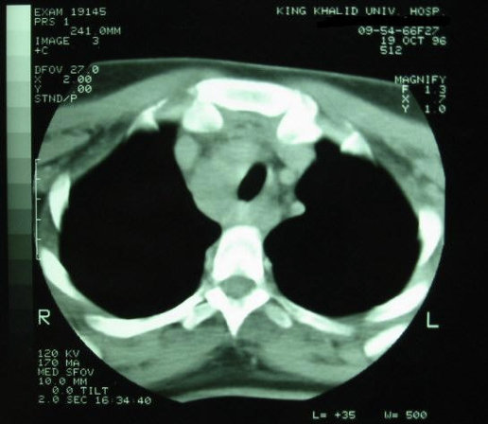
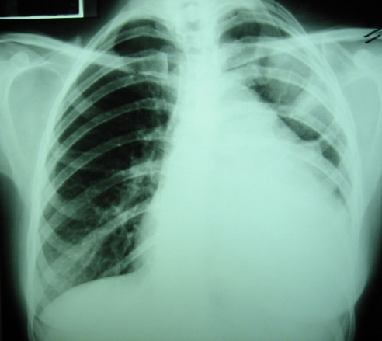
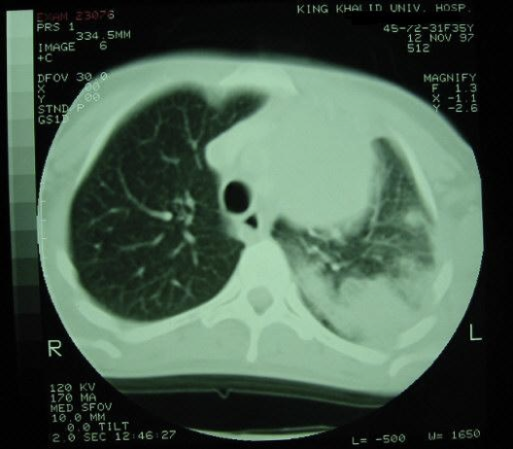
Thymoma
The commonest tumor of anterior mediastinum
Peak 40-60y
M:F (1:1)
Epidemiology
Asymptomatic
Symptomatic:
Mass effect.
Systemic effect: Myasthenia gravis is the commonest 40-50%.
Clinical
Feature
Classification:
Epithelial
Lymphocytic
Lymphoepithelial
Spindle cell
Benign vs. malignant
Stages:
I, II, III, IV
Pathology
CXR / CT / Biopsy
Selected cases:
Bronchoscopy
Esophagoscopy
Angiogram
Benign: complete excision
Malignant: complete excision if possible
If non-resectable or incomplete resection:
Post-op radiotherapy.
Investigation
Treatment
.A.
.B.
.C.
.D.
Picture A: superior mediastinal mass.
picture B CT of big mediastinal mass of thymoma.
Picture C Advanced case of thymoma extended to lungs and pleura (has to be removed along with the lung and metastasis).
picture D Big mass of thymus (anterior mediastinal thymoma) and Left lung is full of metastasis. stage IV.

Slide 16
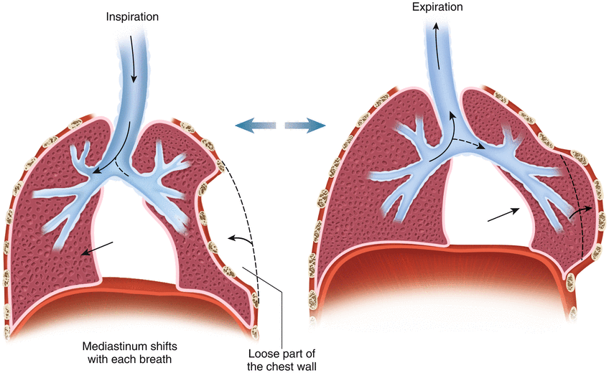
Trauma:
1
2
3
4
5
6
Road Traffic Accidents
Fractured ribs: - Simple - Complicated
Haemothorax
Pneumothorax
Flail Chest
Lung Contusion & ARDS
Fractured ribs & Flail Chest
Picture A: a patient of multiple fractures showing hemothorax opacity, lung contusion¹ and surgical emphysema.
Picture B: Flail chest (fracture in two or more consecutive ribs, causing paradoxical movement of that region of the chest).
In Picture C: multiple fractures.
.B.
.B.
.A.
.C.
Hemothorax
Hemothorax: accumulation of blood in pleural cavity
Picture D: Hemothorax which is usually a complication of trauma, gunshot, stab and one of the causes of pulmonary opacity.
Picture E: Collapsed left lung showing opacity due to hemothorax.
Picture F: Massive hemothorax compressing the trachea and carina
pushing them to the other side.
.D.
.E.
.F.
Lung contusion & ARDS
Picture G - H: X ray showing lung contusion (bleeding within the lungs)
Picture I: Advanced lung contusion opacity usually develops after 2-3 hrs
Picture J: Primary treatment of lung contusion is supportive including intubation, ventilation and antibiotics (unless there was an indication like
hemorrhagic shock, then we treat it surgically to stop the hemorrhage).
Acute respiratory distress syndrome (ARDS)² is characterized by
impaired oxygenation, diffuse lung opacification on chest X-ray and
an increasing ‘stiffness’ of the lungs (decreased compliance).
.G.
.H.
.J.
.I.
Lung contusion or a bruised lung, often occurs after a blow to the chest. The blunt impact can damage blood vessels, causing blood and fluid to build up in your lungs.
Basically it occurs when fluid builds up in the lung. The fluid keeps your lungs from filling with enough air, which means less oxygen reaches your bloodstream.

Slide 17
Pneumothorax
Picture A: Collapsed lung appears radiolucent in X-ray.
Picture B: Both lungs are collapsed with shifted mediastinum
Causes:
40-50 year-old smoker causing secondary pneumothorax.
Spontaneous pneumothorax
cyst or bullae
Treatment: by inserting a large-bore needle or chest tube (tube thoracostomy)
between the ribs to remove the excess air.
Pneumothorax occurs when air enters the potential space between the visceral and
parietal pleura.
Initial management: aspiration or by insertion of a chest drain connected
to an underwater seal into the pleural space.
This allows the lung to re-expand.
.A.
.B.
Types of Pneumothorax:
Traumatic Pneumothorax
Spontaneous pneumothorax
Tension pneumothorax:
Caused by either:
External chest wound: resulting in open pneumothorax that’s often associated with a ‘sucking wound’, where air moves in and out of a chest wound with respiration.
Internal air leak: spontaneous leakage from a large bulla or small air sac on the lung surface.
Primary or Secondary:
Primary pneumothorax: typically occurs in young (15–35 years) individuals with essentially normal lungs apart from a few apical bullae or blebs.
Secondary pneumothorax: develops in elderly patients (55–75 years) with a background of emphysema and chronic obstructive pulmonary disease.
Pathogenesis:
The pulmonary leak point may have a flap valve mechanism that allows air out of but not back into the lung, causing a rapid build-up of pressure within the pleural cavity.
This can be fatal, as the high intrapleural pressure completely flattens the ipsilateral lung while deviating the mediastinum to the opposite side, impeding venous return.

Slide 18
Management:
Spontaneous pneumothorax:
Primary spontaneous pneumothorax:
- If small and patient is asymptomatic:
○ Observation (should resolve spontaneously in 10 days) reassess with CXR.
○ Small chest tube may benefit some patients.
- If larger and/or patient is
symptomatic:
○ Administration of supplemental oxygen
○ Chest tube insertion to allow air to be released.
Secondary spontaneous pneumothorax:
○ Chest tube drainage
Tension pneumothorax (Medical emergency!):
If tension isn’t relieved by decompression (via large-bore needle or chest tube) followed by thoracostomy the patient is likely to die from hemodynamic compromise.
Open pneumothorax:
Immediate treatment with an occlusive dressing taped on three sides to allow air out of the chest but not in.
Definitive treatment is with a chest drain.
Chest wall deformities:
Pectus excavatum¹
(funnel chest)
Pectus carinatum
(pigeon chest)
Pleural Cavity:
1
2
3
4
Spontaneous Pneumothorax
Pleural effusion
Empyema (infection)
Mesothelioma
Pectus excavatum can affect the heart and respiratory system, it's congenital and we have to rule out congenital cardiac anomalies.
Pectus excavatum can be associated with connective tissue disorders such as Marfan’s syndrome, and with unilateral breast hypoplasia. Correction is only indicated when the patient’s quality of life is clearly impaired because of appearance, & it involves major surgery.

Slide 19
Mesothelioma
Mesothelioma is a malignancy that involves mesothelial cells that normally line the body cavities, including the pleura.
Asbestos is the principal carcinogen implicated in the pathogenesis of malignant pleural mesothelioma.
The patient commonly presents with: shortness of breath.
In many cases, the diagnosis is made by a percutaneous pleural biopsy but, if this is not successful, thoracoscopy or open pleural biopsy is useful.
The main differential diagnosis is disseminated adenocarcinoma involving the pleural cavity.
Surgical resection by excision of the parietal pleura, lung, diaphragm and pericardium (pleuropneumonectomy) is not generally reported to offer a survival benefit, except possibly in very early lesions. Radiotherapy and chemotherapy have no curative value. Therapy is, therefore, usually directed towards controlling symptoms.
Empyema & Pleural Effusion
Pleural effusion is an abnormal collection of fluid in the pleural space while
Empyema is a collection of pus within the pleural cavity and it commonly follows
pneumonia due to secondary infection of a reactive parapneumonic effusion.
Thin empyema may be resolved be intercostal drainage.
Thick & loculated empyema requires formal surgical drainage.
Other causes of empyema include postsurgical bronchial or oesophageal suture
line leakage, lung abscesses, esophageal rupture or perforation, repeated aspiration
of pleural effusion, secondary infection of a clotted haemothorax and, rarely, a
sub-phrenic abscess.
Picture A: Parapneumonic effusion and collapsed lung (opacity).
Picture B: Collapsed right lung with empyema failed drainage of pus due to
thickened pleura (visceral and parietal) and thickened debris.
.A.
.B.
.C.
.D.
Picture C-D: Decortication → removing visceral/parietal pleura and debris.
Inserting chest tubes to inflate the lungs and we leave them for few more days until the lungs fills the cavity and return to its normal state.

Slide 20
History and Physical Examination:
Added from Johns Hopkins Textbook of Cardiothoracic Surgery & Talley
History of a potential thoracic surgical patient should include presenting symptoms, previous diagnosis of cardio­ pulmonary disease, comorbid conditions such as diabetes mellitus, renal and liver dysfunction, current medications and allergies, tobacco use, and alcohol use. As the most fre­quent complications are pulmonary and cardiovascular, the history should focus on these areas.
Major presenting symptoms:
History
02
Dyspnoea (acute, progressive or paroxysmal)
Wheeze
Chest pain
01
Cough
Sputum
Haemoptysis
03
Fever
Hoarseness
Night sweats
Physical Examination
Examination begins with an assessment of overall appearance, looking especially for evidence of cachexia and generalized wasting.
Cervical and supraclavicular lymphadenopathy can indicate metastatic disease.
Cardiovascular examination should note murmurs (valvular disease), arrhythmias (atrial fibrillation), and presence of peripheral edema (congestive heart failure).
Pulmonary examination should note respiratory rate, use of accessory respiratory muscles, and presence of wheezing or rales.
Abdominal examination can confirm the presence of regional tenderness, organomegaly, masses, or adenopathy.
The extremities should be examined for equality of pulses, cyanosis, or clubbing.
Neurologic examination should focus on motor strength and gait, both of which are important because deficits can affect postoperative mobilization and rehabilitation.

Slide 21
Assessment of Pulmonary Resection:
Assessment addresses two questions:
Is the patient fit for pulmonary resection?
Is the disease potentially curable?
So, patients with poor LV function and/ or unstable angina are not suitable for pulmonary resection.If an effusion is present, this should be aspirated; if malignant cells are noted on cytology, this would preclude resection.Following assessment and surgical resection, the final pathological Tumour, Node, Metastasis (TNM) stage is helpful in indicating prognosis and determining whether a patient might benefit from adjuvant therapy, usually within the setting of a trial.
Chest tube indications:
Added from Kaplan for Surgery, 2020 edition
The presence of symmetrical breath sounds indicate satisfactory ventilation; an absence or decrease of breath sounds may indicate a pneumothorax and/or hemothorax and necessitate chest tube placement. Pulse oximetry can be used to determine if oxygenation is satisfactory (O2 saturation >90–95%); hypoxia may be secondary to airway compromise, pulmonary contusion, or neurological injury impairing respiratory drive and necessitate intubation. Measurement of end tidal CO2 (capnography) is also very useful.

Slide 22
Summary
Recall
Q1: What’s pulmonary sequestration? What’s the treatment of each type?
Answer: Abnormal benign lung tissue with separate blood supply that DOES NOT communicate with the normal tracheobronchial airway; have systemic arterial blood supply (usually off thoracic aorta).
Treatment → Extralobar? Surgical resection. Intralobar? Lobectomy.
Q2: What is the major risk during operation for sequestration?
Answer: Anomalous blood supply from below the diaphragm (can be cut and retracted into the abdomen and result in exsanguination!); always document blood supply by A-gram or U/S with Doppler flow.
Q3: What’s Pectus Excavatum?
Answer: Chest wall deformity with sternum caving inward (Think: exCAVatum = CAVE).
Q4: What’s Pectus Carinatum?
Answer: Chest wall deformity with sternum outward (pectus = chest, carinatum = pigeon); much less common than pectus excavatum.
Q5: What are the two types of pleural effusions and their etiologies?
Answer:
1. Transudative → congestive heart failure, nephrotic syndrome, and cirrhosis.
2. Exudative → infection, malignancy, trauma, and pancreatitis.
Q6: What are Light’s criteria, whereby if at least one of the criteria is met, the fluid is defined as exudative?
Answer:
1. Pleural fluid-to-serum protein ratio >0.5
2. Pleural fluid-to-serum LDH ratio >0.6
3. Pleural fluid LDH >2/3 upper limit of laboratory’s normal serum LDH
Q7: What is the diagnostic test of choice? And what is the treatment?
Diagnosis: Thoracentesis (needle drainage) with pleural fluid studies, including cytology.
Treatment:
1. Pigtail catheter or thoracostomy (chest tube)
2. Treat underlying condition
3. Consider sclerosis if malignant pleural effusion
Q8: What is an empyema?
Answer: Infected pleural effusion; must be drained, usually with chest tube(s). Decortication (thoracotomy and removal of an infected fibrous rind from around the lung) may be necessary if tube thoracostomy drainage is incomplete
Q9: What type of lung cancer arises in nonsmokers?
Answer: Adenocarcinoma.
Q10: Cancer arises more often in which lung?
Answer: Right > left; upper lobes > lower lobes.
Q11: What are the signs/symptoms of lung cancer?
Answer: Change in a chronic cough. Hemoptysis, chest pain, dyspnea. Pleural effusion (suggests chest wall involvement). Hoarseness
(recurrent laryngeal nerve involvement). Superior vena cava syndrome. Diaphragmatic paralysis (phrenic nerve involvement). Symptoms of metastasis/paraneoplastic syndrome. Finger clubbing.
Q12: What are paraneoplastic syndromes?
Answer: Syndromes that are associated with tumors but may affect distant parts of the body; they may be caused by hormones released from endocrinologically active tumors or may be of uncertain etiology.
Q13: What is the characteristic appearance of hamartoma on CXR?
Answer: “Popcorn” calcification.
Q14: What are the signs/symptoms of lung abscess? What is the associated diagnostic study?
Answer: Symptoms → Fever, productive cough, sepsis, fatigue. Diagnosis → CXR: air–fluid level.
Q15: Where are Thymoma found in the mediastinum? What percentage of patients with thymoma have myasthenia gravis?
Answer: Anterior. 30% to 45%.
Q16: Where in the mediastinum do Neurogenic Tumors occur?
Answer: Posterior, in the paravertebral gutters

Slide 23
Quiz
MCQ
Q1: A 42-year-old homeless man presents with a 3-week history of shortness of breath, fevers, and pleuritic chest pain. Chest x-ray (CXR) reveals a large left pleural effusion. Thoracentesis reveals thick, purulent-appearing fluid, which is found to have glucose less than 40 mg/dL and a pH of 6.5. A chest tube is placed, but the pleural effusion persists. Which of the following is the most appropriate management of this patient?
A) Placement of a second chest tube at the bedside and antibiotic therapy.
B) Thoracotomy with instillation of antibiotics into the pleural space.
C) Thoracotomy with decortication and antibiotic therapy.
Q2: A 63-year-old woman with chronic obstructive pulmonary disease (COPD) presents with a several- week history of fever, night sweats, weight loss, and cough. Her CXR is noted to have a density in the left upper lobe with a relatively thin-walled cavity. Bronchoscopy and computed tomographic (CT) scan are suggestive of a lung abscess rather than a malignant process. Which of the following is the most appropriate initial management of this patient?
A) Systemic antibiotics directed against the causative agent.
B) Left upper lobectomy.
C) Surgical drainage of the abscess.
Q3: A 71-year-old woman with a 40-year smoking history is noted to have a peripheral nodule in her left upper lobe on chest x-ray. Workup is consistent with small cell lung cancer with ipsilateral mediastinal lymph node involvement but no extrathoracic disease. What is the best treatment option for this patient?
A) Thoracotomy with left upper lobectomy and mediastinal lymph node dissection
B) Neoadjuvant chemoradiation followed by thoracotomy with left upper lobectomy.
C) Chemoradiation.
Q4: A previously healthy 20-year-old man is admitted to the hospital with acute onset of left-sided chest pain. Electrocardiographic findings are normal, but CXR shows a 40% left pneumothorax. Appropriate treatment consists of which of the following procedures?
A) Thoracotomy
B) Tube thoracostomy
C) Thoracostomy and intubation
Q5: A 32 years old male presented with history of mild chest pain, productive cough especially early in the morning and dyspnea for 6 weeks. He gave history of swallowing a metal object. Chest CT-scan showed cystic abnormality.
What is the most likely diagnosis?
A) Bronchiectasis
B) Thymoma
C) Pneumonia
Q6: A 72-year-old woman is brought to the emergency department because of lethargy and weakness for the past 5 days. During this period, she has had a headache that worsens when she leans forward or lies down. Her arms and face have appeared swollen over the past 2 weeks. She has smoked two packs of cigarettes daily for 40 years. Examination shows jugular venous distention. There is pitting edema in both arms. Which of the following is the most likely cause of this patient's symptoms?
A) Pulmonary embolism
B) Pulmonary tuberculosis
C) Lung cancer
Q7: In SCLC, which one of the following used for staging?
A) Lung aspiration
B) Bronchoscopy
C) CT
Q8: What is the GOLDEN STANDARD method to investigate primary lung carcinoma?
A) Chest X-ray
B) CT scan with IV contrast
C) Bronchoscopy
Q9: Which one of the following statements are correct regarding SCLC management?
A) No surgical indication to do any intervention
B) Surgery only
C) Chemotherapy to down stage the tumor and then the patient undergo surgery
Answers
Q1 | C | Q4 | B | Q7 | C
Q2 | A | Q5 | A | Q8 | B
Q3 | C | Q6 | C | Q9 | A
Extra Questions

Slide 24
Good Luck!
Team leaders:
Nouf Alshammari
Haneen Somily
Naif Alsulais
Mohammed alshoieer
This lecture was done by:
Ajeed Alrashoud
Ghalia Alnufaei
Shahad Althaqib
Razan AlRabah
Sedra Elsirawani
Nujud Alabdullatif
Badr AlQarni
Abdulaziz Alghamdi
Special thanks to May Babaeer & Ajeed Alrashoud
Feedback
Note taker
Reviewer

