Slide 1
Esophageal Diseases
Objectives
Recognize the symptoms of common esophageal disease.
Discuss the physical examination of the esophagus.
Describe the surgical anatomy of the esophagus.
Describe GERD and Hiatus Hernia.
Describe Barrett's Esophagus.
Discuss Esophageal perforation.
Describe malignant esophageal tumor.
Discuss esophageal motility disorder.
Describe Achalasia.
Describe esophageal diverticulum.
Describe benign esophageal tumor.
Identify the caustic Injury.
Recognize dysphagia.
Colour Index
Main Text
Males slides
Females slides
Doctor notes
Textbook
Important
Golden notes
Extra
Editing File

Slide 2
Anatomy of Esophagus
Through diaphragm to join stomach at T10
25 cm
long
Length
Starts
Passes
End
Cricoid cartilage
– C6
final 2-4 cm lie within the peritoneal cavity, terminates at T11 by entering the
cardiac orifice of the stomach.
Esophagus layers
Mucosa | Submucosa | Musculosa Externa | Outer Layer
Lined by Nonkeratinized Stratified squamous epithelium. | Mucous glands and lymphatics. [Meissner’s plexus: nerve fibers and nerve cells]. | Outside: Longitudinal [Auerbach’s (myenteric) plexus in between the 2 layers]. Inside: Circular Upper 1/3: both are skeletal. Middle 1/3: inner is smooth, outer is skeletal. Lower 1/3: both are smooth. | Adventitia: Upper two thirds Serosa: Lower one third.
 | Cervical | Thoracic | Abdominal
Arterial Supply | Inferior thyroid artery. | Thoracic aorta (bronchial arteries and branches). | Inferior phrenic & left gastric arteries (from celiac trunk).
Venous Drainage | Inferior thyroid veins. | Hemiazygos & azygos veins (systemic circulation). | Left gastric vein (portal circulation).
Lymph Drainage | Deep cervical nodes. | Superior & inferior mediastinal nodes. | Celiac lymph nodes.
Nerve Supply | Sympathetic: Preganglionic (T5&T6) | Postganglionic (cervical & coeliac ganglia) Parasympathetic: Glossopharyngeal | Vagus and Recurrent laryngeal nerves.
Constrictions | Pharyngo-esophageal At junction with pharynx. | Aorto-bronchial Crossing of aortic arch & left main bronchus. | Diaphragmatic (LES) At junction with stomach.

Slide 3
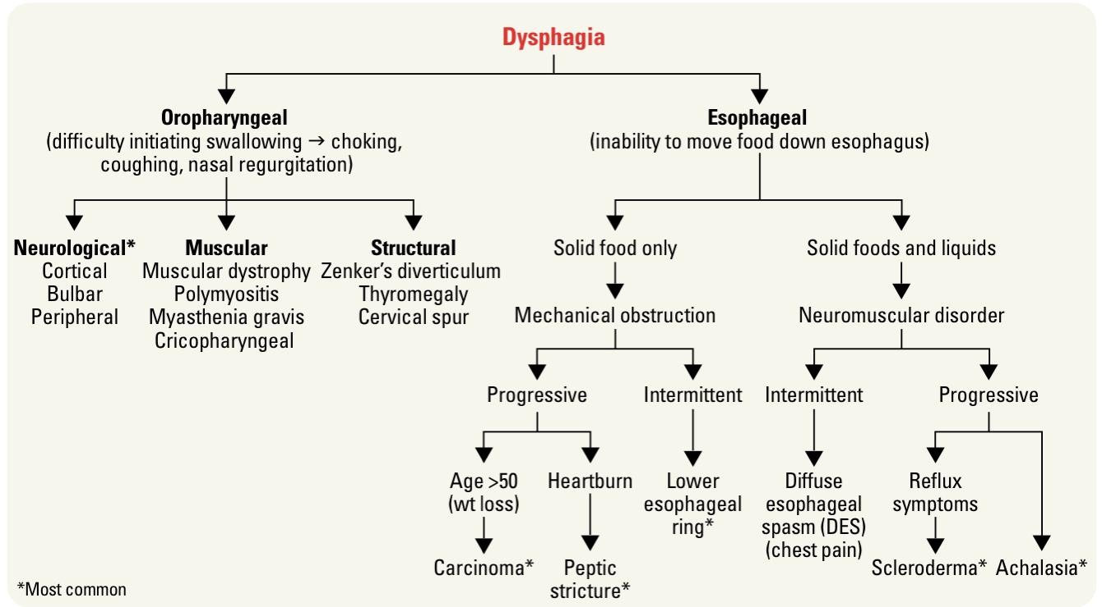
General signs & symptoms
Symptoms
01
Dysphagia: difficulty swallowing
Odynophagia: Pain on swallowing.
02
Heartburn: Retrosternal pain, usually associated with GERD
Dyspepsia: Dyspepsia is something of a ‘catch all’ term used to describe the symptoms of indigestion.
03
Both dysphagia and odynophagia will cause weight loss if symptoms persist for more than a few days
04
Dysphagia can be classified as oropharyngeal or esophageal.
01
Oropharyngeal dysphagia is caused by muscular and neurologic disorders, such as stroke, Parkinson, ALS, NG, Muscular dystrophy, or Zenker’s diverticulum.
02
Patients with esophageal dysphagia report food “sticking” or discomfort in the retrosternal region.
To exclude differentials in dysphagia, it’s helpful to ask about:
Onset: Acute indicates foregin body. Chronic within weeks indicates malignancy
Site; those who feel the obstruction to be high may have a pharyngeal pouch
Progression: Esophageal stricture(Progressive), Motility disorders (Intermittent)
Physical Examination (signs)
01
A smooth tongue, pallor and koilonychia are signs of iron deficiency anaemia, which can be present in oesophageal carcinoma
02
A mass felt in the upper abdomen is usually a bad sign suggesting incurable malignancy.
03
Crepitus in the neck of a patient who has been vomiting is a sign of surgical emphysema and suggests an oesophageal
04
A succussion splash heard over the epigastrium when the patient is gently shaken suggests gastric outlet obstruction.

Slide 4
Basic Overview
Esophageal Diseases
Benign
Malignant
GERD
Barrett’s Esophagus
Achalasia
Diverticula
Diffuse Caustic Injury
Perforation
Benign
tumors
Motility
Disorder
Cancer
Investigations of esophageal diseases
Investigations of esophageal diseases
This is the sequence of investigations for any patient presenting with esophageal symptoms:
01
02
03
Barium swallow “esophagram”
Endoscopy¹. Malignancy suspected? Biopsy
Esophageal Manometry²
Esophageal sphincters
Esophagus has two sphincters:
Upper sphincter: cricopharyngeus.
Lower sphincter: cannot be defined anatomically, 3-5 cm high-pressure area located in the region of esophageal hiatus of the diaphragm.
LES has primary role of preventing reflux of the gastric contents into the esophagus.
When LES has too low pressure to prevent the reflux of gastric contents from entering the esophagus → GERD.
It’s more accurate and diagnostic but invasive, should be saved for confirmation.
Measures esophageal motility and pressure at the lower esophageal sphincter (LES), normally the pressure is between 8-10 mmHg. if it's less than 5 then a reflux occurs. if it's high then it's most likely achalasia.

Slide 5
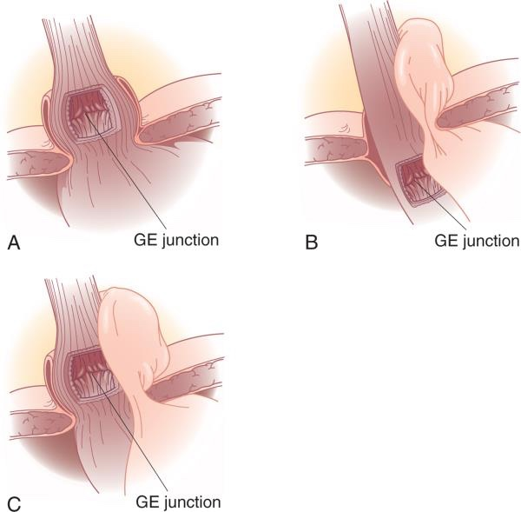
Gastroesophageal Reflux Disease (GERD)
Definition
01
Symptoms OR mucosal damage produced by the abnormal reflux of gastric contents into the esophagus¹
02
LES has primary role of preventing reflux of the gastric contents into the esophagus by maintaining a resting pressure of 15–20 mmHg. When this high pressure zone in the distal esophagus is too low, GERD may occur
03
Often chronic and relapsing.
04
We may see complications of GERD in patients who lack the typical symptoms.
GERD & Hiatal Hernia
A hiatal hernia occurs when a portion of the stomach prolapses through the diaphragmatic esophageal hiatus.
GERD is often associated with a hiatal hernia.
the most common is the type I hernia², also called a sliding-hiatal-hernia (when LES rises up to the level of diaphragm. It’s the associated type of hernia with GERD).
Type II hiatal hernias are often referred as para-esophageal hernias (LES is at a normal level but the stomach is bulging through the diaphragm) and they may be associated with GERD but most commonly present with chest pain and SOB..
Type III is combination of type I & type II
Type IV when there’s another organ herniated into the chest.
About 44% of the US adult population have heartburn at least once a month.
14% of Americans have symptoms weekly. 7% have symptoms daily.
Schematically, the esophagus, lower esophageal sphincter (LES), and stomach can be envisioned as a simple plumbing circuit. The esophagus functions as an antegrade pump, the LES as a valve, and the stomach as a reservoir. The abnormalities that contribute to GERD can stem from any component of the system. Poor esophageal motility decreases the clearance of acidic material. A dysfunctional LES allows reflux of large amounts of gastric juice. Delayed gastric emptying can increase the volume and pressure in the reservoir until the valve mechanism is defeated, leading to GERD. From a medical or surgical standpoint, it’s extremely important to identify which of these components is defective so that an effective therapy can be applied.
Caused in case of excessive negative intra-thoracic pressure or excessive elevation in intra-abdominal pressure (eg: Straining during defecation).

Slide 6
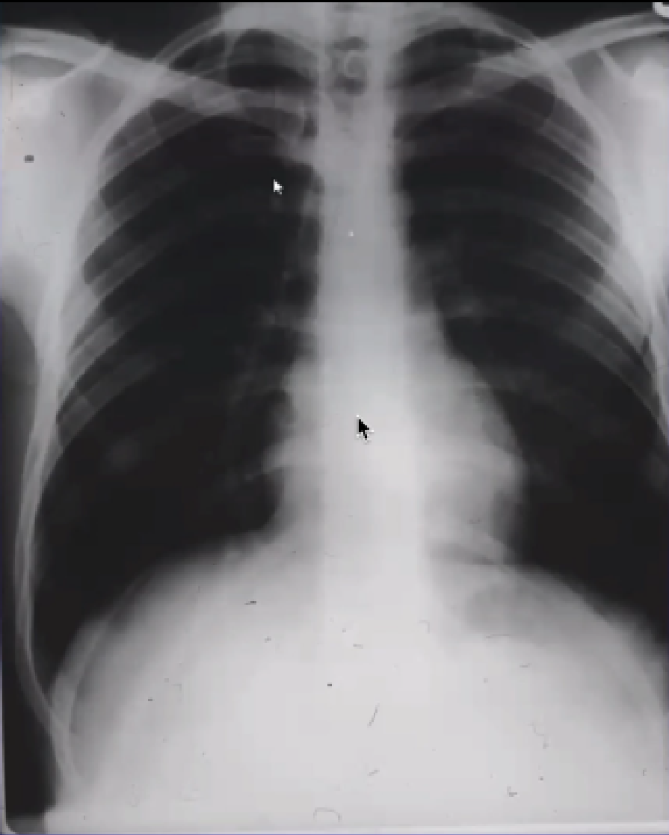
Clinical presentation & Diagnosing of GERDS
Clinical Presentation
Classified into:
Classic GERD
Extra-esophageal (Atypical GERD)
Complicated GERD:
Classic GERD | Extra-esophageal (Atypical GERD) |  |  | Complicated GERD
Substernal Heartburn and/or regurgitation (regurgitation is the sensation of acid/food backing up into the throat or mouth). Postprandial. Aggravated by change of position e.g. laying down. Prompt relief by antacid. | Pulmonary | ENT | Others | Dysphagia: difficulty swallowing (food sticks or hangs up.) Odynophagia retrosternal pain with swallowing. Bleeding.
 | Asthma (if acids reach Bronchial tree which causes spasm and irritation). Aspiration pneumonia. Chronic bronchitis. Pulmonary fibrosis. | Hoarseness (if acids reach vocal cords). Chronic cough. Laryngitis & Pharyngitis (recurrent inflammation every 3-4 months). Globus Sensation. Dysphonia. Sinusitis. Subglottic Stenosis. Laryngeal Cancer. | Chest Pain. Dental Erosion if acids reach Teeth.
pH monitoring
2
Diagnostic tests:
An old method is to insert a probe in the nose till it reaches the esophagus where the pH is measured for 48 hrs.
A newer method is the 'Bravo Capsule' which measures wirelessly.
1
Barium swallowing
3
Endoscopy & Biopsy
No strictures
No tumor
Small hiatus hernia
Evidence of contrast reflux
To detect malignancy
4
Esophageal manometry
Used to measure the motility of the esophagus. Useful in planning for surgery

Slide 7
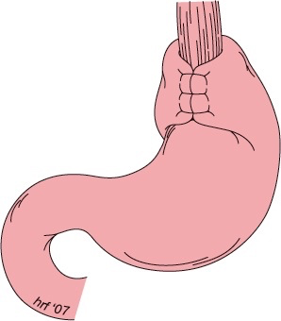
Treatment Of GERD
1
Lifestyle modification :
Elevate head of bed 4-6 inches.
Avoid eating within 2-3 hours of bedtime.
Lose weight if overweight.
Stop smoking.
Modify diet:
Eat more frequent but smaller meals.
Avoid fatty/fried food, peppermint, chocolate, alcohol, carbonated beverages, coffee & tea.
OTC (over-the-counter) medications prn (as needed).
2
Acid suppression therapy
H2 Receptor Antagonists (H2RAs) | Proton Pump Inhibitors (PPIs) “more effective”
-Cimetidine (Tagamet). -Ranitidine (Zantac). -Famotidine (Pepcid). -Nizatidine (Axid) | -Omeprazole (Prilosec). -Lansoprazole (Prevacid). -Rabeprazole (Aciphex). -Pantoprazole (Protonix). -Esomeprazole (Nexium )
3
Anti-Reflux Surgery
Indicated in case of :
Failed medical therapy.
Patient desire.
Complications of GERD (e.g. Barrett's esophagus; grade III or IV esophagitis).
Medical complications attributable to large hiatal hernia (e.g. bleeding, dysphagia).
Atypical symptoms (asthma, hoarseness, cough, chest pain, aspiration) and reflux documented on 24-hour pH monitoring.
4
Endoscopic GERD Therapy
Stretta procedure
Radiofrequency heating of GE junction.
Endoscopic plication TIF.
Suture ligation of the cardia
Enteryx
Submucosal implantation of inert material in the region of the lower esophageal sphincter
Surgical Treatment
When the LES is loose, we strengthen it by doing
'Nissen Fundoplication' which also treats hiatus hernia.

Slide 8
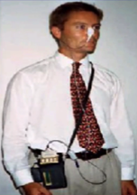
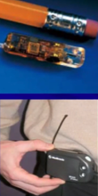
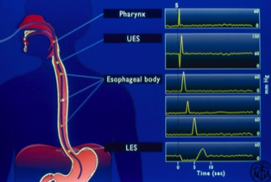
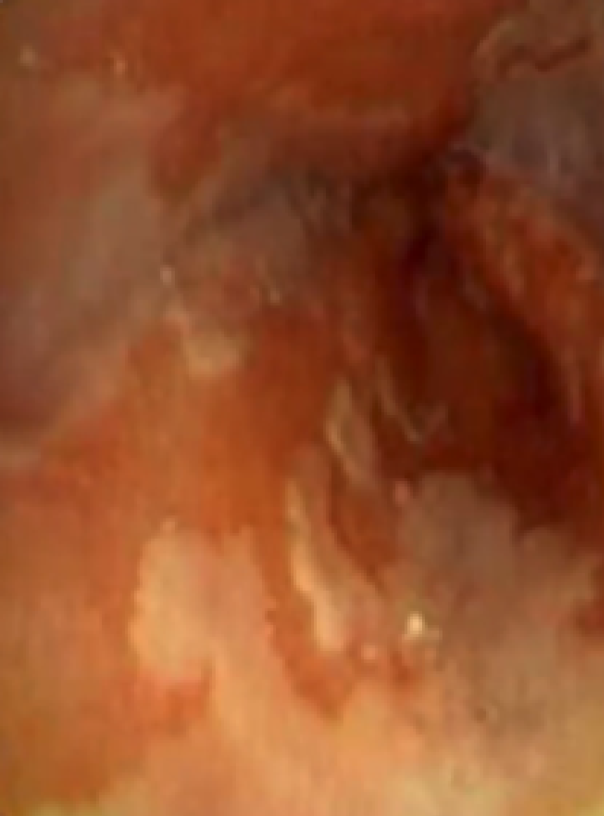
Now, let us start case (1)
50 years old male presented to you in the clinic with history of heartburn and hoarseness. He is obese & smoker.
What else in history?
How many pillows are used? 3 pillows.
Time? postprandial.
Aggravated by spicy food ? yes.
Relieved by antacids? yes, drastically.
Is it complicated or classic GERD? (explained in slide 6)
Examination was unremarkable
What’s the next step? Barium swallow (investigations)
1-Barium
Swallow¹
Findings:-
A
2-Esophageal
pH Monitoring
No strictures
No tumor
Small hiatus hernia
Evidence of contrast reflux
Precede to Endoscopy to exclude barrett’s disease
A device that’s used at home to measure the pH within the esophagus for 48hr
3- Esophageal manometry
4- Esophageal endoscopy
Check esophageal peristalsis
Used mainly in planning for surgery
Redness
Any Endoscopic abnormality is an indication for biopsy (suspect barrett’s disease).
B
5- Esophageal biopsy
Pathology report :
Esophagitis with intestinal, columnar epithelium replaces the stratified squamous epithelium (metaplasia), no evidence of dysplasia.
We don’t consider this metaplasia “Barrett’s Esophagus” unless goblet cells are found on biopsy.
Case will be continued...
1.
Barium Swallow for esophagus
Barium Meal for stomach
Barium Follow-through for Small bowel
Barium Enema for large bowel
Picture A: CXR is usually normal in patients with GERD. Unless the patient has pneumonia or bronchitis secondary to the GERD.
Picture B: Pale pink → normal esophageal epithelium. Red spots → metaplasia.
Cases are in the following slides:
8,9,11,15,19,25

Slide 9
Now, let us continue case (1)
Patient diagnosed with Barrett’s disease, what’s next ?
Treatment:
Explained in slide 7¹
You have advised the patient to : Reduce weight & Quit smoking
You have Started the patient on: Nexium 40mg od
we should schedule the patient for endoscopy every 6 months to monitor and avoid the progression of Barrett’s disease to cancer.
Barrett's Esophagus
Definition:
A condition whereby an intestinal columnar epithelium with goblet cells, replaces the stratified squamous epithelium that normally lines the distal esophagus.
Clinical Features:
01
Chronic gastroesophageal reflux is the factor that both injures the squamous epithelium and promotes repair through columnar metaplasia.
02
Although these metaplastic cells may be more resistant to injury from reflux, they also are more prone to malignancy “Adenocarcinoma”.
10% of patients with GERD develop Barrett's esophagus.
03
The 40-fold increase in risk for developing esophageal carcinoma in patients with Barrett's esophagus.
70 % of patients are men aged 55 to 63 years
Men have a 15 - fold increased incidence over women of adenocarcinoma of the esophagus , but women with Barrett's esophagus are increasing in number as the differences in the Western lifestyle between men and women diminish
04
With continued exposure to the reflux disease, metaplastic cells undergo cellular transformation to low- and high-grade dysplasia.
These dysplastic cells may evolve to cancer
Briefly :
Appropriate treatment (for both GERD & Barrett’s) depends on many factors, but usually we focus on lifestyle modifications (weight loss, smoking cessation, avoid sleeping after having a meal).
Surgery is indicated only if medical therapy has failed or if the patient asked for a surgery

Slide 10
Barrett's Esophagus
Symptoms
Many patients harboring intestinal metaplasia in their distal esophagus are asymptomatic.
Most patients present with symptoms of GERD.
Recurrent respiratory infection, asthma & infections in the head and neck are common complaints
Diagnosis
GERD is diagnosed by history & endoscopy. Barrett’s is diagnosed histologically.
The diagnosis of BE is made by endoscopy and pathology.
The presence of any endoscopically visible segment of columnar mucosa within the esophagus that on pathology identifies intestinal metaplasia defines BE.
Treatment
Yearly surveillance endoscopy is recommended in all patients with a diagnosis of Barrett's esophagus.
For patients with low - grade dysplasia, surveillance endoscopy is performed at month intervals for the first year and then yearly thereafter if there has been no change
Patients undergoing surveillance are placed on acid suppression medication and monitored for changes in their reflux symptoms.
Controversy surrounds the benefits of anti-reflux surgery in patients with Barrett's esophagus.
Those in favour of surgery argue that medical therapy and endoscopic surveillance may treat the symptoms but fail to address the problem.
The problem is the functional impairment of the LES that leads to chronic reflux and metaplastic transformation of the lower esophageal mucosa.
Surgery renders the LES competent and restores the barrier to reflux.
Studies have demonstrated regression of metaplasia to normal mucosa up to 57% of the time in patients who have undergone antireflux surgery.
Photodynamic therapy (PDT) is the most common ablative method used to treat BE.
Endoscopic mucosal resection (EMR) is gaining favor for the treatment of Barrett's esophagus with low - grade dysplasia.
Esophageal resection for Barrett's esophagus is recommended only for patients in whom high-grade dysplasia is found.
Pathologic data on surgical specimens demonstrate a 40% risk for adenocarcinoma within a focus of high-grade dysplasia.

Slide 11
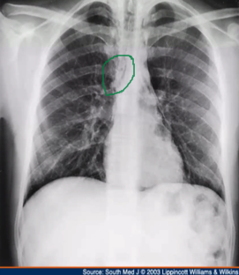
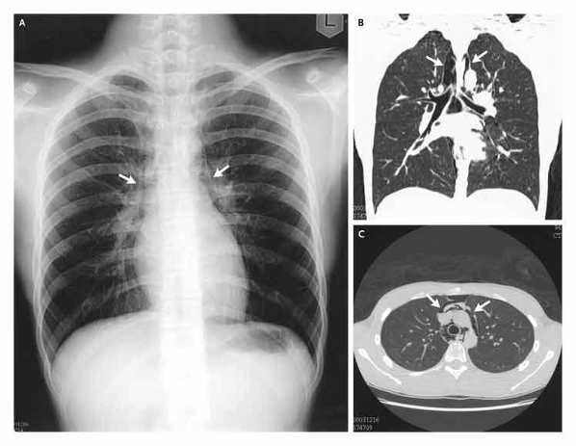
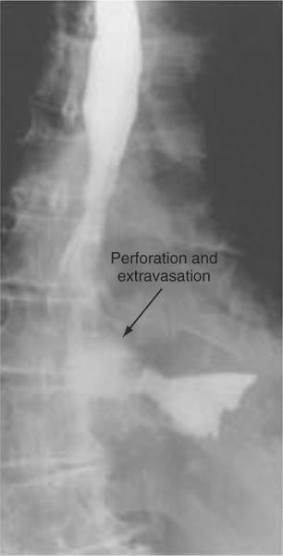
Now, let us continue case (1)
3 months later, you did endoscopy for the patient, 6 hour post-endoscopy patient start to complain of:
Chest Pain
Fever
Classic symptoms of esophageal perforation caused by endoscopy, which’s a common incident.
What else in history?
Odynophagia (pain with swallowing).
Low grade fever
What would you suspect?
Esophageal Perforation
How to confirm?
Barium swallowing
What’s your management plant ?
Look at slide 14.
A
B
C
Case will be continued...
Esophageal Perforation
Early detection and surgical repair within the first 24 hours results in 80% to 90% survival
A surgical emergency
After 24 hours, survival decreases to less than 50%
Picture A : Shows black line in the barium (within the green circle) which indicates perforation “Pneumomediastinum”.
Picture B : Arrows show leakage of barium swallow due to perforation.
Picture C : Severe perforation at which the barium extravasate from esophagus.

Slide 12
Esophageal Perforation
1
Etiology:
Most esophageal perforations occur after endoscopic instrumentation for a diagnostic or therapeutic procedure,
Perforation from forceful vomiting (Boerhaave's syndrome), foreign body ingestion, or trauma accounts for 15%, 14%, and 10% of cases, respectively
Perforation of the esophagus is a surgical emergency
2
History:
History of trauma, advanced esophageal cancer, violent retching as seen in Boerhaave's syndrome, swallowing of a foreign body, or recent instrumentation must raise the question of esophageal perforation
Don’t forget endoscopic procedure history !
3
Symptoms
Symptoms of neck, substernal , or epigastric pain are consistently associated with esophageal perforation
Vomiting, hematemesis, or dysphagia also may accompany them
history of trauma, advanced esophageal cancer, violent wretching as seen in, swallowing of a foreign body, or recent instrumentation must raise the question of esophageal perforation
01
02
03
04
Boerhaave's syndrome
Cervical Perforation
Thoracic Perforation
Abdominal Perforation
present with shortness of breath and retrosternal chest pain lateralizing to the side of perforation
Abdominal perforations present with epigastric pain that radiates to the back if the perforation is posterior
Boerhaave syndrome is due to the rupture of the esophagus due to forceful emesis. The disorder may present with vague symptoms or one may note the classic Mackler triad of vomiting, chest pain, and subcutaneous emphysema.
may present with neck ache and stiffness due to contamination of the prevertebral space Thoracic perforations present with shortness of breath and retrosternal chest pain lateralizing to the side of perforation

Slide 13
Esophageal Perforation
4
Signs
With increased mediastinal and pleural contamination, patients progress toward hemodynamic instability
On exam, subcutaneous air in the neck or chest, shallow decreased breath sounds, or a tender abdomen are all suggestive of perforation.
On examination , patient may present with tachypnea, tachycardia, and a low grade fever but have no other overt signs of perforation
5
Investigations:
Diagnosis of an esophageal perforation may be made radiographically “Barium swallow + CT”
A chest roentgenogram may demonstrate a hydropneumothorax
A contrast esophagram is done using barium for a suspected thoracic perforation and Gastrografin for an abdominal perforation.
Chest CT shows mediastinal air and fluid at the site of perforation
A surgical endoscopy needs to be performed if the esophagram is negative or if operative intervention is planned.
Mucosal injury is suggested if blood, mucosal hematoma, or a flap is seen or if the esophagus is difficult to insufflate.
Laboratory values of significance are an elevated white blood cell count and an elevated salivary amylase in the blood or pleural fluid.
Most perforations are found above the Gastroesophageal junction on the left lateral wall of the esophagus which results in a 10% false - negative rate in the contrast esophagram if the patient is not placed in the lateral decubitus position
A
B
C

Slide 14
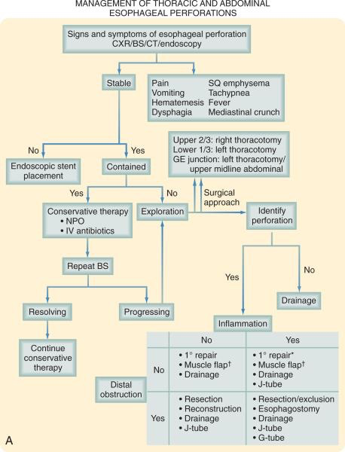
Esophageal Perforation
6
Management:
The picture is a detailed management plan. But simply:
Stable patient
Small perforation.
No Hypertension, no sepsis, no fever.
Treat the patient with conservative therapy.
Conservative therapy involves preventing the patient from eating (NPO) for at least 10-14 days.
Supply food through central line TPN.
Antibiotics immediately for 10-14 days.
A barium swallow needs to be performed at the end of therapy.
after the barium swallow; if there is still a perforation consider surgery
Unstable patient
Consider surgery.
A surgical endoscopy is needed if operative intervention is planned.
Patients with an esophageal perforation can progress rapidly to hemodynamic instability and shock
perforation is suspected, appropriate resuscitation measures with the placement of large - bore peripheral IV catheters, a urinary catheter, and a secured airway are undertaken before the patient is sent for diagnostic testing
IV fluids and broad - spectrum antibiotics are started immediately, and the patient is monitored in an ICU
The patient is kept NPO, and nutritional access needs are assessed
Surgery is not indicated for every patient with a perforation of the esophagus
Management is dependent on several variables: stability of the patient, extent of contamination, degree of inflammation, underlying esophageal disease, and location of perforation
The most critical variable that determines the surgical management of an esophageal perforation is the degree of inflammation surrounding the perforation.
The final variable to consider in the surgical management of esophageal perforations is the location of the perforation
When patients present within 24 hours of perforation, inflammation is generally minimal, and primary surgical repair is recommended
With time, inflammation progresses, and tissues become friable and may not be amenable to primary repair.

Slide 15
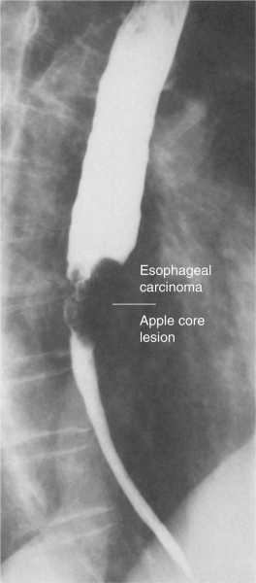
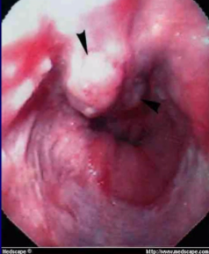
Now, let us continue case (1)
Patient improved and he was discharged home & scheduled for follow up.
Patient didn’t show up for the follow up.
6 years later, he presented to your clinic complaining of :
Dysphagia
Weight loss
What else in history?
Ask about appetite: loss of appetite indicates malignancy
What’s your differentials?
How you going to manage this patient?
5 year survival.
70% with polypoid lesions.
15% with advanced tumors.
Diagnosis
Barium swallow showed this picture of congested, dilated esophagus¹+ Apple core lesion.
Endoscopy showed masses at distal esophagus = Biopsy is needed.
Biopsy revealed: Adenocarcinoma.
Treatment
Stage the tumor first to choose the proper management plan.
If the tumor is localized to the mucosa (early cancer): Surgery.
If metastasized to the lymph nodes: Chemotherapy “Neoadjuvant chemotherapy²” then surgery.
Distant metastasis: radiotherapy and chemotherapy.
End of case (1)
Carcinoma of the Esophagus
Esophageal cancer is the fastest growing cancer in the western countries
Survival based on the stage of the disease
Squamous cell carcinoma still accounts for most esophageal cancers diagnosed
However, in the US esophageal adenocarcinoma now accounts for nearly 70% of all esophageal carcinomas diagnosed in Western countries
BS showed a filling defect due to obstruction. And the dilatation of the esophagus is attributed to increased pressure.
We have two types of chemotherapy: 1- Adjuvant chemotherapy is administered after surgery for the treatment of cancer. Adjuvant chemotherapy is designed to prevent recurrence of the disease. 2- Neoadjuvant chemotherapy is administered before surgery for the treatment of cancer. Neoadjuvant chemotherapy is recommended due to the size of the tumor, since the drugs may shrink the tumor and give you more surgical options. Neoadjuvant chemotherapy in this case is needed to “sterilize” lymph nodes from cancer cells, because surgery cannot be done unless we ensure the success of chemotherapy.

Slide 16
Carcinoma of the Esophagus
01
Squamous cell carcinoma
Arise from the squamous mucosa that is native to the esophagus.
Found in the upper and middle third of the esophagus 70% of the time.
Smoking and alcohol both increase the risk for foregut cancers by 5-fold. Combined.
Food additives, including nitrosamines found in pickled and smoked foods, long-term ingestion of hot liquids.
Caustic ingestion -Ingestion of materials that cause injury or burn to the esophagus-, achalasia, bulimia, tylosis (an inherited autosomal dominant trait), Plummer-Vinson syndrome, external-beam radiation, and esophageal diverticula all have known associations with squamous cell cancer.
02
Esophageal Adenocarcinoma
01
03
02
High acidity
Dysplasia
Barrett’s
Progressive changes from metaplastic (Barrett's esophagus ) to dysplastic cells may lead to the development of esophageal adenocarcinoma
As an adaptive measure, the squamous - lined distal esophagus changes
to become lined with metaplastic columnar epithelium (Barrett's esophagus )
Associated with GERD
Occurs as consequence of esophageal metaplasia & Barrett’s disease
The 5 - year survival rate varies but can be as good as 70% with polypoid lesions and as poor as 15% with advanced tumors . esophageal adenocarcinoma now accounts for nearly 70% of all esophageal carcinomas diagnosed in Western countries
There are a number of factors that are responsible for this shift in cell type:
Western diet leads to obesity.
Increasing incidence of GERD.
Increased use of acid-suppression medications
Intake of caffeine, fats, and acidic and spicy foods all lead to decreased tone in the LES and an increase in reflux → increase risk of Barrett’s metaplasia.

Slide 17
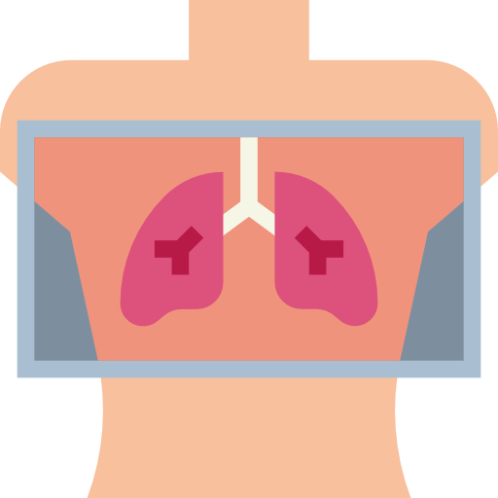
Carcinoma of the Esophagus
appears only when 75% of esophagus is occluded by tumors
Early-stage cancers may be asymptomatic or mimic symptoms of GERD.
Most patients with esophageal cancer present with dysphagia and weight loss.
Because of the distensibility of the esophagus, a mass can obstruct two thirds of the lumen before symptoms of dysphagia are noted.
Choking, coughing, and aspiration from a tracheoesophageal fistula, as well as hoarseness and vocal cord paralysis from direct invasion into the recurrent laryngeal nerve, are ominous signs of advanced disease
Systemic metastases to liver, bone, and lung can present with jaundice, excessive pain, and respiratory symptoms.
Clinical
Feature
There are a plethora of modalities available to diagnose and stage esophageal cancer.
Radiologic tests, endoscopic procedures, and minimally invasive surgical techniques all add value to a solid staging workup in a patient with esophageal cancer.
Details at next page.
Diagnosis
Depends on the clinical stage.
Usually combined multimodality therapy.
Chemotherapy + radiotherapy +/- surgery.
Don’t forget to check notes in case (1) slide (14)
Treatment

Slide 18
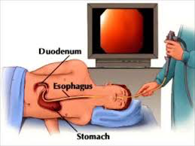
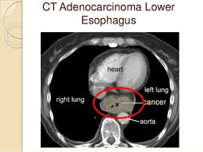
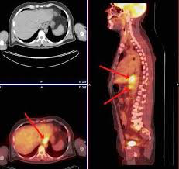
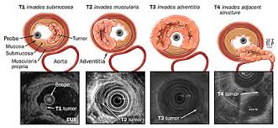
Malignant Esophageal Tumor diagnosis
Esophagram
A barium esophagram is recommended for any patient presenting with dysphagia.
Able to Differentiate:
Intraluminal vs. intramural lesions.
Intrinsic vs. extrinsic compression.
The classic finding of an apple-core lesion in patients with esophageal cancer is recognized easily.
Although the esophagram will not be specific for cancer, it is a good first test to perform in patients presenting with dysphagia and a suspicion of esophageal cancer
The diagnosis of esophageal cancer is made best from an endoscopic biopsy
any patient undergoing surgery for esophageal cancer must have an endoscopy performed by the operating surgeon before entering the operating room for a definitive resection
Endoscopy
Computed Tomography
CT scan of the chest and abdomen and pelvis:
Assess the length of the tumor .
Thickness of the esophagus and stomach.
Regional lymph node status.
Distant disease to the liver and lungs.
PET scan evaluates:
The primary mass.
Regional lymph nodes.
Distant metastasis.
Its sensitivity and specificity slightly exceed those of CT; however, they remain low for definitive staging
Positron
Emission Tomography
EUS is the most critical component of esophageal cancer staging.
The information obtained from EUS will help guide both medical and surgical therapy
biopsy samples can be obtained of the mass and lymph nodes in the paratracheal , subcarinal , paraesophageal , celiac region
Endoscopic Ultrasound

Slide 19
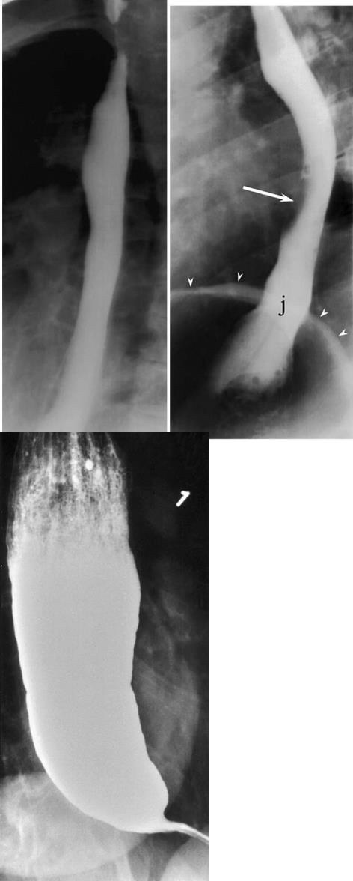
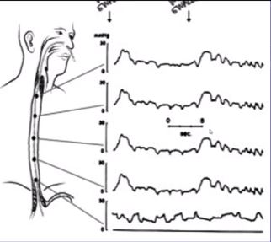
Now, let us start case (2)
24 years old healthy presented to your clinic complaining of:
Dysphagia
How you going to manage this patient?
Suspect Esophageal motility disorder “achalasia is the most common one”. Another type is Diffuse Esophageal Spasm.
Investigate by barium swallow + Esophageal manometry
Barium swallow (diagnostic test) showed this picture of Bird’s beak deformity
Three abnormalities:
Aperistalsis
Hypertensive LES
Closed LES
Diagnosis
Esophageal Manometry (confirmatory test) showed no peristalsis
Endoscopy showed:
Dilated esophagus.
Retained food particles.
Treatment
First line treatment is surgical myotomy “Heller’s myotomy”.
Second line is pneumatic dilation.
These two are done to relieve the pressure of lower esophageal sphincter.
End of case (2)
Achalasia
is an uncommon disease. However ,it is the most common type of esophageal motility disorders.
It is characterized by partial or complete degeneration of the myenteric plexus of Auerbach that innervate LES and esophageal body.
Introduction

Slide 20
Achalasia
Pathogenesis:
01
Primary : Autoimmune? Viral? Familial?
The most concerning secondary etiology is cancer, which can present as achalasia through mechanical obstruction of the GEJ
Chagas disease is a parasitic infection caused by Trypanosoma cruzi which can cause secondary achalasia (Remember, T.cruzie cause mega-esophagus and mega-colon)
02
03
Additional secondary forms of achalasia exist
An increasingly recognized etiology is post fundoplication achalasia caused by mechanical obstruction of the GEJ by the fundoplication or diaphragmatic crural closure
Similar cases have been described following bariatric surgery using a gastric band device which constricts the proximal stomach a few centimeters below the LES
Clinical Feature
2 Peaks: age of 20s and 60s.
An Equal males-to-females gender distribution.
Most common presenting symptoms (in order):
The main feature is failure of relaxation of the lower esophageal sphincter.
Dysphagia (first most common symptom): to both solids & liquids ~90%.
Others:
Heartburn (in 30% of patients).
chest pain (in 20%-60% of patients)
May be related to direct irritation of the esophageal lining by retained content, or acidic byproducts of bacterial metabolism of retained food.
01
Regurgitation (2nd most common symptom): occurring in 60% of patients.
Nocturnal regurgitation of esophageal contents→ night-time cough & aspiration.
Weight loss occurs in end-stage disease.
03
02

Slide 21
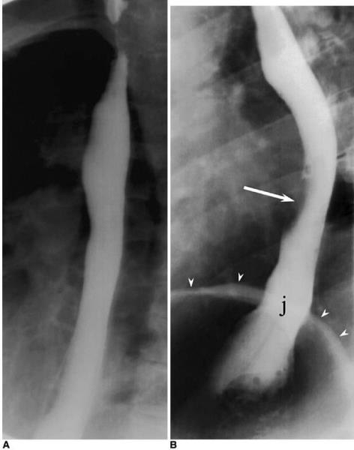
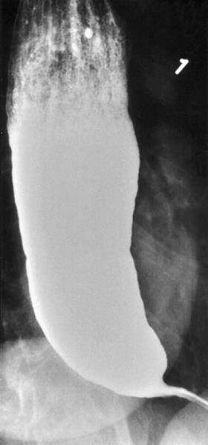
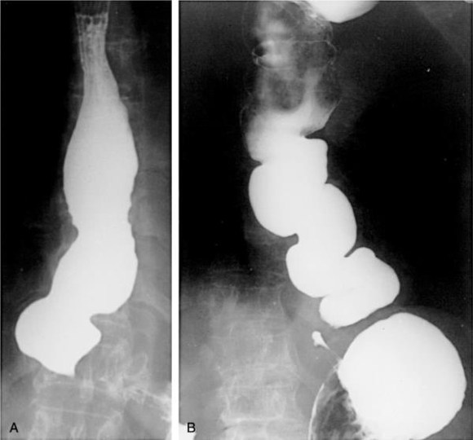
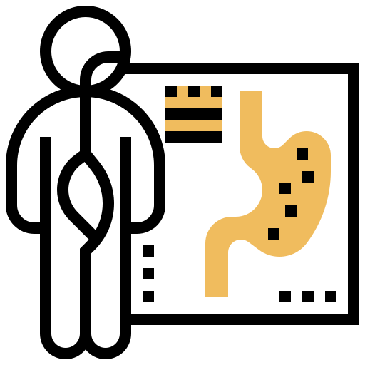
Achalasia
Diagnostic tests for achalasia:
CXR: may show air - fluid level
Barium study: quite dilated, and an air - fluid level may be secondary to retained secretions.
The classic finding is a gradual tapering at the end of the esophagus , similar to a bird's beak
Chest X-ray & Barium
swallow
Pictures show paralized esophagus with constricted LES
Bird beaks
Upper endoscopy is the next diagnostic test in a patient with dysphagia or suspected achalasia
Findings can include :
dilated esophagus with retained food or secretions
normal in as many as 44% of patients with achalasia Difficulty traversing the GEJ should raise suspicion for pseudoachalasia due to neoplastic infiltration of the distal esophagus
Endoscopy
Esophageal manometry has the highest sensitivity for the diagnosis of achalasia :
aperistalsis of the distal esophageal body
incomplete or absent LES relaxation
hypertensive LE
Manometric variants of achalasia exist
Variants are some conditions that resemble achalasia aperistalsis in manometry - called also pseudoachalasia
The best known is vigorous achalasia
defined by the presence of normal to high amplitude esophageal body contractions in the presence of a nonrelaxing LES
Vigorous achalasia may represent an early stage of achalasia
Esophageal Manometry

Slide 22
Achalasia
Complications
01
The primary complications of achalasia are related to the functional obstruction progressive malnutrition and aspiration.
Uncommon but important secondary complications of achalasia include:
02
03
Epiphrenic
diverticula
Esophageal cancer : the most common is squamous cell carcinoma.
The overall prevalence of esophageal cancer in achalasia is approximately 3 % with an incidence of approximately 197 cases per 100,000 persons per year
Treatment
The primary therapeutic goal in achalasia is to reduce the LES basal pressure (to relax the LES)
Treatment options include medical therapy, botulinum toxin injection, pneumatic dilation, and surgical myotomy
Symptom relief, particularly relief of dysphagia , is accepted as the primary desired outcome
We can’t restore movement of a paralysized muscle! So we have to target the LES relaxation in our therapy.
Detailed treatment plan in next slide

Slide 23
Achalasia
Decrease the LES pressure by causing smooth muscle relaxation.
Inconvenient as they are:
Partially effective.
Frequently associated with side effects.
It is reserved for patients who are awaiting or unable to tolerate more invasive treatment modalities.
Medical therapy
Nitrat
Calcium channel Blockers
First recognized as an effective treatment of achalasia.
Their systemic vasodilatory effects and headaches limit their tolerability by patients.
Have a better side-effect profile when compared with nitrates.
30% of patients report adverse side effects including peripheral edema, hypotension, and headache.
Response rates at 1 month following administration average 78% , By 6 months, the clinical response rate drops to 58% and by 12 months to 49% (Efficacy up to 6-12 months)
Given the limitations of the efficacy and durability of response, botulinum toxin is generally reserved for use in patients who are not candidates for more invasive treatments
injected into the LES targets the excitatory, acetylcholine releasing neurons that generate LES basal muscle tone.
Botulinum toxin injection
pneumatic dilation remains one of the most effective 1st-line therapies for achalasia
Long - term follow - up studies reported significant symptom relapse of 50% at 10 years
Complications of pneumatic dilation exist :
Gastroesophageal reflux 25 - 35%
Esophageal perforation 3 %
Pneumatic dilation
Remember:
The ideal therapy is surgical myotomy “Heller’s myotomy”.
Second best option is pneumatic dilation.

Slide 24
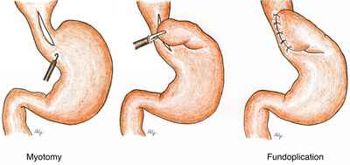
Achalasia
has success rates in excess of 90% with hospital stays averaging only a few days
The difference between Myotomy and Fundiplication
Surgical myotomy
acid exposure is a known complication of surgical intervention for achalasia
Even with a successful myotomy , it is expected that patients will have some degree of dysphagia as a consequence of esophageal peristaltic dysfunction
Delayed recurrence of postoperative dysphagia is most commonly caused by development of a recurrent high pressure zone at the LES or a peptic stricture complicating acid reflux
laparoscopic Heller myotomy demonstrated excellent results, with 98 % of patients reporting symptomatic improvement at 5.3 years
Refractory achalasia:
In patients with achalasia that is refractory to therapy with Heller myotomy, options are limited
Although esophagectomy is considered in patients with marked dilation and sigmoid deformity, such patients may respond to Heller myotomy
Myotomy
Several retrospective and prospective studies have reported superior success rates for surgery when compared with pneumatic dilation
a study of outcomes of 1181 patients treated with pneumatic dilation with that of 280 patients treated with Heller myotomy as initial therapy showed that the risk of subsequent therapeutic intervention at 10 years was significantly higher with dilation (64%) when compared with surgery (38%)
In patients with achalasia that is refractory to therapy with Heller myotomy , options are limited
Although esophagectomy is considered in patients with marked dilation and sigmoid deformity, such patients may respond to Heller myotomy
Refractory Achalasia
The increase in the pressure makes the inner layers of the esophagus bulge out through a weak spots in the outer lining.
Picture A: There’s a slit-like gap caused by diverticulum where food is stuck and fermented resulting in bad breath.

Slide 25
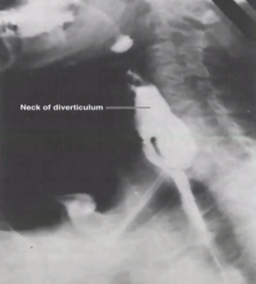
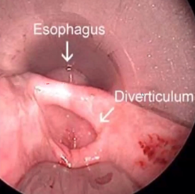
Esophageal diverticula
Now, let us Start case (3)
70 year old male, his wife brought him to your clinical because:
Bad breath (Halitosis)
Chronic cough especially after eating
How are you going to manage this patient?
We have to exclude mouth & dental disorders
As usual : first test is barium swallow
What’s the cause of bad breath?
Undigested food particles in the diverticula
Management?
Diverticulectomy & Myotomy
If we do diverticulectomy alone, the diverticula may reform again because its etiology -high pressure caused by smooth muscles- is still present, so we do myotomy first.
look at slide 26 for more details
What is the cause of diverticula ? and what is the most common sites?
most diverticula are a result of a primary motor disturbance or an abnormality of the UES or LES¹
can occur in several places along the esophagus
The three most common sites of occurrence are pharyngoesophageal (Zenker's, parabronchial midesophageal), and epiphrenic
A
End of case (3)
The increase in the pressure makes the inner layers of the esophagus bulge out through a weak spots in the outer lining.
Picture A: There’s a slit-like gap caused by diverticulum where food is stuck and fermented resulting in bad breath.

Slide 26
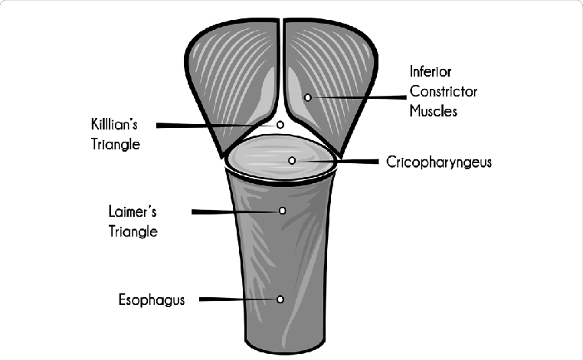
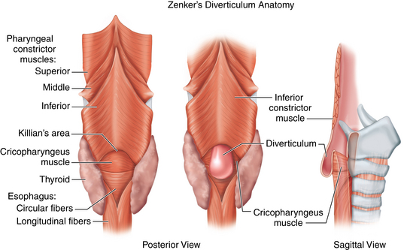
Esophageal diverticula
Three most common sites:
01
02
03
Pharyngoesophageal (Zenker’s):
Is the most common esophageal diverticulum found today.
Disease of elderly (7th decade of life).
Herniation into Killian's triangle between:
Oblique fibers of the thyro-pharyngeus muscle.
Horizontal fibers of the crico-pharyngeus muscle.
Parabronchial (midesophageal).
Epiphrenic:
pulsion diverticula of the distal esophagus arising just above the lower esophageal sphincter
Killian's triangle
True Diverticulum
VS
False Diverticulum
Involve all layers of the esophageal wall, including mucosa, sub-mucosa, and muscularis
True diverticulum (Traction) Results from:
External inflammatory mediastinal lymph nodes adhering to the esophagus..
Consists of mucosa and submucosa only.
Pulsion (pressure) diverticula:
Pulsion diverticula are false diverticula that occur because of elevated intraluminal pressures generated from abnormal motility disorders
It includes: Zenker's & epiphrenic diverticulum.

Slide 27
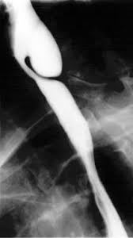
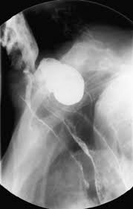
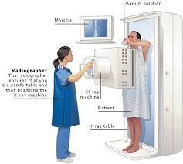
Esophageal diverticula
Symptoms
Commonly, patients complain of a sticking in the throat.
Nagging cough, excessive salivation, and intermittent dysphagia often are signs of progressive disease.
As the sac increases in size, regurgitation of foul-smelling, undigested material is common.
Halitosis (chronic bad breath), voice changes, retrosternal pain, and respiratory infections are especially common in the elderly population.
The most serious complication from an untreated Zenker's diverticulum is aspiration pneumonia or lung abscess.
Presentation & Investigations
Management
Commonly, patients complain of a sticking in the throat.
Diagnosis is made by barium esophagram.
Neither esophageal manometry nor endoscopy are needed to make a diagnosis of Zenker's diverticulum.
Surgical or endoscopic repair is the gold standard of treatment.
Open repair involve : myotomy of the proximal and distal thyropharyngeus and cricopharyngeus muscles
diverticulectomy or diverticulopexy are performed through an incision in the left neck
An alternative to open surgical repair is the endoscopic Dohlman procedure
Endoscopic division of the common wall between the esophagus and the diverticulum using a laser or stapler has also been successful

Slide 28
The following topics aren’t part of the slides that the doctor presented during the lecture, but they’re part of the slides that the doctor sent as reference.
Caustic Injury
Definition & Etiology:
The injury that’s caused by ingestion of caustic materials
the best cure for this condition is an ounce of prevention
In children, ingestion of caustic materials is accidental and tends to be in small quantities
In teenagers and adults, however, ingestion usually is deliberate during suicide attempts, and much larger quantities of caustic liquids are
01
Alkali ingestion is more common than acid ingestion because of its lack of immediate symptoms.
02
Alkali ingestion are much more devastating and almost always lead to significant destruction of the esophagus.
Three Phases of Tissue Injury From Alkali Ingestion
Phase | Tissue injury | Onset | Duration | Inflammatory response | Symptoms
1 | Acute necrosis. | 1-4 days. | 1-4 days. | Coagulation of intracellular proteins. | -Oral and substernal pain -Hypersalivation -Odynophagia & dysphagia -Vomiting & Hematemesis.
 |  |  |  | Inflammation.
2 | Ulceration & granulation. | 3-5 days. | 3-12 days. | Tissue sloughing. | Symptoms may disappear.
 |  |  |  | Granulation of ulcerated tissue bed.
3 | Cicatrization & scarring. | 3 days. | 1-6 months. | Adhesion formation. | Dysphagia reappears; as fibrosis and scarring begin to narrow the esophagus.
 |  |  |  | Scarring.

Slide 29
Caustic Injury
1st Stage: Patients may complain of oral and substernal pain, hyper salivation, odynophagia and dysphagia, hematemesis, and vomiting.
2nd Stage: These symptoms may disappear only to see dysphagia reappear as fibrosis and scarring begin to narrow the esophagus throughout stage three.
Symptoms of respiratory distress, such as hoarseness, stridor, and dyspnea, suggest upper airway edema and are usually worse with acid ingestion.
Pain in the back and chest may indicate a perforation of the mediastinal esophagus, whereas abdominal pain may indicate abdominal visceral perforation.
Clinical
Feature
Diagnosis is initiated with a physical exam specifically evaluating the mouth, airway, chest, and abdomen.
Careful inspection of the lips, palate, pharynx, and larynx is done.
The abdomen is examined for signs of perforation.
Early endoscopy is recommended 12 to 24 hrs after ingestion to identify the grade of the burn.
Serial chest and abdominal radiographs are indicated to follow patients with questionable chest and abdominal exams.
Diagnosis
Management of the acute phase is aimed at limiting and identifying the extent of the injury.
It begins with neutralization of the ingested substance.
Alkalis (including lye) are neutralized with half-strength vinegar or citrus juice.
Acids are neutralized with milk, egg whites, or antacids.
Emetics and sodium bicarbonate need to be avoided because they can increase the chance of perforation.
Depends on the types of burns, There treatment will be as follow:
Treatment

Slide 30
Caustic Injury
1
First-Degree Burn:
48 hours of observation is indicated.
Oral nutrition can be resumed when a patient can painlessly swallow saliva.
A repeat endoscopy and barium esophago-gram are done in follow-up at intervals of 1, 2, and 8 months.
2
Second- and Third-Degree Burns:
Resuscitation is aggressively pursued.
The patient is monitored in the ICU.
kept (NPO) with IV fluids. IV antibiotics and a proton pump inhibitor are started.
Fiber optic intubation may be needed and must be available.
Degree of Burns | Endoscopic Evaluation |  |  |  | Treatment
First Degree | Mucosal Hyperemia |  |  |  | 48-h Observation
 | Edema |  |  |  | Acid Suppression
Second Degree | Limited Hemorrhage |  |  |  | Aggressive IV Resuscitation
 | Exudates |  |  |  | IV Antibiotics
 | Ulceration |  |  |  | Acid Suppression
 | Pseudomembrane Formation |  |  |  | -
Third Degree | Mucosal Sloughing |  |  |  | Inhaled Steroids
 | Deep Ulceration |  |  |  | Fiberoptic Intubation
 | Massive Hemorrhage |  |  |  | -
 | Complete Luminal Obstruction |  |  |  | -
 | Charring |  |  |  | -
 | Perforation |  |  |  | -

Slide 31
Benign Esophageal Tumors, Cysts and Pedunculated Intraluminal Tumors (Polyps)
EXTRA
Benign Esophageal Tumors
Benign tumors are rare (< 1 %).
Classified in two groups:
1
Extramucosal (intramural)
2
Mucosal
Or classified by:
60%
20%
5%
<2%
benign neoplasms are leiomyomas.
Cysts
Polyps
Others
Cysts
Pedunculated Intraluminal tumors (Polyps)
Arise as diverticula of the embryonic foregut.
¾ of this cyst present in childhood.
60% are located along the right side of the esophagus.
60% present in the first year of life with either respiratory or esophageal symptoms.
Cyst found in the upper third of the esophagus present in infancy while lower third lesions present later in childhood.
Rare.
Occur in older men and may cause intermittent dysphagia.
Easily missed with barium swallow and esophagoscopy.

Slide 32
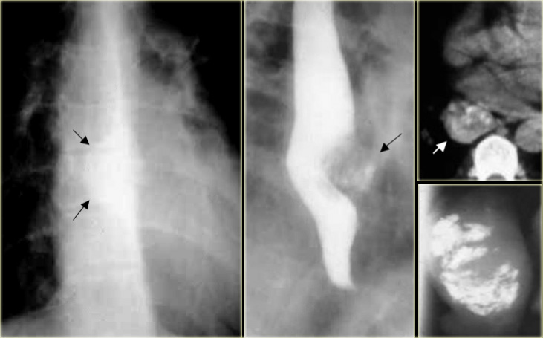
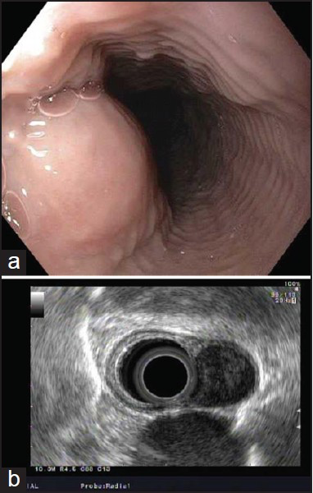
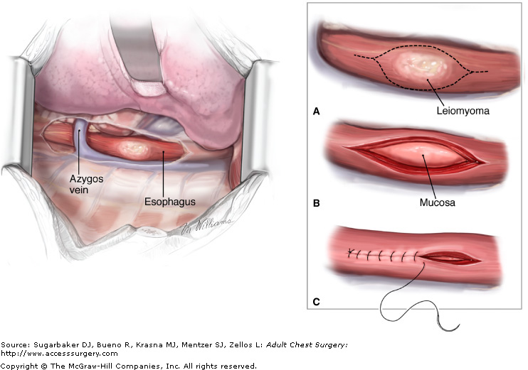
Leiomyomas
60% of all benign esophageal tumors.
Found in men slightly more than women.
Present in the 4th and 5th decades.
They are found in the distal two thirds of the esophagus more than 80% of the time.
They are usually solitary and remain intramural, causing symptoms as they enlarge.
Recently, they have been classified as a gastrointestinal stromal tumor (GIST).
GIST are the most common mesenchymal tumors of the GIT and can be benign or malignant.
All leiomyomas are benign with malignant transformation being rare.
Nearly all GIST tumors occur from mutations of the c-KIT oncogene, which codes for the expression of c-KIT (CD117).
Diagnosis
Treatment
Symptoms
Many leiomyomas are asymptomatic.
Dysphagia and pain are the most common symptoms and can result from even the smallest tumors.
During endoscopy, extrinsic compression is seen, and the overlying mucosa is noted to be intact
Diagnosis also can be made by an endoscopic ultrasound (EUS), which will demonstrate a hypoechoic mass in the submucosa or muscularis propria
A chest radiograph is NOT usually helpful to diagnose leiomyomas, but on barium esophagram, a leiomyoma has a characteristic appearance.
Leiomyomas are slow-growing tumors with rare malignant potential that will continue to grow and become progressively symptomatic with time.
Although observation is acceptable in patients with small (<2 cm)
asymptomatic tumors or other significant comorbid conditions, in most patients, surgical resection is advocated.
Surgical enucleation of the tumor remains the standard of care.
Success in relieving dysphagia approaches 100%.

Slide 33
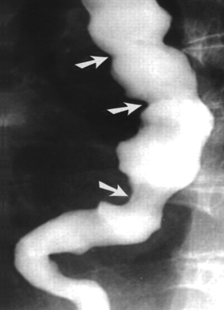
Diffuse Esophageal Spasm
What is it ?
DES is a hypermotility disorder of the esophagus
Is seen most often in women and is often found in patients with multiple complaints
The basic pathology is related to a motor abnormality of the esophageal body that is most notable in the lower two thirds of the esophagus
the esophageal contraction In manometrys are repetitive, simultaneous, and of high amplitude
Symptoms & Diagnosis
Patients will complain of a squeezing pressure in the chest that may radiate to the jaw, arms, and upper back.
The clinical presentation of DES is typically that of chest pain and dysphagia.
These symptoms may be related to eating or exertion and may mimic angina.
02
03
The symptoms are often pronounced during times of heightened emotional stress.
Regurgitation of esophageal contents and saliva is common, but acid reflux is not
acid reflux can aggravate the symptoms, as can cold liquids
irritable bowel syndrome and pyloric spasm, may accompany DES, whereas other gastrointestinal problems, such as gallstones, peptic ulcer disease, and pancreatitis, all trigger DES
The diagnosis of DES is made by an esophagram and manometric studies
Treatment
the mainstay of treatment for DES is nonsurgical, and pharmacologic or endoscopic intervention is preferred
Surgery is reserved for patients with recurrent incapacitating episodes of dysphagia and chest pain who do not respond to medical treatment

Slide 34
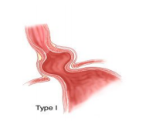
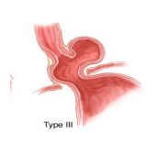
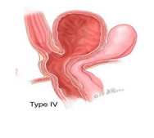
Summary
Recall
Q1: What’s the treatment of sliding esophageal hernia
Answer: 85% of cases treated medically with antacids, H2 blockers/PPIs, head elevation after meals, small meals, and no food prior to sleeping; 15% of cases require surgery for persistent symptoms despite adequate medical treatment
Q2: What’s para-esophageal hernia & treatment ?
Answer: Herniation of all or part of the stomach through the esophageal hiatus intothe thorax without displacement of the gastroesophageal junction.
Surgical, because of frequency and severity of potential complications.
Q3: What is the “parrot’s beak” or “bird’s beak” sign?
Evidence of sigmoid volvulus on barium enema; evidence of achalasia on barium swallow
Q4: What are the associated long-term conditions of achalasia?
Answer: Esophageal carcinoma secondary to Barrett’s esophagus from food stasis
Q5: What’s Zenker’s diverticulum
Answer: Pharyngoesophageal diverticulum; a false diverticulum containing mucosa and submucosa at the UES at the pharyngoesophageal junction through Killian’s triangle
Types of Hiatal Hernias
Type I | Type II | Type III | Type IV
Sliding Hiatal Hernia (90%). | Rolling (paraesophageal) Hernias (10%).
Most Common. | No Acid Reflux | May be associated with GERD
1. Portion of the stomach cardia slides through the diaphragmatic hiatus. 2. Gastroesophageal junction lay within chest cavity resulting in negative pressure in the chest. 3. Pressure will keep LES opened → reflux of acid (Strong association with GERD). | Localized defect in the phrenoesophageal membrane while the gastroesophageal junction remains fixed to the preaortic fascia and the median arcuate ligament. The gastric fundus then serves as the leading point of herniation. (may have dysphagia and/or chest pain because a part of the stomach is constricted). | Have elements of both types I and II hernias. Symptoms will include both of them. | Associated with a large defect in the phrenoesophageal membrane, allowing other organs, such as colon, spleen, pancreas and small intestine to enter the hernia sac.

Slide 35
Summary
Gastroesophageal Reflux Disease (GERD)
Classic GERD Extra-esophageal (Atypical GERD) Complicated GERD | Barium swallow. Endoscopy. Ambulatory pH monitoring. Esophageal manometry. | Lifestyle modification Acid suppression therapy Anti-reflux therapy Endoscopy GERD therapy
Achalasia
Dysphagia Regurgitation Heartburn Chest pain | CXR Barium swallow Upper Endoscopy Esophageal manometry | Nitat and CCB Botulinum toxin injection Pneumatic dilation Surgical myotomy
Esophageal diverticula
sticking in the throat Nagging cough excessive salivation intermittent dysphagia | Barium esophagram | Surgical Endoscopic
Barrett's Esophagus
Asymptomatic | Endoscopy | Anti-reflux surgery
Caustic Injury
Oral & substernal pain Dysphagia Respiratory distress | Physical exam Endoscopy | Neutralization of the ingested substance
Leiomyomas
Dysphagia Pain | Barium esophagram | Surgical enucleation of the tumer
Carcinoma of the Esophagus
Dysphagia Weight loss | Esophagram Endoscopy CT scan & PET scan Endoscopic Ultrasound | Chemotherapy + radiotherapy +/- surgery
Diagnostic tests
Symptoms
Management

Slide 36
Quiz
MCQ
Q1 : A 45-year-old executive experiences increasingly painful retrosternal heartburn, especially at night. He has been chewing antacid tablets. An esophagogram shows a hiatal hernia. In determining the proper treatment for a sliding hiatal hernia, which of the following is the most useful modality?
Bariums wallow with cinefluoroscopy during Valsalva maneuver
Flexible endoscopy
Assessment of the patient’s smoking and drinking history
Q2: What are the diagnostic findings in achalasia?
Radiographic contrast studies reveal dilated esophageal body with narrowing inferiorly
crorkscrew esophagus on esophageal contrast study
Upper GI localized tumor
Q3: What percentage of patient with GERD develops Barrett’s esophagus?
20%
10%
30%
Q4: Which of the following found in achalasia
Hyper-active LES
Hyperactive UES
Paralzed LES
Q5: A patient diagnosed with esophageal adenocarcinoma, if metastasis to lymph nodes detected, what is the first step in management ?
Do surgery as soon as possible
Start with chemotherapy
Start with radiotherapy
Q6: A patient suspected for GERD, what will be your first investigation step ?
Do barium swallow
Exclude cancer by endoscopy
Confirm only by symptome
Answers
Q1 | B | Q4 | A
Q2 | A | Q5 | B
Q3 | B | Q6 | A
Extra Questions

Slide 37
Good Luck!
Team leaders:
Nouf Alshammari
Haneen Somily
Naif Alsulais
Mohammed alshoieer
This lecture was done by:
Abdulrahman Bedaiwi
Wejdan Alnufaie
Khalid Alharbi
Razan AlRabah
Sedra Elsirawani
Nujud Alabdullatif
Abdulaziz Alghamdi
Feedback
Note taker
Reviewer

