Slide 1
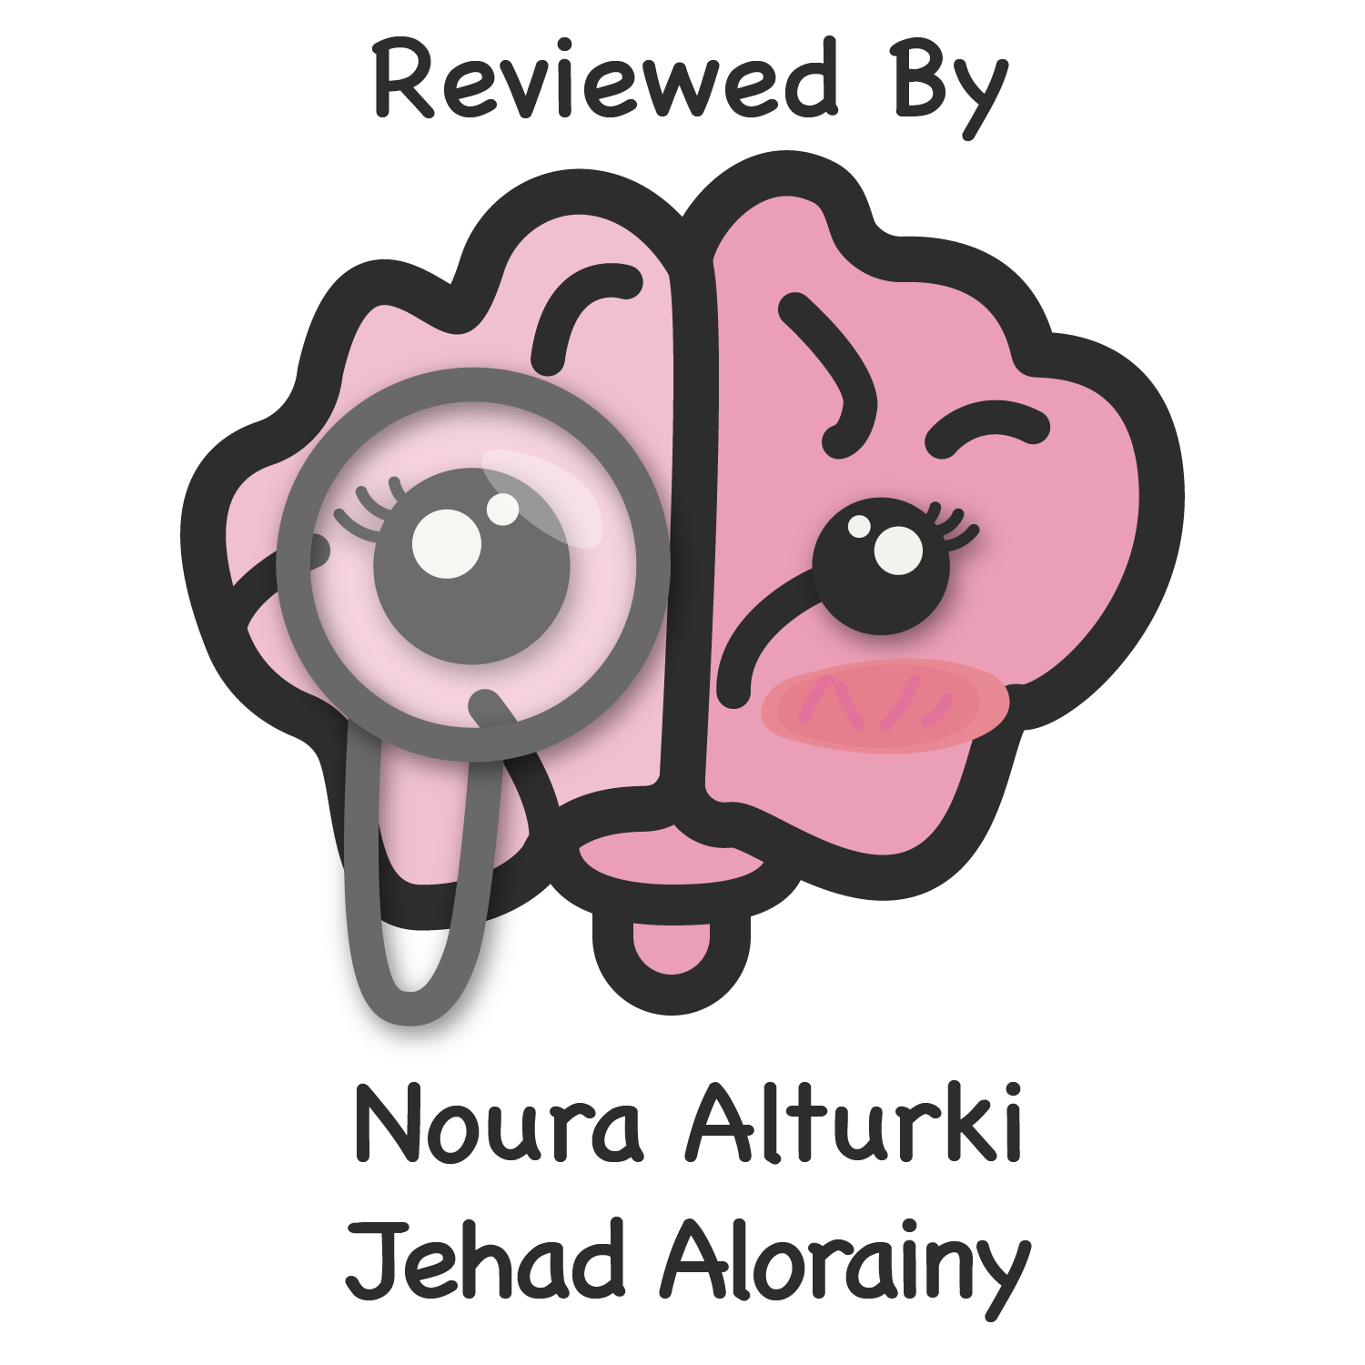
Renal stones, UTIs &
Common urologic disorders
Objectives
Discuss the types of lower urinary tract symptoms
Discuss urinary tract infection (UTI): pathogenesis, epidemiology, how to evaluate and the treatment options. Recognize presentation and symptoms.
Discuss renal stones and renal colic: pathogenesis, epidemiology, how to evaluate and the treatment options. Recognize presentation and symptoms.
Discuss bladder dysfunction and Incontinence
Discuss benign prostatic hyperplasia (BPH).
Colour Index
Main Text
Males slides
Females slides
Doctor notes
Textbook
Important
Golden notes
Extra
Editing File

Slide 2
Urologic disorders:
01
Urinary tract infections
02
Urolithiasis
03
Benign prostatic hyperplasia and voiding dysfunction
04
Scrotal disorders
Urinary tract symptoms:
Lower urinary tract symptoms either:
symptoms happen when you are filling the bladder. it should fill with relaxation and compliance that change with pressure and volume.
storage
voiding
happen when passing urine
Pain
Storage
(irritative)
Voiding
(obstructive)
although characteristic, isn’t usually easily localized.
Renal pain: occurs between 12th rib and sacrospinalis muscle.
Ureteric pain (colic): radiates forwards and downwards toward the groin, testes or labia.
Acute bladder pain: is usually located centrally at lower abdomen.
Bladder and prostate diseases cause perineal or penile pain.
Frequency: may be caused by an actual decrease in the capacity of the bladder or by a decrease in the functional capacity of the bladder
Urgency: a sudden uncontrollable desire to void (storage problem).
incontinence: passage of urine occurs without warning and without any precipitating factors. Urge incontinence is associated with urgency and is seen in acute inflammatory conditions, patients with upper motor neuron injuries and in individuals with an overactive bladder.
Nocturia: night-time frequency may be a result of renal disorders leading to a decrease in the concentrating ability of the kidney, or due to excessive intake of fluids, caffeine or alcohol before bedtime.
Hesitancy: poor stream (delay in starting the stream) and dribbling (obstruction symptoms).
Weak stream: poor stream, they have to strain and increase pressure.
Oliguria: decreased urinary output.
anuria: complete absence of urine output
Discuss the types of lower urinary tract symptoms

Slide 3
UTI
Upper tract¹
Lower tract¹
Acute Pyelonephritis
Chronic Pyelonephritis
Renal abscess
Urethritis
Epididymitis/Orchitis
Prostatitis
Cyctitis
(UTIs) are severe public health problems.
Most common:
Gram –ve Bacteria (Escherichia coli).
Enterococcus faecalis.
Klebsiella
Pseudomonas aeruginosa
Increasing problems due to:
High recurrence rates.
↑ Antimicrobial resistance
The presence of them indicate:
 | Definition
Bacteriuria | The presence of bacteria in the urine, can be Symptomatic or Asymptomatic.
Pyuria | Presence of white blood cells (pus cells) in the urine. not only signify infection, also it can mean only inflammation.
Only Pyuria
Both
Only Bacteriuria³
TB² bacterial
Stones Infection colonization
Cancer without infection
Upper tract infections are usually more severe.
2. Tb is then most common (but nowadays due to proper treatment Tb in general decreased so keep in mind stones & cancer).
3. You don’t have to treat bacteriuria without pyuria because you'll get bacterial resistance
Discuss urinary tract infection (UTI): pathogenesis, epidemiology, how to evaluate and the treatment options. Recognize presentation and symptoms

Slide 4
Routes of urinary tract infections:
Ascending Route (most common) Especially in females because the shorter urethra allows GI pathogens to ascend to the urinary system much easily. And if left untreated it causes upper UTI.
Hematogenous Route (uncommon)
Staph bacteremia (oral sites/candida fungemia) Dental issues and dental infections → disseminate into the bloodstream → renal abscesses.
Lymphatic Route (Rare).
Bowel obstruction inflammation.
Fistula between the bowel and the female genital tract can also cause UTI.
Catheterized patients are at increased risk of infection.
UTI’s are also common after urological or gynaecological operations.
Types of urinary tract infections:
Uncomplicated UTI
VS
Complicated UTI
Treated by GP
Healthy patient (healthy young women not pregnant)
No anatomic or neurological genitourinary abnormality
Ureteric obstruction (stone, stricture)
Urinary retention
Decreased immune system (renal failure,
transplant)
Foreign body ( catheter ) or stent
Male or patient > 65 years
patients with spinal cord injury (they are prone to develop UTI).
Discuss urinary tract infection (UTI): pathogenesis, epidemiology, how to evaluate and the treatment options. Recognize presentation and symptoms

Slide 5
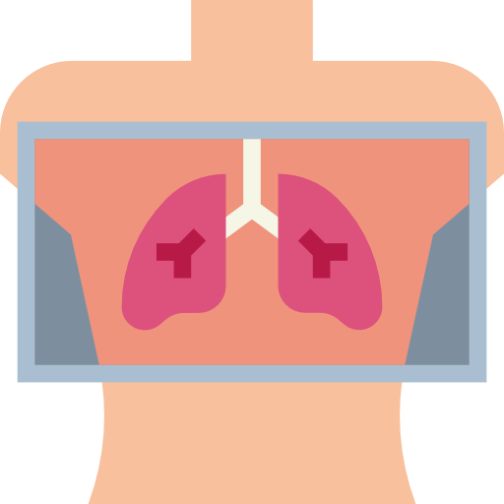
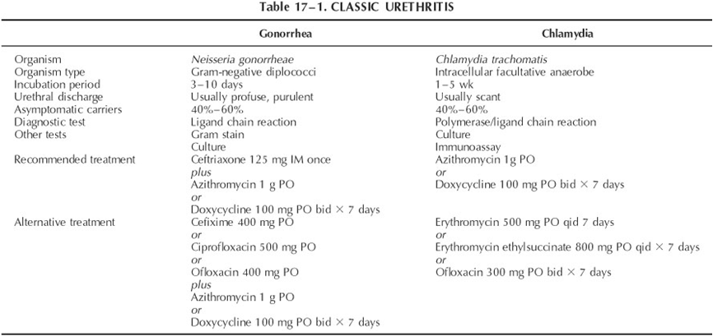
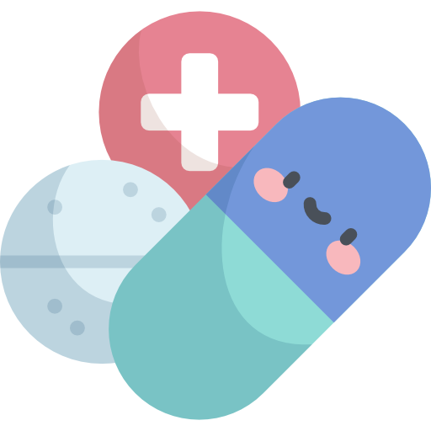
UTI:
Urethritis
Asymptomatic (usually asymptomatic in females).
Burning on urination.
Urethral discharge (especially in young sexually active men. And you have to determine whether this urethral discharge is caused by a gonococcal or a non-gonococcal infection).
Signs and symptoms
By history Incubation period:
Gonococcal (3-10 days) comes with purulent discharge
Nongonococcal (1-5 weeks) comes with scant discharge
Urethral swab (confirmatory)
Serum: Chlamydia specific ribosomal RNA (confirmatory)
Diagnosis
Doctor said you don’t have to memorize it but know that:
Gonococcal usually has incubation period 3-10 days after unprotected intercourse, while in case of chlamydia up to more than a month
Do a swab and culture to avoid antibiotic resistance
The treatment empirically:
1g IM ceftriaxone
1 dose azithromycin orally
Treatment
Epididymitis
Acute: Pain , swelling of epididymis < 6 weeks
Chronic: Long-standing pain in the epididymis and testicle. Usually no swelling
Signs and symptoms
Discuss urinary tract infection (UTI): pathogenesis, epidemiology, how to evaluate and the treatment options. Recognize presentation and symptoms

Slide 6
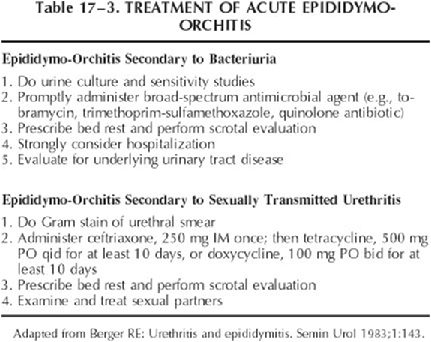
By physical examination: you should be able to differentiate Epididymitis vs. Torsion
Ultrasound (confirmatory)
Testicular scan
By history (age):
Younger¹ : N. gonorrhoeae or C. trachomatis
Older² : E. coli.
Diagnosis
Case: a 12 year old boy came with his mother to the ER complaining of pain, swelling and dysuria. Is it Epididymitis or torsion?
Epididymitis
Torsion
usually in older patients and shows the cardinal signs of inflammation.
Onset: gradual onset of pain (usually preceding UTI).
Physical examination reveals: Fever, local signs of inflammation (redness, hotness).
Ultrasound: increased blood flow to the testis and the epididymis.
usually in younger patients
Acute sudden onset of pain. Pain increases with movement.
Physical examination reveals: High-riding testicle (testicle may appear to be retracted upward and in an abnormal horizontal orientation), absent cremasteric reflex³
Ultrasound: No blood flow.
Torsion is a medical emergency if not treated immediately the testicle will die within 8 hours.
Secondary to Bacteriuria: 2 weeks wide spectrum antibiotics
Secondary to Sexually transmitted urethritis: tetracycline or doxycycline for 10 days
Treatment
thus you have to ask about sexual history with young patients.
usually elderly patients present with prostate-related symptoms, inability to pass urine, and urethral stricture.
The cremasteric reflex, is elicited by pinching the medial thigh, which causes elevation of the testicle. Presence of the reflex suggests, but does not confirm, the absence of testicular torsion
Discuss urinary tract infection (UTI): pathogenesis, epidemiology, how to evaluate and the treatment options. Recognize presentation and symptoms

Slide 7
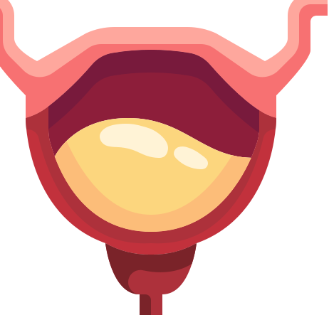
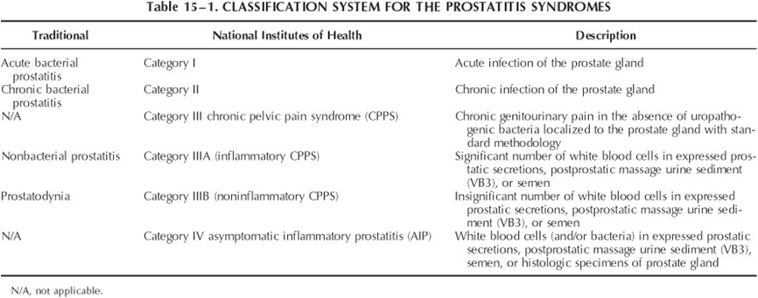
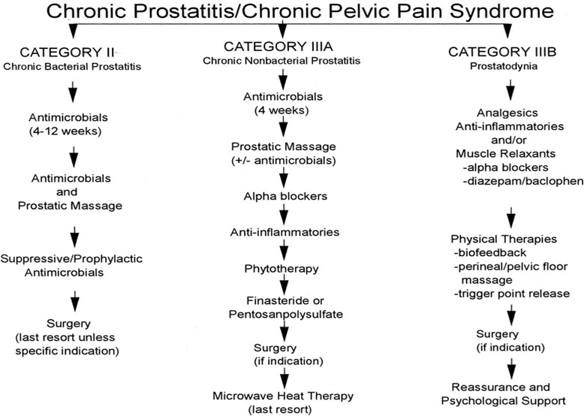
Prostatitis
A syndrome that presents with inflammation ± infection of the prostate gland including:
Dysfunctional void (slow urine stream)
02
Dysuria, frequency
01
03
Perineal Pain
Painful ejaculation
Doctor said Just know that prostatitis can be categorized into more than acute or chronic
Acute Bacterial Prostatitis
Chronic prostatitis/Chronic Pelvic pain syndrome :
Rare
Acute pain
Storage and voiding urinary symptoms
Fever, chills, malaise, Nausea and vomiting (The usual presentation of urosepsis)
Perineal and suprapubic pain
Tender swollen hot prostate (sometimes a prostate abscess can be found as well)
Treatment: antibiotics and urinary drainage
Doctor said this is for your knowledge and we won’t ask you about it
Discuss urinary tract infection (UTI): pathogenesis, epidemiology, how to evaluate and the treatment options. Recognize presentation and symptoms

Slide 8
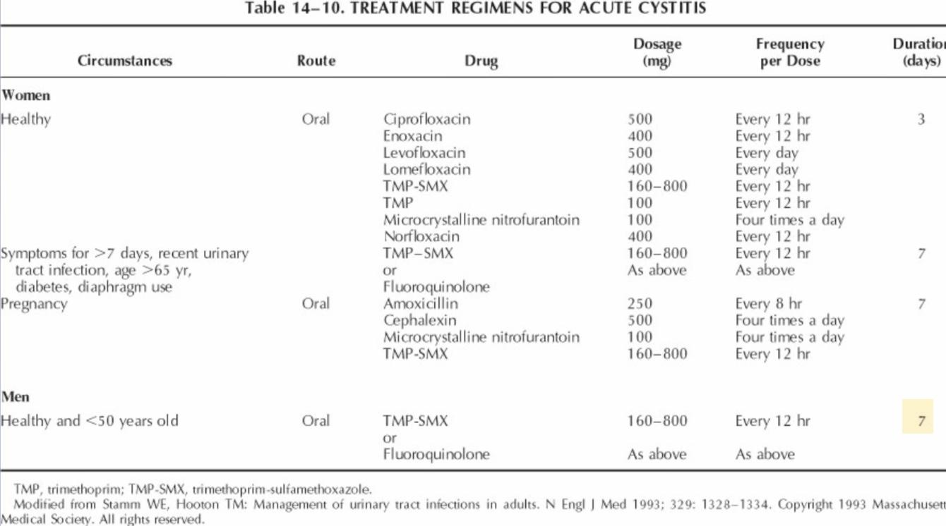
Cystitis
It’s more common in female.
dysuria, frequency, urgency, voiding of small urine volumes.
Suprapubic /lower abdominal pain, on clinical examination : you percuss above symphysis pubis and there is no filled bladder and it is painful this maybe cystitis
± Hematuria, sometimes not visible grossly (microscopic hematuria)
Signs and symptoms
dip-stick you see blood cell , pus , pyoria , positive nitrite
urinalysis It gives more accurate results than using a dipstick. However, dipstick is faster.
Urine culture: the ultimate test but takes days, so we usually start by treating the patient empirically.
Diagnosis
Single dose for 3 or 5 days depending on the antibiotic chosen.
Uncomplicated cystitis → broad spectrum antibiotics for 3 days (mainly) as the following:
01
Nitrofurantoin–100 mg twice daily for 5 days. in KSA we usually use nitrofurantoin or Bactrim because they are least used so less likely to be resistant
02
Fosfomycin –one-time administration of 3 g.
03
Oral fluoroquinolones for more than three days.
04
Trimethoprim/ sulpha ( Bactrim) 160/800 mg, twice daily 3.
05
β-Lactams, oral cephalosporins may be used, 5 or more days.
Treatment
For men it is recommended to have treatment for at least 7 days ( a Quinolone or Bactrim)
Complicated cystitis (symptoms for >7 days or male patient or age >65, recent UTI, diabetic, use of contraceptive diaphragm or pregnancy) → treatment should be extended for at least 7 days.
Discuss urinary tract infection (UTI): pathogenesis, epidemiology, how to evaluate and the treatment options. Recognize presentation and symptoms

Slide 9
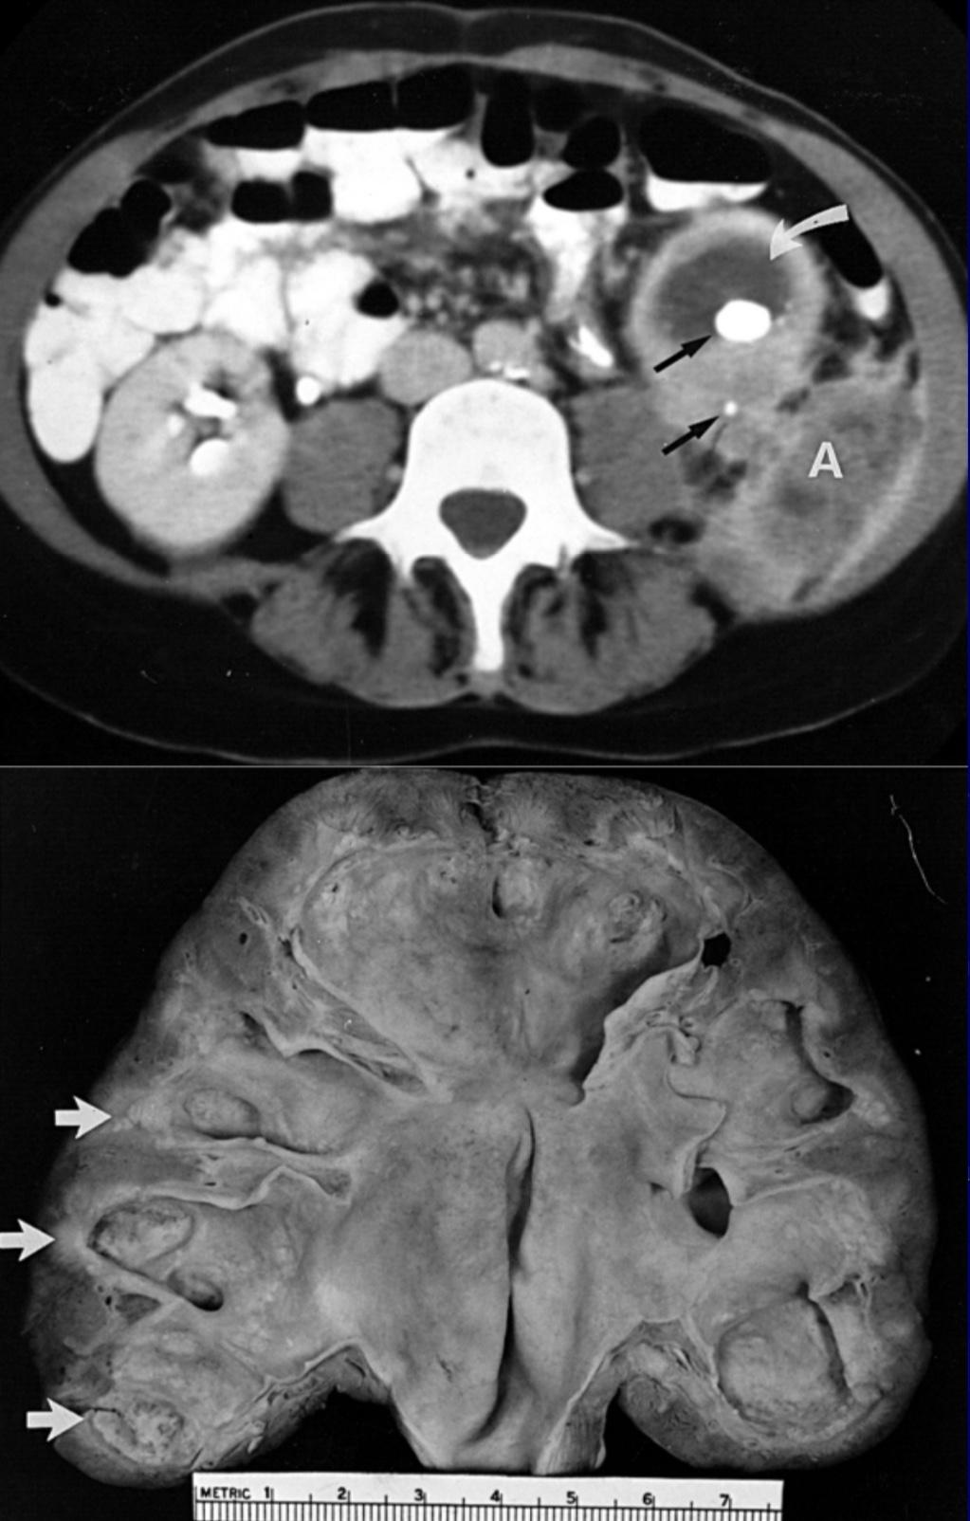
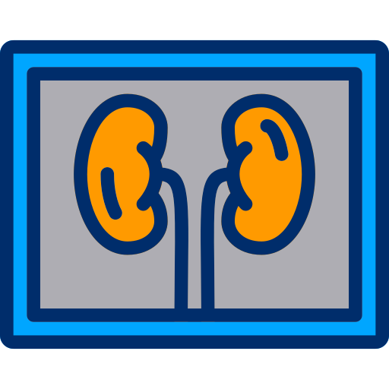
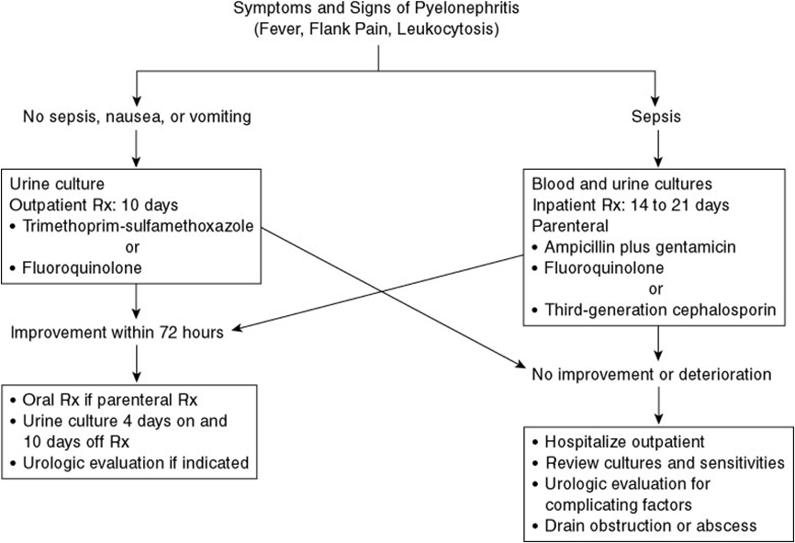
Pyelonephritis
Inflammation of the kidney and renal pelvis.
Chills
Fever
Costovertebral angle tenderness (flank Pain). also called murphy’s punch sign
GI: abdomnal pain, Nausea, vomiting and diarrhea.
Gram -ve sepsis
Dysuria and frequency
Signs and symptoms
±↑serum Creatinine (Pyelonephritis can cause renal impairment with increased creatinine)
Urine culture & sensitivity test : 80% of cultures will be positive
Enterobacteriaceae (E. coli)
Enterococcus
Urinalysis:
↑WBCs
RBCs
Bacteria
CBC:
Leukocytosis (In cystitis there’s NO leukocytosis)
Investigation
A
Picture A: a stone causing granulomatous pyelonephritis
Picture B: pyelonephritis grossly
IVP (intravenous pyelogram) we don’t use anymore
Ultrasound
CT to make sure there’s no abscess
Imaging
B
Basically, if the infection isn’t severe and the patient is hemodynamically stable, then the patient is treated in the outpatient clinic.
But if the patient is elderly, febrile, vomiting or immunocompromised then the patient needs admission.
Treatment
Discuss urinary tract infection (UTI): pathogenesis, epidemiology, how to evaluate and the treatment options. Recognize presentation and symptoms

Slide 10
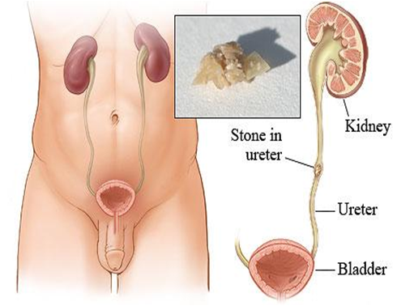
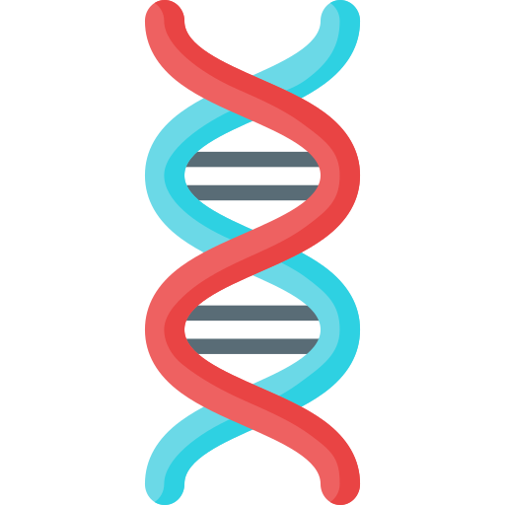
urolithiasis:
have been reported in Egyptian mummies 4800 BC
Prevalence of 2% to 3%,
Lifetime risk: Male 20%, female 5-10%
Recurrence rate 50% at 10 years
Risk factors:
Intrinsic
Extrinsic
Sex
Male > female
Age
(2Os - 4Os)
Water intake
Occupation
(sedentary occupations)
Diet
(purines , oxalates and Na)
Genetics
include cystine stones, and renal tubular acidosis
Geography
(mountainous, desert and tropics)
Climate
(July - October)
Patient who went a bariatric surgery at risk to develop calcium oxalate stones
How do stones form?
Crystal growth
Stones
01
02
03
04
Supersaturated
Aggregation of crystals
Discuss renal stones and renal colic: pathogenesis, epidemiology, how to evaluate and the treatment options. Recognize presentation and symptoms.

Slide 11
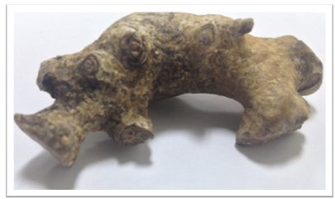
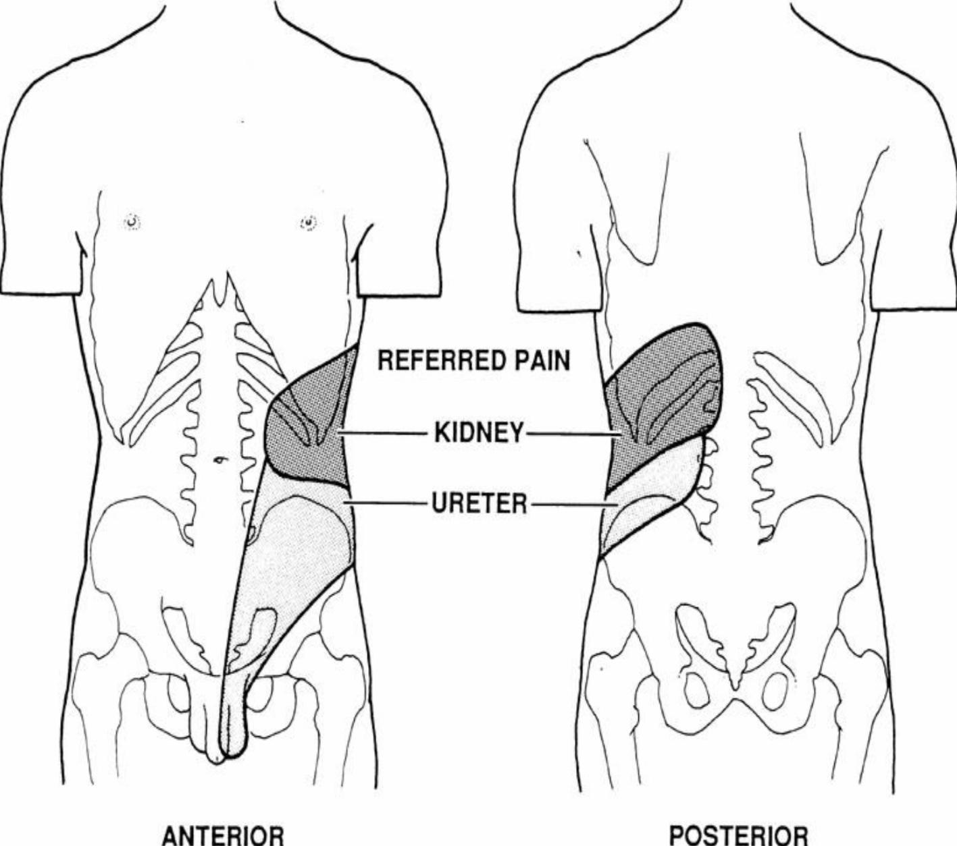
Most people have crystals in their urine, so why not everyone gets stones?
Anatomic abnormalities obstruction of flow
Modifiers of crystal formation (Inhibitors/promoters):
Citrate inhibits stones (calcium Oxalate)
Magnesium
Urinary proteins (nephrocalcin)
Oxalate causes stones and is usually found in parsley (cultural myth about drinking parsley water could cause stones)
Common Stones Types (respectively):
Calcium oxalate stones 75% (Ca Ox)
Calcium phosphate
If there is too much of oxalate present it will lead to Ca-Oxalate stones Otherwise we will have Ca-Phosphate.
Uric acid stones
formed due to gout or myeloproliferative disorders.
Cystine stones¹
Struvite stones²
(Staghorn)
Composed of magnesium ammonium phosphate
Signs and symptoms:
Renal, ureteric colic:
Renal calculi cause flank pain, which may be colicky (arising from the renal pelvis) or a noncolicky (renal pain) dull ache (arising from renal capsule).
Ureteric calculi cause colicky pain and the site of the stone in the ureter determines the site of the pain:
upper ureteric calculi cause costovertebral angle or flank pain
mid-ureteric calculi cause pain radiating from ‘loin to groin’
lower ureteric calculi cause pain radiating to the testicle in males and labia majora in females.
GI symptoms:
Nausea & vomiting.
Ileus or diarrhea.
Differential diagnosis:
Gastroenteritis
acute appendicitis
colitis
salpingitis
01
02
04
03
Restless
↑HR, ↑BP
fever (If UTI)
Tender CVA costovertebral: is pain that results from touching the region inside of the costovertebral angle. The CVA is formed by the 12th rib and the spine.
Frequency, dysuria
Hematuria
Cystinuria is an autosomal-recessive defect. Patients with cystinuria have impairment of renal cystine transport, with decreased proximal tubular reabsorption of filtered cystine resulting in increased urinary cystine excretion and cystine urolithiasis.
They are associated with chronic urinary tract infection with gram-negative, urease-positive organisms that split urea into
ammonia, which then combines with phosphate and magnesium to crystalize into a stone. These organisms are:
Proteus (most common), Pseudomonas, Klebsiella, staphylococcus and mycoplasma
Discuss renal stones and renal colic: pathogenesis, epidemiology, how to evaluate and the treatment options. Recognize presentation and symptoms.

Slide 12
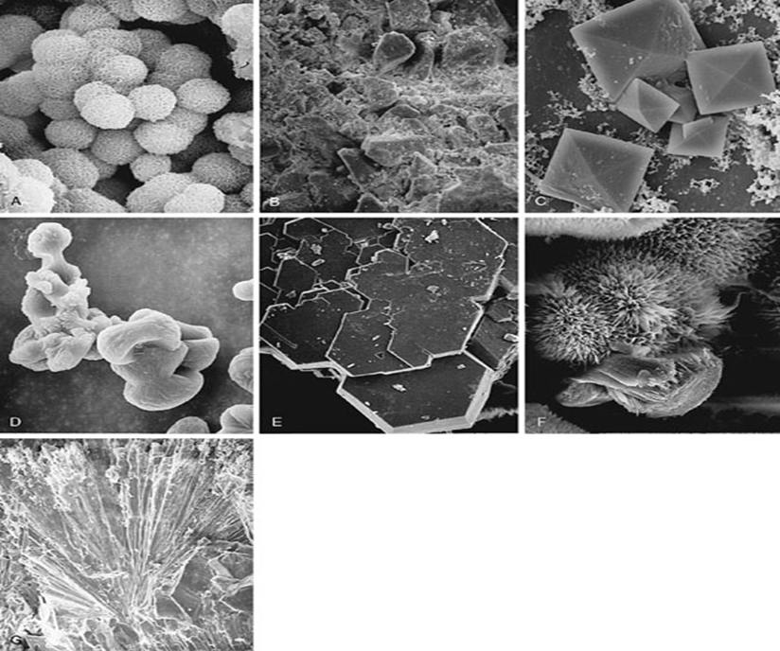
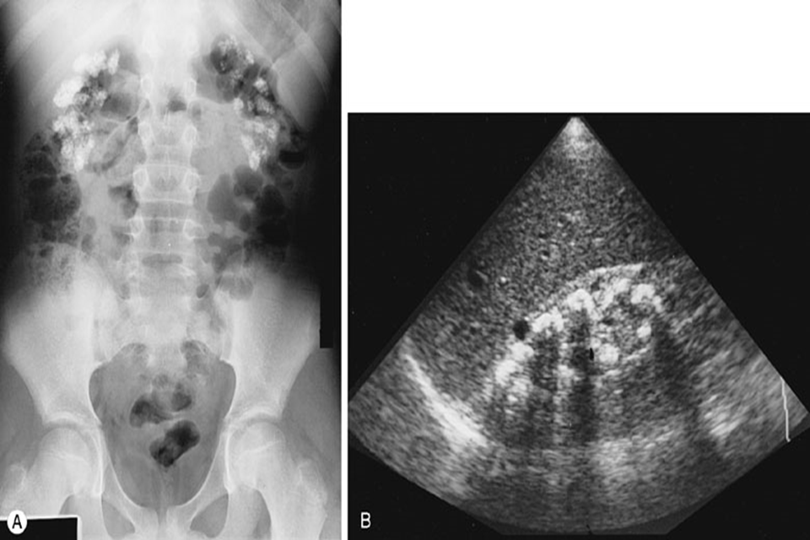
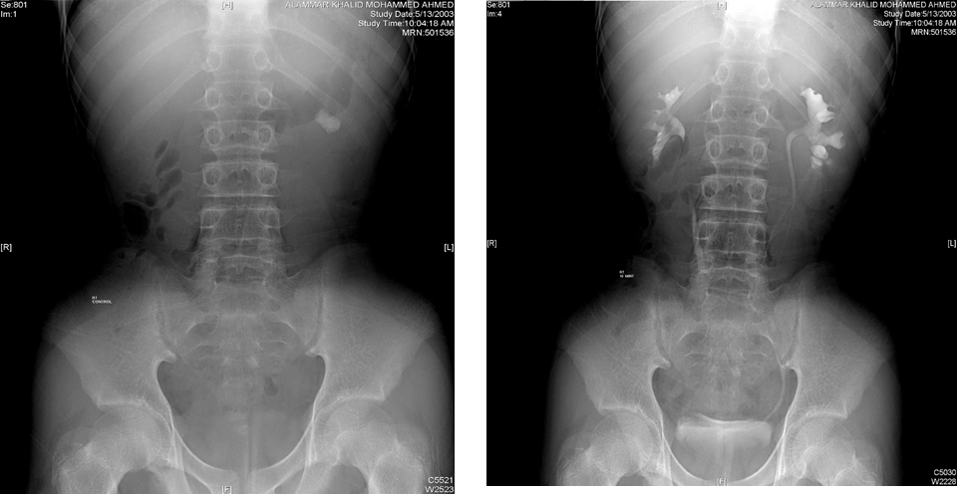
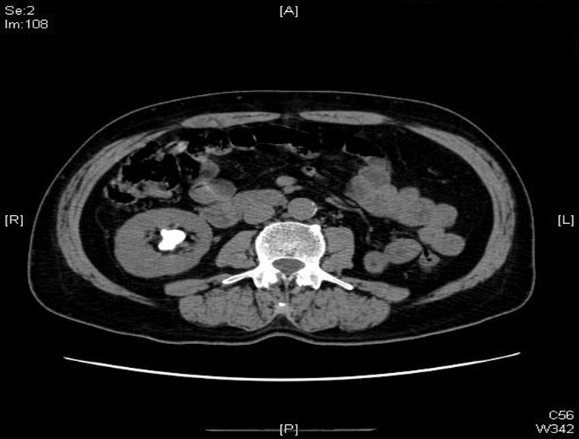
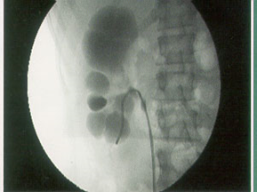
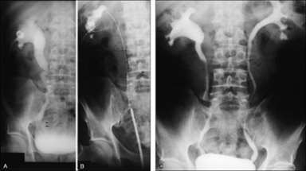
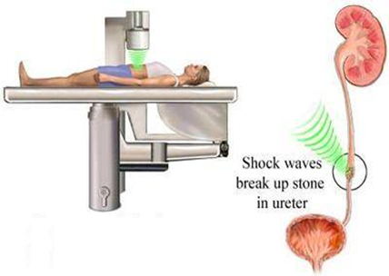
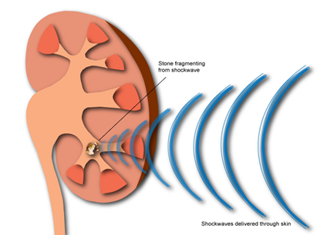
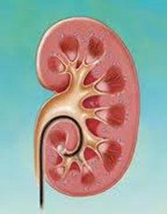
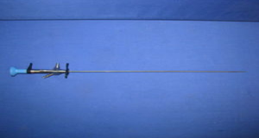
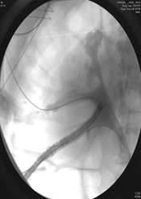
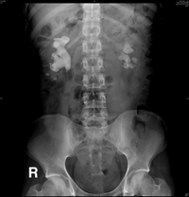
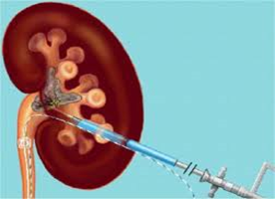
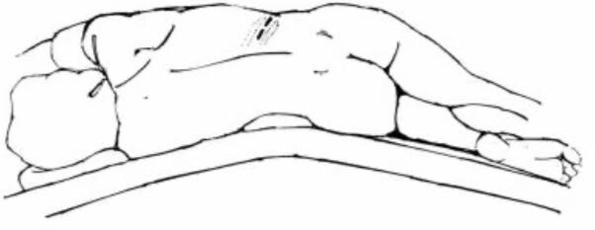
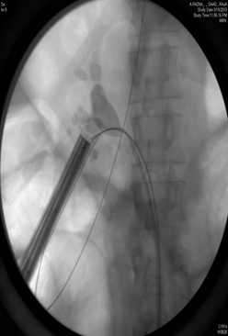
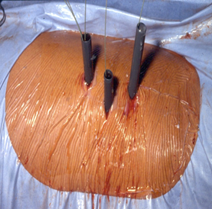
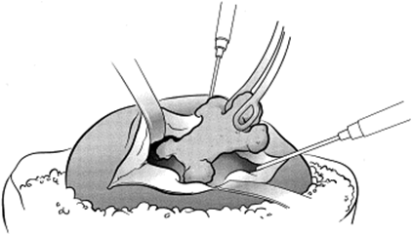
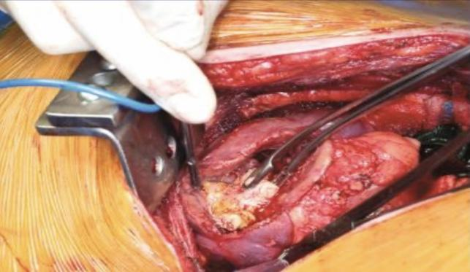
Investigation:
Urinalysis:
RBC
WBC
Bacteria
Crystals
Imaging:
Start with non-contrast CT scan unless it's contraindicated (e.g. pregnant patient), do not use it when we know its a Stone, then we use Ultrasound or X-ray (KUB)
Plain Abdominal Films (KUB)
Intravenous Urography (IVU)
Ultrasonography (U/S)
Computed Tomography (CT)
A
B
C
D
Different shapes of crystals
Other: hematological and biochemical tests are used to exclude metabolic causes and to assess renal function
Picture A: KUB shows stones in the cortex (nephrocalcinosis) stones appear bright (radio opaque), but doesn’t show uric acid (radio lucent) and only shows 70% of stones
Picture B: by US, the sound blocked by stones so shows hyperechoic lesion with acoustic shadow
Picture C: shows radio opaque shadow
Picture D: here we use IVU
E
Picture E: nowadays we use CT with IV contrast instead of using IVU Even uric acid can be shown.
Management:
Most of them Conservative:
Hydration
Analgesia
Antiemetic
Stones (<5mm ) >90% spontaneous Passage
Indication for admission:
Renal impairment
Refractory pain
Pyelonephritis
intractable Nausea and Vomiting
A stone less than 0.5 cm in diameter may pass spontaneously. Immediate treatment should be considered in case of acute pain, renal obstruction, or sepsis. Extracorporeal shock-wave lithotripsy (ESWL) sends shock waves to break up stones. If breaking the stone isn’t sufficient then percutaneous nephrolithotomy (PCNL). PCNL involves puncturing the kidney, inserting a sheath and removing it under nephroscope.
Laser ureteroscopy:
ureteroscopy:
flexibile (on left) Rigid (the right)
For hard stones, failure of shock wave
Extracorporeal Shock Wave lithotripsy(SWL)
Least invasive method. Used for small stones in the kidney or the ureter where there’s no obstruction.
Side effects of SWL: hemorrhage
Percutaneous Nephrolithotripsy (PNL)
only for big stones
Anatrophic nephrolithotomy
Used rarely in very severe cases
Discuss renal stones and renal colic: pathogenesis, epidemiology, how to evaluate and the treatment options. Recognize presentation and symptoms.

Slide 13
Voiding dysfunction
What controls renal continence in males is: the sphincter (mainly) and the neck of the bladder (partially)
In females: the sphincter mainly
The lower urinary tract is innervated by 3 sets of peripheral nerves involving the parasympathetic, sympathetic, and somatic nervous systems:
Pelvic parasympathetic nerves
excite the bladder, and relax the urethra
Motor (contraction) to the detrusor muscle (M3 receptor)
Inhibitory (relaxation) to the internal urethral sphincter.
Pudendal nerve
Hypogastric sympathetic nerve
excite the external urethral sphincter.
inhibit the bladder body and excite the bladder base and urethra.
Inhibitory (relaxation) to the detrusor muscle (β3 receptor)
Motor (contraction) to the internal urethral sphincter (α1 receptor) α blocker relax that muscle
Lower urinary tract symptoms (LUTS):
STORAGE (irritative)
VOIDING (obstructive)
Dysuria
Frequency
Nocturia
Urgency
Incontinence:
Hesitancy
Weak stream
Straining
Intermittency
Drippling
Retention
- Urge incontinence¹ - Stress incontinence²
- Overflow incontinence³ - Functional (total) incontinence⁴
- Mixed incontinence⁵ - Reflex (spastic bladder) incontinence⁶
Involuntary leakage accompanied by or immediately preceded by urgency.
Urine leakage associated with increased intra-abdominal pressure from laughing, sneezing, coughing, climbing stairs, or other physical stressors on the abdominal cavity and, thus, the bladder.
Occurs when the bladder is overdistended and reaches its limit of compliance. At this point, the intravesical pressure exceeds the resting urethral closure pressure and urine overflows despite the absence of detrusor contraction. Patients experience a sense of incomplete emptying, slow-flowing urine, and urinary dribbling.
Inability to hold urine due to reasons other than neuro-urologic and lower urinary tract dysfunction (eg, delirium, psychiatric disorders, urinary infection, impaired mobility).
A combination of stress and urge incontinence, marked by involuntary leakage associated with urgency and also with exertion, effort, sneezing, or coughing
Happens when the bladder fills with urine and an involuntary reflex causes it to contract in an effort to empty
Discuss bladder dysfunction and Incontinence

Slide 14
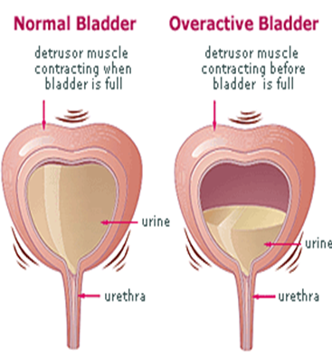
Failure to store
Failure to void
Bladder problems:
overactivity
Hypersensitivity
Outlet problem:
Stress incontinence
Sphincter deficiency
combination
Bladder problems:
Neurologic
Myogenic
idiopathic
Outlet problem:
BPH
Urethral stricture
Sphincter dyssynergia
combination
Overactive bladder:
Diagnosis:
Treatment:
History: If started days ago suspect infection, Make sure the patient is not diabetic, and if diabetic ask whether the diabetes is controlled or not
Physical exam: make sure no signs of infection, fever and sepsis ...
Urine analysis
Culture/ sensitivity test
Ultrasound: to check the kidney, check the bladder capacity and if the bladder empty properly.
Behavioral: smoking cessation, reduce the consumption of stimulants (coffee & tea) and if there is nocturia advise the patient to urinate 2 hours before going to bed
Pelvic floor exercise: strengthening the muscles.
Anti-cholenirgics
beta-3 agonist
Present with frequency, urgency, incontinence and nocturia.
Discuss bladder dysfunction and Incontinence

Slide 15
Benign Prostatic Hyperplasia BPH:
Disease of elderly men (start at age 40) (average age is 60 to 65 years); prostate gradually enlarges, creating symptoms of urinary outflow obstruction
LUTS usually voiding symptoms it may presents as storage if detrusor muscle became hyperactive
Increasing frequency may deceive the patient into believing that an adequate amount of urine is passed
poor bladder emptying
urinary retention
urinary tract infection
Hematuria: Straining may cause vessels at the bladder neck to bleed.
Renal insufficiency
signs and symptoms of obstructive uraemia, including drowsiness, anorexia and personality changes.
Signs and symptoms
Digital rectal examination (DRE):
Evaluate the prostate: size, consistency and tenderness (prostatitis)
hard prostatic nodule: Prostate cancer (asymmetry) , BPH, calcification and TB (granuloma)
firm and fibrous = previously infected or has a large amount of stromal tissue
rubbery consistency symmetrical and smooth prostatic enlargement, with a median groove between the two lateral lobes = BPH
If digital rectal examination raises suspicion, needle biopsy is indicated
Focused neurologic exam: especially elderly aside checking BPH in DRE we check:-
Prostate Cancer
rectal Cancer and hematuria
anal tone: so we can assess the bladder inervation to diagnose neurogenic bladder
neurologic problems
Abdomen: distended bladder without tender comparing to cystitis
Physical examination
Urinalysis, culture
UTI
Hematuria
Serum Creatinine: because the urine put pressure back to kidney and may cause hydronephrosis > renal failure. so we must check renal function.
Serum Prostate: Normal level of PSA: less than 4.0 ng/mL. Elevated by anything that damages the prostate: prostate cancer, prostatitis, surgical procedures or trauma
Blood urea nitrogen
Flow rate explained in next page
Ultrasound (Kidney, Bladder And Prostate) to check complication
elevated PostVoid Residual (PVR)
Investigation
Discuss benign prostatic hyperplasia (BPH).

Slide 16
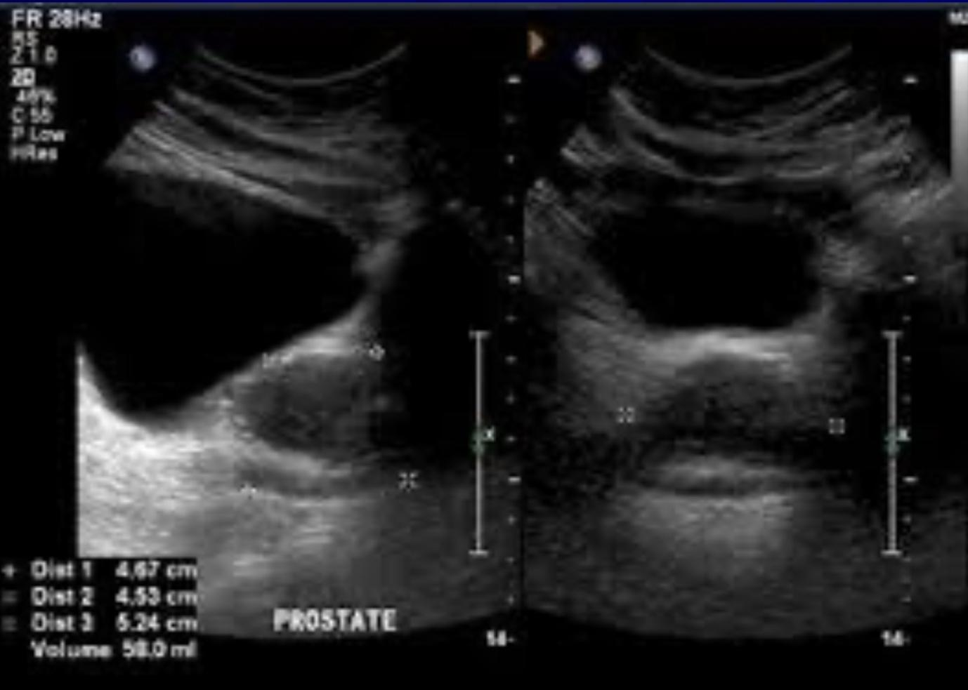
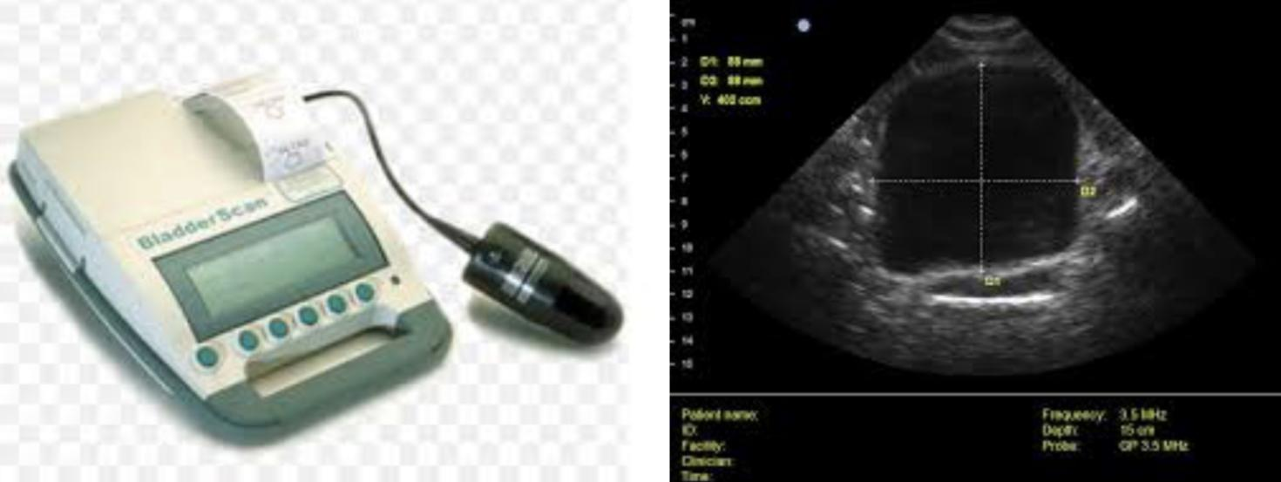
A
B
C
D
Ultrasound
PVR
Uroflowmetry¹
We have to do in two dimensions.
The bladder is full and the prostate volume is 58 ml almost 3 times the normal size
Perform PVR (post void residual volume): PVR is the amount of urine retained in the bladder shortly after a voluntary void and functions as a diagnostic tool. This can be accomplished through ultrasound.
Picture A: Normally it's bell-shaped
Picture B: Fluctuating "but more than 20/sec" = not obstructive
Picture C: Fluctuating "less than 20/sec" = obstructed bladder
Picture D: lesser than 20 = bladder neuropathy
Complications:
01
02
03
04
bladder stones
UTI
bladder decompensation
incontinence
05
06
07
08
upper tract deterioration (hydroureter)(hydronephrosis)
hematuria
acute urinary retention (AUR)
Bladder diverticula which may cause infection, stones and tumour
Uroflowmetry measures the flow of urine. It tracks how fast urine flows, how much flows out, and how long it takes. Average results are based on age and sex. Typically, urine flow runs from 10 ml to 21 ml per second. Women range closer to 15 ml to 18 ml per second. A slow or low flow rate may mean there is an obstruction at the bladder neck or in the urethra, an enlarged prostate, or a weak bladder.
A fast or high flow rate may mean there are weak muscles around the urethra, or urinary incontinence problems.
Discuss benign prostatic hyperplasia (BPH).

Slide 17
Treatment options:
Medical therapy
We treat only symptomatic patients
if patient presented with moderate symptoms, we give him alpha-blocker
no response? add the other drug (Androgen suppressor)
α-Adrenergic Blockers:
Tamsulocin
Alfuzocin
Terazocin
Androgen Suppression:
Finasteride
Dutasteride
Surgical therapy
When medical treatment failed
The absolute indications for surgery in a patient with BPH are: refractory urinary retention, recurrent UTI, recurrent haematuria, bladder stones, and/or diverticula and high-pressure chronic urinary retention leading to renal insufficiency.
Retrograde ejaculation(infertility) is a common sequel to any operative procedure on the prostate and all patients should be advised preoperatively of this effect. The main postoperative hazard is bleeding
Endoscopic
Transurethral Resection of the Prostate (TURP): Gold Standard we do surgery either for patients with severe symptoms (Recurrent UTI, Hematurea, Bladder stones), or patients who "want" to do surgery
Laser ablation
prostatic stents
Open Prostatectomy
Transurethral Resection of the Prostate TURP
Open Prostatectomy
A transurethral resection of the prostate (TURP) is surgery to remove parts of the prostate gland through the penis. No incisions are needed.
The surgeon reaches the prostate by putting an instrument into the end of the penis and through the urethra. This instrument, called a resectoscope, contains a lighted camera and valves that control irrigating fluid. It also contains an electrical wire loop that cuts tissue and seals blood vessels. The wire loop is guided by the surgeon to remove the tissue blocking the urethra one piece at a time. The pieces of tissue are carried by the irrigating fluid into the bladder and then flushed out at the end of the procedure.
Indications for open prostatectomy: large prostate (>100 cc) or the presence of bladder diverticulum or bladder stone (to treat the prostate and the bladder simultaneously).
Disadvantages:
1- length of hospitalization
2- abdominal wound
3- damage to external sphincter (in smaller adenomas) may cause incontinence
Discuss benign prostatic hyperplasia (BPH).

Slide 18
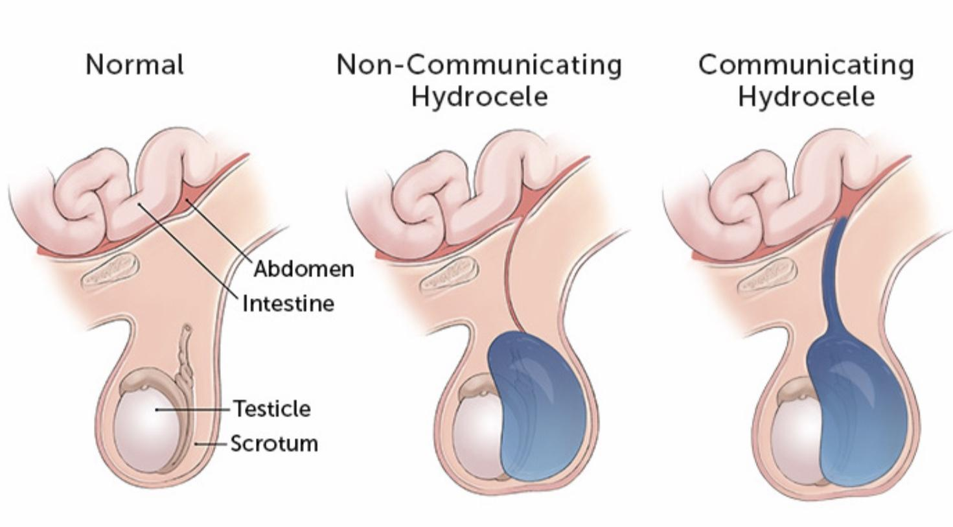
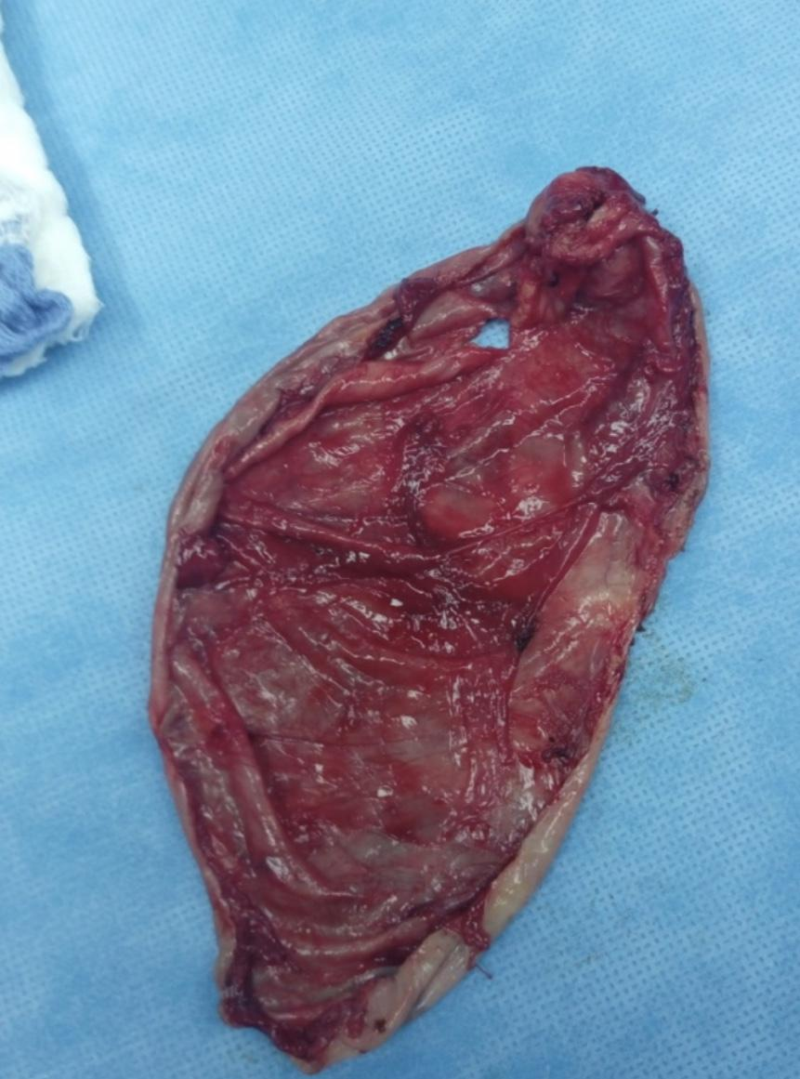
Scrotal disorders
Hydrocele:
hydrocele occurs in males when fluid fills the scrotum (painless)
Fluid can surround one or both testicles, causing swelling in the scrotum.
More common in baby boys, it may also occur in adult men.
The distinction between a cyst of the epididymis and a hydrocoele is easy. Epididymal cysts transilluminate brightly and almost always multiple, therefore nodular on palpation and the testes palpated separately from the cyst unlike in hydrocoele the testes palpated within a fluid filled sac and demonstrates transillumination.
Communicating
Non-Communicating
Occurs from the incomplete closure of the tunica vaginalis, forming a direct path between the abdomen and the scrotum so that a small amount of abdominal fluid may flow in and out of the thin pouch. It is distinctive because the fluid fluctuates throughout the day and night, altering the size of the mass
Contain fluid confined to the scrotum within the tunica vaginalis. The processus vaginalis is obliterated, and thus the fluid does not communicate with the abdominal cavity. Such hydroceles are common in infants, and the hydrocele fluid is usually reabsorbed before the infant reaches the age of 1 year. This type of hydrocele usually remains the same size or has a very slow growth
In the fetus, the tunica vaginalis is formed in the abdomen and then moves into the scrotum with the testes. After the pouch is in the testes, it seals off from the abdomen.
Check for tenderness in an enlarged scrotum.
Apply pressure to the abdomen and scrotum to check for inguinal hernia (if you can feel the cord above the swelling then it's most probably a hydrocele. In case of hernia, the bowel is projecting through the inguinal canal and you won't be able to feel the cord).
Shine a light through the scrotum (transillumination) --> If hydrocele is present transillumination will show clear fluid surrounding the testicle.
Physical examination
Imaging: ultrasound
Two surgical techniques are available:
Hydrocelectomy with Excision of the Hydrocele Sac¹
Hydrocele Surgery with Plication of the Hydrocele Sac²
Needle Aspiration is not favoured and not used anymore because the hydrocele will refill and reoccur.
Diagnosis and management
Hydrocele sac
An incision is made directly into the scrotum. The hydrocele sac is removed (care is taken not to injure testicular vessels, epididymis or ductus deferens), fluid is removed from the scrotum, and the incision is closed with sutures. This technique is useful for large or thick-walled hydroceles.
The hydrocele is opened with a small skin incision. The hydrocele sac is reduced (plicated) by suture. The plication technique is suitable for medium-sized and thin-walled hydroceles. The advantage of the plication technique is the minimized dissection with a reduced complication rate..

Slide 19
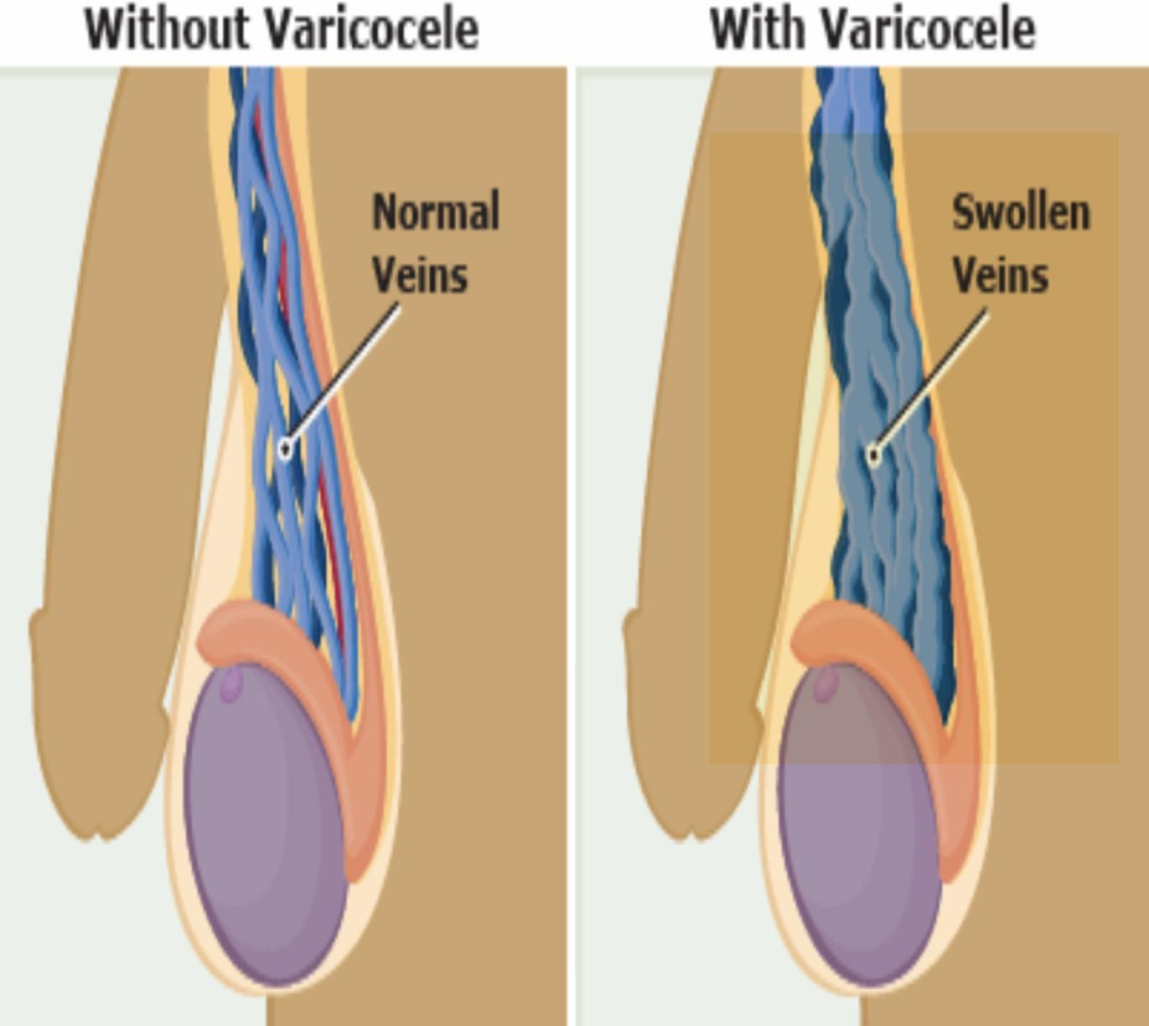
Scrotal disorders
Varicocele:
Abnormal dilation of the pampiniform plexus to the spermatic vein in the spermatic cord; described as a “bag of worms”
Most identified common cause of male infertility.
It affects 20% of male population.
Not all men with varicocele are infertile.
It can be graded:
Palpable with Valsalva maneuver
Palpable without Valsalva maneuver.
Visible.
More common on the left side¹
It impairs fertility by increase intratesticular temperature
The main symptom is a dragging sensation in the scrotum, and a feeling of heaviness.
Treatment :
Indicated in:
Procedures:
Infertility with abnormal semen parameters.
Testicular pain
Impaired testicular volume.
01
ligation (open, microscopic or lap)
02
Angioembolization: is a minimally invasive procedure done by interventional radiologists. Access can be achieved via the internal jugular or femoral veins to insert a catheter into the testicular vein using x-ray guidance. Then small, metal coils or a special medical foam (glue) is used to block off the abnormal testicular vein.
More common on the left side? because of several anatomic factors, including the following:
- The angle at which the left testicular vein enters the left renal vein
- The lack of effective antireflux valves at the juncture of the testicular vein and renal vein
- The increased renal vein pressure due to its compression between the superior mesenteric artery and the aorta (ie, nutcracker effect)

Slide 20
Recall
Q1: What are the three common organisms in UTI?
Answer: 1. E. coli (90%) 2. Proteus 3. Klebsiella
Q2: what are the predisposing factors for UTI?
Answer: stones , obstruction , reflux , diabetes mellitus , pregnancy , indwelling catheter
Q3: what is the etiology of UTI?
Answer: Ascending infection , instrumentation , coitus in females.
Q4: How is UTI diagnosis made?
Answer: Symptoms, urinalysis (>10 WBCs/HPF,>10⁵ CFU)
Q5: When should work up be performed?
Answer:
After the first infection in male patients (unless Foley is in place)
After the first pyelonephritis in prepubescent female patients
Q6: What is the treatment?
Answer:
Lower: 1 to 4 days of oral antibiotics
Upper: 3 to 7 days of IV antibiotics
Q7: What is the incidence of renal stones?
Answer: 1 in 10 people will have stones
Q8: what are the risk factors for developing calculus disease?
Answer: Poor fluid intake, IBD, hypercalcemia (“CHIMPANZEES”), renal tubular acidosis, small bowel bypass
Q9: What are the four types of stones?
Answer:
1. Calcium oxalate/calcium PO4 (75%)—secondary absorption, ↓renal reabsorption, ↑ bone reabsorption)
2. Struvite (MgAmPh) (15%)—infection stones; seen in UTI with urea-splitting bacteria (Proteus); may cause staghorn calculi; high urine pH
3. Uric acid (7%)—stones are radiolucent (Think: Uric = Unseen); seen in gout, Lesch–Nyhan, chronic diarrhea, cancer; low urine pH
4. Cystine (1%)—genetic predisposition
Q10: What type of stones is not seen on AXR?
Answer: Uric acid (Think: Uric = Unseen)
Q11: What stone is associated with UTIs?
Answer: Struvite stones (Think: Struvite = Sepsis)
Q12: What stones are seen in IBD/bowel bypass?
Answer: Calcium oxalate
Q13: What are the symptoms of calculus disease?
Answer: Severe pain; patient cannot sit still: renal colic (typically pain in the kidney/ureter that radiates to the testis or penis), hematuria (remember, patients with peritoneal signs are motionless)
Q14: What are the classic findings/symptoms?
Answer: Flank pain, stone on AXR, hematuria
Q15: Diagnosis?
Answer: KUB (90% radiopaque), IVP, urinalysis and culture, BUN/Cr, CBC
Q16: What is the significance of hematuria and pyuria?
Answer: Stone with concomitant infection

Slide 21
Recall
Q17: treatment of kidney stones?
Answer: Narcotics for pain, vigorous hydration, observation.
Further options: ESWL (lithotripsy), ureteroscopy, percutaneous lithotripsy, open surgery; metabolic workup for recurrence
Q18: what are the indications for intervention?
Answer: Urinary tract obstruction, Persistent infection, Impaired renal function
Q19: What are the contraindications of outpatient treatment?
Answer:
Q20: What are the contraindications of outpatient treatment?
Answer: Pregnancy, diabetes, obstruction, severe dehydration, severe pain, urosepsis/fever, pyelonephritis, previous urologic surgery, only one functioning kidney
Q22: What are the three common sites of obstruction?
Answer:
1. UreteroPelvicJunction(UPJ)
2. UreteroVesicularjunction(UVJ)
3. Intersectionoftheureterandtheiliacvessels
Q23: What are the common types of incontinence?
Answer: Stress incontinence, overflow incontinence, urge incontinence
Q24: How is the diagnosis made?
Answer: History (including meds), physical examination (including pelvic/rectal examination), urinalysis, Post Void Residual (PVR), urodynamics, cystoscopy/VesicoCystoUrethroGram (VCUG) may be necessary
Q25: What is the “Marshall test”?
Answer: Woman with urinary stress incontinence placed in the lithotomy position with a full bladder leaks urine when asked to cough
Q26: What is the treatment of the following disorders:
Stress incontinence?
Bladder neck suspension
Urge incontinence?
Pharmacotherapy (anticholinergics, α-agonists)
Overflow incontinence?
Self-catheterization, surgical relief of obstruction, α-blockers:
Q27: What is the size of a normal prostate?
Answer: 20 to 25 g
Q22: Where does BPH occur?
Answer: Periurethrally (Note: Prostate cancer occurs in the periphery of the gland)
Q22: What is the differential diagnosis?
Answer:
- Prostate cancer (e.g., nodular)
- biopsy Neurogenic bladder
- history of neurologic disease Acute prostatitis
- hot, tender gland
- Urethral stricture
- RUG, history of STD
- Stone
- UTI

Slide 22
Recall
Q22: What are the treatment options?
Answer:
Pharmacologic:
α-1 blockade Hormonal, antiandrogens
Surgical:
TURP, TUIP, open prostate resection and Transurethral balloon dilation
Q22: Why do α adrenergic blockers work?
Answer:
1. Relax sphincter
2. Relaxprostatecapsule
Q22: What is Proscar?
Answer:
Finasteride: 5-α-reductase inhibitor; blocks transformation of testosterone to dihydrotestosterone; may shrink and slow progression of BPH
Q22: What is Hytrin?
Answer: Terazosin: α-blocker; may increase urine outflow by relaxing prostatic smooth muscles
Q22: What are the indications for surgery in BPH?
Answer: Because of obstruction:
Urinary retention
Hydronephrosis
UTIs
Severe symptoms
Q22: What is TUIP?
Answer: TransUrethral Incision of Prostate
Q22: What percentage of tissue removed for BPH will have malignant tissue on histology?
Answer: Up to 10%!
Q22: What are the possible complications of TURP?
Answer: Immediate:
Failure to void
Bleeding
Clot retention
UTI Incontinence

Slide 23
Summary
 | Symptoms | Diagnosis | Management
Urethritis | Asymptomatic Burning on urination. Urethral discharge | Incubation period: Gonococcal (3-10 days) Nongonococcal (1-5 weeks) Confirm: Urethral swab Serum: Chlamydia specific ribosomal RNA | 1g IM ceftriaxone 1 dose azithromycin orally
Epididymitis | Acute: Pain , swelling of epididymis < 6 weeks Chronic: Long-standing pain in the epididymis and testicle. Usually no swelling | History and physical examination Confirmatory: ultrasound Testicular scan | Bacteriuria: 2 weeks wide spectrum antibiotics Sexually transmitted urethritis: tetracycline or doxycycline for 10 days
Prostatitis | Dysuria, frequency Dysfunctional void Perineal pain Painful ejaculation | - | Acute: antibiotics and urinary drainage
Cystitis | dysuria, frequency, urgency, voiding of small urine volumes. Suprapubic /lower abdominal pain ± Hematuria | urinalysis It gives more accurate results than using a dipstick. However, dipstick is faster. Urine culture: the ultimate test but takes days | Uncomplicated: broad spectrum antibiotics for 3 days Complicated: Quinolone or Bactrim (TMP-SMX) for 7 days
Pyelonephritis | Chills. Fever. Costovertebral angle tenderness (flank Pain). GI: abdominal pain, Nausea, vomiting and diarrhea. Gram -ve sepsis Dysuria and frequency | serum Creatinine Urine culture & sensitivity test Urinalysis CBC Imaging: Ultrasound CT IVP | Stable: 10 days wide spectrum antibiotic outpatient Unstable: admit for 2-3 weeks IV antibiotics

Slide 24
Summary
 | Symptoms | Diagnosis | Management
Urolithiasis | Renal, ureteric colic Frequency, dysuria Hematuria Restless GI symptoms | Urinalysis Imaging: start with non-contrast CT, if sure use ultrasound and x-ray: KUB IVU CT | Conservative Indication for admission: Renal impairment Refractory pain Pyelonephritis intractable Nausea and Vomiting
Overactive bladder | Frequency Urgency Incontinence Nocturia | History Physical exam Urine analysis Culture/ sensitivity test Ultrasound | Behavioral Pelvic floor exercise Anticholinergic beta-3 agonist
BPH | LUTS poor bladder emptying urinary retention urinary tract infection Hematuria Renal insufficiency | Physical examination: DRE, Focused neurologic exam and Abdomen Serum creatinine Serum prostate Urinalysis, culture Flow rate Ultrasound, PVR | Medical therapy: α-Adrenergic Blockers Androgen Suppression Surgical therapy: Endoscopic TURP Laser ablation prostatic stents Open Prostatectomy
Hydrocele | swelling in the scrotum | Physical examination Imaging: ultrasound | Hydrocelectomy with Excision of the Hydrocele Sac Hydrocele Surgery with Plication of the Hydrocele Sac
Varicocele | dragging sensation in the scrotum, and a feeling of heaviness. bag of worms Infertility | Physical examination | Indicated in: infertility, testicular pain and low testicular volume Procedure: ligation and angioembolization

Slide 25
Quiz
MCQ
Q1:A 55-year old man presents with fever and pain in the perineal region. He also complains of frequency, urgency, dysuria, and decreased urinary stream. Upon examination, his abdomen is soft, nondistended, and nontender. Rectal exam demonstrated exquisite tenderness on the anterior aspect. Laboratory exam was consistent with bacterial infection. Which of the following is the most likely diagnoses?
A) Urinary tract infection
B ) Nephrolithiasis
C) Prostatitis
Q2: A healthy female came to the emergency with flank pain and fever. She is not complaining of nausea and vomiting .The best management for her is?
A) Admission with IV ciprofloxacin for 3 days
B) Outpatient with oral ciprofloxacin for 3 days
C) Outpatient with oral ciprofloxacin for 10 days
Q3: With regards to renal stones, which of the following is true?
A) Pure uric acid stones are radiopaque
B) A staghorn calculus is composed of calcium-ammonium-magnesium phosphate
C) Uric acid stones are the least common type of stone
Q4: 40 year old male presents with 4 hour history of excruciating left loin pain radiating to the groin. He informs you that his father had gout. KUB revealed radio-opaque stone in the ureter 4mm in diameter. What is the most likely stone type ?
A) Cysteine
B) Uric Acid stone
C) Calcium oxalate
Q5: A 60-year-old man seeks medical attention because of recurrent urinary tract infections. The patient also reports a history of increasing difficulty in urination (decreased flow, straining, and hesitancy) over the last several months. A prostate-specific antigen (PSA) level is mildly elevated and a prostate biopsy proves benign. Which of the following is the most appropriate initial management of this patient with benign prostatic hyperplasia (BPH)?
A) α-Adrenergic blocker
B) 5-alpha reductase inhibitor
C) Transurethral resection of the prostate (TURP)
Q1 | C
Q2 | C
Q3 | B
Answers
Q4 | C
Q5 | C
Extra Questions

Slide 26
Good Luck!
Team leaders:
Nouf Alshammari
Haneen Somily
Naif Alsulais
Mohammed alshoieer
This lecture was done by:
Lina Alosaimi
Sara Alkhalife
Nouf Alshammari
Khalid Alkhani
Omar Alotaibi
Ahmed Alshamasi
Faris Almubarak
Feedback
Note taker
Reviewer

