Slide 1
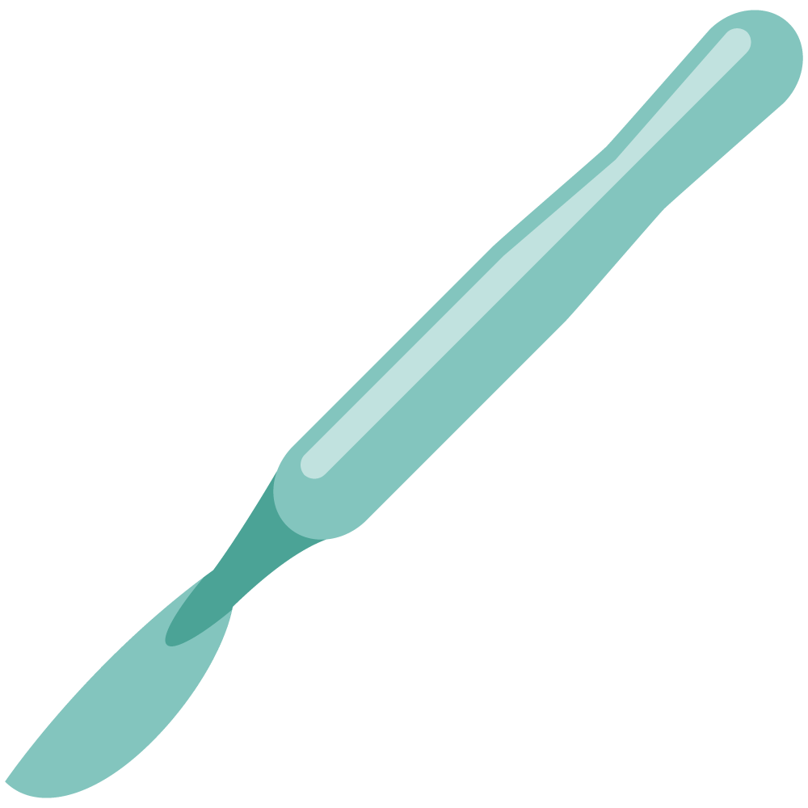
Abdominal wall, Umbilicus and Hernia
Objectives
The student is expected to describe and explain the different types, surgical anatomy, predisposing factors, clinical features and the complications of the following )
Groin hernias (inguinal and femoral)
Other hernias (umbilical, paraumbilical, epigastric, divarication, incisional, obturator, Spigelian, perineal and lumber)
Abdominal wall (hematoma, tumours)
Umbilicus ( fistulae, granuloma, adenoma, omphalitis, secondary deposits, endometrioma, and discoloration)
Colour Index
Main Text
Males slides
Females slides
Doctor notes
Textbook
Important
Golden notes
Extra
Editing File

Slide 2
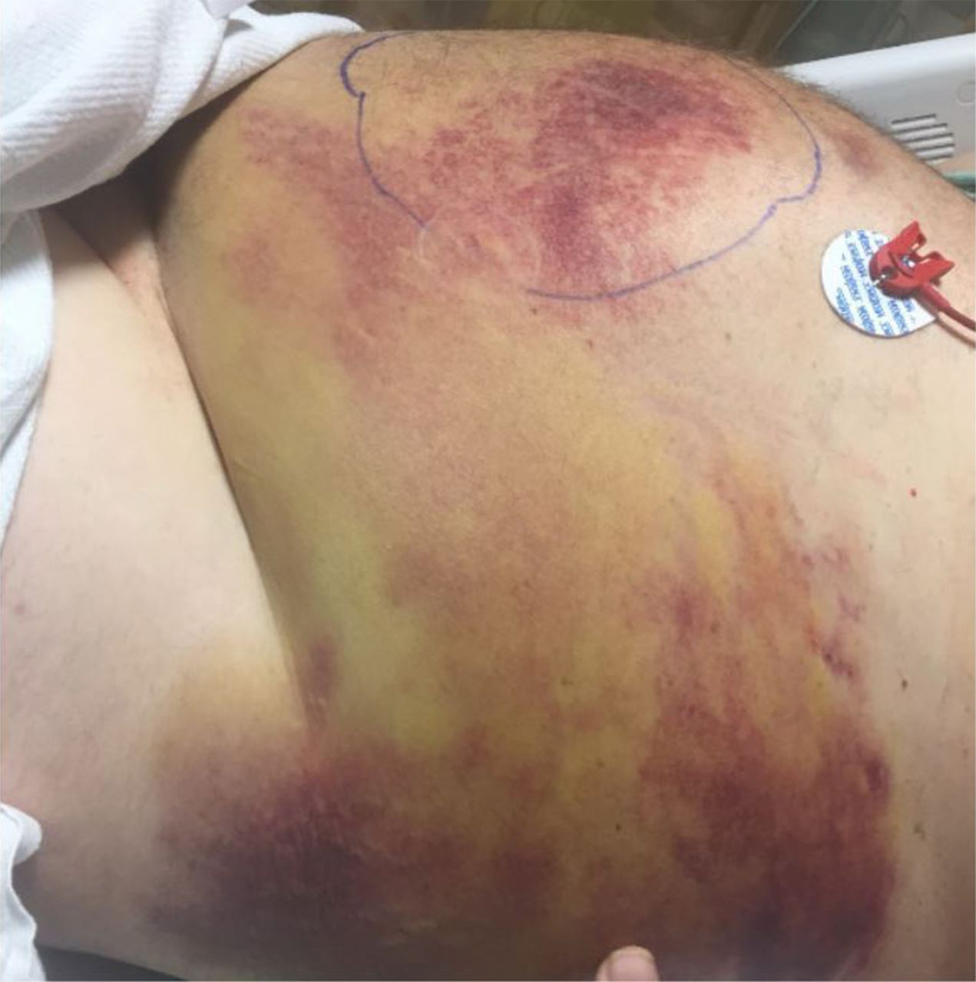
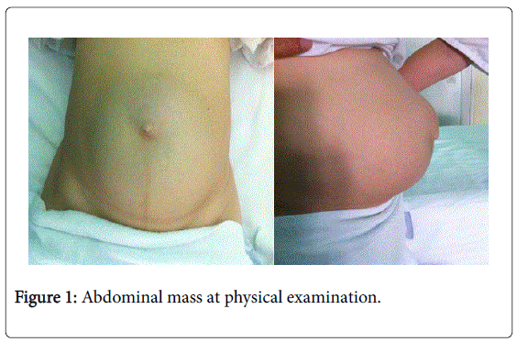
Tutorial titles
01
Abdominal wall disorders
Hematoma
Tumors
02
Groin Hernias
Inguinal (Direct, Indirect)
Femoral
03
Other Hernias
Umbilical, paraumbilical, epigastric, divarication, incisional, obturator, Spigelian, perineal and lumber
04
Umbilicus
Fistulae, granuloma, adenoma, omphalitis, secondary deposits, endometrioma, and discoloration
1- Rectus Muscle Disorders
Rectus sheath Hematoma
Extra Picture
a painful swelling within the rectus sheath Due to ruptured artery.
This condition is rare, but may represent an unusual presentation of acute abdominal pain in the elderly patient
Anticoagulant is a major risk factor, History may be accompanied with Excessive physical exertion
US can be used to confirm the diagnosis
(in elderly after violent cough, especially in those on steroids)
A-Rupture of inferior epigastric artery:
presents with tender mass in right or left iliac fossa and with overlying bruise
B- rupture of superior epigastric artery:
presents with upper abdominal tenderness and a bruise below the costal margin
Norman browse
Acute
presents as non tender upper abdominal mass
The swelling will be firm to hard, and without a definite edge because it is deep seated.
Chronic
Desmoid Tumor
Rare benign tumor. Can progress to be malignant fibrosarcoma
Thought to arise from fibrous intramuscular septa in the lower rectus abdominis muscle.
it does not change in size when the abdominal muscles are contracted.
Associated with Gardner’s syndrome.
Most common in women of child-bearing age

Slide 3
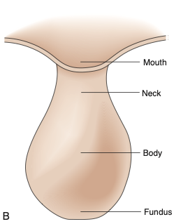
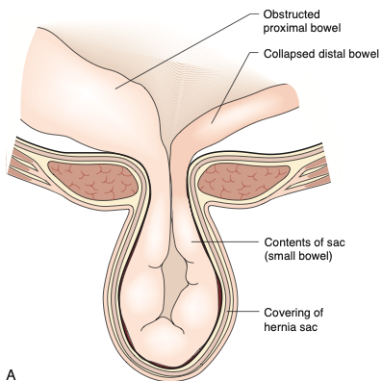
Hernias (In general)
Hernia Derived from Latin word for rupture
An abnormal protrusion of an organ or tissue through a defect in its surrounding walls
Hernias can be considered as a disease of collagen metabolism. Collagen I/III ratio is important.
In summary: weak areas are caused by stretching or surgical incisions in association with a defect in collagen metabolism
Reference Pictures
Hernia Parts
Hernia neck Located at the innermost musculoaponeurotic layer whereas the hernia sac is lined by peritoneum and protrudes from the neck
No consistent relationship between the area of a hernia defect and the size of a hernia sac
In physical examination, we don’t care how large the “sac” is. We must palpate the hernia and push it centrally to estimate its “defect” size.
Hernia Contents
A hernia may contain any intra abdominal structure, but most commonly contains omentum and/or small bowel.
A hernia is an abnormal protrusion of a cavity’s contents through a weakness in the wall of the cavity, but takes with it all the linings of the cavity “To form its wall”
Terminology
Reducible Hernia
Contents of the hernia can be returned to their normal location
Irreducible Hernia
Incarceration
Irreducible hernia with compromised blood supply “Gangrene”
Usually due to occluded Vein then complicate to artery
Strangulation

Slide 4
Hernias (In general)
Etiology (Unified theory)
Not part of the objectives
Traditionally thought of a weakness of the transversalis fascia
Evolving evidence points to multifactorial evidence
(I doubt you will be asked about these theories, but at least understand it)
Anatomy:
20% of males will have a patent processus vaginalis in adulthood (But <50% will develop a hernia)
Weakness of the posterior Inguinal wall is due to the degeneration of the fibers, muscles, and aponeuroses of the transversus abdominis and internal oblique/
Collagen framework of the transversals fasciae appears to be modified in patients with direct hernias
Biochemistry:
Smooth muscle activity within the tunica vaginalis must undergo atrophy and apoptosis for it to seal; this system is dependent on sympathetic nervous system and androgens
Chemical mediators which interfere with fibrinogenesis contribute to hernia formation
01
03
Collagen:
Type III collagen is not a sufficient barrier and may dispose a patient herniation, as opposed to Type I
Decrease in Type I or increase in Type III collagen has been linked to herniation
Smoking:
smoking likely globally affects collagen formation/degradation/modification
02
04
Proteases
Cellular Mediators
Collagen quality is affected by the protease-anti-protease balance
Imbalance of proteases and antiproteases may contribute to collagen synthesis
Enzymatic Pathology
Increase levels of elastase and metalloproteinases, and decreases levels of metalloproteinase inhibitors are associated with hernia formation
05
06
Summary
“Hernia disease” is multifactorial in etiology
Final common pathway seems to be the collagen matrix
Many details and the exact pathway remain unclear
Investigation are ongoing
Genetics
Connective tissue disorders, Hypermotility, Congenital hip dislocation, are all associated with hernia formation
07
06
Risk groups
Intraabdominal high pressures from constipation, prostatic symptoms, excessive coughing & lifting.
However, it has been shown that hernia is no more common in Olympic weightlifter than in general population, suggesting that high pressure is not a major factor causing hernia
Many patients will first notice hernia after excessive straining
Pregnancy due to hormonally induced laxity of pelvic ligaments
Elderly due to degenerative weakness of muscles and fibrous tissue
Hernia is more common in smokers.
A recent Swedish report has shown that inguinal hernia is less common in obese patient with hernia risk being negatively related to BMI contrary to widespread belied

Slide 5
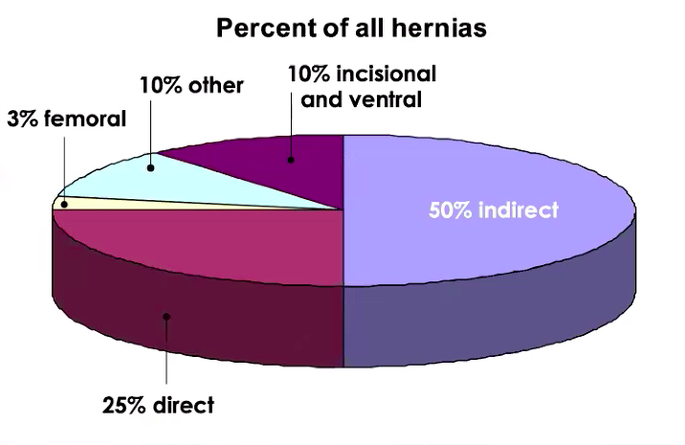
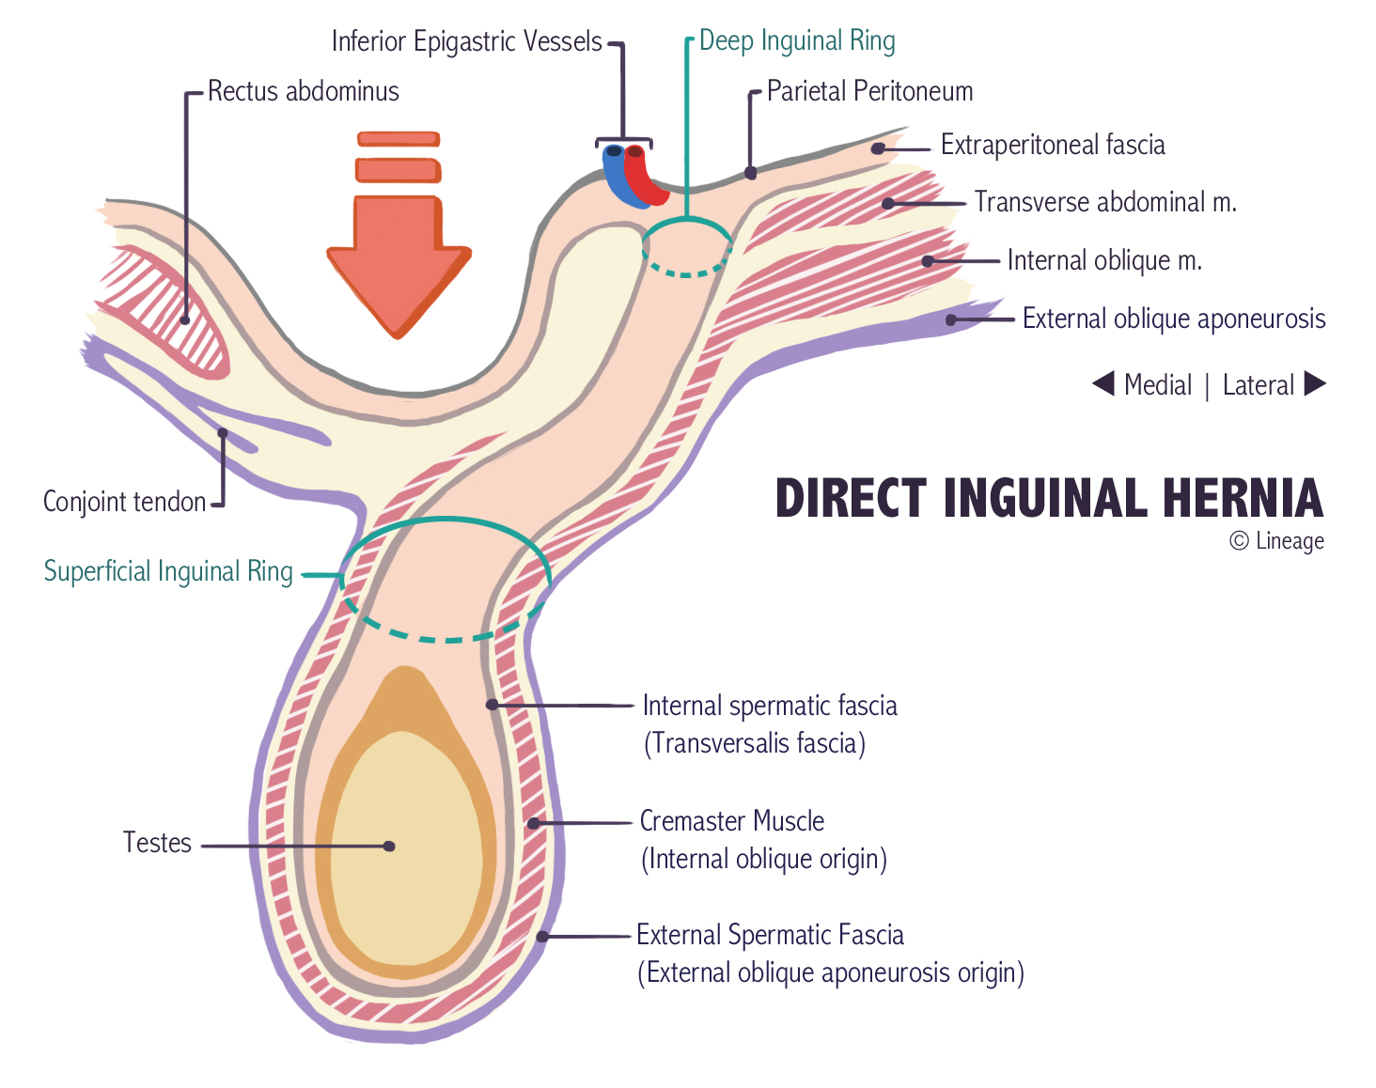
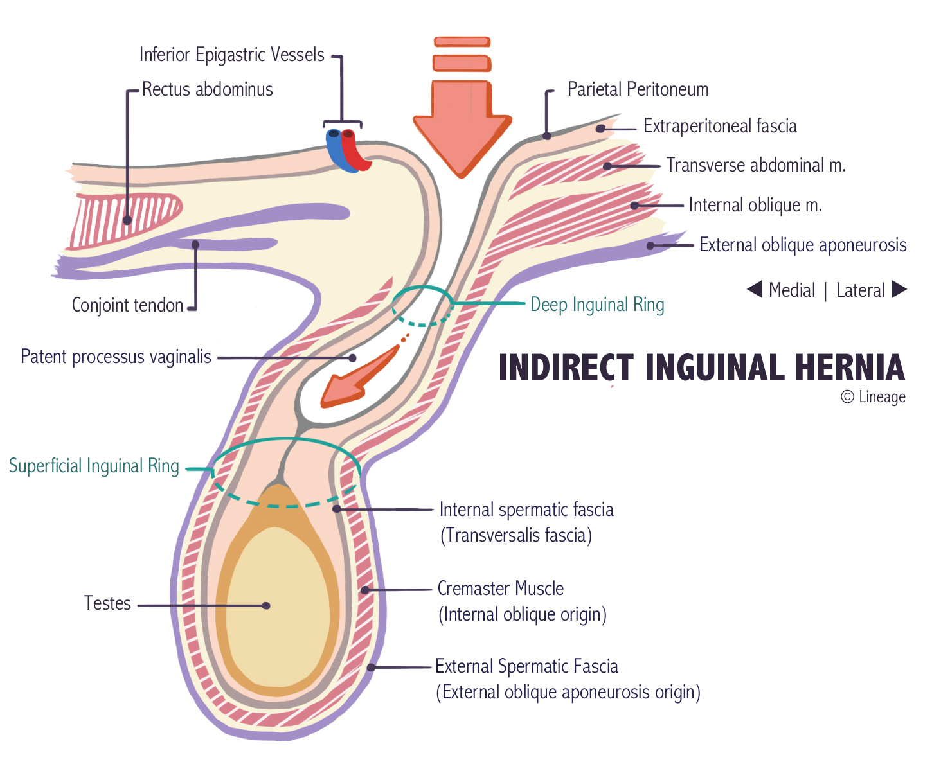
Groin Hernias
Backgrounds
Groin hernias are divided into (Inguinal & Femoral)
“These are important facts you need to remember” you have to consider which type is more common in each gender
(Femoral commonly occur in females, Inguinal commonly occur in males “Indirect in children”. Don’t get confused when asked about this part)
You can use these gender and age groups as tips if asked to determine the type of hernia in the MCQ
Indirect inguinal is the most common in both males and females
Direct hernias are very uncommon in women
Indirect inguinal and femoral hernias are more common on the right side
Attributed to a delay in atrophy of the processus vaginalis following the normal slower descent of the right testis to the scrotum during fetal growth; tamponading effect of the sigmoid colon on the left femoral canal
Inguinal Hernias
25M:1F For groin hernias
Prevalence of hernias increases with age, as does likelihood of strangulation
Strangulation occurs in 1% to 3% of groin hernias
75% of all abdominal wall hernias occur in inguinal region
2/3 are indirect, 1/3 direct
5% of all hernias are femoral
Other hernias represent 20%
F:M is 10:1 for femoral hernias
10% of F and 50% of M who have a femoral hernias either have or will develop an inguinal hernia
Femoral hernias have the highest rate of strangulation (15% to 20%) of all hernias
Femoral Hernias
Inguinal Hernia
Extra Pictures
Direct Inguinal
Indirect
Herniated part pushes skin directly
Herniated part pushes Inguinal canal contents, which indirectly pushes the underlying skin

Slide 6
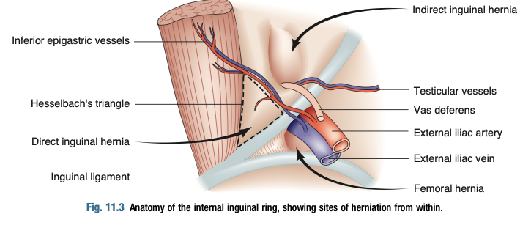
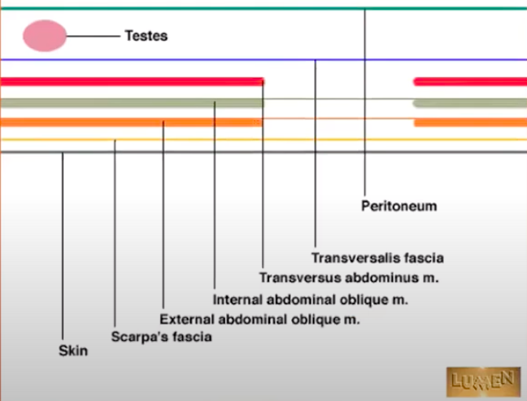
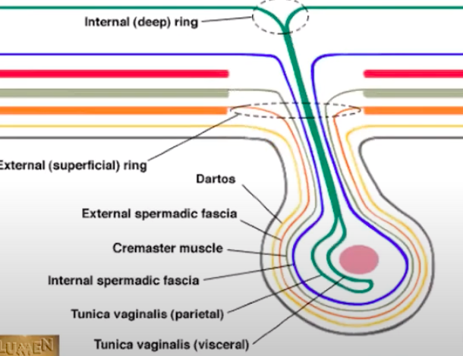
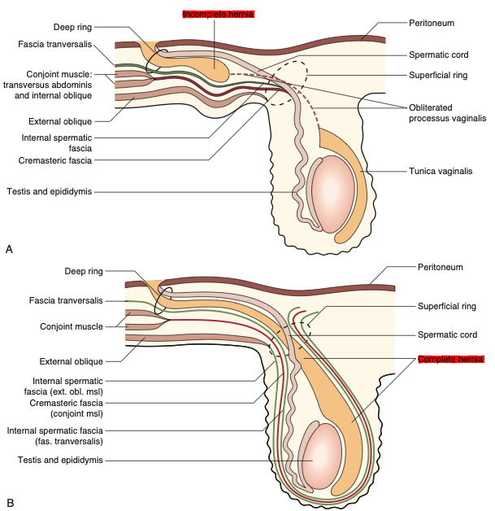
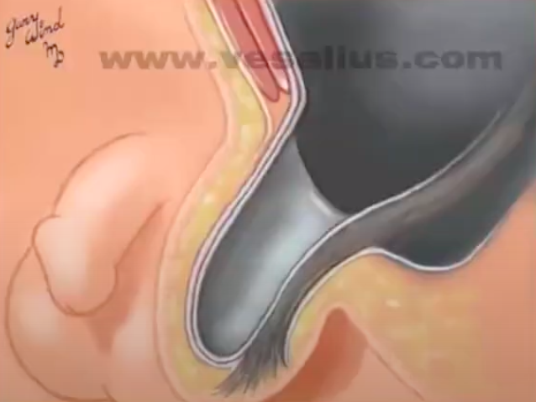
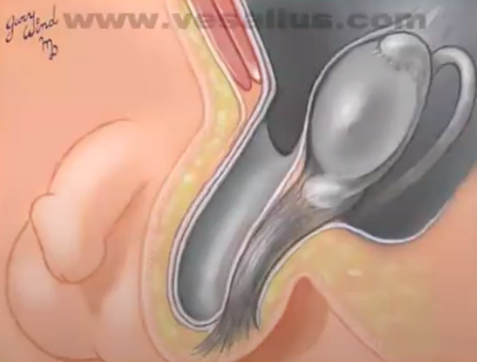
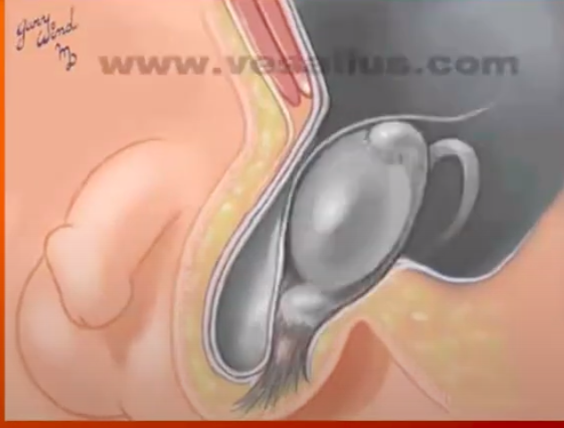
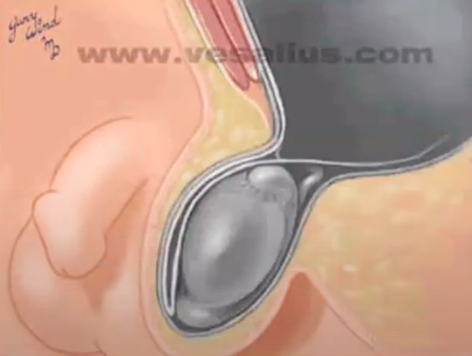
2- Groin hernias (Inguinal)
Surgical Anatomy
Reference Picture
Abdominal wall
Inguinal Canal
Formed of (from external to internal):
Skin
Soft tissue (Scarpa’s fascia)
External oblique muscle
Internal Oblique Muscle
Transversus abdominis muscle
transversalis fascia
The canal that contains spermatic cord (males) or round ligament (Females) & Processus Vaginalis
Have deep (Internal) & Superficial (External) rings
Passes Above inguinal ligament, lateral to inferior epigastric arteries
Will be discussed in details in next slide
Testicular descendant
after descendant
Scarpa’s gives dartos fascia
Transversus doesn’t contribute
Internal oblique forms the cremaster muscle
External oblique forms the external spermatic fascia
(in females, the ovaries don’t descend as the testicles in males, this is why inguinal hernias are more common in males)
Reference Pictures
Sequence from Dr.Bisher slides

Slide 7
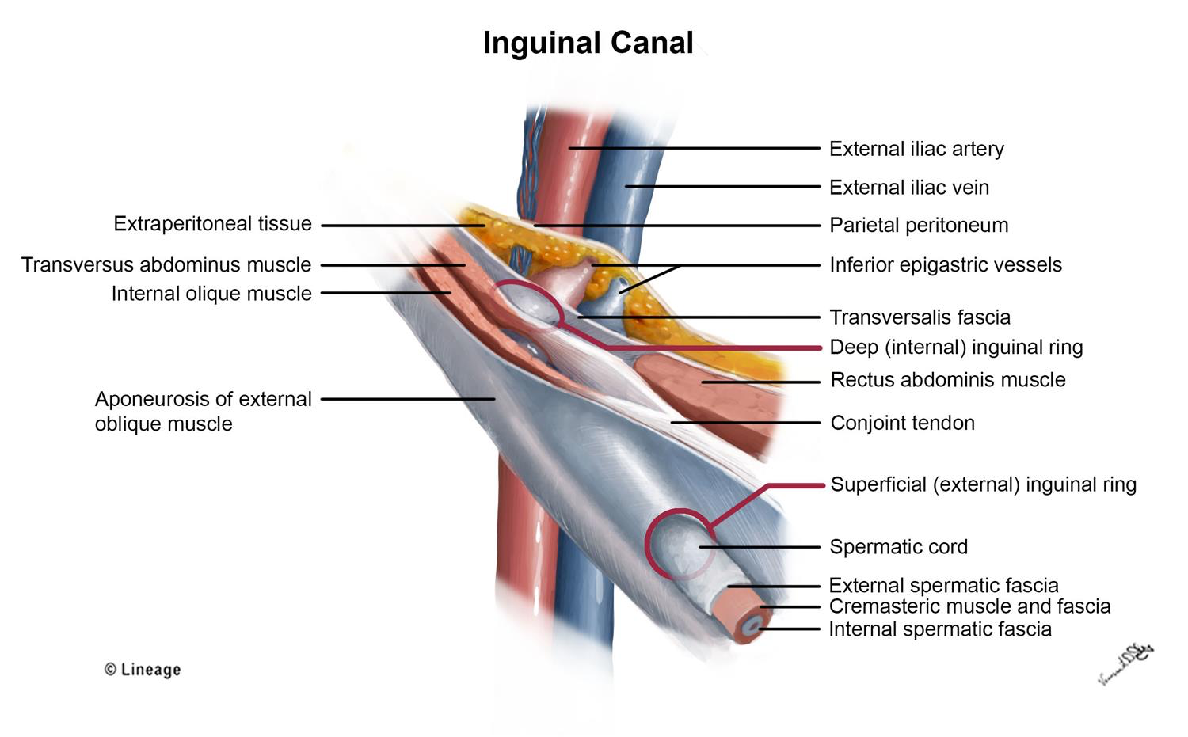
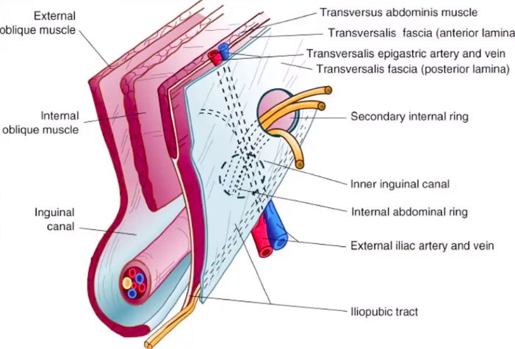
2- Groin hernias (Inguinal)
Surgical Anatomy
Extra Picture
4 cm oblique passage, lies just above inguinal ligament
Bounded by the deep and superficial inguinal rings, and the four walls
The internal (deep) inguinal ring is an opening in the transversalis fascia
Bounded medially by inferior Inferior epigastric artery Important landmark to differentiate between direct and indirect hernia
The inguinal canal ends at the external (superficial) inguinal ring, which is an opening in the aponeurosis of the external oblique muscle
Contents of Inguinal canal
Males:
Rule of three
Females:
Rule of two
Three layers of fascia
External spermatic fascia,
Middle spermatic fascia (Cremasteric)
Internal spermatic fascia
Three arteries
Cremasteric artery,
Testicular artery.
Artery of the vas deferens
Three Nerves
Ilioinguinal,
Genital branch of genitofemoral,
Sympathetic fibers to vas and testes
Three veins:
Pampmiform plexus ,
External spermatic vein,
Deferential vein
Three other things
Two main things
Fat pad
Round ligament
Two vessels
Artery to round ligament
Vein of the round ligament
Two nerves
Ilioinguinal
Genital branch of genitofemoral

Slide 8
2- Groin hernias (Inguinal)
Clinical features of inguinal hernias: (Norman Browse)
Progressive pain and discomfort at the groin
If very painful and tender hernia -> strangulation
can be painless swelling in the groin or scrotum
colicky pain and bowel obstruction
 | Indirect hernia | Direct hernia
Prevalence | Most common hernia in all genders. Most commonly occur in pediatrics | Most commonly occurs in males (Adults) Rare in children
Predisposing factors | Persistence of a patent processus vaginalis | weakness of the abdominal wall (hesselbach’s triangle).
Site | above inguinal ligament, and lateral to the inferior epigastric artery. The defect (Neck) is not palpable, as it is behind the fibres of the external oblique muscle | above inguinal ligament, and medial to the inferior epigastric artery. The defect (neck) may be felt in the abdominal wall above the pubic tubercle
Clinical Features | Lump is Clearly visible when patient stands, or asked to cough, and reduces when lying down Resolve spontaneously in children within 1st year of life | Lump is Clearly visible when patient stands, or asked to cough, and reduces when lying down Bilateral hernia is usually direct
Signs | Lump can present either at groin or scrotum Reduces upwards, then laterally (to pass inguinal ligament) and backwards Controlled after reduction by pressure at internal inguinal ring | Does not (hardly ever) go down into the scrotum Reduces upwards and then straight backwards Not Controlled after reduction
Complications | Occasionally irreducible, rarely strangulated testicular infarction is more common than bowel infarction. | rarely becomes irreducible, obstructs or strangulates.

Slide 9
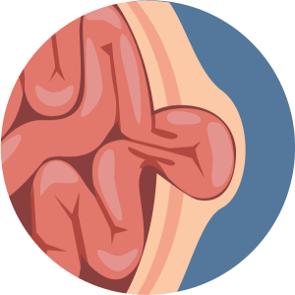
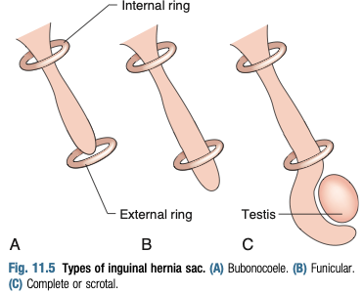
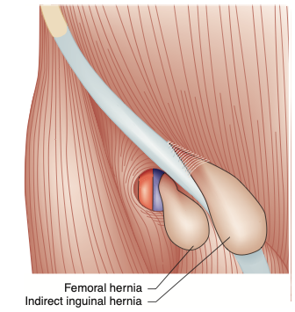
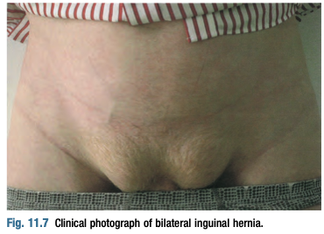
2- Groin hernias (Inguinal)
01
Indirect Inguinal Hernia
The most common Hernia
Predisposing factors are: Persistence of a patent processus vaginalis which is the primary causative factor in pediatric population; in adults, the case is likely multifactorial
An indirect inguinal hernia enters the internal (deep) inguinal ring and descends within the coverings of the spermatic cord so that it can pass into the scrotum, the so-called inguino-scrotal hernia.
It enters the inguinal canal. So, it will protrude above inguinal ligament, and lateral to the inferior epigastric artery, this protrusion may remain in the inguinal region, or extend by passing above the inguinal ligament to the scrotum.
Clinical Features
In adults it Develops over months to years
More common in children, spontaneous resolution during the first year of life
once the child begins to walk it’s resolution less likely.
02
May remain asymptomatic with some dragging or discomfort in the groin during lifting or straining or at the end of the day
Relieved by rest
Develop over months to years.
01
03
It is unusual for a patient to present with a lump without a pain
Reference Pictures
Signs of the hernia
A
Figure (A), Picture (A) Bubonocele:
Hernia forms a swelling in the inguinal region (Appearing as a bulge
Figure (A), Picture (C) Hernia extended into the scrotum
passes above and medial to the pubic tubercle (Landmark of inguinal ligament), in contrast to a femoral hernia, which bulges below and lateral to the tubercle (Figure B)
Clearly visible when patient stands, or asked to cough, and reduces when lying down
If you couldn’t find a protrusion, look for asymmetry (Bilateral hernia is uncommon, and if present they wouldn’t be symmetrical)
If you also couldn’t (Like in obese patients), try to palpate the cough impulse
B

Slide 10
2- Groin hernias (Inguinal)
02
Direct Inguinal Hernia
Predisposing factors
Association with indirect hernia
Due to weakness of the abdominal wall (hesselbach’s triangle).
precipitated by increases in intra- abdominal pressure
Other common causes of hernia
Weakness is usually bilateral
The neck of the sac of a direct inguinal hernia lies medial to the inferior epigastric vessels, whereas that of an indirect hernia lies lateral to them.
A combined indirect and direct hernia may occur on the same side (pantaloon (بنطلون) or saddle-bag hernia), with sacs straddling the inferior epigastric vessels.
Hesselbach’s Triangle
Once Again ;)
A direct hernia is a weakness of the inguinal floor.
Pushes the transversalis fascia -which is void of muscle- to protrude.
It lies between Inferior epigastric vessels (Superolateral), Lateral border of rectus abdominis muscle (Medial) and inguinal ligament (Inferolateral)
These boundaries mark the area known as Hesselbach's triangle.
Clinical Feature
01
The hernia forms a bulge in the medial side of inguinal canal.
reduced by backward pressure, and the edges of the defect may then be palpable.
it is often difficult to distinguish between the direct and indirect hernias
“deep ring occlusion test” may aid in differentiating, but it is unreliable test. Often the final differentiation made on the operating table.
The hernia occasionally bulges through the external (superficial) inguinal ring, but the transversalis fascia cannot stretch sufficiently to allow it to descend down into the scrotum (Direct hernias never extend to scrotum)
The sac has a wide neck, so that the hernia rarely becomes irreducible, obstructs or strangulates.
02
03

Slide 11
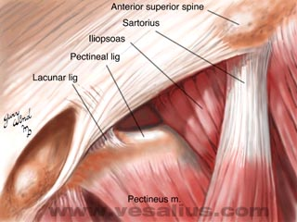
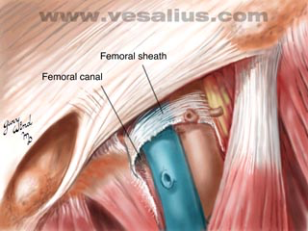
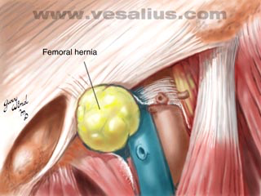
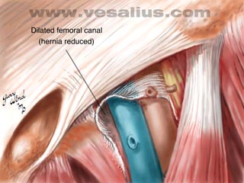
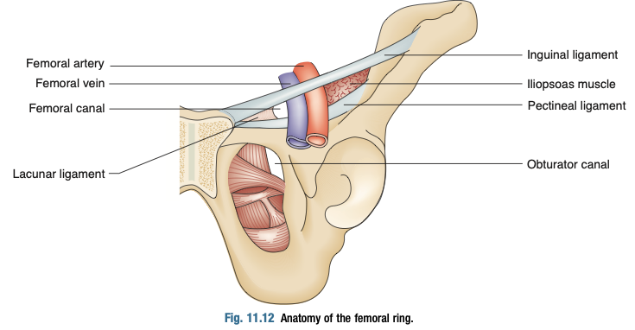
2- Groin hernias (Femoral)
Surgical Anatomy of femoral hernia
What is in the femoral sheath ?
surrounds the femoral vessels forming the femoral sheath.
Femoral vein Medially, and Femoral artery laterally
Femoral nerve is outside the lateral sheath
What is in the femoral canal ?
The small space medial to the vein within the femoral sheath is the femoral canal through which lymphatics pass from the thigh into the abdomen.
Femoral Hernia
A
Picture (A): This is a bowel passing through the femoral canal forming femoral hernia.
Picture (B): And this is when the hernia reduced “void of bowel”.
As the hernia enlarges, it passes through the saphenous opening of the thigh and then turns upwards to lie in front of the inguinal ligament (Forms J-shaped course).
B
Femoral Canal Boundaries
Reference Picture
Anterior: Inguinal (Poupart’s) ligament
Posterior: Pectineal (Cooper’s) Ligament
Lateral: Femoral vein
Medial: Edge of the lacunar (Gimbernat’s) ligament
In 10-20% of cases, the aberrant obturator artery passes adjacent to the lacunar ligament
Want more details about these ligaments? Click here

Slide 12
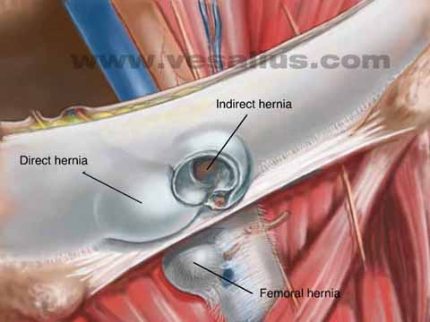
2- Groin hernias (Femoral)
Surgical Anatomy of femoral hernia
Look at the picture
What is the easiest way to locate pubic
tubercle ? (to locate inguinal ligament)
By tracing the tendon of adductor longus upward
What's the simplest anatomical difference between direct, indirect and femoral hernias?
Inguinal Ligament
Another ?
Above: Inguinal hernia (Direct and indirect)
Below: Femoral hernia
Another difference is the relation to Inferior epigastric vessels
Medial to the vessels = Direct
Lateral to the vessels = Indirect
Clinical Features of femoral hernia
Predisposing factors are similar to the direct hernia
Femoral hernias are often small (Because it has many coverings) and easy to miss on clinical examination,
They are prone to obstruction and strangulation (Because it has a small neck)
~40% presents this way
Patient presents either by a lump in the upper medial thigh
Or by exercise induced pain
02
01
is frequently difficult or impossible to reduce because of its J-shaped course and the tight neck of the sac.
There is cough impulse
03
Differentials (Extra):
Inguinal lymph node (No cough impulse, irreducible)
Saphenous varix: (positive cough impulse or ‘saphenous thrill’, which is prominent on standing but disappears on elevating the leg)
Ectopic testis, psoas abscess, hydrocele of spermatic cord
Needle aspiration is not advisable for any such swelling (only after clearly defining diagnosis or after removal of the mass)

Slide 13
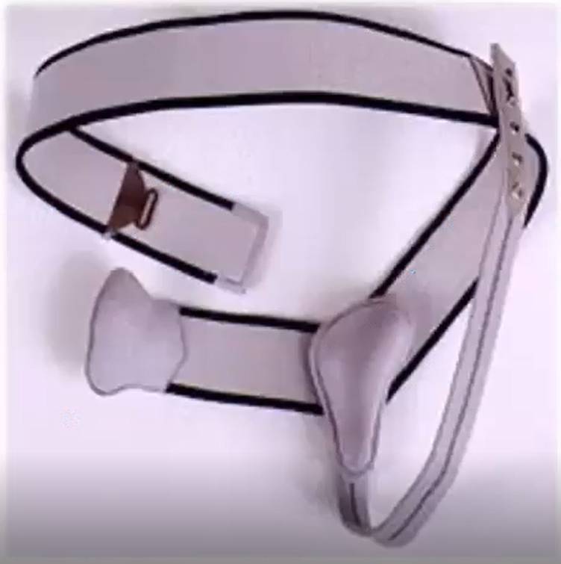
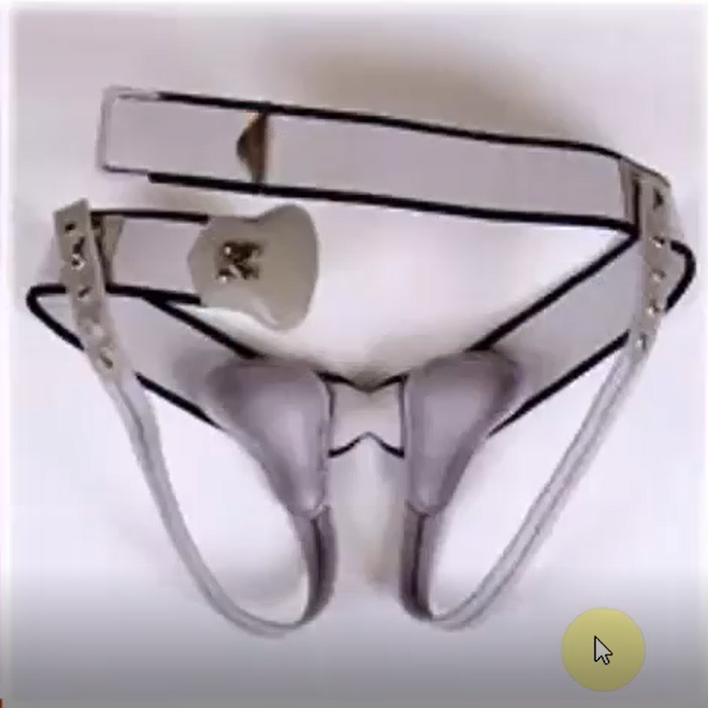
2- Groin hernias (Treatment)
Sportsman hernia
Groin injury leading to chronic groin pain is often referred to as the sportsman’s hernia
Mostly, there is no clinical signs (No lumps), despite the pain symptoms.
If you perform dynamic U/S (rest and straining), you may find “impalpable hernia” in some patients which causes the pain, and you will find nothing in others.
Treatment is controversial, some can be treated as hernia, and other will be treated with NSAIDs.
A deficiency of the posterior inguinal wall is the most common operative finding in patients with chronic groin pain.
The differential diagnosis includes
musculotendinous injuries, urological pathology, or bone and joint disease.
MRI is gold standard for diagnosis
Treatment of “uncomplicated” inguinal hernia
Management is not part of our objectives, but some doctors mentioned it.
Adults with a symptomatic inguinal hernia should be offered surgery.
Children usually need observation only, depending on the type of hernia
Elective surgery (Open or laparoscopic, Mesh network or without mesh)
01
03
The identification of an inguinal hernia in any child is nearly always an indication to operate.
Strangulated surgery must undergo emergent surgery!
02
Controlling inguinal hernias by the use of a truss (non-surgical option) is unfavorable, as this is uncomfortable and causes pressure-induced weakening of the abdominal wall muscles & testicular atrophy.
These are the trusses, they apply pressure to the hernia and reduce it backward, to keep the protruding tissue in place and relieve discomfort.
The upper picture is unilateral truss
The lower picture is bilateral truss
Trusses can be used to provide symptomatic relief of hernias
Hernia control (partial or total symptom relief) has been reported in 31-70% of patients with trusses,
Trusses should be used only for low-risk, completely reducible groin inguinal, not femoral hernias
Trusses should be preserved and offered to those in whom the surgical option is contraindicated, like those who cannot tolerate anaesthesia (severe CVD or respiratory disease).

Slide 14
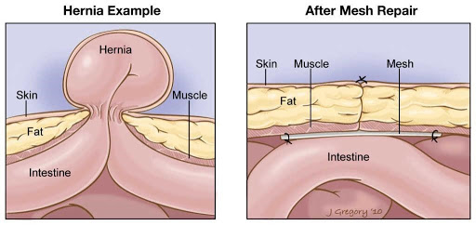
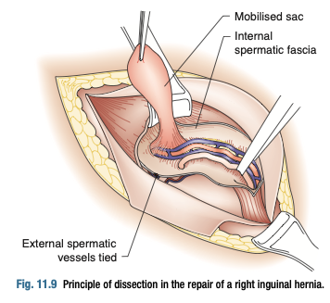
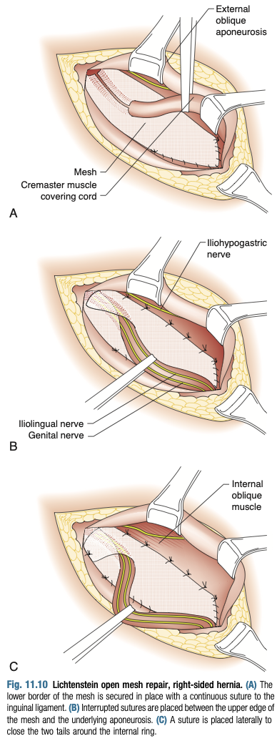
2- Groin hernias (Treatment)
Surgical repair of uncomplicated hernia
The first step in the open approach is to open the inguinal canal, free the hernial sac from the spermatic cord, reduce its contents, if any (like bowel or omentum), and excise it after transfixing and ligating its neck.
If the posterior wall is weak, then you need to add a mesh network to strengthen it (this is common in children and elderly)
In adults and adolescents, suture repair “without a mesh” is prefered, as te mesh my cause fibrosis and infertility
Reference Picture
Repair Types (No need to know the details of these procedures and how they are done. But at least have an idea about the different names)
Iliopubic Tract
Bassini
Shouldice
Cooper Ligament (McVay)
Lichtenstein (most common)
Plug and Patch
Preperitoneal
Laparoscopic
Reference Pictures
Lichtenstein Repair
(A) The lower border of the mesh is secured in place with a continuous suture to the inguinal ligament.
(B) Interrupted sutures are placed between the upper edge of the mesh and the underlying aponeurosis.
(C) A suture is placed laterally to close the two tails around the internal ring.
Lichtenstein repair used only for inguinal hernias
benefit of laparoscopic surgery is that the mesh is larger than that used at open surgery, and covers the direct, indirect and femoral hernial orifices. (Prefered in bilateral or recurrent hernia)
McVay (Cooper ligament) repair: This is the only anterior tissue repair approach that treats all three groin hernias (Indirect, Direct, and femoral)

Slide 15
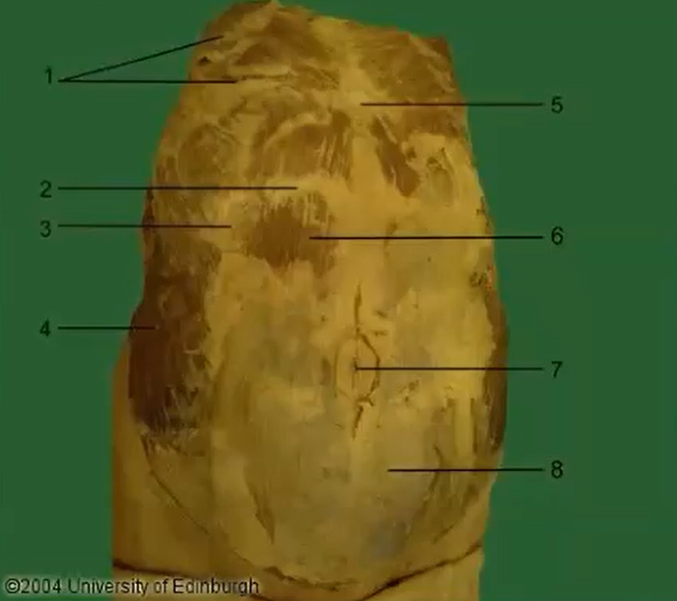
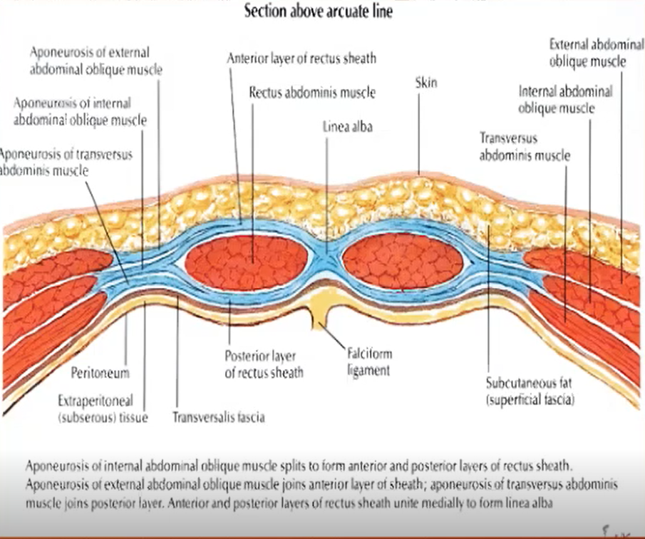
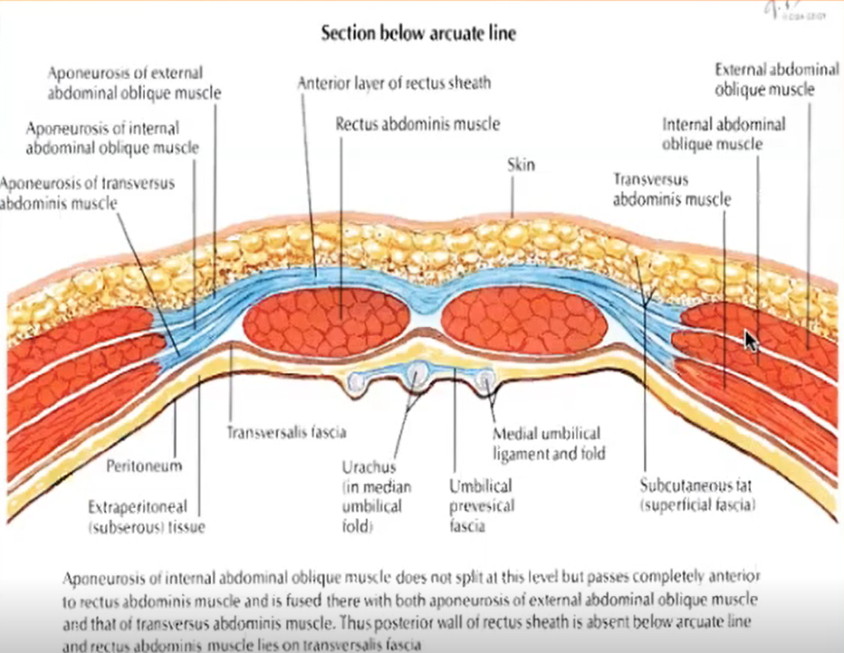
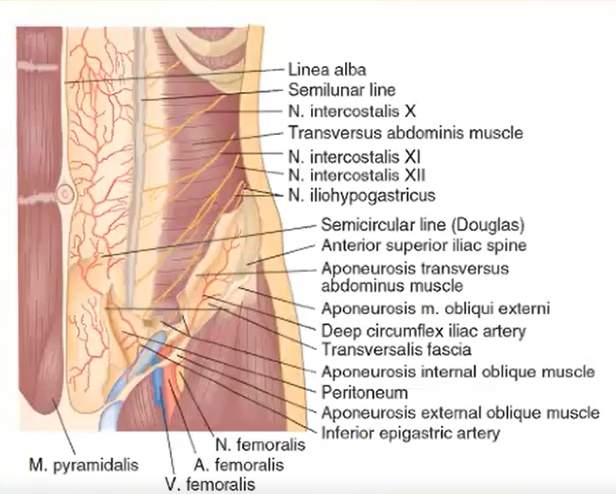
3- Other Hernias (Ventral Hernias)
Surgical anatomy of Anterior abdominal wall
Single Anterior muscle:
Rectus abdominis
Linea Alba separates left RA from right RA
In the middle of the abdomen we have the umbilicus
Arcuate line: 3-6cm below the umbilicus
3 Lateral muscles
External oblique
Internal oblique
Transversus Abdominis
Linea semilunar lies between anterior muscle and lateral muscles
Above arcuate line
Posterior rectus sheath:
present above, absent below arcuate line. (most important fact)
Anterior rectus sheath:
Formed by External oblique aponeurosis always
Internal Oblique muscle aponeurosis contributes to both the anterior and posterior rectus sheaths
Transversus abdominis aponeurosis passes posterior to the rectus muscle to form the posterior rectus sheath.
Below arcuate line
Internal oblique and transversus abdominis aponeurosis:
anterior to the rectus muscle.
Rectus abdominis muscles are nearly fused with the transversalis fascia.
This distinction is important in the laparoscopic approach to inguinal hernia repair.

Slide 16
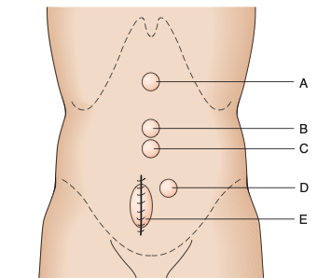
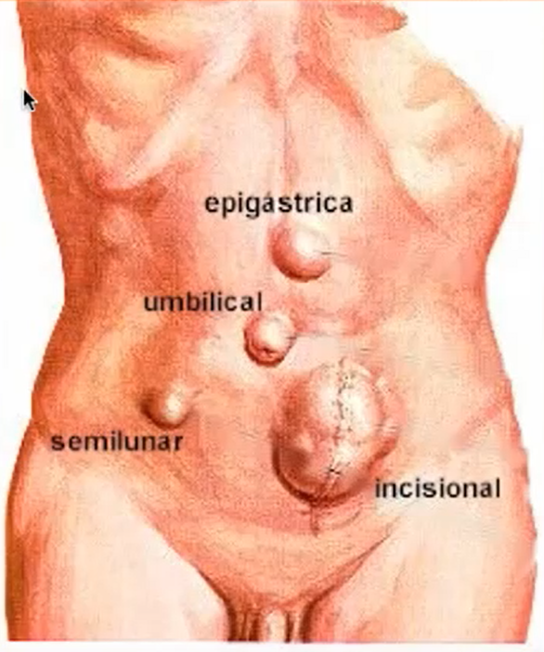
3- Other Hernias (Ventral Hernias)
Reference Picture
What are ventral hernias ?
Ventral hernias occur through areas of weakness in the anterior abdominal wall
A) through the linea alba (epigastric hernia)
B&C) Through the umbilicus (umbilical”B” and paraumbilical”C” hernia)
D) Through the lateral border of the rectus sheath (Spigelian hernia)
E) Through the scar tissue of surgical incisions (incisional hernia)
scars from laparoscopic surgery, are called port-site hernia.
Innervation and blood supply of anterior abdomen
You are supposed to remember these from your anatomy lecture
Epigastric hernia
Predisposing Factors
Clinical Features
Complications
Common in thin individuals
Especially in children and associated with divarication of Rectus abdominis
Common in individuals with a single aponeurotic
It is a hernia of linea alba, above umbilicus and below xiphoid process
Patient complain of a local discomfort at that site Especially during ingestion
Rarely visible on inspection, but is palpable as a firm midline lump.
The herniation may consist of extraperitoneal fat or may be a protrusion of peritoneum containing omentum.

Slide 17
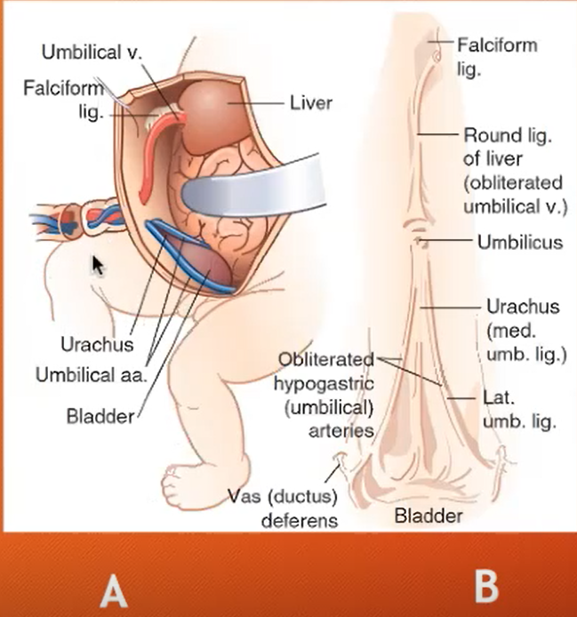
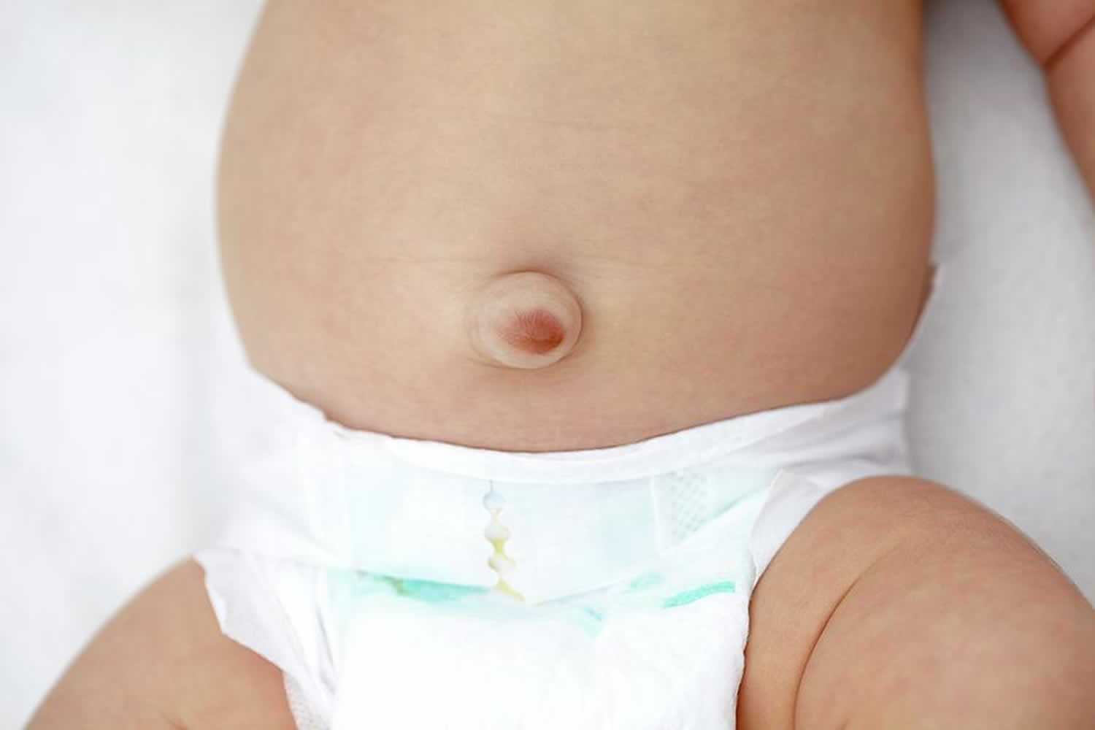
3- Other Hernias (Ventral Hernias)
Umbilical & Paraumbilical hernias
Picture (A), in the fetus
In the fetus, the umbilical vein radiates superiorly and
the two umbilical arteries and urachus inferiorly radiate from the umbilicus
Picture (B), After birth
Umbilical vein obliterated superiorly to become the round ligament of the liver.
Urachus Obliterated to form Median umbilical ligaments inferiorly
Umbilical Arteries obliterated to form Lateral umbilical ligament (called also the medial umbilical ligaments.)
Umbilical Hernia
Paraumbilical hernia
Called also (Infantile umbilical hernia)
Predisposing Factors
Age group: Occur in infants
Protrude through Umbilical ring
it is caused by a weakness in the adhesion between the scarred remnants of the umbilical cord and umbilical ring
Clinical Features
These small hernias occur in the superior margin of the umbilical ring
Easily reducible and become prominent when the infant cries
Most of these hernias resolve within the first 24 months of life (Strangulation is rare
Over 95% of these hernias close spontaneously in the first 3 years.. Persistence after the 3rd birthday is an indication for elective repair.
Called Also (Acquired umbilical Hernia
Predisposing Factors
Age group: occur in Adults
(Obese Multiparous women, Ascites)
Protrusion is part of linea alba (Just above or below the Umbilicus)
Above is more common
Caused by gradual weakening of tissues around the umbilicus
This weakening can be caused by excessive stretching.
Clinical Features
Do not spontaneously resolve but gradually increase in size
The dense fibrous ring at the neck of this hernia makes strangulation of herniated intestine or omentum an important complication
Both these hernias are covered by skin, while omphalocele is not.
Omphalocele is a type of congenital hernia in which the contents of the abdomen are herniated through the umbilicus and covered only with peritoneum.

Slide 18
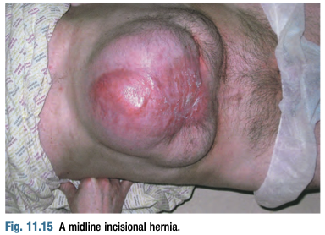
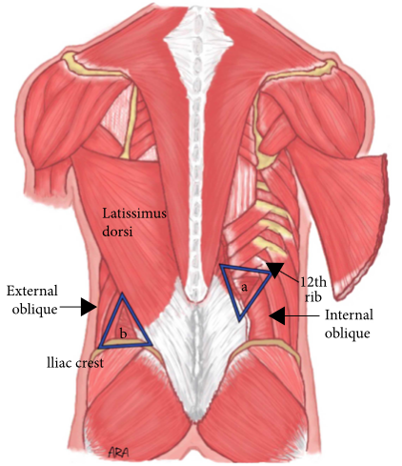
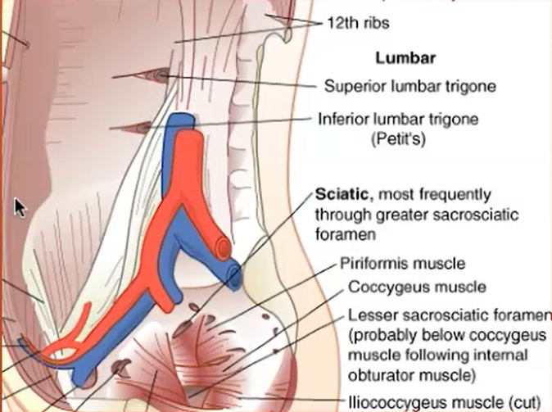
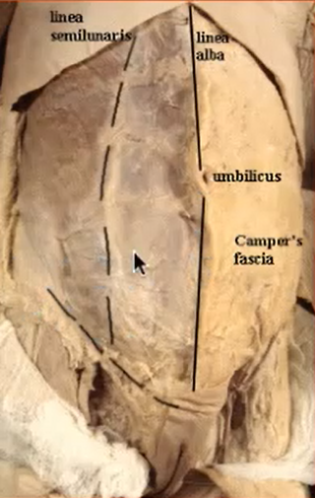
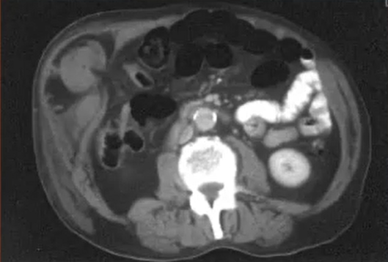
3- Other Hernias (Ventral Hernias)
Incisional Hernias
Predisposing Factors
Clinical Features
1
Poor surgical technique.
Hernia through an incision site
>50% of incisional hernias occur in the first 5 years after the original surgery.
Midline vertical incisions are most often affected.
The Bulge is better seen when patient contract his abdomen muscles “Coughing or raising from the bed”
2
wound infection
3
Obesity
Complications
Especially Elderly, diabetic patients, Immunocompromised patients or patients on steroids (All have poor healing)
Strangulation is rare, but surgical repair is usually advised.
Lumbar Hernia (Rare)
Extra Picture
Grynfeltt’s: through superior lumbar triangle:
12th rib, paraspinal muscles, and internal oblique.
More common
Petit’s: through inferior lumbar triangle
iliac crest, latissimus dorsi muscle, and external oblique
Both may occur primary due to increased intra-abdominal pressure, or secondary complication to spinal surgery
Spigelian (Semilunar) Hernia (Rare)
Hernia through the Linea semilunaris between rectus abdominis and lateral abd. Wall muscles
This area is Lack of posterior rectus fascia -> inherent weakness.
Nearly all occur at or below the arcuate line
The conjunction of arcuate line and linea semilunaris is the weakest area.
often interparietal - hernia sac dissects posterior to the external oblique aponeurosis. (at the outer border of the rectus abdominis muscle)
Treatment is surgical, as the hernia is liable to strangulate
This is the hernia

Slide 19
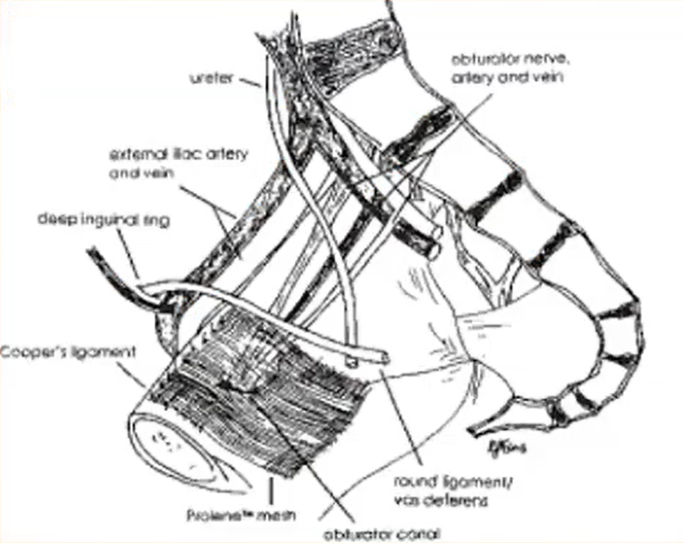
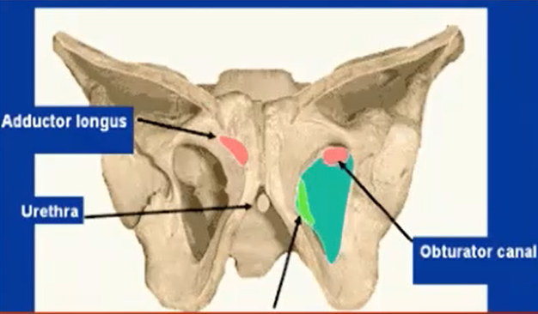
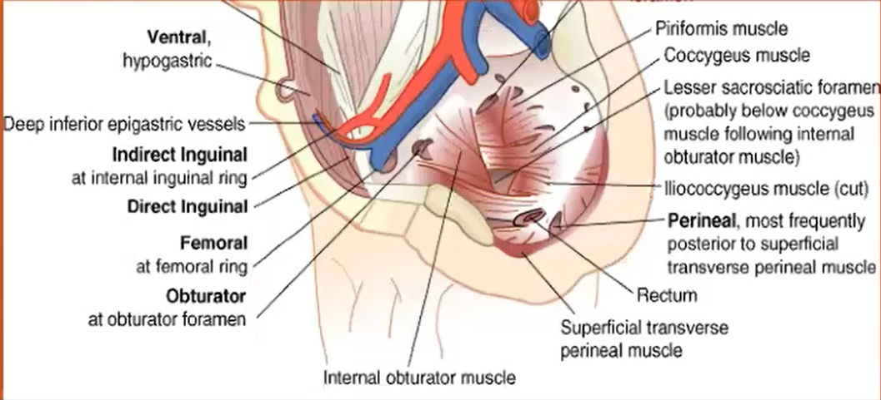
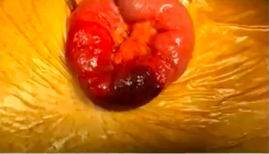
3- Other Hernias (Ventral Hernias)
Divarication Hernias
An acquired condition in which the rectus muscles are separated by an abnormal distance (>2cm) along their length, but with no fascial defect
Progressive thinning of the linea alba
It is most commonly found in middle-aged and older men with central obesity, or in women who have carried a large fetus or twins to term
It can also occur in infants, but mostly improve spontaneously
Called also (Rectus diastasis)
It is considered as Rectus muscle disease, it is not true hernia
Divarication is best observed with the patient lying supine. If asked to raise the head and legs together, the recti are fully tensed and the abdominal pressure rises. producing a visible swelling of that weak area.
It is an important risk factor for developing ventral hernias
It is not true hernia, no risk of strangulation.
Obturator Hernia (Rare)
Through the obturator canal
Patients may present with knee pain owing to pressure on the obturator nerve; however, the diagnosis is frequently made only when the hernia has strangulated and is discovered at laparotomy.
Perineal & Sciatic Hernia
hernia sac protrudes through the pelvic diaphragm
Rare but mostly in older, multiparous women. (or iatrogenic in those who underwent rectal surgery)
Sciatic Hernia: through greater sciatic foramen
Special Hernias
Littre’s hernia | hernia content include Meckel's diverticulum
Petersen hernia | Seen after bariatric gastric bypass
Petit’s, Gyrnfeltt’s & Pantaloon hernias | Peter’s & Gyrnfeltt’s had Mentioned Earlier in Lumbar hernia Pantaloon: had mentioned in Inguinal hernias
Richter hernia | Incarcerated/strangulated hernia involving one sidewall of the bowel only (bowel wall only)
Amyand’s hernia | Hernia sac containing a ruptured appendix
Sliding hernia | It is a sort of chronic groin hernias in which the protruded organ is “fused” with the sac wall
Maydl’s Hernia | hernial sac contains two loops of bowel with another loop of bowel being intra-abdominal

Slide 20
Hernia Complications
Irreducibility / Incarceration
when the intraperitoneal organs can move freely in and out of the hernia
An irreducible hernia is one in which the contents cannot be manipulated back into the abdominal cavity.
This may be due to narrowing of the neck of the sac by fibrosis, distension of the contained bowel, or adhesions to the walls of the sac.
Irreducible hernia isn’t an indication for emergent surgical intervention
Obstruction
Obstruction of the intestinal lumen (Precede the strangulation)
There is no Ischemia
Colicky abdominal pain, vomiting, constipation and distension signal the need for urgent operation before strangulation supervenes.
Obstruction is an indication of emergent surgery
Strangulation
Occur after obstruction
The vessels supplying the bowel within a hernia may be compressed by the neck of the sac or by the constricting ring through which the hernia passes.
The contents initially become swollen as a result of venous congestion (Veins occlude first) & Exudation
The arterial supply is subsequently compromised and gangrene follows
The skin overlying the hernia is red, warm to touch and tender, cough impulse is lost, and there may be increasing evidence of circulatory collapse and sepsis.
In richter's hernia, there may be strangulation w/o obstruction signs (Make it harder to diagnosis clinically, this non-diagnosed strangulation increases the mortality risk in these patients)
In Maydl’s hernia (Hernia-in-W shape) Postural or manual reduction of the hernia is contraindicated as it may result in non-viable bowel being missed (Look at the picture below)
What is the main clinical feature to differentiate between Obstructed and strangulation hernia ?
The color of the lump (strangulated hernia will be darkened, reddish or bluish. Pain may present in both.
Complete and incomplete hernia (occur in indirect hernia)
Complete extend to scrotum while incomplete remain in the inguinal canal
If the lump isn’t associated with cough impulse, you have to think of other differentialis depending of the site of that hernia (Lymph nodes, mass, etc)

Slide 21
4- Umbilicus Diseases
Norman Browse
The commonest abnormality of the umbilicus is an umbilical hernia, described earlier.
The important congenital abnormalities of the umbilicus are exomphalos and fistula, and the common acquired conditions (apart from herniae) are inflammation and invasion by tumour.
Exomphalos (Omphalocele)
1
The intestines protrude through a central defect of all layers of the abdominal wall.
Void of skin (this is the difference from Umbilical hernia)
Their only covering is a thin, transparent membrane formed from the remnant of the coverings of the yolk sac
If this membrane ruptures, death from peritonitis may follow.
2
Present at birth
Represents an intrauterine failure of the intestines to return to the abdomen
combined with a failure of the two sides of the laterally developing abdominal wall to unite to cover the embryonic defect
3
Umbilical Granuloma
It is a mass that occur in the umbilical ring, as result of inflammation, Granuloma and excessive granulation tissue
The baby presents with an inflated umbilicus overlied by a bright-red, moist, friable, sometimes hemispherical mass of bleeding granulation tissue
(You need to send a specimen for pathology to confirm it is a granulation tissue).
Not present at birth. It occur gradually after the umbilical cord has been tied
Usually regress spontaneously in the first month, if not the possibility of a patent vitello-intestinal duct or an umbilical adenoma should be considered.

Slide 22
4- Umbilicus Diseases
Norman Browse
Umbilical Fistula
Four structures pass through the umbilicus during fetal growth: the umbilical vein, the umbilical arteries, the vitello-intestinal duct and the urachus. If either of the last two tubes fails to close properly, there will be an intestinal or a urinary fistula.
Norman’s Pictures
Patent Vitello-intestinal tract
The vitello-intestinal duct runs in intrauterine life from the apex of the midgut loop to the yolk sac. It is normally obliterated long before birth
If not, it may persist as meckel’s diverticulum, or rarely develop into another complication (Figure A)
(A) A Meckel’s diverticulum.
(B) A fibrous cord to the ileum.
(C) An umbilical intestinal fistula.
(D) An enterocystoma.
(E) An umbilical sinus
(F) An enteroteratoma.
Can Present either as a complicated Intestinal fistula in which food leak from the umbilicus, or resembles umbilical granuloma
Figure A
Patent Urachus
A patent urachus can become a track through which urine can leak through umbilicus
Rare in children, more common in adults with chronic retention
The patient complains of a watery discharge from the umbilicus. (this discharge usually caused by umbilical infection, bladder fistula in which urine leak through the umbilicus is a complication)
Duct cyst
Both these tracts may partially close, leaving a patent segment that becomes a cyst.
Vitello intestinal tract leaves a small mobile cyst
Urachus tract cyst is immobile and large situated below the umbilicus

Slide 23
4- Umbilicus Diseases
Norman Browse
Umbilical Adenoma
The mother complains that the baby has a lump (Raspberry like) at the umbilicus and a mucous discharge.
Pathology specimen for confirmation
An umbilical adenoma is a patch of intestinal epithelium left behind when the vitello-intestinal duct closes.
Omphalitis
Infection of the umbilicus (Dermatitis)
Common in adults
Risk factors include poor hygiene and sunken umbilicus caused by obesity
The commonest cause of umbilical discharge. although, you need to exclude other causes.
True omphalitis is infection of the stump of the umbilical cord following inadequate postnatal care and cleanliness.
The causes of a discharge from the umbilicus
The patient complains of umbilical discharge, pain and soreness.
On examination, the skin within and around the umbilicus is red and tender, and exuding a seropurulent discharge with a characteristic foul smell.
Congenital
Intestinal fistula
Patent urachus
Umbilical adenoma
Acquired
Umbilical granuloma
Dermatitis (intertrigo)
Ompholith (umbilical concretion)
Fistula (intestinal)
Secondary carcinoma
Endometriosis
Secondary deposits
Ompholith
(Umbilical stones)
Sister Joseph’s
nodules
02
01
A stone form from accumulation of sebum with broken hair (or clothes fluff) and remain as a lump.
Risk factor is poor hygiene “especially in those with deep and narrow umbilicus i.e obese”
Patient present with pain, or as umbilical infection.
These are A firm or hard nodule bulging into the umbilicus, underneath the skin or eroding through it, present in malignant cancer
Primary malignant tumors are rare. Nearly all umbilical malignant tumors are metastatic through lymphatics from intra-abdominal cancer
patient who is losing weight and looks unwell must attract your suspicion

Slide 24
4- Umbilicus Diseases
Norman Browse
Endometrioma
If in a female patient, the umbilicus enlarges, becomes painful and discharges blood during menstruation, it may contain a patch of ectopic endometrial tissue.
Discoloration of the umbilicus
01
02
03
Blue Tinge
Yellow-blue bruising
Bruising
around the umbilicus, caused by dilated, tortuous, sometimes visible veins, is called a caput medusae
Due to digested subcutaneous tissues following an attack of severe acute pancreatitis(E.g pasto history of gallstones)
occur after few days of the acute attack.
around the umbilicus (Cullen’s sign) = tracked by falciform ligament to the umbilicus
and in the flank (Grey Turner’s sign) = tracked by retroperitoneal space
can also be associated with intra-abdominal bleeding, particularly when it is extraperitoneal.
Causes include ruptured ectopic pregnancy and accidental peri-uterine bleeding in pregnancy.
(Cullen’s sign)
(Grey Turner’s sign)
imp: examples of cases from the Dr
you have 55 y.o male came with groin swelling that he had since the last year, on and off. What’s your best diagnostic tool?
Most hernias are diagnosed clinically, You need to check reducibility and cough impulse to check the complications.
If the diagnosis was hard (As in sportsman’s hernia, pain w/o a visible mass) you can use MRI or CT
pt came with nausea, vomiting and abdominal distension, what’s the Dx? “they may add picture”
Depending on the picture :) but generally abdominal distension is caused by intestinal obstruction, if the hernia was red or blue colored then it is strangulation
they may show picture with A B C label of bowel ischemia and ask you how you are gonna treat it? which type of hernia caused this?
I suppose the picture will come like this

Slide 25
Summary
Recall
Q1:Why should hernias be repaired?
Answer: To avoid complications of incarceration/strangulation, bowel necrosis, SBO, pain
Q2: What is more dangerous: a small or large hernia defect?
Answer: Small defect is more dangerous because a tight defect is more likely to strangulate if incarcerated
Q3: What are the boundaries of Hesselbach’s triangle?
Answer: 1. Inferior epigastric vessels 2. Inguinal ligament (Poupart’s) 3. Lateral border of the rectus sheath Floor consists of internal oblique and the transversus abdominis muscle
Q4:What is the differential diagnosis for a mass in a healed C-section incision?
Answer: Hernia, ENDOMETRIOMA
Q5: Direct Inguinal Hernia
-What is it? Hernia within the floor of Hesselbach’s triangle, that is, the hernia sac does not traverse the internal ring (Think: directly through the abdominal wall)
-What is the cause? Acquired defect from mechanical breakdown over the years
-What is the incidence? ≈1% of all men; frequency increases with advanced age
-What nerve runs with the spermatic cord in the inguinal canal? Ilioinguinal nerve
-What happens if you cut the ilioinguinal nerve? Numbness of inner thigh or lateral scrotum; usually goes away in 6 months
Q6: Indirect Inguinal hernia
What is it? Hernia through the internal ring of the inguinal canal, traveling down toward the external ring; it may enter the scrotum upon exiting the external ring (i.e., if complete); think of the hernia sac traveling indirectly through the abdominal wall from the internal ring to the external ring
What is the cause? Patent processus vaginalis (i.e., congenital)
What is the incidence? ≈5% of all men; most common hernia in both men and women
What is the risk of strangulation? Higher with indirect than direct inguinal hernia, but highest in femoral hernias
Q7:What is the hernia sac made of?
What is it? Hernia traveling beneath the inguinal ligament down the femoral canal medial to the femoral vessels (Think: FM radio, or Femoral hernia = Medial)
What are the boundaries of the femoral canal? 1. Cooper’s ligament posteriorly 2. Inguinal ligament anteriorly. Femoral vein laterally 4. Lacunar ligament medially
What factors are associated with femoral hernias? Women, pregnancy, and exertion
Q8: Femoral hernia
Answer: Small defect is more dangerous because a tight defect is more likely to strangulate if incarcerated
Q9: What are the boundaries of Hesselbach’s triangle?
Answer: 1. Inferior epigastric vessels 2. Inguinal ligament (Poupart’s) 3. Lateral border of the rectus sheath Floor consists of internal oblique and the transversus abdominis muscle
Q10:Define the following terms:
Cullen’s sign Bluish discoloration of the periumbilical area from retroperitoneal hemorrhage tracking around to the anterior abdominal wall through fascial planes
Grey Turner’s sign Ecchymosis or discoloration of the flank in patients with retroperitoneal hemorrhage from dissecting blood from the retroperitoneum (Think: Grey TURNer = TURN side to side = flank [side] hematoma)
Q11:Omphalocele
What is it? Defect of abdominal wall at umbilical ring; sac covers extruded viscera
How is it diagnosed prenatally? May be seen on fetal U/S after 13 weeks’ gestation, with elevated maternal AF
How is the diagnosis made? Prenatal U/S
What are the possible complications? Malrotation of the gut, anomalies
Of what “pentalogy” (Associated abnormalities) is omphalocele a part? Pentalogy of Cantrell
What is the pentalogy of Cantrell? “D COPS”: Diaphragmatic defect (hernia) Cardiac abnormality Omphalocele Pericardium malformation/absence Sternal cleft

Slide 26
Quiz
MCQ
Q1: which of the following is a common type of hernia that occurs in children
A) incisional hernia
B) direct hernia
C) femoral hernia
D) indirect hernia
Q2: which of the following is most liable to strangulation?
A) incisional hernia
B) direct hernia
C) femoral hernia
D) indirect hernia
Q3: what are the boundaries of Hesselbach’s triangle?
A)inferior epigastric artery, lateral border of rectus abdominis, inguinal ligament
B) inferior epigastric artery, medial border of rectus abdominis, inguinal ligament
C) superior epigastric artery, lateral border of rectus abdominis, inguinal ligament
D) superior epigastric artery, medial border of rectus abdominis, inguinal ligament
Q4: what is the sign shown in the picture?
A) Cullen’s
B) Grey Turner’s
C) sister Joseph
D) castell
Q5:Patient came with apparent mass when he stands and it disappear with lying down, what is the diagnosis?
A)femoral hernia
B)inguinal hernia
C)communicable hydrocele
D)non communicable hydrocele
Q6:A 58-year-old man presents with a bulge in his right groin associated with mild discomfort. On examination the bulge is easily reducible and does not descend into the scrotum. Which of the following changes is most concerning for possible strangulation requiring emergent repair of the hernia?
A)increase in the size of the hernia
B)descent of the hernia to the scrotum
C)appearance of a new hernia in the left groin
D)worsening pain over the hernia during walking
E)inability to reduce the hernia
Answers
Click here for explanation
Q1 | D | Q4 | A
Q2 | C | Q5 | B
Q3 | A | Q6 | E
Extra Questions

Slide 27
Good Luck!
Team leaders:
Nouf Alshammari
Haneen Somily
Naif Alsulais
Mohammed alshoieer
This lecture was done by:
Mohammed Alshoieer
Hashem Bassam
Feedback
Note taker
Reviewer

