Slide 1
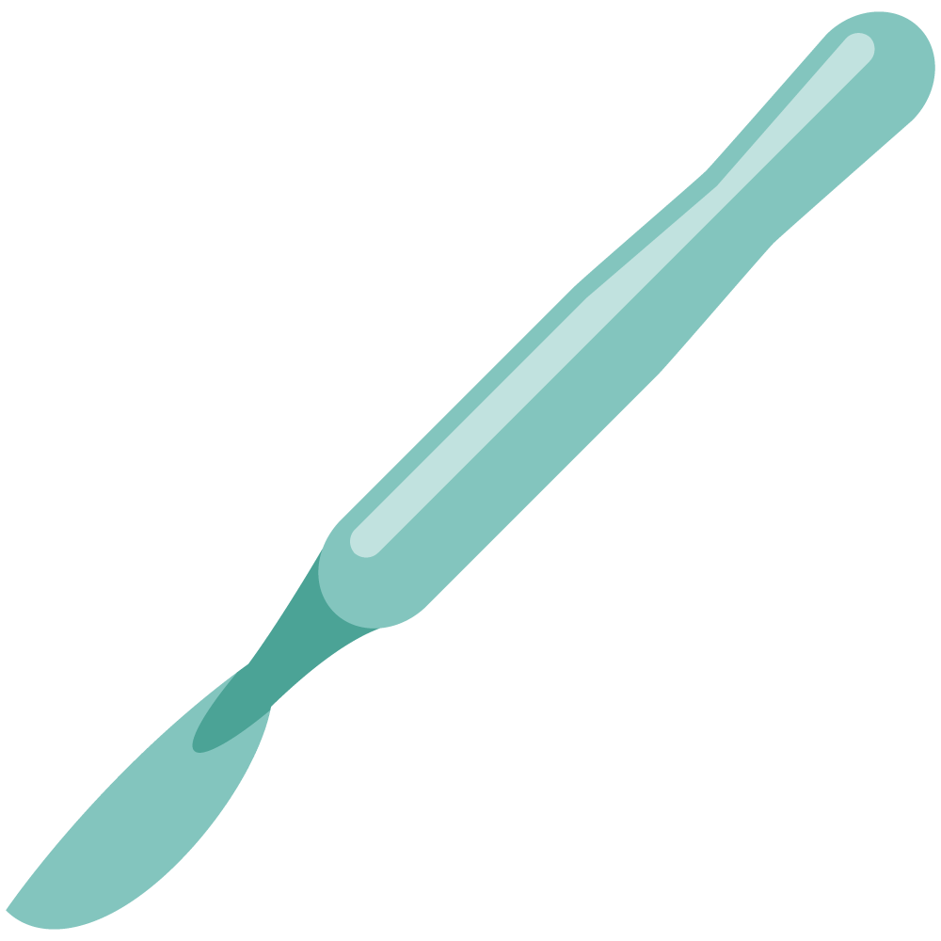
Approach to wound healing & Burn case-scenario
Objectives
Approach to wound healing The students should be able to:
List and explain the phases of Normal Wound Healing
The hemostatic phase,The inflammatory phase, The proliferative phase,The remodeling (maturing) phase
List and describe the types of Wound Healing
Healing by primary intention (first intention),Healing by secondary intention, Healing by tertiary intention (delayed primary closure)
Identify and differentiate between the factors Affecting Wound Healing
Local factors: Wound site, Wound contamination, Infection, Mechanism of wounding, Tissue loss, Hematoma formation in the wound, Vascular insufficiency, Previous radiation of wounded area, A pressure in the wounded area
Systemic Factors: Malnutrition, Uncontrolled diabetes, Medications, Chronic diseases, Immunosuppression, Smoking
List and discuss the types of wounds
Acute Wound
Chronic
Classify Wounds According to the Mechanism of Wounding
Clean. Avulsion, Abrasion, Puncture,Crushing
Explain the Management plan of Acute Wound
Explain the Management plan of Chronic Wound
Explain the mechanism of Compartment Syndrome
Describe Degloving Injury
Demonstrate the following points regarding leg ulcer:
List the different types of leg ulcer including: Venous Ulcer, Ischemic Ulcer, Traumatic Ulcer, Chronic Infection, Neoplastic Ulcer, Pressure ulcer, Venous ulcer, Ischemic ulcer,Diabetic Ulcers
List and explain the Risk factors, and the prevention mechanisms of Different Leg Ulcer
Abnormal scars:
Explain how scars are formed
Explain the different abnormal scars and how they are formed
Atrophic scar, Hypertrophic scar, Keloid scar, Contracture scar
Explain the Management plan of abnormal scar
Burn- case scenario
The student is expected to describe and perform the following:
Calculation
Management
Surgical options
Non surgical options
Colour Index
Main Text
Males slides
Females slides
Doctor notes
Textbook
Important
Golden notes
Extra
Editing File

Slide 2
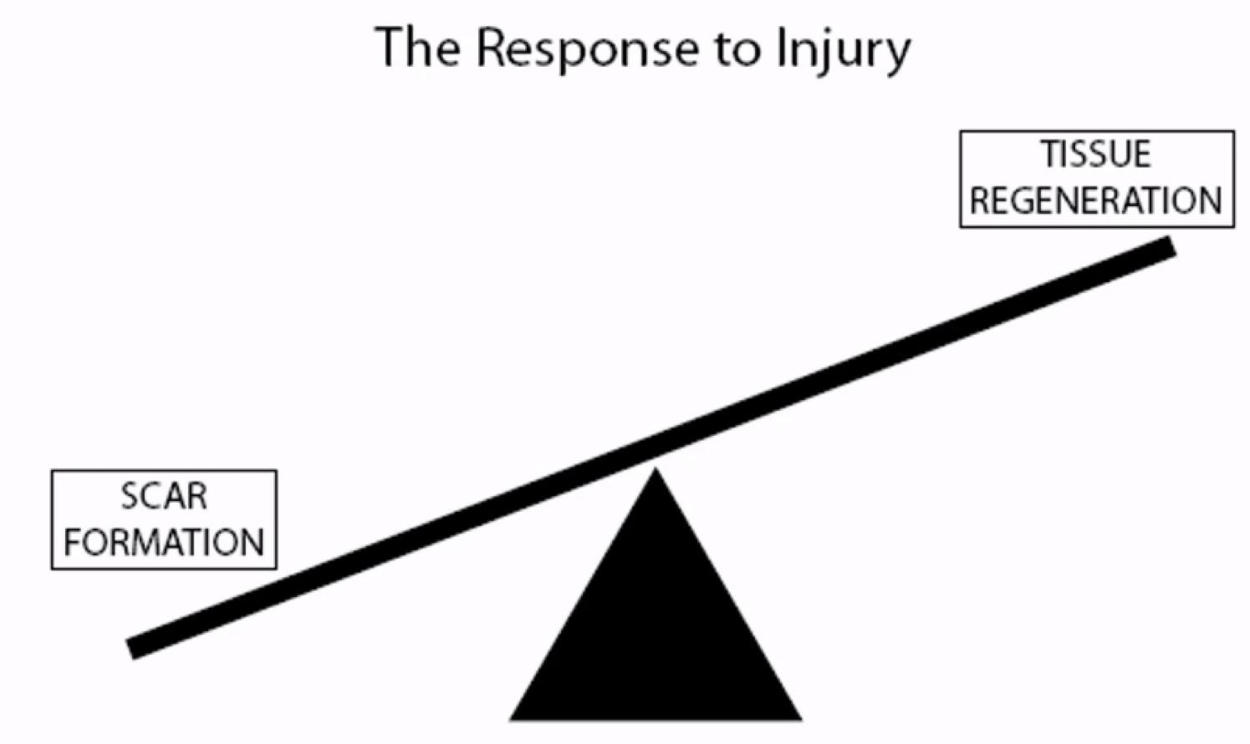
Wound healing
Definitions
Wound: disruption of normal anatomical structure and function on the skin or internal organ
Acute wound: proceeds through an orderly and timely reparative process to restore function and anatomical integrity (3-4 wk).
Chronic wound: proceed through a reparative process without establishing a sustained anatomic and functional result (beyond 6 wk)
Healing: response of an organism to a physical disruption in an organ or a tissue to repair a defect.
Abnormal healing:
Overgrowth: keloid or hypertrophic scar.
Undergrowth: wide or thin or chronic unstable.
Abnormal pigmentation: hypo/hyper
Whenever there is injury in the skin the melanin production can be over or under produced
Local factors:
Wound site.
For example, the presence of persistent pressure or recurrent trauma at wound site may compromise the healing of the wound.
Wound contamination
Such wound require debridement, removal of all dead tissues and foreign bodies, and cleaning.
Infection
It reduces the rate of wound healing, granulation tissue formation, oxygen and nutrient delivery.the use of debriding agent to clean the wound and appropriate prophylactic antibiotics is important in preventing wound infection.
Mechanism of wounding
For example, the incisional wound will follow the normal phases of wound healing, whereas crushing or avulsion wounds may not heal in normal process and may have a prolonged healing process.
Tissue loss
This will delay the slow wound healing and predispose to infection.
Hematoma formation in the wound
Bleeding must be controlled because hematoma formation in the wound predisposes to wound infection and it separates the wound edges and prevents wound healing.
Vascular insufficiency
Poor blood supply leads to decreased oxygen and nutrients delivery which will retard the wound healing.
Previous radiation of wounded area
This will result in vasculitis with local hypoxia, ischemia, reducing the amount of oxygen and nutrition to the wound site.
Pressure in the wound area
Pressure in the wound will reduce the blood supply, which causes hypoxia, ischemia, and retarded wound healing.
Scar formation VS regeneration:
Scar formation: substitution of a different cellular matrix as a patch to immediately re-establish both a physical and a physiological continuity of the injured organ. Will not behave like normal tissue
Regeneration: recreating the original organ by the developmental process which created it.
The more the tissue regeneration the better the function of the organ
Wound contraction:
Active, normal & essential part of healing, that starts from the proliferative phase.
This is beneficial especially in bigger or chronic wounds where the contracture will bring the cells together at a faster rate which will accelerate the healing process.
Rate depends on the number of myofibroblasts
Myofibroblasts resemble fibroblasts but contain smooth muscle Actin.
Responsible for wound contraction.
From end to end
Contracture: an undesirable result of healing due to excessive contraction and fibrosis.

Slide 3
Wound:
Collagen
Type I ≅ 90% of all collagen in body
Type IV collagen found in basement membrane
Normal skin ratio - Type I:Type III = 4:1
Hypertrophic / immature scar 2:1 ratio
Formation inhibited by:
Colchicine (a medication used in Gout), penicillamine (anti tumor), steroid, Vit.C deficiency and Fe deficiency.
They activate collagenase which degrades collagen synthesis and inhibits cross linkage hydroxylation of lysine and proline.
Classification of Wound Closure:
Primary healing (1st intention) | Secondary healing (2° intention) | Tertiary healing (3° intention)
Primary closure by suturing the edges together. Within hours of repairing full-thickness surgical incision. Results in mortality of minimal number of cellular constituents. Considered the most efficient method and results when a clean incised surgical wound is meticulously apposed. | Wound left open to heal¹ by processes of granulation, contraction², and epithelialization³. Results in more intense inflammatory response. Larger quantity of granulation tissue with pronounced contraction of wounds. Like chronic wounds | Delayed primary closure Desired for contaminated wounds (infected wounds)⁴. Phagocytosis of contaminated tissues well underway by 4th day. Foreign materials walled off by macrophages. 3° intention healing describes the situation where a wound healing by 2nd intention (neglected traumatic wound/burn) is treated by excising its margins and then apposing them or covering the area with a skin graft. The final cosmetic result may be better than if the wound had been left to heal by 2° intention.
Note
Examples of some cases where we use 2nd wound healing intention are:
1. Perineal abscess 2. Diabetic foot.
If we treat by 1st intention it may lead to Cellulitis
Do we need to give the patient antibiotics? If the wound is fresh and clean, it is not preferred to give prophylactic Abx
If dirty —> always start with oral antibiotics (IV requires admission)
You keep the wound open (you do dressing and wound care but no suturing) and it heals by itself by contraction of myosin and actin, as well as epithelialization of dermis and epidermis, and it usually takes longer than primary healing.
Contraction results in edge to edge (horizontal) repair.
Epithelialization results in vertical repair.
Tertiary healing is a combination of primary healing and secondary healing. Clean the contaminated wound, wait for about 3 days and then re-approximate it by suturing.

Slide 4
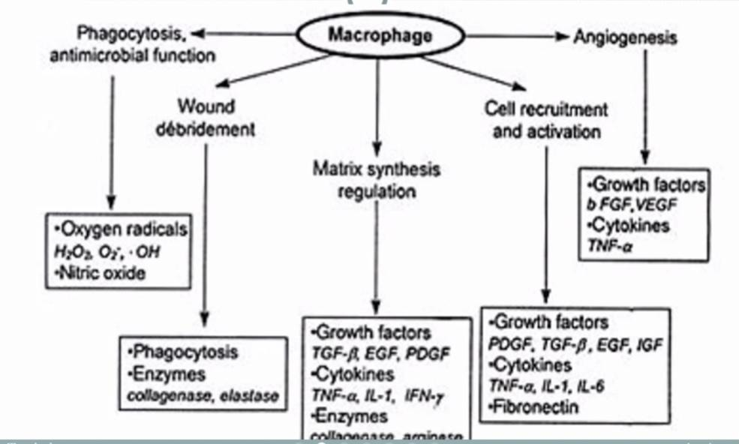
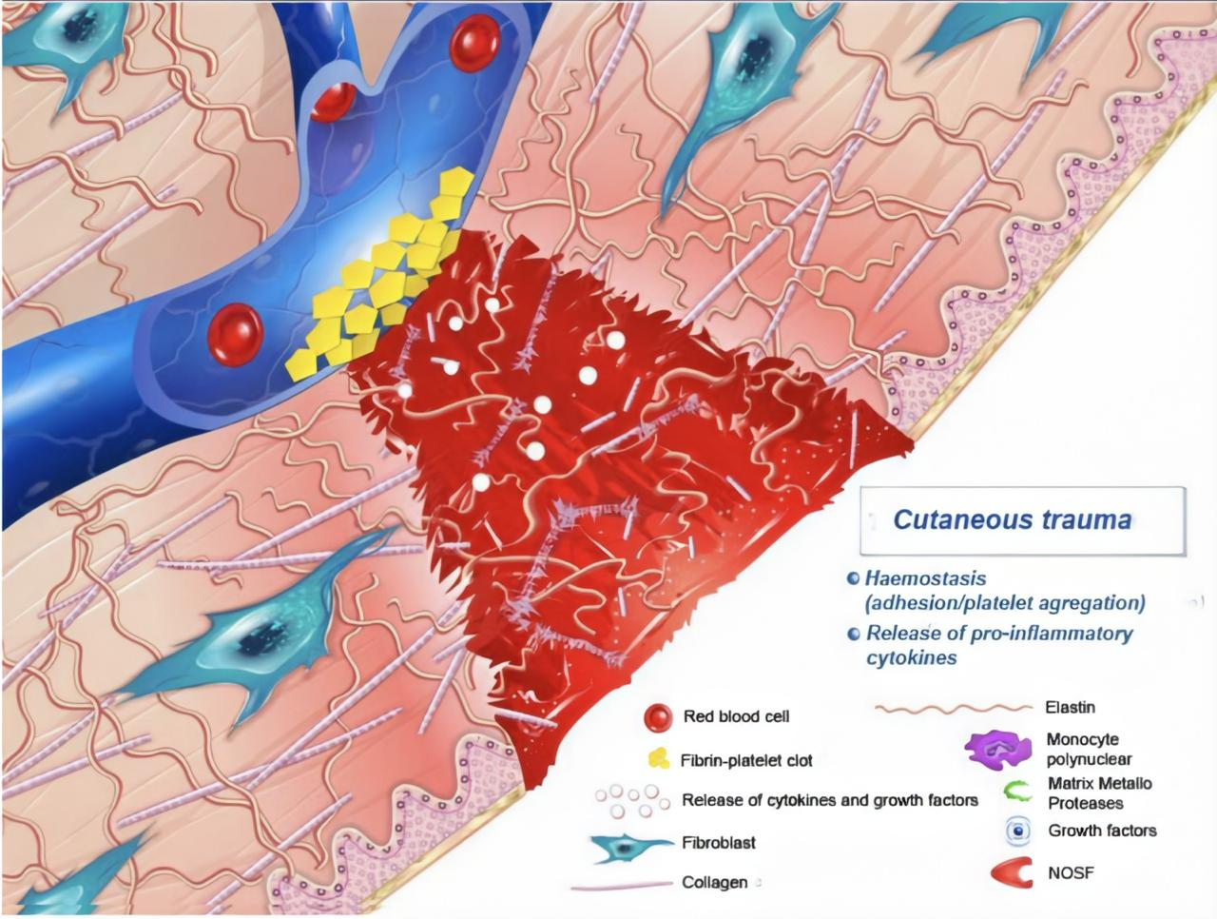
Note
If a patient presents with a wound, always ask about Tetanus status:
Received a booster in the last 5-10 years?
If not —> give a booster
If a child is not immunized or missed a dose in childhood —> give passive and active immunizations
Phases of Wound Healing:
01
Heamostasis¹ (5-10min)
Main cells in this phase: platelets
Initial response to injury = constriction followed by dilation. (vasoconstriction is to reduce blood loss and aggregate the platelets)
Platelet plug forms after adherence to exposed subendothelial collagen via vWF
Platelets degranulate releasing: ADP, thromboxane-A2, bradykinin, and 5-HT → further vasoconstriction and platelet aggregation.
Platelets stimulated to release :
platelet derived growth factor (PDGF)
made by macrophages, endothelial cells, fibroblasts
chemotaxis, fibroblast stimulation
Chemotaxis: dealing with debris from the wound
transforming growth factor β (TGFβ)²
made by macrophages, platelets, fibroblasts
fibrinogenesis, angiogenesis, chemotaxis, immune suppression
fibroblast growth factor
made by macrophages and endothelial cells
angiogenesis and chemotaxis
Form the platelet plug
Degranulation of platelets (release of cytokines and growth factors)
Activation and recruitment of neutrophils
Considered as phase zero or part of the inflammatory phase. This phase is delayed by bleeding disorders.
It has a major role in wound healing. The main source for the production of TGFβ is the Alpha granules of platelets. Excess production of TGF-β isoforms causes abnormal scars (Hypertrophic and Keloid scars).

Slide 5
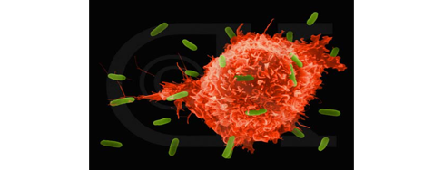
Phases of Wound Healing cont.:
02
Inflammatory/Migratory ”lag” phase¹ (1-4 Days)
Typically starts immediately after hemostasis.
Main cells in the inflammatory phase: in the first 24 hours → PMNs (neutrophils)
After 24 hours → Macrophages.
Classically represented by:
01
Rubor (redness) caused by:
vasodilation
primarily result of prostacyclin (PGI₂) and histamine, also caused by prostaglandin A, D, E (PGA, PGD, PGE)
02
Tumour (swelling):
caused by leakage of plasma proteins through gaps in vascular endothelium
edema potentiated by PGE₂, prostaglandin F_{2α} (PGF_{2α})
03
Calour (heat)
Increased local temperature secondary to both:
Increased blood flow
Elevated metabolic rates
04
Dolour (pain)
Macrophages :
Phagocytosis
Wound debridement
activation of fibroblast
Angiogenesis
Matrix synthesis (granulation tissue formation) regulation
Characterized by an inflammatory response to injury, through an increased capillary permeability, proliferation of capillaries at wound edges and accumulation of protein-rich exudate preceding collagen synthesis

Slide 6
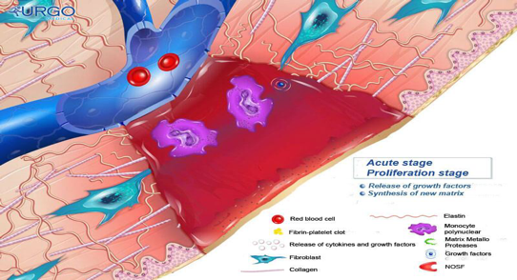
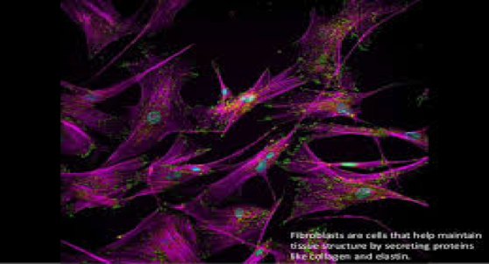
Phases of Wound Healing cont.:
03
Proliferative/Fibroplasia “incremental“ ¹ (3 days - 3 weeks)
Begins 2-3 days after wounding.
Signalled by arrival of fibroblasts (Main cells in the proliferative phase, they play a role in collagen synthesis).
Driven by macrophage-derived bFGF, TGFβ, PDGF to proliferate and synthesize glycosaminoglycans (GAGs) and proteoglycans (building blocks of new extracellular matrix of granulation tissue and collagen).
Also produce bFGF, TGFβ, PDGF, keratinocyte growth factor, insulin-like growth factors-1.
Dominant cell type peaking at 7-14 days.
Collagen synthesis² (net production for next 3-6 weeks).
↑ Keratinocyte mitosis, ↑Endothelial cells and ↑Angiogenesis (from vessels at wound margins).
Lasts 2-4 weeks depending on site and size of wound with slowing of fibroblast
migration and proliferation.
Different cells differentiate into different types and new blood vessels are formed (angiogenesis).
Collagen and elastin synthesis
In this phase there is progressive collagen synthesis by fibroblasts and a corresponding increase in tensile strength with Increased collagen turnover. This phase is delayed by: Microvascular diseases (Diabetes), Macrovascular (Atherosclerosis).
Arterial oxygen tension (PaO2) is a key determinant of the rate of collagen synthesis.

Slide 7
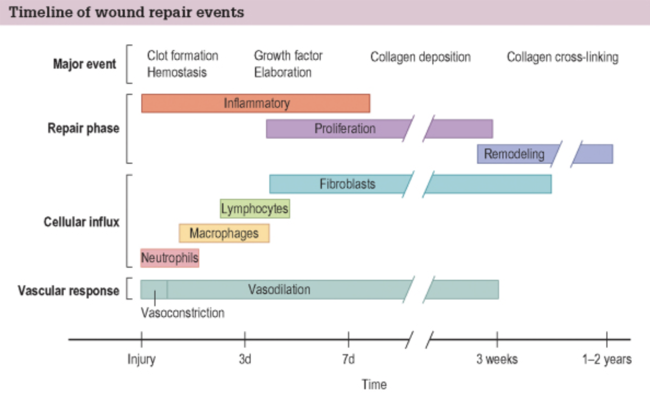
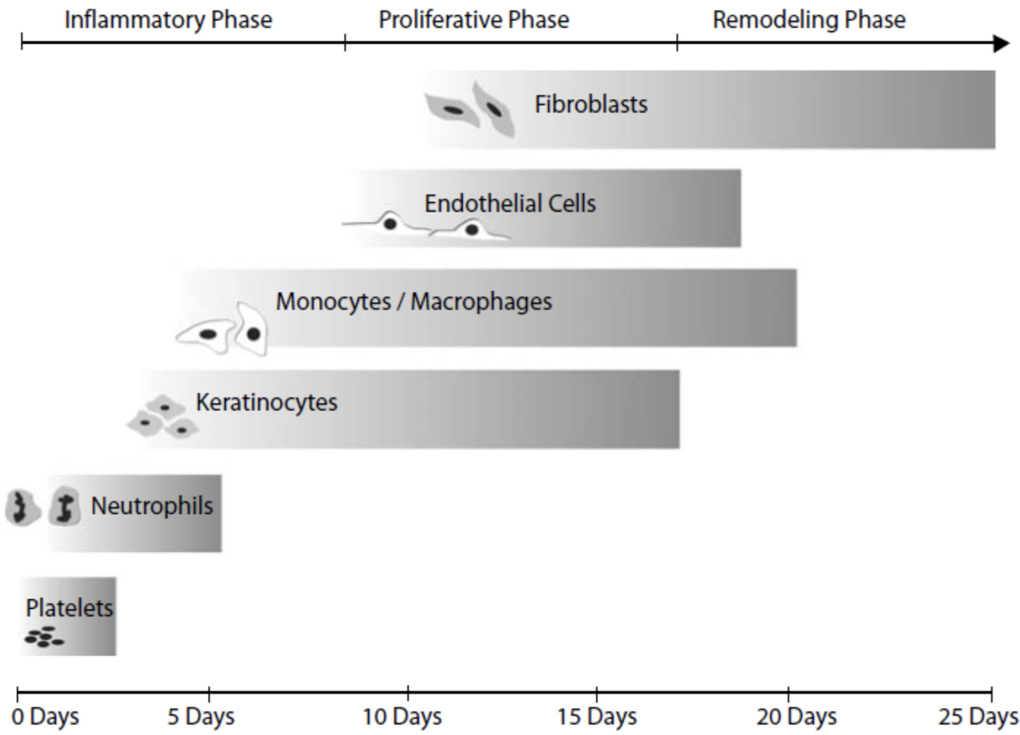
04
Remodeling /Maturation (3 weeks - one year)
Begins approx. 3 weeks after injury
Collagen synthesis and degradation are accelerated but in equilibrium
with collagen breakdown (no net increase in collagen content)¹
Collagen deposition peaks by 3rd week
Large capillaries growing into wound regress/disappear
Indurated, raised, pruritic scar becomes mature scar
Collagen fibers become organized
Type III collagen replaced by type I collagen
re-establishing normal 4:1 ration (I:III):
Duration depends on age, genetics, type of wound, location (1-2 years)².
Tensile strength increases to 80% of pre-injured skin³
Collagen becomes more organized in shape depending on the location of the wound (6-8 weeks)
Epithelial Repair: outermost portion of the skin that heals from edge to edge
Epithelial continuity is reestablished across a wound: Multiple events happen during the healing process. The cells (from the two edges of the wound) mobilize & migrate to the middle and get in proximity then duplicate by mitosis and differentiate to different cells.
Mobilization
Migration
Epithelial cells continue to grow across the defect
1st
2nd
(stimulus is loss of contact inhibition)
Cellular differentiation
To form a similar cell to the skin
4th
3rd
Mitosis
When an epithelial cell touches another one they start to make new cells
The major event in the remodeling phase.
Type three collagen is the main collagen present in the wound healing process. In abnormal wound healing (such as in hypertrophic scars and keloids) we have a higher ratio that could reach up to 1:30 so you'll have high collagen type 3 compared to the normal ratio, and you’ll have abnormal scarring.
Especially in healing tendons, muscles, and blood vessels. For example for tendons it reaches up to 60-80%, but for normal wounds it usually reaches 100%.

Slide 8
Wound healing
Factors affecting wound healing:
The aim of wound care is to achieve healing by primary intention and thereby reduce the proliferative and inflammatory phases, by correcting any abnormality that can retard or slow the wound healing.
Several local and systemic factors can influence the wound healing, that can result in delay or abnormal healing process which will lead to a poor cosmetic outcome and delay recovery of the function of the wounded part.
These factors should be addressed and controlled by the treating clinician.
Local factors
Local factors:
Wound site.
For example, the presence of persistent pressure or recurrent trauma at wound site may compromise the healing of the wound.
Wound contamination
Such wound require debridement, removal of all dead tissues and foreign bodies, and cleaning.
Infection
It reduces the rate of wound healing, granulation tissue formation, oxygen and nutrient delivery.the use of debriding agent to clean the wound and appropriate prophylactic antibiotics is important in preventing wound infection.
Mechanism of wounding
For example, the incisional wound will follow the normal phases of wound healing, whereas crushing or avulsion wounds may not heal in normal process and may have a prolonged healing process.
Tissue loss
This will delay the slow wound healing and predispose to infection.
Hematoma formation in the wound
Bleeding must be controlled because hematoma formation in the wound predisposes to wound infection and it separates the wound edges and prevents wound healing.
Vascular insufficiency
Poor blood supply leads to decreased oxygen and nutrients delivery which will retard the wound healing.
Previous radiation of wounded area
This will result in vasculitis with local hypoxia, ischemia, reducing the amount of oxygen and nutrition to the wound site.
Pressure in the wound area
Pressure in the wound will reduce the blood supply, which causes hypoxia, ischemia, and retarded wound healing.
1
Blood supply
Decreased tissue perfusion results in decreased wound oxygenation.
Fibroblasts are oxygen-sensitive and their function is reduced in hypoxic states.
Poor blood supply also leads to decreased nutrients delivery which will retard the wound healing.
2
Causes endothelial cell, capillary and arteriole damage.
Irritated fibroblasts secrete less collagen and extracellular matrix.
Lymphatics are destroyed resulting in edema and risk of infection.
Previous radiation of wounded area also results in vasculitis with local hypoxia, ischemia, reducing the amount of oxygen and nutrition to the wound site.
Radiation
3
Infection
Wounds with over 105 organisms per gram of tissue are considered infected and are unlikely to heal without further treatment with debridement and Abx
It reduces the rate of wound healing, granulation tissue formation, oxygen and nutrient delivery.the use of debriding agent to clean the wound and appropriate prophylactic antibiotics is important in preventing wound infection.

Slide 9
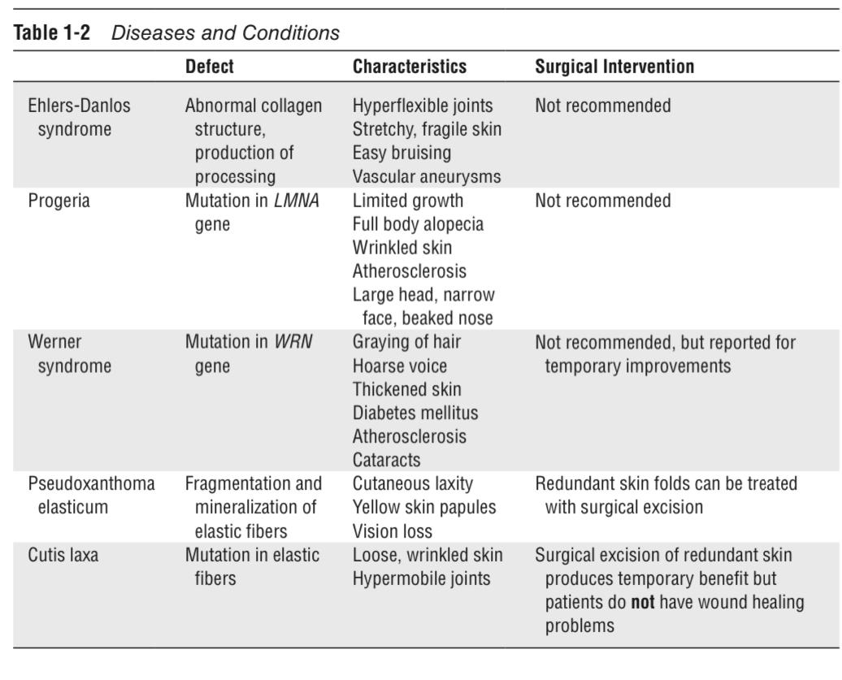
Wound healing
Local factors
4
5
6
Wound site
Wound contamination
Hematoma formation in the wound
The presence of persistent pressure or recurrent trauma at wound site may compromise the healing of the wound.
Bleeding must be controlled because hematoma formation in the wound predisposes to wound infection and it separates the wound edges and prevents wound healing.
Such wound require debridement, removal of all dead tissues and foreign bodies, and cleaning.
Local factors:
Wound site.
For example, the presence of persistent pressure or recurrent trauma at wound site may compromise the healing of the wound.
Wound contamination
Such wound require debridement, removal of all dead tissues and foreign bodies, and cleaning.
Infection
It reduces the rate of wound healing, granulation tissue formation, oxygen and nutrient delivery.the use of debriding agent to clean the wound and appropriate prophylactic antibiotics is important in preventing wound infection.
Mechanism of wounding
For example, the incisional wound will follow the normal phases of wound healing, whereas crushing or avulsion wounds may not heal in normal process and may have a prolonged healing process.
Tissue loss
This will delay the slow wound healing and predispose to infection.
Hematoma formation in the wound
Bleeding must be controlled because hematoma formation in the wound predisposes to wound infection and it separates the wound edges and prevents wound healing.
Vascular insufficiency
Poor blood supply leads to decreased oxygen and nutrients delivery which will retard the wound healing.
Previous radiation of wounded area
This will result in vasculitis with local hypoxia, ischemia, reducing the amount of oxygen and nutrition to the wound site.
Pressure in the wound area
Pressure in the wound will reduce the blood supply, which causes hypoxia, ischemia, and retarded wound healing.
7
8
9
Mechanism of wounding
Pressure in the wound area
Incisional wounds will follow the normal phases of wound healing, whereas crushing or avulsion wounds may not heal in normal process and may have a prolonged healing process.
Tissue loss
This will delay the slow wound healing and predispose to infection.
Pressure in the wound will reduce the blood supply, which causes hypoxia, ischemia, and retarded wound healing.
In addition to Nerve supply, trauma, hydration and temperature.
Congenital
Systemic factors
Acquired
Pseudoxanthoma elasticum
Autosomal dominant
Problem with collagen cross linkage
→ weakness and failure of healing
Ehler-Danlos syndrome
AD, defect in synthesis, structure
and cross linkage of collagen
Cutis laxa
Progeria
Werner syndrome
Epidermolysis bullosa
Similar to a burn

Slide 10
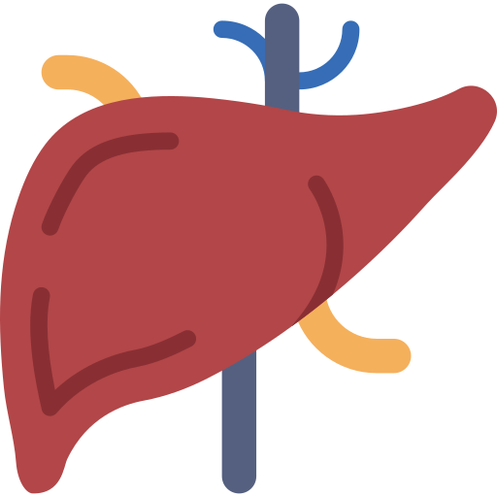
Factors affecting wound healing:
Congenital
Systemic factors
Acquired
Malnutrition:
Nutrition is extremely important for protein and collagen synthesis, and metabolic energy for wound healing.
Systemic factors
Malnutrition
Nutrition is extremely important for protein and collagen synthesis, and metabolic energy for wound healing.
Folic acid is important for the synthesis of collagen.
Vitamin K is essential for the process of carboxylation in the synthesis of coagulation factors II, VII, IX, and X. deficiency of vitamin K will cause coagulopathy and hematoma formation in the wound that retards the wound healing.
Vitamin A increases collagen synthesis, inflammatory response, and recruitment of macrophages into the wound.
Zinc is an essential co-factor for the synthesis of RNA and DNA.
Magnesium is required for the synthesis of protein.
General malnutrition or deficiency of any of these vitamins or trace elements will adversely affect the wound healing.
Uncontrolled diabetes
Hyperglycemia will inhibit fibroblast proliferation, alter collagen formation, and retard wound healing. Hyperglycemia predisposes to wound infection by making good media for bacteria growth, and suppression of phagocytic function of neutrophils.
Medications
Receiving some medications may affect the wound healing, steroids reduce inflammatory response, vitamin A availability, collagen deposition, and remodeling the wound.
Chronic diseases
Diseases such as liver disease, jaundice, malignancy, uremia, will dispose to malnutrition, wound infection, and delay wound healing.
Immunosuppression
Immunosuppression status due to some conditions (leukemia, post-transplant, immunosuppressive drugs, chemotherapy, and AIDS) will predispose to wound infection, reduce the inflammatory response, and retard wound healing.
Smoking
It may cause hypoxia, and thereby delays wound healing. It also reduced insulin formation in the wound.
Folic acid is important for the synthesis of collagen.
Magnesium is required for the synthesis of protein.
Vitamin K is essential for the process of carboxylation in the synthesis of coagulation factors II, VII, IX, and X. deficiency of vitamin K will cause coagulopathy and hematoma formation in the wound that retards the wound healing.
Vitamin A
Deficiency delays wound healing. Because it’s part of the structure of collagen fibers
25,000 IU po OD increases tensile strength.
200,000 IU topical Q8 increases epithelialization.
Increases collagen synthesis, inflammatory response, and recruitment of macrophages into the wound.
Vitamin C
Collagen synthesis.
Scurvy : Immature fibroblasts,deficient collagen synthesis, capillary hemorrhage, decreased tensile strength.
Vitamin E
Antioxidant and a membrane stabilizer.
Large doses may inhibit healing but unproven to reduce scarring.
Too much Vit E will negatively affect wound healing
Zinc is an essential cofactor for many enzymes and the synthesis of RNA and DNA.
Deficiency causes impared epithelial and fibroblast proliferation. Deficiency of zinc can also affect migration and mobilization
Chronic diseases
Diseases such as liver disease, jaundice, malignancy, uremia, will dispose to malnutrition, wound infection, and delay wound healing.

Slide 11
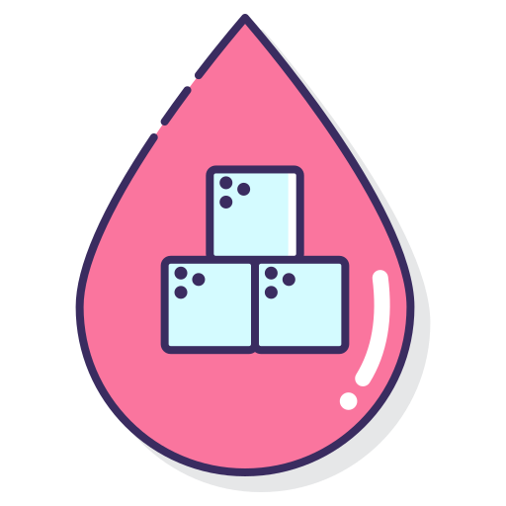
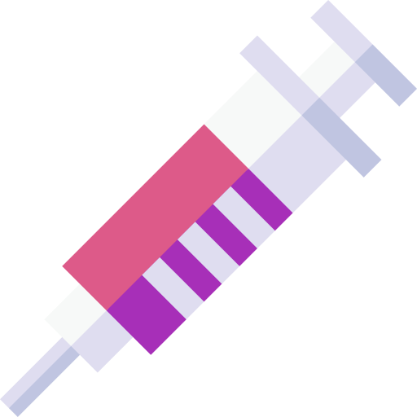
Factors affecting wound healing:
Congenital
Systemic factors
Acquired
Pharmacological
Steroids decrease inflammation and subsequent wound healing.
NSAIDS decrease collagen synthesis and inhibit platelet aggregation.
Antineoplastic agents decrease fibroblasts proliferation and wound contraction.
Few or no adverse reaction of administered 10-14 days after wound closure.
Systemic factors
Malnutrition
Nutrition is extremely important for protein and collagen synthesis, and metabolic energy for wound healing.
Folic acid is important for the synthesis of collagen.
Vitamin K is essential for the process of carboxylation in the synthesis of coagulation factors II, VII, IX, and X. deficiency of vitamin K will cause coagulopathy and hematoma formation in the wound that retards the wound healing.
Vitamin A increases collagen synthesis, inflammatory response, and recruitment of macrophages into the wound.
Zinc is an essential co-factor for the synthesis of RNA and DNA.
Magnesium is required for the synthesis of protein.
General malnutrition or deficiency of any of these vitamins or trace elements will adversely affect the wound healing.
Uncontrolled diabetes
Hyperglycemia will inhibit fibroblast proliferation, alter collagen formation, and retard wound healing. Hyperglycemia predisposes to wound infection by making good media for bacteria growth, and suppression of phagocytic function of neutrophils.
Medications
Receiving some medications may affect the wound healing, steroids reduce inflammatory response, vitamin A availability, collagen deposition, and remodeling the wound.
Chronic diseases
Diseases such as liver disease, jaundice, malignancy, uremia, will dispose to malnutrition, wound infection, and delay wound healing.
Immunosuppression
Immunosuppression status due to some conditions (leukemia, post-transplant, immunosuppressive drugs, chemotherapy, and AIDS) will predispose to wound infection, reduce the inflammatory response, and retard wound healing.
Smoking
It may cause hypoxia, and thereby delays wound healing. It also reduced insulin formation in the wound.
(Endocrine abnormalities) Uncontrolled diabetes
Diabetics often have delayed wound healing.
Neuropathy rather than small vessel occlusive disease may be responsible for delayed healing.
Hyperglycemia will inhibit fibroblast proliferation, alter collagen formation, and retard wound healing. Hyperglycemia predisposes to wound infection by making good media for bacteria growth, and suppression of phagocytic function of neutrophils.
Smoking
Nicotine causes vasoconstriction decreasing perfusion. Decreasing cell production
CO shifts the oxygen dissociation curve to the left and reduces tissue oxygenation.
It also reduces collagen formation in the wound.
Age
Rate of cell multiplication decreases with age.
All stages of healing are protracted in elderly.
Healed wounds have less tensile strength in elderly.
Thus their wounds break easily and no problem with hypertrophic scars and keloids
Immunosuppression
Immunosuppression status due to some conditions (leukemia, post-transplant, immunosuppressive drugs, chemotherapy, and AIDS) will predispose to wound infection, reduce the inflammatory response, and retard wound healing.
Decreased oxygen delivery to tissue reduce:
Collagen formation
Extracellular matrix deposition
Angiogenesis
Epithelialization

Slide 12
Classification of contamination in Surgical wounds (WHO classification of wound):
1
Clean:
3
Clean-contaminated:
nontraumatic, non infected wounds & no breach of Resp, GI, or GU tract.
No spillage of the content of the tract itself.
E.g. thyroid and breast surgeries.
No need for antibiotics.
Infection rate should be less than 1%.
Use of Ab prophylaxis isn’t recommended.
Small breach in protocol; Resp/GI/GU tract are entered with minimal contamination.
Very minor spillage of the content.
E.g. cholecystectomy, uncomplicated appendicitis, intestinal resection ONLY if there was no spillage.
Infection rates in excess of 5% may suggest a breakdown in wards.
Give prophylactic Abx
2
Contaminated “Dirty”:
4
Infected:
Fresh traumatic wounds; major break in sterile technique, nonpurulent inflammation; in or near contaminated skin.
Major spillage.
E.g. hemicolectomy or resection of the intestine with spillage, emergency surgery for perforated diverticular disease, or drainage of a subphrenic abscess.
Give prophylactic Abx
Purulent infection.
Traumatic & severe wounds.
They have positive culture and require broad spectrum antibiotics.
E.g. traumatic open bone fracture, and purulent pyogenic perforated appendicitis.
Must go to specialized OR
Types of wounds
Wounds can be classified into:
Acute wounds such as clean incised, avulsion, abrasion puncture and crushing.
Chronic wounds such as venous, ischemic, pressure and diabetic ulcers.
Acute wounds <24 hours
Tidy
VS
Untidy
Incised, clean wound in healthy tissue without tissue loss such as a wound from a clean sharp object.
Can be closed immediately.
Heals by primary intention.
Crushed or avulsed tissues with contamination, devitalized tissues and tissue loss, such as wounds caused by explosion, missile or bullet injury.
Requires debridement, excision of devitalized tissues, and cleaning several times before definitive repair is performed
Usually heals by secondary or tertiary intention.

Slide 13
Chronic wounds
Ischemic ulcer
This ulcer results from atherosclerosis of the main lower limb arteries or due to thromboembolic occlusion of theses arteries
.
Ischemic ulcer contains little granulation tissue, indicating impairment of healing process with exposure of deep structures such as bones, tendons, and joints with black mummified (dry gangrene) or black suppurative (wet gangrene) tissues.
Ischemic ulcer most commonly involves the toes but any part of the leg or foot can be affected.
Peripheral pulses (dorsalis pedis and posterior tibial) will be absent, but the evaluation with doppler ultrasound is more accurate.
Ischemia is the harbinger of limb loss due to infection when associated with diabetic ulcers.
Treatment
Intervention is very important to save the limb and prevent major amputation. Endovascular balloon angioplasty or stenting is the appropriate intervention for focused obstruction or stenosis. However, the long segment arterial obstruction or stenosis require bypass surgery with the autologous saphenous vein or synthetic graft.
This is to improve tissue perfusion and enhance ulcer healing. Most ischemic ulcer will not without revascularization.
After intervention and improvement of blood supply, wounds debridement, cleaning, excision of all dead tissues, local antibiotics and amputation of dead parts (e.g toes) are essential.
Systemic antibiotics are required in the presence of infection.
Incompletely healed clean ulcers with the favorable condition may require skin flap or graft fore coverage.
This ulcer results from atherosclerosis of the main lower limb arteries or due to thromboembolic occlusion of theses arteries
Ischemic ulcer contains little granulation tissue, indicating impairment of healing process with exposure of deep structures such as bones, tendons, and joints with black mummified (dry gangrene) or black suppurative (wet gangrene) tissues.
Ischemic ulcer most commonly involves the toes but any part of the leg or foot can be affected.
Peripheral pulses (dorsalis pedis and posterior tibial) will be absent, but the evaluation with doppler ultrasound is more accurate.
Ischemia is the harbinger of limb loss due to infection when associated with diabetic ulcers.
Treatment:
1
2
Intervention is very important to save the limb and prevent major amputation.
After intervention and improvement of blood supply, wounds debridement, cleaning, excision of all dead tissues, local antibiotics and amputation of dead parts (e.g toes) are essential.
Endovascular balloon angioplasty or stenting is the appropriate intervention for focused obstruction or stenosis
long segment arterial obstruction or stenosis require bypass surgery with the autologous saphenous vein or synthetic graft.
This is to improve tissue perfusion and enhance ulcer healing. Most ischemic ulcer will not without revascularization.
Systemic antibiotics are required in the presence of infection.
Incompletely healed clean ulcers with the favorable condition may require skin flap or graft fore coverage.

Slide 14
Acute wounds cont.
Classification of wounds according to the mechanism of wounding:
1
Clean
New wound (<12 hours), minimal contamination, may need debridement, usually closed primarily, the edges approximated with an appropriate method.
2
Avulsion
Shearing force causing such wound, with skin flap or total skin loss, and exposure of underneath structures.
Management includes several debridement sessions, cleaning, with a pressure dressing to prevent accumulation of blood and serum under the skin flap of sometimes a skin graft or flap os required when there is significant blood loss.
3
Abrasion
This is a superficial loss of epithelial cells and portions of the dermis with intact deep structures.
Management includes cleaning to prevent traumatic tattoo and and to allow the wound to heal by regeneration of epithelial cells.
4
Puncture
Such wound does not need closure, but assessment for deep structures injury or deep foreign bodies by imaging and clinical follow up to detect the development of infection is required.
5
Crushing
This injury is associated with significant loss of tissues including different structures that may initially appear viable. Non-viable tissues need debridement, cleaning of the wound, closure with a skin graft or myocutaneous flap depending on the exposed underlying structures.

Slide 15
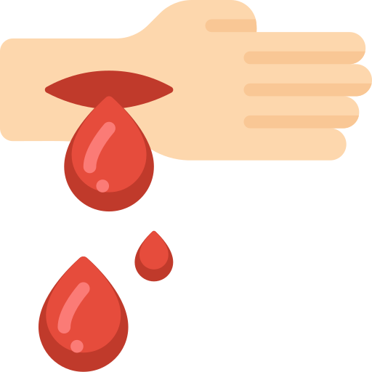
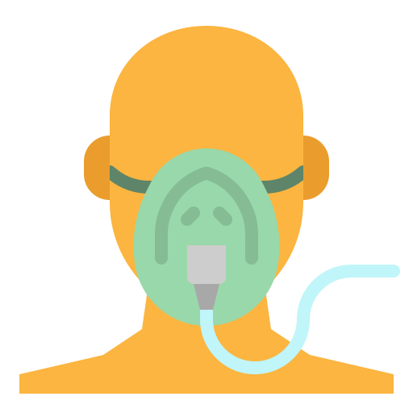
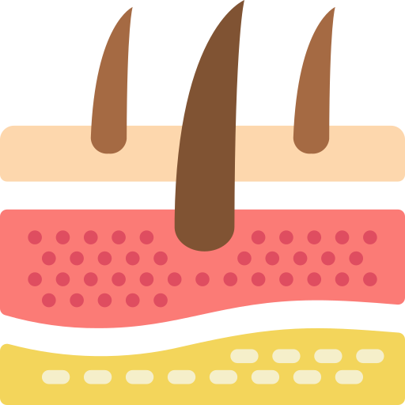
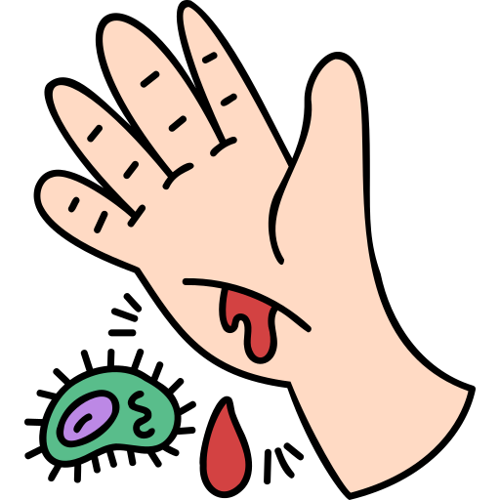
Acute wounds cont.
Management of acute wounds:
Management of the patient should follow the acute trauma life support (ATLS) principles.
The patient should be examined completely and a stab wound in the wound should not be missed.
The wound should be examined, taking into consideration the site and the possible damaged structures including vascular structures.
1
2
Assess the severity of the pain and motor and sensation function.
Tetanus therapy should be assessed and appropriate treatment given.
Pressure pad or tourniquet should be applied over the bleeding wound. Clamps should not be applied blindly to a bleeding wound because it may cause nerve damage and cause further damage to the vessels which rendered vascular anastomosis impossible.
3
4
Adequate anesthesia (local, regional or general) is sometimes required to facilitate the examination. The toxic level of local anesthesia should not be exceeded.
Prophylactic antibiotics for anaerobic bacteria are required in certain cases and wounds in a certain location. The tourniquet should be used in limb injuries in order to facilitate examination and visualization of all structures. During tourniquet application, care should be taken to avoid uneven pressure and the tourniquet time must be noted.
5
6
An x-ray may be required to rule out deep foreign bodies.
After complete assessment, a thorough debridement of the wound should be performed. All dead or devitalized tissue should be excised and foregin bodies should be removed.copious irrigation of the wound with saline is helpful. Debridement should be carried out until bleeding occurs. Avoid injuries to the nerves,vessels, and tendons.
Muscle viability is judged by the color, bleeding pattern, and contractility.
Repair of damaged structures (nerves, vessels, and tendons) maybe attempted in a tidy wound.
Large hematoma may require evacuation by incision or aspiration. If the large hematoma is not evacuated, it calcifies with htime, and cause symptoms include local lump or mass.
7
8
Skin cover by graft or flap may be required if there is skin loss, as skin closure should always be without tension.
Needle stick injuries should be managed according to the protocols of hepatitis and HIV risks.
Preparation of the wound by cleansing and debridement before closure is important. All wounds are contaminated, even the wounds that considered to be clean contain bacterial inoculum. Therefore, lavage and adequate debridement are essential steps in wound care. The decision to close the wound primarily depends on the extent of contamination.for example, the incised clean wound can be closed primarily, but crush wounds, human bite or farm injury should be managed as open wound till the appropriate condition of closure is reached. Delayed closure give time for further debridement, cleaning and reduction of bacterial count in the wound.
9
10
The dressing of the wound to provide important issues including complete wound cover, protect the wound, immobilize, compress the wounded area evenly, and absorb any secretion. The wound might need to be checked frequently to avoid infections.
Infection of the closed wound clinically evidenced after few days with pain, redness, swelling, tenderness, and hotness with or without discharge. Such wound should be opened with the evacuation of any collection, lavage, debridement, and left open with daily dressing.
11
12
The sutures or clips should be removed under sterile condition after they have done the job for which they placed.

Slide 16
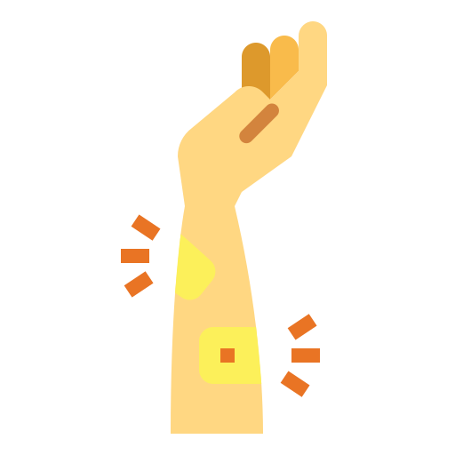
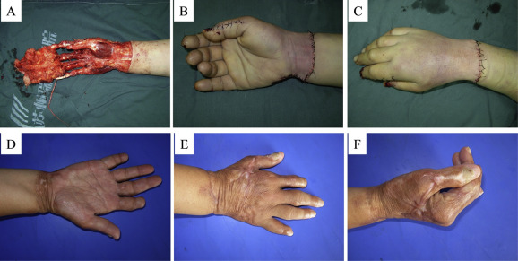
Acute wounds cont.
Compartment syndrome
1
This occurs due to increased pressure in the muscles compartment after trauma. It occurs most commonly after closed trauma (crushing injury).
This occurs due to increased pressure in the muscles compartment after trauma.
It occurs most commonly after closed trauma (crushing injury).
The typical clinical feature is severe pain in the affected compartment particularly with passive muscles movement, distal sensory deficit, and the late sign is absent distal pulses.
A catheter can be inserted in the muscles compartment and using a pressure monitor to measure the intra-compatrment pressure.
Presence of clinical features with persistent pressure of 30 mmHg or higher is an indication for fasciotomy.
Fasciotomy is performed by skin incisions in specific locations depending on the area involved that includes skin, fat and fascia to decompress the muscle compartments and relieve the pressure.
Late fasciotomy in the presence of dead muscles may lead to a sudden release of a large amount of myoglobin to the bloodstream which may cause myoglobinuria, blockage of glomeruli, and precipitate acute renal failure.
Therefore, severely traumatized limb with extensive dead tissues better to be amputated.
The typical clinical feature is severe pain in the affected compartment particularly with passive muscles movement, distal sensory deficit, and the late sign is absent distal pulses.
2
3
A catheter can be inserted in the muscles compartment and using a pressure monitor to measure the intra-compartmental pressure.
Presence of clinical features with persistent pressure of 30 mmHg or higher is an indication for fasciotomy.
Fasciotomy is performed by skin incisions in specific locations depending on the area involved that includes skin, fat and fascia to decompress the muscle compartments and relieve the pressure.
Late fasciotomy in the presence of dead muscles may lead to a sudden release of a large amount of myoglobin to the bloodstream which may cause myoglobinuria, blockage of glomeruli, and precipitate acute renal failure.
Therefore, severely traumatized limb with extensive dead tissues better to be amputated.
fasciotomy
Degloving injury
This occurs when the skin and subcutaneous tissue are avulsed from the underlying fascia with exposed neurovascular structures, bones, and tendons.
It can be an open or closed injury.
The treatment includes antibiotics prophylaxis, saline irrigation, removal of foreign bodies, resection of nonviable skin and subcutaneous tissue with adequate debridement, followed by skin flap or grafting.
The trial of replantation or revascularization is extremely challenging.
This occurs when the skin and subcutaneous tissue are avulsed from the underlying fascia with exposed neurovascular structures, bones, and tendons.
It can be an open or closed injury.
The treatment includes antibiotics prophylaxis, saline irrigation, removal of foreign bodies, resection of nonviable skin and subcutaneous tissue with adequate debridement, followed by skin flap or grafting.
The trial of replantation or revascularization is extremely challenging.

Slide 17
Chronic wounds
Debridement, cleaning, daily dressing changes, and negative pressure devices have been the main method to enhance the healing process in chronic wounds.
02
Chronic wounds develop when the normal wound healing process fails to repair the tissue injury.
Debridement, cleaning, daily dressing changes, and negative pressure devices have been the main method to enhance the healing process in chronic wounds.
Several local and systemic factors are well known to retard the healing process, and results in a chronic wound.
Judicious intervention is essential in countering these factors to enhance the normal wound healing. E.g, debridement can change the wound to an acute state or condition that will accelerate normal healing.
01
Chronic wounds develop when the normal wound healing process fails to repair the tissue injury.
Several local and systemic factors are well known to retard the healing process, and results in a chronic wound.
Judicious intervention is essential in countering these factors to enhance the normal wound healing. E.g, debridement can change the wound to an acute state or condition that will accelerate normal healing.
03
Leg ulcer
An ulcer is a break in the epithelial continuity.
The persistent inflammatory phase of wound healing results in overgrowth of the granulation tissues and attempt of wound healing by scarring with fibrotic ulcer margin.
Necrotic tissue is in the ulcer floor is called “Eschar” whereas yellowish soft material are called “Slough”.
Etiologies of leg ulcers:
An ulcer is a break in the epithelial continuity.
The persistent inflammatory phase of wound healing results in overgrowth of the granulation tissues and attempt of wound healing by scarring with fibrotic ulcer margin.
Necrotic tissue is in the ulcer floor is called “Eschar” whereas yellowish soft material are called “Slough”.
Etiologies of leg ulcers:
Venous ulcer
The usual site is above the medial malleolus. It results from venous hypertension due to varicose veins or deep vein thrombosis.
Ischemic ulcer
This is due to arterial insufficiency or vasculitis. it occurs commonly at the tip of the toes or in the shin area of the leg.blood supply insufficiency is obvious, and the ulcer is dry with minimal granulation tissue.
Traumatic ulcer
This is due to repeated trauma and can be self-inflicted.
Infective ulcer
This is due to Tuberculosis or Syphilis
Neoplastic ulcer
It could be squamous or basal cell carcinoma or sarcoma.
Biopsy should be obtained from any chronic ulcer which is persistent and unresponsive to appropriate wound care to rule out malignant changes (squamous cell carcinoma called “Marjolin’s ulcer”). It usually affects the area with chronic or prolonged scar (chronic burn), and it has poor prognosis.
Treatment of chronic leg ulcer includes treatment of underlying cause, appropriate wound care, but skin graft is required in some cases.
Venous ulcer
Ischemic ulcer
The usual site is above the medial malleolus. It results from venous hypertension due to varicose veins or deep vein thrombosis.
This is due to arterial insufficiency or vasculitis. it occurs commonly at the tip of the toes or in the shin area of the leg.blood supply insufficiency is obvious, and the ulcer is dry with minimal granulation tissue.
Traumatic ulcer
Infective ulcer
This is due to repeated trauma and can be self-inflicted.
This is due to Tuberculosis or Syphilis
Neoplastic ulcer
It could be squamous or basal cell carcinoma or sarcoma.
Biopsy should be obtained from any chronic ulcer which is persistent and unresponsive to appropriate wound care to rule out malignant changes (squamous cell carcinoma called “Marjolin’s ulcer”).
It usually affects the area with chronic or prolonged scar (chronic burn), and it has poor prognosis.
Treatment of chronic leg ulcer includes treatment of underlying cause, appropriate wound care, but skin graft is required in some cases.

Slide 18
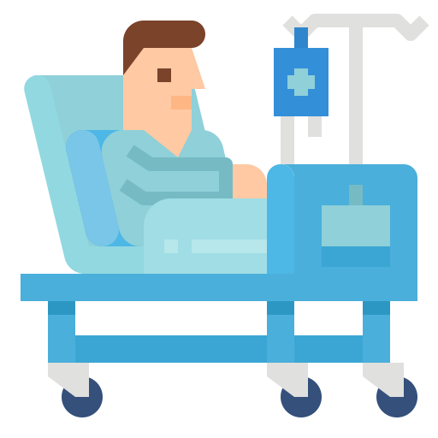
Chronic wounds
Pressure ulcer
It is defined as tissue necrosis and ulceration as a result of prolonged pressure.
Other terms are pressure sore, bed sore, and decubitus ulcer.
When the pressure on the skin exceeds the capillary pressure, it causes tissue hypoxia, necrosis, and ulceration.
01
03
It is defined as tissue necrosis and ulceration as a result of prolonged pressure.
Other terms are pressure sore, bed sore, and decubitus ulcer.
when the pressure on the skin exceeds the capillary pressure, it causes tissue hypoxia, necrosis, and ulceration.
It occurs most commonly in bedridden, praplegic or severely ill patients in the intensive care unit.
The most commonly affected sites in the body are sacrum, greater trochanter, heel, ischium, occiput, and lateral malleolus.
Prevention
Good skin care and avoid shearing.
Special pressure relief mattresses or dispersion cushions (e.g air-fluidized beds) to minimize pressure.
Urinary or fecal diversion in some cases.
The bedridden patient should be turned at least every 2 hours.
Staging of pressure ulcers
Stage1. Intact dermis, no open wounds. The skin may painful, but appears reddened and does not blanch and feel either softer or firmer than the skin area around it.
Stage2. Partial thickness skin loss, with breaks, forms an ulcer which is tender and painful.
Stage3. Full thickness skin loss and the wound extends into the tissues beneath the skin, but not through the underlying fascia.
Stage4. Full thickness skin loss, with very deep pressure sore, reaching into muscle and bone and causing extensive damage to deeper tissues, such as tendons, and joints.
Treatment
Nutrition optimization.
Antibiotics therapy when there is evidence of infection.
Adequate debridement and excision of devitalized tissues and sloughs.
Drainage of any collection.
Negative pressure vacuum-assisted closure (VAC) may enhance the closure of the ulcer (porous sponge packed into the wound connected to negative pressure). The negative pressure will stimulate wound closure, promote drainage, and provide a moist wound environment which is favorable for the growth of granulation tissue.
Fecal diversion stoma is indicated when the ulcer is recurrently contaminated by fecal materials.
Large skin flap with intact blood supply and sensation is the best cover when the ulcer is clean and ready for grafting.
The most commonly affected sites in the body are sacrum, greater trochanter, heel, ischium, occiput, and lateral malleolus.
It occurs most commonly in bedridden, praplegic or severely ill patients in the intensive care unit.
02
04
Prevention:
Staging of pressure ulcers
Extra
1
Good skin care and avoid shearing.
Stage1. Intact dermis, no open wounds. The skin may painful, but appears reddened and does not blanch and feel either softer or firmer than the skin area around it.
Stage2. Partial thickness skin loss, with breaks, forms an ulcer which is tender and painful.
Stage3. Full thickness skin loss and the wound extends into the tissues beneath the skin, but not through the underlying fascia.
Stage4. Full thickness skin loss, with very deep pressure sore, reaching into muscle and bone and causing extensive damage to deeper tissues, such as tendons, and joints.
2
Special pressure relief mattresses or dispersion cushions (e.g air-fluidized beds) to minimize pressure.
3
Urinary or fecal diversion in some cases.
4
The bedridden patient should be turned at least every 2 hours.
Treatment:
Nutrition optimization.
Drainage of any collection.
Fecal diversion stoma is indicated when the ulcer is recurrently contaminated by fecal materials.
Negative pressure vacuum-assisted closure (VAC) may enhance the closure of the ulcer (porous sponge packed into the wound connected to negative pressure). The negative pressure will stimulate wound closure, promote drainage, and provide a moist wound environment which is favorable for the growth of granulation tissue.
Antibiotics therapy when there is evidence of infection.
Large skin flap with intact blood supply and sensation is the best cover when the ulcer is clean and ready for grafting.
Adequate debridement and excision of devitalized tissues and sloughs.

Slide 19
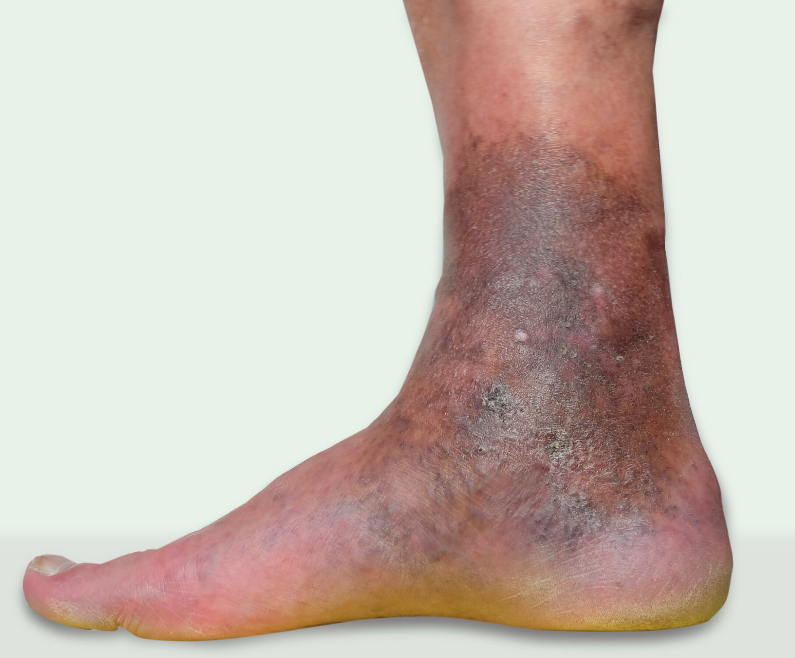
Chronic wounds
This is due to venous valvular incompetence of the lower limb, resulting in venous insufficiency.
the patient usually develops discomfort in the leg,heaviness, and edema.
Ulceration may develop in the anteromedial aspect of the leg “gaiter zone”, ulcers are generally superficial.
The pathophysiology is venous hypertension due to deep and and superficial venous valve incompetence.
The pressure is transmitted to the skin resulting in deposition of plasma proteins and red cells in the skin, which leads to edema and hyperpigmentation of the skin “dermatofibrosis”.
Patients with chronic venous insufficiency who develops venous ulcer has retarded wound healing due to reduced skin perfusion and reduced delivery of oxygen and glucose to the tissues.
Treatment
Debridement of the ulcer with excision if all dead tissues.
Sterile moist dressing.
Weekly or biweekly application of compression with paste bandages or multiple layer dry bandages.
Antibiotic therapy when infection is present.
Teaching the patient to elevate the limb most of the time.
Most venous ulcers will heal with compression within a few months, but some refractory ulcer may need surgery for ablation of normal venous perforators and skin grafting of the ulcer.
Venous ulcer
This is due to venous valvular incompetence of the lower limb, resulting in venous insufficiency.
the patient usually develops discomfort in the leg
,heaviness, and edema.
Ulceration may develop in the anteromedial aspect
of the leg “gaiter zone”, ulcers are generally superficial.
02
Pathophysiology:
01
02
03
04
Deep and and superficial venous valve incompetence.
venous hypertension
The pressure is transmitted to the skin resulting in deposition of plasma proteins and red cells in the skin,
Edema and hyperpigmentation of the skin “dermatofibrosis”.
Treatment:
Debridement of the ulcer with excision if all dead tissues.
1
4
Antibiotic therapy when infection is present.
Sterile moist dressing.
2
5
Teaching the patient to elevate the limb most of the time.
Weekly or biweekly application of compression with paste bandages or multiple layer dry bandages.
3
6
Most venous ulcers will heal with compression within a few months, but some refractory ulcer may need surgery for ablation of normal venous perforators and skin grafting of the ulcer.

Slide 20
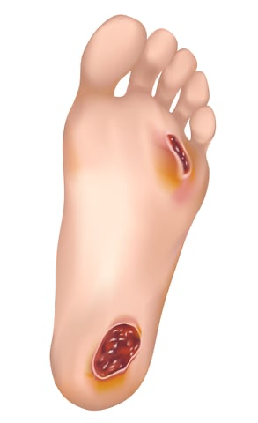
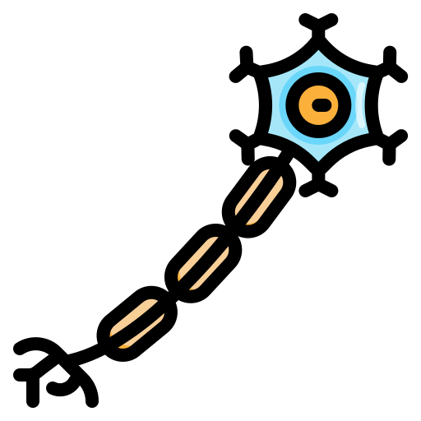
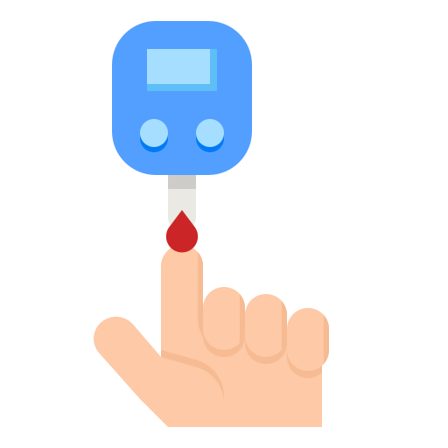
Chronic wounds
Diabetic ulcer
Diabetic patients are at risk of skin ulcer for the following reasons:
Neuropathy
Diabetic patient develop polyneuropathy of the nerves supplying the lower extremities.
Motor neuropathy results in atrophy of the small intrinsic muscles of the foot with derangement of the bony structures with the collapse if the midfoot and plantar subluxation (Charcot’s foot). This will result in excessive weight bearing in area at the risk of ulceration.
Sensory neuropathy will result in loss of sensation and protective reflexes.
Diabetic patients are at risk of skin ulcer for the following reasons:
Neuropathy
Diabetic patient develop polyneuropathy of the nerves supplying the lower extremities. Motor neuropathy results in atrophy of the small intrinsic muscles of the foot with derangement of the bony structures with the collapse if the midfoot and plantar subluxation (Charcot’s foot). This will result in excessive weight bearing in area at the risk of ulceration. Sensory neuropathy will result in loss of sensation and protective reflexes.
Hyperglycemia
Uncontrolled blood sugar will impair the leukocytes response to infection, create good media for bacterial growth, and retard the wound healing.
Arterial disease
Deficiency of blood supply will cause ischemic ulceration. Poor oxygen and nutrients delivery will retard the wound healing.
The commonest sites of dibetic ulcers are found at the plantar surface of the metatarsal, heels and dorsum of foot but it can occur anywhere in the foot or leg. It can be superficial, clean ulcer or even deep penetrating the deep structures with sloughs, purulent discharge with a limb or even life-threatening sepsis.
Treatment
Tight control of blood sugar.
Antibiotics therapy covering aerobic and anaerobic bacteria.
Plain x-ray to look for osteomyelitis.
Adequate debridement, drainage of any collection, excision of dead tissues.
Daily sterile dressing.
The negative pressure vacuum-assisted closure may enhance the wound healing and closure when the wound is clean and granulating.
Minor amputation is required for dead or severely infected toes.
Major amputation is required for limb-threatening or life-threatening infected diabetic foot or in the presence of extensive osteomyelitis.
Arterial surgery or endovascular intervention may be required when the ischemia is a prominent factor.
Hyperglycemia
Uncontrolled blood sugar will impair the leukocytes response to infection, create good media for bacterial growth, and retard the wound healing.
Arterial disease
Deficiency of blood supply will cause ischemic ulceration. Poor oxygen and nutrients delivery will retard the wound healing.
The commonest sites of dibetic ulcers are found at the plantar surface of the metatarsal, heels and dorsum of foot but it can occur anywhere in the foot or leg. It can be superficial, clean ulcer or even deep penetrating the deep structures with sloughs, purulent discharge with a limb or even life-threatening sepsis.
Treatment:
01
Tight control of blood sugar.
06
The negative pressure vacuum-assisted closure may enhance the wound healing and closure when the wound is clean and granulating.
02
Antibiotics therapy covering aerobic and anaerobic bacteria.
07
Minor amputation is required for dead or severely infected toes.
03
Plain x-ray to look for osteomyelitis.
Adequate debridement, drainage of any collection, excision of dead tissues.
Major amputation is required for limb-threatening or life-threatening infected diabetic foot or in the presence of extensive osteomyelitis.
04
08
05
Daily sterile dressing.
09
Arterial surgery or endovascular intervention may be required when the ischemia is a prominent factor.

Slide 21
Scar formation
Scars form in the maturation phase of wound healing, and over a year or more the immature scar becomes a mature scar.
The collagen matures and becomes aligned along the stress lines of the skin and and their strength increased.
Although the tensile strength of the wound continues to increase, it would not exceed 80% of the normal skin.
Abnormal scar formation
How can it prevented?
If acute wound managed correctly, most of the abnormalities in scar formation will be prevented.
Proper scrubbing and cleansing of the wound with the proper alignment of all deep structures and good apposition of the wound edges are important in preventing the formation of an abnormal scar.
Suture marks can be prevented by the use of fine (5-6/0) monofilaments suture under less tension and can be removed as early as 3-5 days in certain area and replaced by sticky strips, but subcuticular suture will result in a much better cosmetic scar.
When the size of suture increases, it leaves obvious marks with the less cosmetic outcome.
Atrophic scar
This is a flat, pale and stretched in appearance. It can be traumatized easily as the epidermis and dermis are thinned. Excision and resuturing may improve such scar.
Hypertrophic scar
This is an excessive scar tissue that does not extend beyond the original wound boundaries. It results from the prolongation of the inflammatory phase of wound healing and from inappropriate scar sitting such as wound across the lines of skin tension.
Keloid scar
This is an excessive scar tissue that extends beyond the original wound boundaries. The etiology of keloid scar is unknown, but it is associated with deeply pigmented skin and inherited tendency. It is more common in the body triangle between the point of each shoulder tip, xiphisternum, ear, and chin of the tibia. Hypertrophic scars improve with time spontaneously, while keloid scars do not. All excisions have high rates of recurrence.
Treatment of hypertrophic and keloid scars
Pressure with elasticated garments.
Triamcinolone intralesional injection.
Excision and steroid injection.
Excision and postoperative radiation.
Laser to reduce redness.
Massage with palm oil or vitamin E.
Contracture scar
This is when the scar form across a joint or flexion or extension skin creases.
It may cause restriction of the movement at the joint , flexion or extension deformity. Contracture can be prevented be postoperative splints and intensive physiotherapy. Treatment include multiple Z-plasty or skin graft or flap.
If acute wound managed correctly, most of the abnormalities in scar formation will be prevented.
Proper scrubbing and cleansing of the wound with the proper alignment of all deep structures and good apposition of the wound edges are important in preventing the formation of an abnormal scar.
Immature scar
Mature scar
Pink
Hard
Raised
Itchy
VS
Paler
Soft
Flattened
Less itchy
Suture marks can be prevented by the use of fine (5-6/0) monofilaments suture under less tension and can be removed as early as 3-5 days in certain area and replaced by sticky strips, but subcuticular suture will result in a much better cosmetic scar
When the size of suture increases, it leaves obvious marks with the less cosmetic outcome.
Types of abnormal scars
Atrophic scar
This is a flat, pale and stretched in appearance.
It can be traumatized easily as the epidermis and dermis are thinned.
Excision and resuturing may improve such scar.
Contracture scar
This is when the scar form across a joint or flexion or extension skin creases.
It may cause restriction of the movement at the joint , flexion or extension deformity.
Contracture can be prevented be postoperative splints and intensive physiotherapy.
Treatment include multiple Z-plasty or skin graft or flap.

Slide 22
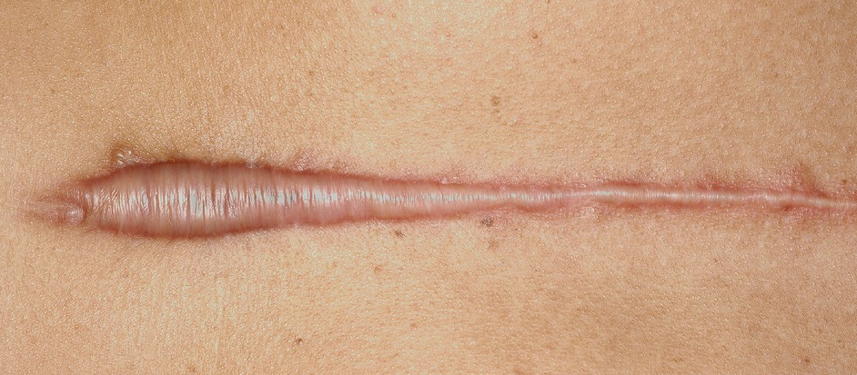
Scar formation
Types of abnormal scars cont.
Hypertrophic scar
This is an excessive scar tissue that does not extend beyond the original wound boundaries.
It results from the prolongation of the inflammatory phase of wound healing and from inappropriate scar sitting such as wound across the lines of skin tension.
Keloid scar
Overproduction of collagen and fibroblasts
This is an excessive scar tissue that extends beyond the original wound boundaries.
The etiology of keloid scar is unknown, but it is associated with deeply pigmented skin and inherited tendency.
It is more common in the body triangle between the point of each shoulder tip, xiphisternum, ear, and chin of the tibia.
Hypertrophic scars improve with time spontaneously, while keloid scars do not. All excisions have high rates of recurrence.
Features | Hypertrophic scar | Keloid scar
Genetic | Low familial incidence | Significant familial incidence
Race | Low racial incidence | Dark > fair skin
Sex | Female = Male | Female > Male
Age | Any age | Most common 10-30 years
Borders Diagnostic feature | Remains within wound borders | Outgrows wound area
Natural history | Appears soon after surgery (less than 2 years) and subsides with time | Appears months after surgery and rarely subsides
Site | Flexor surfaces | Mostly in earlobes, anterior chest , deltoid and shin of the tibia
Aetiology | Related to tension at closure | Possible autoimmune phenomenon

Slide 23
Scar formation
Treatment of hypertrophic and keloid scars:
Hypertrophic scars are treated like keloids with better outcome
Prevention by avoiding
Unnecessary surgeries
High risk patients or sites
People who have multiple piercings
Closure under tension
Crossing joint lines when performing surgery
Rough tissue handling
Infection and hematoma
Therapeutic
Excision then a combination of the following
Pressure garments
Silicone sheets for symptoms like itching
Steroid injections (triamcinolone injection a2 macroglobulin inhibitor)
Radiation
Revision mandatory
Success rate of triple therapy (surgical revision,radiation and steroids)can exceed 95%
Click here for more on surgical revision
Doctor’s questions
What is the cell that peaks in wound healing at 3 weeks
What’s the main cell in the inflammatory phase
Medications
Clinical case will be given during OSCE about keloid and hypertrophic scars
When to do primary/secondary/tertiary closure

Slide 24
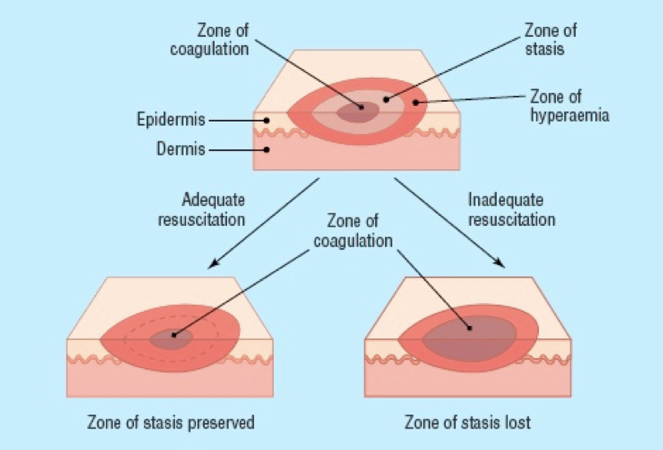
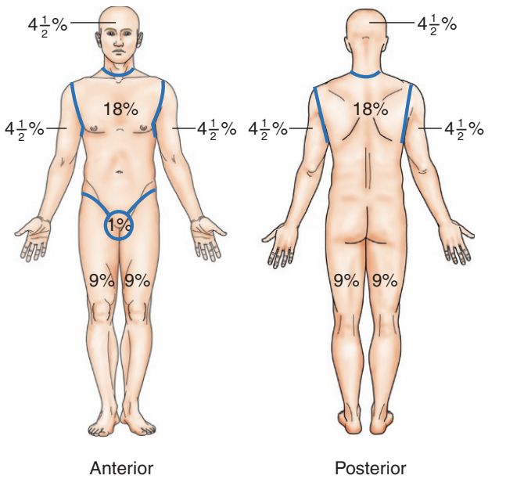
Burn
Pathophysiology of burn:
01
The local effects are the result of tissue destruction and inflammatory response.
02
The inflammatory response to injury causes capillary dilation (manifested as erythema) in mild cases, or if there is capillary damage, that leads to protein leakage and edema.
03
Insensible fluid loss can cause severe hypovolemia which might progress to hypovolemic shock ( when > 15% of the body surface area is burned).
04
Destruction of the Epidermis causes impairment of the physical barriers and predispose to infections which can delay healing and increase energy demand.
05
Burns have 3 zones : 1-Zone of coagulations 2-Zone of stasis (the area of potential reversible cell damage) 3-Zone of hyperemia.
Calculations:
01
02
03
Rule of nines
Mortality
Parkland formula
Used to approximate burn size.
Divides the body into areas that each represent approximately 9% of the total body surface area (TBSA) of an adult
less useful in children because of the relatively large head size (and the relatively small limbs.
Palm without fingers = 1%
Head in kids = 18% (9% in adults)
Single leg in kids = 9% (18% in adults)
Mortality =
(body surface area % + age )/100
Fluid volume of crystalloid administration during the first 24 hours of admission
Volume of lactated Ringer's
= 4 mL × weight (kg) × TBSA%
50% given in the first 8 hours
50% given in the next 16 hours
Crystalloid is preferred because of the tendency to hyponatremia after the injury
Parkland's Formula only for more than 20 TBSA
Not used in the case of first degree burns

Slide 25
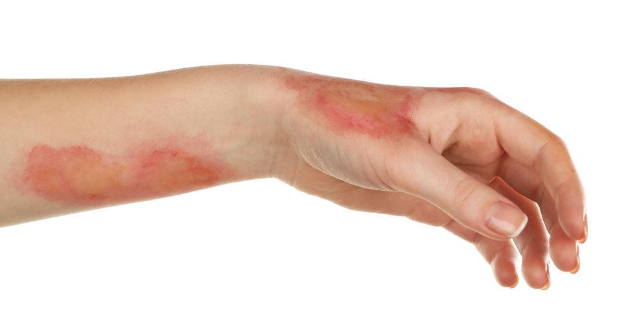
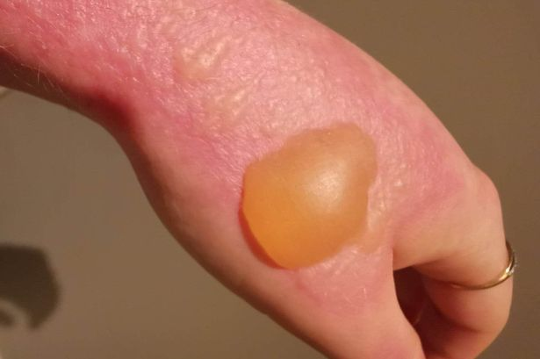
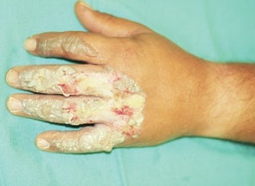
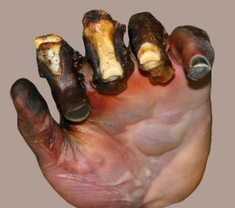
Classification of Burns Based on the Depth of Skin Injury¹ (main clinical classification):
Note for OSCE: in the exam, they will bring a picture and ask you to estimate the degree of burn.
 | Degree | Treatment
First Degree (superficial burn) | Epidermal injury only. Clinically characterized by: edema and erythema. No fluid collection occur at this degree. Most common presentation is kitchen burns and sunburns. | Symptomatic treatment: Mild analgesics/NSAIDs pain is the commonest presentation Local wound care: Daily cleansing. Topical antibiotics (silver sulfadiazine)² if needed. Elevation Occupational therapy Splints in functional position. Early range of motion.³
Second Degree (superficial/deep partial thickness) | Injury to epidermal +/- dermal⁴ layers. Clinically characterized by: painful blisters⁴ (Hallmark of Second degree burns). Skin is repopulated by viable germinal cells in follicles.⁵ | Similar to first degree burns. Leave blisters intact they are the best natural dressing . If debrided, cover with an occlusive dressing. Compression garment after wound epithelialization.
Third Degree⁶ (full thickness) | Entire dermal layer and subdermal fat injury the entire content of the skin+nerve endings are completely burnt here. Clinically characterized by: dry, inelastic and waxy appearing scar skin is similar to commercial leather. | Early tangential skin excision and meshed split thickness skin grafting (within 7 days). We have to surgically debride and skin graft. We remove the eschar (the white patch) we clean the wound until we reach healthy tissue then we remove a skin patch from one area of the body and transplant it to the burned area.
Fourth Degree (full thickness) | Dermis and deep tissue injury. Clinically characterized by: injury to all skin layers, and injury to tendon, nerve, bone and joint in addition to Muscles and subcutaneous fat. Caused when the patient is unable to move away from the burning agent eg: unconscious patients/disabled patients/infants. | Skin grafts not adequate for exposed deep structures. Treatment options: Amputation. Flap coverage with salvage procedures. Both grafts and flaps will be further explained in the following slides
First degree burn
Second degree burn
Third degree burn
Fourth degree burn
1- In clinical practice, most burns are a mix of types. Any burn is surrounded by lighter zones eg: 2nd degree burns are surrounded by 1st degree burns and 3rd degree burns are surrounded by an engorge erythematous area (2nd degree burns). First site to come in contact with the burning agent is the deepest site of the burn. Retainment of sensations at the site of the burn suggest more superficial injury.
2-AKA: Flamazine is the gold standard in preventing infections due to its broad spectrum activity.
3-Start early physical therapy if burns and edema are near a joint.
4-Blistering occur when the burn exceed the basement membrane of the epidermis going down to the dermis.
5-In partial thickness burns the epithelium lining the skin appendages is preserved and heals the wound by creating new epithelium in a process called (epithelization), unlike full thickness burn where there’s no remaining appendages to heal the skin eg: Deep 2nd degree burn > “the burn has exceeded reticular layer of the dermis” leading to delayed healing and scarring and surgical intervention is indicated.
6-Whitish in color; Skin has 5 vascular plexuses, the most important are the Sub-dermal and Sub-epidermal plexuses, these Plexuses provide blood to the skin (give the reddish appearance of the skin).In 3rd ° burn These plexus are gone = no blood supply = skin looks white.
white skin = no skin content to re-Heal = Surgery is required.

Slide 26
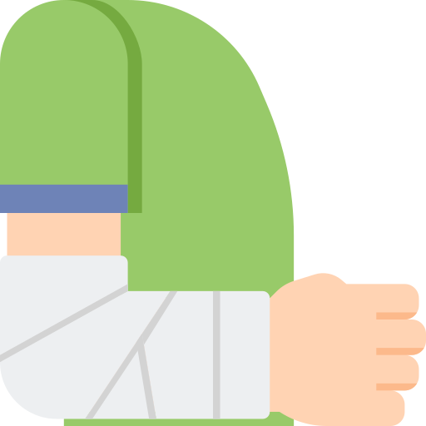
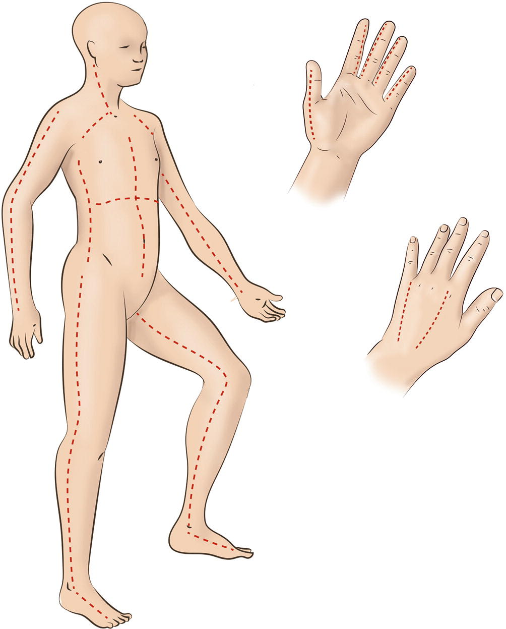
Management of Burns:
Surgical
Non surgical
Escharotomy
Skin grafting
Tetanus prophylaxis
Analgesia
Dressing
Nutrition
Fluid
Foley Catheter
01
Escharotomy¹:
Indication:
Poor tissue perfusion.
Threat to perfusion after volume resuscitation.
Deep Circumferential burns.
Use mid-axial incisions.
Digital Escharotomy:
Use mid-axial incisions:
Index, long → ulnar incision.
Ring → radial or ulnar incision.
Little → radial incision.
Leave wounds open
Consider carpal tunnel release.
Consider intrinsic muscle release.
Skin Grafting & Flap:
Skin grafting is a surgical procedure that involves removing skin from one area of the body and moving it, or transplanting it, to a different area of the body.
Grafts are similar to first degree burns (First layer is removed and appendages are preserved in both of them so healing and epithelialization is possible) the difference is that grafts occur in a controlled environment unlike burns.
The main differences between grafts and flap:
Grafts do not contain blood vessels but flaps do
Grafts are thin sheet of skin and is used more with 3rd degree. Flap is a bulky tissue (e.g. muscle flap, subcutaneous tissue flap) used when there’s a deep burn (4th degree burns) or when a deep reconstruction following cancer ablation is needed.
1- The most important indication of escharotomy is circumferential burn (which causes hypoperfusion due to edema).
Circumferential burns: are seen in cases where a full thickness burn affects the entire circumference of a digit, extremity, or even the torso, this is called a circumferential burn. as oedema forms the inelastic eschar can cause a buildup of pressure and act like a tourniquet (impairs blood flow). This pressure can lead to significant complications such as respiratory compromisation and loss of tissue perfusion requiring a surgical procedure known as an ‘escharotomy’. An escharotomy is performed by making an incision through the eschar to release the pressure.

Slide 27
02
Antibiotics:
Intravenous or oral antibiotics should cover skin flora for initial treatment.
Topical antibiotics (silver sulfadiazine) for prevention of infection.
Topical application of (mafenide acetate) penetrates through eschar and may be effective against a wider variety of organisms.
03
Non-Surgical Management:
The first Priority would be maintaining an adequate airway and first Aid (ABCDE) especially in case of risk of inhalation injury, with continuous observation for signs of respiratory failure.
IV fluid resuscitation if > 15% of BSA is affected (Parkland formula).
Analgesic (eg: opioids).
placing the patient in a warm room (to reduce energy expenditure) and enteral feeding using nasogastric tube with vitamin supplements and iron (Better to eat normally after 48 hours).
Prophylaxis against Tetanus (eg: Clostridium Tetani) by Tetanus Immunoglobulins (TIG)
Foley catheter to monitor urine output
Dressings, essential to protect from contamination and for promotion of healing
Types:
Evaporative dressings: eg: paraffin, gauze
Semi occlusive and occlusive: eg: hydrogel, hydrocolloid
Topical antibiotics, like Silver Sulfadiazine (Flamazine) and Povidone Iodine (Betadine)
(Not advised in the first 48 hours as they can make the determination of the depth more difficult).
special Cases
preexisting Renal disease or Impaired renal function → diuretics.
Only in positive blood culture and septicemia → Systemic antibiotics.
Proton pump inhibitors (PPI) eg: Omeprazole → prophylaxis for curling’s ulcer.

Slide 28
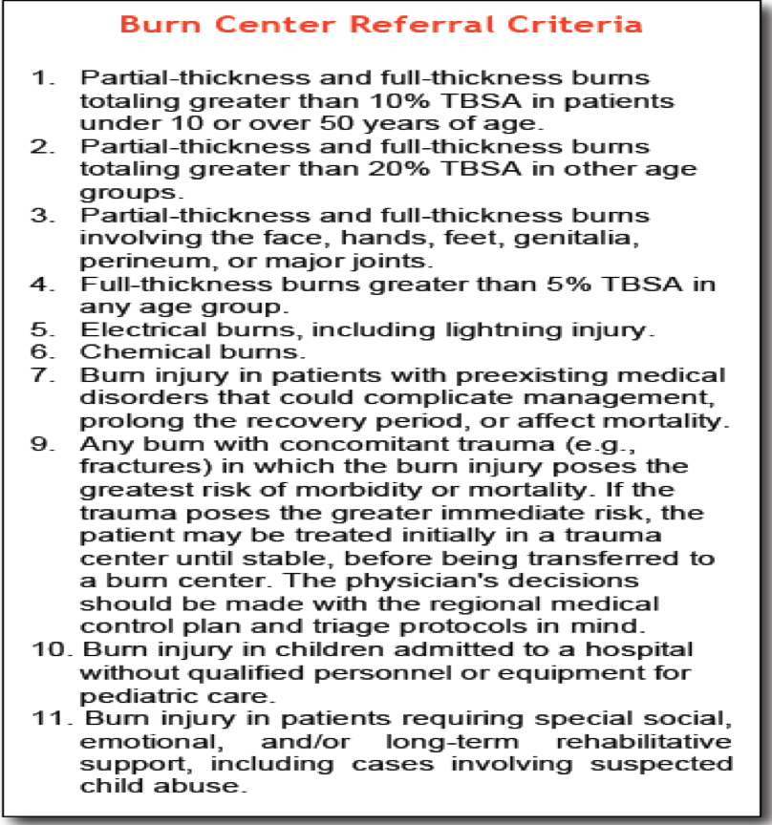
When to transfer to a burn center
(transfer criteria):
>25% body surface area (BSA).
>20% BSA in children.
High voltage burns.
Inhalation injuries.
Burns in the genital area, face, neck, feet and hands in addition to full thickness burns.
Chemical burns.
Inhalation injury
The mechanisms of inhalation injury can be divided into three broad areas
Inhalation of products of combustion
Carbon monoxide inhalation
Direct thermal injury to the upper aero-digestive tract (inhaling hot air)
Features of inhalation injury (physical/mechanical components)
Flame burn in a closed space
Singed (burned) nasal hair
Facial or oropharyngeal burns
Expectoration of carbonaceous (blackish) sputum
Loss of facial hair (eyebrows,mustache..etc)
On intraoral examination: burns on the soft and hard palate
Does Not occur with burns caused by hot water
Acutely the patient is fine, the problems begins when the patient starts receiving fluids.
This fluid will go to third spacing (interstitial edema) and compromises the airway.
Patient will start developing signs of upper respiratory obstruction—such as crowing, dyspnoea, cough, stridor, or air hunger.
Intubating in this stage is semi-impossible due to swelling of the vocal cords and trachea, tracheostomy or cricothyroidotomy which is not always feasible, that's why you should intubate the patient as soon possible until this phase passes. (don't miss inhalation component)

Slide 29
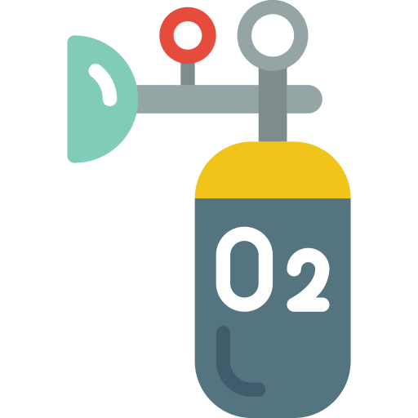
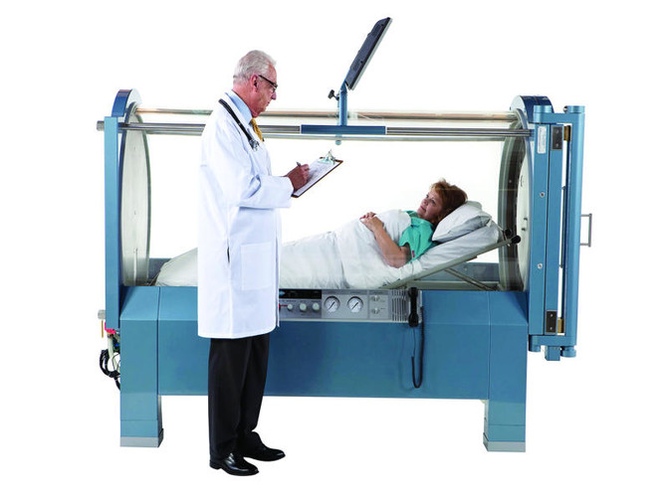
Carbon monoxide chemical component of inhalation injuries
Why is it bad?
Signs
Odourless, tasteless gas
Impairs tissue oxygenation by preferentially binding to Hgb
Affinity 240 times that of oxygen
shifts the Hb dissociation curve to the left decreasing O2 delivery
Headache
cherry red lips
arrhythmias
acidosis
seizures
LOC
CO level | Symptoms
0-5 | Normal Value Normal people don't have any carbon monoxide
15-20 | Headache, Confusion
20-40 | Disorientation, Fatigue, Nausea< Visual Changes
40-60 | Hallucinations, Coma< Shock
60 or above | Mortality >50%
Not done routinely, you have to call the lab and ask for it with the regular Arterial Blood Gas analysis (ABG)
Treatment:
Indications for hyperbaric oxygen therapy HBO
100 % O2 +/- intubation and ventilation
t1/2 of CO is 5 to 6 hours on R/A
45 min on 100% O2
27 min HBO @ 3 atm
Coma
LOC
ischemic ECG changes
focal neurological deficits
+/- CO Hb >40%

Slide 30
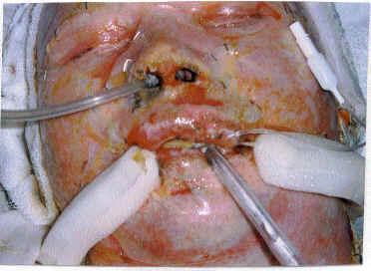
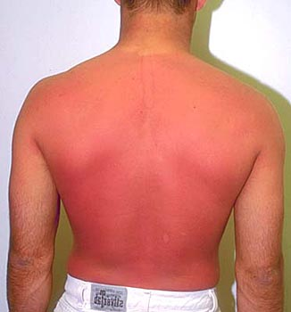
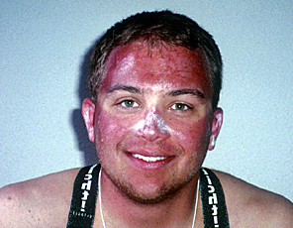
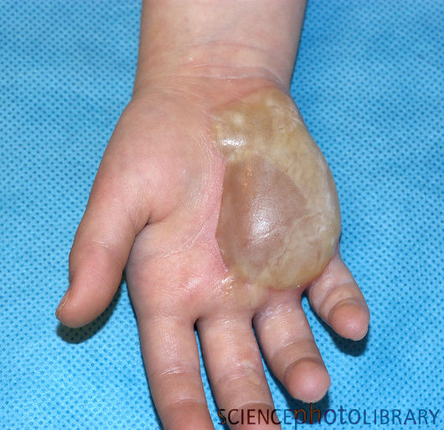
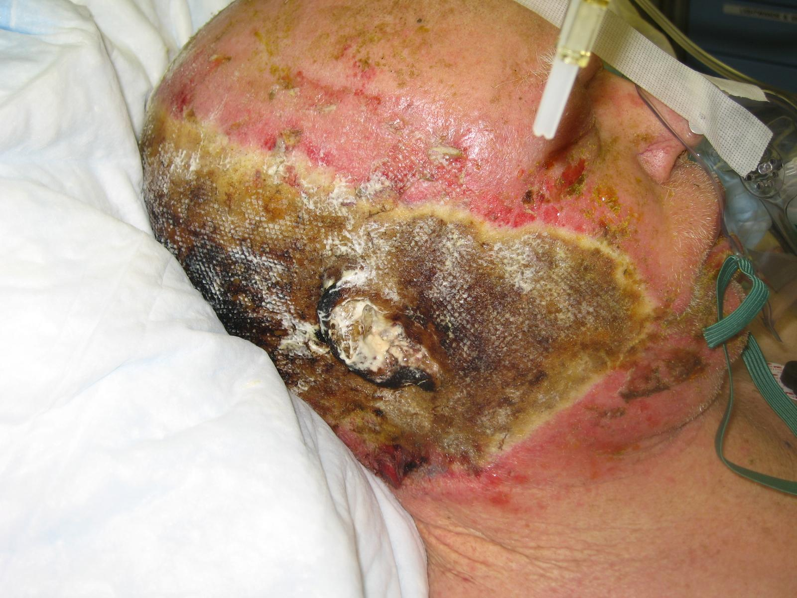
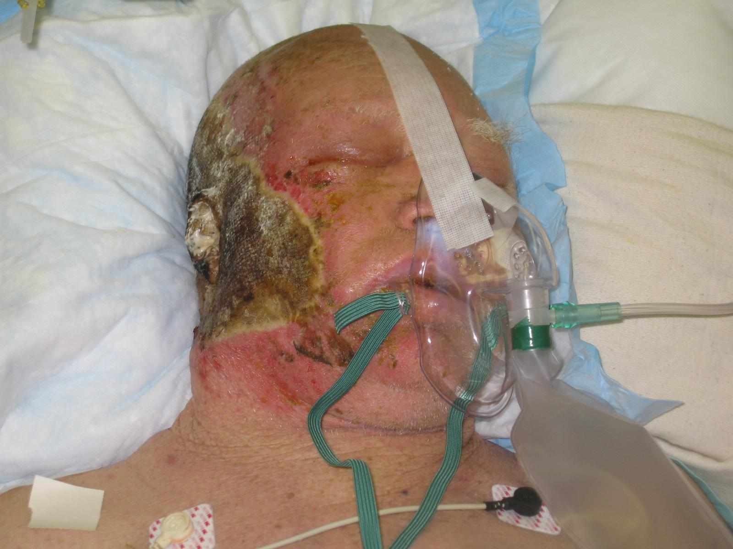
Questions /cases from the doctors
1
A 29 years old male, sustained a burn 1 hour ago, cam to the ER with these features.
What will be your main concern?
Inhalation injury
What are the features of this injury?
Calculation of inhalation burns
Add 25% to TBSA
In this case the patient is suffering burns on his head,neck and right arm =18%
18+25= 43%
If we only calculate the external TBSA the patient will be under resuscitated.
Most common cause of morbidity and mortality in burn patients acutely is
under resuscitation
Most common cause of morbidity and mortality in burn patients a week after the injury is infection
2
What is the degree of the burn?
First degree
What is diagnostic feature?
Erythema
Only requires analgesia because it only affects the epidermis
3
What is the degree of the burn?
Second degree
Why?
Presence of blisters, there is loss of fluid underneath the skin and the burn extends to the dermis
Second degree burns are divided into
Superficial partial thickness (upper layer of the dermis)
Deep partial thickness (middle layer of the dermis) facial burns heal on their on because the face has a big blood supply
4
What is the degree?
Third degree burns involve the whole dermis
What is the diagnostic feature ?
The presence of an eschar
Fourth degree burns are rare and require
surgery and skin grafts

Slide 31
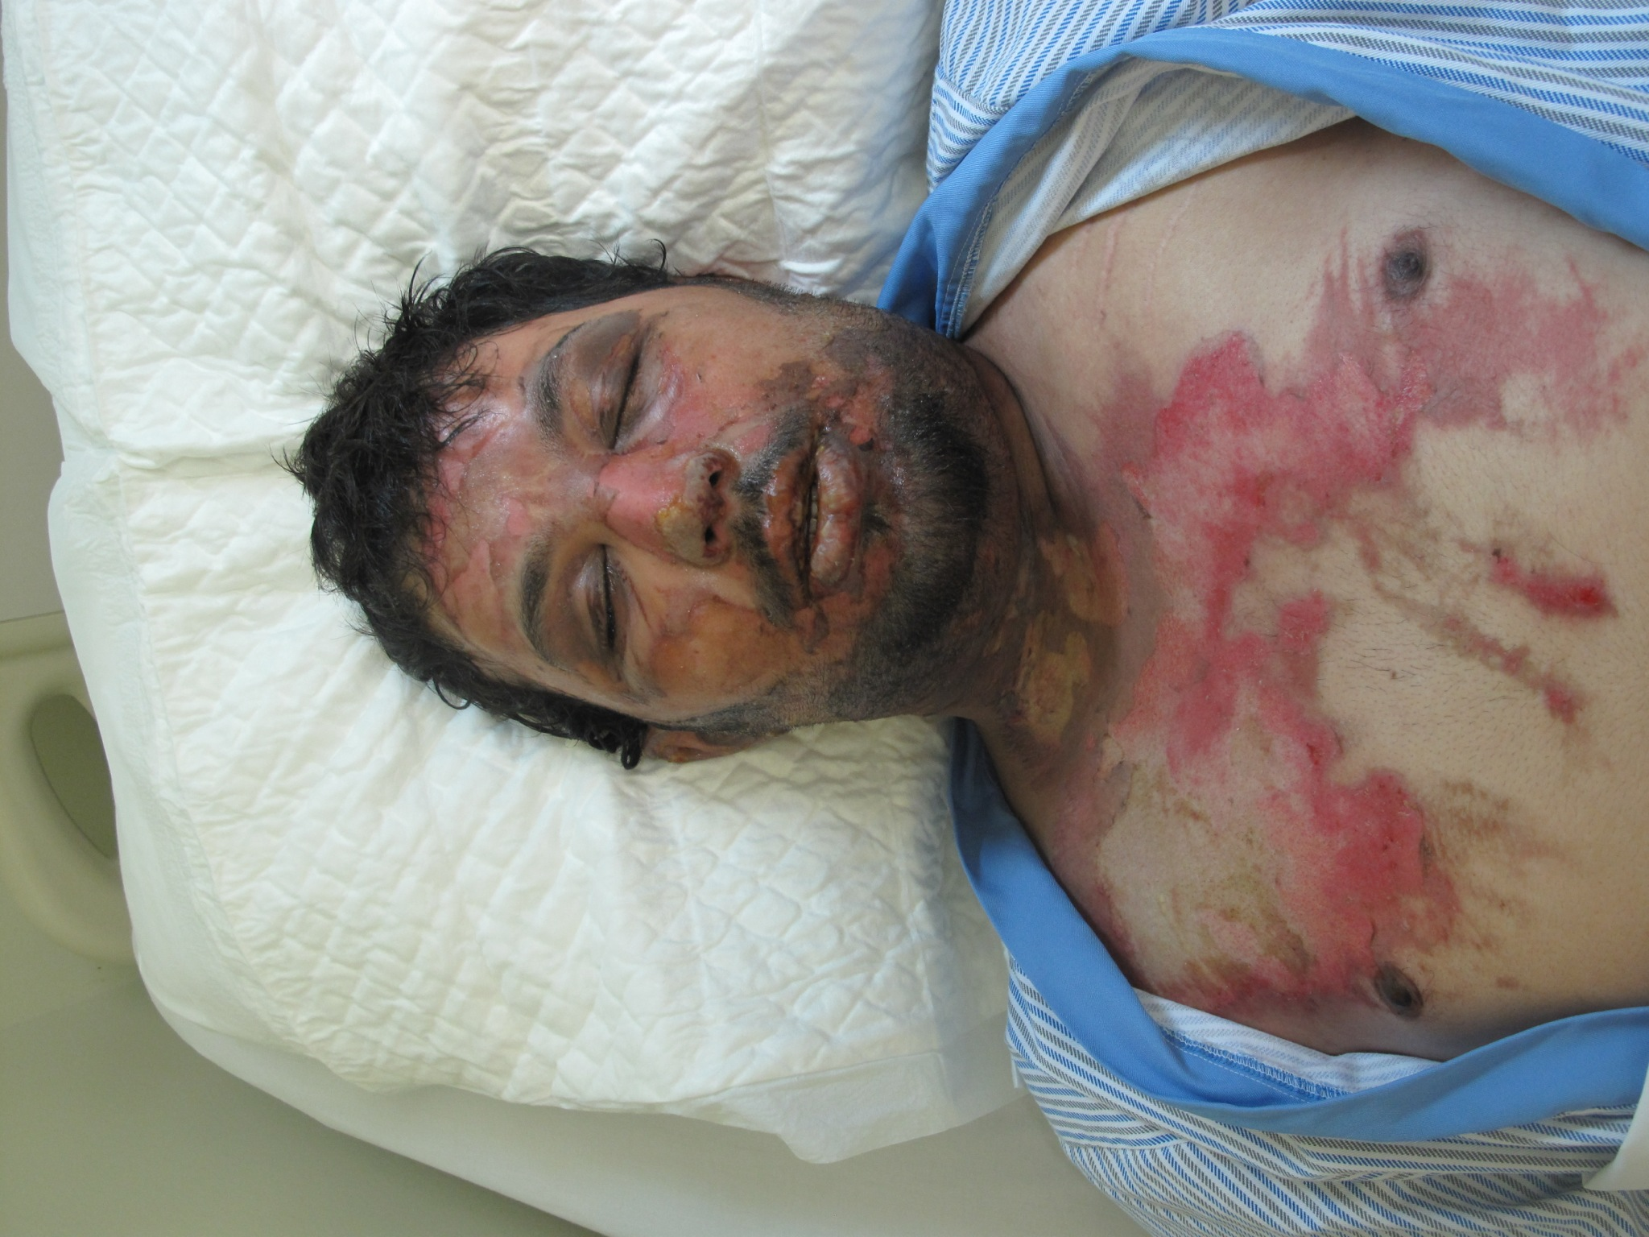
Questions /cases from the doctors
5
A patient presents to the ER suffering from a cut wound in the right hand, the wound has been 2 hours and is superficial , how would you approach this pt ?
Hx & Px
Ask about Tetanus Vaccine
Do you need to give ABx ? if the wound dirty and old > YES
Start with oral ABx > after 48h , progression of clinical infection ? shift to IV
6
Patient sustained a burn at 4 o'clock, presented to ER at 8 , when would you give the first half amount ?
You estimate time from the time of injury NOT admission
7
History:
CC: Difficulty breathing; Machine (in wheat house--closed area) exploded in face
Comments:
This patient most likely have inhalation injury, so ask yourself:
Can the patient see?
Can the patient hear?
Since its a burn bare in mind the following:
Vaccination and degree of pain
Was the patient wearing clothes or not?
If so, did the clothes burn or not?
Covered after removal of clothes?—to avoid dehydration and hypothermia. —in case of continuous contact
Assess breathing, assess mucosal lining,
Transfers to burn unit (more than 30% and inhalation injury)
The burn will demarcate after 3-5 days
Management:
Maintain Airway, breathing and circulation (make sure patient is stable)
Make sure patient is pain free and the wound is covered
if chemical then irrigate with NS or water
Decide on surgery after 3-5 days
If circumstantial burn → escharotomy
If compartment → fasciotomy

Slide 32
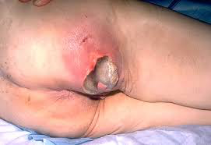
Questions /cases from the doctors
8
History
Personal: Khalid , 65 yo from SA, retired policemen - no allergies
CC: Came to ER
large wound with pain in right upper buttocks and scarring X 2 years ago
Wound has discharge now (note: Painful wound on Right lower buttocks for two years. With discharge so ask about: color, smell, how many times do you change dressing (continuous or not), amount)
Assos.: fever, loss of weight, redness around wound
PMx:
Admitted 5 times to hospital 5/7 past years for this issue, improved with AxB
Paraplegic for the last 10 years due to RTA
Diabetic since long time and takes insulin and glucophage
HTN, dyslipidemia
Recurrent UTI (note:can’t control bowel and urine output so ask: is there a need for a catheter? Colostomy? )
PSx:
Peripheral vascular disease with clopidogrel (Plavix) for stent
Sx:
Smokes 10 cigs for 20 years
Clinical exam:
(inspect: site, size, depth of floor, granulation tissue of unhealthy tissue
Palpate: Discharge (pus, yellow, green, blood) and (continuous-then its a sinus continuously draining), Around the wound (raised edges, laceration (with an M), muscle wasting, frail skin, redness), Pulses (Femoral, popliteal, dorsalis pedis) incase its vascular or hematoma, Percuss ( around for abscess))
Site: On the right ischium
Single wound
Measure size
Irregular edges
With areas of necrosis
Redness in surrounding skin
The edges are darker
Purulent discharge
Measure depth of wound
Assess base
Palpate for tenderness and
Asses temperature of surrounds area and floor
Check for disagree or bleeding
Percuss around loculated abscess
Random comment: Usually the cause of sepsis is urosepsis

Slide 33
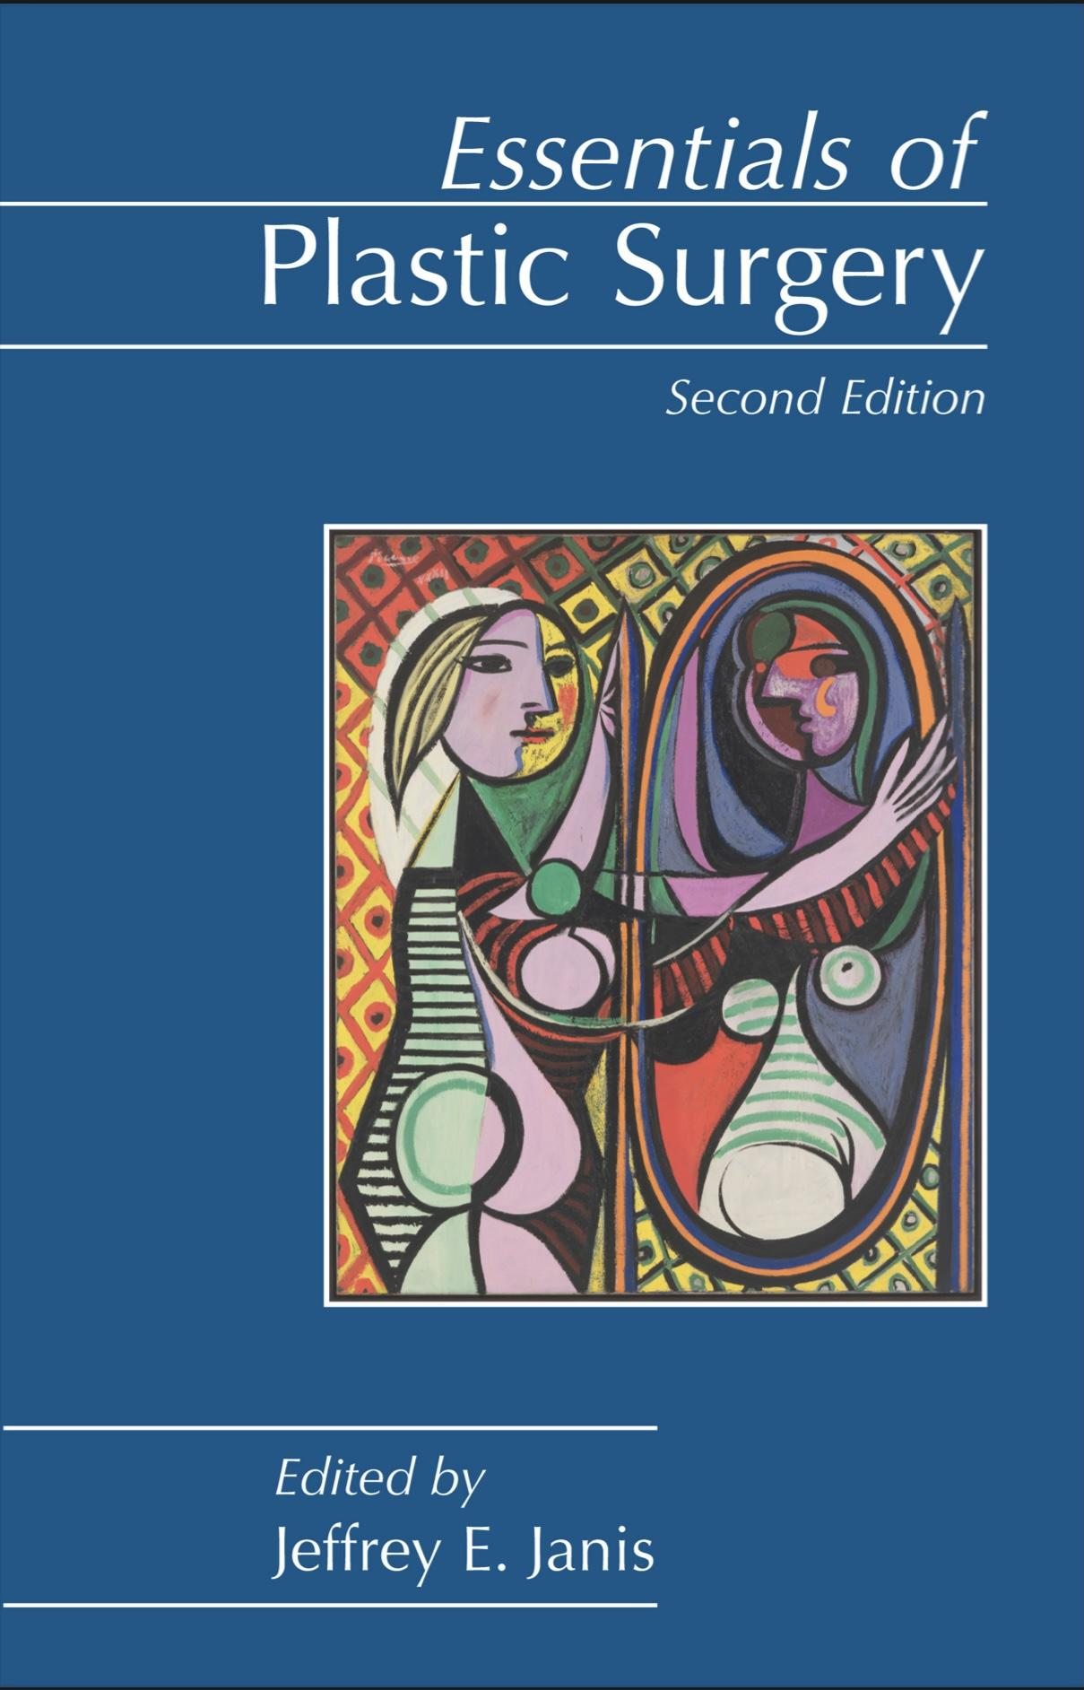
Quiz
The doctor recommended this book (click on it)
MCQ
Q1:A 22-year-old healthy African-American woman presents with a recurrent growth on her right thigh.She has a childhood history of a third-degree scald burn to the same area that did not require skin grafting.The growth was completely removed 2 years ago. On physical examination there is a 5 cm× 2 cm, raised,irregularly shaped purple lesion with a smooth top. Which of the following is the most likely diagnosis?
Angiosarcoma
Malignant melanoma
Squamous cell carcinoma
Kaposi sarcoma
Keloid
Q2:A 65-year-old man sustains a 50% TBSA burn while burning trash in the backyard. The patient is
resuscitated with lactated Ringer (LR) solution using the Parkland formula and a weight of 80 kg. What is the rate of LR given in the first 8 hours?
100 mL/h
500 mL/h
1000 mL/h
5000 mL/h
10,000 mL/h
Q3:What reverses the deleterious effects of steroids on wound healing?
Vitamin A
Q4:What are the signs of smoke inhalation?
Smoke and soot in sputum/mouth/nose, nasal/facial hair burns, throat/mouth erythema, history of loss of consciousness/explosion/fire in small enclosed area, dyspnea, low O2 saturation, confusion, headache, coma
Q5:What lab value assesses smoke inhalation?
Carboxyhemoglobin level (carboxyhemoglobin level >60% is associated with a 50% mortality); treat with 100% O2 and time
Q6:How should the airway be managed in the burn patient with an inhalational injury?
With a low threshold for intubation; oropharyngeal swelling may occlude the airway so that intubation is impossible; 100% oxygen should be administered immediately and continued until significant carboxyhemoglobin is ruled out
Answers
Click here for explanation
Q1 | E | Q4
Q2 | C | Q5
Q3 |  | Q6
Extra Questions

Slide 34
Good Luck!
Team leaders:
Nouf Alshammari
Haneen Somily
Naif Alsulais
Mohammed Alshoieer
This lecture was done by:
Haneen Somily
Nouf Alshammari
Fawaz Alotaibi
Mohammed Alhamad
Nujud Alabdullatif
Lama Alassiri
Razan Alrabah
Ibrahim Aldakhil
Special thanks to members of the original Burns and Wound healing lectures
Feedback
Note taker
Reviewer

