Slide 1
Breast Diseases:
Tutorials are theoretical lectures, taken in small groups to ensure an interactive learning experience.
Objectives
The student is expected to describe and explain the pathogenesis and clinical features of the following conditions:
Lump and nodularity
Pain
Nipple discharges
Nipple changes
Breast enlargement
Breast skin changes and ulceration
List the differential diagnosis of breast diseases
Colour Index
Main Text
Males slides
Females slides
Doctor notes
Textbook
Important
Golden notes
Extra
Editing File

Slide 2
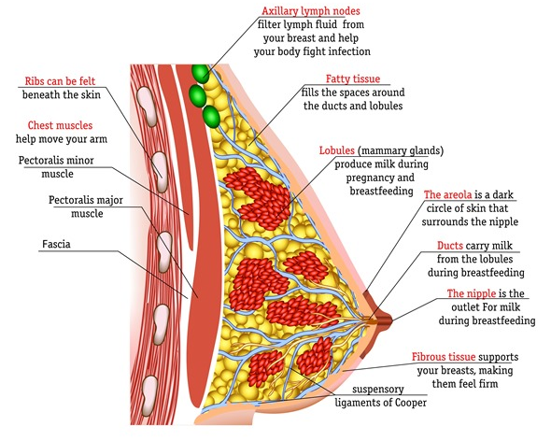
Overview
Development of the breast:
Breast development and milk discharge might be seen in neonates (males & females) in first 2 weeks of life due to maternal hormones (oestrogens) crossing the placenta. This enlargement is normal and subsides within few weeks.
The breast life cycle:
Development & Early reproductive life:
Occurs at puberty and involves proliferation of ducts, ductules & fat associated with very rudimentary lobule formation, and regular changes in relation to the menstrual cycle.
Mature reproductive life:
Occurs during pregnancy.
The breast enlarges with proliferation of the ducts and lobules in preparation for the production of milk.
1st
2nd
3rd
Involution:
By 30 years of age, involution is evident and continues to menopause and beyond. During involution, both the glandular and fibrous tissue atrophy and the shape of the breast changes.
Breast Symptoms:
More than a quarter of general surgical outpatient referrals are of females with breast symptoms.
Less than 10% of general surgical operations are for breast disease.
Breast symptoms include:
Lump (most common symptom), Pain, breast tenderness, change in breast size or shape.
01
Nipple retraction, nipple discharge, scaling nipple or eczema, inflammation and ulceration of the overlying skin.
02

Slide 3
Breast Investigations (Triple Assessment):
Triple assessment is the assessment of breast lump or other breast symptoms suspicious of carcinoma, where the diagnosis should be made by a combination of:
01
02
03
Clinical Assessment
Imaging
Biopsy
History:
Full & complete history should be taken, particular attention should be paid to:
Breast development starting from childhood to present.
Endocrine status of patient mainly menstruation and oral contraceptives.
Size of lump in relation to menses.
Pattern of pain in relation to menses.
How regular the cycle is and quantity of blood.
Age at menarche.
Age at 1st birth.
Premenopause vs perimenopause (menopausal transition) or postmenopause.
For postmenopausal women: hormonal replacement therapy & date of menopause.
Changes in breast during previous pregnancies e.g. abscess, nipple discharge, retraction of nipple.
Number of pregnancies.
Last menstrual period.
Nipple discharge.
Premenopause vs perimenopause (menopausal transition) or postmenopause.
For postmenopausal women: hormonal replacement therapy & date of menopause.
Breastfeeding.
Abnormalities which took place during previous lactation period e.g. abscesses, nipple retraction, milk retention.
Family history of breast diseases especially cancer & particularly in near relatives.
Physical Exam:
Disrobed from waist and above.
Examine in sitting and supine position and 45° position.
Inspection with arms by the side and above head: size, symmetry, skin changes, & nipple complex.
01
03
Always compare both breasts.
Examine the normal side first.
Before you comment on any changes on the appearance of nipples or chest, you must make sure that it’s not congenital first.
Examine axilla, arm, SCF.
If you find a mass in breast = Examine axillary lymph nodes and vice versa.
Examine abdomen.
Examine the back.
02
04

Slide 4
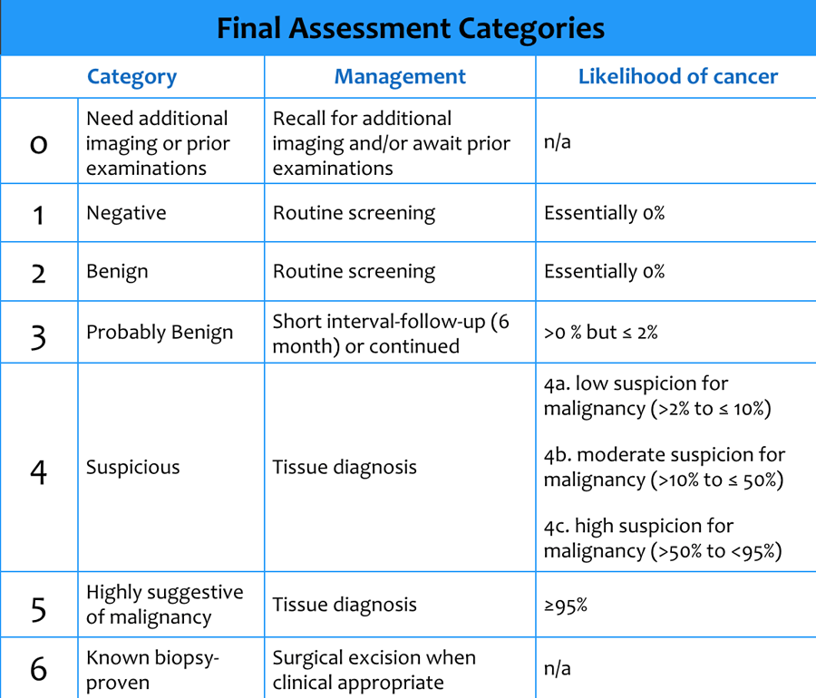
01
02
03
Clinical Assessment
Imaging
Biopsy
Ultrasound | Useful for diagnosis of breast cancer, especially in young patients under the age of 40 (mammogram is difficult to interpret in young patients due to the dense breast tissue). Distinguishes cyst from a solid lesion (cysts show up as transparent objects while benign lesions tend to have well-demarcated edges and cancers usually have an irregular indistinct outline). Localizes an impalpable breast pathology. Guides percutaneous biopsy. Guides percutaneous biopsy for any suspicious axillary lymph node. Not useful screening tool for breast cancer.
Mammography | Useful for diagnosis of breast cancer. Safe (dose of radiation is low) but uncomfortable. Sensitivity increases with age as the breast become less dense. Normal mammogram doesn’t exclude the presence of carcinoma. Rarely of value in the age below 30, because the breasts are relatively radiodense.
MRI | Distinguishes scar from recurrent cancer after conservative breast surgery. Assesses multicentricity and multifocality in lobular breast cancer. Assesses the extent of ductal carcinoma in situ (DCIS). Identifies a breast cancer in women with a malignant axillary node where there’s no obvious primary cancer seen on mammography and ultrasound. Assesses young women with dense breasts who have a lump or a cancer that is not well visualised on other imaging. Assesses response to chemotherapy or endocrine therapy. Best imaging for the women with breast implants, to detect leak or rupture. Best screening tool when combined with mammogram, more effective than using mammogram alone in high-risk women between the age of 35-50 years (family history of breast cancer or BRCA1 or BRCA2).
To communicate with a radiologist use: BI-RADS (Breast Imaging-Reporting and Data System):

Slide 5
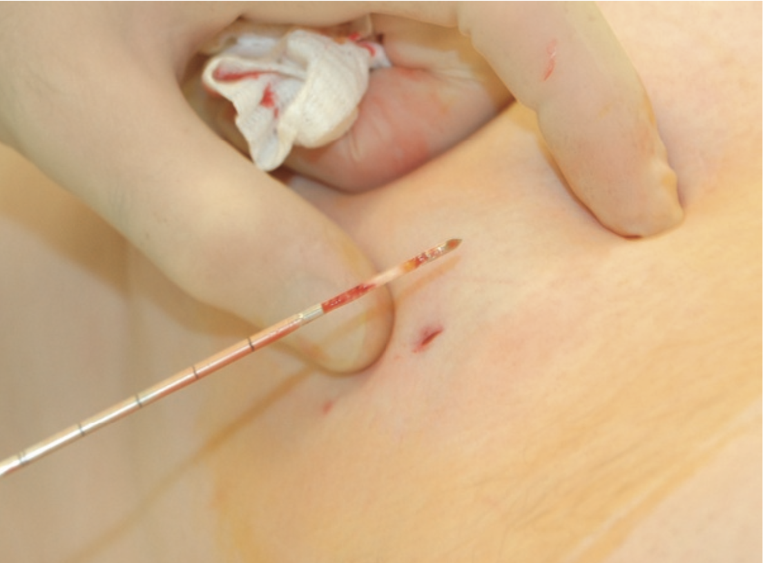
01
02
03
Clinical Assessment
Imaging
Biopsy
Fine-needle aspiration for cytological examination (FNA):
Core biopsy
(Tru-cut biopsy):
This is now rarely used to diagnose palpable breast lumps.
It can differentiate cystic from a solid lesion.
If a lesion is a simple cyst on ultrasound, aspiration is indicated only for symptoms or reassurance.
Any fluid aspirated should be discarded unless it is evenly blood stained, then it should be sent for cytological analysis.
FNA cytology cannot differentiate invasive from in situ cancer. Therefore, surgical procedure should not be performed according to the result of FNA.
It is used most frequently to sample lymph nodes that are abnormal on imaging in patients with breast cancer. FNA of nodes should be performed under image guidance with use of local anaesthesia.
If you need to take out a biopsy do Tru-Cut biopsy.
Core biopsy offers several advantages over fine-needle aspiration cytology:
It can differentiate invasive from in situ disease
Cancer type and receptor status can be assessed, which is important before commencing neoadjuvant therapy.
It has an extremely low rate of false positives
It has a very high sensitivity when image guided.
Definitive preoperative diagnosis.
After injection of local anaesthetic several cores are removed from a mass or an area of microcalcification by means of a cutting needle technique.
Core biopsy can be performed using palpation to guide biopsy, although image-guidance using ultrasound is recommended for mass lesions and a stereotactic technique for calcifications. Vacuum-assisted core biopsy devices allow larger volumes of tissue to be removed and produce more reliable results in microcalcification biopsies.
Sensitivity of investigations in the diagnosis of symptomatic breast disease:
Test: | Clinical examination | Mammography | Ultrasonography | Core biopsy | Fine-needle aspiration cytology
Sensitivity for cancers | 86% | 86% | 90% | 98% | 95%

Slide 6
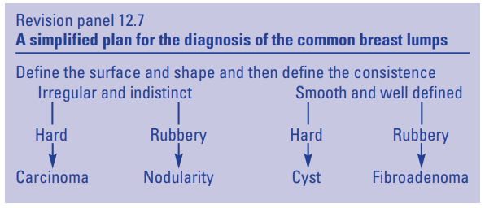
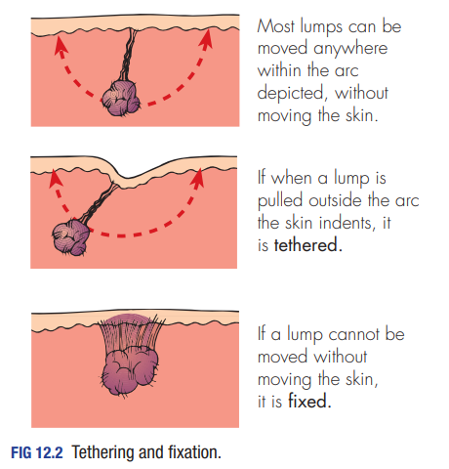
Breast pain
Cyclical breast pain
(related to the menstrual cycle):
Non-cyclical breast pain:
Cyclical breast pain is very common.
Almost all females go through this pain with variable degrees of pain.
Hormonal in origin.
During the second half of the cycle.
Unilateral mostly (but can be bilateral), Upper outer quadrant.
The pain is usually reduced by the use of oral contraceptives
On Examination:
No discrete lump.
There may be tenderness
Diffuse nodularity is common.
Less common.
Pathological, especially if it’s associated with a mass, nipple discharge or skin changes.
Usually resolves spontaneously.
In elderly female careful examination is essential to exclude cancer (especially when the pain is described as ‘prickling’.) and to make sure it’s not musculoskeletal pain.
Requires investigations after clinical examination:
Breast ultrasound.
Mammogram if the patient's age is >40.
MRI if patients is <40 y/o with strong family history of breast cancer.
Lumps and nodularity
Type of Lump:
 | Age (years) | Pain | Surface | Consistency | Axilla
Solitary Cyst | 40-55 | Occasional | Smooth | Soft to hard | Normal
Nodularity | 20-55 (the years of ovarian activity) | Often | Indistinct | Mixed | Normal
Fibroadenoma | 15-55 | No | Smooth and bosselated | Rubbery | Normal
Carcinoma | 35+ | Uncommon | Irregular | Hard | Nodes may be palpable
History
Examination
Investigation
The symptoms occur during the years of ovarian activity due to hormonal changes.
One or more tender lumps with variable size and clearly related to menses (during the second half -second 2 weeks- of the cycle).
Vary from a diffuse nodularity to quite discrete lesions.
Most common site is Upper outer quadrants because this part has more breast tissue.
Begin by assessing the asymptomatic breast to get an idea of its consistency
Not fixed or tethered to the skin or the muscle. Unlike cancerous lumps which are fixed and associated with skin changes and tethering.
NO lymph node enlargement
Breast masses must be investigated: most of the time is benign.
Radiologically by breast ultrasound or mammogram as age indicates.
Pathologically by ultrasound guided trucut biopsy.

Slide 7
Benign Breast Conditions
Fibrocystic Changes
The most common breast disease.
Fibrous and cysts formation due to surge of estrogen resulting in the proliferation of tissue causing pain due to the stretch of the epithelial tissue which is attached to nerve endings, hence the pain.
Cyclic pain, discomfort and engorgement, once the period comes the symptoms disappears.
History: Patient will complain of pain before period (cyclic pain).
Diagnosis
Investigation: US (modality of choice): multiple variable microcysts with no calcification. If the women is over the age of 40 mammogram is needed to rule out malignancy and to see if there’s calcification.
01
03
Physical Exam: bumpy lumpy breast tissue or nodular breast. No skin changes or dilated veins.
02
04
No indication of biopsy because it’s variable in size and location (assuring sign). Variable location means that on each follow up the lumps appear at different locations, so they appear and disappear constantly, which is a reassuring sign.
Lifestyle changes: reduce tea, coffee, chocolate intake (things that increase water retention).
Wearing a supportive bra and avoiding wired bras to reduces fluid accumulation.
Treatment
The most important goal is to reduce cyst formation and increase the filtration of the breast (lymphatic filtration) with muscle contraction by exercising the hands and the pectoral major muscle, like stretching a band up and down or rolling.
01
03
Primrose oil tablet.
Vitamin E: unclear mechanism but thought to stabilize the breast tissue and decrease cyst formation.
Symptomatic treatment: Give analgesia (paracetamol every 6 hours).
02
04
In extreme cases: give Danazol (antiestrogen). However, it’s not preferred because it can cause musclization (hoarseness of the voice, muscle gain, hair growth).

Slide 8
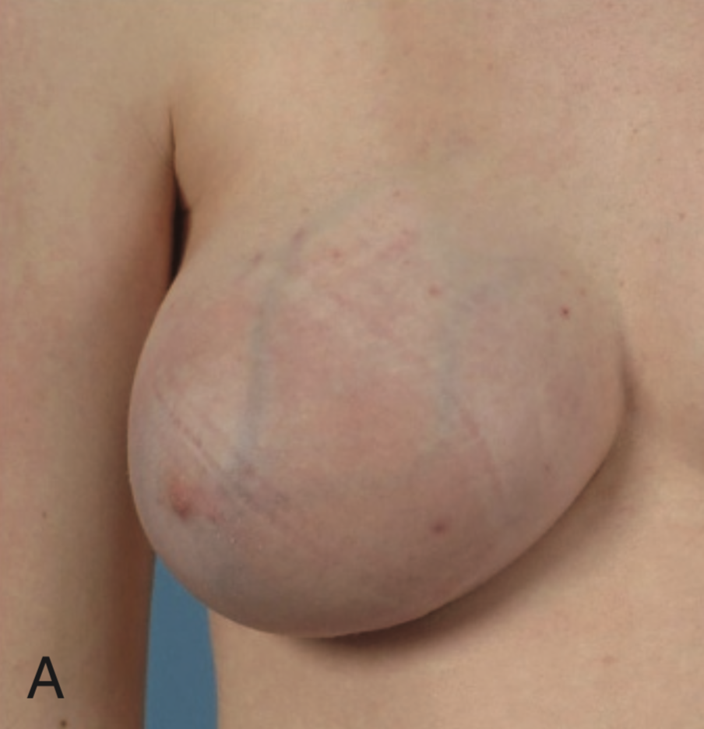
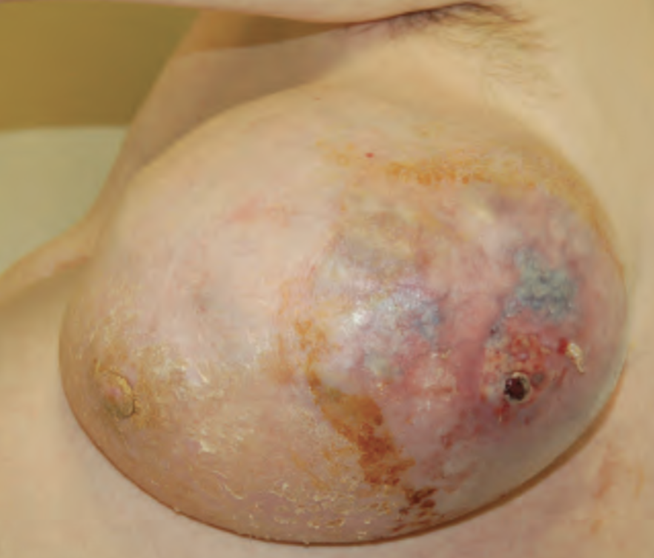
Fibroadenomas
Common in young age group (puberty to late 20s or early 30s).
Fibroadenomas develop from a whole lobule rather than from a single cell, and show hormonal dependence similar to that of normal breast tissue, lactating during pregnancy and involuting in the perimenopausal period.
Presentation: mass and occasional pain. No discharge or skin changes.
Diagnosis:
01
02
03
Hx: young females
Examination: well localized, mobile and non tender mass. Could be multiple.
US: solid well encapsulated mass, variable in size, single or multiple.
Ultrasound is used to differentiate between fibroadenoma and cysts.
Biopsy is needed, ultrasound guided trucut (core) biopsy to differentiate between fibroadenoma and phyllodes.
Fate of fibroadenoma: 50% disappear spontaneously, the other 50% either gets smaller or bigger or the stays the same.
Transformation to malignancy = 0%
Once a diagnosis of fibroadenoma has been established, options for management are reassurance with no follow-up or surgical excision.
Criteria for surgery:
Any fibroadenoma >4cm (to ensure that a phyllodes tumor is not missed).
Painful and rapidly growing fibroadenoma.
Unusual age group (40-50 yo), First you’re gonna perform US then Mammogram then eventually a biopsy to confirm your diagnosis, then remove it.
Family Hx of malignancy (however there’s no chance for fibroadenomas to be malignant, it’s just to relieve the patient from stress).
Unclear pathology (e.g. the pathology report says fibroadenoma with hypercellularity, or phyllodes atypia).
Phyllodes Tumor
It differs from fibroadenoma in that it has:
More fibrous tissue component
Malignant potential of <1%
If not excised completely there is a high chance of recurrence.
Getting another phyllodes tumor somewhere else in the body is different from recurrence in the same location. Why? Because of the hormonal stimulation.
Phyllodes tumor can be graded to benign, mild and malignant (Sarcoma, which is a very nasty cancer, that rapidly grows and spreads via blood. Almost ¼ of malignant cases metastasise , most commonly to the lungs).
History
Presentation
Investigation
Treatment
Female >30 y/o
Similar presentation to fibroadenoma but single large (>4 cm) fibroepithelial mass, well localized, mobile and non tender mass.
Skin changes and discharge when malignant.
Biopsy is a must, after the US
surgical excision for both malignant or benign. While for larger lesions, mastectectomy may be needed.
(the chance of malignancy increases with size).

Slide 9
Lipoma
Presentation:
Investigation
Treatment
Soft, lobulated and radiolucent mass.
Diagnosed by clinical exam and US. Biopsy is not required in most of cases.
Surgical excision.
Fat Necrosis
Cause
Presentation:
Investigation
Treatment
Occurs due to trauma (impaction and disimpaction)
Present later after 3-4 months from the injury as irregular, hard, non tender mass of dead or damaged breast tissue.
Trucut biopsy
Reassurance (resolves with time).
Breast Cysts
Simple | Complicated / Complex
Cyst filled with clear fluid. Presentation: localized painful single mass. Diagnosis: US → well circumscribed simple cyst filled with fluid lined with single layer of epithelium. Aspiration (diagnostic and therapeutic) then send it for cytology. Blood could be malignant of traumatic. Repeat US after 6 weeks: if the cyst refilled, aspirate it for the second time and send it for cytology (if it’s benign → follow up in 6 weeks) If it refills for the third time it needs to be excised, because the epithelial lining can have malignant potential. | Complicated cyst: cyst with turbid fluid Complex cyst: cyst with solid component or septation Diagnosis: Trucut biopsy is needed from inside the cyst if it’s benign just asprate it. If there is atypia then excise it.

Slide 10
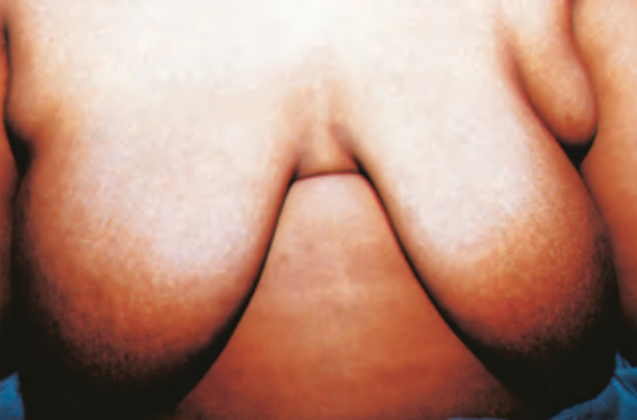
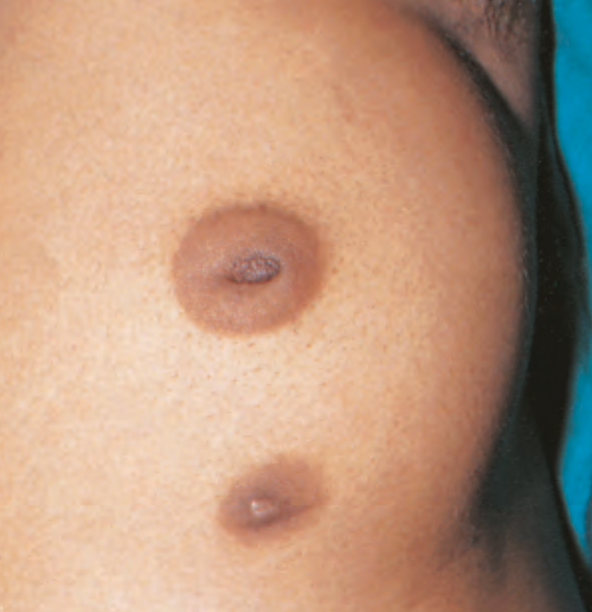
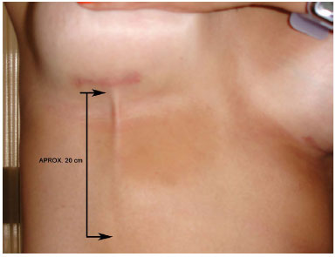
Galactocele
Galactic lump is a cystic lump which contains milk, develops in lactating women and usually resolves upon the cessation of breastfeeding but large ones may require repeated aspiration.
How to differentiate between galactocele and abscess?
Galactocele mass is associated with slight tenderness with no fever or rigors.
Accessory Breast Tissue
Located under the arm or breast, as extension of the axillary fat.
Occurs during puberty, lactation or pregnancy.
Examination: If you find a mass in the axilla, does the size of the mass changes with period? If yes, accessory breast tissue. Is the mass mobile & hard? If yes and does not change with period, then it’s lymph node.
Diagnosis: US and biopsy if needed.
Surgical indication: if it’s big enough to limit the movement of the patient arm or for cosmetic reasons.
Accessory Nipple
Accessory nipples are usually found along the line of nipple development.
looks like a nevus, might be unnoticeable.
Some patients will have swelling and discharges during their period.
Treatment is not needed unless for cosmetic reasons.
Mondor’s disease
A thrombophlebitis of the lateral thoracic vein
Produces a cord-like, linear skin puckering that can alarm patient and clinician
causes pain at an early stage and subsequently becomes a painless fibrous band
It Resolve spontaneously
The Nipple
The symptoms associated with the nipple are:
01
02
03
Nipple discharge
Nipple inversion
Skin changes

Slide 11
Nipple discharge:
It occurs in any age group , commonly during reproductive life.
It could be thick or thin, cloudy or clear, or bloodstained. Unilateral or bilateral , spontaneous or induced, single duct or multiple ducts.
Will be considered pathological if it‘s unilateral & spontaneous (coming out by itself without squeezing the nipple) from a single duct or associated with pain or mass.
If the discharge is:
Milk → usually benign, and if it’s related to pregnancy or lactation it’s considered normal. If not then investigations are needed.
Serous or bloody → always requires investigating.
Investigations include:
01
Culture and cytology of the discharge.
02
Radiology by breast ultrasound or mammogram or MRI depending on the patient’s age.
03
If it’s associated with mass then biopsy is needed.
 | Pathology | Discharge Characteristics | Management
Duct Ectasia (Explained in details in the next slide.) | Most common cause of nipple discharge. Inflammatory condition that causes dilatation of the duct beneath the nipple. | Variable color and consistency. Multiple ducts discharging. | Reassurance Excision of the ducts
Duct Papilloma | Intraductal papilloma is the most common cause of blood-stained discharge. Benign neoplasm arise from the ducts under the nipple and can be single or multiple. May show minimal malignant potential. | Copious serous, bloody. Single duct. | Most of the time it’s self limiting. If persistent: Microdochectomy to make sure that the papilloma doesn’t harbor DCIS.
Carcinoma in situ (DCIS) | Least common cause of nipple discharge. | Bloodstained, spontaneous persistent, serous discharge. Single duct. | Image-guided biopsy, or Microdochectomy.
Prolactinoma | Benign hormone-secreting pituitary tumor that produces the hormone prolactin. | Milky, bilateral. Multiple ducts. | Reassurance & Endocrine evaluation. No need of surgical intervention for the breast.

Slide 12
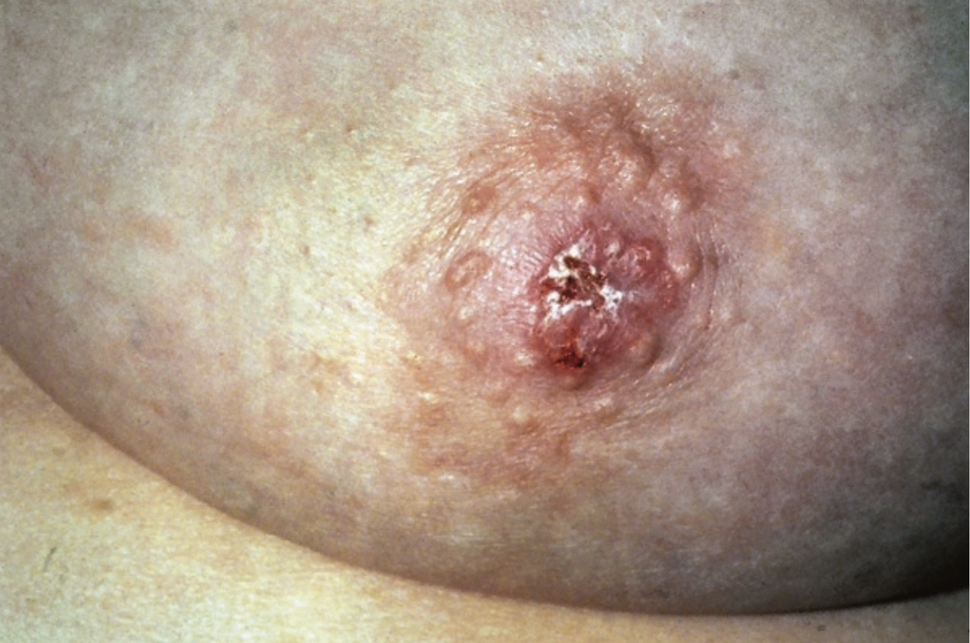
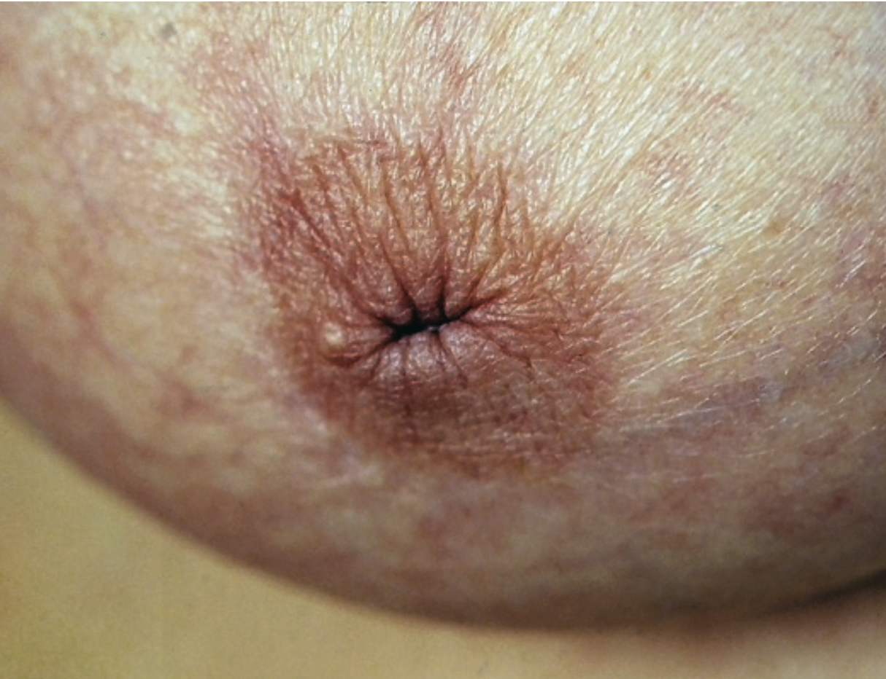
Nipple inversion:
Usually associated with significant disease and always merits full assessment. When is nipple inversion worrisome? If the onset is recent, if the inversion is unilateral and if upon examination you can’t evert the nipple.
Paget’s Disease
Pathology of Paget’s Disease:
Investigations & Treatment:
Paget’s disease of the nipple is caused by cancer cells migrating or spreading along the duct system & the subdermal layer of the areola, from an underlying breast carcinoma situated deeply in the breast, which in the early stages is usually confined to the epithelium (DCIS).
Patches of skin first become red and then encrusted and oozy.
Any patient coming to the clinic complaining of nipple inversion and skin changes around the nipple, always assume that it’s paget’s disease until proven otherwise. Because if the diagnosis of paget’s disease is missed, the cancer will progress.
Investigations: Skin biopsy.
Treatment: mastectomy.
Patients may present with symptoms mimicking Eczema:
Eczema
VS
Paget’s Disease
Bilateral
Sometimes lactating
Itches
Vesicles
Nipple intact
No lumps
Unilateral
Older females
Does not itch
No vesicles
Nipple may be destroyed
May be an underlying lump. If you can’t feel a lump that doesn’t rule out cancer!
Duct Ectasia
Pathology of Duct Ectasia:
Investigations & Treatment:
Common inflammatory condition of unknown aetiology.
Dilatation of the mammary ducts for more than 4 cm.
Presenting features:
Nipple inversion, transverse slit appearance.
Difficulty in breastfeeding.
Nipple discharge.
Anyone can get duct ectasia. However the complications are seen in smokers.
Complications:
Chronic low-grade infection of the periareolar area.
Periductal abscess
Mammillary fistula between the skin and the ducts. ¹
Investigation:
US: is diagnostic.
Over the age of 40 mammogram is needed to exclude malignancy.
Treatment:
Reassurance, local cleaning externally and avoid squeezing the nipple as it will only increase the chance of trauma and retraction.
If there’s fever, pain and tenderness, excise the dilated ducts surgically to avoid the risk of developing periductal mastitis and abscess.
Diabitic patient with duct ectasia are at increased risk for periductal abscess.
Extra: fistula is an opening between two epithelial surfaces. While sinus is a blind-ended tract that extends from the surface of an organ to an underlying area or abscess cavity.

Slide 13
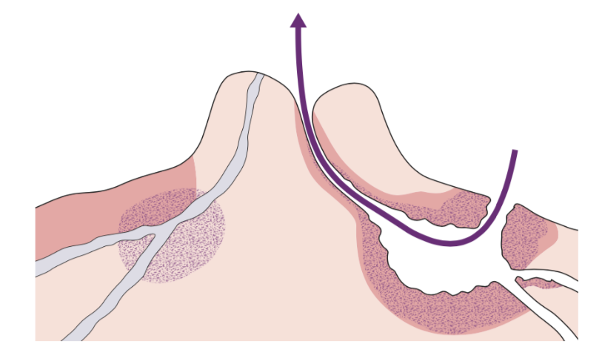
Breast Infection
Can be divided into lactational and non-lactational.
The principles of treatment:
Give appropriate antibiotics early to prevent abscess formation.
Confirm Abscess by ultrasound then aspirate if small or surgically drain.
Exclude breast cancer by taking a biopsy from the walls of the abscess. Because some types of breast cancers present with abscess formation.
After it resolves reassess the patient to make sure there’s no residual mass that was hidden by the abscess.
Usually develops within the first 6 weeks of breastfeeding secondary to bacterial infection contracted from the baby’s mouth which is colonized by staph aureus that can enter through nipple cracks and skin abrasions on the mother’s breast.
Present with pain, swelling, tenderness and a cracked nipple or skin abrasion.
Most common pathogen: Staphylococcus aureus.
Women should be encouraged to breastfeed because the milk comes from the lactocytes which’s nowhere near the infection. Stop breastfeeding only if the baby is quiet, or having diarrhea because the antibiotic can be excreted in the milk. But she has to pump her breast and discard it so that the breast won't become engorged and tender and milk production won’t stop.
Treatment: as mentioned above. First give antibiotics (IV antibiotic against staph aureus: floxacillin, cloxacillin, augmentin for 24 hrs then continued orally) and if at any point they develop an abscess you have to confirm it by US then drain it.
If left untreated the body will try to fight it off and an abscess will be formed (filled with necrotic debris and inflammatory cells walled by fibrous tissue)
Abscess presentation is more acute, with way more tender breasts, sky high fever and rigors.
Lactating infection:
Types of non-lactating infections:
Central (periareolar) infection.
Peripheral non-lactating abscesses.
Tubercular mastitis.
Skin-associated infection.
Non-lactating infection:
Central (periareolar) infection:
A complication of duct ectasia.
Commonly seen in young women, with periductal mastitis (inflammation and infection of the ducts).
Smoking is an important etiological factor¹.
Presentation: Breast pain, erythema, swelling and tenderness.
Treatment: Antibiotics, aspiration or incision and drainage.
Mammary duct fistula:
Mammillary fistula
Occurs when a periductal abscess -formed due to periductal mastitis- ruptures (or is drained externally) and stays in communication with the duct system.
Treatment: excision and antibiotic.
Remember: the etiological factor of duct ectasia is unknown. However the complications of duct ectasia are caused by smoking.

Slide 14
Peripheral non-lactating abscesses:
Peripheral infection (away from the nipple)
A general infection similar to any other skin infection.
Some are associated with an underlying condition, such as diabetes, Rheumatoid arthritis, steroid treatment or trauma.
Tubercular mastitis:
Reproductive age group with painless lump.
They don’t have open TB but they have history of TB themselves or history of contact with TB patients.
Confirm TB with FNA or needle Biopsy.
A prolonged course of antitubercular treatment is preferred. No need for surgical intervention unless they develop an abscess.
Skin-associated infection
Anyone can get this infection regardless if they have underlying conditions or not.
Commonly affects the lower half of the breast (inframammary area) and can be recurrent.
Intertrigo: present with redness itching and pain. Advice the patient to keep the area clean and dry.
Epidermoid (sebaceous cysts): often forms within sebaceous glands.
Hidradenitis suppurativa: seen in the axilla, groin and inframammary area. Patients need antibiotics and surgical excision of the skin involved.
Gynaecomastia
Abnormal development of both the ductal and stromal elements of the breast in males.
Presentation:
01
02
03
04
05
Transient in male infants: is due to maternal hormones. No need for intervention, it resolves on its own.
Breast development in adolescents: is due to hormonal changes during puberty, and it is Bilateral
Breast enlargement in middle-aged adults: is usually associated with bilateral trauma to the breast. Not caused by hormones!
Breast enlargement in elderly males: is usually caused by medications as a side effect.
Inappropriate hormone secretion: with liver diseases or cancers that secrete hormones such as testicular tumors or adrenal gland tumors.
History:
Exam:
Investigation:
Treatment:
Painless, enlargement of one or both breasts.
Taking a drug history is essential.
Rule out taking steroids, endocrine hormones, obesity.
In young patients: Palpable rounded hard disc of breast tissue.
In elderly patients: More diffuse, with fatty elements.
Axillary lymph glands will not be enlarged. If enlarged, suspect cancer.
General examination, especially of the abdomen scrotum and testes.
Ultrasound (mainly)
Mammogram, and biopsy if there is a mass.
Liposuction

Slide 15
Breast Cancer
Epidemiology:
Male represent <1% of patients with breast cancer
The most common malignancy in women, comprising 18% of all female cancers.
Risk factors:
Age:
The risk is higher in young age groups, but the incidence increases with age until menopause.
It’s extremely rare below the age of 20 years.
Diet:
High alcohol intake and saturated fat increases breast cancer risk.
Exogenous hormones:
Hormonal Replacement Therapy and Oral Contraceptive Pills increase the risk, but combined Progesterone and estrogen HRT is associated with a greater risk than preparations containing estrogen alone.
Geographical variations:
Higher in developed countries (Caucasian, Western Europe and Australia).
Menstrual and pregnancy factors:
Early menstruation, late menopause, nulliparous women , late first childbirth after the age of 30 are at higher risk.
The highest risk is in women having a first pregnancy over the age of 40.
Early first delivery and breastfeeding may protect against breast cancer.
Physical activity, weight and height:
Moderate physical activity reduces the risk, obesity increases the risk in postmenopausal women while may reduce the risk in premenopausal women, and taller women have higher risk.
Radiation:
Women treated by mantle radiotherapy for Hodgkin’s or non-Hodgkin’s lymphoma during adolescence and teenage are at significant risk of developing early-onset breast cancer.
Genetics:
Many genes involved in breast and ovarian cancers are DNA repair genes (Mutations, insertions or deletions).
High Risk Genes: The vast majority of families having members with breast and ovarian cancers are linked to BRCA1 & BRCA2 genes.
Mutations in the p53 gene and mutation of PTEN can also lead to breast cancer.
Benign disease:
Severe atypical hyperplasia is associated with increased risk of breast cancer.

Slide 16
Management for high risk women:
01
Bilateral risk reducing surgery by removing as much of the breast and the nipples if required.
02
Regular screening involving MRI and Mammography.
03
Chemoprophylaxis with tamoxifen, raloxifene and the aromatase inhibitors.
Pathology of breast cancer:
Breast cancers are derived from epithelial cells that line the terminal duct lobular unit.
Breast cancer is classified into:
In situ (noninvasive).
Invasive.
Both in situ and invasive cancers have characteristic patterns by which they are classified.
The most commonly used classification of invasive cancers divides them into ductal and lobular types and is based on the belief that ductal carcinomas arise in ducts and lobular carcinomas in lobules.
This is now known to be incorrect, as almost all cancers arise in the terminal duct lobular unit. The two types behave differently, so the classification remains in use.
Hormone and growth factor receptors:
ERs & PgRs
overexpression of HER2
Triple
negative
Estrogen receptors (ERs) and progesterone receptors (PgRs) are expressed in breast tissue and expressed in much greater amount in breast cancer cells.
Breast cancer positive for ERs or PgRs is associated with better prognosis.
It’ll be a target for the hormonal therapy.
The most important growth factor is human epidermal growth factor receptors (HER2). Breast cancer with overexpression of HER2 is associated with worse prognosis.
It’ll be a target for the monoclonal antibody therapy (trastuzumab).
Triple negative cancer (ERs, PgRs, HER2) is associated with the worst prognosis.
Triple negative cancers are more common in BRCA1 gene mutation carriers.
Chemotherapy.

Slide 17
Presentation:
01
Skin Ulceration:
- Texture change
- Dimpling/Tethering¹
- Peau d’orange²
can be a sign of advanced breast cancer and should always be checked immediately. The ulceration associated with breast cancer is painless and develops gradually (over months or even years).
04
02
Lump:
Nipple inversion
05
Upper outer quadrant
Irregular painless mass, variable in size, usually unilaterally but it may present bilaterally.
Fixation of a lump to the skin or the muscle is almost diagnostic of a carcinoma.
Palpable axillary lymph node.
03
Serous discharge
Bloody discharge
06
Diagnosis:
US: solid mass with irregular border.
Mammogram: solid mass with or without stellate features, irregular borders of the mass, asymmetric thickening of breast tissue, clustered microcalcification (presence of fine, stippled calcium in and around a suspicious lesion is suggestive of breast cancer).
Trucut biopsy is a must.
Staging:
Stage 01
less than 2 cm with no lymph nodes involvement.
Stage 02
2-5 cm with presence of one mobile lymph node in the axilla
Stage 03
>5 cm, skin involvement, nipple retraction, fixed lymph node.
Stage 04
anything with metastasis (CT scan chest, abdomen, pelvic, bone scan).
Prognostic Factors:
Stage of the tumour at diagnosis: its size and involvement of the axillary lymph nodes or the presence of any metastases.
Biological factors: histological grade, histological type, presence of lymphatic and/or vascular invasion, hormone receptor and HER2 status.
Genomic
Tethering is a feature of cancerous lumps and it’s pulling of the overlying skin inward causing a visible dimple.
Peau d’orange (orange peel appearance): characterized by edema and pitting and results from blockage of lymphatic drainage. The infiltrated skin is tethered by the sweat gland ducts where it cannot swell, leading to an orange skin like appearance.

Slide 18
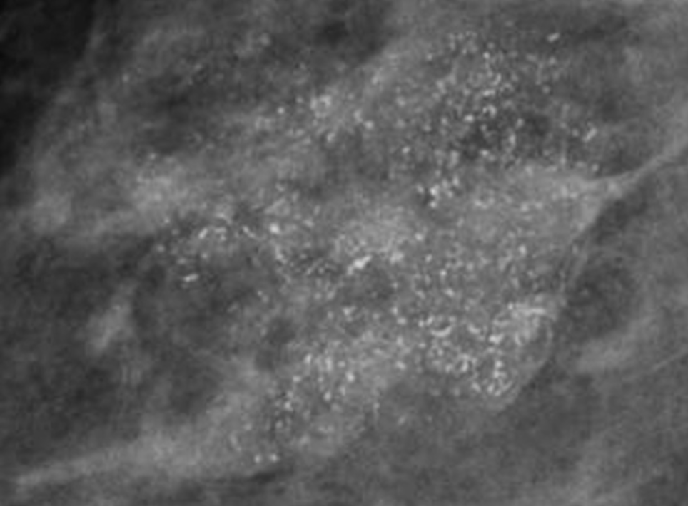
Noninvasive cancer:
Ductal carcinoma in situ (DCIS) is the most common form of non-invasive cancer, making up 3–4% of symptomatic and 17–25% of screen-detected cancers.
Screen-detected DCIS is most commonly associated with microcalcifications on mammography, which can be either localised or widespread.
01
Microcalcification
Lobular carcinoma in situ (LCIS) and atypical lobular hyperplasia (ALH) have been combined into a single diagnostic condition called lobular intraepithelial neoplasia (LIN).
It is usually an incidental finding and is treated by regular follow-up and US observation, as these women are at significant risk of developing invasive cancer in either breast.
02
Invasive cancer:
The majority of invasive cancers are of no special type and are often referred to as ductal cancers.
Certain invasive carcinomas show distinct patterns of growth and are classified as tumors of ‘special type’; this includes
lobular, tubular, cribriform, papillary, mucinous, medullary and inflammatory cancers.
The presence of tumour cells in lymphatics or blood vessels is associated with an increased risk of both local and systemic recurrence.
Breast cancers can be graded.
Grade I have the best prognosis.
Grade II have an intermediate prognosis.
Grade III or high-grade cancers have a poorer prognosis than Grade 1 or 2 cancers.
Invasive lobular
Invasive Tubular, cribriform, mucinous
Invasive Medullary
Invasive lobular cancer accounts for up to 10% of invasive cancers and is characterised by a diffuse pattern of spread that causes problems with clinical and mammographic detection.
These tumours are often large at diagnosis.
Tubular, cribriform and mucinous cancers are well differentiated and have a better than average prognosis.
Mucinous cancers are rare circumscribed tumors characterised by tumour cells that produce mucin; these also have a good prognosis.
Medullary cancers are circumscribed and soft, and consist of aggregates of high-grade pleomorphic cells surrounded by lymphoid cells, and this type of cancer is seen more often in BRCA1 carriers.

Slide 19
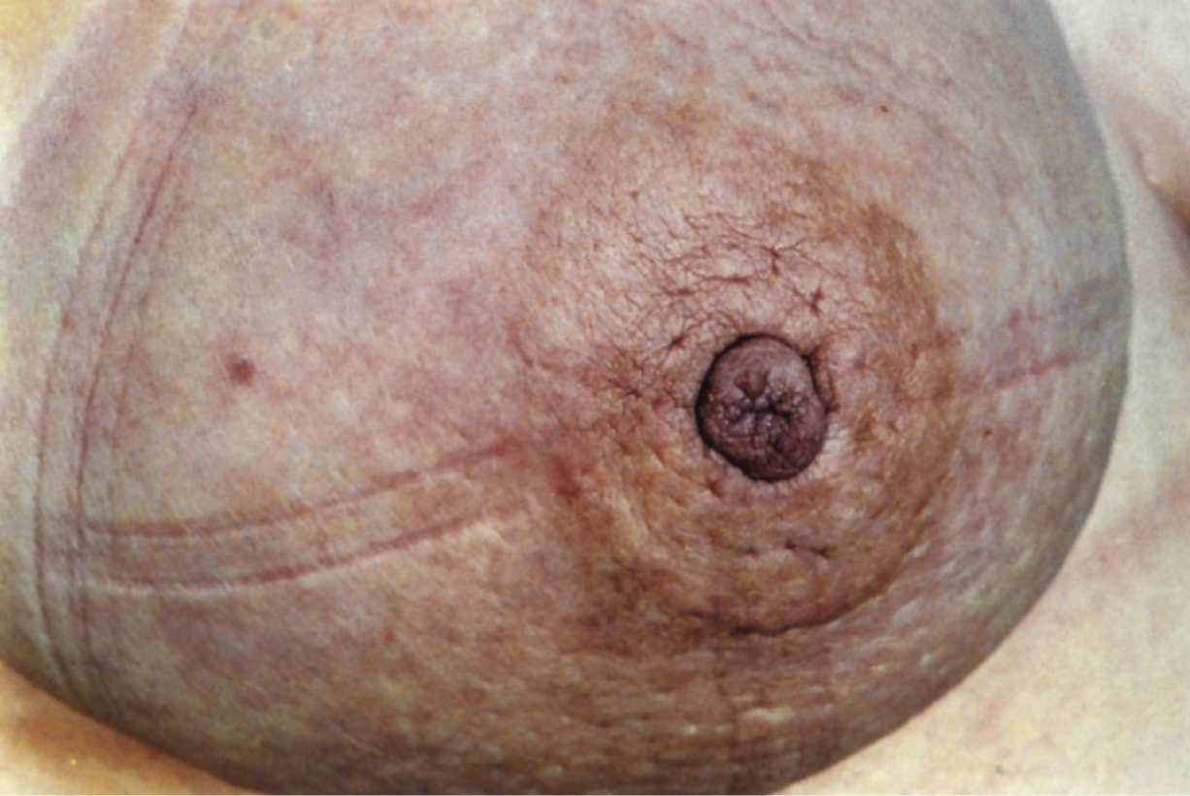
Inflammatory Breast Cancer:
Inflammatory breast cancer (IBC) is a specific type of invasive breast cancers that’s highly aggressive.
IBC often does not produce a lump that can be felt within the breast. Instead, it presents as a painful, swollen, tender, warm, breast with with widespread peau d’orange, due to edema from obstruction of dermal lymphatics by tumour cells.
It mimics infective mastitis or breast abscess.
Biopsy confirms the diagnosis.
Inflammatory carcinomas are uncommon but they’re fast-growing and have the worst prognosis of all invasive cancers.
It’s a rapidly fatal breast cancer that needs aggressive chemo-radiotherapy followed by surgery.
Take a Break

Slide 20
Treatment:
Operable Breast Cancer
All invasive and non-invasive cancer must be completely excised.
There are two accepted methods of local therapy for operable breast cancer:
1
Breast-conserving surgery:
Breast conserving surgery is done when there is no evidence of metastasis beyond the axillary nodes, and it includes wide local excision to clear histological margins.
Should be combined with sentinel node biopsy or axillary clearance. Sentinel lymph node biopsy has reduced the complications that were seen after axillary clearance such as lymphoedema (A long-term swelling of the arm after axillary surgery or radiotherapy to the axilla).
Wide excision should be followed by radiotherapy to reduce the local recurrence which is too high after treatment by local excision only.
The aim of this procedure is to remove the breast cancer completely in as small volume of breast tissue as possible with the best cosmetic outcome.
2
Mastectomy:
This is an alternative method for the local treatment of operable breast cancer.
Mastectomy includes the removal of all breast tissue (usually including the nipple) but leaves the muscles of the chest wall intact.
Should be combined with sentinel node biopsy or axillary clearance.
Indicated in the following situations:
Radiotherapy isn’t available.
The desire of the patient to avoid radiotherapy.
The desire of the patient to have mastectomy.
Incomplete excision after breast conserving surgery.
Large cancer (>4 cm) in comparison to the size of the breast.
Multifocal breast cancer.
Inflammatory breast cancer.
Localized invasive cancer with a large area of surrounding non-invasive disease.
Central breast cancer involving the nipple or directly underneath it.
Pregnancy.
Women with high risk of local recurrence should get radiotherapy following mastectomy.
Risk factors for local recurrence after mastectomy include:
Involvement of axillary lymph node (>3 nodes).
Lymphatic invasion.
Vascular invasion.
01
Grade III cancer.
Tumor >5 cm (pathological measurement).
The tumor involves the pectoral fascia or pectoral muscle.
02

Slide 21
Treatment Cont.:
Adjuvant Systemic Therapy
The aim of adjuvant systemic therapy is to delay recurrence and prolong survival in a patient with micrometastatic disease.
Indications for adjuvant systemic therapy:
Lymph node-positive.
Higher risk node-negative women.
Women with hormone receptor-positive cancers.
1
Hormone Therapy:
Tamoxifen:
reduces the rate of recurrence, reduces the risk of tumors in the contralateral breast, preventative agent.
It’s effective in premenopausal and postmenopausal women.
Luteinizing hormone releasing hormone (LHRH) agonists (Goserelin):
induces a reversible ovarian suppression.
Only of benefit in premenopausal women with receptor-positive cancer.
Aromatase inhibitors (Letrozole, Anastrozole).
For postmenopausal women.
2
Chemotherapy:
Combination of chemotherapeutic drugs is more effective than a single drug.
Chemotherapy regimen include:
First generation chemotherapy (cyclophosphamide, methotrexate, 5-Fluorouracil-CMF).
Modern regimens (anthracycline, doxorubicin or epirubicin)
Newer agents (taxanes)
3
Anti-HER2 Therapy:
Monoclonal antibodies (trastuzumab - Herceptin).
Neoadjuvant Therapy
This’s when chemotherapy, hormonal, or biological therapy is given before surgery to shrink the tumor.
Must be preceded by core biopsy of the cancer and nodes (if involved).
Should be considered in patients with large or locally advanced tumors that would otherwise require a mastectomy who may become suitable for breast-conserving surgery or in patients with inoperable cancer that may become operable.

Slide 22
Treatment Cont.:
Breast Reconstruction:
Options include placement of an implant (silicon gel) at the time of mastectomy behind the pectoral muscle.
Other options are myocutaneous flaps, and the most commonly used is latissimus dorsi myocutaneous flap with or without an implant, and the rectus abdominis myocutaneous flap alone. These are used if the skin at the mastectomy site is poor (e.g. following radiotherapy).
 | Stage 1-2 | Stage 3 | Stage 4
Summary of management made by the doctor | Mastectomy or conservative breast surgery with radiation. Sentinel lymph node needs to be excised and assessed. | Neoadjuvant chemotherapy and surgical removal. | Chemotherapy and surgery and radiation and hormonal therapy (Tamoxifen).
Breast Self-Exam (Extra)
01
A breast self-examination involves checking your breasts for lumps or changes.
Many breast problems are first discovered by women themselves, often by chance.
02
The best time to examine your breasts is usually 1 week after your menstrual period starts, when your breasts are least likely to be swollen or tender.
03
Remove all your clothes above the waist. Lie down. Lying down spreads your breasts evenly over your chest and makes it easier to feel lumps or changes.
04
Use the pads of your three middle fingers—not your fingertips. Use the middle fingers of your left hand to check your right breast. Use the middle fingers of your right hand to check your left breast. Move your fingers slowly in small coin-sized circles.
You can use an up-and-down pattern or a spiral pattern or circular pattern.
Palpate
Circles
Up-and-down
Spiral

Slide 23
DDx
 | DDx
A painless lump | Carcinoma Cyst Fibroadenoma An area of fibroadenosis
A painful lump | An area of fibroadenosis Cyst Periductal mastitis Abscess (usually postpartum or lactational) Sometimes a carcinoma
Pain and tenderness but no lump | Cyclical breast pain Non-cyclical breast pain Very rarely, a carcinoma
Nipple discharge | Duct ectasia Intraductal papilloma Ductal carcinoma-in-situ Associated with a cyst
Changes in the nipple and/or areola | Duct ectasia Carcinoma Paget’s disease Eczema
Changes in breast size and shape | Pregnancy Carcinoma Benign hypertrophy Rare large tumours
Cases From the Doctor
01
lactating female with breast mass and pain < mastitis ( if signs of infection are present ) or milk cyst ( no signs of infection ).
02
Young female with cyclic breast pain, on PE you found a mass 2x2 in size < most likely fibroadenoma.

Slide 24
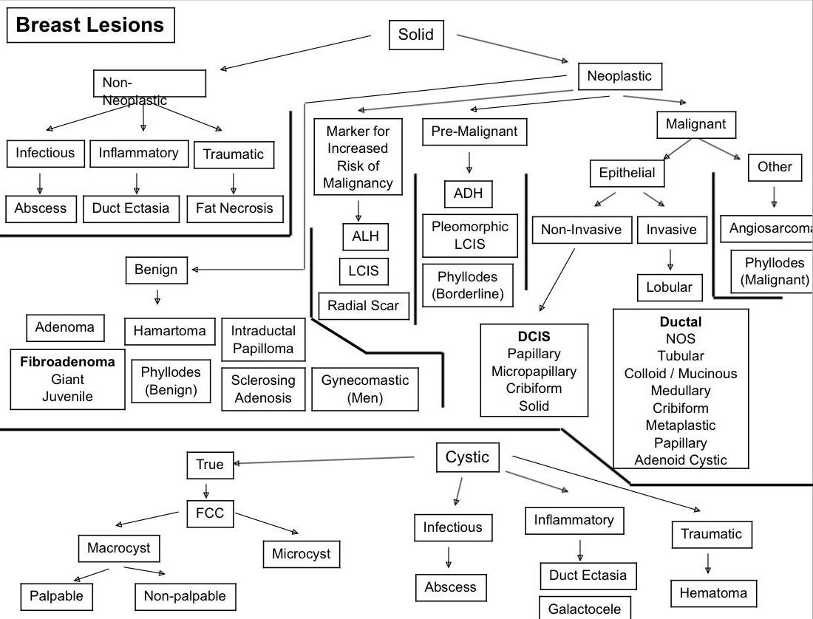
Summary From the Doctor
Recall
Q1: What option exists to decrease the risk of breast cancer in women
with BRCA?
Prophylactic bilateral mastectomy.
Q2: What is the “TRIAD OF ERROR” for misdiagnosed breast cancer?
Age <45 years
Self-diagnosed mass
Negative mammogram
Note: >75% of cases of MISDIAGNOSED breast cancer have these 3 characteristics.
Q3: Why does skin retraction occur?
Tumor involvement of Cooper’s ligaments and subsequent traction on ligaments
pull skin inward.
Q4: What is the most common type of breast cancer?
Infiltrating ductal carcinoma.
Q5: What is the differential diagnosis?
Fibrocystic disease of the breast
Fibroadenoma
Intraductal papilloma
Duct ectasia
Fat necrosis
Abscess
Radial scar
Simple cyst
Q6: What follows a positive sentinel node biopsy?
Removal of the rest of the axillary LNs.
Q7: Is the fluid from a breast cyst sent for cytology?
Not routinely. However, bloody fluid should be sent for cytology.

Slide 25
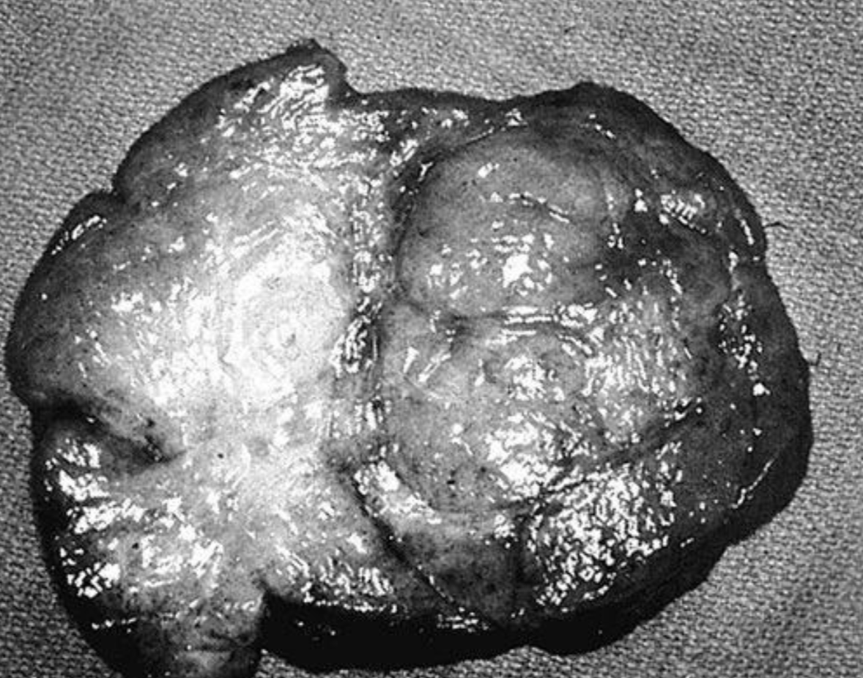
Quiz
MCQ
Q1: Which of the following conditions have an increased risk of breast carcinoma?
A) Atypical ductal or lobular hyperplasia
B) Fibroadenoma
C) Duct ectasia
Q2: A 29-year-old woman presents with a 6-month history of erythema and edema of the right breast with palpable axillary lymphadenopathy. A punch biopsy of the skin reveals neoplastic cells in the dermal lymphatics. Which of the following is the best next step in her management?
A) Mastectomy followed by adjuvant chemotherapy.
B) Mastectomy followed by hormonal therapy.
C) Combined modality therapy with chemotherapy, surgery, and radiation.
Q3: A 35-year-old woman presents with a lump in the left breast. Her family history is negative for breast cancer. On examination the mass is rubbery, mobile, and nontender to palpation. There are no overlying skin changes and the axilla is negative for lymphadenopathy. An ultrasound demonstrates a simple 1-cm cyst in the area of the palpable mass in the left breast. Which of the following represents the most appropriate management of this patient?
A) Reassurance and reexamination.
B) Mammography and reevaluation of options with new information.
C) Immediate excisional biopsy.
Q4: A 14-year-old black girl has her right breast removed because of a large mass.
The tumor weighs 1400 g and has a bulging, very firm, lobulated surface with a whorl-like pattern,
as illustrated here. Which of the following is the most likely diagnosis?
A) Intraductal carcinoma
B) Fibroadenoma
C) Cystosarcoma phyllodes
Q5: A 33-year-old pregnant woman notices a persistent, painless lump in the left breast. On examination the left breast has a single mobile mass without evidence of skin changes or lymphadenopathy in the neck or axilla. An ultrasound demonstrates a solid, 1-cm mass in the upper outer quadrant of the breast. A core-needle biopsy shows invasive ductal carcinoma. The patient is in her first trimester of pregnancy. Which of the following is the most appropriate management of this patient?
A) Administration of radiation in the third trimester followed by modified radical mastectomy after delivery of the baby.
B) Mastectomy
C) Immediate administration of chemotherapy followed by modified radical mastectomy after delivery of the baby.
Q6: A 33-year-old, non-smoking, breastfeeding woman is 10 days postpartum. She has a 4-day history of a slight crack on the surface of her left nipple. She presents with a 2-day history of severe continuous pain in the left breast, spiking pyrexia up to 38.8 with rigours which has prevented her from sleeping. On examination, you find the outer quadrants of the left breast to be red, warm and tender with a hard 3 cm lump at the edge of the left nipple. The most likely diagnosis is
A) Periductal mastitis
B) Breast cyst
C) Breast abscess
Answers
Click here for explanation
Q1 | A | Q4 | B
Q2 | C | Q5 | B
Q3 | A | Q6 | C
Extra Questions

Slide 26
Good Luck!
Team leaders:
Nouf Alshammari
Haneen Somily
Naif Alsulais
Mohammed alshoieer
This lecture was done by:
Nouf Alshammari
Noura Alturki
Ateen Almutairi
Razan AlRabah
Jude Alkhalifah
Hamdan Aldossari
Nujud Alabdullatif
Noura Abdulaziz
Nouf Alshammari
Abdulaziz Alghamdi
Feedback
Note taker
Reviewer

