Slide 1
Gastric outlet, small and large bowel obstruction
Objectives
The student is expected to describe and explain the pathogenesis, etiology, clinical features and complications of each of the following conditions:
Mechanical
Non-mechanical
Adhesive
Non-adhesive
Gastric outlet obstruction
Colour Index
Main Text
Males slides
Females slides
Doctor notes
Textbook
Important
Golden notes
Extra
Editing File

Slide 2
Intestinal obstruction
Defined as mechanical or functional obstruction of intestine by causes in the lumen/ wall/ outside wall resulting in stoppage in anal ward movement of bowel content, proximal dilation and distal collapse and associated with complex of symptoms and signs
One of the common cause of acute abdomen
May lead to high morbidity and mortality if not treated correctly
Classification:
Peristalsis is working against a mechanical obstruction
(partial or complete)
Mechanical element is absent, peristalsis may be absent (paralytic ileus) or present in non propulsive form (mesenteric vascular occlusion or pseudo-obstruction)
Localized: when there is appendicitis obstructing only part of intestine
Generalized: generalized peritonitis and after any abdominal surgery there is physiological ileus for two days
Mechanical (dynamic)
Non-mechanical
(adynamic)
Clinical picture:
Cardinal symptoms of bowel obstruction are abdominal pain, vomiting, Distention and constipation
As we move distally; abdominal pain↓ vomiting↓ distention↑ constipation↑
Vary according to location, duration, underlying pathology and intestinal ischemia
The clinical presentation of mechanical bowel obstruction reflects the anatomical location of the lesion.
The predominating features from proximal to distal are as follows:
Proximal
short history of colicky midgut (periumbilical pain, distension, vomiting and recent absolute constipation)
very short history of anorexia, vomiting
relatively severe upper abdominal pain
absent/minimal abdominal distention
limited if any changes in bowel
Profound vomiting!
Distal
Colonic
more insidiously with poorly defined hindgut abdominal pain/discomfort
weight loss, pronounced abdominal distension
history of altered bowel habit tending to constipation with little or no vomiting

Slide 3
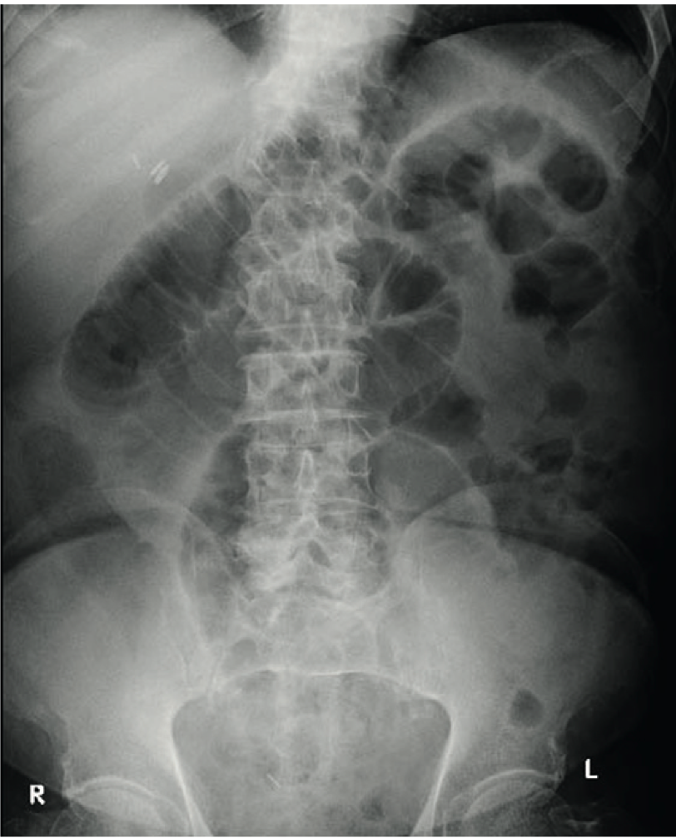
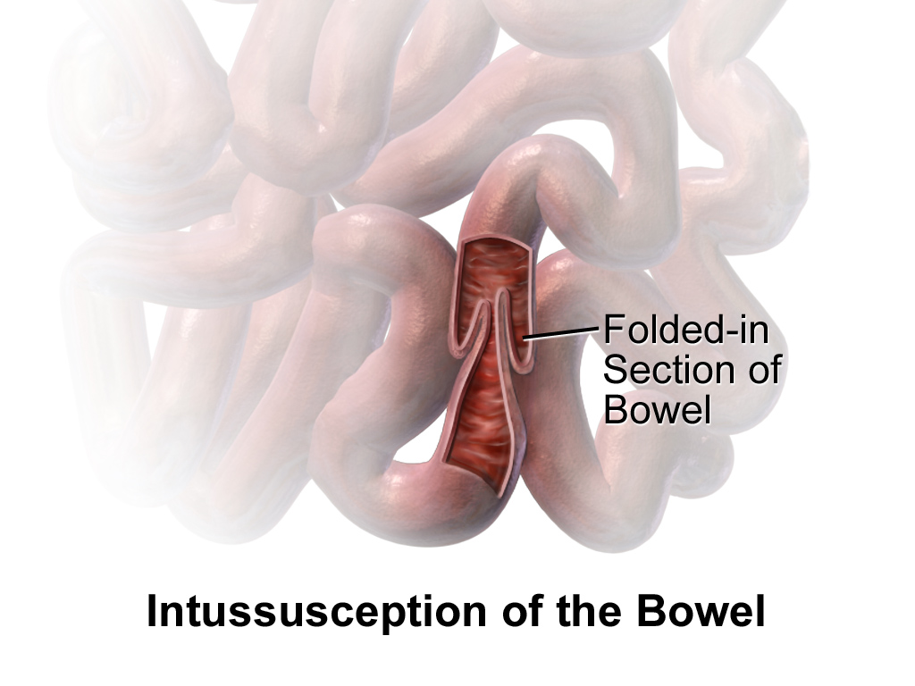
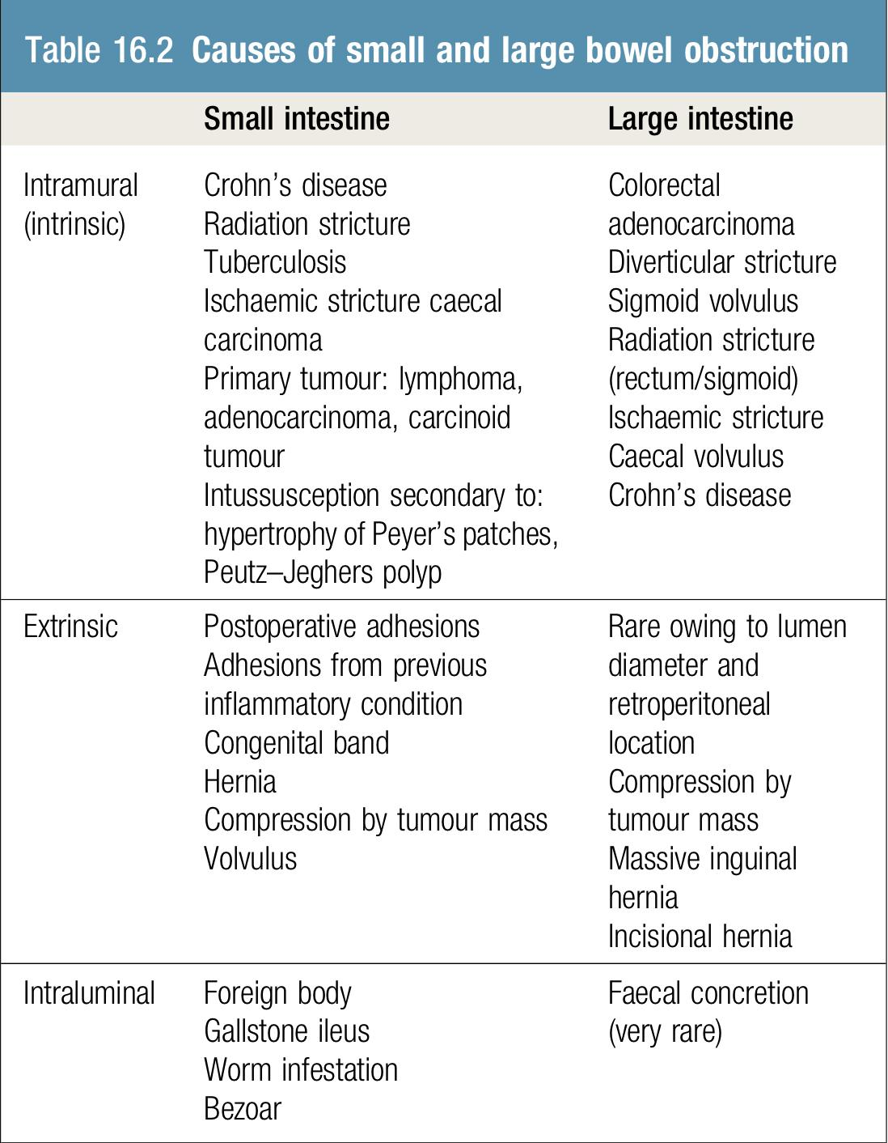
Mechanical obstruction
Classification:
Small bowel obstruction (SB0):
High --> vomiting occurs early, profuse and causes rapid dehydration. Distension is minimal with little evidence of dilated small bowel loops on abdominal radiography
low --> predominant pain, and central distention. Vomiting is delayed, multiple central air-fluid levels seen on abdominal x-rays (dilated small bowel loops) (pic A)
Large bowel obstruction (LB0):
Early pronounced distension, mild pain and vomiting, dehydration late
e.g. carcinoma, diverticulitis or volvulus. An emergency, take to OR!
Site
A
Intraluminal:
impacted faeces, foreign bodies, gallstones, Bezoars: solid mass of indigestible material “hair or food” that accumulates
Intramural:
tumors, inflammatory strictures
Extramural:
adhesion, hernias, tumors, volvulus: twisting or axial rotation of a portion of bowel about its mesentery, intussusception: when one portion of the gut invaginates into an immediately adjacent segment.
Location
Open loop obstruction (simple linear obstruction):
when there is one point of obstruction in intestine it is less severe in symptoms & signs (without interfering with vascular supply)
Closed loop obstruction (rotational obstruction):
When there are two points of obstruction in intestines. Loop of intestine between these two points is isolated from rest (more severe) and more likely to strangulate and perforate and manade early surgical intervention. may present in those who have competent ileocecal valve (present in 15% of population)
Strangulation (surgical emergency):
Significant impairment of blood supply. Most commonly associated with hernia, volvulus, intussusception, mesenteric infarction, adhesions/Bands
Nature
Etiology:
Doctor said Percentages aren’t important, just know the two most common
Small intestine
Large intestine
Miscellaneous 8%
Intraluminal 10%
sigmoid volvulus 5%
Adhesions 40%
(MOST COMMON)
Obstructed hernia 12%
Adhesion can be congenital but mostly post-op
Colorectal adenocarcinoma 70%
(MOST COMMON)
Inflammatory 15%
stricturing diverticular disease 10%
Tumors 15%
Percentages from davidson:
intestinal obstruction are adhesions (60%)
obstructed hernia (20%)
malignancy (primary or secondary; 5–8%)
Diverticulosis if it happened it will cause large abscess that will cause bowel obstruction

Slide 4
Pathophysiology:
Initially the small bowel proximal to an obstruction contracts vigorously to overcome the mechanical impedance (This why exaggerated bowel sound at the beginning)
Distal to obstruction nothing is passed & bowel collapse > constipation
01
03
The distension is caused by three factors:
Solids: the food we eat
Fluids: this is made up of the various digestive juices 1 litre per day (saliva, bile, pancreatic and gastric secretions)
Gas: there is a significant overgrowth of both aerobic and anaerobic organisms, resulting in considerable gas production
Dehydration caused by:
Reduced oral intake
Defective intestinal absorption
Losses as a result of vomiting
Sequestration in the bowel lumen
Transudation of fluid into the peritoneal cavity (third space loss)
Enforced fasting
04
02
Fecalization happens in small bowel where there is no stool usually (only chyme); microorganisms will grow in the stagnated chyme and converted to a stool like material then the wall of the intestine will be inflamed
Systemic effects of inflammation are hypovolemia, PH abnormality (acidosis) and sepsis
Reflex contraction of smooth muscle > colicky pain
Increased intraluminal pressure > Vomiting
Increased peristalsis > Increased bowel sounds
If obstruction not overcome > bowel atony
Complications:
Paralytic ileus
Perforation
Infection
If obstruction not overcome > peristalsis subsides and paralytic ileus (bowel atony) ensues due to electrolyte imbalance and gross distension proximal to the obstruction
Decreased reabsorption with time and flaccidity prevent vascular damage from high pressure
Distension > blood vessels will collapse due to the pressure > ischemia then perforation
Features that indicate imminent perforation, strangulation or established peritonitis from perforation are:
pyrexia, tachycardia, dehydration
hypotension, leukocytosis
peritonism on abdominal palpation and completely absent bowel sounds
The risk of perforation increases as the cecal diameter exceeds 12 cm, so take immediately to the OR.
If the situation continues without decompression and resolution, there is progressive bacterial translocation into the portal circulation then septicemia
perforation may progress to peritonitis

Slide 5
History:
Full clinical history and examination is essential, along with immediate initiation of intravenous fluid and electrolyte therapy.
The diagnosis of Mechanical obstruction depends mainly on the cardinal symptoms and signs, The nature of the presentation will also be influenced by the type of obstruction (small bowel/ large bowel) and degree¹ (complete/ incomplete). The symptoms:
Abdominal pain
Early in proximal obstruction, late when distal
Constipation
the distension greater the more distal the lesion.
Bowel sounds may be scanty or absent if the obstruction is longstanding and the small bowel has become inactive
Dehydration
first encountered symptoms, colicky severe around umbilicus (small bowel) or lower abdomen (large bowel)
absolute² (i.e. neither faeces nor flatus is passed) or relative (where only flatus is passed)
most commonly in small bowel obstruction because of repeated vomiting and fluid sequestration
Vomiting
Abdominal distension
Bowel sounds
Symptoms In strangulation (EMERGENCY):
Severe constant abdominal pain
Fever indicate ischaemia, perforation and inflammation
Marked leukocytosis
tachycardia
shock
tenderness with rigidity and peritonism/rebound tenderness
Examination:
In general examination check vital sign and signs of dehydration, tachycardia, hypotension, dry mucus membrane, decreased skin turgor, decreased urine output.
Any patient with bowel obstruction; you MUST do Digital rectal & Hernial orifices exam
Inspection
distension, scars, peristalsis, masses, hernial orifices
Percussion
tympanitic abdomen
Examine rectum for mass, blood, feces or it may be empty in case of complete obstruction. Hernial orifices must be carefully inspected and any previous surgical abdominal scars noted.
Right iliac fossa tenderness along with radiological evidence of gross cecal distension in the presence of distal colonic obstruction is a critical sign as it indicates imminent caecal perforation, which is a frequent complication of distal colonic obstruction. think of competent ileocecal valve
Palpation
tenderness³, rebound tenderness⁴, guarding⁵, masses and rigidity
Auscultation
high pitched bowel sound or silent abdomen, Early tinkling bowel sounds, absent bowel sounds lately
The reason that the caecum perforates even with obstruction due to sigmoid cancer is because the caecum is anatomically the largest diameter segment in the gut. Thus tension is greatest in the caecal wall, despite equalized intra-luminal pressure along the colon.
complete: has all the cardinal features, food and gas can’t pass (no air in rectum). Incomplete: food and gas will be able to pass (air in rectum)
Absolute constipation (Obstipation: failure to pass stool & gas) is a cardinal feature of complete intestinal obstruction. Some patients may pass flatus or faeces after the onset of obstruction as a result of the evacuation of the distal bowel contents. The administration of enemas should be avoided in cases of suspected obstruction. This merely stimulates evacuation of bowel contents distal to the obstruction and confuses the clinical picture.
Pain when you press means there is inflammation in an organ
When you press the abdomen and suddenly release your hand, patient will feel severe pain. That means there is inflammation in the abdominal wall
Contraction of muscles of the abdominal wall whenever there’s an inflammation in the abdomen so you feel the abdomen hard and tense

Slide 6
Investigation:
In patients without evidence of strangulation there is a role for other imaging modalities¹
Plain X-ray² best initial, in upright and supine position reveal distended small bowel (pic A) or large bowel loops (pic B ) Grossly distended bowel loops or evidence of a closed loop obstruction also merit early surgical intervention
CT abdomen³ most accurate used to determine the cause and assess bowel obstruction, because it allows interpretation of the likely need for surgery.
A
B
1
Contrast enema. Contrast study are used to assess the level and the degree of obstruction. water-soluble enema used to differentiate large bowel obstruction from pseudo-obstruction. contraindicated when complete obstruction is suspected. Has a therapeutic role
Contrast follow through. study of choice when investigating possible malrotation and contraindicated in the presence of acute obstruction and may be life-threatening.
Contrast study Indicated in patient who failed to resolve: Passed contrast → continue conservative management, Delayed passages → OR
2
3
CBC, High WBC (neutrophilia with strangulation)
Hyperkalemia: due to the release of intracellular K+ from ischemic cells into the circulation, hyperamylasemia & raised LDH may be associated with strangulation
Sigmoidoscopy (only in carcinoma, volvulus)
Management:
There should be frequent clinical assessments and monitoring ins and outs
Some cases will settle by using this conservative regimen, other need surgical intervention
01
02
03
04
Fluid and electrolyte replacement
NG (nasogastric) tube decompression
NPO (nothing per mouth) + Foley catheter⁴
IV antibiotics and administration of Analgesics⁵
with Normal saline and K (low Cl and K, metabolic alkalosis)
Surgery should be delayed till resuscitation is complete unless signs of strangulation and evidence of closed-loop obstruction and large bowel obstruction
procedure: exploratory laparotomy
"The sun should not both rise and set" in cases of unrelieved obstruction.
Indication for surgery:
Virgin abdomen (No previous surgery)
Failure of conservative management
Tender, irreducible hernia
Strangulation or perforation
Complete or losed-loop obstruction obstruction
Cases that show reasons for delay should be monitored continuously for 72 hours in hope of spontaneous resolution e.g. adhesions with radiological findings but no pain or tenderness
even with the best imaging techniques, the diagnosis of strangulation remains a clinical one
A chest x-ray should be obtained to screen for air under the diaphragm indicates perforation and mandates laparotomy
You can see the transition zone = distended bowel followed by collapsed bowel. It will show you “Pneumatosis intestinalis “ air in the intestinal wall. It’s a feature of ischemia. And it can show poor blood supply
to monitor the urine output to assess dehydration
mandatory for all patients undergoing surgery for intestinal obstruction.

Slide 7
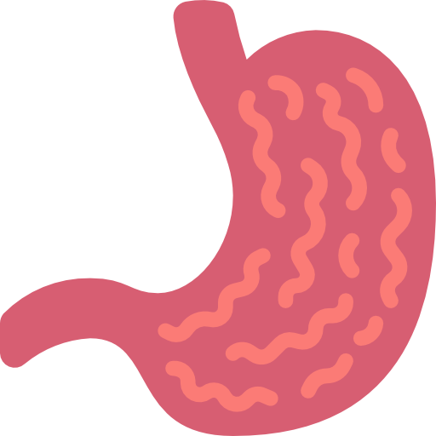
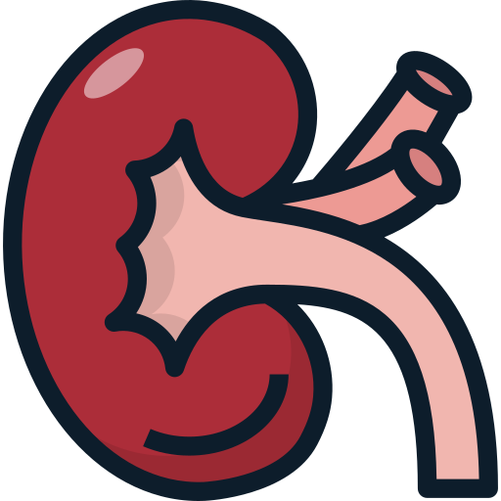
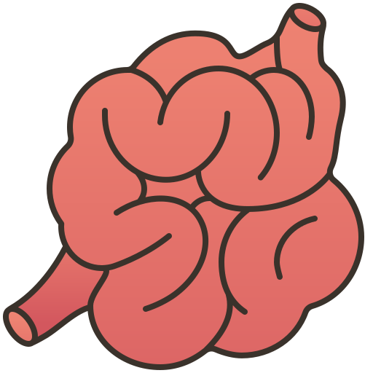
Non-Mechanical obstruction
Mechanical element is absent, peristalsis may be absent (paralytic ileus) and present in non propulsive form (mesenteric vascular occlusion or pseudo-obstruction)
Paralytic ileus:
The term refers to lack of propulsive contractions or absent peristaltic movement of both jejunum and ileum due to neuromuscular failure (i.e. submucous "Meissner's" and myenteric "Auerbach's" plexuses), although the ileus can be localized in some instances. It is common as a secondary feature of peritonitis due to any cause or sequela of the end stage of mechanical obstruction.
Etiology:
Abdominal surgery
after any surgical procedure due to handling of the bowel
Peritonitis
Advanced mechanical bowel obstruction
Gastroenteritis
Renal & lung disease
Bowel ischemia
Electrolyte imbalance
such as hypokalaemia (when we put patient on NPO potassium decreases), hyponatraemia, uraemia, diabetic ketoacidosis
Drugs
such as tricyclic antidepressant; lithium therapy, excessive opiate use and Narcotic analgesics
Pathophysiology:
Stressful stimuli to the bowel (e.g., surgery, peritonitis) → sympathetic nervous system activation → decreased/arrested peristalsis
Inflammation or intraoperative manipulation → local release of nitric oxide → relaxation of intestinal smooth muscles → decreased/arrested peristalsis
Decreased/arrested peristalsis → bowel wall distention → progresses to paralytic ileus as detailed in mechanical bowel obstruction.

Slide 8
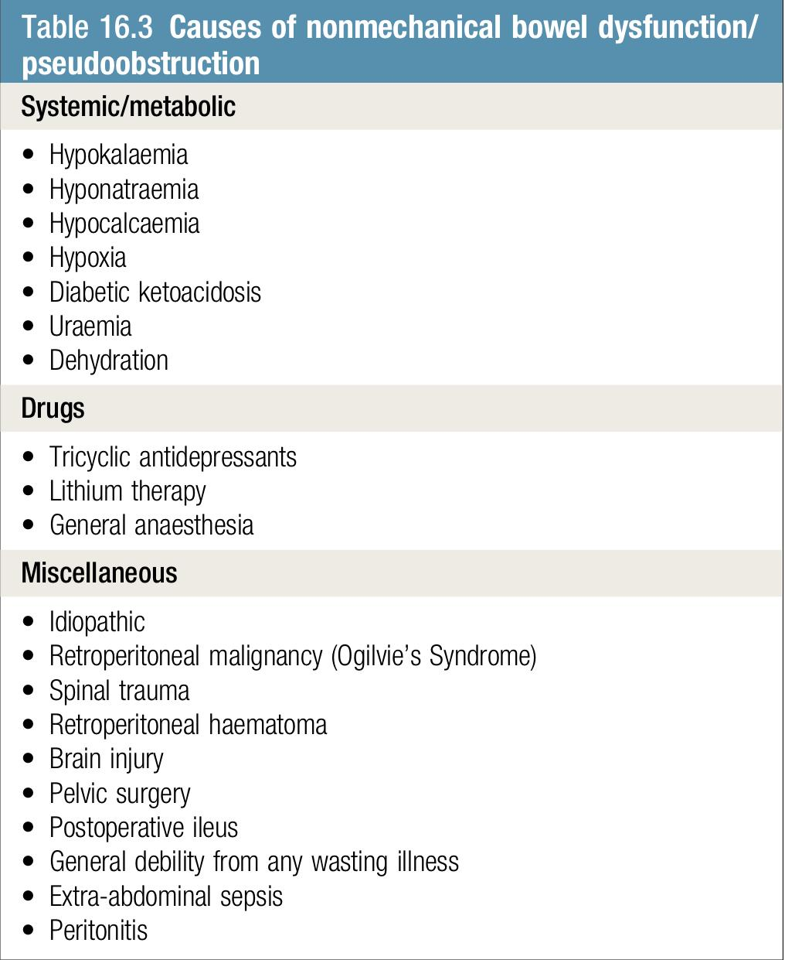
Clinical features:
Paralytic ileus is clinically significant if it prolonged more than 72 hours after abdominal surgery:
No passage of flatus
Colicky abdominal pain is not a feature
1
5
No return sounds on auscultation
Increased pain in the abdominal wound due to abdominal distension
2
Effortless vomiting may occur in the absence of gastric aspiration
6
3
Tympanic and marked abdominal distension and bowel sounds are usually absent on auscultation
Abdominal x-ray shows gas-filled loops of small and large intestine down to the rectum with multiple air-fluid levels (erect film)
4
7
Management:
Treatment is focused on the cause and conservative management with:
01
02
03
04
bowel rest (NPO)
nasogastric aspiration
fluid and electrolyte support
treat underlying cause
Pseudoobstruction:
The underlying mechanism of pseudoobstruction is not fully understood
Autonomic imbalance resulting from decreased parasympathetic tone or excessive sympathetic output. The majority of cases are due to large bowel dysfunction.
Stimulant enemas
Colonoscopic deflation: in cases where cecal distension causes perforation
IV erythromycin: shown to stimulate motility by binding to colonic motilin receptors.
IV neostigmine: when other measures fail
In a small minority of cases colectomy with ileorectal anastomosis, or with ileostomy
Blood electrolyte analysis is essential
imaging to exclude mechanical obstruction
Diagnosis
Management

Slide 9
Adhesive obstruction
Most common cause of mechanical obstruction.
It start after surgery in hour, difficult to distinguish from paralytic ileus.
Causes:
Any irritation to the peritoneum. May cause local production of fibrin which result in adhesions
1
Postoperative
4
Infection (peritonitis, TB)
Acute inflammation
Chronic inflammatory disease (crohn disease)
2
5
3
Foreign bodies (mesh, gauze, sutures)
6
Radiation enteritis
Management:
The initial treatment is based on intravenous fluid rehydration, electrolytes replacement, and nasogastric decompression.
this conservative treatment is successful and curative
regular clinical evaluation is necessary and the surgical intervention indicated in:
Failure of conservative treatment > 72 hours
‏Free intraperitoneal gas in the abdominal imaging
Laparoscopic adhesiolysis
‏Evidence of strangulation or peritonitis
‏‏Complete intestinal obstruction in the abdominal imaging

Slide 10
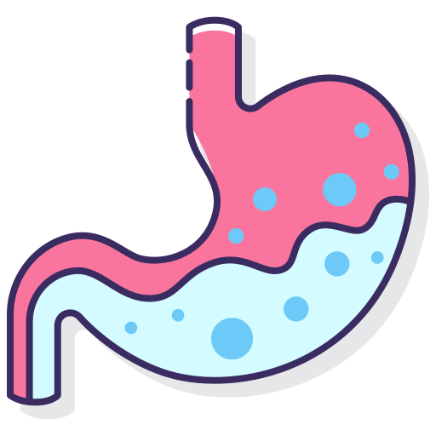
Gastric outlet obstruction
GOO is the clinical and pathophysiological consequences of any impediment to gastric emptying mechanism due to gastric, duodenal or extraluminal disease
Classified to benign or malignant causes
The two common causes of gastric outlet obstruction are gastric cancer and pyloric stenosis secondary to peptic ulceration.
Etiology:
PUD (peptic ulcer disease)
Cancers (gastric, duodenal, ampullary, pancreatic, cholangiocarcinoma)
Gastric, duodenal polyps
Caustic ingestion
Pyloric stenosis (in newborns diagnosed with US)
Congenital duodenal webs
Metastasis
Gallstone (Bouveret syndrom): a gastric outlet obstruction secondary to an acquired fistula between the gallbladder and stomach or in duodenum, in duodenum called “gallstones ileus”
Bezoars: solid mass of indigestible material “hair or food” that accumulates
Pancreatic pseudocysts
SMA (Superior mesenteric artery) syndrom: acute angulation of the SMA causes compression of the third part of the duodenum between the SMA and the aorta In people who lost a significant amount of weight the mesentery of SMA will press over the duodenum
Diagnosis:
with the decrease in the incidence of peptic ulceration and the advent of potent medical treatments, gastric outlet obstruction should be considered malignant until proven otherwise
Symptoms
Signs
Abdominal pain¹
Upper abdominal distension²
Chronically ill looking
Epigastric ,left or right hypochondrium tenderness
01
04
Nausea, vomiting (copious, projectile³, non bilious (no bile, bile duct joins the GI at the 2nd part of the duodenum) undigested food taken several hours to days ago
Visible gastric peristalsis
Succussion splash⁴ (splash sound indicating the presence of a hollow viscus filled with both fluid and gas)
02
05
Signs of gastric cancer (supraclavicular lymph node enlargement, sister mary joseph sign: palpable nodule bulging into the umbilicus as a result of metastasis of a malignant cancer in the pelvis or abdomen
Anorexia and early satiety
Dehydrated and Pallor
03
06
can be due to the Disease that caused the obstruction, not due to the distention itself
generalized distention happens if the obstruction was at a lower level of the GI tract
Projectile vomiting, it’s a classical finding in neonates with pyloric stenosis projectile means it’s so strong that it’s shooting off the patient's mouth لدرجة يضرب بالجدار
put the stethoscope on the stomach and place your right hand on the left side of the patient and try to shake the patient then you will hear the suction splash (صوت خض القربه)

Slide 11
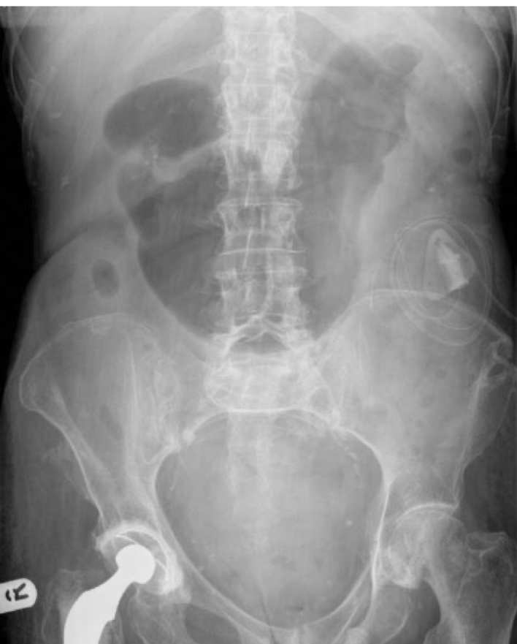
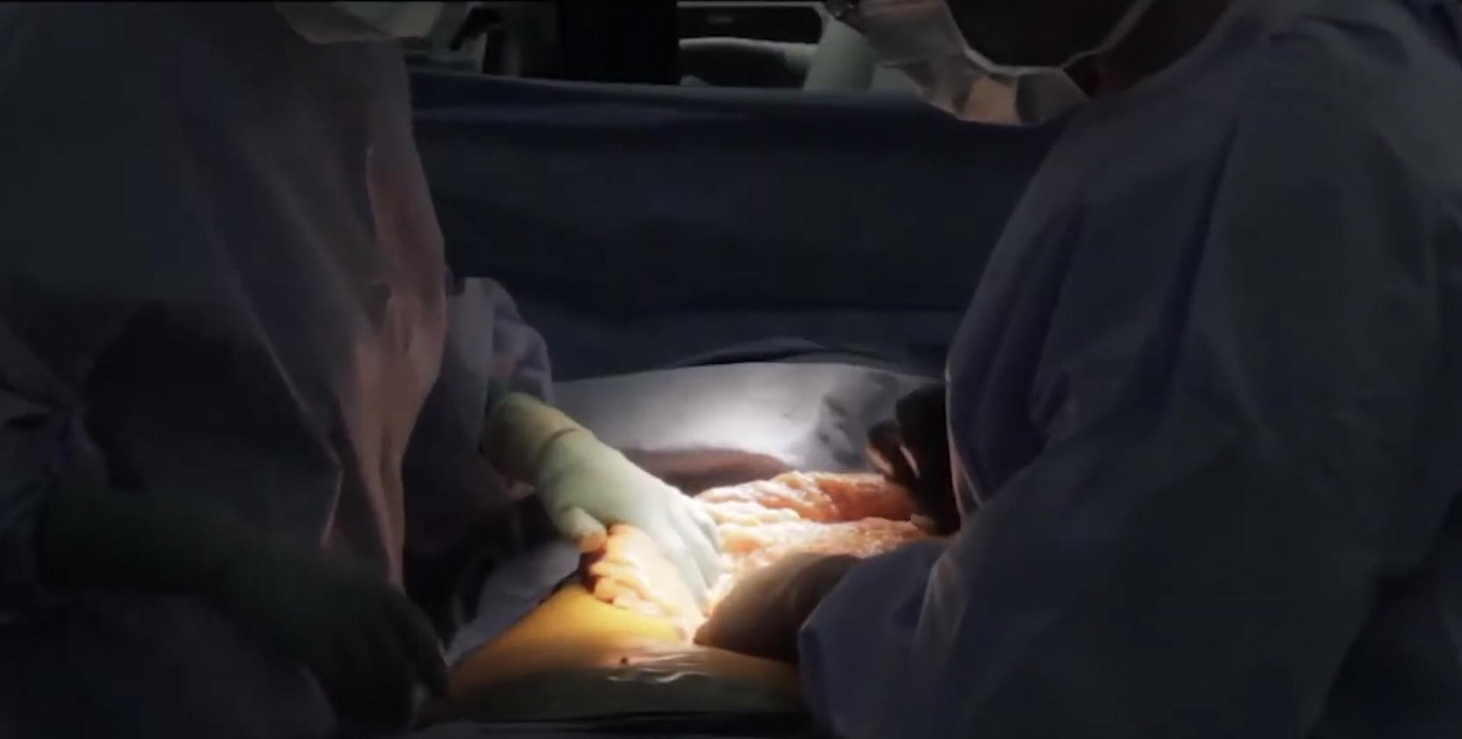
Investigation:
Blood work
AXR
Gastroscopy²
(CBC And other usual stuff and Electrolytes)
Stabilization¹ (acute vs chronic)
Barium meal
CT scan
gastric emptying studies
Apple core appearance = cancer, we can see peptic ulcer disease.
Management:
First Correct the electrolyte imbalance and give iron if they’re anemic and suck the gastric stuff. Then try to detect the cause.
01
adequate resuscitation
02
normalization of electrolyteand acid-base abnormalities
03
nasogastric suction and washout
04
A subsequent Oesophago-Gastro-Duodenoscopy is mandatory to rule out carcinoma of the stomach
If medical therapy failed surgical treatment will involve a gastrojejunostomy, performed by open or laparoscopic access
Click and enjoy watching how they do this amazing operation (anastomosis between stomach and jejunum)
ABC if the patient is severely unstable, and electrolyte correction because the patient usually will be hyponatremic, hypokalemic and having high levels of bicarb. The metabolic abnormality of hypochloremic alkalosis is usually only seen with peptic ulcer disease (less in malignancy) and should be treated with isotonic saline with potassium
Endoscopic biopsy is essential to determine whether the cause of the problem is malignancy. Usually useless as first line investigation because the stomach will be full of hard food that we can’t suck up so basically we won’t see anything, we should do Gastric Aspiration first where we place 2 large tubes while the patient is fasting and if it got fIlled with 400 cc of gastric content then this is diagnostic of obstruction. Then we will do a gastric lavage using large tubes. Then we can do the gastroscopy and diagnose.

Slide 12
Summary
The obstruction patient is gonna present in ER because it’s a surgical emergency
There are imp things to know about them like
the level of obstruction (gastric, small bowel, large bowel)
is it acute or chronic?
What is the cause of it?
What is the grade of obstruction? (complete, partial)
Etiology:
Clinical features:
first exclude strangulation, perforation and peritonitis symptoms. Then try to differentiate based on cardinal symptoms:
SBO
LBO
GOO
Paralytic ileus
Adhesions
Tumors
Inflammatory
Obstructed hernia
Intraluminal
Colorectal carcinoma
stricturing diverticular disease
Sigmoid volvulus
PUD
Cancers
Gastric, duodenal polyps
Pyloric stenosis
Gallstone
Bezoars
Pancreatic pseudocysts
SMA
Abdominal surgery
Peritonitis
Advanced mechanical bowel obstruction
Gastroenteritis
Drugs
Electrolyte imbalance
Renal & lung disease
Bowel ischemia
 | SBO | LBO | GOO | Paralytic ileus
Pain | Colicky, periumbilical | Colicky or constant | Epigastric pain | Continuous (noncolicky) abdominal pain or discomfort
Vomiting/ nausea | Early-onset Large volume Bilious | Late-onset Little vomiting Initially bilious Progresses to fecal vomiting | Postprandial, nonbilious projectile vomiting | Effortless vomiting
Constipation | Late-onset | Early-onset Pronounced | - | -
Distention | Minimal or absent | Early Pronounced | Upper abdominal distention | Marked
Other | Dehydration. Tympanic percussion. Increased high-pitched, tinkling bowel sounds (early) or absent bowel sounds (late) Generalized tenderness Collapsed, empty rectum on digital rectal examination |  | Dehydration Early satiety Alkalosis Epigastric ,left or right hypochondrium tenderness Succussion splash sister mary joseph sign | Tympanic percussion Bowel sounds usually absent No tenderness unless there is peritonitis

Slide 13
Summary
Investigation:
In the workup of suspected mechanical bowel obstruction, imaging allows for quick confirmation of the diagnosis as well as detection of conditions requiring immediate surgery (e.g., perforation). Laboratory tests may further help to assess the severity of the condition (e.g., electrolyte imbalance due to vomiting).
Imaging
erect and supine abdominal x-rays (best initial):
SBO → central dilated loops
LBO → peripheral dilated loops
GOO → enlarged stomach
paralytic ileus → Generalized small and large bowel gaseous distention
erect chest x-ray: air under the diaphragm indicates perforation
Abdominal CT: most accurate determine the cause and assess the bowel
mechanical obstruction → transition point
paralytic ileus → only to rule out suspected mechanical bowel obstruction
Contrast study: has a therapeutic role
water-soluble enema → differentiate large bowel obstruction from pseudo-obstruction
barium meal → apple core appearance in GOO
to follow up conservative treatment if not passed take to OR
Laboratory
Blood work and electrolyte:
vomiting → Hypochloremic hypokalemic metabolic alkalosis and Hyponatremia
strangulation → neutrophilia, hyperkalemia, hyperamylasemia & raised LDH
Endoscopy
Sigmoidoscopy → in carcinoma, volvulus
gastroscopy → to determine pathology in GOO
Management:
Management in general is conservative by Fluid resuscitation, correction of electrolyte imbalance, Intestinal decompression( nasogastric tube), Bowel rest (NPO) and Administration of IV analgesics and antiemetics if needed. Procedure:
 | Mechanical | Adhesive | GOO | Pseudoobstruction
Procedure | exploratory laparotomy | Laparoscopic adhesiolysis | gastrojejunostomy | colectomy
Indication | Virgin abdomen (No previous surgery) Failure of conservative management Tender, irreducible hernia Strangulation or perforation Complete or closed-loop obstruction obstruction | Failure of conservative treatment > 72 hours Evidence of strangulation or peritonitis Free intraperitoneal gas in the abdominal imaging Complete intestinal obstruction in the abdominal imaging | If medical therapy failed | Failure of conservative treatment which is: Stimulant enemas Colonoscopic deflation IV erythromycin IV neostigmine

Slide 14
Summary
Recall
Q1: What is small bowel obstruction (SBO)?
Answer: Mechanical obstruction to the passage of intraluminal contents
Q2: What are the signs/symptoms?
Answer: Abdominal discomfort, cramping, nausea, abdominal distention, emesis, high- pitched bowel sounds
Q3: What lab tests are performed with SBO?
Answer: Electrolytes, CBC, type and screen, urinalysis
Q4: What are classic electrolyte/acid–base findings with proximal obstruction?
Answer: Hypovolemic, hypochloremic, hypokalemia, alkalosis
Q5: What must be ruled out on physical exam in patients with SBO?
Answer: Incarcerated hernia (also look for surgical scars)
Q6: What major AXR findings are associated with SBO?
Answer: Distended loops of small bowel air-fluid levels on upright film
Q7: Define complete SBO.
Answer: Complete obstruction of the lumen
Q8: What is the danger of complete SBO?
Answer: Closed loop strangulation of the bowel leading to bowel necrosis
Q9: Define partial SBO.
Answer: Incomplete SBO
Q10: What is initial management of all patients with SBO?
Answer: NPO, NGT, IVF, Foley
Q11: What tests can differentiate partial from complete bowel obstruction?
Answer: CT scan with oral contrast
Q12: What are the ABCs of SBO?
Answer: Causes of SBO:
1. Adhesions
2. Bulge(hernias)
3. Cancer And Tumors
Q13: What is the treatment of complete SBO?
Answer: Laparotomy and lysis of adhesions
Q14: Intraoperatively, how can the level of obstruction be determined in patients with SBO?
Answer: Transition from dilated bowel proximal to the decompressed bowel distal to the obstruction
Q15: What is the most common indication for abdominal surgery in patients with Crohn’s disease?
Answer: SBO due to strictures
Q16: Can a patient have complete SBO and bowel movements and flatus?
Answer: Yes; the bowel distal to the obstruction can clear out gas and stool
Q17: What may cause SBO if patient is on Coumadin®?
Answer: Bowel wall hematoma
Q18: What is an absolute indication for operation with partial SBO?
Answer: Peritoneal signs, free air on AXR
Q19: What tumor classically causes SBO due to “mesenteric fibrosis”?
Answer: Carcinoid tumor

Slide 15
Quiz
MCQ
Q1: A 54-year-old man comes to the emergency department because of a 2-day history of increasingly severe abdominal pain, nausea, and bilious vomiting. His last bowel movement was yesterday and he has not passed flatus since then. He takes a topical corticosteroid, ramipril, metformin, and ibuprofen daily. Abdominal examination shows three well-healed laparoscopic scars. The abdomen is distended and there are frequent, high-pitched bowel sounds on auscultation. Which of the following is the most likely cause of this patient's condition
A) Ibuprofen
B) paralytic ileus
C) History of abdominal surgery
Q2: A 63-year-old man comes to the emergency department because of a 2-day history of persistent vomiting after meals. The vomit consists of undigested food and a clear fluid. Abdominal examination shows epigastric fullness with mild tenderness. Which of the following is most likely to confirm the diagnosis?
A) Upper endoscopy
B) AXR
C) Esophageal manometry
Q3: Four days after undergoing a total abdominal hysterectomy for atypical endometrial hyperplasia, a 59 year-old woman reports abdominal bloating and discomfort. She has also had nausea without vomiting. Her postoperative pain has been well controlled on a hydromorphone patient-controlled analgesia (PCA) pump. Examination shows a mildly distended, tympanic abdomen; bowel sounds are absent. An x-ray of the abdomen shows uniform distribution of gas in the small bowel, colon, and rectum without air-fluid levels. Which of the following is the most appropriate next step in the management of this patient?
A) Reduce use of opioid therapy
B) Gastrografin enema
C) Return to OR for bowel resection
Q4: A 63-year-old man is brought to the emergency department for evaluation of abdominal pain. The pain started four days ago and is now a diffuse crampy pain. The patient has nausea and has vomited twice today. He has a history of hypertension and recurrent constipation. Five years ago, he underwent emergency laparotomy for a perforated duodenal ulcer. His father died of colorectal cancer at the age of 65 years. The patient has been smoking one pack of cigarettes daily for the past 40 years. Abdominal examination shows distention and mild tenderness to palpation. There is no guarding or rebound tenderness. The bowel sounds are high-pitched. In addition to fluid resuscitation, which of the following is the most appropriate next step in the management of this patient?
A) Colonoscopy
B) Nasogastric tube placement and bowel rest
C) Surgical bowel decompression
Q1 | C
Q2 | A
Q3 | A
Answers
Click here for explanation
Q4 | B
Extra Questions

Slide 16
Good Luck!
Team leaders:
Nouf Alshammari
Haneen Somily
Naif Alsulais
Mohammed alshoieer
This lecture was done by:
Naif Alsulais
Razan AlRabah
Jude Alkhalifah
Abdullah alghamdi
Feedback
Note taker
Reviewer

