Slide 1
Generalized, Upper,
Central and Lower Abdominal Pain
Objectives
The student is expected to describe and explain the pathogenesis, etiology, and the clinical features of each of the following conditions:
Next page
Colour Index
Main Text
Males slides
Females slides
Doctor notes
Textbook
Important
Golden notes
Extra
Editing File

Slide 2
Generalized abdominal pain
Upper abdominal pain
Random stuff
Irritable bowel syndrome Recurrent adhesive bowel obstruction Mesenteric vascular ischemia Diffuse carcinomatosis Chronic constipation Radiation visceral damage Retroperitoneal neoplasms Diffuse endometriosis Lumbar spinal pain Extensive retroperitoneal fibrosis Psychosomatic
Acute | Chronic
Oesophagitis Boerhaave’s syndrome Acute gastritis Perforated peptic ulcer Acute cholecystitis Gallstone and biliary colic Acute pancreatitis | Chronic peptic ulceration Carcinoma of the stomach Chronic cholecystitis Chronic pancreatitis Liver metastases Splenomegaly
Central abdominal pain
Acute | Chronic
Meckel’s diverticulitis Acute gastroenteritis Inflammatory bowel disease Acute Crohn’s disease Acute ulcerative colitis Yersinia ileitis Typhoid Tuberculosis Urinary tract infection Ischaemia of the small bowel Acute appendicitis Crohn’s disease Carcinoma of the cecum and right colon Acute diverticular disease Carcinoma of the left colon/rectum Bladder outflow obstruction Interstitial/irradiation cystitis Pelvic inflammatory disease | Crohn’s disease Tuberculosis Radiation bowel damage Tumours of the small bowel Recurrent adhesive obstruction/malrotation Endometriosis Chronic appendicitis Crohn's disease Carcinoma of the cecum and right colon Diverticular disease Carcinoma of the left colon/rectum Bladder outflow obstruction Pelvic inflammatory disease
Lower abdominal pain
Acute | Chronic
Acute appendicitis Meckel’s diverticulitis Mesenteric adenitis Crohn’s disease Diverticulitis Salpingitis/pelvic inflammatory disease Ectopic pregnancy Twisting or degenerating fibroid Acute urinary retention Cystitis/pyelonephritis/renal colic Colonic carcinoma/diverticulitis/perforation | Diverticular disease Crohn’s disease Carcinoma of the colon Gynecological malignancy Chronic infections Chronic appendicitis Chronic pelvic sepsis Endometriosis Degenerating fibroid Urological causes (Urinary retention, cystitis, bladder colic, ureteric colic) Uterine colic

Slide 3
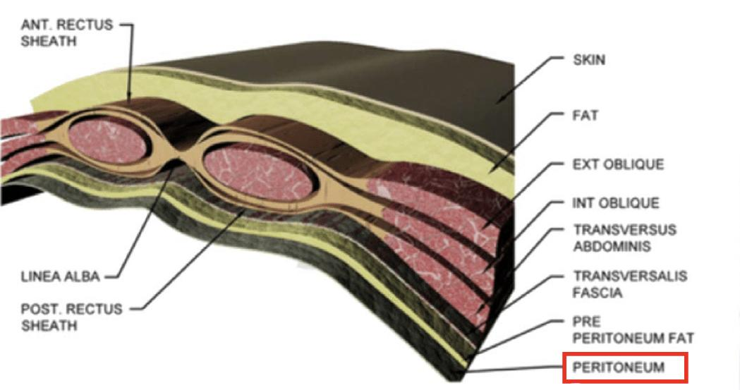
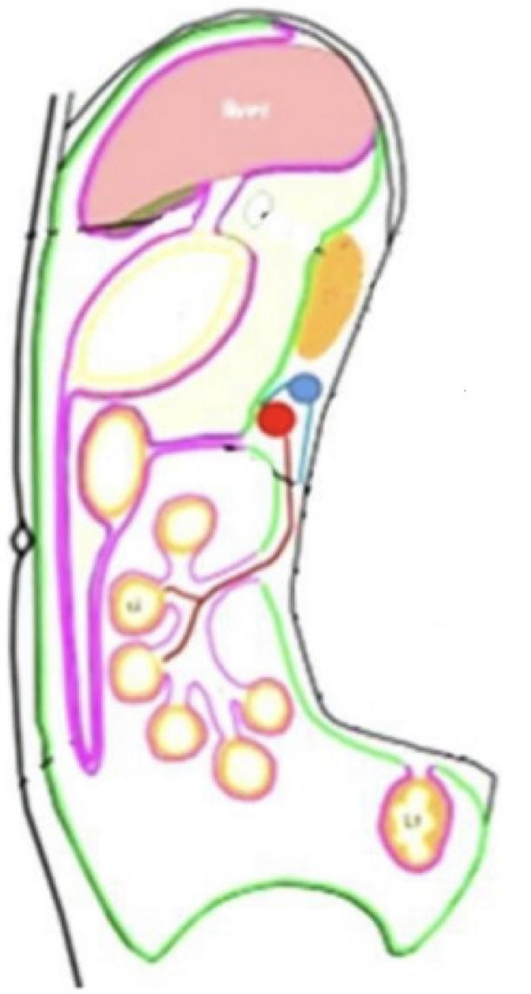
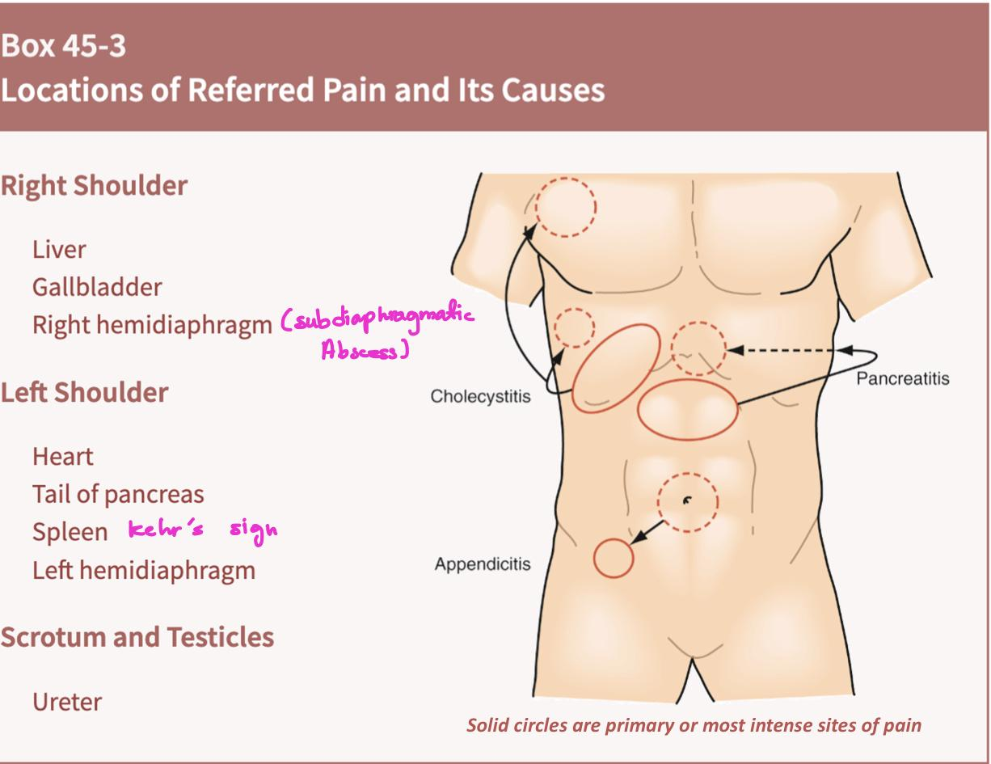
Abdominal Pain
Peritoneum:
Abdominal wall is a complex structure. It not about few muscles, aponeurosis and peritoneum, It is more complex than this.
Peritoneum work as a bag:
Greater sac (intra-peritoneal organs): Stomach, small bowel, T.colon, Sigmoid, upper rectum
Lesser sac (retro-peritoneal organs): left & right side colon, mid & lower rectum and pancreas
Peritoneum consist of two layers:
Visceral: Lining the organs ( all, aside of the spleen and lower part of esophagus). nerve endings are mostly all autonomic nerve endings
Parietal: Lining the sides toward the abdominal wall. Here we have muscle nerves passing (somatic)
Types of abdominal pain
Parietal
Visceral
Somatic pain (parietal): is classically described as sharp or knife-like in nature, and is usually well localized to the affected area.
can come from pertominum which is sensitive to mechanical, thermal or chemical stimulation, so when irritated, a reflex contraction of muscles, causing guarding (and hyperaesthesia of skin).¹
Visceral pain (referred)² is typically described as dull and deep seated. It is usually localized poorly and vaguely to the area occupied by the viscus during development.
insensitive to mechanical, thermal, or chemical stimulation.
However, they are sensitive to tension, visceral muscle spasm (colicy pain³) and ischaemia.
Although the division of abdominal pain into visceral and somatic pain is useful, it is important to realise that some pathological conditions will result in a mixed picture. For example, acute appendicitis classically presents with acute abdominal pain that is initially felt in the umbilical area (referred pain) resulting from appendicular obstruction, which gradually localises to the right iliac fossa and becomes sharper in nature as the overlying parietal peritoneum becomes inflamed.
Referred pain
Memorize it
Pain perceived at a site distant from the source of stimulus why? The theory is based on the embryological origin of the organs & interconnected nerves
Parietal peritoneum innervation follow the corresponding nerve innervation at the different level of the spinal cord.
It's autonomic (if you know the feature of autonomic pain you can differentiate between both pain). Features: Referred (not connected; pain site is distant from source of stimulus) and radiating pain (continues). While parietal is featured as radiating only. E.x. of referred pain:
Cardiac pain: is usually felt in the left jaw.
Gallbladder inﬂammation (cholecystitis): pain is felt in the RUQ and right shoulder.
Khmer sign is pain coming from the left shoulder but the problem is in the spleen.
pattern of pain in which it’s related to the contractions & relaxations of the visceral organ, it will increase with contraction of the organ and decrease in relaxation.
Pain is referred to the overlying skin of the abdominal wall according to the dermatome level with the sympathetic supply. The pain felt in:
midline if arising from the intestine and its outgrowths (the liver, biliary system and pancreas).
epigastric area if arising from Irritation of foregut structures (the lower oesophagus to the second part of the duodenum)
umbilicus if arising from midgut structures (the second part of the duodenum to the splenic flexure)
hypogastrium/ suprapubic area if arising from hindgut structures (the splenic flexure to the rectum)

Slide 4
Abdominal Pain
Pattern of pain:
Any pain you encounter, try to ask about all these 10 points:
Site
Frequency
Character
Type
Radiation¹: not every pain radiates
Aggravating factors
Severity²: subjective from one person to another
Relieving factors
Duration
Associated problems
Rigidity VS Guarding:
Rigidity
Guarding
Rigidity when the inflammation reach the parietal layer Permanent persistence of muscle spasm, i.e. involuntary
Characteristics of peritoneal inflammation, frank perforation
Starts with localized tenderness, progresses to tenderness then guarding, and finally it reaches rigidity.
You don’t need a stimulus (Involuntary-permenant)
Muscle contraction produced by additional stimulation, e.g. in physical examination
Voluntary and involuntary
Occurs with infection, irritation, early frank perforation and localized perforation..
Needs a stimulus (A person contract his abdomen once someone touch it-not permanent)
Regarding diffuse pain: try to ask the patient to localize it by asking him to point to the area he think the pain emerge from. There is only one pain and the rest are radiation and referral
Regarding the severity scale: Try to replace the scale by asking about its activity during the day; is the pain makes him wake up from sleeping, the is at least moderate to severe pain

Slide 5
Abdominal Pain
Clinical assessment
A full history is key.
Two approaches:
Systemic
Abdominal tomography (4 quadrants)
Palpate each quadrant
Work toward area of pain
Warm hands
Patient on back, knee bent (if possible)
Note tenderness, rigidity (involuntary movement), guarding (voluntary movement), masses.
History
Physical Exam
CBC ( limited clinical utility)
UA / Urine culture
Lactic acid to exclude ischemia
LFT / Amylase / Lipase
CE / Troponin
HCG (quant / qual) because some types of pregnancy are painful (Ectopic pregnancy)
Stool Culture for chronic pain
Plain abdominal radiographs¹ or abdominal series has several limitations and is subject to reader interpretation
CT scan in conjunction with ultrasound is superior in identifying any abnormality seen on plain film
Lab
tests
Radiographic tests
Are you ready to master abdominal pain!
Initially we start with flat & upright KUB x-ray (In upright KUB look for free air under the right hemidiaphragm = perforation). If you suspect biliary diseases & GYN pathology US is better. If you suspect anything else → CT scan.

Slide 6
Upper Abdominal Pain

Slide 7
Right Upper Quadrant Pain
RUQ pain is a very common presentation, you want to rule out biliary diseases., sometimes may be due to right sided pneumonia
Acute cholecystitis type of pain is somatic pain
Cholecystitis pain is somatic pain
Complete obstruction → stasis → continuous contraction of the gallbladder → inflammation
The pain is somatic due to the involvement of the anterior abdominal wall (has feature of somatic)
Duration: 1 - 1hr and 30 mins
Presented with fever
Signs:
distressed by the pain and lies quietly, breathing shallowly.
Zackary Cope’s sign
Murphy’s sign. clinical diagnostic test to differentiate between colic of gallbladder and cholecystitis.
Boas’ sign: pain radiates to the tip of the scapula
Clinical Features
Diagnosis
Colicky pain with progression to constant pain in RUQ that may radiate to R scapula
Nausea and vomiting and fever
If there is obstructive jaundice (urine may be dark, the stools pale and the skin itchy.)
tender to palpation or percussion RUQ, may have palpable gallbladder.
CBC, LFTs (bilirubin, alkaline phosphatase), serum pancreatic enzymes.
Plain abdominal films demonstrate biliary air hepatomegaly, and maybe gallstones.
Ultrasound considered accurate about 95%
Presence of gallstones.
Thickening of gallbladder wall.
Dilatation of biliary tree.
Gallstones and biliary colic type of pain is autonomic pain
Present in 10-20% of the population, and 1-2% of them will develop symptoms annually. no need to remove the gallbladder unless symptomatic
Increase in solute concentration combined with stasis in the gallbladder between meals predisposes to stone formation in the gallbladder
Two types: 75% cholesterol stones (yellowish green) and 25% Pigmented stones Infectious or hemolytic (Sickle cell) causes
Risk factors (5 Fs): Female, Fertility, Fatty diet, Forties, Family history. (others: race (more in black), increased cholesterol ratio, rapid wight loss, dysmotility)
Mechanism: The pain elicited when the smooth muscles of the GB contract to push a stone forward. The contractions (contract due to the release of CCK & VIP from the duodenum the food reaches the antrum to secrete the bile for digestion). The pain come in waves and last less than 12-24 hours. pain starts 30-40 minutes after the meal, and will persist for 2-3 hours then subside
Pathophysiology :
Clinical features
gall bladder is lined by a mucous membrane that keeps secreting bile which leads to accumulation of bile (usually due to blockage caused by stone) within the gallbladder and will increase in size and become distended stimulating stretch receptors on gallbladder wall. (no inflammation here so no peritonitis)
Recurrent attacks of right upper quadrant colicky pain related to fatty food intake and have a short duration
pain is severe and begins suddenly across the upper abdomen.
Nausea is usually present, with or without vomiting
E.x. If a patient had biliary colic and the attack resolved within 18 hrs he/she will have gall stone colic , But If the patient had reached the cut-off 15-20hrs he/ she will develop inflammation and will suffered from cholecystitis
NO MURPHY SIGN NO FEVER
if there’s fever > cholecystitis

Slide 8
Acute cholangitis not mentioned in the objectives but important
Cholecystitis pain is somatic pain
Stone in the gallbladder goes to the bile duct
Presented with:
Janduince
Abdominal pain (RUQ might progress to Generalized)
Chronic Cholecystitis
Cholecystitis pain is somatic pain
Inflammation and scarring of the neck of the gallbladder and cystic duct. Due to repeated untreated episodes of acute cholecystitis that wasn't managed surgically (medically by Antibiotic)
Mechanism:
Recurrent attacks of biliary colic, with only temporary occlusion of the cystic duct
Presentation:
Similar to biliary colic with increased in frequency. rarely present with fever
Liver metastases
Cholecystitis pain is somatic pain
Liver metastases are a common complication of all intra-abdominal malignancies
A constant dull ache in the right hypochondrium, general malaise, weight loss and sometimes mild jaundice may be the first indication of their presence
Distension of the liver capsule stimulates pain fibres
Left Upper Quadrant Pain
Mechanism: barogenic esophageal rupture.
• Causes:
themucosa
submucosa
Boerhaave’s syndrome (starts with prolonged forceful vomiting)
Pathogenesis:
Known as spontaneous esophageal rupture or effort rupture of the esophagus. involves all the layers in contrast to mallory tear which only involve submucosa
Poreferation of the distal esophagus, Recurrent and forceful vomiting. The most common location is at the left lateral lower part of the esophagus (weakest point of the esophagus) If it happens in the abdominal part (poreferation of the left upper quadrant and upper abdominal pain) then the patient will have poreferation of the mediastinum part of the esophagus and free air mediastinum
Mechanism:
Clinical features
barogenic esophageal rupture
Causes:
Depends on the location
Mackler’s Triad: mid-epigastric and/or lower chest pain, vomiting and subcutaneous emphysema
Pleural pain worsen by neck flexion and swallowing.
Mediastinal crunch (Hamman’s sign) heard with stethoscope
Septic shock very rapidly
Ratcheting vomiting (most common cause) in Alcoholics
Weightlifting
Straining during defecation and childbirth delivery
Epileptic seizures
Abdominal trauma
Iatrogenic (e.g. endoscopy)
Splenomegaly
A large spleen can cause dull, persistent left hypochondrial pain
Splenic infarction, which is often associated with sickle-cell disease, causes a more severe pain which may be exacerbated by deep res- piration

Slide 9
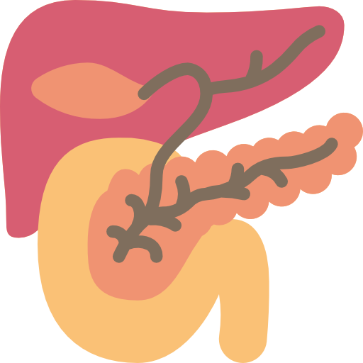
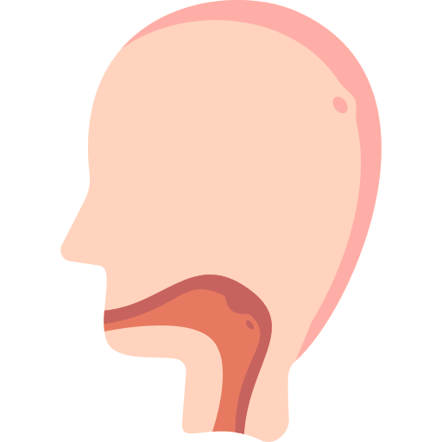
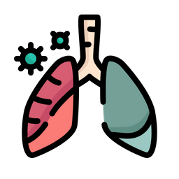
Epigastric Pain
Pancreatitis somatic pain
A nonbacterial inflammatory disease caused by activation and autodigestion of the pancreas by its own enzymes
Causes:
Sometimes the pain is due to the alcohol or the food. If it’s food then the pain occurs when stone passes
It doesn't cause upper abdominal pain (according to the doctor it's mostly central aka umbilical)
according to ranson criteria we classify the patient to mild, moderate and severe pancreatitis.
Gallstone (most common) by blocking the common bile duct treated by ERCP
Alcohol (second most common)
Viral infection (mumps, CMV or Coxsackie B infections)
Drug induced (steroids, OCPs, diuretics: thiazide)
Iatrogenic (post ERCP) observe for 24 hrs to avoid this complication
Idiopathic unless the patient had several attacks & you fail to diagnose the underlying etiology
Hypercalcemia
Hyperlipidemia
Familial
Tumor
Trauma
Scorpion bite
Presentation
Epigastric pain usually radiates to the back and improves in leaning forward and epigastric tenderness with guarding (only in the midline)
Nausea, vomiting
History of previous attack
Hypotension, tachycardia and fever
Dehydration, because of inflammation with edema up to 3-4 L pooling to pancreas. This may lead to shock and consequently, renal failure. treatment fluid fluid with ringer lactate
Ascites: may pool to the left side of the chest by channels causing pleural effusion which indicates severe condition
Hemorrhage may develop by digesting the vessels’ walls. If continuing develops:
Cullen’s sign: periumbilical superficial edema
Grey Turner’s sign: flank area occurs first because pancreas is retroperitoneal organ
Oesophagitis
Causes:
Reflux (reflux esophagitis)
Infectious esophagitis candidiasis in immunocompromised
Pill induced esophagitis (oral bisphosphonates like alendronate, some antibiotics like tetracycline, doxycycline, and clindamycin NSAIDs, aspirin ... Etc.
Eosinophilic esophagitis
Radiation-induced esophagitis
Clinical features:
often accompanied by flatulence and coughing.(if any of the refluxing acid spills over into the lungs)
Dysphagia- suggests development of stricture/achalasia/carcinoma/ cardia (develop with years)
Can cause abdominal pain (SOCRATES, students foregts C) but it’s not classical (small percentage only) it really just depends on the cause. If it’s gastroesophageal related it will present with heartburn. V.IMP to ask if the pain is continuous or not For example patient went to the ER if the pain is subsumed by medications or anything in general this patient doesn't need emergency service rather he needs investigations and work up
heartburn(often at night) worse by lying flat. often initiated by bending, stooping or heavy lifting.
Diagnosis:
endoscopy

Slide 10
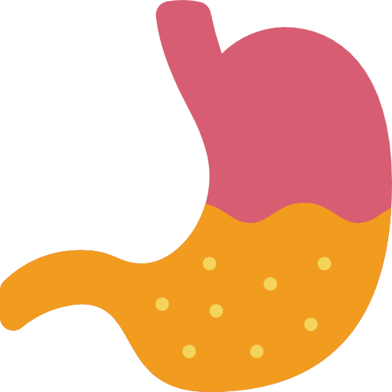
Acute gastritis
Acute Gastritis is a widespread name. When you say acute that means there’s chronic but there’s no acute or chronic gastritis only gastritis
It’s inflammation of the mucosal layer
It’s more of discomfort with possible indigestion rather than pain “feels like the food stopped after I ate”
Mechanism:
Causes:
Risk Factor & Causes
Mucosal layer penetrated
HCl direct contact to the mucosa
injury to small vessels
Edema, hemorrhage, possible ulcer formation
Infectious (viral or bacterial: H.pylori) the most common
Drug induced (e.g. NSAIDs, steroids)
Toxic substance (e.g. alcohol, harsh chemicals)
Hypoperfusion of gastric mucosa due to shock
Radiation therapy
Reduced mucin synthesis (e.g. elderly)
Chronic peptic ulcer autonomic pain
may occur in esophagus, duodenum, stomach itself or jejunum
Results from the corrosive action of acid gastric juice on a vulnerable epithelium
Men are affected three times as often as women
Ulceration of the first part of the duodenum is the commonest form of peptic ulcer & the commonest to perforate. Gastric ulceration is the second commonest form
Duodenal ulcer is ten times more common than gastric ulcers in young patients, but in older age groups the frequency is about equal.
The ulcerative process can lead to four types of disability: Pain (the most common), bleeding (when Attack the blood vessel), perforation, obstruction (with adhesions)
 | Gastric ulcer | Duodenal ulcer
Risk factors | The target age is 40-60 years Ten years older than average of those with duodenal ulcer 95% of gastric ulcers are located on the lesser curvature, and 60% of these are within 6cm of the pylorus H. pylori and NSAID are important predisposing factors & elderly cancer | Affects young and middle age group, i.e. 20-45 years About 95% of duodenal ulcers are situated within 2 cm of the pylorus, in the duodenal bulb H. pylori is the principal cause of duodenal ulcer disease & smoking Gastric acid secretion is characteristically higher than normal.
Presentation | Epigastric pain, can radiate to the back, and increased with food intake due to increase acidity Anorexia and weight loss. Ulcer demonstrated by x-ray (barium swallow). Acid present on gastric analysis (on pH monitoring) Upper endoscopy confirms the diagnosis best model | Epigastric pain relieved by food (less acid in the duodenum) or antacids, and epigastric tenderness may be present. Normal or increased gastric acid secretion. Signs of ulcer disease on upper gastrointestinal x-rays (barium swallow) or endoscopy (the best of diagnosis & biopsy) Evidence of H. pylori infection.

Slide 11
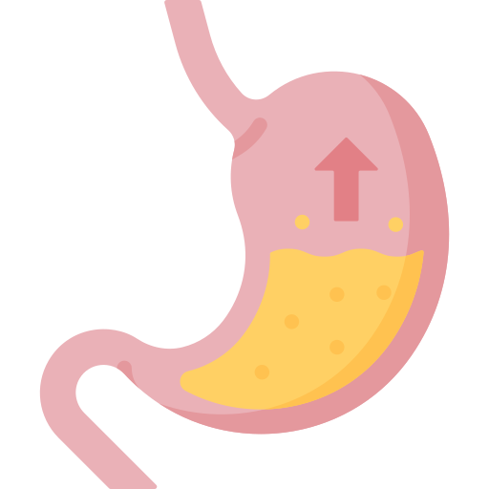
Perforated peptic ulcer SURGICAL EMERGENCY
Life-threatening complication of peptic ulcer disease - more common with duodenal than gastric.
Risk factors and causes:
Clinical features:
Smoking
Use of NSAIDs on empty stomach
Alcohol abuse
Chronic Helicopacter Pylori infection.
Advanced age
Ulceration of the 1st part of the duodenum
Depends on the size of the ulceration and how much leak there is of the gastric content
Sudden onset of severe intense, steady epigasric pain with radiation to sides, back, or right shoulder then it might progress to generalized
Abdominal tenderness, guarding and rigidity (when it becomes generalized peritonitis)
Progressive abdominal distention. Why? 1-ileus due to inflammation 2-air from perforation
Absent bowel sounds
When the patient is hungry the pain will increase due to HCl secretion
Anemic
Guarding
Tenderness
Rebound tenderness
Rigidity
Peritoneal Signs
Diagnosis:
upright or lateral decubitis X-ray shows pneumoperitoneum (air under the diaphragm or peritoneal cavity)
Treatment:
Omental patch repair (Graham’s patch)
Work up
GERD
Movement of gastric contents from stomach to esophagus
May produce S & S within esophagus, pharynx, larynx, respiratory tract
Most prevalent condition affecting GI tract
About 15% of adults use antacid > 1x/wk
Clinical features:
Heartburn - most common (severity of does not correlate with extent of tissue damage)
Burning, gnawing in mid-epigastrium worsens with recumbency
Water brash (appearance of salty-tasting fluid in mouth because stimulate saliva secretion).
Occurs after eating may be relieved with antacids (occurs within 1 hr of eating - usually large meal of day).
Dysphagia & odynophagia predictive of severe disease
Chest pain - may mimic angina
Foods that may precipitate heartburn: high fat or sugar, chocolate, coffee, onions, citrus, tomato-based and spicy
Cigarette smoking and alcohol
Aspirin, NSAIDS, potassium, pills

Slide 12
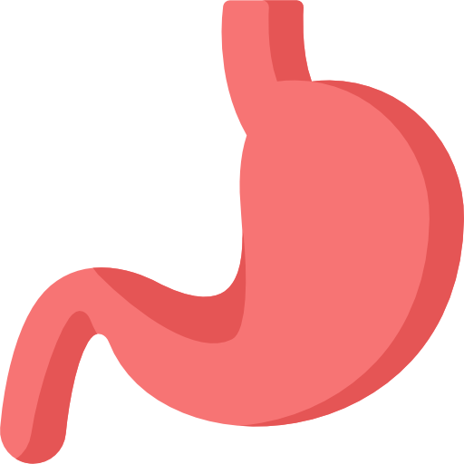
Chronic Pancreatitis
Progressive inflammatory disease of the pancreas that cause fibrosis and loss of endocrine and exocrine functions (in Acute loss of function)
The commonest cause is alcohol intake
Alcoholic patients often resort to increased alcohol intake to obtain relief
Abdominal pain, cause of obstruction may be present with pain only
Diabetes
Malabsorption may cause steatorrhea and/or fat-soluble vitamins deficiency
Presentation:
Carcinoma of the stomach
the majority of gastric ulcers arise spontaneously
Helicobacter pylori is an important predisposing factor
Gastric cancer is the fourth most common cancer and the second leading cause of cancer death
Prevalent in East Asia and South America
More common at age >65
More common in male than female
Epigastric pain, constant and nonradiating and is generally not relieved by eating.
Early satiety, and weight loss.
Advanced lesions may manifest with either obstruction or dysphagia depending on the location of the tumor
Some degree of GI bleeding is common (melena or hematemesis)
Enlarged lymph nodes:
evidence of intra-abdominal metastases such as hepatomegaly, jaundice, or ascites (usually present late)
Presentation:
supraclavicular especially left (Virchow)
periumbilical (Sister Mary Joseph node)
during PR Anteriorly enlarged lymph node (Blumer's Shelf)
Cardiopulmonary (extra-abdominal diagnosis of acute abdominal pain )
Pain is usually in upper half of abdomen.
If epigastric pain is present one should inquire about cardiac history, get and ECG, and consider further cardiac evaluation
A neg. film plus pleuritic pain could mean PE.
A chest film should be done to look for pneumonia, pulmonary infarction, pleural effusion, and / or pneumothorax.

Slide 13
Lower Abdominal Pain

Slide 14
Endometriosis
The presence of endometrial tissue outside the uterus.
Pathology: Retrograde menstruation followed by implantation of endometrial tissue in the ovaries or coelomic metaplasia.¹
Most Common Sites: Ovaries (most common), rectouterine pouch and other pelvic organs. Distant organs: Lungs (hemoptysis), nose (epistaxis), bowels (GI bleeding).
Diagnosis
Treatment
Transvaginal US (best initial test) which shows ovarian chocolate cysts or peritoneal nodules. Laparoscopy confirms the diagnosis.
Medical (mild or moderate pain in the absence of complications)
NSAIDs (especially in those planning conception)
NSAIDs and contraceptives or synthetic androgens
Severe symptoms: GnRH agonists and combined oral contraceptives
Surgical (no response to medical therapy or in case of ectopic extension)
Laparoscopic removal and ablation of ectopic endometrium (first-line)
Hysterectomy (second- line)
Ectopic Pregnancy
Symptoms:
Episodes of iliac fossa pain prior to rupture → rupture → severe pain, bleeding or even fainting.
Patient c/o of severe RLQ or LLQ pain with radiation.
Fertilized egg is implanted outside the uterus.
Growth causes rupture and can lead to massive bleeding.
The trophoblasts might penetrate the wall of the involved organ in an attempt to manifest a feto-maternal circulation → wall lysis → rupture.
The ectopic fetus might escape through the fallopian tubes into the abdominopelvic cavity.
Diagnosis
Treatment
Consider a pregnancy test in all females in childbearing age
Transvaginal US: Best initial test and confirms the diagnosis.
β-HCG: Supportive.
Hemodynamically Stable: Methotrexate (drug of choice), do not use it in cases of rupture.
Hemodynamically Unstable: Salpingostomy (unruptured), salpingectomy (ruptured).
Controversial, as endometriosis can occur in men. It is probably that endometriosis is a final manifestation of various mechanisms.

Slide 15
Pelvic Inflammatory Disease
Occurs after extension of infections into the upper genital tract (any of the following: cervix, endometrium, fallopian tubes, ovaries or the peritoneum).
Acute Salpingitis: an infection in one or both Fallopian tubes, commonly caused by Gonococcus & Streptococcus
Commonly caused by: C. trachomatis, N. gonorrhoeae and Mycoplasma genitalium.
Risk Factors: Unprotected sex, intrauterine devices, vaginal dysbiosis and STDs.
Symptoms: Abdominal pain (typically lower abdominal or pelvic pain), fever, nausea, vomiting, menorrhagia, abnormal vaginal discharge or dyspareunia.
Diagnosis
Treatment
Mainly clinical. A pregnancy test should be performed to rule out ectopic pregnancy.
Cervical and urethral swabs followed by culture, PCR, or Giemsa stain for C. trachomatis.
US if there is no response to treatment: abscesses, pyosalpinx or hydrosalpinx
Mid-stream urine sample if co-existing UTI is suspected.
IM ceftriaxone and doxycycline, add metronidazole in cases of vaginitis or recent instrumentation (first-line)
Ofloxacin and metronidazole (first-line if Mycoplasma genitalium is present)
In severe cases, inability to ingest oral antibiotics: Cefotaxime or cefotetan and doxycycline or clindamycin and gentamicin.
Chronic Pelvic Sepsis
Pelvic sepsis is a complication of untreated PID.
Symptoms:
Adnexal tenderness on bimanual exam + low-grade fever + continuous vaginal discharge indicates the Dx.
May be associated with urinary frequency and dysuria.
Diagnosis
Treatment
Gonococcal pathogen on high vaginal swab (HVS) confirms the Dx.
Abscess → drainage → failure? → pelvic washout
Sometimes broad-spectrum antibiotics are used alone as conservative treatment.
Fibroid Twisting and Degeneration
Fibroid is another name for uterine leiomyoma (uterine smooth muscle neoplasm). It is a hormone-sensitive neoplasm
Symptoms: Patients may present with acute pain in case of torsion of a pedunculated fibroid or red degeneration usually during pregnancy.¹
Diagnosis
Treatment
Usually clinical, US (best initial test).
Degeneration: Bed rest, hydration and analgesics.
Definitive: Uterine fibroid embolization
Twisting/torsion: Myomectomy (in case conception is desired) or hysterectomy.
Degeneration in this context refers to the fibroid outgrowing its blood supply, the cells will necrotize and the patient will present with acute pain. Red refers to its color.

Slide 16
Uterine colic
This is always associated with pregnancy.
The presence of a large pelvic mass should confirm the presence of a pregnant uterus.
Gynecological Malignancy
Ovarian Cancer
More common in the elderly population
Associated with increase in abdominal girth with classical constitutional symptoms of cancers
Diagnose by US or CT (best initial), and confirm by biopsy (most accurate)
Treat by removing the tumor and chemotherapy
Cervical, Vaginal and Vulvar Cancers
High risk HPV infection (16, 18) due to sexual transmission is the most common cause.
Symptoms include pain during sex, pelvic pain along with the classical constituitonal symptoms of cancers.
Cervical Cancer Staging
In-situ (no basement membrane invasion)
Stage I: Confined to the cervix
Stage II: Invasion of uterus
Stage III: Invasion of the pelvic wall and/or lower third of vagina and/or hydronephrosis
Stage IV: Beyond the true pelvis to adjacent organs
Treatment is by surgery with or without chemotherapy and radiation.
Screening is advised for cervical cancer
Endometrial Cancer
Postmenopausal bleeding in an elderly woman is the cardinal symptom with a usually normal pelvic examination.
Diagnose by US and confirm by biopsy
Treatment usually involves surgical removal of the uterus or pharmacological/chemotherapy in advanced diseases or in young patients with early cancers who desire pregnancy
Take a break & Click here to Play Pacman

Slide 17
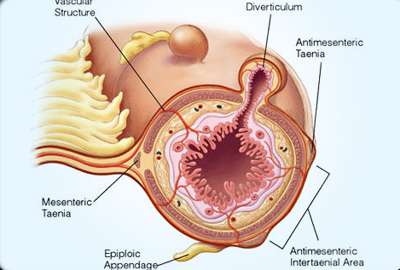
Diverticulosis
Introduction
Diverticulosis is perhaps the most common abnormal finding in routine colonoscopy
Usually found in sigmoid and descending colon, could be found proximally in elderly.
Only a minority develop diverticulitis.
Diverticula often cause no symptoms but they become obstructed & often inflamed = Acute Diverticulitis
Chronic Diverticular Disease commonly presents in middle-aged or elderly patients with episodes of central and lower left-sided abd pain, often associated or preceded by constipation.
Diverticulosis tend to develop between the mesenteric and antimesenteric teniae coli¹
Risk Factors
Increasing age
Obesity → ↑ proinflammatory adipokines → ↑ collagenases and connective tissue turnover
Low-fiber, high red meats and fat diet
Sedentary lifestyle → ↑ colonic pressure
NSAIDS →↑ Complications (bleeding, as blood contains enzymatic irritants that aggravate inflammation)
Other aggravants: Steroids (reduce collagen → progressive weakness → ulcers or perforation), immunosuppressed (infection), smoking (decreases collagen), alcohol (autonomic neuropathy or a direct toxic effect on smooth muscle cells → ↓motility → ↑ stasis and colonic pressure)
Connective tissue disorders: Marfan syndrome, Ehler-Danlos syndrome, polycystic kidney disease
Pathology
Unclear pathogenesis (could be caused by one or more of the following):
Intrinsic colonic abnormalities: increased elastin deposition or collagen abmormalities (e.g. Ehler-Danlos Syndrome)
Dysbiosis: increase in proinflammatory flora → an inflammatory soup of cytokines→ chronic inflammation and destruction leading to weakening, diverticula and acute flares if severe. (Bacteroides are an example of such flora)
Dysmotility and fecal stasis: Dysfunction or lack of interstitial cells of Cajal.
Low fiber diet (major factor): Less water and smaller stool → Greater colonic contractions → high intracolonic pressure → diverticula.
Some inflammation triggers: (1) Obstruction, (2) Stasis, (3) Dysbiosis, (4) Positive association with older age
Anatomy recap: The mesentery attaches the intestines to the abdominal wall, antimesenteric refers to the site opposite to mesenteric attachment. The teniae coli are the longitudinal muscle bands that run through the colon.

Slide 18
Diverticulosis
Clinical Features¹
Complications
Diverticulosis: Asymptomatic, abdominal pain with or without bleeding and/or constipation. Change in stool: flattened or ribbon like.
01
01
Destructive perforations
Diverticulitis: Fever (low-grade), left lower quadrant pain (usually, sigmoid colon), constipation or diarrhea, nausea and vomiting, urinary urgency and frequency (prompted by the close proximity of the bladder).
02
Sepsis
02
03
Abscess, fistula (bladder, vagina (especially in hysterectomy), uterus, skin or a bowel loop)
Diagnostic Workup
CBC, Stool for occult blood.
Colonoscopy: Initial modality of choice - indicated in lower GI bleeding, recurrent abdominal pain, suspected malignancy (Avoid in suspected acute diverticulitis).
01
Barium studies: Bleeding if colonoscopy cannot be performed, alteration in bowel habits (to identity luminal narrowing), abdominal pain without signs of inflammation (no fever, tenderness or inflammatory markers).
02
Diverticulosis
CT scan: Initial modality of choice in suspected diverticulitis (thickening of the wall, outpouching and identifies complications).
01
MRI: If CT is contraindicated.
02
US: If CT & MRI are contraindicated.
Diverticulitis
03
Diverticulitis can be divided into acute uncomplicated (pain, fever, leukocytosis), chronic (generally at least two months of pain, bloating, sometimes obstruction and acute complicated (fistula, abscess, obstruction, perforation). The clinical features are not exhaustive.
Oral and IV contrast if partial obstruction, and IV contrast only if complete obstruction, non-contrast if there is a contraindication to its use.

Slide 19
Diverticulosis
Treatment
01
Asymptomatic: Nothing, except increasing fiber intake and avoidance of diverticulitis risk factors.
Avoid: popcorn, corn, nuts, seeds.
02
Bleeding:
Endoscopic treatment (epinephrine, cauterization, ligation etc..)
Angioembolization (1st) or intra-arterial vasopressin (less common): If hemodynamically unstable or ongoing bleeding after endoscopy.
Surgery: Last resort, ongoing bleeding (a choice between surgery and angioembolization is made after consultation)
Diverticulosis
Uncomplicated:
Spontaneous resolution common with low-grade fever, mild leukocytosis, and minimal abdominal pain.
Broad-spectrum antibiotics: Metronidazole + Fluoroquinolones, TMP-SMX or amoxicillin-clavulanic acid for 4-7 days.
Use when: Fever or other signs of infection are present (e.g. leukocytosis), pregnancy, comorbidities (e.g. diabetes mellitus or immunocompromised).
Analgesics, limited physical activity, bowel rest and antiemetics if needed.
01
02
Complicated:
Patients who present acutely ill with possible signs of systemic peritonitis, sepsis, and hypovolemia need admission.
Broad-spectrum antibiotics (Same antibiotics).
Bowel rest, analgesics, antiemetics if needed + IV fluids (If abscess is found send aspirate and modify antibiotics).
Perforation:
Hemodynamically stable: Colectomy with or without stoma
Unstable: Hartmann’s procedure (rectosigmoid colon removal and stoma formation).
Diverticulitis
Obstruction:
Partial: Consider stents or elective resection
Complete: Usually resected

Slide 20
Meckel Diverticulum
The three most common small bowel diverticula are: duodenal (45%), jejunoileal (25%) and Meckel’s (25%).
The most common congenital anomaly of the small intestine.
Rule of twos: 2 feet (60 cm) from the terminal ileum, 2 inches in length, affecting 2% of the general population, occurring twice as often in males, containing one or two types of heterotopic “misplaced” mucosa (commonly gastric or pancreatic), and most commonly within the first 2 years of life.
Duodenal and jejunoileal diverticula are false diverticula¹
Pathology
Early in embryological life, the intestinal tract consists of a one longitudinal tube divided into three parts (foregut, midgut, hindgut).
The midgut is connected to the yolk sac through the vitelline duct (also called itellointestinal duct, the yolk stalk, the omphaloenteric duct, or the omphalomesenteric duct).²
01
02
Between the fifth and ninth week, the duct normally obliterates.
Patent vitelline duct → ileal umbilical fistula (discharge of dark green feces called meconium)
Failure to obliterate from the umbilical side → vitelline duct cyst (may cause pain, mostly pediatric)
Failure of the vitelline duct to obliterate from the intestinal side (most common 90%) → Meckel’s diverticulum (only true diverticulum of the small intestines).
Meckel diverticulum heterotopic mucosa (normally it has small intestinal mucosa):
1. Pancreatic (most common)
2. Gastric (most common in symptomatic patients)
03
Clinical Features
Usually asymptomatic.
symptoms, usually with complications (2-4%). The symptoms are indistinguishable from acute appendicitis, although pain & tenderness is felt more towards the center of the abdomen than in the right iliac fossa.
01
02
03
Lower gastrointestinal bleeding (most common)³
Colicky
abdominal pain
Nausea, vomiting and diarrhea
Also called pseudodiverticula as they do not contain all layers of the gastrointestinal wall (Typical GIT layers: mucosa, submucosa, muscularis, serosa or adventitia).
This provides a pathway for the vitelline vessels to reach the yolk sac where nutrient exchange occurs, similar to the placental circulation prior to its establishment in the 11th-12th week.
Pancreatic enzymes or gastric acid → lysis of ileal wall → ulceration → bleeding (hematochezia if severe or quick, melena if slow, or stool mixed with blood and mucus (currant jelly, indicating a possible intussusception)

Slide 21
Meckel Diverticulum
Complications
1
Bowel obstruction: Mechanisms: Entrapment of the intestine within a fibrous band attached to the umbilicus, intussusception, volvulus (Latin for twisting), and stenosis (repeated bouts of diverticulitis in chronicity).
2
Infection: Diverticulitis.
3
Ulcer or perforation → Hemorrhage (reported as the most common complication along with obstruction)¹
4
Herniation: can slip into a femoral or an inguinal hernial sac (Littre hernia).
5
Neoplasm: Most common is a carcinoid tumor (other tumors: leiomyoma, leiomyosarcoma among others).
Diagnostic Workup³
Can be indistinguishable from appendicitis in presentation and complications, like perforation²
Imaging: Indicated in hemodynamic stable patients, usually with bleeding
CT or US: Limited, difficult to differentiate from bowel loops. CT angiography might demonstrate vitelline artery or contrast extravasation in bleeding.
Meckel scintigraphy (modality of choice): Usually when bleeding is present, Technetium is preferentially picked up by gastric mucosa
SPECT/CT: When scintigraphy is negative, but suspicion is high.
Management
Asymptomatic
1
2
Symptomatic
Asymptomatic on imaging: No treatment.
Asymptomatic on surgical exploration: Resection in patients younger than 50¹
Some sources suggest resection when any of the following criteria are met: <40, longer than 2cm, presence of a fibrous band, heterotopic mucosa.
Ileal resection in case of a bleeding ulcer
Simple diverticulotomy
Diverticulitis: IV antibiotics (e.g. aminoglycosides, clindamycin) followed by resection.
Obstruction: Laparotomy then resection
Rare in older patients, gastric mucosa tends to atrophy after that time. Hence why it doesn’t pose a concern when found in older individuals.
When a patient presents with signs and symptoms of appendicitis with an intraoperative normal appearing appendix, look for a Meckel diverticulum or a possible mesenteric adenitis.
Meckel diverticulum does not have any unique presenting features, rather it is a rare cause for many common presentations (obstruction, diverticulitis and bleeding). Therefore the key to approach Meckel diverticulum is knowing the original workup for these complications, as they tend to present as medical emergencies.

Slide 22
Inflammatory Bowel Disease
01
02
Both ulcerative colitis and Crohn’s have similar presentations.
Abdominal pain may be only complaint and may have been intermittent for years.
Abdominal pain and diarrhea present in most pts.
Cramping sensation - intermittent or constant.
Tenesmus & fecal incontinence.
Other complaints: fatigue, weight loss, anorexia, fever, chills. nausea, vomiting, joint pains, mouth sores.
Crohn’s Disease:
Acute CD: Most common site for crohn disease is the terminal ileum. Thus, patients complain of central or rt. iliac fossa pain.
1
Distinguishing Sx: occurrence of repeated episodes of diarrhea in the weeks before the attack.
2
Runs a chronic course: long Hx of colicky central/lower and pain coming on every 15-20 min associated with diarrhea.
3
Can involve any portion from mouth to anus.
Inflammation is patchy.
Complications:
Anal abscess & fistulae are common.
Ulcerative Colitis:
Acute fulminating UC: acute abd pain preceded by severe diarrhea accompanied by the passage of blood, mucus and pus.
1
Inflammation is diffuse & continuous
beginning in rectum.
2
May involve entire colon or only rectum
(proctitis).

Slide 23
Appendicitis
Acute Appendicitis
The commonest cause of acute and pain in the western world.
Etiology is related to obstruction of the lumen by any cause:
Fecal (most common cause in adults).
Lymphoid hyperplasia (most common cause in children and young adults).
Consider a neoplasm in elderly.
Presents with vague pain which begins in the center of the abdomen (first 12 hours) with increase in the bowel movement & vomiting and nausea and anorexia. After few hours to 2-3 days pain shifts to the rt. Iliac fossa & becomes more severe (sharp aching pain).
If it poliferates it will cause spillage and it will cause general abdominal pain.
The “typical” history is almost diagnostic but only occurs in about 1/2 patients.
Diagnosis
Treatment
Diagnosis of appendicitis is usually based on Hx & PE.
Tenderness and guarding in the right iliac fossa (McBurney’s point) usually excludes the need of investigations (if the diagnosis in doubt or to exclude a malignancy).
Positive psoas sign¹
investigations (if the diagnosis in doubt or to exclude a malignancy)
CT with IV (initial modality in adults): Enlarged appendix ( >6mm), edema.
US (initial in children and pregnant women): Target sign (rings of hyper- and hypoechogenicity) and maybe a fecalith.
MRI if findings remain inconclusive.
CBC, HCG: WBC range from 10,000-16,000
Supportive care followed by broad-spectrum antibiotics.
Appendectomy: operate them under 36 hours to avoid rupture of appendix.
In case of abscess (drain) or an appendices like mass: IV fluids and antibiotics only should resolve the lesion (in case of worsening perform an open surgery).
Chronic Appendicitis
Two forms of chronic inflammation may develop in the appendix:
Mucocele
Empyema
Both follow an attack of acute inflammation & both may cause recurrent pain in the right iliac fossa.
Usually happens when the appendicitis is managed with antibiotics and not surgically.
The psoas sign is an indicator of irritation to the iliopsoas group of hip flexors in the abdomen.

Slide 24
Radiation Enteritis
Overview
Can appear after months or decades following radiation treatment. The terminal ileum is the most commonly affected site in the small intestines.
Pathology
Risk
Factors
Clinical
Features
Diagnosis
1
2
3
4
Ionizing radiation → breaks chemical bonds and produces reactive oxygen species → DNA damage and cellular stress
High radiation treatment, chemotherapy, HIV, vascular connective tissue diseases and IBD.
Abdominal pain, diarrhea (acute), malabsorption and weight loss (chronic)
Endoscopy and CT or MRI:
Acute: Edema and thickening
Chronic: Fibrosis and strictures
Complicated: Fistula and leakage
Treatment
Medical
Surgical
Antidiarrheal agents
Cholestyramine (in case of bile salt malabsorption)
Antibiotics (in case of bacterial overgrowth)
Hyperbaric oxygen (increases angiogenesis)
Perforation: Resection
Fistula: Resection or bypass
Obstruction: Resection, bypass or stricturoplasty (removes strictures without removing any part of the guy)
Mesenteric Enteritis
Pathology
Risk
Factors
Clinical
Features
Treatment
1
2
3
4
Mesenteric adenitis affects lymph nodes in the mesentery. It causes inflammation and swelling of the lymph nodes
Infections (mostly viral).
Has similar presentation to appendicitis. It differs from acute appendicitis in the fact that it starts localized with no shift to the right lower quadrant.
It’s not an emergency. Treat with conservative measures, and NSAIDs.

Slide 25
Bowel Ischemia
Mesenteric Ischemia (MI)
Diagnosis can be divided into the following:
Arterial insufficiency
Venous insufficiency - Venous Thrombosis
1
2
Occlusive:
Embolic (A. Fib) / Thrombotic, Embolic MI has the most abrupt onset.
Nonocclusive:
Low flow state (AMI / Shock), Usually has clinical evidence of a low flow state (acute cardiac disease).
Occurs in hypercoagulable states.
Usually is found in younger pts.
Has a lower mortality.
Can be treated with immediate anticoagulation.
Mesenteric Ischemia Risk factors:
3
Preexisting cardiovascular disease (atrial fibrillation, congestive heart failure, acute MI).
Recent abdominal vascular surgery.
Hypercoagulable states.
Medications (e.g. vasopressors and digoxin).
Vasculitis.
Symptoms
Diagnosis
Treatment
Abdominal pain that is sudden, severe, diffuse, and on examination is without rebound tenderness
Diarrhea
Occult gastric or rectal blood may be present
Vomiting
Late findings of peritoneal signs and acidosis are usually indicative of dead bowel
Made based on clinical index of suspicion.
Labs: High LDH, lactate (metabolic acidosis), creatine kinase, leukocytosis.
Confirm the diagnosis by CR angiography (MR angiography if contraindicated).
Emergent laparotomy (advanced ischemia or hemodynamically unstable)
SMA embolectomy (if embolus) or SMA bypass (thrombosis) or immediate heparin (venous thrombosis) and resection of necrotic bowel.
Revascularization in hemodynamically stable patients without ischemia.
Ballon angioplasty and stenting, catheter-based thrombolytics and/or mechanical thrombectomy
Ischemic colitis
It is a diagnosis of an older patient.
Compared to mesenteric ischemia, this is not due large vessel occlusive disease.
Symptoms
Diagnosis
Treatment
Pain described as diffuse, lower abdominal pain in 80% of pts.
Can be accompanied by diarrhea often mixed with blood in 60% of patients. (Bowels are initially hyperactive then they become paralytic).
Angiography is not indicated. If it is performed it is often normal.
Imaging (CT and X-ray) shows thumbprint sign: Edema and thickening of mucosa appearing like Thumbprints.
Colonoscopy is indicated as the procedure of choice in mild to moderate cases.
Exploratory laparotomy w/o excision in severe cases.
Mild: Supportive
Severe (shock or peritonitis): resection

Slide 26
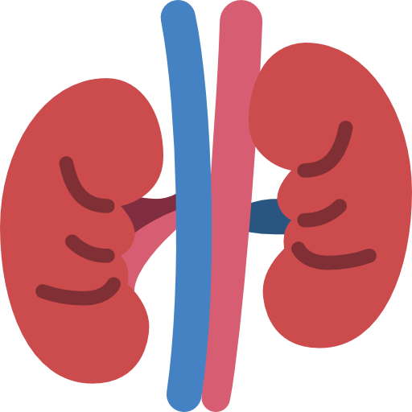
Urological Causes
Kidney, Bladder, Ureteric Stones
Kidney and Ureter:
Mineral deposits form in kidney, move to ureter.
Often associated with history of recent UTI.
Symptoms:
Severe flank pain radiates to groin, scrotum.
Nausea, vomiting, hematuria.
Restlessness
Bladder:
Stones may form in the bladder in association with stasis, infection or tumour, or enter from the ureter. There is always a degree of bladder outlet obstruction, otherwise the stone would have been rapidly voided.
Symptoms:
The most common symptom is an increased frequency of micturition.
Intermittent sudden cessation of urinary flow, relieved by lying down.
Suprapubic stabbing pain, exacerbated by standing.
Haematuria, particularly at the end of micturition.
Acute and Chronic Urinary Retention
Causes of retention:
Mechanical or Neurogenic.
Acute:
Sudden, painful inability to micturate.
Chronic:
Painless and there is a chronically distended bladder whether or not the patient is having difficulty micturating.
Has 2 types:
High-pressure type, the cause is obstruction of the bladder outlet which ultimately results in renal failure, of the post-renal type.
Low-pressure type, the fault seems to lie with the bladder muscle, which is atonic. There is no back-pressure effect on the kidneys.
Urinary Tract Infection (Cystitis, Pyelonephritis)
Suggestive of Cystitis: Suprapubic pain, lower urinary tract symptoms (frequency, urgency, dysuria) without or with low-grade fever
Consider interstitial cystitis if presenting with chronic recurrent suprapubic pain (at least 6 weeks) and is relieved by voiding. The diagnosis is usually clinical.
It is a non infectious disease with unknown etiology
Urine culture and urinalysis: rules out cystitis
Cystoscopy: rules out cancer (it can show Hunner lesions which are ulcers and patches on bladder wall)
Treatment:
Behavioural (first-line): avoid caffeine and recognized triggers with bowel training.
Amitriptyline in persistent pain
Intravesical lidocaine with heparin or sodium bicarboante, intravesical steroids, removal of Hunner lesions as a last resort.
Suggestive of Pyelonephritis: High-grade fever, chills, right flank pain, costovertebral angle tenderness, nausea and vomiting

Slide 27
Central Abdominal Pain

Slide 28
Gastroenteritis
Usually acute and associated with fever, abdominal pain and diarrhea (watery or bloody)
History of travel, food poisoning (S. aureus), undercooked food (C. jejuni, Shigella, Yersinia), water contamination (Giardiasis, Cholera), prior antibiotic use (C. difficile) are key features.
Yersinia ileitis can mimic appendicitis and IBD even on endoscopy and merits stool analysis for distinction. Remember to rule out infections before diagnosis of IBD.
Other Infectious Variants
Typhoid Fever
Caused by S. typhi, S. paratyphi and several other Salmonella species.
Pathophysiology: Attaches to enterocytes → endocytosis → kills enterocytes → enters underlying blood vessels → bacteremia → picked up by reticuloendothelial system → multiplies and eventually kills phagocytes → further bacteremia and multiorgan infection.
Transmission: Fecal-oral route
Clinical Features (IP: 7-14 days)
First Week: Fever, abdominal pain, diarrhea or constipation
Second Week: Fever, rose-colored spots (rash on the abdomen and chest), typhoid tongue (grey or yellowish with reddish edges), neurological symptoms (coma, headache, delirium).
Third Week: Week two features + GIT ulceration or perforation. If it perforates → severe abdominal pain and all the signs of peritonitis will be present. Bleeding, hepatosplenomegaly, greenish soup-like diarrhea and rarely meningitis, sepsis and renal failure.
Treatment: Fluoroquinolones (first-line), 3rd generation cephalosporins and amoxicillin-clavulanic acid (first-line in pregnancy, children, severe illness and South Asian patients
Mesenteric Adenitis
Inflammation of the mesenteric lymph nodes (>3 nodes, 5mm or greater in the right lower quadrant).
It’s usually due to an infectious process (organisms leaking through the interstitial space and subsequently the lymph vessels and nodes).
The lymph nodes may show necrosis or immunogenic hyperplasia.
Clinical Features
Diagnosis
Treatment
Causative Agents
Fever, RLQ pain (mimics appendicitis), diarrhea
Usually upon surgical exploration . US is usually the initial the modality of choice and can differentiate mesenteric adenitis from appendicitis. CT is sometimes considered the modality of choice in older patients.
Broad-spectrum antibiotics (covers Yersinia e.g. ciprofloxacin). Mild cases don’t require antibiotics.
Yersinia (most common), Mycobacterium tuberculosis, HIV and gastroenteritides pathogens.

Slide 29
Gastrointestinal Tuberculosis
Can affect any part of the alimentary tract.
Route of infection is usually by infiltration of the gut mucosa by swallowed organisms.
Pulmonary involvement is seen in approximately half of the patients.
The most common sites of involvement are the ileum and cecum in 75% cases.¹
The ileocecal valve is usually involved, this finding helps to differentiate TB from Crohn’s disease.
Three main lesions
Ulcerative lesions (most common): Multiple superficial lesions
Hypertrophic lesions: Fibrosis, heaped-up masses that can mimic a carcinoma.
Ulcerohypertrophic: Combination of the two.
The mesenteric lymph nodes may be enlarged.
The mucosa might look cobblestoned and edematous, much like Crohn’s, except that the ulcers tend to be circumferential and perpendicular to the longitudinal axis of the gut.
Pathology
Abdominal pain (90%, most common)
Constitutional symptoms (Fever, fatigue, weight loss, loss of appetite)
Abdominal mass (usually deep in the right lower quadrant). Ascites or signs of chronic intestinal obstruction, together with evidence of TB infection other sites (lungs, cervical LN)
Clinical Features
Ulcer → bleeding → anemia
Ulcer → extension → fistula
Ulcer → penetration → perforation
Intestinal obstruction → reduced bacterial clearance → overgrowth → malabsorption
Complication
CT findings (Initial modality of choice): Might show lymphoadenopathy and thickening of the bowel loops.
Endoscopy: Circumferential perpendicular superficial ulceration, friable mucosa.
Definitive diagnosis: Identification by acid-fast stain in cultured tissue or throuagh PCR.
Barium enema (characteristic): Stirelin’s sign of incompetent ileocecal valve and tapering (conification) of the cecum.
Diagnosis²
Treatment: TB drugs (Rifampicin, INH, pyrazinamide, ethambutol)
Duration: Controversial, 12 months might just be suitable.
Indications for surgery: Obstruction, fistula, mass lesions, perforation, massive hemorrhage.³
Treatment
Less common sites (in order of descending frequency of involvement): ascending colon, jejunum, appendix, duodenum, stomach, esophagus, sigmoid colon, and rectum.
These features closely resemble Crohn’s disease and Y. enteroclotica infection, it is prudent to obtain a biopsy for a definitive diagnosis.
Sources suggest that the first two usually respond usually respond to medical treatment, however careful medical judgement is needed to avoid complete obstruction or the spread of the infection.

Slide 30
Small Bowel Neoplasms
5% of all GIT neoplasms, >90% are benign, the rest are malignant.
Malignant small bowel neoplasms (in order of frequency): Adenocarcinoma, carcinoid, lymphoma and GISTs
All can potentially present with abdominal pain, bleeding and obstruction. Unique clinical presentation occurs in carcinoid syndrome (very rare).
Adenocarcinoma of the Small Bowel
Two-thirds of small bowel malignancies.
Highest incidence of adenocarcinoma is in the duodenum.
Other Risk Factors: Alcohol, APC mutations (10% risk to develop duodenal cancer), celiac disease and Crohn’s disease.
Symptoms:
Duodenal: Abdominal pain, obstruction, nausea, vomiting, bleeding and anemia.
Jejunal and Ileal: Asymptomatic or nonspecific symptoms (Pain, malaise and nausea), advanced cases present with obstruction, bleeding or even perforation.
Diagnosis
Treatment
Duodenal: Upper endoscopy (modality of choice) imaging studies show filling defects or thickening, CA-19-9 is elevated in one-third of the patients.
CT: For staging the tumor.
Endoscopic US: Local invasion of vascular structures to assess resectability.
Surgical resection
Jejunal and Ileal: Difficult to scope, plain radiography, CT and MRI are often used.
If there is a high suspicion of malignancy (e.g. Crohn’s) → balloon-assisted endoscopy and capsule endoscopy.
Small Intestinal Carcinoids
Strongest risk factor is family history of an extrapulmonary carcinoid neoplasm and genetic disorders (MEN1, VHL, NF1, tuberous sclerosis).
Sporadic risk factors are unknown.
Symptoms:
Carcinoid syndrome from excess serotonin (uncommon):, flushing, shortness of breath, diarrhea,
Mass symptoms: Abdominal pain, intermittent obstruction, bleeding or could be totally asymptomatic.
Diagnosis
Treatment
24-hour urinary sample of 5-HIAA (serotonin metabolite)
Endoscopy with US: Gastric, rectal and duodenal carcinoids (confirmatory test)
CT and MRI: Helps in staging, calcifications may be seen.
Surgical resection
Octreoscan (somatostatin receptor scintigraphy): For staging and to detect small neoplasms or remnant metastases.

Slide 31
Colorectal Carcinoma
Introduction
Colon cancer (CC) is the leading type of cancer in men and the 3rd runner for women of Saudi Arabia.
Adenocarcinoma of the colon is the most common malignancy of the gastrointestinal tract (constitutes 98% of all cancers in large intestine).
Risk Factors
01
Male gender (1.5 greater lifetime risk)
02
Strong family history (35% of incidence due to genetics)
Autosomal dominant (HNPCC¹ “most common”, FAP, PJS, JPS)
Recessive inheritance (MUTYH associated polyposis)
03
IBD
04
Western diet, specifically:
Low fiber → reducing stool bulk and altering gut microbial profile → proinflammatory flora → constant cell turnover → increased chance of mutation and cancer
High fat → enhances cholesterol synthesis and bile acids which get can potentially get converted to carcinogens
Red meat and high energy diets
Low calcium and vitamin D
Alcohol and smoking (mainly in men)
Protective Associations
01
Aspirin
02
Vitamin D and calcium supplements
03
Hormone replacement therapy
04
Diet: High fiber diet including brassica vegetables, such as broccoli, contain antioxidants and potential antineoplastic compounds.
Males are at a greater risk, also associated with endometrial, gastric, ovarian, urothelial, and small intestinal cancers. It is due to to a mutation in mismatch repair genes such as: MLH1, MSH2 and MSH6

Slide 32
Major and Recognized Pathoetiologic Pathways
APC/Beta catenin pathway OR Adenoma to Carcinoma pathway (common): Normally APC binds to beta-catenin (proliferative marker) to suppress it from hyperproliferation. If APC is abnormal or absent: hyperproliferation→ dysplastic adenoma→KRAS mutation & other mutations → P53 mutations and finally invasion of basement membrane.
DNA mismatch repair pathway (MSI-H tumors): gives rise to hereditary non-polyposis colon carcinoma.
Clinical Features
There are no specific features to distinguish a malignancy from a benign disease.
CC can be divided anatomically into; right-sided (proximal) and left-sided, including the rectum (distal).
Both of which have unique clinical presentation and manifestation:
Hepatomegaly may be present
Perianal or sciatic pain is indicative of local invasion
Both commonly metastasize to: liver, lung, peritoneum and to lesser degrees the spleen and ovaries.
Cecum and Rt. colon (proximal)
Left colon and rectum (distal)
Better prognosis
Polypoid, fungating that are sometimes asymptomatic but present with iron deficiency anemia (due to melena) and weight loss.
Usually silent until it has grown to a considerable size.
More aggressive
Annular, encircling with early-symptoms of obstruction, tenesmus.
Majority of colon cancers → sigmoid & recto-sigmoid junction.
Presents with a change in the bowel habit (alternating constipation & diarrhea)
Screening
45 and above for males and 50 and above for females in Saudi Arabia and then every 10 years by colonoscopy¹. High risk? screen every 2-3 year.
Previous CRC: Colonoscopy at 1 year after resection, then at 3 years then every 5 years.
Previous history of adenomatous polyp: Colonoscopy every 3-5 years.
Positive Family History (single member): Start at 40 or 10 years earlier than index case, whichever is earliest, every 5-10 years (5 if family history of cancer or advanced adenoma <60) by colonoscopy.
3 family members, 2 generations, 1 premature (age <50) as in hereditary nonpolyposis colon cancer syndrome (HNPCC): Screening at age 25 with colonoscopy every 1–2 years.
Familial adenomatous polyposis (FAP): beginning at age 12, sigmoidoscopy every year.
Inflammatory bowel disease → Eight years after diagnosis with follow-up every 1-3 years.
CT angiography is excellent but polyps under 3 cm can’t be seen with it

Slide 33
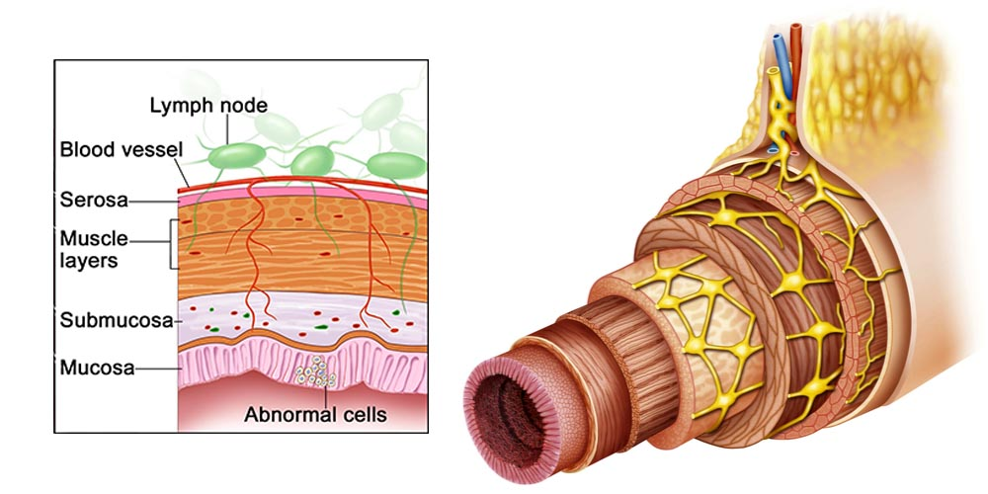
TNM Staging
Stage | Involvement
Tumor
TX | Cannot be assessed
T1 | Limited to mucosa and submucosa
T2 | Extends to muscularis propria
T3 | Extends through muscularis propria to perirectal or pericolic tissues
T4 | Extends to adjacent structures or organs
Nodes
NX | Cannot be assessed
N0 | None
N1 | <4 regional lymph nodes
N2 | 4 or more regional lymph nodes
N3 | Distant lymph node involvement
Metastasis
MX | Cannot be assessed
M0 | None
M1 | Distant metastasis
Other Staging Methods

Slide 34
Diagnostic Workup
Digital Rectal Examination: <10% are palpable
Colonoscopy and Biopsy: Gold-standard, the whole colon should be scoped.
Double-contrast barium enema: If colonoscopy is incomplete
Look for a filling defect or an apple core lesion
Staging
Endorectal Ultrasound: Depth of infiltration
CT or MRI of chest, abdomen and pelvis
Carcinoembryonic Antigen (CEA): Treatment monitoring, recurrence and progression.
Treatment
Total resection with metastasectomy (mainstay): If the patient can tolerate it followed by chemotherapy according to sensitivity.
If a patient can not tolerate surgery or in cases of extensive metastasis: Palliative chemotherapy or radiotherapy and surgery can be indicated to prevent or treat complications.
Mucinous subtypes are diagnosed late associated with a poor prognosis and are sometimes considered to be high risk.
CLICK HERE TO REVIEW THE LECTURE FROM SURGICAL RECALL

Slide 35
General Abdominal Pain

Slide 36
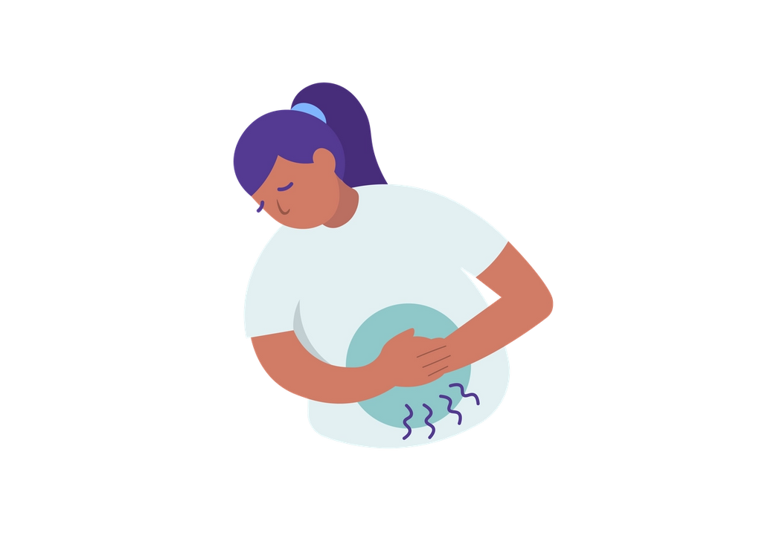
Peritonitis
these Peritonitis may affect the entire abdominal cavity or localized a portion of the visceral or parietal peritoneum
Pathophysiology:
Causes:
these Patients with extensive ‘seedling’ metastases through out the peritoneal cavity may develop a non-specific aching abdominal pain which they find difficult to describe and which may be associated with few physical signs.
Eventually, clinical ascites, abdominal masses, evidence of tumour at other sites and generalized weight loss and cachexia make the diagnosis obvious
01
02
03
Inflammatory insult
Peritoneum response
Localize the Inflammation
Bacteria or irritating chemicals
increased blood flow
increased permeability
formation of a fibrinous exudate
to contain the inflammation
fibrinous surface and decreased intestinal movement cause adherence between the bowel and omentum or abdominal
Gram-negative infections ( Normal flora) with enteric organisms or anaerobes most common
Noninfectious inflammation (common example; pancreatitis)
pneumococcus or hemolytic streptococcus cause primary peritonitis occurs more commonly in children Babies takes time to develop the normal flora
secondary peritonitis: Adults with ascites and cirrhosis can develop primary peritonitis, and in these cases the organisms are usually Escherichia coli and Klebsiella
gram-positive cocci in adults with end-stage renal disease on peritoneal dialysis not hemodialysis, most common organisms being primary & secondary
Irritable bowel syndrome
The irritable bowel syndrome is a functional disorder of the bowel of unknown aetiology which causes chronic intermittent abdominal pain, very vague ill defined pair that may be associated with changes in bowel habit and abdominal distension.
Clinical features: Normal examination, Constipation / diarrhea, On and off pain and Discomfort.
Diagnosis of exclusion, The following symptoms suggest the diagnosis of irritable bowel syndrome:
continuous or recurrent abdominal pain or discomfort for at least 3 months – relieved by defecation
It is important to exclude all other causes of abdominal pain, so enquire about any symptoms or signs that might indicate the presence of organic disease such as anaemia, bleeding, weight loss, fever or a change in bowel habit
a change in the frequency of defecation
a change in the consistency of the stool

Slide 37
Recurrent adhesive bowel obstruction
Adhesive obstruction is suggested when the signs and symptoms of small bowel obstruction develop in a patient with an abdominal scar, patient present with Nausea, vomiting, Constipation and Obstipation
Congenital bands and internal hernia may also cause recurrent episodes of small bowel obstruction
Mortality caused from dehydration due to loss of fluids, electrolytes and proteins, septicemia and toxemia in strangulated cases
Clinical Features
Diagnosis
Four cardinal symptoms:
Colic abdominal pain the bowel try to push more and more
Distension
Vomiting due to back flow
Obstipation failure to pass stool gas
They occur in this order in small bowel obstruction, and the sequence is reversed in large bowel obstruction
Adhesive obstruction is a difficult diagnosis to make and is often applied incorrectly to any patient who experiences pain after abdominal surgery
The diagnosis can only be made with certainty when the obstruction becomes acute and laparotomy confirms the presence of adhesions obstructing the bowel.
Diffuse carcinomatosis
these Patients with extensive ‘seedling’ metastases through out the peritoneal cavity may develop a non-specific aching abdominal pain which they find difficult to describe and which may be associated with few physical signs.
Eventually, clinical ascites, abdominal masses, evidence of tumour at other sites and generalized weight loss and cachexia make the diagnosis obvious
Constipation
Acute constipation: Pain, tenderness and hard mass (stool)
Severe chronic constipation may cause a rather indeterminate abdominal pain and general abdominal distension (according to the doctor no pain because its chronic)
In these cases there are hard faeces in the rectum and palpable, indentable masses in the abdomen
In fecaloma CT scan will show that feces reached the terminal ileum (abnormal) “Normally the bowel is liquid and water absorption happens in the colon”

Slide 38
Radiation visceral damage
Most patients develop transient diarrhoea at the time of the radiation, but some present months or years later, when fibrosis and strictures form, with colicky or continuous pain, vomiting, weight loss, constipation or diarrhoea.
Eventually, the endarteritis in the small mesenteric vessels, caused by the irradiation, may lead to ischaemia, necrosis and perforation of the bowel it damage the surrounding structure
Lumbar spinal pain
Pain caused by abnormalities in the spine may radiate from the back to the front of the abdomen and cause diagnostic difficulties. Nerve root orginate mainly from lumbar region
Any suggestion that an abdominal pain is affected by movement and position should indicate the possibility that the pain is arising in the back
This can sometimes be confirmed by careful examination of the spine
Extensive retroperitoneal fibrosis
very rare & unknown case
It often causes a vague central, persistent abdominal pain
If the fibrosis obstructs the vena cava, the patient may present with the symptoms of an acute deep vein thrombosis or oedema of the lower limbs
Psychosomatic
Diagnosis of exclusion
the pain has no organic origin
some patients with profound psychological disturbances, severe anxiety or ‘cancer phobia’ who persistently present with abdominal pain for which no cause can be found
malingering: the pain has no organic origin they & don’t have psychological disease the patient لعاب
Beware of adopting the ‘cry wolf ’ attitude. Each new episode of pain requires an open-minded new history and examination.

Slide 39
General notes
We can divide the abdomen into quadrants and it’s important because it can shape your differential diagnosis by relating the pain to an organ.
Acute abdominal pain is the pain acutely presented ( less than 24 hours up to a few weeks ) or the patient is known to have chronic abdominal pain and had an episode of acute pain ( example chronic pancreatitis patients ).
Chronic abdominal pain patients are less likely to have life threatening conditions.
Surgical abdomen : can present sometimes with peritonitis and you should pay attention to these signs because they usually indicate either perforation, ischemia or catastrophic intra abdomen.
In generalized AP or peritonitis If you detect a mass on the physical exam that means it’s AAA
Hepatitis can cause abdominal pain but rarely
General Abdominal Pain
Diffused pain is mainly caused by peritonitis or any acute severe disease of the abdomen
Vague not specific, related to the gastrointestinal tract most of the time
Abdominal Aortic Aneurysm might cause generalized abdominal pain
Any irritation to the peritoneum will cause pain (free poreferation)
Carcinoma of the stomach, Liver metastasis, splenomegaly were mentioned in the objectives but according to the doctor they don't cause abdominal pain why?
Splenomegaly: it’s like any other organ megaly why should it? It causes discomfort and indigestion
Carcinoma of the stomach : ulceration → bleeding → gastritis → might cause pain
Liver metastasis if it causes perforation or bleeding
Generally they don't cause pain “period”
Neoplasm, lumbar spine, extensive retroperitoneal fibrosis mentioned in the objectives but the doctor doesn't believe that it causes pain
Neoplasm: high pressure and the tumor is 20 cm or larger (severe compression) it will press on the retroperitoneal organs and cause pain other than that no pain because if it did we would’ve discovered the tumor early on
Iatrogenic abdominal pain
Laparoscopic surgery → infiltrates to the abdomen with CO2 which is very irritable to the bowel → will be absorbed by the bowel and the patient will return to normal

Slide 40
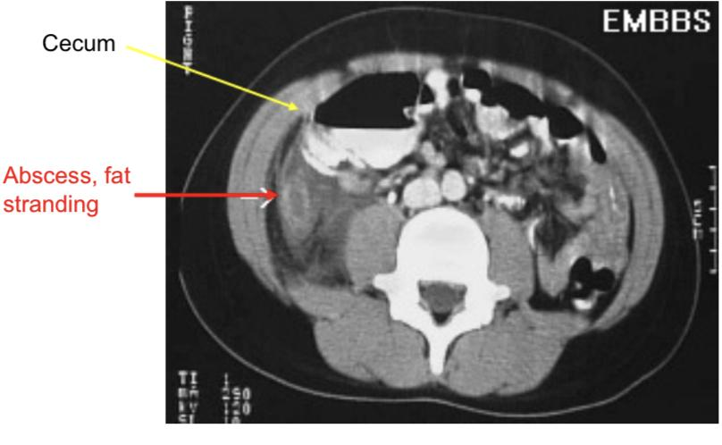
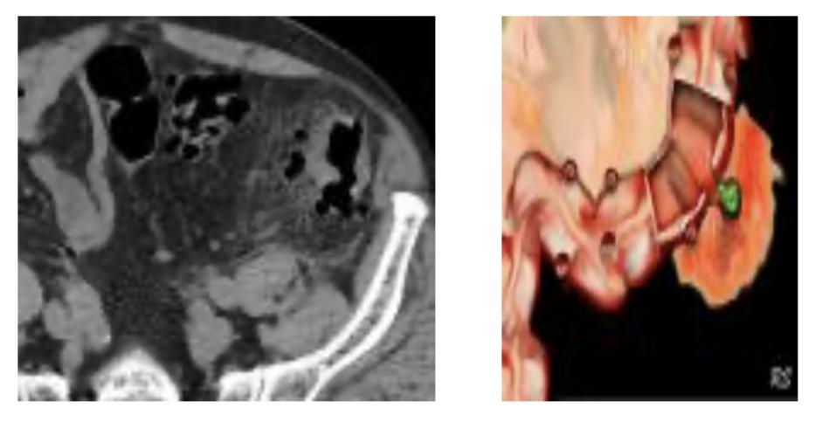
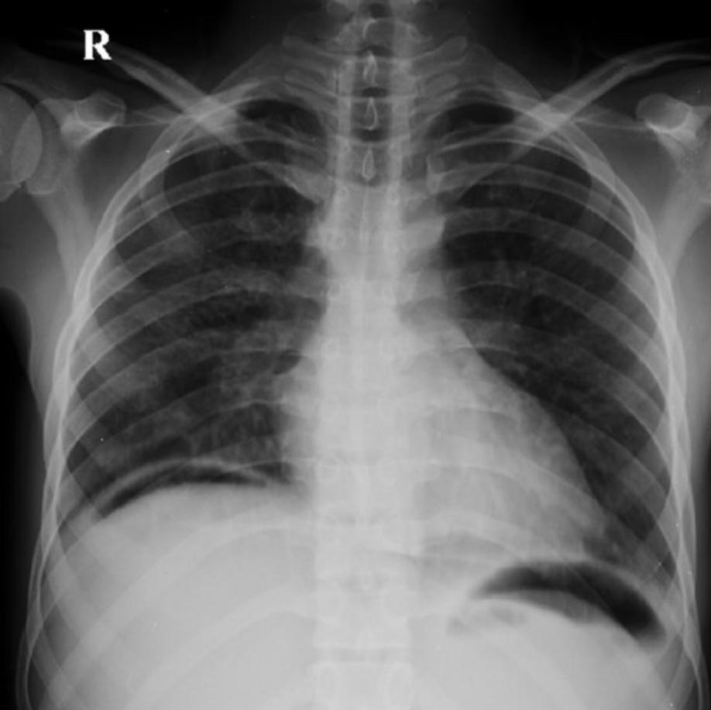
Cases from the doctor
Case 1:
24 years old healthy male with one day history of abdominal pain. Pain was generalized at first, now worse in right lower abdomen & radiates to his right groin. He has vomited twice today. Denies any diarrhea, fever, dysuria or other complaints.
T: 37.8, HR: 95, BP 118/76, Uncomfortable appearing, slightly pale. Abdomen: soft, non-distended, tender to palpation in RLQ with mild guarding; hypoactive bowel sounds. What is your differential diagnosis and what do you do next?
Appendicitis
The patient’s pain is localized on the RLQ.
Investigations: History,
Physical exam: tender RLQ,
Labs: Slight increase in WBCs otherwise normal
Imaging: plain imaging is unremarkable, US, CT.
Case 2:
68 years old Female with 2 days of LLQ abdominal pain, diarrhea, fevers/chills, nausea; vomited once at home.
Past medical history: HTN on hydrochlorothiazide, T: 37.6, HR: 100, BP: 145/90, R: 19. Abdomen: soft, moderately LLQ tenderness. What is your differential diagnosis & what next?
Diverticulitis
DDx: Diverticulitis, cystitis, Acute pancreatitis, same as Suprapubic differentials.
Investigations: History, physical exam,
Lab: CBC, electrolytes, LFT, RFT, UA, Lipase and amylase
Imaging: X RAY followed by CT OR CT right away
Case 3:
46 years old male with history of alcohol abuse with 3 days of severe upper abdominal pain, vomiting, subjective fevers.
Vital signs: T: 37.4, HR: 115, BP: 98/65, Abdomen: mildly distended, moderately epigastric tenderness, +voluntary guarding
What is your differential diagnosis & what next?
Pancreatitis
DDx: Pancreatitis, peptic ulcer, esophagitis
Approach: labs: CBC, electrolytes, LFT, RFT, UA, Lipase and amylase
Imaging: CT
Case 4:
72 years old male with history of CAD on aspirin and Plavix with several days of dull upper abdominal pain and now with worsening pain “in entire abdomen” today. Some relief with food until today, now worse after eating lunch
T: 99.1, HR: 70, BP: 90/45, R: 22
Abdomen: mildly distended and diffusely tender to palpation, rebound and guarding
What is your differential diagnosis & what next?
Peptic Ulcer Disease
DDx: perforation from Stomach due to peptic ulcer disease due to NSAIDs
Usually those patients can relieve their pain by drinking milk or taking antacids but when the perforation happens that can lead to generalized peritonitis and it can wake the patient up
CXR: shows air under the diaphragm as a sign of gastric perforation

Slide 41
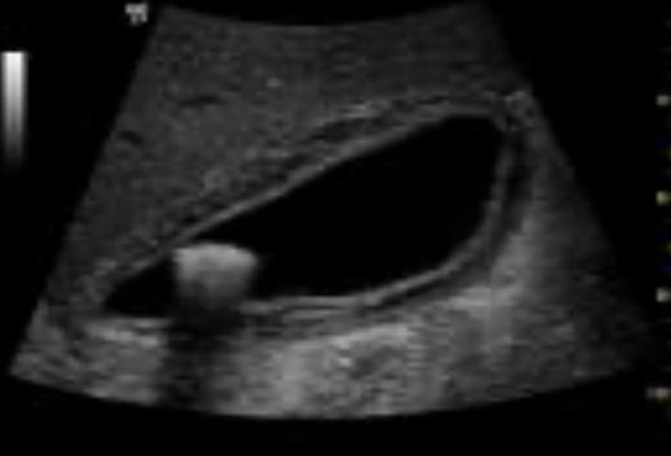
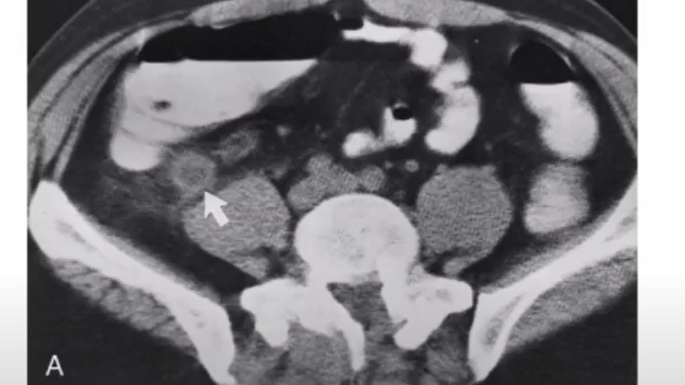
Cases from the doctor
Case 5:
35 years old healthy female to ED c/o nausea and vomiting for 1 day along with generalized abdominal pain
T: 36.9, HR: 100, BP: 130/85, R: 22
Abdomen: moderately distended, mild TTP diffusely, hypoactive bowel sounds, no rebound or guarding
What is your differential and what next?
Bowel Obstruction
Approach: labs: CBC, electrolytes, LFT, RFT, UA, Lipase and amylase
Imaging: CXR multiple air-fluid levels and dilated intestine.
Small bowel obstruction causes: all types of hernia, foreign body ingestion,...
Clinical features: The pain can be diffused or periumbilical.
History: the patient will report to you that they haven’t had any bowel movements
And classically present with distended abdomen N\V
Case 6:
48 years old Female with one day history of upper abdominal pain after eating, N/V, no diarrhea, subjective fevers.
T: 100.4, HR: 96, BP: 135/76, R: 18
Abdomen: moderately TTP RUQ, +Murphy’s sign, non-distended, normal bowel sounds
What is your differential diagnosis & what next?
Cholecystitis
DDx: Cholecystitis
Approach : labs: CBC, electrolytes, LFT, RFT, UA, Lipase and amylase
Imaging: US the modality of choice.
If all came out negative we can do an endoscopy.
Case 7:
83 years old female brought to emergency department by daughter, with progressive weakness & functional decline over the past 5 days, initially vague abdominal complaints, on physical exam she looks sick, & she has generalized tenderness maximum over RUQ. DDx?
Pancreatitis , Cholysitis, Cholangitis, PUD
Generalized tenderness? Perforated Ulcer.
Case 8:
19 years old male with periumbilical pain that shifted to RUQ, on exam he was febrile, sick, and has RLQ tender.
CT scan showed:
What is the diagnosis? Appendicitis.

Slide 42
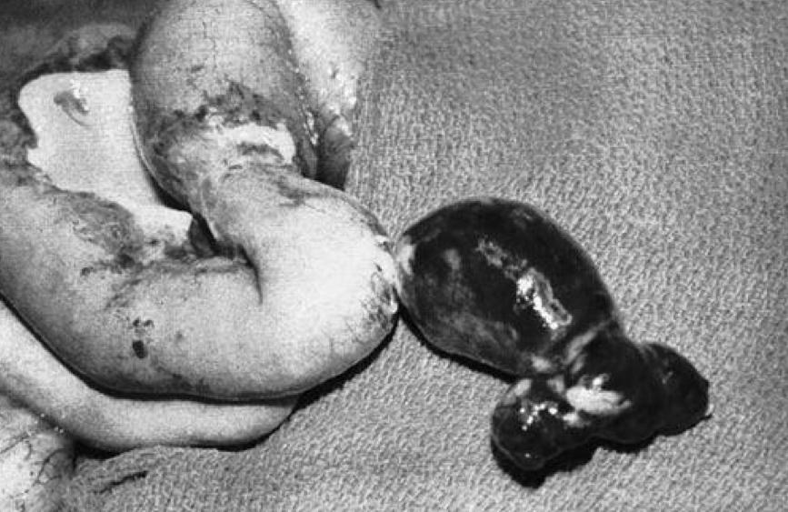
Quiz
MCQ
Q1:A 42-year-old man with no history of use of NSAIDs presents with recurrent gastritis. The patient was diagnosed and treated for Helicobacter pylori 6 months ago. Which of the following tests provides the least invasive method to document eradication of the infection?
A)Serology testing for H pylori
B)Carbon-labeled urea breath test
C)Rapid urease assay
D)Histologic evaluation of gastric mucosa
E)Culturing of gastric mucosa
Q2:. A 22-year-old college student notices a bulge in his right groin. It is accentuated with coughing, but is easily reducible. Which of the following hernias follows the path of the spermatic cord within the cremaster muscle?
A)Femoral
B)Direct inguinal
C)Indirect inguinal
D)Spigelian
E)Interparietal
Q3:A 29-year-old woman complains of postprandial right upper quadrant pain and fatty food intolerance. Ultrasound examination reveals no evidence of gallstones or sludge. Upper endoscopy is normal, and all of her liver function tests are within normal limits. Which of the following represents the best management option?
A)Avoidance of fatty foods and reexamination in 6 months.
B)Ultrasound examination should be repeated immediately, since the false negative rate for ultrasound in detecting gallstones is 10% to 15%.
C)Treatment with ursodeoxycholic acid.
D)CCK-HIDA scan should be performed to evaluate for biliary dyskinesia.
E)Laparoscopic cholecystectomy for acalculous cholecystitis.
Q4:A 28-year-old woman who is 15 weeks pregnant has new onset of nausea, vomiting, and right-sided abdominal pain. She has been free of nausea since early in her first trimester. The pain has become worse over the past 6 hours. Which of the following is the most common non obstetric surgical disease of the abdomen during pregnancy?
A)Appendicitis
B)Cholecystitis
C)Pancreatitis
D)Intestinal obstruction
E)Acute fatty liver of pregnancy
Q5:An 18-year-old woman presents with abdominal pain, fever, and leukocytosis. With the presumptive diagnosis of appendicitis, a right lower quadrant (McBurney) incision is made and a lesion 60 cm proximal to the ileocecal valve is identified (see photo). Which of the following is the most likely diagnosis?
A)Intestinal duplication
B)Mesenteric cyst
C)Meckel diverticulum
D)Ileoileal intussusception
E)“Christmas tree” type of ileal atresia
Q6:A 58-year-old man presents with a bulge in his right groin associated with mild discomfort. On examination the bulge is easily reducible and does not descend into the scrotum. Which of the following changes is most concerning for possible strangulation requiring emergent repair of the hernia?
A)Increase in size of the hernia
B)Descent of hernia into the scrotum
C)Development of a second hernia in the left groin
D)Inability to reduce hernia
E)Worsening pain over the hernia with walking
Answers
Click here for explanation
Q1 | B | Q4 | A
Q2 | C | Q5 | C
Q3 | D | Q6 | D
Extra Questions

Slide 43
Quiz
MCQ
Q1:A 28-year-old woman who is 15 weeks pregnant has new onset of nausea, vomiting, and right-sided abdominal pain. She has been free of nausea since early in her first trimester. The pain has become worse over the past 6 hours. Which of the following is the most common non obstetric surgical disease of the abdomen during pregnancy?
A)Appendicitis
B)Cholecystitis
C)Pancreatitis
D)Intestinal obstruction
Q2:An 18-year-old woman presents with abdominal pain, fever, and leukocytosis. With the presumptive diagnosis of appendicitis, a right lower quadrant (McBurney) incision is made and a lesion 60 cm proximal to the ileocecal valve is identified. Which of the following is the most likely diagnosis?
A)Intestinal duplication
B)Mesenteric cyst
C)Meckel diverticulum
D)Ileoileal intussusception
Q3:Which of the following statements about ectopic pregnancy is false?
A) Lower abdominal pain with vaginal bleeding in early pregnancy should alert one to ectopic pregnancy unless otherwise proven.
B)Transvaginal US showing absence of intrauterine gestational sac and a positive urinary pregnancy test points to ectopic pregnancy.
C)Levels of beta-human chorionic gonadotropin (𝛃-HCG) are a useful guide.
D)Laparoscopy is the best diagnostic test.
E)Salpingectomy is the treatment of choice.
Q4:Which of the following statements about pelvic inflammatory disease (PID) is false?
A)The majority are caused by sexually transmitted ascending infection.
B)Streptococcus is the most common organism.
C)A low threshold for empirical treatment should be adopted.
Q5:Which of the following concerning the staging of colorectal cancer are true?
A)T3b refers to invasion of between 5 and 15 mm beyond the muscularis propria.
B)N2 means involvement of four or more regional lymph nodes.
C)V1 means intramural vascular invasion.
D)T0 means tumour limited to mucosa.
E)R0 means complete surgical resection with adequate margins.
Q6:Which of the following is not a clinical presentation of Crohn's disease?
A)Blood Stained diarrhoea
B)Intermittent abdominal pain
C)Mass in the right iliac fossa
D)Typical evening rise of temperature
E)Pneumaturia and urinary tract infections.
Answers
Click here for explanation
Q1 | A | Q4 | B
Q2 | C | Q5 | B,E
Q3 | E | Q6 | D
Extra Questions

Slide 44
We’d like to express our sincere gratitude to our team members.
Thank you for always going above and beyond what’s expected of you.
The time and effort that you have put in are truly exceptional.
We were so fortunate to have you on our team!
Our gratitude also extends to our brilliant note takers.
Despite having a busy schedule, the dedication you showed has impressed us immensely. The exceptionally high-quality work you delivered was remarkable and the dedication you displayed was exemplary.
You were a true asset to our team. Thank you once again for all the effort.
Words will fall small to express the appreciation we have for our intelligent reviewers.
Your diligence as well as dedication to always go the extra mile in order to achieve the best possible results is admirable. The amount of effort that you guys put into this was tremendous. It would not have been possible to reach the goals that we set out to achieve without your help. Our team is truly graced with members like you.
Your hard work is greatly appreciated.
Special thanks to Ibrahim Aldakhil for his phenomenal contribution.
Finally, special thanks to Noura Alturki and Jehad Alorainy.
It’s been an incredible experience to work with leaders whose skills and talents are notable.
Your guidance and advice have been invaluable to us.
We’re, truly, proud and honored to be led by such great leaders.
Thank you for everything.
Surgery Team Leaders:
Nouf Alshammari, Haneen Somily, Naif Alsulais, Mohammed alshoieer

Slide 45
Reviewers
Hashem Bassam
Abdulaziz Alghamdi
Abdullah alghamdi
Omar al-otaibi
Zyad aldosari
Nayef Alsaber
Omar Alshenawy
Note Takers
Razan AlRabah
Lama Alassiri
Jude Alkhalifah
Nujud Alabdullatif
Sedra Elsirawani
Noura Abdulaziz
Leena alnassar
Fawaz Alotaibi
Mohammed Alhamad
Ibrahim Aldakhil
Hamdan Aldossari
Rakan Alfaifi
Fahad alsultan
Bader Alqarni
Members
Noura Alturki
Alhanouf Alhaluli
Wejdan Alnufaie
Abeer Almutairi
Rema Alkahtani
Lama Alzamil
Deema Almaziad
Lina Alosaimi
Ateen Almutairi
Ghalia Alnufaie
Shahad Althaqib
Jehad Alorainy
Mohammed Alhumud

Slide 46
Good Luck!
Team leaders:
Nouf Alshammari
Haneen Somily
Naif Alsulais
Mohammed alshoieer
This lecture was done by:
Noura Alturki
Wejdan Alnufaie
Abeer Almutairi
Rema Alkahtani
Alhanouf Alhaluli
Razan AlRabah
Jude Alkhalifah
Lama AlAssiri
Badr Alqarni
Rakan Alfaifi
Mohammed Alshoieer
Sedra Elsirawani
Fahad Al-sultan
Nujud Alabdullatif
Zyad aldosari
Nayef Alsaber
Feedback
Note taker
Reviewer

