Slide 1
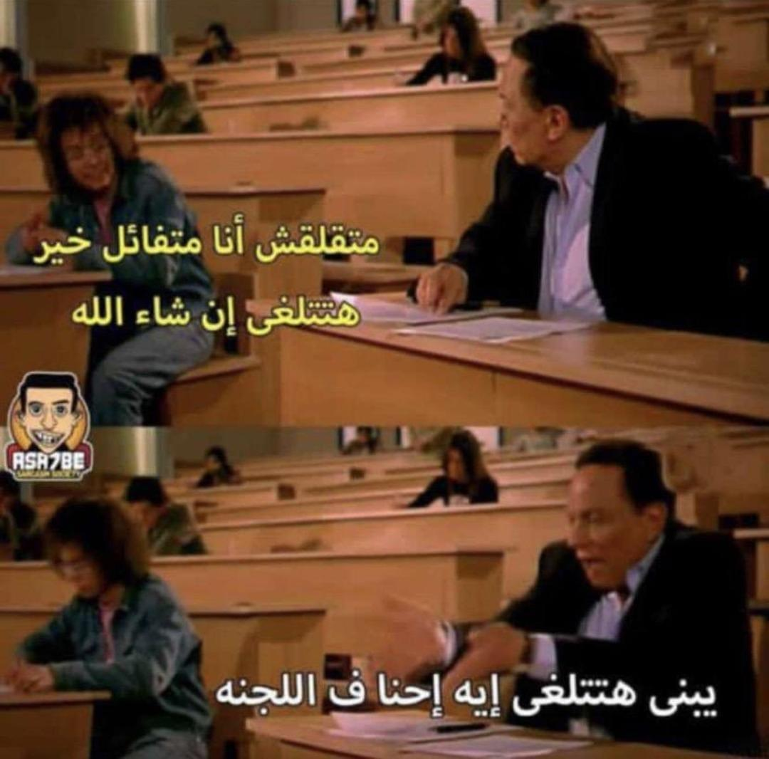
Intra-abdominal and Gastrointestinal bleeding
Objectives
Intra-abdominal hemorrhage:
The student is expected to describe and explain the etiology and clinical features of the following conditions:
Ruptured abdominal aortic aneurysm
Ruptured spleen
Ruptured ectopic pregnancy
Ruptured ovarian cyst
Ruptured liver adenoma
Gastrointestinal hemorrhage
The student is expected to describe and explain the etiology, clinical features and complications of the following conditions:
a- Upper gastrointestinal bleeding
Peptic ulcer disease
Gastroesophageal varices
Portal hypertensive gastropathy
Gastroduodenal tumors
Dieulafoy’s lesion
Mallory Weiss syndrome
Others
Ruptured hepatocellular carcinoma
Ruptured visceral aneurysm (splenic, hepatic and mesenteric)
Retroperitoneal hemorrhage (over anticoagulation)
b- Lower gastrointestinal bleeding
Angiodysplasia
Diverticulosis
Inflammatory bowel diseases
Anorectal conditions
Colitis (infectious and ischemic)
Colorectal tumors
Colorectal polyps
Meckel’s diverticulum
Colour Index
Main Text
Males slides
Females slides
Doctor notes
Textbook
Important
Golden notes
Extra
Editing File

Slide 2
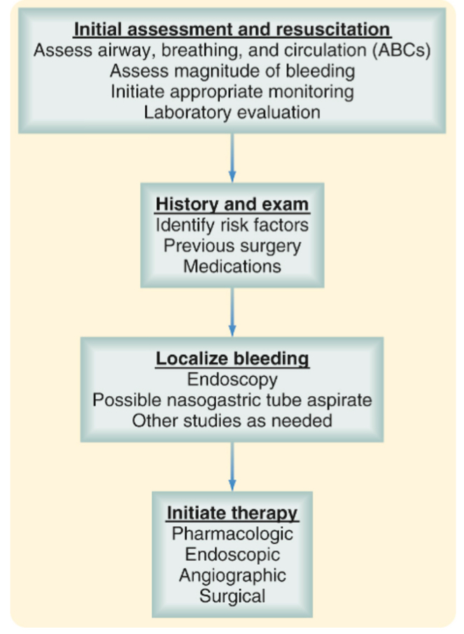
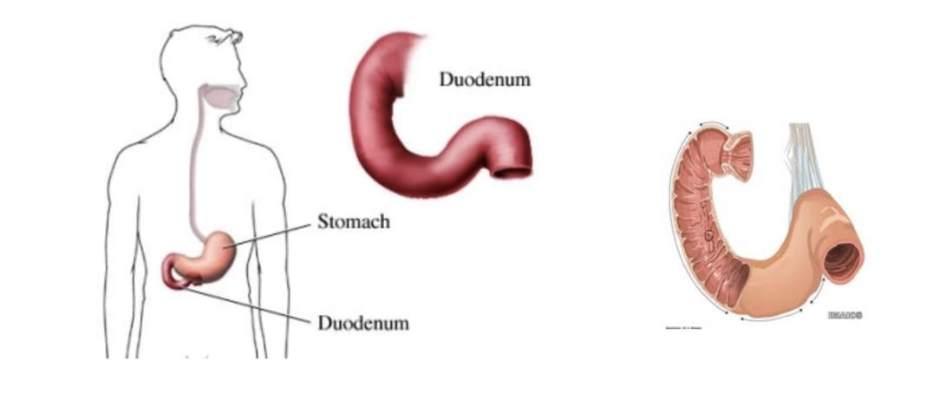
GI Bleeding
“Determination of the site of bleeding is important for directing diagnostic interventions with minimal delay. However, attempts to localize the source should never precede appropriate resuscitative measures”
Sebastian textbook of surgery 20th edition
GI bleedings are a TOP EMERGENCY!
General Approach for trauma and GI bleeding patients:
+CT angiogram with angiogram
We’re too tired to edit it..
Embolization
Upper VS lower GI bleeding
Blue arrow
Anatomical landmark:
4th part of duodenum is suspended by Ligament of Treitz (anything above its level is considered upper GI and anything below is lower GI)
Another reason for this classification is that upper GI scopes can’t exceed the 4th part of duodenum and lower GI scopes can’t reach the terminal ileum.
(we start the management with scoping)
Even though nowadays we have techniques that can scope the small intestines like capsule endoscopy and balloon follow through, their use is limited to diagnosis and biopsies

Slide 3
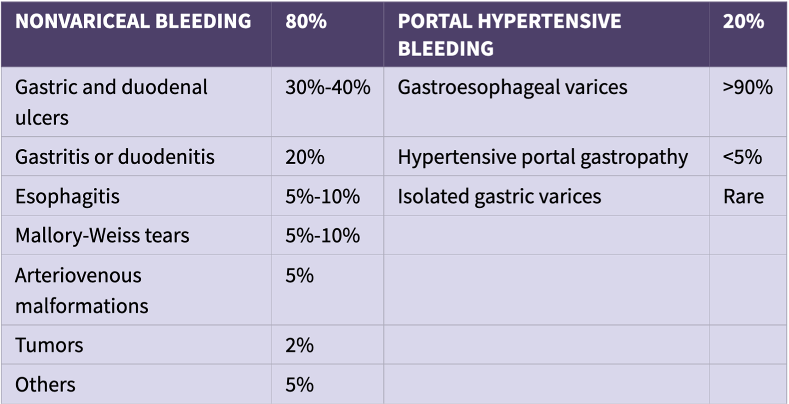
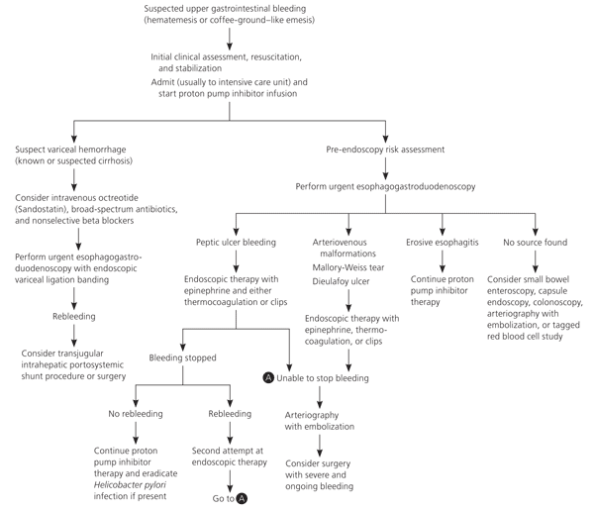
GI Bleeding
History
Examination
Onset today vs 2 months ago
Frequency
Volume try to estimate it by asking the patient and some signs
Type:
Hematemesis vomiting fresh blood
Melena passing black dark stool per rectum (upper GI or proximal colon bleed)
Hematochezia passing fresh blood per rectum (distal source, or a massive upper bleed)
Epigastric tenderness = peptic ulcer disease
Stigmata of liver disease jaundice, spider nevi, palmar erythema,flapping tremor and caput medusae
Telangiectasias can be found in any part of GIT
Masses
Splenomegaly with portal hypertension
Adenopathy indicates malignancy
Rectal examination is a part of the abdominal examination (don’t forget for your OSCE and career)
Upper GI Bleeding
Differential diagnosis (DDx):
Determining whether the bleeding is variceal or not will aid in management and resuscitation
Approach to upper GI bleeding:

Slide 4
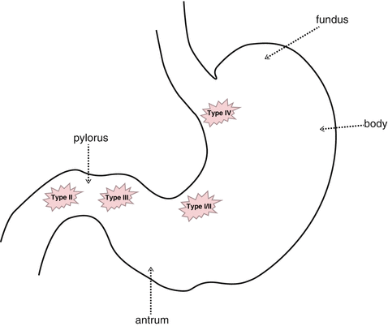
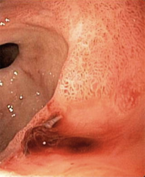
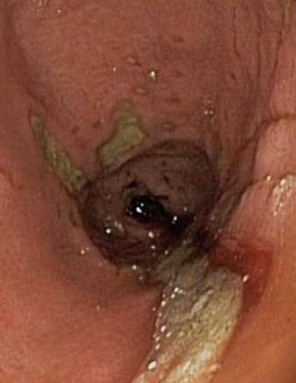
Upper GI Bleeding
Peptic Ulcer disease
Most common cause of upper GI bleeding is PUD (duodenal ulcer is ⅔ of PUD cases).
Approximately 10% to 15% of patients with peptic ulcer disease develop bleeding at some point in the course of their disease (mild bleeding).
Bleeding develops as a consequence of acid-peptic erosion of the mucosal surface. muscular layer is rich in vessels
The most significant hemorrhage occurs when duodenal or gastric ulcers penetrate into branches of the gastroduodenal artery (GDA) .Very Important “you may get asked”: Gastroduodenal artery is the most common artery that may bleed “this question will haunt you for the rest of your life”
Chronic peptic ulcer disease can cause fistula with aorta.
Peptic Ulcer disease
Etiology
Clinical Features
Helicobacter pylori
Nonsteroidal anti-inflammatory agents
Stress
Smoking
Increased acid secretion (e.g ZES)
Recurrent well-localised epigastric pain¹
Heartburn
Anorexia
Waterbrash (a sudden flow of saliva into the mouth)
Intolerance of certain foods
Intermittent vomiting may occur
Etiology
Clinical Features
Treatment: not a part of objectives
We start treating bleedings with one of the following endoscopy techniques:
clipping, banding, sclerotherapy, cauterization and injection of epinephrine.
Since PUD bleeding is caused by rupture of a vessel, the best approach is through clipping.
classically, the pain of a gastric ulcer occurs during eating and is relieved by vomiting. Patients with duodenal ulceration describe pain when they are hungry and pain is relieved by food, antacids, milk and vomiting.

Slide 5
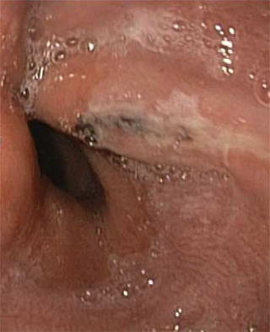
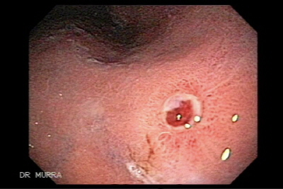
Upper GI Bleeding
Mallory Weiss tear
History of heavy drinking
Longitudinal Mucosal and submucosal tears that occur near the gastroesophageal junction.
Most tears occur along the lesser curvature.
Etiology
Clinical Features
Classically, these lesions develop in alcoholic patients after a period of intense retching and vomiting.
(Retching = forceful projectile vomiting due to strong contraction of the diaphragm).
90% of bleeding episodes are self-limited.
Dieulafoy lesion
Dieulafoy’s lesions are vascular arterial malformations characterized by abnormally large diameter submucosal arterioles which do not decrease in size as they approach the mucosa, if it gets irritated by acidity of the stomach it ruptures causing a massive bleeding.
Found primarily along the lesser curve of the stomach within 6 cm of the gastroesophageal junction.
75% in stomach but can occur throughout the gastrointestinal tract.
Treatment: endoscopic clipping
Etiology
Clinical Features
Not well-understood
High pressure arterial bleeding

Slide 6
Upper GI Bleeding
Gastroduodenal Tumors (Neoplasms)
Neoplasms such as gastrointestinal stromal tumors (GIST) and adenocarcinomas rarely cause UGIB.
Occasionally, might bleed persistently, rebleeding rate is high. They don’t commonly bleed, but once they bleed the rebleeding rate is high. Rebleeding increase the risk of malignancy.
Most characteristic of the GI stromal tumor (GIST) You must remember this tumor.
It presents in different histological grades, If malignant, surgical resection is indicated.
If significant bleeding does occur from a GIST, resection with negative margins can be considered.
Adenocarcinoma rarely presents with massive hemorrhage and frequently can be managed with endoscopic therapy.
Radiation therapy is an alternative.
Tumors which present with hemorrhage are often late stage. Surgical resection would likely be palliative only and should be carefully considered along with goals of care.
GI stromal tumor is the most common tumor that may cause bleeding. Why ? Because it grows from stroma
Presents with melena, if massive bleeding then it is severe. +ve occult blood.
Clinical Features
Usually associated with chronic anemia (Microcytic Hypochromic anemia) or hemoccult-positive stool (blood that is invisible to the naked eye, sensitive but not specific).
Hemobilia
Blood inside the biliary duct.
Treated by correcting the coagulopathy, if it fails treat by embolization, if it fails treat by surgery.
Etiology
Clinical Features
Caused by coagulopathies in elderly post simple procedures.
Causes include:
Liver biopsy
Biliary instrumentation
Hepatocellular carcinoma
Cholangiocarcinoma
Post-cholecystectomy
Jaundice, Right upper quadrant pain and GI bleeding.

Slide 7
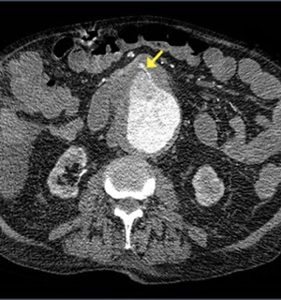
Upper GI Bleeding
Aortoenteric Fistula
Aortoenteric fistulas are classified as primary:
Erosion of the aneurysm into the adjacent bowel,
Infection
Neoplasm
Radiation therapy
Secondary:
Previous endovascular stent or graft aneurysm repair.
Management endovascular stenting +/- open surgical repair.
Etiology
Clinical Features
After repairing an aortic aneurysm with a graft, this graft can erode the bowel wall forming a fistula between the bowel and the aorta, leading to bleeding from aorta to the intestine and bacteremia.
Associated with bacteremia and sepsis.
Other causes
Stress gastritis:
Happens due to inflammatory stress “cytokine storm” (e.g. burn victim, trauma, long term ICU admission, sepsis) where the gastric mucosa is inflamed and starts to slough and necrosis exposing the muscular layer which will start to bleed. The problem here that there is no single source of bleeding, it’s multiple spots. Treated by reversing the underlying cause and PPI to suppress the acid, if that fails you must take the patient to the OR (gastrotomy and suture of the bleeding site).
Esophagitis:
Caused by severe GERD, irritating agents, corrosives and the most common cause is candidiasis with chemotherapy and in immunocompromised patients.
Gastric antral vascular ectasia (GAVE):
telangiectasia of the gastric antrum
Iatrogenic bleeding:
e.g. perforation by a scope or ERCP
Pancreatitis can cause hemorrhage if the enzyme gets in contact with any blood vessels which lead to digestion and hemorrhage.

Slide 8
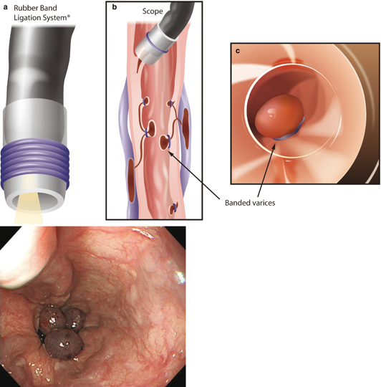
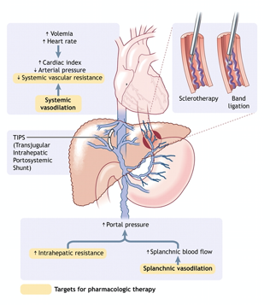
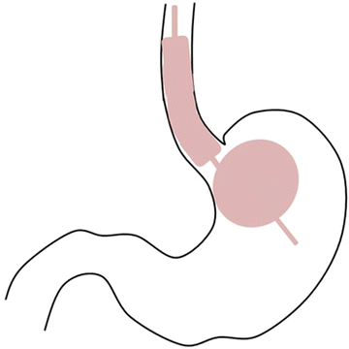
Upper GI Bleeding
Gastroesophageal varices
The most common cause of portal hypertension is cirrhosis
Most commonly the result of bleeding from varices veins. As they enlarge, the overlying mucosa becomes increasingly tenuous, excoriating with minimal trauma.
Most common in the distal lower third of esophagus
May also develop in the stomach and the hemorrhoidal plexus of the rectum and the umbilicus (caput medusa)
When Portal vein pressure increase, veins will develop collaterals “Shunts” which will cause the Varices, Caput medusa & Hemorrhoids depending on the site of shunts.
Approximately 30% of patients with cirrhosis and portal hypertension, and 30% in this group develop variceal bleeding.
Variceal hemorrhage is associated with an increased risk of rebleeding, increased need for transfusions, longer hospital stays, and increased mortality.
6-week mortality rate after the first bleeding episode is almost 20%. Thus after initial management with scope we don't wait for the next episode to intervene, rather 10 days-2 weeks post-scope we scope again and search for prominent veins and band them (veins→banding, arteries →clipping)
Once an episode occur, you shouldn't ignore it
You need firstly to act with the bleeding vessels
Then, occlude every dilate vessel
Then reschedule visit to occlude any additional vessel.
Etiology
Variceal hemorrhage occurs from portal hypertension.

Slide 9
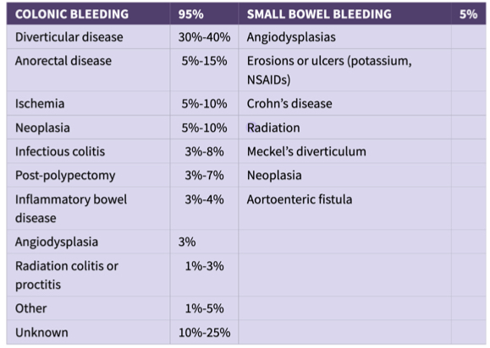
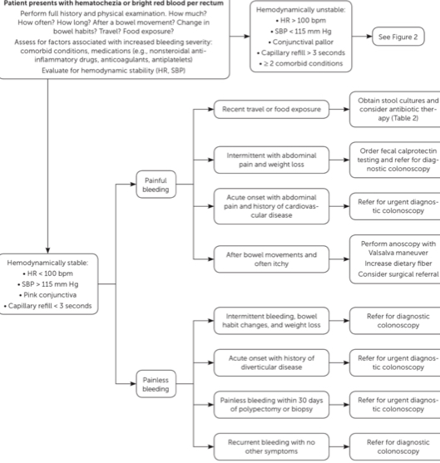
Lower GI Bleeding
Differential diagnosis (DDx):
Approach to hematochezia or rectal bleeding:

Slide 10
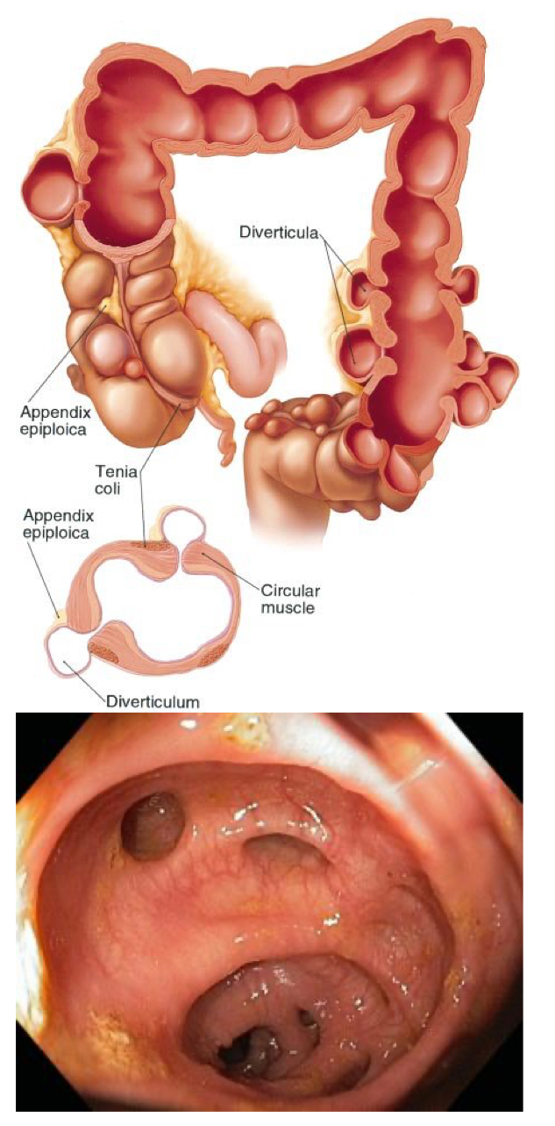
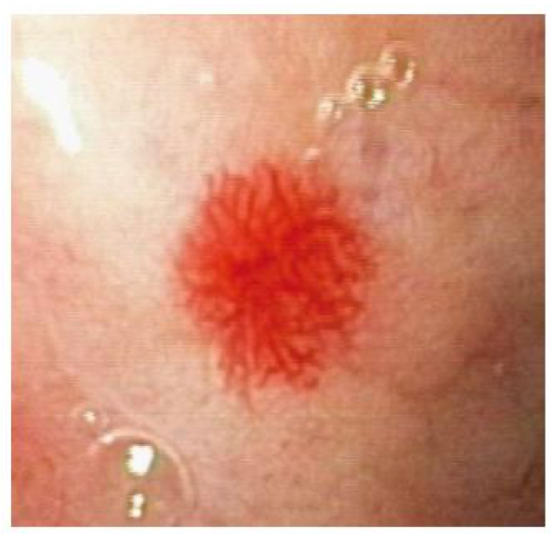
Lower GI Bleeding
Diverticular Disease:
Pseudo-diverticulum.
True diverticulum: all the layers are pouching e.g. Mickle’s
False diverticulum: inner layers will pouch on the outer layer
Most common cause of significant lower GI bleeding.
Only 3% to 15% experience any bleeding.
75-80% resolves spontaneously
10% rebleed within a year.
Most common risk factor is chronic constipation
It is very common
Mostly stops spontaneously, low rebleeding incidence
Colonoscopy is diagnostic gold standard
Once a diverticula occur, it never regress “anatomically”
Diagnosis
Treatment
If bleeding is massive or cannot be controlled by endoscopy treatment:
Angioembolization (risk for perforation & ischemia)
Surgery
best Initial, diagnostic
test and treatment is Colonoscopy
Angiodysplasia:
Etiology
Clinical Features
Acquired arteriovenous malformations.
Secondary to progressive dilation of normal blood vessels within the submucosa of the intestine.
Rare disease, and if present rarely causes major bleeding.
How to differentiate it from Hemangioma ?
Hema is congenital
Angio is acquired
Both are AV malformation
Almost uniformly found in patients > 50, 65 years.
Associated with aortic stenosis and renal failure. Classic presentation: elderly patient with renal failure or aortic stenosis.
Hemorrhage tends to arise from the right side of the colon, most common location is the cecum.
Bleeding stops spontaneously in most cases.
Increased pressure will cause the walls of the veins and arteries to open on each other and form a Star-like sign.

Slide 11
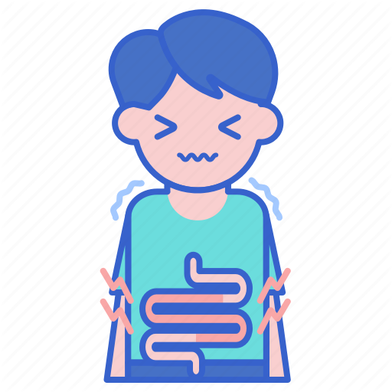
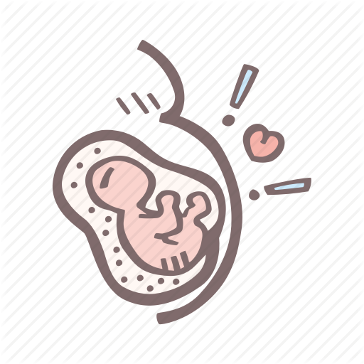
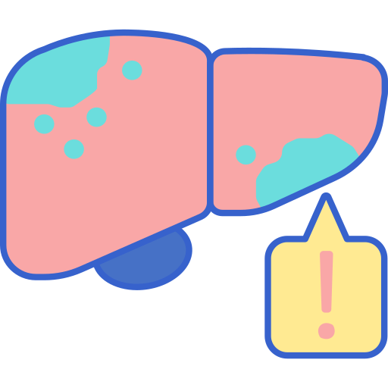
Lower GI Bleeding
Neoplasia: lower GI malignancies are common to bleed
1
Colorectal carcinoma
Uncommon
Painless,
intermittent
Slow -> iron deficiency anemia
Age >50 (Do colonoscopy even if you see by your eyes bleeding hemorrhoids!!) some will also have colorectal cancer
3
Gastrointestinal stromal tumor (GIST)
Anywhere in the GIT
2
Polyps
Can bleed
Most commonly after polypectomy
4
Juvenile polyps
2nd most common cause of spontaneous bleeding in patients < 20 years.
1st most common is Meckel’s diverticulum
 | Colorectal carcinoma | Polyps | Juvenile polyps | Gastrointestinal stromal tumor (GIST)
Bleeding 🩸 | Uncommon Painless, intermittent Slow -> iron deficiency anemia Age >50 (Do colonoscopy even if you see by your eyes bleeding hemorrhoids!!) some will also have colorectal cancer | commonly after polypectomy. | 2nd most common cause of bleeding in patients < 20 years. Younger than 20 (2nd most common in these people) 1st most common is Meckel’s
Anorectal disease:
Major causes: internal hemrrhoid(vascular structures in the anal canal), anal fissures and colorectal neoplasia
Chronic hemorrhoids or fissures can cause anemia. It doesn’t cause shock.
Features:
Low-volume bleeding
Bright red blood per rectum seen in the toilet bowl and on the toilet paper
Tenesmus: feeling of incomplete evacuation
Internal hemorrhoids
Anal fissure
Painless
Often accompanied by prolapsing tissue that reduces spontaneously or has to be manually reduced by the patient.
Painful bleeding after a bowel movement.
Risk factors:
Constipation
Obesity
Pregnancy
Straining during defecation
Liver cirrhosis

Slide 12
Lower GI Bleeding
Anorectal disease:
Approach:
01
02
03
Comprehensive Hx & physical examination.
Auscopy & rectoscopy (if needed).
Exclude other diagnoses. (e.g. colorectal cancer, Crohn disease)
Lifestyle & dietary changes, toileting behavior education, fiber supplements
Grading and management
• Internal Hemorrhoids develop above the dentate line covered by mucous membrane of the upper half( dilated veins)
• External hemorrhoids develop at the anal orifice covered with the skin of the lower half
Grade I | Hemorrhoids don’t prolapse (only project into the anal canal): above the dentate (pectinate) line: reversible, often bleed. Management: Conservative therapy with supplements, dietary & lifestyle changes.
Grade II | Prolapse when straining, but spontaneously reduce at risk . Management: Office-based treatments (e.g. rubber band ligation)
Grade III | Prolapse when straining, only reducible manually. Management: Rubber band ligation, consider surgical management
Grade IV | Irreducible prolapse: may be strangulated and thrombosed with possible ulceration. Surgical management
Grade I
Grade II
Grade III
Grade IV

Slide 13
Lower GI Bleeding
Colitis:
Causes :
02
04
01
Infectious
03
Radiation proctitis
Inflammatory bowel disease
Ischemia
 | Ulcerative colitis | Crohn’s disease
Location | Starts distally in the rectum Progresses proximally to occasionally involve the entire colon. | Can affect the entire GI tract.
Pattern | Mucosal disease | Skip lesions Transmural thickening Granuloma formation.
Bleeding 🩸 | More likely Can present with up to 20 bloody bowel movements / day. | Very rare Positive fecal-occult blood Not with bright red blood.
Associated Symptoms | Crampy abdominal pain Tenesmus. | Diarrhea Mucus-filled bowel movements
Diagnosis | Careful history Flexible endoscopy with biopsy. | Endoscopy biopsy Contrast studies. MR or CT enterography

Slide 14
Lower GI Bleeding
Colitis:
02
04
01
Infectious¹
03
Radiation proctitis
Inflammatory bowel disease
Ischemia
 | C. difficile² opportunistic | Cytomegalovirus (CMV)
Risk factors | Prior antibiotic use IV Abx Hospitalization | Immunocompromised patient
Symptoms | Diarrhea: Explosive Foul-smelling May develop into toxic megacolon | Bloody Diarrhea
Bleeding 🩸 | Uncommon but can be present Indicating severe mucosal slough
Diagnosis | History Stool culture | History Stool culture Endoscopy with biopsy confirms the diagnosis
Treatment | Oral or transrectal enema with vancomycin and high dose metronidazole
E.coli, Shigella, Salmonella (food poisoning) are the most common, I will not talk about them, only “treat by antibiotics”
You must wash your hands after examining the patient. Sanitizing is not enough

Slide 15
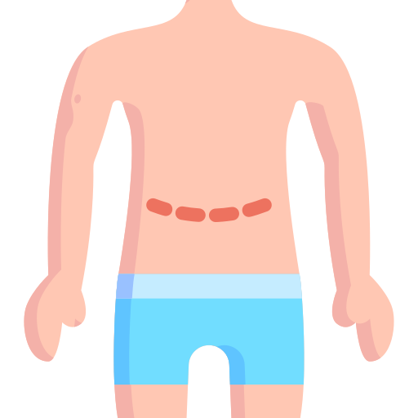
Lower GI Bleeding
Colitis:
02
04
01
Infectious
03
Radiation proctitis
Inflammatory bowel disease
Ischemia
Acute vs. Chronic
Symptoms:
Bloody diarrhea
Abdominal pain
1
3
Arterial vs. Venous
Location: watershed areas of:
splenic flexure
Rectosigmoid colon
Cecum
2
4
Predisposing factors:
Hypercoagulable states. E.g. malignancy, esp. Adenocarcinoma, autoimmune, pregnancy and trauma patients.
Vasculitis
cardiovascular disease
Atrial fibrillation
Congestive heart failure
Acute myocardial infarction.
Recent abdominal vascular surgery
Medications
Vasopressors
Digoxin
02
04
01
Infectious
03
Radiation proctitis
Inflammatory bowel disease
Ischemia
Radiation proctitis is a complication of radiation therapy.
Those who have had radiation directed at their rectum or at areas around their rectum (e.g. after treatment for pelvic malignant neoplasms) have increased risk of developing radiation proctitis.

Slide 16
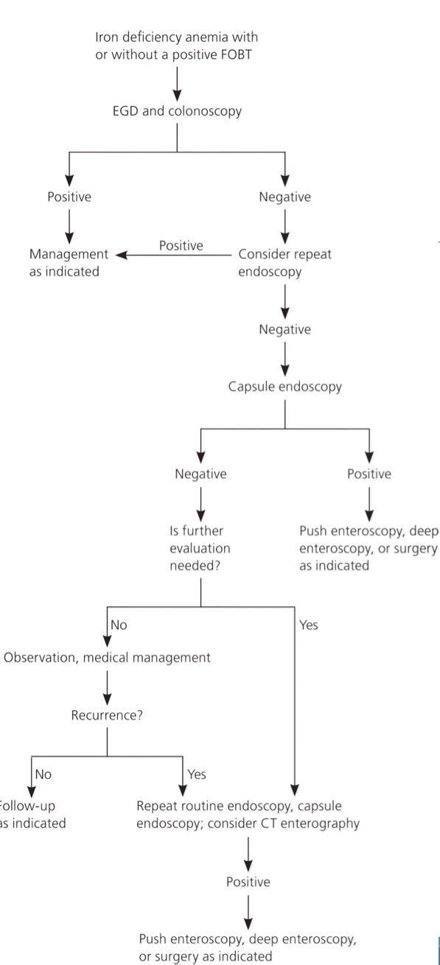
Lower GI Bleeding
Occult GI Bleed:
Diagnosis
If -ve UGI and LGI endoscopy:
Push endoscopy
or capsule endoscopy
Extra notes:
Patient resuscitation:
ABCD + IV cannula Packed RBCs.
How do you know if the patient has adequate tissue perfusion? Normal Urine output.
Risk assessment & severity of bleeding :
Volume loss:
<10% blood volume loss = Minor bleeding
10-20% blood volume loss + hemodynamically stable = Moderate.
>20-25% blood volume loss = Massive bleeding + shock.
Type of bleeding;
Melena = not massive
Clot = massive
Fresh red blood = more massive
Low risk → medication.
High risk → Endoscopy.
Approach:
Hx & PE (suspect GI bleeding?)
NG tube.
Endoscopy (best modality).
If the endoscopy failed? Targeted RBC scan.
Active massive bleeding & the pt is stable → Angiography.
More accurate but only with active bleeding to identify the source of bleeding.
Active massive bleeding & the pt is unstable → surgery.

Slide 17
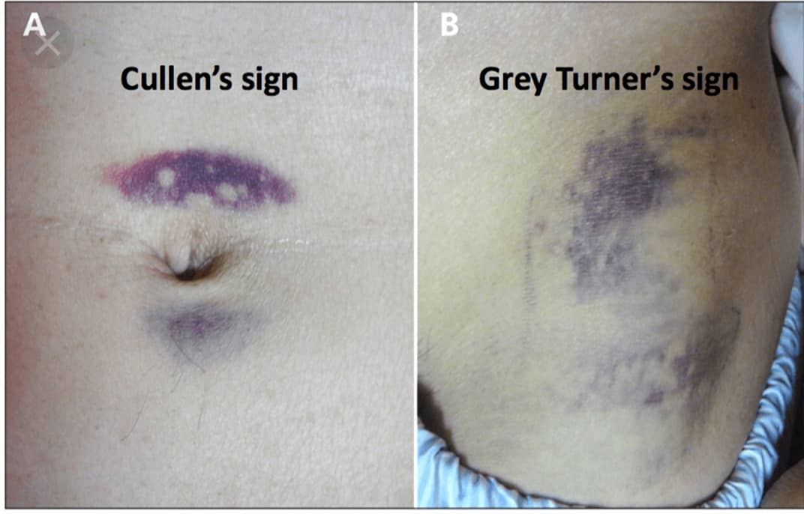
Intra-abdominal Bleeding
 | Etiology | Clinical Features
Ruptured Abdominal Aortic Aneurysm | Ruptured AAA: is the most common emergency presentation of AAA. Patients with abdominal aortic aneurysms invariably are, or have been, smokers and may have a family history of atherosclerotic aneurysms. It’s a surgical emergency; it should be suspected in a patient with the triad of severe abdominal and/or back pain, hypotension and a pulsatile abdominal mass. | The pain from a ruptured abdominal aortic aneurysm begins in the centre of the abdomen but commonly radiates to the back and may radiate to the groin along the course of the genito-femoral nerve. Grey Turner’s sign and Cullen’s sign – bruising around the umbilicus and in the flank respectively – are late (3–4 days) indicators of a long-standing rupture. expansile pulsatile tender mass may be confirmed. It consists of the aneurysm and the surrounding haematoma. Large amounts of free blood in the abdomen, obesity, marked guarding and hypotension may all conspire to render a leaking aneurysm impalpable. Severe abdominal pain and collapse with clear evidence of hypovolaemia are strongly suggestive of a leaking aneurysm in an elderly male who is known to be hypertensive and a smoker. The bowel sounds may be diminished as a consequence of the irritation caused by intraperitoneal blood. Vascular bruits may be heard.
Ruptured Spleen | The spleen may be ruptured by blunt or penetrating injuries. Delayed presentation, due to an unusual mechanism (e.g., postcolonoscopy). | When the spleen is ruptured by an external injury, the left lower ribs are often fractured. If the ribs are broken, there will be local pain and tenderness and sharp pain on inspiration. Splenic haemorrhage usually causes pain in the left hypochondrium and upper abdomen. It may be associated with left shoulder-tip pain if blood or a haematoma is irritating the left hemidiaphragm. Shifting dullness and flank dullness may be detected. Occasionally, a ruptured pathologically enlarged spleen is palpable in the right hypochondrium.
Ruptured Ectopic Pregnancy | A fertilised ovum implants at an abnormal site; usually the fallopian tube. The erosive trophoblast may penetrate the wall of the tube, and often ruptures after about 6 weeks. | The patient may know she is pregnant; morning sickness, amenorrhoea, breast swelling or a positive pregnancy test are present before the rupture happens. The patient experiences bouts of cramping iliac fossa pain that may be associated with fainting and vaginal bleeding. Rupture produces sudden severe pain, bleeding and circulatory collapse, with the abdominal pain often becoming generalised.
Ruptured Ovarian Cyst | Benign ovarian cysts are a common cause of torsion, rupture and bleeding. | large pathological ovarian cysts can rupture and bleed profusely. Patients may collapse from the associated hypovolaemic shock or present with sudden and severe lower abdominal pain and then develop the signs of internal bleeding.
Ruptured liver adenoma | Liver cell adenoma can develop in young women taking the contraceptive pill containing high levels of estrogen and may rupture spontaneously. | They may be asymptomatic but generally present with right hypochondrial pain as a result of haemorrhage within the tumor. Superficial tumors may bleed spontaneously and present with symptoms of hemoperitoneum. Hypovolemic collapse is common.

Slide 18
Intra-abdominal Bleeding
 | Etiology | Clinical Features
Ruptured hepatocellular carcinoma | HCC is relatively uncommon in the developed world but is common in Africa and the Far East. In the West, about two- thirds of patients have preexisting cirrhosis and many others have evidence of hepatitis B or C infection. In Africa, ‘aflatoxin’ (derived from the fungus, Aspergillus flavus, which contaminates maize and nuts) is an important hepatocarcinogen. | Progression of the existing liver disease symptoms. Abdominal pain and distention. Hepatosplenomegaly or palpable abdominal mass. Loss of appetite and weight loss. Fever. Spontaneous rupture with intraperitoneal hemorrhage.
Ruptured visceral aneurysm (splenic artery aneurysm) | This may occur primarily as a complication of atherosclerosis in elderly patients where the calcified wall of the aneurysm may be visible on x-ray or secondary to intra-abdominal sepsis and acute or chronic pancreatitis. Rupture occurs more commonly during pregnancy (3rd trimester) or at labor. | It ruptures into the peritoneal cavity with similar symptoms to those of splenic rupture: Abdominal pain, distention, drowsiness, pain in the tip of the left shoulder, and hypovolemic shock.
Ruptured visceral aneurysm (hepatic artery aneurysm) | Intrahepatic (20%) In the past, infections associated with IVDU were the most common cause. Nowadays, the majority are due to trauma or interventional biliary and hepatic procedures. Extrahepatic (80%) Due to degenerative and atherosclerotic changes Aneurysms due to liver transplant are usually extrahepatic and associated with infections. | Asymptomatic (Found incidentally). If symptomatic, it usually presents with RUQ or Epigastric pain. Jaundice can also occur if the aneurysm compresses the bile duct. Rupture: Patients present with abdominal pain and shock. Intrahepatic: Rupture into biliary tree causing Quincke triad (Abdominal pain, Hemobilia, Obstructive jaundice). Extrahepatic: Intraperitoneal rupture.
Ruptured visceral aneurysm (mesenteric artery aneurysm) | The primary etiology now is atherosclerotic. Up to one-third of superior mesenteric artery aneurysms have historically been described as mycotic or septic, with septic emboli being a known cause. Streptococcus from left-sided cardiac valvular endocarditis has been reported. When excluding pseudoaneurysms, infection is currently an etiologic factor in less than 5% of cases. Medial degeneration, also seen in splenic and hepatic aneurysms, often with secondary atherosclerosis, accounts for 25% of SMA aneurysms. Other reported causes are inflammatory processes in the abdomen or retroperitoneum (cholecystitis, pancreatitis) and trauma. | Most patients (90%) are symptomatic with abdominal pain and a pulsatile mass.80 The pulsatile mass may be notably mobile, differentiating it from an abdominal aortic aneurysm.88 Patients also may present with frank intraperitoneal hemorrhage or symptoms and signs of mesenteric ischemia. 50% of patients present with rupture, and the mortality rate is 30%.
Retroperitoneal hemorrhage (over anticoagulation) | Retroperitoneal bleeding has been shown in patients on systemic anticoagulation with warfarin, unfractionated heparin, or low-molecular-weight heparin. | Clinically present as pain in the lower abdominal, flank, or inguinal area with radiation to the thigh and lumbar region. Hypotension and nerve-compression effects characterized by motor or sensory deficits in the groin and thigh may be additional suggestive signs.

Slide 19
Cases from the doctor
Case 1
A 65 Y/O male with a known knee pain ( NSAIDS ) presented with hematemesis.
His airway is intact .
breathing 100% O₂ Sat on RA .
circulation :HR 120 & BP is 70/50 .
2 IV access were established.
Q1: What is next?
Start PPI then do a cross match + 2 PRBC transfusion (since the patients is hypotensive its a sign of active bleeding thus you do a blood transfusion instead of IVFs).
Then you send Labs such as CBC , LFTs & Electrolytes.
Now his HR is 100 and the BP is 99/60 (stable).
Q2: What is next?
Perform EGD.
EGD showed PUD and the patient was given epinephrine then admitted to ICU.
Next day he vomited again.
Q3: What is next?
Perform EGD again with dual therapy and admit to ICU again.
The patient is stable for the next 24 hrs.
Q4: What are you gonna discharge him with?
PPI then a follow up after few weeks to do another endoscopy to rule out any malignancies and to take a biopsy to diagnose H.Pylori and treat it.

Slide 20
Cases from the doctor
Case 2
Patient presented to the ER with large volume lower GI bleeding.
The patient is unstable.
How do you approach this?
1- vitals signs.
2- once the patient is in bed, put a volley foley catheter and observe urine output.
3- 2 Large IV (crystalloid*) cannula, take a blood sample* before introducing any fluid.
4- If 2 liters of fluid have been introduced and the patient is still unstable, give them Packed RBC*. ( AFTER 2 LITERS, EVERYTHING BECOMES RED )
5- Nasogastric tube to rule out upper GI causes.
6- Upper,lower endoscopy.
7- still can’t find a source of bleeding? Urgent mesenteric angiography is performed.
8- Found it? Stop the bleeding.
9- You found it, but you can’t stop the bleeding? Take them to the OR and do FOCUS RESECTION.
10- If you couldn't find the source of bleeding at all and the patient is unstable, do a total colectomy.
*(normal saline or ringer’s lactate)
* We take a blood sample for CBC and to determine the blood type (cross and match).
How many units should we cross and match? 4 units Packed RBC
*ASK FOR PLATELETS AND FRESH FROZEN PLASMA, BECAUSE THE PATIENT MIGHT DEVELOP DIC,COAGULOPATHY FROM REPEATED TRANSFUSIONS.
• to produce hypotension you need at least to lose 1–1.5 liter of blood
• Young patients may need to lose more than 2.5 liters of blood to show hypotension ( their cardiovascular systems are strong and able to compensate).

Slide 21
Summary
Recall
Q1:What is the definition of upper GI bleeding?
Answer: Bleeding proximal to the ligament of Treitz.
Q2: What are the symptoms of upper GI bleeding?
Answer: hematemesis , melena , coffee ground emesis .
Q3: What are the DDX of upper GI bleeding?
Answer: PUD , Esophageal varices , Mallory weiss tear , Neoplasm , Aortoduodenal fistula
Q4: What is the definition of lower GI bleeding?
Answer: Bleeding distal to the ligament of Treitz; vast majority occurs in the colon
Q5: What are the symptoms of lower GI bleeding?
Answer: Hematochezia (bright red blood per rectum [BRBPR]), with or without
abdominal pain, melena, anorexia, fatigue, syncope, shortness of breath, shock.
Q6 :What are the DDX of lower GI bleeding?
Answer: Hemorrhoids , Diverticulosis , Angiodysplasia , ischemic , IBD , Neoplasm .
Q7: What are the most common causes of massive lower GI bleeding?
Answer: Diverticulosis & Vascular ectasia.
Q8:What is the initial treatment?
Answer:IVFs: Lactated Ringer’s; packed red blood cells as needed, IV × 2, Foley
catheter to follow urine output, discontinue aspirin, NGT.
Q9:What diagnostic tests should be performed for all lower GI bleeds?
Answer:History, physical exam, NGT aspiration (to rule out UGI bleeding; bile or blood
must be seen; otherwise, perform EGD), anoscopy/proctoscopic exam.
Q10:What must be ruled out in patients with lower GI bleeding?
Answer:Upper GI bleeding! Remember, NGT aspiration is not 100% accurate (even if
you get bile without blood)
Q11::How can you have a UGI bleed with only clear succus back in the NGT?
Answer:Duodenal bleeding ulcer can bleed distal to the pylorus with the NGT sucking
normal nonbloody gastric secretions! If there is any question, perform EGD
Q12: What is the diagnostic test of choice for localizing a slow to moderate lower GI bleeding source?
Answer: Colonoscopy

Slide 22
Quiz
MCQ
Q1: which of the following statements is true regarding H.Pylori?
A)The organism is round in shape.
B)It has the ability to hydrolase urea with production of ammonia.
C)Treatment is recommended in asymptomatic patients.
Q2: common sites of peptic ulcer includes:
A) First part of duodenum.
B) Esophagus.
C)Fundus of the stomach.
Q3:Which of the following is a predisposing factor for gastric ulcers?
A) Gastric Acid.
B) NSAIDS.
C) Smoking.
Q4:: A 50 Y/O man presents to the outpatients clinic with an 8 - week history of bleeding from his back end. This is typically bright red and copious during or following a stool. The patient has had no change in his bowel habits , no weight loss or family Hx of bowel cancer, what os the most appropriate course of action?
A)Perform rubber band and ligation of hemorrhoids.
B)Blood tests including CEA.
C)Flexible sigmoidoscopy.
Q5: A patient is rushed to the ER following a large amount of hematemesis, what is the best initial step?
A) Resuscitate with crystalloid solution.
B) Cross match and blood transfusion.
C) Maintain ABC.
Answers
Click here for explanation
Q1 | B | Q4 | c
Q2 | A | Q5 | C
Q3 | B&C
Extra Questions

Slide 23
Good Luck!
Team leaders:
Nouf Alshammari
Haneen Somily
Naif Alsulais
Mohammed Alshoieer
This lecture was done by:
Deema Almaziad
Lama Alzamil
Lina Al-osaimi
Razan Alrabah
Hamdan Aldossri
Mohammed Alshoieer
Rakan Alfaifi
Bader Alqarni
Feedback
Note taker
Reviewer

