Slide 1
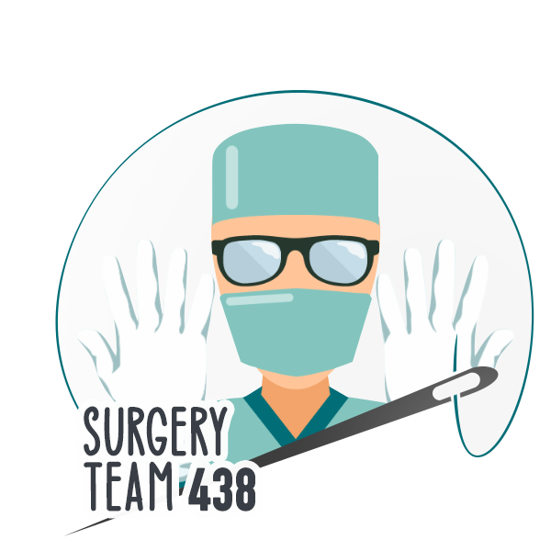
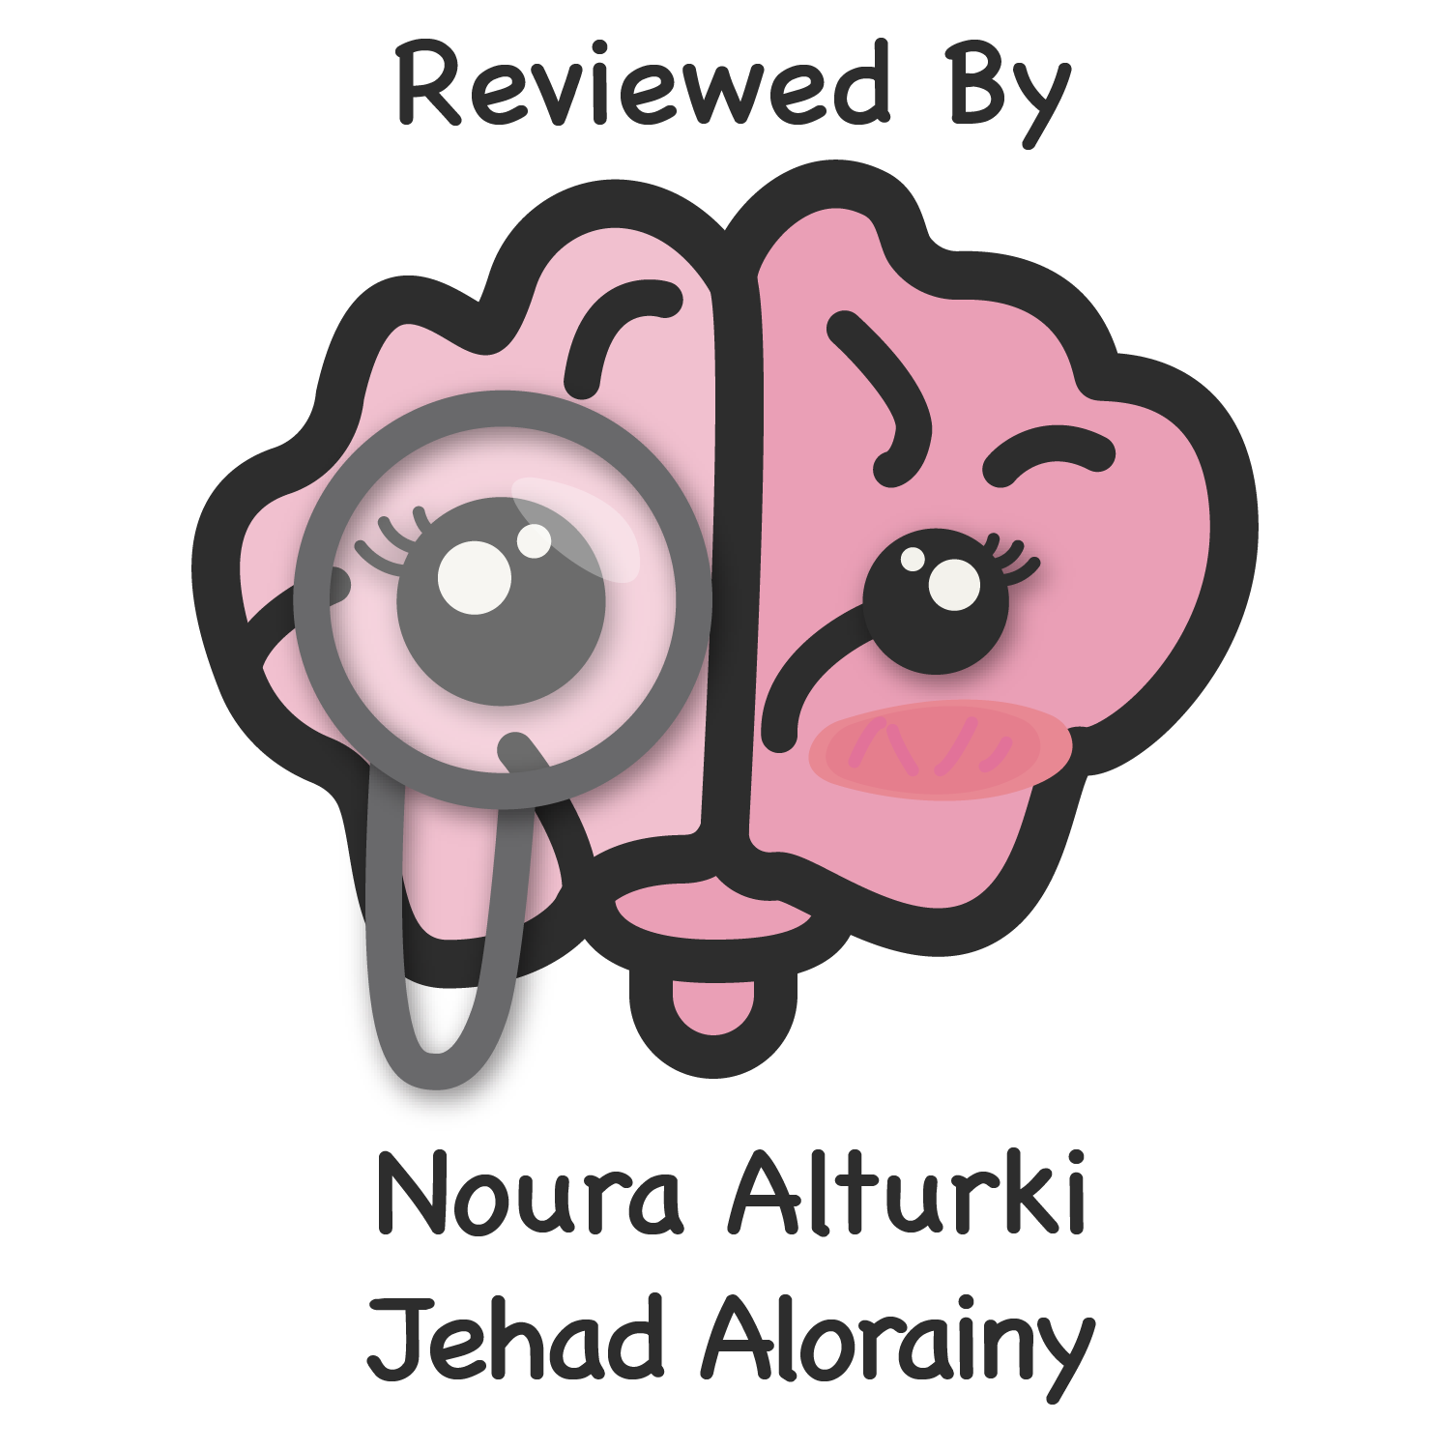
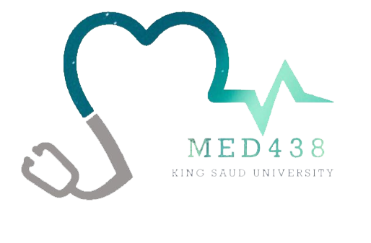
Jaundice
Objectives
The student is expected to describe and explain the pathogenesis, etiology,
clinical features and complications of each of the following conditions:
Prehepatic
Hemolysis
Transfusion reaction
Hepatic
Infectious Hepatitis
Cirrhosis
Drugs
Alcohol
Posthepatic
Intraluminal
Stones
Polyps
Intramural
Benign biliary stricture (ischemic, Mirizzi’s syndrome,, iatrogenic, inflammatory, sclerosing cholangitis)
Primary cancer (cholangiocarcinoma)
Extramural
Secondary carcinoma (porta hepatic LN metastasis)
Carcinoma in the head of pancreas
Chronic pancreatitis
Colour Index
Main Text
Males slides
Females slides
Doctor notes
Textbook
Important
Golden notes
Extra
Editing File

Slide 2
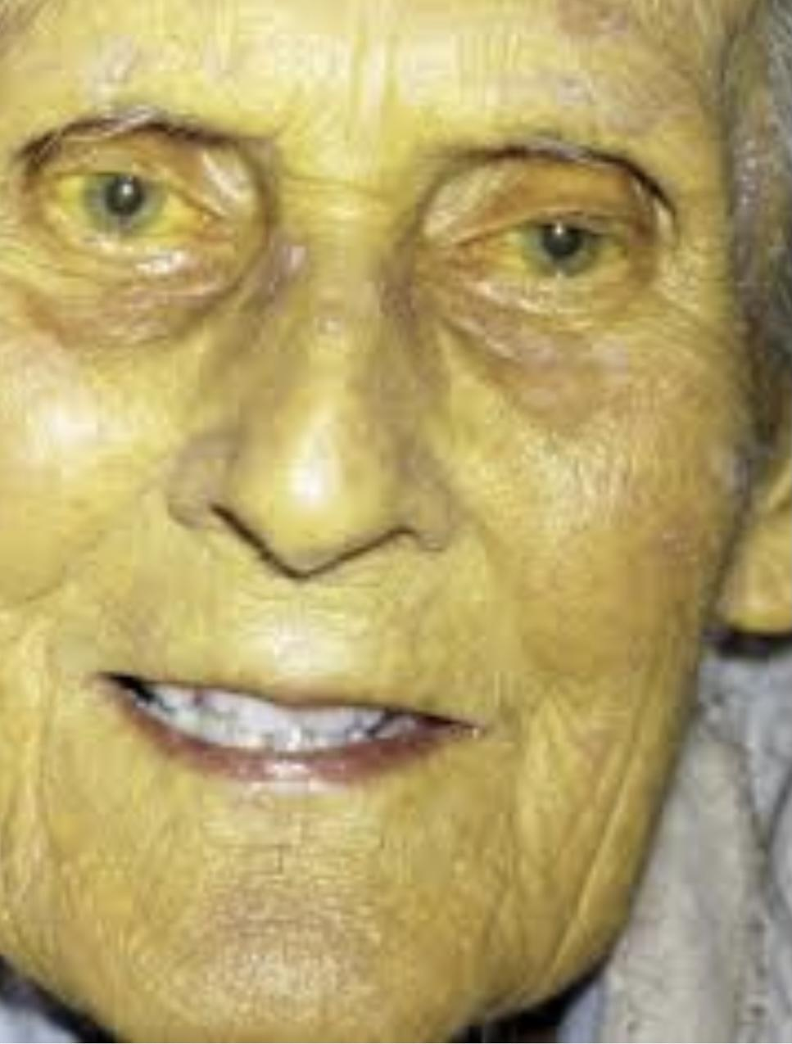
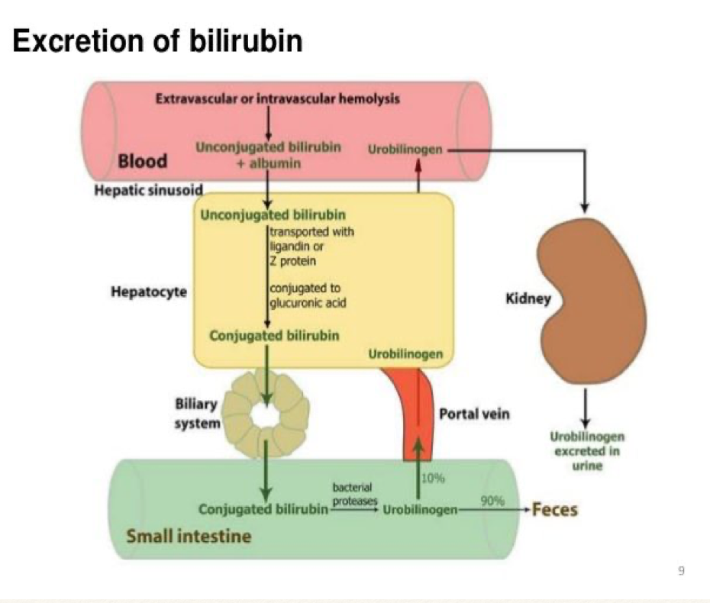
Jaundice
Introduction
Definition: It is the Yellowish discoloration of skin, mucous membranes, sclera first to be seen in the sclera,because it’s white thus any change can be seen early and body fluids due to hyperbilirubinemia. In advance cases yellow discoloration is seen in the saliva, urine, sweat and even fat.
Clinical diagnosis made by inspection
Usually clinically apparent when serum level of bilirubin > 50 mmol/l (3 mg/dl)
Could be: based on the pathology site
A. Pre-Hepatic
B. Hepatic
C. Post-Hepatic
Cholangitis cause RUQ pain, fever, jaundice (Charcot’s Triad), and leukocytosis,Surgical emergency that need ERCP.
500-1000 ml of bile is produced daily
Any problem in this process will result in hyperbilirubinemia
RBC breakdown
Water insoluble, thus combined w/ albumin
through IVC
Water soluble
Reabsorbed
Back to the liver forming circle
Give it the dark brown color

Slide 3
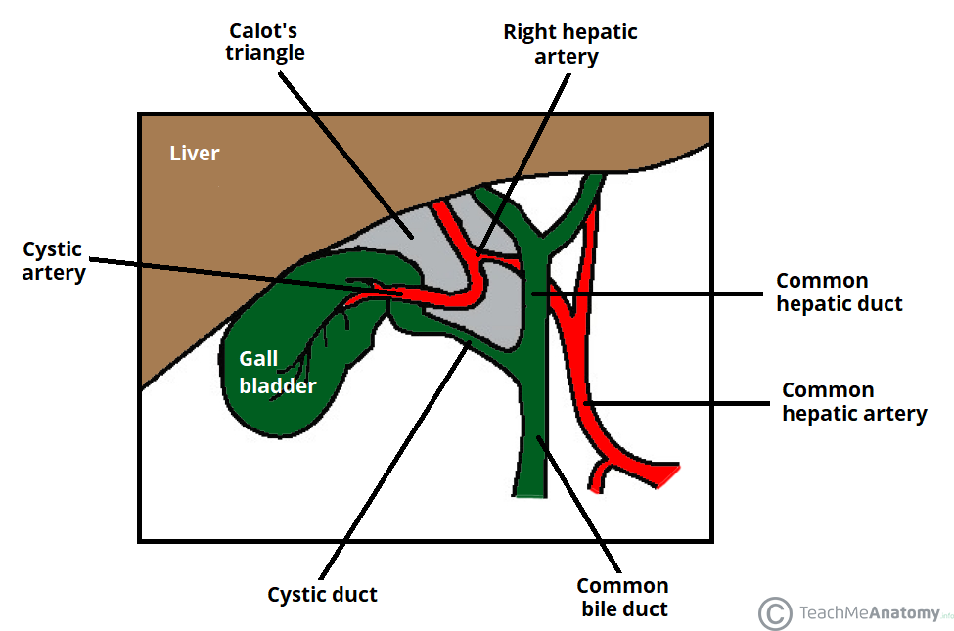
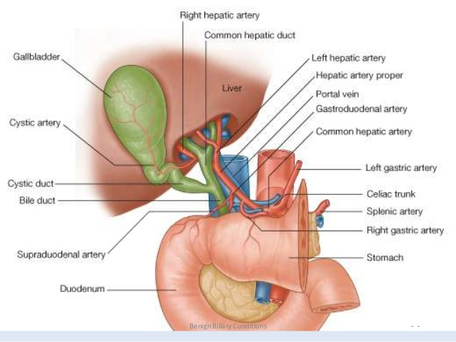
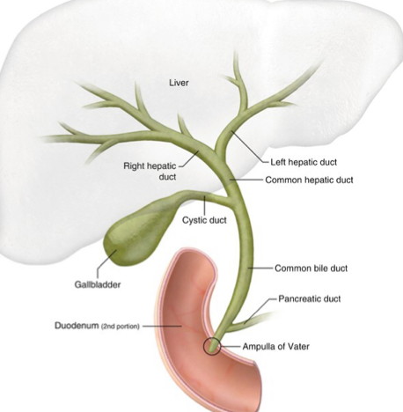
Jaundice
Surgical anatomy of the biliary system
Gallbladder lies beneath segments IV and V of the liver.
Normal sizes (diameter):
common bile duct (CBD) < 8 mm < 10 mm after cholecystectomy)
gallbladder wall < 4 mm,
pancreatic duct < 4 mm.
Right hepatic (lateral) and retroduodenal branches of the gastroduodenal artery (medial) supply the hepatic and common bile duct (9- and 3-o’clock positions when performing endoscopic retrograde cholangiopancreatography [ERCP]); considered longitudinal blood supply
Cystic veins drain into the right branch of the portal vein.
Cystic artery branches off right hepatic artery
(Is found in the triangle of Calot)
Triangle of Calot boundaries:
cystic duct [lateral,
common hepatic duct [medial]
liver [superior]
Lymphatics are on the right side of the common bile duct.
Parasympathetic fibers come from left (anterior) trunk of the vagus.
Sympathetic fibers from T7–10 (splanchnic and celiac ganglions).
Drains 60% of the liver
Drains 40% of the liver
CBD:Divided to proximal, middle,distal

Slide 4
Classification of Jaundice
Pre-hepatic jaundice :
The liver conjugation is NOT compromised
The liver excretion is not affected
The capacity of the liver is overwhelmed The liver has a limited number of receptors when they are all occupied the rest will circulate freely
Total bilirubin increased and UNCONJUGATED ( Indirect) (Fat soluble)
also increased in:
Hemolytic Anemia E.g. sickle cell anemia, spherocytosis, drugs or sepsis.
Transfusion reaction. specifically Hemolytic reaction
Hematoma secondary to trauma or surgery.
Total bilirubin (>50%unconjugated) --> prehepatic cause
Hepatic jaundice:
Liver dysfunctional metabolism leads to increased bilirubin level and failure to remove bilirubin , may be due to storage problems, intrahepatic obstruction, or extrinsic insults.
Results in Mixture of conjugated and unconjugated bilirubin.
Infectious hepatitis
Viral hepatitis (A-B-C) increase unconjugated mostly
Cirrhosis: the most common cause of hepatic jaundice.
End stage liver disease that obstructed the intrahepatic biliary duct causing conjugated hyperbilirubinemia
Decompensated ones regardless of etiology
Alcohol
Drugs : paracetamol toxicity
Other causes: liver cysts, Crigler-Najjar syndrome and Gilbert syndrome (Mostly Unconjugated) and liver abscess.
Post-hepatic jaundice:
It is due to obstruction of the bile duct (extrahepatic ducts ) after liver secretion.Direct hyperbilirubinemia. (Water soluble).
Depending on the location of the duct obstruction can be classified into:
Intraluminal : inside the lumen of the duct. Caused by bilirubin stones and sludge (pre-stones stage, more friable) and polyps (Gallbladder polyps – if > 1 cm, need to worry about malignancy).Polyps in patients > 60 years more likely malignant. Tx: cholecystectomy.
Intramural : Inside the wall of the duct, Mass (cholangiocarcinoma), Fibrosis from pancreatitis leading to strictures, Ampullary carcinoma.
Benign Biliary Strictures can be classified into: Traumatic, Ischemic, Primary sclerosing cholangitis and choledcocal cyst.
Extramural : Outside the duct (extrinsic). Caused by lymph node metastasis, gastric, duodenal, hepatic, and pancreatic cancer. Investigated by MRI and CT
Painless jaundice is cancer until proven otherwise.
Mirizzi syndrome: is defined as common hepatic duct obstruction caused by extrinsic compression from an impacted stone in the cystic duct. The bile duct is normal won't be dilated distally.

Slide 5
Classification of Jaundice
Difference between the types of jaundice
 | Hemolytic | Hepatic | Obstructive
Age | Young | Young /middle age | Older age group
Abdominal pain | No | +/- | +
Color of urine | Normal | Yellow | Dark yellow
Color of stool | Normal | Normal | Clay colour Very specific
Pruritus | -- | -- | Characteristic
Icterus | Lemon yellow | Yellow | Greenish / dark yellow
Liver | -- | + | +
Gallbladder | -- | -- | +
Serum bilirubin | 4-5 mg/dl (indirect) | Up to 10-12 mg/dl (indirect/direct) | 15-20 mg/dl (direct)
SGOT/SGPT | Elevated | Markedly elevated | Normal / elevated
Alkaline phosphatase | Normal | Normal / elevated | Elevated Very specific
Serum proteins | Normal | Decrease | Normal
Surgical Jaundice (obstructive jaundice) must meet the following:
Elevated ALP
Elevated GGT
Elevated Total bilirubin (direct)

Slide 6
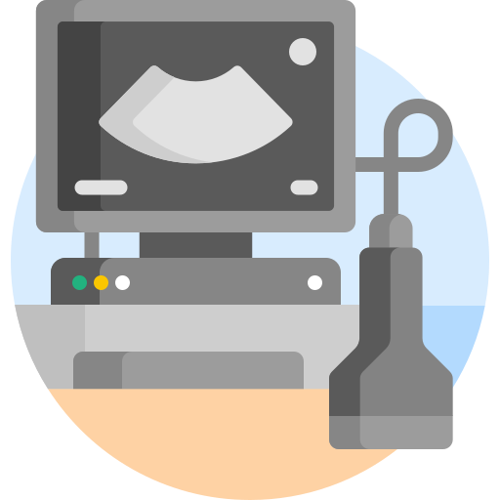
Investigations
Computed Tomography CT
Contrast enhanced CT is used Most commonly when malignant obstructive jaundice is suspected .
It can show you hepatic , bile duct and pancreatic tumors.
It demonstrates the biliary tree dilatation to the level of the obstruction.
It also identifies vascular abnormality or invasion and any metastases to adjacent lymph nodes or to the liver .
Liver Biopsy
Liver biopsy is indicated in patients with unexplained jaundice, provided that the obstructing lesion as been ruled out by imaging.
biopsy of the liver lesion can be performed under ultrasound or CT guidance
coagulation profile platelets can count must always be determined, and any clotting abnormalities Must be corrected before the procedure of liver biopsy
Laparoscopy
Laparoscopic Examination under general anesthesia can be used to assess the liver disease
it is used also in the staging of the malignancy of the liver, biliary tree, and pancreas in selected patients
It can detect hepatic, peritoneal and omental metastases .
When disseminated malignancy is discovered during laparoscopy,it safe that patient unnecessary laparotomy
Ultrasonography
The best initial imaging test when evaluating any jaundiced patient.
It can show:
1)Gallstones and intraductal stones.
2)Gallbladder distension due to obstruction.
3)Dilation of intrahepatic and extrahepatic biliary tree.
4)Space-occupying lesion in the liver or the pancreas.
5)Metastatic lesions in the liver due to malignant obstructive jaundice
Laparotomy
intraoperative ultrasound may be used to assess the liver and pancreatic tumours, Vascular invasion by tumours, metastases n the lymph nodes.
it commonly used in the liver surgery to evaluate the relation of the tumors to the vascular structures and to help in planning and performing a safe and curative liver resection intraoperative cholangiography may be used to assess any clear biliary anatomy to assess for any iatrogenic biliary injury, and to assess for any intraductal stones or lesions.
Intraoperative choledochoscopy is used to inspect the biliary tree for any pathology, biopsy taken, and to extract any intraductal stones.

Slide 7
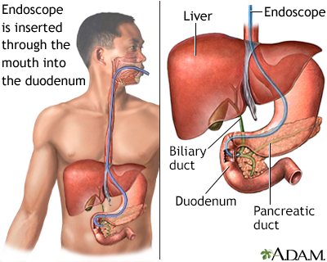
Laboratory tests
CBC, LFTs, coagulation profile, hepatitis panel, serum protein and creatinine.
Prehepatic Jaundice: High unconjugated bilirubin, normal liver enzymes and pale urine and dark stool.
Intrahepatic jaundice: High liver enzymes and mainly high conjugated bilirubin , prolonged coagulation profile.
Obstructive jaundice: High serum conjugated bilirubin hence dark urine, and urine doesn’t contain urobilinogen therefore a pale stool is present. High alkaline phosphatase and maybe high liver enzymes and serum lactic dehydrogenase. Other haematological findings include: prolonged coagulation profile, prolonged prothrombin time.
ERCP:
ERCP (endoscopic retrograde cholangiopancreatography): gastroscope with side camera (to see the ampulla of vater), it's retrograde because it goes against the flow of the bile and X-ray is involved too where contrast is injected showing us filling defect (most likely stones). It's Diagnostic and therapeutic.
ERCP can be used to insert stent when there is thickening , brushing for cytology, removal of stone.
Stent:
ERCP complications
Plastic
Metal
Removable 6-10 weeks.
High risk of obstruction.
Better patency
Once placed can't be removed.
For palliative care
Pancreatitis
Infection
2
4
Bleeding
Perforation
Inflammation
1
3
5
while inserting the catheter inside the ampulla of vater sometime the sphincter won't open thus the preform sphincterotomy to get access in addition to easily remove the stone out.
(most common) either because of entering the wrong duct or manipulation
cannula is a sharp object the can perforate the duodenum
Introduction of infections into an obstructive biliary system or pancreatic duct.
Acute cholangitis, acute cholecystitis and rarely gallstones.

Slide 8
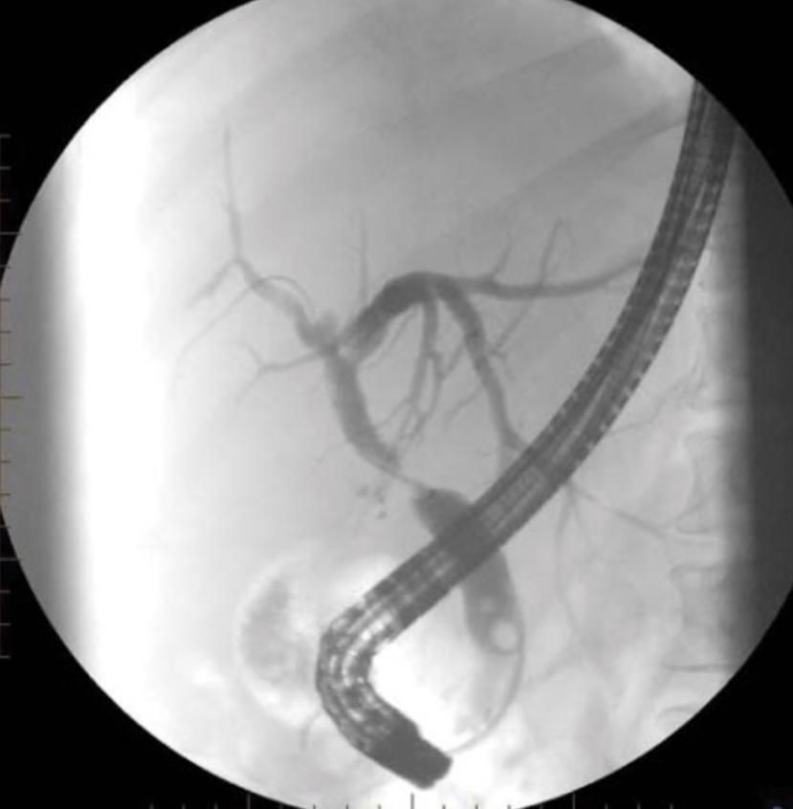
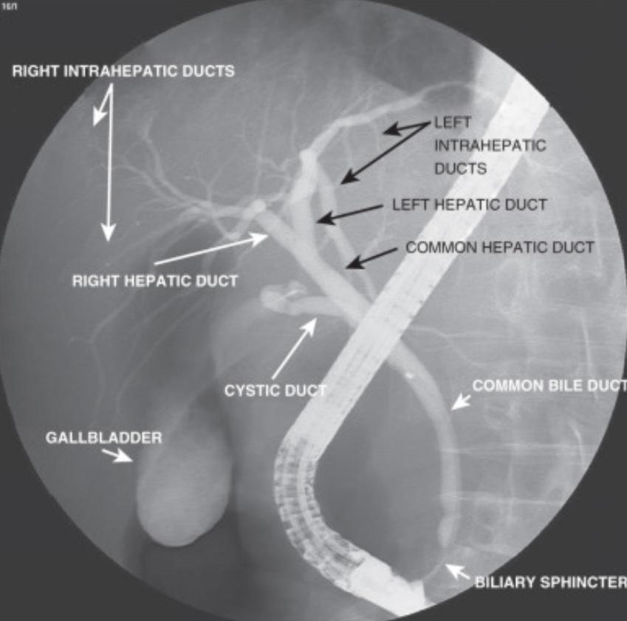
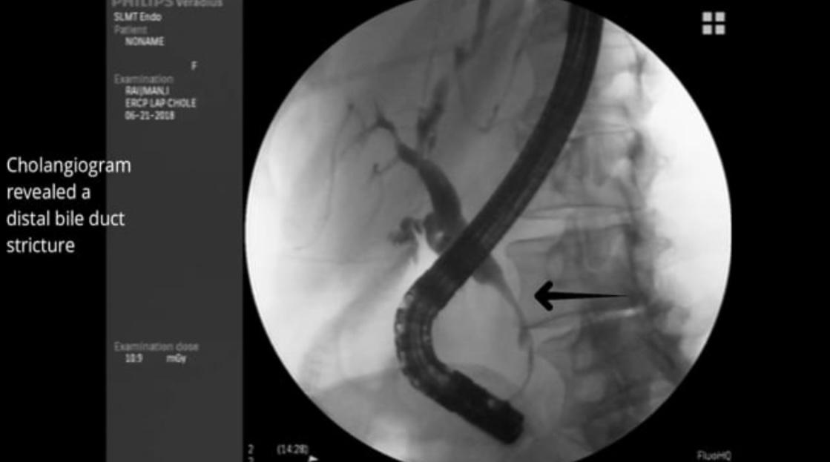
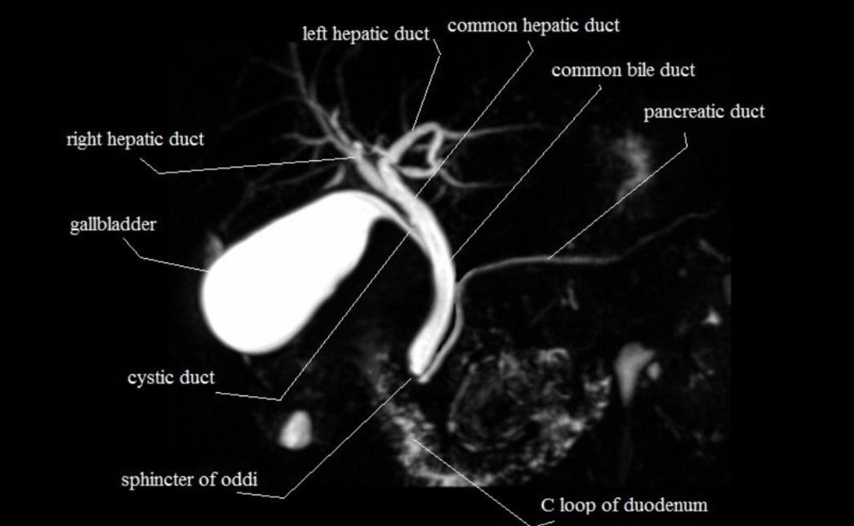
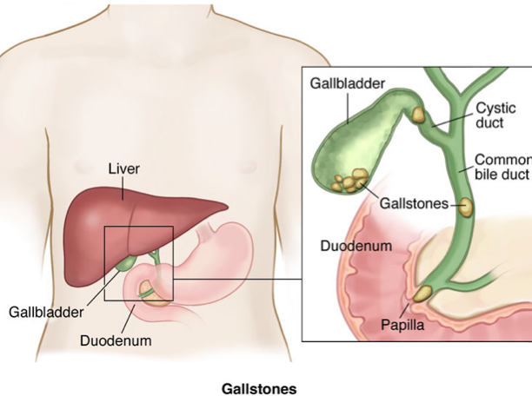
Investigations
Proximal to the obstruction if it was dilated it indicate chronic condition ,Not dilated here
Stricture
Contrast fill the duct in a uniform way , smooth, no abrupt change in diameter, no filling defect (normal)
Arrow: narrowing (distal bile duct stricture)
Obstruction (filling defect) most likely a sludge
MRCP:
MRCP (Magnetic Resonance Cholangiopancreatography): Not therapeutic, only diagnostic and non invasive, time consuming
Most accurate investigation
Obstructive jaundice
Gallstones :
Age is important. 4 F’s
(all increase the risk of gallstones)
40’S
Female
Fat
Fertile
Meanwhile if the patient is 75 with obstructive jaundice then most likely it’s cancer

Slide 9
Obstructive jaundice
1
Cholelithiasis
Cholelithiasis: A stone in the gallbladder.
Presented as RUQ pain radiating to right shoulder.
Stones found in the gallbladder never causes obstructive jaundice unless
Stones pass through the common bile duct
At the level of the ampulla of vater → pancreatitis along with obstructive jaundice. 80% of pancreatitis is caused by biliary stone
Gallstones is the most common cause of acute pancreatitis
Diagnosis
Laboratory tests: CBC and LFTs are normal, elevated serum conjugated bilirubin.
Ultrasound: reveals gallstones with acoustic shadowing.
Treatment
Analgesia during acute attacks to relieve pain.
Cholecystectomy is indicated to prevent recurrent attack and gallstones complications.
Ursodeoxycholic acid must be supplied after removal of gallbladder.

Slide 10
Obstructive jaundice
2
Acute calculous cholecystitis:
Acute calculous cholecystitis: a stone in the neck of gallbladder or the cystic duct.
Presents with +ve Murphy’s sign and signs of inflammation (Fever and leukocytosis) and RUQ pain.
Diagnosis
Laboratory tests: CBC shows leukocytosis, there might be mild elevation of serum amylase and moderate elevation of LFTs.
Ultrasound: shows distended gallbladder with thickened wall and pericholecystic fluid. While CT scan can be used when the diagnosis is in doubt. HIDA scan may help in atypical cases.
Treatment
Patient must be admitted to the hospital as soon as possible, and must be NPO and given adequate analgesic and IV fluids.
Broad-spectrum antibiotics are effective against gram -ve aerobes (Cefazolin or Cefuroxime) and anaerobes (Metronidazole).
Emergent cholecystectomy is indicated if the patient presents within 7 days from the onset of abdominal pain, while delayed presentation mandate conservative treatment and interval cholecystectomy in 8-12 weeks.

Slide 11
Obstructive jaundice
3
Choledocholethias
Choledochlithiasis : A stone in the common bile duct
Manifested as RUQ pain and +ve Murphy’s sign, signs of obstructive jaundice, pruritus and fever.
Diagnosis
Laboratory tests: shows elevated WBCs count, elevated Liver enzymes particularly ALP and GGT, and direct bilirubin will be more than 50% of total bilirubin.
Ultrasound: it’s the initial imaging for jaundiced patients and it shows gallstones, dilated intrahepatic and extrahepatic bile ducts. But less sensitive for common bile duct stones especially in the distal part of CBD.
Endoscopic US: the most sensitive test, and shows dilated biliary tree.
CT: not commonly used but it shows dilated biliary tree and intraductal stones.
Treatment
ERCP with extraction of biliary tree follows by cholecystectomy to prevent recurrent passing of stones from gallbladder into biliary tree.
Temporary biliary stenting is indicated when it’s difficult to remove the stones, followed by endoscopic extraction of stones after few days,p, when it fails the surgical exploration of CBD is indicated.

Slide 12
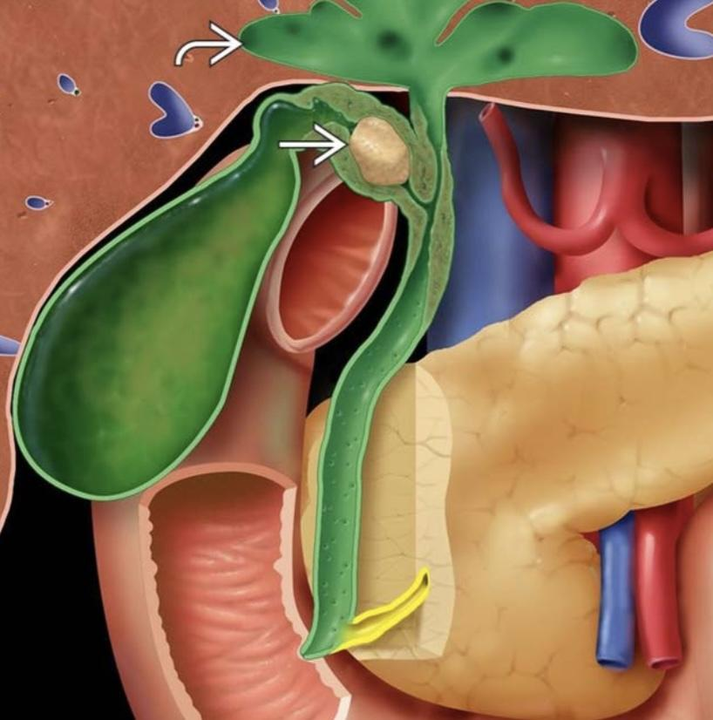
Obstructive jaundice
Complications of obstruction
Stone causes stasis and inflammation → cholangitis.
A
C
Choledocholithiasis can cause pancreatitis by obstructing the pancreatic duct.
Bile is destructive to the liver (primary biliary cirrhosis).
B
D
No bile → not fat absorption → no absorption of fat soluble vitamins (ADEK) → decrease in vitamin K → coagulopathy
Intramural cause of obstruction: Fibrosis
1
2
2
3
4
fibrosis in the wall that causes obstruction and can transform to cholangiocarcinoma.
Can be caused by extrinsic compression, iatrogenic, or pancreatitis, primary biliary cholangitis (PBC) and primary sclerosing cholangitis (PSC)
Investigated by MRCP, ERCP, and Choledocalscopes to inspect the mucosa.
In any intramural thickening we assume it's cancer until proven otherwise as well as painless jaundice (esp. elderly)

Slide 13
Obstructive jaundice
Mural cause of obstruction: Choledocal cyst
A Rare Congenital cystic disease of biliary tree, may involve intrahepatic or extrahepatic tree or both and it has a potential of malignant transformation into cholangiocarcinoma.
More common in women than men.
Clinical features:RUQ pain and mass, jaundice , recurrent cholangitis and recurrent acute pancreatitis
In the Choledochal cysts the common bile duct is dilated like the gallbladder → stasis → stones
Types 1-4 : can cause present with extra hepatic jaundice.
Type 5 : Intrahepatic cystic dilation, don't cause extra hepatic jaundice
Type I:complete fusiform dilation of the bile duct
Type III :
intrapancreatic portion dilation
Type V: intrahepatic only
Type II :
cystic dilation
Type IVA: both bile duct and hepatic ducts dilated
Type IVB: limited to extrahepatic duct.
Management:
01
02
03
Type 1,2 and 4B:
via excision of the cysts and cholecystectomy with Roux en-y hepaticojejunostomy.
Type 4B:
initially via conservative treatment and liver transplantation when surgery is required.
Type 3:
treated by endoscopic sphincterotomy when symptomatic.
Type 5:
requires liver resection when cyst is limited to one loben and liver transplantation when the disease is diffuse.
Extramural cause of obstruction:
Metastasis to lymph nodes of porta hepatis or inflammation.
External compression caused by a mass in any of the adjacent organs (duodenal cancer, pancreatic cancer..etc)
Confirmed by CT or MRI

Slide 14
Obstructive jaundice
Benign biliary strictures:
Etiology
90% of cases caused by damage during cholecystectomy.
Devascularization of bile duct during cholecystectomy.
Damage during distal gastrectomy or pancreatic surgery and erosion of duodenal ulcer in distal common bile duct.
Abdominal trauma.
Mirizzi’s syndrome.
Primary and secondary sclerosing cholangitis.
Clinical features
Complications
Signs of obstructive jaundice: Dark urine and pale stool and Right hypochondriac pain.
1
1
Recurrent cholangitis.
Fever indicates development of cholangitis.
2
2
Liver abscess and Liver failure.
Prolonged obstruction may cause signs of liver cirrhosis.
3
3
Secondary biliary cirrhosis with sign of portal HTN.
Diagnosis
Laboratory tests may show leukocytosis and positive blood culture in case of cholangitis, also shows elevated liver enzymes and raised CA 19-9 marker.
Trans-abdominal ultrasound shows dilated proximal biliary tree, while MRCP/ERCP shows the site and extent of the stricture.
Treatment
Definitive treatment is done by reconstructive surgery (bilioenteric anastomosis).
Temporary treatment is done by either: endoscopic or percutaneous dilation with high recurrence rate, or via endoscopic stenting or percutaneous catheter especially in the presence of cholangitis and it improves LFTs.

Slide 15
Obstructive jaundice
Chronic pancreatitis
Etiology
Alcohol (The most common cause)
Obstruction of pancreatic duct by tumor or stricture or stones.
others: Hereditary,Tropical and autoimmune pancreatitis and smoking.
Clinical features
Complications
Abdominal pain, nausea and vomiting and weight loss. Signs of obstructive jaundice.
1
1
Pancreatic abscess, pancreatic pseudocyst.
Exocrine insufficiency: steatorrhea turning stool into pale and bulky.
2
2
Portal and splenic vein thrombosis.
Endocrine insufficiency: leads to diabetes mellitus several years later.
3
3
Common bile duct obstruction.
Diagnosis
Labs shows elevated serum amylase in early disease and later shows minimally or normal levers.
Plain x-ray shows diffuse pancreatic calcification.
CT shows speckled pancreatic parenchymal calcification, ductal dilation, masses and pseudocyst.
MRCP can show any associated biliary dilation.
ERCP is the most accurate test, it shows details of pancreatic duct, dilation, stones and strictures. It helps in choosing the appropriate operation when surgery is indicated.
Treatment
Conservative management includes NSAIDs for pain relief, Abstinence of alcohol, treating DM, pancreatic enzymes supplements and nutritional support.
Surgical management Indications:
Intractable pain.
Symptoms of obstruction of CBD, duodenum, portal or splenic veins.
pseudocyst when endoscopic therapy fails.
Abscess when percutaneous drainage fails or is impossible.
When Cancer can’t be excluded.
Two types of procedures:
Drainage procedures: when pancreatic duct is dilated (>8 cm) and it includes: puestow procedure, Hamburg modification of puestow procedure, Frey procedure, Beger procedure and Bern procedure.
Reactive procedures: when pancreatic duct is not dilated and includes:
Whipple’s procedure: when focus of the disease or a mass located in pancreatic head.
Distal pancreatectomy:when the disease is focused the body and the tail.
Total pancreatectomy: when the disease is diffuse to involve the whole pancreas.it’s associated with high morbidity and even mortality.

Slide 16
Obstructive jaundice
Carcinoma of the head of pancreas:
Associated with: Smoking, chronic pancreatitis, BRCA2, Lynch syndrome, Peutz-Jeghers syndrome, Diabetes mellitus, Race( more common in black race)
Clinical features
PAINLESS jaundice (CBD obstruction): Dark urine and pale stool.
1
4
Distended, palpable, non-tender gallbladder (Courvoisier’s law) Courvoisier’s law states that ‘a palpable non-tender gallbladder in the presence of jaundice is unlikely to be due to gallstones’. It usually indicates a neoplastic stricture obstructing the distal common bile duct. A palpable gallbladder due to stones is usually tender i.e. due to acute cholecystitis.
Constitutional symptoms.
Vague epigastric pain or discomfort.
Itching.
2
Trousseau’s sign and hypercoagulable states.
3
5
Enlarged supraclavicular lymph nodes (Virchow nodes) (Troisier sign).
Diagnosis
Labs show elevated liver enzymes, elevated CA 19-9 (but it lacks specificity and sensitivity but helpful for following-up)
Imaging::
US may reveal the pancreatic mass or liver metastasis.
CT shows the tumor and gives evidence of irresistibility in case of encasement of major arteries (superior mesenteric, hepatic and celiac).
MRI/MRCP: gives similar information as CT, but it gives more accurate picture of biliopancreatic ducts changes.
ERCP/PTC: ERCP is indicated in case of acute cholangitis, doubtful diagnosis, sky high liver function tests, deep jaundice. PTC is one when ERCP fails. Early drainage should be avoided due to risk of introduction of infection.
Endoscopic ultrasound: gives information about the site and staging which can’t be demonstrated by CT.
Diagnostic laparoscopy:it’s the initial step in the procedure of pancreatic tumor resection.it reveals small peritoneal and liver metastasis that couldn’t be seen by preoperative ultrasound. And can be combined with laparoscopic US for more accurate results.
Treatment
Surgical resection is the only potential cure.
Pancreatoduodenectomy (Whipple’s procedure) is the standard procedure.
Other procedure is Pylorus preserving pancreatoduodenectomy which is reserved when the tumor doesn’t involve the stomach or duodenum and no indication for complete duodenal resection.

Slide 17
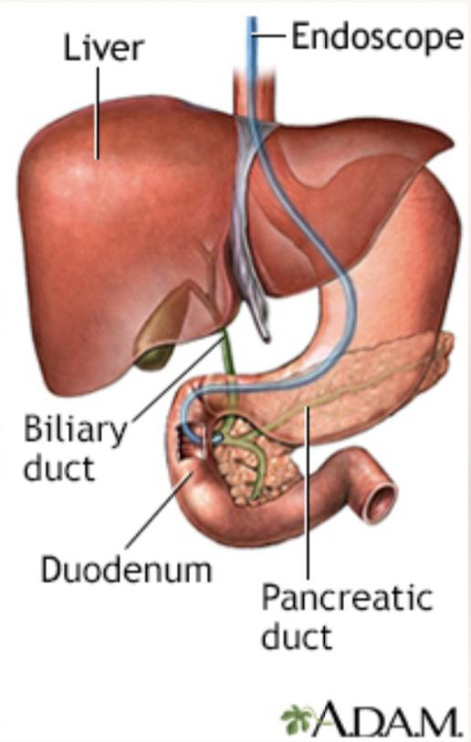
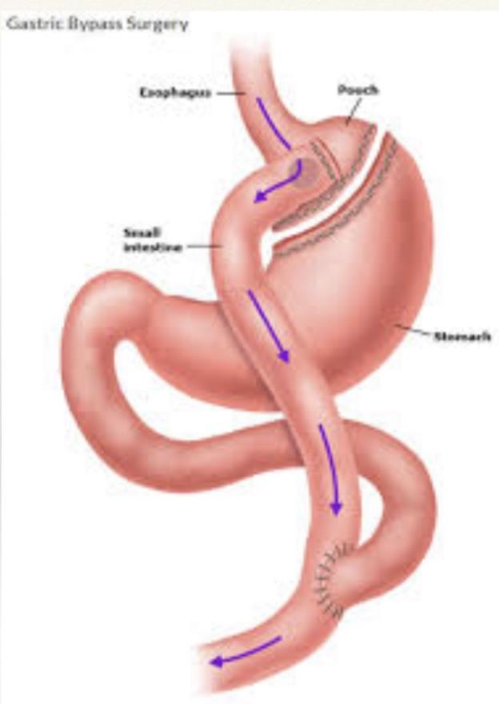
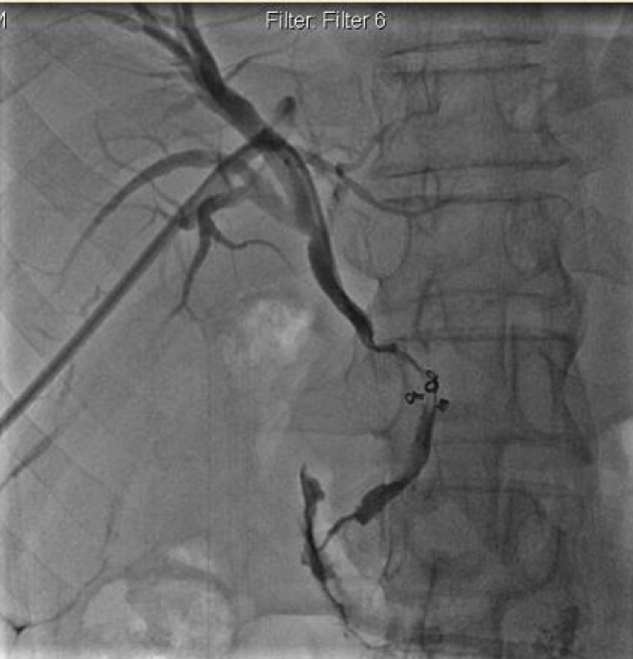
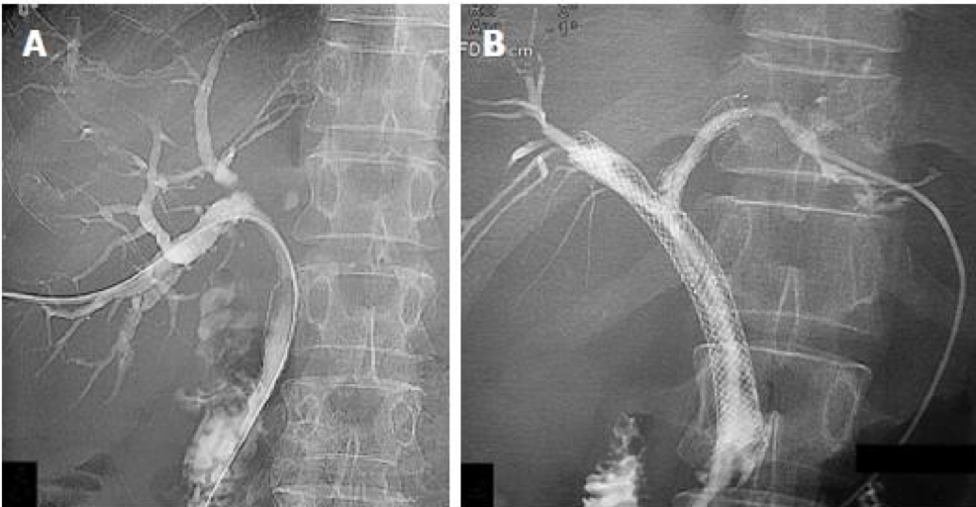
Management
General management:
IV fluids, Oxygen mask and immediate IV Broad-Spectrum antibiotics.
Emergent ERCP or PTC to decompress biliary tree for patients didn’t respond to medical therapy.
Cholangitis (surgical management):
Cholangitis is an acute surgical emergency managed with ERCP to remove the stone.
Clinical features:
Charcot triad (Fever, jaundice and RUQ pain) seen in less than 50% of the patients.(must give prophylaxis antibiotics)
Reynolds Pentad (Fever, jaundice, RUQ pain, Hypotension and Altered mental status) seen in toxic cholangitis with septic shock.
What if the patient has had a gastric bypass or a total gastrectomy and they developed cholangitis?
the last option is bile duct exploration (laparoscopic surgery)
1
The least invasive: Through the liver, by interventional radiology PTC antegrade approach
laparoscopic with gastroscope, make a hole in the stomach and perform ERCP through the stomach the original route is still there. Why? You are away from the inflammation are, and it's a big caliber less likely to leak and low pressure.
Less 2 invasive solutions
2
PTC
Rendezvous procedure combining PTC and ERCP, if can't be reached due to structure There's a cancer somewhere in the GI tract involving the bile duct
Once you drained the bile outside the body through PTC, it will stop the jaundice and the harmful effect of bilirubin and bile. However, your draining around 1-2L of bile thus dehydration, electrolyte imbalance, unable to absorb fat soluble vitamins. Yellow box : metal stent

Slide 18
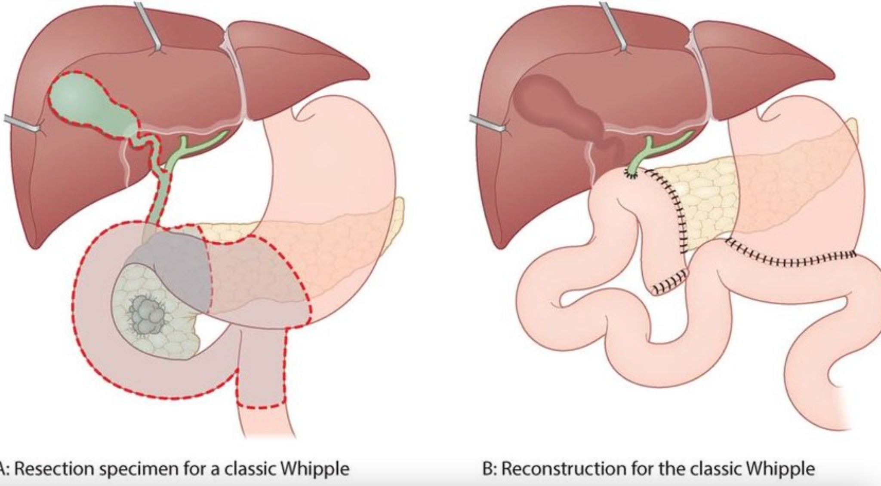
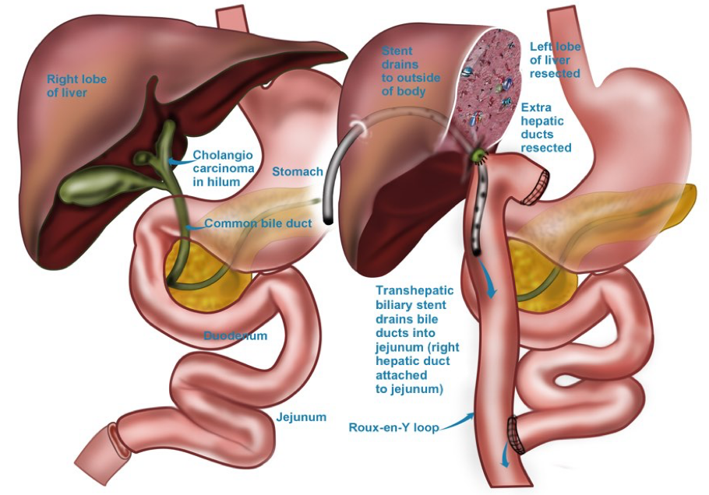
Cholangiocarcinoma (surgical management):
Adenocarcinoma of biliary tree , & can be either intrahepatic or extrahepatic.
Risk factors include: Primary sclerosing cholangitis, Hepatitis C, Parasitic biliary infestation, and choledocal cyst.
Clinical features: Abdominal pain, Anorexia, weight loss, Jaundice ,dark urine and pale stool, pruritus, and in patients with distal mass it presents with palpable gallbladder (Courvoisier’s law)
Associated with elevated tumor marker CA 19-9.
Cholangiocarcinoma don't respond to chemo and have poor prognosis the only option is surgery.
A
Middle to Distal bile duct cancer: -> Whipple procedure
Distal bile duct cancer may be indistinguishable clinically and radiologically from pancreatic head cancer. It’s associated with better prognosis due to the early obstruction with the early development of jaundice.
Whipple procedure is removal of distal stomach, head and half the body of the pancreas, duodenum, early jejunum, gallbladder, and bile duct. And perform anastomosis pancreaticojejunostomy, hepaticojejunostomy, gastrojejunostomy..
why remove all of this? because they share the same blood supply. And generally speaking: any abdominal cancer the cancer spread fast through the lymph node thus perform lymphectomy.
B
Middle - proximal bile duct cancer
Middle - proximal bile duct cancer will spread to the liver either to the left or right side thus hepatectomy of the side of the involved duct, and bile duct, gallbladder removal.
Treated with radical resection of the extrahepatic biliary tree along with the tumor with bilio-enteric anastomosis.
To restore the biliary system

Slide 19
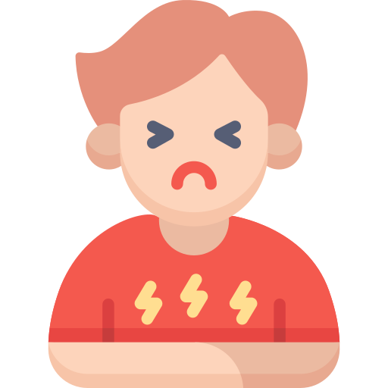
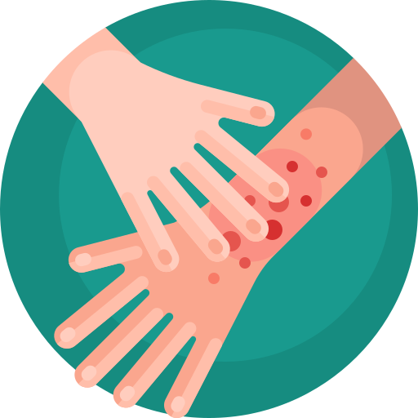
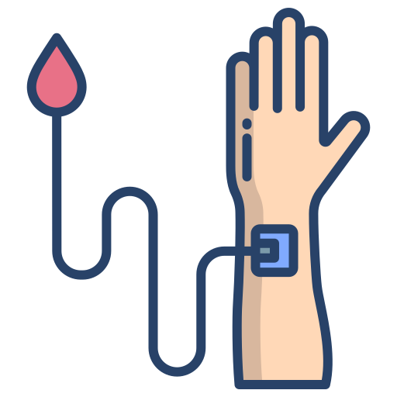
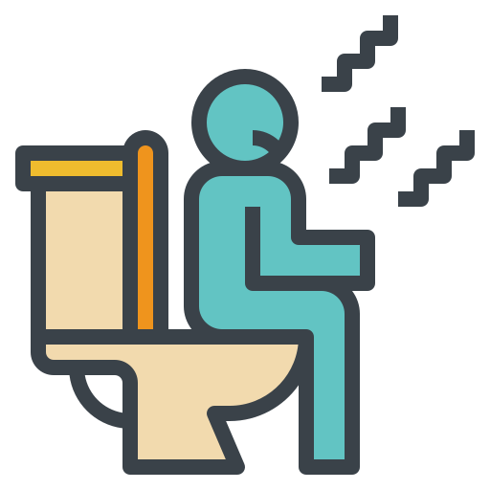
History taking of a jaundiced patient:
Dark urine, pale stool.
-Urine color differentiates between mechanical obstruction (dark in color) and non mechanical obstruction (Normal)
-clay color stool is a very specific sign for obstructive jaundice
Weight loss or Loss of appetite.
Diarrhoea, steatorrhea.
Abdominal pain, fever, nausea and vomiting.
Itching.
very characteristic
Blood transfusion, travelling abroad, Alcohol, IV drugs injection, and Tattooing.
Physical examination may show:
Yellow skin, sclera and mucosa under the tongue.
1
4
Palpable gallbladder.
Scratch marks
2
5
Palpable liver.
3
6
Signs of Chronic Liver Disease and Cirrhosis:
Altered mental status
Asterixis
Palmar erythema
Caput medusae
Spider angiomata
Ascites
Testicular atrophy
Gynecomastia
Fetor hepaticus
Abdominal tenderness, Abdominal mass.

Slide 20
Summary
Doctor’s Qs
When will jaundice appear? X3 normal (at least again it depends on the race)
What is the best test for stones in the gallbladder ? US
What about CBD? Distal CBD will pass behind the duodenum and cant be seen on US
Recall
Q1:Which artery is susceptible to injury during cholecystectomy?
Right hepatic artery, because of its proximity to the cystic artery and Calot’s triangle
Q2:At what level of serum total bilirubin does one start to get jaundiced?
2.5
Q3: What are the signs and symptoms of obstructive jaundice?
Jaundice-Dark urine-Clay-colored stools (acholic stools)-Pruritus (itching)-Loss of appetite-Nausea
Q4:What causes the itching in obstructive jaundice?
Bile salts in the dermis (not bilirubin!)
Q5:What is the histology of Cholangiocarcinoma?
Almost all are adenocarcinomas
Q6:What is the differential diagnosis of proximal bile duct obstruction?
Cholangiocarcinoma-Lymphadenopathy-Metastatic tumor-Gallbladder carcinoma-Sclerosing cholangitis-Gallstones-Tumor embolus-Parasites-Postsurgical stricture-Hepatoma-Benign bile duct tumor
Q7:What is the differential diagnosis of distal bile duct obstruction?
Choledocholithiasis (gallstones)-Pancreatic carcinoma-Pancreatitis-Ampullary carcinoma-Lymphadenopathy-Pseudocyst-Post Surgical stricture-Ampulla of Vater dysfunction/stricture-Lymphoma-Benign bile duct tumor-Parasites
Q8:What is the initial study of choice for obstructive jaundice?
Ultrasound
Q9:What lab results are associated with obstructive jaundice?
Elevated alkaline phosphatase, elevated bilirubin with or without elevated LFTs
Q10:What are the “Big 4” risk factors of cholelithiasis?
“Four Fs”: Female-Fat-Forty-Fertile (multiparity)
Q11:What are the causes of black-pigmented stones?
Cirrhosis, hemolysis
Q12:What are the five major complications of gallstones?
Acute cholecystitis-Choledocholithiasis-Gallstone pancreatitis-Gallstone ileus-Cholangitis
Q13:What are the indications for cholecystectomy in the asymptomatic patient?
Sickle-cell disease-Calcified gallbladder (porcelain gallbladder)-Patient is a child
Q14:What is the major feared complication of ERCP?
Pancreatitis
Q15:What are the complications of acute cholecystitis?
Abscess-Perforation-Choledocholithiasis-Cholecystenteric fistula formation-Gallstone ileus
Q16:What lab results are associated with acute cholecystitis?
Increased WBC; may have: Slight elevation in alkaline phosphatase, LFTs-Slight elevation in amylase, total bilirubin
Q17:What is Cholangiocarcinoma?
Malignancy of the extrahepatic or intrahepatic ducts—primary bile duct cancer

Slide 21
Quiz
MCQ
Q1: 10 days after a motor vehicle collision, a 28M develops jaundiced skin. Upon initial presentation for his injuries, the patient was taken for an emergency laparotomy, which revealed significant internal hemorrhage from blunt abdominal trauma to the spleen. He required rapid transfusion with a total of 7 units of packed red blood cells. He has recovered well from the procedure until this morning, when he began to develop jaundiced skin and sclerae. He does not have pruritus. He has had no prior surgeries and takes no other medications. He is sexually active with one female partner. Prior to the accident, he drank 4 beers per day. His vital signs are within normal limits. Abdominal examination is limited due to pain. There are no palpable abdominal masses. There is a midline surgical scar with no erythema, purulence, or drainage. He has healing abrasions on the upper left side of his face and bruises over the anterior abdomen. CT scans show a resolving hematoma in the peritoneal cavity. Laboratory studies show:
Hemoglobin 9.7 g/dL, Hematocrit 30%, Leukocyte count 7,000/mm3, Platelet count 135,000/mm3
Serum: Total bilirubin 3.9 mg/dL, Indirect bilirubin 3.7 mg/dL, Direct bilirubin 0.2 mg/dL, Aspartate aminotransferase (AST) 60 U/L, Alanine aminotransferase (ALT) 92 U/L
Biliary obstruction
Hepatocellular injury
Increased formation of bilirubin
Intrahepatic cholestasis
Impaired conjugation of bilirubin
Decreased hepatic uptake of unconjugated bilirubin
Q2: A previously healthy 2-year-old girl is brought to the physician because of a 1-week history of yellow discoloration of her skin, loss of appetite, and 3 episodes of vomiting. Her parents also report darkening of her urine and light stools. During the last 2 days, the girl has been scratching her abdomen and arms and has been crying excessively. She was born at 38 weeks’ gestation after an uncomplicated pregnancy and delivery. Her family emigrated from Japan 8 years ago. Immunizations are up-to-date. Her vital signs are within normal limits. Examination shows jaundice of her skin and sclerae. Abdominal examination shows a mass in the right upper abdomen. Serum studies show:
Bilirubin (total) 5 mg/dL, Direct 4.2 mg/dL, Aspartate aminotransferase (AST) 40 U/L, Alanine aminotransferase (ALT) 60 U/L, γ-Glutamyltransferase (GGT) 110 U/L (N = 5–50)
Abdominal ultrasonography shows dilation of the gallbladder and a fusiform dilation of the extrahepatic bile duct. Which of the following is the most likely diagnosis?
Biliary cyst
Mirizzi syndrome
Biliary atresia
Caroli disease
Hepatic abscess
Pancreatic pseudocyst
Answers
Click here for explanation
Q1 | C | Q4
Q2 | A | Q5
Q3 |  | Q6
Extra Questions

Slide 22
Good Luck!
Team leaders:
Nouf Alshammari
Haneen Somily
Naif Alsulais
Mohammed Alshoieer
This lecture was done by:
Ghalia Alnufaei
Ateen Almutairi
Razan Alrabah
Lama AlAssiri
Abdulaziz AlGhamdi
Feedback
Note taker
Reviewer

