Slide 1
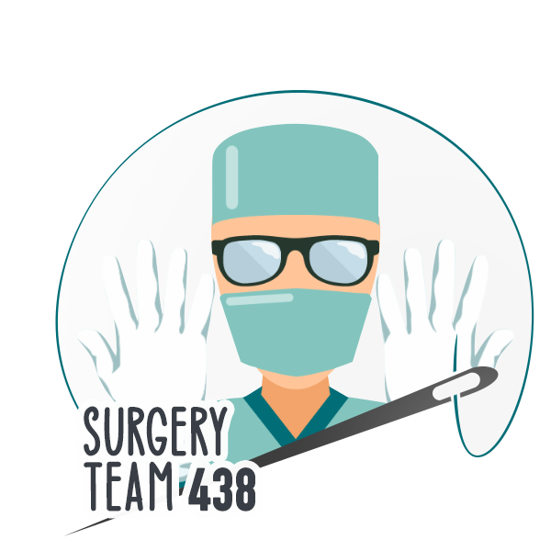
Neck swelling
Objectives
Thyroid swelling (physiology, diffuse, multinodular and solitary)
Lymphadenopathy ( infectious and neoplastic)
Salivary glands swellings
Others (branchial cyst and fistula, thyroglossal cyst, pharyngeal pouch, carotid body tumor, sternomastoid tumor, cystic hygroma, cervical rib, other tumors)
Parathyroid disease (hormone and calcium metabolism, types of hyperparathyroidism, causes of hypoparathyroidism- transient and permanent)
describe and explain the pathogenesis and clinical features of the following:
List the differential diagnosis by neck triangles
Colour Index
Main Text
Males slides
Females slides
Doctor notes
Textbook
Important
Golden notes
Extra
Editing File

Slide 2
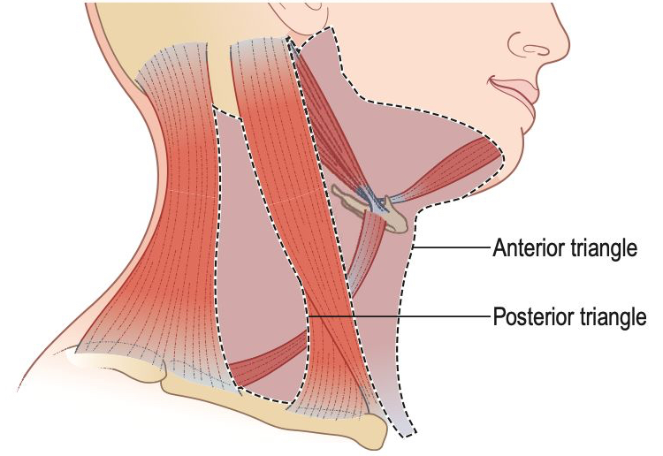
Thyroid swellings
Introduction:
Most neck masses are painless, but infection and malignant disease may cause pain.
Goitre is a visible or palpable enlargement of the thyroid
The swelling characteristically moves upwards on swallowing because of the gland’s attachment to the larynx and trachea.
Majority of thyroid swellings grow slowly and painlessly.
A rapid change in the size of part of the gland, or of an existing lump, may be caused by haemorrhage into a necrotic nodule,a fast-growing carcinoma or subacute thyroiditis.
Also, Rapid enlargement makes malignant disease more likely.
infection and inflammation of the thyroid can be a complication of otitis media
Physiological enlargement: Transient enlargement may occur during
Puberty or
Pregnancy
Thyroid swelling are:
Diffuse, Eg:
Graves
Hashimotos
Lymphoma
Anaplastic tumours
Single, Eg:
Adenoma
Cancer:
Medullary tumour
Follicular tumour
Multinodular, Eg:
Iodine deficiency
(Most common cause).
Systemic illness, general malaise, fever and rigors.
Loss of appetite, loss of weight and other symptoms.
Head and neck symptoms.
Pain in the mouth, sore throats or ulceration, discharge.
Discomfort during swallowing
Compression symptoms: Dysphagia, odynophagia, Dyspnoea, changes in voice.
Hyper/Hypo-thyroidism symptoms?
Family history of thyroid cancer?
Radiation exposure (especially in childhood)?
History
Examination
Site (Lump In the neck)
Relation to muscles.
Relation to the trachea.
Relation to the hyoid bone.

Slide 3
Thyroiditis
Autoimmune thyroiditis (Hashimoto’s disease):
The patient is usually euthyroid, but thyrotoxicosis can occur early. In the long term, the patient becomes hypothyroid as the gland is progressively destroyed.
The thyroid is diffusely enlarged and firm. A nodular form may be confused with multinodular goitre
Lymphoma may occur in a thyroid that has been affected by long-standing Hashimoto’s disease
Antibodies are detected in the serum against thyroglobulin, antithyroid antibodies, particularly to microsomal components of the follicle cells. Biopsy for cytology helps to confirm the diagnosis.
Early-stage
Primarily asymptomatic
Goiter: nontender or painless, rubbery thyroid with moderate and symmetrical enlargement
Hashitoxicosis may occur: transient hyperthyroidism due to follicular rupture of hormone-containing thyroid tissue that manifests with, e.g., irritability, heat intolerance, diarrhea.
Late-stage
Thyroid may be normal-sized or small if extensive fibrosis has occurred.
Hypothyroidism (e.g., cold intolerance, constipation, fatigue)
Clinical features
Thyroid markers:
Early-stage: transient hyperthyroidism (↓TSH, ↑FT3, and ↑ FT4)
Progression: subclinical hypothyroidism (↑ TSH; FT3 and FT4 normal)
Late-stage: overt hypothyroidism (↑ TSH; ↓ FT4 and ↓ FT3)
Antibody:
Anti-TPO (anti-microsomal) & Anti-Tg antibodies
US -Results depend on the form of Hashimoto thyroiditis-:
Atrophic phenotype: reduction in thyroid size (mainly observed)
Goitrous phenotype: heterogeneous enlargement
Diagnostics
Management
Levothyroxine (T4) replacement therapy

Slide 4
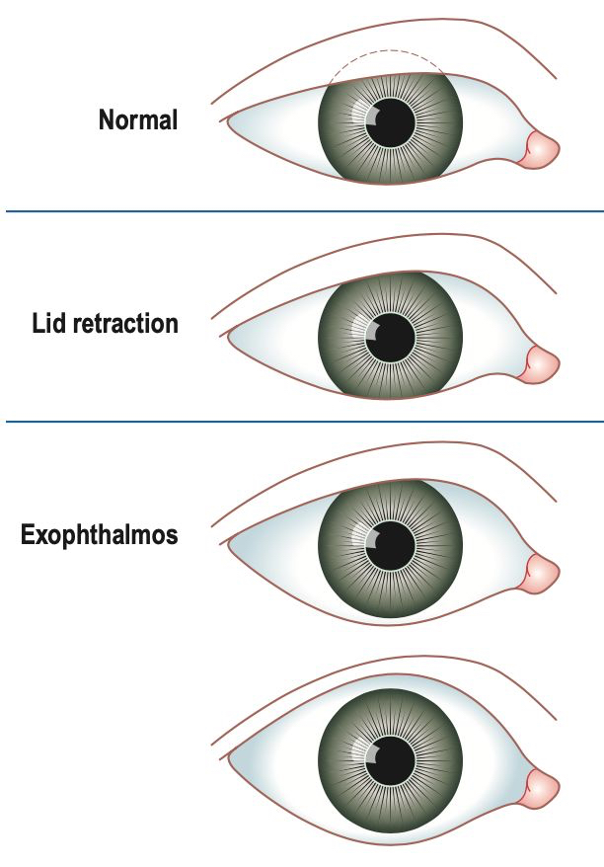
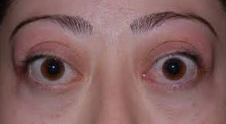
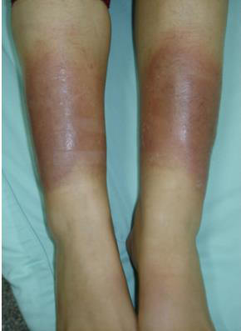
Thyrotoxicosis
Primary thyrotoxicosis (Graves’ disease)
Introduction
An autoimmune disease in which TSH receptors in the thyroid are stimulated by circulating thyroid receptor antibodies (TRAbs).
The gland is uniformly hyperactive, very vascular and usually symmetrically enlarged.
TRAbs can cross the placental barrier, so that neonatal thyrotoxicosis can occur.
Young female (female/male ratio 8:1) and the condition can be familial.
Triad of Graves disease
Diffuse goiter
Moderately and diffusely enlarged and soft, because of its vascularity a bruit may be audible.
Ophthalmopathy -due to inflammation of the extraocular muscles-:
Exophthalmos (specific for graves)
Ocular motility disturbances (Ophthalmoplegia)
Lid retraction
Conjunctival conditions (Chemosis)
Dermopathy (pretibial myxedema): presents commonly as raised pigmented lesions typically on the shins (specific for graves)
Clinical features
Diagnostics
Thyroid markers: Raised T3 and T4 levels, coupled with low TSH levels, are confirmatory.
Thyroid antibodies: ↑ TRAbs (specific)
Thyroid scintigraphy: Diffuse uptake of radioactive iodine (123I)
Antithyroid drugs: methimazole, propylthiouracil
block the incorporation of iodine into tyrosine and so prevent the synthesis of T3 and T4
Radioactive iodine ablation: Many consider this to be the treatment of choice. As long as it is not used in pregnancy
Surgery: Thyroidectomy is a highly successful form of treatment for many patients, especially younger ones. Patients are cured by surgery, total thyroidectomy being the operation of choice. Before surgery, patients must be rendered euthyroid with antithyroid drugs. Iodine has historically been given orally for 10 days before surgery to reduce vascularity, but the evidence base to support this is weak.
Management

Slide 5
Thyrotoxicosis
Toxic multinodular goitre and toxic adenoma
A toxic multinodular goitre is responsible for thyrotoxicosis in about 25% of patients. There is usually a long-standing nontoxic goitre in which one or more nodules become hyperactive and begin to hyperfunction independently of TSH levels. A single hyperfunctioning adenoma is a rare cause of thyrotoxicosis.
Toxic multinodular goitre is more common in older women, and cardiac complications such as arrhythmias are particularly frequent due to the presence of an already compromised cardiovascular system.
Multinodular goitre:
Painless goiter with multiple palpable nodules.
Symptoms of thyrotoxicosis.
Toxic adenoma:
Palpable, usually painless nodule in otherwise normal gland
Symptoms of thyrotoxicosis
Clinical features
Diagnostics
Thyroid scintigraphy:
In a toxic multinodular goitre, the isotope scan usually demonstrates multiple ‘patchy’ areas of increased uptake.
In toxic adenoma, the nodule is ‘hot’ and the remainder of the gland is ‘cold’.
Management
Initial management -treatment of hyperthyroidism-:
Beta blockers for symptom control
Antithyroid drugs to achieve euthyroidism
Definitive treatment options:
Multinodular goitre:
Total thyroidectomy or near-total thyroidectomy.
Radioactive iodine ablation.
Toxic adenoma:
Hemithyroidectomy.
Radioactive iodine ablation.

Slide 6
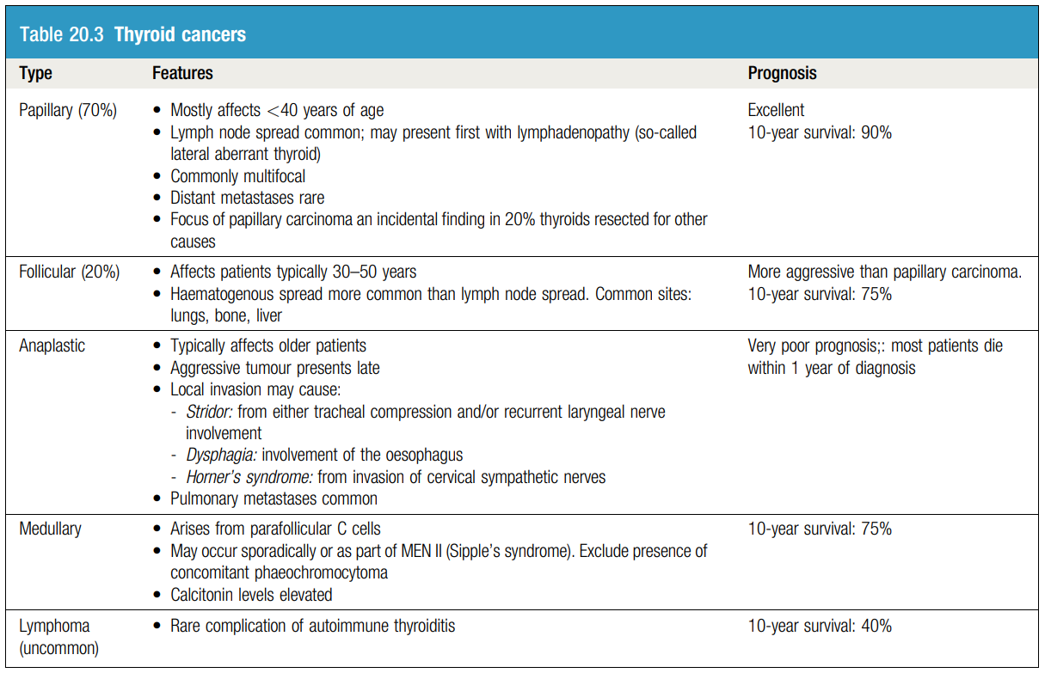
Malignant tumours of the thyroid
Overview of Malignant tumours of the thyroid
Thyroid carcinoma may be asymptomatic (e.g., thyroid incidentaloma) or manifest with any or all of the following clinical features:
Thyroid nodule
Firm to hard consistency
Typically painless
Features of local infiltration or compression
Recent onset of any of the following:
Hoarseness, Dyspnea, Dysphagia, Horner syndrome (rare).
Painless cervical lymphadenopathy
More common in papillary and anaplastic thyroid cancer
Less common in follicular thyroid cancer
Signs of distant metastasis
More common in follicular and anaplastic thyroid cancer
Less common in papillary thyroid cancer
Examples include:
Pulmonary metastases: coughing, hemoptysis, dyspnea
Bone metastases: bone pain, pathologic fractures
Brain metastases: focal neurologic deficit, seizures
Paraneoplastic syndrome: diarrhea and facial flushing (typically seen in advanced medullary carcinoma).

Slide 7
Malignant tumours of the thyroid
Papillary carcinoma
Most common type of thyroid cancer
Most prevalent before the age of 40 years and presents as a slow-growing, solitary thyroid swelling.
The disease has an excellent prognosis, with 10-year survival rates approaching 90%.
Diagnostics
Histologically, complex papillary folds lined by several layers of cuboidal cells project into what appear to be cystic spaces. Psammoma bodies and nuclear inclusions with a resemblance to a comic-strip character (Orphan Annie) may be found.
Lymph node spread is common in papillary carcinoma in comparison to follicular carcinoma.
Management
The disease is commonly multifocal, and thus total thyroidectomy is the optimal surgical procedure. It has the advantage of facilitating early detection of metastases by using radioactive iodine scan, as no functional thyroid tissue is left in the body after surgery
Microscopic disease (<1 cm and unifocal) and tumours with favourable histology and <2 cm in size may be treated by hemithyroidectomy alone
Follicular carcinoma
This disease typically presents as a solitary thyroid nodule in patients aged 30–50 years
The disease is more aggressive than papillary carcinoma and the 10-year survival rate is 75%.
Diagnostics
Histologically:
Uniform follicles
Vascular and/or capsular invasion
Treatment consists of total thyroidectomy with preservation of the parathyroids where the index of suspicion is high
When a hemithyroidectomy has been done for a thyroid nodule that turns out to be a follicular carcinoma on biopsy, a completion thyroidectomy is preferred over radioactive ablation of the remaining gland.
. If a postoperative radioisotope scan (challenge scan) reveals increased uptake in the skeleton or neck, therapeutic doses of radioiodine are given.
Plasma thyroglobulin levels should be undetectable after a successful surgery and radioiodine therapy.
Management

Slide 8
Malignant tumours of the thyroid
Anaplastic carcinoma
Typically affects older patients.
Poor prognosis: Most patients die within 1 year of diagnosis.
The tumours feel hard and are usually locally fixed at the time of presentation.
Local invasion may involve the recurrent laryngeal nerve(s) and cause hoarseness, trachea causing dyspnoea and stridor, and the oesophagus causing dysphagia.
Invasion of the cervical sympathetic nerves may cause Horner’s syndrome (contraction of the pupil, enophthalmos, narrowing of the palpebral fissure and loss of sweating on the face and neck). Pulmonary metastases are common.
Diagnostics
Histologically:
Undifferentiated giant cell (i.e., osteoclast-like cell)
Areas of necrosis and hemorrhage
Management
Resection is rarely curative in the early stages of the disease, but the main goal of surgery is to relieve tracheal compression.
Medullary carcinoma
This tumour arises from the parafollicular C cells. There is hard enlargement of one or both thyroid lobes, and in more than 50% of patients the cervical lymph nodes are involved.
10-year survival: 75%.
The tumour may occur sporadically or as part of an inherited multiple endocrine neoplasia (MEN) syndrome type II (Sipple’s syndrome).
Calcitonin levels are elevated, and can be used to monitor progress and screen relatives.
Diagnostics
Histologically:
Ovoid cells of C cell origin and therefore without follicle development
Amyloid in the stroma (stains with Congo red)
Management
Treatment consists of total thyroidectomy and, if the calcitonin level is raised, dissection of the lymph nodes in the central compartment of the neck (levels 6 and 7)

Slide 9
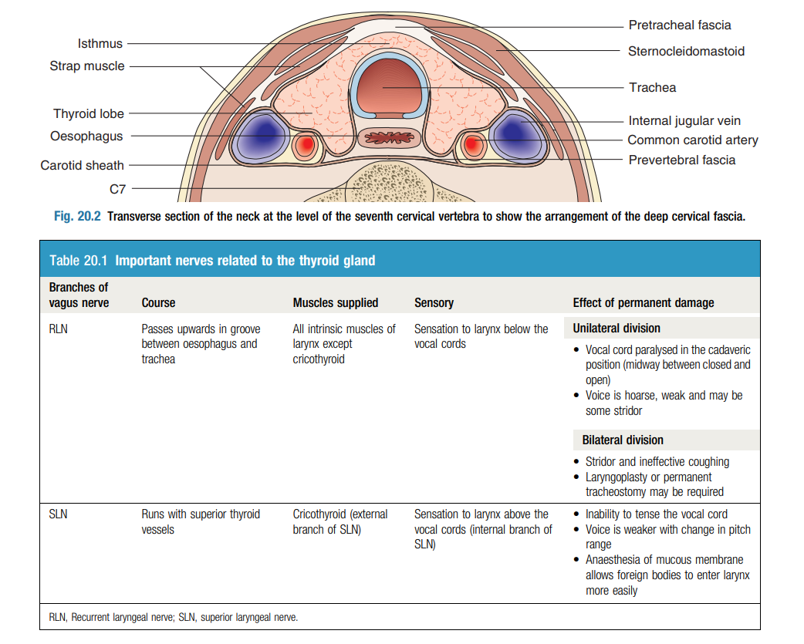
Extra
Malignant tumours of the thyroid
Thyroidectomy
The following terminologies are used in relation to surgery of the thyroid gland based on the extent of the gland removed for different indications:
Lobectomy: Removal of one lobe of the thyroid gland leaving behind the other lobe and isthmus; usually for solitary nodule
Hemithyroidectomy: Removal of one lobe along with the isthmus; most common operation for a solitary thyroid nodule and toxic nodule
Subtotal thyroidectomy: Removal of majority of both lobes leaving behind 6–8 g (equivalent to the size of a normal thyroid gland) of thyroid tissue on one or both sides; most common operation for multinodular goitre
Near-total thyroidectomy: Removal of entire thyroid gland leaving behind 1–2 g of tissue usually on the non affected or least affected side of a malignant gland to preserve damage to the parathyroid glands and avoid injury to recurrent laryngeal nerve
Total thyroidectomy: Removal of the total thyroid gland sparing the recurrent laryngeal nerves by identification and preservation of parathyroid glands by individual ligation of the branches of the inferior thyroid artery, keeping their blood supply intact as far as possible, or by reimplanting the parathyroids in the sternomastoid muscle to prevent postoperative hypoparathyroidism.
Complications
Haemorrhage | If delayed bleeding is not recognised early, it can compress the internal jugular veins, leading to laryngeal oedema and asphyxia.
Nerve damage | The external branch of the superior laryngeal nerve may be damaged while securing the superior thyroid pedicle, causing inability to tense the vocal cord and a weaker voice with noticeable pitch range changes. It can be prevented by consciously ligating the superior polar vessels as close to the thyroid gland as possible, as the nerve travels away from the superior thyroid vessels as it approaches the thyroid gland. Damage to the recurrent laryngeal nerve is more serious. Traction or bruising of this nerve causes temporary paralysis of a vocal cord in 1% of patients undergoing thyroidectomy, but recovery within 3 months is the rule. Division of the nerve paralyses the cord in the ‘cadaveric’ position (i.e., midway between the closed and open positions). Bilateral nerve injury results in stridor and ineffective coughing when the endotracheal tube is withdrawn at the end of the operation. The tube is re inserted immediately and, if there is no early improvement, tracheostomy may be required
Scar complications: | The scar can become hypertrophic or keloid, particularly when the incision has been placed low in the neck. Recurrent keloid formation is common after excision of the scar
Others | Hypothyroidism Hypoparathyroidism Bruising or accidental removal of the parathyroid glands leads to hypoparathyroidism, manifest by hypocalcaemia and symptoms of increased neuromuscular excitability

Slide 10
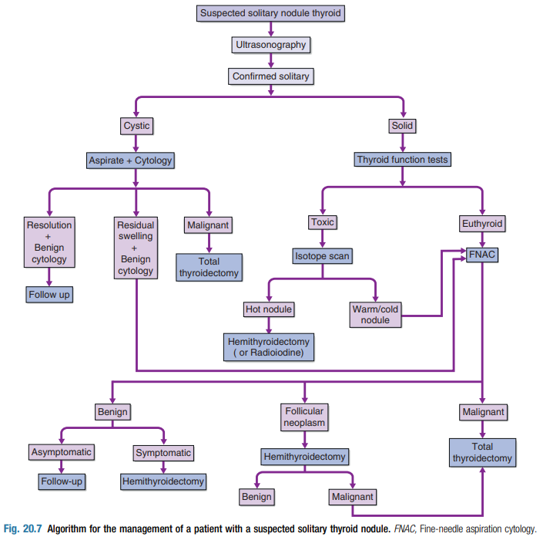
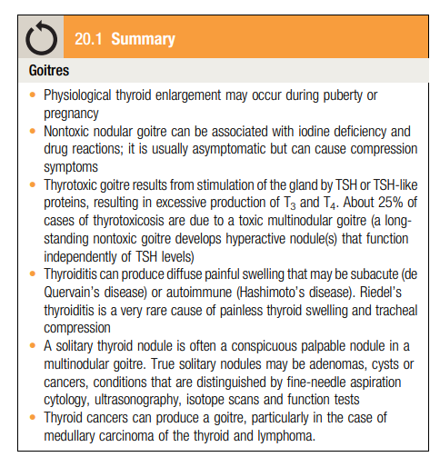
Thyroid swellings
Solitary thyroid nodules:
Slow-growing and painless clinically ‘solitary’ nodules are common, although 50% really represent a clinically dominant nodule within part of a multinodular goitre.
Amongst patients presenting with a thyroid nodule, the incidence of malignancy is approximately 10%. The others are benign adenomas or cysts
All patients with new thyroid nodules should be referred for investigation.
Patients with concerning features should be referred urgently, features include:
increasing size
Family history of thyroid cancer
Previous radiation exposure
Patient over 65 years
Unexplained hoarseness
Cervical lymphadenopathy
Stridor
Ultrasound is the most sensitive first-line investigation in the management of thyroid nodules and allows identification of nodules suitable for FNAC.
Parathyroid disease
Introduction
Parathyroid conditions are rarely accompanied by clear physical signs.
Extremely uncommon to be able to palpate an abnormal parathyroid gland in the neck.
The parathyroid glands receive a rich blood supply from the inferior thyroid artery
Histologically, the glands contain chief cells that secrete parathormone (PTH).
Hypoparathyroidism
Temporary | Permanent
Usually seen post-operatively, labs findings: LOW PTH LOW Ca Symptoms & Signs: Numbness, Paresthesia around the tips of finger and the mouth Chvostek and Trousseau sign Managed by high Ca doses and active Vit. D | When the gland is removed by accident (Eg. during thyroidectomy)

Slide 11
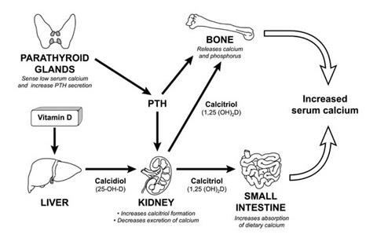
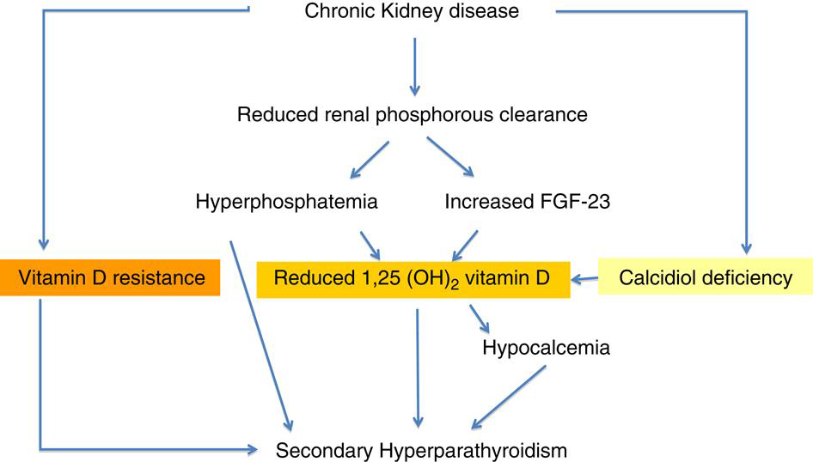
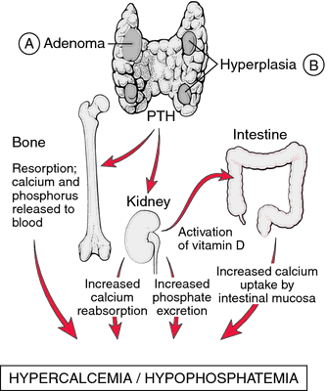
Parathyroid disease
Primary hyperparathyroidism
In 90% is due to an adenoma, in 10% it results from hyperplasia (usually affecting all four glands, incase of MEN syndrome), and in less than 1% it results from parathyroid carcinoma
Clinical features: ‘broken bones, renal stones, abdominal groans and psychic moans’
Bones | Renal stones | Gastrointestinal | Psychiatric
Demineralisation and subperiosteal bone resorption Cysts in long bones and jaw Moth-eaten appearance to skul Pathological fractures | Nephrocalcinosis and calculi Polyuria: An early symptom | Peptic ulcer Pancreatitis Nausea and vomiting increase dehydration and increase serum calcium further leading to a vicious spiral of deterioration) | Psychosis and acute confusion (uncommon but indicate marked hypercalcaemia >3.5 mmol/L) Others: Lethargy and general weakness
Secondary hyperparathyroidism
Secondary hyperparathyroidism, there is over-secretion of PTH in response to low plasma levels of ionised calcium, usually because of renal disease, Vit. D deficiency or malabsorption
Managed initially by dietary phosphate restriction and by giving 1-α-hydroxyvitamin D3 (alfacalcidol) (They should be given the active form of Vit.D) to increase calcium absorption and provide negative feedback on the parathyroids
Tertiary hyperparathyroidism
Excessive PTH secretion in secondary hyperparathyroidism may become autonomous; it is then termed tertiary hyperparathyroidism. This may occur after renal transplantation.
Total parathyroidectomy may be needed, with calcium and vitamin D replacement therapy
subtotal parathyroidectomy leaving half-equivalent of a normal gland in situ or autotransplantation of parathyroid tissue (equivalent in size to one normal gland) into an arm muscle (where it can be readily located if problems persist)

Slide 12
Parathyroid disease
Serum calcium and PTH levels must be measured on more than one occasion. PTH levels may be normal, but the detection of unsuppressed PTH values in a patient with hypercalcaemia supports the diagnosis of primary hyperparathyroidism
01
02
Other supportive findings include a low serum phosphate, hyperchloraemia (and an abnormal Cl/PO4 ratio), and a raised 24-hour urinary calcium excretion.
Diagnosis
03
A low urinary calcium excretion should alert the clinician to the possibility of familial hypercalcaemic hypocalciuria, a disease of the renal tubules in which the parathyroids are norma
Remove all overactive parathyroid tissue
Preoperative imaging with ultrasound and sestamibi (MIBI) scans will allow selection of patients for a focused approach.
With discordant imaging or associated multinodular goitre and previous neck surgery, traditional cervicotomy and four-gland exploration will be required.
If two or more glands are enlarged, they should be removed.
If all four glands are thought to be hyperplastic, then all but a portion of the smallest gland should be removed, then transplanted in other regions
If exploration fails to identify an adenoma or hyperplasia, the incision is closed. Reoperation is considered after (re)confirming the diagnosis and attempting to localise the gland using CT, MRI or selective venous catheterisation
Management:
In asymptomatic patients, surgery may be indicated for:
01
02
03
- Patients <50 years
Serum calcium levels >1 mg/dL (>0.25 mM/L)
above the upper limit of normal
Evidence of end-organ disease. Eg:
Impaired bone mineral density
24 hour urinary calcium >400 mg/day and increased stone risk
Reduced creatinine clearance

Slide 13
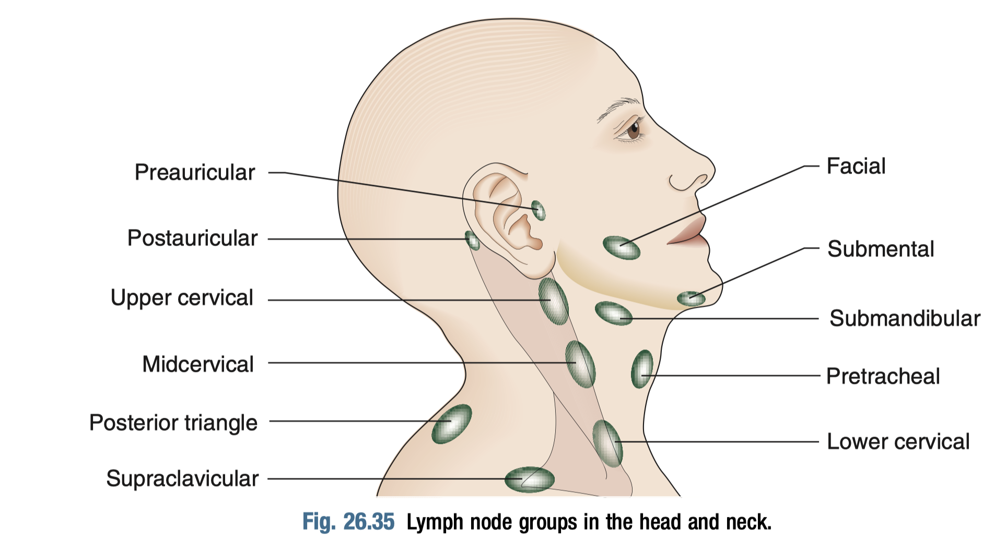
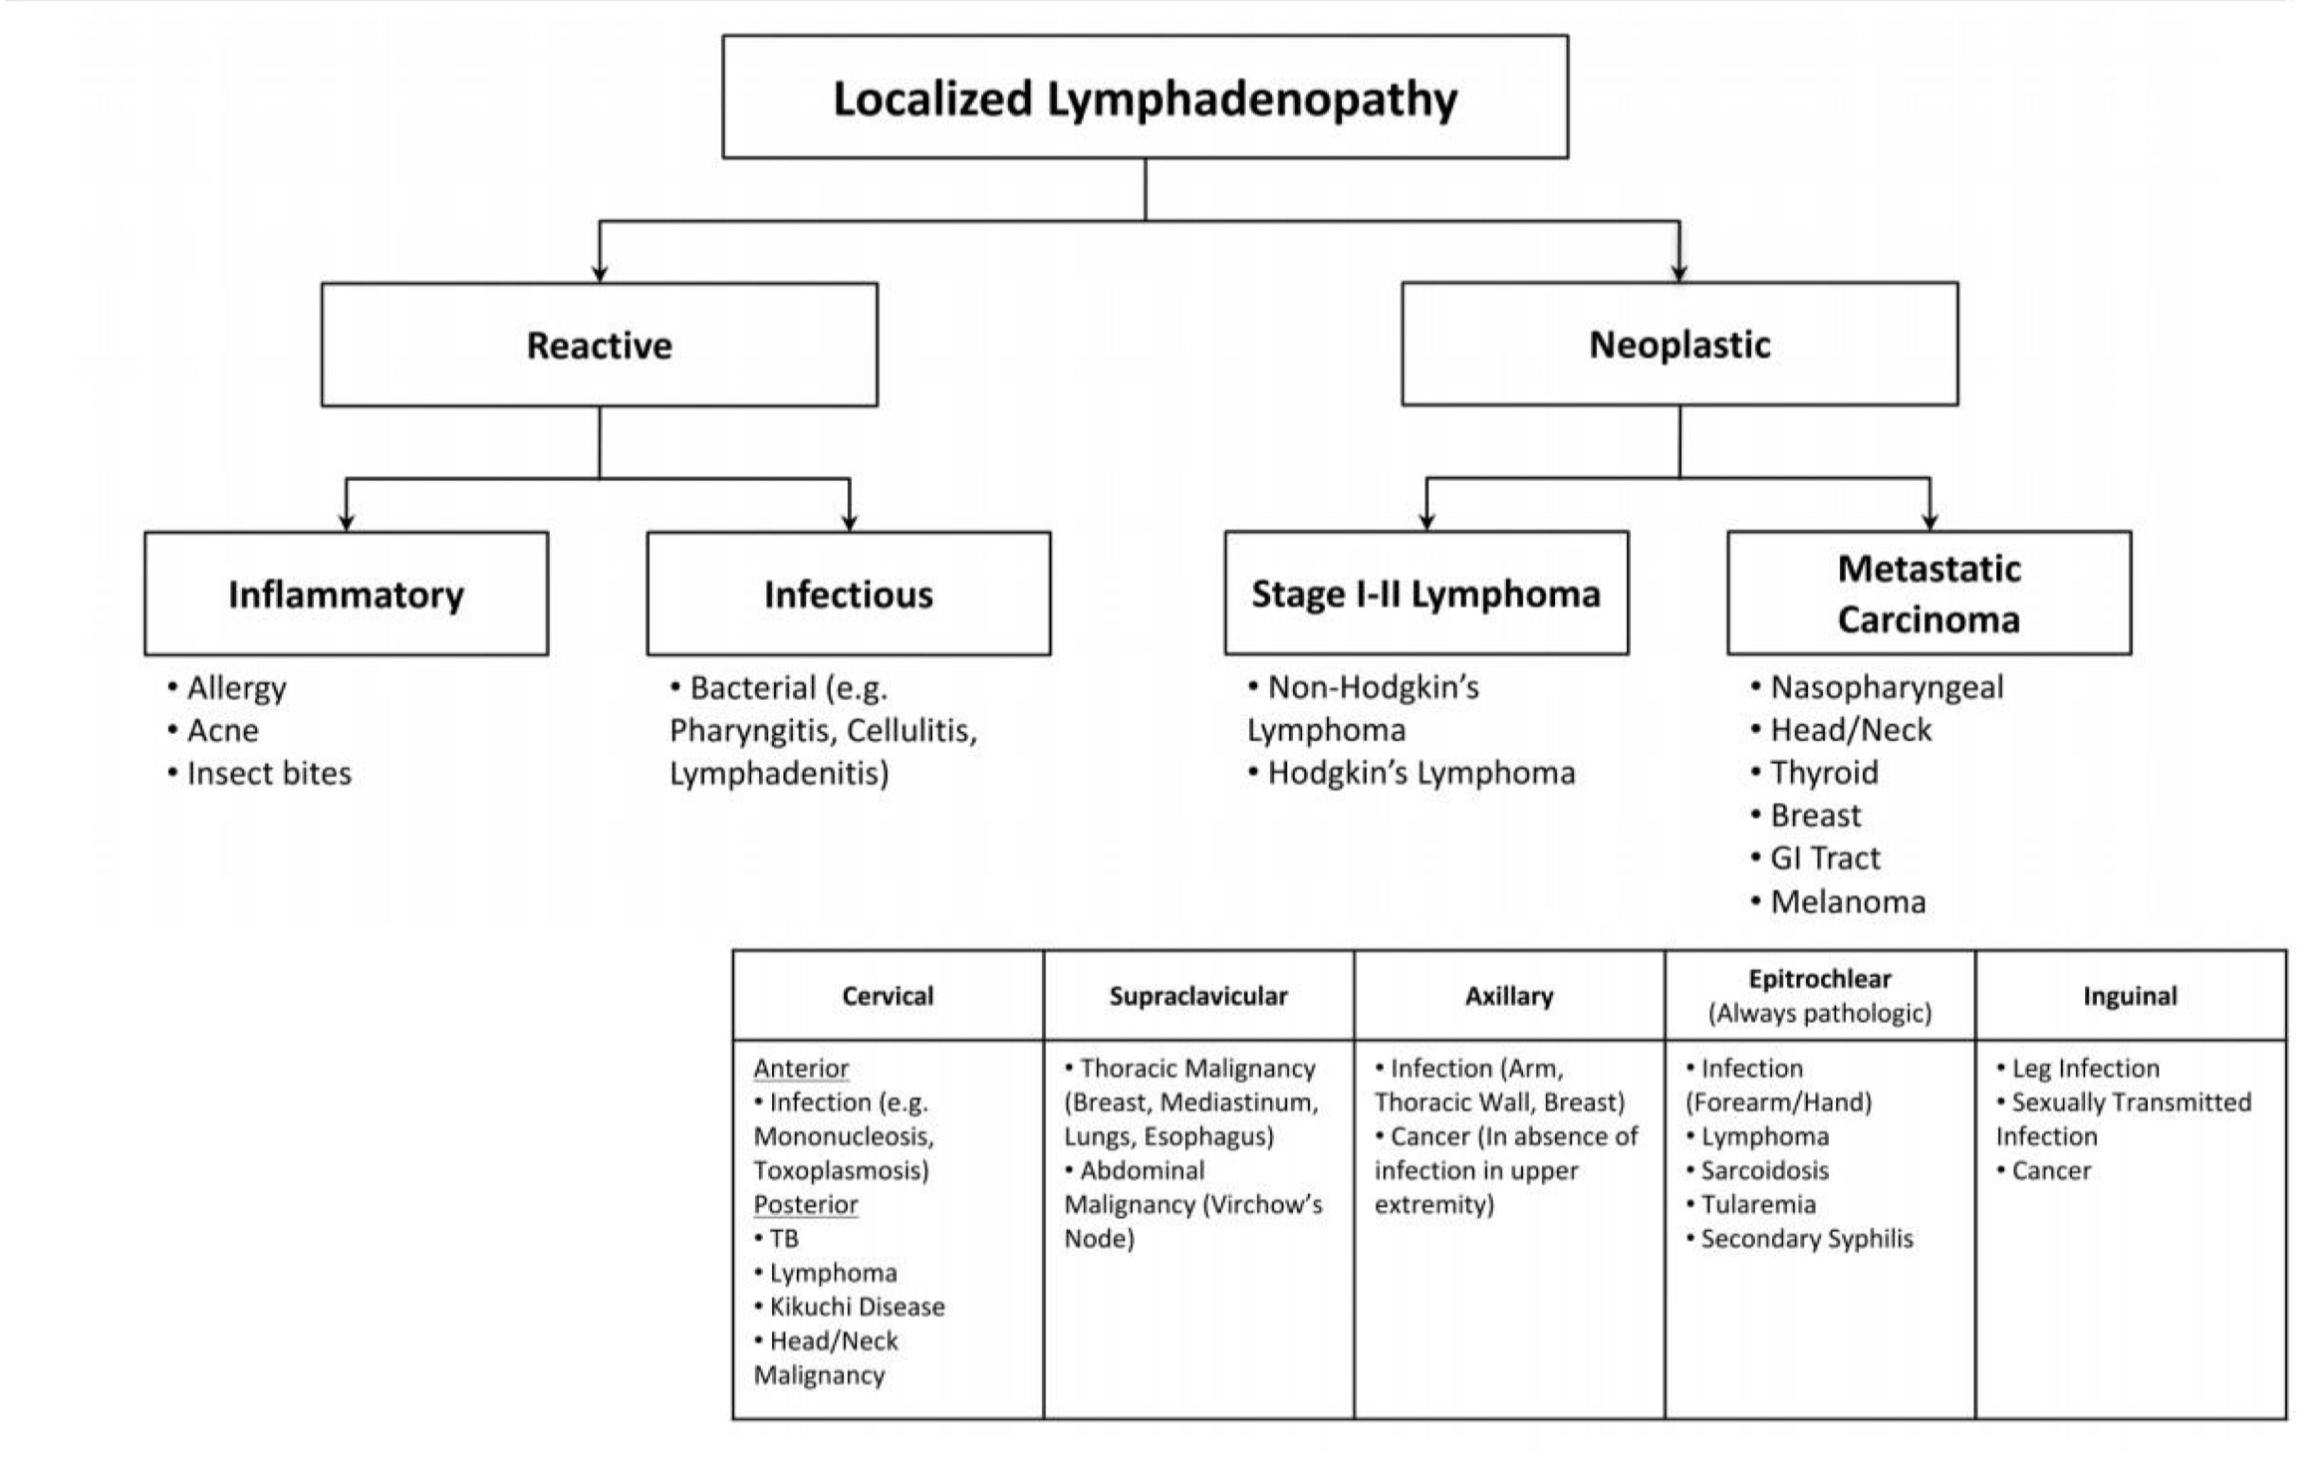
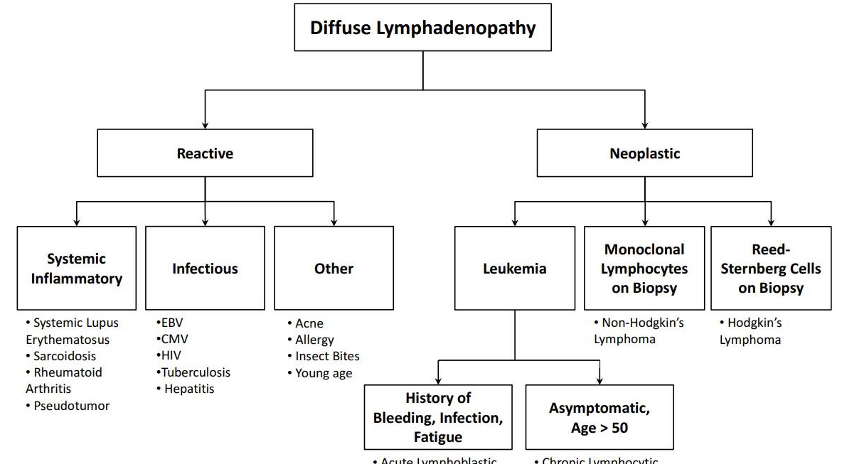
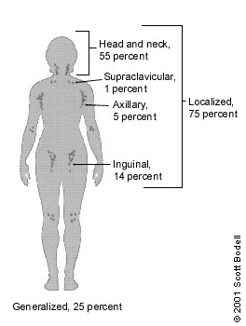
Lymphadenopathy
Introduction
The most common sources of neck swelling is lymph node enlargement.
Lymph nodes may become enlarged in response to infection or cancer in their area of drainage
Instructions:
Primary neoplasms of lymph nodes (lymphomas), tuberculous lymphadenitis and secondary deposits (usually from squamous carcinoma of the head and neck) are commonly seen lymph node swellings in the neck.
Secondaries from thyroid carcinoma.
Lymph node enlargement in the lower half of the neck warrants exclusion of a primary in the breast, chest and abdomen (including testis/ovary).
Systemic lymph node enlargement (including hepatosplenomegaly) should be looked for.
Causes of cervical lymph gland enlargement
The four main causes of cervical lymph gland enlargement are:
01
02
03
04
Infection
Metastatic tumour
Primary reticuloses
Sarcoidosis
DDx of localized lymphadenopathy
Infections
Metastatic cancer
You should think of gastric cancer when the supraclavicular lymph nodes are enlarged
DDx of generalized lymphadenopathy:
Infections (TB)
Autoimmune disease
Lymphomas
Hints for infectious cause: Tenderness, fever, acute presentation
You should think of lymphoma when the patient presents with lateral neck swelling and constitutional symptoms

Slide 14
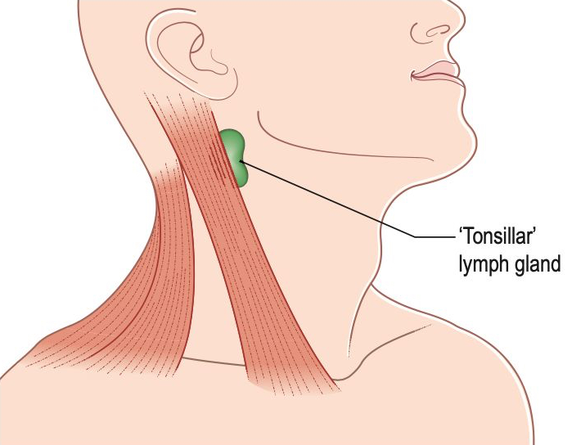
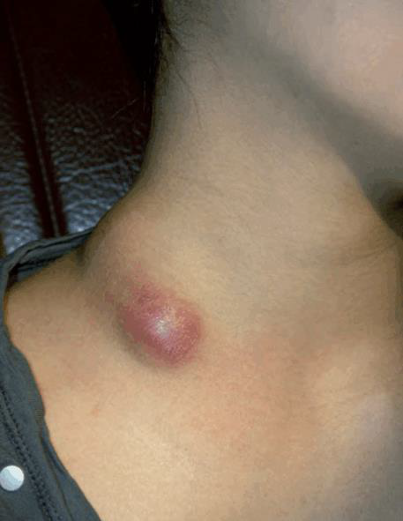
Lymphadenopathy
Non-specific cervical inflammatory lymphadenopathy
Follow any inflammatory process, mostly recurrent tonsillitis.
The upper deep cervical glands are most often affected.
History
Below the age of 10 years.
Painful lump just below the angle of the jaw.
The patient often feels ill, has a sore throat and pyrexia.
Examination
Tonsillar gland : upper deep cervical lymph glands , deep
to the angle of the mandible.
Tender.
1–2 cm in diameter.
With enlarged tonsils.
Tuberculous cervical lymphadenitis and abscess
Follow any inflammatory process , mostly recurrent tonsillitis.
The upper deep cervical glands are most often affected.
History
Common in all ages.
The patient complains of a lump in the neck with or without pain.
There is no generalized infection.
Check for a family history of tuberculosis , and Vaccination ( BCG).
Tuberculous lymphadenitis
Upper and middle deep cervical glands.
NOT hot.
1 and 2 cm in diameter.
Indistinct, firm mass of glands (matted).
Tuberculous abscess
The overlying skin turns reddish-purple.
Skin temperature is normal (cold abscess).
Tender.
3–5 cm across.
The other lymph glands in the neck near the abscess may be enlarged.
Tachycardia, pyrexia, anorexia and general malaise.
Examination

Slide 15
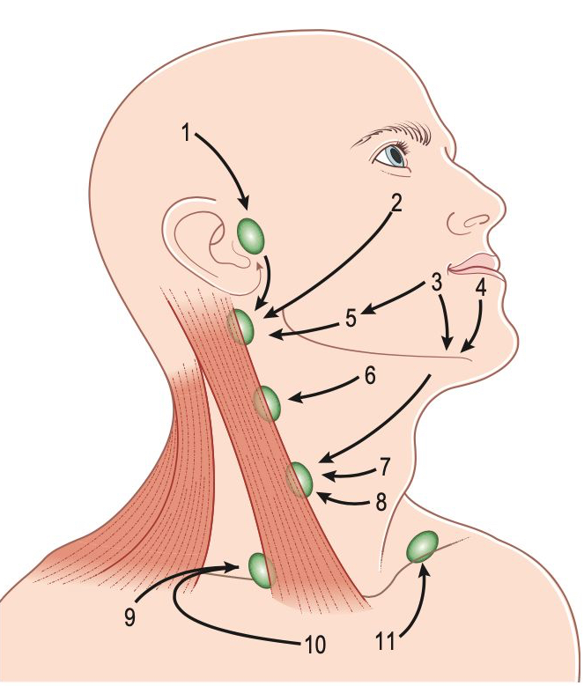
Lymphadenopathy
Carcinomatous lymph glands
Malignant metastatic deposits in the cervical lymph glands are the most common
cause of cervical lymphadenopathy in adults.
History
Over the age of 50 years.
Common in males.
Painless lump in the neck.
Patient may have symptoms from the primary lesion.
Examination
Site depend on the primary lesion location.
An enlarged supraclavicular lymph gland commonly indicates intra-abdominal or thoracic disease.
This gland is called Virchow’s gland; its presence is Troisier’s sign.
General Examination
Examine all sites that might contain the primary lesion.
Primary neoplasm of the lymph glands (Reticuloses, lymphoma)
The most common primary tumour of lymphoid tissue is malignant lymphoma.
History
Common in children and young adults.
Males are affected more.
Painless lump that grows slowly.
Malaise, weight loss and pallor.
Itching of the skin (pruritus) is a distinctive complaint.
Fever with rigors.
Examination
Any Lymph gland group , often bilateral.
Not tender.
Solid and rubbery , possible to define.
Liver and spleen may be palpable.
Anemia and jaundice.
Book’s Summary of lymphadenopathies
Nodes become palpable when their diameter exceeds 1 cm, but impalpable nodes may contain tumour.
Painless neck nodes in patients >45 years are often due to metastases from carcinoma. In most cases, the primary is within the head and neck. A thorough search for a primary lesion must precede biopsy.
Fine-needle aspiration cytology can be diagnostic for secondary carcinoma in lymph nodes from head and neck tumours or for tuberculosis; histology is needed for lymphoma.
In lymphoma:
The nodes are often bilaterally enlarged, rubbery, firm and discrete.
Extranodal disease suggests non-Hodgkin’s lymphoma.
Bone marrow examination and CT are used in staging.

Slide 16
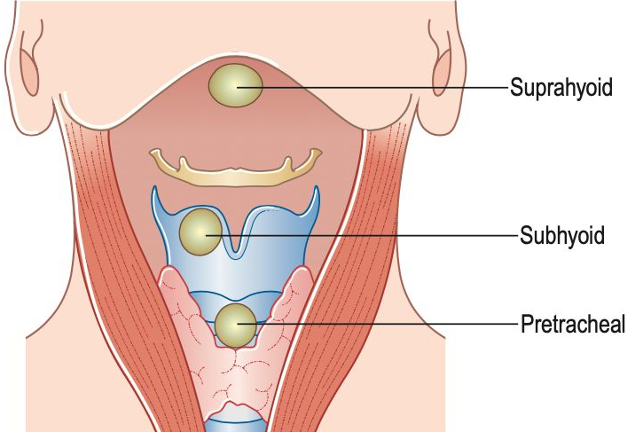
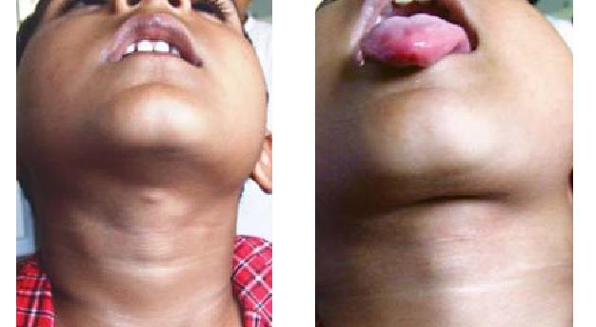
Thyroglossal cyst
Thyroglossal cyst
Portion of the thyroglossal duct remains patent.
Between the isthmus of the thyroid gland and the hyoid bone, and just above the hyoid bone.
A midline swelling usually situated just above the upper border of the thyroid cartilage. The cyst may contain mucoid-to-purulent fluid, rich in cholesterol
Since the duct or its remnant is attached to the foramen caecum, it moves on protrusion of the tongue (a thyroid swelling does not move up on protrusion of the tongue). Also, as a thyroglossal cyst is intimately related to the hyoid bone, it also moves on swallowing
If an infected thyroglossal cyst bursts or is incised for drainage a thyroglossal fistula results
History
Between 15 and 30 years old.
Common in females
Painless prominent lump
Examination
Close to the midline.
Skin is normal unless infected.
0.5 to 5 cm in diameter.
Moves with protruding of the tongue.
Diagnostics
Ultrasound of the neck to evaluate the cyst and confirm the location of the thyroid
Thyroglossal cysts may be differentiated from aberrant thyroid tissue by an ultrasound scan
If an infection is suspected, fine needle aspiration should be performed for Gram stain and culture (including AFB and mycobacterial culture).
Management
Need surgery cause it’s an important risk of cancer
Elective surgical excision (Sistrunk procedure) to prevent infection: includes removal of:
the cyst
A portion of the hyoid bone
Excision of tissue comprising the path of descent from the foramen cecum (The whole trunk)
Treatment of any active infection with antibiotics before surgery

Slide 17
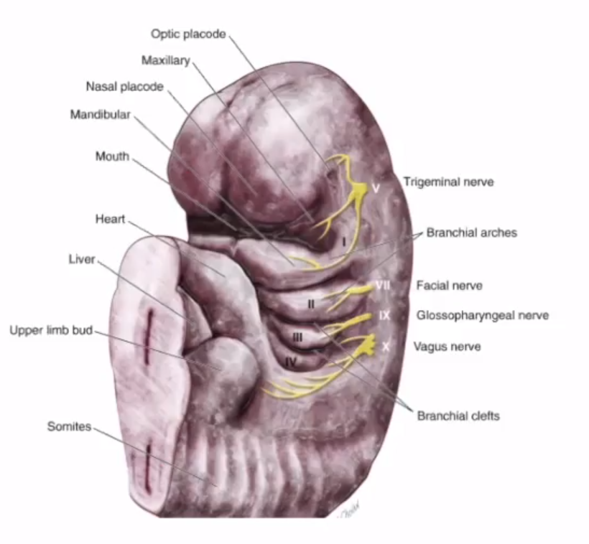
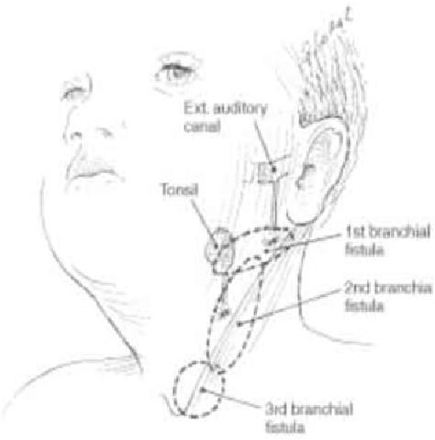
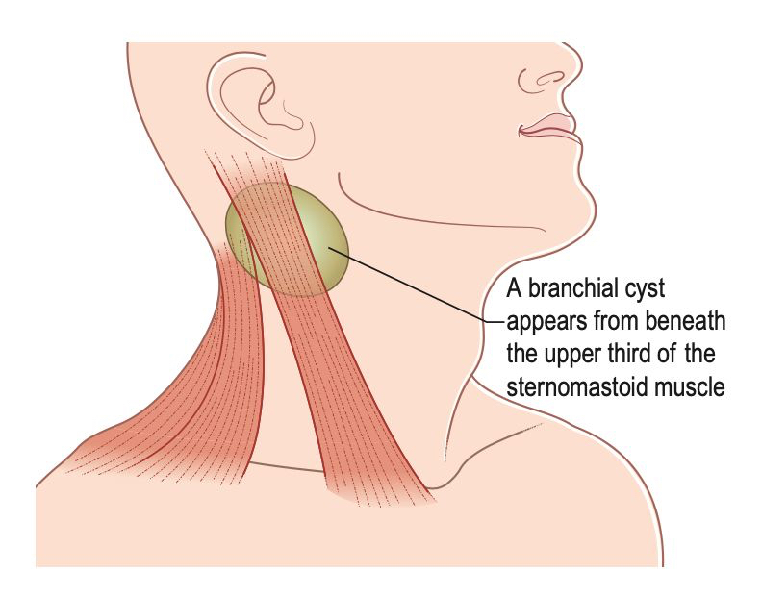
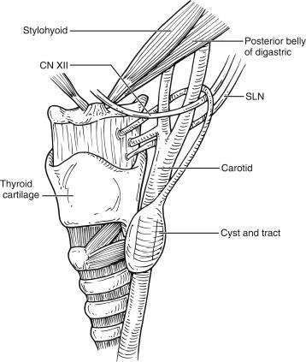
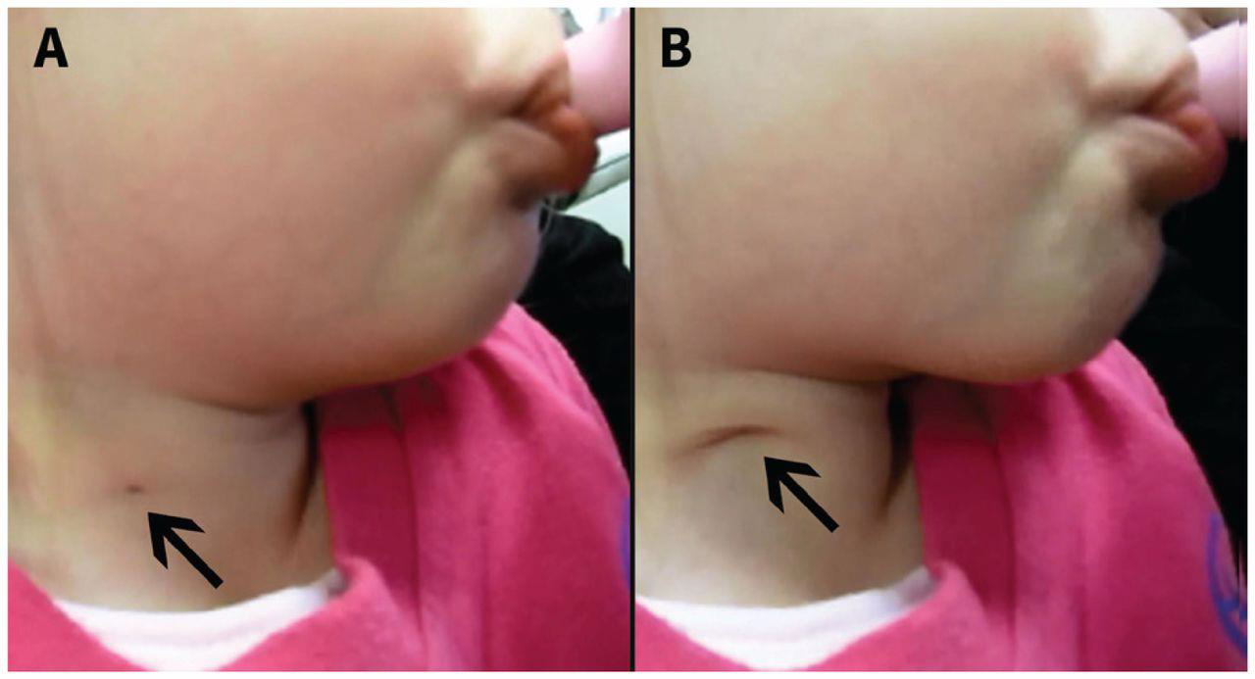
Branchial cyst & Branchial fistula
Branchial cyst
It can be from any cleft, but most commonly from the remnant of the second branchial cleft.
History
Mostly between the ages of 15 and 25 years.
Males and females are equally affected.
Painless swelling in the upper lateral part of the neck.
( upper neck anterior to upper third of sternomastoid)
No systemic effects and are not associated with any other congenital abnormality.
Examination
Behind the anterior edge of the upper third of the sternomastoid muscle.
Between 5 and 10cm long.
Sometimes the fluid is golden yellow and shimmers with fat globules and cholesterol crystals.
Skin is normal and no enlarged LN.
Smooth cyst with distinct margins with minimal mobility.
Characteristic finding: tethering of the skin upon swallowing
Diagnostics
Neck examination
Ultrasound
CT or MRI to further assess anatomical structures for surgical planning
Management
Complete surgical excision of both the cyst and any associated tracts
Branchial fistula (or sinus)
Rare congenital abnormality.
Branchial cleft which has not closed off.
Small dimple in the skin at the junction of the middle and the lower third of the anterior edge of the sternomastoid muscle that discharges clear mucus.
Swallowing accentuates the openings on the skin.

Slide 18
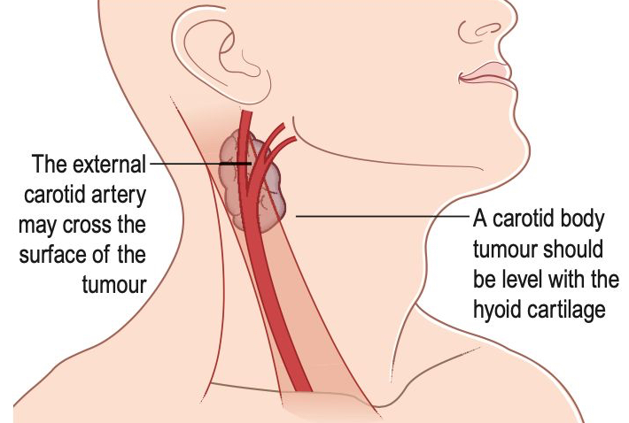
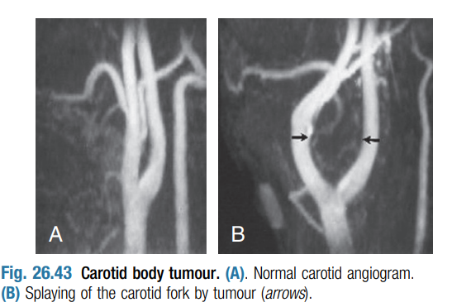
Carotid body tumour
Introduction
Rare tumour of the chemoreceptor tissue in the carotid body (chemodectoma).
The incidence is higher at high altitudes
It is estimated that malignant paragangliomas have less than a 50% 10-year survival rate; surgery is the treatment of choice as chemotherapy and radiation do not appear to be of significant benefit.
History
Between the ages of 40 and 60 years.
Painless, slowly growing lump.
Symptoms of transient cerebral ischaemia.
May be bilateral in 10%
Variable history of fainting
Always be gentle especially when palpating a lump close to the bifurcation of the carotid artery.
They are found in the upper part of the anterior triangle of the neck, level with the hyoid bone and beneath the anterior edge of the sternomastoid muscle. (Lateral neck swelling)
Not tender, not hot, skin is normal.
Vary from 2–3 cm to 10cm in diameter.
Lesion is mobile only transversely
Solid and hard, dull to percussion and do not fluctuate.
Sometimes they pulsate.
The common carotid artery can be felt below the mass.
Examination
Diagnostics
Angiography is useful to define (and possibly embolize) the feeder vessels. Biopsy is hazardous because of the risk of bleeding and formation of a pseudoaneurysm.
A diagnosis of malignancy is based on lymph node or distant metastases as pathology.
Histopathological criteria are unreliable to make a diagnosis of malignant carotid body tumour.
CT: splaying of internal and external carotid arteries (lyre sign)
MRI: ‘Salt’ (High signal foci of hemorrhage /Slow flow) & ‘pepper’ (The low signal flow voids)
Management
Treatment is surgical excision.
Operative bleeding and duration of surgery are reduced by preoperative embolisation.
The superior laryngeal nerve, vagus nerve and hypoglossal nerve are at risk during the procedure
In bilateral lesions, operate on the smaller first and counsel the patient that there may be fluctuation in blood pressure following the second side excision due to complete loss of carotid sinus function

Slide 19
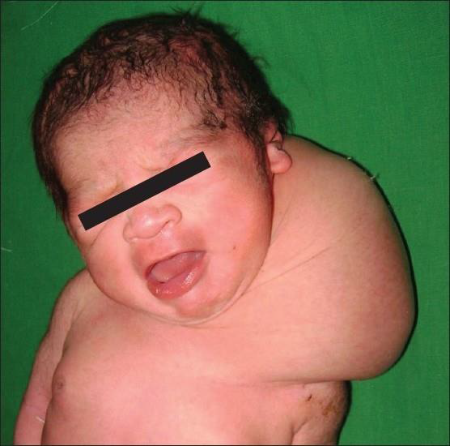
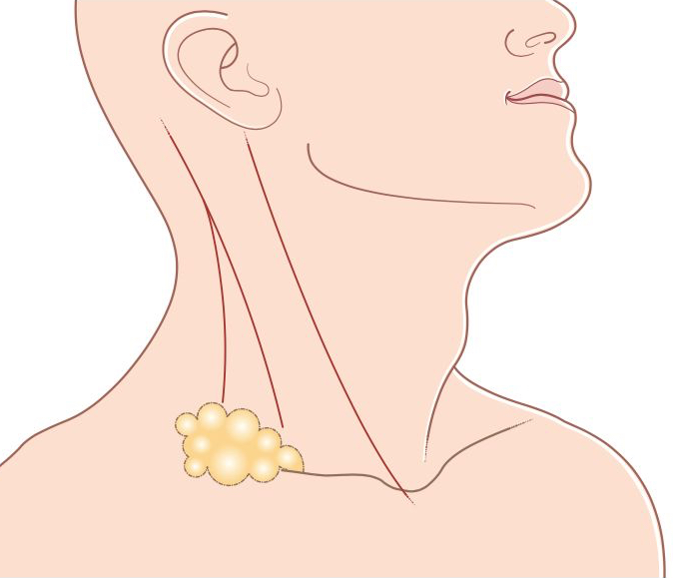
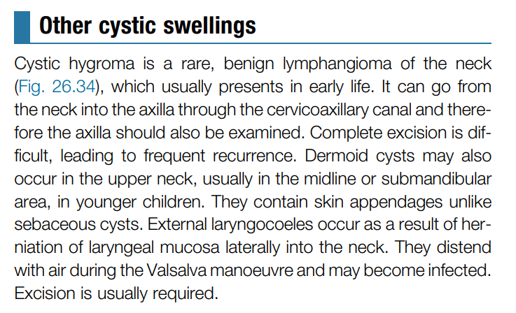
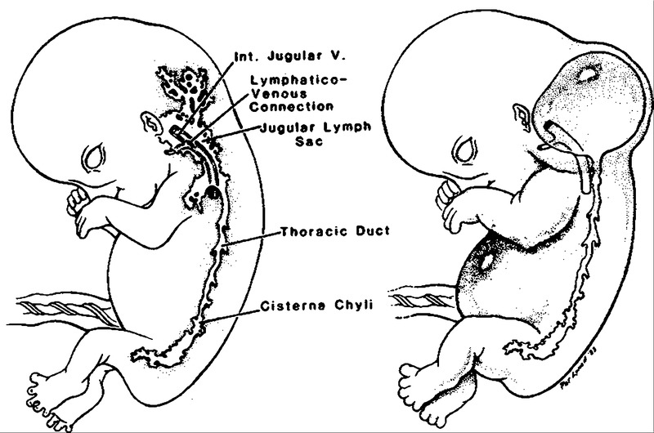
Cystic hygroma
Cystic hygroma (Lymph cyst, lymphocele, lymphangioma)
Congenital collection of lymphatic sacs in underdeveloped lymphatic channels that contain clear, colourless lymph.
Commonly occur near the root of the arm and the leg.
History
The majority present at birth.
The only symptom is the complaint about the lump.
This condition is not familial.
Examination
Found around the base of the neck ,usually in the posterior triangle.
Diffuse swelling, Not tender, not hot , normal skin.
Variable in size.
Their distinctive physical sign is a brilliant translucence.
Superficial to the neck muscles and close to the skin
It can go to the axilla, therefore it should be examined.
Fluctuation may present at first, but lost later on
Diagnostics
Prenatal ultrasound : fluid-filled neck mass with or without septations
Ultrasound to identify mass in infancy
CT or MRI may be used to further assess anatomical structures for surgical planning.
Management
Small masses may regress spontaneously, but surgical excision is usually indicated to prevent infection or airway compromise, as well as for cosmesis.
Recurrence is common following surgical excision of extensive hygromas.
brilliant translucence.

Slide 20
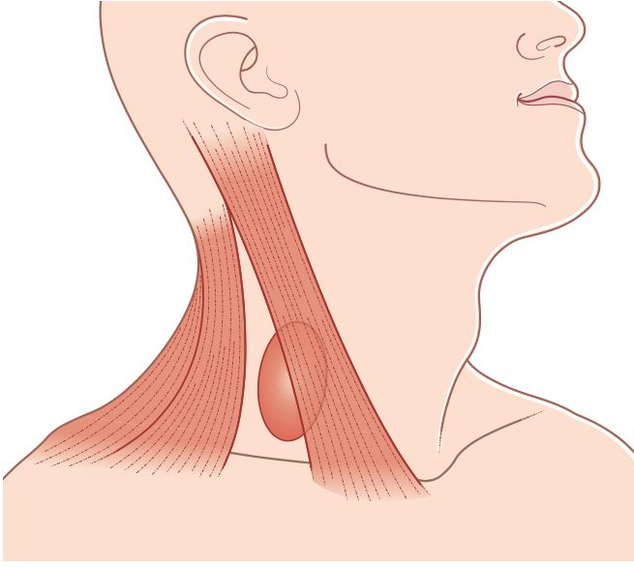
Zenker’s diverticulum
Pharyngeal pouch ( Zenker’s diverticulum )
‘Pulsion’ diverticulum of the pharynx between the cricopharyngeus muscle below and the lowermost fibres of the inferior constrictor muscle above.
History
Middle and old age Males.
Long history of halitosis and recurrent sore throats.
Common presenting symptom is regurgitation of froth and undigested food.
Dysphagia, cough
If it is longstanding it might lead to malnutrition and weight loss
Examination
In most patients, there is no palpable swelling , but if present it appears behind the sternomastoid muscle, below the level of the thyroid cartilage.
5–10 cm diameter.
It can be compressed and sometimes emptied with gurgling sounds.
Pay special attention to the chest.
Diagnostics
Barium swallow (best confirmatory test): contrast-filled pouch protruding dorsally from the hypopharynx at the level of C5/C6.
Management
Endoscopy: with diverticulostomy and myotomy
Open surgery: cricopharyngeal myotomy
There is no need to empty this area for your notes
Our team covers all doctor’s notes and objectives
You can play Tic-tac-toe :)
Click to play with AI

Slide 21
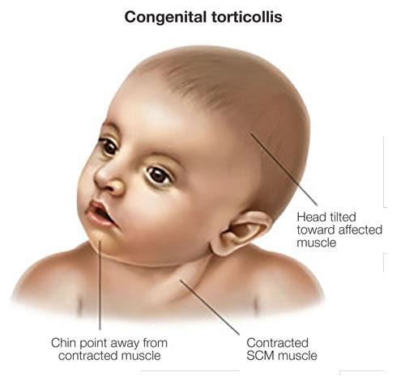
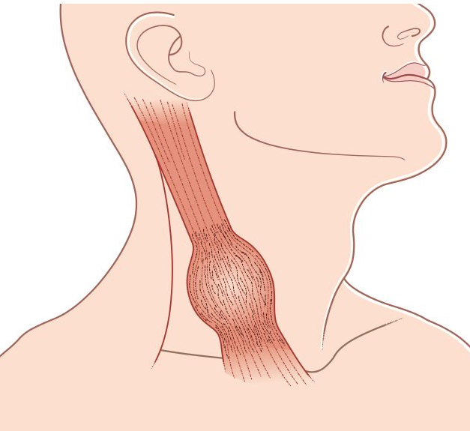
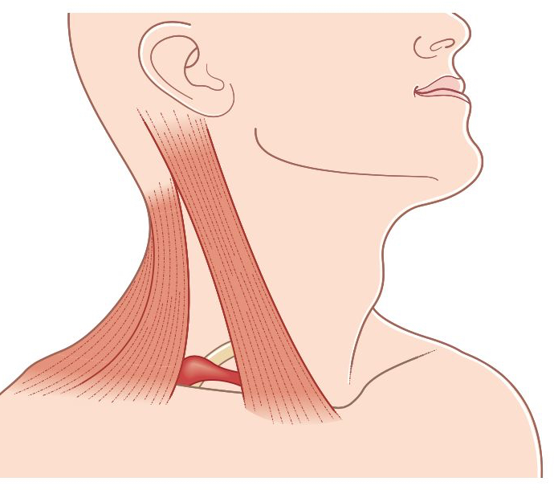
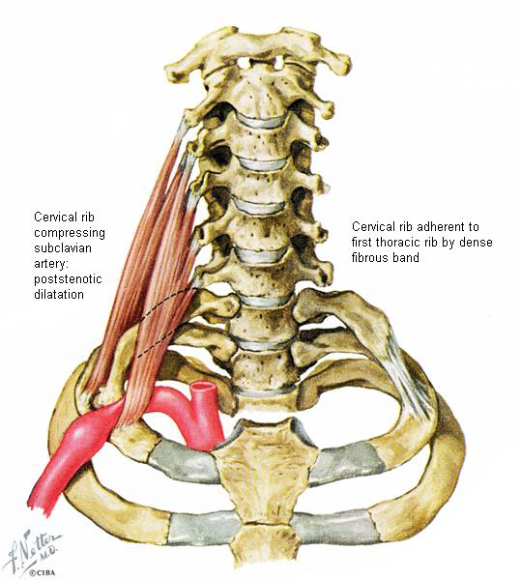
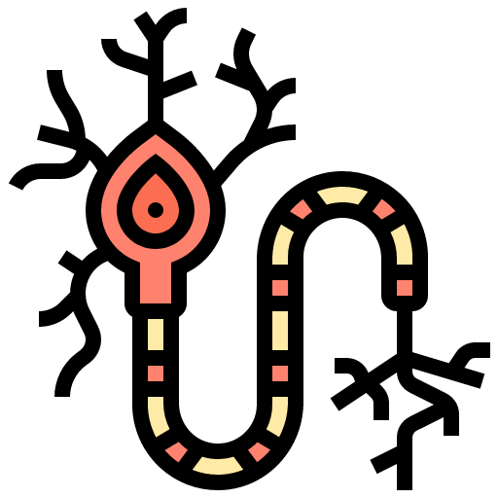
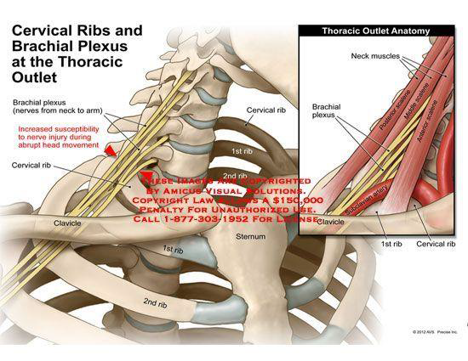
Sternomastoid ‘tumour’
Sternomastoid ‘tumour’ (Ischaemic contracture of a segment of the sternomastoid muscle)
Swelling of the middle third of the sternomastoid muscle due to ischemic attack, it is not a tumor
History
Lump is noticed at birth or in the first few weeks of life.
Mother may notice the lump or that the child keeps their head turned to one side – torticollis.
There is no curative procedure, physiotherapy may help.
The lump:
Tender Lump in the middle third of the neck on the anterolateral surface.
Usually 1–2cm across, fusiform.
The neck:
Examine the movements of the neck.
Child will turn head to the other side but tilt head to same side.
The eyes:
Squint.
The head:
An uncorrected torticollis may cause facial asymmetry.
Examination
Cervical Rib
Basically it is additional rib adherent to the first rib by fibrous bands
It causes narrowing of the thoracic outlet, compressing a lot of structures like :
Subclavian artery
Brachial plexus
Sudden turning of the head causes severe compression especially to the nerves
Elevation of the hands may exacerbate the symptoms
Although a cervical rib can cause serious neurological and vascular symptoms in the upper arm, clinical examination of the neck does not usually reveal any abnormalities.
Symptoms & Signs may include:
Numbness, weakness
Trophic changes: Muscle Atrophy (due to brachial plexus damage)
Fatigue, Pain
Raynaud phenomenon
Quick summary by the doctor
Branchial cyst + fistula
Patient with small lateral neck swelling with discharge, when the patient swallows, the swelling moves (with skin tethering)
Sternomastoid tumor
2 days old infant with lateral neck swelling
Cystic hygroma
5 Months old baby with diffuse, lobulated lateral neck swelling with fluctuation
Central neck swelling that moves upon:
1. protruding the tongue
Thyroglossal cyst
2. upon swallowing?
Thyroid mass

Slide 22
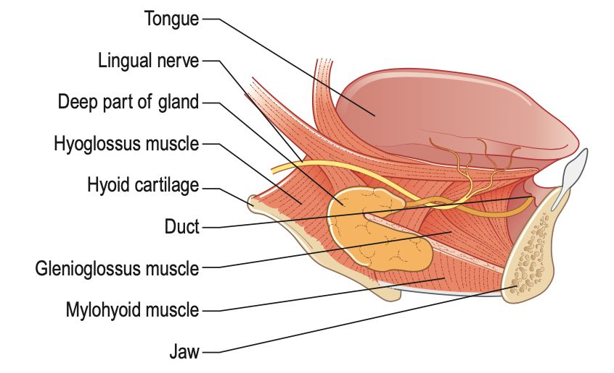
THE SALIVARY GLANDS:
Introduction
Saliva is produced by the paired parotid, submandibular and sublingual glands and many other small, unnamed glands.
Salivary stagnation, increased alkalinity or calcium content of the saliva, infection or inflammation of the salivary duct or gland, and physical trauma to the salivary duct or gland may predispose to calculus formation.
Submandibular gland swelling results from obstruction of the duct by a stone or inflammation.
Salivary gland swellings caused by duct obstruction enlarge when the patient eats; there may also be a bad taste.
The most common surgical conditions:
Infection and calculus formation.
Tumours.
THE SALIVARY GLANDS:
The Submandibular Gland
Submandibular calculi
Submandibular calculi
Submandibular calculi are common.
Gland lies below the opening of its duct.
Secretion of the submandibular gland contains a considerable quantity of mucus.
The submandibular salivary gland is the source of 80% of salivary
gland calculi, most of which are radio-opaque.
History
Young to middle-aged adults.
Main symptoms are pain and swelling beneath the jaw.
Swelling appears before, and persists after, the pain.
Symptoms appear, or worsen, before and during eating.
The lump
The submandibular gland lies beneath the horizontal ramus of the mandible on the mylohyoid muscle.
Tender when tense or infected.
3–5 cm across.
It is important to ascertain the relations of the lump to the floor of the mouth and the tongue by bimanual palpation.
The floor of the mouth
Inspect
Palpate
General examination
Examine all the salivary glands
Examination

Slide 23
THE SALIVARY GLANDS:
The Submandibular Gland
Submandibular calculi
Diagnostics
Sonography
Noncontrast CT
Sialography (rarely)
Possibly x-ray of the skull (particularly the base of the mouth)
Management
Mainly conservative
NSAIDs for pain relief
Stimulation of salivary flow by sucking sour candies, massaging the gland, and applying warm compresses
Invasive (only in severe cases): dilatation of the salivary duct or ultrasonic lithotripsy
Adenoid cystic carcinoma
This tumour can affect any of the salivary glands and is the most common malignant tumour of the submandibular salivary gland.
It is locally aggressive and tends to invade the nerves.
It has a high propensity to recur, even after several years.
Pathological grades are
Grade 1 (tubular)
Grade 2 (cribriform)
Grade 3 (solid).

Slide 24
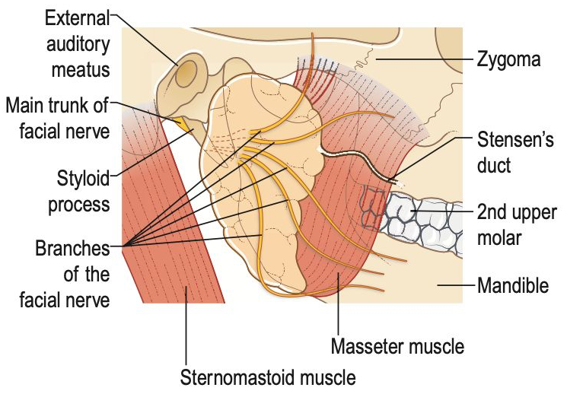
THE SALIVARY GLANDS: The Parotid Gland
Introduction
Most swellings of the parotid gland are (benign) tumours.
Since total removal of the parotid gland would be required to treat inflammation, this should be avoided if possible due to the risk of damage to the facial nerve
The parotid gland is the most common site of origin of salivary neoplasms, almost 80% of which are benign
Acute bacterial parotitis
The most common infection of the parotid gland is mumps.
Epidemic viral parotitis.
Bilateral involvement.
Bacterial parotitis? Staphylococcus
History
More common in the elderly and the debilitated.
Sudden onset of pain and swelling in the side of the face.
Symptoms of another illness.
Hot, red, tender parotid gland and increased WBCs
The lump
The parotid gland lies in front of and below the lower half of the ear.
The skin is discolored a reddish-brown, feels hot and is smooth and shiny, and tender.
The function of the facial nerve is not impaired.
The mouth
Inspection The Stensen’s duct.
The parotid gland cannot be palpated bimanually.
Examination
Management
Antibiotics
Operative drainage as necessary

Slide 25
THE SALIVARY GLANDS: The Parotid Gland
Pleomorphic adenoma (Mixed parotid tumour, sialoma)
Most common salivary gland tumour (Most in parotid gland). And More common in adult males
They are Benign, slow growing with Potential for malignant transformation.
Lobulated: pseudocapsule with pseudopods
Epithelial and mesenchymal elements with fibromyxoid, fibroid stroma
Facial nerve is never involved.
Prognosis is good.
Adenolymphoma (Warthin’s tumour)
The second most common tumour of the salivary glands.
Almost exclusively parotid (Most in the lower pole of the gland)
60% male. 30% bilateral
Option of watchful waiting may be discussed with patient.
History
Over the age of 50 years.
Rapidly enlarging swelling on the side of the face.
Painful, especially during movements of the jaw.
Patients may complain of symptoms of fascial nerve involvement
Examination
Skin may be infiltrated, hyperaemic and hot.
Soft or cystic, not very tender.
The cervical lymph glands are likely to be enlarged and hard.
Look for distant metastasis.
Diagnostics
Ultrasound: diagnostic method of choice in salivary gland tumors
Pleomorphic adenoma: Best treatment is superficial parotidectomy to prevent recurrence
Adenolymphoma (Warthin’s tumour): complete extirpation of the tumor with preservation of facial nerve
Complications of parotidectomy:
Facial nerve palsy due to neuropraxia/neurotmesis
Loss of sensation on and around the lower half of the pinna
Soft tissue defect proportional to size of resection
Gustatory sweating (Frey’s syndrome)
Salivary fistula.
Management

Slide 26
THE SALIVARY GLANDS: The Parotid Gland
Carcinoma of the parotid gland
It is uncommon but not rare
Features suggestive of malignant transformation of a benign salivary gland tumor:
1
Sudden and rapid increase in size
2
Change to harder consistency
3
Prominence of the veins over the swelling
4
Deep tissue fixation
Pain
5
Overlying skin infiltrated
6
Involvement of the facial nerve
7
Area of anesthesia over the skin
8
Restriction of Jaw movement
9
Enlargement of cervical lymph nodes
10
Evidence of distant metastases
Mucoepidermoid carcinoma
This is the most common salivary gland malignancy
It has a mix of mucin-producing columnar cells and squamous cells.

Slide 27
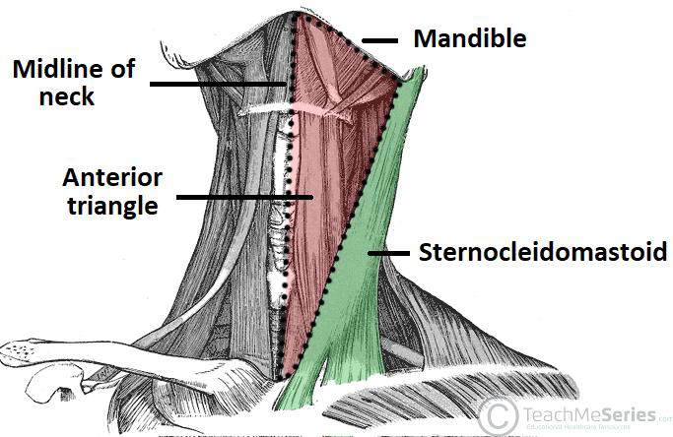
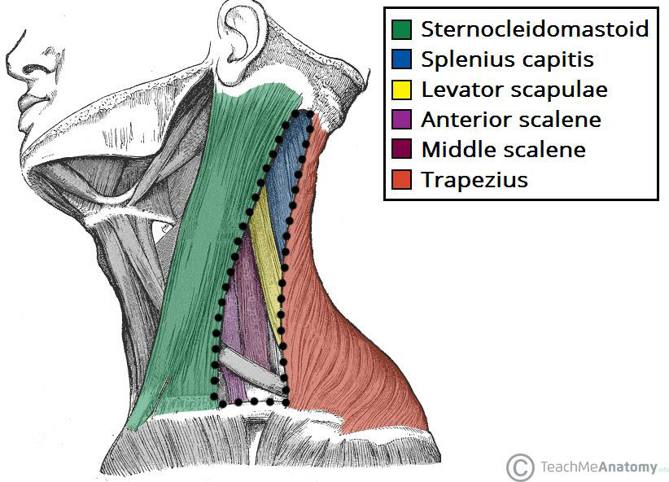
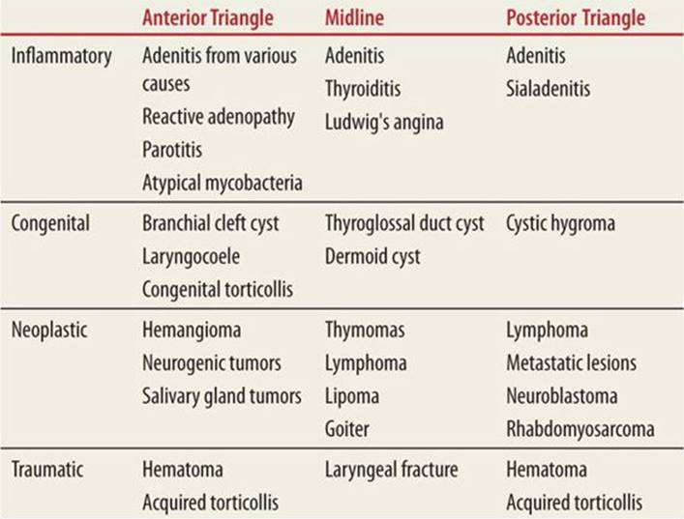
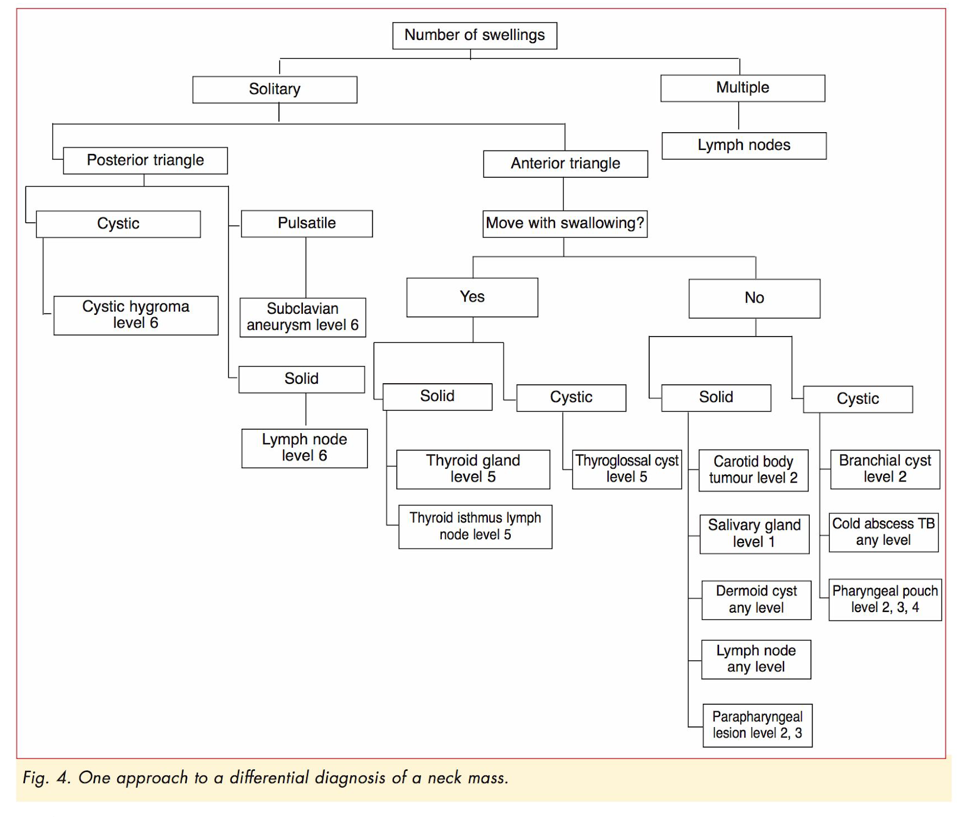
Triangles of the neck
Anterior and posterior triangles are separated by sternocleidomastoid muscle
Anterior triangle borders: | Posterior triangle borders:
Medially: Midline of the neck Above: Inferior border of the mandible Laterally: anterior border of the sternocleidomastoid muscle | Anterior: Posterior edge of the sternocleidomastoid muscle Posterior: Anterior edge of the trapezius muscle Apical: Occipital bone Inferior: Clavicle
Differential diagnosis | Differential diagnosis
Enlarged lymph nodes Thyroglossal cyst Thyroid pathology Lipoma Sternocleidomastoid tumor Submandibular salivary gland swelling | Enlarged lymph nodes Cystic hygroma Zenker’s diverticulum
There are 3 ddx for masses located in the midline: 1)thyroid mass. 2)dermoid cyst. 3)thyroglossal cyst
We can differentiate between them in physical examination by first asking the patient while you inspect to swallow then protrude the tongue :
the mass is moving with swallowing = thyroid mass
the mass moves with tongue protrusion = thyroglossal cyst
Extra
Extra

Slide 28
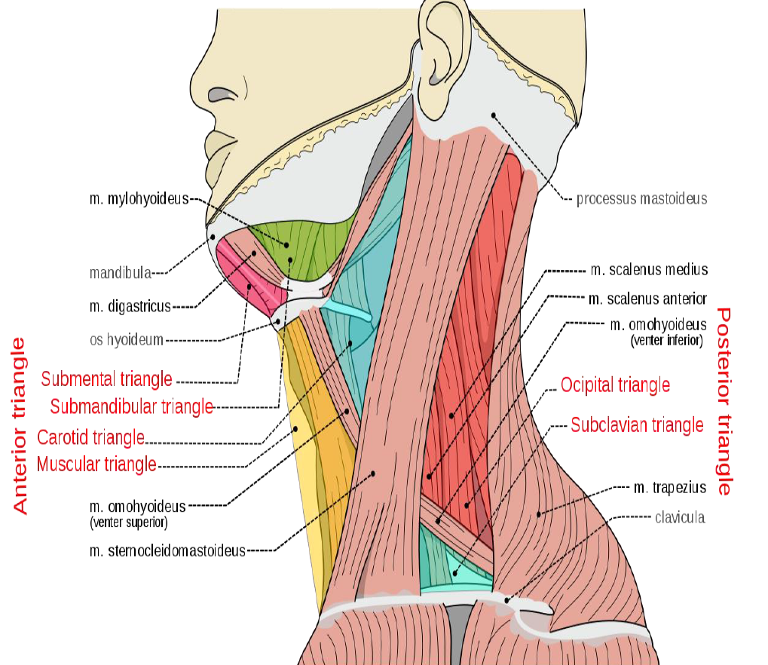
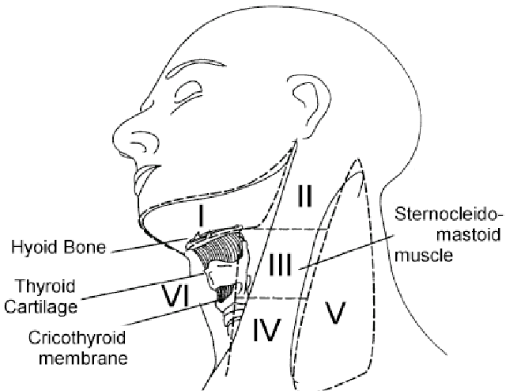
Triangles of the neck
Anterior triangle is further divided into:
Submental triangle: Below the mental notch
Submandibular triangle: below the angle of the mandible
Carotid triangle: between the Omohyoid, SCM & digastric muscle
Muscular triangle: in front of the thyroid gland. It contains strap muscles
Posterior triangle is further divided into:
Occipital triangle: Above omohyoid
Subclavian triangle: Below omohyoid
Contains supraclavicular lymph nodes
Lymph node levels of the neck
Level I: Submandibular and submental nodes.
Level II: Upper internal jugular (deep cervical) chain
Level III: Middle internal jugular (deep cervical) chain
Level IV: Lower internal jugular (deep cervical) chain
Level V: Posterior triangle
Level VI: Central (anterior) compartment

Slide 29
Doctor’s notes
Differential diagnosis:
infection
inflammation (ex: sarcoidosis, thyroiditis)
congenital (ex :cystic hygroma = located in the posterior triangle comes at 1-4 years old + dermoid cyst)
trauma (ex: causing hematoma)
malignancy (ex: lymphoma)
autoimmune (ex: Graves disease)
vascular (ex: carotid body tumor also known as carotid body paraganglioma which presents as a painless pulsatile lump)
History:
when you have a patient complaining of neck swelling the most imp thing is to take a history which will help in 99% of the cases, the most imp part of history is compression symptoms which may present as dysphagia, odynophagia & dyspnea
some question may help to reach a definitive diagnosis or help in exclusion of a disease “ symptoms of hypo & hyperthyroidism”
constitutional symptoms is important such as weight loss (it may be called B symptoms which are significant to the diagnosis of lymphoma)
family history of any thyroid disease, laryngeal cancer, skin cancer or lymphoma is imp
in case of patient shoe had recent trauma we need to consider hematoma.
Examination: The doctor revised the Thyroid examination with the student and emphasized on understanding of it
In general examination you must look for the sign of hypo & hyperthyroidism
A trick to know the origin of the swelling is to ask the patient to swallow if it moving during the swallowing process it’s thyroid origin, if it’s not moving it’s unlikely to be a thyroid origin
Investigation:
Blood test: CBC to check for chronic anemia, platelet count & coagulation profile, liver function test (if needed), kidney function test (if needed for example in CT scan with contrast), thyroid function test (90% of cancer patient will have euthyroid)
Imaging: first start with ultrasound (will tell us if the lesion is cystic or solid lesion and to know the vascularity of the lesion, and to look for other lesions), if no findings do CT, if still no findings do MRI. Nuclear medicine is done only if we have high T4 If their is hot uptake that means their is less than 1% chance of malignancy so no need to take a biopsy If their was cold uptake that means their is 20% chance of malignancy and we need to take a biopsy
Biopsy (two types):
fine needle aspiration (FNA): which shows only the cytology (tells us whether its malignant or not only). Papillary thyroid can be confirmed by FNA alone and also medullary thyroid but need also markers with it
true cut: shows us the histology; which is our go to biopsy
Incisional biopsy is a medical test to remove a piece of tissue from a lesion or mass
excisional biopsy is a medical test in which the whole lesion or mass is removed and tested with negative margin ( region around lesion)
Management:
For Cancerous lesion we first stage
Thyroglossal cyst: need surgery cause it’s an important risk of cancer
Dermoid cyst: excision
Multinodular goiter (benign): we remove only if there's symptoms

Slide 30
Summary
Major Symptoms
Diagnosis | Symptoms
Cervical lymphadenopathy | The common presenting symptom is a painful lump just below the angle of the jaw. Which becomes acute when the patient has a sore throat. The child may snore at night, have difficulty in breathing, have nasal speech, and suffer from recurrent chest infections. The four main causes of cervical lymph gland enlargement are: Infection: non-specific tonsillitis, glandular fever, toxoplasmosis, tuberculosis, cat scratch fever. Metastatic: tumor from the head, neck, chest and abdomen. Primary reticuloses: lymphoma, lymphosarcoma, reticulosarcoma. Sarcoidosis.
Branchial cyst | The common presenting complaint is a painless swelling in the upper lateral part of the neck. The lump may be painful when it first appears and later cause attacks of pain associated with an increase in the size of the swelling. The pain is usually caused by infection. A severe throbbing pain, exacerbated by moving the neck and opening the mouth, develops if the contents of the cyst become infected and purulent.
Branchial fistula | The patient complains of a small dimple in the skin at the junction of the middle and the lower third of the anterior edge of the sternomastoid muscle, that discharges clear mucus, and sometimes becomes swollen and painful and discharges pus. When the whole branchial cleft stays patent, the fistula connects the skin with the oropharynx, just behind the tonsil. Swallowing accentuates the openings on the skin.
Carotid body tumor | Commonly appear in patients between the ages of 40 and 60 years. The common presentation is a painless, slowly growing lump. The patient may notice that the lump pulsates, and may also suffer from symptoms of transient cerebral ischaemia (blackouts, transient paralysis or paraesthesia). Carotid body tumor may be bilateral.
Cystic hygroma | Lymph cysts commonly occur near the root of the arm and the leg (i.e. in the anatomical junction between the limbs and head and the trunk). The only symptom is the complaint about the lump, but the parents of an affected child are usually more concerned about the disfigurement caused by the cyst.
Pharyngeal pouch | Pharyngeal pouches appear in middle and old age. More common in men than in women. Patients often have a long history of halitosis and recurrent sore throats before noticing the common presenting symptom of regurgitation of froth and food. The regurgitated food is undigested. There is no bile or acid taste to it. Regurgitation at night causes bouts of coughing and choking. As the pouch grows, it presses on the oesophagus and causes dysphagia. Patients can sometimes swallow their first few mouthfuls of food (until the pouch is full), but thereafter have difficulty in swallowing. By the time these symptoms become severe, the patient may have noticed a swelling in the neck, and find that pressure on the swelling causes gurgling sounds. The swelling changes in size and often disappears.
Sternomastoid tumors | A swelling of the middle third of the sternomastoid muscle that’s noticed at birth or in the first few weeks of life caused by the trauma of birth. As the patient grows, the lump disappears and the abnormal segment of muscle becomes fibrotic and contracted. The child keeps their head turned to one side (torticollis). Attempts to turn the head straight may cause pain or distress.
Cervical rib | Neurological symptoms: pain in the C8 and T1 dermatomes, and wasting and weakness of the small muscles in the hand. Vascular symptoms: Raynaud’s phenomenon, trophic changes, even rest pain and gangrene, may occur but are uncommon.

Slide 31
Summary
Major Symptoms
Diagnosis | Symptoms
Thyroglossal cyst | Theoretically, thyroglossal cysts can occur anywhere between the base of the tongue and the isthmus of the thyroid gland, but they are commonly found in two sites: between the isthmus of the thyroid gland and the hyoid bone, and just above the hyoid bone. Thyroglossal cysts are seen in patients between 15 and 30 years old. Females > males. The commonest symptom is a painless lump. Pain, tenderness and an increase in size occur only if the cyst becomes infected.
Thyroid gland | Symptoms secondary to the swelling in the neck: Discomfort during swallowing: this is not true dysphagia. Dyspnoea: This symptom is often worse when the neck is flexed laterally or forwards and when the patient lies down. Pain is not a common feature of thyroid swellings. Hoarseness: a very significant symptom. Symptoms related to the endocrine activity of the gland: Thyrotoxicosis: nervousness, irritability, insomnia, palpitations, breathlessness on exertion, swelling of the ankles and chest pain, increase in appetite but loss of weight, and sometimes a change of bowel habit, usually diarrhea. Muscle wasting and weakness, excessive sweating and an intolerance of hot weather. Some women have amenorrhoea. Myxoedema: increase of weight, with deposition of fat across the back of the neck and shoulders. Symptoms also include: slow thought, speech and action; intolerance of cold weather; loss of hair, especially the outer third of the eyebrows; muscle fatigue; a dry skin and ‘peaches and cream’ complexion; and constipation.
Salivary glands swellings | Submandibular swelling: Calculi → Occur in young to middle-aged adults. They are rare in children. The main symptoms are pain and swelling beneath the jaw. The pain is a dull ache, which radiates to the ear or into the tongue. Both symptoms appear, or worsen, before and during eating. Infection (secondary to the presence of a stone) → pain is severe, throbbing, continuous and exacerbated by eating. The mass is hot and tender. Tumor → Adenoma forms a painless, slow-growing, non-tender, hard, well-defined, spherical mass. Carcinoma causes an indistinct, hot, slightly tender, rapidly growing, painful mass. Parotid gland swelling: Calculi → Stones causes Chronic parotitis. Main symptoms are recurrent swelling of the parotid gland that’s particularly noticeable before eating and is associated with an aching pain. Infection → Acute parotitis more common in the elderly and the debilitated. The patient complains of the sudden onset of pain and swelling in the side of the face. The pain is continuous and throbbing, and radiates to the ear and over the side of the head. Speaking and eating cause pain. The patient feels hot, sweaty and ill and may complain of shivering attacks (rigors). Tumor → Adenoma forms a painless, slow-growing, non-tender, hard, well-defined, spherical mass. Carcinoma causes an indistinct, hot, slightly tender, rapidly growing, painful mass.
CLICK HERE TO REVIEW THE LECTURE FROM SURGICAL RECALL

Slide 32
Quiz
MCQ
Q1: A 55-year-old woman presents with a 6-cm right thyroid mass and palpable cervical lymphadenopathy. Fine-needle aspiration (FNA) of one of the lymph nodes demonstrates the presence of calcified clumps of sloughed cells. Which of the following best describes the management of this thyroid disorder?
a. The patient should be screened for pancreatic endocrine neoplasms and hypercalcemia.
b. The patient should undergo total thyroidectomy with modified radical neck dissection.
c. The patient should undergo total thyroidectomy with frozen section intraoperatively, with modified radical neck dissection reserved for patients with extra-capsular invasion.
d. The patient should undergo right thyroid lobectomy followed by iodine 131 ( 131 I) therapy.
Q2: Which of the following patients with primary hyperparathyroidism should undergo parathyroidectomy?
a. A 62-year-old asymptomatic woman
b. A 54-year-old woman with fatigue and depression
c. A 42-year-old woman with a history of kidney stones
d. A 59-year-old woman with mildly elevated 24-hour urinary calcium excretion
Q3: A 62-year-old man presents with a 3-month history of an enlarged lymph node in the left neck. He is a long-time smoker of cigarettes and denies fevers, night sweats, fatigue, or cough. On physical examination there is a 1.5-cm hard, fixed mass below the angle of the mandible in the left neck. Which of the following is the most likely cause of an enlarged lymph node in the neck?
a. Thyroglossal duct cyst
b. Dermoid tumor
c. Carotid body tumor
d. Metastatic squamous cell carcinoma
Q4: An 89-year-old man has lost 30 lb over the past 2 years. He reports that food frequently sticks when he swallows. He also complains of a chronic cough. Barium swallow is shown here. What is the best treatment option for this patient?
a. Placement of an esophageal stent
b. Diverticuloplasty
c. Excision of the diverticulum and cricopharyngeal myotomy
d. Excision of the diverticulum and administration of a promotility agent
Q5: Who is going to ACE their exam?
a. Me
b. Myself
c. I
Q1 | B
Q2 | C
Q3 | D
Q4 | C
Q5 | A, B & C
Answers
Click here for explanation
Extra Questions

Slide 33
Good Luck!
Team leaders:
Nouf Alshammari
Haneen Somily
Naif Alsulais
Mohammed alshoieer
This lecture was done by:
Jehad Alorainy
Mohammed Alhumud
Rakan Alfaif
Leena alnassar
Razan Alrabah
Feedback
Note taker
Reviewer

