Slide 1
Perforation and Infarction of viscus
This lecture had given by 3 doctors, They focused only on perforation. Dr.hussam mentioned infarction in a single slide
Please note that “Investigations” and “Treatment” are NOT part of the OBJs. Although, some doctors mentioned them while presenting.
Objectives
Perforation:
The student is expected to describe and explain the etiology, clinical features and complications of the following conditions:
Peptic ulceration, Boerhaave’s syndrome , Gangrenous appendicitis, Perforated gallbladder, Acute diverticulitis، Small bowel (Crohn’s, typhoid, strangulation, tumour and foreign body) , Ulcerative colitis (toxic megacolon), Ischemia, Radiation necrosis, Carcinoma colon , Ruptured bladder
Infarction:
The student is expected to describe and explain the etiology, clinical features and complications of each of the following conditions
Small and large bowel infarction: Strangulation, Volvulus, Arterial thrombosis, Arterial embolism, Venous thrombosis, Dissecting aneurysm
Stomach (volvulus)
Spleen, liver and kidney (arterial occlusion)
Ovary (torsion of pedicles)
Omentum/appendix epiploica (strangulation)
Colour Index
Main Text
Males slides
Females slides
Doctor notes
Textbook
Important
Golden notes
Extra
Editing File

Slide 2
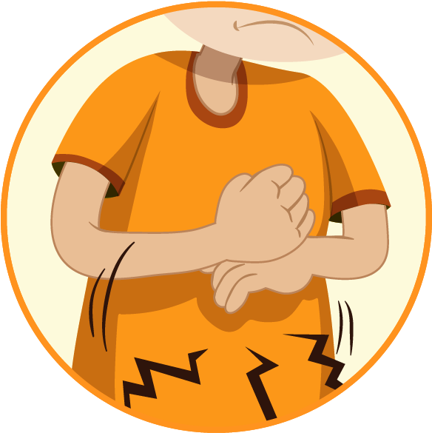
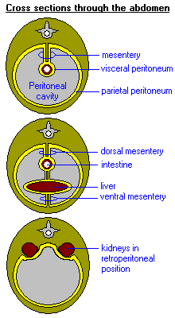
Extra
Introduction
Acute Abdomen: Is any abdominal condition (With main symptoms being the pain) that mandate emergent intervention (That intervention not necessary surgical, it may be medical). It can be life-threatening or trivial.
Medical Acute abdomen
Surgical Acute abdomen
Cardiovascular (Referred MI)
Gastrointestinal (Gastritis and hepatitis)
Metabolic (Uremia)
Hematological (Sickle cell)
Gynaecological
Inflammatory (Acute pancreatitis, cholecystitis)
Obstruction (Intestinal, biliary and ureteric)
Perforation
Ischemia
Intra Abdominal bleeding (Ruptured aneurysm, ruptured ectopic pregnancy)
The highest mortality conditions of acute abdomen
Laparotomy of unresectable cancer | Ruptured abdominal aortic aneurysm | Perforation of the viscus (Especially the colon)
Types of pain
Parietal Peritoneum
Visceral Peritoneum
Parietal peritoneum covers all abdominal wall aspects (Anterior, Posterior, Superior and Inferior)
It is supplied by somatic nerve endings (derived from underlying muscles and skin)
Gives somatic pain
Sensitive to chemical, mechanical or thermal irritation
The pain is localized. Patient presents with guarding + rigidity
The visceral peritoneum covers all organs (Aside of spleen and lower esophagus).
It is supplied by autonomic nerve endings
Sensitive to ischemia, distension and temperature only.
Not sensitive to chemical, mechanical or thermal.
Poorly localized pain (Vague), deep seated. Patient have guarding only
Extra picture

Slide 3
Introduction - Perforation
Etiology
You must understand the physiology of peritonitis. If you do, there will be no need to memorize each subject separately.
The easiest cause to recognize is trauma then inflammation then ischemia.
HCL
01
01
Perforated viscus
Blood
05
02
Chyme
Stool
04
03
Bile
Upper abdomen:
Boerhaave’s syndrome
Peptic ulceration
perforated gallbladder
Lower abdomen:
Gangrenous appendicitis
Acute diverticulitis
Ulcerative colitis (Toxic Megacolon)
Carcinoma colon
Ruptured Bladder
General
Small bowel (Crohn’s, Typhoid, Strangulation, Tumor and foregn body)
Ischemia, Radiation necrosis
Leakage of any of these results in peritonitis.
What happens when there is a leakage of these ? the peritoneum will act as an organ to minimize the inflammation, it will try to make it localized as possible as it can by 3 protective mechanisms.
The aim of these mechanisms is to
Give rest to intestine (Intestine shouldn’t be contracted or pushed)
Protect organs
Prevent spread of inflammation
Pylorospasm (Contraction of Pyloric sphincter)
Paralytic ileus
Role of omentum
1
2
Lead to loss of intestinal motility
Due to: Same as pylorospasm, but in terminal ileum.
Clinically manifested as: symptoms of obstruction (Distension and constipation)
3
It is abdomen policeman!
It protects viscera and prevent spread of inflammation by (Sticking /surrounding/ isolating) an organ.
Lead to enhance satiety to stop your feeding
Due to: Neural, Hormonal, Chemical Stimuli.
Clinically manifested as: Anorexia, Nausea, Vomiting .
Remember, Peritonitis doesn’t mean at all generalized pain. It can be generalized (If the protective mechanism failed), and it also can be localized depending on the layer of peritoneum and the localization response of the peritoneum and the presence of microbes or chemicals in the leaked fluid.
AS example, if we have inflamed appendix, the omentum will cover the appendix; stick & surround it and prevent its inflammation from spreading
This rule is deficient in (pregnancy & infants)

Slide 4
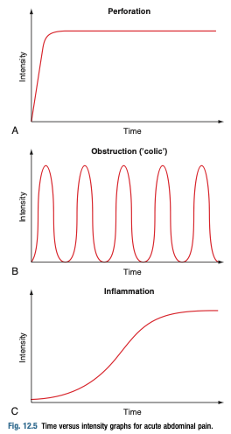
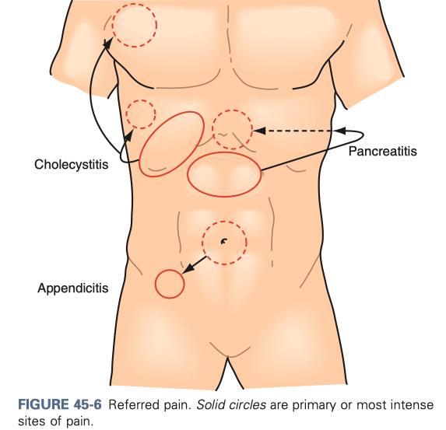
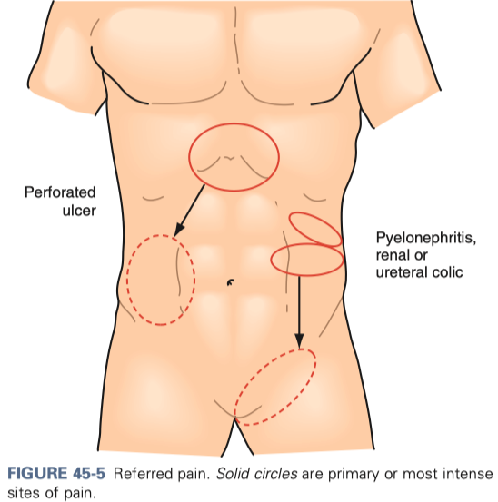
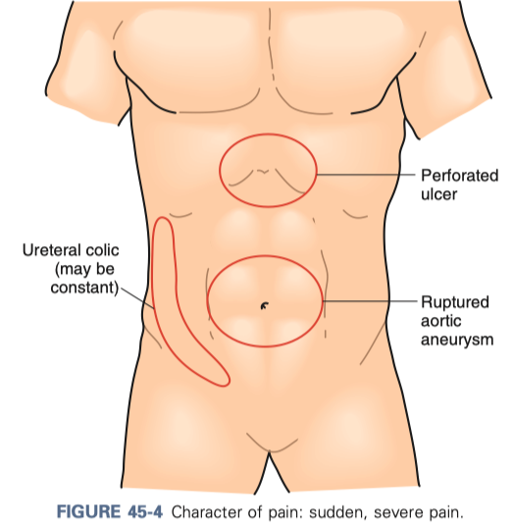
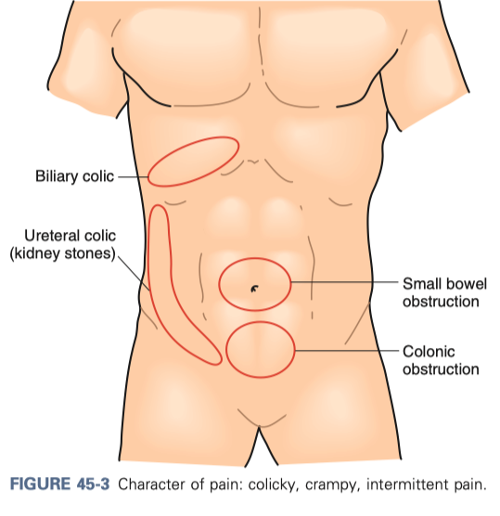
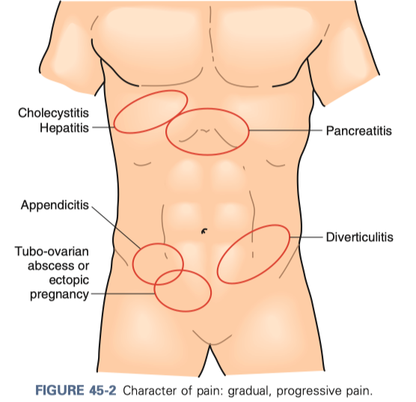
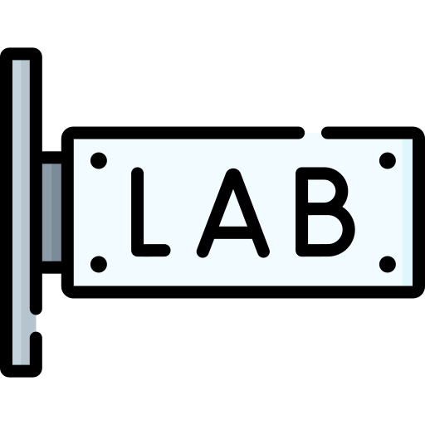
You can use this page as summary
Introduction - Perforation
Perforated hollow viscus is a life-threatening cause of abdominal pain and
carries a high mortality rate.
Perforation → spillage → sepsis and high risk of mortality.
These patient usually very sick. They have progressing tachycardia within first 2 hours.
Pyrexia usually indicates highly infected peritoneum.
The pain is constant, and progressing, never relieved (Picture A)
Patient will have a history of localized pain (Underlying pathology; Pictures B).
When that pathology perforate, it will causes severe pain at the same site
Once defense mechanism fails, and generalized peritonitis develop → there will be generalized pain.
Usually, there is abdominal distension, By 2 mechanisms
Inflammation will cause ileus ---> Pseudo Obstruction then distension.
Some breathed air will go through esophagus to the abdomen , then through the perforation to the abdominal cavity (Such case can be complicated when the emergency department put the patient on O2 once he arrived)
Peritonitis leads to difficulty moving, rebound tenderness. Don't forget to look for hernia
in the physical exam.
A; reference picture
Clinical
Feature
B
(B) pictures summarize underlying abdominal pain, click on the picture for higher resolution
From left picture to right:
First 2 pictures: Referred pain (solid circles are primary or the most intense pain)
Sudden and severe abdominal pain.
Colicky, crampy intermittent abdominal pain.
Colic is a form of visceral pain that rises from a hollow viscus with muscle in its wall (e.g., gut, gallbladder and ureter). The pain is due intense peristalsis that tries to push the obstruction in these structures
Gradual, progressive abdominal pain
CBC Look at WBC count, which will be elevated
Urine analysis:
Acute pyelonephritis present some times with typical acute abdomen symptoms
VBG (Venous blood gases)
Ph, Lactate, Base deficit (Elevated lactate indicate ischemic tissue in general)
What is the difference between ischemic and gangrenous bowel ? Gangrene (Bowel dead) = lactate not raise
We do amylase, lipase, LFT (to exclude Pancreatitis and Cholangitis)
CXR/AXR (Best initial; shows pneumoperitoneum)
Order upright X-ray
Can be done standing and laying down. (2 contradictory notes :/)
US is helpful in biliary disease
CT-scan (Gold standard for any perforation)
We can add IV contrast to detect ischemia
Oral contrast not required, but it gives more clear picture
The contrast most be water-soluble
MRI (In pregnant)
Labs
Imaging
Peptic Ulcer: Omental (Graham) patches
Perforated diverticula: Hartmann’s procedure
Grade 1 and 2 can be managed conservatively (IV. Antibiotics + Resuscitation w/o surgery)
Contained or controlled perforations of intestines can be managed conservatively with interventional radiology guided drainage of fluid collections.
If not contained, resection of the perforated site and diversion usually done.
Treatment
Ultimate complications:
Localized access (Peritonitis) ---> Generalized Peritonitis >may lead to sepsis (Gram -ve) --- > which may lead to shock ---> Shock leads to DIC ---> DIC leads to Multi-organ-failure

Slide 5
Perforation of the viscus
01
Perforated Peptic Ulcer
Etiology
The most common causes of peptic ulcers are infection with the bacterium Helicobacter pylori (H.pylori) and long-term use of nonsteroidal anti-inflammatory drugs (NSAIDs) & spicy food
Stomach is Intraperitoneal, if perforated, gastric acids will leak into the visceral peritoneum which will lead to peritonitis
Duodenum is not fully intraperitoneal, if the perforated ulcer was exposed to the visceral peritoneum (Anterior perforation) it will cause peritonitis. (MORE COMMON PRESENTATION)
Otherwise (Retroperitoneal perforation), acids will accumulate without symptoms in the retroperitoneal space until sepsis ensues.
Salicylates, Acid/alkali ingestion can cause perforation also.
Clinical Features
History | Physical Examination
History of past Dyspepsia, Heartburn (The patient will tell you “I had a burning sensation which was relieved by drinking milk”) , Chest discomfort or Early satiety Hematemesis (If bleeding was severe) or melena (signs of risk of concurrent perforation) When the ulcer gets perforated, it causes sudden severe and constant epigastric pain. Begins at the epigastrium, then extend gradually to involve the whole of the abdomen (Peritonitis) | Patient looks ill, Any movement can exacerbate the pain (Even breathing) Tachycardia, Low RR, normal temperature. Palpation: Early: Epigastric tenderness Late: Board-like rigidity (While abdomen is very tender with intense rigidity = Whole Peritoneum contaminated) Bowel sounds: Disappear once generalized peritonitis develop Triad: Abdominal constant pain, rigidity and tachycardia
After 4-6 hours, Pain and guarding decrease (acids in the peritoneum dilute), Patients think they are improving but they are in fact getting worse (Peritonitis is progressing and tachycardia still present with hypervolemia)
Any perforation can lead to generalized peritonitis → shock → DIC → Multiorgan failure
Alarming Symptoms:
Bleeding or anemia
Early satiety
Unexplained weight loss
Progressive dysphagia or odynophagia
Recurrent vomiting
Family history of gastrointestinal cancer
Complications

Slide 6
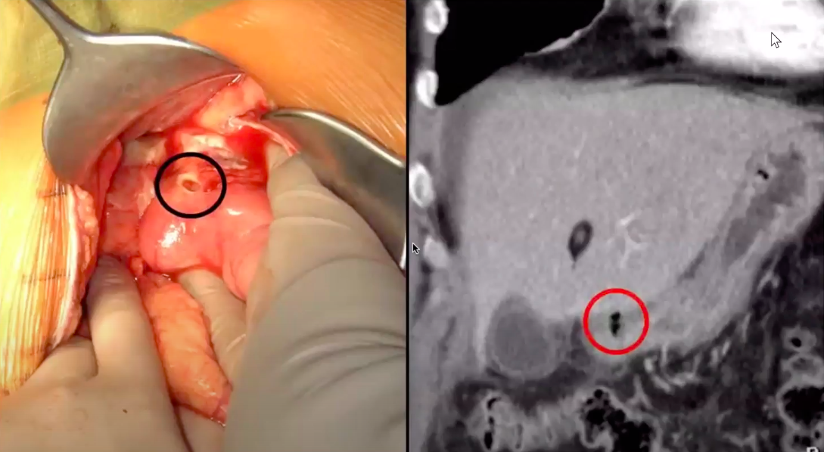
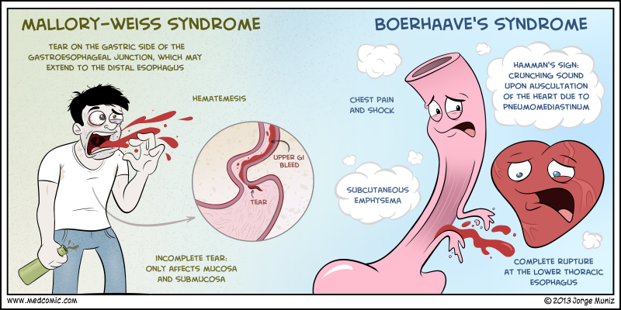
Perforation of the viscus
Investigation of Peptic ulcer perforations
Endoscopy
Urea Breath Test
Imaging:
Upright CXR: Pneumoperitoneum
CT (rule out perforation- CT is gold standard for perforation)
CT shows perforated duodenum due to PUD, and leakage of bile. Red circle: free air
Treatment
Eradicate H.Pylori
Lifestyle modifications
If perforated:
ABC (Any peritonitis require emergent resuscitation),
Resuscitation
Surgery for perforated ulcers/ resistant disease
Omental (Graham) patches
02
Boerhaave’s syndrome
Boerhaave syndrome, a transmural (Full-thickness) perforation of the esophagus, should be distinguished from Mallory-Weiss syndrome
Mallory-Weiss syndrome, a non transmural esophageal tear
Etiology
Spontaneous rupture of the esophagus, which typically occurs after forceful emesis.
Perhaps as a consequence of attempting to suppress a vomit.
Any act that may increase the intra-abdominal pressure (Ratcheting vomiting, Weight-lifting, childbirth delivery, Seizures and Iatrogenic)
Presentation
Triad: Sudden pain onset, Vomiting, and supraclavicular subcutaneous emphysema.
With each time patient take a breath, some air will leak to the esophagus then through the tear, it will cause subcutaneous emphysema (You can feel bag of worms “Bubble wrap” when you gently palpate lower part of chest above mid abdomen)
Risk factors: History of alcohol and food abuse. Past history of underlying PUD (peptic ulcer disease), EoE(Eosinophilic esophagitis), Esophagitis may be present.
Diagnosis & Complications
Imaging: CT scan or Upright Chest X-ray (Pneumoperitoneum or hydrothorax)
Patient will be at risk of sepsis within 1-2 hours (we must resuscitate & repair it)
Perforation may leak either into abdominal cavity (Peritonitis) = midline abdominal pain
or thoracic cavity (usual site for the tear is above diaphragm) = Pleural and neck pain

Slide 7
Perforation of the viscus
03
Gangrenous Appendicitis
01
Appendicitis starts by unknown etiology that causes Appendix’s submucosal lymphoid tissue hypertrophy, ↝ This hypertrophy narrows or decompress appendix lumen ↝ Hinges fecolith or any foreign body which will later on cause the obstruction.
02
This obstruction leads to bacterial overgrowth, inflammation, edema, lymphatic and vascular compromise and finally↝ gangrene and perforation.
Within 12–24 hours, the appendix distal to the site of obstruction becomes inflamed and subsequently gangrenous.
In the nonobstructive or catarrhal type (1/3 of cases), inflammation of the wall of the appendix causes venous congestion ↝ compromise arterial inflow. especially in the distal appendix where the artery lies in a subperitoneal position
Presentation
The typical history is of periumbilical pain (visceral midgut pain), followed within several hours by right iliac fossa pain (somatic pain from parietal peritonitis). Tenderness and muscle guarding in the right iliac fossa are the most reliable signs
Appendix Perforation will have similar symptoms to any perforation (Sudden, Progressing & constant”Never relieved”).
Although, Appendix is an exception have a period of relieve. (Inflamed appendix cause dissension of the peritoneum, so when it gets perforated, the distention relieved, so the pain relieved with it)
Improvement only for some time, then the pain will exacerbate
A
B
A: Acute appendicitis(Arrow)
B : complicated perforated appendicitis (Arrow)
Complications
The overall mortality of appendicitis is less than 1%, rising to 5% if perforation occurs and increasing with age.
As mentioned earlier, peritoneum is an organ, and has his own response to inflammation. Rarely, Perforated appendix complicate to generalized peritonitis, why ?
This duo to the peritoneum response to appendix inflammation, which will make small bowel and omentum adhere to the appendix. So, when the appendix perforate, its content will remain (Localized) within the adhesion area. (If left untreated, it will complicate to appendix mass, or pelvic abscess)
If perforation occurs early in the clinical course, the inflamed area will not have had time to be walled off, and generalised peritonitis follows.

Slide 8
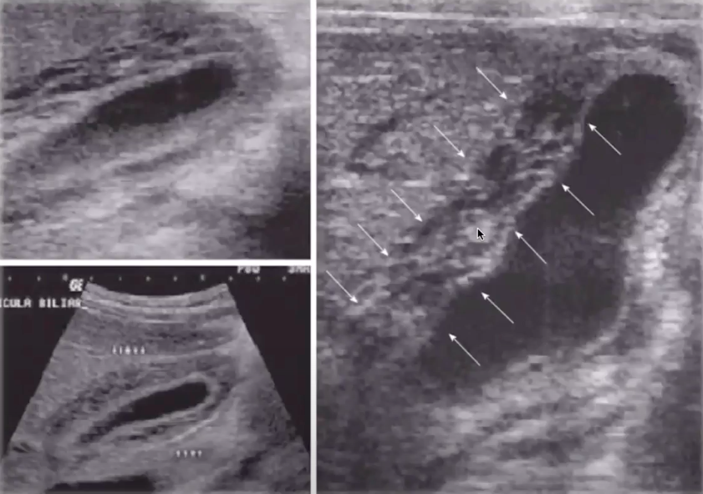
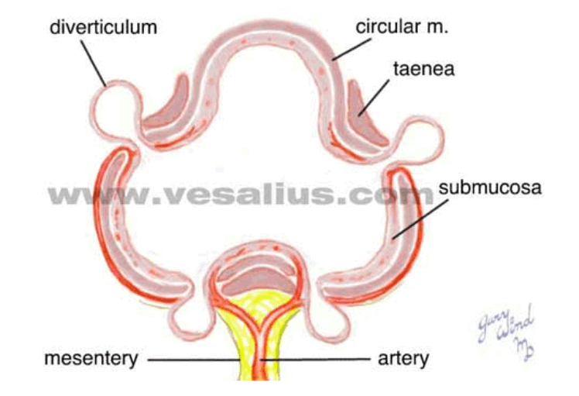
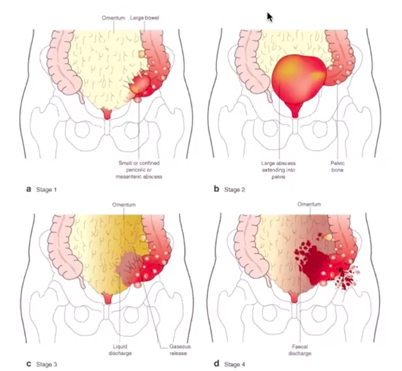
Perforation of the viscus
04
Perforated gallbladder
Gallbladder perforation is a rare but life-threatening complication of acute cholecystitis
Persistent obstruction of the gallbladder ↝ Inflamed and edematous gallbladder ↝ if the obstruction couldn’t resolve ↝The transmural pressure in the wall of the gallbladder can result in venous ischaemia ↝ Impair arterial blood flow ↝ gangrene and ischemia
Another cause of (Biliary peritonitis) is iatrogenic, due to a ligature or clip slipping off the cystic duct
Gangrene (Bowel died) = not elevated lactate. It get elevated only in ischemia
Presentation & Complications
Perforation may be contained by the liver or surrounding viscera leading to localised abscess ↝ can be indistinguishable from uncomplicated acute cholecystitis.
If that protective mechanism failed, there will be biliary peritonitis (Rigidity, progressive and constant pain)
Bacteria from gallbladder (E. coli, Klebsiella, and Strep. faecalis) can be a source of sepsis.
Management
ABC, Resuscitation
Percutaneous drainage with antibiotics following resuscitation Surgery in special cases (delayed or initial)
Diagnosis of perforation:
U/S shows a perforated Gallbladder
CT Scan is gold standard
05
Acute Diverticulitis
Extra Picture
Sigmoid colon is the most common site
The colonic blood supply penetrates the muscular layers of the wall to ramify in the submucosal layer.
This points of penetration create areas of weaknesses. Which can protrude as result to increased intracolonic pressure (In susceptible patients with unknown etiology)
Hinchey Classification or grading: (A-D or 1-4)
Grade 1- Contained small abscess
Grade 2- One large abscess extending in the abdomen
Grade 3- Multiple abscess with small air leak
Grade 4- Fecal peritonitis

Slide 9
Perforation of the viscus
05
Acute diverticulitis
Presentation
Diverticula often cause no symptoms
If obstructed ↝ Inflammation – acute diverticulitis. ↝ pericolic abscess then perforation
Same pathophysiology as appendix perforation (Localized then shifts)
Solitary diverticulum of the caecum inflamed, ---> signs are the same as Appendicitis.
The first symptom is often a mild intermittent lower abdominal ↝ shifts to the left iliac fossa (same as appendicitis mechanism). Once perforation occurs ↝ symptoms of peritonitis
Complications
Rupture of a pericolic abscess ↝ purulent peritonitis,
Free perforation of the bowel ↝ faecal peritonitis.
bleeding from erosion of the adjacent vessel by a fecolith (self-limited episodes)
If the perforation contained, there will be risk of fistula formation (To bladder)
Treatment
Grade 1 and 2 can be managed nonoperatively
For Grade 3 and 4 require surgery. (if any grade is complicated then they require colonoscopy in the future to exclude malignancy)
Hartmann’s surgery: Diverticulosis pockets in the sigmoid require resection of the sigmoid portion of the colon. And then the descending colon is closed as close-end colostomy. And the rectum is then closed off.
* Keep in mind that we don’t anastomose the colon to rectum directly after resection, because there is a risk of re-perforation and leakage.
06
Small Intestine
01
Any bowel obstruction can complicate to cause Bowel perforation
Small bowel obstruction can be distinguished from large bowel by the signs of early vomiting & Late constipation
CT-scan always is the gold standard
Obstruction in the ascending colon can complicate to cause cecal perforation
Management: Complete? surgery. Partial? there is a window for observation
Crohn’s disease
Infections
02
02
The symptom that helps distinguish acute Crohn’s disease from appendicitis is the occurrence of repeated episodes of diarrhoea
Perforation is associated commonly with IBD, especially UC (Will be discussed later). Crohn’s rarely cause perforation
Why perforation is rare? because inflamed bowel in crohn's usually adhere to any adjacent structure, and form fistula rather than free perforation.
Typhoid: Ulcers caused by typhoid usually erode into artery and cause septicemia and diarrhea. If that erosion perforate, it will cause peritonitis
C.Diff colitis → dilated due to toxins of bacteria (Toxic megacolon)

Slide 10
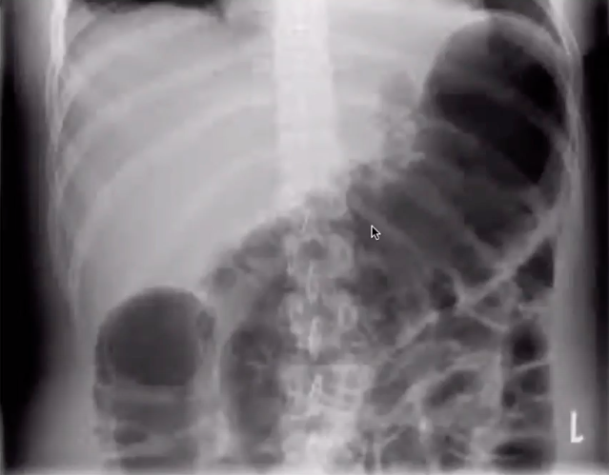
Perforation of the viscus
06
Small Intestine
Strangulation
Tumor
04
05
Hernia is a huge category of perforation (strangulation and perforation)
Umbilical & femoral hernia especially have high tendency to be strangulated and perforated (not in infants).
Any abdominal mass (e.g left colon mass) can perforate if it was associated with inflammation and abscess (Pericolic abscess).
Abominable tumor may become tender in that case.
Malignant tumors have higher tendency to perforate.
Tumor lysis syndrome can make abdominal wall loss its integrity → perforate
06
Foreign body
Bezoars are: when you have patients eat their hair (Or any indigestible material), and it accumulates leading to obstruction with food and others.
Foreign body relates (truma, endoscopy) eg:
Patient with achalasia came for ballooning/endoscopy that led to perforation
Pediatric patient ingesting batteries that led to a chemical reaction and perforation
07
Toxic megacolon
Etiology
Toxic megacolon is a potentially lethal complication of inflammatory bowel disease (IBD) or infectious colitis (C.difficile) that is characterized by total or segmental nonobstructive colonic dilatation plus systemic toxicity.
It is part of Acute fulminating ulcerative colitis (defined as >6 stools per day + evidence of toxicity “Fever, Anemia”)
During this Acute colitis dilatation the dilated colon may become paper-thin. Which makes the colon more susceptible to be perforated.
Presentation: Varies Bloating, fever, pain, shock ....
Historical Diagnostic Criteria of toxic megacolon
Any 3 of the following - Fever (>101.5°F), tachycardia (>120 beats/min), Leukocytosis +/- Anemia
Any 1 of the following - Dehydration, altered mental status, electrolyte abnormality, or hypotension
Radiographic evidence of colonic dilatation - The classic finding is more than 6 cm in the transverse colon
Complications | Ulcerative colitis | Crohn’s diseases
Diarrhea | Severe, bloody | Less severe, blood rare
Fistula & Stricture | Uncommon | Common
Perforation | Free perforation (Spillage of bowel content) | Localized perforation (No spillage; fistula(
Cancer | Can cause sigmoid polyps or tumor → Obstruction> perforation
Diagnosis of perforation
Labs , CT
Management
ABC, Resus, Etiology specific Rx (Steroids for IBD, Abx for infections ) Surgery (If the person didn’t respond to above Rx or is in shock)

Slide 11
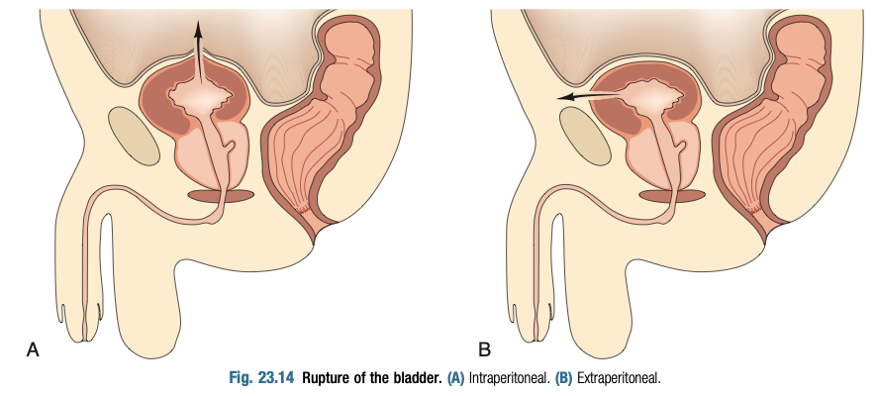
Perforation of the viscus
Perforation due to ischemia | Ischemia can happen if a thrombosis in an artery lead to ischemia OR hernia—> strangulation then no blood supply leading to ischemia and perforation
Radiation necrosis | Etiology: Radiation beams to treat pelvic malignancies (cancer of uterus, cervix and bladder.) Affect both small and large intestines. Presentation: Radiation fistula and perforation typically present several years after the primary treatment. Late manifestation owing to the late development of endarteritis of small mesenteric vessels → Necrosis → Perforation or fistula formation Most be differentiated from recurrence of the primary tumor
Carcinoma colon | Carcinoma of right colon and cecum Must be suspected in any patient >40y who presents with acute appendicitis (Cecum carcinoma can cause 2ry appendicitis) Symptoms usually are anemia and weight loss +ve Occult blood If peritonitis is present “Due to perforation” bowel sounds will be absent with generalized abdominal pain. Carcinoma of left colon and cecum Eldery >50, or past history of UC or family history Sigmoid colon is the most common site If ignored, it may cause peritonitis (By ruptured distended cecum due to obstruction, not by perforation)
Ruptured bladder | Etiology: Blunt trauma (Car or motorcycle accident) = Intraperitoneal “Pressure push urine towards weakest wall” (Picture A) Pelvic fractures or penetrating trauma = Extraperitoneal (PictureB) Iatrogenic: Colorectal or urologic procedures and foley catheter Rarely rupture spontaneously due to vaginal delivery, malignancy and radiation Clinical presentation: Intraperitoneal rupture= peritonitis (Ileus and abdominal distension) & inability to pass urine Extraperitoneal rupture= suprapubic and lower abdominal pain Diagnosis: X-ray (Cystogram) Management: Intraperitoneal: laparotomy and repair Extraperitoneal: Conservative.
A
B
Reference picture

Slide 12
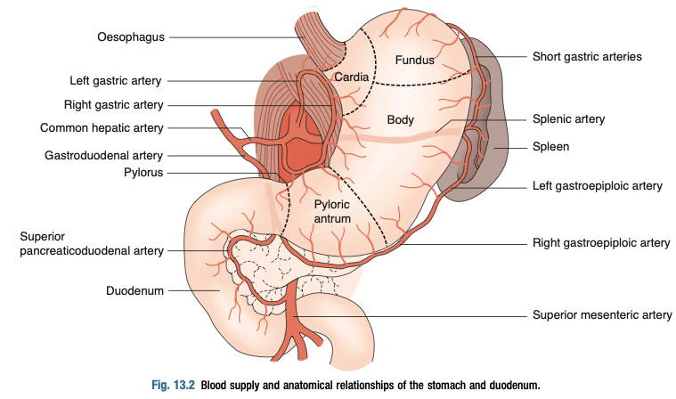
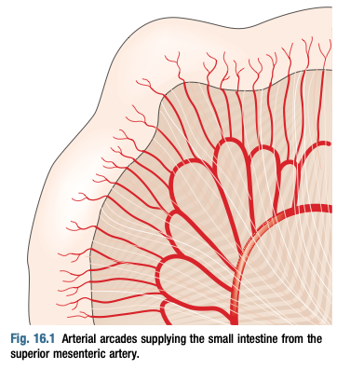
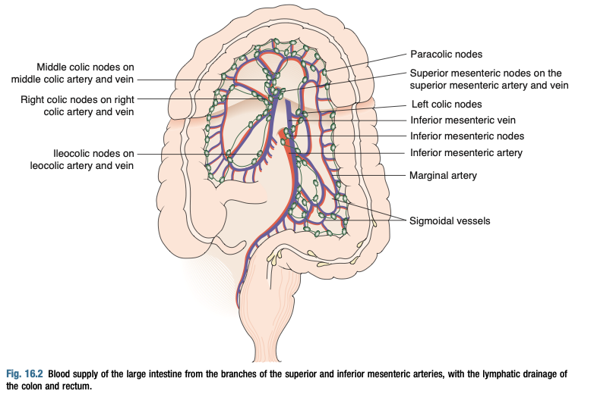
Infarction of the viscus
Reference pictures
1- Celiac Trunk
Celiac trunk: Gives left gastric, splenic and common hepatic arteries.
Left gastric: Supply stomach lesser curvature & Lower esophagus
Splenic artery: Supply stomach greater curvature, Body of pancreas and spleen
Common hepatic artery: Give 2 branches
Proper hepatic: Supply pylorus, corresponding liver and gallbladder
Gastroduodenal: supply & anastomose with splenic artery at the greater curvature of the stomach, and supply the head of pancreas
2- Superior mesenteric artery (MSA)
Superior mesenteric artery: Arise at level L1
Supply Small intestine, cecum, ascending colon (right colon artery), and 1st ⅔ of transverse colon (Middle colon artery)
Give inferior pancreaticoduodenal artery which supplies uncinate head of pancreas and lower duodenum
The arteries pass between the layers of the mesentery and form anastomotic arcades – from which smaller, straight arteries (known as the “vasa recta”) arise to supply the organs
Jejunum= smaller number of arcade, but larger vasa recta
Ileum= Opposite
Blood arterial supply comes to the small bowel through the mesentery via Superior mesenteric artery and then colon to the ⅔ of the transverse colon is shared between superior mesenteric artery and inferior mesenteric artery (?) So what happens in a clot appears in s the sup. mesenteric artery? Ischemia of the small intestine.
3- Inferior mesenteric artery (ISA)
Reference picture
It is retroperitoneal structure
Gives branches
Left colic = Splenic flexure, descending colon and rectum
Marginal artery (of Drummond): forms a continuous arterial circle along the inner border of the colon. It is formed by the union of several branches; the ileocolic, right colic and middle colic of the SMA and left colic and sigmoid branches of the IMA. = anastomosis
Superior rectal = Supply upper part of rectum

Slide 13
Smal
Infarction of the viscus
Introduction
Davidson & Norman browse
01
Small bowel, large bowel, Ovary, omentum, stomach, spleen and kidney. All can be infarcted.
Infarction is one of acute abdomen causes, and hardest to diagnose.
Histological pattern: coagulative necrosis
02
Severe, sudden pain. Constant and aggravated by movement, and relieved only by strong analgesic.
Poorly localized and quickly develops all hallmarks of peritonitis.
Suspect bowel ischemia in any patient have severe pain with minimal signs
Vomiting can accompany the pain as a result of the ileus (Intestine paralysis) caused by inflammation.
01
02
Occlusive
Non-occlusive
Arterial:
Embolism, Thrombosis
Venous
Thrombosis
External:
Hernia strangulation, Volvulus (Vessel torsion)
Shock:
Hypovolemia, Cardiogenic, sepsis.
Vasoconstrictor drugs
Emboli can come from cardiac origin. Thrombi can be an aneurysm, dissection, arthritis, MI, CHF or severe dehydration.
Vasopressors (like Epi/NE can lead to vasoconstriction and eventual ischemia).
Hypercoaguclitiy: Factor V deficiency, Pregnancy, Long standing travel.
Signs: Nothing specific. Patient is pale (Hypovolemic), sweating and have tachycardia.
Guarding and rigidity are late signs denoting gangrene and perforation
In general, non-occlusive are more gradual than occlusive. Embolism is more acute than thrombosis.
Complications:
inflammation due to ischemia can cause ileus.
Ischemia can develop into gangrenous tissue, which is susceptible to be perforated.
As a result of perforation, sepsis may ensues, which leads to death.
03
04
Labs: Patient will have metabolic acidosis (Lactate is raised)
Gold standard imaging is CT with IV contrast

Slide 14
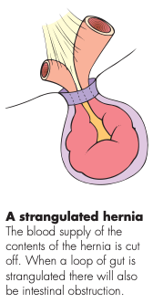
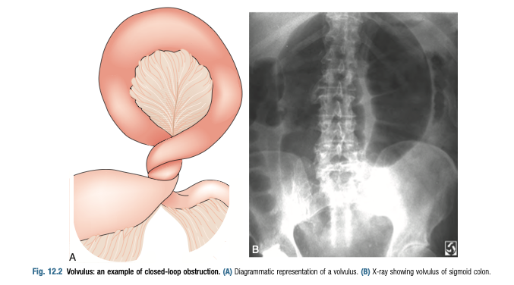
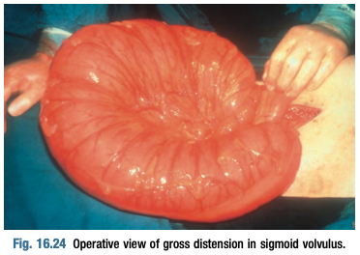
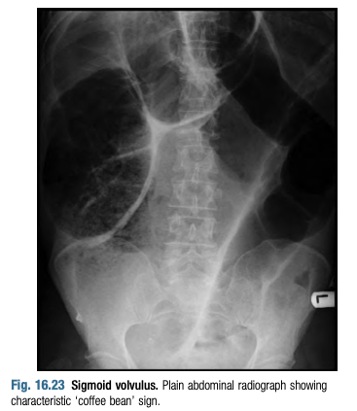
Smal
Small and large bowel infarction
Small and large intestines infarction
1
Etiologies from Dr.Hussam slides
Occlusive mesenteric ischemia (OMAI)
acute mesenteric embolism (AMAE)
Cardiac emboli
emboli from fragments of proximal aortic thrombus due to a ruptured atheromatous plaque
Atheromatous plaque dislodged by arterial catheterization or surgery
acute mesenteric arterial thrombosis (AMAT)
Atherosclerotic vascular disease (most common)
Aortic aneurysm
Aortic dissection
Arteritis
Decreased cardiac output from MI Or CHF (thrombotic AMI may cause acute decompensation)
Dehydration from any cause
Mesenteric Venous Thrombosis (MVT):
Hypercoagulability
Tumor causing venous compression
Infection, usually intra-abdominal (eg, appendicitis, diverticulitis, or abscess)
venous congestion from cirrhosis (portal hypertension)
Pancreatitis.
Systemic lupus erythematosus (Or any vasculitis), Polycythemia and Sickle cell disease.
Nonocclusive mesenteric ischemia (NOMI)
Hypotension from CHF, MI, sepsis, aortic insufficiency, severe liver or renal disease. or recent major cardiac or abdominal surgery, Vasopressors ,Cocaine
2
Clinical Features Click on the picture for higher resolution
Reference pictures
Strangulation:
You must examine the patient for any hernia. Femoral and umbilical hernias are at higher risk of strangulation.
Patient may have classical colic pain (Intestine smooth muscle try to push the food from the strangulated loop)
01
Volvulus:
It is an example of “closed loop obstruction”.
Acquired condition, affects adults in countries with high fibre diet
It is due to a twist around a narrow origin in the sigmoid mesentery.
Most common site is sigmoid colon (75%), then cecum(25%) (Around SMA origin).
Clinical presentation “Typical obstruction symptoms”:
Lower abdominal pain, distension, nausea, vomiting and absolute obstruction.
Plain X-ray:
Characteristic Y-shaped shadow with grossly distended colon
Giver contrast to confirm obstruction (CT or X-ray)
Sigmoidoscopy is both therapeutic and diagnostic in sigmoid volvulus
Cecal volvulus usually require emergent laparotomy.
02

Slide 15
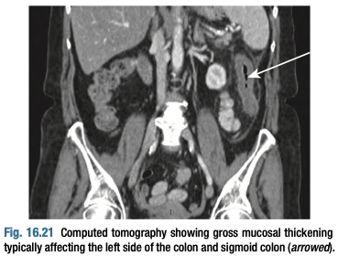
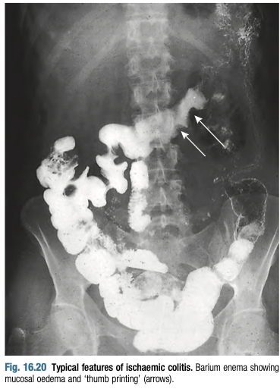
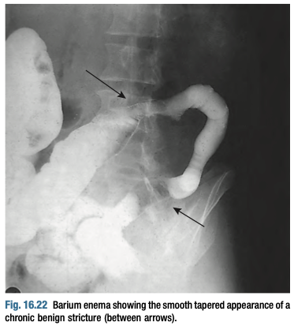
Smal
Small and large bowel infarction
2
Clinical Features Click on the picture for higher resolution
Small intestine arterial thrombosis and embolism
Mesenteric thrombosis: past history of DVT, CAD, strokes or intermittent claudications.
Mesenteric embolus: likelihood increase if there is A.fib
May have acute (Embolus) or chronic (Thrombosis) onset.
Celiac artery & Superior mesenteric artery (SMA) supply small intestine
Chronic atherosclerotic lesion in these arteries’ branches gives (Intestinal angina) feature
Abdominal pain that develops 30-60 minutes after eating - causing fear of eating and weight loss
03
Early diagnosis is difficult, due to the nonspecific signs
Diarrhea (Watery or bloody) can present in ⅓ of patients
A
C
Intestinal angina can precedes the acute pain in history
B
D
Abdominal pain is a predominant symptom and may be associated with vomiting.
The pain is poorly localized, vague and constant.
Large intestine Arterial thrombosis and embolism
Similar etiology to that of small intestine
Atheroma at the origin of (IMA) results in relative insufficiency of marginal artery supply.
Rarely, IMA ligation can occur as complication of aortic aneurysm surgery.
80% of cases are transient.
Lower left abdominal pain
Sigmoid colon is the most affected site.
Radiography: thickened (A) segment of colon and Thumb printing (B) (Both due to submucosal edema))
Barium enema is for confirmation.
VBG is necessary to measure lactic acid and exclude gangrene.
Tx: Conservative unless abdominal signs reveal peritonitis.
Further assessment by colonoscopy is indicated once the acute episode has settled, to exclude diverticular disease and colorectal cancer.
Picture(C): shows smooth tapered appearance in a patient with typical symptoms of bowel ischemia.
This patient have ischemic stricture of the bowel.
It is benign because it lacks the (shouldering) appearance of malignancy.
04
Reference pictures
A
B
C
may pres- ent as acute abdominal pain, especially when com- plicated by acute toxic dilatation or perforation of the colon. The abdominal pain is invariably pre- ceded by severe incessant diarrhoea accompanied by the passage of blood, mucus and pus.

Slide 16
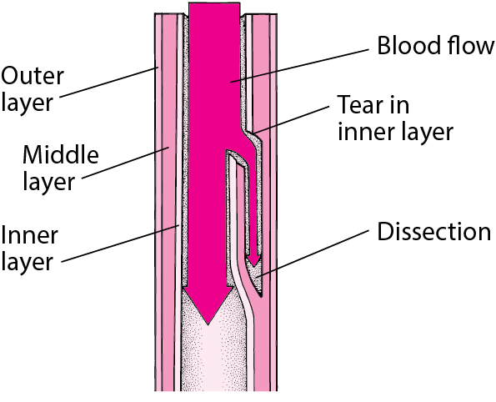
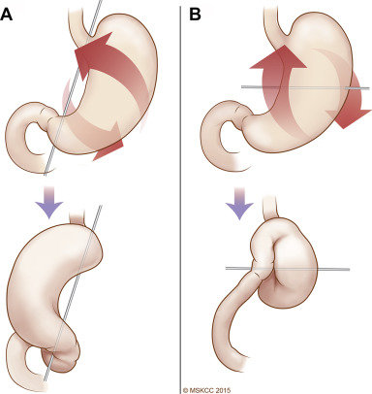
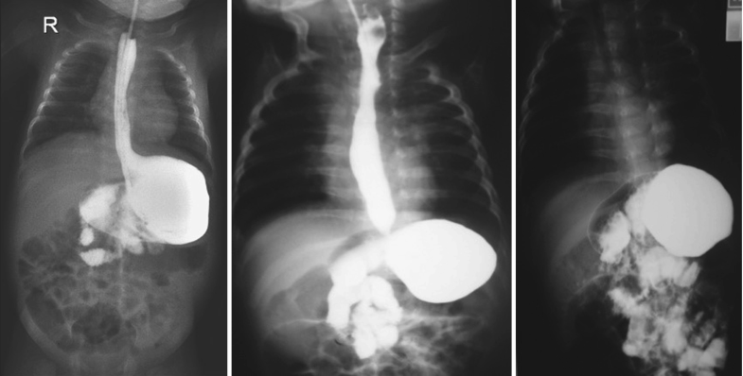
Smal
Small and large bowel infarction
2
Clinical Features Click on the picture for higher resolution
Venous thrombosis
When the venous thrombosis blocks almost all the main outflow veins, arterial inflow will get congested, which will lead ultimately to blood insufficiency in that area.
Mesenteric venous thrombosis can complicate abdominal trauma, portal vein thrombosis, splenectomy and other causes of a hypercoagulable state.
Portal vein thrombosis (OVT): develop in patients with liver cirrhosis, is severe, it can obstruct portal vein drainage and impair the outflow of the whole intestines.
Predisposing factors: Reduced mobility, BMI >30, OCC, hypercoagulability, and Surgical patients.
05
A
B
A: you can see the thrombosis at the arrow
B: Small bowel ischemia
Dissecting aneurysm
Due to the separation of the layers of the aortic wall. A tear in the intimal layer results in the progression of the dissection
This dissection can narrow the artery lumen.
Major risk factors are atherosclerosis and hypertension (70% of cases)
Aneurysm can occur in the aorta, or in the branches of the corresponding artery (SMA, IMA, Celiac)
Carries high mortality rates.
CTA is gold standard
06
Stomach Volvulus
A gastric volvulus occurs when the stomach rotates on itself at least 180 degrees along its transverse or longitudinal axis.
Patients can simply present with mild abdominal pain associated with nausea, vomiting (Due to obstruction) and dysphagia.
For the majority of cases, gastric volvulus is caused by a gastric, splenic, or diaphragmatic anatomic disorder, the most common being a diaphragmatic hernia or Hiatal hernia.
Extra Pictures
Organoaxial rotation (Singleton): The most common. occurs when the stomach rotates around the pylorus and the gastroesophageal (GE) junction Picture (A).
Mesenteroaxial rotation: occurs when the stomach rotates longitudinal line parallel to the gastrohepatic omentum Picture (B).
Barium meal studies showing chronic gastric volvulus. Note the associated gastroesophageal reflux in the first two films
may pres- ent as acute abdominal pain, especially when com- plicated by acute toxic dilatation or perforation of the colon. The abdominal pain is invariably pre- ceded by severe incessant diarrhoea accompanied by the passage of blood, mucus and pus.

Slide 17
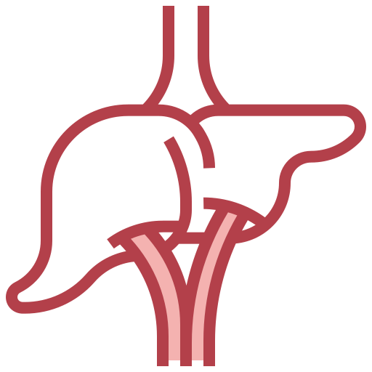
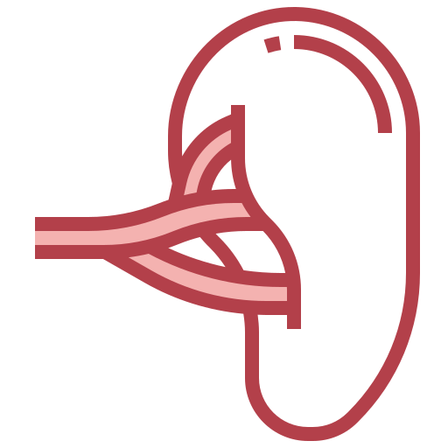
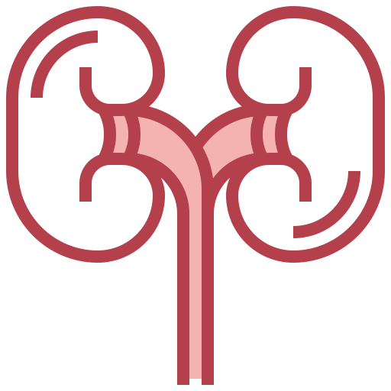
Smal
Infarction of the viscus
Spleen, Liver and Kidney (Arterial occlusion)
These OBJs were not found in davidson nor norman browse
Liver
Spleen
Extremely rare situation because the liver has a dual blood supply from the hepatic artery (25%) and portal vein (75%). Also, there are many collaterals between these circulations, which makes it triple blood supply.
Most commonly occurs in liver transplant patients.
It can also occur as result of hepatic artery ligation as a complication of cholecystectomy
May cause RUQ pain, with elevated aminotransferases
It may be the result of arterial or venous occlusion.
Splenic artery is the most common visceral artery that may develop aneurysm.
The infarction may be global or involve a small segmental area of the spleen depending on which vessel is occluded.
Typical presentation includes left sided abdominal pain in a person with an underlying
hematologic disorder,
hypercoagulable state,
blood-borne malignancy,
blunt abdominal trauma
embolic illness.
Extra
Therapeutic splenic infarction via splenic embolization has been used to treat hemorrhage from traumatic splenic injuries. Splenic embolization has also been used in the treatment of severe portal hypertension and in the preoperative phase of splenectomy to reduce intraoperative blood loss.
Kidney
Renal infarction is the major complication that may result from an untreated renal artery thrombosis.
The pain is typically persistent and can mimic the symptoms seen with nephrolithiasis and pyelonephritis.
A strong correlation with hematuria, proteinuria, elevated aspartate aminotransferase (AST), and elevated LDH has been noted once the thrombosis has progressed to renal infarction.
Ovary torsion (Torsion of pedicles)
Ovaries have dual supply (Ovarian and uterine arteries). Twisting of the ligaments the support the adnexa, can lead to venous congestion, compression of arteries, and, eventually, loss of blood supply to the ovary.
The main risk factor is an ovarian mass (or cyst) that is 5 cm in diameter or larger (Increase to weight in one pole and increase the chance of ovarian rotation)
Patient presents with severe pelvic pain (Exclude hernia first), pain may be dull or stabbing.
Pain may radiate to the abdomen, back, or flank.
This is a true surgical emergency that can lead to necrosis, loss of ovary, and infertility if not identified promptly.

Slide 18
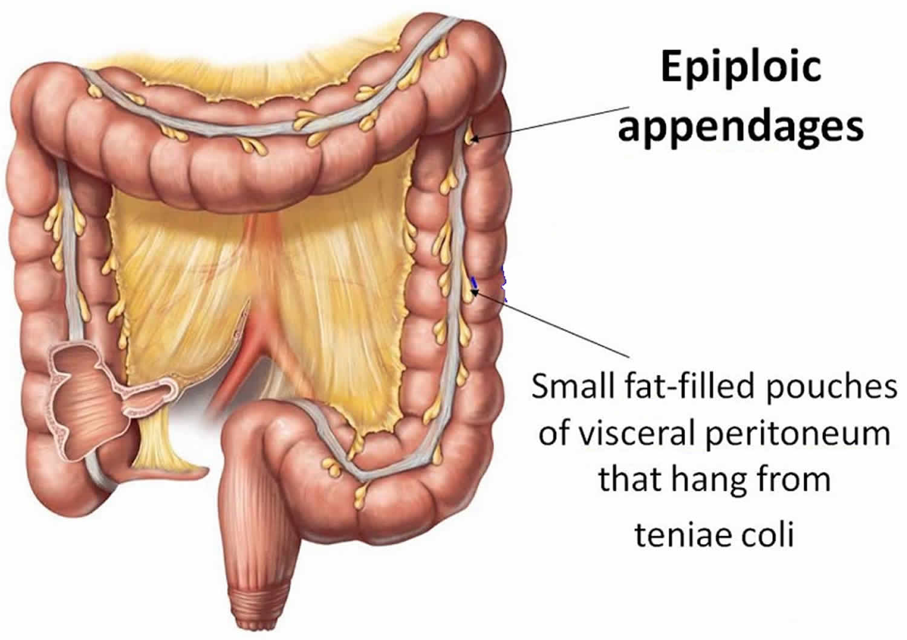
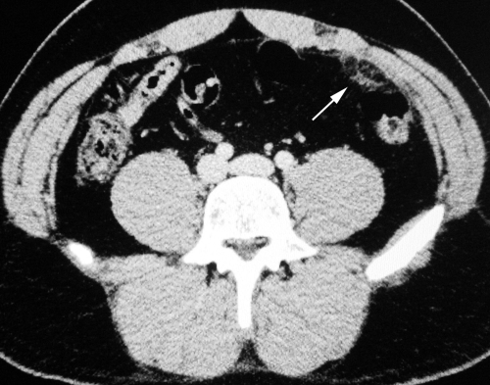
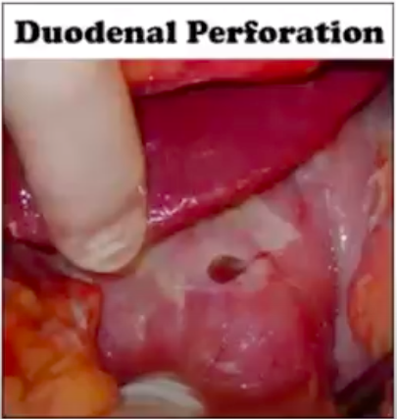
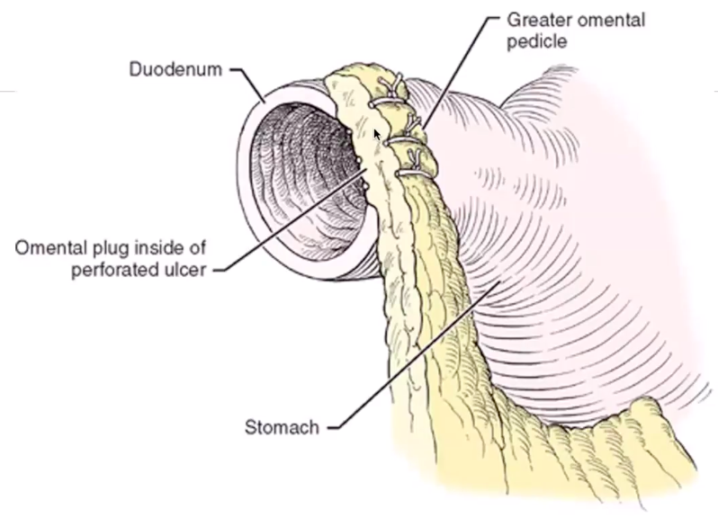
Smal
Infarction of the viscus
Omentum/appendix epiploica (strangulation)
These OBJs were not found in davidson nor norman browse
Acute epiploic appendagitis is an uncommon cause of abdominal pain (most often mistaken for acute diverticulitis.).
It is caused by torsion of an epiploic appendage or spontaneous venous thrombosis of a draining appendageal vein.
The diagnosis of this condition primarily relies on CT-scan
Patients is afebrile, LLQ pain, labs show leukocytosis
Extra Picture
Case from the Dr
Case: A 72-year-old male, known for chronic knee pain on NSAIDS, had one months hx of epigastric pain, presented to ER with acute onset of severe abdominal pain, mainly epigastric.
HR120, BP80/52, Temp 39.5 (Pyrexic)
Physical Examination: Rigid Abdomen
Labs: WBC elevated, Amylase elevated
On Imaging showed: free air under diaphragm (no need for endoscopy)
Answer: In this case, the patient have peptic ulcer perforation Picture (A).
We manage him by Omental (Graham) patches Picture (B) - Takes a piece of omentum and adhere it to the perforation.
Generally, we will start with AirwayBreathingCirculation (stabilize), surgery (Perform omental graham patch) then conservative PPI & ABX.
Dr. Omar gave these notes which are not related to our objectives:
Acute pancreatitis is caused by (Gallstones), while chronic by (Alcohol)
Abdominal Aortic Aneurysm symptoms starts only if (>4-5cm)
A
B

Slide 19
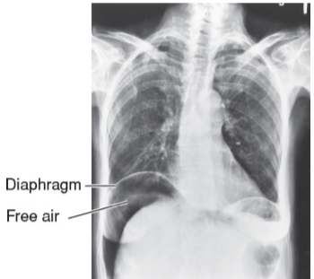
Summary
Recall
Q1:What is the treatment of appendicitis?
Answer Nonperforated—prompt appendectomy and cefoxitin to avoid perforation
Perforated—triple antibiotics, fluid resuscitation, and prompt appendectomy; all pus is drained and cultures obtained, with postoperative antibiotics continued for 5 to 7 days, ±drain
Q2: What is the approximate risk of perforation of inflamed appendix ?
Answer: ≈25% after 24 hours from onset of symptoms
≈50% by 36 hours
≈75% by 48 hours
Q3: What is Boerhaave’s syndrome?
Answer: Esophageal perforation
Q4: Why is the esophagus susceptible to perforation and more likely to break down an anastomosis?
Answer: No serosa
Q5: What is the treatment of Boerhaave’s syndrome?
Answer: Surgery within 24 hours to drain the mediastinum and surgically close the perforation and placement of pleural patch; broad-spectrum antibiotics
Q6: Overall, what is the most common cause of esophageal perforation?
Answer: Iatrogenic (most commonly cervical esophagus)
Q7:What are graham patches
Answer Placement of omentum with stitches over a gastric or duodenal perforation (i.e., omentum is used to plug the hole)
Q8: What is Free air ?
Answer: Air free within the peritoneal cavity (air or gas should be seen
only within the bowel or stomach); results from bowel or stomach perforation
Q9: What is the seatbelt sign?
Answer: Ecchymosis on lower abdomen from wearing a seatbelt (≈10% of patients with this
sign have a small bowel perforation!)
Q10: What is diverticulitis?
Answer:Infection or perforation of a diverticulum
Q11: What is the pathophysiology?
Answer:Obstruction of diverticulum by a fecalith leading to inflammation and microperforation
Q12: What are the associated radiographic findings?
Answer: On x-ray: ileus, partially obstructed colon, air-fluid levels, free air if perforated On abdominal/pelvic
CT scan: swollen, edematous bowel wall; particularly helpful in diagnosing an abscess
Q13: What are the associated barium enema findings?
Answer: Barium enema should be avoided in acute cases
Q14: Is colonoscopy safe in an acute setting?
Answer: No, there is increased risk of perforation
Q15: What is the best test for diverticulitis?
Answer: CT scan
Q16: What is the initial therapy?
Answer: IV fluids, NPO, broad-spectrum antibiotics with anaerobic coverage, NG suction (as needed for emesis/ileus)

Slide 20
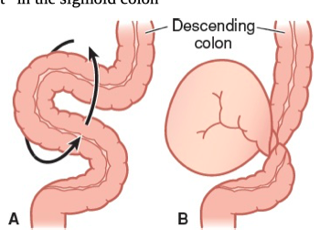
Summary
Recall
Q17:What type of surgery is usually performed for an acute case of diverticulitis with a complication?
Answer
1. Hartmann’s procedure: resection of involved segment with an end colostomy and stapled rectal stump
2. Resection, primary anastomosis loop ileostomy
Q18: How common is massive lower GI bleeding with diverticulitis?
Answer: Very rare! Massive lower GI bleeding is seen with diverticulosis, not diverticulitis
Q19: What is Colonic volvulus ? What is the most common type of it ?
Answer: Twisting of colon on itself about its mesentery, resulting in obstruction and,
if complete, vascular compromise with potential necrosis, perforation, or both
Most common type: Sigmoid volvulus (~75%)
Q20: What are the etiologic factors
Answer: High-residue diet resulting in bulky stools and tortuous, elongated colon; chronic constipation; laxative abuse; pregnancy; seen most commonly in bedridden elderly or institutionalized patients, many of whom have history of prior abdominal surgery or distal colonic obstruction
Q21: What findings are evident on abdominal plain film?
Answer: Distended loop of sigmoid colon, often in the classic “bent inner tube” or “omega” sign with the loop aiming toward the RUQ
Q22: How is the diagnosis made?
Answer:CT scan, sigmoidoscopy, or radiographic exam with Gastrografin ® enema
Q23:What are the signs of strangulation?
Answer Discolored or hemorrhagic mucosa on sigmoidoscopy, bloody fluid in the rectum, frank ulceration or necrosis at the point of the twist, peritoneal signs, fever, hypotension, ↑ WBCs
Q24: What is the initial treatment?
Answer: Nonoperative: If there is no strangulation, sigmoidoscopic reduction is successful in ≈85% of cases; enema study will occasionally reduce (5%)
Q25: Most common complications of crohn’s disease?
Answer: Fistula (Anal or others), obstruction (Stricture) and abscesse.
Q26: Most common complications of Ulcerative colitis?
Answer Cancer, toxic megacolon, colonic perforation, hemorrhage,

Slide 21
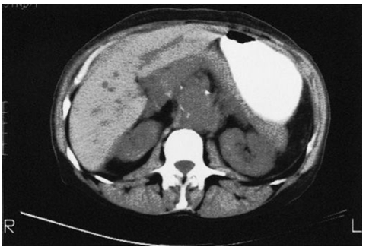
Quiz
MCQ
Q1: What are the most appropriate surgical procedures in 2 patients, the first with bleeding diverticulosis, and the other with perforated diverticulitis, respectively ?
1-Sigmoid resection with end colostomy and rectal pouch (Hartmann procedure). 2-Sigmoid resection with primary anastomosis
1-Sigmoid resection with primary anastomosis 2-Sigmoid resection with end colostomy and rectal pouch (Hartmann procedure).
1- Long-term suppressive antibiotic therapy. 2- Hartmann procedure
1. Hartmann procedure 2. Long-term suppressive antibiotic therapy
Q2: 34 y/o patient presented with Suprapubic pain and tenderness, Difficulty or inability in passing urine and Hematuria. Which of the following is suggestive of bladder perforation ?
Past History of pyelonephritis
Being a female
Pain is relieved after passing urine.
Past history of prostatic cancer that excised surgically
Q3: A 45-year-old woman with history of heavy nonsteroidal anti-inflammatory drug ingestion presents with acute abdominal pain. She undergoes exploratory laparotomy 30 hours after onset of symptoms and is found to have a perforated duodenal ulcer. Which of the following is the procedure of choice to treat her perforation?
Truncal vagotomy and pyloroplasty
Truncal vagotomy and antrectomy
Simple closure with omental patch
Highly selective vagotomy with omental patch
Q4: A 76-year-old woman presents with acute onset of persistent back
pain and hypotension. A CT scan is obtained (shown below), and the patient
is taken emergently to the operating room. Three days after surgery she
complains of abdominal pain and bloody mucus per rectum. Which of the
following is the most likely diagnosis?
Diverticulitis
Ischemia of left colon
Enterocolitis
Q5: IN the previous scenario, which artery is most likely to be occluded ?
IMA
SMA
Celiac artery
Answers
Click here for explanation
Q1 | B | Q4 | B
Q2 | D | Q5 | A
Q3 | C | Q6
Extra Questions

Slide 22
Good Luck!
Team leaders:
Nouf Alshammari
Haneen Somily
Naif Alsulais
Mohammed alshoieer
This lecture was done by:
Mohammed Alshoieer
Fahad alsultan
Nujud Alabdullatif
Omar al-otaibi
Feedback
Note taker
Reviewer

