Slide 1
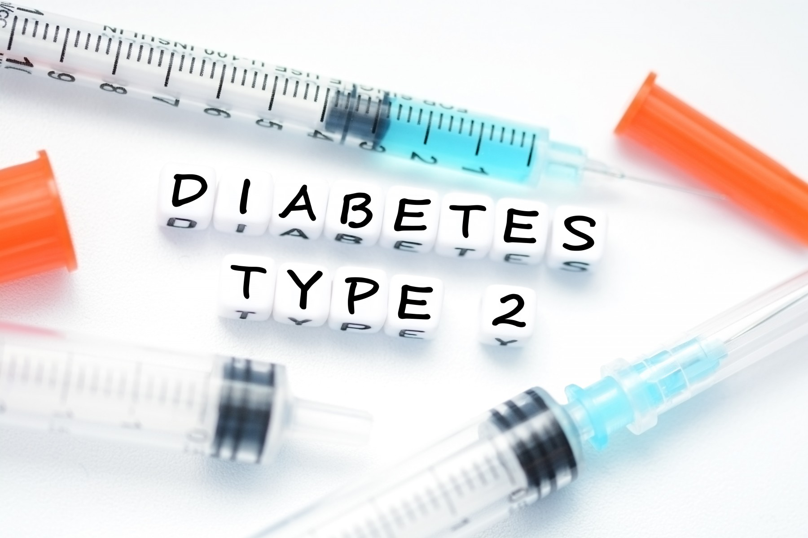
Mazen Barhoush
Endocrine and Metabolism Consultant

Slide 2
Outline
Introduction
Pathogenesis
Diagnostic criteria
Screening
Diabetic complication
Medical treatment

Slide 3
Type 2 diabetes mellitus (T2DM) is one of the most common health problems facing mankind and is a major public health problem.
The International Diabetes Federation (IDF) estimated in 2014 that 387 million people have diabetes worldwide and that by 2035 this number will rise to 592 million.

Slide 5
Globally in 2013, it is estimated that almost 382 million people suffer from diabetes with a prevalence of 8.3%.
Top 10 countries with higher prevalence of diabetes are Tokelau (37.5%), Federated States of Micronesia (35%), Marshall Islands (34.9%), Kiribati (28.8%), Cook Islands (25.7%), Vanuatu (24%), Saudi Arabia (23.9%), Nauru (23.3%), Kuwait (23.1%) and Qatar (22.9%).
Saudi Arabia is among top ten countries of the world with highest prevalence
IDF Diabetes Atlas : sixth edition, 6th ed., International Diabetes Federation, Basel, Switzerland.

Slide 6
Diabetes in Middle-East and North Africa
IDF Diabetes Atlas : Tenth edition, 10th ed., International Diabetes Federation,

Slide 7
Criteria for the Diagnosis of Diabetes
 |  | Increased Risk
Test | Normoglycemia | mpaired Fasting Glucose | Impaired Glucose Tolerance | High Risk | Diabetes
PG, fasting (mg/dL) | <100 | 100-125 |  |  | ≥126
PG, 2-hour (mg/dL) | <140 |  | 140-199 |  | ≥200 plus classical symptoms of diabetes or hyperglycemic crisis
Hemoglobin A1c (%) |  |  |  | 5.7-6.4 | ≥6.5
PG, casual (mg/dL)
Modified from American Diabetes Association. Standards of medical care in diabetes—2010. Diabetes Care. 2010;29:s11-s61

Slide 8
Classification
I. Type 1 diabetes (beta-cell destruction, usually leading to absolute insulin deficiency)
Immune mediated, including LADA
Idiopathic
II. Type 2 diabetes (may range from predominantly insulin resistance with relative insulin deficiency to a predominantly insulin secretory defect with insulin resistance)
III. Gestational Diabetes mellitus (GDM)
IV. Monogenic / MODY
V. Others

Slide 9
Major Risk Factors for Type 2 Diabetes
• Overweight (BMI ≥25 kg/m2 or ≥23 kg/m2 in Asian Americans) • Physical inactivity • First-degree relative with diabetes • Member of a high-risk ethnic population (e.g., African American, Latino, Native American, Asian American, Pacific Islander) • Female with a history of delivering a baby weighing >4 kg or prior diagnosis of GDM • Hypertension (≥140/90 mm Hg or on therapy for hypertension) • HDL cholesterol level <35 mg/dL (0.90 mmol/L) or triglyceride level >250 mg/dL (2.82 mmol/L) or both • Female with polycystic ovary syndrome • Hemoglobin A1c ≥5.7%, impaired glucose tolerance, or impaired fasting glucose on previous testing • Other clinical conditions associated with insulin resistance (e.g., severe obesity, acanthosis nigricans) • History of cardiovascular disease • Age over 45 years

Slide 10
PATHOGENESIS
Genetic factors (monogenic, polygenic)
Environmental factors
• Resistance to the action of insulin in peripheral tissues, particularly muscle and fat but also liver • Defective insulin secretion, particularly in response to a glucose stimulus • Increased glucose production by the liver

Slide 12
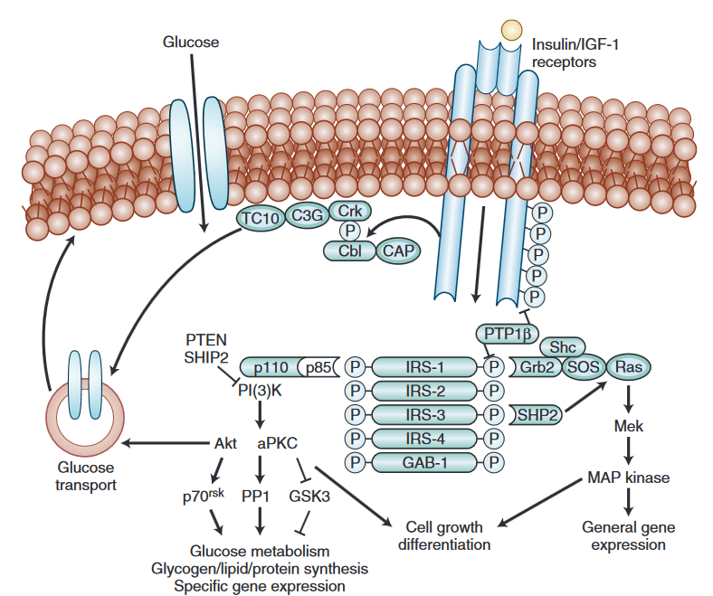
Activation tyrosine kinase activity

Slide 14
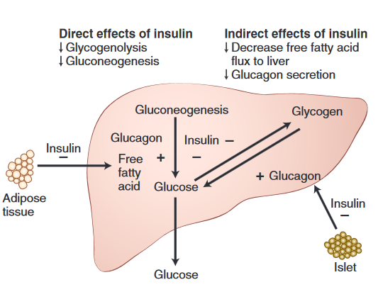

Slide 15
Insulin Resistance(Diminished insulin sensitivity)
presence of an impaired biologic response to either exogenously administered or endogenously secreted insulin.
Insulin resistance is primarily manifested by decreased insulin-stimulated glucose transport and metabolism in adipocytes and skeletal muscle and impaired insulin suppression of adipocyte lipolysis and hepatic glucose output.
(affects the muscle, liver, and adipose tissues).

Slide 16
Insulin Resistance(Diminished insulin sensitivity)
Insulin resistance → increases gluconeogenesis in the liver and impairs glucose uptake and utilization in muscle →lipolysis → large amounts of non‐esterified fatty acids (NEFAs) → inhibit insulin secretion, by enhancing the accumulation of triglycerides within the β cells.
adipose tissue produces cytokines, such as TNF‐α, resistin and IL‐6, all of which have been shown to interfere with insulin action.
TNF‐α inhibit tyrosine kinase activity at the insulin receptor and decrease expression of the glucose transporter GLUT‐4.
Resistin is an adipocyte‐secreted hormone that increases insulin resistance

Slide 17
Insulin Resistance(Diminished insulin sensitivity)
Adiponectin is a hormone with anti‐inflammatory and insulin‐sensitising properties that is secreted solely by fat cells.
It suppresses hepatic gluconeogenesis and stimulates fatty acid oxidation in the liver and skeletal muscles, as well as increasing muscle glucose uptake and insulin release from the β cells.
Circulating adiponectin is reduced in obesity.

Slide 18
MODY

Slide 19
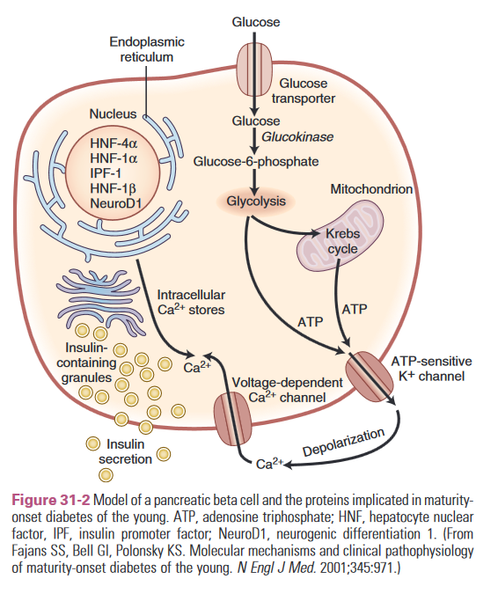

Slide 34
Lifestyle Intervention
The components of lifestyle intervention include medical nutrition counseling, exercise recommendations, and comprehensive diabetes education.

Slide 40
Management of DM
The major components of the treatment of diabetes are:
A
Diet and Exercise
B
Oral hypoglycaemic therapy
C
Insulin Therapy

Slide 41
Exercise
Physical activity promotes weight reduction and improves insulin sensitivity, thus lowering blood glucose levels.
Together with dietary treatment, a programme of regular physical activity and exercise should be considered for each person. Such a programme must be tailored to the individual’s health status and fitness.
People should, however, be educated about the potential risk of hypoglycaemia and how to avoid it.

Slide 42
A. Diet
Diet is a basic part of management in every case. Treatment cannot be effective unless adequate attention is given to ensuring appropriate nutrition.
Dietary treatment should aim at:
ensuring weight control
providing nutritional requirements
allowing good glycaemic control with blood glucose levels as close to normal as possible
correcting any associated blood lipid abnormalities

Slide 43
A. Diet (cont.)
The following principles are recommended as dietary guidelines for people with diabetes:
Dietary fat should provide 25-35% of total intake of calories but saturated fat intake should not exceed 10% of total energy. Cholesterol consumption should be restricted and limited to 300 mg or less daily.
Protein intake can range between 10-15% total energy (0.8-1 g/kg of desirable body weight). Requirements increase for children and during pregnancy. Protein should be derived from both animal and vegetable sources.
Carbohydrates provide 50-60% of total caloric content of the diet. Carbohydrates should be complex and high in fibre.
Excessive salt intake is to be avoided. It should be particularly restricted in people with hypertension and those with nephropathy.

Slide 44
Pharmacotherapy for Type 2 Diabetes Mellitus
Insulin Sensitizers With Predominant Action in the Liver (biguanide)
Metformine – stimulate skeletal muscle glucose uptake and inhibition of hepatic gluconeogenesis.
The major clinical activity of metformin is to reduce hepatic gluconeogenesis and glucose production, and improves insulin sensitivity in peripheral tissues.
Adverse events are gastrointestinal : nausea, diarrhea, crampy abdominal pain, and dyspepsia , very rare can cause lactic acidosis.
Not associated with a significant risk of hypoglycemia.
Does not cause weight gain.
contraindicated in patients with :-
(1)renal insufficiency estimated glomerular filtration rate (eGFR) less than 35 mL/minute per 1.73 m2.
(2)hepatic insufficiency and in the setting of alcohol abuse.

Slide 45
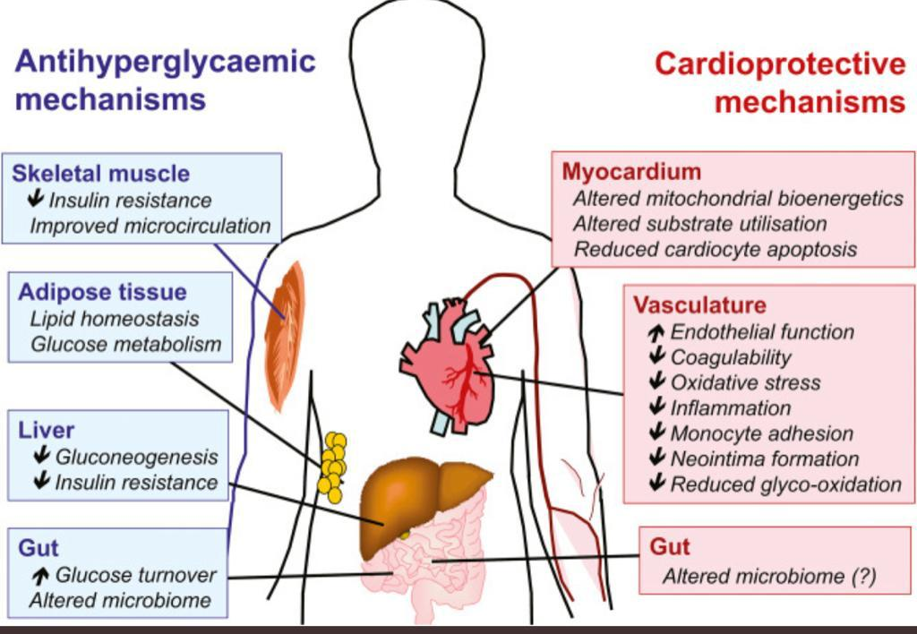
Biguanide mechanism of action

Slide 46
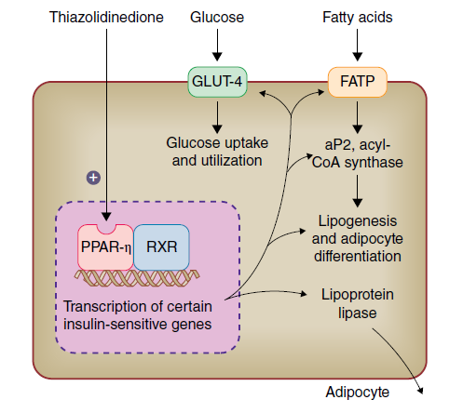
II. Insulin Sensitizers With Predominant Action in Peripheral Insulin-Sensitive Tissues - thiazolidinedione class (TZDs, or glitazones).
pioglitazone and rosiglitazone
These agents work through binding and modulation of the activity of peroxisome proliferator-activated receptors (PPARs), leads to improvement in glycemic control over weeks to months in parallel with an improvement in insulin sensitivity and a reduction in FFA levels.
Adverse effects are weight gain and fluid retention (and associated edema formation and hemodilution), and increased risk of bone fractures.
contraindicated in patients with active hepatocellular disease and in patients with unexplained serum alanine
aminotransferase (ALT) levels greater than 2.5 times the
upper limit of normal.

Slide 47
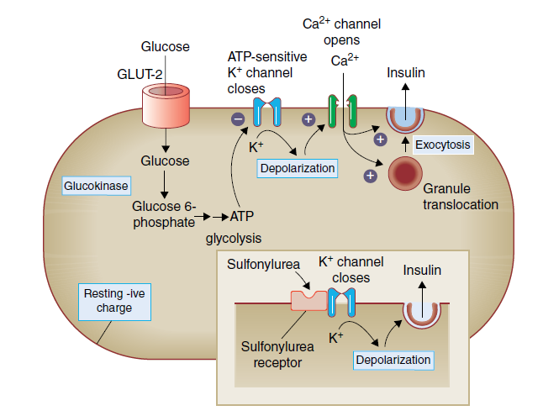
Insulin Secretagogues
insulin secretagogues bind to the SUR1, a subunit of the K ATP potassium channel on the plasma membrane of pancreatic beta cells, leads to closing of the channel, as do increases in intracellular ATP and decreases in ADP resulting in membrane depolarization that causes opening
of voltage-dependent calcium channels and
calcium influx results in an increase in
intracellular calcium, which leads to insulin
secretion.
Sulfonylurea group , and Glinides

Slide 48
Insulin Secretagogues
Sulfonylurea (Chlorpropamide, Tolazamide, Tolbutamide, Glipizide, Glimepiride, Gliclazide)
Adverse effects are weight gain and hypoglycemia.
Has a long half-life, has an effect on both pre-pandial and post-prandial.
Contraindicated in renal failure, and hepatic failure.

Slide 49
Insulin Secretagogues
Glinides
Repaglinide and Nateglinide are members of the meglitinide family of insulin secretagogues, distinct from the sulfonylureas.
It has a short half-life and a distinct SUR1 binding site.
it is typically taken with each meal and provides better postprandial control and generally less hypoglycemia and weight gain than Sulfonylurea
Suitable for use in diabetic patients with IRF or with renal failure undergoing dialysis.

Slide 50
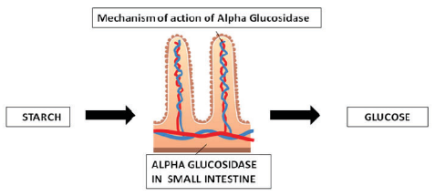
Carbohydrate Absorption Inhibitors:
α-Glucosidase Inhibitors
inhibit the terminal step of carbohydrate digestion at the brush border of the intestinal epithelium, as a result, carbohydrate absorption is shifted more distally in the intestine and is delayed.
Available agents are acarbose and miglitol.
Adverse effects flatulence and gastrointestinal upset.
Doesn't cause hypoglycemia .
Weight neutral.

Slide 51
Incretin-Related Therapies
GLP-1 Receptor Agonists and DPP4 Inhibitors.
GLP-1(glucagon like peptide) is produced in intestinal L cells and is secreted in response to nutrients.
GLP-1 stimulates insulin secretion in a glucose-dependent fashion, inhibits inappropriate hyper-glucagonemia, slows gastric emptying, reduces appetite and improves satiety.
GLP-1 has a very short half-life in plasma (1 to 2 minutes) due to aminoterminal degradation by the enzyme dipeptidyl peptidase 4 (DPP4).

Slide 52
Incretin-Related Therapies
DPP4 Inhibitors (sitagliptin, saxagliptin, linagliptin, and alogliptin)
they are not associated with nausea because of the lesser increase in GLP-1 activity.
Weight effect neutral
Contraindication : history of pancreatitis, and advanced kidney disease (eGFR <30 mL/minute per 1.73 m2), except linagliptin which can be used
Saxagliptin: increased risk for heart failure hospitalization.

Slide 53
Incretin-Related Therapies
GLP-1 Receptor Agonists : Exenatide, Liraglutide, Dulaglutide, semaglutide, etc.
Effect :Weight loss and reduction in HbA1c.
Does not cause hypoglycemia.
Associated with gastrointestinal adverse effects
Beneficial effect include weight reduction, and positive cardiovascular outcome (all cause mortality, nonfatal stroke , and nonfatal MI).
Contraindication : history of pancreatitis, family or personal history of medullary thyroid carcinoma (there is a clear increase in the incidence of these tumors in rodents), and advanced kidney disease (eGFR <30 mL/minute per 1.73 m2).

Slide 54
Incretin-Related Therapies

Slide 55
Sodium-Glucose Transporter-2 Inhibitors. SGLT2i
Sodium-glucose cotransporters (SGLTs) are important mediators of glucose uptake across apical cell membranes.
SGLT1 mediates almost all sodium-dependent glucose uptake in the small intestine and kidney’s proximal straight tubule.
SGLT2 mediates almost all sodium-dependent glucose uptake in kidney’s proximal convoluted tubule.

Slide 56
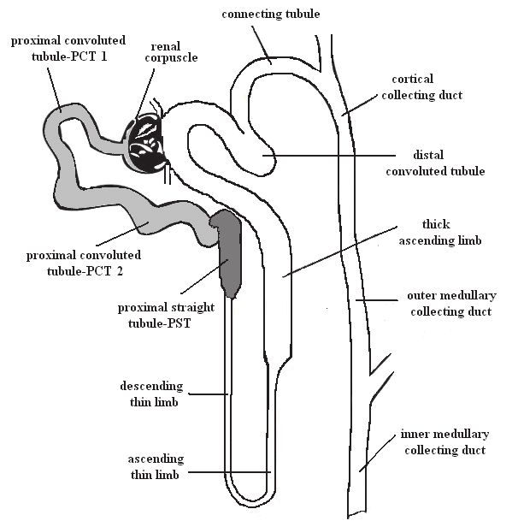
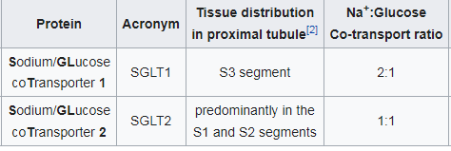
SGLT2
SGLT1

Slide 57
Sodium-Glucose Transporter-2 Inhibitors. SGLT2i
SGLT2, and to a lesser extent SGLT1, account 90% and nearly 10%,respectively, of glucose reabsorption from the glomerular ultrafiltrate.
If the plasma glucose concentration is too high (hyperglycemia), glucose passes into the urine (glucosuria) because SGLT are saturated with the filtered glucose.

Slide 58
Sodium-Glucose Transporter-2 Inhibitors. SGLT2i
Sodium-Glucose Transporter-2 Inhibitors(Empagliflozin, Canagliflozin, Dapagliflozin, etc).
They work by blocking the SGLT2 protein located in the proximal convoluted tubule of the nephron resulting in glycosuria and thereby lowering plasma glucose concentration.
Beneficial effect include weight reduction, positive cardiovascular outcome (all cause mortality, nonfatal stroke , and nonfatal MI),and lower hospitalization for heart failure.
Associated with risk of diabetic ketoacidosis, dehydration, increased incidence of genitourinary tract infection “fungal”.
Canagliflozin :- increased risk of fracture and toe amputation.

Slide 59
Major sites of action of antidiabetic drugs and genes associated with pharmacokinetics or clinical response

Slide 60
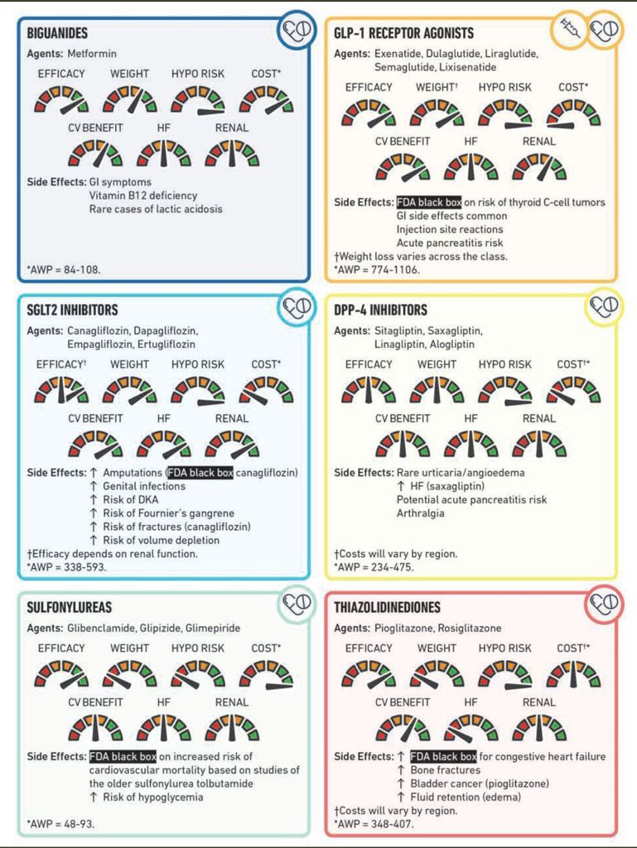

Slide 61
Antidiabetic medication and cardiovascular safety

