Slide 1

Dyslipidemia
(Med-341)
Anwar A Jammah, MD, FRCPC, FACP, FACE, Cert. Endo.
Professor of Medicine, King Saud University
Consultant Endocrinology, Diabetes & Thyroid Oncology

Slide 2
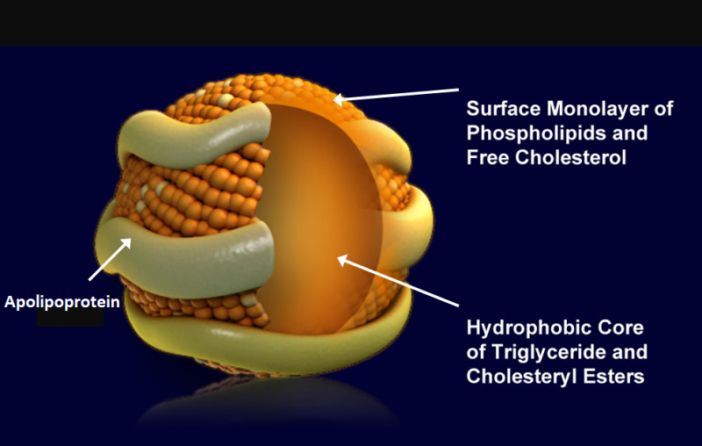
Lipoproteins are complex particles that have a central hydrophobic core of non-polar lipids, primarily cholesterol esters and triglycerides. This hydrophobic core is surrounded by a hydrophilic membrane consisting of phospholipids, free cholesterol, and apolipoproteins
Lipoprotein Structure (figure modified from Biochemistry 39: 9763, 2000)

Slide 3
Plasma lipoproteins are divided into seven classes based on size, lipid composition, and apolipoproteins
Lipoprotein | Density (g/ml) | Size (nm) | Major Lipids | Major Apoproteins
Chylomicrons | <0.930 | 75-1200 | Triglycerides | Apo B-48, Apo C, Apo E, Apo A-I, A-II, A-IV
Chylomicron Remnants | 0.930- 1.006 | 30-80 | Triglycerides Cholesterol | Apo B-48, Apo E
VLDL | 0.930- 1.006 | 30-80 | Triglycerides | Apo B-100, Apo E, Apo C
IDL | 1.006- 1.019 | 25-35 | Triglycerides Cholesterol | Apo B-100, Apo E, Apo C
LDL | 1.019- 1.063 | 18- 25 | Cholesterol | Apo B-100
HDL | 1.063- 1.210 | 5- 12 | Cholesterol Phospholipids | Apo A-I, Apo A-II, Apo C, Apo E
Lp (a) | 1.055- 1.085 | ~30 | Cholesterol | Apo B-100, Apo (a)

Slide 4
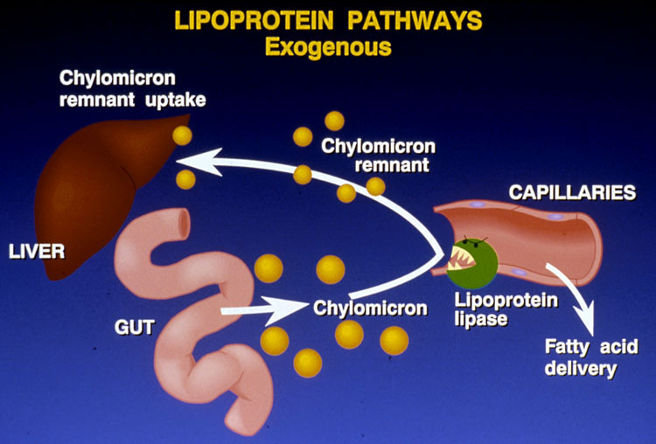

Slide 5
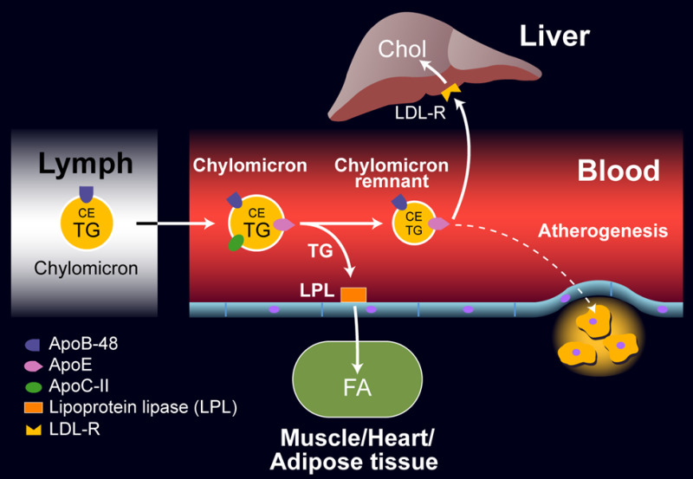
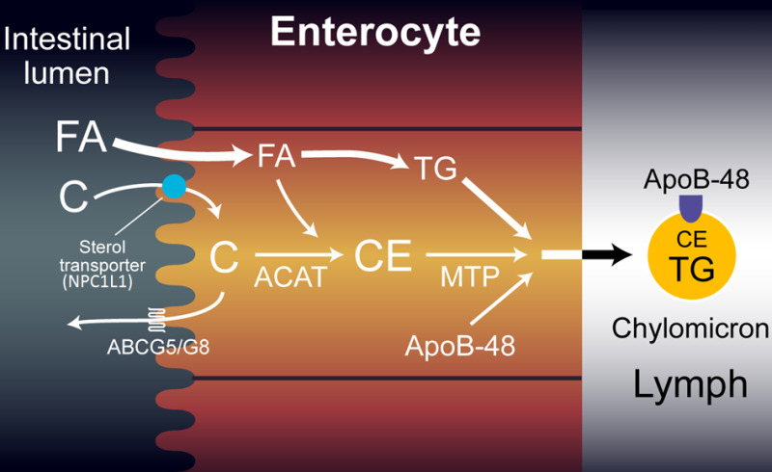

Slide 6
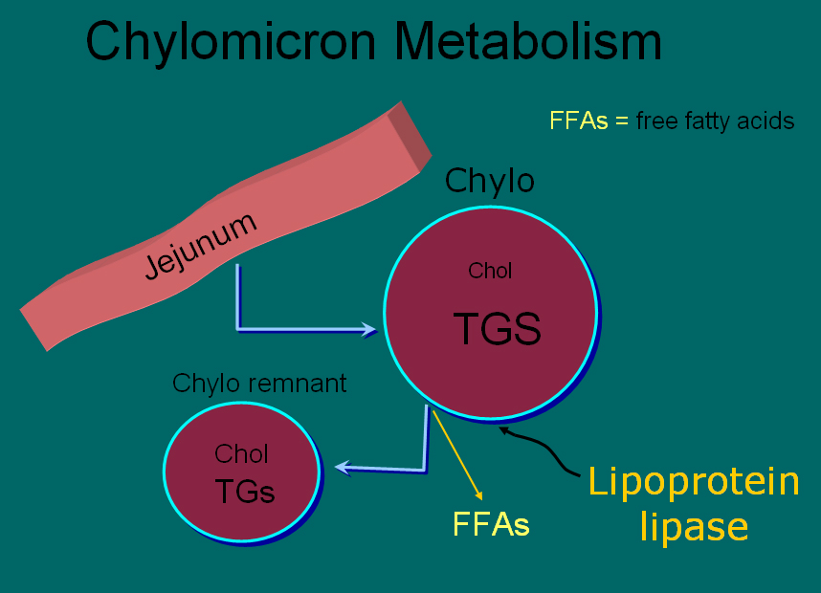
[ CLOSE WINDOW ]

Slide 7
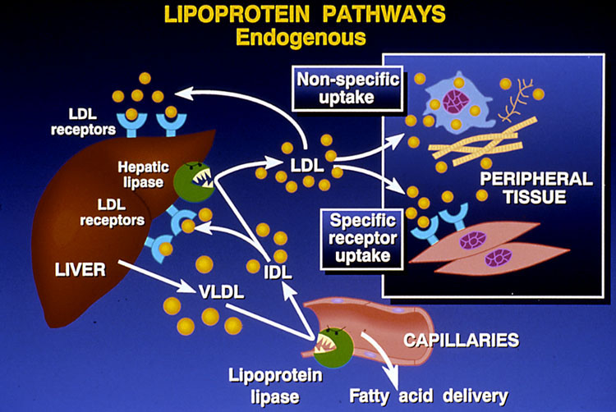

Slide 8
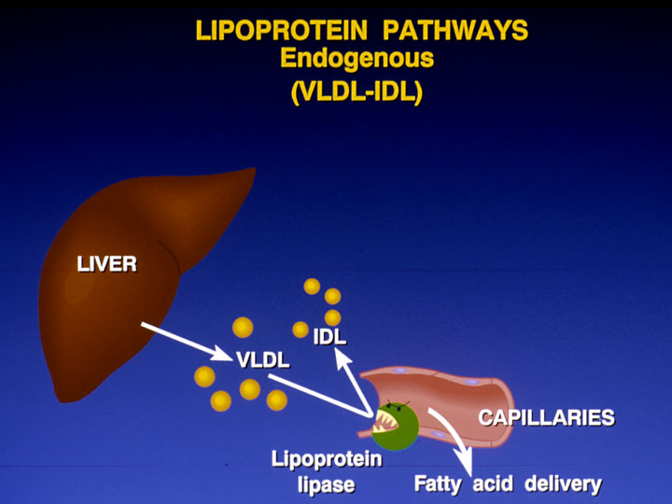

Slide 9
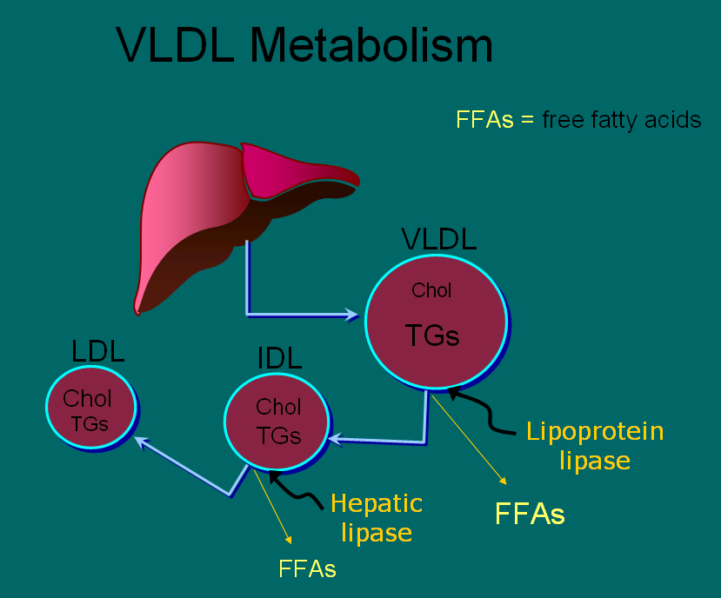
[ CLOSE WINDOW ]

Slide 10
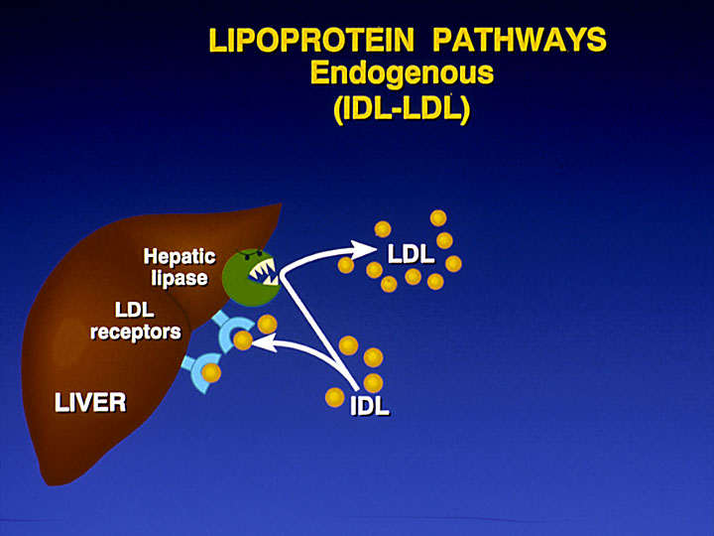

Slide 11
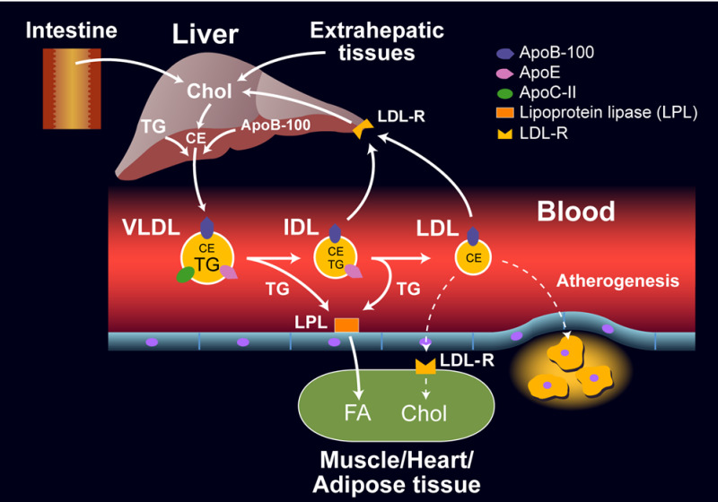

Slide 12
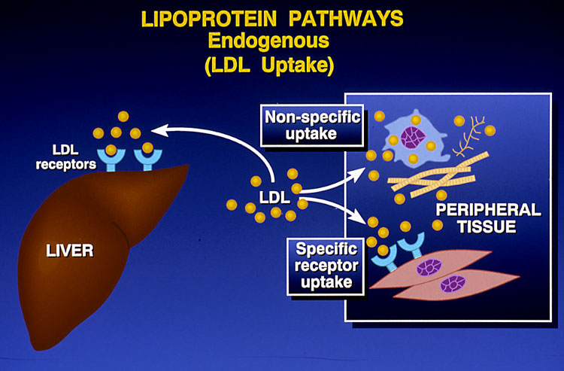

Slide 13
The story of lipids
Chylomicrons transport fats from the intestinal mucosa to the liver
In the liver, VLDL released to blood stream to form LDL, IDL and LDL.
LDL then carries fat and cholesterol to the body’s cells. LDL receptors in Liver take the LDL to Liver.
High-density lipoproteins (HDL) released from intestine and liver and carry fat and cholesterol from blood vessels to the liver.

Slide 14
The story of lipids (cont.)
When oxidized LDL cholesterol gets high, atheroma formation in the walls of arteries occurs, which causes atherosclerosis.
HDL cholesterol is able to go and remove cholesterol from the atheroma.
Atherogenic cholesterol → LDL, VLDL, IDL

Slide 15
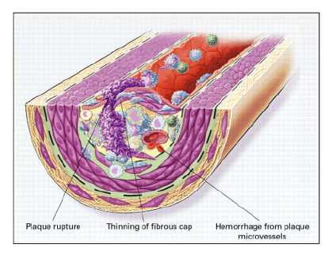
Atherosclerosis

Slide 16
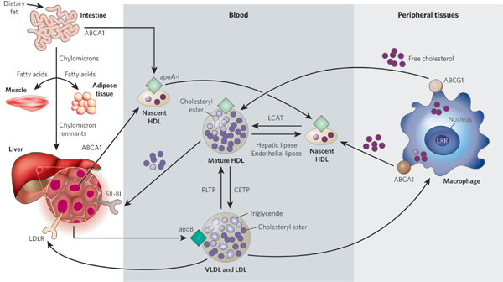
Lipid Transport
LPL/Apo C2
Rader DJ, Daugherty, A Nature 2008; 451:904-913
Notes:
Lipoprotein metabolism has a key role in atherogenesis. It involves the transport of lipids, particularly cholesterol and triglycerides, in the blood. The intestine absorbs dietary fat and packages it into chylomicrons (large triglyceride-rich lipoproteins), which are transported to peripheral tissues through the blood. In muscle and adipose tissues, the enzyme lipoprotein lipase breaks down chylomicrons, and fatty acids enter these tissues. The chylomicron remnants are subsequently taken up by the liver. The liver loads lipids onto apoB and secretes very-low-density lipoproteins (VLDLs), which undergo lipolysis by lipoprotein lipase to form low-density lipoproteins (LDLs). LDLs are then taken up by the liver through binding to the LDL receptor (LDLR), as well as through other pathways. By contrast, high-density lipoproteins (HDLs) are generated by the intestine and the liver through the secretion of lipid-free apoA-I. ApoA-I then recruits cholesterol from these organs through the actions of the transporter ABCA1, forming nascent HDLs, and this protects apoA-I from being rapidly degraded in the kidneys. In the peripheral tissues, nascent HDLs promote the efflux of cholesterol from tissues, including from macrophages, through the actions of ABCA1. Mature HDLs also promote this efflux but through the actions of ABCG1. (In macrophages, the nuclear receptor LXR upregulates the production of both ABCA1 and ABCG1.) The free (unesterified) cholesterol in nascent HDLs is esterified to cholesteryl ester by the enzyme lecithin cholesterol acyltransferase (LCAT), creating mature HDLs. The cholesterol in HDLs is returned to the liver both directly, through uptake by the receptor SR-BI, and indirectly, by transfer to LDLs and VLDLs through the cholesteryl ester transfer protein (CETP). The lipid content of HDLs is altered by the enzymes hepatic lipase and endothelial lipase and by the transfer proteins CETP and phospholipid transfer protein (PLTP), affecting HDL catabolism.

Slide 17
HDL and Reverse Cholesterol Transport
Bile
A-I
A-I
FC
CE
LCAT
CE
FC
FC
CE
FC
SR-BI
Nascent
HDL
ABCA1
Liver
Macrophage
Mature
HDL
Notes:
HDL and reverse cholesterol transport
HDL is believed to protect against atherosclerosis at least in part through the process of reverse cholesterol transport, whereby excess free cholesterol (FC) is removed from cells in peripheral tissues, such as macrophages within the arterial wall, and returned to the liver for excretion in the bile. FC is generated in part by the hydrolysis of intracellular cholesteryl ester (CE) stores. Several key molecules play a role in reverse cholesterol transport, including ATP-binding cassette protein A1 (ABCA1), lecithin:cholesterol acyltransferase (LCAT), and scavenger receptor class-B, type I (SR-BI). Promotion of this pathway could in theory help reduce atherosclerosis.

Slide 18
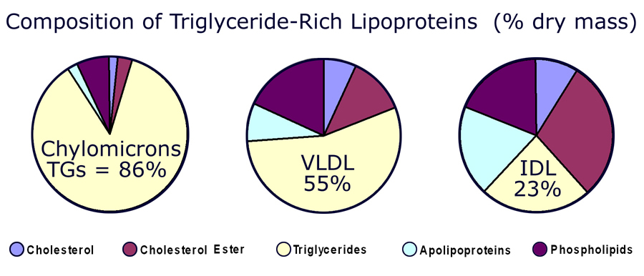
[ CLOSE WINDOW ]

Slide 19
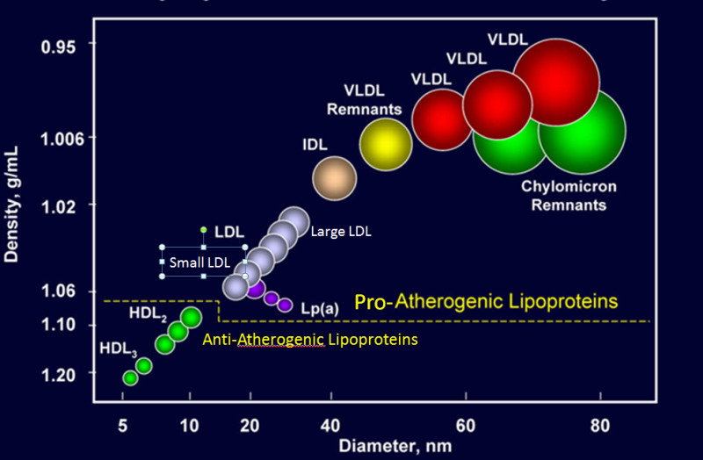

Slide 20
Atherogenic Particles
MEASUREMENTS:
VLDL
VLDL_{R}
IDL
LDL
Small,
dense
LDL
TG-rich lipoproteins
Notes:
Atherogenic particles
Not only is LDL-C a risk factor for cardiovascular disease, but triglyceride-rich lipoproteins—very low density lipoprotein (VLDL), VLDL remnants, and intermediate-density lipoprotein (IDL)—may also increase the risk of heart disease. The NCEP ATP III uses non-HDL-C principally as a surrogate for these atherogenic particles.

Slide 21
Plasma lipoproteins
Type | Source | Major lipid | Apoproteins | ELFO | Athero-genicity
Chylomicrons | Gut | Dietary TGs | A-I, B-48, C-I, C-III, E | no mobility | – (pancreatitis)
VLDL | Liver | Endogenous TGs | B-100, E, C-II, C-III, | Pre-β | +
IDL | VLDL remnant | Ch esters, TGs | B-100, C-III, E | Slow pre- β | +
LDL | VLDL, IDL | Ch esters | B-100 | β | +++
HDL | Gut, liver | Ch esters, PLs | A-I, A-II, C-II, C-III, D, E | α | anti- atherogenic
Notes:
Fredrickson Classification of the Hyperlipidemias
Fredrickson phenotypes may be used to classify dyslipidemias on the basis of which lipoproteins are elevated. The Fredrickson classification system is not etiologic, does not distinguish between primary and secondary hyperlipidemias, and does not include HDL.
Reference:
Fredrickson DS, Lees RS. A system for phenotyping hyperlipoproteinemia. Circulation 1965;31:321-327.

Slide 22
Hereditary Causes of Hyperlipidemia
Familial Hypercholesterolemia
    Codominant genetic disorder, coccurs in heterozygous form
    Occurs in 1 in 500 individuals
    Mutation in LDL receptor, resulting in elevated levels of LDL at birth and throughout life
    High risk for atherosclerosis, tendon xanthomas (75% of patients), tuberous xanthomas and xanthelasmas of eyes.
Familial Combined Hyperlipidemia
    Autosomal dominant
    Increased secretions of VLDLs
Dysbetalipoproteinemia
    Affects 1 in 10,000
    Results in apo E2, a binding-defective form of apoE (which usually plays important role in catabolism of chylomicron and VLDL)
    Increased risk for atherosclerosis, peripheral vascular disease
    Tuberous xanthomas, striae palmaris

Slide 23



Physical findings
Diagnosis?
Normal

Slide 24
Fredrickson classification of hyperlipidemias
Phenotype | Lipoprotein(s) elevated | Plasma cholesterol | Plasma TGs | Athero-genicity | Rel. freq. | Treatment
I | Chylomicrons | Norm. to ↑ | ↑↑↑↑ | – pancreatitis | <1% | Diet control
IIa | LDL | ↑↑ | Norm. | +++ | 10% | Bile acid sequestrants, statins, niacin
IIb | LDL and VLDL | ↑↑ | ↑↑ | +++ | 40% | Statins, niacin, fibrates
III | IDL | ↑↑ | ↑↑↑ | +++ | <1% | Fibrates
IV | VLDL | Norm. to ↑ | ↑↑ | + | 45% | Niacin, fibrates
V | VLDL and chylomicrons | ↑ to ↑↑ | ↑↑↑↑ | + pancreatitis | 5% | Niacin, fibrates
Notes:
Fredrickson Classification of the Hyperlipidemias
Fredrickson phenotypes may be used to classify dyslipidemias on the basis of which lipoproteins are elevated. The Fredrickson classification system is not etiologic, does not distinguish between primary and secondary hyperlipidemias, and does not include HDL.
Reference:
Fredrickson DS, Lees RS. A system for phenotyping hyperlipoproteinemia. Circulation 1965;31:321-327.

Slide 25
Primary hypercholesterolemias
Disorder | Genetic defect | Inheritance | Prevalence | Clinical features
Familial hyper-cholesterolemia | LDL receptor | dominant | heteroz.:1/500 5% of MIs <60 yr homoz.: 1/1 million | premature CAD (ages 30–50) TC: 7-13 mM CAD before age 18 TC > 13 mM
Familial defective apo B-100 | apo B-100 | dominant | 1/700 | premature CAD TC: 7-13 mM
Polygenic hypercholesterolemia | multiple defects and mechanisms | variable | common 10% of MIs <60 yr | premature CAD TC: 6.5-9 mM
Familial hyper-alphalipoproteinemia | unknown | variable | rare | less CHD, longer life elevated HDL
Notes:
Fredrickson Classification of the Hyperlipidemias
Fredrickson phenotypes may be used to classify dyslipidemias on the basis of which lipoproteins are elevated. The Fredrickson classification system is not etiologic, does not distinguish between primary and secondary hyperlipidemias, and does not include HDL.
Reference:
Fredrickson DS, Lees RS. A system for phenotyping hyperlipoproteinemia. Circulation 1965;31:321-327.

Slide 26
Primary hypertriglyceridemias
Disorder | Genetic defect | Inheritance | Prevalence | Clinical features
LPL deficiency | endothelial LPL | recessive | rare 1/1 million | hepatosplenomegaly abd. cramps, pancreatitis TG: > 8.5 mM
Apo C-II deficiency | Apo C-II | recessive | rare 1/1 million | abd. cramps, pancreatitis TG: > 8.5 mM
Familial hyper-triglyceridemia | unknown enhanced hepatic TG-production | dominant | 1/100 | abd. cramps, pancreatitis TG: 2.3-6 mM
Notes:
Fredrickson Classification of the Hyperlipidemias
Fredrickson phenotypes may be used to classify dyslipidemias on the basis of which lipoproteins are elevated. The Fredrickson classification system is not etiologic, does not distinguish between primary and secondary hyperlipidemias, and does not include HDL.
Reference:
Fredrickson DS, Lees RS. A system for phenotyping hyperlipoproteinemia. Circulation 1965;31:321-327.

Slide 27
Primary mixed hyperlipidemias
Disorder | Genetic defect | Inheritance | Prevalence | Clinical features
Familial dysbeta-lipoproteinemia | Apo E high VLDL, chylo. | recessive rarely dominant | 1/5000 | premature CAD TC: 6.5 -13 mM TG: 2.8 – 5.6 mM
Familial combined | unknown high Apo B-100 | dominant | 1/50 – 1/100 15% of MIs <60 yr | premature CAD TC: 6.5 -13 mM TG: 2.8 – 8.5 mM
Notes:
Fredrickson Classification of the Hyperlipidemias
Fredrickson phenotypes may be used to classify dyslipidemias on the basis of which lipoproteins are elevated. The Fredrickson classification system is not etiologic, does not distinguish between primary and secondary hyperlipidemias, and does not include HDL.
Reference:
Fredrickson DS, Lees RS. A system for phenotyping hyperlipoproteinemia. Circulation 1965;31:321-327.

Slide 28
Causes of Hyperlipidemia
Diet
Hypothyroidism
Nephrotic syndrome
Anorexia nervosa
Obstructive liver disease
Obesity
Diabetes mellitus
Pregnancy
Obstructive liver disease
Acute heaptitis
Systemic lupus erythematousus
AIDS (protease inhibitors)

Slide 29
Dietary sources of Cholesterol
Type of Fat | Main Source | Effect on Cholesterol levels
Monounsaturated | Olives, olive oil, canola oil, peanut oil, cashews, almonds, peanuts and most other nuts; avocados | Lowers LDL, Raises HDL
Polyunsaturated | Corn, soybean, safflower and cottonseed oil; fish | Lowers LDL, Raises HDL
Saturated | Whole milk, butter, cheese, and ice cream; red meat; chocolate; coconuts, coconut milk, coconut oil , egg yolks, chicken skin | Raises both LDL and HDL
Trans | Most margarines; vegetable shortening; partially hydrogenated vegetable oil; deep-fried chips; many fast foods; most commercial baked goods | Raises LDL

Slide 30
Secondary hyperlipidemias
Disorder | VLDL | LDL | HDL | Mechanism
Diabetes mellitus | ↑ ↑ ↑ | ↑ | ↓ | VLDL production ↑, LPL ↓, altered LDL
Hypothyroidism | ↑ | ↑ ↑ ↑ | ↓ | LDL-rec.↓, LPL ↓
Obesity | ↑ ↑ | ↑ | ↓ | VLDL production ↑
Anorexia | - | ↑ ↑ | - | bile secretion ↓, LDL catab. ↓
Nephrotic sy | ↑ ↑ | ↑ ↑ ↑ | ↓ | Apo B-100 ↑ LPL ↓ LDL-rec. ↓
Uremia, dialysis | ↑ ↑ ↑ | - | ↓ | LPL ↓, HTGL ↓ (inhibitors ↑)
Pregnancy | ↑ ↑ | ↑ ↑ | ↑ | oestrogen ↑ VLDL production ↑, LPL ↓
Biliary obstruction PBC | - | - | ↓ | Lp-X ↑ ↑ no CAD; xanthomas
Alcohol | ↑ ↑ chylomicr. ↑ | - | ↑ | dep. on dose, diet, genetics

Slide 31
When to check lipid panel
Different Recommendations
  Adult Treatment Panel (ATP III) of the National Cholesterol Education Program (NCEP)
      Beginning at age 20: obtain a fasting (9 to 12 hour) serum lipid profile consisting of total cholesterol, LDL, HDL and triglycerides
      Repeat testing every 5 years for acceptable values

Slide 32
United States Preventative Services Task Force
      Women aged 45 years and older, and men ages 35 years and older undergo screening with a total and HDL cholesterol every 5 years.
      If total cholesterol > 200 or HDL <40, then a fasting panel should be obtained
      Cholesterol screening should begin at 20 years in patients with a history of multiple cardiovascular risk factors, diabetes, or family history of either elevated cholesteral levels or premature cardiovascular disease.

Slide 33
Treatment
Targets
LDL: To prevent coronary heart disease outcomes (myocardial infarction and coronary death)
Non LDL( TC/HDL): To prevent coronary heart disease outcomes (myocardial infarction and coronary death)
Triglyceride: To prevent pancreatitis and may be coronary heart disease outcomes (myocardial infarction and coronary death)

Slide 34
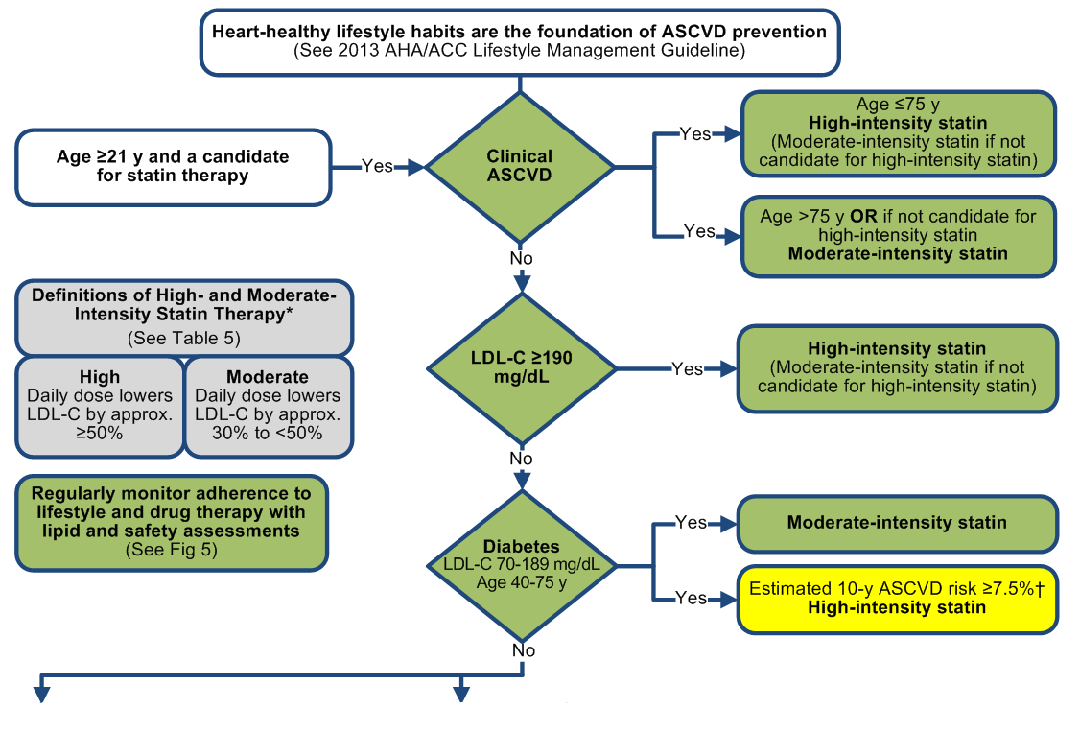

Slide 35
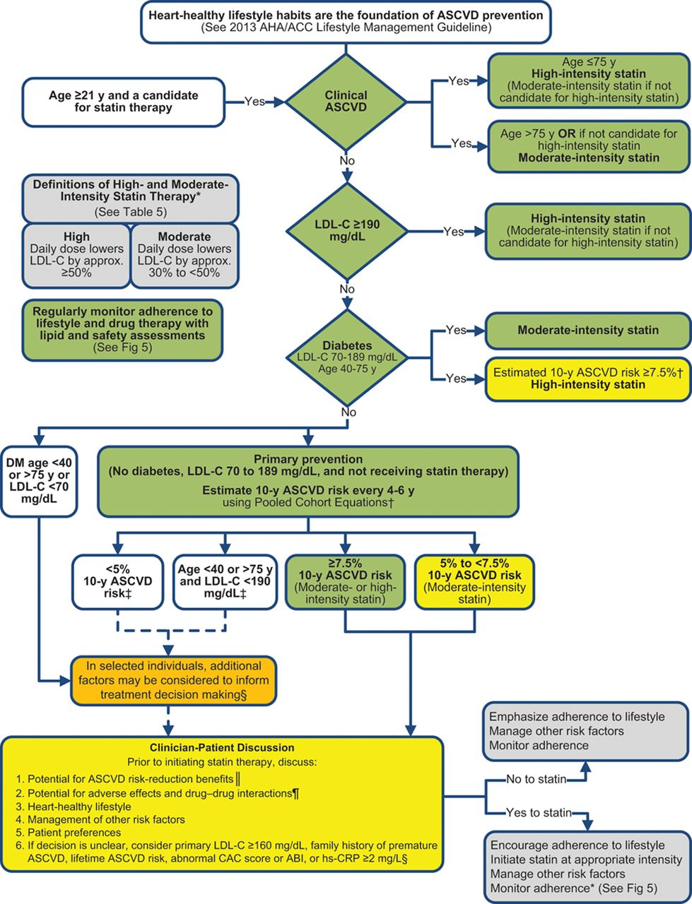

Stone N J et al. Circulation. 2014;129:S1-S45
Copyright © American Heart Association, Inc. All rights reserved.
Notes:
Summary of Statin Initiation Recommendations for the Treatment of Blood Cholesterol to Reduce ASCVD Risk in Adults (See Figures 3, 4, and 5 for More Detailed Management Information). Colors correspond to the Classes of Recommendation in Table 1. Assessment of the potential for benefit and risk from statin therapy for ASCVD prevention provides the framework for clinical decision making incorporating patient preferences. *Percent reduction in LDL-C can be used as an indication of response and adherence to therapy, but is not in itself a treatment goal. †The Pooled Cohort Equations can be used to estimate 10-year ASCVD risk in individuals with and without diabetes. The estimator within this application should be used to inform decision making in primary prevention patients not on a statin. ‡Consider moderate-intensity statin as more appropriate in low-risk individuals. §For those in whom a risk assessment is uncertain, consider factors such as primary LDL-C ≥160 mg/dL or other evidence of genetic hyperlipidemias, family history of premature ASCVD with onset <55 years of age in a first-degree male relative or <65 years of age in a first-degree female relative, hs-CRP ≥2 mg/L, CAC score ≥300 Agatston units, or ≥75th percentile for age, sex, and ethnicity (for additional information, see http://www.mesa-nhlbi.org/CACReference.aspx), ABI <0.9, or lifetime risk of ASCVD. Additional factors that may aid in individual risk assessment may be identified in the future. ‖Potential ASCVD risk-reduction benefits. The absolute reduction in ASCVD events from moderate- or high-intensity statin therapy can be approximated by multiplying the estimated 10-year ASCVD risk by the anticipated relative-risk reduction from the intensity of statin initiated (~30% for moderate-intensity statin or ~45% for high-intensity statin therapy). The net ASCVD risk-reduction benefit is estimated from the number of potential ASCVD events prevented with a statin, compared to the number of potential excess adverse effects. ¶Potential adverse effects. The excess risk of diabetes is the main consideration in ~0.1 excess cases per 100 individuals treated with a moderate-intensity statin for 1 year and ~0.3 excess cases per 100 individuals treated with a high-intensity statin for 1 year. In RCTs, both statin-treated and placebo-treated participants experienced the same rate of muscle symptoms. The actual rate of statin-related muscle symptoms in the clinical population is unclear. Muscle symptoms attributed to statin therapy should be evaluated (see Table 8, Safety Recommendation 8). ABI indicates ankle-brachial index; ASCVD, atherosclerotic cardiovascular disease; CAC, coronary artery calcium; hs-CRP, high-sensitivity C-reactive protein; LDL-C, low-density lipoprotein cholesterol; MI, myocardial infarction; and RCT, randomized controlled trial.

Slide 36
Guideline of therapy
Age | Risk Factors | Statin Intensity*
>29 Age | ASCVD | High
>29 years | LDL >190 mg/dl (4.9 mmol/l) | High
NO DM LDL <190 | estimate 10-year risk for ASCVD <5% | No
 | estimate 10-year risk for ASCVD 5-7.5% | Moderate
 | estimate 10-year risk for ASCVD >7.5% | High
Jammah

Slide 37
Estimate 10-year risk for ASCVD
http://tools.acc.org/ASCVD-Risk-Estimator-Plus/#!/calculate/estimate/
AGE
SBP/DBP
T cholesterol
HDL
LDL
DM
Smoking
On Anti HTN
On statin
On asprin

Slide 38
Estimate 10-year risk for ASCVD

Slide 39
Recommendations in DM
Age | Risk Factors | Statin Intensity*
<40 years | None | None
 | ASCVD risk factor(s) | Moderate or high
 | ASCVD | High
40–75 years | None | Moderate
 | ASCVD risk factors | High
 | ACS & LDL ≥50 or in patients with history of ASCVD who can’t tolerate high dose statin | Moderate + ezetimibe
>75 years | None | Moderate
 | ASCVD risk factors | Moderate or high
 | ASCVD | High
 | ACS & LDL ≥50 or in patients with history of ASCVD who can’t tolerate high dose statin | Moderate + ezetimibe
Jammah

Slide 40
Statin Treatment
Low-Intensity Statin Therapy | Moderate-Intensity Statin Therapy | High-Intensity Statin Therapy
Daily dose lowers LDL-C, on average, by <30% Simvastatin 10 mg Pravastatin 10–20 mg Lovastatin 20 mg Fluvastatin 20–40 mg Pitavastatin 1 mg | Daily dose lowers LDL-C, on average, by approximately 30% to <50% Atorvastatin 10 (20 ) mg Rosuvastatin (5 ) 10 mg Simvastatin 20–40 mg‡ Pravastatin 40 (80 ) mg Lovastatin 40 mg Fluvastatin XL 80 mg Fluvastatin 40 mg BID Pitavastatin 2–4 mg | Daily dose lowers LDL-C, on average, by approximately ≥50% Atorvastatin (40†)–80 mg Rosuvastatin 20 (40) mg
Jammah

Slide 41
Treatment of Hyperlipidemia
Lifestyle modification
  Low-cholesterol diet
  Exercise
  Smoking
  Alcohol

Slide 42
Medications for Hyperlipidemia
Drug Class | Agents | Effects (% change) | Side Effects
HMG CoA reductase inhibitors | Statins | ↓LDL (18-55),↑ HDL (5-15) ↓ Triglycerides (7-30) | Myopathy, increased liver enzymes
Cholesterol absorption inhibitor | Ezetimibe | ↓ LDL( 14-18), ↑ HDL (1-3) ↓Triglyceride (2) | Headache, GI distress
Nicotinic Acid |  | ↓LDL (15-30), ↑ HDL (15-35) ↓ Triglyceride (20-50) | Flushing, Hyperglycemia, Hyperuricemia, GI distress, hepatotoxicity
Fibric Acids | Gemfibrozil Fenofibrate | ↓LDL (5-20), ↑HDL (10-20) ↓Triglyceride (20-50) | Dyspepsia, gallstones, myopathy
Bile Acid sequestrants | Cholestyramine | ↓ LDL↑ HDL No change in triglycerides | GI distress, constipation, decreased absorption of other drugs
PCSK9 | Evolocumab Alirocumab | ↓ LDL (50-60%) | injection-site reactions, muscle pain, neurocognitive adverse events. These included memory impairment and confusion

Slide 43
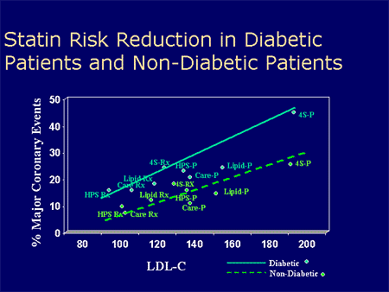
MI = myocardial infarction.
Adapted with permission from Robinson JG et al. J Am Coll Cardiol. 2005;46:1855–1862.
Notes:
Key Point¹:
This meta-regression analysis found that nonstatin (diet, bile acid sequestrants, and ileal bypass surgery) and statin interventions seemed to reduce CHD risk, consistent with a 1-to-1 relationship described by the National Cholesterol Education Program (NCEP).
Additional Background Information¹:
Results from a large number of studies with clinical events (eg, CHD, myocardial infarction [MI]) as end points showed that the risk for specific CHD events decreased as LDL-C decreased.
This relationship is strongly supported by the aggregate clinical trial evidence.
The figure shows the estimated change in the 5-year relative risk of nonfatal MI or CHD death associated with mean LDL-C reduction for the diet, bile acid sequestrant, surgery, and statin trials (dashed line) along with the 95% probability interval (dotted lines). The solid line has a slope of 1. The crude risk estimates from the individual studies are plotted along with their associated 95% confidence intervals.
MRC = Medical Research Council; LRC = Lipid Research Clinics; NHLBI = National Heart, Lung, and Blood Institute; POSCH = Program on the Surgical Control of the Hyperlipidemias; 4S = Scandinavian Simvastatin Survival Study; WOSCOPS = West of Scotland Coronary Prevention Study; CARE = Cholesterol and Recurrent Events study; LIPID = Long-Term Intervention with Pravastatin in Ischemic Disease; AF/TexCAPS = Air Force/Texas Coronary Atherosclerosis Prevention Study; HPS = Heart Protection Study; ALERT = Assessment of LEscol in Renal Transplantation; PROSPER = PROspective Study of Pravastatin in the Elderly at Risk; ASCOT-LLA = Anglo-Scandinavian Cardiac Outcomes Trial–Lipid Lowering Arm; CARDS = Collaborative Atorvastatin Diabetes Study.
Reference:
1. Robinson JG, Smith B, Maheshwari N, Schrott H. Pleiotropic effects of statins: benefit beyond cholesterol reduction? A meta-regression analysis. J Am Coll Cardiol. 2005;46:1855–1862.

Slide 44
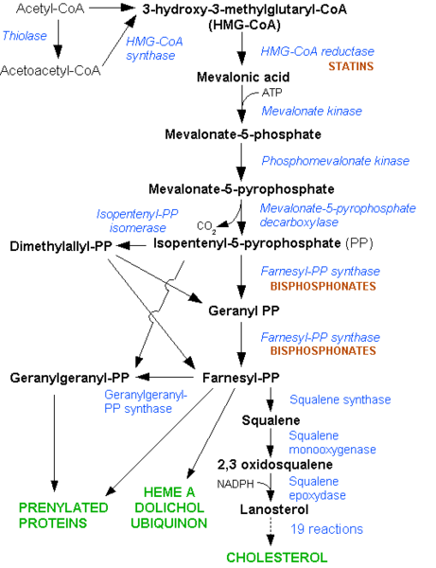

Slide 45
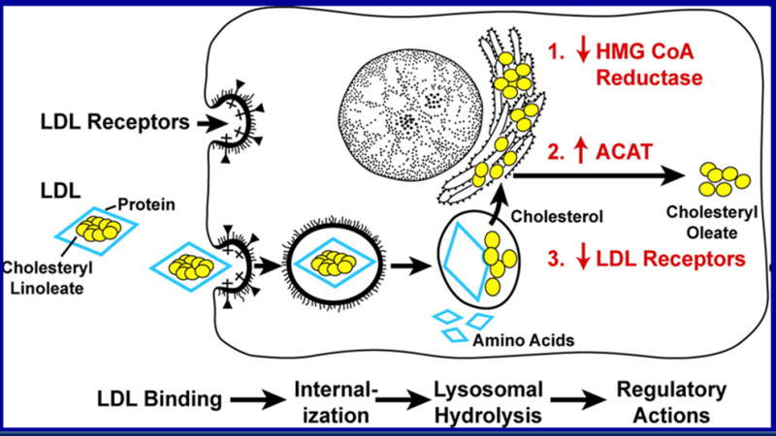

Slide 46
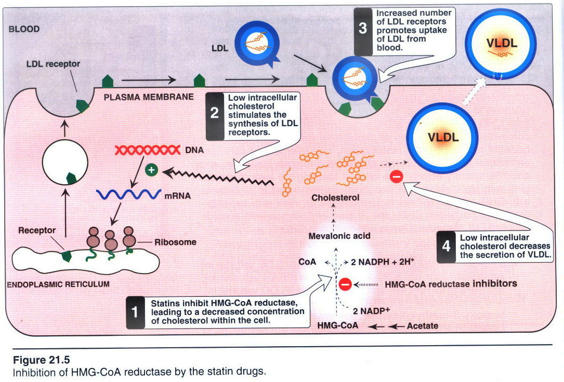

Slide 47
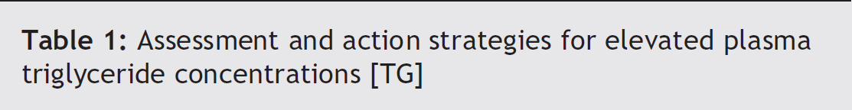
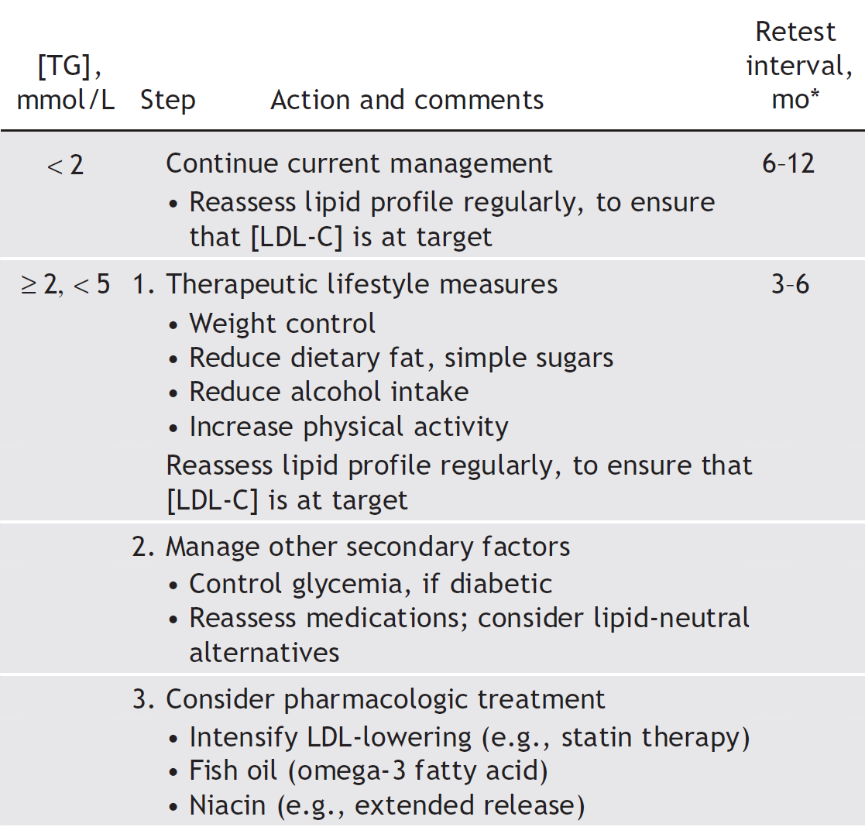

Slide 48
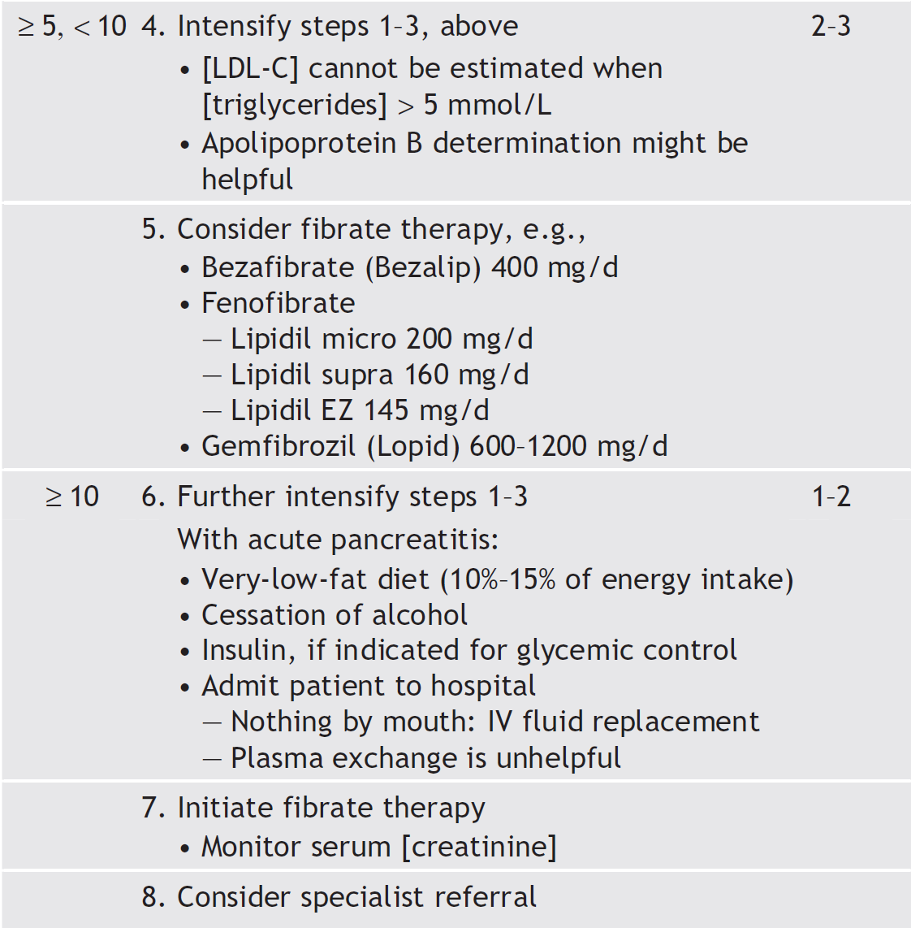
George Yuan, Khalid Z. Al-Shali, Robert A. Hegele
CMAJ • April 10, 2007 • 176(8)

Slide 49
THANK YOU
drjammah@gmail.com
See you in 5th year MED-441 Course
Notes:
sd

