Slide 1
Use of Antibiotics and its stewardship
Naif Alotaibi
ID consultant
KSUMC

Slide 2
Objectives:
By the end of the lecture the student should be able to:
The different classes of Antibiotics.
Learn when to use antibiotics.
To monitor antibiotics response and toxicity.
To know the impact of antibiotics misuse and the importance of stewardship.

Slide 3
Introduction
Whey we should know about Antibiotics ?

Slide 4

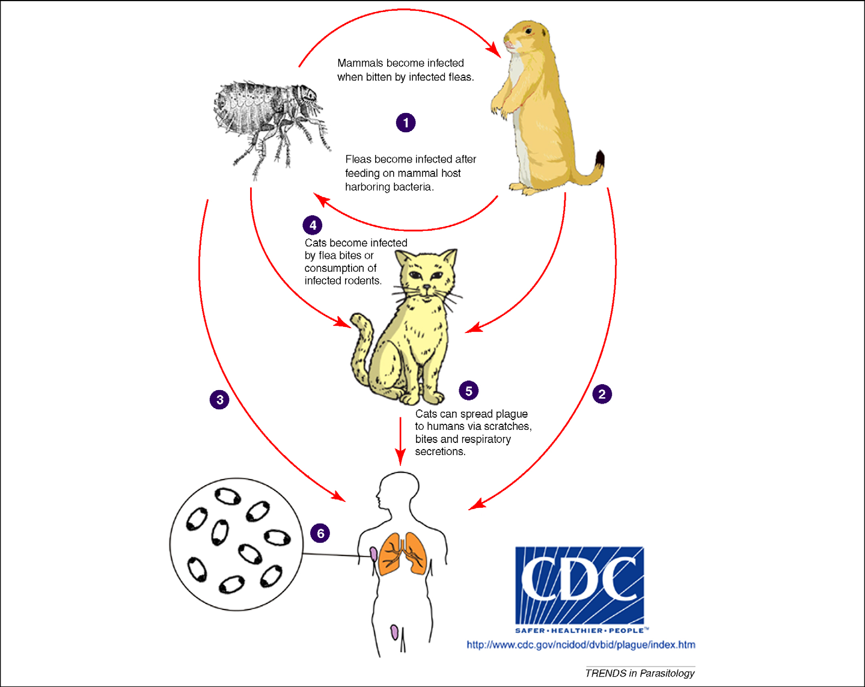
The first recorded pandemic, the Justinian Plague, was named after the 6th century Byzantine emperor Justinian I. The Justinian Plague began in 541 AD and was followed by frequent outbreaks over the next two hundred years that eventually killed over 25 million people (Rosen, 2007) and affected much of the Mediterranean basin–virtually all of the known world at that time.
WW1
1914-1918

Slide 5
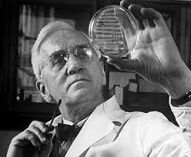
Hx
discovery of the therapeutic value of penicillin by Alexander Fleming from Penicillium notatum in 1928.

Slide 8
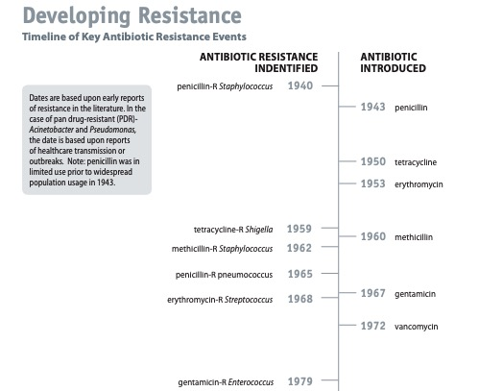



Slide 9
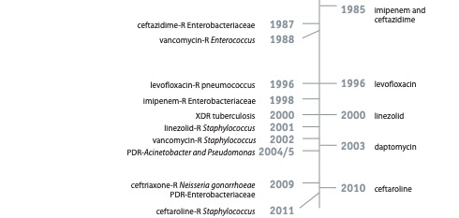

Slide 10
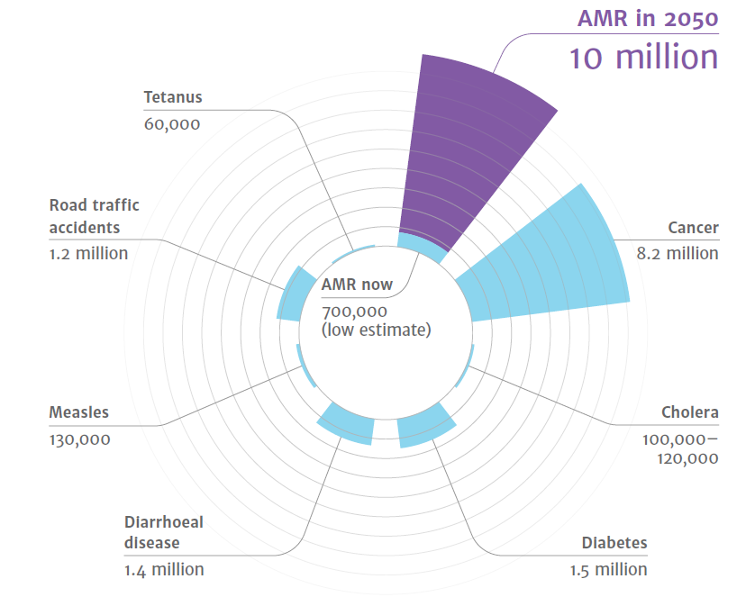
Source: The Review on Antimicrobial Resistance, Jim O'Neill, 2014

Slide 11
Global Response to AMR
The G7 and G20 have been seized with the issue for several years
• Global AMR Research and Development Collaboration Hub (June 2017)
UN General Assembly High Level Meeting (September 2016)
Agreement to develop and implement national action plans
.Only 4th health issue taken up in 72 years

Slide 12
AMR surveillance programs are being conducted in 147 countries worldwide

Slide 13
Global Response to AMR

Slide 15
Which AB is appropriate for this patient?

Slide 16
Approach
1- Patient factors
2- microbiological factors
3- Pharmacological factors

Slide 17
1- Patient factors
Obtaining an accurate infectious Disease Diagnosis
1- History :
Include detailed history and examination of his current presentation
History of chronic diseases(Renal, Liver , Immune status, etc…)
History of allergy
History of travel
History of contact
History of animal contact
Drug history
History of antibiotic use or other risk factors of HCAI
History of previous Microbiological cultures
Pregnancy and lactation

Slide 18
1- Patient factors
Age.
Patients at both extremes of age handle drugs differently, primarily due to differences in body size and kidney function.
Most pediatric drug dosing is guided by weight.
In geriatric patients, the serum creatinine level alone is not completely reflective of kidney function, and the creatinine clearance should be estimated by factoring in age and weight for these patients.

Slide 19
1- Patient factors
Renal and Hepatic Function.
Because the kidney and the liver are the primary organs responsible for elimination of drugs from the body, it is important to determine how well they are functioning during antimicrobial administration.
In most cases, one is concerned with dose reduction to prevent accumulation and toxicity in patients with reduced renal or hepatic function.
However, sometimes doses might need to be increased to avoid under dosing young healthy patients with rapid renal elimination or those with rapid hepatic metabolism due to enzyme induction by concomitant use of drugs such as rifampin or phenytoin.

Slide 20
1- Patient factors
Genetic Variation.
Genetic susceptibility to the adverse effects of antimicrobial agents, which has been demonstrated for several antimicrobial agents, is occasionally significant enough to warrant testing for such variability before administration of certain drugs.
For example, the antiretroviral drug abacavir, which has become part of the standard combination treatment for HIV infection, is associated with a well-described and potentially fatal hypersensitivity reaction that can manifest with any combination of fever, rash, abdominal pain, and respiratory distress.
The risk of experiencing this reaction has been shown to be significantly higher in patients with the human leukocyte antigen allele HLA-B*5701 and current HIV treatment guidelines recommend routine screening for the presence of this genetic susceptibility in patients before prescribing this drug.
Another example is that of glucose-6-phosphate dehydrogenase (G6PD) deficiency, which can result in hemolysis in individuals when exposed to certain antimicrobial agents, such as dapsone, primaquine, and nitrofurantoin.

Slide 21
1- Patient factors
Pregnancy and Lactation.
Special considerations for the use of antimicrobial agents in pregnancy relate to both the mother and the fetus.
In the case of the mother, increases in plasma volume and renal blood flow, especially by the third trimester, can result in more rapid clearance and lower serum levels of pharmaceutical agents, including antimicrobial agents.
However, data to support the clinical relevance of this change are sparse, and higher antimicrobial doses are not routinely recommended in the third trimester of pregnancy.

Slide 22
1- Patient factors
History of Allergy or Intolerance.
A history of antimicrobial allergy or intolerance should be routinely obtained in the evaluation and management of infection

Slide 23
1- Patient factors timing Of initiation Of antimicrobial therapy
The timing of initial therapy should be guided by the urgency of the situation.
In critically ill patients, such as those in septic shock, febrile neutropenic patients, and patients with bacterial meningitis, empiric therapy should be initiated immediately after or concurrently with collection of diagnostic specimens.
In more stable clinical circumstances, antimicrobial therapy should be deliberately withheld until appropriate specimens have been collected and submitted to the microbiology laboratory.

Slide 24
1- Patient factors timing Of initiation Of antimicrobial therapy
Important examples of this principle are subacute bacterial endocarditis and vertebral osteomyelitis/diskitis.
Patients with these infections are frequently ill for a period of several days to weeks before presentation, and administration of antibiotic therapy should be delayed until multiple sets of blood cultures (in the case of endocarditis) or disk space aspirate and/or bone biopsy specimens (for osteomyelitis/diskitis) have been obtained.
Premature initiation of antimicrobial therapy in these circumstances can suppress bacterial growth and preclude the opportunity to establish a microbiological diagnosis, which is critical in the management of these patients, who require several weeks to months of directed antimicrobial therapy to achieve cure.

Slide 25
1- Patient factors site of infection

Slide 26
Approach
1- Patient factors
2- microbiological factors
3- Pharmacological factors

Slide 27
2- microbiological factors

Slide 28
2- microbiological factors
IDENTIFICATION OF THE INFECTING ORGANISM

Slide 29
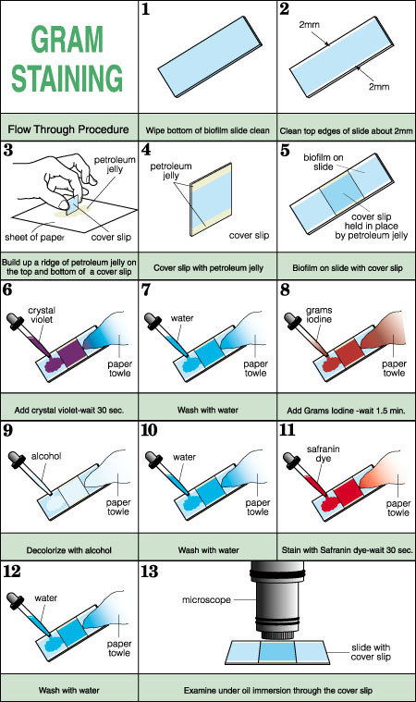
IDENTIFICATION OF THE INFECTING ORGANISM
Several methods for the rapid identification of pathogenic bacteria in clinical specimens are available.
A Gram stain preparation is perhaps the simplest, least expensive, and most useful of all the rapid methods of identification of bacterial (and some fungal) pathogens.

Slide 30
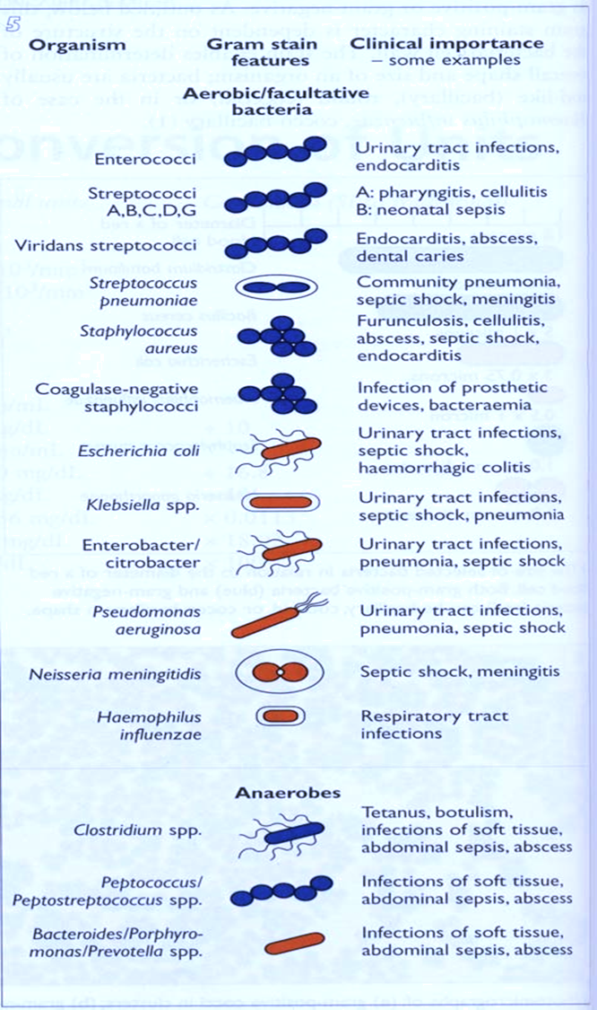
2- microbiological factors

Slide 31
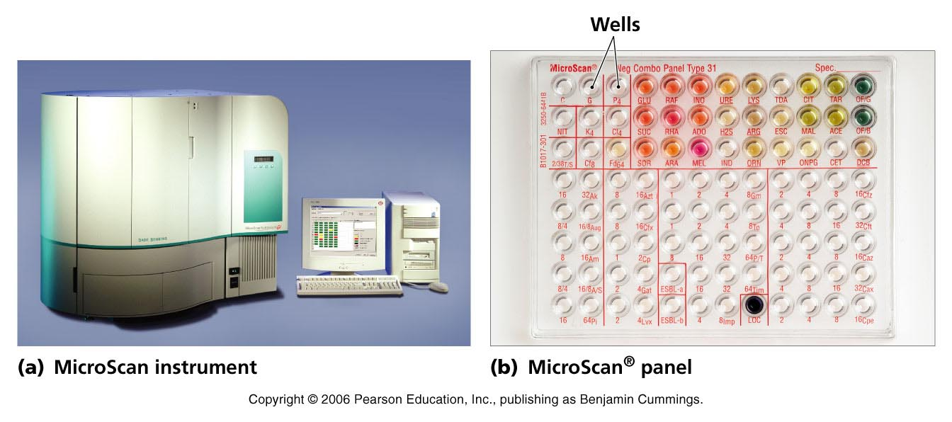

Slide 32
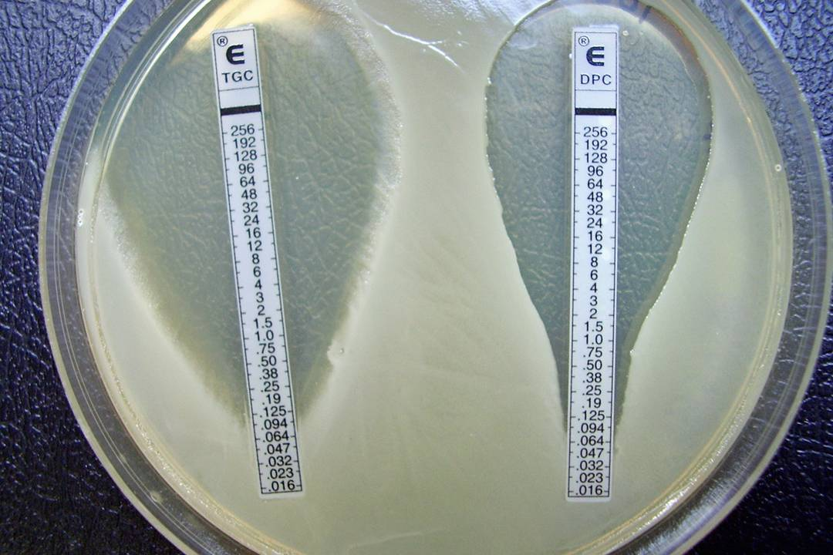
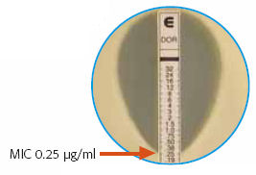
A refinement of the disk diffusion technique uses antimicrobial gradient strips (e.g., Etest, by bioMérieux; M.I.C.E. by Oxoid) applied to agar plates seeded with the test organism. With these methods, intersection of the inhibition zone with the graduated strip permits determination of an actual minimal inhibitory concentration endpoint.

Slide 34
2- microbiological factors
Empiric vs Definitive antimicrobial therapy
Because microbiological results do not become available for 24 to 72 hours, initial therapy for infection is often empiric and guided by the clinical presentation.
It has been shown that inadequate therapy for infections in critically ill, hospitalized patients is associated with poor outcomes, including greater morbidity and mortality as well as increased length of stay.
Therefore, a common approach is to use broad-spectrum antimicrobial agents as initial empiric therapy (sometimes with a combination of antimicrobial agents with the intent to cover multiple possible pathogens commonly associated with the specific clinical syndrome).
This is true for both community and hospital-acquired infections

Slide 35
2- microbiological factors
Community vs HCAI
History of Recent Antimicrobial Use.
Eliciting a history of exposure to antimicrobial agents in the recent past (approximately 3 months) can also help in selection of antimicrobial therapy.
Because the causative microorganism for a current episode of infection emerged under the selective pressure of a recently used antimicrobial agent, it is likely to be resistant to that drug and/or drug class, and an alternative agent should be used.

Slide 36
2- microbiological factors
Antibiogram

Slide 37
Approach
1- Patient factors
2- microbiological factors
3- Pharmacological factors

Slide 38
3- Pharmacological factors

Slide 39
3- Pharmacological factors

Slide 40
3- Pharmacological factors
Principles:
Narrow vs broad spectrum agents.
Least toxic agent.
Cheaper.

Slide 41
3- Pharmacological factors
Criteria for Use of New Agent
Antimicrobial activity is superior
Have a therapeutic advantage
Better pharmacokinetics
  Site penetration
  Longer t ½
  Shorter duration
Less toxic
Better tolerance

Slide 42
3- Pharmacological factors
What is the appropriate dose?
The lowest dose that is effective..
Avoid sub-therapeutic doses
Determined by:
  Serious vs non-serious infections
  Site of infection
  Drug PK/PD properties
  Other host factors (e.g. renal function … etc)

Slide 43
3- Pharmacological factors
Bioavailability
The percentage of the oral dose that is available unchanged in the serum).
Examples of antibiotics with excellent bioavailability are:
Trimethoprim-sulfamethoxazole
.

Slide 44
3- Pharmacological factors
The efficacy of antimicrobial agents depends on their capacity to achieve :
Concentration equal to or greater than the MIC at the site of
infection..
Ocular fluid, CSF, abscess cavity, prostate, and bone) are often
much lower than serum levels
For example:
First- and second- generation cephalosporins
do not cross the blood-brain barrier

Slide 45
3- Pharmacological factors
Aminoglycosides: are less active in the :
low-oxygen, low-pH, of Abscesses
Fluoroquinolones achieve high concentrations in the prostate
preferred oral agents for the treatment of Prostatitis..
Moxifloxacin does not achieve significant urinary concentrations
therefore not suitable for treatment of UTIs.

Slide 46
3- Pharmacological factors
Oral vs Intravenous Therapy
Candidates for treatment mild to moderate infections
well-absorbed oral antimicrobial agents :
A] Pyelonephritis
Fluoroquinolones ..
B] Community-acquired pneumonia
Augmentin and macrolides coverage

Slide 47
3- Pharmacological factors
Sign for the narrowest spectrum and shortest duration of
therapy, and:
switching to oral agents as soon as possible.
In addition,
Non antimicrobial interventions, such as abscess drainage,
are equally or more important in some cases and should be
pursued diligently in comprehensive infectious disease
management.

Slide 48
use Of antimicrobial combinations
Although single-agent antimicrobial therapy is generally preferred, a combination of 2 or more antimicrobial agents is recommended in a few scenarios.

Slide 49
When Agents Exhibit Synergistic Activity Against a Microorganism.
Synergy between antimicrobial agents means that, when studied in vitro, the combined effect of the agents is greater than the sum of their independent activities when measured separately.
For example, the combination of certain b-lactams and aminoglycosides exhibits synergistic activity against a variety of gram-positive and gram-negative bacteria and is used in the treatment of serious infections, for which rapid killing is essential (eg, treatment of endocarditis caused by Enterococcus species with a combination of penicillin and gentamicin).
In this setting, the addition of gentamicin to penicillin has been shown to be bactericidal, whereas penicillin alone is only bacteriostatic and gentamicin alone has no significant activity.
For certain streptococci, similar synergistic combinations that result in more rapid clearance of the infecting microorganism can also be used to shorten the course of antimicrobial therapy (eg, for endocarditis due to viridans group streptococci, a combination of penicillin or ceftriaxone with gentamicin for 2 weeks can be as effective as penicillin or ceftriaxone alone for 4 weeks).

Slide 50
When Critically Ill Patients Require Empiric Ther­apy Before Microbiological Etiology and/or Antimicro­bial Susceptibility Can Be Determined.
antibiotic combinations are used in empiric therapy for health care–associated infections that are frequently caused by bacteria resistant to multiple antibiotics.
Combination therapy is used in this setting to ensure that at least 1 of the administered antimicrobial agents will be active against the suspected organism(s).
For example, when a patient who has been hospitalized for several weeks develops septic shock and blood cultures are reported to be growing gram-negative bacilli, it would be appropriate to provide initial therapy with 2 agents that have activity against gram-negative bacilli, particularly P aeruginosa, which is both a common nosocomial pathogen and frequently resistant to multiple agents in this case, a combination of an antipseudomonal b-lactam with a fluoroquinolone or aminoglycoside could be used.

Slide 51
To Extend the Antimicrobial Spectrum Beyond That Achieved by Use of a Single Agent for Treatment of Poly­ microbial Infections.
When infections are thought to be caused by more than one organism, a combination regimen may be preferred because it would extend the antimicrobial spectrum beyond that achieved by a single agent.
For example, most intra-abdominal infections are usually caused by multiple organisms with a variety of gram-positive cocci, gram-negative bacilli, and anaerobes +- candida.

Slide 52
To Prevent Emergence of Resistance.
The emergence of resistant mutants in a bacterial population is generally the result of selective pressure from antimicrobial therapy.
Provided that the mechanisms of resistance to 2 antimicrobial agents are different, the chance of a mutant strain being resistant to both antimicrobial agents is much lower than the chance of it being resistant to either one.
In other words, use of combination therapy would provide a better chance that at least one drug will be effective, thereby preventing the resistant mutant population from emerging as the dominant strain and causing therapeutic failure.
This is why combination drug therapy is used as the standard for treatment of infections such as tuberculosis and the human immunodeficiency virus (HIV) when treatment duration is likely to be prolonged, resistance can emerge relatively easily, and therapeutic agents are limited.

Slide 53
Antimicrobial Agents as Prophylactic
1) Presurgical Antimicrobial Prophylaxis
is used to reduce the incidence of postoperative surgical site infections..
A single dose of a cephalosporin (such as cefazolin) administered
within 1 hour before the initial incision is appropriate for
most surgical procedures..

Slide 54
Antimicrobial Agents as Prophylactic
2) Prevent Transmission
of Communicable Pathogens to Susceptible Contacts
ciprofloxacin for close contacts of a patient with N.meningitis
3) Antimicrobial Prophylaxis Before Dental Procedures:
Prosthetic valves
Rheumatic heart..
to prevents Endocaridits

Slide 55
Treatment of a Positive Clinical Culture in the Absence of Disease:
Colonization without any associated manifestation
of disease occurs frequently in certain populations:
Colonization of :
Old women with indwelling urinary catheter:
Active infection are absent
(asymptomatic bacteriuria)
Endotracheal tubes in mechanically ventilated patients,
chronic wounds..

Slide 56
MRSA
R mechanism: PBP2a
Antibiotics:
    Vanocomycin
    Teicoplanin
    Linezolid
    Tedizolid
    Daptomycin
    Telavancin
    Dalbavancin
    Oritavancin
    Tigecycline
    Delafloxacin
    Ceftaroline
    Ceftobiprole

Slide 57
VRE
Antibiotics:
    Teicoplanin
    Linezolid
    Tedizolid
    Daptomycin
    Oritavancin
    Tigecycline
    Eravacycline

Slide 58
ESBL
Antibiotics:
    Carbapenems
    Piperacillin/tazobactam, nitrofutantoin, fosfomycin (UTI)
    Tigecycline
    Eravacycline
    Colistin
    Plazomicin

Slide 59
CRE
Antibiotics:
    Nitrofutantoin, fosfomycin (UTI)
    Tigecycline
    Eravacycline
    Colistin
    Ceftazidime/avibactam
    Meropenem/vaborbactam
    Plazomicin
    Cefidricol

Slide 60
Acinetobacter
Antibiotics:
    Carbapenems
    Tigecycline
    Eravacycline
    Aminoglycosides
    Colistin

Slide 61
Pseudomonas aeruginosa
Antibiotics:
    Piperacillin/tazobactam
    Ceftazidime, cefepime Ceftobiprole
    Meropenem, imipenem
    Aztreonam
    Some fluoroquinolones
    Aminoglycosides
    Colistin
    Ceftolozane/tazobactam
    Ceftazidime/avibactam

Slide 62
MCQs

Slide 63
54 years old male known case of DM , HTN, ESRD on hemodialysis presented to the ER with fever cough and S.O.B for 4 days he is conscious and oriented BP normal RR 22 CBC showed leukocytosis C-XRAY as following:
Which of the following is the beast treatment option ?
1-Admit & start IV ceftriaxone and azithromycin
2- Oral cefuroxime and azithromycin
3- tazocin and ciprofloxacin
4- Vancomycin 1gm iv bid

Slide 64
A 78-year-old man presents with a 4-day history of fever and cough productive of thick sputum. He has never smoked. Clarithromycin, given for the past 2 days, has been ineffective. A blood culture drawn in the office is reported to be growing gram-positive cocci in pairs. Chest radiograph shows an infiltrate in the right lower lobe. The patient is unable to produce sputum for examination.
Which of the following antibiotics, administered intravenously, is the most appropriate initial therapy?
1. Azithromycin
2. Vancomycin
3. Ceftazidime
4. Trimethoprim-sulfamethoxazole

Slide 65
A 60 year-old Saudi male, heavy smoker for 40 years. Presented to ER with 4 months history of fever and yellowish sputum. He lost 10 kgs over 2 months. He was treated with antibiotics twice in another hospital over the past month. He had temporary improvement but got worse after stopping the antibiotics. He is otherwise well with no other illnesses. CXR shown.
The most likely explanation for his illness is:
1.Recurrent aspiration
2.Atypical pneumonia
3.Post obstruction bacterial pneumonia
4.Pulmonary tuberculosis

Slide 66
45 years old African man presented to the emergency room with history of low grade fever ,cough with hemoptysis , decrease appetite and weight loss for the last 1 month
Which of the following steps should be done next :
1- isolate the patient in negative pressure room and do sputum AFB
2- start INH, rifampin, pyrazinamide and ethambutol
3- start ceftriaxone and azithromycin
4- reassure the patient and book him for PFT

Slide 67
54 years old patient post RTA intubated in ICU for 1 week we have been consulted for new chest infiltrate and increase in his ventilator setting and fio2 requirement for 1 day patient is hypotensive on inotropes his chest x-ray as following :
Full septic work up sent
Which empiric AB is appropriate:
1- ceftriaxone azithromycin
2- meropenem vancomycin
3- tigecycline
4- colistin

Slide 68
After 48 hours patient has increase in inotropes requirement and micro lab notified for gm-negative bacilli there is multiple cases in ICU with Stenotrophomonas maltophilia infection
Which changes in antibiotics is required?
1- continuo the current treatment
2- add colistin
3- D/C vancomycin and add Bactrim
4- add aminoglycoside

Slide 69
A 16 year-old male patient comes to ER with a 3 days history of fever, headache, neck pain, and double vision. No history of raw milk ingestion or contact with animals. Examination revealed an uncomfortable and emaciated young aged man.
He has neck stiffness.
CSF analysis showed WBC 100 cells/µL with 90% polymorph, high protein and low glucose, gram stain showed gram +ve diplococci .
Which ONE of the following empirical antimicrobial combination would you start?
  Ceftriaxone and vancomycin
  Ceftriaxone, vancomycin and dexamethasone
  Doxycycline, rifampin and ciprofloxacin
  INH, rifampin, pyrazinamide, ethambutol and dexamethasone
Temperature | 38.9ºC,
BP | 120/70 mmHg
Pulse rate | 100 per min.
Respiratory rate | 16 per min.

Slide 70
Which of the following is the most common organism/s causing osteomyelitis in all age groups?
a) streptococci
b) staph aureus
c) Ecoli
d) Haemophilus

Slide 71
24 years old pregnant lady in the second trimester presented to the antenatal care clinic For routine follow up , she has no complain lab test revile positive urine culture E.COLI ESBL sensitive to ciprofloxacin, trim-sulfa, meropenem. Which of the following is the beast option?
1- No treatment
2- Ciprofloxacin 500mg BID
3- cefuroxime 500mg bid
4- Ertapenem 1 gm daily

Slide 72
Which one of the following organisms is the most likely?
Prevotella melaninogenica
Nocardia cyriacigeorgica
Actinomyces israelii
Mycobacterium tuberculosis

Slide 73
Dx?
What is the causative organism?
What is the treatment?

Slide 74
All of the following are antipseudomonal except :
Ceftazidime
Ertapenem
Cefepime
Meropenem

Slide 75
All of the following are anti MRSA except:
Linezolid
Vancomycin
Tigecycline
Cefazolin

Slide 76
All of the following can be used for MRSA bacteremia except :
Tigecycline
Vancomycin
Daptomycin
Linezolid

Slide 77
Which one of the following bacteria have a high frequency of intrinsic resistance to polymyxins (colistin)antibiotics?
Serratia marcescens
Klebsiella pneumonia
Pseudomonas aeruginosa
Acinetobacter baumannii

Slide 78


