Slide 1
Common endemic infections in the Middle East
DR. Naif Alotaibi
Infectious Diseases Consultant
Clinical Assistant Professor of Medicine

Slide 2
Objectives:
By the end of the lecture the student should be able to:
Common terminology describing Endemicity.
Common Endemic disease in KSA: especially typhoid, Brucella.
Viral hemorrhagic fever (Dengue, RVF, KHV).
Leishmaniasis, MERS-COV,covid-19 Malaria
For each endemic diseases: Epidemiology, Pathogenesis, Clinical features, Complications, Diagnostic workup, Differential diagnosis, Treatment & prevention

Slide 3
Some Definitions
Sporadic is a disease that occurs infrequently and irregularly.
Endemic refers to the constant presence and/or usual prevalence of a disease or infectious agent in a population within a geographic area.
Hyper endemic refers to persistent, high levels of disease occurrence.
Epidemic refers to an increase, often sudden, in the number of cases of a disease above what is normally expected in that population in that area.
Outbreak carries the same definition of epidemic, but is often used for a more limited geographic area.
Pandemic refers to an epidemic that has spread over several countries or continents, usually affecting a large number of people.

Slide 4
Typhoid fever

Slide 5
Typhoid fever
It is an acute febrile disease, caused by Salmonella typhi and S. paratyphi A, B,C
S. typhi and paratyphi lives only in humans.
Persons with typhoid fever carry the bacteria in their bloodstream and intestinal tract.
Carriers recovering from typhoid fever shed S. Typhi in their feces.
It is transmitted through the ingestion of food or drink contaminated by infected people.

Slide 6
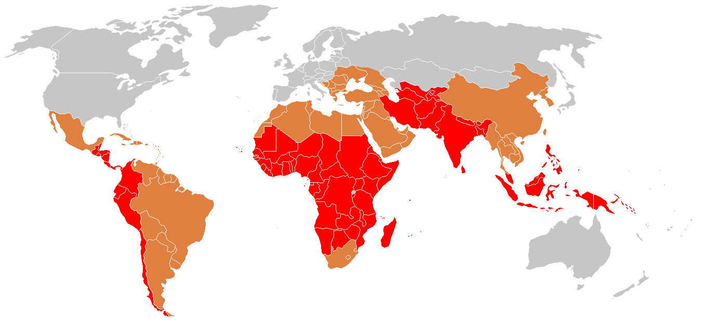
Epidemiology
  ♦ strongly endemic
  ♦ endemic
  ♦ sporadic cases

Slide 7
Pathogenesis of Enteric fever
- The organisms penetrate ileal mucosa
- Reach mesenteric lymph nodes - multiply there.
- Invade Blood stream
- Infect Liver, Gall Bladder,, spleen, Kidney, Bone marrow.
- After 7-10 days bacilli pass into blood stream (secondary bacteremia )

Slide 8
Clinical features
In the first week of illness, rising ("stepwise") fever and bacteremia develop .
While chills are typical, frank rigors are rare .
Relative bradycardia or pulse-temperature dissociation may be observed.
In the second week of illness, abdominal pain develops and "rose spots" (faint salmon-colored macules on the trunk and abdomen) may be seen .
During the third week of illness, hepatosplenomegaly, intestinal bleeding, and perforation due to ileocecal lymphatic hyperplasia of the Peyer's patches may occur, together with secondary bacteremia and peritonitis. Septic shock or an altered level of consciousness may develop;

Slide 9
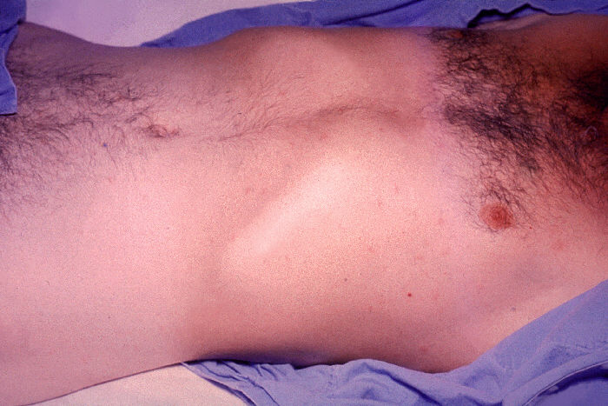
Rash in Typhoid
Rose spots: 2 -4 mm in diameter raised discrete irregular blanching pink maculae's found in front of chest
Appear in crops of up to a dozen at a time
Fade after 3 – 4 days

Slide 10
Complications
Pneumonia, meningitis, osteomyelitis
Severe intestinal hemorrhage and intestinal perforation
If not treated can be fatal.

Slide 11
Carriers
5% of the survivors continue to excrete the organism for months = carriers.
In carriers the bacteria remain in the gall bladder and are shed into the intestine.

Slide 12
Investigations
WBC
ESR
Blood, bone marrow, or stool cultures
Widal test (serum agglutination test). It has cross reactions– false positives. Also false negatives. Not a good test.

Slide 13
Blood Cultures in Typhoid Fevers
Bacteremia occurs early in the disease
Blood Cultures are positive in
1st week in 90%
2nd week in 75%
3rd week in 60%
4th week and later in 25%

Slide 14
Differential Diagnosis
Brucellosis
Tuberculosis
Infective endocarditis
Lymphoma
Adult Still's disease
Malaria

Slide 15
Treatment
3rd generation cephalosporins, like Ceftriaxone are effective
ESBL in Pakistan
Fever may continue for several days after starting therapy.
The majority are cured with antibiotics.
10% may relapse.

Slide 16
Prevention and Control (WHO,2009)
Control measures:
Health education
Antibiotic treatment
Excluding disease carriers from food handling.
A vaccine is available recommended for travelers to high risk areas. It does not provide full protection.

Slide 17
Brucellosis

Slide 18
Brucellosis
Systemic febrile illness
Zoonosis.
B. melitensis and B. abortus are the most frequent.
The incubation period is 1 – 4 weeks.

Slide 19
Transmission
Infection transmitted to humans by:
→ contact with fluids or meat from infected animals (sheep, cattle, goats, camels)
eating food products such as unpasteurized milk and cheese(can stay viable for 90 days)
Partially cocked liver!!!!
→need biosafety level 4 for culture (bioterrorism)

Slide 20
Pathogenesis
Enters the body
To lymph nodes
To blood stream
Reticulo-endothelial System
Blood
Any organ

Slide 21
Clinical Manifestations
Symptoms :
Fever, Night sweats, Fatigue
Anorexia, Weight loss
Arthralgia ,Low back pain
Depression
Signs:
Arthritis
Lymphadenopathy
Hepatosplenomegaly

Slide 22
Localized Brucellosis
Osteoarticular disease: especially sacroiliitis, vertebral spondylitis and large joints arthritis
Genitourinary disease, especially epididymo-orchitis
Neurobrucellosis, usually presenting as meningitis, radiculopathy.
Abscess involving the liver, spleen, abdomen.

Slide 23
DDX
Typhoid fever
Tuberculosis
Infective endocarditis
Collagen vascular disease
lymphoma

Slide 24
Investigations
  WBC
  ESR , CRP
  Blood cultures
    slow growth = 2 weeks
  Serology: SAT positive in recent infection
  cut off limit 1:640 or 1:320 with symptoms and risk factor ( it can be negative in meningitis)
  Radiological assessment if needed

Slide 25
Treatment
Treatment for uncomplicated Brucellosis
  Streptomycin (14 days) + Doxycycline for 6 weeks
  Rifampicin + Doxycycline for 6 weeks
Treatment of complicated Brucellosis
  Endocarditis, meningitis
  No uniform agreement
  Usually 3 anti Brucella drugs for 3 or more months

Slide 26
Relapse vs Re infection
About 10 percent of patients relapse after therapy.
Most relapses occur within three months following therapy and almost all occur within six months.
Relapse should prompt assessment for a focal lesion
Most relapses can be treated successfully with a repeat course of a standard regimen.
Reinfection because ongoing risk factor

Slide 27
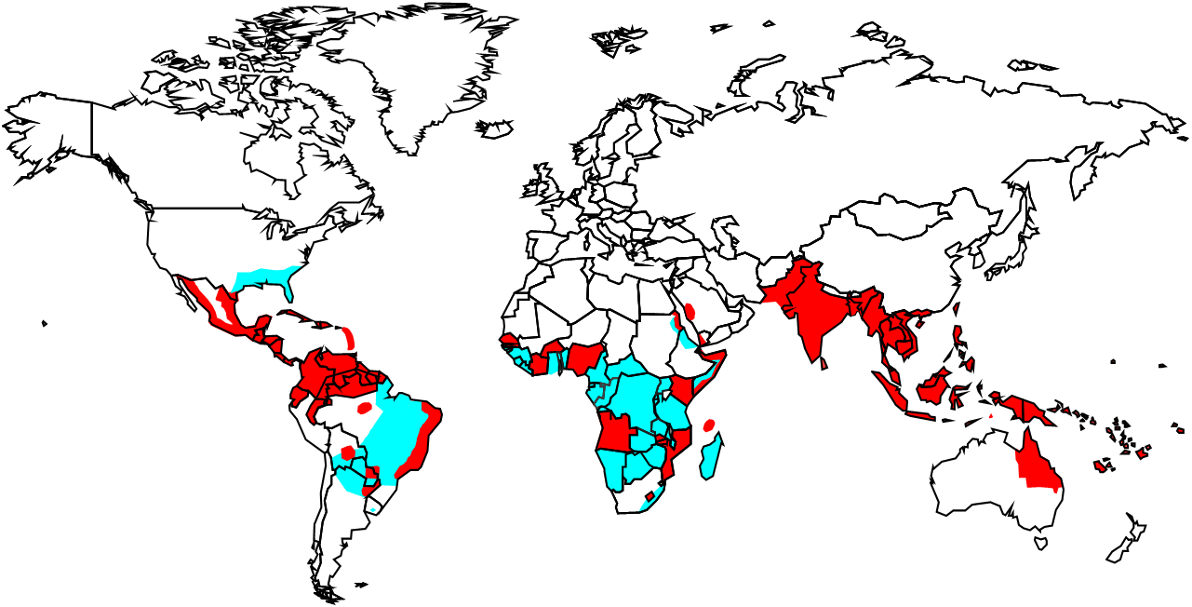
Viral hemorrhagic Fevers:
Dengue

Slide 28
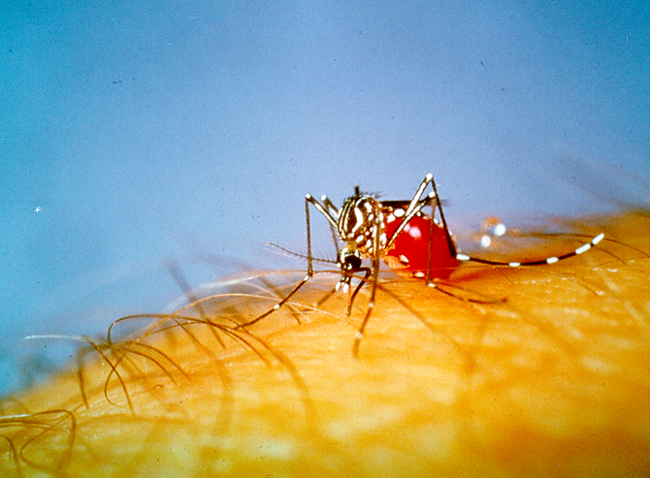
Dengue Virus
Causes dengue and dengue hemorrhagic fever
Is an arbovirus
Transmitted by mosquito: Aedes Aegypti
Composed of single-stranded RNA
Has 4 serotypes (DEN-1, 2, 3, 4)
Notes:
3

Slide 29
Four Dengue Virus Serotypes (DEN 1,2,3, and 4)
All can cause severe & fatal infection
Infection by one serotype gives No cross immunity to other types but life long immunity to the same type, however, more predisposition to DHF/DSS if infected by another serotype.
2o immunopathological mechanism triggered by sequential infections with different dengue viral serotypes.
Complicated pathogenesis – partially attributable to Ab- dependent enhancement.
Humans are the main reservoir but monkeys may be.

Slide 30
Dengue Clinical Syndromes
Undifferentiated fever
Classic dengue fever
Dengue hemorrhagic fever
Dengue shock syndrome
Notes:
17

Slide 31
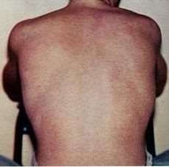
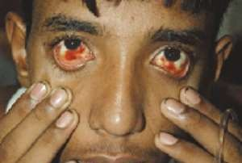
- Classic Dengue Fever
Acute febrile illness
Severe Hemorrhage mainly retro-ocular;
Myalgia & arthralgia – often severe (breakbone fever);
- Nausea & vomiting > 50%; diarrhea (30%)
- Rash (50%) (of variable appearances; maculopapular, petechial, or erythematous.

Slide 32
Dengue Hemorrhagic Fever (DHF):
  Most serious form of dengue infection
  WHO estimates 500,000 cases /year
  Mortality ≈ 10%; high as 50%
- WHO 4 diagnostic criteria (Fever (2-7 days) – Hemorrhagic manifestations – Low platelet counts (< 100000 /ml) – evidence of leaky capillaries)

Slide 33
Prevention
Elimination & destruction of mosquitos and larval habitat:
Space Spraying of insecticide is not usually effective.
Spraying residual insecticides in-door.
Larval source reduction : Cover water holding containers.
Personal protection against mosquito biting:
Screening
Protective clothing
Repellents
Centralized, vertically-structured programs with military-type organization, strict supervision, high level of discipline.
Vaccine

Slide 34
Treatment
Symptomatic treatment
Hydration
Avoid NSAIDS or Aspirin, only acetaminophen for fever, headache or arthralgia
Platelet transfusion only if platelets <10-20

Slide 35
Rift Valley Fever
What is Rift Valley fever?
Rift Valley fever (RVF) is an acute, fever-causing viral disease that affects domestic animals (such as cattle, buffalo, sheep, goats, and camels) and humans.
RVF is most commonly associated with mosquito-borne epidemics during years of unusually heavy rainfall.
The disease is caused by the RVF virus, a member of the genus Phlebovirus in the family Bunyaviridae.
The disease was first reported among livestock by veterinary officers in Kenya in the early 1900s.

Slide 36
Rift Valley Fever
On 11 September 2000, the Ministry of Health (MOH) of the Kingdom of Saudi Arabia (Riyadh) received reports of unexplained severe hepatitis in 7 patients from the Jizan region at the southwestern border of Saudi Arabia.
A team from the MOH started investigations within 24 h after notification.
Clinical manifestations included low-to-moderate–grade fever, abdominal pain, vomiting, diarrhea, and elevated liver enzyme levels progressing to liver failure, encephalopathy or encephalitis, disseminated intravascular coagulation (DIC), renal failure, and, in 5 of the 7 patients, death.

Slide 37
Rift Valley Fever
Next outbreak was reported in Yemen.
Now Rift valley fever is considered to be at a low level of endemicity in Saudi Arabia
Treatment is symptomatic
Vaccines for veterinary use are available

Slide 38
Alkhurma hemorrhagic fever
Alkhurma hemorrhagic fever (AHF) is caused by Alkhurma hemorrhagic fever virus (AHFV), a tick-borne virus of the Flavivirus family.
The virus was initially isolated in 1995 from a patient in Saudi Arabia. Subsequent cases of AHF have been documented in tourists in Egypt, extending the geographic range of the virus and suggesting that geographic distribution of the virus is wide and that infections due to AHFV are underreported.

Slide 39
Transmission
Transmission of AHFV is not well understood.
AHFV is a zoonotic virus, and its described tick hosts (the soft tick Ornithodoros savignyi and the hard tick Hyalomma dromedari) are widely distributed. People can become infected through a tick bite or when crushing infected ticks. Epidemiologic studies indicate that contact with domestic animals or livestock may increase the risk of human infection. No human-to-human transmission of AHF has been documented.
Although livestock animals may provide blood meals for ticks, it is thought that they play a minor role in transmitting AHFV to humans. No transmission through non-pasteurized milk has been described, although other tick-borne flaviviruses have been transmitted to humans through this route.

Slide 40
Signs and Symptoms
after an incubation period that could be as short as 2-4 days, the disease presents initially with non- specific flu-like symptoms, including fever, anorexia (loss of appetite), general malaise, diarrhea, and vomiting; a second phase has appeared in some patients, and includes neurologic and hemorrhagic symptoms in severe form. Multi-organ failure precede sfatal outcomes. No repeated or chronic symptoms have been reported following recovery. Evidence suggests that a milder form may exist, where hospitalization is not required.

Slide 41
Risk of Exposure
Contact with livestock with tick exposure are risk factors for humans, as is contact with infected ticks, whether through crushing the infected tick with unprotected fingers or by a bite from an infected tick. Slaughtering of animals which may acutely but asymptomatically infected may also be a risk factor, as it is possible that infected animals develop a viremia without obvious clinical signs.

Slide 42
Diagnosis
Clinical diagnosis could be difficult due to similarities between AVHF, Crimean-Congo Hemorrhagic fever (CCHF), and Rift Valley fever
( RV F ) , which occur in similar geographic areas . Laboratory diagnosis of AHF can be made in the early stage of the illness by molecular detection by PCR or virus isolation from blood. Later, serologic testing using enzyme-linked immunosorbent serologic assay (ELISA) can be performed.

Slide 43
Treatment
There is no standard specific treatment for the disease. Patients receive supportive therapy, which consists of balancing the patient’s fluid and electrolytes, maintaining oxygen status and blood pressure, and treatment for any complications. Mortality in hospitalized patients ranges from 1-20%.

Slide 44
Prevention
Given that no treatment or specific prophylaxis is presently available, prevention and increased awareness of AHFV are the only recommended measures. Complete control of ticks and interruption of the virus life cycle is impractical; in endemic regions, it is important to avoid tick-infested areas and to limit contact with livestock and domestic animals.
Individuals should use tick repellants on skin and clothes and check skin for attached ticks, removing them as soon as possible. Tick collars are available for domestic animals, and dipping in acaricides is effective in killing ticks on livestock. People working with animals or animal products in farms or slaughterhouses should avoid unprotected contact with the blood, fluids, or tissues of any potentially infected or viremic animals.

Slide 45
Leishmaniasis
Leishmaniasis is a protozoal disease caused by Leishmania parasite, which is transmitted by the sand fly.
Leishmaniasis is of three types ; cutaneous leishmaniasis, muco-cutaneous and the visceral (Kala-azar )

Slide 46
Visceral Leishmaniasis
N
Northern
Al-jouf
Tabouk
Medina
Riyadh
Makkah
Baha
Eastern
Najran
Aseer
Affected area
Jazan

Slide 47
Geographical Distribution of
Northern
Cutaneous Leishmaniasis
Al-jouf
9.1 %
2004
Tabouk
26.6%
18.5 %
Hail
4.1 %
Qaseem
Alhsa 20.9%
Medina
Riyadh
Makkah
4.1 %
Baha
Eastern
Najran
Aseer
N
Jazan

Slide 48

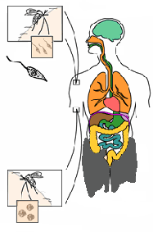



Leishmaniasis Life-Cycle
Sand fly Stages
Human Stages
1
Sand fly takes a blood meal
8
Divide in midgut and
migrate to proboscis
(Injects promastigote
stage into the tissue)
2
Promastigotes are
Phagocytized by
macrophages
i
3
Promastigotes transfer
into amastigotes inside
macrophages
7
Amastigotes transform
Into promastigote
stage in midgut
d
6
Ingestion of
Parasitized cell
4
Amastigotes multiply in cells
(Including macrophages) of
Various tissues
5
Sand fly takes
a blood meal
i
Infective stage
Diagnostic stage
(ingest macrophages
Infected with amastigotes )
d

Slide 49
VL in KSA
VL in KSA caused by L.Donovani and the Rattus rattus is the reservoir.

Slide 50
CLINICAL MANIFESTATIONS
Asymptomatic infection
Visceral leishmaniasis The most important clinical manifestation of VL is the syndrome known as kala-azar (Hindi for "black fever").
The incubation period is usually two to six months but can range from a few weeks to several years.
Onset of symptoms is usually insidious or subacute, with slow progression of malaise, fever, weight loss, and splenomegaly (with or without hepatomegaly) over a period of weeks to months
Hemophagocytic lymphohistiocytosis Hemophagocytic lymphohistiocytosis (HLH) is a systemic disorder of excess immune activation that can be triggered by certain infections it is an uncommon complication of VL

Slide 51
Diagnostic tools of VL
Histopathology diagnosis requires visualization of amastigotes; these are spherical or ovoid bodies that measure 1 to 5 microns long by 1 to 2 microns wide.
CultureTypical liquid media consists of Schneider's drosophila media supplemented with calf serum, or Novy, MacNeal, Nicolle (NNN) media.
Molecular techniques Polymerase chain reaction is one of the most sensitive diagnostic tests for VL

Slide 52
Visceral leishmaniasis: Treatment
Liposomal amphotericin B is the drug with the highest therapeutic efficacy and the most favorable safety profile monotherapy (total dose 20 to 21 mg/kg
The pentavalent antimonial drugs sodium stibogluconate(SSG) and meglumine antimoniate, are still widely used; however, monotherapy with antimonial agents is no longer a first-line treatment for VL
Two new drugs have been added paromomycin and miltefosine

Slide 53
Cutaneous Leishmaniasis in KSA
The disease is endemic in many parts of KSA, with the majority of cases concentrated in six regions, including Al-Qaseem, Riyadh, Al-Hassa, Aseer, Ha’il, and Al-Madinah.
Leishmania major (L. major) and Leishmania tropica (L. tropica) are the main dermotropic species, and Phlebotomus papatasi (vector of L. major) and Phlebotomus sergenti (vector of L. tropica) are the proved vectors of the disease.
Psammomys obesus and Meriones libycus have been defined as the principal reservoir hosts of zoonotic CL in Al-Hassa oasis, Al-Madinah, and Al-Qaseem provinces.
Clinically, males are affected more than females, and there is no variation between the Saudis and expatriates in terms of number of reported cases, but the disease tends to run a more severe course among non-Saudis.
Face is the most commonly affected site, and ulcerative pattern accounts for 90% of lesions.
Phlebotomus papatasi
Psammomys obesus
Meriones libycus

Slide 54
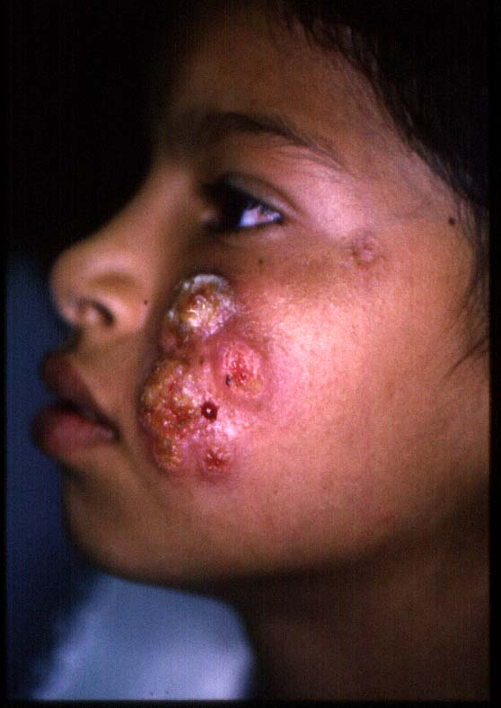
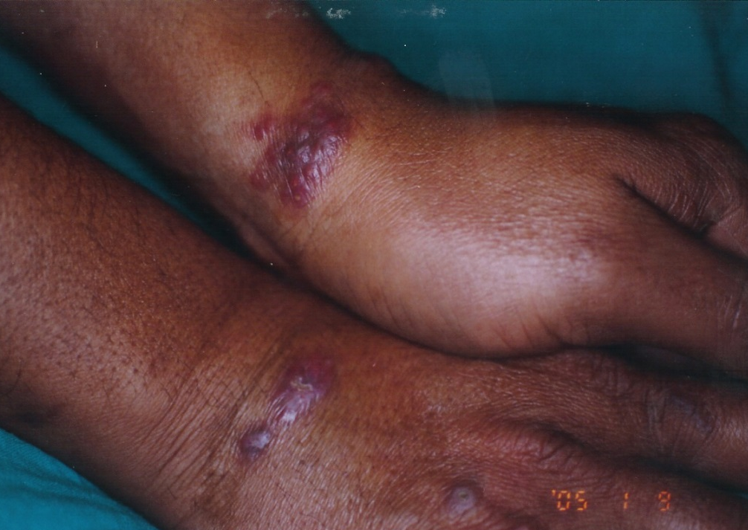
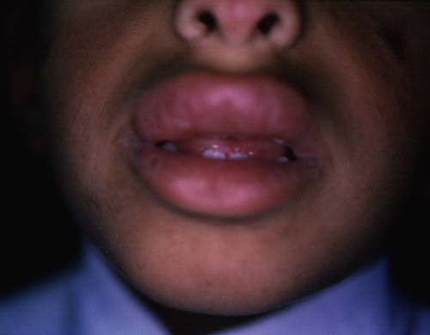
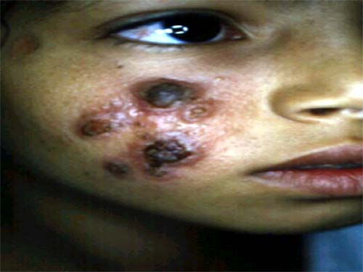
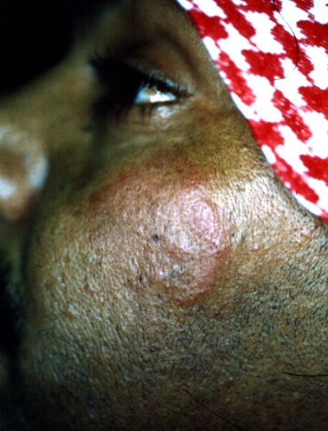
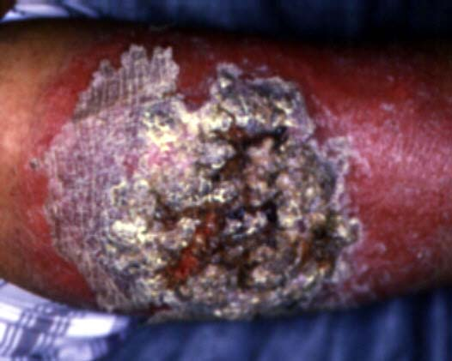
Types of Cutaneous Leishmaniasis
Hyperkeratotic
Mucosal
Erysipeloid
Recidivans
Plaque

Slide 55
Cutaneous leishmaniasis Diagnostic tools
Histopathology :Giemsa staining is typically used; with this stain, the cytoplasm is blue, the nucleus violet-blue, and the kinetoplast red to violet
Culture Typical liquid media consists of Schneider's drosophila media supplemented with calf serum, or Novy, MacNeal, Nicolle (NNN) media.
Molecular techniques Polymerase chain reaction is one of the most sensitive diagnostic tests for CL

Slide 56
DIFFERENTIAL DIAGNOSIS of CL
Sporotrichosis
Mycobacterial infection
Leprosy
Skin cancer

Slide 57
Cutaneous leishmaniasis: Treatment
CL due to L. major may heal spontaneously within 4–6 months in 50–75% of cases and almost in all patients at 8 months,
while in L. tropica spontaneous healing occurs within 1 year or longer
Therapeutics for CL consist of local/topical (paromomycin ointment, imidazole ointment.
local infiltration of lesion with antimonials (sodium antimony gluconate; Pentostam)

Slide 58
Preventions
NO pre or post exposure prophylaxis
Effective prevention requires health education regarding risk of infection and epidemiology of transmission.
Covering skin with clothing is helpful as sand fly mouthparts do not penetrate clothing (in contrast, mosquito mouthparts do penetrate clothing).
Clothing can be impregnated with an insecticide such as permethrin.
An insect repellent such as DEET (NN-diethyl-3-methylbenzamide) can be applied to exposed skin areas.
Use of fine mesh insecticide-treated bednets may also be helpful

Slide 59
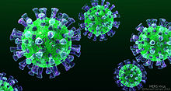
MERS CoV
MIDDLE EAST RESPIRATORY SYNDROME CORONAVIRUS

Slide 60
MERS CoV
OUTBREAK :
-2012 emerged in Saudi Arabia
-2014 March -April increased dramatically in Arabian Peninsula → declined sharply in ensuing months. → still detected cases
-2015 May -early July : in South Korea : large outbreak (the index case was an individual who had traveled to the Arabian Peninsula )
-2015: large outbreak began in a hospital in Riyadh, Saudi Arabia
Notes:
Last data : http://www.who.int/emergencies/mers-cov/en/
To be updated

Slide 61
Where Does the Virus Come From?
Partial sequence found in bat in Saudi Arabia near location of human case
Growing evidence that camels play an important role in transmission across the region
Virus has been detected in dromedary camels in:
  Qatar, Saudi Arabia and Egypt
Antibodies have been found in camels in: (? Crosse reactivity !! )
  Jordan, Tunisia, Ethiopia, Nigeria, Egypt, Saudi Arabia, Canary Islands, UAE
MERS-CoV likely widespread in camels throughout region
Transmission likely occurring from camel to human

Slide 63
MERS CoV: Diagnosis and Treatment
DIAGNOSIS:
Real-time reverse-transcriptase polymerase chain reaction (rRT-PCR) for respiratory secretions
EXPERIMENTAL TREATMENT:
Convalescent plasma
IVIG
IFN
Protease Inhibitors used In HIV infection
Ribavirin
Corticosteroids
Nitazoxanide
Cyclosporin A
Combination therapy
Treatment is mainly SUPPORTIVE
No vaccine available yet

Slide 64
COVID-19 timeline

Slide 66
Case definition

Slide 67
COVID-19

Slide 68
Respiratory Triage Checklist

Slide 69
THANK YOU

