Slide 1
Acute Central and Lower Abdominal Pain
Hussam Alamri MD FRCSC
MIS Bariatric and General Surgeon
Assistant Professor Department of Surgery
King Saud University

Slide 2
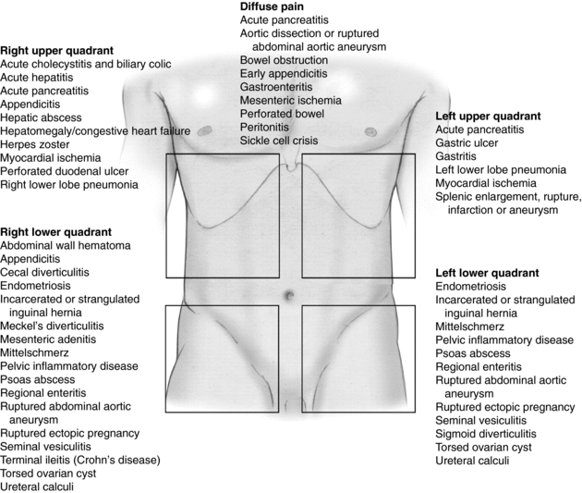

Slide 3
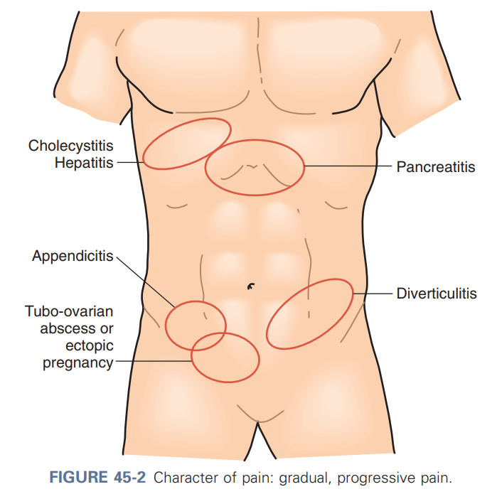

Slide 4
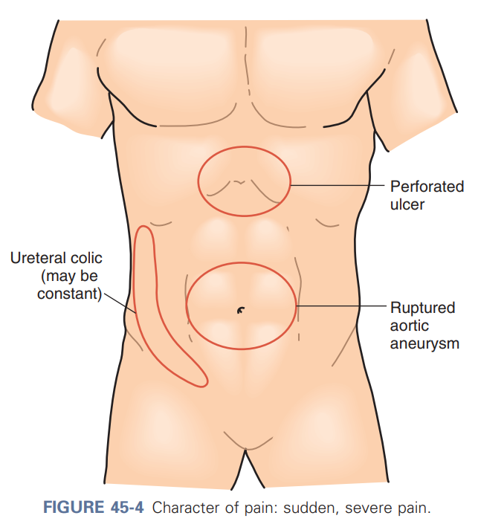

Slide 5
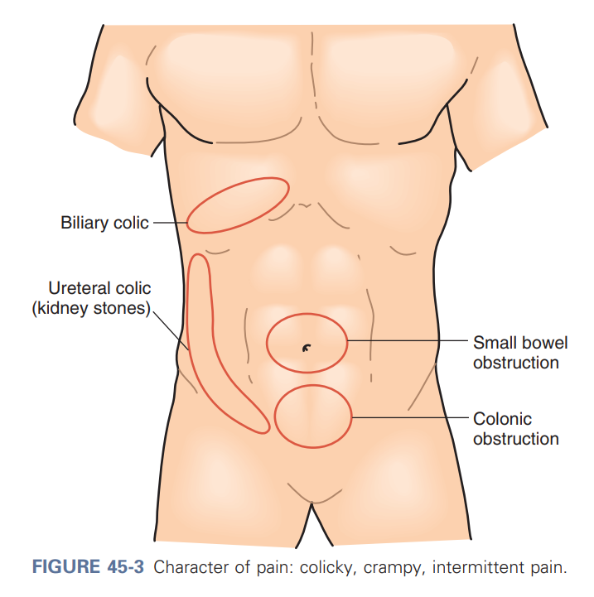

Slide 7
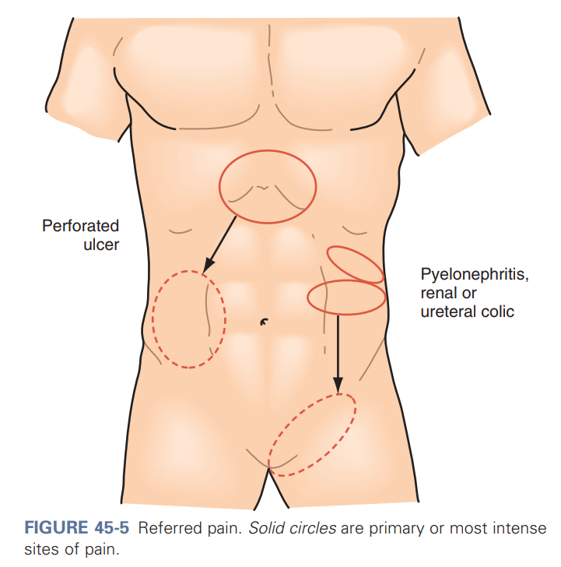

Slide 8
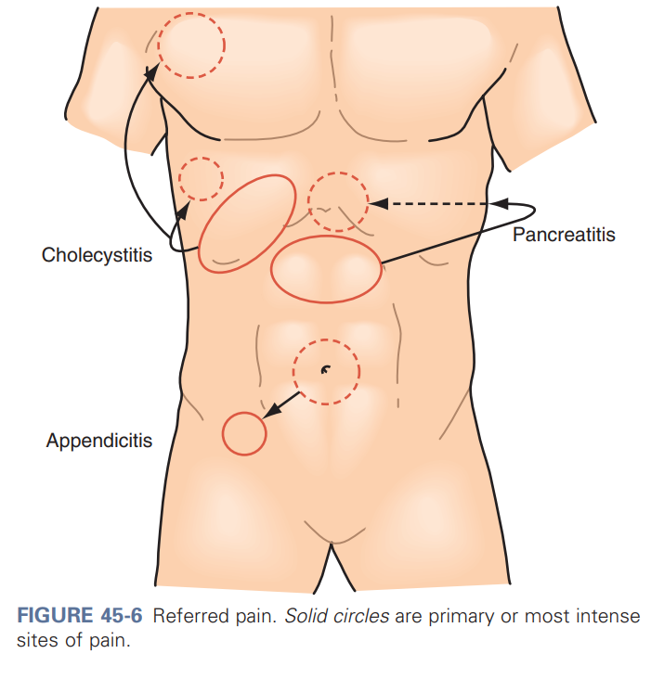

Slide 9
History
Pain History (SOCRATES)
Sudden pain can suggest perforation or embolism and ischemia
Gradual can suggest inflammation and abscess formation
Detailed PMHx and PSHx
Medication History

Slide 10
Physical Exam
Start with General Inspection
Patients with peritoneal irritation lie still with flexion of knee and hips
Some patients keep moving to find comfortable position (ureteral or biliary colic)
Fascial hernias may be suspected and can be confirmed during palpation of the abdominal wall

Slide 11
Laboratory Studies
Helpful Laboratory Studies
Hemoglobin White blood cell count with differential Electrolyte, blood urea nitrogen, and creatinine concentrations Urinalysis Urine human chorionic gonadotropin Amylase and lipase levels Total and direct bilirubin concentration Alkaline phosphatase Serum aminotransferase Serum lactate levels Stool for ova and parasites C. difficile culture and toxin assay

Slide 12
Imaging
CXR/AXR
US
CT Scan
MRI

Slide 13
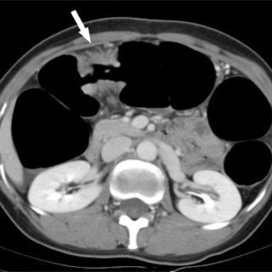

Slide 14
Management
Based on etiology
Complications of perforation include:
Shock
Abscess Formation
Wound Infection
Mortality

Slide 15
Meckel Diverticulum
Etiology
Diagnosis
Most common congenital abnormality of the small intestine
Can cause bleeding (mainly in younger patients) or inflammation, obstruction, and rarely perforation
Often referred to by the rule of 2's; 2% of the population, within 2 feet of the ileocecal valve, 2 inches in length, tow types of heterotopic Mucosa (gastric and pancreatic), and presentation before the age of two
CT Scan
Meckel Scan
Management
Incidental finding during other surgeries
Symptomatic Meckel -> Surgery

Slide 16
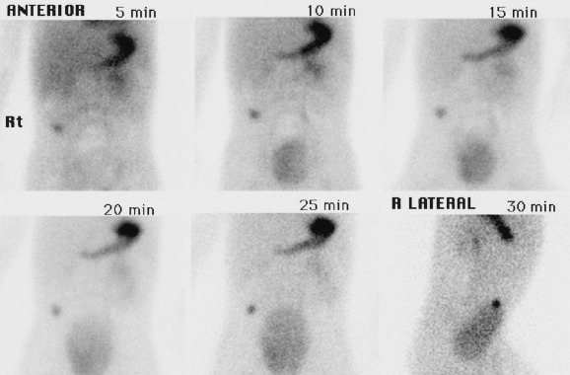

Slide 17
Inflammatory Bowel Disease
Etiology
Diagnosis
Ulcerative colitis — Ulcerative colitis is a chronic inflammatory condition characterized by relapsing and remitting episodes of inflammation limited to the mucosal layer of the colon
Crohn disease — Crohn disease is characterized by transmural inflammation and by skip areas of involvement (ie, segments of normal-appearing bowel interrupted by areas of disease).
CT Scan
Endoscopy
Management
Medical (steroids, biological)
Surgery for complications and other specific scenarios

Slide 18
Yersinia Ileitis
Etiology
Diagnosis
In the genus Yersinia, three species are important human pathogens: Yersinia pestis, Yersinia enterocolitica, and Yersinia pseudotuberculosis
Presentation: right lower abdominal pain, fever, vomiting, leukocytosis, and understated diarrhea may be confused with acute appendicitis
post-infectious sequelae are erythema nodosum and reactive arthritis
CT Scan
Stool Culture
Management
Usually self-limiting/ Medical (Antibitoics)

Slide 19
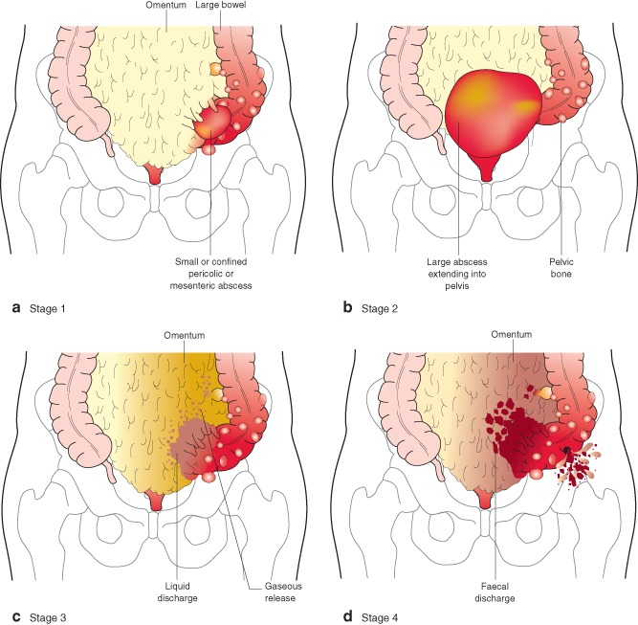
Acute diverticulitis
Diagnosis
CT Scan
Colonoscopy (delayed after complicated diverticulitis )
Management
Conservative
Antibitoics/Drainage
Surgery (Hartmann’s)

Slide 20
Acute Appendicitis
Etiology
Diagnosis
Acute appendicitis is the most common abdominal surgical emergency in the world, with a lifetime risk of 8.6 percent in males and 6.9 percent in females
Presentation:
Right lower quadrant (right anterior iliac fossa) abdominal pain
Anorexia
Nausea and vomiting
CT Scan/ US
Management
Surgery
Antibiotics and Drainage followed by surgery (in perforated appendicitis)

Slide 21
Mesenteric lymphadenitis
Etiology
Diagnosis
Mesenteric lymphadenitis refers to nonspecific self-limiting inflammation of the mesenteric lymph nodes and is considered present if a cluster of three or more lymph nodes, each measuring 5 mm or greater, is detected in the right lower quadrant mesentery
Presents with symptoms similar to appendicitis
CT Scan/ US
Management
Self-limiting with supportive care

Slide 22
Thank you , Read Read Read

