Slide 1
Dermatologic Emergencies
Prof. Marwan Al Khawajah
College of Medicine
King Saud University.

Slide 2
Definition
Emergency is ---
Acute
Unexpected
Dangerous
Requires quick action.

Slide 3
Alarming Morphological patterns.
Urticaria / Angioderma
Purpura / Echymosis
Bullae / Sloughing
Necrosis / Gangrene
Erythroderma

Slide 4
I - Urticaria / Angioedema
Transient swellings and erythema due to vasodilatation and fluid exudation. Manifest by weals that develop rapidly and clear within hours.
Can be life threatening esp. when associated with angioedema of the larynx.
May take years to resolve.

Slide 5
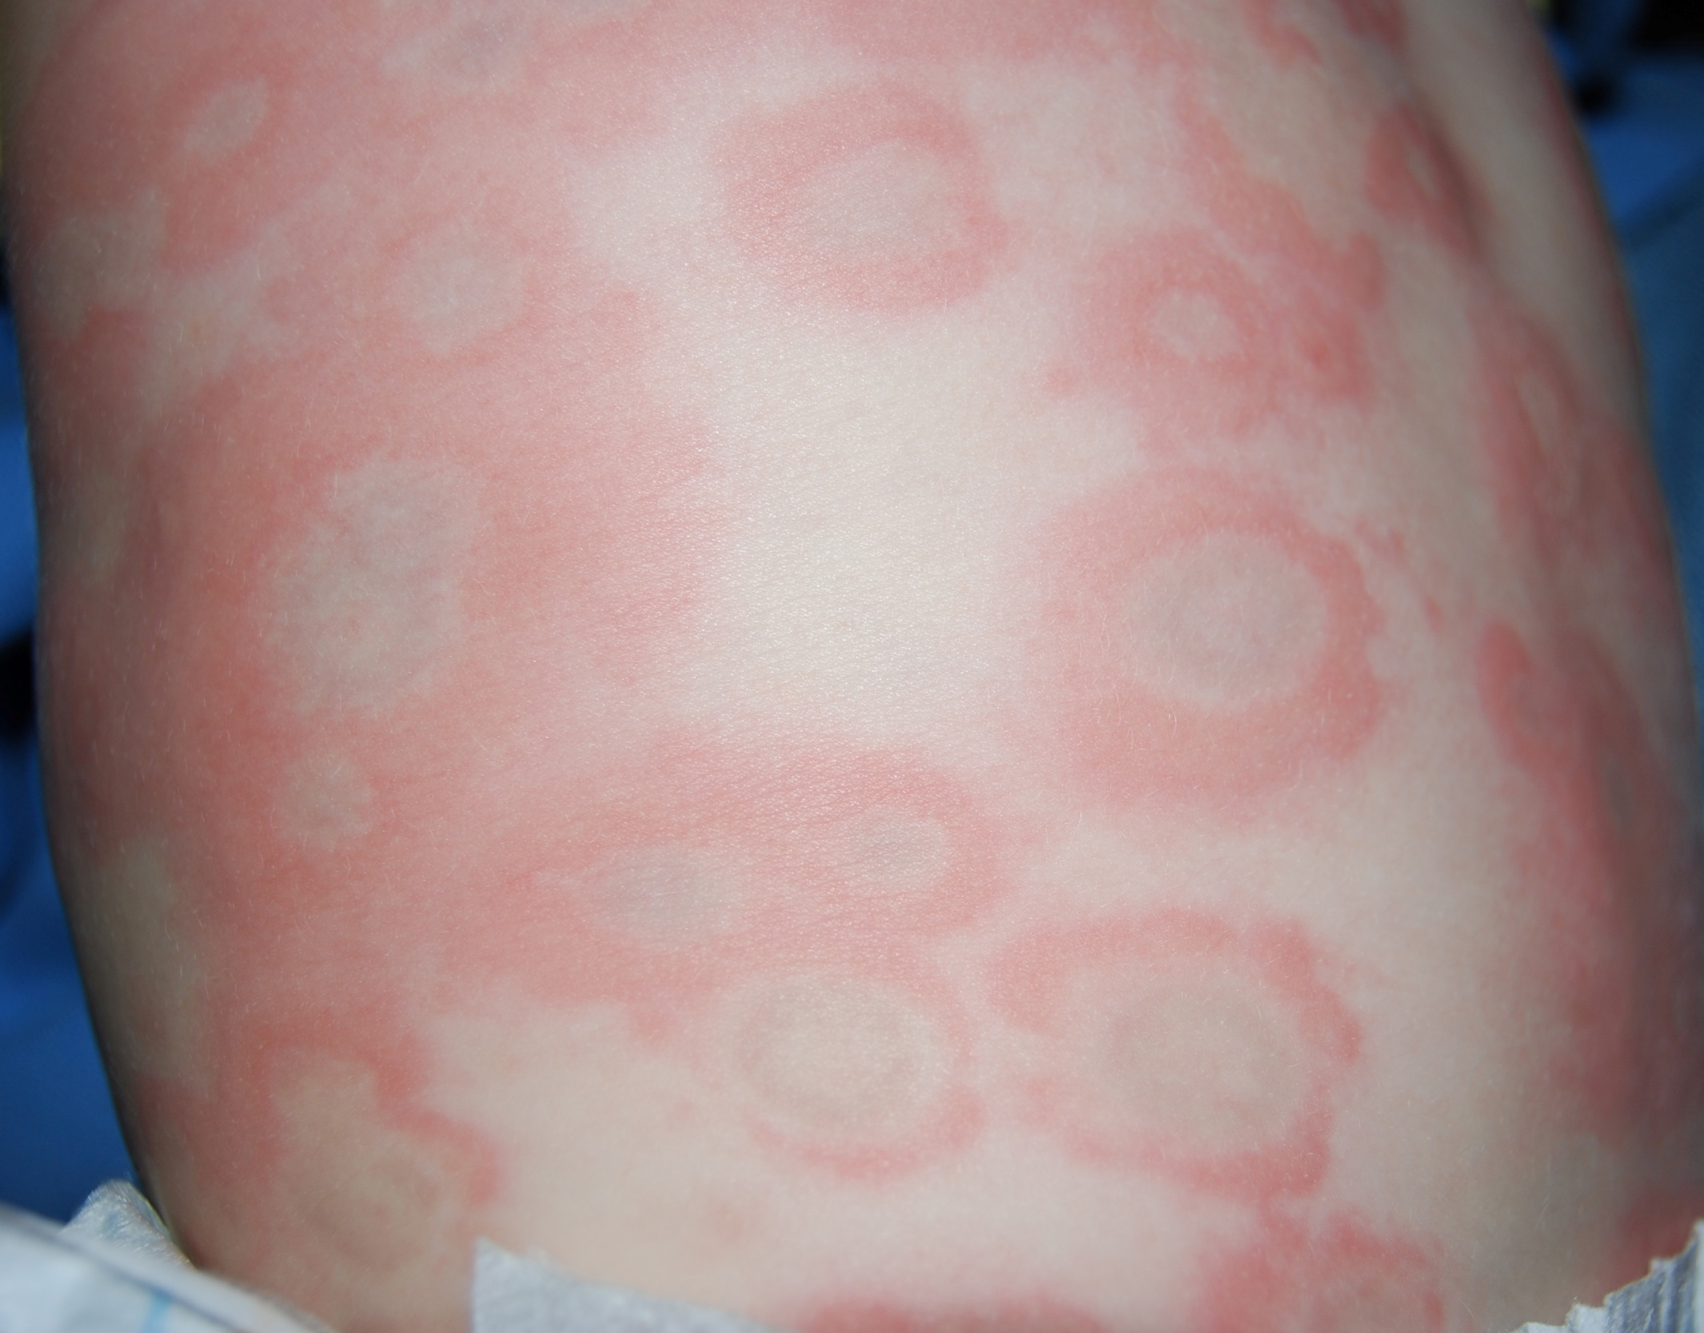

Slide 6
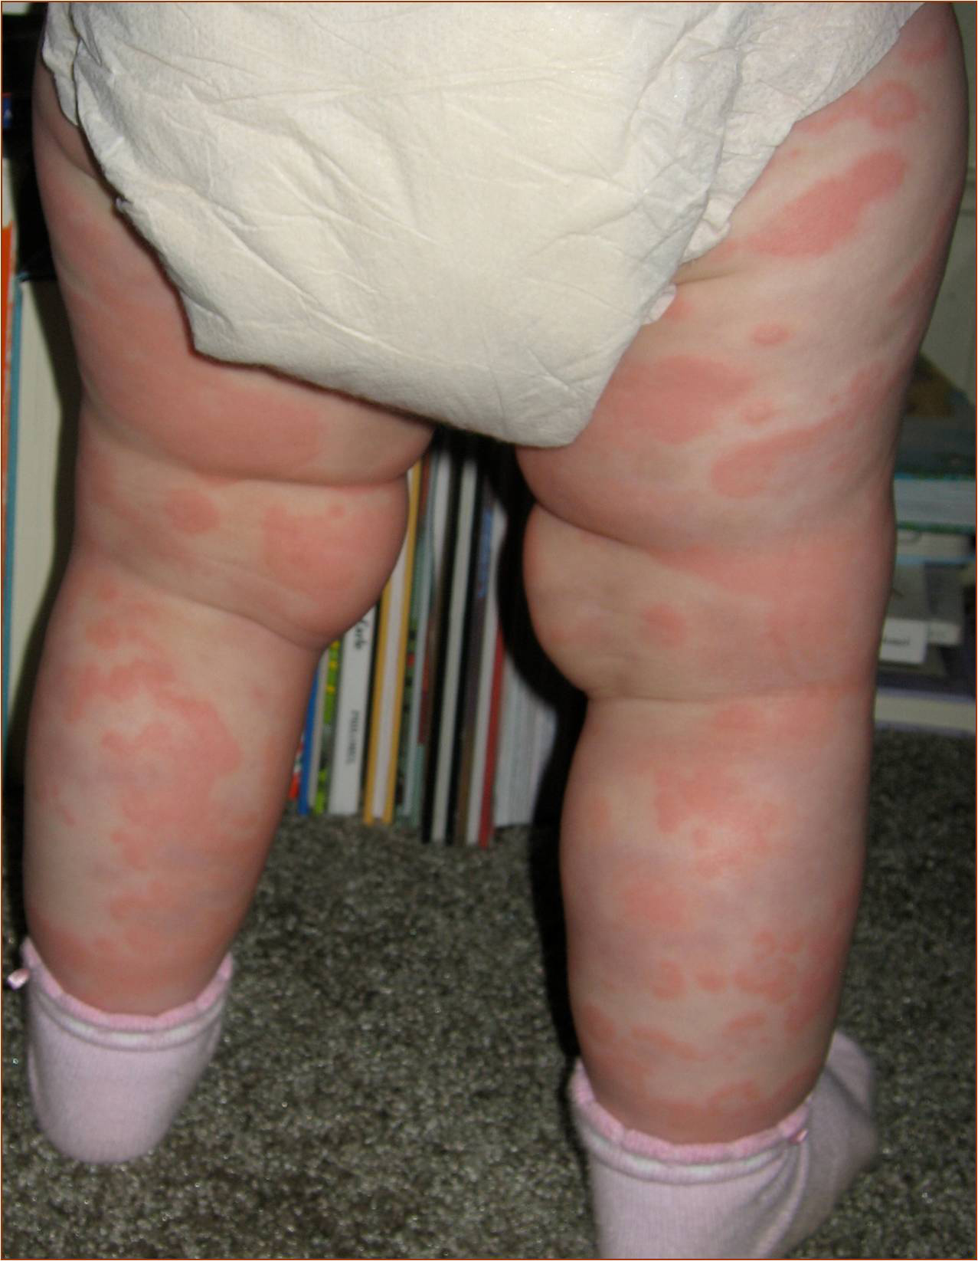

Slide 7
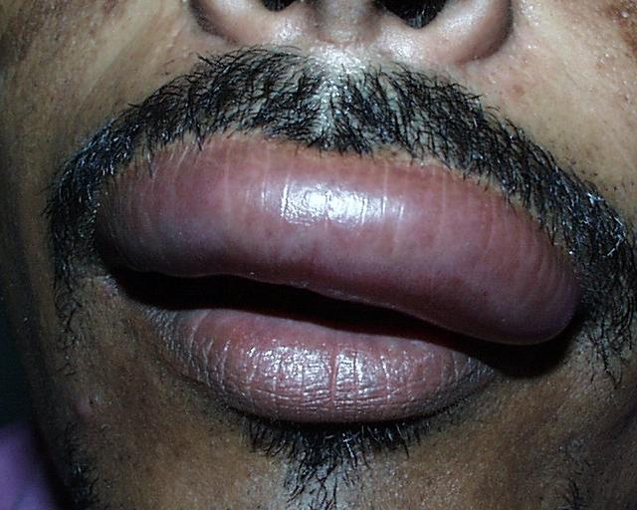

Slide 8
Causes
Most cases are idiopathic
Drugs and food additives / cantact urticaria
Physical
Infections and infestations
Autoimmune disease (SLE, Thyrotoxicosis)
Paraneoplastic
Hereditary angio-edema

Slide 9
Management
Investigation is only warranted if more than 6 months duration esp. if antihistamine resistent
Non-Sedating H1 antihistamines/ combination of antihistamine
Subcutaneous adrenalin as a life-saving measure
Elimination diets, dapsone, cyclosporin A, PUVA, Oral steroids.

Slide 10
II - Purpura
Bleeding into the skin (petechiae, purpura, Echymoses)
Caused by pathology:
I - Inside blood vessel (disorders of coagulation
II - Of blood vessel walls (Vasculities)
III – Outside blood vessels (affecting supporting stroma eg: aging, drugs, Vit C, deficiency, amyloidosis)

Slide 11
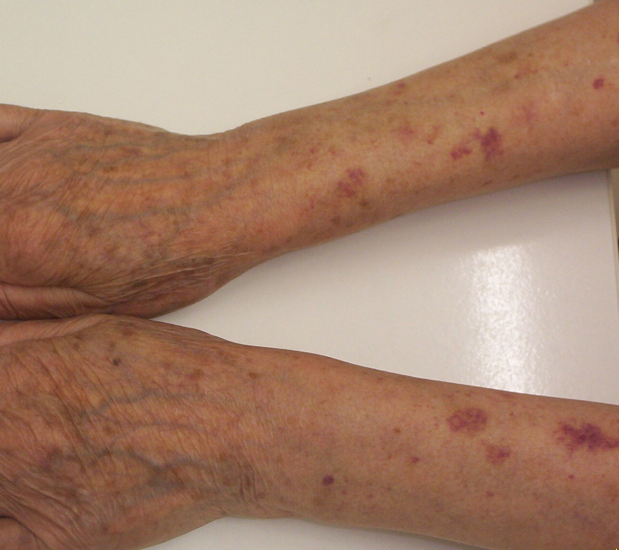

Slide 12
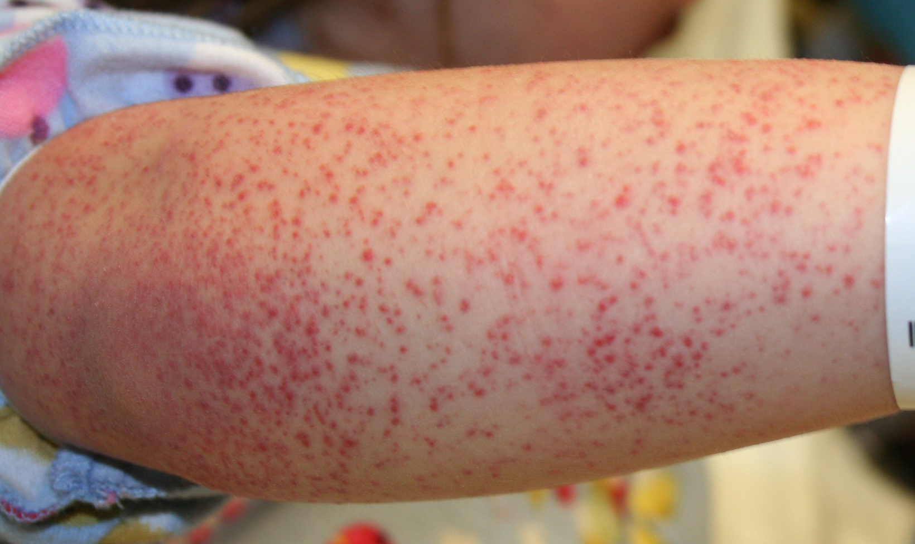

Slide 13
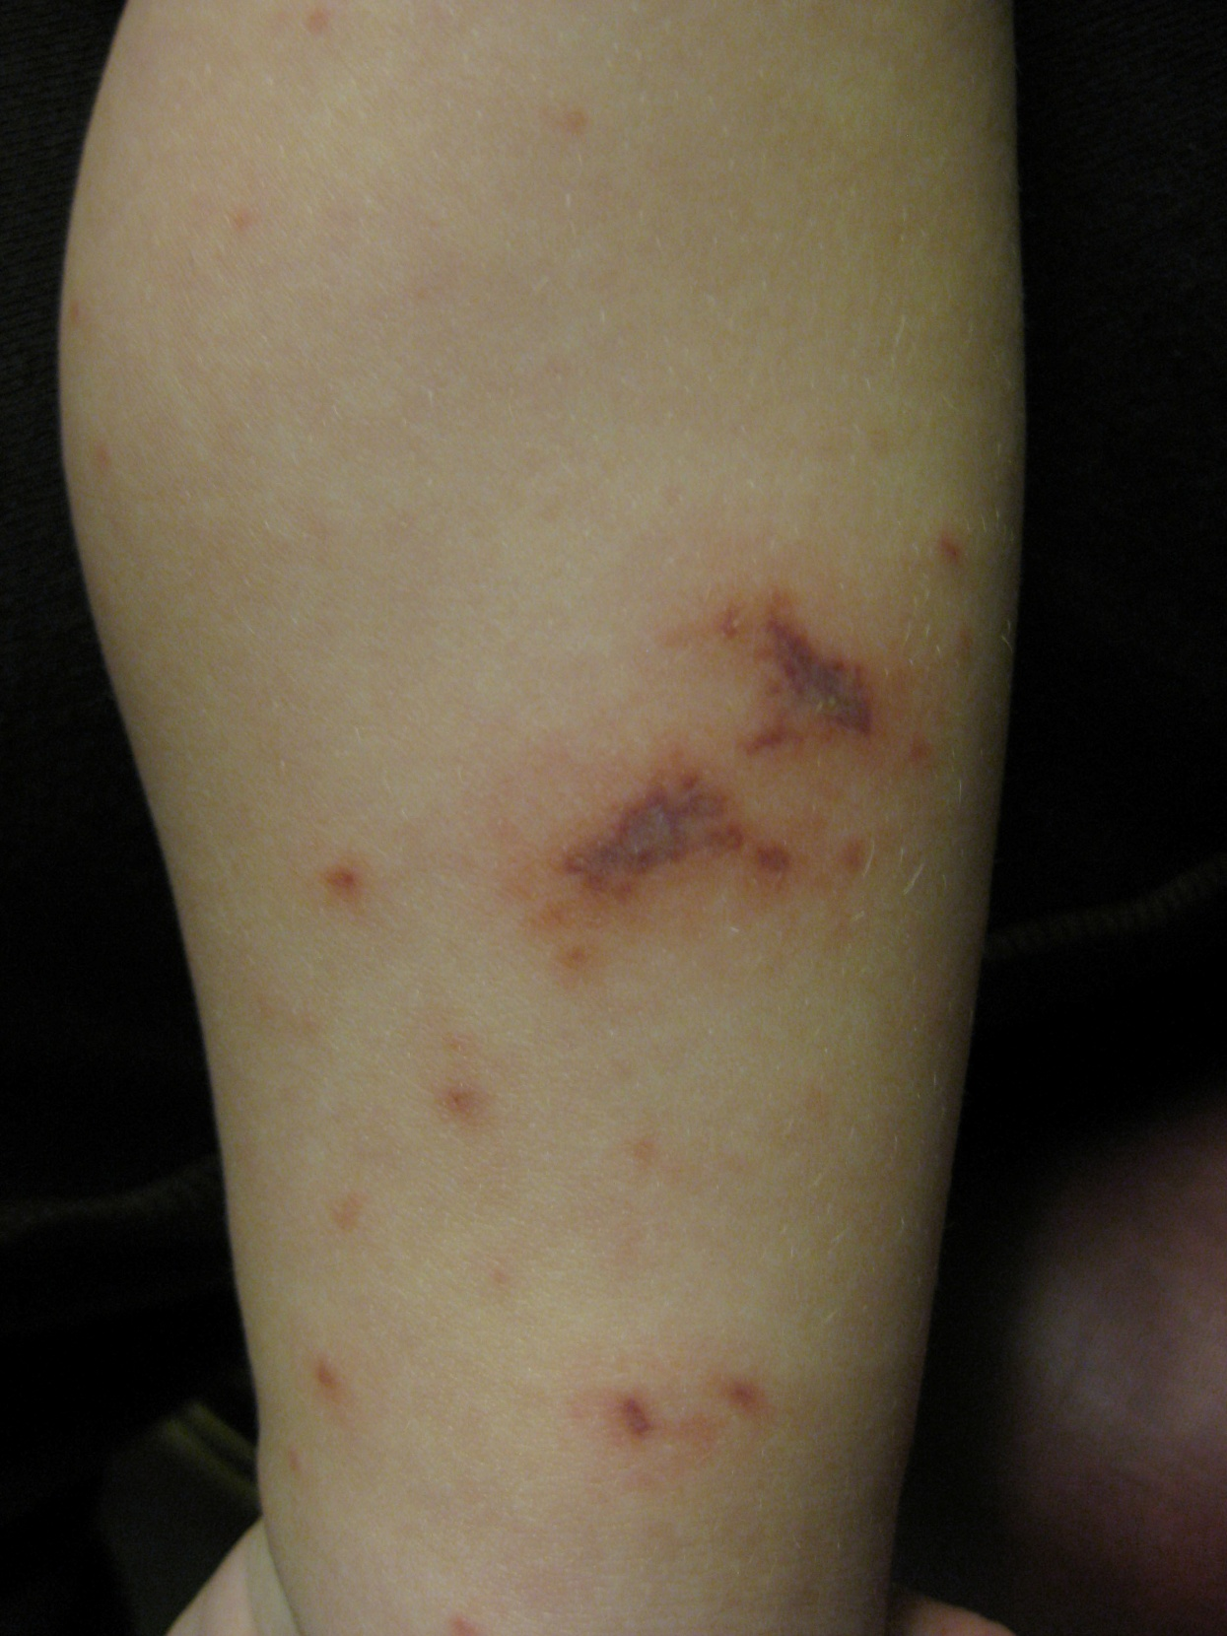

Slide 14
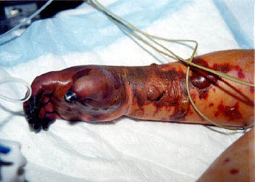

Slide 15
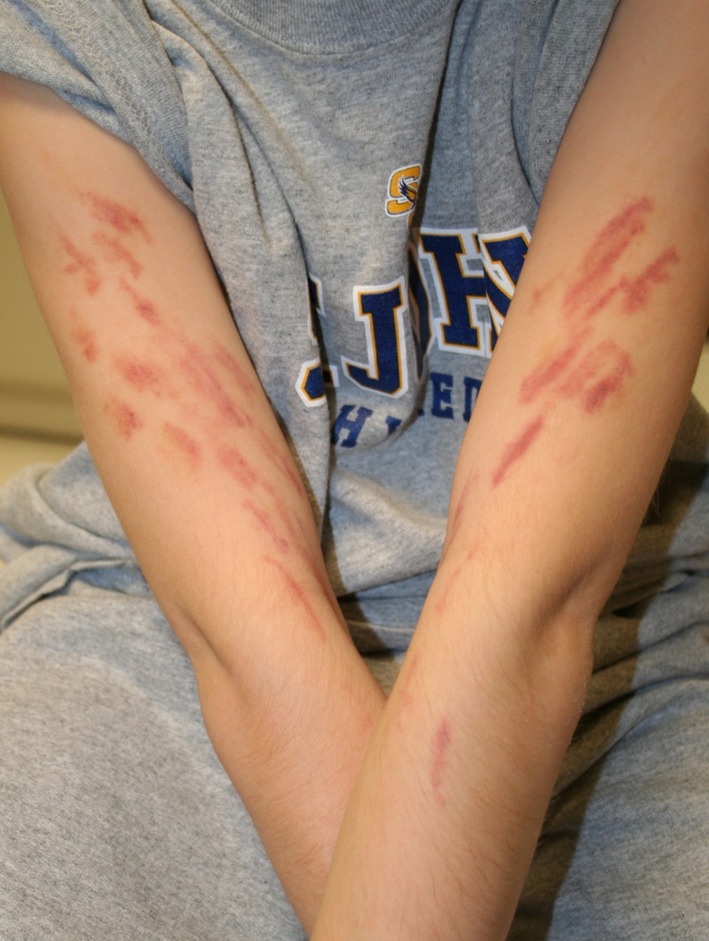

Slide 16
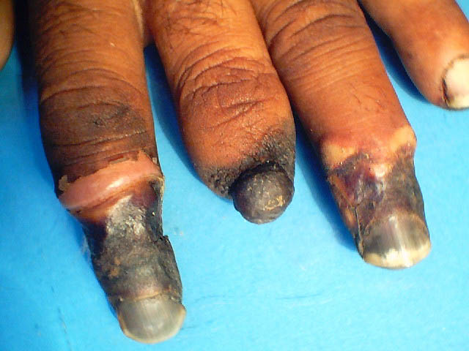

Slide 17
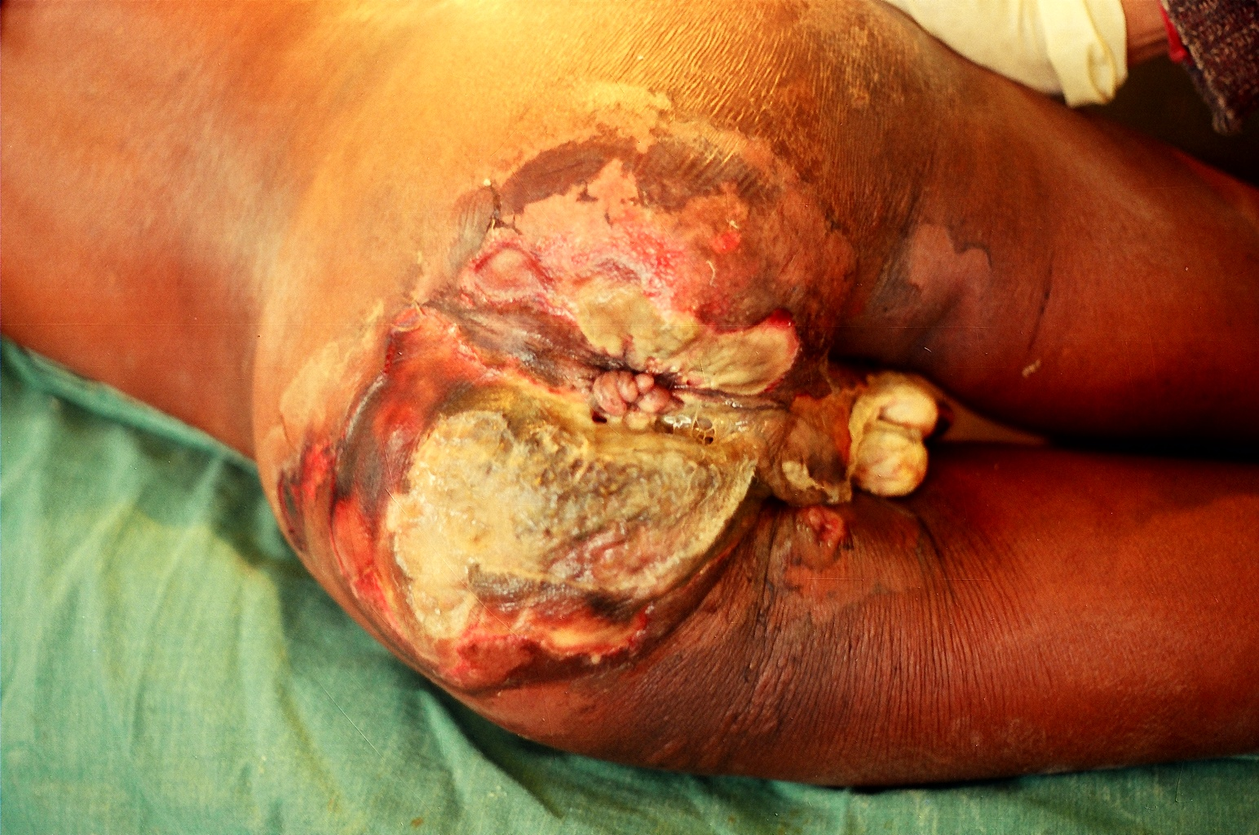

Slide 18
Vasculitis
Inflammation of blood vessels characterized by the alteration or destruction of the vessel wall. Usually a generalized systemic disease
Several classification: small
-according to size of blood vessel medium, large
Lymphocytic
-according to type of cell involved, Neutrophilic granulomatous
- according to etiology
- others

Slide 19
Lymphocytic vasculitis
Chillblains
Lupus erythematosus
Erythema Nodosum
Pityriasis Lichenoides
Pigmented purpura

Slide 20
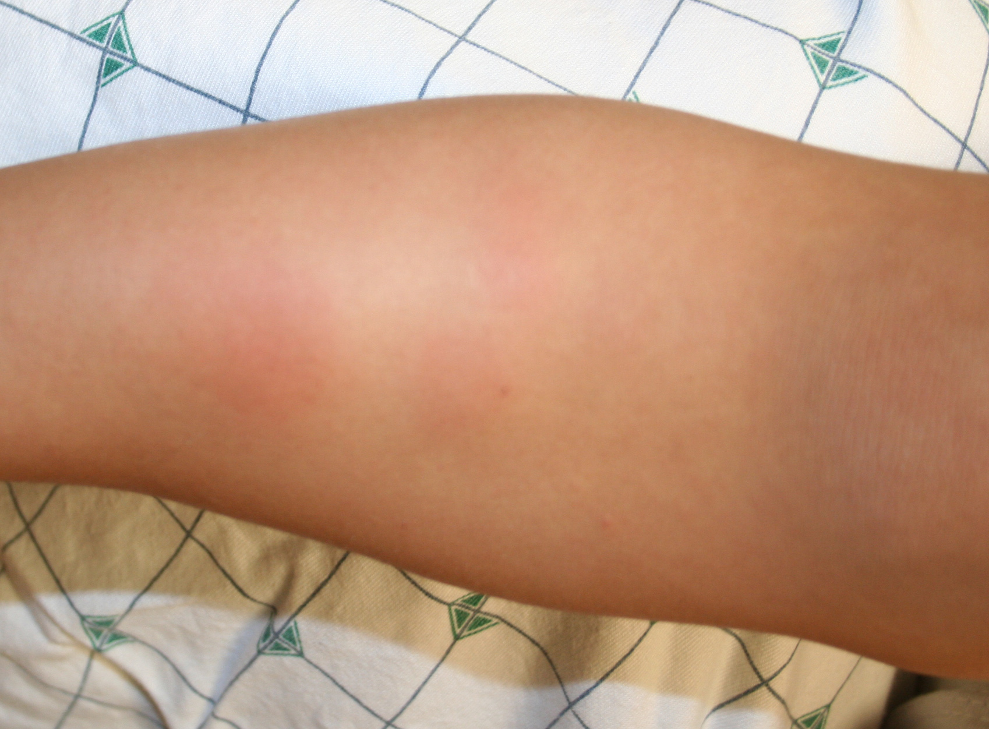

Slide 21
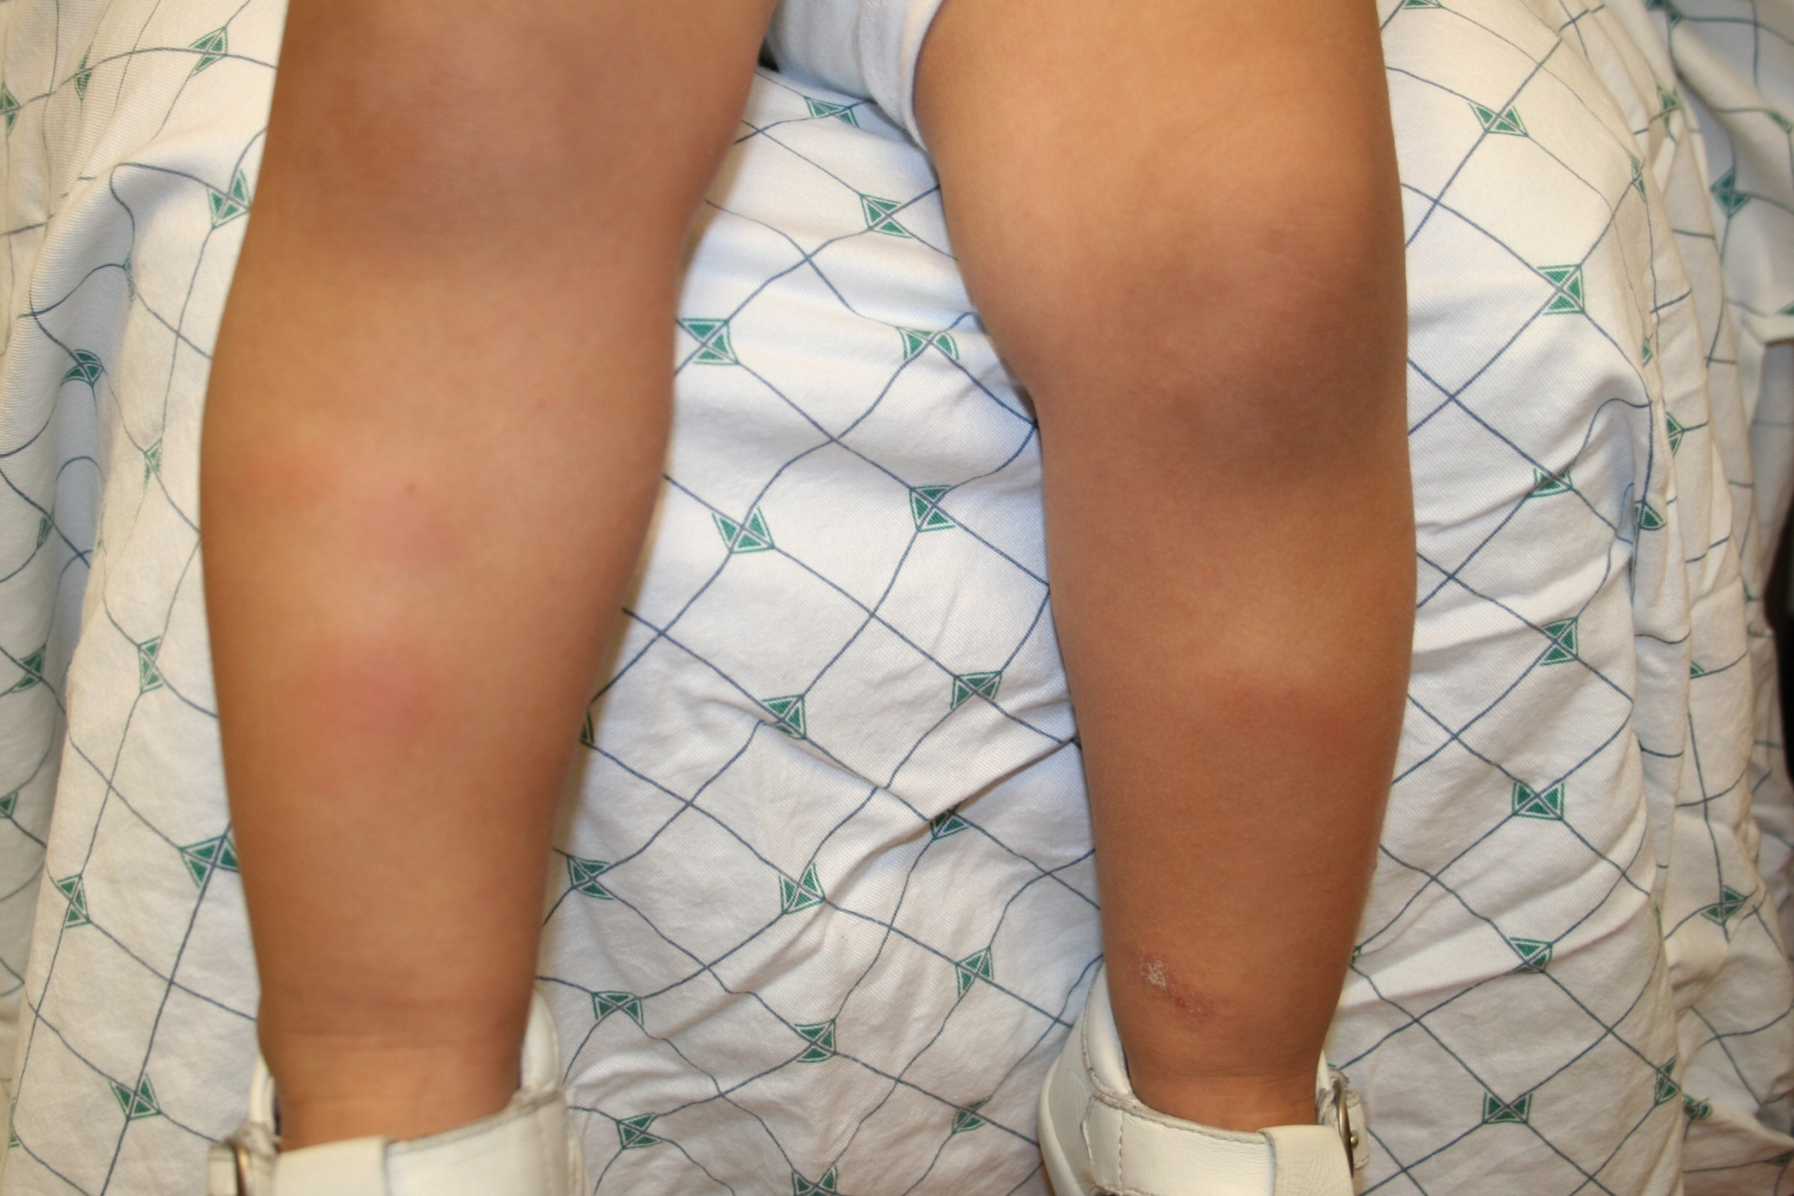

Slide 22
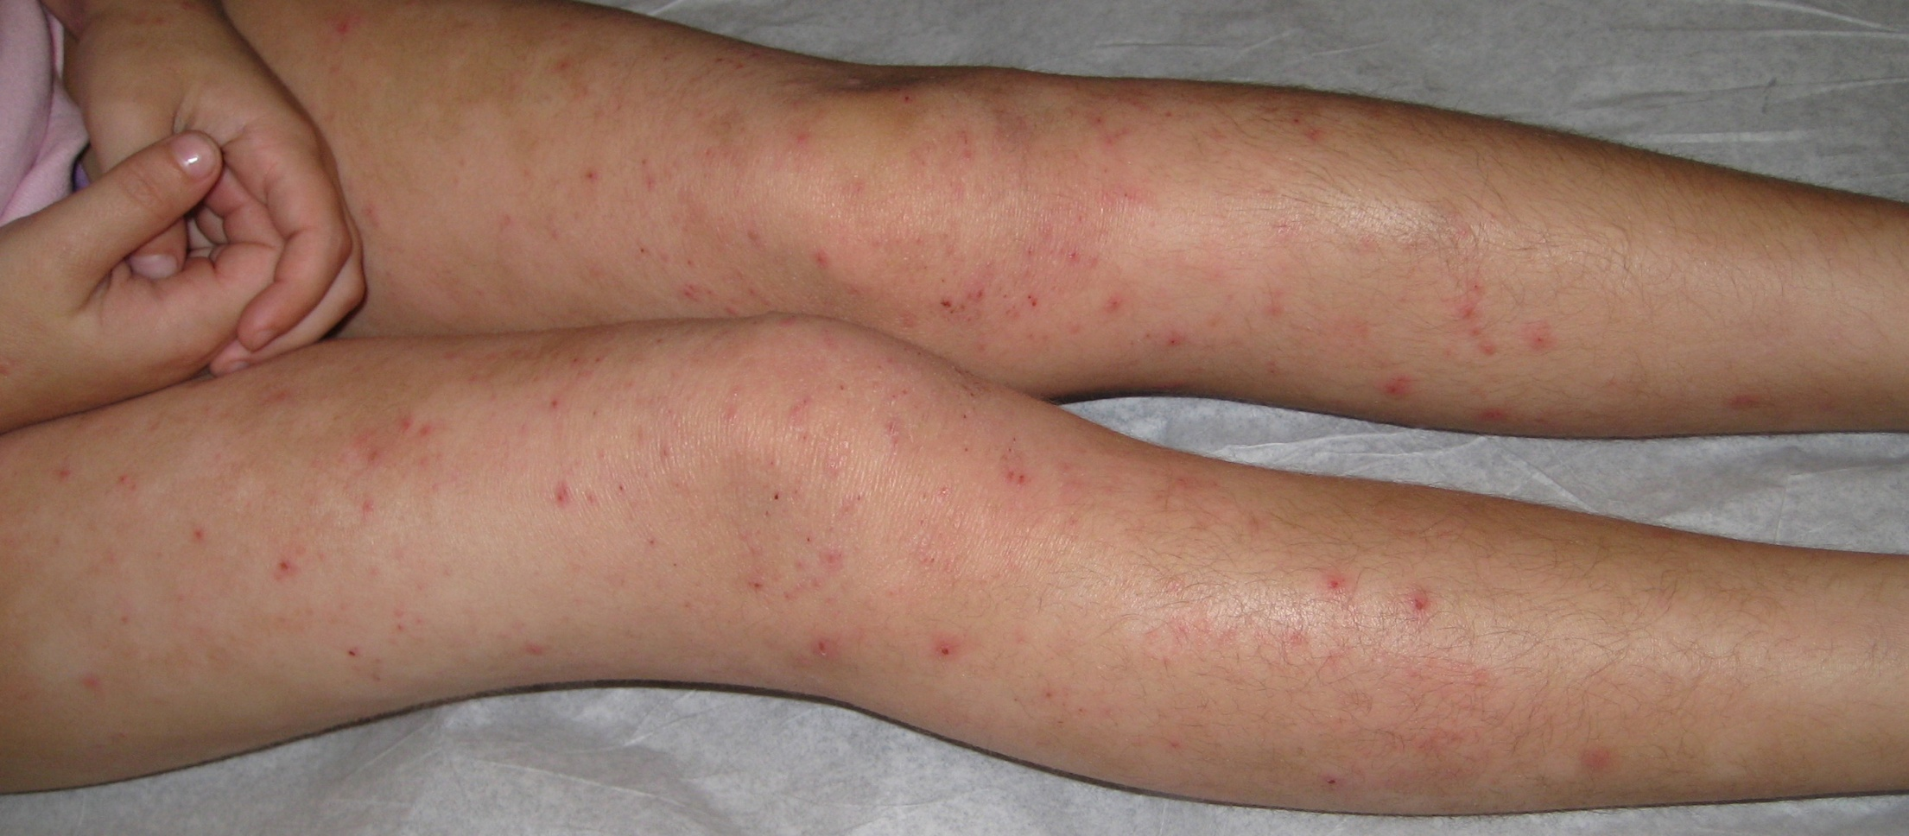

Slide 23
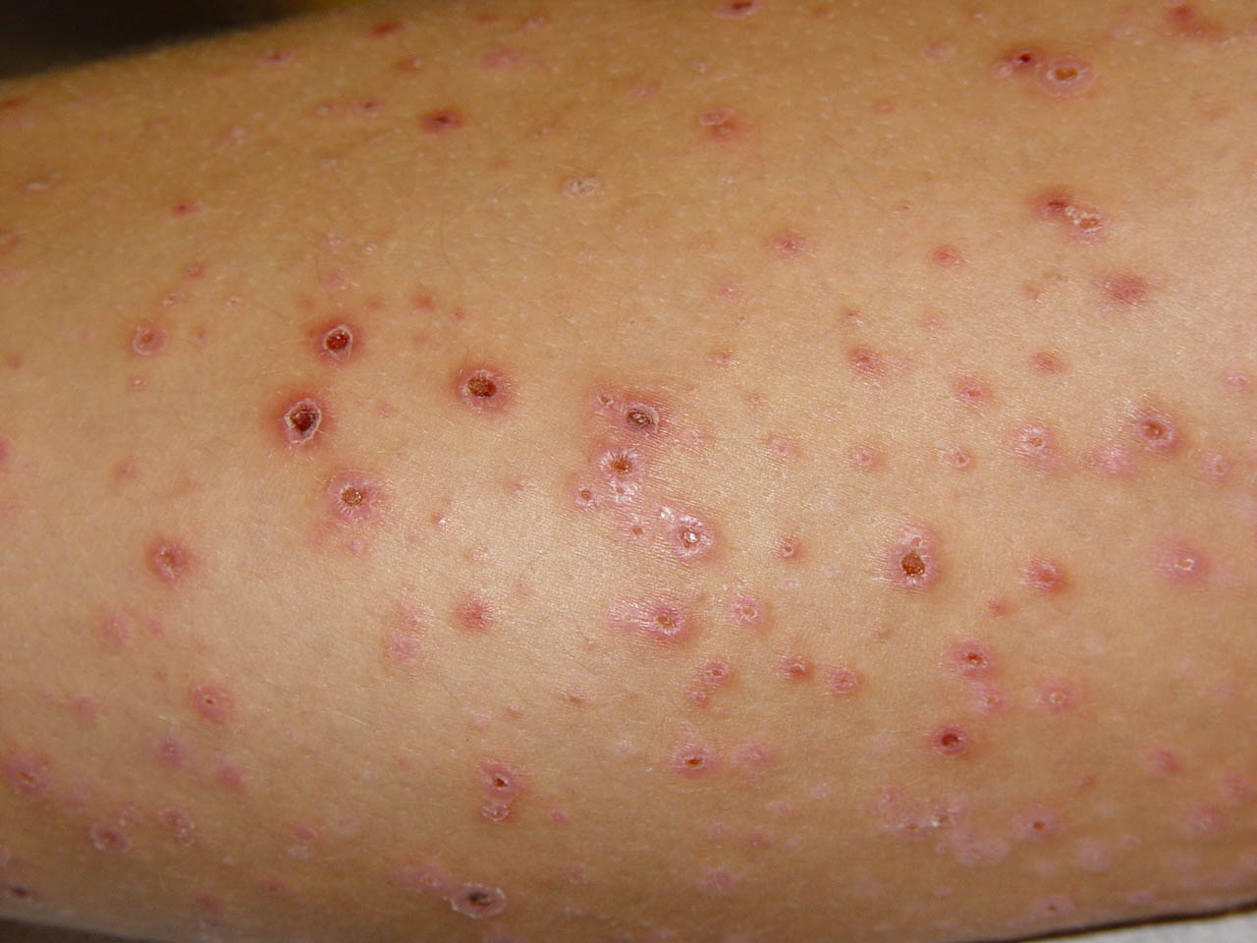

Slide 24
Polymorphonuclear (Leukocytoclastic) Vasculitis
Characterized by PMN in the vessels walls, fibrinoid necrosis of blood vessels, nuclear dust, and exocytoses of erythrocytes.
Due to immune complexes deposition in the walls of capillaries and venules.

Slide 25
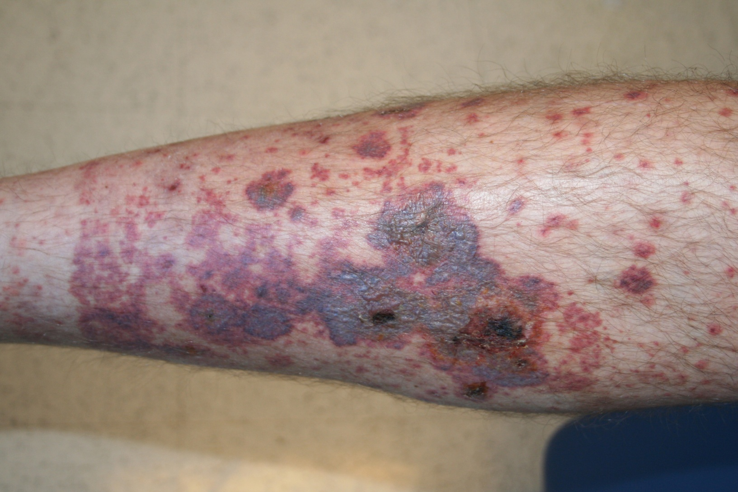

Slide 26
Causes:
Infection: Streptococci, influenza V., hepatitis A,B,C, CMV, HIV, mycobacteria.
Drugs: Aspirin, penicillin, sulphonamides, Immunization, oral contraceptives, B-blockers, Thiazides, ImG, Phenytoin, phenothiazines, allopurinol, and others.
Malignancies: Leukemia, Lymphoma, MM
Miscellaneous: Collagen autoimmune diseases, Behcet dis. Ulcerative colitis, Bowel bypass syndrome, Primary biliary cirrhosis, hemolytic anaemia, mixed cryoglobulinemia, Hypergamumaglobulinemia, Cystic fibrosis.
Idiopathic: Variable

Slide 27
Clinical Findings
Highly variable, but symmetrical and the legs are most heavily involved.
Classic presentation is of painfull, palpable, purpuric, non-blanchable papules and plaques.
Typical color changes of a resolving bruise
May be macular, nodular, urticarial, bullous, ulcerative and necrotic.
Possible systemic involvement include arthralgias, hematuria, gastrointestinal bleeding pulmonary hemorrhage, and CNS disease.

Slide 28
Management.
Skin biopsy with immunofluorescence.
Laboratory work-up to exclude other causes of purpura and for internal involvement.
Remove possible triggers and treat underlying disorders.
Bed rest, elevation of the legs, and compression bandaging Topical/systemic corticosteroids, Dapsone or Colchicine.

Slide 29
III – Bullous Diseases
Blisters are circumscribed fluid filled skin lesions.
Burns, bullous impetigo, herpes simplex and zoster, severe contact dermatitis and insect bites are common examples.
Skin diseases presenting mainly with blisters are relatively rare but may be fatal
eg: autoimmune and mechanobullous diseases.

Slide 30
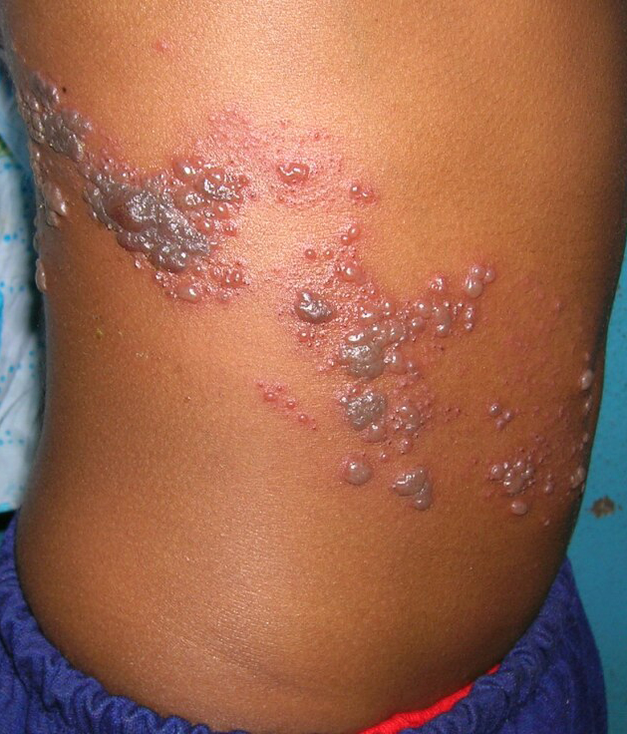

Slide 31
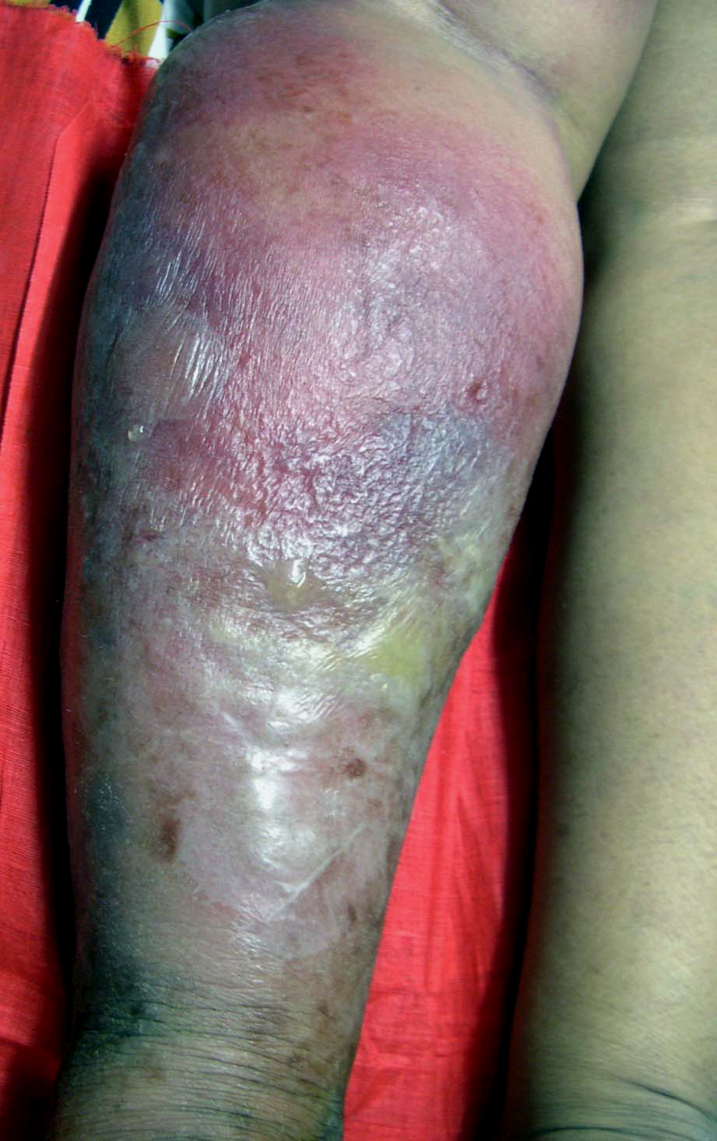

Slide 32
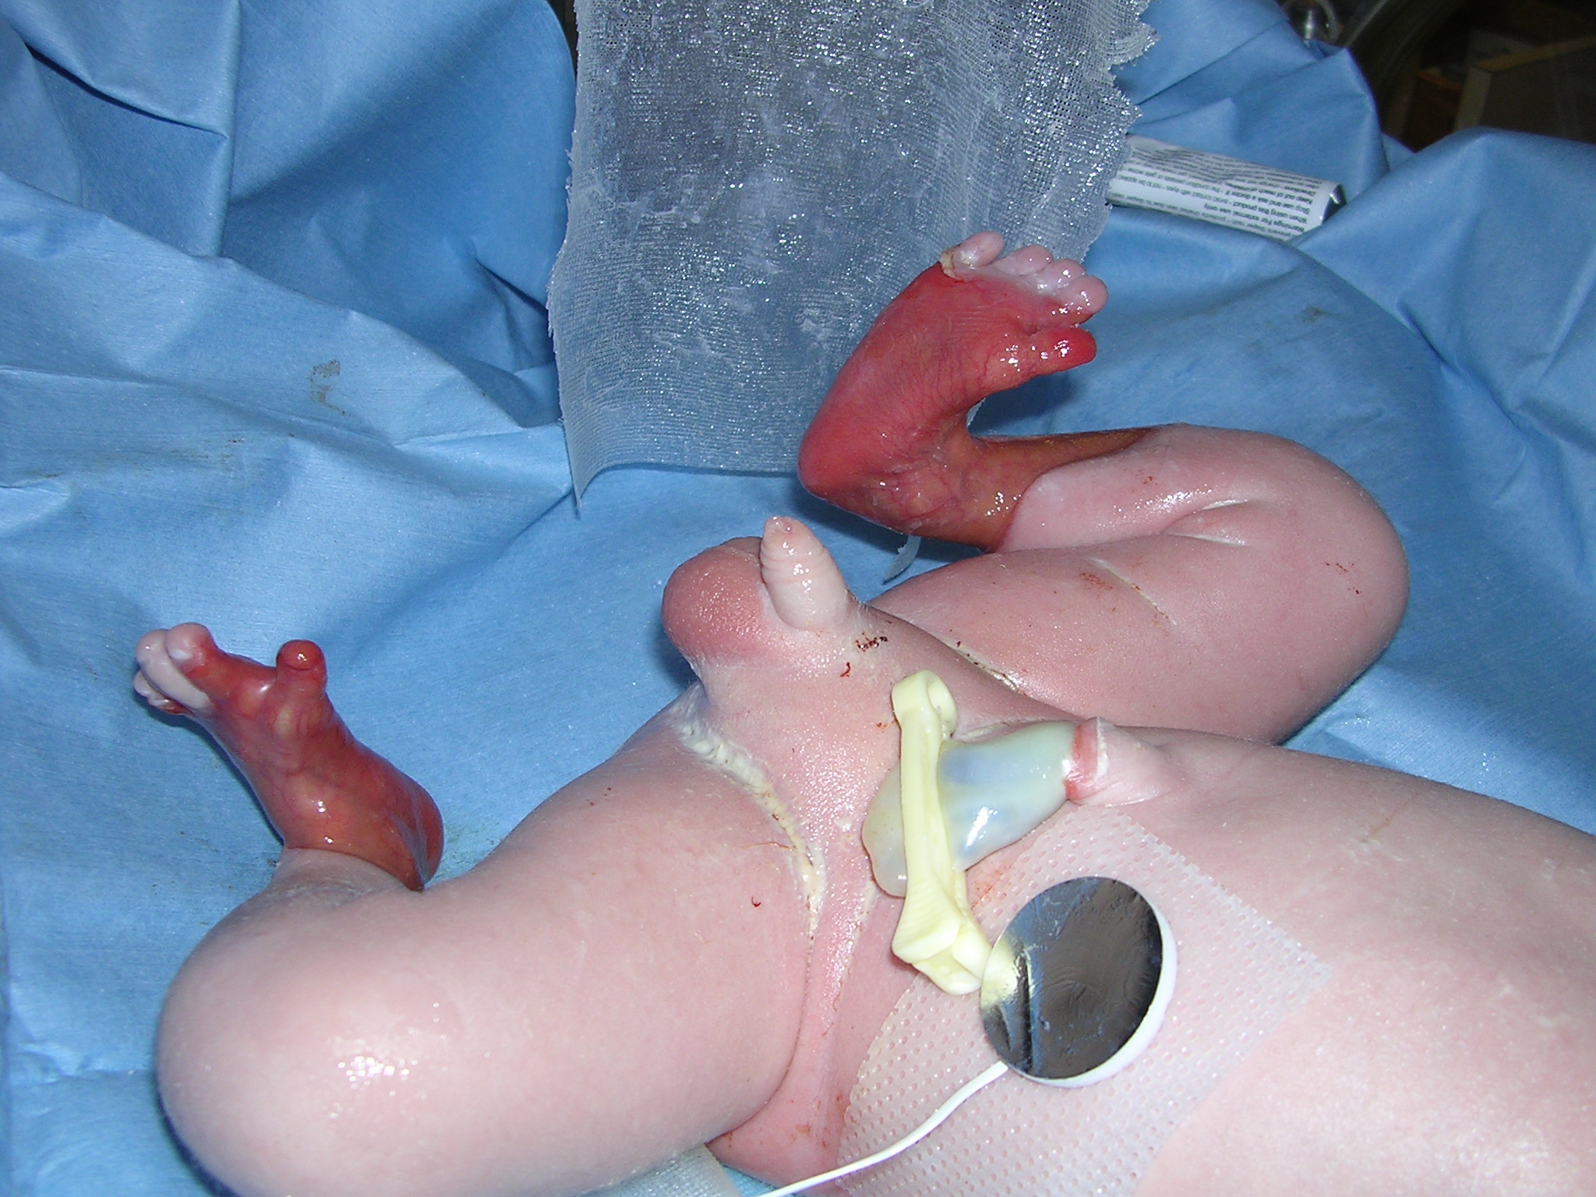

Slide 33
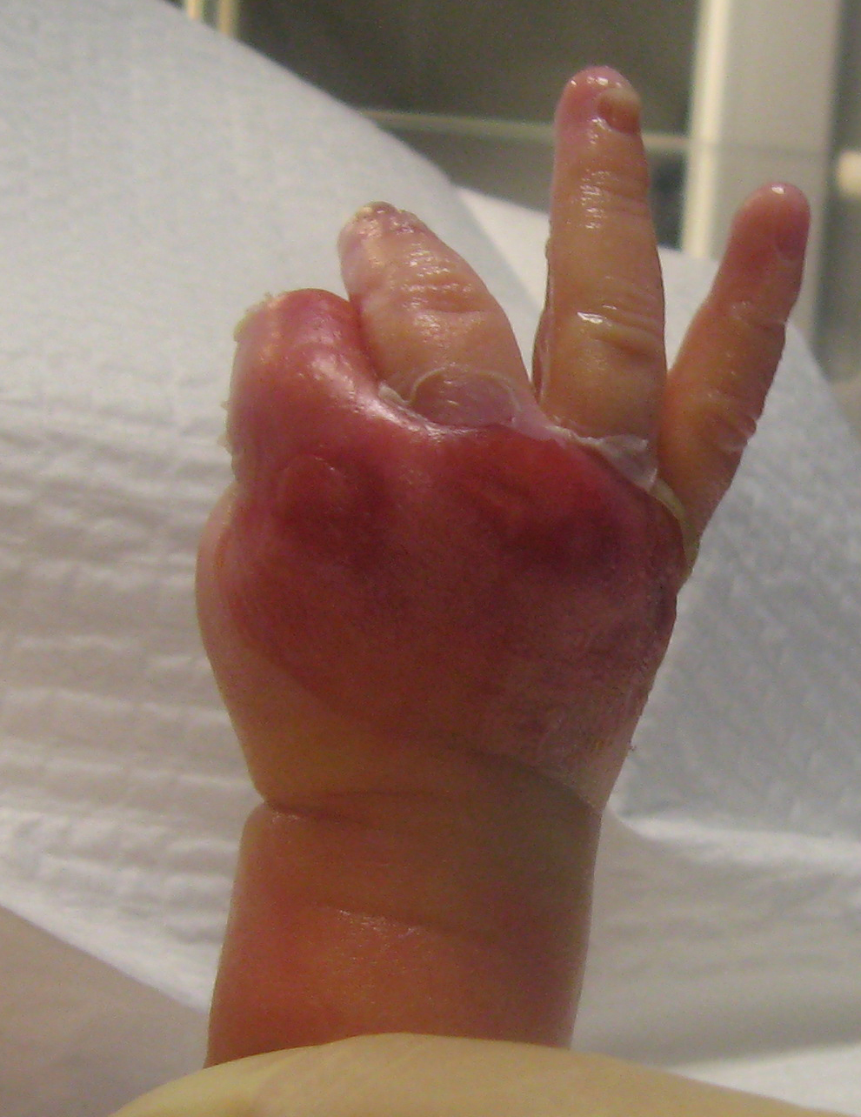

Slide 34
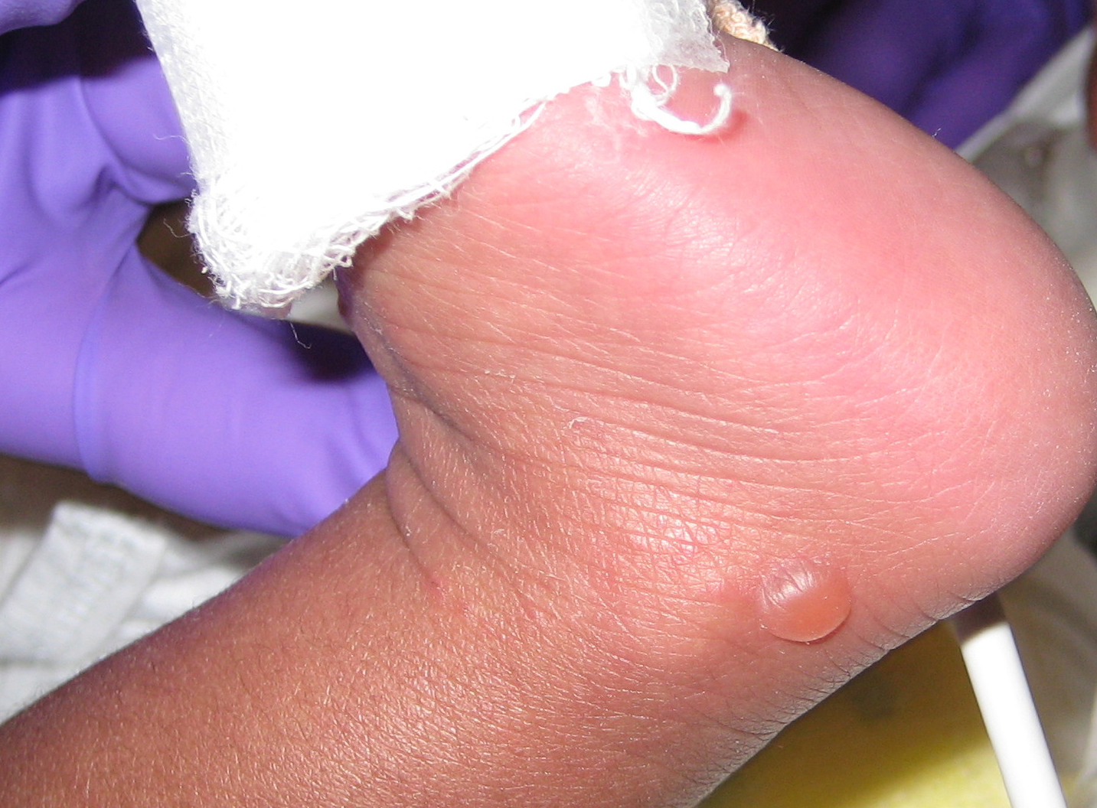

Slide 35
Blisters are either intra-epidermal or subepidermal
Accurate diagnosis requires: H and E histopathological staining, immunoflorescence, electron microscopy, and genetic studies.

Slide 36
Pemphigus:
Caused by auto-antibodies against desmocollins and desmogliens of the epidermis (circulating and fixed)
4 main varieties: Vulgaris, Vegetans, folioceous, Erythematosus
Flaccid blisters and shallow erosions of skin and mucous membranes are the wholemark of the disease
Secondary infection, fluid and electrolyte disturbance are common and potentially life-threatening complications.

Slide 37
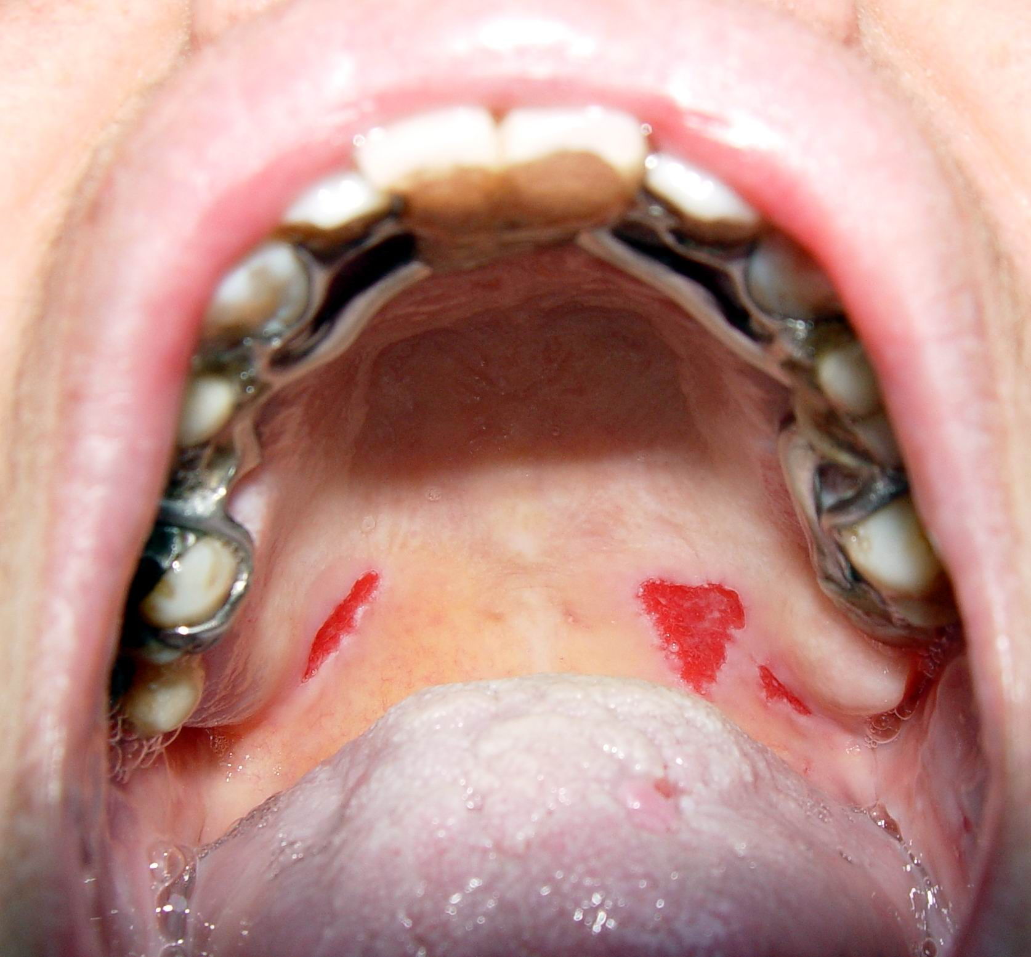

Slide 38
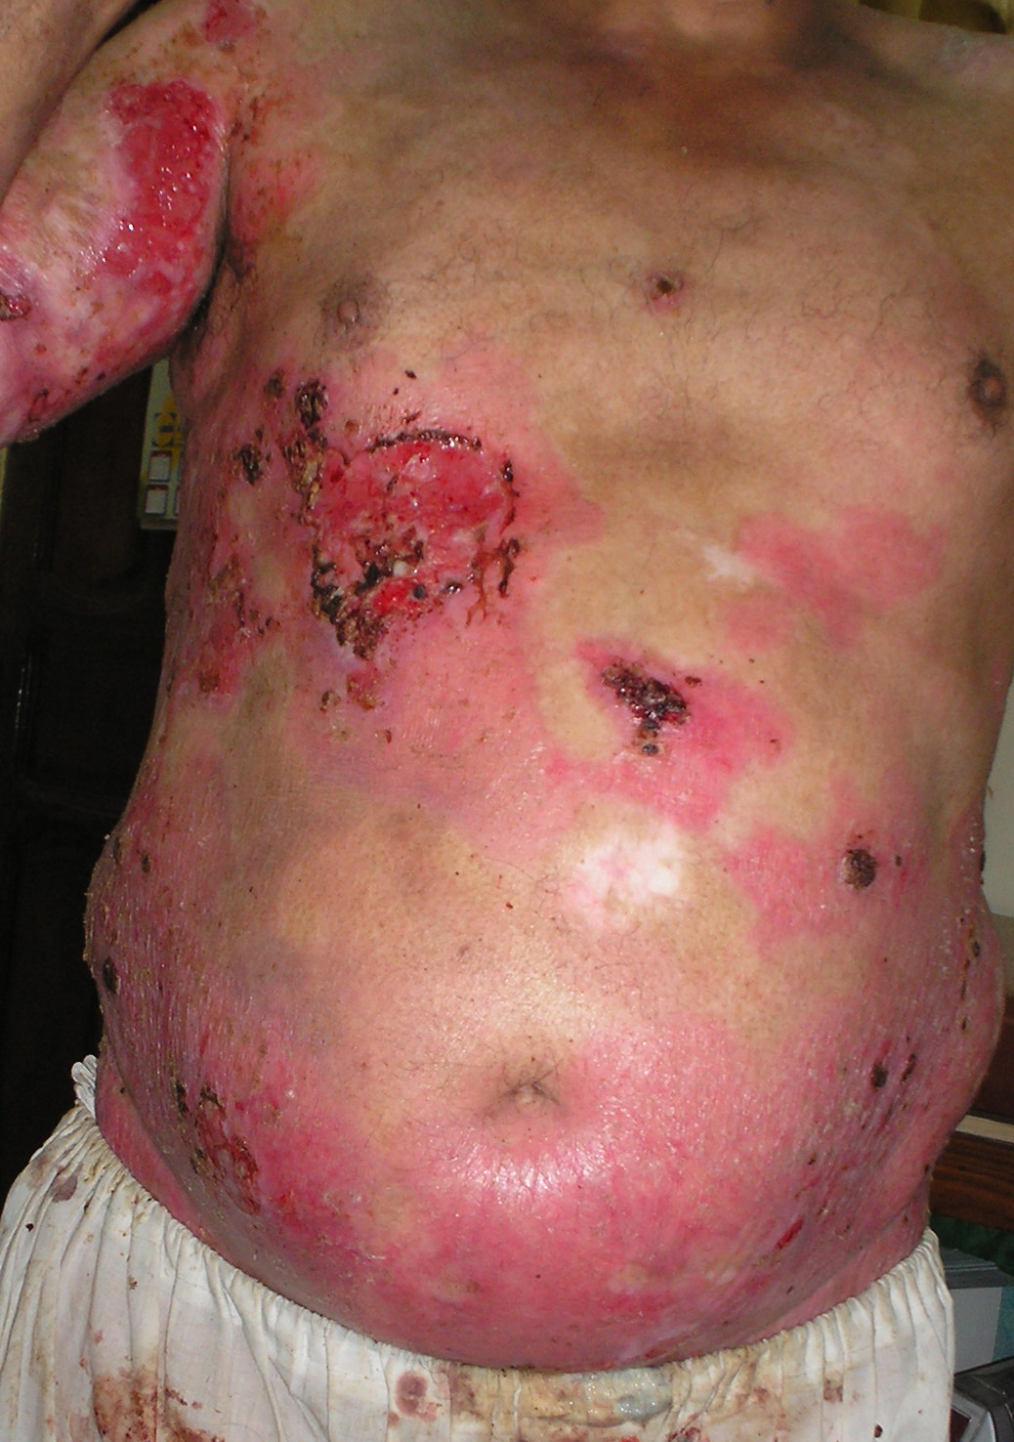

Slide 39
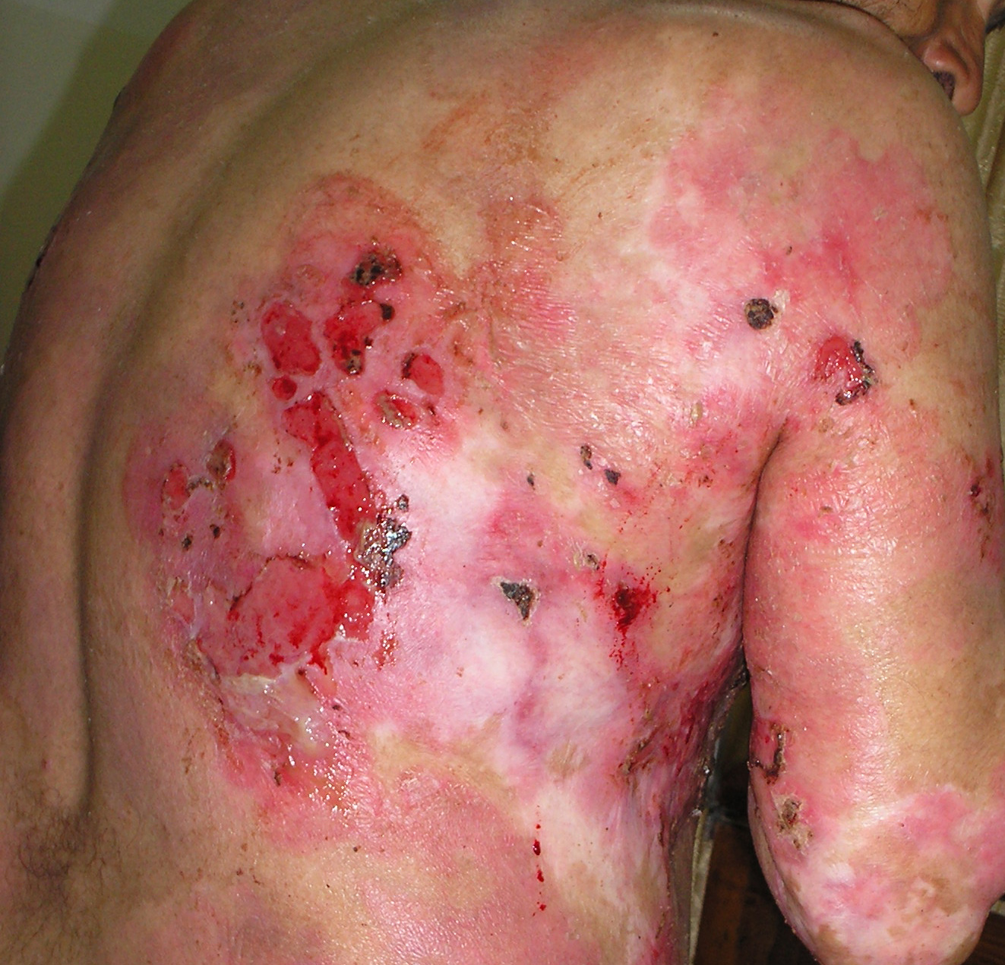

Slide 40
Direct and indirect immunofluorescence of IgG and complement of the epidermal intercellular substance is pathognomonic

Slide 41
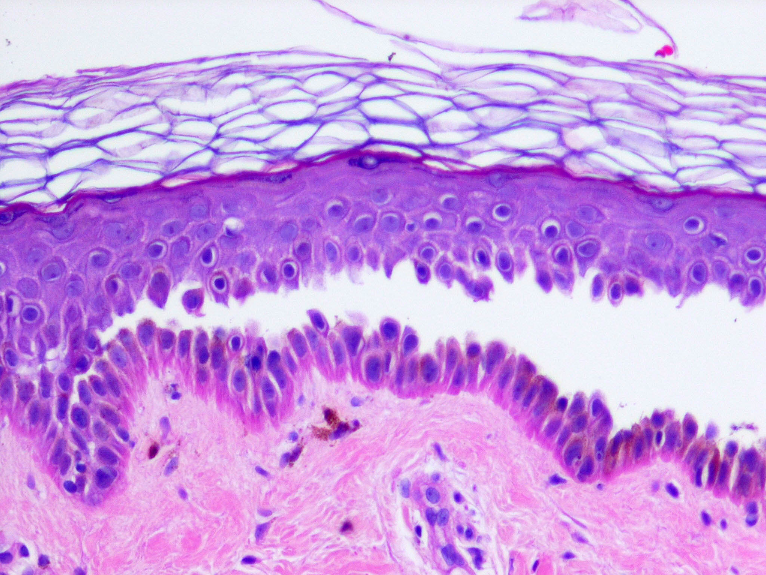

Slide 42
Management:
Systemic Steroids 1- 2 mg / kg/day body weight A maintenance dose is usually necessary possibly for life, to prevent recurrences Azathioprine, cyclophosphamide, mycophenolate mofetic, cyclosporin.
Plasmopheresis / intravenous immunoglobulins. Topical therapy for protecting raw areas and decreasing secondary infection
Symptomatic management as in burns.

Slide 43
Bullous Pemphigoid
Caused by autoantibodies against BP1 and 2 antigens of the Lamina Lucida of the basement membrane. Itchy large tense blisters on an inflamed base in patients aged 60 and older
Upper arms and thighs. Oral lesions are less frequent than in pemphigus.

Slide 44
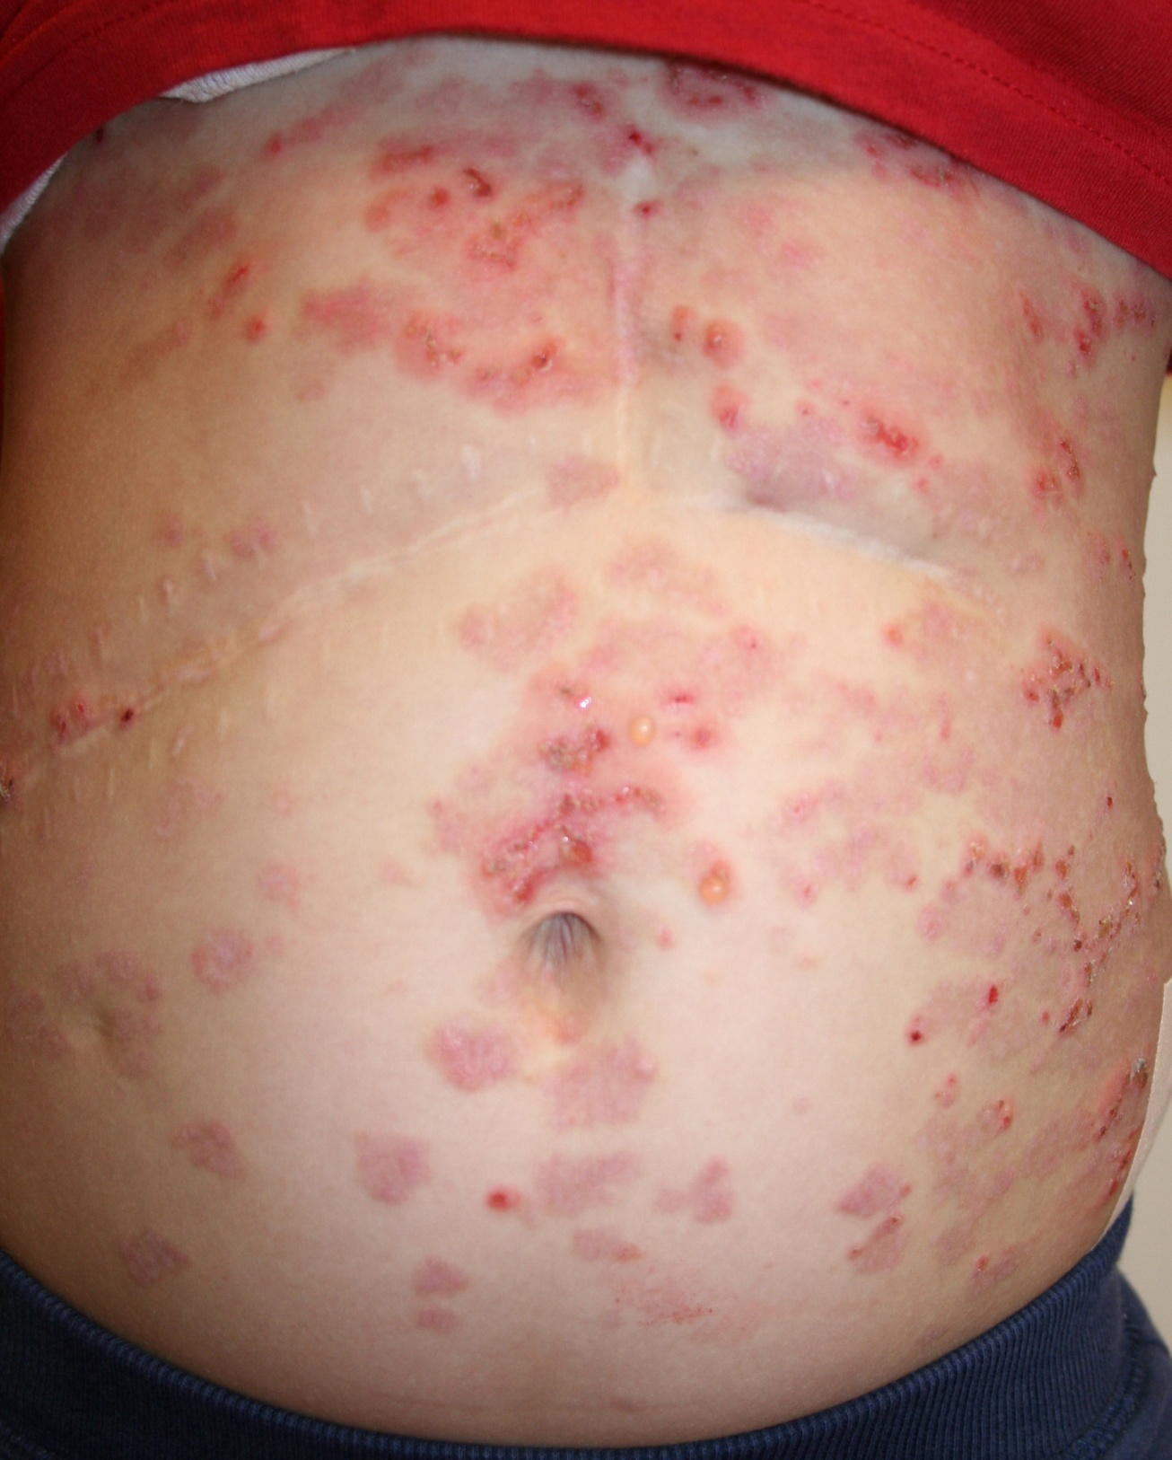

Slide 45
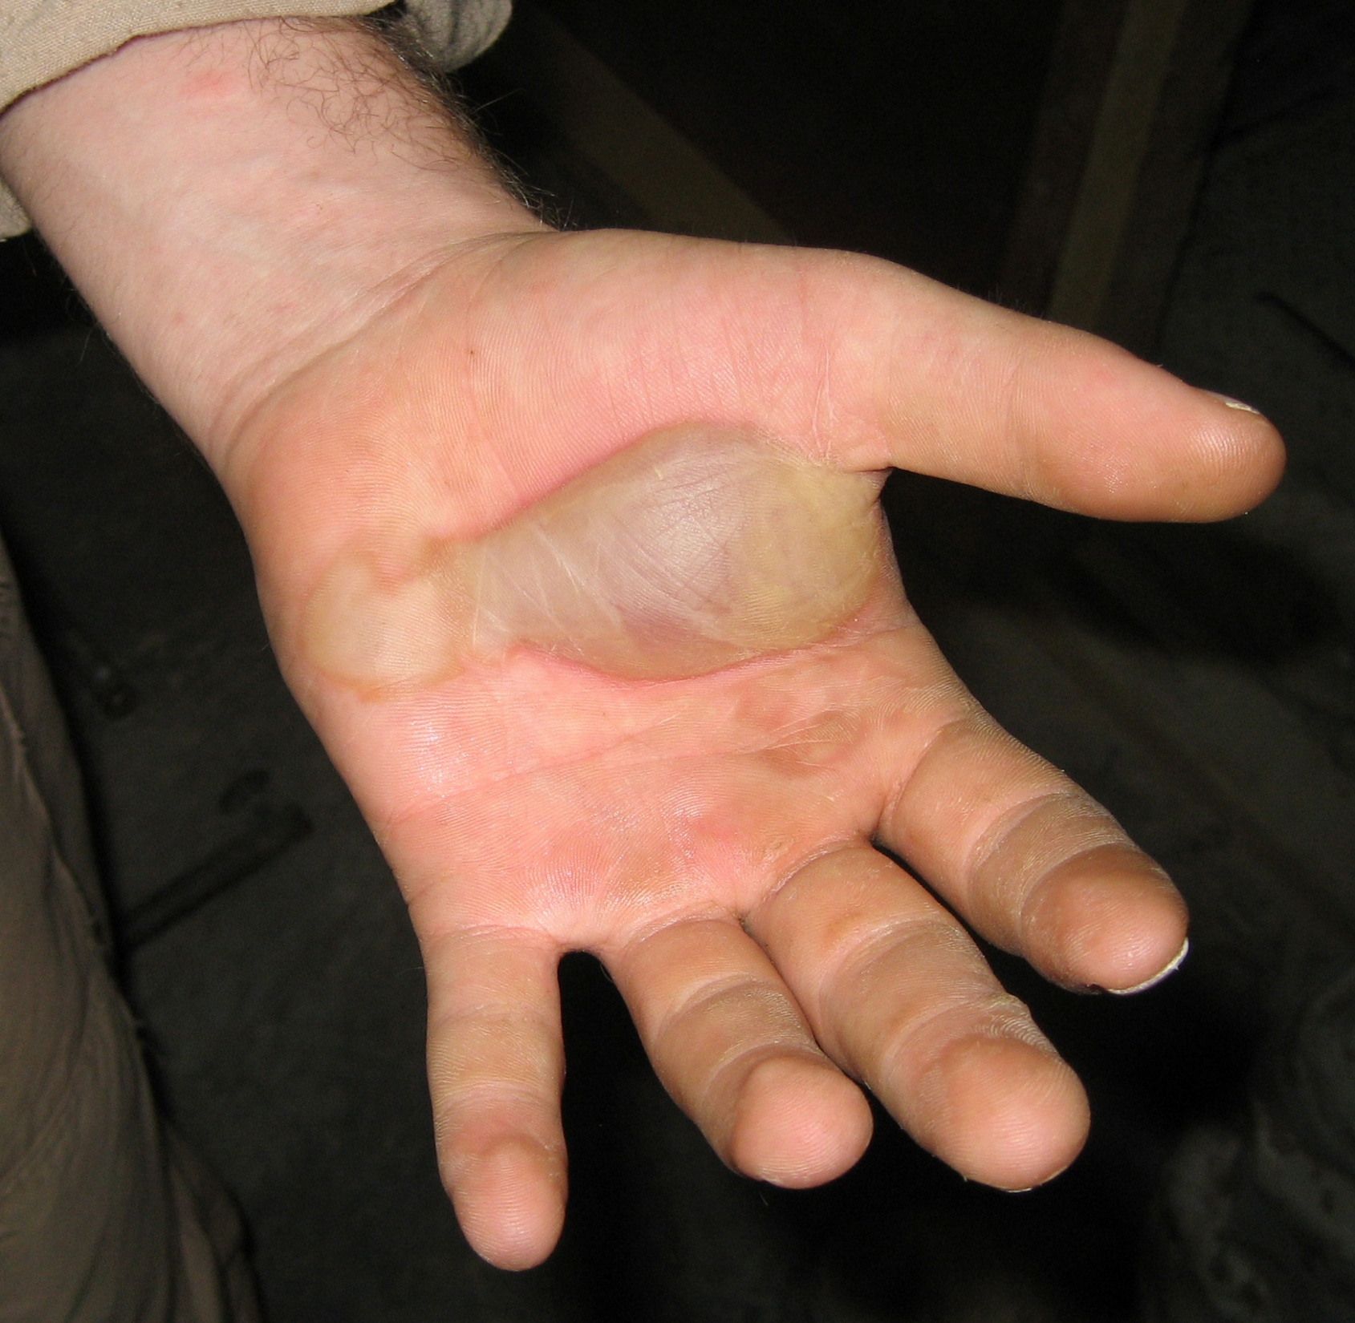

Slide 46
Management:
Subepidermal blisters
Immunoglobulins and complement are deposited in a linear band along the basement membrane

Slide 47
Systemic steroids 0.5 – 0.75 mg /kg/day
May be possible to discontinue treatment after 2-3 years
Oral dapsone 50- 150 mg
Less morbidity / mortality than in pemphigus

Slide 48
Erythema Multiforme – Stevens-Johnson – TEN Spectrum
EM is a cutaneous reaction pattern to several provoking stimuli including herpes simplex, bacterial infection and drugs. May be idiopathic.
(cf. SSSS)

Slide 49
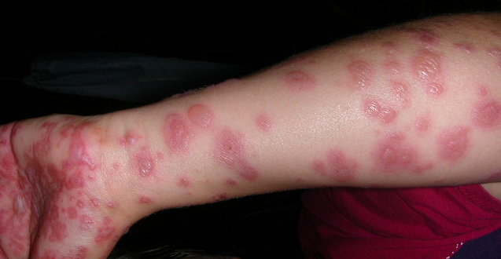

Slide 50
Clinical Findings
Target (iris – like) lesions involve the hands and feet
The bullous lesions of EM with severe involvement of the eyes and other mucosal surfaces is termed Stevens-Johnson Syndrome. When accompanied with extensive sloughing (shedding) of epidermis it is TEN (Toxic epidermal necrolysis)
The blisters form at the dermo-epidermal junction with necrosis of the overlying epidermis

Slide 51
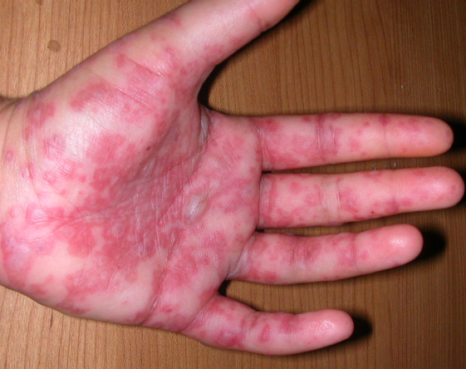

Slide 52
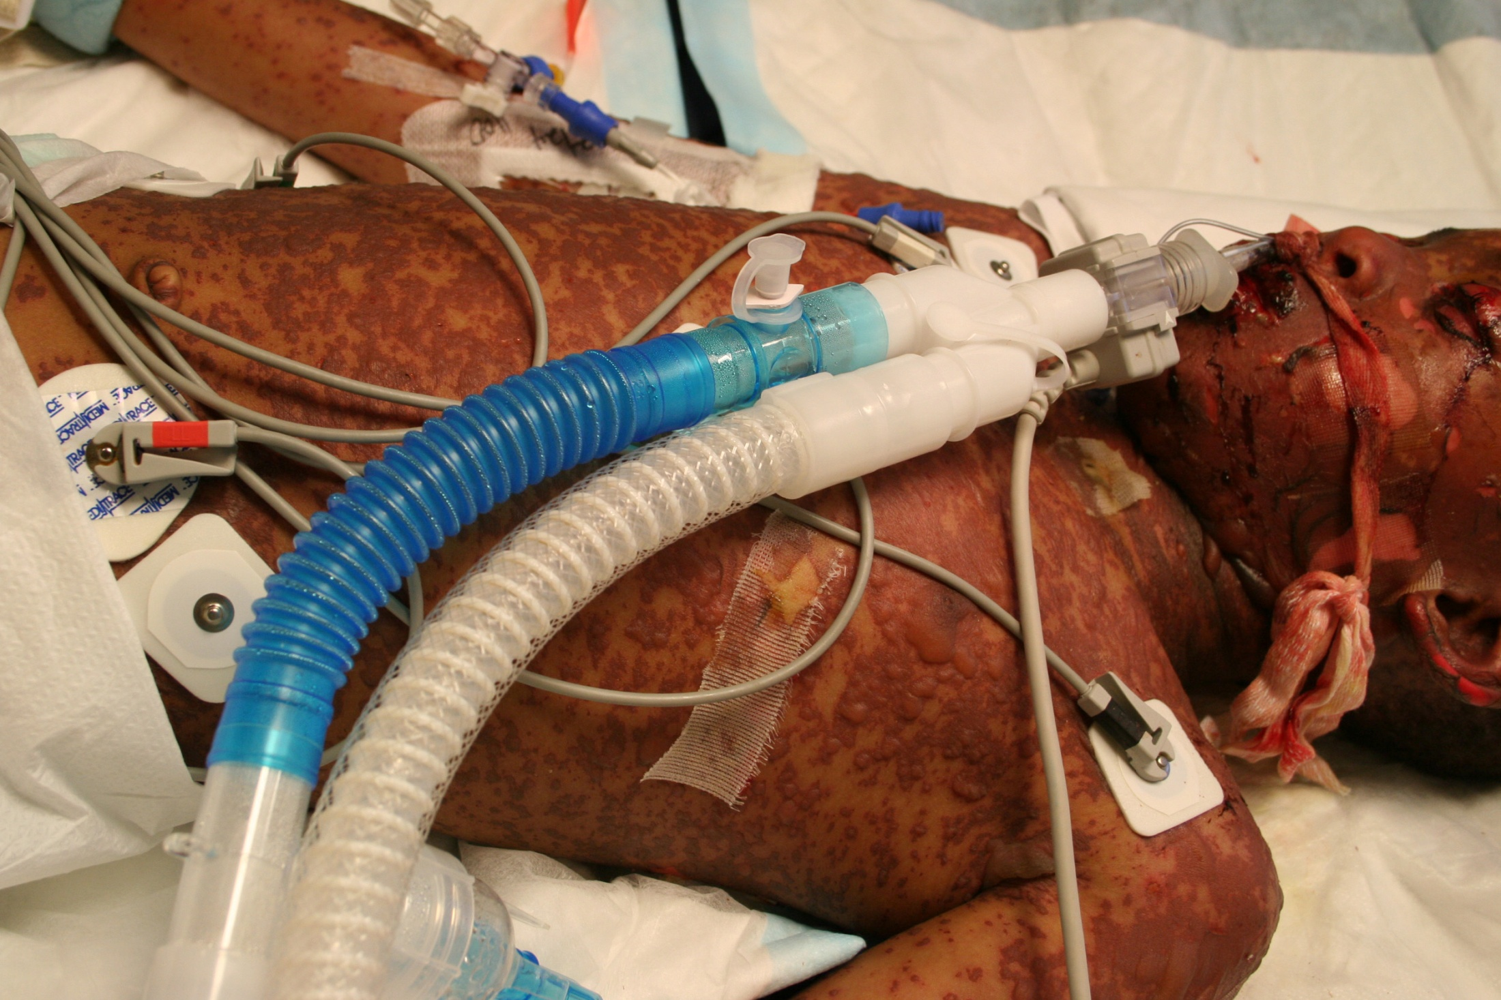

Slide 53
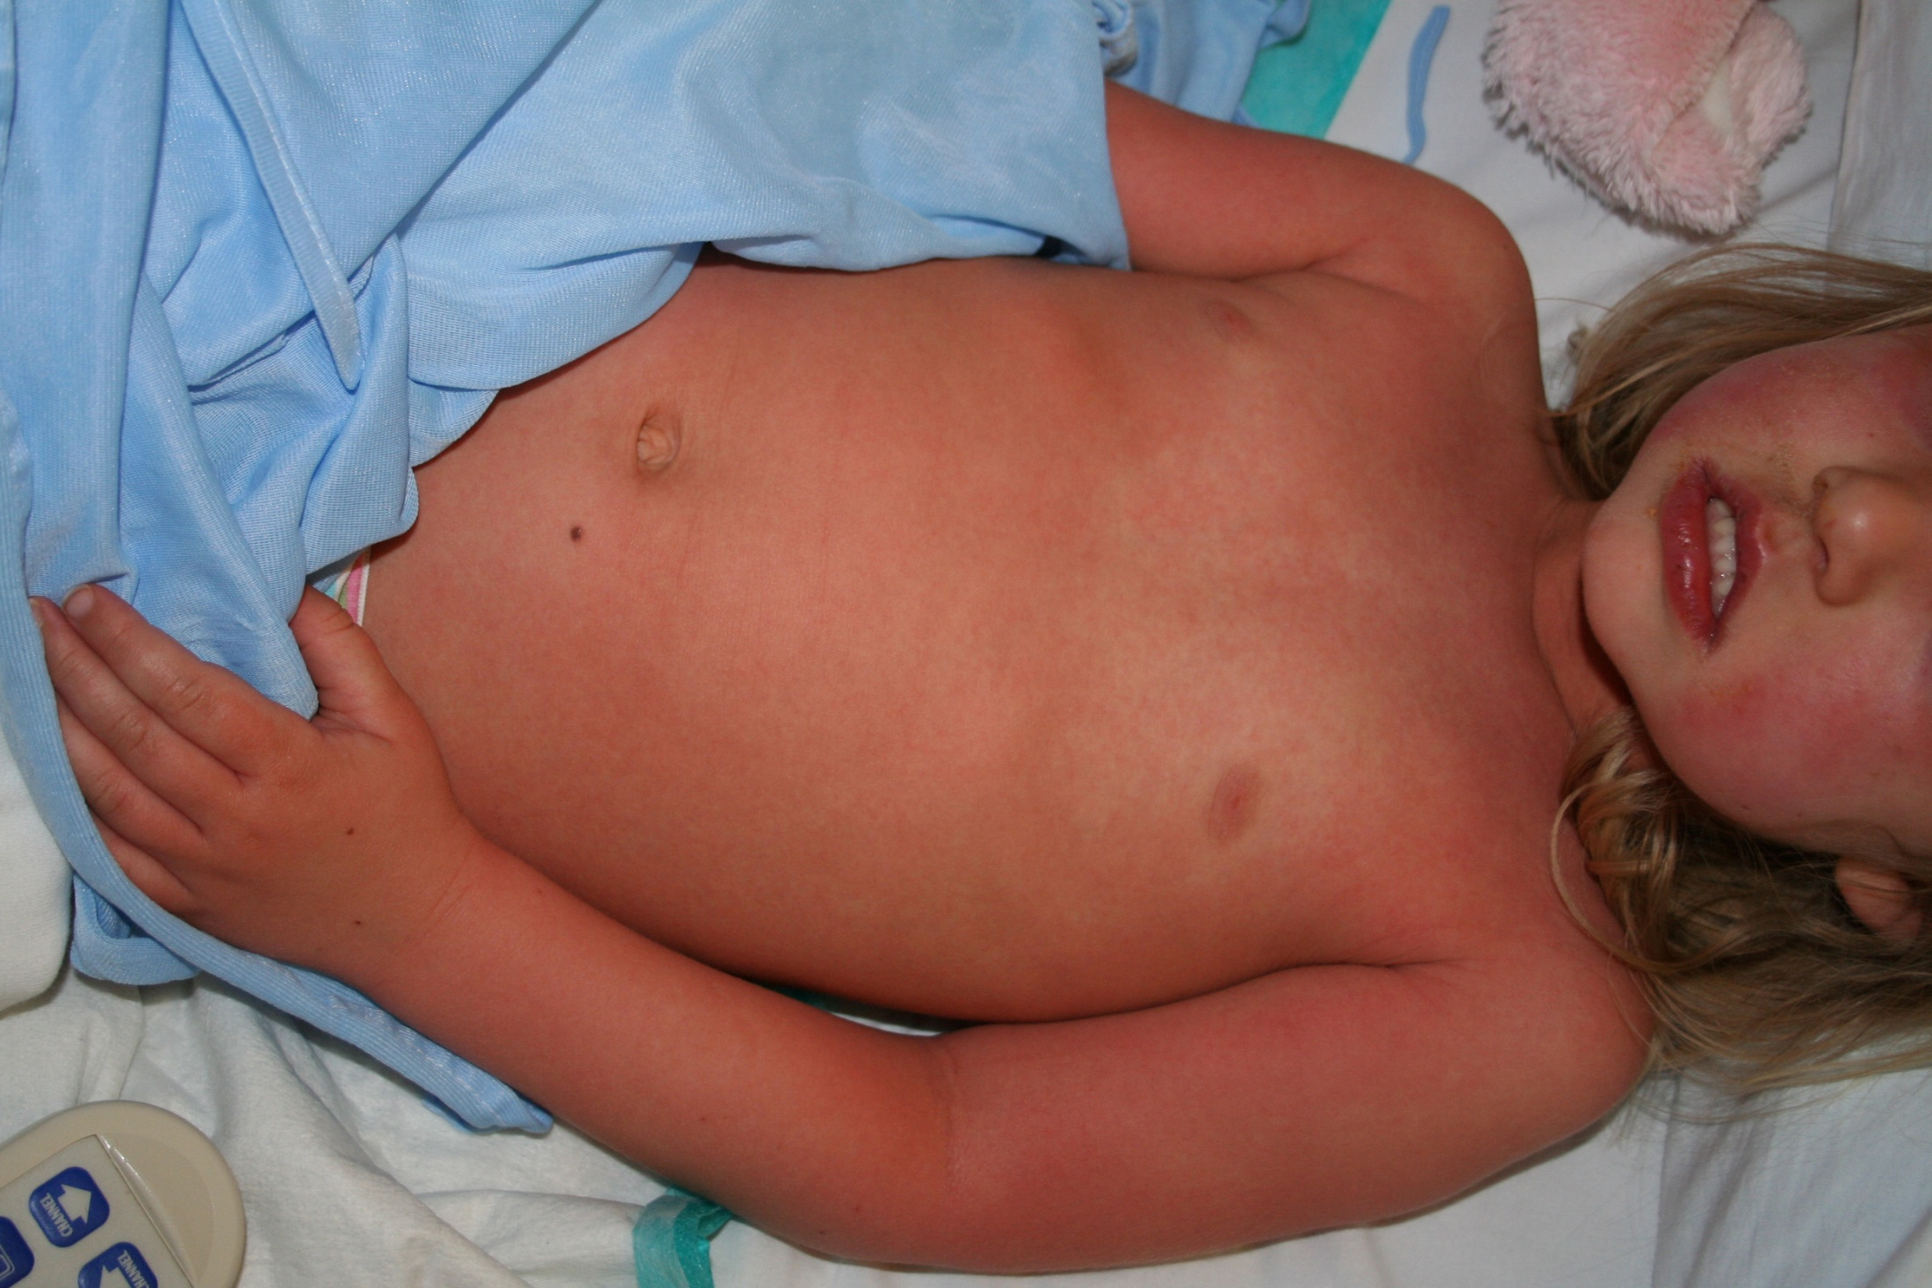

Slide 54
Management
Treated Like burns
Systemic steroids and immunoglobulins are controversial
Sepsis is a major cause of mortality
Meticulous care of the eyes is essential to avoid blindness.

Slide 55
Erythroderma
Involvement of more than 90% of skin by erythema and scaling (exfoliation)
May complicate some skin diseases eg: Psoriasis, atopic eczema and mycosis fungoides
Other causes include drugs and malignancies Also idiopathic.

Slide 56
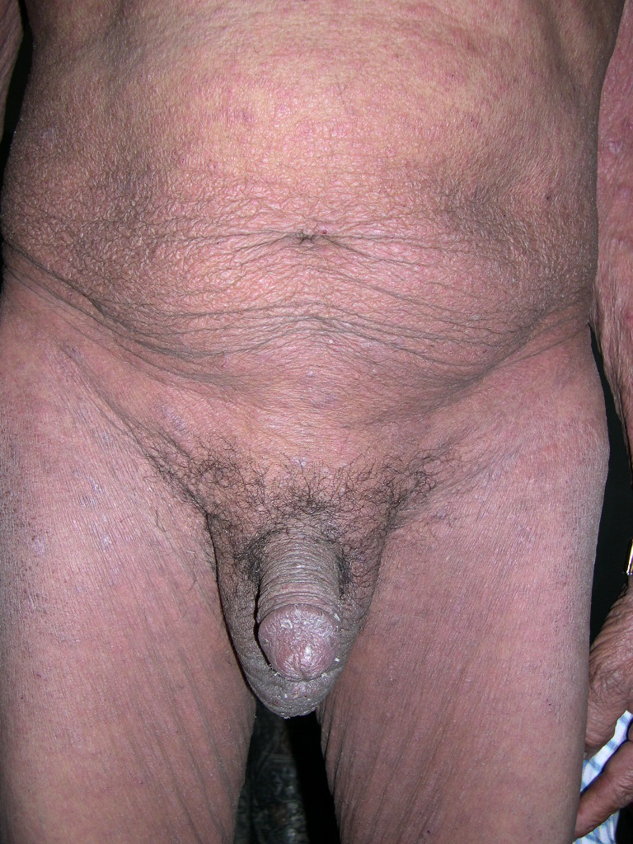

Slide 57
Acute erythroderma is caused by drugs and is potentially fatal
Erythroderma has profound effects on the entire body. eg: poikilothermia, fluid and electrolyte imbalance, high output cardiac failure,increased basal metabolic rate,hypoproteinemia, anemia due to reduced levels of iron, folic acid and other vitamins, endocrine, hepatic and renal complications, effects on hair and nails.

Slide 58
Management
Histopathology is not always helpful
History and physical examination for clues are important
Chest X ray, immunoelectrophoresis, CT scans and bone marrow aspiration

Slide 59
Treatment is supportive, including fluid restoration, parenteral nutrition and temperature control.
Be aware of signs of sepsis, renal and cardiac failure.

