Slide 1
BULLOUS DISEASES

Slide 2
Bollous Diseases Difinitions
•Blister: collection of clear fluid.
•Bulla: Blister>5mm diameter.
• Vesicle: Blister<5mm diameter.
• Crust Dried exudate on skin.
•BSDs are skin conditions characterised by blister formation.

Slide 3
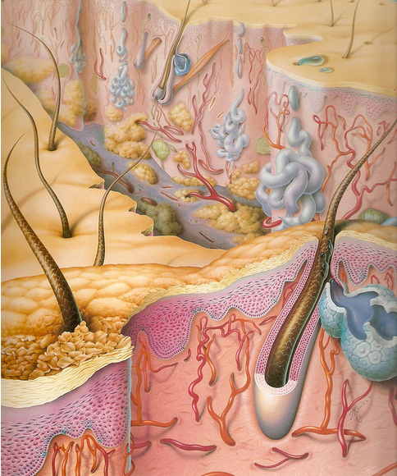

Slide 4
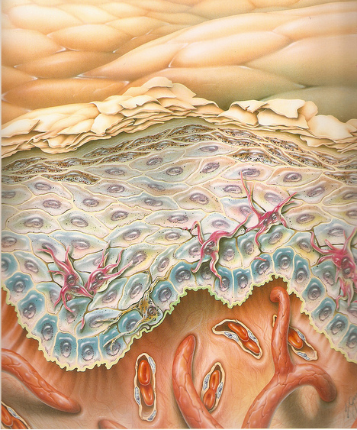

Slide 5
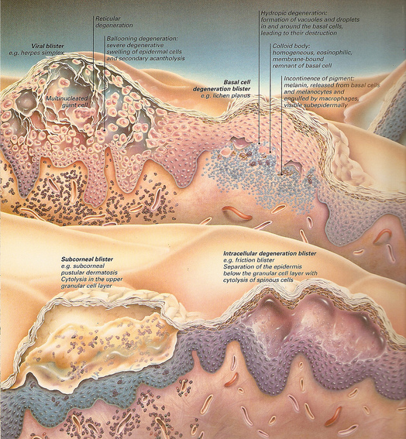

Slide 6
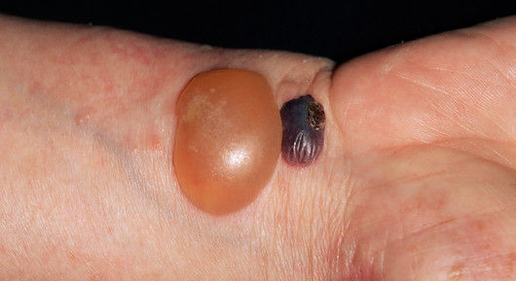

Slide 7
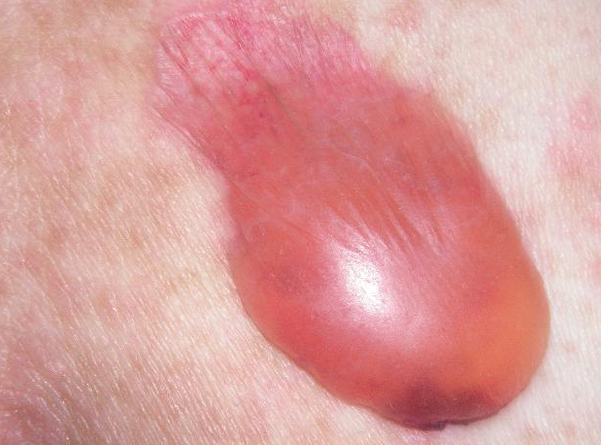

Slide 8
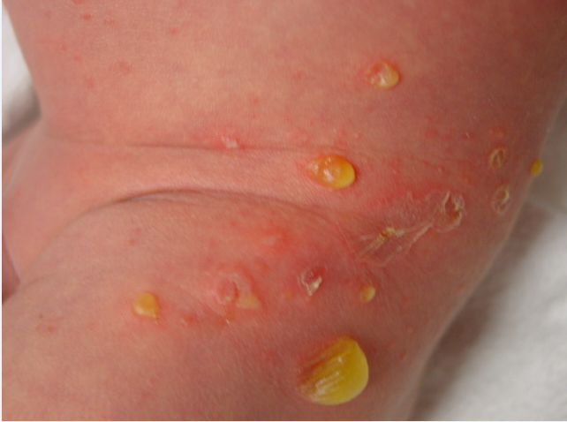

Slide 9
Diagnosis of bullous Disorders
-clinical evaluation
-histopathological examination
-Immunoflourescent examination

Slide 10
Light microscopy
-inflammatory infilterate
-level of blister formation

Slide 11
Immunofluorescence
-tissue-bound antibodies(direct)
-circulating antibodies(indirect)

Slide 12
Basement membrane zone
• Plasma membrane:
basal keratinocyte
hemidesmosome
• Lamina Lucida
• Lamina Densa
– Type IV collagen
• Anchoring fibrils
– Type VII collagen

Slide 13
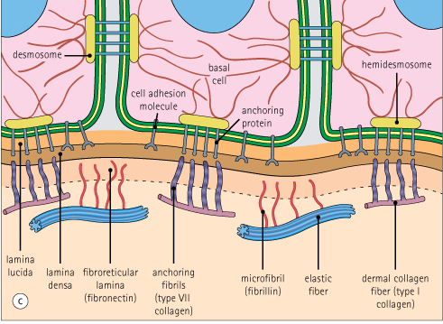

Slide 14
PATHOPHYSIOLOGY
.The keratinocytes of the epidermis are tightly bound together by desmosomes .
.Beneath the epidermis lies the BMZ, which is a specialised area of cell- extracellular matrix adhesion.
.Specialised structures traversing this zone anchor the epidermis to the dermis.
.These structures(matrix) comprises polysaccharides and proteins(including collagens) linked to form macromolecules(adhesion complex).

Slide 15
If any of these specialised attachments are malformed, absent or damaged, seperation may occur leading to accumulation of fluid in the extracellular space and blister formation.
The BMZ is particularly vulnerable to damage or malfxn and is a common site of blister formation.

Slide 16
Pathomechanisms of Blistering
• Epidermal oedema(spongiosis causing separation of keratinocytes)
• Epidermal necrosis eg erythema multiforme
• Damage to intercellular connections eg
pemphigus
• Basal Cell degeneration eg Lupus
erythematosus
• Damage to basal cell membrane
eg pemphigoid
• Dermal damage eg dermatitis herpetiformis

Slide 18
Differential diagnosis | characteristics | Site of blister
Impetigo, miliaria, SSSS | Very thin roof breaks easily | Subcorneal
Acute eczema, varicella, herpes simplex, pemphigus | Thin roof ruptures to leave denuded surface | Intraepidermal
Bullous pemphigoid, dermatitis herpetiformis, erythema multiforme, TEN, friction blisters | Tense roof often remain intact | Subepidermal

Slide 19
Nikolsky sign vs. Asboe-Hansen
.Nikolsky sign:Shearing stress on normal skin(sliding pressure) can cause new erosion to form(+ve Nikolsky sign).
. Asboe-Hansen sign: direct pressure on intact bulla leading to bulla-spread phenomenon.

Slide 20
Causes of Blistering Disorders
• Congenital
• Acquired
Infection
Trauma
Autoimmune
• Idiopathic

Slide 21
Autoimmune diseases
Organ specific autoimmune disease
Mediated by pathogenic
autoantibodies to specific tissue
antigens

Slide 22
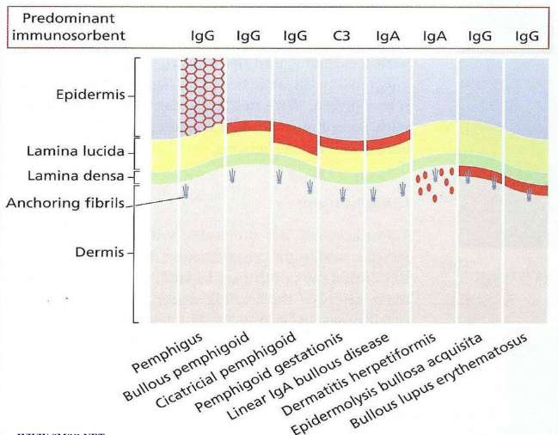

Slide 23
Pemphigus
group of autoimmune blistering diseases of skin and mucous membranes that are
characterized by intraepidermal blisters due to acantholysis -separation of epidermal cells from each other with bound and circulating IgG directed against the cell surface of keratinocytes

Slide 24
Classification of Pemphigus
Pemphigus vulgaris
Pemphigus vegetans
Pemphigus foliaceus
Pemphigus erythematosus
Paraneoplastic pemphigus
Drug-induced

Slide 25
Pemphigus Vulgaris
-middle age groups(40-60 yrs of life)
-usually begins with painful mouth erosions.
-fragile flaccid blisters break and expand to form large erosions.
-nikolsky sign.
-fatal in all cases if not treated.

Slide 26
Pemphigus Vulgaris cont.
-Biopsy shows that vesicles are intraepidermal with rounded keratinocytes floating freely within the blister cavity(acantholysis)
-Direct IF of adjacent normal skin shows intercellular epidermal deposits of IgG and C3
-In indirect IF, Abs that binds to the desmogleins in the desmosomes of normal epidermis is found in pxs serum (correlates with disease activity)

Slide 27
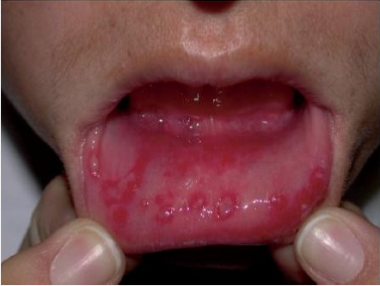

Slide 28
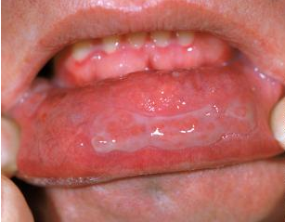

Slide 29
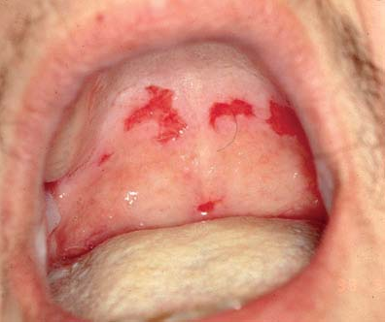

Slide 30
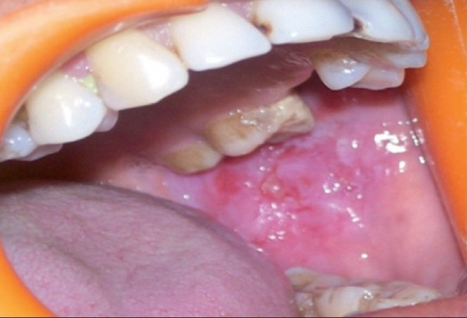

Slide 31
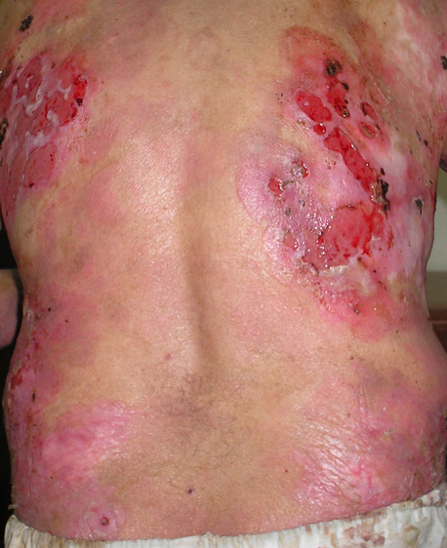

Slide 32
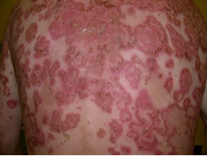

Slide 34
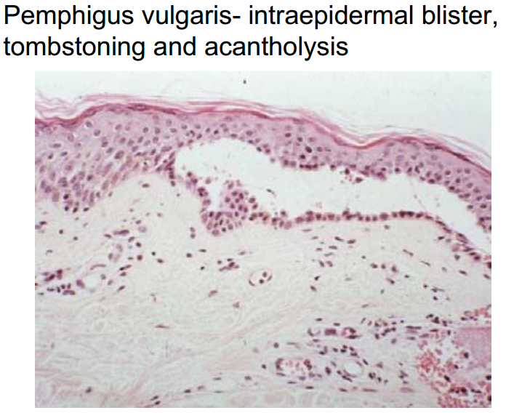
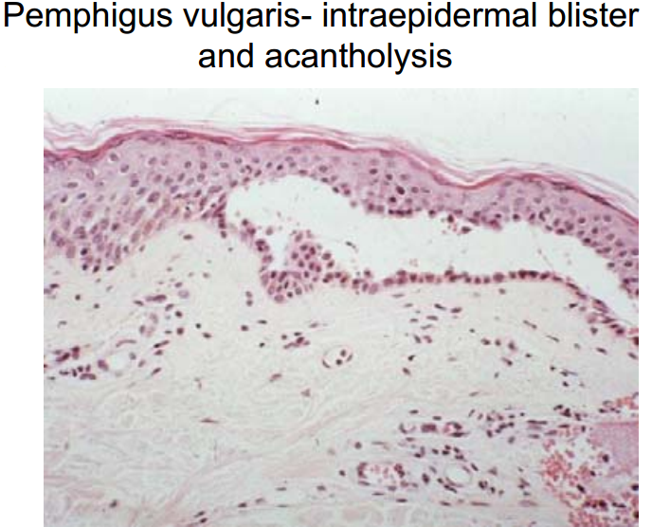

Slide 35
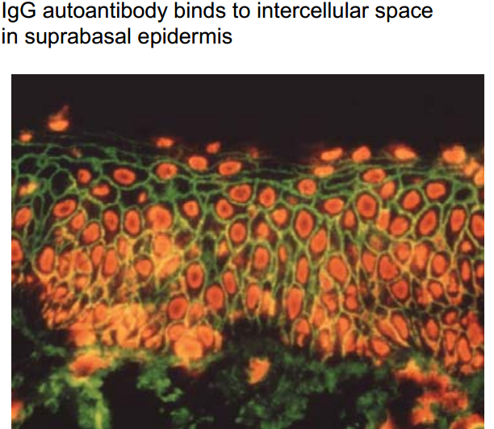

Slide 36
P.V. Treatment
-Supportive care
-Systemic corticosteroids
-Adjuvant immunosuppressive therapy
mycophenolate mofetil (CellCept)
azathioprine (Imuran)
cyclophosphamide (Cytoxan)
cyclosporine, gold, antimalarials, or dapsone
-Biologicals: monoclonal anti-CD20 antibody [rituximab (Rituxan)
-Plasmapheresis/IVIG
-Extracorporeal photochemotherapy

Slide 37
Pemphigus
P.vegetans: form of vulgaris;crusted papillomatous(vegetating)lesions on scalp and intertriginous areas.
P.foliaceus:scaly crusted well demarcated lesions on face and upper trunk.
P.erythematosus:the most localized form of P.foliaceus ;face.
Drug induced Pemphigus: penicillamine ,captopril,rifampin……
:Paraneoplastic Pemphigus
Clinical & hist. Features of both stevens-Johnson synd. P.Vulg, Ass: Non Hodgkin’s Lymphoma

Slide 38
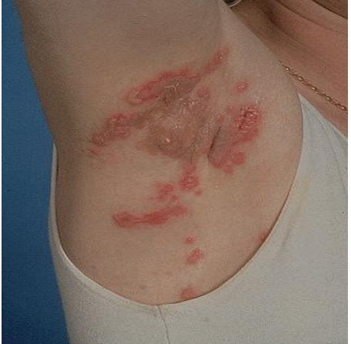

Slide 39
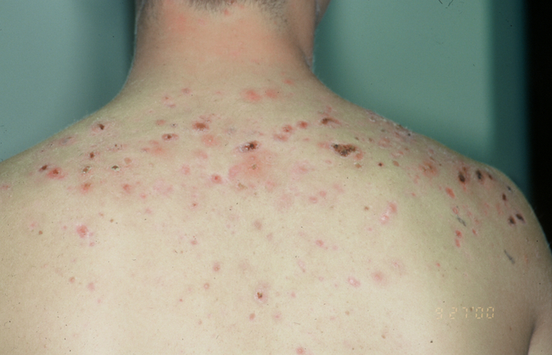

Slide 40
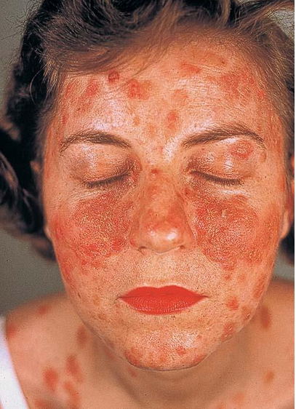

Slide 41
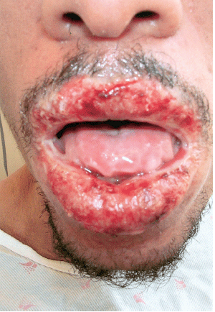

Slide 42
Pemphigoid Group of Dis.
-Group of autoimmune subepidermal blistering diseases with circulating IgG;and BMZ bound IgG and C3.
-Bullous pemphigoid.
-Herpes gestationis.
-Cicatricial pemphigoid.

Slide 43
Bullous Pemphigoid
• Elderly M+F
• Subepidermal bullae often predated by itchy urticated
areas on limb girdles
• Tense blisters last several days
•pruritus
• Mucosal lesions unusual, patients well
• good prognosis.

Slide 44
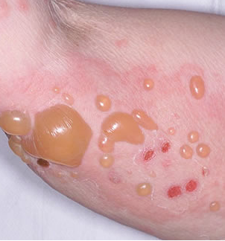

Slide 45
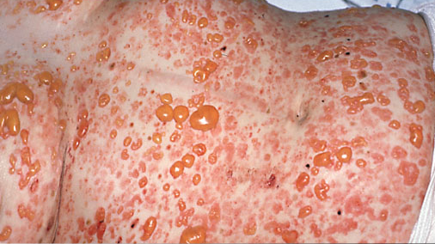

Slide 46
B.P.
-Skin biopsy shows a deeper blister(than in pemphigus) owing to a subepidermal split through the BM
-On direct IF, perilesional skin shows linear band of IgG and C3 along BMZ
-Indirect IF shows IgG antibodies that reacts with the BMZ in most patients

Slide 47
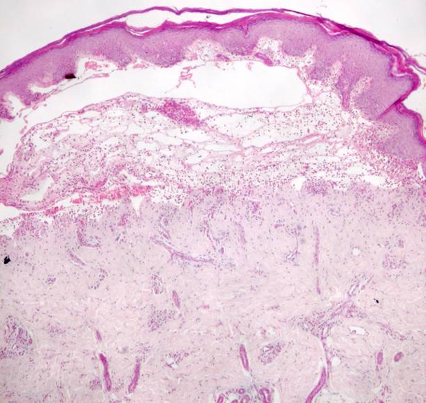

Slide 48
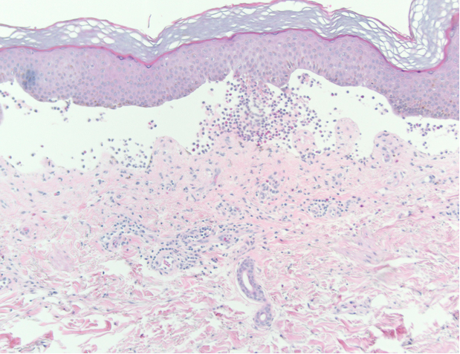

Slide 50
B.P. treatment
Steroid Topical
Systemic Steroid
Antibiotics : Tetracycline, Minocin
Dapsone
Immuno suppressive.

Slide 51
Cicatricial Pemphigoid
Tense blisters & erosions of M.M, Oral cavity, eyes Nose pharynx
Skin occas. Involv. – 25%
Pronounced tendency to scarring Strictures
Sub epidermal blister
IgG, IgA, C3 BMZ
Complications:
Pharyngeal, Laryngeal, Esoph,Strictures
Ocular Involv. -----------→ Blindness.

Slide 52
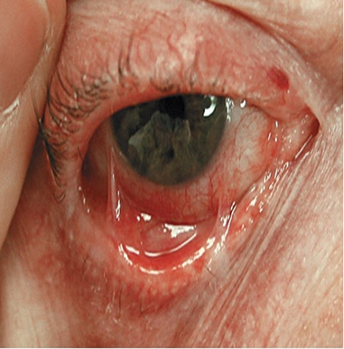

Slide 53
Cicatricial Pemphigoid
Rx
steroid Topical
Intralesional steroid
steroid.System
For ocular C.P. Dapsone- Ist Choice
Imm.Supp. Cyclophosphamide, Azath.IVIG
. Surgical Therapy

Slide 54
Pemphigoid Gestationis
-Erythematous urticarial plaques, alone or with papules vesicles blisters erosions most on abdomen proximal extr.
-Intense pruritus
-Sub epidermal blister
-C3 IgG At BMZ, H.G. Factor in patient’s sera
-2nd 3rd trimester, flares at post partum , OCP
-Treatment: steroid (topical or systemic).

Slide 55
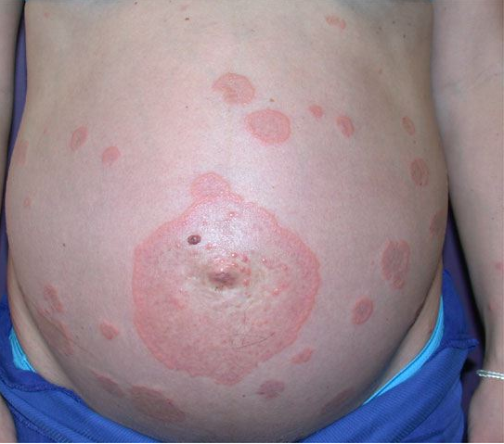

Slide 56
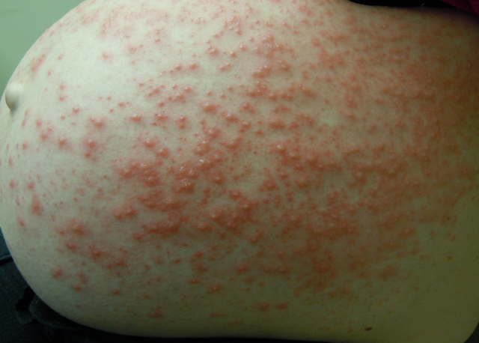

Slide 57
Dermatitis Herpetiformis
Small grouped papules, Vesicles, Blisters, Erosions on erythematous plaques.
* Intense pruritus
* Extensors of large joints (knees, elsbows, buttock, neck shoulders, frontal hairline, scalp)
* Papillary microabscesses, sub epidermal split
* IgA: Granular, BMZ, pronounced in dermal papillae
* Iodides may induce flares.
Age: any ages late 2nd Early 4th decades
ASS : Gluten sensitive enteropathy +/-
clinical features of coeliac disease.
Rx
Dapsone, Sulfapyridine,
Dietary measures

Slide 58
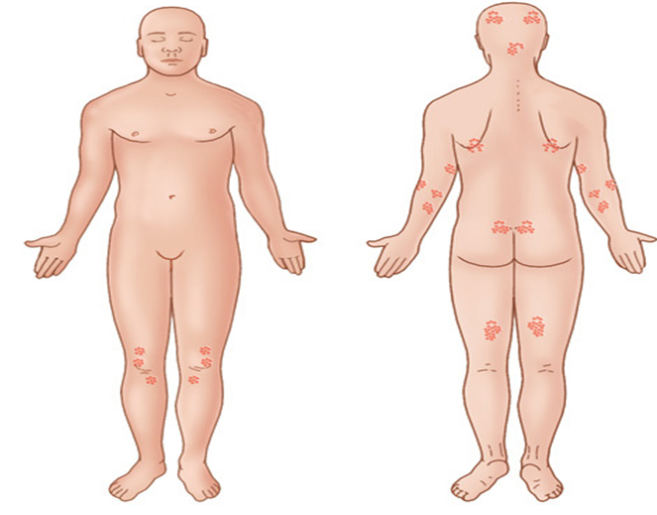
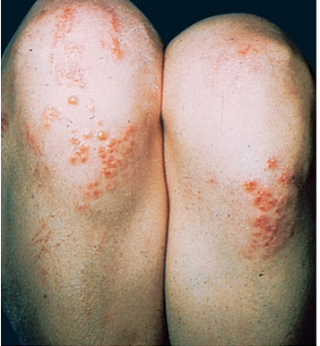
D.H.

Slide 59
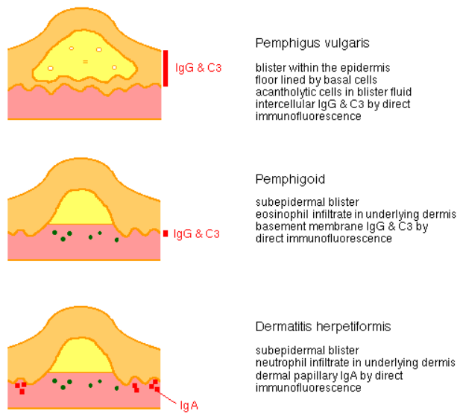

Slide 60
THANK YOU

