Slide 1
ECZEMA and eczematous disorders
Dr. Sami N. Alsuwaidan
Associate Professor
Consultant Dermatologist & Laser surgeon
Department of Dermatology- KSU

Slide 2
Eczema
Definition:
Ezema vs. dermatitis

Slide 3
Eczema
Classification:
    Types of classification
    Benefit of classification

Slide 4
Eczema
Acute eczema:

Slide 5
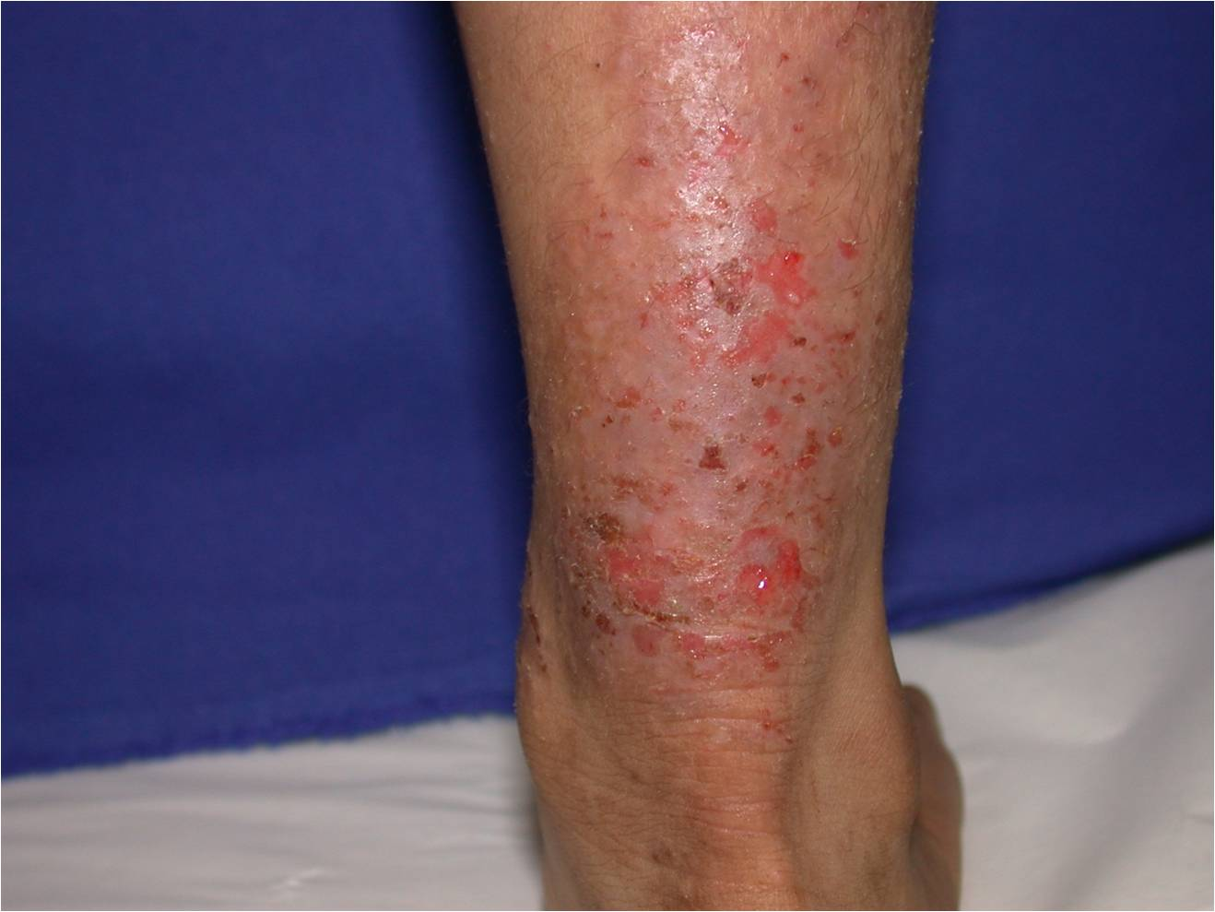

Slide 6
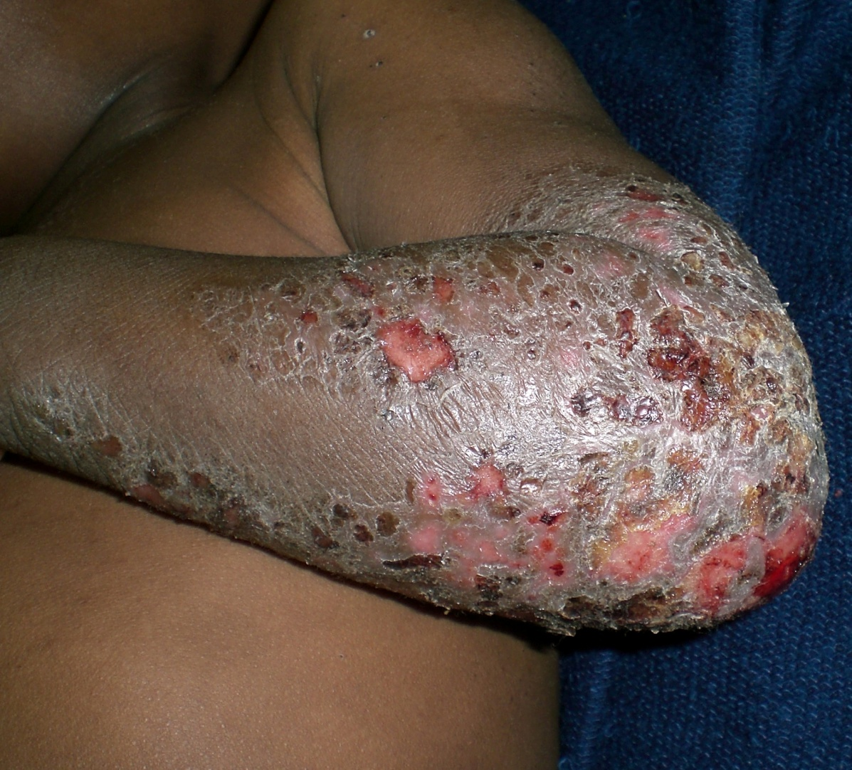

Slide 7
Eczema
Chronic eczema:

Slide 8
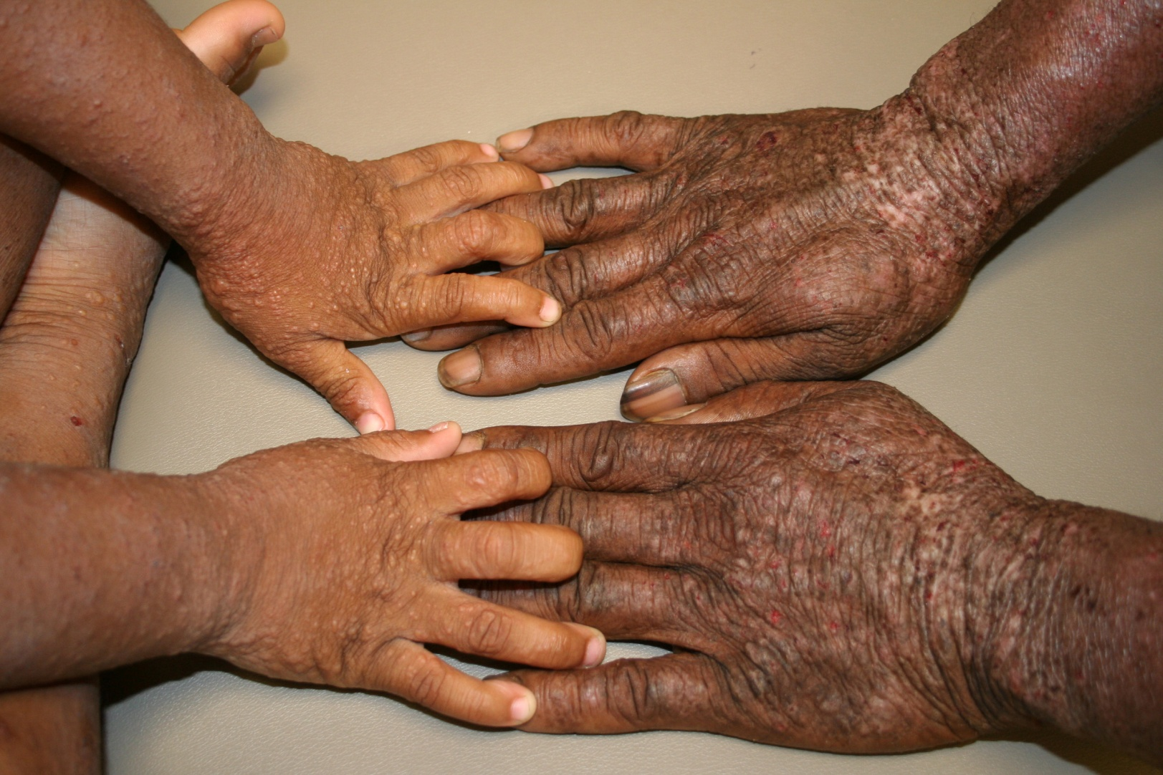

Slide 9
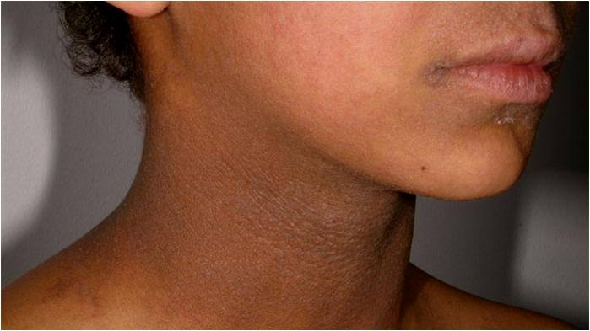

Slide 10
Contact Dermatitis

Slide 11
Contact Dermatitis
Definition:

Slide 12
Contact Dermatitis
Pathogenesis:
  Irritant vs. allergic
  Common irritants
  Common allergens
  Cosmetics

Slide 13
Contact Dermatitis
Clinical features
  Prediliction sites:
  Distribution & configuration
  Autosensitization:

Slide 14
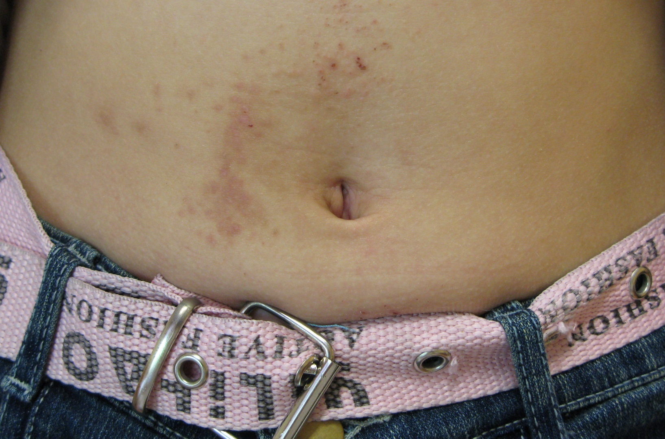

Slide 15
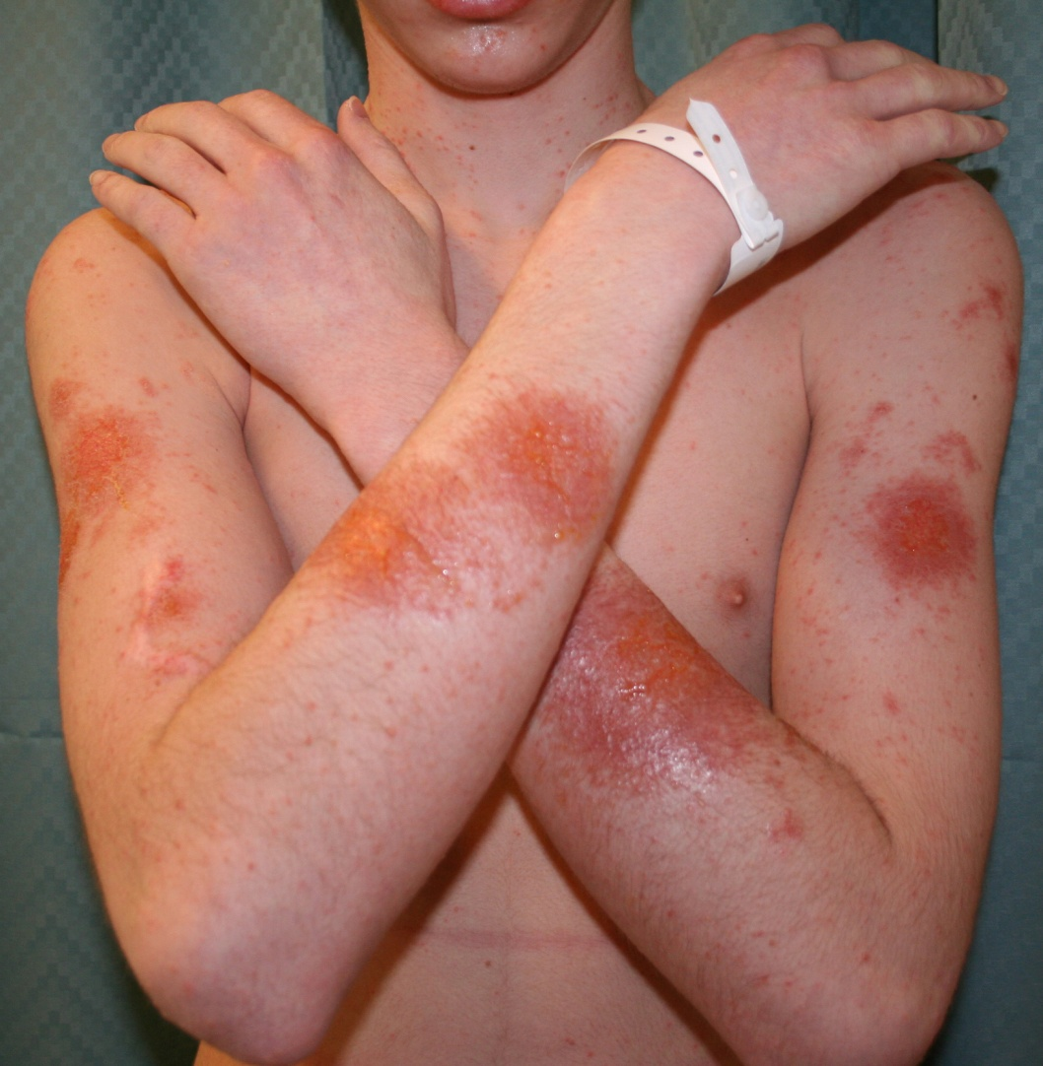

Slide 16
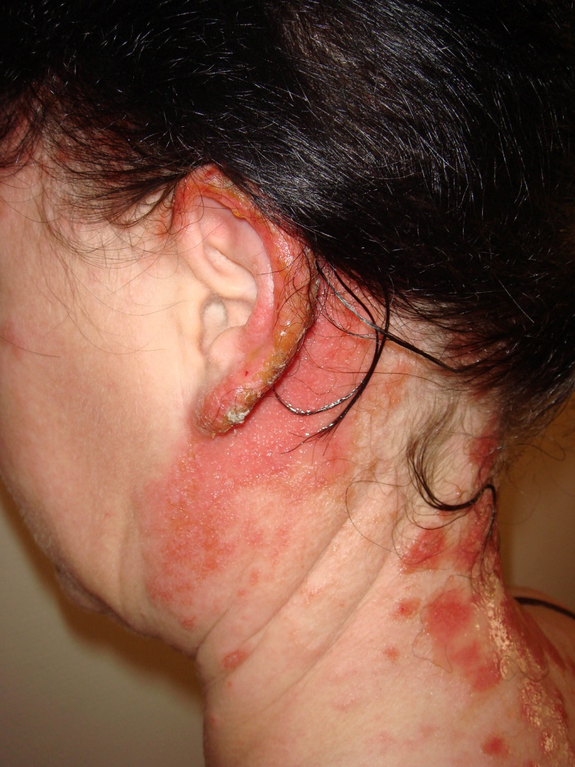

Slide 17
Contact Dermatitis
Management:
  Identification
  Patch testing
  Avoidance measures
  Topical corticosteroids

Slide 18
Atopic Dermatitis

Slide 19
Atopic Dermatits
Definition:
Incidence!
Grow out tendency!

Slide 20
Atopic Dermatitis
Pathogenesis:
    “Atopy”
    IgE ?
    T-Cell !
    Allergy!

Slide 21
Atopic Dermatitis
Clinical Variants:
    Infantile AD
    Childhood AD
    Adult AD

Slide 22
Atopic Dermatits
Infantile AD:
    Distribution
    Presentation
    Behaviour

Slide 23
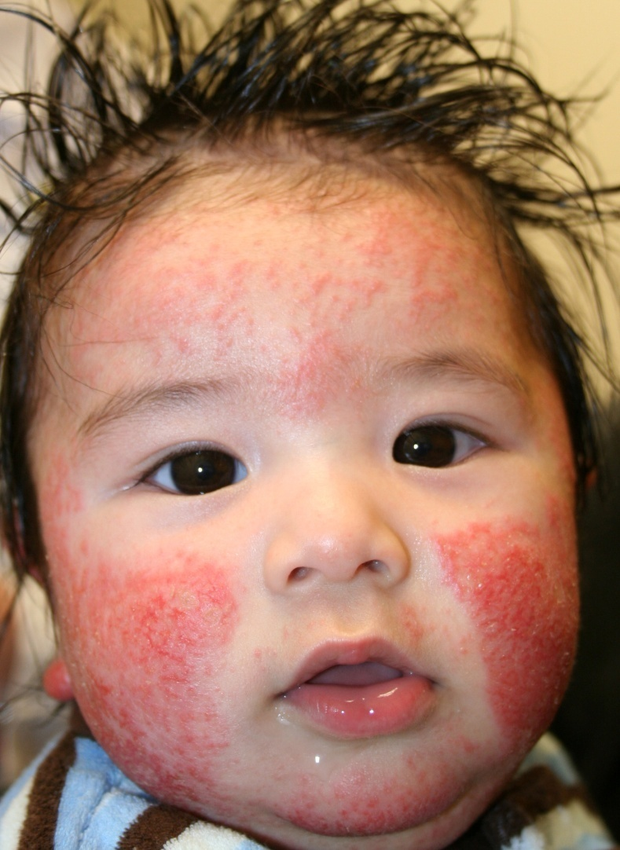

Slide 24
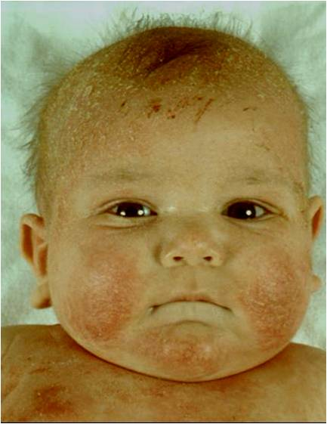

Slide 25
Atopic Dermatits
Childhood AD:
    Distribution
    Presentation
    Behaviour

Slide 26
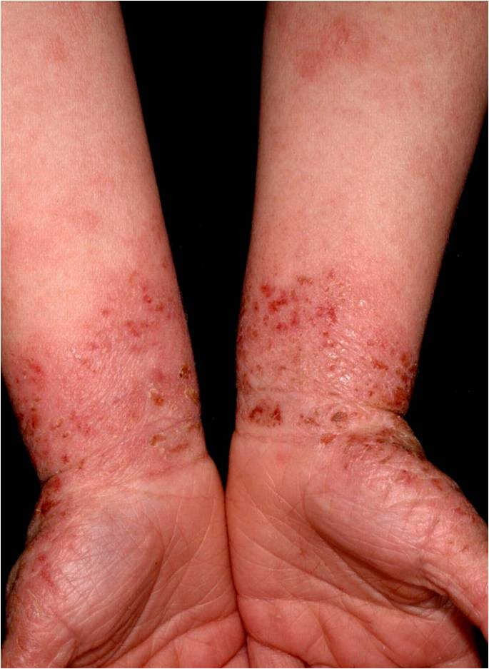

Slide 27
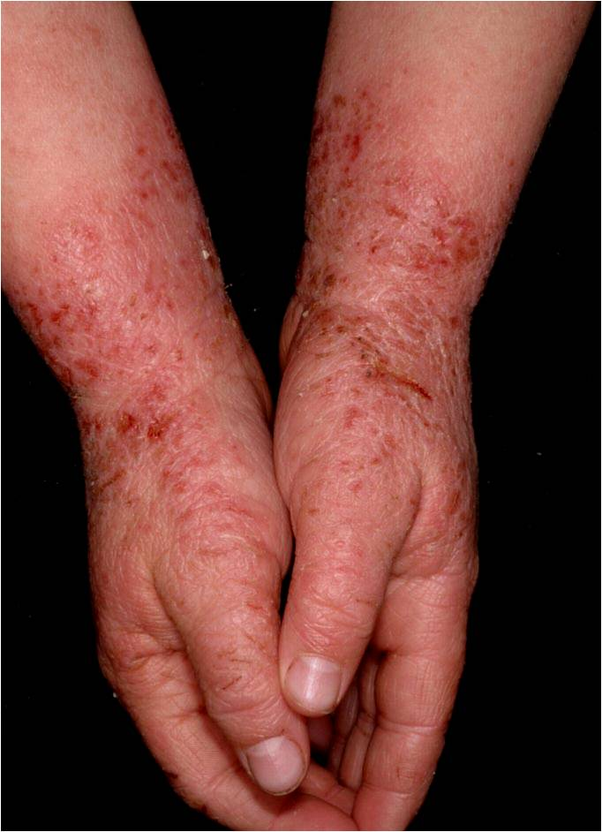

Slide 28
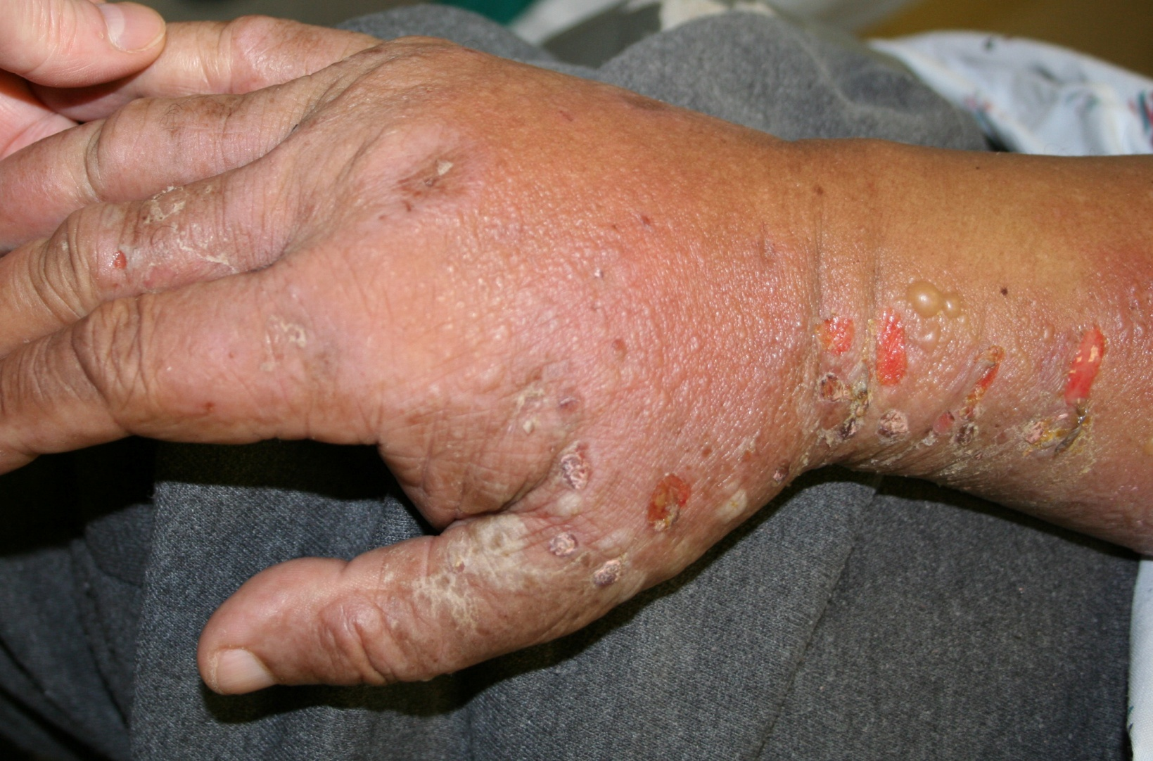

Slide 29
Atopic Dermatits
Adult AD:
    Distribution
    Presentation
    Behaviour

Slide 30
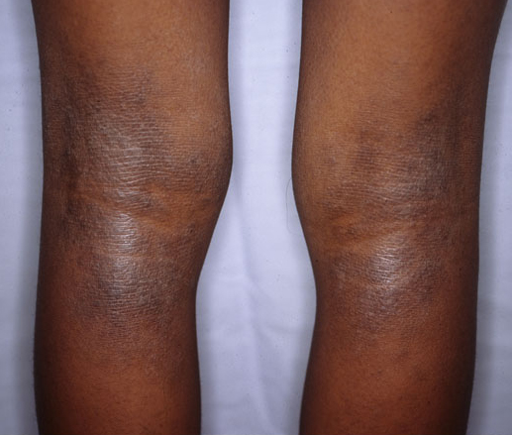

Slide 32
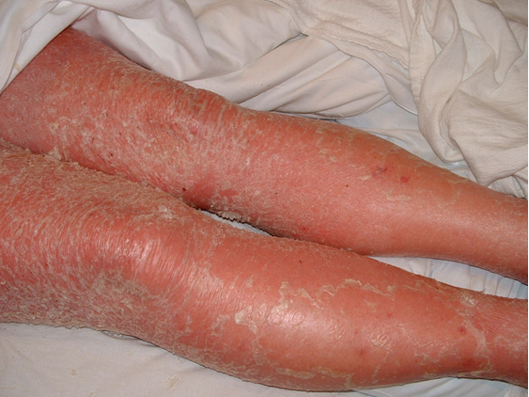

Slide 33
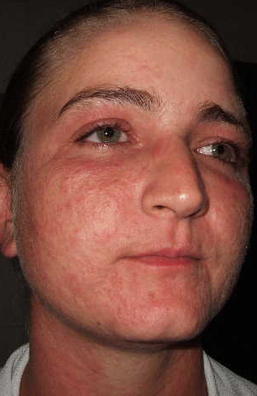

Slide 34
Atopic Dermatits
Complications:
  Secondary infections
  Eczema herpeticum
  Growth retardation
  psychological

Slide 35
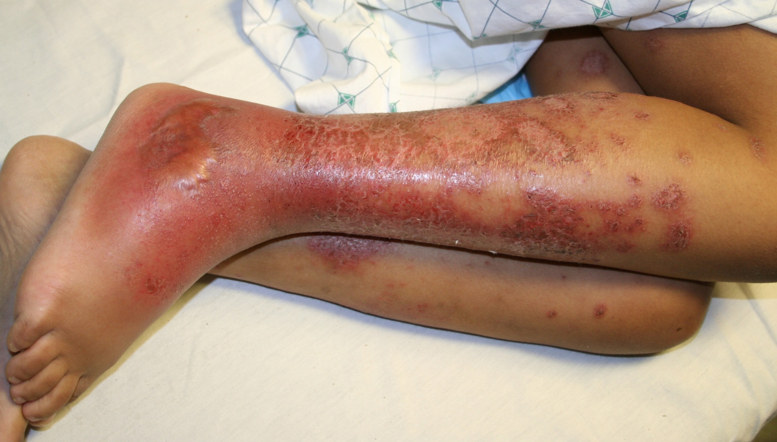

Slide 36
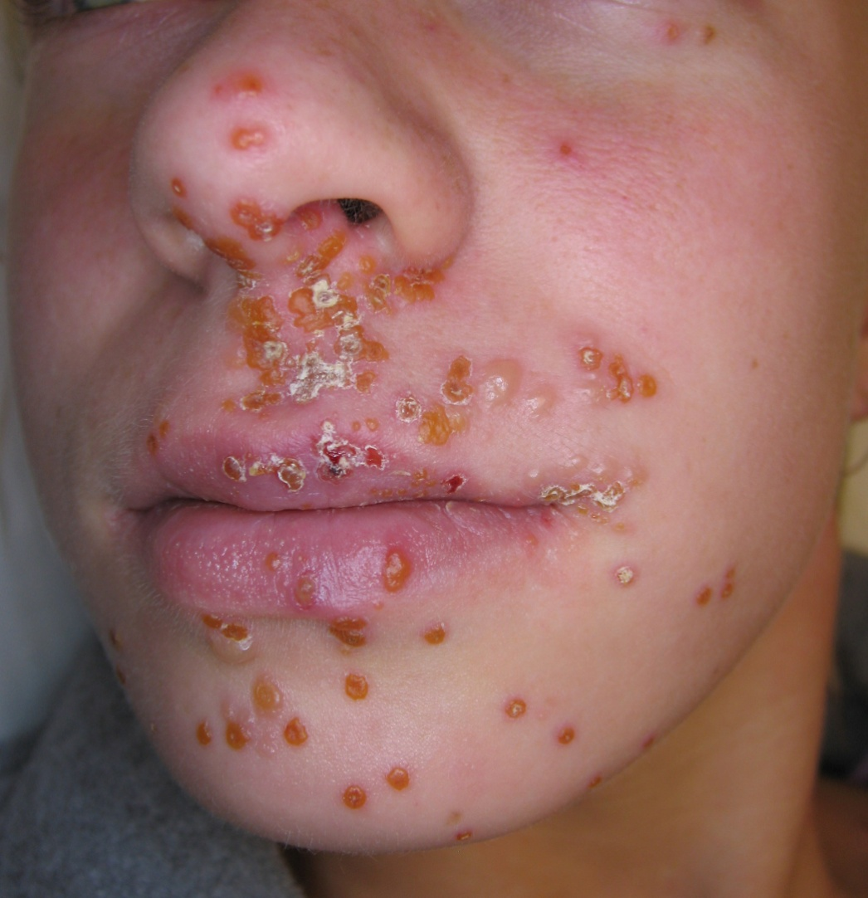

Slide 37
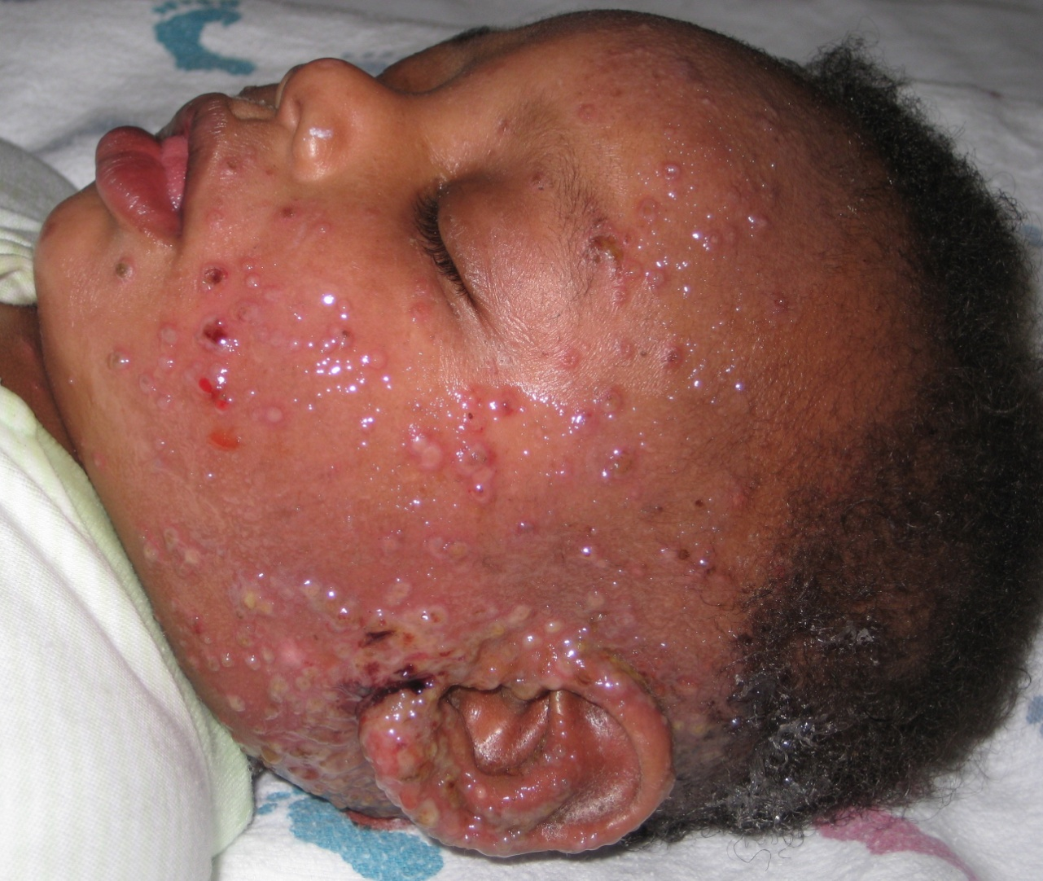

Slide 38
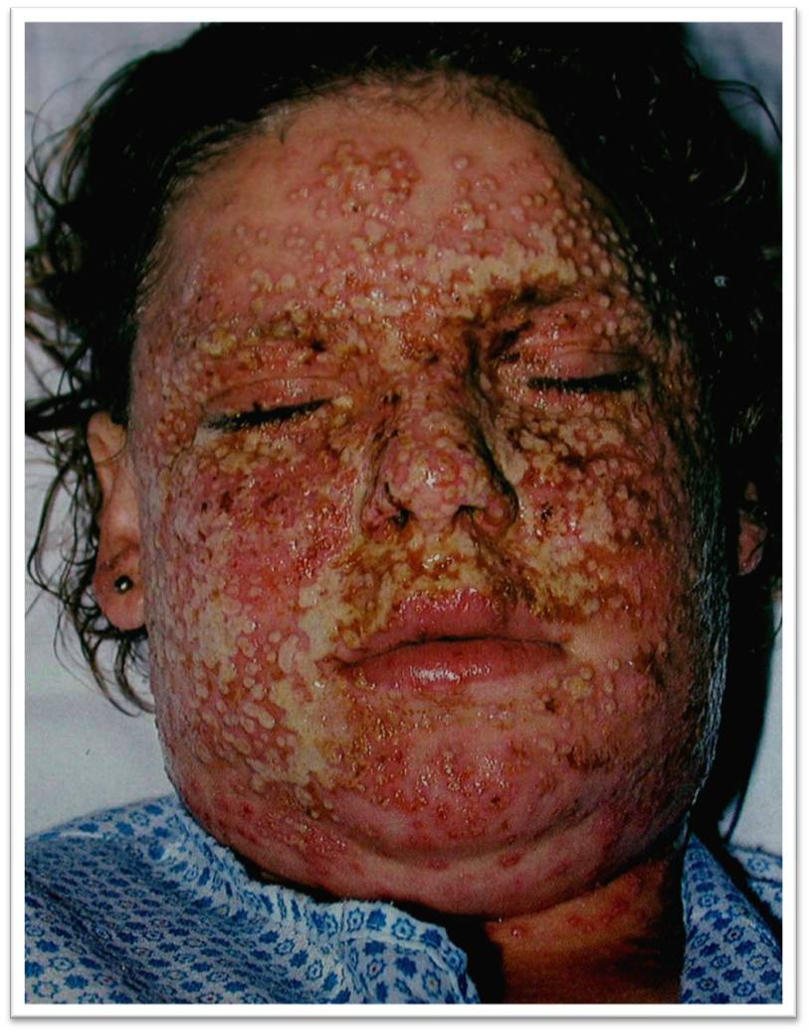

Slide 39
Atopic Dermatits
Investigations:
    ????????

Slide 40
Atopic Dermatits
Management:
  Education! Education! Education!
  Support!
  Skin care:
  Topical therapy
  Systemic therapy

Slide 41
Atopic Dermatits
AD and Food!

Slide 42
Seborrhoeic Dermatitis

Slide 43
Seborrhoeic Dermatits
Definition:

Slide 44
Seborrhoeic Dermatits
Pathogenesis:
    Sebum!
    Tendency
    Pityrosporum ovale

Slide 45
Seborrhoeic Dermatits
Clinical features:
    Presentation
    Distribution

Slide 46
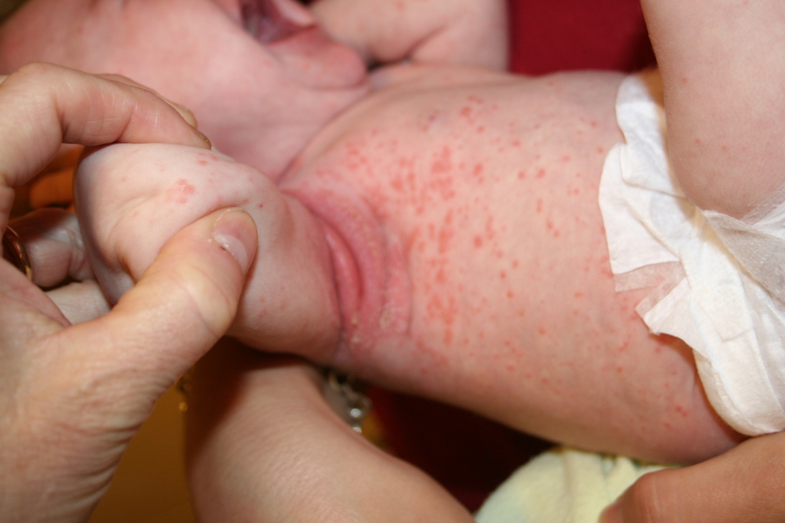

Slide 47
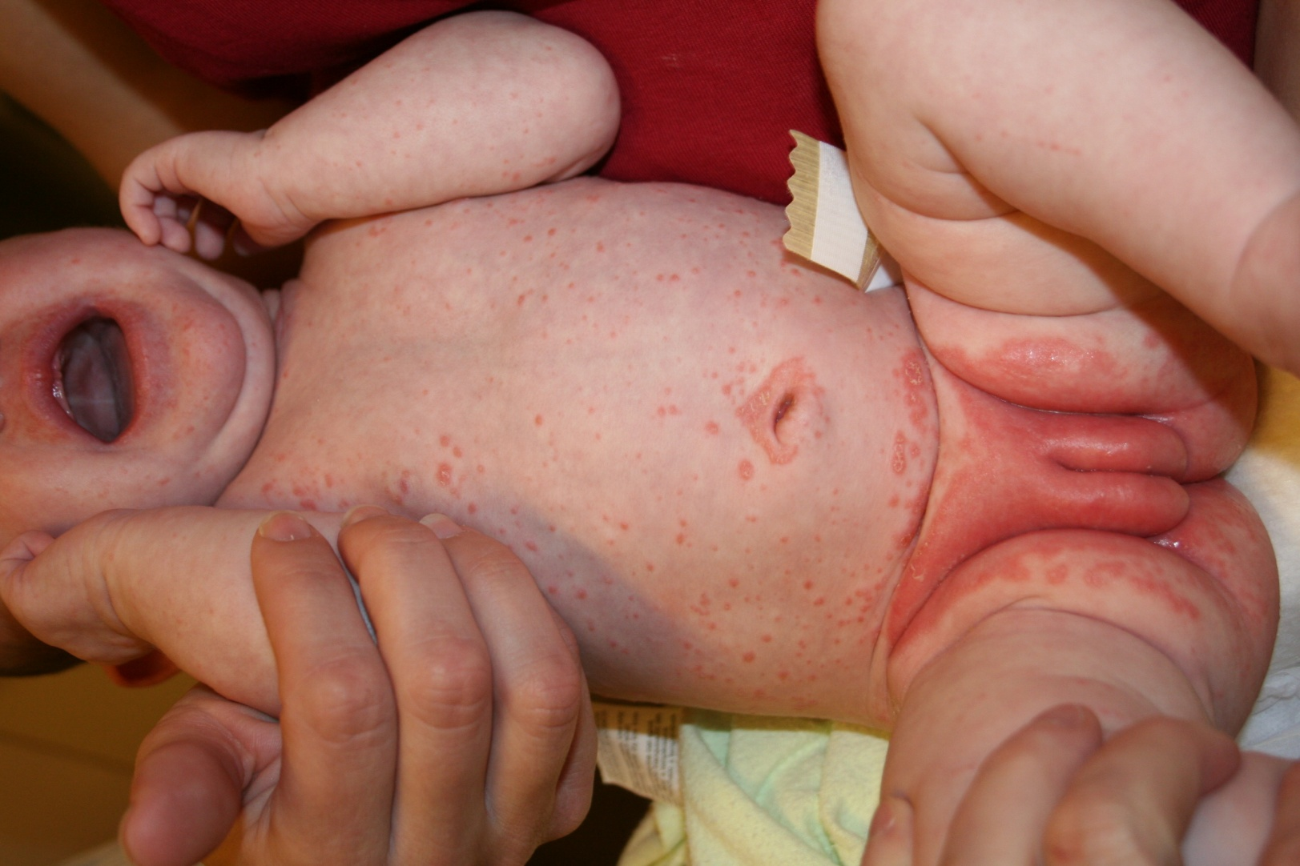

Slide 48
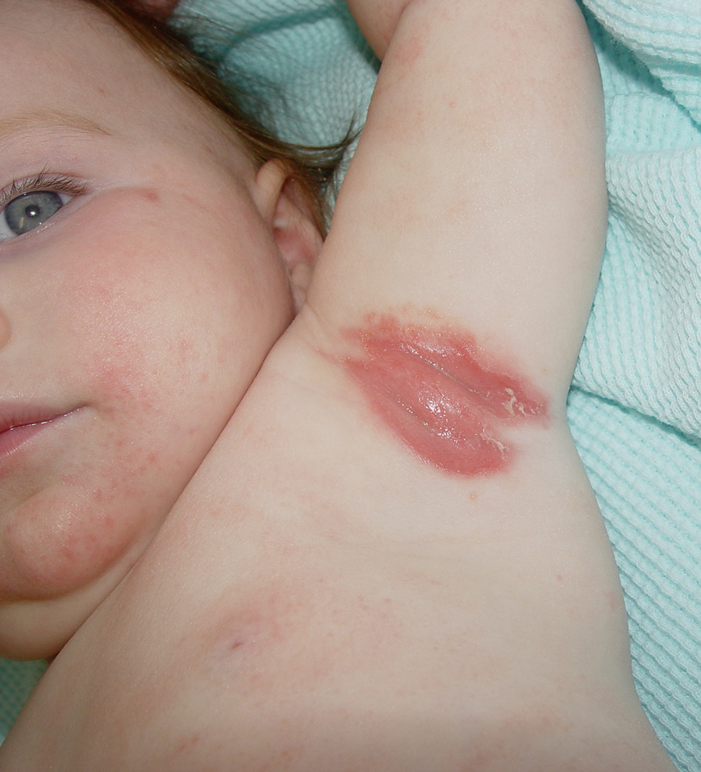

Slide 49
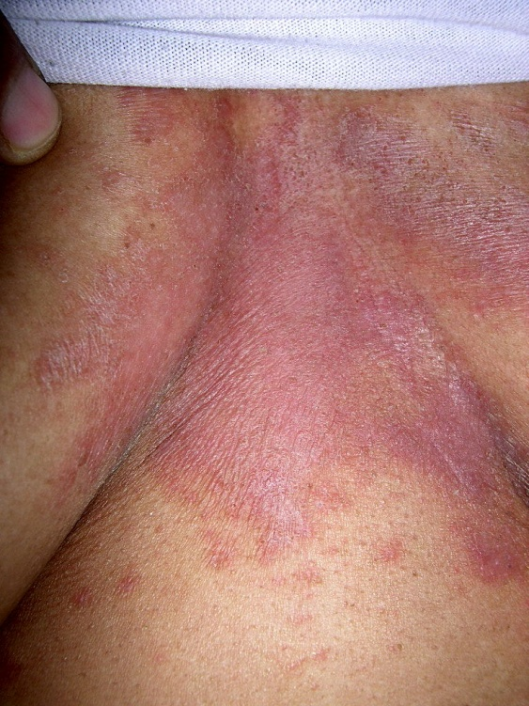

Slide 50
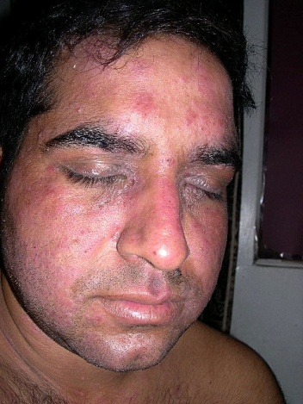

Slide 51
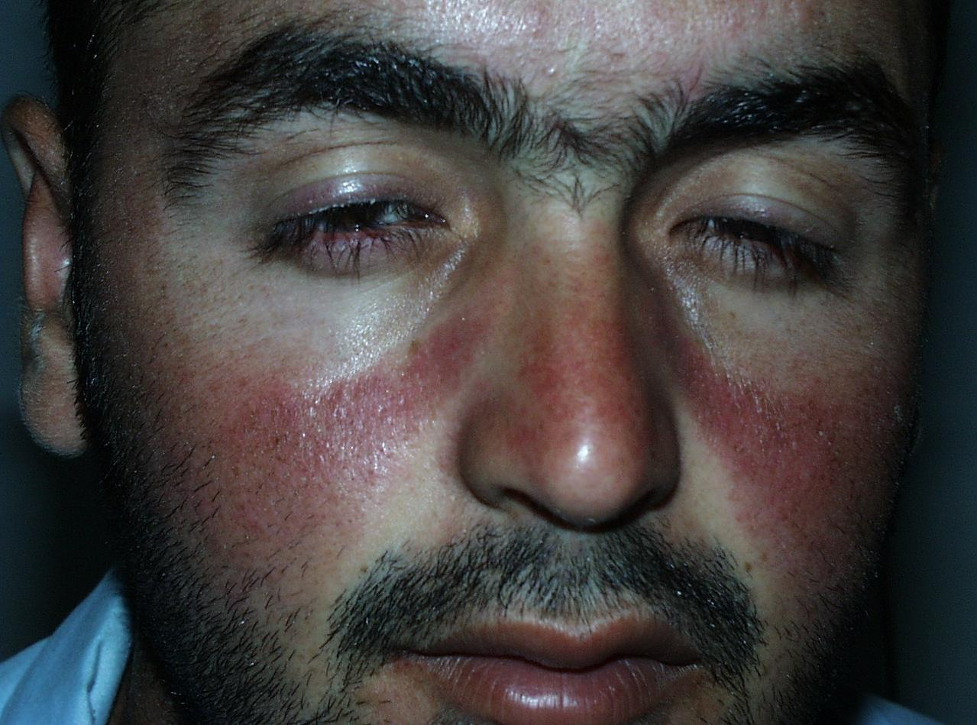

Slide 52
Seborrhoeic Dermatits
Investigations:
?????

Slide 53
Seborrhoeic Dermatits
Management:
  Shampoo
  Antigungals
  Topicals
  Combined therapy
  Maintenance & recurrence

Slide 54
