Slide 1
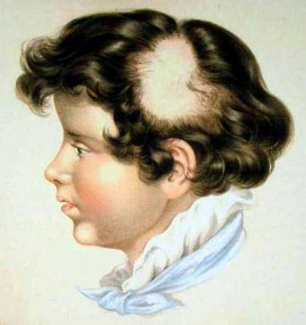
ALOPECIA
Prof. Khalid M. AlGhamdi
Professor and Consultant
Dermatology and Cutaneous Laser Surgery
King Saud University www.dralghamdi.net

Slide 2
Introduction & definition
Alopecia = HAIR LOSS
Basic hair anatomy and Physiology
Hair growth is very dynamic
Vellus and Terminal hair

Slide 3
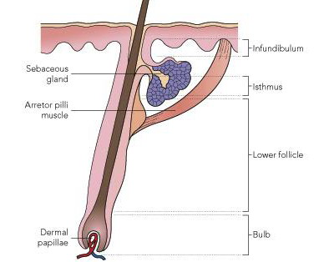

Slide 4
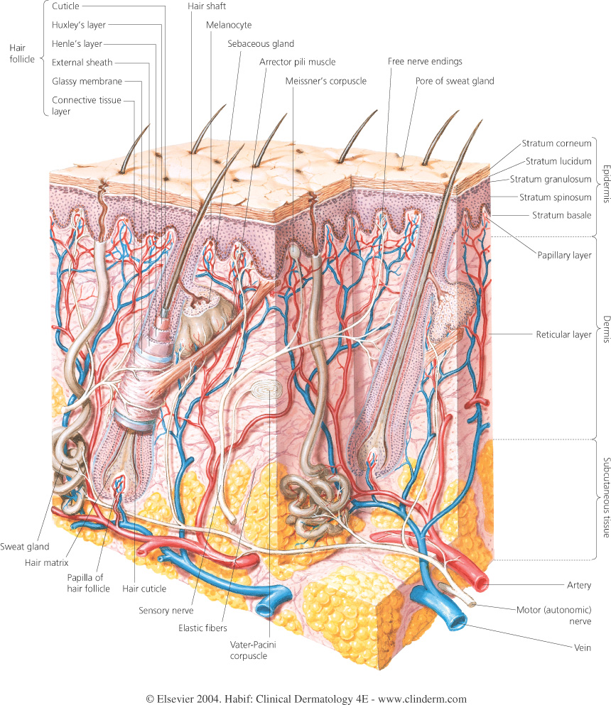

Slide 5
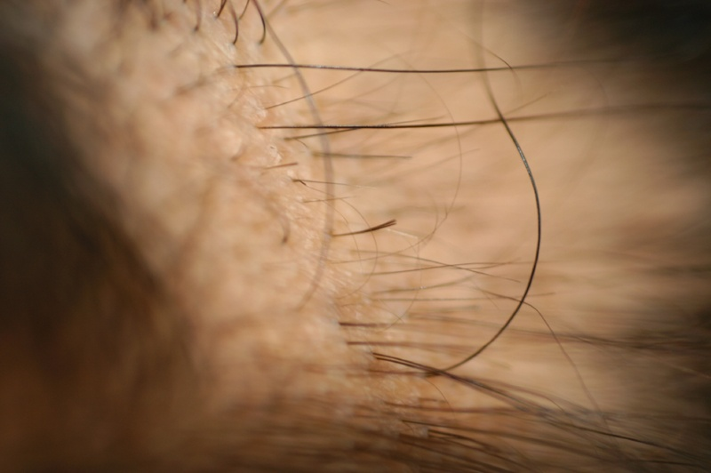

Slide 6
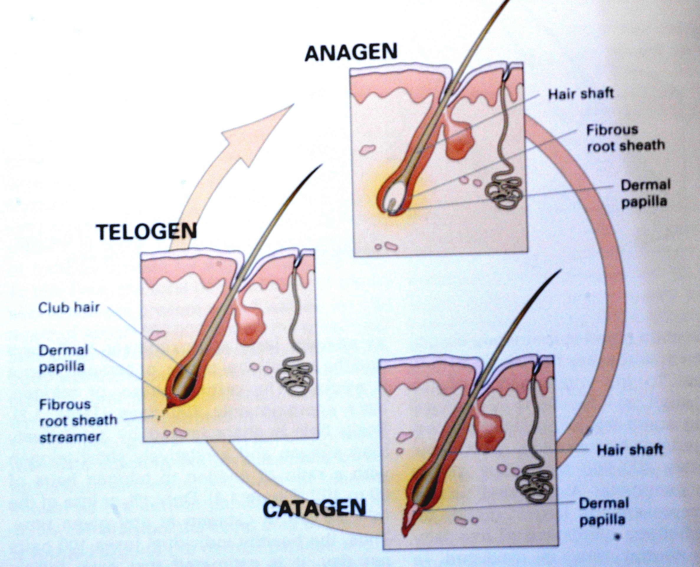

Slide 7
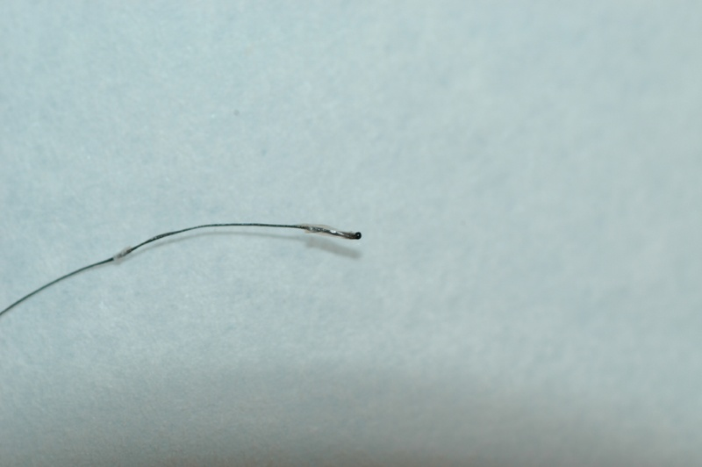
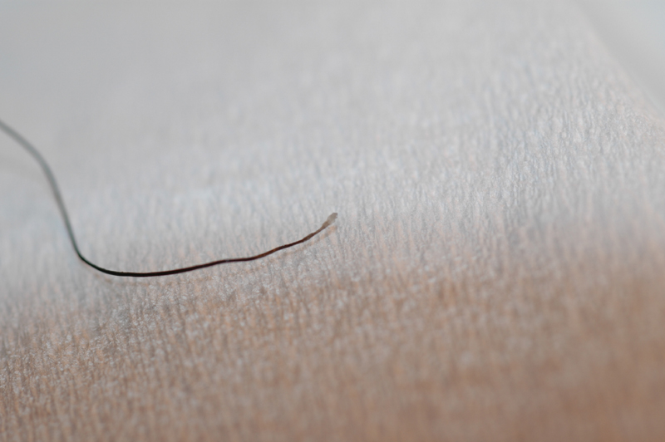
1
2

Slide 8
Introduction & definition
How many hairs in the body?
5 millions hairs;
100,000 in the scalp
Growth rate?
0.3mm/day for scalp hair

Slide 9
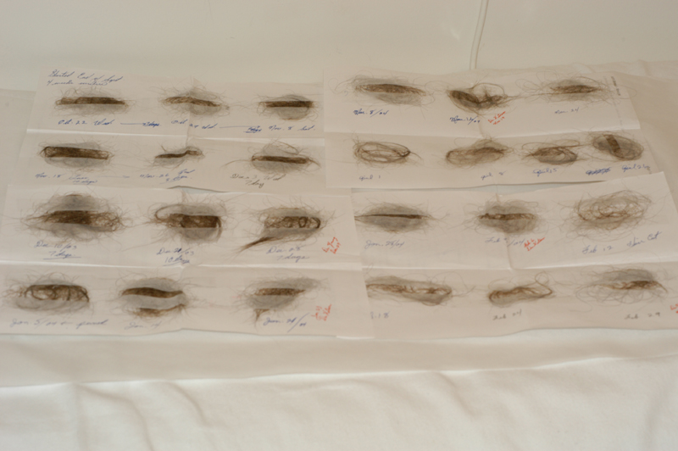
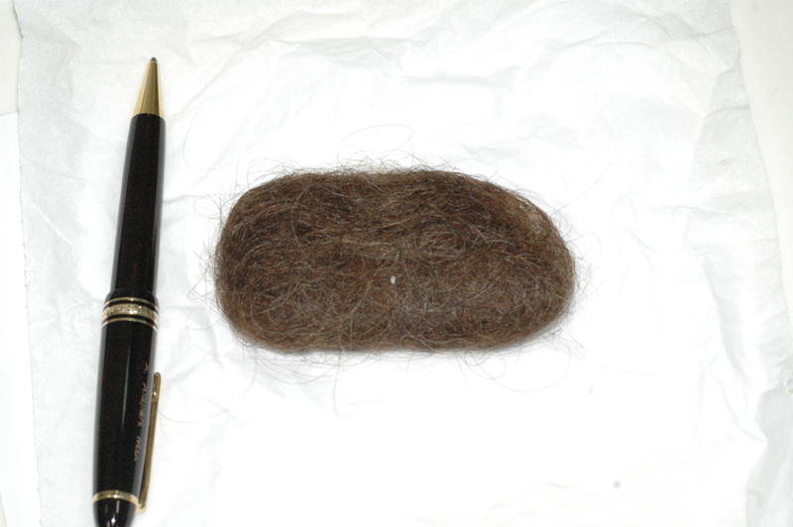

Slide 10


Alopecia
Non-Scarring
(Reversible)
Scarring
(Irreversible)
$$$$
$$Χ$$

Slide 11
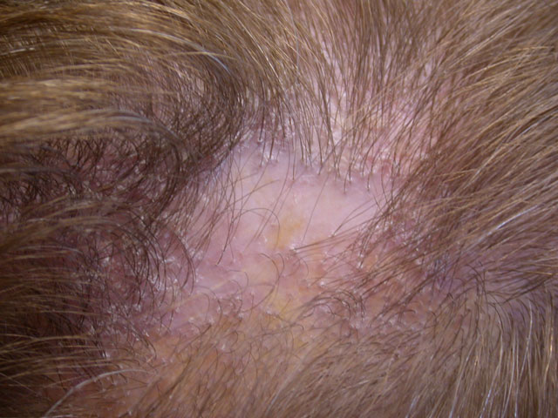

Slide 12
Androgenetic Alopecia
(Male and Female Pattern Hair Loss)

Slide 13
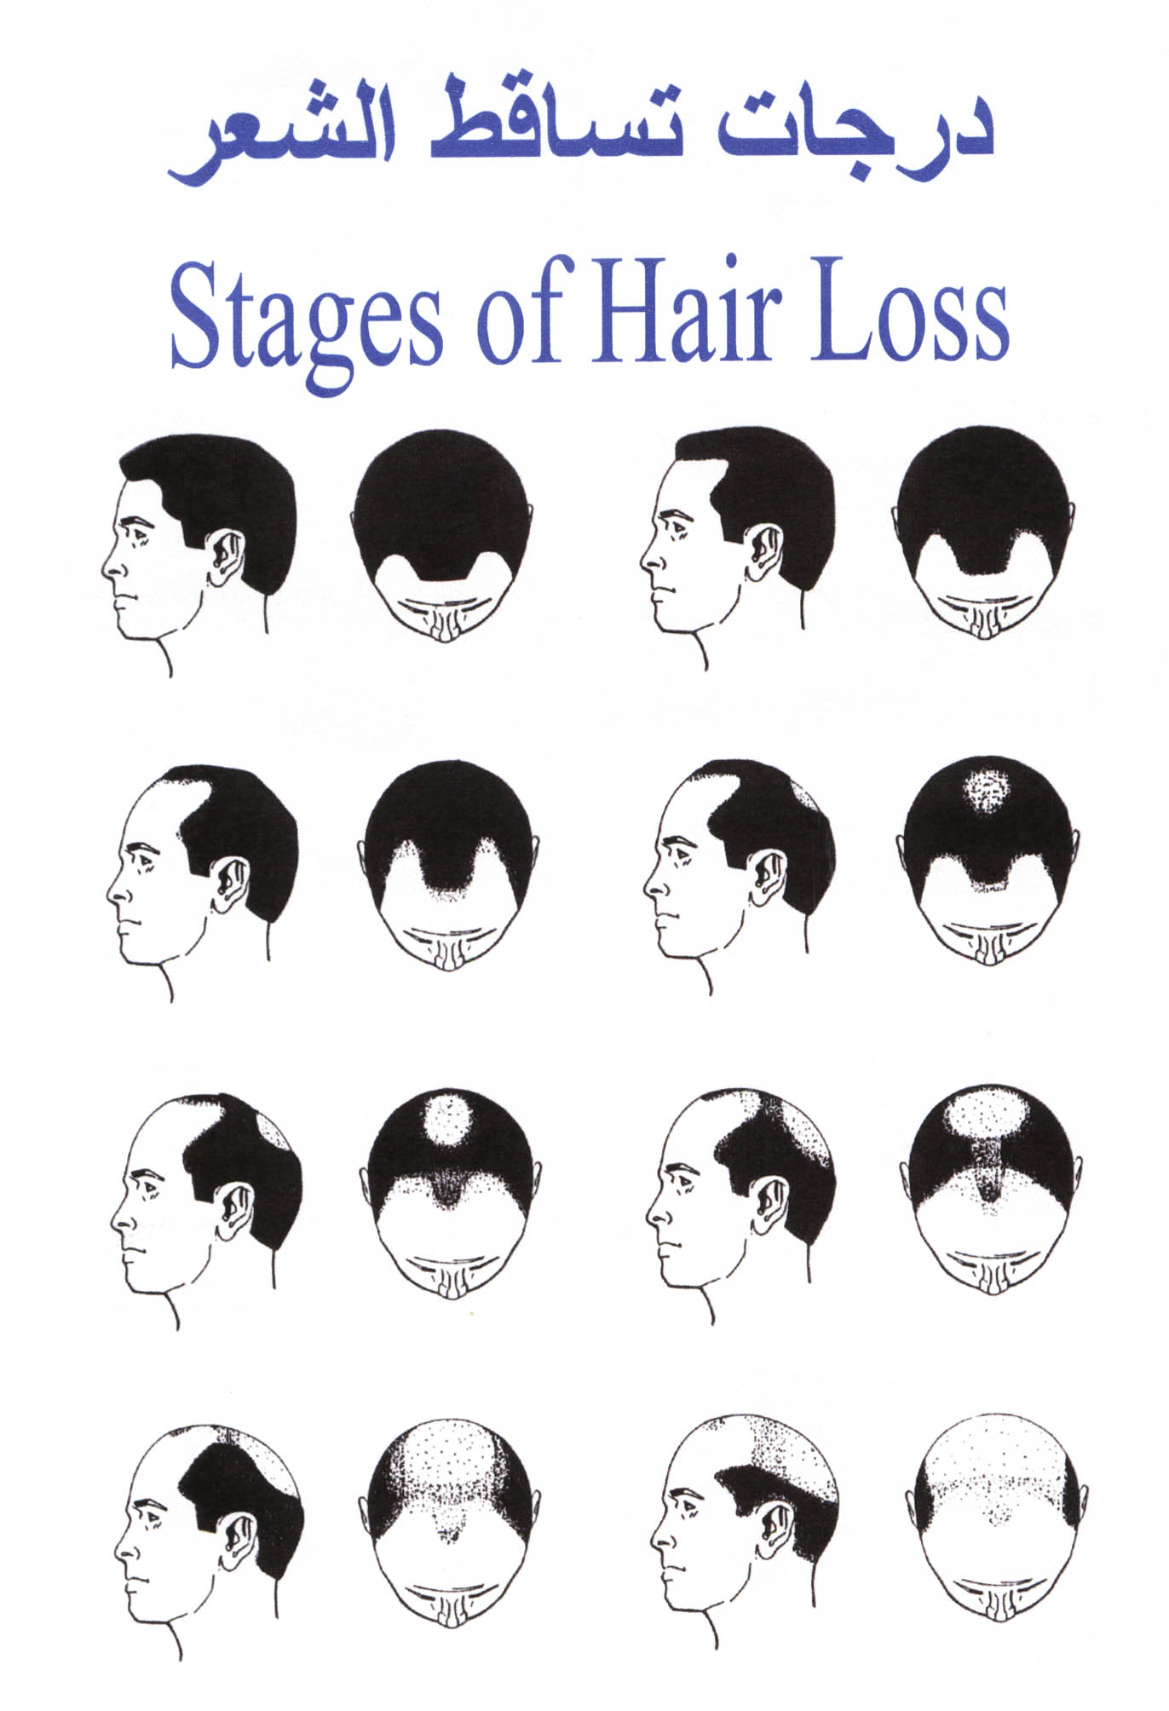
Male Pattern Hair Loss

Slide 14
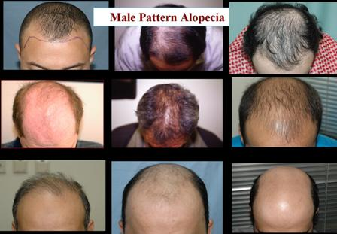

Slide 15
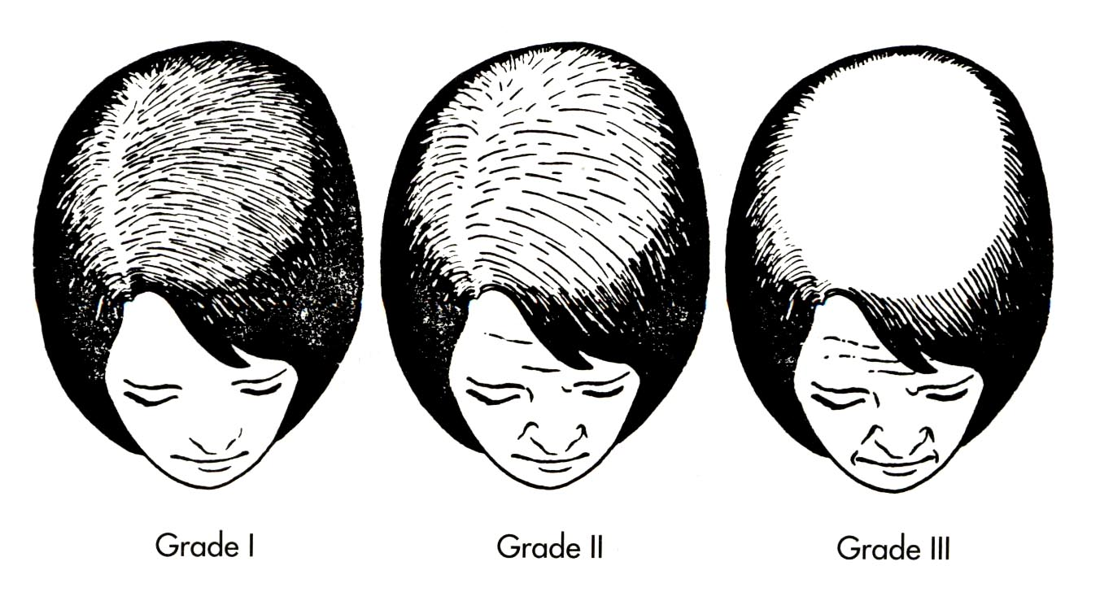
Female Pattern Hair Loss

Slide 16
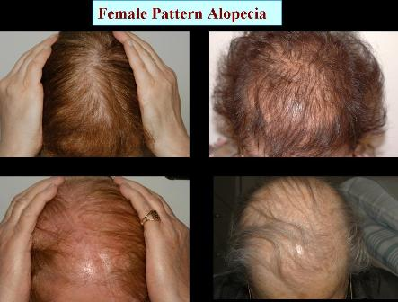

Slide 17
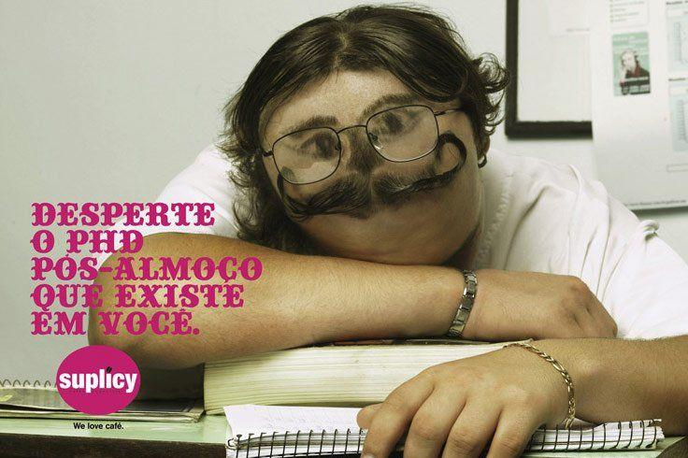

Slide 18
Androgenetic Alopecia
Androgenetic Alopecia affects up to 50% of males and 40% of females
Autosomal dominant with variable penetrance
85% : +ve family history
Role of androgens in the pathogenesis:

Slide 19
Systemic Treatment
Testosterone
Fenastride
X
5 ALPHA Reductase
Miniaturization of Terminal Hairs
DihydorTestosterone (Active)

Slide 20
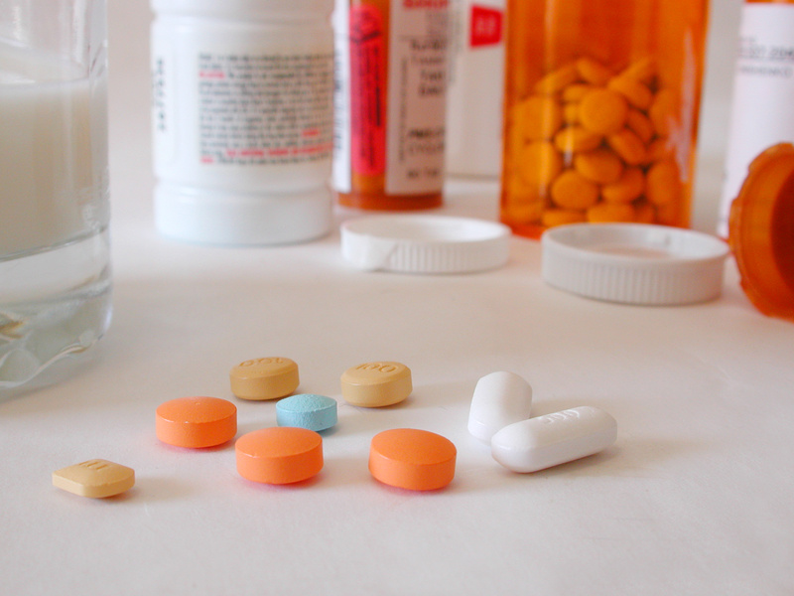
Topical Treatment:
Minoxidil 2% and 5% Solution
:Systemic
Finastride 1 mg daily
Surgical:
Hair transplantation

Slide 21
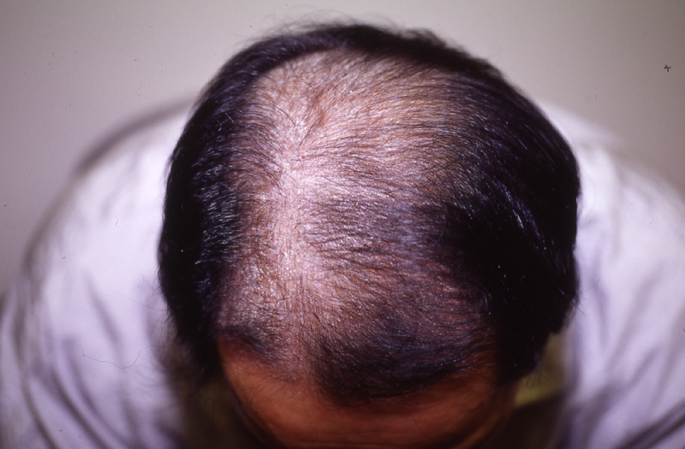
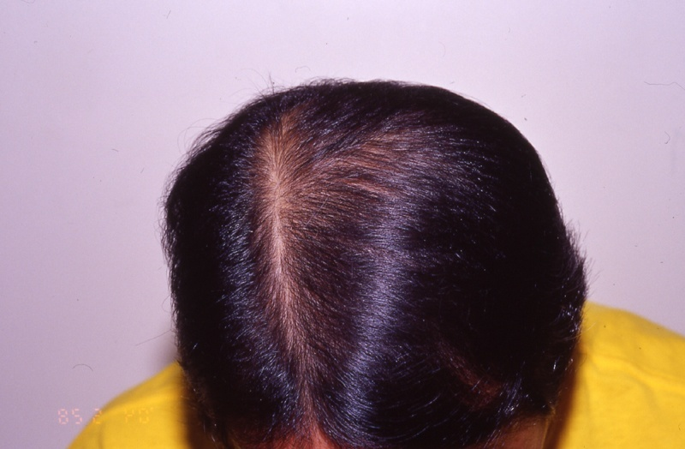
Fenastride

Slide 22


Slide 23
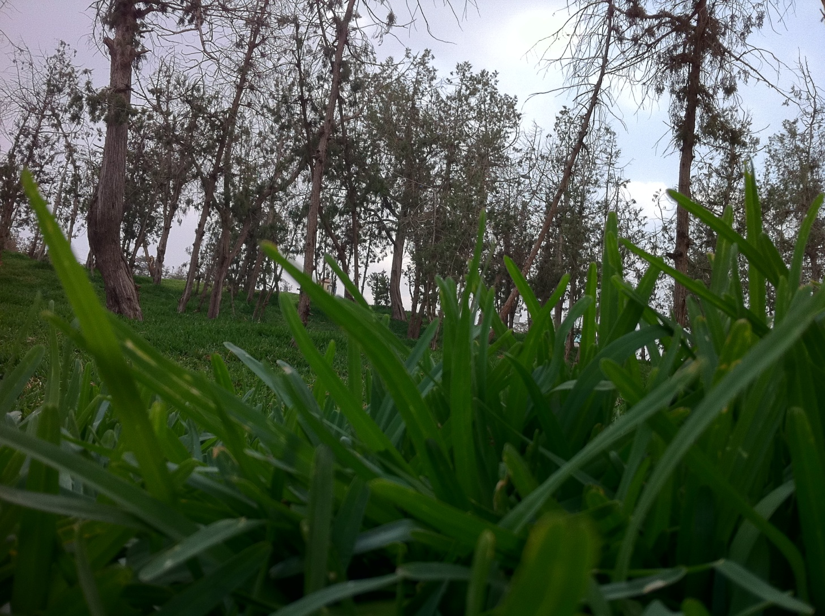

Slide 24
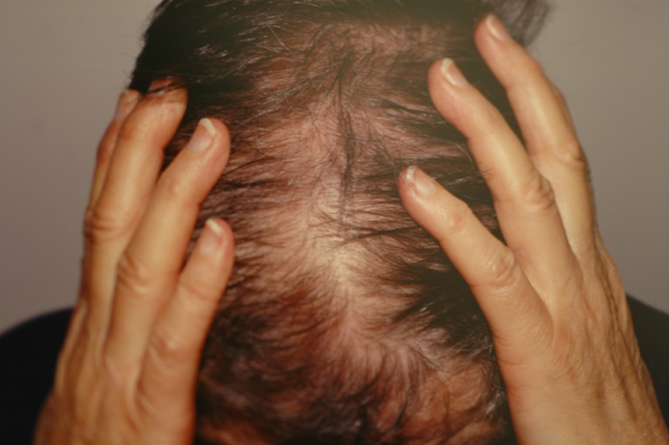
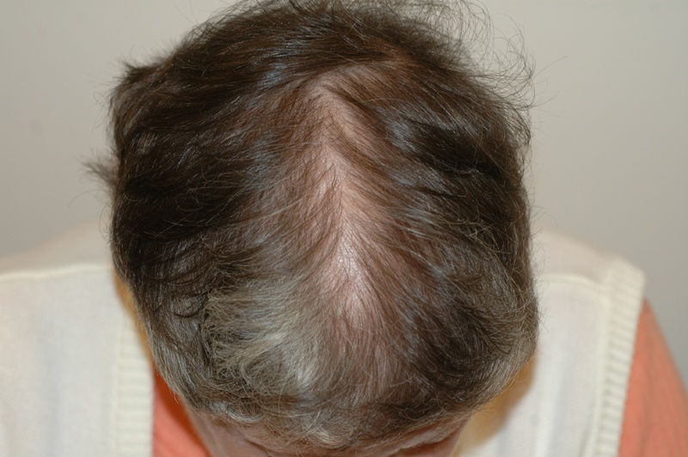
Minoxidil 5%

Slide 25
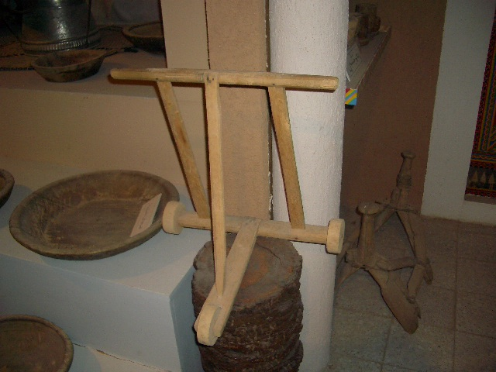

Slide 26
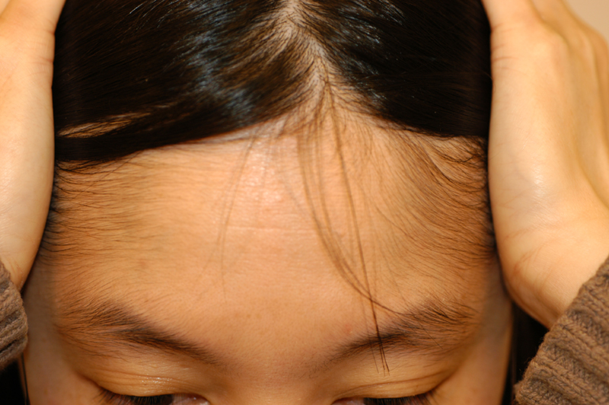
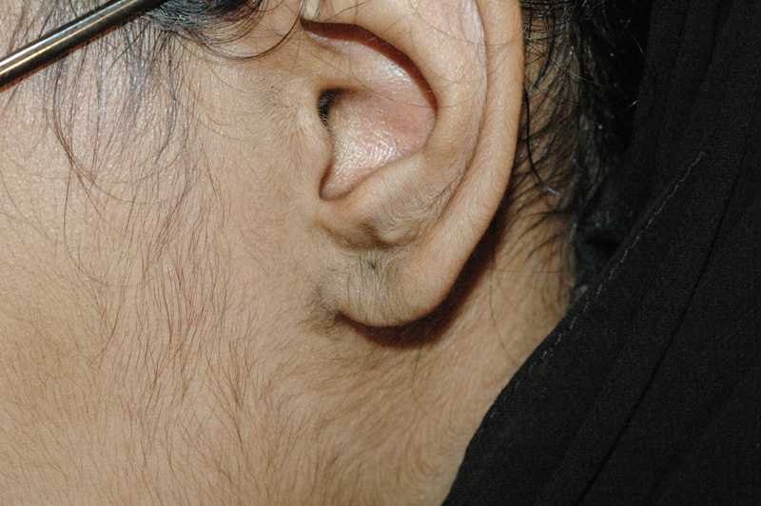
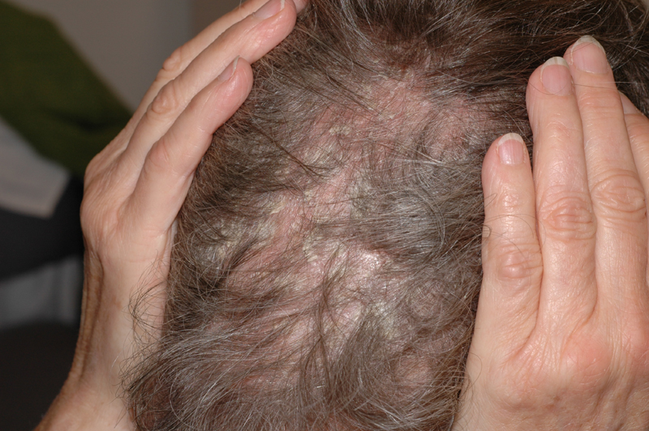
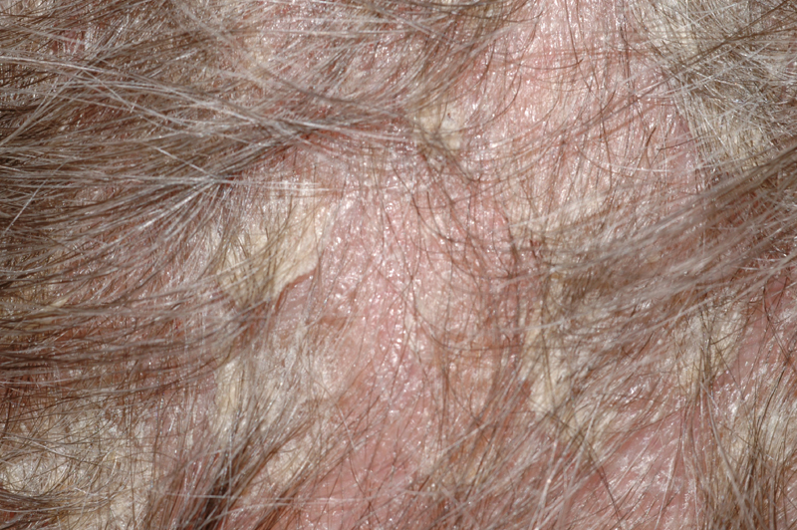
Minoxidil 2% and 5%

Slide 27
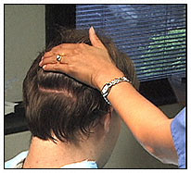
Hair Transplant

Slide 28
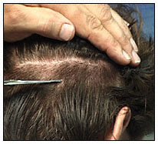

Slide 29
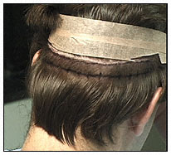

Slide 30
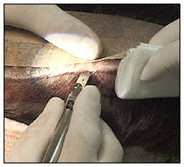

Slide 31
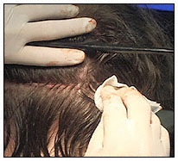

Slide 32
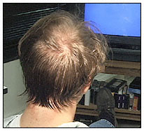

Slide 33
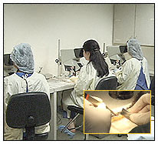

Slide 34
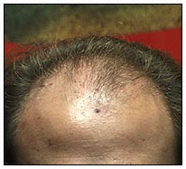

Slide 35
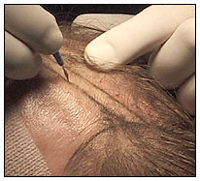

Slide 36
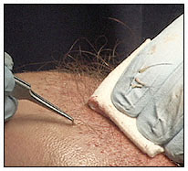

Slide 37
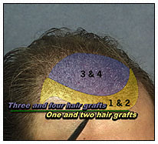

Slide 38
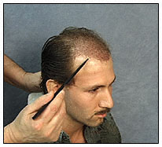

Slide 39
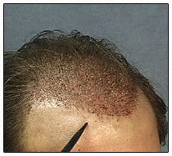

Slide 40
Hair Transplant Videos

Slide 41
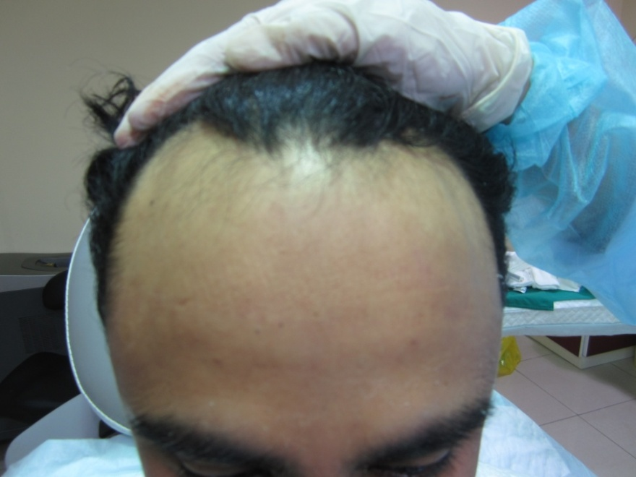
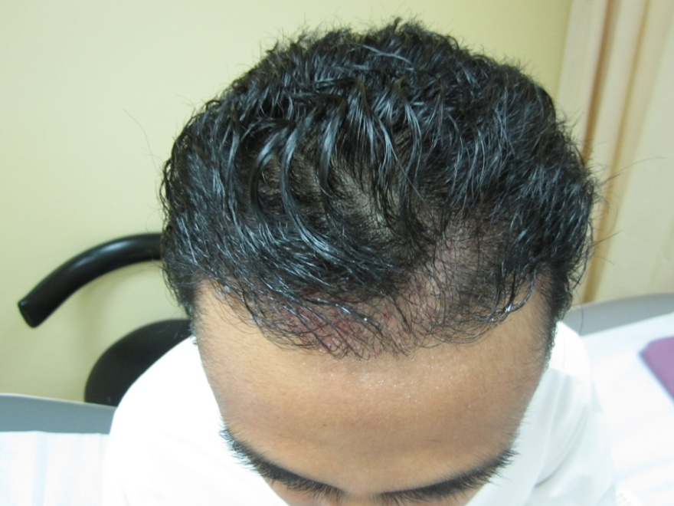
Before
Post 3 months

Slide 42
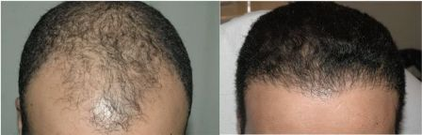

Slide 43
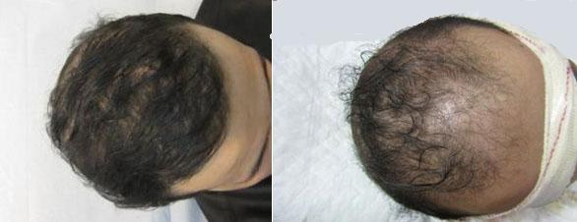

Slide 44
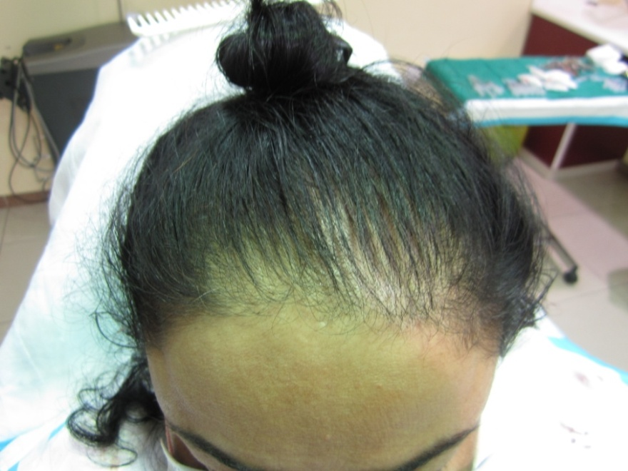
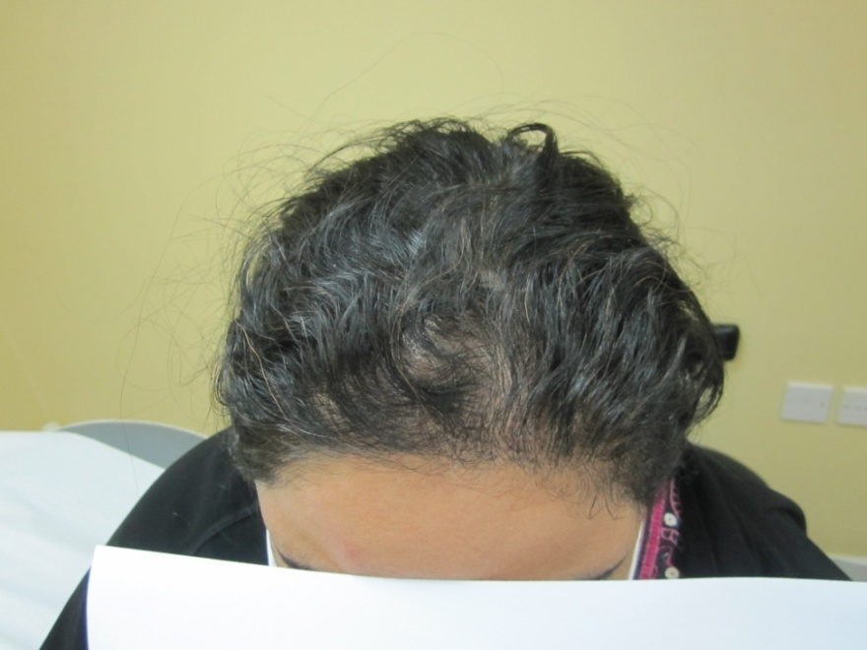
Pre HT
Post 6 months HT

Slide 45
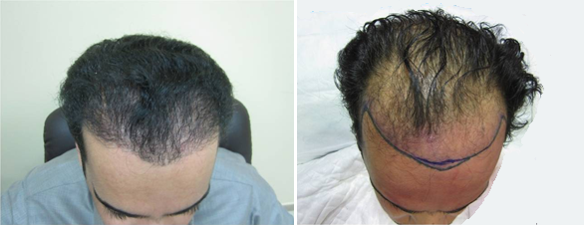

Slide 46
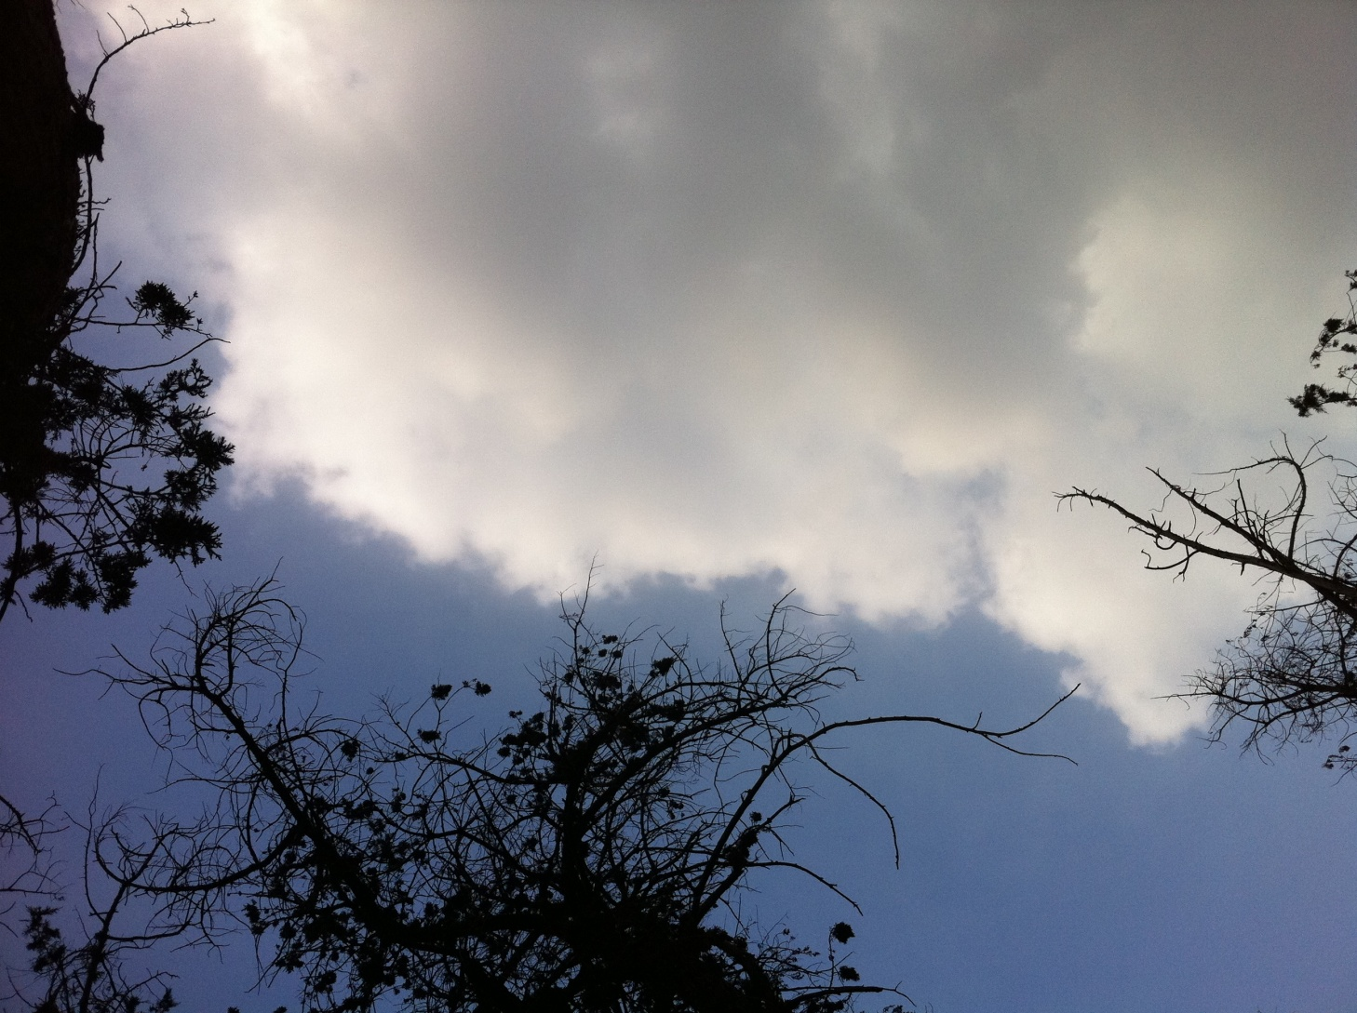

Slide 47
Alopecia Areata

Slide 48
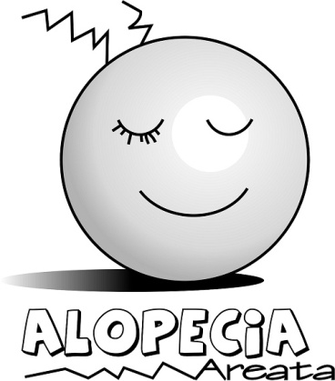

Slide 49
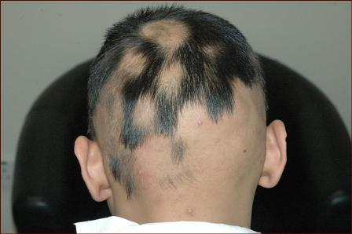

Slide 50
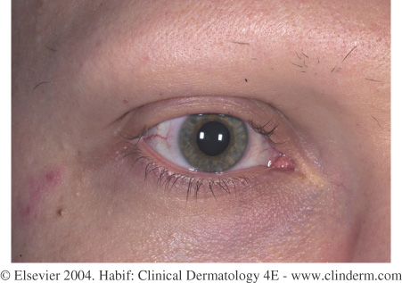

Slide 51










Slide 52
Alopecia Areata
30%: +ve Family history
High rate of self recovery
Role of immune system in the pathogenesis

Slide 53
Clinical presentation;
Uninflammed skin
Sites:
Nails:
Prognosis: limited vs extensive

Slide 54


Slide 55


Slide 56
Treatment
No treatment
Topical steriod
5% Topical minoxidil
Intralesional Corticosteroids
Skin Sensitizers(Anthralin)
Oral steriods
Iv steriod pulse therapy
Hair transplant ?????

Slide 57




Slide 58



Slide 59

Skin Sensitizers Immune modulating Rx

Slide 60


Slide 61


Slide 62
Anagen Effluvium
Cause: cytotoxic chemotherapy
Sudden and severe alopecia
Mostly reversible but not always

Slide 63
Telogen effluvium
Common and Non-specific
Acute or chronic
Reversible (but may be become chronic)

Slide 65


Slide 66
Telogen effluvium
Causes:
Anemia // Low iron
Postpartum
Postfebrile
Drugs
Weight loss (crash dieting)
Acute blood loss
Postsurgical
Thyroid disorders
Others
INVESTIGATIONS

Slide 67
Telogen effluvium
Treatment:
-Treat the cause
-Zinc and biotin
-Iron
-Minoxidil topical 2 and 5 %

Slide 68
Trichotillomania
Obsessive compulsive disorder
Pulling of hair
Asymmetrical areas
Treatment:
Behavioural therapy
SSRI

Slide 69


Slide 70


Slide 71
Fungal Scalp Infections (tinea capitis)
Child had contact with animals.
-Scaly or inflammed alopecia or Kerion
- siblings may also be affected.
-Wood’s Light
-Scalp scrapings and hairs should be examined microscopically, and cultured to demonstrate the fungus.

Slide 72


Slide 73


Slide 74
Fungal scalp infections
Treatment:
-Oral antifungal( griseofulvin or terbinafine or itraconazole)
-Hair regrow normally unless a kerion has led to scarring.

Slide 75


NO

Slide 76
Chronic Discoud lupus
patchy and scaly alopecia ,
follicles plugged by scales and erythematous advancing margin.
- scaring process => permanent alopecia
-Treatment of early lesions

Slide 77


Slide 78


Slide 79


Slide 80


Slide 81

You see!
I have a nice hair!!

Slide 82


