Slide 1
INTRODUCTION TO DERMATOLOGY
Dr. AMAL AL-BALBEESI

Slide 2
Objectives of the course:
To be able to take proper history.
To be able to describe lesions by using proper dermatological terminology.
To be able to formulate a differential diagnosis.
To be able to diagnose and treat common skin disorders.
To be familiar with dermatologic emergencies .

Slide 3
Lecture outlines
-Function , Structure of the skin.
-Approach to dermatology patient.
-Morphology of skin lesions.
-Reaction patterns.
-Basic pathological terminology.
-Topical therapy.

Slide 4
Introduction to dermatology
The skin is a complex, dynamic organ.
It is the largest organ of the body.

Slide 5
Introduction to dermatology
It is composed of many cell types Keratinocytes .
Specialized structures like the Basement Membrane.
It serves multiple functions that are crucial to health and survival.
Notes:
D

Slide 6
Function:
Barrier to harmful exogenous substance & pathogens.
Prevents loss of water & proteins.
Sensory organ protects against physical injury.
Regulates body temperature.
Important component of immune system.
Vit .D production by absorbing UVB.
Has psychological and cosmetic importance such as hair, nails

Slide 7
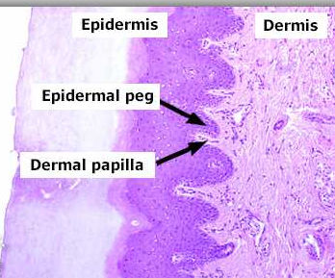
Skin Structure
The skin consists of:
Epidermis
Basement membrane
Dermis
Subcutaneous tissue
Skin appendages

Slide 8
Skin Structure
Epidermis:Composed of many cell types, Keratinocytes, Melanocytes, Lanherhan cells and Merkel cells. Consists of several zones:
Basal layer (Stratum basale): columnar dividing cells.
Spinous layer (Stratum spinosum): polyhedral cells , attached by desmosomes.
Granular layer (Stratum granulosum): flat cells containing keratohyaline granules.
Cornified layer (Stratum corneum ): dead cell with no organells.
7

Slide 9
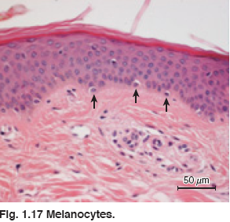
Skin Structure
Basal cell layer
Rest on the basement
membrane ;they divide
continuously and move
upwards.
Melanocytes are dendritic
cells lying between basal
cells in a ratio of 1:10 or 1:5 .
They synthesize melanin stored in melanosomes.

Slide 10
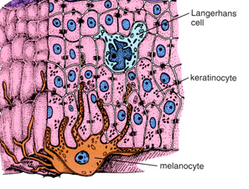
Skin Structure
Melanosomes are transferred to
adjacent cells by means of
dendrites thus forming the
Epidermal Melanin Unit
The size of melaosomes and
packaging differentiate white
from dark skin.
The number of melanocytes are
equal in white and dark skin

Slide 11
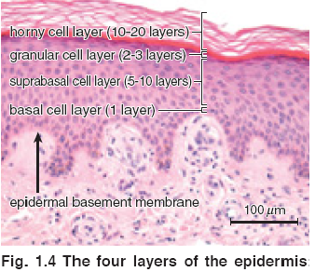
Skin Structure
The spinous cell layer:
Usually 5 -10 layers thick .
Adhere to each other by
Desmosomes are complex
modification of the cell
membrane .
They appear like
spines hence the name
Stratum Spinosum.
Cells are polyhedral.

Slide 12
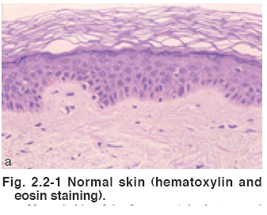
Skin Structure
Granular cell layer :
Diamond shaped cells.
Filled with keratohyaline granules.
Thickness of this layer is
proportional to the thickness
of the stratum corneum layer .
In thin skin it is 1 -3- cell.
layers and 10 cell layers in thick
skin like palms and soles.
Absent in oral mucosa.

Slide 13
Skin Structure
Stratum corneum layer:
The cells in this layer
Have no nucleus .
Have thick envelope
that resist chemicals.
Held together by
desmosomes.
It is 25 cell layer .
Arranged in basket weave or compact pattern
Absent in oral mucosa.

Slide 14
Skin Structure
Stratum lucidum:
The lowest portion of the S. corneum.
Pronounced in palms & soles
Rich in protein bound phospholipids (Odland bodies)

Slide 15
Basement membrane
It is a pink undulated
homogenous area between
the epidermis and dermis .
It consist of number of
proteins.
It is the site of attack injury
in blistering diseases.

Slide 16
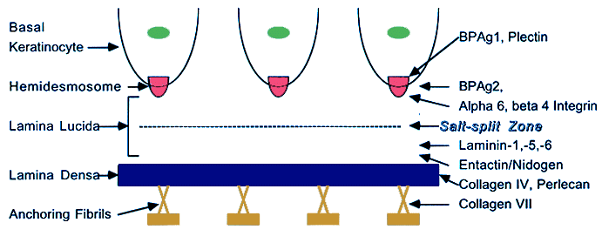
Skin Structure
Basement membrane
Formed by:
Plasma membrane of the
basal cells
Thin clear amorphous
space (lamina lucida)
An electron dense area
(lamina densa )
Anchoring fibrils (type 7 collagen )that anchors the epidermis to dermis .

Slide 17
Skin structure
Dermis is divided into
Papillary dermis .
Reticular dermis
Consists of :
1.Collagen fibers .
Provides strength
Thin fibers in the papillary
Dermis but thick and coarse in
the reticular dermis .

Slide 18
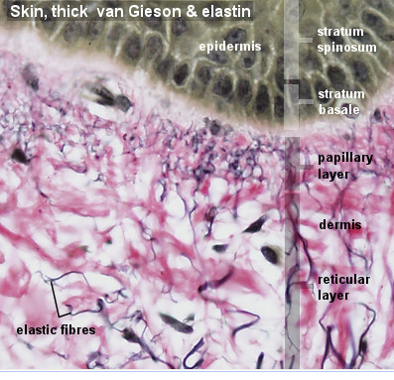
Skin Structure
.2. Elastic Fibers.
Provides elasticity
Protection against shearing
forces.

Slide 19
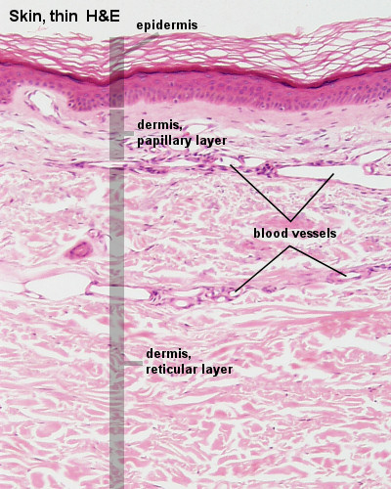
Skin structure
3. Ground substance
Binds water and maintains
the skin turger.
4. Blood vessels.
To nourish the overlying
epidermis also.
5. Fibroblasts
Produce the above
elements..

Slide 20
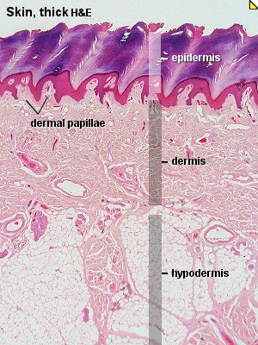
Skin Structure
Function of dermis:
It provides nourishment to
the epidermis and interact
with it during wound repair.
It gives the skin its strength
,elasticity, and softness.

Slide 21
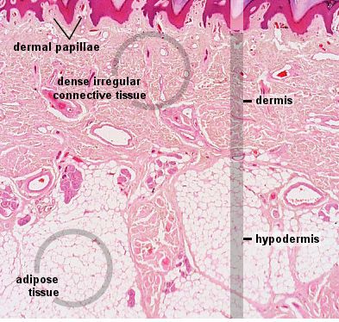
Skin structure
Subcutaneous Fat:
Composed of lipocytes

Slide 22
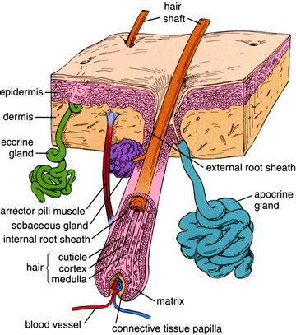
Skin Structure
Skin Appendages include:
Eccrine/ apocrine sweat
glands.
Sebaceous glands.
Hair Follicles.
Nails

Slide 23
Skin appendages
Eccrine sweat glands
Tubular structures open
freely on the skin; not
attached to hair follicles.
Under the influence of
cholinergic stimuli.
.

Slide 24
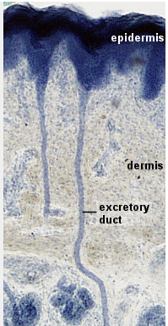
Skin appendages
Eccrine sweat glands.
Present everywhere except
the vermilion border ; nail
beds ; labia minora ; glans
Abundant in palms ; soles.

Slide 25
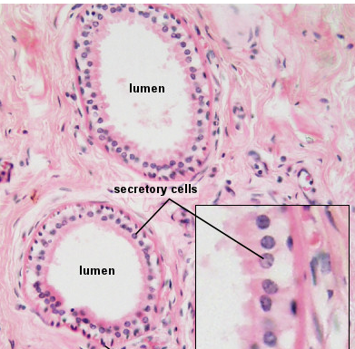
Skin appendages
Apocrine sweat glands:
Secrete viscous material
that give musky odor when
acted upon by bacteria.

Slide 26
Skin appendages
Apocrine sweat glands:
Present in the axillae ;
; inframammary and anogenital areas;
glands of external ear
canal ; the eye lids moll’s
glands ; and areolae.
Under adrenergic stimuli.

Slide 27
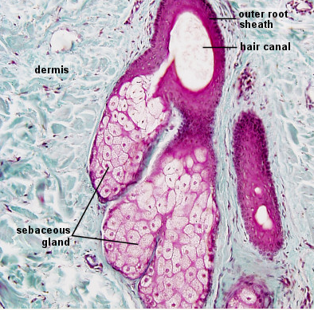
Skin appendages
Sebaceous glands:
Attached to hair follicles or open
freely.
Present in the scalp, forehead, face
upper chest except palms and soles.

Slide 28
Skin appendages
Sebaceous glands:.
In the areola as Montgomery
tubercles
In the eye lids as Meibomian
glands.
Ectopic glands in the mucous membrane are called fordyce spots.
Under the control of androgens.

Slide 29
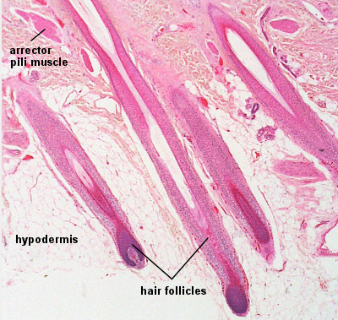
Skin Appendages
Hair follicles:
The hair follicle with it’s
attached sebaceous gland
form the Pilosebaceous
Unit.

Slide 30
Skin Appendages
Structure:
Infundibulum :Surface to area of Sebaceous Gland (SG) opening.
Isthmus :Begins at SG end at bulge
Bulge: Arrector Pilli muscle Insertion
Matrix: Cotains melanocytes
Bulb :Envelopes the Dermal Papilla

Slide 31
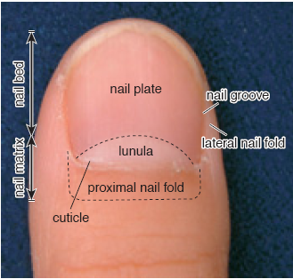
Skin appendages:
Nails.
Nail Bed is visible through
nail plate
Proximal nail fold
morphology can be altered
in connective tissue disease
Nail plate is formed of
hard keratin

Slide 32
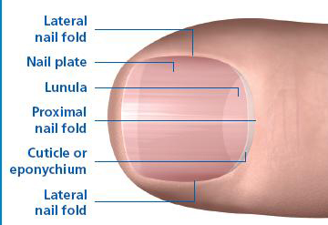
Skin appendages:
The lunula is the visible
part of the matrix
The matrix covers the
midportion of the distal phalanx.
Fingernails grow
3mm/month
Toenails grow 1mm/month

Slide 33
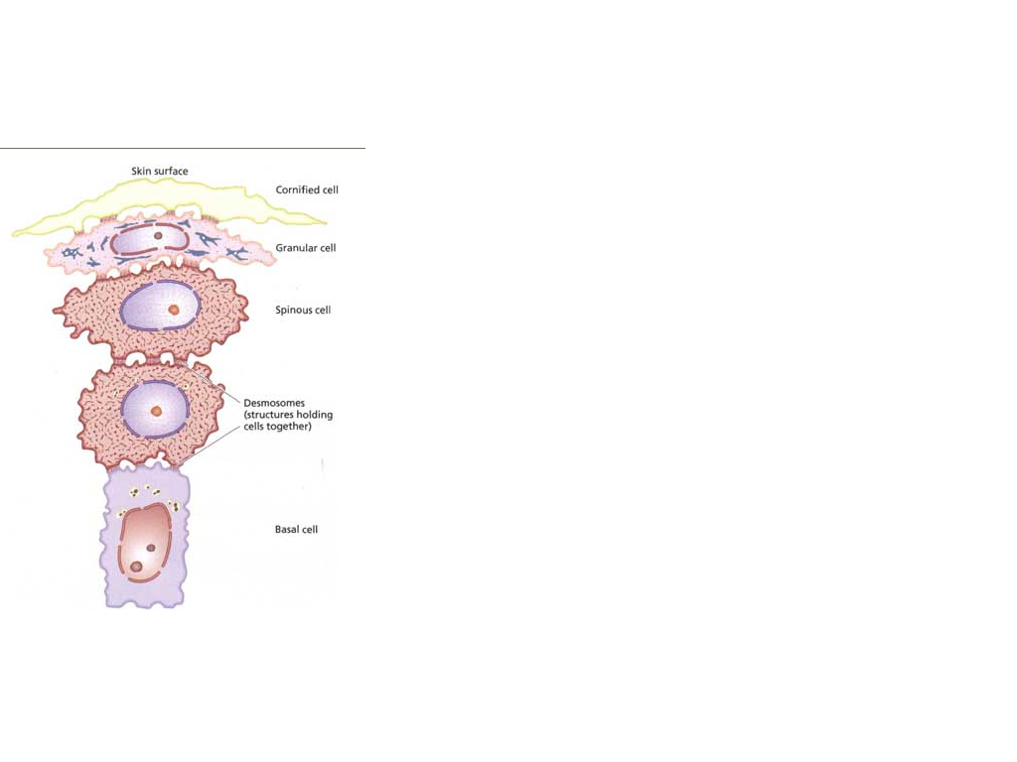
Cornification (keratinization)
It is the cytoplasmic events
that occur in the cytoplasm
of epidermal keratinocytes
during their terminal
differantiation into dead
horny cell(corneocyte)
The total process takes
approximately 2 months.

Slide 34
Cornification (keratinization)
It involves the formation of
keratin polypeptides.
Abnormalities in this process
leads to roughness and scaling
of the skin e g : psoriasis.

Slide 35
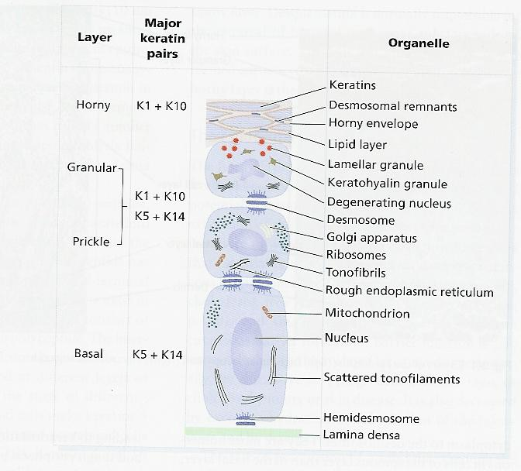

Slide 36
Lecture Outlines
-Function , Structure of the skin.
-Approach to dermatology patient.
-Morphology of skin lesions.
-Reaction patterns.
-Basic pathological terminology.
-Topical therapy.

Slide 37
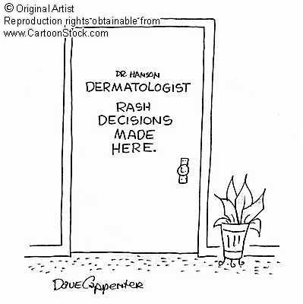
Approach to Dermatology Patient
Step 1: Start with basics
Age
Race
Sex
Occupation

Slide 38
Approach to Dermatology Patient
Step 2 :
Present complaints .

Slide 39
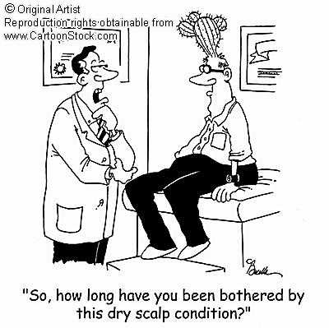
Approach to Dermatology Patient
History of skin lesion
Onset - when?
Where? site of onset.
Extension of lesions.
Evolution.
Itchy/ painful
Provocative factors (sun , cold).
Treatment.

Slide 40
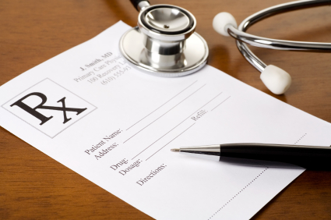
Approach to dermatology patient
Past medical history.
Family history.
Drug history.
Recreational and social
history.

Slide 42
Examination
Use good light when
examining a patient.
Examine nails & mucous
membrane.

Slide 43
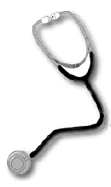
Examination:
Describe the general
appearance of patient.
Describe distribution of lesions
Describe arrangement of
lesions
Describe the type of the lesion
Describe the shape.
Describe the color.
Describe size.

Slide 44
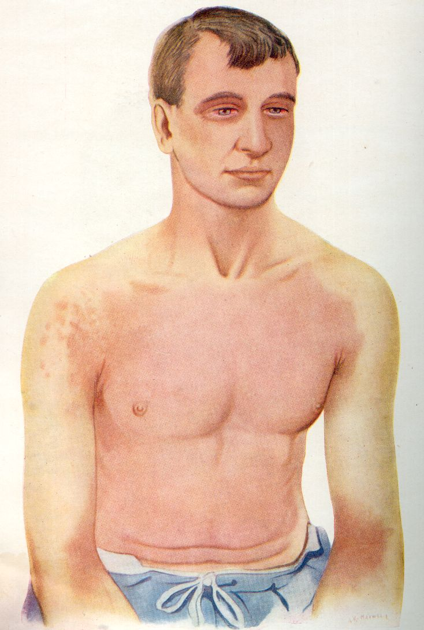
Distribution
Generalized :can be
1.symmetrical
a.Universal (head to toe)
b.bilateral

Slide 45
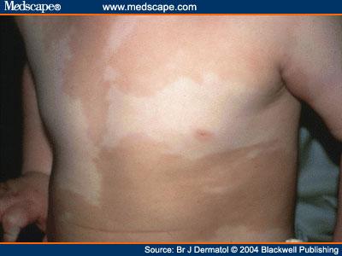
Distribution
2. Asymmetrical
a.Diffuse
b.Unilateral

Slide 46
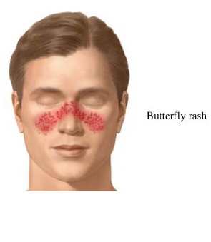
Distribution
Localized to:
-Acral
-Sun exposed.
-Trauma sites.
-Flexures.
-Specific part.

Slide 47
Configuration
The relation of lesions to each other.
-Linear.
-Grouped.
-Annular.
-Reticular.
-Circinate (circular)
-Arciform (arc like)
-Dermatomal.

Slide 48
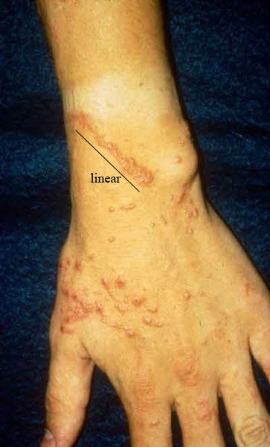
Configuration
Linear:
Forms a line .

Slide 49
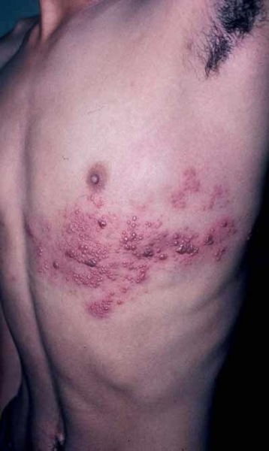
Configuration
Dermatomal.

Slide 50
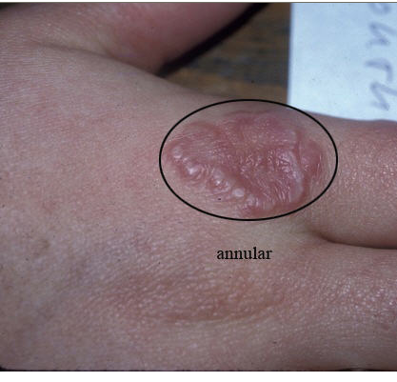
Configuration
Annular
Ring like .

Slide 51
Configuration
Grouped

Slide 52
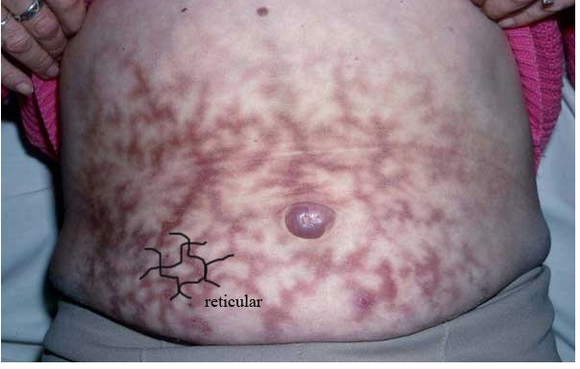
Configuration
Reticular
Net like .

Slide 53
Lecture outlines
-Function , Structure of the skin.
-Approach to dermatology patient.
-Morphology of skin lesions.
-Reaction patterns.
-Basic pathological terminology.
-Topical therapy.

Slide 54
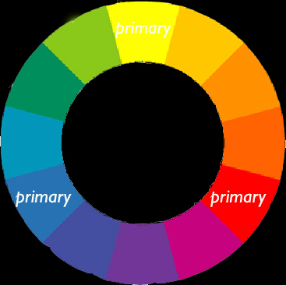
Morphology
Skin lesions are divided into
Primary =Basic lesion.
Secondary= Develop
during evolution of skin
disease created by
scratching or infection

Slide 55
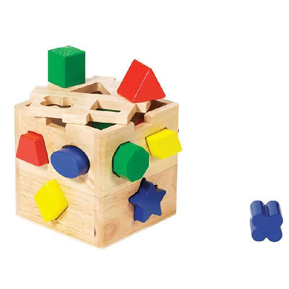
Morphology
It is the shape of lesion
The margination of the
lesion.
It is the type of the lesion.

Slide 56
Morphology
Primary lesions
Macule/patch
Papule/plaque
Nodule
Cyst
Wheal
Secondary lesions
Excoriation
Erosion
Scale
Ulcer

Slide 57
Morphology
Primary lesions
Vesicle/bulla
Pustule
Purpura
Burrow
Secondary lesions
Excoriation
Erosion
Scale
Ulcer

Slide 58
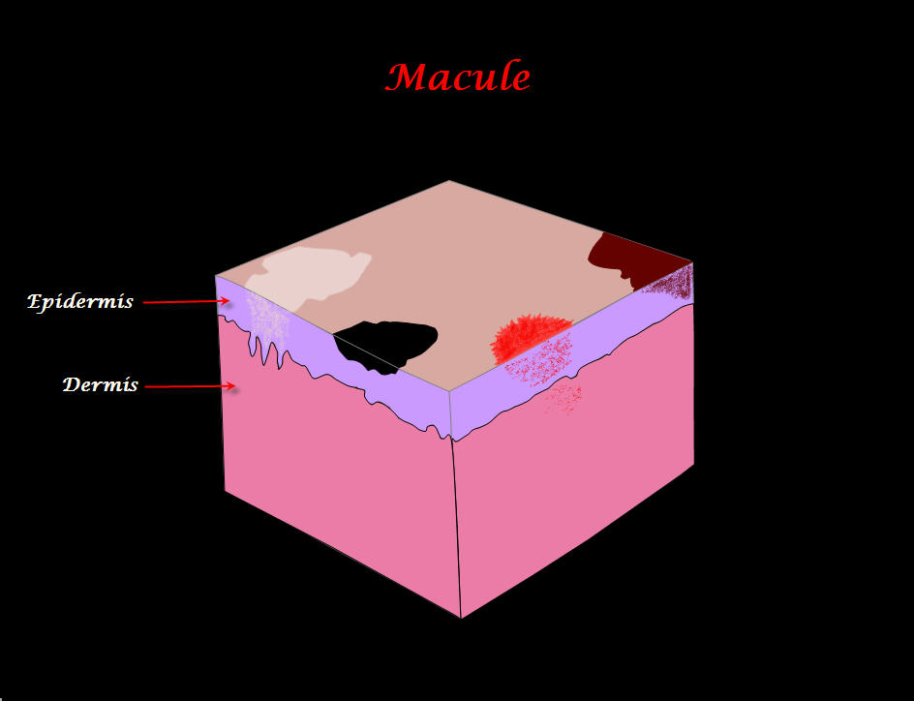
Primary Skin Lesions
Macule :
Flat circumscribed
discoloration that lacks
surface elevation or
depression.

Slide 59
Primary lesions
Patch:
Flat circumscribed skin
discoloration: a very large
macule.

Slide 60
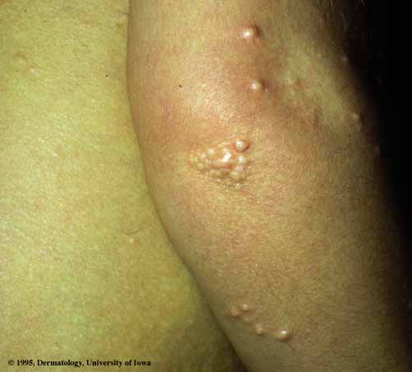
Primary Skin Lesions
Papule :
Elevated, Solid lesion
<0.5cm in diameter.
Notice color and surface
Changes eg.Umblicated-
Keratotic-Papillomatous-
Flat topped.

Slide 61
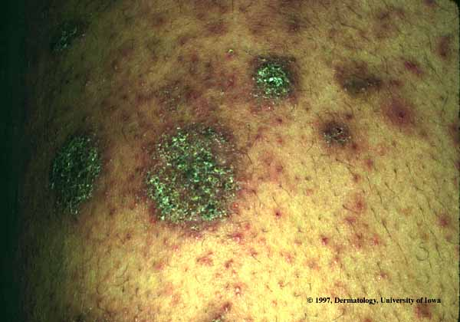
Primary Skin Lesion
Plaque:
Elevated, solid confluence
of papules >0.5 ( lacks a
deep component ).

Slide 62
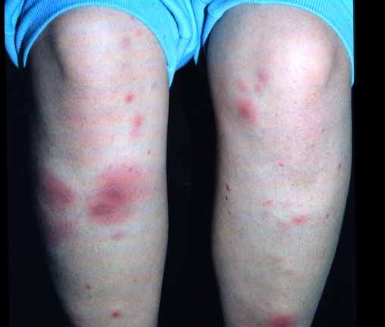
Primary Skin Lesions
Nodule :
Elevated, Solid lesion
>0.5 cm in diameter:
a larger deeper
papule.

Slide 63
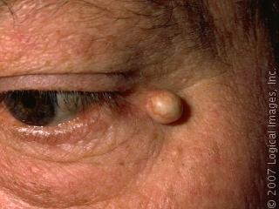
Primary Skin Lesions
Cyst:
Nodule that contains fluid
or semisolid material.

Slide 64
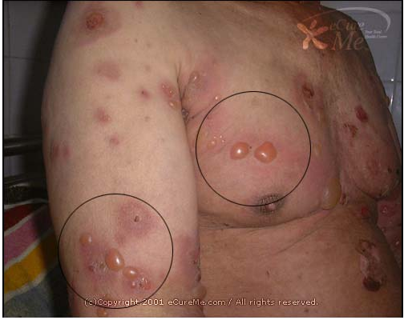
Primary Skin Lesions
Vesicle:
Elevation that
contains clear fluid.
Bulla:
Localized fluid
collection >0.5cm in
diameter a large vesicle

Slide 65
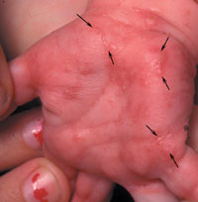
Primary Skin Lesions
Burrow:
linear tunnel in the
epidermis induced by
scabies mite

Slide 66
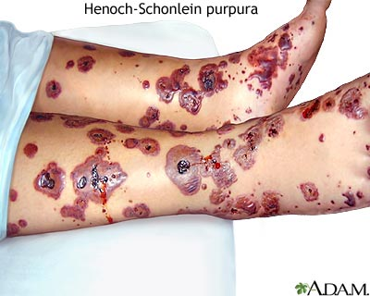
Primary Skin Lesions
Purpura:
Extra-vasation of red
blood cells giving non-
blanchable erythema

Slide 67
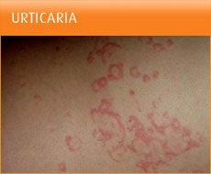
Primary Skin Lesion
Wheal:
Firm, edematous plaque
that is evanescent (short
lived)and pruritic; a hive.

Slide 68
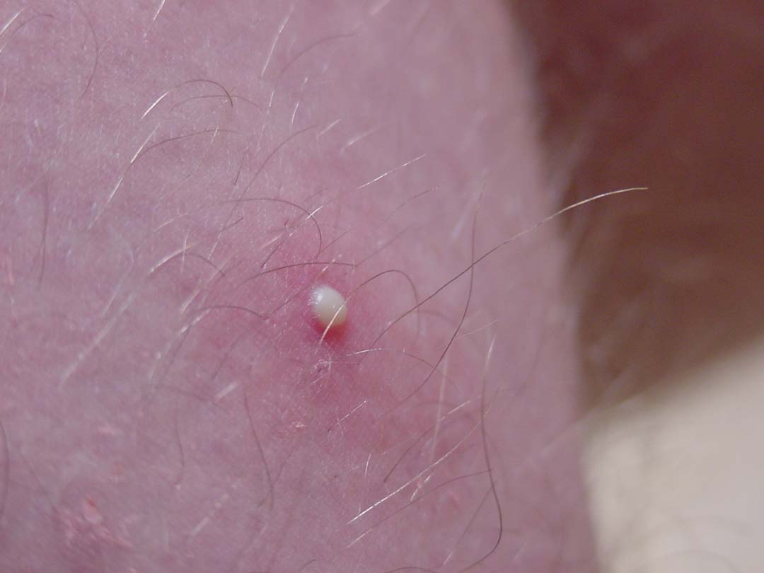
Primary Skin Lesions
Pustule:
Elevation that contains
purulent material.

Slide 69
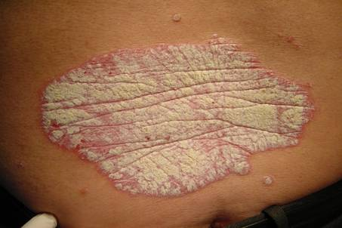
Secondary Skin Lesions
Scale:
Thick stratum cornium
secondary to:
Hyper -proliferation .
Increased cohesion of
keratinocytes eg Psoriasis.

Slide 70
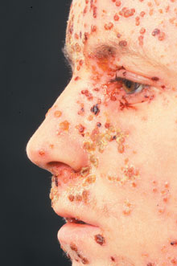
Secondary Skin Lesion
Crust:
A collection of cellular
debris, dried serum and
blood .
Antecedent primary
lesion usually a vesicle,
bulla, or pustule.

Slide 71
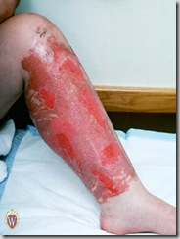
Secondary Skin Lesions
Erosion:
A partial focal loss of
epidermis that heals without scarring.

Slide 72
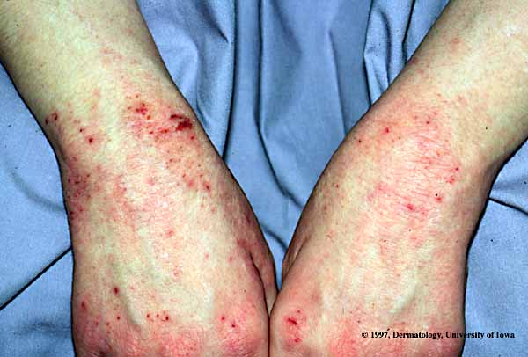
Secondary Skin Lesions
Excoriation :
Linear erosion induced by
scratching

Slide 73
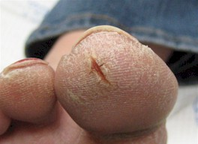
Secondary Skin Lesions
Fissure :
Vertical loss of epidermis
and dermis with sharply
defined walls.

Slide 74
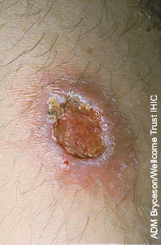
Secondary Skin Lesion
Ulcer :
A full thickness focal loss
of epidermis and dermis;
heals with scarring

Slide 75
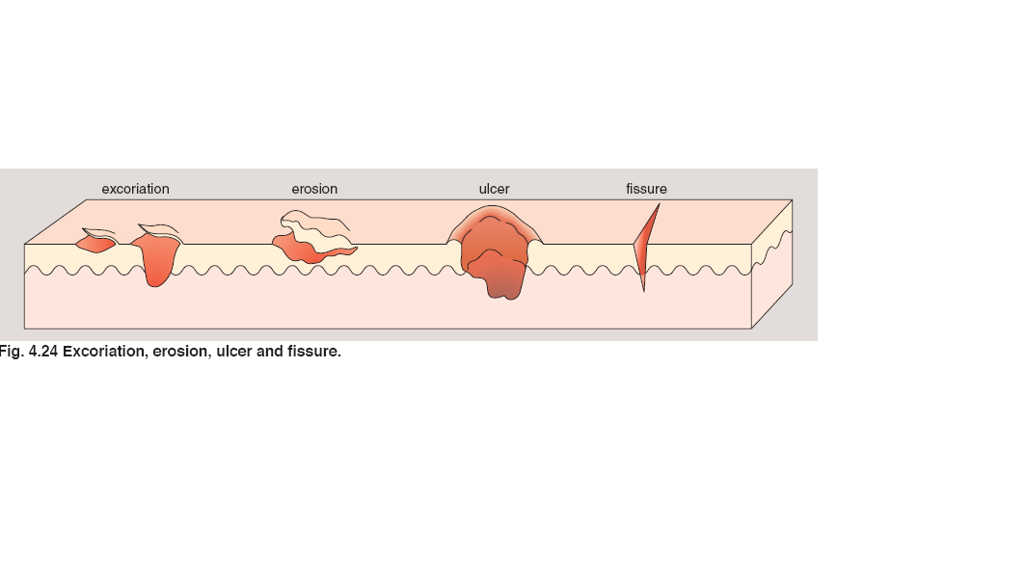

Slide 76
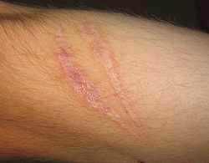
Secondary Skin Lesions
Scar:
A collection of new
connective tissue; may
be hypertrophic or
Atrophic; implies
dermoepidermal
damage

Slide 77
Secondary Skin Lesions
Lichenification:
Increased skin markings
secondary to scratching.

Slide 78
Specialized Terminology
Sclerosis:
Hardening of the skin .
Skin is un-pinchable .

Slide 79
Quiz
Bilateral yellow plaques

Slide 80
Quiz
Keratotic papillomatous skin colored plaque

Slide 81
Quiz
Umblicated pearly papules, some are grouped

Slide 82
Quiz
Erythematous scaly plaque

Slide 83
Quiz
Grouped vesicles on erythematous base

Slide 84
Quiz
Yellow crust, erosions, flacid bulla on erythematous base

Slide 85
Quiz
1 cm cyst with telangiectasia

Slide 86
Quiz
Unilateral erythematous patch

Slide 87
Lecture Outlines
-Function , Structure of the skin.
-Approach to dermatology patient.
-Morphology of skin lesions.
-Important signs and Investigations.
-Reaction patterns.
-Basic pathological terminology.
-Topical therapy.

Slide 88
Important Sign in Dermatology:
A
NIKOLSKY SIGN:
Rubbing of apparently
normal skin induce
blistering
Seen in pemphigus vulgaris
and toxic epidermal
necrolysis (TEN)

Slide 89
Important Signs in Dermatology
AUSPITZ SIGN
Removal of scale on top of
a red papule produces
bleeding points
Seen in psoriasis

Slide 90
Important Sign in Dermatology:
Koebner’s phenomenon:
Trauma to the skin produce
certain diseases like
a.Psoriasis
b.Vitiligo
c.Lichen planus.
d.Warts.

Slide 91
Important Signs in Dermatology
DERMATOGRAPHISM
Firm stroking of the skin
produce erythema and
wheal.
Seen in physical urticaria
In patient with atopy,
stroking produces white
dermato -graphism rather
then red.

Slide 92
Investigations
Woods lamp :
Produces long wave UVL (360 nm)
Useful in
Tinea Versicolor-yellowish
green flourescence
Tinea Capitis -yellow green
flourescence in M.canis, M.
andouini

Slide 93
Investigations
Woods lamp :
Vitiligo - Milky
white.
Erythrasma –coral red
flourescence

Slide 94
Investigation:
KOH preparation for
fungus:
Cleanse skin with alcohol
Swab.
Scrape skin with edge of
microscope slide onto a
second microscope slide

Slide 95
Investigation:
KOH preparation for
fungus:
Put on a drop of 10% KOH
Apply a cover slip and
warm gently
Examine with microscope
objective lens

Slide 96
Investigation:
Tzank smear:
Important in diagnosing
Herpes simplex or VZV
(multinucleated giant cells)
Pemphigus Vulgaris
(acantholytic cells).

Slide 97
Investigation:
Tzank smear:
METHOD
Select a fresh umblicated
vesicle.
Scrape the base of the
vesicle.
Smear onto a slide.
Fix with 95% alcohol.
Stain with Giemsa stain.
Examine under
microscope.

Slide 98
Investigation
Prick test :
Put a drop of allergen
containing solution
A nonbleeding prick is
made through the drop.
After 15-20 mins the
antigen is washed , the
reaction is recorded.

Slide 99
Investigation
Prick test :
A positive test shows
urticarial reaction at site of
prick.
The test is done for
immediate-type reaction
(IgE mediated).
Emergency theraputic
measures should be
available in case of
anaphylaxis.

Slide 100
Investigations
PATCH SKIN TEST
Important in contact dermatitis
Select the most probable
substance causing dermatitis
Apply the test material over the
back
Read after 48 & 72 hr. looking
for
(erythema, edema, vesiculation)

Slide 101
Investigations
Positive patch test showing erythema ,edema and vesiculation.
In severe positive reaction bulla may be seen

Slide 102
Investigation
SKIN PUNCH BIOPSY
Clean skin with alcohol
Infiltrate with 1-2% xylocaine with adrenaline
Rotate 2-6 mm diameter punch into the lesions
Lift specimen and cut at base of lesion
Fix in 10% formaline or put in normal saline for IF
Suture if 5 mm is used

Slide 103
Investigations
Direct immunoflouresence DIF
Used for autoimmune
diseases e.g.
PemphigusVulgaris
Bullous pemphigoid

Slide 104
Investigations
Direct immunoflouresence DIF
Detects immunoglobulin(Ig)
and complement (C)deposits
in skin.

Slide 105
Investigations
Direct immunoflouresence
Fluorescinated antihuman Ig
/anti(Complement)antibodies
added to fresh skin biopsy
Fluorescence will be noted if
immunoglobulin deposits are
found

Slide 106
Investigation:
Indirect Immuno
Fluorescence IDIF
Detect auto antibodies (AB)in the serum
The substrate used is
monkey esophagus or rat
bladder as a source of antigens
Serum is added to substrate
Flourescenated Anti Ig
AB added

Slide 107
Summary:
Don’t forget the Q about the lesion
Full description of lesion
Appropriate investigation
Final Diagnosis.

Slide 108
Lecture Outlines
-Function , Structure of the skin.
-Approach to dermatology patient.
-Morphology of skin lesions.
-Important signs and Investigations.
-Reaction patterns.
-Basic pathological terminology.
-Topical therapy.

Slide 109
Reaction Patterns
Skin has limited number of
morphological expressions
as a result of inflammation

Slide 110
Reaction Patterns
Psoriasiform:
Well defined erythematous
papules with thick scale
Differential diagnosis
Psoriasis
Lichen simplex chronicus

Slide 111
Reaction Patterns
Pityriasiform:
Papules and plaques with
delicate scales
Differential diagnosis
Pityriasis rosea

Slide 112
Reaction Pattern:
Lichenoid :
Flat topped polygonal
papules
Differential diagnosis
Lichen planus
Lichenoid drug reaction

Slide 113
Reaction Patterns
Bullous:
Differential daignosis
Pemphigus Vulgaris
Bullous Pemphigoid

Slide 114
Reaction Patterns
Pustular:
Differential diagnosis
Folliculitis
Varicella
Pustular psoriasis

Slide 115
Reaction Patterns:
Eczematous:
Puritic, erythematous
edematous, vesicular eruption
Differential diagnosis
Atopic dermatitis
contact dermatitis

Slide 116
Lecture Outlines
-Function , Structure of the skin.
-Approach to dermatology patient.
-Morphology of skin lesions.
-Important signs and Investigations.
-Reaction patterns.
-Basic pathological terminology.
-Topical therapy.

Slide 117
Basic Pathology
Epidermis:
Acanthosis:
Increase in the number of
spinous cell layer; manifest
as thickening of the skin.

Slide 118
Basic Pathology
Atrophy :
Decrease in the thickness
of epidermis.

Slide 119
Basic Pathology
Cell differentiation disturbances:
A:Parakeratosis: retention
of the nuclei in the cell of
the cornified layer
Eg :psoriasis
What is orthokeratosis?
physiological parakeratosis?

Slide 120
Basic Pathology
B. Hyperkeratosis: Increased thickness of the stratum corneum .
Caused by increased production or reduced desquamation of corneocytes

Slide 121
Basic Pathology
Epidermal cohesion
Disturbances : due to
a. Spongiosis:
Intercellular edema.

Slide 122
Basic Pathology
b.Acantho-lysis:
Dissolution of intercellular
bridges, the separated cells
become round,
called(acantholytic cells)

Slide 123
Basic Pathology
c. Ballooning
Intracellular edema
associated with viral
infection.

Slide 124
Basic Pathology
Basement membrane Disturbances
IF showing 2 sites of deposition
Epidermal side
e.gErythema Multiforme
Bullous pemphigoid

Slide 125
Basic Pathology
Basement membrane Disturbances
Dermal side e.g.
Dermatitis Herpitiformis

Slide 126
Basic Pathology
Dermis pathology:
Cellular infiltrate :
Neutrophils as in
Dermatitis herpitiformis)
Lmphocytes
Granulomas

Slide 127
Basic Pathology
Collagen / ground substance abnormality
Hypertrophy
Atrophy

Slide 128
Basic Pathology
Vasculitis :
Damage to the blood
vessels with Neutrophilic
infiltrate, manifest clinically
as purpura

Slide 129
Basic Pathology
Subcutaneous pathology
Inflammation of the
fat cells is called
Panniculitis

Slide 130
Lecture Outlines
-Function , Structure of the skin.
-Approach to dermatology patient.
-Morphology of skin lesions.
-Important signs and Investigations.
-Reaction patterns.
-Basic pathological terminology.
-Topical therapy.

Slide 131
Topical Therapy
A wide variety of topical
agents are available.
If the lesion is dry -wet it ,
if wet -dry it.(Golden rule)

Slide 132
Topical Therapy
Topical drugs consist of
active substance ,and
vehicle.
Vehicle:
Is the base in which the
active ingredient is
dispersed.

Slide 133
Topical Therapy
Basic principals
Wet compresses - dries wet lesions.
Like acetic acid.
Wet compresses are
antibacterial-cause debridment
and suppress inflammation.

Slide 134
Topical Therapy
Creams are mixture of oils
and water in which the
active substance is
dispersed.
Creams are white in color-
useful in folds.

Slide 135
Topical Therapy
Ointments are primarily
grease. They are useful in
dry lesions
Preserve moisture
Like petrolatum
jelly and mineral oil.
Ointments are applied to
dry skin
Are translucent.

Slide 136
Topical Therapy
Gels are mixtures of
propylene glycol ,and water
Sometimes they contain
alcohol .They are
translucent and are best
used in wet disorders and
hairy regions

Slide 137
How much to use?
Finger tip unit:
The amount of
cream/ointment expressed
from 5mm nozzle.
It weighs 0.5g.
It covers 2 hand units.

Slide 138
Finger Tip Unit

Slide 139
Required Reading
Chapters 3&4.
Brief notes on
dermatological therapy
page 359-362.
thanx.

