Slide 1
Cutaneous Manifestation of Systemic disease
By:
Dr.Eman Almukhadeb

Slide 2
CUTANEOUS MANIFESTATIONS OF Endocrine DISORDERS

Slide 3
CUTANEOUS MANIFESTATIONS OF DIABETES MELLITUS

Slide 5
1-Diabetic Dermopathy or “Shin Spots”
• Most common cutaneous manifestation of diabetes; M > F, males over age 50 years with
long standing diabetes
• There are bilateral asymptomatic red-brown atrophic macules on shins
• There is no effective treatment

Slide 6
2-Necrobiosis Lipoidica Diabeticorum (NLD)
• Patients classically present with single or multiple red-brown papules, which progress to sharply demarcated yellow-brown atrophic, telangiectatic plaques with a violaceous,irregular border.
-Common sites include shins followed by ankles, calves, thighs and feet.
-Ulceration occurs in about 35% of cases. Cutaneous anesthesia, hypohidrosis and partial alopecia can be found
• Pathology: Palisading granulomas containing degenerating collagen (necrobiosis).

Slide 7
NLD
• Approximately 60% of NLD patients have diabetes & 20% have glucose intolerance. Conversely , up to 3% of diabetics have NLD. Women are more affected than men.
-Pathogenesis is thought to involve the nonenzymatic glycosylation of dermal collagen and elastin
• Treatment: Ulcer prevention. No impact of tight glucose control on likelihood of developing NLD.
-Intralesional steroids
-Systemic aspirin: 300mg/day and dipyridamole 75 mg/day.
-Antiplatelet
-Pentoxyfylline.
-Preilesional heparin injection

Slide 8
Acanthosis nigricans

Slide 9
3-Acanthosis Nigricans
-Causes:
-obesity & insulin resistance & endocrinopathy
(DM ,acromegaly ,cushing syndrome ,hypothyroidisim , Addison disease & hyperandrogenic state as HAIRAN syndrome (hyperandrogen, insulin resistance, acanthosis nigricans)
-Malignancy (esp. GIT, Lung & Breast CA)
-Medications(nicotinic acid ,niacinamide , testosterone, OCP & Glucocorticoid)

Slide 10
Acanthosis nigricans
• Clinical picture: Hyperpigmented velvety plaques of the flexures. The face, external genitalia, medial thighs, dorsal joints, lips and umbilicus can be involved in extensive cases

Slide 11
3-Acanthosis Nigricans
• Pathogenesis involves:
– Genetic sensitivity of the skin to hyperinsulinemia
– Aberrant keratinocyte and fibroblast proliferation stimulated by excess growth factor(e.g., Insulin like growth factor)
• Treatment: Tight blood glucose control, treatment of underlying malignancy, weight control, and discontinuation of offending agent

Slide 12
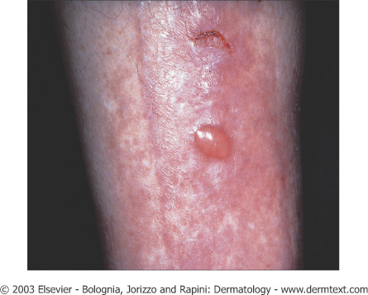
4-Diabetic Bullae or Bullosis Diabeticorum
• Rarest cutaneous complications of diabetes; M > F, long standing diabetics.
-Trauma and microangiopathy may play a role
• Clinical: Rapid onset of painless tense blisters on the hands and feet
• Pathology: Intraepidermal and/or subepidermal split without acantholysis. DIF is negative
• Treatment: Spontaneous healing in two to five weeks

Slide 13
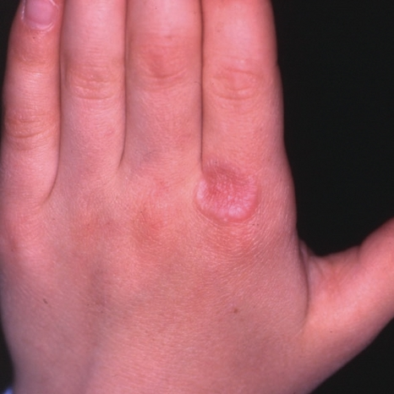
5-Granuloma Annulare
• Association between granuloma annulare and diabetes is controversial.
-Generalized form of GA is the most closely associated with DM.
-It has a chronic and relapsing course
• Treatment :
IL steroid
Systemic steroid
PUVA
• Asymptomatic red-purple dome shaped papules arranged in annular configuration

Slide 14
6-Scleredema Diabeticorum
• Occurs more commonly in type 2 diabetics,long-standing disease, and obese men
• Painless, symmetric woody “peau d’orange” induration the upper back and neck.
-No specific treatment is available

Slide 15
7-Cutaneous Infections
Diabetic patients are predisposed to develop cutaneous infections due to poor microcirculation
-candidal
-Bacterial
-Fungal

Slide 16
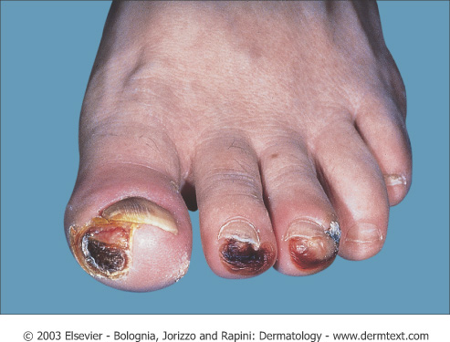
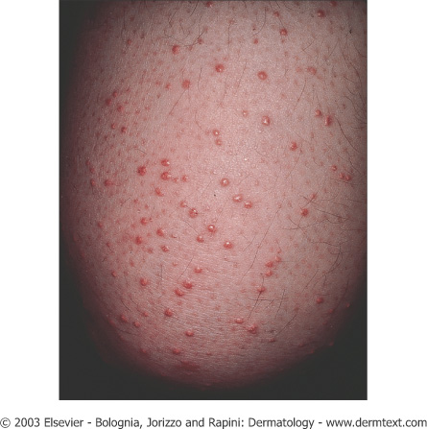
Other manifestation of DM:
- Pruritus
-Yellow Skin or Carotenosis
-Diabetic neuropathy (peripheral) ,Neuropathic ulcers
Eruptive Xanthomas

Slide 17
Cutaneous Manifestation Of Thyroid disease

Slide 19
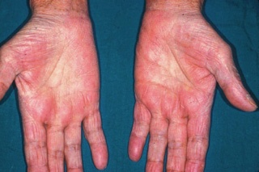
Non-specific Manifestations of Hyperthyroidism
Skin
• Warm, and moist
• Localized or generalized hypertrichosis
• Palmar erythema
• Flushing of head/neck, trunk
Hair
• Soft/fine/straight
• Diffuse reversible alopecia(Telogen effluvium)
Nails
• Faster rate of growth
• Onycholysis
• Plummer nails: concave deformity with distal onycholysis
Pigmentation
• Focal or generalized hyperpigmentation
• Vitiligo

Slide 20
GRAVES Disease

Slide 21
Thyroid dermopathy (Pretibial Myxedema):
-Bilaterally symmetric, non-pitting yellowish-brown to red waxy papules, nodules and plaques on the shins
- Occur in Graves disease.
-The clinical findings are due to an increase in hyaluronic acid in dermis.
- Treatment regimens include high potency topical steroids & intralesional steroid.

Slide 23
Non-specific Manifestations of Hypothyroidisim
Skin
• Cool, dry, pale
• Xerosis
• Hypohidrosis
• Yellowish hue secondary to carotenemia
• Generalized myxedema: swollen waxy appearance
• Swollen lips, broad nose, macroglossia
• Purpura secondary to impaired wound healing
Hair
• Dry, brittle, coarse
• Increase in percentage of telogen hairs
• Diffuse alopecia
• Loss of lateral third of eyebrow (madarosis)

Slide 25
Hypocorticism (Addison disease):
-Generalized hyperpigmentation that is more prominent in light exposed areas, scars, genitalia, palmar and finger creases, and under the nails. The pigmentation characteristically affects the mucous membranes.
-Loss of pubic and axillary hair in females.
-Improvement of acne

Slide 27
Cushing syndrome:
-endogenous or exogenous
-Deposition of fat over the clavicles and back of the neck” Buffalo hump”
-rounded erythematosus face with telangiectasia “Moon face”
-Trunkal obesity with slender wasting limbs.
-Striae distensae .
-Hirsutism, acneform rash, androgenetic alopecia.
-Addisonian-like pigmentation
-Easy bruising of the skin on simple trauma.

Slide 28
Striae distensae

Slide 29
Buffalo hump

Slide 31
Acromegaly
-Skin is oily and wet due to hyperhidrosis with wet hands on hand shaking.
-The lower lip is thickened, protruded with wide spaced teeth.
-Large and furrowed tongue.
-Increased skin pigmentation.
-Hirsutism.
-Acanthosis nigricans

Slide 32
Hyperlipoproteinemia
Type I
• Familial lipoprotein lipase deficiency (AR) or apoprotein CII deficiency
• Increased chylomicrons
• Associated with hepatomegaly, pancreatitis
Type IIa
•Familial hypercholesterolemia, common hypercholesterolemia (AD)
• Increased LDL
Type IIb
• Familial hypercholesterolemia (AD)
• Increased LDL and VLDL
Type III
• Familial Dysbetalipoproteinemia (AR)
• Increased IDL
Type IV
• Familial hypertriglyceridemia (AD)
• Increased VLDL
Type V
• Familial type V hyperlipoproteinemia, familial lipoprotein lipase deficiency (AD)
• Increased chylomicrons and VLDL

Slide 33
Xanthomatosis
6 Clinical Types:
Tuberous Xanthoma
Tendinous Xanthoma
Eruptive Xanthoma
Planar Xanthoma
Palmar Xanthoma
Xanthelasma

Slide 34
1-Tuberous Xanthoma
• Flat or elevated, rounded, grouped, yellowish-orange nodules over joints (particularly
elbows and knees)
• Types II, III, and IV
• Biliary cirrhosis
2-Tendinous Xanthoma
• Papules or nodules over tendons (extensor tendons on dorsum of hands, feet, and achilles)
• Types II, III
3-Eruptive Xanthoma
• Small yellow/orange/red papules appearing in crops over entire body → buttocks, flexor
surfaces, arms, thighs, knees, oral mucosa and may koebnerize
• Associated with markedly elevated or abrupt increase in triglycerides (elevated
chylomicrons)
• Types l ,lll , lV , and V
• Diabetes, obesity, pancreatitis, chronic renal failure, hypothyroidism, estrogen therapy,
corticosteroids, isotretinoin, acitretin
Eruptive Xanthomas

Slide 35
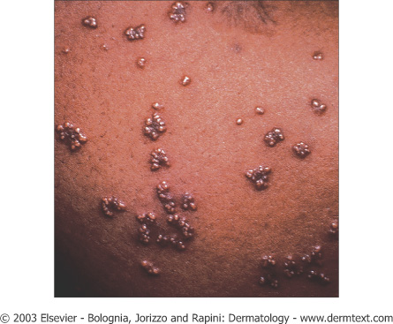
Eruptive xanthomas. Note the yellowish hue
Tuberous xanthomas of the knee. Note the yellowish hue.

Slide 36
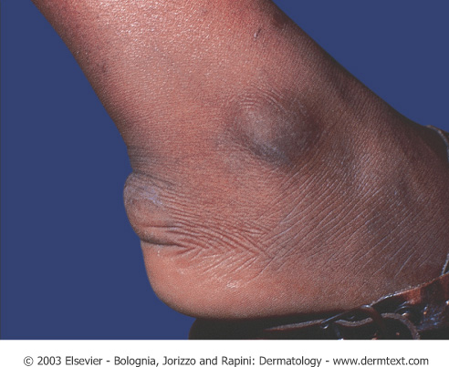
Tendinous xanthoma. Linear swelling of the Achilles area representing a tendinous xanthoma in a patient with dysbetalipoproteinemia.
Tendinous xanthomas of the fingers in a patient with homozygous familial hypercholesterolemia.

Slide 37
4-Planar Xanthoma
• Flat macules or slightly elevated plaques, yellow/tan color
• Associated with biliary cirrhosis, biliary atresia, myeloma, monoclonal gammopathy, lymphoma.
• Characteristically around eyelids, neck, trunk, shoulders, or axillae
• Types ll,lll
5-Palmar Xanthoma
• Nodules and irregular plaques on palms and flexural surfaces of fingers
• Type III
6-Xanthelasma
• Most common type of xanthoma
• Eyelids
• Usually present without any other disease, but can occur in types II and III
• Common among women with hepatic or biliary disorders, also seen in myxedema, diabetes
• Best treated with surgical excision
Plane xanthoma in a patient with a monoclonal IgG gammopathy

Slide 38
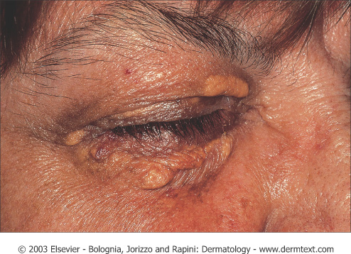
Xanthelasma palpebrarum with typical yellowish hue. Courtesy of Yale Residents Slide Collection.
Plane xanthomas of the palmar creases in a patient with dysbetalipoprotenemia (arrows).

Slide 39
CUTANEOUS MANIFESTATIONS OF GASTROINTESTINAL DISORDERS

Slide 40
Manifestations of Inflammatory Bowel Disease (IBD)

Slide 42
Other less common manifestation: Epidermolysis bullosa acquisita, erythema multiforme, urticaria, clubbing, psoriasis, vitiligo. Note: CD = Crohn’s disease ,UC = Ulcerative Colitis
Cutaneous Findings | Association
Commonly involves perineum associated with edema and inflammation | CD > UC | Fissures and Fistulas
Edema, cobblestone, ulcerations, nodules | CD | Oral Crohn’s
Nodules, plaques, ulcerations; commonly on extremities or intertrigenous regions mimics Erythema Nodosum | CD | Metastatic Crohn’s
Tender red nodules on anterior lower legs; precedes or occurs simultaneous with IBD flare | UC>CD | Erythema nodosum
Papules, pustules, hemorrhagic blisters → enlarge, ulcerate with dusky undermined edges; exacerbated by trauma; frequently on legs | UC>CD | Pyoderma Gangrenosum (PG)
Vegetating plaques, vesiculopustules of intertrigenous areas; heal with hyperpigmentation; when process involves mucosa =Pyostomatits vegetans | UC | Pyoderma Vegetans
Identical to common aphthous ulcers; develop with IBD flares | UC>CD | Chronic Apthous Ulcers

Slide 43
Metastatic crohns disease

Slide 44
Erythema Nodosum
-Inflammation of SC fat
• Erythematous, tender nodules on anterior shins; also seen on thighs, lateral aspects of lower legs, arms, and face , bilateral , symmetrical.
• Often accompanied by fever, chills, malaise, and leukocytosis
• 70% have associated arthropathy
• Occurs at any age, but most prevalent between 20 and 30 years of age
• Results from immunologic reaction triggered by drugs, benign and malignant systemic illness, bacterial, viral, and fungal infections

Slide 45
Causes
MNEMONIC
SHOUT BCG
S=Sarcoid, Sulfa drug, Strep.
H=Histoplasmosis
O=Oral contraceptives , pregnancy
U=Ulcerative colitis
T=TB
B=Bechet’s
C=Crohns
G=GI (Yersinia, salmonella )

Slide 46
Work up:
-Hx ( exclude drugs , hx of infection & GI symptoms)
-CBC ,diff.
-ESR
-Throat swab
-ASO titre
-CXR
-PPD
-Stool for occult blood

Slide 47
Histology
Septal panniculitis without vasculitis

Slide 48
Treatment
• Spontaneous resolution usually occurs within three to six weeks without scarring
• NSAIDs such as indomethacin or naproxen
• Systemic steroids effective in severe cases and can be dangerous if infection is etiology
• Potassium iodide 400 to 900 mg daily

Slide 49
Pyoderma gangrenosum
-1.5-5% of patients with IBD develop PG
• Associated with leukemia, myeloma, monoclonaL gammopathy (IgA),
polycythemia, chronic active hepatitis, HCV , HIV , SLE & pregnancy
• Associated with PAPA syndrome → pyogenic arthritis, pyoderma gangrenosum, severe cystic acne
• May be associated with arthritis

Slide 50
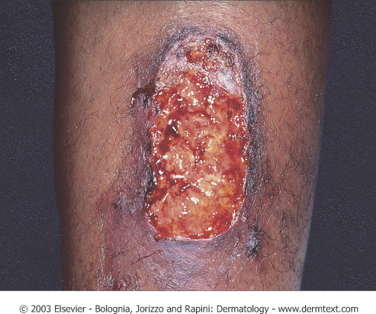
Pyoderma gangrenosum
Four Types:
Ulcerative
Pustular
Bullous
Vegetative
Distinct rolled edges and show satellite violaceous papules that break down and fuse with central ulcer

Slide 51
Peristomal Pyoderma Gangrenosum

Slide 52
Pyoderma gangrenosum
Histology
• Massive dermal edema with epidermal neutrophilic abscesses.

Slide 53
Treatment
-Treat underleying cause
• Potent topical steroids or IL steroids
• Topical tacrolimus
• Systemic steroids
• Sulfapyridine, sulfasalzine, and dapsone
• Cyclosporine is the next choice, with 85% of reported cases responding dramatically
• Infliximab
• Other agents: thalidomide, SSKI, azathioprine, cyclophosphamide, chlorambucil

Slide 54
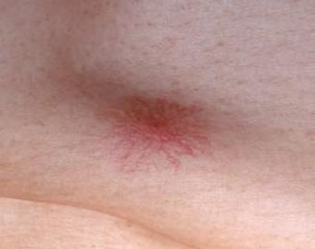
Cutaneous Manifestation of Liver diseases
-Pruritus: generalized itching especially in the presence of biliary obstruction or jaundice.
-Jaundice.
-Spider naevi: small telangeictatic blood vessels especially on the face and upper chest.
-Palmar erythema.
-Diffuse hyperpigmentation
-Thinning of the hair and sometime loss of sexual hair in the axillae and pubic areas.
-Gynaecomastia.
-Porphyria cutana tarda.
-Xanthoma

Slide 56
Diffuse bronzing of the skin in Hemochromatosis

Slide 57
CUTANEOUS MANIFESTATIONS OF RENAL DISEASE

Slide 58
End Stage Renal Disease (ESRD) and Dialysis
1- Pruritus: the most common cutaneous manifestation of ESRD
2-Half and half (Lindsay’s) nails result from edema of the nail bed and capillary network and give the proximal half of the nail an opaque white appearance

Slide 59
End Stage Renal Disease (ESRD) and Dialysis
3-Metastatic Calcification
• Deposition of calcium within tissue secondary to abnormal calcium and or phosphate metabolism
• It can manifest in the skin as benign nodular calcifications (calcinosis cutis) or as a more serious condition (calciphylaxis) with an associated mortality rate between 60-80%
calcinosis cutis

Slide 60
calciphylaxis
• Calciphylaxis presents as painful purpuric plaques and retiform pupura with progression to ulceration and necrosis. Distribution of the lesions may predict prognosis; patients with acral lesions have a better outcome that those with proximally located lesions
• Histological finding of medial calcification/intimal hyperplasia of small arteries and arterioles points to an abnormality of calcium/phosphate metabolism
• Management of these patients includes total or subtotal parathyroidectomy (if PTH levels are elevated), wound care, and avoidance or precipitating factors. Mortality is related to Staphylococcal superinfection of ulcers with resultant sepsis

Slide 61
4-Nephrogenic fibrosing dermopathy /nephrogenic systemic fibrosis
Pathogenesis
• Occurs in patients with renal insufficiency who have had imaging studies with gadolinium
Clinical Manifestations
• Induration, thickening, hardening of skin with brawny hyperpigmention
• Flexion contractures, stiffening of the hands
• Pain, pruritus common
• Extremities most commonly involved, then trunk
• Affected skin is shiny, with peau d’orange appearance
Treatment
• Extracorporeal photophoresis
• Increased morbidily/mortality because of contractures, mobility problems, falls, and fractures

Slide 62
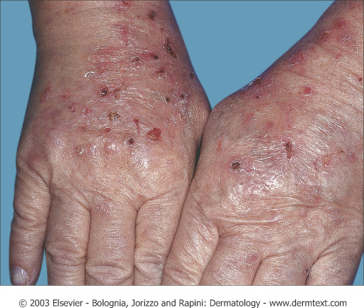
End Stage Renal Disease (ESRD) and Dialysis
5-Porphyria Cutanea Tarda (PCT)
• The pathogenesis may be related to the suboptimal clearance of uroporhyrins (product of heme synthesis pathway) from the circulation
• Patients may present with bullae, skin fragility, photodistributed
hyperpigmentation and hypertrichosis
• Pathology demonstrates a subepidermal bulla
• Treatment includes phlebotomy to decrease iron load
6-Pseudo-PCT
• Similar clinical and histological findings of PCT, in setting of normal porphyrin
profile
• Usually due to certain medications such as furosemide, naproxen, tetracycline, nalidixic acid, or amiodarone

Slide 64
Generalized Pruritus
-Generalised pruritus in the absence of a rash requires investigation and exclusion of an underlying systemic disorder
-it is important to distinguish these from an underlying primary skin disease such as scabies or eczema

Slide 65
Conditions that Cause Pruritis
1-Chronic Renal Disease
2-Cholestasis
3-Endocrine Disease
• Thyrotoxicosis – often due to increased skin blood flow which raises skin temperature
• Hypothyroidism – pruritus secondary to the dry skin
4-Malignancy
• Most common association: Hodgkin’s disease and polycythemia rubra vera
5-HIV Infection
6-Iron deficiency anemia
7-Parasetic infection

Slide 66
Workup of Generalized Pruritus
• Physical exam
• CBC, diff , Blood film
• Stool for O&P, occult blood
• CXR
• Thyroid, renal, and liver function tests
• Drug history

Slide 68
PARANEOPLASTIC DERMATOSES
Benign dermatoses that appear in relation
to an internal neoplasm

Slide 69
PARANEOPLASTIC DERMATOSES

Slide 71
ACANTHOSIS NIGRICANS
• Malignant acanthosis nigricans should be suspected:
• In the absence of a family history, obesity, or endocrine disorders.
• Abrupt onset of lesions after the age of 40-50 years.
• Rapid evolution.
• Involvement of atypical areas: lips, oral mucosa, palms (tripe
palms), flexor surface of the fingers, eyelids.
• It is associated with an abdominal (most often gastric)
adenocarcinoma in 90% of cases
Tripe palms

Slide 72
BAZEX SYNDROME (Acrokeratosis paraneoplastica)
– Psoriasiform dermatitis with acral distribution
– Usually precedes the diagnosis of the neoplasm by months or years
– Associated to squamous carcinoma of the upper aerodigestive tract

Slide 73
Sign of LESER-TRÉLAT
• Seborrheic keratoses:
– Multiple lesion
– Eruptive
– Abrupt increase in number and size
– Pruritus
– Association with Acanthosis nigricans
– Associated with gastrointestinal tumors, lymphomas

Slide 74
ACQUIRED ICHTHYOSIS
• Ichthys = fish
• Generalized ichthyosis
• Absence of family history
• > 20 years of age
• Association with hematological neoplasms, basically: Hodgkin’s lymphoma 70%-80%, non-Hodgkin’s lymphoma, multiple myeloma

Slide 75
ERYTHEMA GYRATUM REPENS
• Rare, few cases reported.
• 100% cases associated with neoplasms: bronchial carcinoma, esophageal carcinoma.
• Clinical characteristics: urticarial, wavy,concentric
erythematous bands that change in a few hours.

Slide 76
NEUTROPHILIC DERMATOSES
Sweet’s syndrome
Pyoderma gangrenosum

Slide 77
SWEET’S SYNDROME (Acute febrile neutrophilic dermatosis )
– Acute erythematous indurated plaques or nodules
– Upper region of the trunk, face, and upper limbs
– Accompanied by:
– Fever
– Leukocytosis-neutrophilia (histopathologically)
– Rapid response to systemic corticosteroids
- 85% hematological neoplasms: acute myeloid leukemia,lymphomas.

Slide 78
HYPERTRICHOSIS LANUGINOSA ACQUISITA
• More common in women, ♀:♂ ratio 3:1
• > 40 years
• Fine whitish silky hair (lanugo)
• Starts on the face, later generalizes
• Rapidly Progresses
-Associated neoplasms:
– ♀: colorectal and breast cancer
– ♂: lung and colorectal cancer
• In general, the neoplasm has already spread at the time of
diagnosis

Slide 79
PARANEOPLASTIC DERMATOSES CONCLUSION
SUSPECT A PARANEOPLASTIC DERMATOSIS IF:
• Abrupt onset of dermatosis in advanced age
• Rapid course
• Atypical clinical presentation
• More severe skin lesions

Slide 80
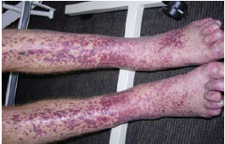
Purpura and vasculitis

Slide 81
Definition
Visible hemorrhage into the skin or mucous membrane subdivided as a follow:
-Petechiae less than or equal 4 mm
-Purpura (>4mm - < 1cm)
which can be either Palpable or non-palpable(macular)
-Ecchymoses > or equal to 1 cm

Slide 82
Purpura
Causes
Platelet disease
Coagulation defect
Blood vessel wall pathology

Slide 83
Causes
1-Platelet Disorders
Thrombocytopenia
Platelet Dysfunction
2-Coagulation Factor Deficiency
Congenital
Factor VIII Deficiency
Factor IX Deficiency
Von Willebrands disease
Acquired
Disseminated Intravascular Coagulopathy
Liver disease
Uremia
Vitamin K deficincy
3-Vascular Factors
Congenital
Hereditary Hemorrhagic Telangectasia
Ehlers-Danlos Syndrome (Type IV)
Acquired:
Inflammation(Vasculitis)
Trauma
Vitamin c deficiency (scurvy)

Slide 84
vasculitis

Slide 85
Definition
A clinicopathologic process characterized by inflammatory destruction of blood vessels that results in occlusion or destruction of the vessel and ischemia of the tissues supplied by that vessel.

Slide 86
Classification

Slide 87
Classification
-Large-vessel vasculitis
Aorta and the great vessels (subclavian, carotid)
Claudication, blindness, stroke
-Medium-vessel vasculitis
Arteries with muscular wall
Mononeuritis multiplex (wrist/foot drop), mesenteric ischemia, cutaneous ulcers
-Small-vessel vasculitis
Capillaries, arterioles, venules
Palpable purpura, glomerulonephritis, pulmonary hemorrhage

Slide 88
Cutaneous small vessel vasculitis
-Is the most common type of vasculitits and it primarily affect post-capillary venules

Slide 89
Cutaneous small vessel vasculitis
Pathogenesis:
-Many forms of small-vessel vasculitis are felt to be caused by circulating immune complexes
-These lodge in vessel walls and activate compliment

Slide 90
Cutaneous small vessel vasculitis

Slide 91
Cutaneous small vessel vasculitis
-Palpable purpura is the hallmark
-Pinpoint to several centimeters
-Early on lesion may not be palpable,Papulonodular, vascular, bullous, pustular or ulcerated forms may develop
-Predominate on the ankles and lower legs i.e dependent areas

Slide 92
Cutaneous small vessel vasculitis
-Mild pruritis, fever, malaise, arthralgia and/or myalgia may occur
-Typically resolve in 3 to 4 weeks
-Residual postinflammatory hyperpigmentation may be seen
-Self-limiting
-May recur or become chronic
-Hemorrhagic vesicles or bullae may develop

Slide 93
Cutaneous small vessel vasculitis
-may be localized to the skin or may manifest in other organs.
-The internal organs affected most commonly include the joints, GIT, and the kidneys.
-Renal involvement present as glomerulonephritis
- The prognosis is good in the absence of internal involvement

Slide 94
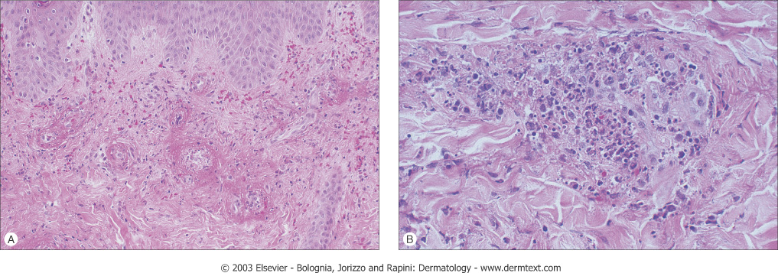
Histology
Agiocentric segmental inflammation, endothelial cell swelling, fibrinoid necrosis of blood vessel walls and a cellular infiltrate composed of neutrophil with RBC extravasation.

Slide 95
Work up
-Detailed history and physical examination
-History should focus on possible infectious disorders, prior associated diseases, drugs ingested, and a thorough review of systems
-CBC, strep throat culture or ASO titer, Hep B & C serologies and ANA are a reasonable initial screen
-Urinalysis (RBC cast)

Slide 96
Treatment
-treatment of cause.
-Symptomatic treatment (if skin is only involved): rest ,NSAIDS ,Antihistamine
-severe visceral involvement may require high doses of corticosteroids with or without an immunosuppressive agent
-Immunosuppressive agents for rapidly progressive course and severe systemic involvement

Slide 97
Henoch-Schönlein purpura((HSP)
-Primarily occurs in male children
-peak age 4-8 years
-Adults may be affected
-A viral infection or streptococcal pharyngitis are the usual triggering event
-In about 40 % of the cases the cutaneous manifestations are preceded by mild fever, headache, joint symptoms, and abdominal pain for up to 2 weeks

Slide 98
Henoch-Schönlein purpura(HSP)
-Characterized by intermittent purpura, arthralgia, abdominal pain, and renal disease
-Typically purpura appears on the extensor surfaces of the extremities
-Become hemorrhagic within a day and fades in 5 days
-New crops appear over a few weeks

Slide 99
Henoch-Schönlein purpura
-May be associated with:
pulmonary hemorrhage
Abdominal pain and GI bleeding
-GI radiographs may show “cobblestone” appearance
-Renal manifestations may occur in 25% or more but only 5% end up with ESRD

Slide 100
Henoch-Schönlein purpura
-The long-term prognosis in children with gross hematuria is very good; however, progressive glomerular disease and renal failure may develop in a small percentage
-IgA, C3 and fibrin depositions have been demonstrated in biopsies of both involved and uninvolved skin by immunofluorescence techniques

Slide 101
Mucocutaneous lymph node syndrome (Kawasaki’s disease)
-Predominantly seen in children less than 5 years of age.
-Occurs most often in Japan

Slide 102
Mucocutaneous lymph node syndrome (Kawasaki’s disease)
-To make the diagnosis a patient should have a fever above 38.3 C for 5 days plus 4 of the 5 following criteria;
-Edema of hands and feet
-Polymorphous exanthem
-Nonpurulent bilateral conjunctival injection
-Changes in the lips and oral cavity
-Acute, nonpurulent cervical adenopathy

Slide 104
Mucocutaneous lymph node syndrome (Kawasaki’s disease)
-Coronary arterial disease occurs and
thrombocythemia may occur
-In combination vessel occlusion may occur and the subsequent MI, which occur as the child is recovering from the acute illness

Slide 105
Mucocutaneous lymph node syndrome (Kawasaki’s disease)
Treatment:
-IVGG is the cornerstone of treatment
-Antiplatelet therapy with aspirin is recommended

Slide 106
Thank you

