Slide 1
Dermatitis (Eczema)
By:
DR. Eman AL-Mukhadeb

Slide 2
Outline:
-Atopic dermatitis
-seborrheic dermatitis
-contact dermatitis:
-allergic
- irritant
-Nummular dermatitis (discoid eczema)
-Dyshidrotic eczema.
-Stasis dermatitis.
-Neurodermatitis.

Slide 3
Hypersensitivity Reaction
Type 1: Immediate Hypersensitivity Reaction
Mediated by IgE to specific antigens
Mast cells stimulated and release histamine
Reaction within 15-30 minutes of exposure
Examples: Anaphylaxis (e.g.penicillin) ,Urticaria , Angioedema .
Type 2: Cytotoxic Antibody mediated Reaction
Mediated by IgG and IgM to specific antigens
Examples: Transfusion Reaction ,Rhesus Incompatibility (Rh Incompatibility), Hashimoto‘ thyroiditis.

Slide 4
Cont…
Type 3: Immune Complex Reaction
Antigen-Antibody complexes deposit in tissue
Reaction within 1-3 weeks after exposure
SLE, serum sickness , vasculitis:Examples
Type 4: Delayed-Type Hypersensitivity
Mediated by T-Lymphocytes to specific antigens
Reaction within 2-7 days after exposure
Examples: Allergic contact dermatitis (e.g. Nickel allergy)

Slide 5
ATOPY:
is familial predisposition to development of bronchial asthma ,allergic conjunctivitis ,rhinitis & atopic dermatitis.

Slide 6
Atopic Dermatitis
Is chronic relapsing eczema associated with intense pruritus

Slide 7
Pathogenesis:
-Genetic pedisposition
-immune mediated (increase IgE)
-Impaired skin barrier.

Slide 8
Clinical picture:
- Acute:
-eryhema
- papules & vesicles
- oozing
-Subacute:
- scales
- Excoriation
-Chronic:
-lichenificaion & hyperkeratosis

Slide 9
Three stages:
-Infantile
-Childhood
-Adulthood
-Acute inflammation & extensor/facial involvement is more common in infant whereas chronic inflammation increase in prevalance with age as does localization to flexures.

Slide 10
Infantile

Slide 12
Childhood

Slide 14
Diagnosis

Slide 15
criteria
Major
1.pruritus
2.typical morhology and distribution
3.chronicity
4.Personal or family history of atopy

Slide 16
Minor criteria
-Xerosis
-Icthyosis/hyperlinear palms/keratosis pilaris.
-IgE reactivity
-Elevated IgE level
-Early onset
-Skin infection
-Chelitis
-Nipple eczema
-Recurrent conjuctivitis
-Keratoconus
-Dennie morgan fold
-Anterior cataract
-Orbital darkening
-Facial erythema
-Pityriasis alba
-Food hypersensitivity
-White dermatographism

Slide 17
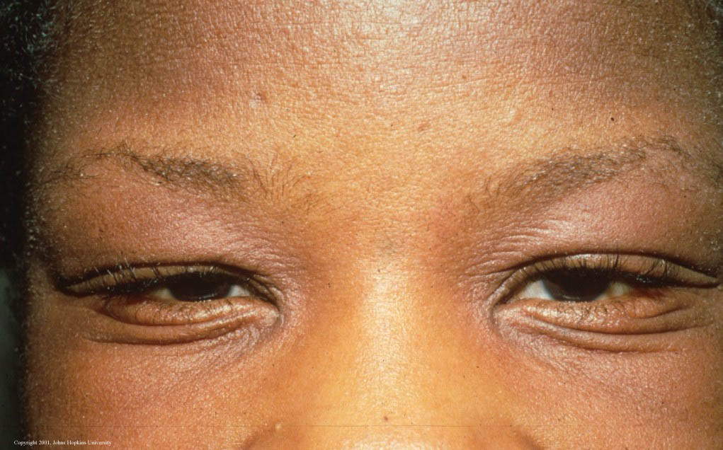
Dennie morgan fold

Slide 18
Pityriasis alba

Slide 19
Pityriasis alba

Slide 20
Keratosis pilaris

Slide 21
Pathology
-Depend on the stage
-Spongiosis (oedema)
-Exocytosis of lymphocytes

Slide 22
Complication

Slide 23
SKIN INFECTIONS
-STAPH AURIOUS:
1.folliculitis
2.impetigo
eczema herpeticum) )-Herpes Simplex Virus
-TRICHOPHYTON RUBRUM

Slide 24
Education :
-Avoid alkali soaps
-Avoid woolen clothes and wear cotton instead

Slide 25
Emollient

Slide 26
Treatment
-Education.
-Emmolient.
-topical steroid
-topical tacrolimus
-oral antihistamine
-oral Antibiotic (for 2ry bacterial infection)
-ultraviolet light
-systemic steroid
-others: cyclosporin , methotrexate ,azathioprine, IVIG , Biologic

Slide 27
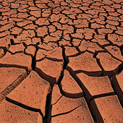

Slide 29
Seborrheic Dermaitis
Is a common mild chronic eczema typically confined to skin regions with high sebum production & the large body folds

Slide 30
Pathogenesis
-Seborrhea & abnormal sebum production.
-Commensal yeast Malassezia furfur (pityrosporum ovale)

Slide 31
Clinical Picture:
Seborrheic dermatitis is defined by clinical
parameters which include:
1-erythematous red-yellow , poorly circumscribed patches & thin plaques with bran-like to flaky (greasy) scales.
2-Limitation to those periods of life when sebaceous gland are active i.e. the 1st few months of life & post puberty (infantile & adult forms).

Slide 32
Cont….
3- A predilection for areas rich in sebaceous glands
e.g: scalp , face, ears , presternal region & flexural areas (axillae, inguinal & inframammary folds , umbilicus).
4-A mild course with moderate discomfort.

Slide 34
Cradle cap: is coherent scaly & crusty mass covering most of the scalp & can be seen in infanile seborreic dermatitis.

Slide 37
Treatment:
-Antifungal shampoo (ketoconazole shampoo)
-Topical antifungal.
-low potency topical steroid.

Slide 38
Contact Dermatitis
-Allergic contact dermatitis.
-Irritant contact dermatitis.

Slide 39
Allergic cotact dermatitis (ACD)
Definition:
Dermatitis resulting from type 4 reaction following exposure to topical substances in sensitized individuals.

Slide 40
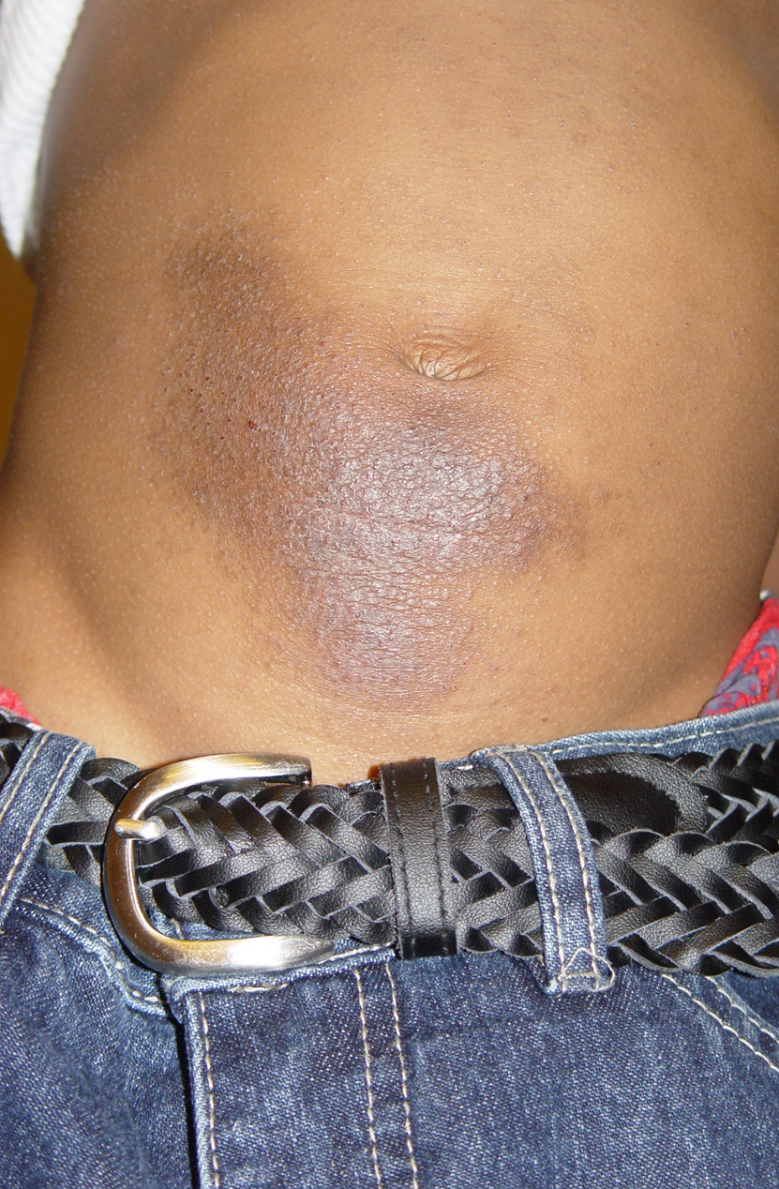
Clinical picture:
-Acute form present with crusted erythematous papules, vesicles & bullae that is well demarcated & localized to the site of contact with the allergen.
-ACD can be more diffuse in distribution .
-Example: Nickel , rubber , fragrances , preservatives.

Slide 41
ACD

Slide 42
Diagnosis:
-Hx.
-Examination.
-PATCH testing remain the gold standard for accurate diagnosis.

Slide 43
Patch test

Slide 44
Treatment of ACD:
-Avoidance.
-topical steroid
-systemic steroid
-systemic antihistamine

Slide 45
Irritant contact dermatitis (ICD)
-Is localized non immunologically mediated inflammatory reaction.
-ICD results from direct cytotoxic effect d.t single or repeated application of a chemical substance to the skin.

Slide 46
Clinical picture:
-Similar to ACD but ICD never extend beyond the area of contact.
-tend to be painful rather than pruritic .
-can occur from the 1st exposure to the irritant unlike ACD which only occur in previously sensitized individual.

Slide 47
Treatment:
Same as ACD.

Slide 48
Nummular (discoid) dermatitis
-Sharply circumscribed eczema , nummular means ( coin -shaped)
-Pathogenesis: Probably microbial in origin i.e. 2ry to bacterial colonization or disseminaion of bacterial toxins.

Slide 49
Clinical picture:
-coin shaped eczematous plaques .
-Usually very pruritic.

Slide 50
Treatment:
-Topical steroid
-Topical antibiotic
Oral antibiotic-

Slide 51
Dyshidrotic dermatitis (pompholyx)
Acute dermatitis which is often vesicular with tiny deep seated vesicles along the sides of the fingers associated with pruritus

Slide 52
Cont..
-Not considered as a separate disease
-Can be associated with atopy of patients with dyshidrosis, 50% have atopic dermatitis.
-Exogenous factors (eg, contact dermatitis to nickel,chemicals) also play a role.
-Affect hands & feet.

Slide 53
Dyshidrotic dermatitis

Slide 54
Treatment:
-Avoidance of triggering factor.
-topical seroid.

Slide 55
Stasis dermatitis
-seen in patient with signs of venous hypertension like chronic lower limb edema, varicose vein.
-can be complicated by superimposed allergic contact dermatitis.

Slide 56
Neurodermatitis
-Include dermatitis which results from repeated rubbing & scratching of the skin .
-Chronic itching and scratching can cause the skin to thicken and have a leather texture with exaggeration of skin marking.
-A scratch-itch cycle occurs which is difficult to break .

Slide 57
Neurodermatitis
-Can be triggered by stress and anxiety.
-Occur commonly in atopic patient.

Slide 58
lichen simplex chronicus
Present as thick hyperkeratotic plaque with accentuation of skin marking that occurs on any site that the patient can reach, including the following:
-Scalp
-Nape of neck
-Extensor forearms and elbows
-Vulva and scrotum
-Upper medial thighs, knees, lower legs, and ankles

Slide 59
lichen simplex chronicus

Slide 61
Treatment:
-control itching (break itch scratch cycle).
-topical or intralesional steroid.
-oral antihistamine
- Oral Anxiolytic

Slide 62
THANK YOU

