Slide 1

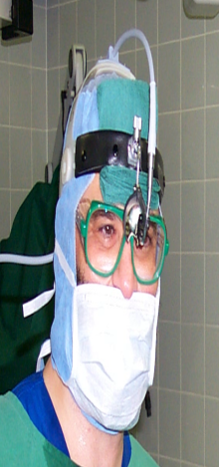


Non Allergic Rhinitis
Prof. Sameer Bafaqeeh, M.D.
University Professor
in Rhinology & Rhinoplasty

Slide 2
Vasomotor Rhinitis
Symptoms : as Perennial Allergic Rhinitis
Paroxsysmal course
Local Finding: Livid, pale nasal mucosa.
Profuse watery secretion
Nasal turbinates swollen

Slide 3
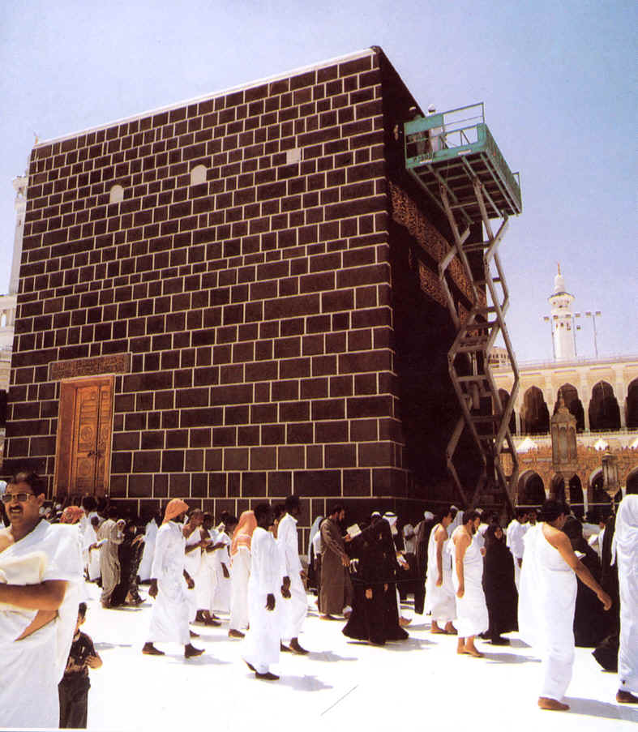
Pathogenesis
Neurovascular disorder
No specific antibodies
Nonspecific reflex hypersensitivity
Caused by various influences

Slide 4
Pathogenesis
Change of temperature or humidity
Alcohol , dust, smoke, mechanical irritation, stress, anxiety neurosis, endocrine disorders, rhinitis of pregnancy.
Drugs: (e.g., antihypertensive agents as reserpine or beta-blockers, oral contraceptives)
Drug abuse: (imidazoline & catechol derivatives, clomethiazole, etc.)

Slide 5
Diagnosis
Typical history
Negative allergen tests
No elevated IgE in the secretion

Slide 6
Differential diagnosis
Allergic Rhinitis
Foreign body in the Nose
Common Cold

Slide 7

Vasomotor Rhinitis
Conservative Tretment
Elimination of irritant factors
Antihistamines
Nasal decongestant drops
Oral decongestant drugs
Steroids (e.g., beclomethasone)
Metabolic & endocrine systems
Sedatives
Imidazoline preparations
(Potential for habituation)

Slide 8
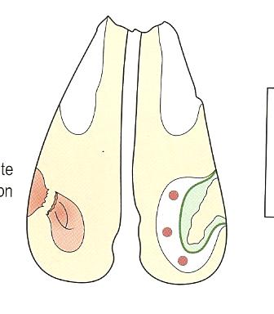
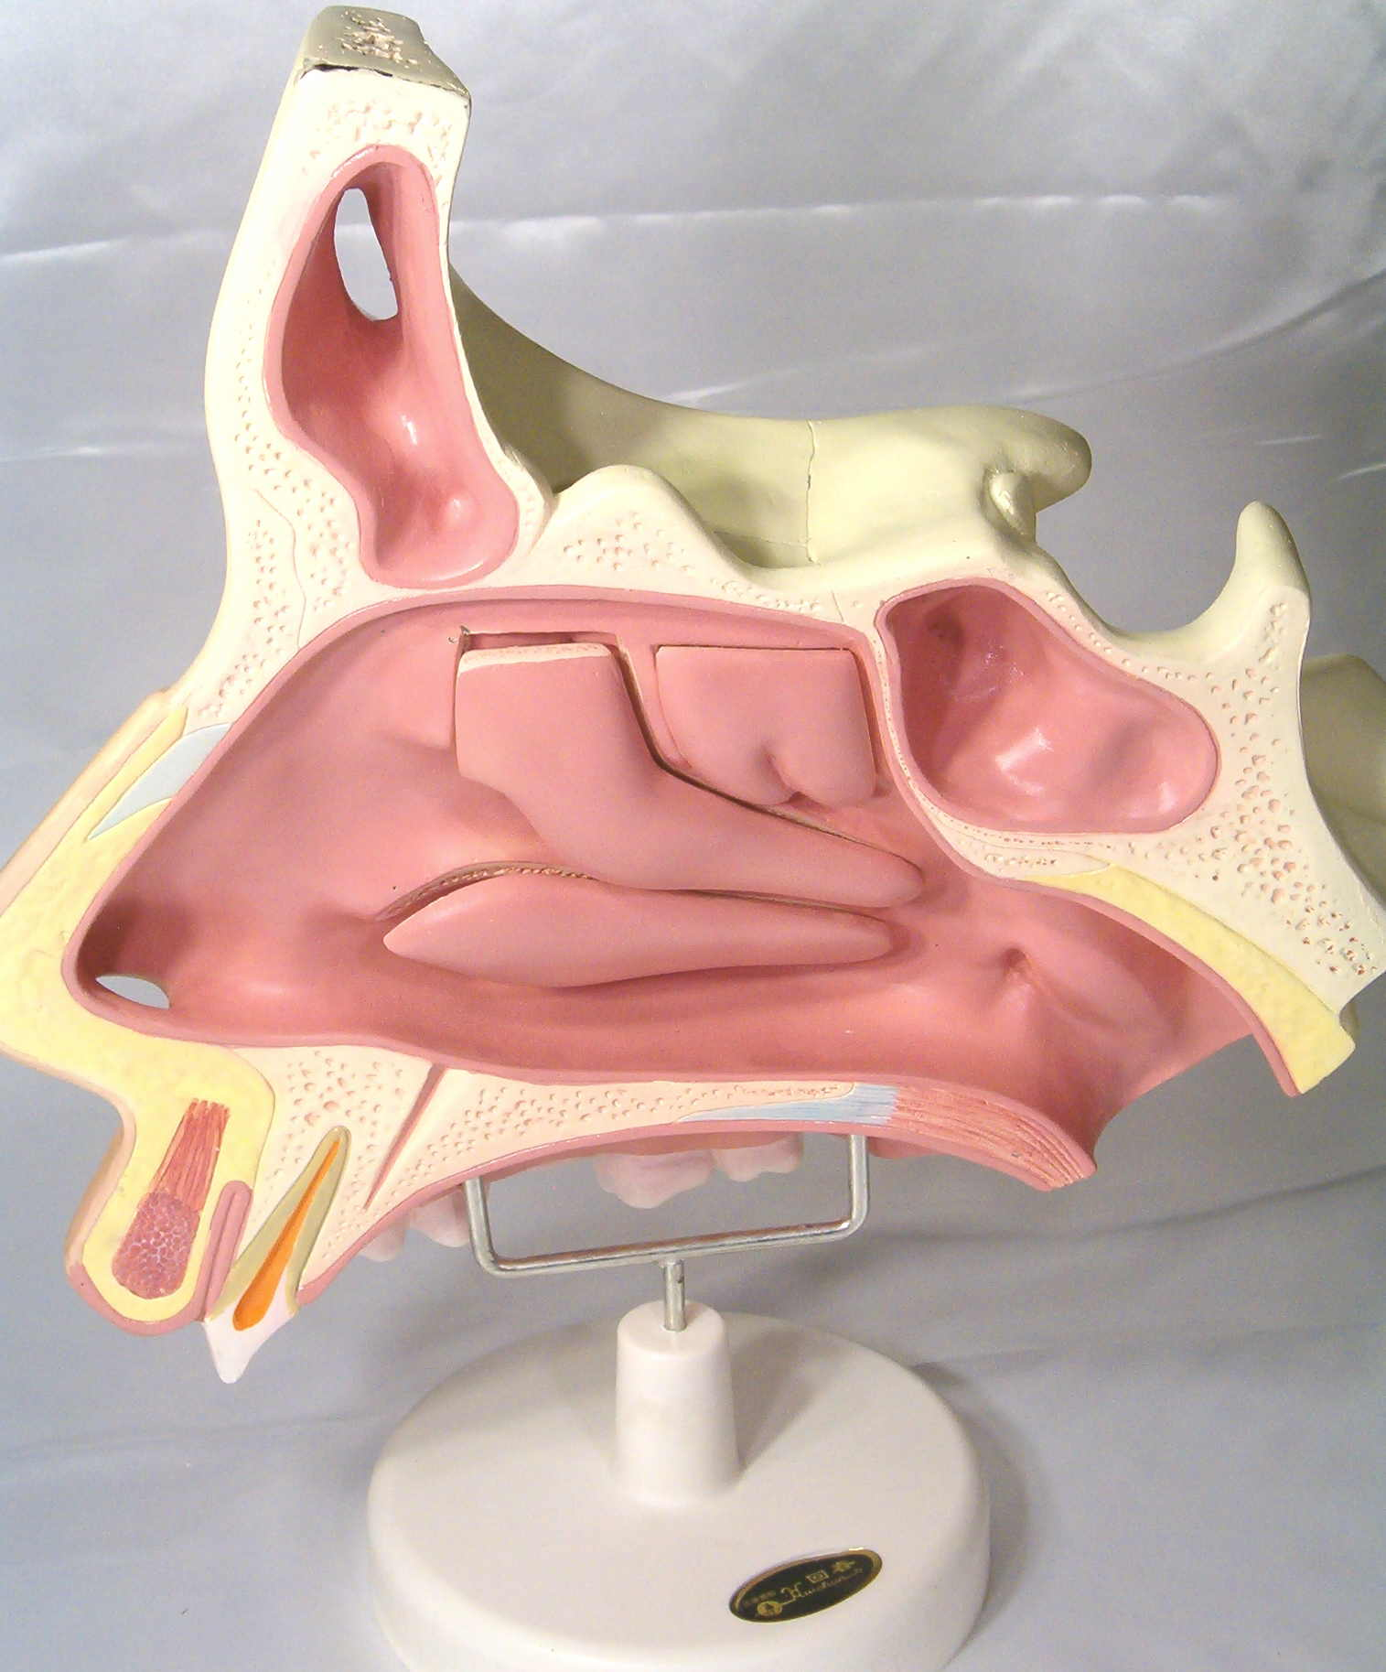
Vasomotor Rhinitis
Surgical Treatment
Turbinate surgery Electrocautery,cryosurgery, laser
Correction of anatomical deformity
Conchotomy
Parasympathetic nasal fibers divisions
(Pterygoid canal n., vidian n., greater petrosal n.) M.C.F.

Slide 9
Vasomotor Rhinitis
Prognosis
Uncertain
Suddenly improves
Resistant to treatment

Slide 10
Rhinitis Sicca Anterior
Symptoms
Dryness
Irritation
Crusts formation
Nasal bleeding

Slide 11
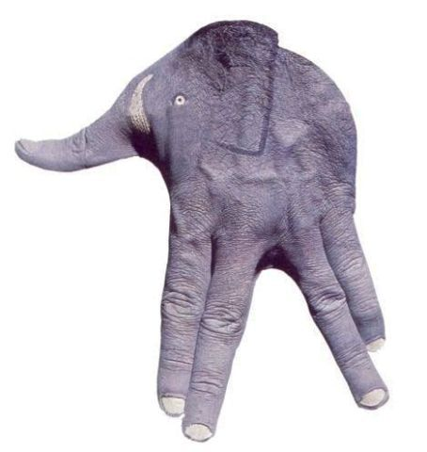
Rhinitis Sicca Anterior
Pathogenesis
Anterior nasal mucosa injury
Dust
Nose picking
Extremes of temperature

Slide 12
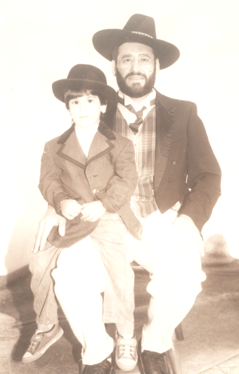
Rhinitis Sicca Anterior
Diagnosis
Nasal septum is dry
Mucosal surface is:
Raw, roughened, & granular.
Crustation →ulceration→ Septal perforation

Slide 13
Rhinitis Sicca Anterior
Differential Diagnosis
Chemical injury
(Chromium workers)
Iatrogenic septal perforation
Trauma
Lupus
Leprosy
syphilis

Slide 14
Rhinitis Sicca Anterior
Treatment
Nasal ointments
Septal perforation closure

Slide 15

Chronic Rhinitis
Irritation Or Inflammation
Hypertrophied Nasal Mucosa
Hyperemia & edema
True tissue hypertrophy

Slide 16
Chronic Rhinitis
SYMPTOMS
Nasal obstruction
Tough, Stringy, Colorless secretions (rarely purulent)
Post nasal catarrh
Rhinolalia clausa &Epiphora
2nd dacryocystitis
2nd pharyngitis

Slide 17

Chronic Rhinitis
SYMPTOMS
Fatigue ,sleeplessness
Unsteady or woozy feeling
Headache
Feeling of pressure in the head
Psychological & physical well-being loss

Slide 18
Chronic Rhinitis
Pathogenesis
Recurrent inflammation
Sinusitis
Enlarged adenoid
Nasopharyngeal tumor
VMR & Side effects of drugs
Tobacco, smoke, dust, chemicals, acquired toxins, temperature extremes , humidity
Pregnancy, menstruation, menopause
Endocrine disturbances
Heart &circulatory diseases
Infective allergy “late-type allergy”

Slide 19
Chronic Rhinitis
Diagnosis
Long-standing disease
History of toxins
Dark red &bluish-violet swelling turbinate
Narrowed or obstructed nasal cavity
Nasal decongested

Slide 20
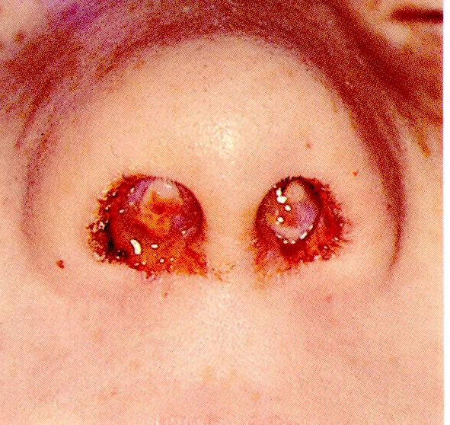
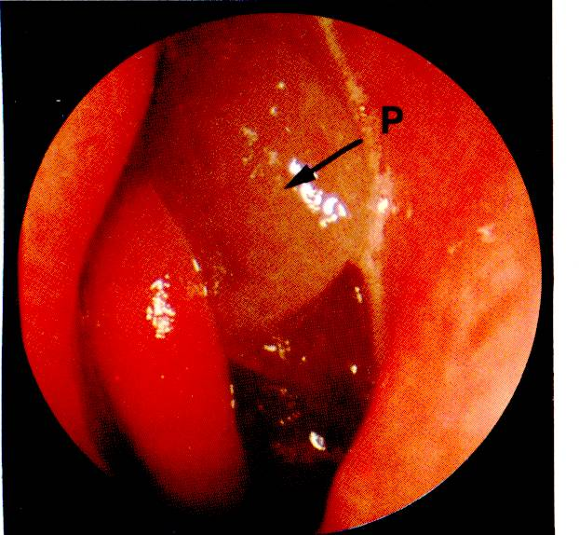
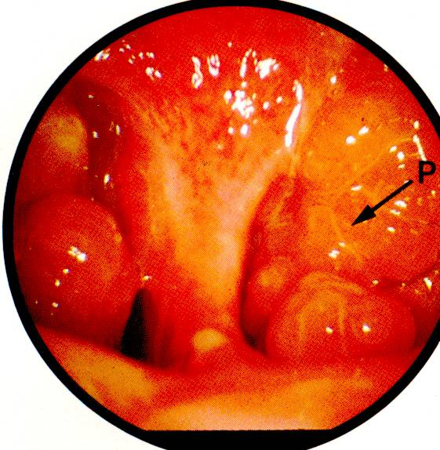
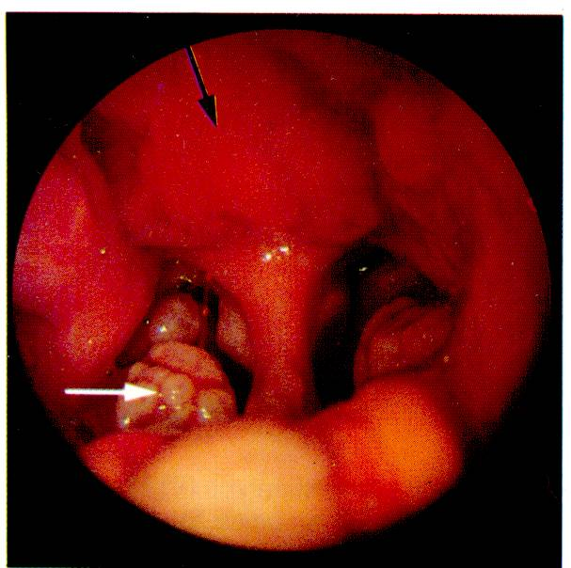
Chronic Rhinitis
Diagnosis
Granular →nodular surface
(Micro-polyps) →nasal polypi
Mulberry-like masses

Slide 21
Chronic Rhinitis
Differential diagnosis
Sinusitis
Foreign bodies
Specific infections
Adenoidal hypertrophy
wegener’s granuloma
allergy
Tumors
Biopsy

Slide 22
Chronic Rhinitis
Conservative Treatment
Treatment of etiological agents
Drug overuse controlled
Endocrinologic investigation
Environment & occupation
Symptomatic treatment by decongestant nose drops
(Not in long term)

Slide 23
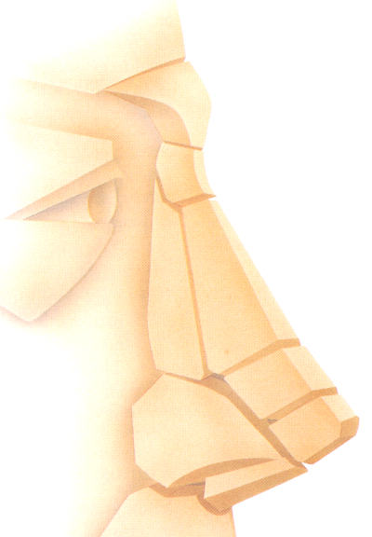
Chronic Rhinitis
Surgical Treatment
Reduction of the inferior turbinate by sclerosing agents, cryoprobe, or the laser.
-Electrocoagulation→ multiple, localized scars in N.M.
-Cryosurgery→partial obliteration
-CO2 or argon laser→mucosal scars (evaporation or coagulation)
Turbinectomy or mucotomy
turbinoplasty

Slide 24

Pregnancy Rhinitis
Nasal swelling & obstruction
2nd hafe of pregnancy
Resolve after delivery

Slide 25
Rhinitis Medicamentosa
Reversible or irreversible damaged mucosa caused by topically or systemically applied drugs:-
Hyper-plastic Rhinitis
Dryness of the nasal mucosa
Toxic Rhinopathy
1
2
3

Slide 26
Rhinitis Medicamentosa
Hyperplastic Rhinitis
Mucosal swelling
Acetylsalicylic acid
Oral contraceptives
Guanethidine , hydantoin , estrogens, paraamino-salicylic acid, phenothiazine, rauwolfia preparations,
Beta-blocking drugs
Tetraethyl ammonium

Slide 27
Rhinitis Medicamentosa
Dryness of the Nasal Mucosa
Atropine, belladonna preparatios
Corticosteroids
Imidazoline, or catecholamine derivatives

Slide 28
Rhinitis Medicamentosa
Toxic Rhinopathy
#Vasoactive subsances
Adrenalin or imidazoline derivatives as privine, nasivine...
Habituation → R.M.
Autonomic vascular regulation failure→ O mucosal damage
Local or systemic decongestant
Acute intoxication in infants & small children

Slide 29
Atrophic Rhinitis
& Ozena
Atrophic rhinitis+ foul smell = Ozena
Mainly in women
At puberty
Flattened
& broad Face

Slide 30
clinical presentation
Greenish–yellow or brownish-black crusts
Wide nasal cavity
Atrophic mucosa & dry:
Subepithelial layer fibrosis
Fetid secretion &crusts (Ozena)
Anosmia & social problem
Nasal obstruction
Mucosal changes in ph., la., & tr.,

Slide 31
Pathogenesis
Unknown but is multifactorial
Common in orientals than in whites than in blacks
Geographic concentration
Abnormally wide nasal cavity
Mucosal atrophy& bony nasal skeleton.
M.G. & S.N.F. degenerate
Respiratory epith.→ sq. metaplasia
Destroyed mucociliary cleaning system
Bacterial proteolysis decomposed the thick & gluey secretions

Slide 32
2nd Atrophic Rhinitis
Nasal Trauma
Extensive surgery
Occupational exposure to:-
Glass, wood, asbestos, etc.

Slide 33
Diagnosis
Gluey, dry, greenish-yellow secretions & crusts
→ wide nasal cavity & very small turbinates
Foul-smelling crusts in Ozena

Slide 34
Differential Diagnosis
Atrophic rhinitis with fetor (ozena)
Tumors of the Nose & Sinuses
Purulent Rhinitis & Sinusitis
Rhinolith & foreign body
Gumma due to stage III Syphilis
Nasal diphtheria &Nasal Tuberculosis
glanders

Slide 35
Conservative Treatment
Nasal douching
Alkaline nasal lotion
Greasy ointments
Oily nasal drops, emulsions , or ointments, ?! Vitamin A
Steam inhalations
Osmotic Powders :Dextrose

Slide 36
Operative Treatment
Bolstering of the Nasal Mucosa
(Cartilage or Bone chips)
Median Displacement of the lateral nasal wall by internal rotation of the mobilized lateral nasal wall

