Slide 1
Prof. Mohammed Attallah
College of Medicine
King Saud University
ORL Course 431
ORL Department
King Abdulaziz University Hospital
Ear III Lecture
by

Slide 2
Chronic Otitis Media

Slide 3
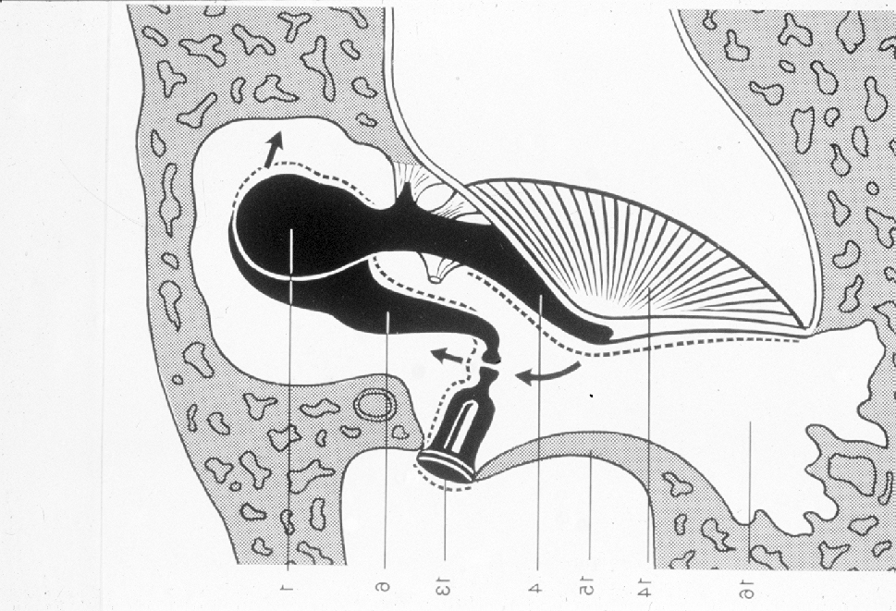
Normal Middle Ear Cavity

Slide 4
Classifications of Chronic Otitis Media
Safe
Unsafe

Slide 5
Investigations in chronic otitis media
Audiology
Radiology
All the others

Slide 6
Management of chronic Otitis Media
Surgery in the form of
a. Tympanoplasty
b. Mastoidectomy
c. Tympanomastoidectomy
2. Medical treatment

Slide 7
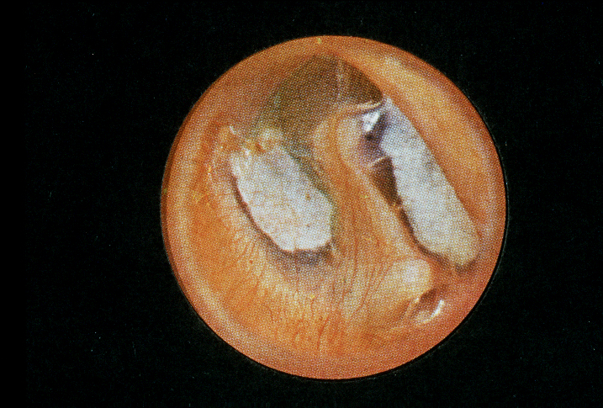
Healed Tympanic Membrane with tympanosclerosis

Slide 8
Safe and Unsafe perforation in chronic otitis media

Slide 9
Total perforation in chronic suppurative otitis media

Slide 10
Mastoidectomy operation as the possible operation in chronic suppurative otitis media

Slide 11
Post auricular incision approach to middle ear and mastoid

Slide 12
Facial paralysis as a complication of middle ear and mastoid surgery

Slide 13
Otitis Media with effusion
Definition

Slide 14
Acute Otitis Media – Stage IV

Slide 15
Pathophysiology of Otitis Media

Slide 16
Stages of Otitis Media
Stage I
Stage II
Stage III
Stage IV

Slide 17
Adhesive otitis media (end stage)

Slide 18
Management of Otitis Media
Medical
Surgical

Slide 19
Ventilation tube insertion (surgical treatment of otitis media)

Slide 20
Thank you

