Slide 1
Air Way Obstruction
Dr. Manal Bukhari King Saud University Otolaryngology
Assistant professor
consultant Phonosurgeon King Abdulaziz University
Done By: 428 C2

Slide 2
the Upper airway extended from the nares and lip to the subglottic area
Air comes inside the airway through the nose to the larynx
Upper airway obstruction :
Congenital below one year we think of congenital causes
Acquired

Slide 3
A) Congenital upper airway obstruction
From birth to the first few weeks of
Congenital upper-airway obstruction
Nasal obstruction
1-nasal masses
2-Choanal atresis and stenosis
3-Pyriform aperture stenosis (stenosis at the level of the nose)
Pharyngeal
1-Craniofacial anomalies
Laryngeal
1-Laryngomalcia
2-Vocal cord paralysis
3- subglottic haemangioma
4-Subglottic stenosis
5-Laryngeal web
6-Laryngeal lymphangioma
7-Saccular cyst

Slide 4
1) Nasal obstruction
neonates are obligatory nasal breather
in neonate Cyanosis improved with crying but worsens on feeding
Nasal masses : could be external or internal or immediately above the base
Cystic ( meningoencephalocoele, )
Solid (glioma, hamartoma ,teratoma ,and lymphangioma)
mixed
Ct scan and MRI is important for diagnosis coz these masses may have an extension with the brain
So the peads surgeon must go in the OR with the ENT doctor to correct the brain defect

Slide 5
Nasal obstruction

Slide 6
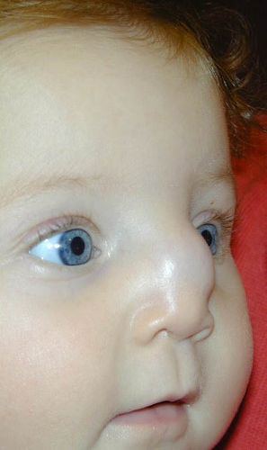
Midline cyst think of dermoid cyst- hemangioma -meningeocele next step : CT or MRI

Slide 7
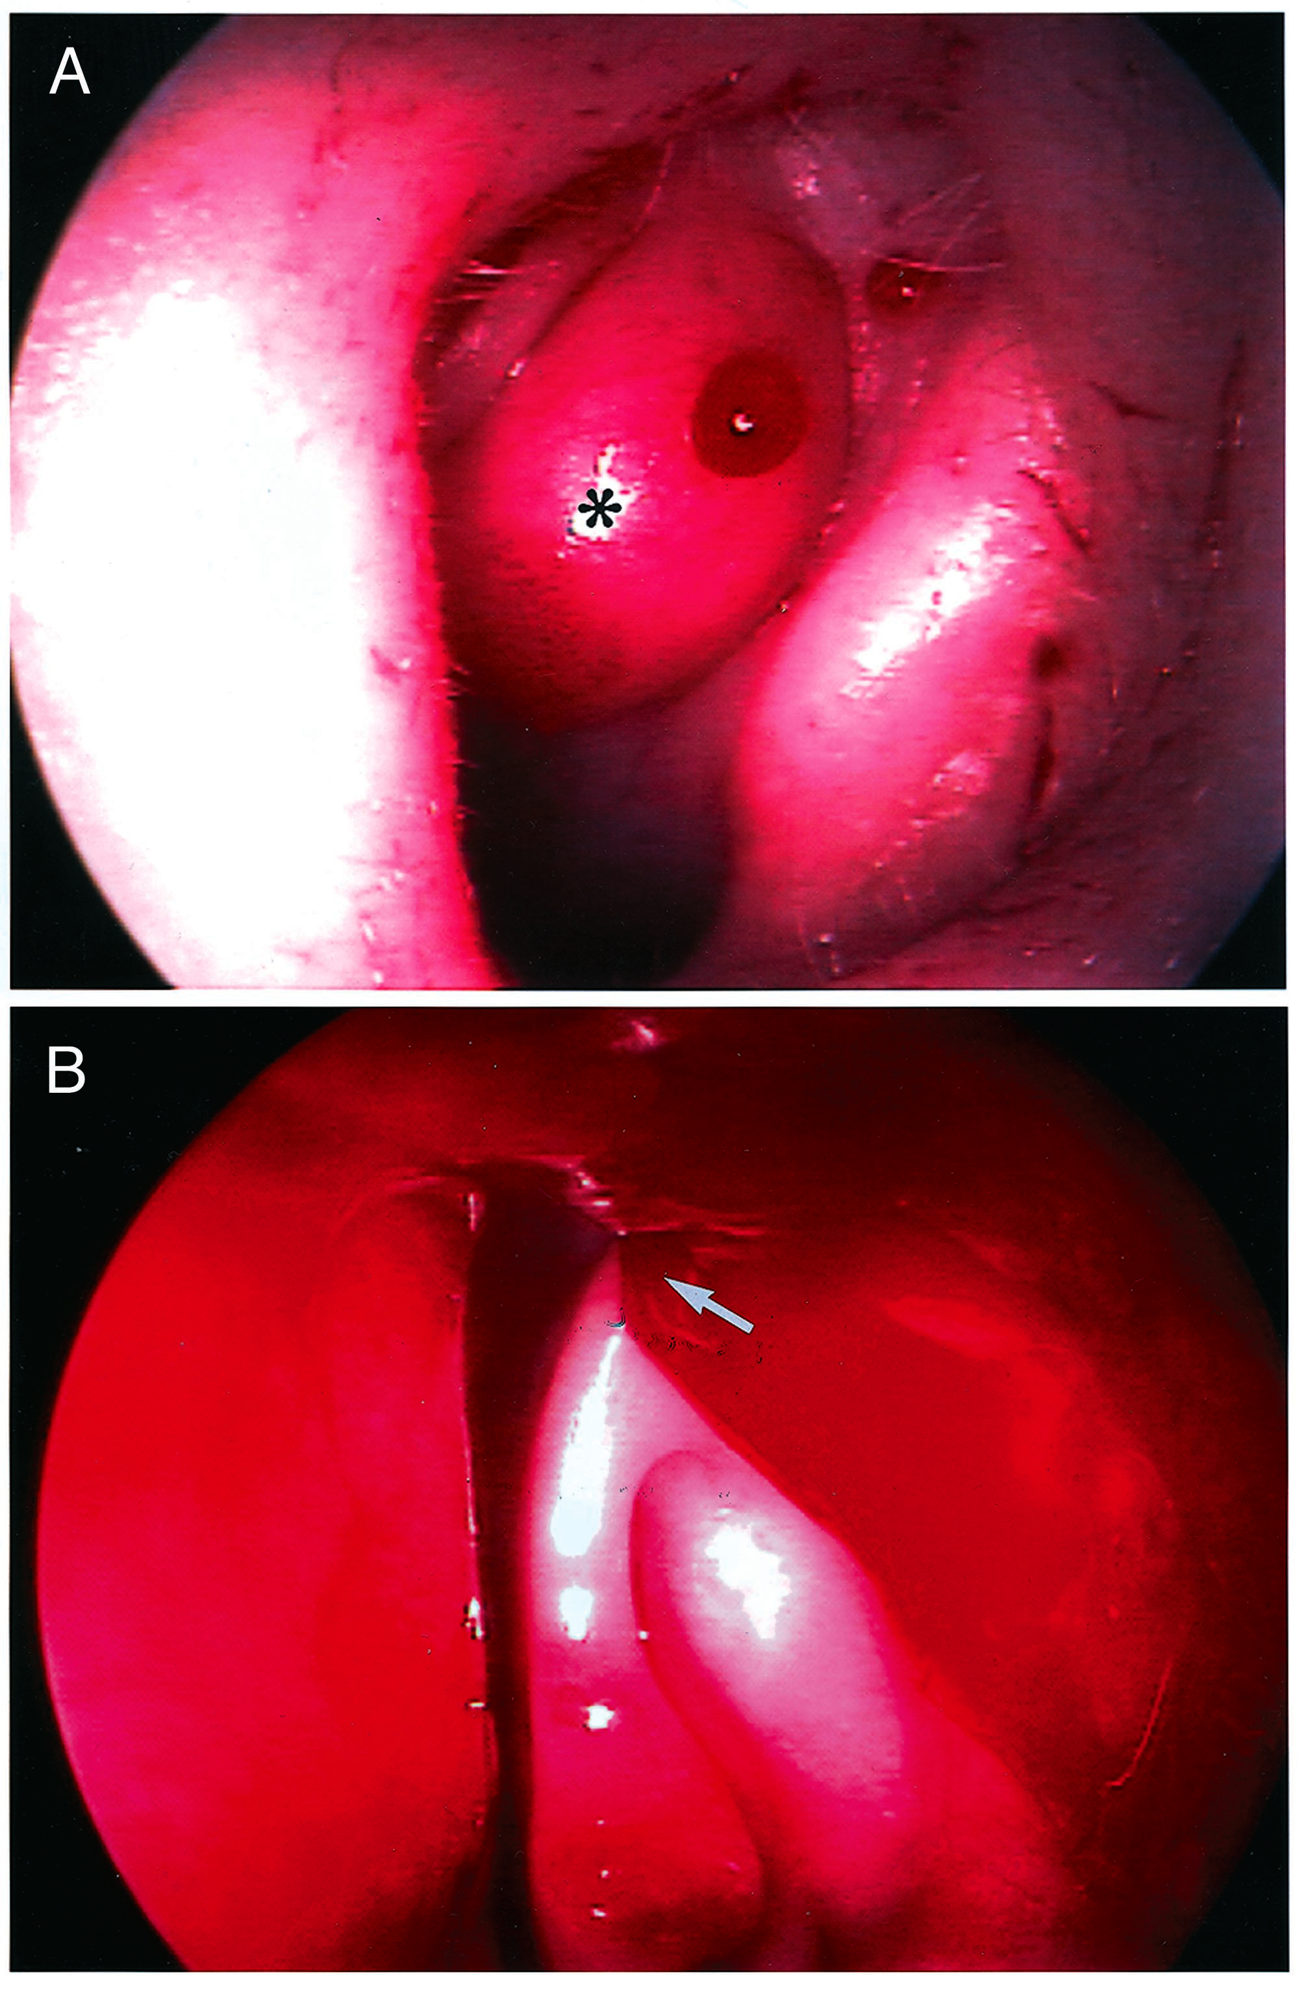
Endoscopic view of an internal nose mass then CT SCAN

Slide 8
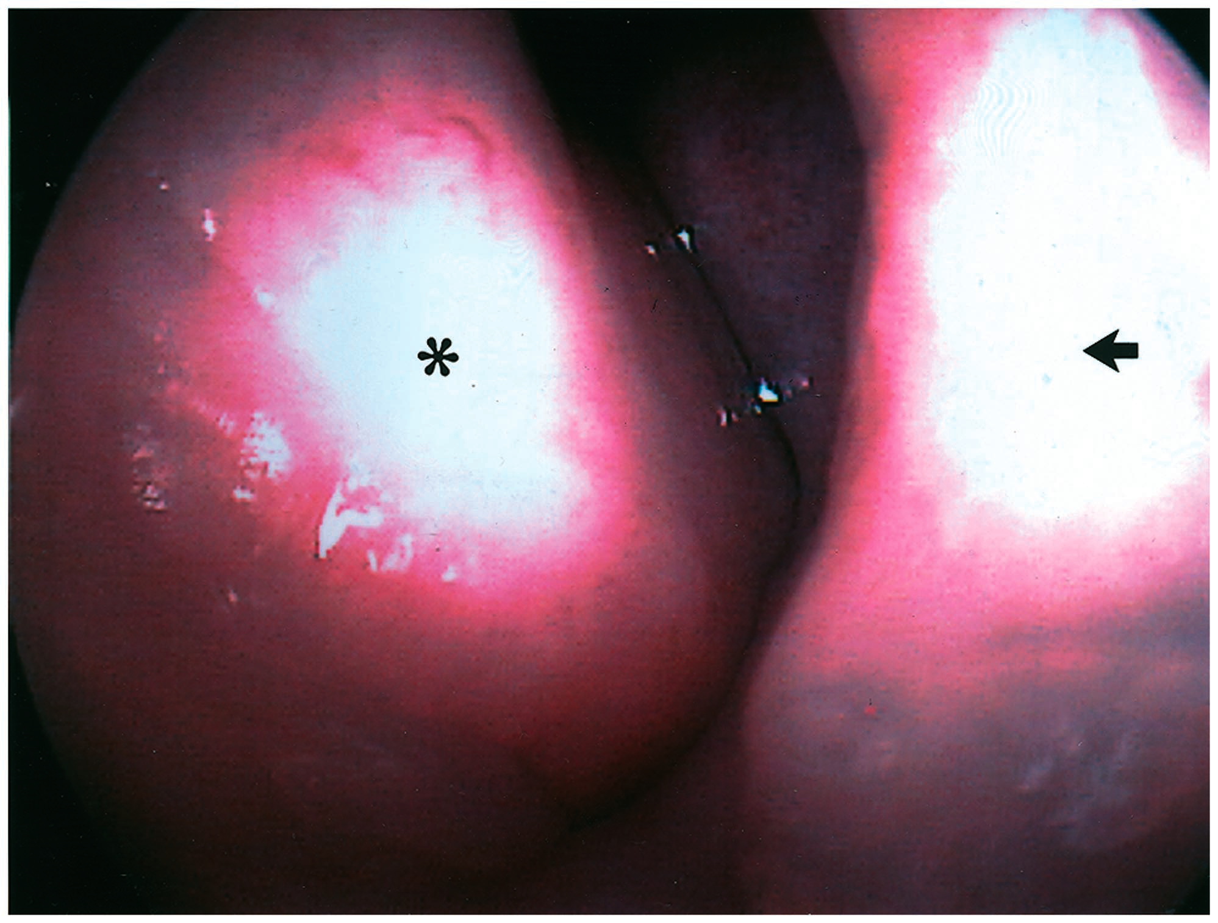

Slide 9
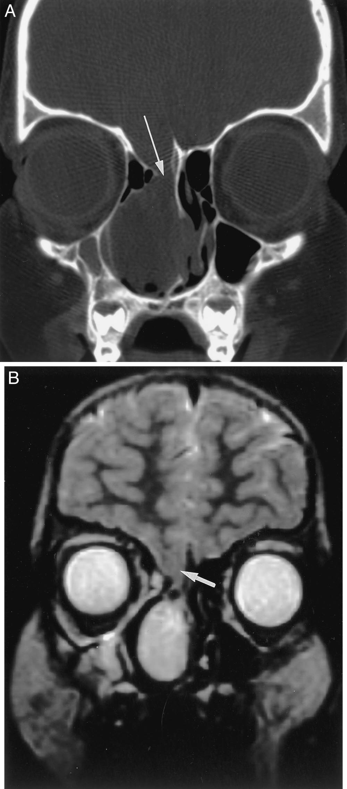
CT scan showing a nasal mass with cranial extesion so must have a neurosurgeon in the OR to correct cranial defect and prevent meningitis

Slide 10
2) Choanal atrasia : complete closure
-we have 2 ant choana and 2 post choana
Lack of patency of posterior nasal aperture
Bilateral atrasia presents soon after birth with sever respiratory distress
Unilateral atrasia may undiagnosed until later in childhood (rhinorrheoa - nasal discharge)
Types :
Membranous 10%
Bony
mixed
DX:
Cyanosis improved with crying
Inability to pass size 6 French catheter usually catheter should pass easily into the mouth if it faces resistance then atresia
-flexible fibrotic endoscope
-CT scan

Slide 11
The image :Unilateral bony choanal atresia
70% of choanal atrasia associated with CHARGE
C coloboma
H heart disease
A atrasia
R retarded growth
G genital hypoplasia
E ear deformity
So must examine the ear the heart … so must be transferred to peadritian

Slide 12
Treatment
Emergency treatment ( in the delivery room )is by insertion of oral tube so he can breath from his mouth
Surgical treatment is by either transnasal or transpalatal choanal atrasia repair
most common approach is nasal endoscopic approach : through the nose if its bone by drilling if membrane cut it with debrider
Other approch from palate or maxillary

Slide 13
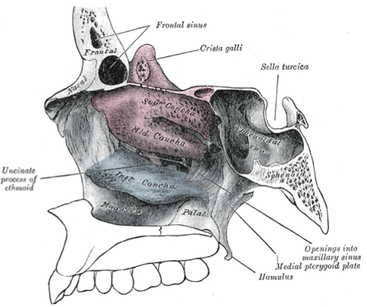
bilateral membranous post choanal atresia
anal atresia

Slide 15
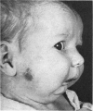
3) Pharyngeal obstruction
Craniofacial anomalies : deformity in face or mandible may cause obstruction
Pierre –Robin syndrome:
Glossoptosis, micrognatheia, cleft palate , large tongue
Treacher- Collins syndrome:
(Mandibuo-facia; dystosis)
Narrow nose high arched palate

Slide 16
Laryngeal
4) Laryngomalcia :
Scenario : Child with obstruction usually improves within a year or 2 but need to interfere if severe symptoms – weakness of artynoid cartilage
The most common cause of congenital airway obstruction
The most common cause of stridor in infancy
What is stridor?
Audible sound produce during breathing due to air- flow change within the larynx ( air passing throught narrow channels)
Inspiratory
expiratory
Biphasic
Snoring : is low pitch sound caused by tissue vibration of the nasopharynx pharynx and soft plate due to obstruction above the larynx

Slide 17
Symptoms
Stridor in the first weeks of life
Inspiratory phase
Worse with crying ,feeding ,and respiratory tract infection
Improved in prone position
DX : flexible fibrotic endoscopy patient must be awake to see the movement of the epiglottis and aretynoid cartilage

Slide 18
Endoscopic finding:
Tall ,omega shape epiglottis
Inward forward movement of arytenoid mucosa (sucked)
Short aryepiglottis fold
Treatment :
Mild cases :( no cyanosis not effecting the child growth )
observation
Sever cases:
supraglottoplasty : patients have short aryepiglottic fold so we release it so epiglottis moves anteriorly ( open airway )
tracheostomy
Must ask patients about feeding coz if not then needs surgical interevention

Slide 19
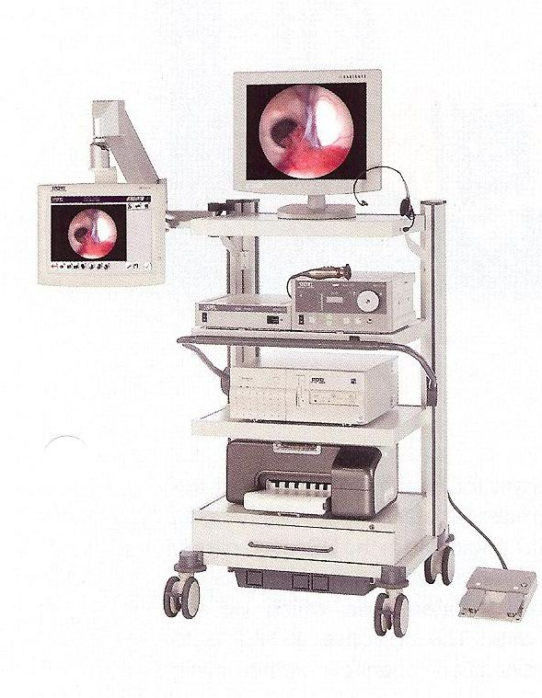
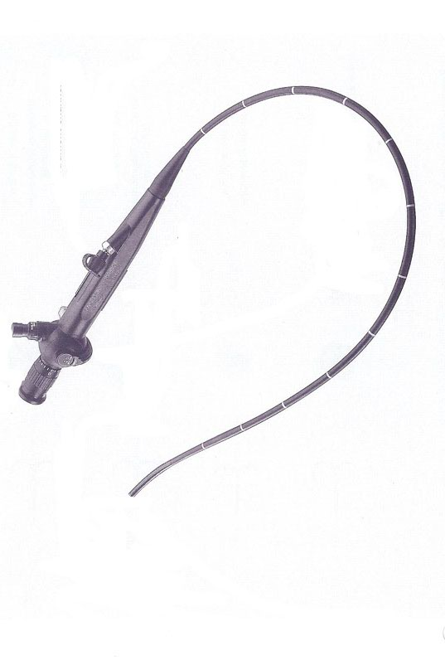
Flexible fibrotic endoscopy indications : dx of nasal ,pharyngel ,laryngeal obstruction

Slide 20
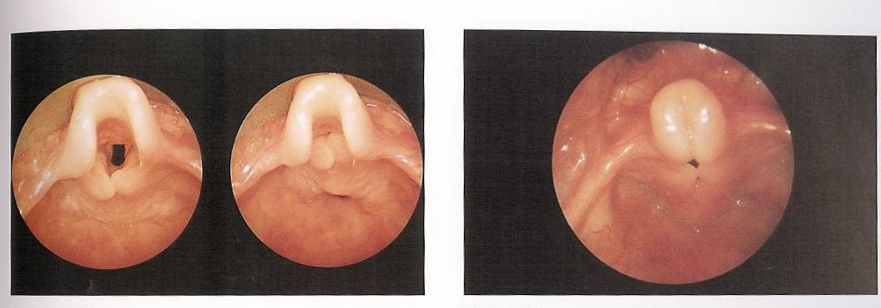
Omega shaped epiglottis aretynoid cartilage is upward and forward

Slide 21
5) Vocal cord paralysis :congenital form is the 2nd most common cause of airway abstruction in infants
Can be unilateral or bilateral ,congenital or acquired
Congenital form may associated with abnormality of the central nervous system (Arnold Chiari syndrome ) or cardiovascular anomalies (vagal nerve is affected )
Symptoms:
high pitch inspiratory stridor
Treatment :
trechestomy in sever cases
-Spontaneous recovery occurs in half patients
-Vocal cord lateralization if congenital we wait coz it could be immature so we wait , surgical intervention postponed until the patient become old
-arytoidectomy and laser cordotomy

Slide 22
6) Subglottic haemangioma
Congenital vascular lesion
not present at birth but grow rapidly over the first few months of life
Symptoms:
Biphasic stridor
Tend to involute slowly after one year
50% of the patients have cutaneous haemangioma in the head and neck \
Could be from one side or circumferencial
Treatment :
Systemic steroid ,
interlesional steroid ,
laser ablation treachestomy
New medication : beta blockers
** Any subglottic cause will cause biphasic stridor

Slide 23
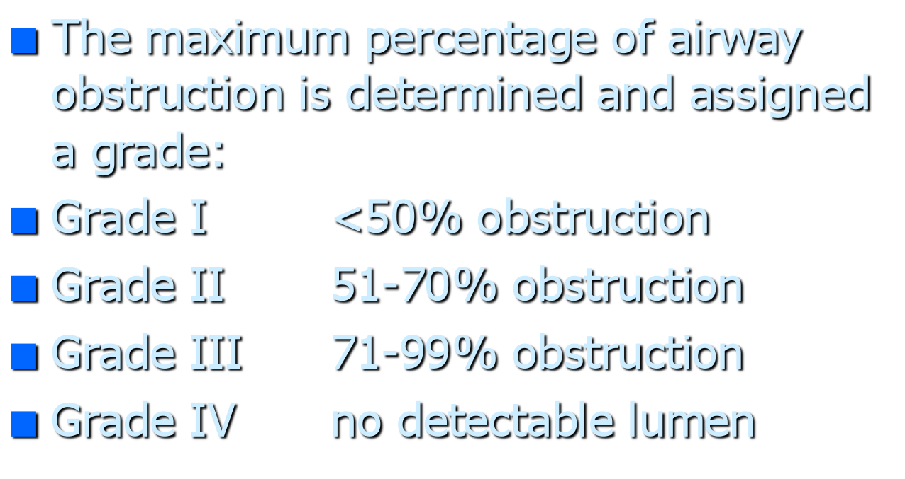
7) Congenital subglottic stenosis
Subglottic area is the narowest area in the airway ,stenosis if the diameter less than 4 mm in term infant
Symptoms depend on the degree of stenosis
Biphasic stridor
Recurrent croup ( sometimes misDx for croup or bronchial asthma especially if grade 1 )
Dx:
bronchoscopy under GA
,plain xray HKV (high kilo voltage ) if air column at level of subglottis is very narrow so stenosis
-hard to Dx by flexible endoscope
Tx :
Grade 1 and 2 : endoscopic laser dilatation ( non need for opening )
Grade 3 and 4 : open procedure CTR (cricotracheal reanastamosis) or LTR (laryngeotracheal reconstruction)

Slide 24
Treatment
Depend on the degree of stenosis
Tracheostomy
laser excision
Laryngotracheal reconstruction
Criocotracheal resection

Slide 25
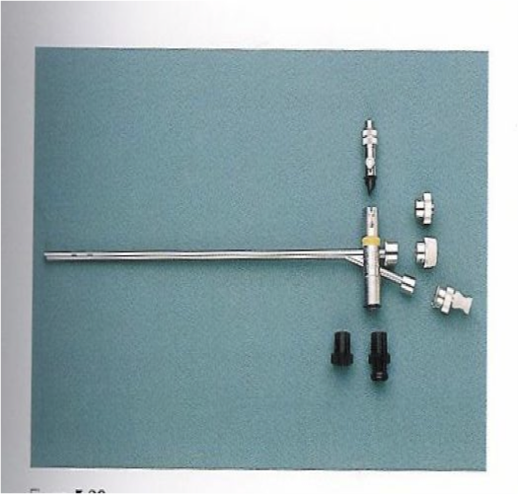
Indictaions of bronchoscope: removal of foreigh body – Dx of subglottic hemangioma – subglottic stenosis – laryngeobronchal lavage

Slide 26
8) Laryngeal web : vocal cord don’t open and close properly
Week cry
Stridor ( the more the web is posteriorly the more the stidor )
Treatment :
Laser excisions
Trachestomy

Slide 27
9) Extratracheal compression
Cystic hygroma in lymphatic system compressing airways – tongue is pushed up - even tracheostomy is hard so we need specialized anesthetic , ENT , pediatritian

Slide 28
B) Acquired upper airway obstruction
acquired upper airway obstruction are more common than congenital type
Subglottic area is the narrowest area
Causes:
Infectious
1-Peritonsillar abscess ( hot potatoe voice )
2-Retropharyngeal abscess
3-Epiglottis ( bacterial )
4-Croup ( viral )
5-Bacterial tracheitis
At the level of the nose u get blocked nose with infection but not to the degree of obstcution of airway
noninfectious
1-FB aspiration
2-acquired vocal cord paralysis
3-Acquired subglottic stenosis
4-adenotonsillar enlargement
5-respiratory papillomatosis
6-malignancy
7-Angiodema
8-cautsic ingestion
9-trauma
10-laryngospasm

Slide 29
1) Peritonsillar abscess
common deep infection in late childhood
Symptoms : low grade fever sever sore throat ,muffled voice ,drooling, trismus( cant open the mouth )

Slide 30
Peritonsillar abscess
Diagnosis
Clinical diagnosis
CT scan: If u negelct the abscess it will go to the retropharyngeal or the parapharyngeal space , dangerous coz contains cranial nerves and bld vessels so if suspected need to do CT scan but not always
Treatment :
aspiration
Excision and drainge
later tonsillectomy
IV ABX

Slide 31
2) Retropharyngeal abscess
Symptoms :
fever, cervical adenopathy ,stridor torticollis, drooling , u can see a bulge posteriorly when he opens his mouth ,difficulty breathing and swallowing
Causes : source from the area around it ex tonsillitis
progressive pharyngitis S.aureus ,Haemophilus , group A beta haemolytic sterptococcus , bacteroides
Treatment :
Transoral excision and drainge
IV ABX
INTUBATION sometimes very big mass so cant intubate we need to tracheotomy
Tracheotomy

Slide 32
Retropharyngeal abscess : case : child 3 years – torticollis – difficulty swallowing …

Slide 33
3) Epiglottitis
It is life threatening rapidly progressive condition
Cause :H influenzae typeB
Age:2-7 years
Symptoms :
High fever dysphagia, drooling stridor toxic looking child ( sit upright with head extended )
Treatment :
NO EXAMINATION SHOULD BE DONE IN ER take the patient directly to the OR
Intubation ( secure airway )
tracheostomy
IV ABX
Endoscopic picture

Slide 34
Epiglottitis
Thumb sign

Slide 35
4) Croup
Croup (laryngotracheobronchitis
Primary involves the subglottic
Parainfluenza 1-3
6 months-3 years
SSX:
biphasic stridor, fever , brasssy cough , hoarseness , no dysphagia
DX:
x-ray ,steeple sign , inflammation and edema at the level of larynx and trachea
RX:
humidified oxygen,racmic epinephrine ,steroid

Slide 36
Steeple sign

Slide 37
Non infectious causes
1) FB aspiration
Foreign body aspiration is a common accident in children and represents an important cause of morbidity and mortality.
500 children die of FBA each year in the USA and 40% of lethal accident among children under 1year of age were caused by FBA
Int J Pediatric Otorhinolaryngol
Children before 2 years are prone to get it coz they explore eveything by putting things in their mouth and in elderly coz their swallowing becomes weak

Slide 38
FBA is common among infants and preschool children

Slide 39
Clinical presentations; acute phase - plateau phase( child looks normal) – complicated phase
Acute episode
Period of choking ,gagging, wheezing ,hoarseness
Asymptomatic (plateau )( miss diagnosis?)
Cough , wheezing …
Complication
Pneumonia, obstructive emphysema and bronchiectasis ….

Slide 40
Medical history is the key to diagnosis FBA
Physical examination finding were abnormal in 80% of children with FBA , these were abnormal also in 40% of children without FBs , so don’t depend on examination coz not always findings are present
the sensitivity and specificity of physical examination were 80.4% and 59% respectively.
Pediatr surg 2005;40:1122-1127
Not Dx by xray coz could be normal , and not with CT , so we do bronchoscopy

Slide 41
Radiological examination
Many FB are not radiopaque and small FB may cause symptoms but not radiographic changes
Plain film (inspiratory expiratory )
Air trapping,
obstructive emphysema ,mediastinal shift
Rt and LT lateral decubitus film

Slide 42
Endoscopic view
The most common objects aspirated by young children are food products (peanuts ,seeds) corn
Beans and seeds absorb water over time so with the absorption of secretion enlarges so presents after 4 -5 hours
Inert FB (Pieces of toys casuse less reaction )

Slide 43
Negative imaging studies do not exclude the presence of an FB we don’t depend on them
A High degree of clinical suspicion is the most important element in the diagnostic work –up

Slide 44
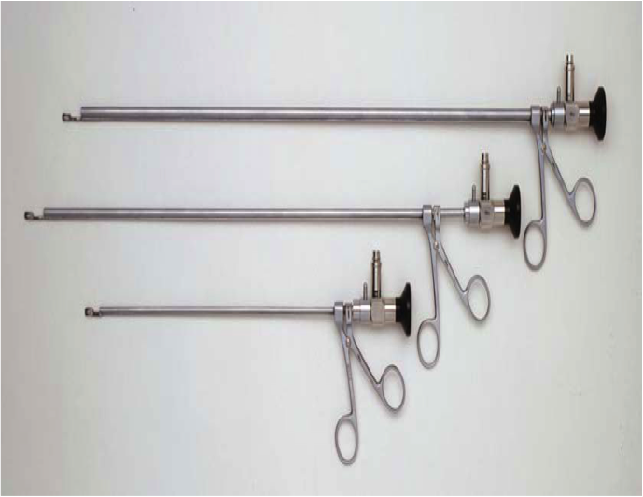
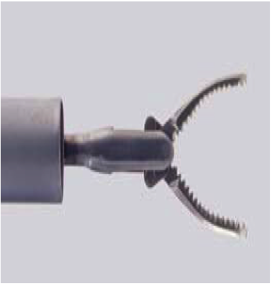
Airway foreign bodies are removed most safely under general anesthesia using the ventilating rigid bronchoscope with thelescopic frorceps

Slide 45
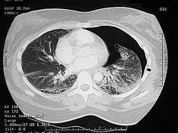
Collapse- emphesyma – pneumothorax all these are complications of the FB

Slide 48
2) Acquired vocal cord paralysis
Unilateral
Bilateral
All musles are supplied by reccurent laryngeal except cricothyroid muscle by superior laryngeal nerve
Left nerve has a longer course coz it loops around the aortic arch
Causes :- iatrogenic after tumor removal (brain-lung…)
- Idiopathic if after we ct for brain,chest , neck and no evident cause
1-Birth trauma(forceps delivery)
2-Cardiac surgery( PDA repair)
3-Mediastinal or neck surgery
4-Tracheo-esophageal fistula repair coz reccurent nerve passeds bet trachea and esophagus
5-mass compressing the nerve

Slide 49
Bilateral vocal cord paralysis (abduction type)
symptoms :
Stridor
Treatment :
Need temporary tracheotomy
Vocal cord lateralization
Cordectomy arytenoidectomy

Slide 50
Risk factors
3) Acquired subglottic stenosis
Scenario : 3 year old child had a history of intubation and after intubation presented with stridor – or after RTA needed prolonged intubation then complained of stridor
1-Prolong intubation ( prolonged and not any )
2-size of the tube, material ( if tubes was the type that moves causes irritation)
3-poor care of intubated patient
4-High pressure cuffs tube ( must be high volume and low pressure if don’t inflate it high pressure so stenosis)
5-Difficult intubations
6-multiple intubation
7-GERD ( acid causes inflammation )
8-Tracheobronchial infection (untreated MRSA infection in icu)

Slide 51
Laryngeal ➔ granulation tissue ➔ ulceration➔ perichondratis ➔ subglottic stenosis

Slide 52
Treatment
Grade I&II
Observation
Laser excision
Grade III&IV
Trachestomy
Laryngotracheal reconstruction
Cricotracheal resection

Slide 53
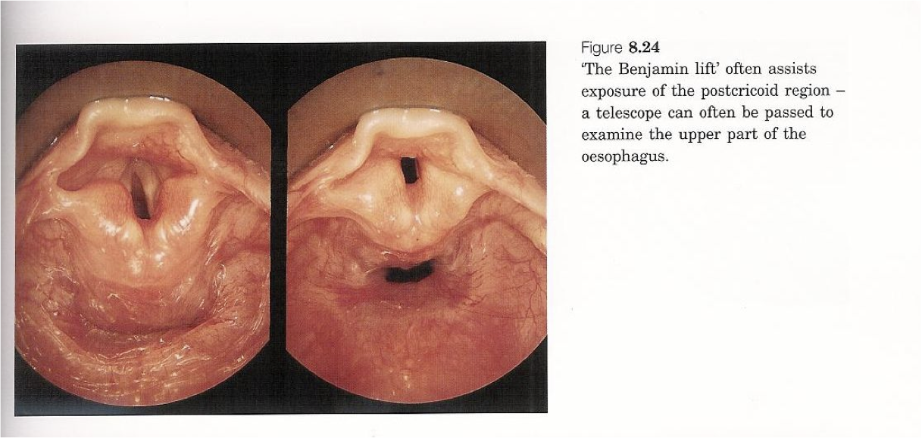
Acquired subglottic stenosis

Slide 54
4) Respiratory papillomatosis
Scenario : Stridor- hoarsness –multiple surgery (recurrent) – 3 year child
2/3 before age 15
rarely malignant change
HPV 6-11
Risks:
younger first time mother (condyloma acuminata)
Lesions: wart like (cluster of grapes )
Types :
juvenile
Senile
SSX:
Hoarseness :if on vocal cord
Stridor: if large
RX;
laser excision ,microdebrider
Adjunctive therapy: acyclovir(antiviral ) , interferon

Slide 55
5) Thermal injury
Aspiration hot liquid ,caustic fluid, slough tissue and edema
Will aspirate acid or alkali
Scarring
Alkali is more dangerous than acid coz erosive
Treatment :
intubation
Trachestomy
IV ABX

Slide 56
Cricothyroidectomy
If tracheostomy wasn’t available ex RTA or acute presentation ,
a technique for obtaining an emergency airway through the cricothyroid membrane when standard airway techniques have failed, has a lot of complications
sometimes may use with it a cannula, in which a large-bore intravenous cannula is inserted directly through the membrane.
Surgical cricothyroidotomy in which a surgical hole is made in the membrane and a cuffed tube, similar to a short endotracheal tube is inserted directly.

Slide 57
Indications:
Need for an emergency airway where
1-Intubation is not possible
2-Need to avoid neck manipulation
3-Severe maxillofacial trauma
4-Oedema of throat
5-Severe oropharyngeal/tracheobronchial haemorrhage
6-Foreign body in upper airway
7-Lack of equipment for endotracheal intubation
8-Technical failure of intubationSevere

Slide 58
Complications:
1-Thyrohyoid membrane incision
2-Intra/postoperative bleeding
3-Subglottic stenosis
4-Dysphonia/hoarseness ( injury to vocal cords)
5-Laryngeal damage
6-Tube misplaced in bronchus
7-Pulmonary aspiration
8-Tracheal stenosis .
9-Recurrent laryngeal nerve injury ( if u go lateral )
10-Oesophageal perforation or tracheo-oesophageal fistula.
11-Tracheo-left brachiocephalic vein fistula ( if u go lateral)
12-Fracture of thyroid cartilage

Slide 59
Trachestomy: opening of the trachea by knife or by diathermy between 2nd and 3rd ring insteaand not between cricoid and the first ring to avoid stenosis, could be done under local anesthesia (in emergency so we need expert nurses) or general anesthesia
Indications for a tracheostome
1-Obstruction of the upper airway, e.g. foreign body, trauma, infection, laryngeal tumour, facial fractures
2-Impaired respiratory function, e.g. head trauma leading to unconsciousness, bulbar poliomyelitis
3-To assist weaning from ventilatory support in patients on intensive care
4-To help clear secretions in the upper airway in recurrent infections for a good lavage

Slide 60
Complications : must choose the right size …
Immediate:
Haemorrhage, e.g. from thyroid isthmus
Hypoxia
Trauma to recurrent laryngeal nerve
Damage to oesophagus
Pneumothorax
Infection
Subcutaneous emphysema
Early:
Tube obstruction or displacement
Aspiration
Bleeding from tracheostomy site
Infection
Late:
Airway obstruction with aspiration
Tracheomalacia
Aspiration and pneumonia
Fistula formation, e.g. tracheo-cutaneous or tracheo-oesophageal
Damage to larynx, e.g. stenosisTracheal stenosis
After we treat the cause of obstruction we remove the tracheostomy and leave the trachea to regenerate ( 5 days ) so no need for suturing but if it was used for a long time we will have a fistula so we need to close it by suturing

Slide 61
In peds we suture the tubes to the skin and keep it for 5 days and we should label the right and left side in case it got removed by mistake

Slide 63
Clinical assessment of child with upper airway obstruction
History :
Age
Speed of onset and precipitating event
Associated symptoms (fever ,drooling. Hoarseness ..)
Feeding difficulty
Past medical history (birth trauma, intubation…)

Slide 64
Examination
Craniofacial anomalies
Cutaneous haemangiomas
Respiratory distress sign ( cyanosis – using of abdominal muscle , flaring of nares, inward and outward of cartilage)
Neck mass
Growth chart ( if below normal helps in the decision of surgery)
ENT EXAMINATION ( flexible endoscope through nose examines the nose , nasopharynx , larynx)

Slide 65
Investigation : not all of them only whatever is needed
Physiological studies:
ABG
Spirometry
Imaging :
Chest Xray (FB)
HKV (subglottic stenosis)
CT scan( choanal atrasia ,retropharyngeal abscess ,tumor )
MRI (intracranial extension )
Barium swallow (vascular ring)
Endoscopy : is the tool of examination

Slide 66
Thank you

