Slide 1
pharynx
Dr. Manal Bukhari King Saud University Otolaryngology
Assistant professor
consultant Phonosurgeon King Abdulaziz University
Done By: 428 C2

Slide 2
pharynx
It extend from the base of the skull to the level 6 cervical vertebra at the lower border of cricoid cartilage.
Funnel shaped,10 cm length

Slide 3
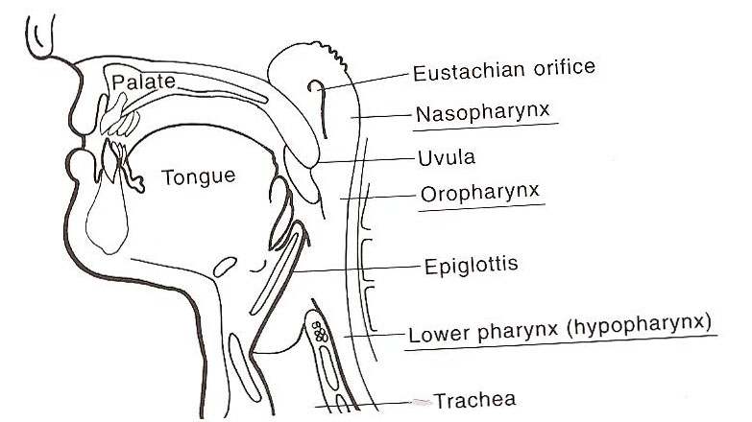
Parts of the pharynx:
1-Nasopharynx:
Open ant to the nose ,
Above: the base of skull
below: soft palate ( when u open ur mouth u cant see it coz its opposite to the nose)
Laterally :opening of the eustachain tube
torus tuberous
Pharyngeal recess (fossa of rosenmuller) : the area where the the nasopharyngeal cancer
Adenoid
Nasopharyngeal isthmus
Scenario : Adult patient and a smoker and nasal obtruction secretory otitis media . Coughing blood so must think of nasophatyngeal cancer and not adenoid coz it grows in children

Slide 4
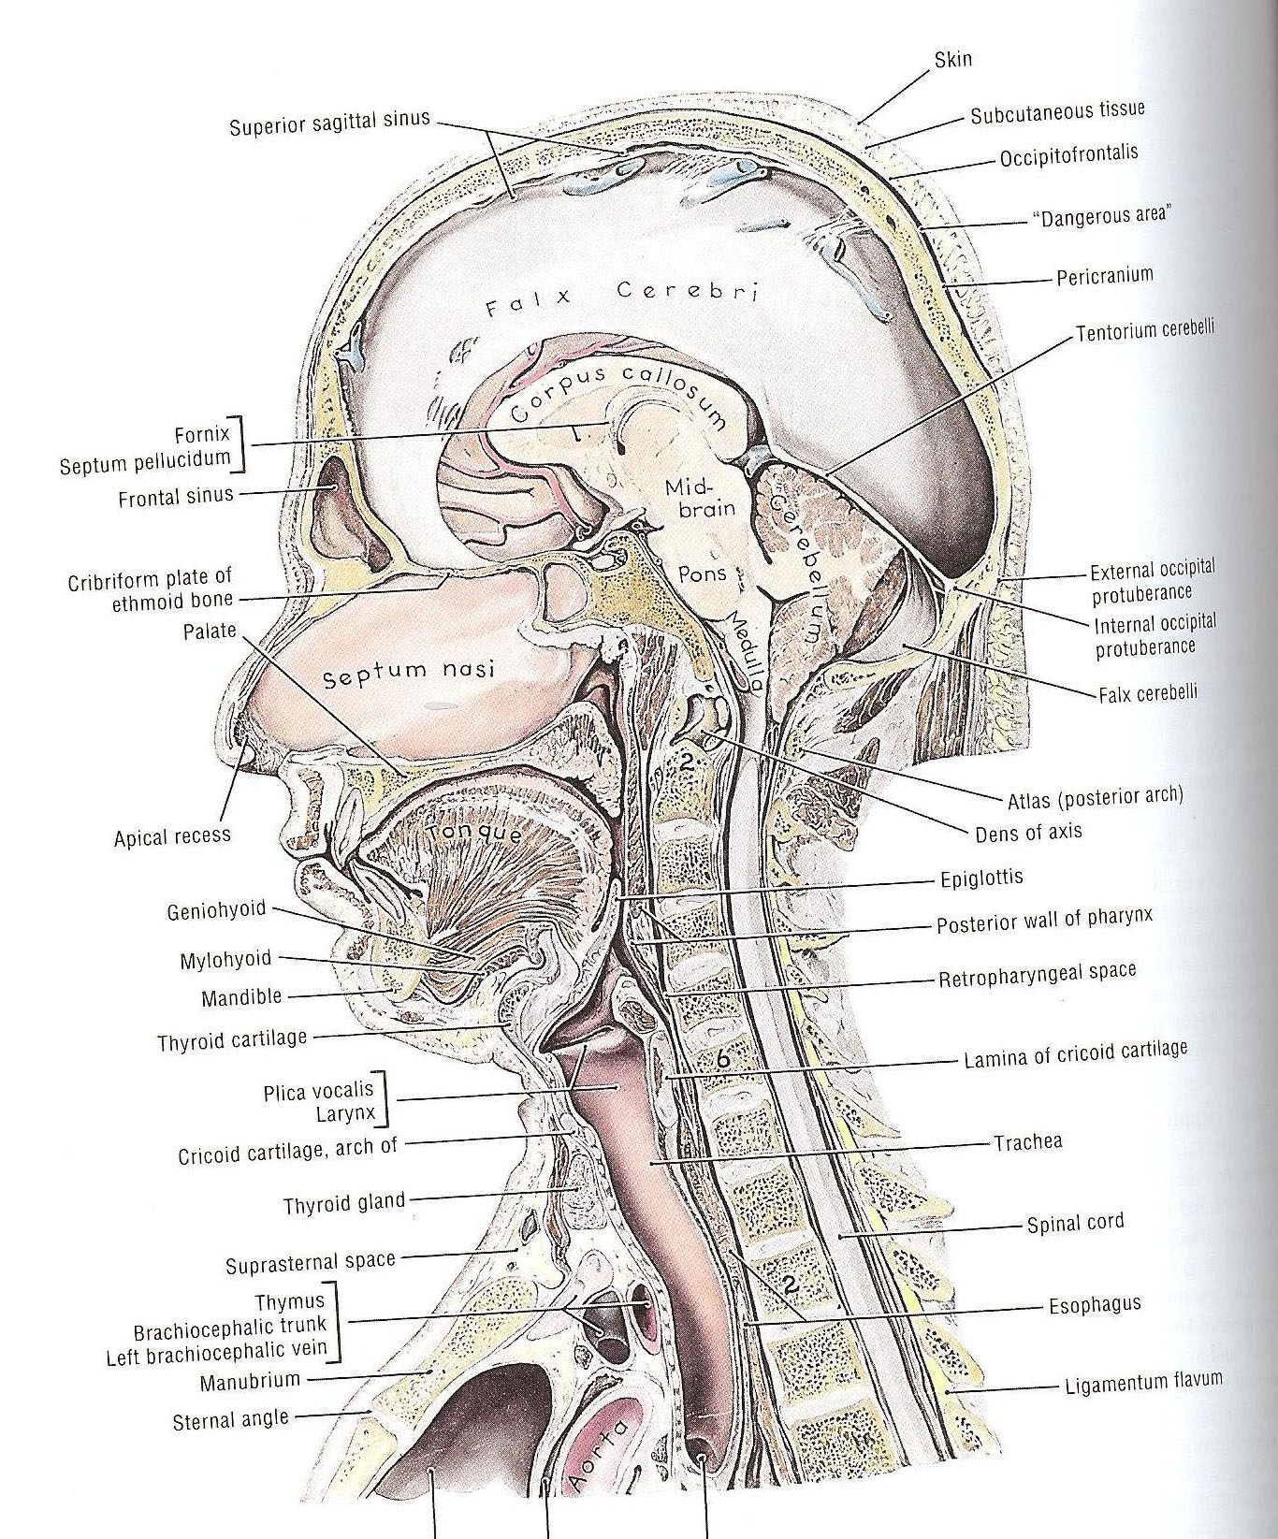
Oropharynx
Open ant to mouth ( opposite to the throat)
Above: soft palate.
below : the upper border of epiglottis.
Palatine tonsils ( this is the tonsils that mostly get affected in tonsillitis ) between the ant pillars and post pillars.

Slide 5
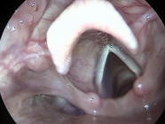
Laryngopharynx (hyoppharynx)
Open ant to the larynx
Above : the upper border of the epiglottis
Below :lower border of cricoid
Pyriform fossa
valleculae : between tongue and epiglottis contains the pyriform fossa

Slide 6
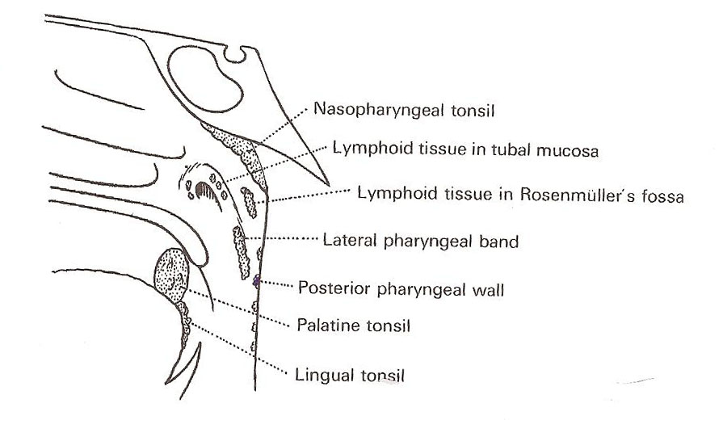
Structure of the pharynx
Fibromuscular tube
Four layers:
1-mucous membrane:
Ciliated epithelium
Stratified squamous epithelium
Transitional epithelium
Subepithelial lymphoid tissue of the pharynx( waldeyer’s ring) : scattered rings of lymphoid tissue in lateral pharyngeal wall, in nasopharynx, in posterior wall

Slide 7
Palatine tonsils
Some patients come complaining of small white tissue coming from their mouth , without fever or pain --- it’s the secretion of the crypt
12-----15 crypt
The deep surface is separated from the constrictor muscles of the pharynx by connective tissue’ capsule’
So when we do tonsollectomy must remove the capsule and dissect it to get out the tonsil (be in the capsule away from the muscles )

Slide 8
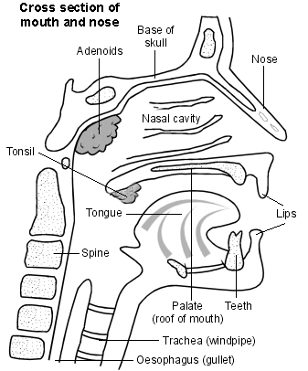
Adenoid :No capsule so may reccur after removal
Lingual tonsils : at the tip of the tongue
Tubal tonsils
Lateral pharyngeal bands
discrete nodules

Slide 9
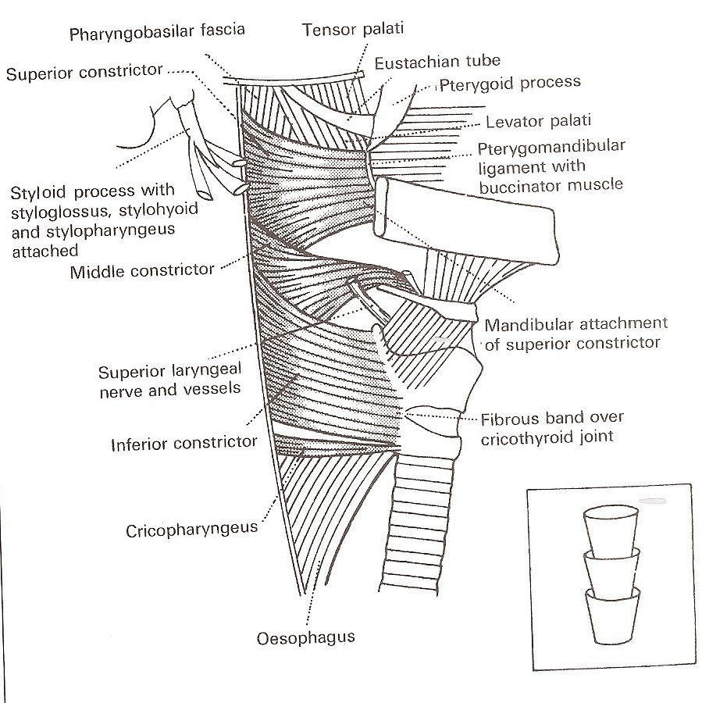
2-Pharyngeal aponeurosis
Incomplete connective tissue coat in the lateral and posterior walls of the pharynx between the muscular layers ( to strengthen the tube )
Pharyngobasilar fascia

Slide 11
3-Muscular coat
External :
Three constrictor muscles:
Superior constrictor
arise from pterygoid , ptergomandibular ligament post end of mylohyoid fibers
Middle constrictor:
Arise from the hyoid bone and stylohyod ligament
Inferior constrictor: 2 parts
Thyropharyngeus : from thyroid
Cricopharyngus : from cricoid
Between the 2 parts there is a weak defect where the mucosa may herniate
Killian’s dehiscence
Potential gap between the thyropharyngus and cricopharyngus

Slide 14
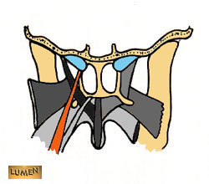
Internal:
Three muscles:
Stylopharyngus
Salpingopharyngus
palatopharyngus

Slide 15
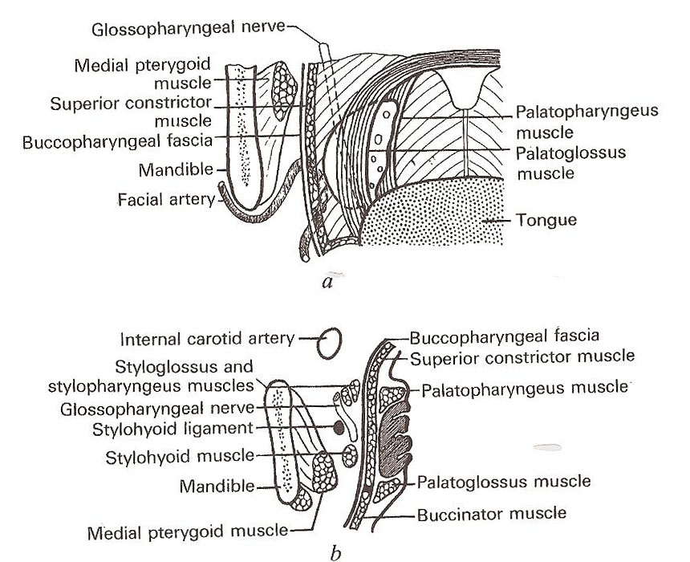
Buccopharyngeal fascia: covering the muscles from the outside giving more strength to the pharynx

Slide 16
Relation of the pharynx
Posteriorly :
prevertebral fascia
Anteriorly:
Parapharyngeal space

Slide 17
Parapharyngeal space
Potential space lies out side the pharynx, Triangular in cross section , it extend from the base of the skull above to the sup mediastinum and apex of hyoid bone
Anteromedial wall: buccopharyngeal fascia
Posteromedial wall : cervical vertebrae, prevertebral muscle and fascia
Lateral wall: (up) the mandible ,tergoid muscle, pparotid gland
(Lower) sternomastoid muscle
Compartment :divided into two parts by styloid process
prestyloid:
internal maxillary artery, fat,inferior alveolar ,lingual, and auricultemporal nerves.
Poststyloid:
neurovascular bundle (carotid artery,, internal jugular vein, sympathatic chain ,CN IX,X and,XI
** If tonsillitis and not treated will have peritonsillar abscess that may go to this space leading to rupture of carotid or cranial nerve injury …. So its dangerous if u don’t treat

Slide 18
Retropharyngeal space :
It extend from the base of skull to supr mediastinum
Lies behind the pharynx
Ant: posterior pharyngeal wall and its covering buccopharyngeal fascia
Post: cervical vertebrae and muscles and fascia
Contents :
Reteropharyngeal lymph nodes
Scenario : A 50 year old patient with torticollis and bulging in posterior pharyngeal wall should take it seriously cause site of lymph node so think of TB
If in child think of tonsillitis that spread to this space

Slide 19
physiology
Functions of the sub epithelial lymphoid tissue:
Protective functions :
Formation of lymphocytes
Formation of antibodies
Acquisition of immunity
Localization of infection
Salivation:

Slide 20
Deglutition:
Three stages
Oral stage: voluntary,closure of mouth,cessation of respiration ,rasing of larynx ,sudden elevation of the tongue,press the tongue against the palate, and pushes it backwards towards the oropharynx
Pharyngeal stage :non voluntary reflux, contraction of nasopharynx sphincter, larynx rises more, laryngeal inlet closure , epiglottis diverts the food into cricopharyngeal sphincter ,contraction of constrictor muscles ,relaxed cricopharyngeal sphincter
-If soft palate is not closed by nasopharynx food will get regurgitated through nose so must check for nasopharyngeal imcompetence and he will also be complaining of hypernasality
-if sphincter is not functioning properly food will remain in the airway
Esophegeal phase :

Slide 21
Respiration
Speech
Resonating cavity any mass in the mouth will affect the resonation of ur voice
Articulation
Taste:
taste buds in the oral cavity

Slide 22
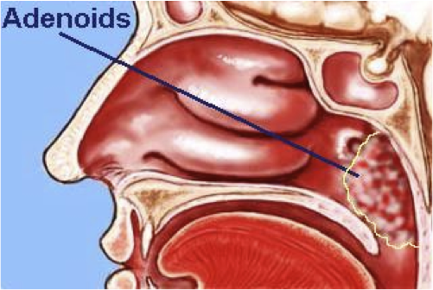
Adenoid
A hypertrophy of the nasopharyngeal tonsil to produce symptoms , most commonly between the age of 3---7 years , most common cause of nasal obstruction in children
Pathological types:
1- simple inflammatory
2- tuberculosis
Clinical features:
Mouth breathing , snoring , sleep disturbance, toneless voice, adenoid face (mickey mouse face ) , nasal discharge, Eustchain tube obstruction if big enough coz it opens in the nasopharynx, so interferes with the areation of middle ear and its not equalizing the outside and inside pressure –secretory otitis media (blue ear) affecting hearing- adenoid face

Slide 23
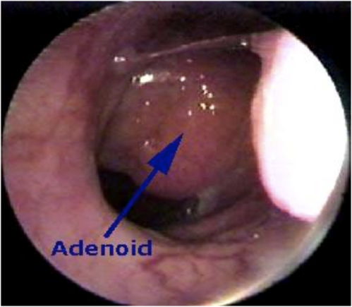
Grade the obstruction by adenoid grade 1 : 25% grade 2 : 50% grade3 : 75% grade 4: 100% diagnosis : x ray: if no endoscope, u follow air column if there is a cut in it then adenoid,to comment on xray neck must be extended and at the end of inspiration so diffucult but sometimes for medicolegal reason s its necessary flexible fiberoptic : better coz no radiation and could see the exaxt grade of the adenoid Treatment:if small conservative Surgical: adenoidectomy if complete obstruction

Slide 24
Sleep apnea and snoring
Snoring is a sign of partial obstruction of the upper airway during sleep
Snoring is always present during type of sleep apnea
Sleep apnea:
Cessation of airflow at the mouth and nostrils lasting 10 seconds for at least 30 apnoeioc episodes
Types :
central sleep apnea: Failure of respiratory drive from the brain,no movement of the chest , should be treated by neurologist
Obstructive sleep apnea (OSA) : Due to anatomical narrowing of the upper airway due to adenoid , large tonsils,,, his chest is moving
Mixed
If left untreated will develop cor pulmonare, pulmonary edema ,heart failure , HTN ,they don’t go in deep sleep so hormonal changes

Slide 25
Stage of sleep
Slow wave sleep : Brain waves are slow deep restful sleep decrease in vascular tone and respiratory rate and basal metabolic rate
Rapid eye movement : Brain quite active active dream
pathophysiology of OSA:
During REM or deep sleep ,obstructive occurs resulting in decrease arterial oxygen and increased arterial carbon dioxide pressure
Nocturnal desaturation arouses patient and causes increase pulmonary artery, systemic arterial pressure
lead to hypersomnolence

Slide 26
Investigation
Sleep study:
EEG,EKG,EOG,pulse oximeter, respiration rate , nasal and oral air flow
Treatment:
Nonsurgical :
behavior modification : if excess weight must lose weight, don’t eat before sleeping
medical treatment : nasal spray
CPAP: continous positive air pressure
Surgical :
UPPP : uvulopalatopharyngioplasty , very painful

Slide 28
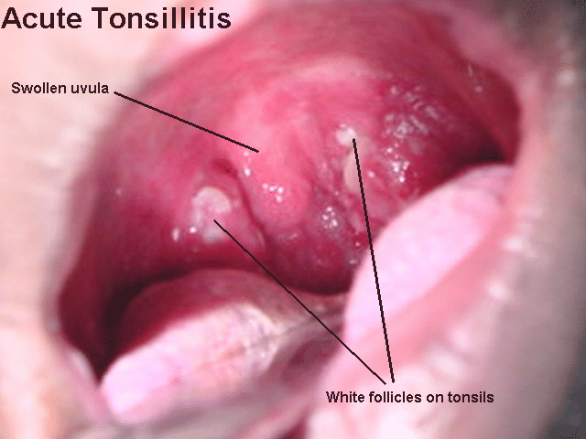
Acute infection of oropharynx
Acute tonsillitis:
Causes: viral fellow by bacterial (group AB-hemolytic streptococcus , moraxella, H. influenza, bacteroides
SSX: fever , sore throat odynophagia trismus, halitosis,dysphagia
Phases: erythema,exudative ,follicular tonsillitis
Complication:
peritonsillar abscess parapharyngeal or retropharyngeal abscess , rheumatic fever ,glomerulonephritis

Slide 29
Rx of acute tonsillitis :
ABX, bed rest ,hydration , analgesia
indication for tonsillectomy :
1- If recurrent 6-7 times per year, 4 times per year for 2 years or if 3 times per year for 3 years
2-snoring , mouth breathing , causing obsrtuction (hypertrophy)
3-if he is assymetric tonsilar enlargement inquiry for malignancy ( smoker )
4-peritonsillar abscess

Slide 30
Infectious mononucleosis (viral)
Pathogen: Epstein barr virus
SSX: fever, lymphadenopath malaise, exudative tonsilitis, hepatosplenomegaly,white membreane of tonsils
DX: monosopt test ,paul bunnel test (heterophil antibodies in serum)
80% mononuclear and 10% atypical lymphocytes on smear
CBC :mainly lymphocytes
Complication: cranial nerves involvement ,meningitis ,autoimmune hemolytic anemia , splenic rapture
RX: hydration, analgesia oral hygiene
**Differs from tonsillitis by the whiite membrane and the systemic involvement ( adenpopathy hepatosplenomegaly)

Slide 31
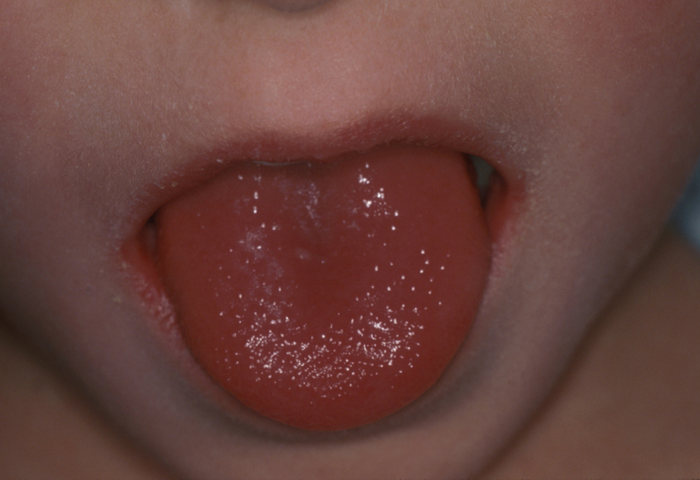
Scarlet fever
Endotoxin produced by by type A B-hemolytic streptococcus
SSX: red pharynx , strawberry tongue, perioral skin erythema and desquamation, dysphagaia ,malaise,sever cervical lymphodenopathy
DX : dick test
RX: ABX

Slide 32
Diphtheria
Corynbeactrium diphtheria
SSX: sore throat, fever, green plaques friable membrane, white membrane on the tonsils
DX: culture
Complication :nephritis, airway obstruction, death
RX: ABX, antitoxin

Slide 33
Vincen’ts angina:
Acute ulcerative lesion
Gram negative fusiform bacillus and a spirillum with anaerobic
SSX:
Sudden in onset,pain,fever, cervical adenitis, the base of the deep ulcers bleeds when the membranous slough is removed ,the symptoms subside in 4—7 days
RX: metronidazole(flagyl), antiseptic , mouthwash

Slide 34
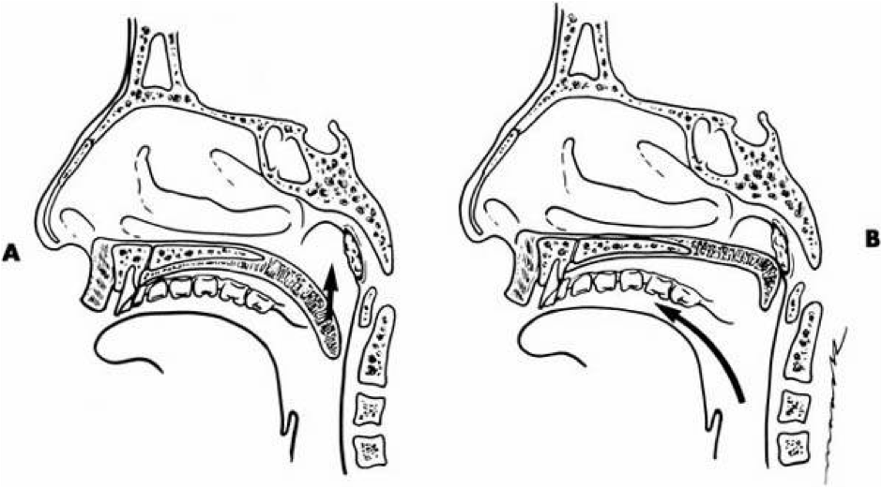
Bifid uvula: -snoring , mouth breathing with bifid uvula shouldn’t do adenoidectomy coz will get hypernasality and regurgitation so contraindicated for adenoidectomy if necessary do partial adenoidectomy remove the part against the nose but keep the oral part coz it supports the defect in the soft palate

Slide 36
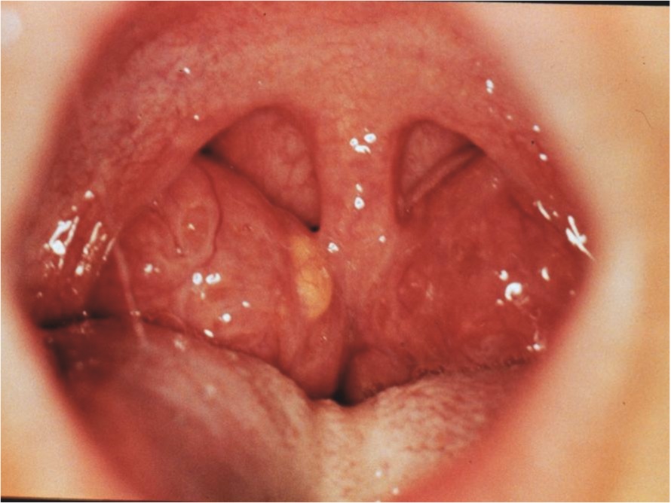
Tonsillectomy

Slide 37
In down syndrome patients they have neck sublaxation so must be gentle and keep that in mind during the sugery to prevent injuring them

Slide 38
Adenoid is approached from the oral cavity

Slide 39
Complication of Tonsillectomy :
Hemorrhage
Primary
Reactionary
Secondary
Respiratory obstruction
Injury to near-by structures
Pulmonary and distant infections

Slide 40
Primary hemorrhage
Bleeding occurring during the surgery
Causes
Bleeding tendency
Acute infections
Bad technique
Management
General supportive measures
Diathermy, ligature or stitches
Packing

Slide 41
Reactionary hemorrhage
Bleeding occurring within the first 24 hours postoperative period
Causes
Bleeding tendency
Slipped ligature
Diagnosis
Rising pulse & dropping blood pressure
Rattle breathing
Blood trickling from the mouth
Frequent swallowing
Examination

Slide 42
Treatment
General supportive measures
Take patient back to OR
Control like reactionary hemorrhage

Slide 43
Secondary hemorrhage
Occur 5-10 days posoperatively
Due to infection
Treated admit and give 2 IV antibiotics
May need diathermy or packing

Slide 44
Slough tissue after the surgery may stay for 2-3 weeks so must inform the mother or else may think its absess or pus

Slide 45
Monoliasis :
White patches caused by candidaalbicans fungus
RX: nystatin

Slide 46
Peritonsillar abscess (quinsy):
An abscess between the tonsil capsule and the adjacent lateral pharyngeal wall
SSX: fever, otalgeia odynophagia, uvular deviation trismus ,drooling of saliva , looks sick . Dehydrated
Complication:
Para and retrpharyngeal abscess, aspiration pneumonia
Rx:
Incision and drainage ( in ER )
aspiration
Iv ABX

Slide 47
Parapharyngeal abscess
Source of the infection: odontogenic ,tonsils, , parotid , teeth
SSX:
trismus, fever, muffled voices , intraoral bulge
Complication:
aspiration,cranial nerve palsy 9 , 10, 11 - airway compromise, septic hrombophlepitis, carotid blowout
,endocarditis
RX:
external drainage, iv ABX,airway management

Slide 48
Retropharyngeal abscess
More common in children
SSX: odynophagia hot potato voice drooling stiff neck fever ,stridor
Complication :mediastnitis , respiratry distress, rupture abscess
RX: drainge , IV ABX

Slide 49
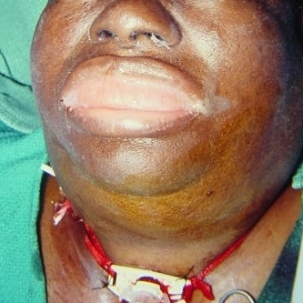
Ludwig’s angina
Bilateral cellulitis of submandibular and sublingual spaces
SSX:
wooden floor of the mouth , neck swelling and indurations , drooling , respiratory distress ,swollen tongue ,dysphagia trismus ,
Complication:
airway distress , sepesis
RX:
tracheotomy ,external drainge IV ABX

Slide 50
Chronic pharyngitis
Pathogenesis :
postnasal drip, irritant ( dust. Dry heat, smoking, alcohol),reflux esophagitis chronic mouth breathing ,allergy granulomatoues disease connective tissue disease , malignancy
SSX:
constant mouth clearing , dry throat pharyngeal crusting, thick granular wall
RX:
address underlying etiology

Slide 51
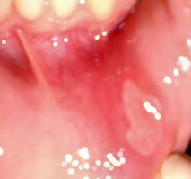
Aphthous ulcer caused by stress, dehydration , family history … Tx: goes spontanously

Slide 53
zanker’s diverticulum
Herniation of the mucosa at killian’s triangle due to increase intraluminal pressure
SSX: dysphagia, regurgitation of undigested food aspiration
DX: barium swallow
RX:
exciosion by endoscope or surgery
Cricopharyngeal myotomy.
Diverticulectomy

Slide 54
THANK YOU

