Slide 1
Done By: 428 C2
Khalid H Al Malki, MD, PhD
Consultant, Associate Professor
Phoniatrics (Voice, Communication and Swallowing Disorders)
Head, Communication and Swallowing Disorders Unit (CSDU)
ENT Department
King Abdulaziz University Hospital
King Saud University, Riyadh, Saudi Arabia.
Head, Communication and Swallowing Division (CSDD)
ORL/HNS Department
Riyadh Military Hospital, Riyadh, Saudi Arabia
http://faculty.ksu.edu.sa/kmalky/default.aspx

Slide 2
Khalid H Al Malki, MD, PhD

Slide 5
Internet Site
http://vas.ksu.edu.sa

Slide 6
Communication
and Swallowing
Disorders
Khalid H Al Malki, MD, PhD

Slide 7
Aim of this presentation:
Introduce Communication and Swallowing
Disorders and how they are managed generally,
and NOT to cover all disorders in details.
Khalid H Al Malki, MD, PhD

Slide 8
Communication Disorders
Communication difficulties have an impact on
the following aspects:
Academic (misarticualtion, stuttering)
Social,
Psychological,
Employment (part of qulaification)
Professional (singer, actor, teacher, doctor, imam
Of masjd, public speaker
Financial: very expensive to treat these disorders
Ex: 50,000 sr are the fees per year for on child who
has autism
Family relations.
Khalid H Al Malki, MD, PhD

Slide 9
Things he mention in intro
امراض التخاطب:
الكلاو, الصوت, النطق
A child was delayed in language development; is it important to treat him? And if it is who treats him?
When does a baby says his first word?
Is stuttering (تلعثم )a psychiatric problem?
Does nasality الخنةindicate a problem and how many types are there (hypo-hyper nasality).
(م,ن) الخنة الطبيعية

Slide 10
Voice comes from the vocal fold.
How many times do we swallow a day?

Slide 11
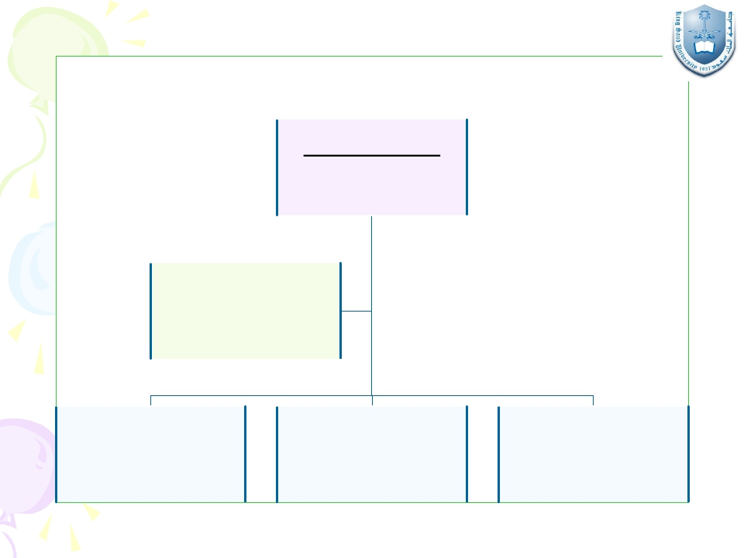
ﺐﻁﺎﺨﺘﻟﺍ ﺽﺍﺮﻣﺃ ﺕﻻﺎﺠﻣ
Communication
Disorders
ﻊﻠﺒﻟﺍ ﺽﺍﺮﻣﺃ
Swallowing Disorders
ﺕﻮﺼﻟﺍ ﺽﺍﺮﻣﺃ
Voice Disorders
Khalid H Al Malki, MD, PhD
ﻡﻼﻜﻟﺍ ﺽﺍﺮﻣﺃ
Speech Disorders
ﺔﻐﻠﻟﺍ ﺽﺍﺮﻣﺃ
Language Disorders

Slide 12
Language (لغة): I inderstand – comprehend- I say a sentencce
Asymbolic arbitrary system relating sounds to
meaning. Has two types: receptive (understands the question), expressive (ask him to say a sentence and answer in a fluent way). It has more central effect that speech) معنةالكلام
Speech (كلام)
A neuro-muscular process whereby language is
uttered.
It
includes
the
coordination
of
respiration, phonation, articulation, resonation
and prosody. Pronounce the letters right (r, s) no nasality,
stuttering, no misarticulation. النطق
Khalid H Al Malki, MD, PhD

Slide 13
Voice
The result of vibration of the true vocal folds
using the expired air. Remember not cord
Swallowing
The process of successful passage of food and
drinks from the mouth through pharynx and
esophagus into the stomach. It is a process in which food
bullos, passes normally from the mouth until it by passes
The lower esophageal sphincter.
Khalid H Al Malki, MD, PhD

Slide 14
Who is managing Communication
and Swallowing Disorders?
Two schools:
Phoniatricians (MD’s).
Manage better from a medical backgound
Can do endoscopy without supervision
Give medical diagnosis
Give medication
Can be a surgeon
2. Speech-Language pathologists.
Khalid H Al Malki, MD, PhD

Slide 15
What is Phoniatrics?
A
medical
specialty
that
deals
with
communication and swallowing disorders.
It stems mainly from ORL (ENT), especially
when dealing with VOICE disorders.
Union of the European Phoniatricians (UEP)
www.phoniatrics-uep.org
Khalid H Al Malki, MD, PhD

Slide 16
Phoniatrics (cont.)
In
1931,
”Phoniatrics“
was
officially
recognized
and
acknowledged
as
an
independent medical specialty of its own in
Sweden.
In 1992, ”Phoniatrics & Pedaudiology“
became a new self-standing medical discipline
in Germany.
Union of the European Phoniatricians (UEP)
www.phoniatrics-uep.org
Khalid H Al Malki, MD, PhD

Slide 17
Phoniatrics (cont.)
Amedical subspecialty of ENT (Otorhinolaryngology)
as approved by:
- Saudi Commission For Health Specialties.
- ENT Department, King Saud University.
- Saudi Society of Otorhinolaryngology.
Khalid H Al Malki, MD, PhD

Slide 18
The Phoniatrician:
- Deals with the patient from a MEDICAL
prospective.
- Can perform endoscopies without any
limitations.
- Can prescribe medications when needed.
- Can perform surgeries if interested and trained.
Khalid H Al Malki, MD, PhD

Slide 19
IALP
Khalid H Al Malki, MD, PhD

Slide 20
Is Phoniatrics
internationally?
recognized
The International Association of Logopedics and
Phoniatrics (IALP) is a global organization which
promotes the improvement of care for people with
communication disorders.
www.ialp.info
Khalid H Al Malki, MD, PhD

Slide 21
IALP:
IALPrepresents a professional body of:
✓ 125.000 members in human communication
✓ 56 affiliated national societies from
✓ 38 countries and
✓ over three hundred individual members.
✓ IALP has informative status with UNESCO,
UNICEF, WHO, ….
Khalid H Al Malki, MD, PhD

Slide 22
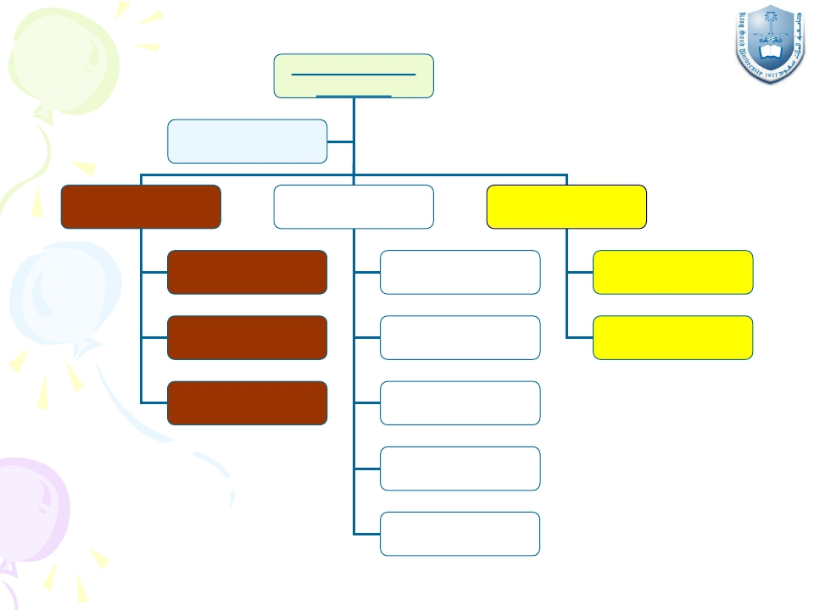
Communication
Disorders
Swallowing
Disorders
Voice
Disorders
Speech
Disorders
Language
Disorders
Organic
Non-organic
MAPLs
Stuttering
Cluttering
Misarticulation
DLD
(Children)
Dysphasia
(Adults)
Hypernasality
Dysarthria
Khalid H Al Malki, MD, PhD

Slide 23
Language
Disorders
Khalid H Al Malki, MD, PhD

Slide 24
I. Language Disorders:
[1] Delayed Language Development (DLD): is the most
Common language disorder in children
In adults its called dyphasia; misarticualtion, stuttering,
Cluttering, hypernasality,
Definition of DLD:
Delay or failure to acquire language matched
with age.
Khalid H Al Malki, MD, PhD

Slide 25
Prerequisites of normal language development:
1. Normal brain function.
2. Intact sensory channels (eg auditory).
3. Normal psyche.
4. Stimulating environment.
Khalid H Al Malki, MD, PhD

Slide 26
Causes of DLD:
A) Brain damage:
- Diffuse brain damage (MR).
- Brain damaged motorly handicapped child (CP).
- Minimal brain damage (ADHD).
B) Sensory deprivation:
Hearing impairment.
C) Psychiatric disorders:
-Autism.
- Childhood schizophrenia.
D) Non - stimulating environment.
E) Idiopathic.
Khalid H Al Malki, MD, PhD

Slide 27
Diagnosis of the Cause of DLD:
I.
History taking.
II. Physical examination.
III. Investigations:
- Psychometry (IQ).
-Audiometry.
DLD Sheet
Khalid H Al Malki, MD, PhD

Slide 28
Management of DLD:
Early detection.
Providing the suitable aid (HAor CI).
Family counseling.
Language therapy.
Khalid H Al Malki, MD, PhD

Slide 29
I.Language disorders:
[2] Dysphasia:
Definition:
Language deterioration after its full development
due to brain insult: infarction, hemorrhage,
atrophy, etc
Khalid H Al Malki, MD, PhD

Slide 30
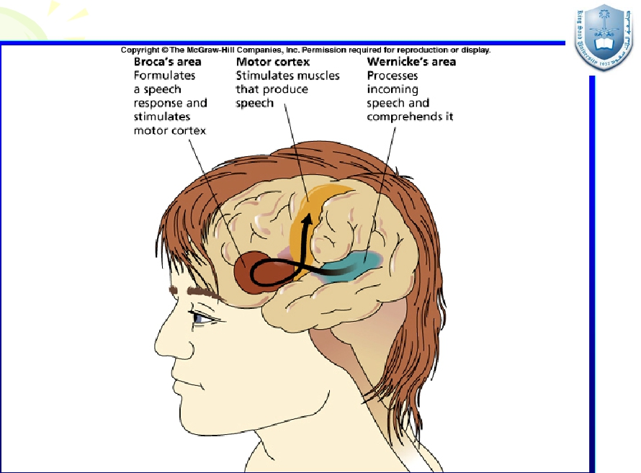
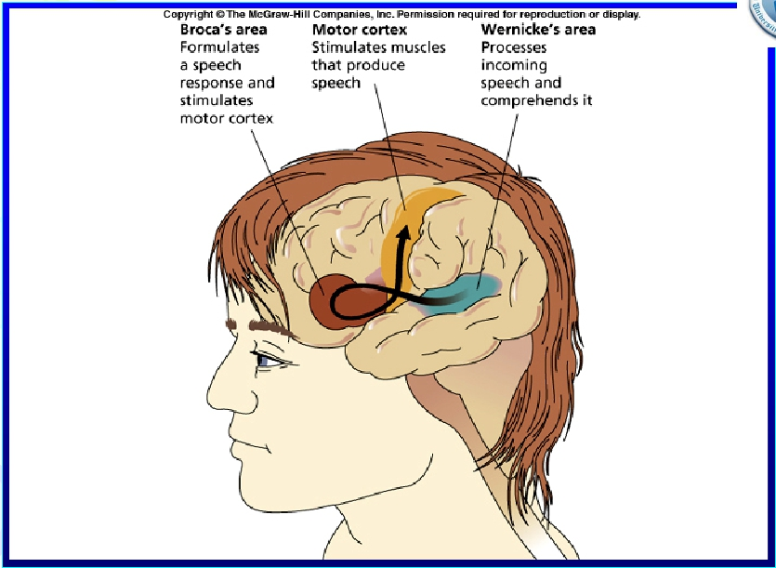
Khalid H Al Malki, MD, PhD

Slide 31
Types of dysphasia:
1. Expressive.
2. Receptive.
3. Mixed predominantly expressive.
4. Mixed predominantly receptive.
5. Global.
Khalid H Al Malki, MD, PhD

Slide 32
Diagnosis of dysphasia:
I.
History taking.
II. Physical examination: … , neurological
exam.
III. Investigations:
- CT / MRI brain.
- Dysphasia test.
- Psychometry (IQ).
-Audiometry.
Dysphasia Sheet
Khalid H Al Malki, MD, PhD

Slide 33
Management of dysphasia:
Individualized:
Management of the cause.
Physical rehabilitation (Physiotherapy).
Family counseling.
Language therapy.
Alternative and augmentative communication.
Khalid H Al Malki, MD, PhD

Slide 34
Voice
Disorders
Khalid H Al Malki, MD, PhD

Slide 35
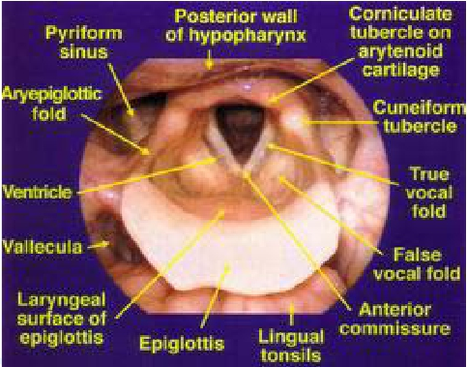
Khalid H Al Malki, MD, PhD

Slide 36
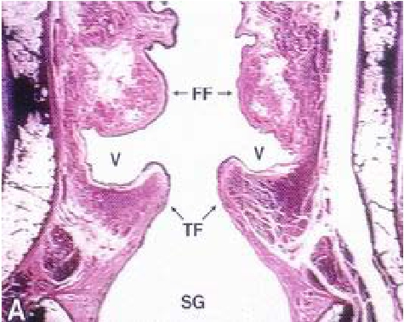
Khalid H Al Malki, MD, PhD

Slide 37
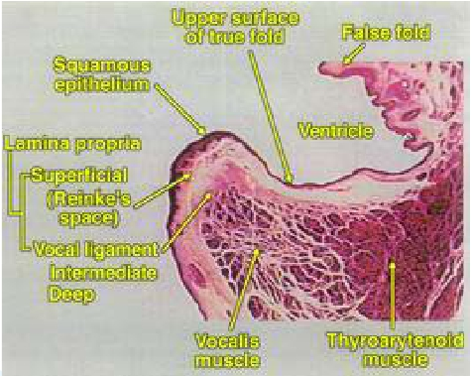
Khalid H Al Malki, MD, PhD

Slide 38
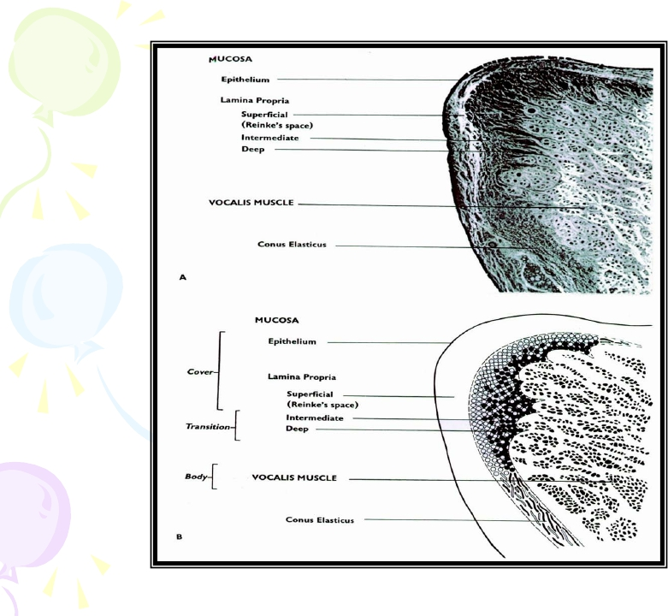
Khalid H Al Malki, MD, PhD

Slide 39
Prerequisites of “normal” voice production:
1. Normal range of movement of vocal folds.
2. Normal mobility of mucosa on deep layers.
3. Optimal coaptation of vocal folds’edges.
4. Optimal motor force.
5. Optimal pulmonary support.
6. Optimal timing between vocal fold closure and
pulmonary exhalation.
7. Optimal tuning of vocal fold musculature (int. &
ext.).
Khalid H Al Malki, MD, PhD

Slide 40
Definition of dysphonia:
- “Difficulty in phonation”.
- “Change of voice from his /her habitual”.
- “Hoarseness” = roughness & harshness of voice.
Khalid H Al Malki, MD, PhD

Slide 41
Etiological classification of
dysphonia:
Organic Causes
Ex: paralysis of one
Vocal fold
II. Non-Organic Causes
Habitual
Psychogenic
Everything appears normal even endoscopy no pathology no foreign body
III. Minimal Associated
Pathological Lesions
(MAPLs)
IV. Accompaniment of Neuro-psychiatric Ailments
Khalid H Al Malki, MD, PhD

Slide 42
An example of inorganic causes:
Person has no problem starting to talk but at the end of the day she / he is exhausted and gets tried from talking with no underlying pathology. This is called phonasthenia (voice fatigue)

Slide 43
III.Voice disorders:
A) Organic voice disorders:
.
.
.
.
.
.
.
Congenital.
Inflammatory.
Traumatic.
Neurological.
Neoplastic.
Hormonal.
Status post-laryngectomy.
Khalid H Al Malki, MD, PhD

Slide 44
To produce a word, sentence, letter, etc we need energy (our energy source is breathing/air) because any voice needs power. Air enters into the lung then trachea then to larynx particularly between vocal fold (which adduct in phonation) and little air passes through the adducted folds to produce phonation.
Sound to be clarified passes through resonators (over resonance is hypernasality; nasal contamination of sound)
Finally the resonating sound passes through articulators (lip, soft, hard palate, tongue, lips) which modulates the primary laryngeal sound. Dr. said pharynx and lung but I thinks these are resonators correct me if I am wrong.
All these functions are controlled by centers

Slide 45
Function of the larynx
Respiration
Phonation not the most important function of the larynx. Close the vocal folds
Protection
Valsalva the vocal folds must close in order to do effort as a result of an increase in the intrathoracic pressure
Swallowing also closes the vocal folds or else will result in aspiration
The most important functions of the larynx are both respiration and protection

Slide 46
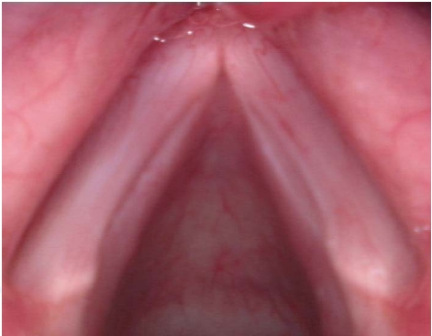
Sulcus vocalis
Khalid H Al Malki, MD, PhD

Slide 47
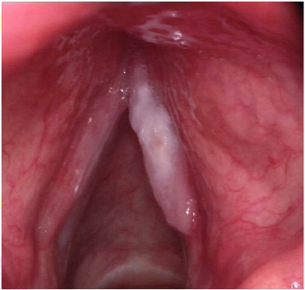
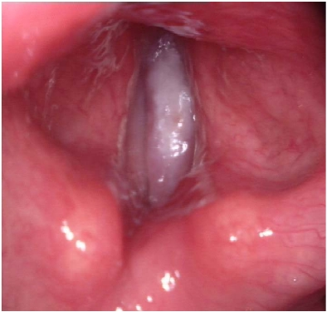
Laryngeal carcinoma
Respiration
Khalid H Al Malki, MD, PhD
Phonation

Slide 48
Approach to patient with dysphonia:
History and examination
Investigation
Endoscopy
Laryngeal stroboscopy is a special method used to visualize the vocal folds vibration. It uses a synchronized, flashing light passed through a flexible or rigid telescope. The flashes of light from the stroboscope are synchronized to the vocal fold vibration at a slightly slower speed, allowing the examiner to observe vocal fold vibration during sound production in what appears to be slow motion. A telescope is inserted per oral/ per-nasal. Per-oral is better and per-nasal is used in a hyper-gagging child). A microphone is put at the neck of the patient and a recording is made. Voice = folds have to adduct. Air builds up below subglottis increases subglottic pressure. Lower lip opens then upper lip opens by bernoulli’s effect. The movement of vocal folds is normally not seen by the naked eye because the frequency is high (female= 220 cycles/sec; male=110). Frequency of flash = frequency of vibration; allowing us to visualize the movement in slow motion (mucosal wave is important in phonation).
High speed camera no sampling (takes a picture of everything and shows it in true slow motion) 2000 frames/sec.
Acoustic analysis “say Ahh” and gives a certain analysis

Slide 49
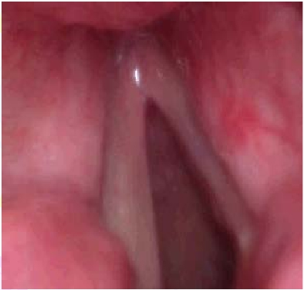
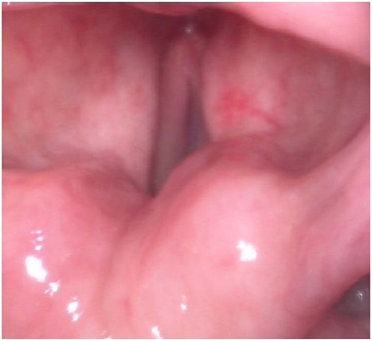
Left vocal fold paralysis
*
*
Respiration
Khalid H Al Malki, MD, PhD
Phonation

Slide 50
III.Voice disorders:
B) Non-organic voice disorders:
i. Habitual:
1. Hyperfunctional childhood dysphonia.
2. Incomplete mutation.
3. Phonasthenia (Voice fatigue).
4. Hyperfunctional dysphonia.
5. Hypofunctional dysphonia.
6. Ventricular dysphonia.
Khalid H Al Malki, MD, PhD

Slide 51
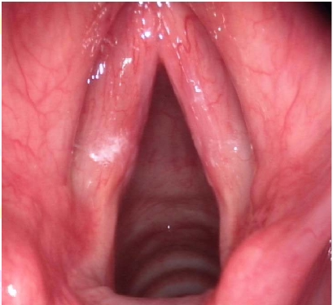
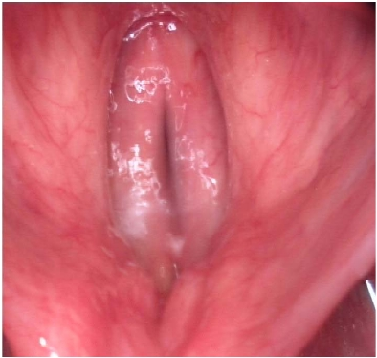
Hyperfunctional dysphonia
Respiration
Khalid H Al Malki, MD, PhD
Phonation

Slide 52
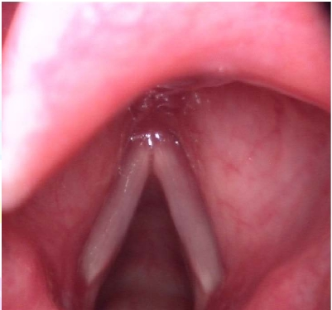
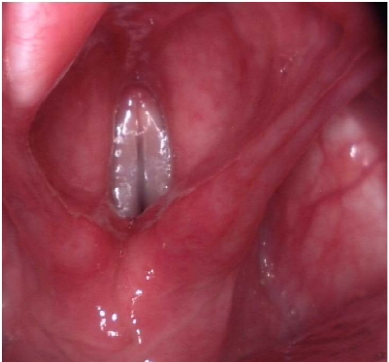
Phonasthenia
Respiration
Khalid H Al Malki, MD, PhD
Phonation

Slide 53
B) Non-organic voice disorders (cont.):
ii. Psychogenic:
1- Psychogenic dysphonia.
2- Psychogenic aphonia.
Khalid H Al Malki, MD, PhD

Slide 54
Voice can be affected by technology
Mothers yell a lot and therefore affect their voice and children end up talking to each other loudly.
Pharynx:
True vocal cords which is the source of voice and opens during breathing. It is a multilayered structure any part that is effected as a result of scar, edema, mass will cause dysphonia. Diagnose always by endoscopy. These folds for waves that contain muscles giving it a multilayered apperance.
False vocal folds: nothing to do with voice if he uses them he will have a deep resonating voice. If the true vocal folds are not being used he has to phonate one way or the other so he uses his ventricular folds and which results in deep phonation. It is a very trouble some condition

Slide 55
III.Voice disorders:
C) Minimal associated pathological lesions
(MAPLs) :
1. Vocal fold nodules.
2. Vocal fold polyps.
3. Vocal fold cysts.
4. Reinke’s edema.
5. Contact granuloma.
Khalid H Al Malki, MD, PhD

Slide 56
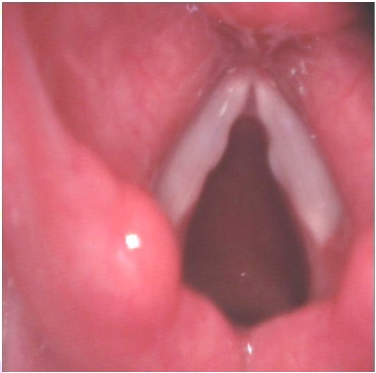
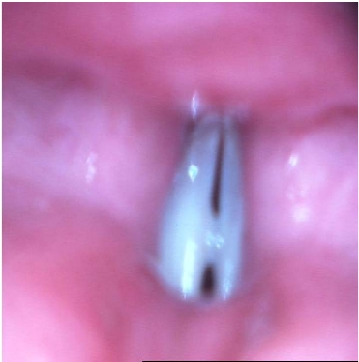
Vocal Fold Nodules: Adult Type
Anterior commisure; found anteriorly with epiglottis
Respiration
Khalid H Al Malki, MD, PhD
Phonation
The vocal folds meet anteriorly hence the anterior commisure but they don’t meet posteriorly so we don’t have a posterior commisure

Slide 57
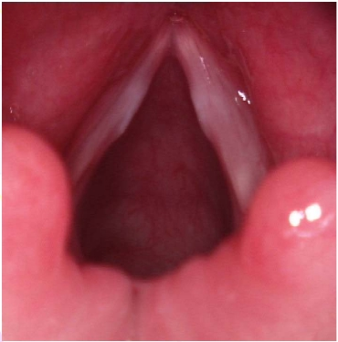
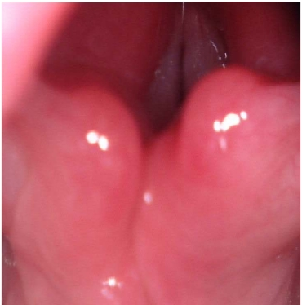
Vocal Fold Nodules: Juvenile Type
Respiration
Khalid H Al Malki, MD, PhD
Phonation

Slide 58
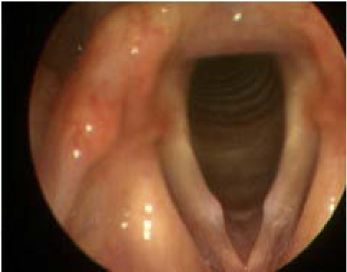
Khalid H Al Malki, MD, PhD

Slide 59
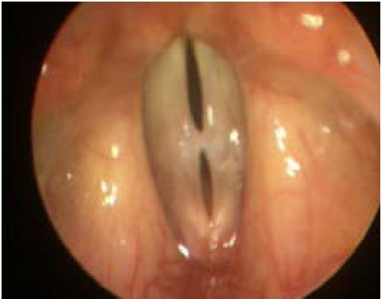
Khalid H Al Malki, MD, PhD

Slide 60
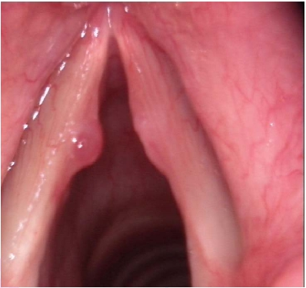
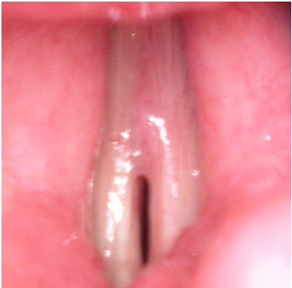
Left Vocal Fold Polyp with a Reaction
Respiration
Khalid H Al Malki, MD, PhD
Phonation

Slide 61
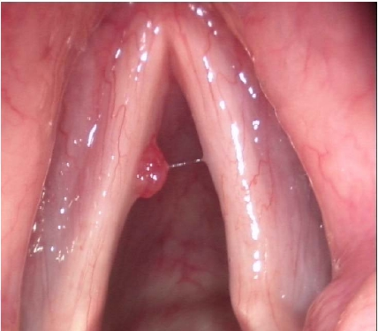
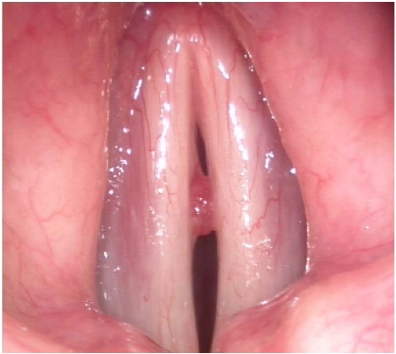
Respiration
Khalid H Al Malki, MD, PhD
Phonation

Slide 62
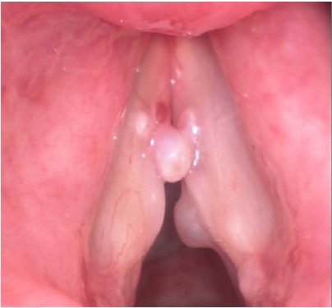
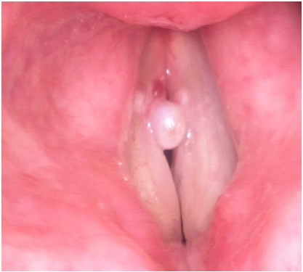
Respiration
Khalid H Al Malki, MD, PhD
Phonation

Slide 63
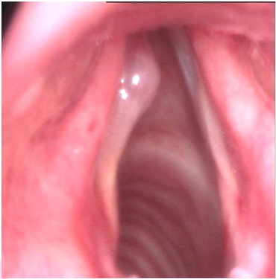
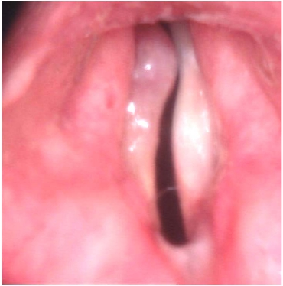
Left Vocal Fold Cyst
Respiration
Khalid H Al Malki, MD, PhD
Phonation

Slide 64
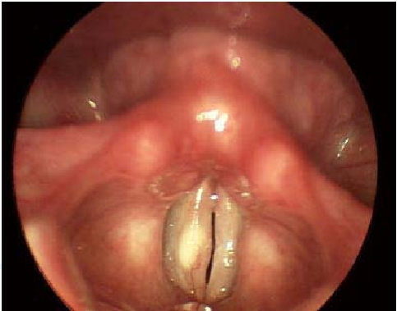
Khalid H Al Malki, MD, PhD

Slide 65
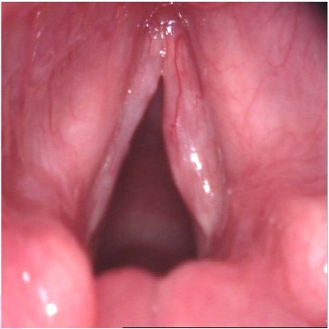
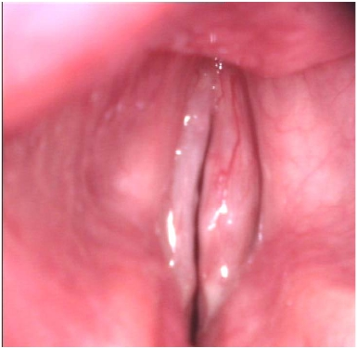
Right-sided Reinke’s Edema
Respiration
Khalid H Al Malki, MD, PhD
Phonation

Slide 66
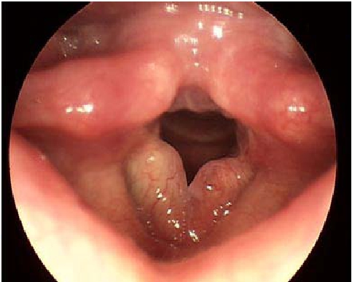
Khalid H Al Malki, MD, PhD

Slide 67
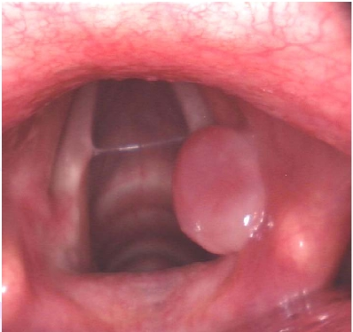
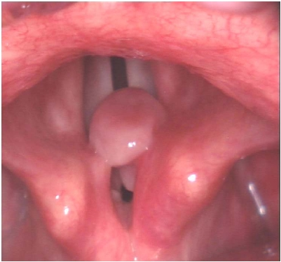
Right-sided Contact Granuloma
Respiration
Khalid H Al Malki, MD, PhD
Phonation

Slide 68
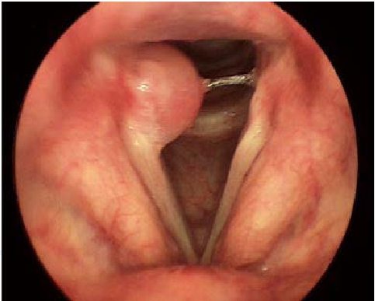
Khalid H Al Malki, MD, PhD

Slide 69
Vocal fold nodules:
Tx: voice therapy, vocal hygiene advice. Surgery indicated in advanced stage and grossly asymmetrical.
Polyps surgery is primary and others secondary.
Polyp and contralateral reaction may be confused with nodules; the more symmetrical goes with nodules.
Cyst is surgical marsuplization to avoid recurrance.
Edema of the whole vocal fold: Renikies edema (vocal fold swollen unilateral or bilteral:
Smoking
Laryngeal pharyngeal refulx
Tx: surgery (incision + suction)
Before start treat tell patient to stop smoking coz end up in carcinoma

Slide 70
Anything posterior on the vocal fold: granuloma
Reflux
Intubation granuloma
Tx: treat the cause which is usually reflux.
Surgery last option due to recurrance
Generally tx of voice disorders (mostly due to reflux)
Medication: management of reflux Proton pump inhibitors (omperazole)
Phonosurgery: polyps, cyst, renkis edema
Technical air device.

Slide 71
After laryngectomy (servox): voice produced by membrane probe not vocal fold. But the voice produced very mechanical.
Reflux:
50% of patients having dyspena is due to reflux.
10% of ENT patients that come to clinic is due to reflux
Laryngopharygeal reflux is more resistant to treatment and more sensitive to acid.
Gastroesophageal reflux (GERD)
Diagnosis is made by history and examination and pH metry (device is inserted from the nose to the esophagus which stays for 24hrs to read the pH using a sensor)
Tx: is Proton pump inhibitors with dietary modification (avoid fried food, tea, coffee, spicy food, mint, soda etc

Slide 72
Diagnosis of dysphonia:
I.
History taking.
II. Physical examination:APA , … , neck , …
III. Investigations:
-Audio recording.
- Digital laryngostroboscopy.
- Digital laryngokymography.
-Acoustic analysis (MDVP).
-Aerodynamic analysis (Aerophone II).
- GERD (LPR) work-up.
- CT neck.
*Voice Sheet
Khalid H Al Malki, MD, PhD

Slide 73
Auditory Perceptual Analysis (APA):
1. Overall grade: normal, slight, moderate, severe.
2. Character (quality): strained, leaky, breathy, rough.
3. Pitch: increased, decreased, diplophonia, normal for age.
4. Register:
- habitual register: modal, falsetto, vocal fry.
- register break.
5. Loudness: loud, soft, fluctuation, normal.
6. Glottal attack: hard, soft, normal.
7. Associated laryngeal functions : cough, whisper, laughter.
Khalid H Al Malki, MD, PhD

Slide 74
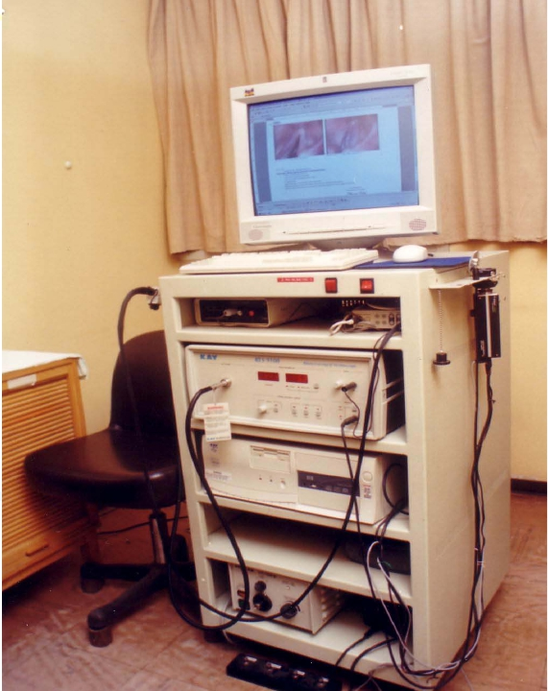
Khalid H Al Malki, MD, PhD

Slide 75
Stroboscopic examination:
1- Glottic closure: complete, incomplete (shape).
2- Glottic gap: site, size.
3- Glottic wave: great, normal, small, absent.
4- Amplitude: great, normal, small, zero.
5- Symmetry: in phase, in amplitude.
6- Phase closure: open phase predominate, close phase predominate.
7- Stroboscopic fixation .
8- Additional morphological findings .
Khalid H Al Malki, MD, PhD

Slide 76
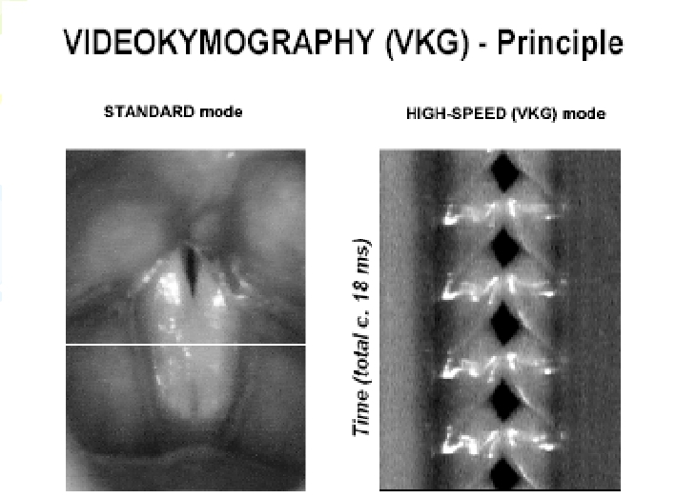
Khalid H Al Malki, MD, PhD

Slide 77
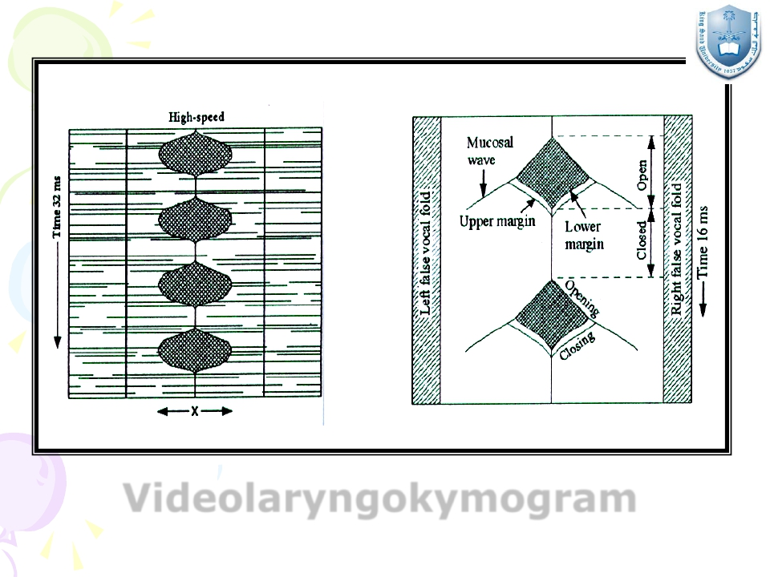
Videolaryngokymogram
Khalid H Al Malki, MD, PhD

Slide 78
Videolaryngokymography:
- Symmetry (both sides) in: #Amplitude.
# Mucosal wave.
# Phase.
- Periodicity (same side) in: . Amplitude.
. Glottal cycle timing.
- Closed phase.
Khalid H Al Malki, MD, PhD

Slide 79
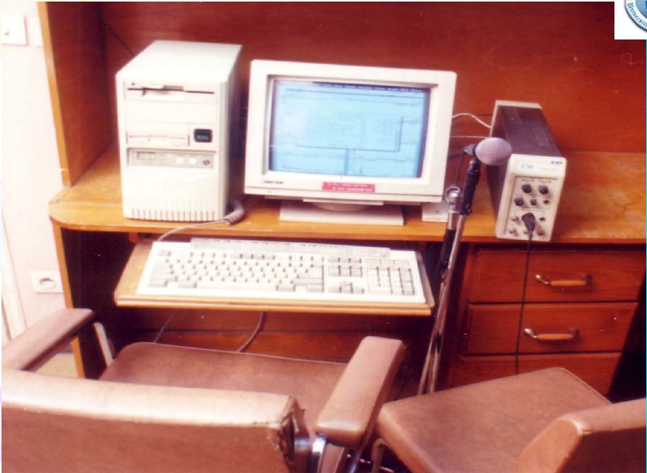
CSL(MDVP)
Khalid H Al Malki, MD, PhD

Slide 80
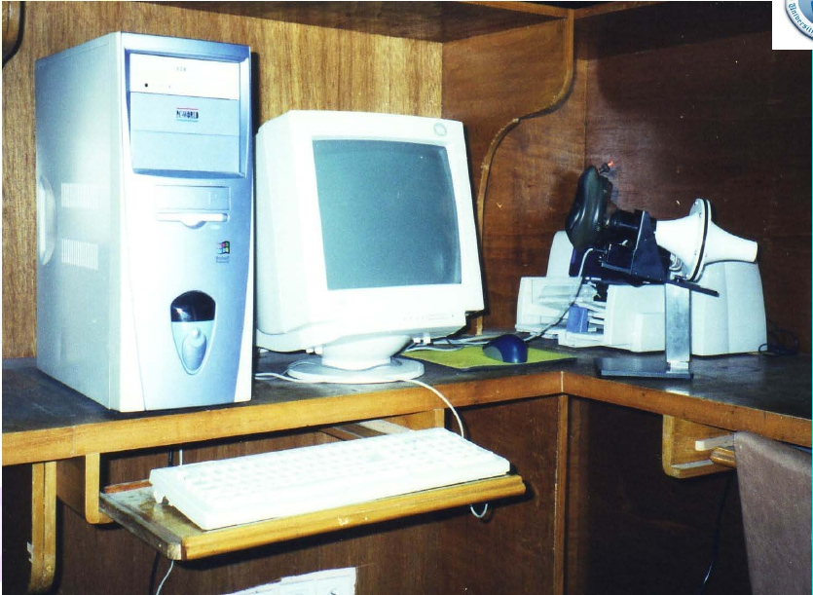
Aerophone II
Khalid H Al Malki, MD, PhD

Slide 81
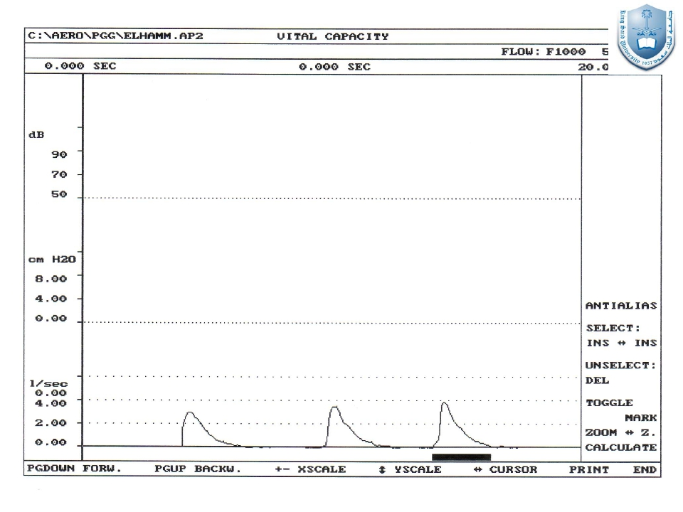
Khalid H Al Malki, MD, PhD

Slide 82
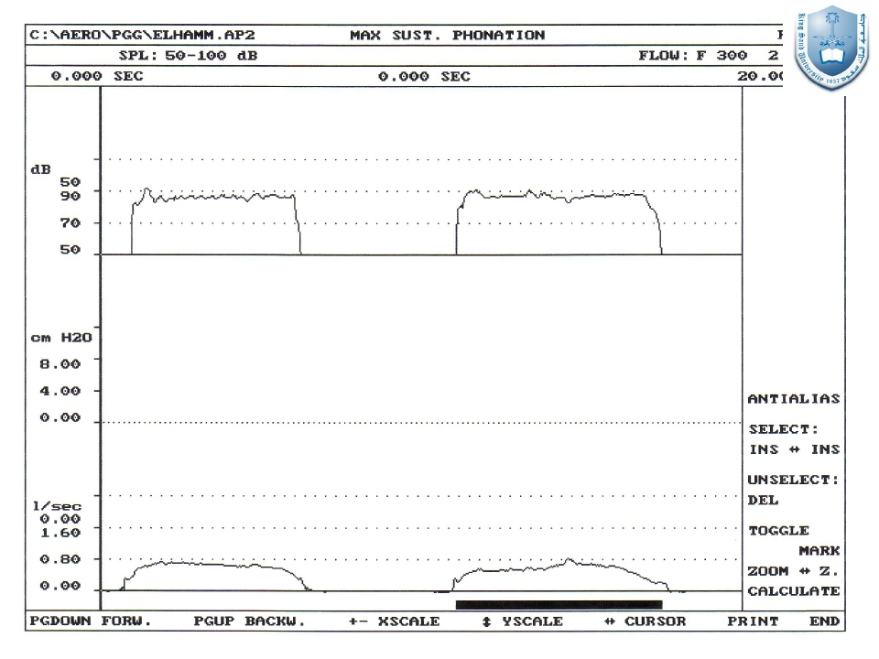
Khalid H Al Malki, MD, PhD

Slide 83
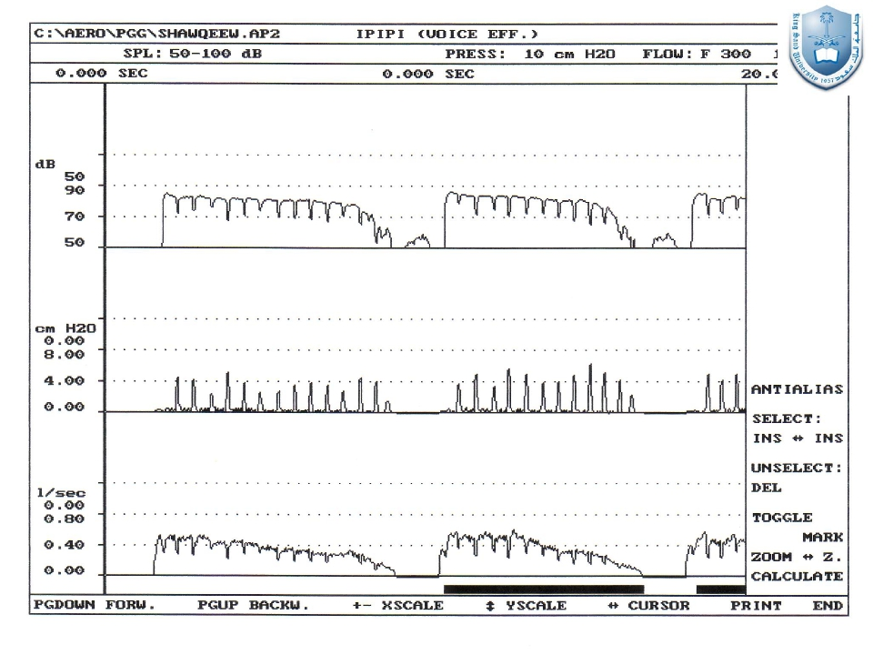
Khalid H Al Malki, MD, PhD

Slide 84
Management of voice disorders:
Pharmacological agents.
Surgical procedures (Phonosurgery).
Technical aid devices.
Voice therapy.
Khalid H Al Malki, MD, PhD

Slide 85
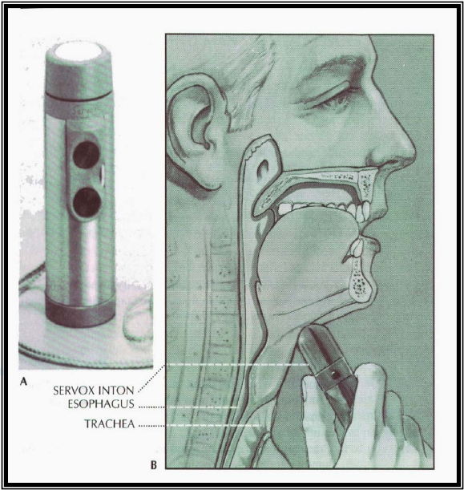
Khalid H Al Malki, MD, PhD

